Slide 1
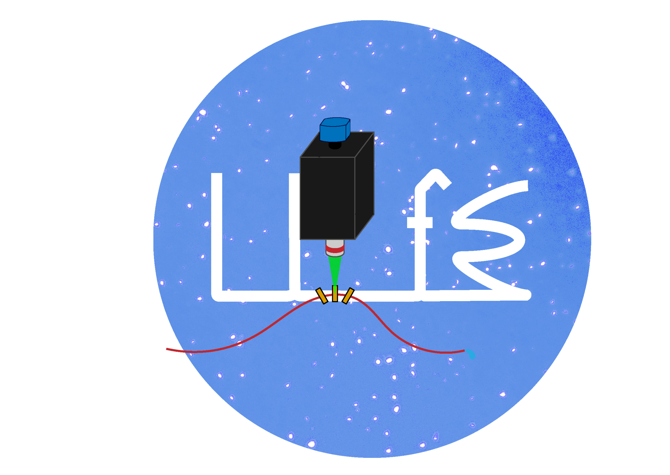
Microscopy Methods for Life Detection on Ocean Worlds
Pavel E.Z. Klier¹, Nathan Bramall², Antonio J. Ricco³ and Richard C. Quinn³
¹Oakridge Associated Universities/NASA Ames Research Center, Moffett Field, CA, United States
²Leiden Measurement Technology, LLC, Sunnyvale, CA, United States
³NASA Ames Research Center

Slide 2
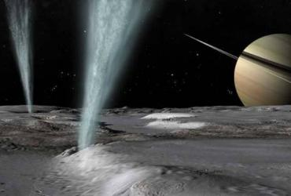
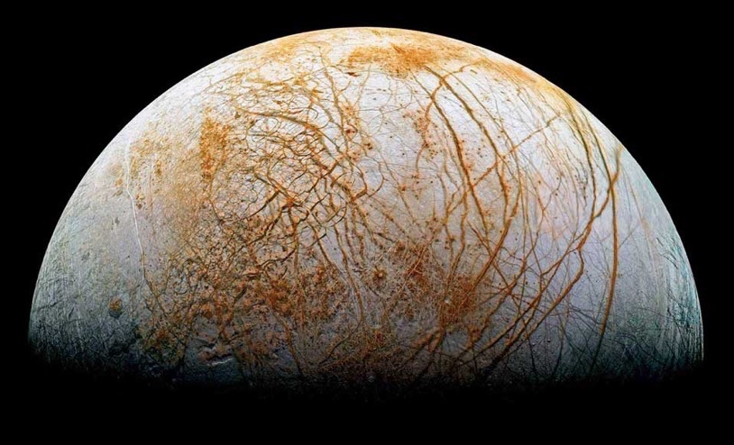

The Search for Extraterrestrial Life
Enceladus
Raw Materials
Energy
light, chemical
CHNOPS
H
NASA
Solvent
Conditions
Europa
water
T, pH, Eh,...
H = Habitable conditions
NASA

Slide 3
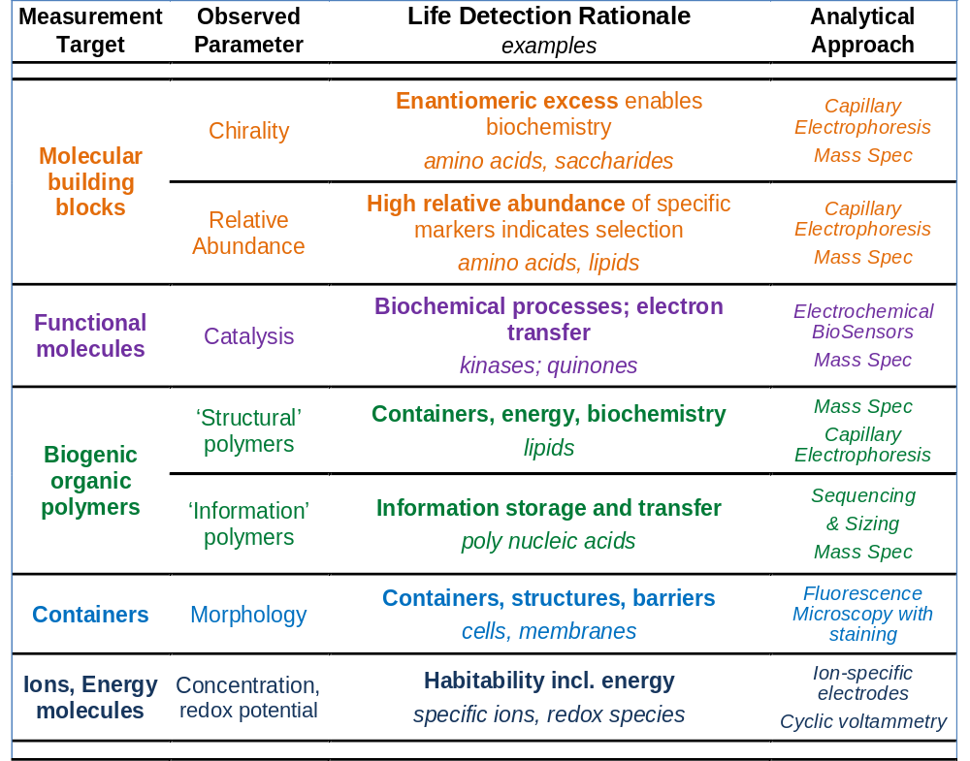
The Search for Extraterrestrial Life
Building blocks
?
~
?
Bio
catalysts
~
LIFE!
~
Containers
?
~
?
"Information" polymers

Slide 4
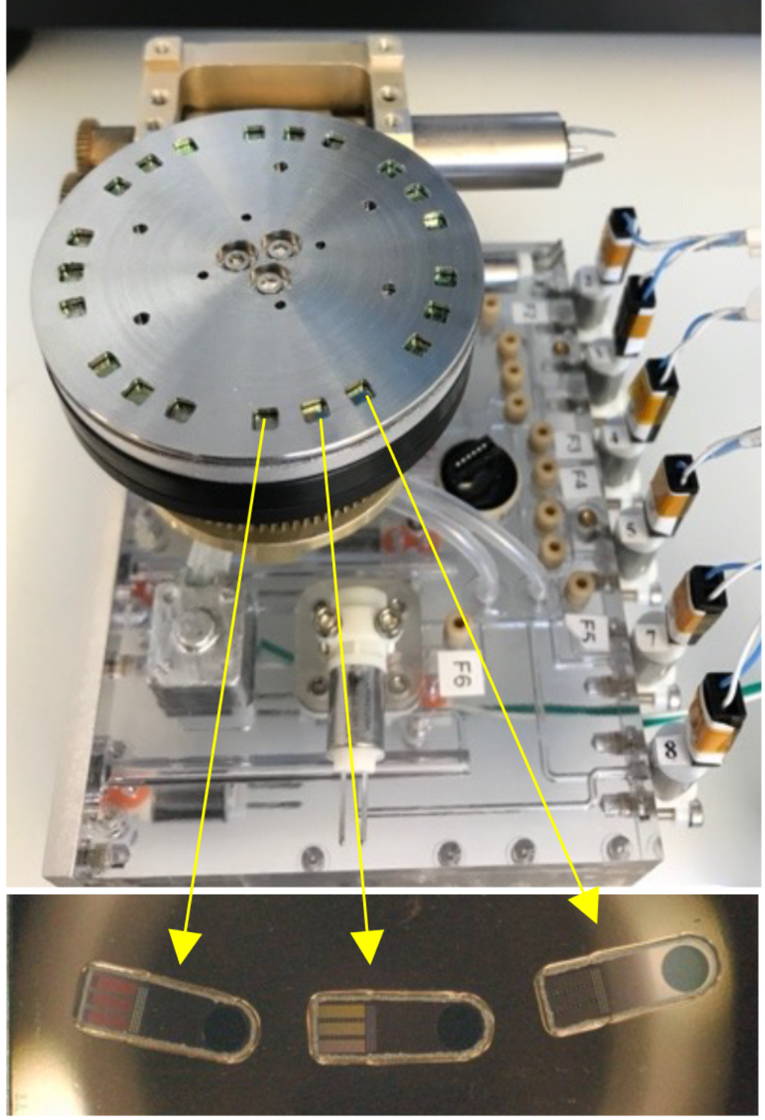
The Luminescence Imager for Exploration (LIfE)
Fluidics subsystem
Optics subsystem

Slide 5
The Luminescence Imager for Exploration (LIfE)
Rotary sample filtering stage (5 cm dia.)
Fluidics manifold (9 x 8 x 4 cm) Functionality includes pressure, pH, conductivity measurements
fluorescent stain dry storage; metering pump and valves for sample manipulation and processing
In-line 10, 1, and 0.25 µm silicon nitride filters for sample size sorting/imaging
Fluidics subsystem
Passed environmental testing (GSFC-STD-7000A)

Slide 6
The Luminescence Imager for Exploration (LIfE)
Microscope box with excitation LEDs, emission filters, folded optics
Resolution | <0.5 um
LED 1 excitation | 275 nm
LED 2 excitation | 375 nm
LED 3 excitation | 470 nm
LED 4 excitation | 525 nm
Emission filter 1 | 334/40 nm
Emission filter 2 | 432/36 nm
Emission filter 3 | 515/30 nm
Emission filter 4 | 595/31 nm
Objective
Piezo stage
Passed environmental testing (GSFC-STD-7000A)
Passed shock/vibrational testing
Lens, filter, mirror and coating materials have passed 300 krad total ionizing dose gamma-radiation testing.
Optics subsystem

Slide 7
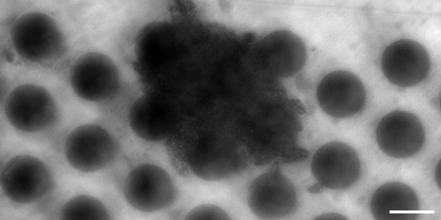
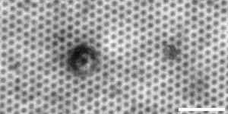
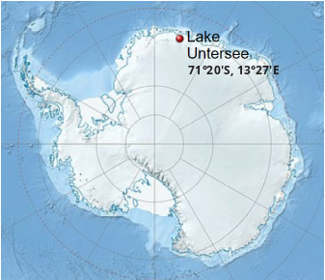
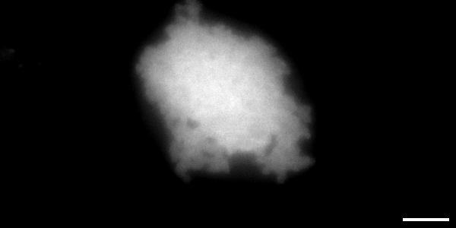
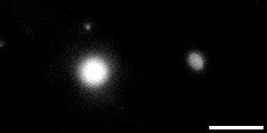
Brightfield and Fluorescence Imaging
Lake Untersee, Antarctica Brightfield Images (470 nm LED)
10 µm filter
1.2 µm filter
Lake Untersee UV Fluorescence Images (275 nm excitation/334 nm emission)
10 µm filter
1.2 µm filter

Slide 8
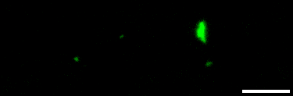
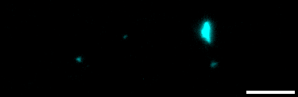
Colocalization of Structural Biosignatures
Lake Untersee Samples
Stained with Alexa 488-nhs
(primary amines)
Lake Untersee Samples
Stained with Primuline
(lipids)

Slide 9
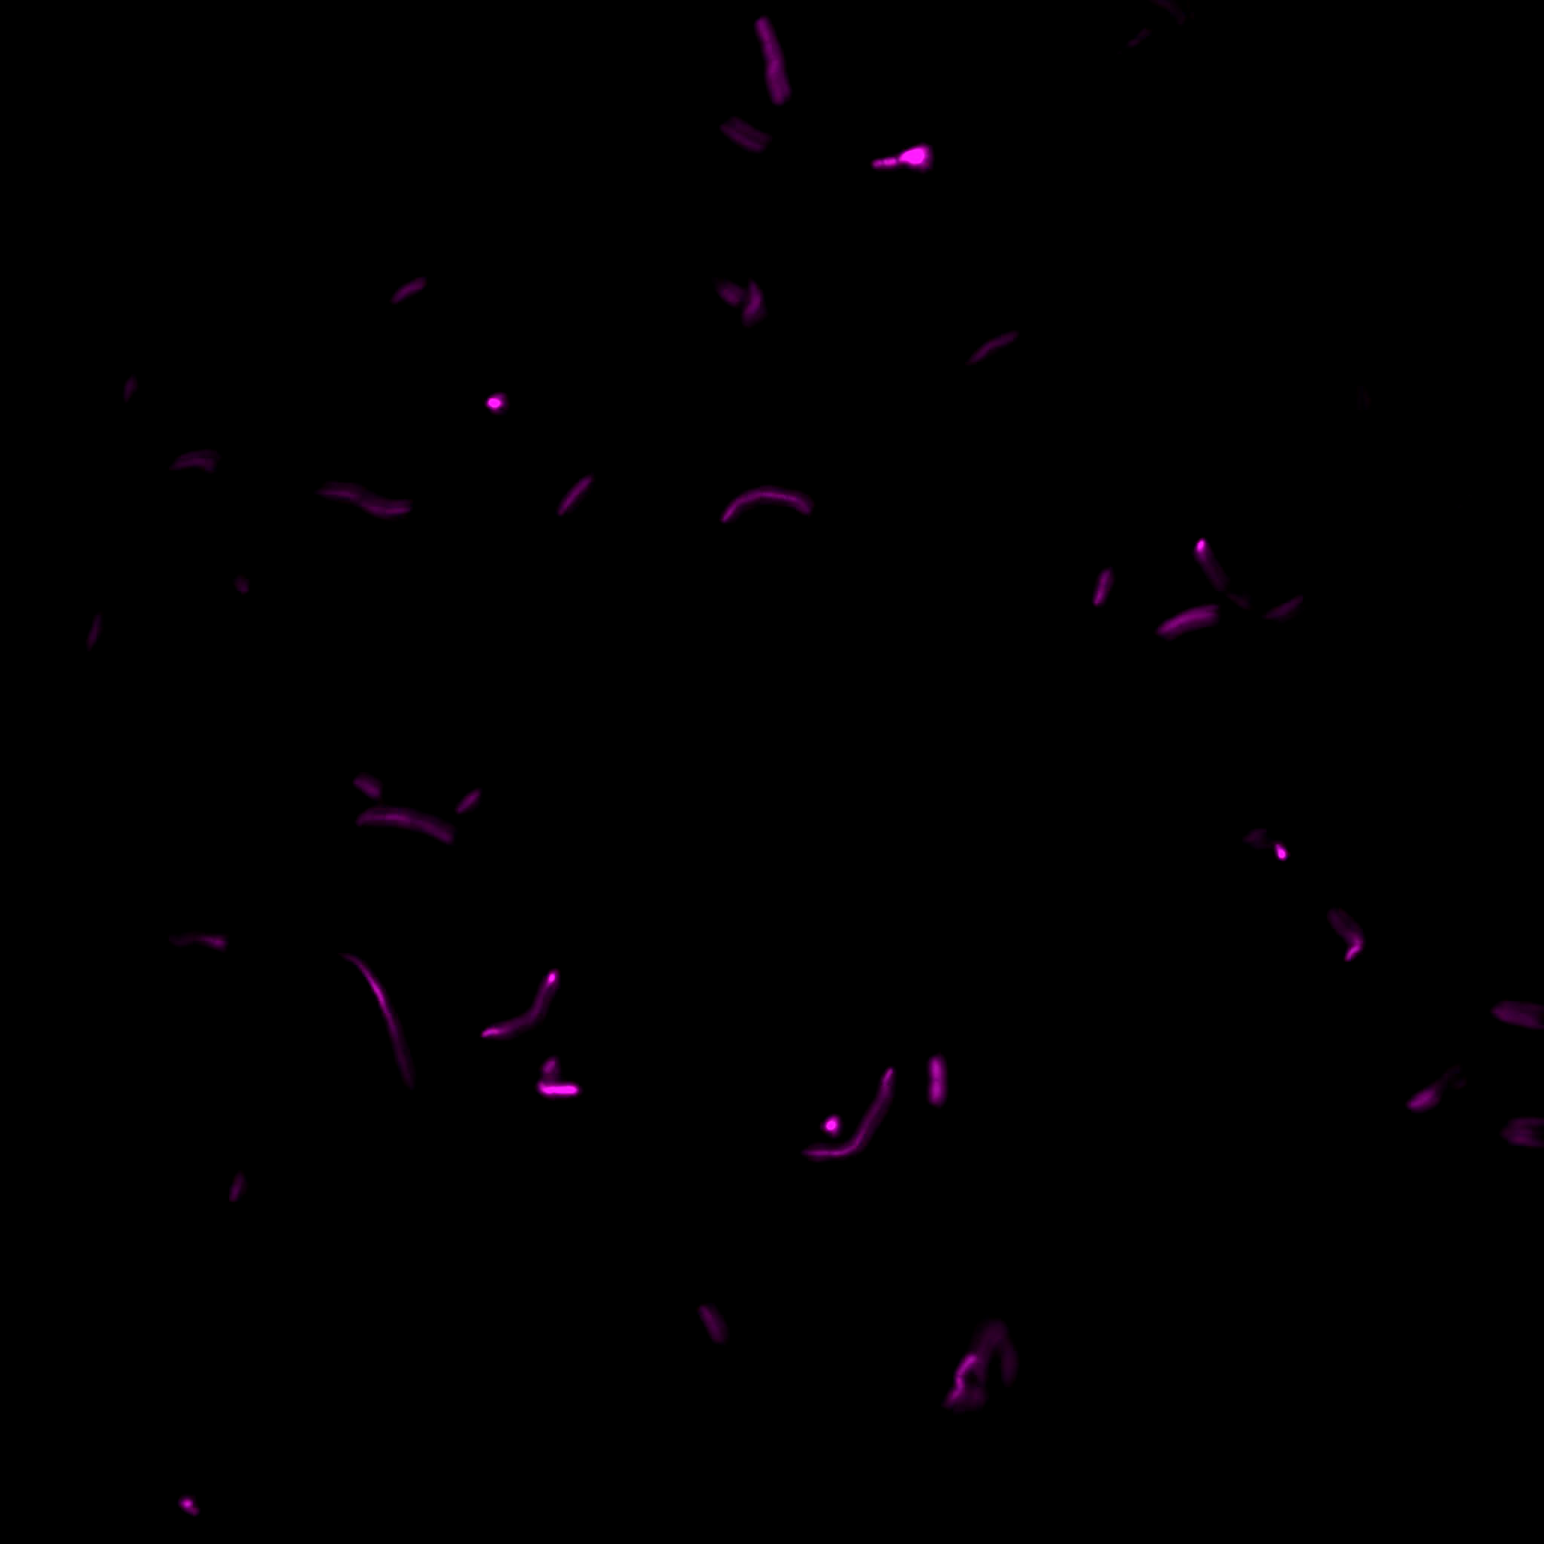
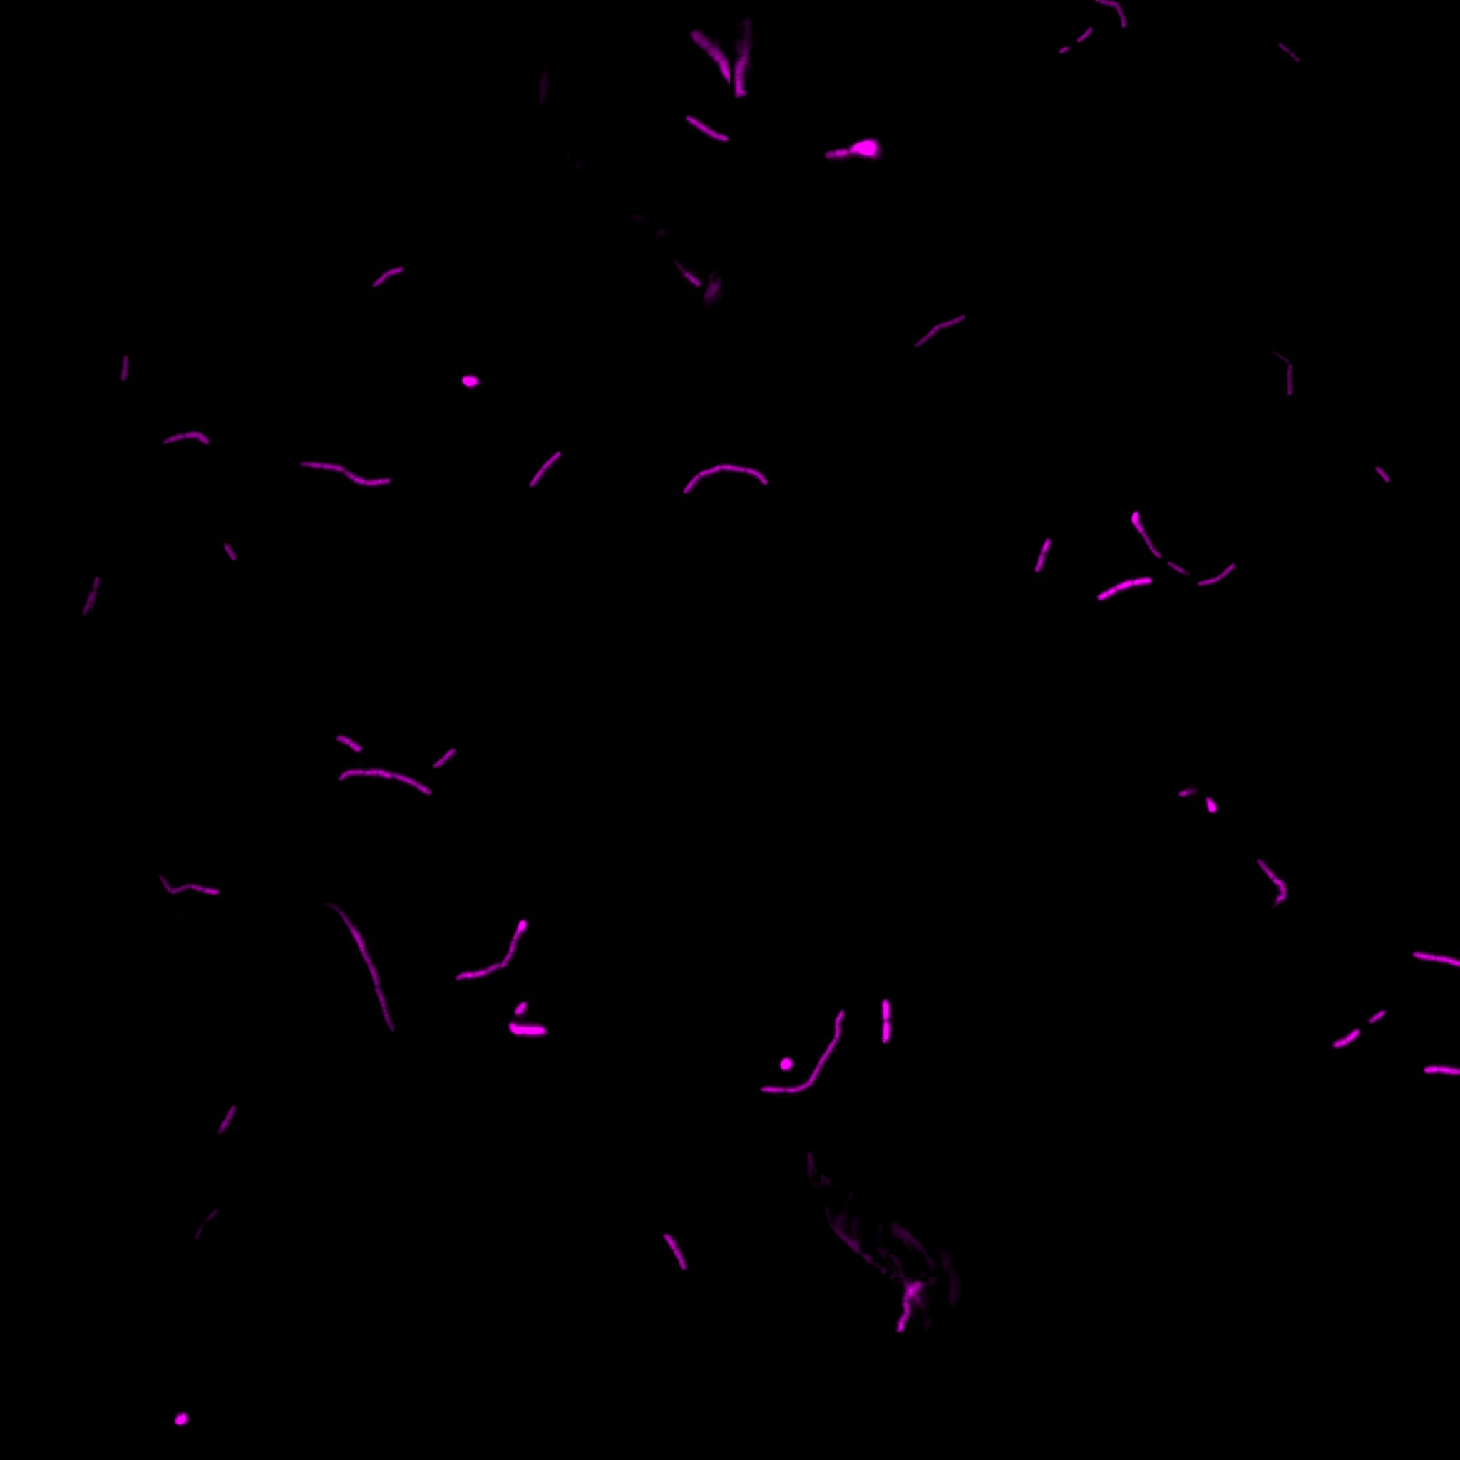
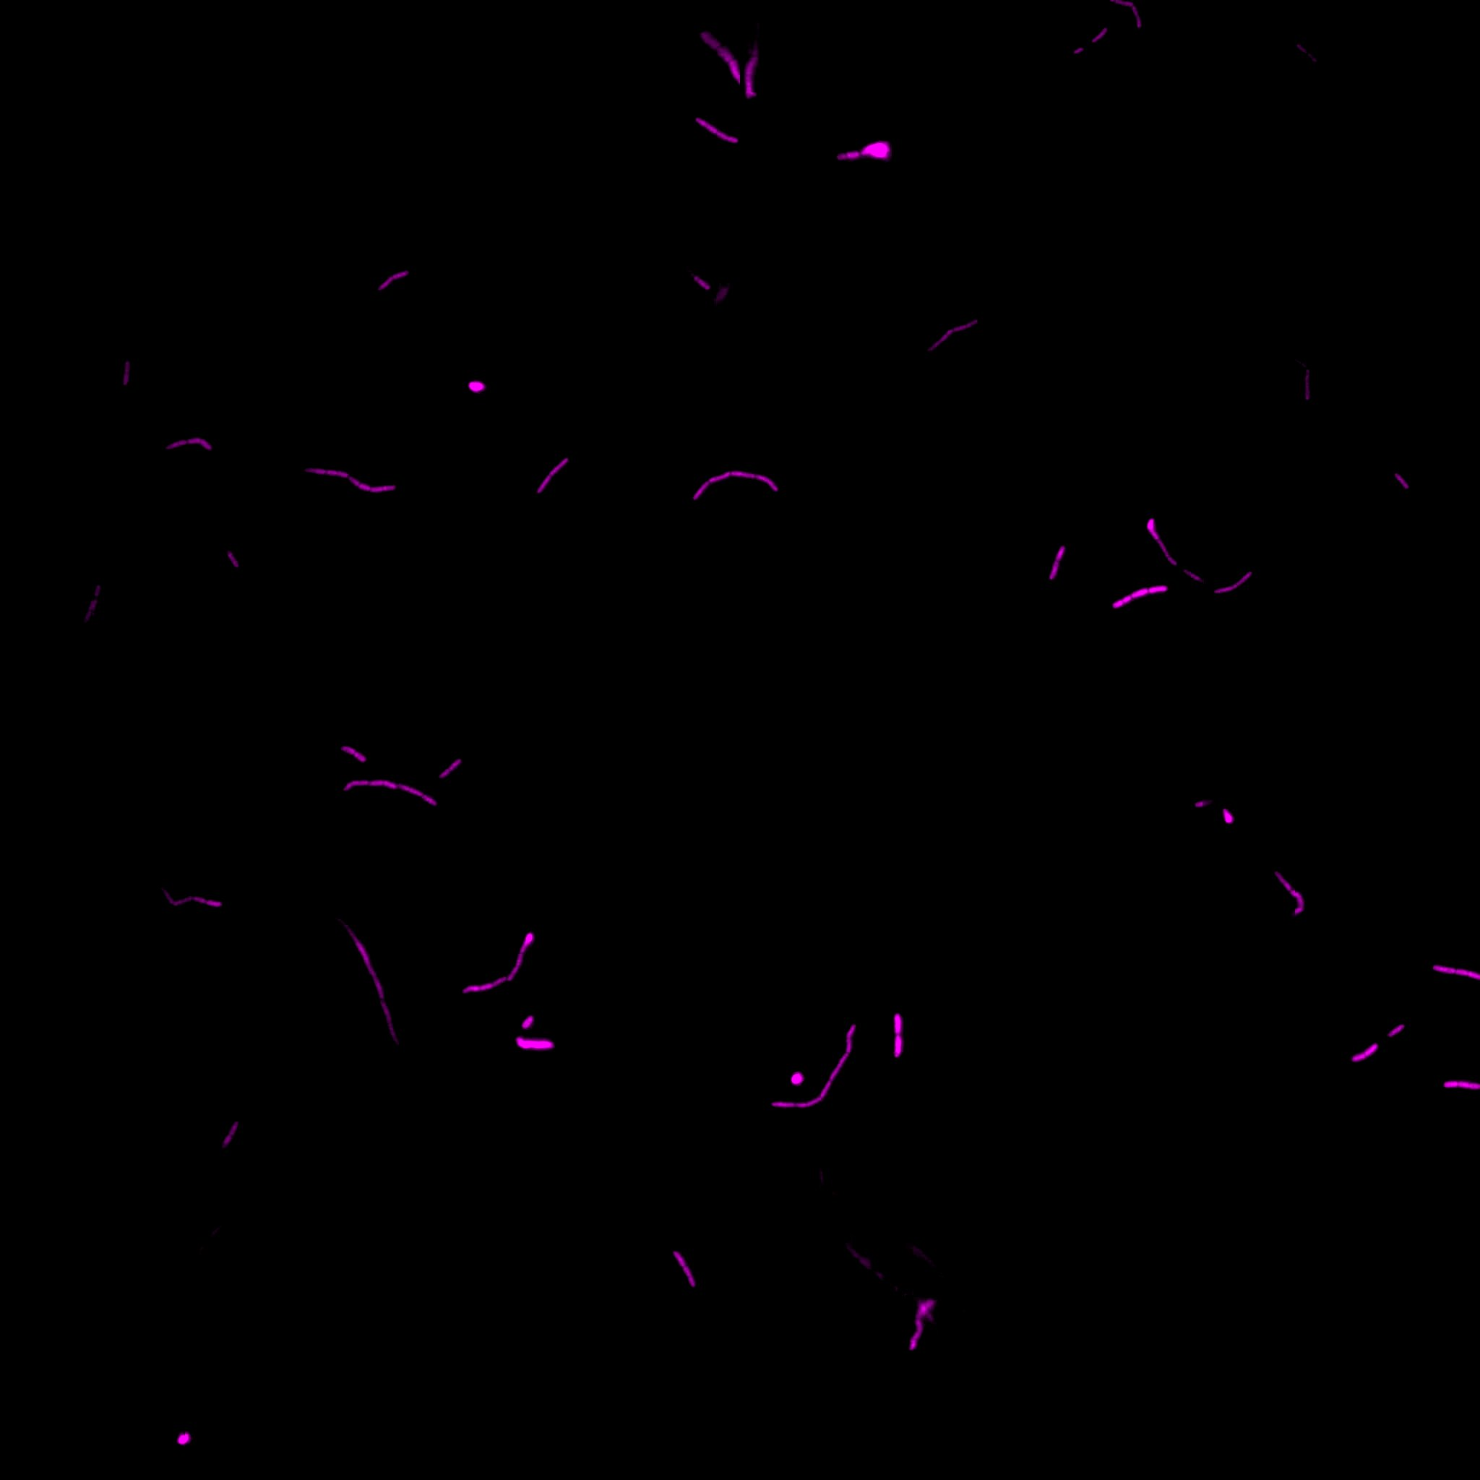
Image Data Compression
Full z-stack
4 mb per slice
Focused (stacked) image
81 kb
Selected objects against dark background
79 kb

Slide 10
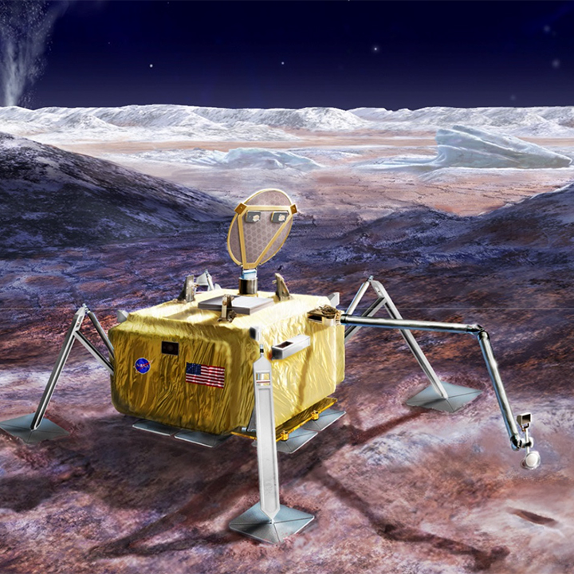

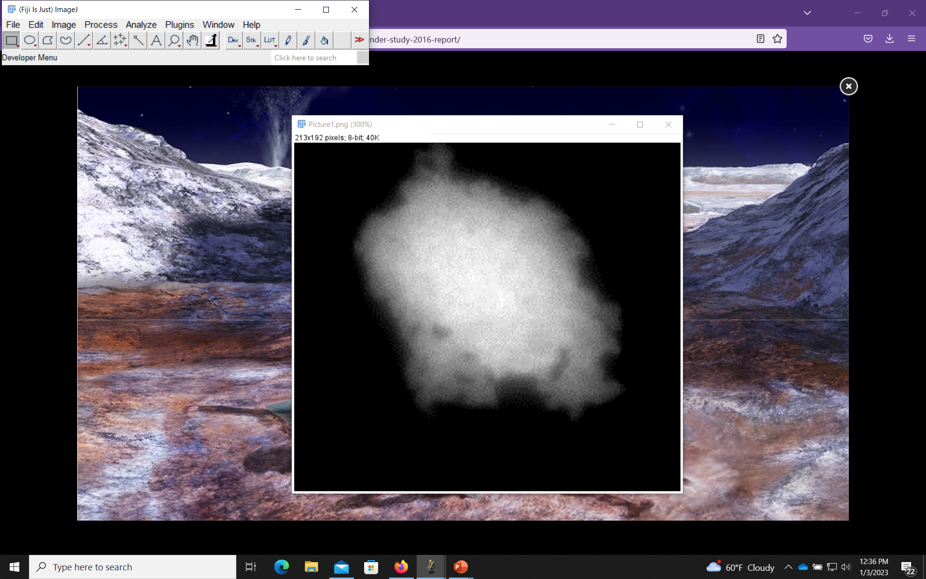
Mission Implementation Overview
Megabytes of data
Hand et al. 2017
Kilobytes of data

Slide 11


Acknowledgements
Pavel Klier is supported by an ORAU NASA Postdoctoral fellowship
The development of the Luminescence Imager for Exploration (LIfE) microscope is based upon work supported by NASA issued through the SMD Concepts for Ocean worlds Life Detection Technology (COLDTech), Instrument Concepts for Europa Exploration-2 (ICEE-2), and Maturation of Instruments for Solar System Exploration (MatISSE) programs

