Slide 1
On Computationally Efficient Radiative Transfer Calculations for Three-Dimensional Entry Problems
Amal Sahai
AMA, Inc. at NASA Ames Research Center
Christopher Johnston
NASA Langley Research Center
January 23, 2023

Slide 2
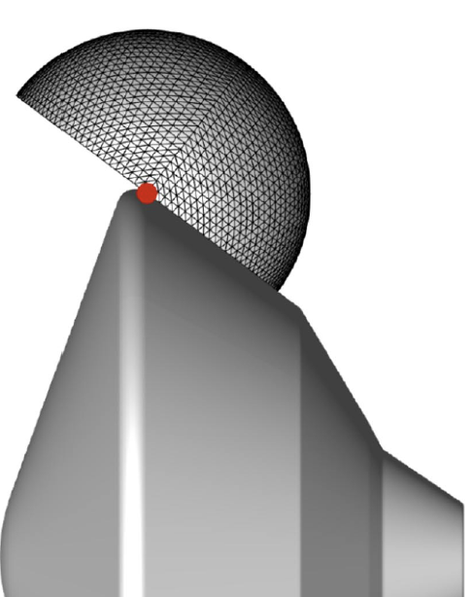
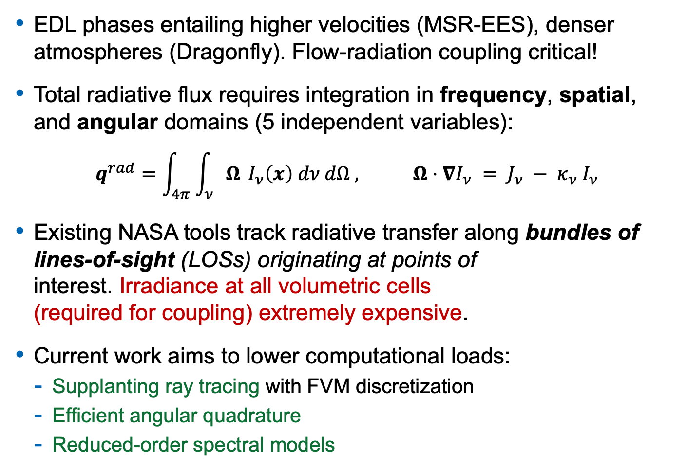
Introduction
EDL phases entailing higher velocities (MSR-EES), denser atmospheres (Dragonfly). Flow-radiation coupling critical!
Total radiative flux requires integration in frequency, spatial, and angular domains (5 independent variables):
$$q^{rad}=\int_{4π}{\int_{ν}{Ω}} I_{ν}\left(x\right) dν dΩ , Ω⋅∇I_{ν} = J_{ν} − {κ_{ν} I}_{ν}$$
Existing NASA tools track radiative transfer along bundles of lines-of-sight (LOSs) originating at points of interest. Irradiance at all volumetric cells (required for coupling) extremely expensive.
Current work aims to lower computational loads:
  Supplanting ray tracing with FVM discretization
  Efficient angular quadrature
  Reduced-order spectral models

Slide 3
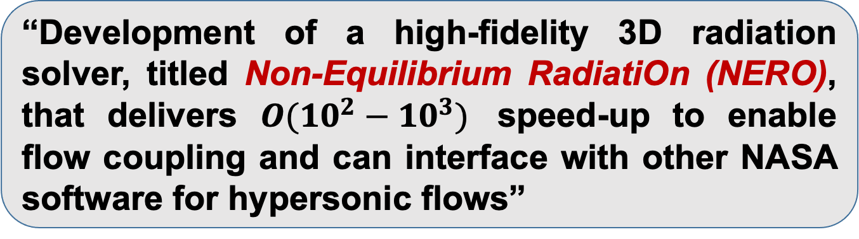
Objective
“Development of a high-fidelity 3D radiation solver, titled Non-Equilibrium RadiatiOn (NERO), that delivers $O(10^{2}−10^{3})$ speed-up to enable flow coupling and can interface with other NASA software for hypersonic flows”
CFD
(US3D)
Particle
Radiation
Ablation
Maxwell

Slide 4
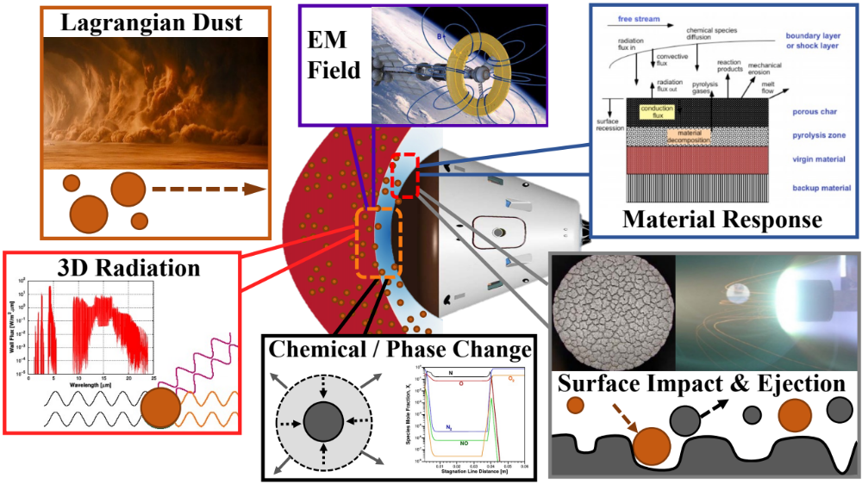

Objective

Slide 5
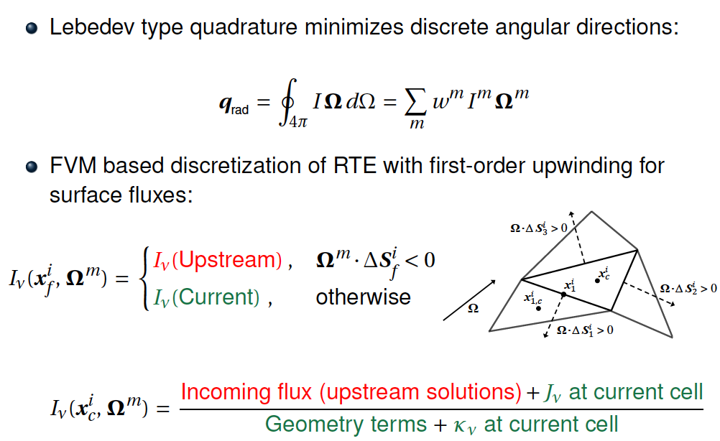
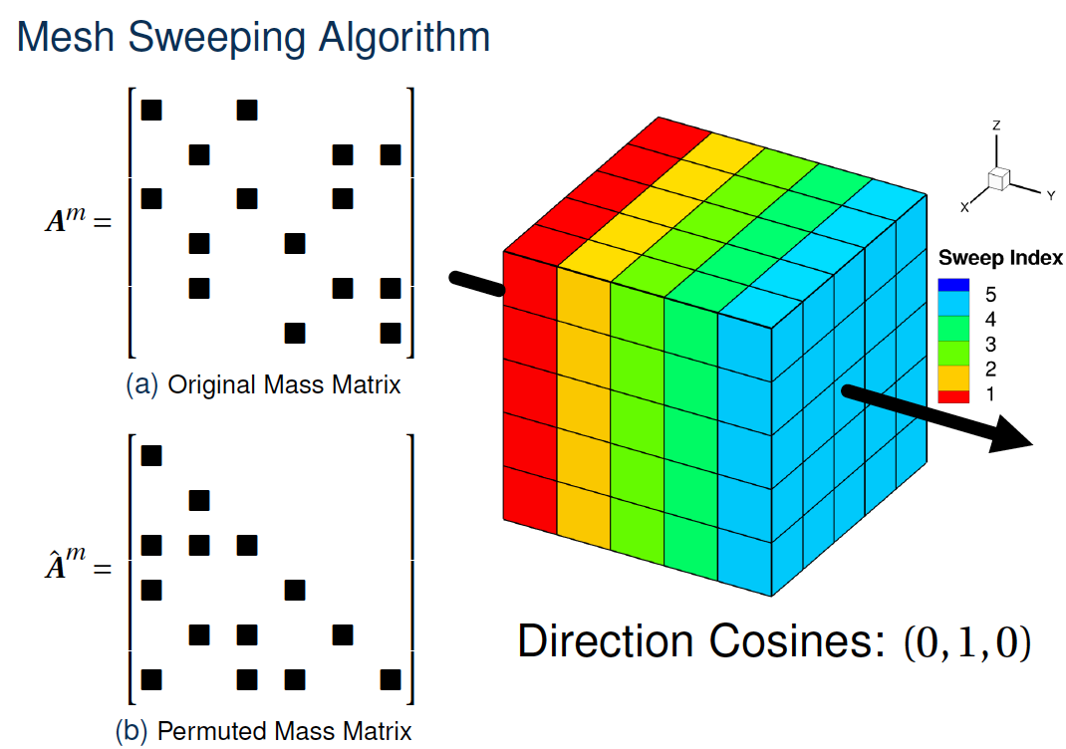
NERO: Efficient Angular-Spatial Solutions
Lebedev type quadrature minimizes angular directions:
FVM discretization of RTE with first-order upwinding for surface fluxes and “mesh sweeping”:

Slide 6
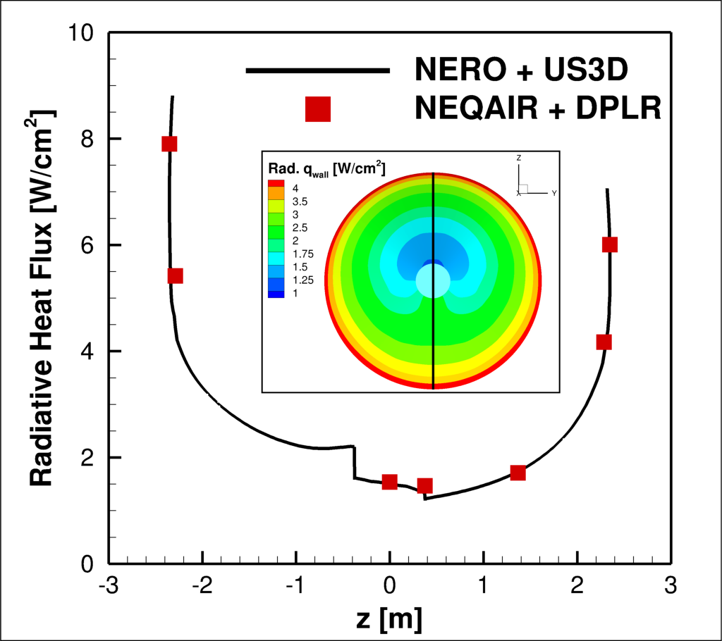
Results: Sample Return Lander Afterbody
Smeared Rotational Band model for CO₂ IR properties, Boltzmann vibrational population, and 1-way coupling.

Slide 7
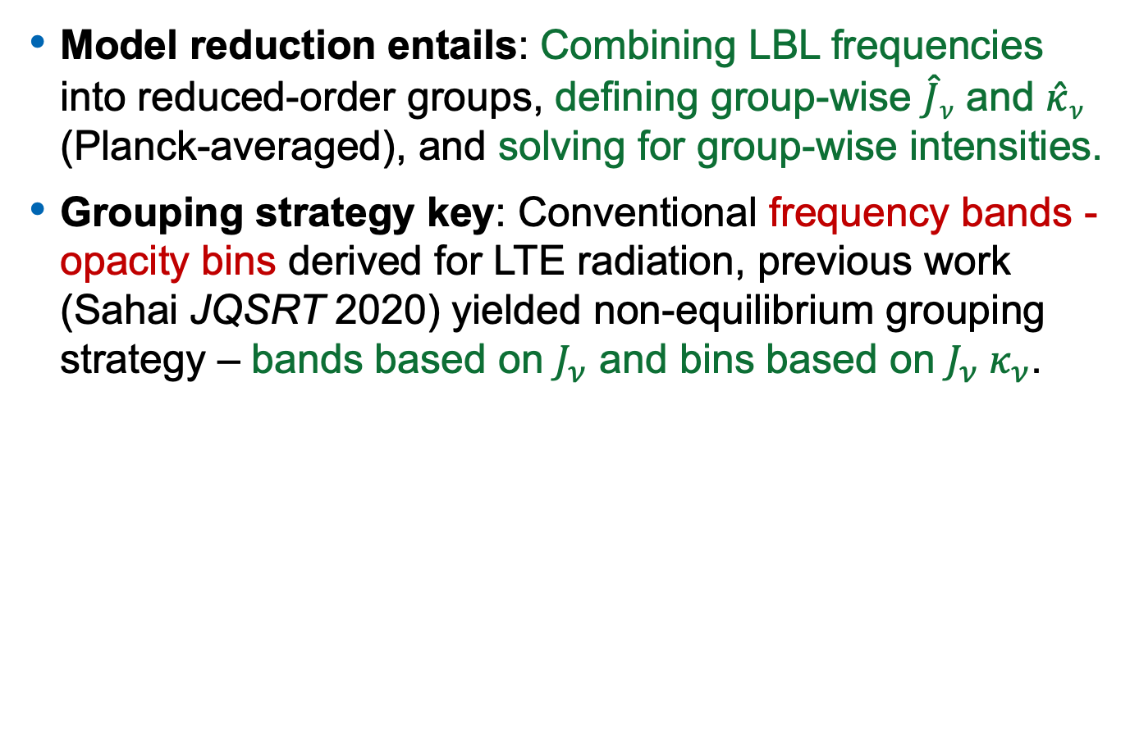
NERO: Reduced-order Spectral Models
Model reduction entails: Combining LBL frequencies into reduced-order groups, defining group-wise $\hat{J}ν$ and $\hat{κ}ν$ (Planck-averaged), and solving for group-wise intensities.
Grouping strategy key: Conventional frequency bands - opacity bins derived for LTE radiation, previous work (Sahai JQSRT 2020) yielded non-equilibrium grouping strategy – bands based on $J_{ν}$ and bins based on $J_{ν}{ κ}_{ν}$.
Old
New

Slide 8
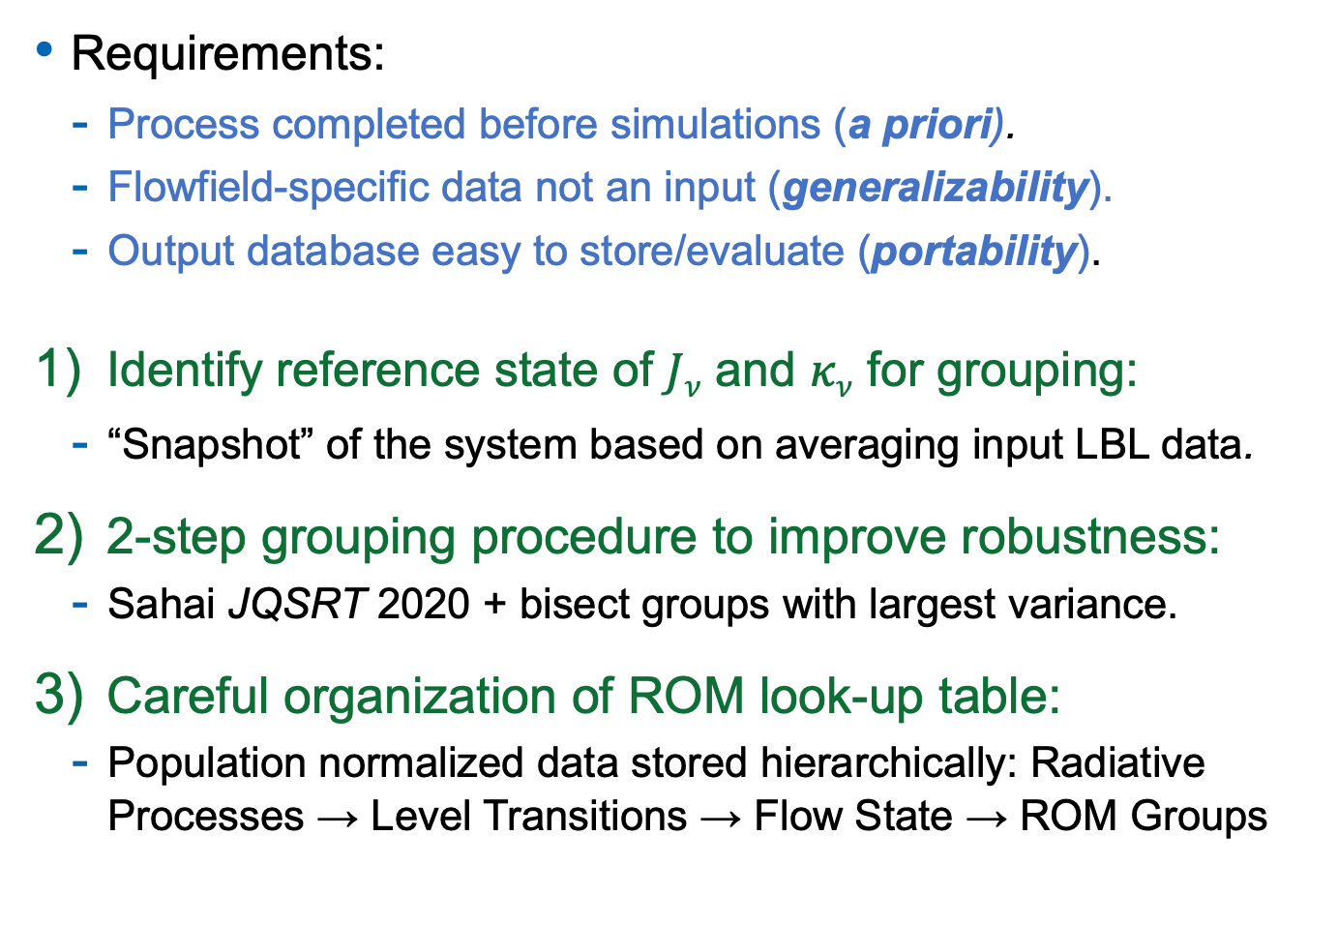
NERO: General-purpose ROM Database
Requirements:
  Process completed before simulations (a priori).
  Flowfield-specific data not an input (generalizability).
  Output database easy to store/evaluate (portability).
Identify reference state of $Jν$ and $κν$ for grouping:
  “Snapshot” of the system based on averaging input LBL data.
2-step grouping procedure to improve robustness:
  Sahai JQSRT 2020 + bisect groups with largest variance.
Careful organization of ROM look-up table:
  Population normalized data stored hierarchically: Radiative Processes → Level Transitions → Flow State → ROM Groups

Slide 9
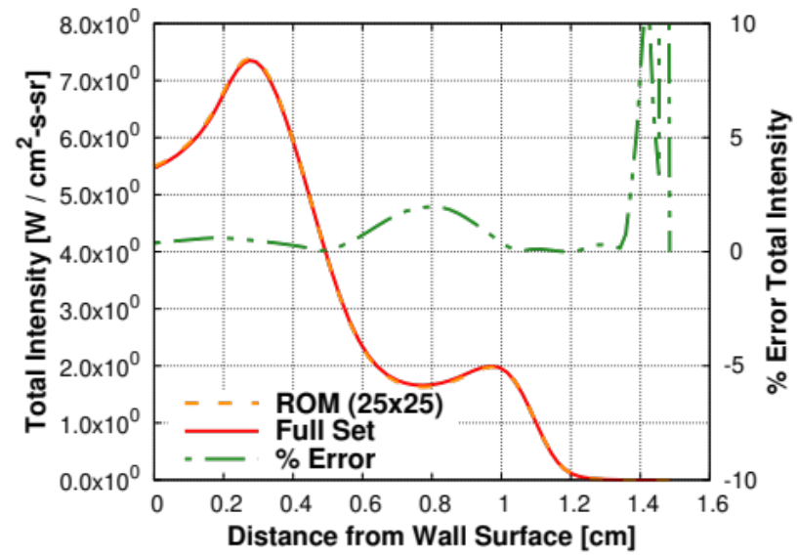
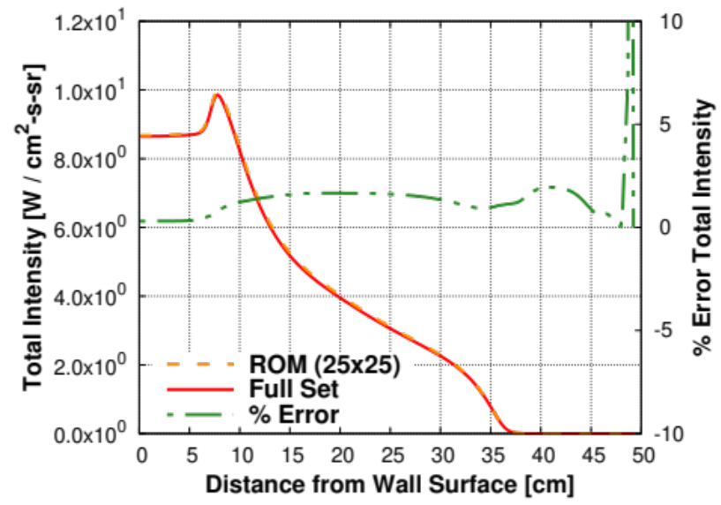
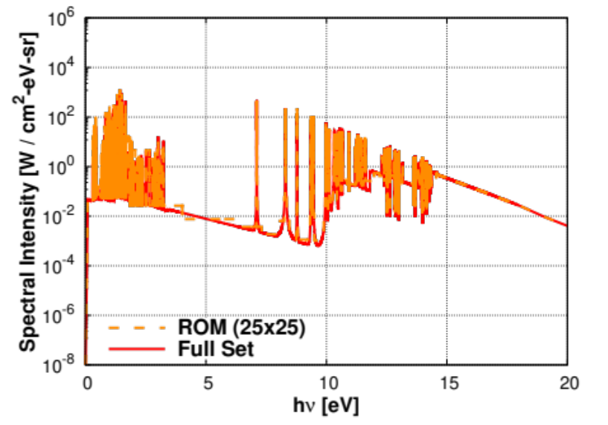
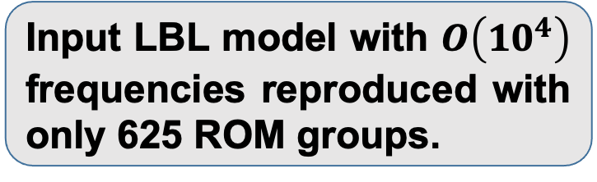
Results: N Radiation LOS Analysis
Stardust Stagnation
FIRE II Wake
Input LBL model with $O\left(10^{4}\right)$ frequencies reproduced with only 625 ROM groups.

Slide 10
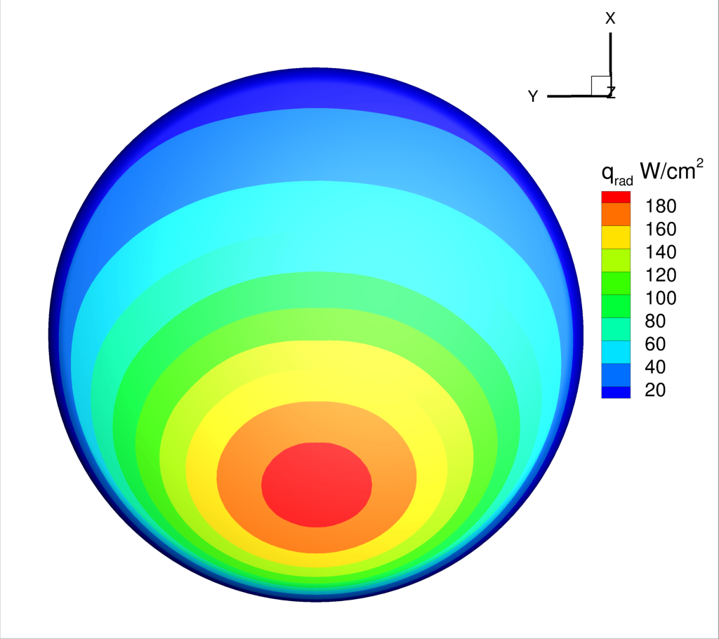
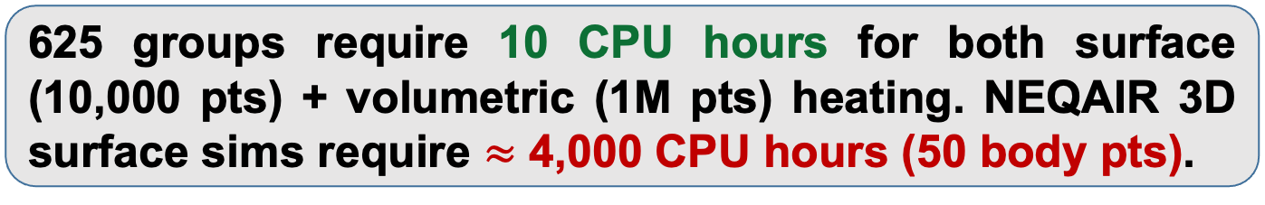
Results: N Radiation for Orion Forebody
625 groups require 10 CPU hours for both surface (10,000 pts) + volumetric (1M pts) heating. NEQAIR 3D surface sims require $≈$ 4,000 CPU hours (50 body pts).

Slide 11
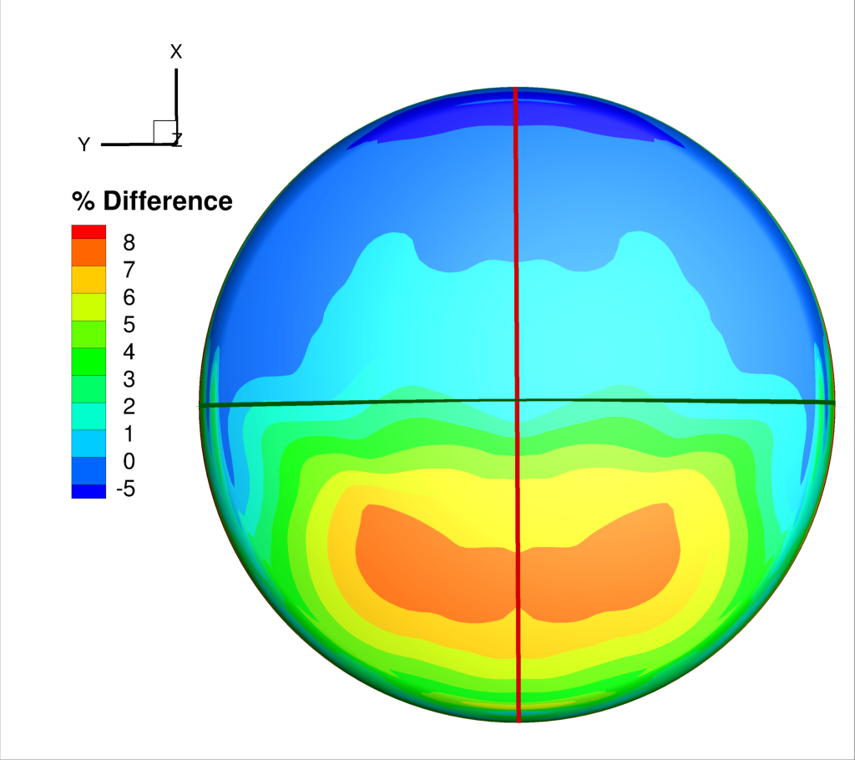
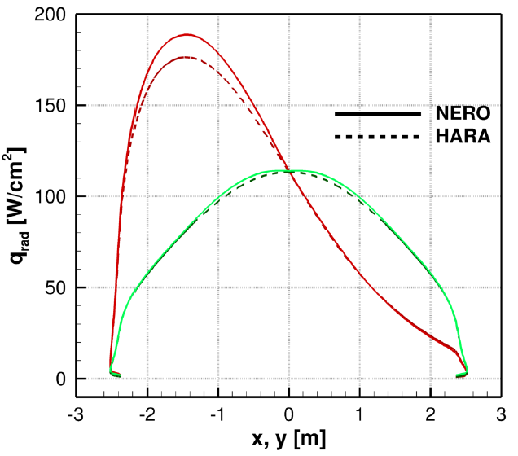
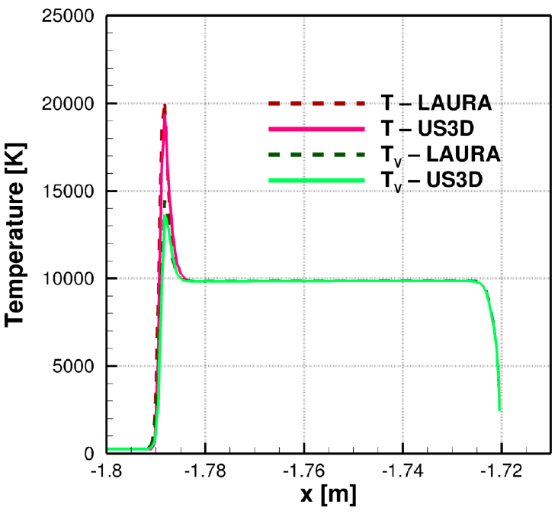
Results: N Radiation for Orion Forebody
Maximum difference in surface heat flux < 8%; 5-10% differences in peak temperatures between LAURA and US3D contributory factor.

Slide 12
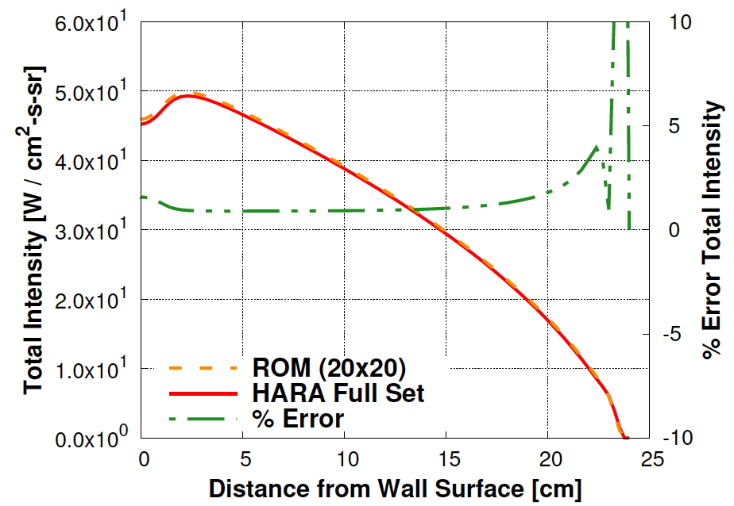
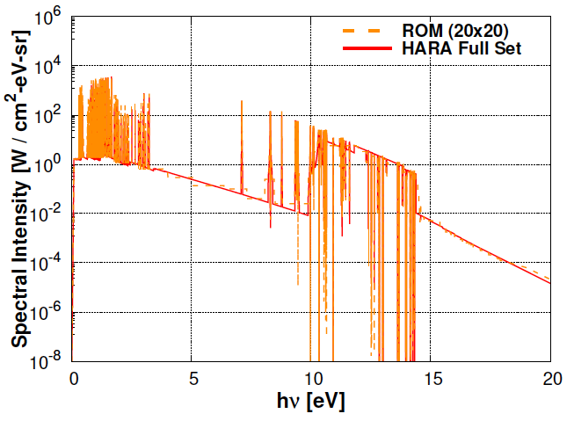
Results: N Radiation for Orion Forebody
Total/spectral quantities match when evaluating same US3D stagnation LOS.

Slide 13
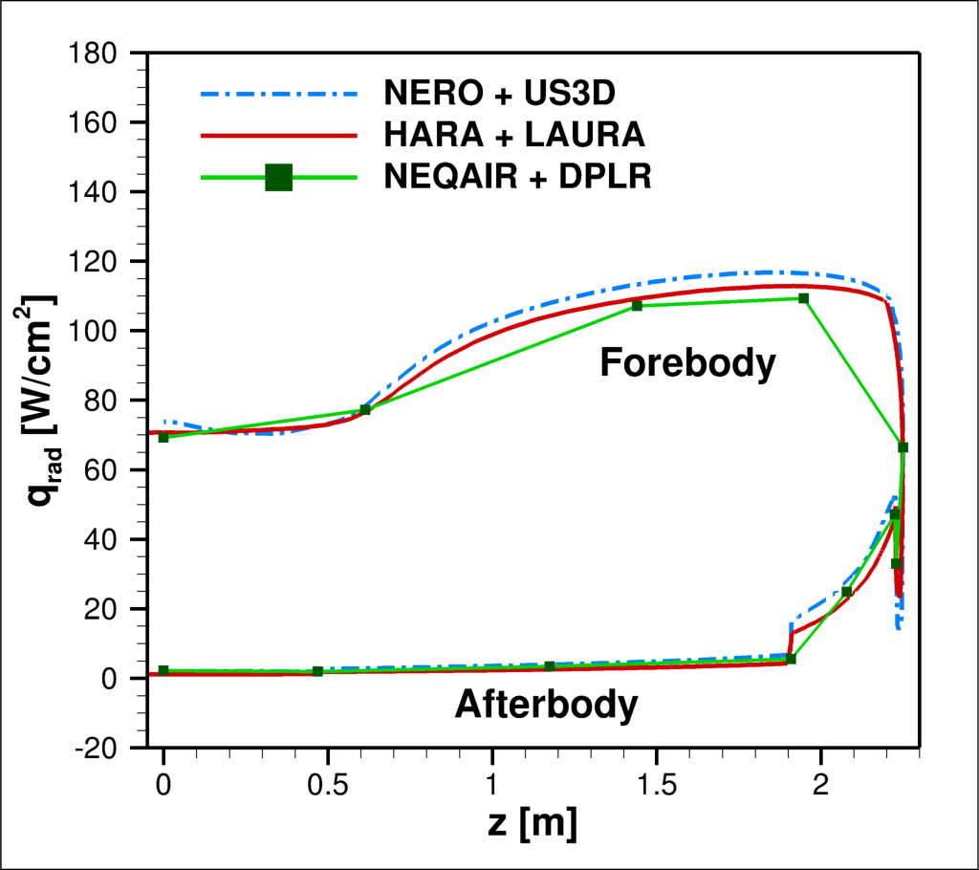
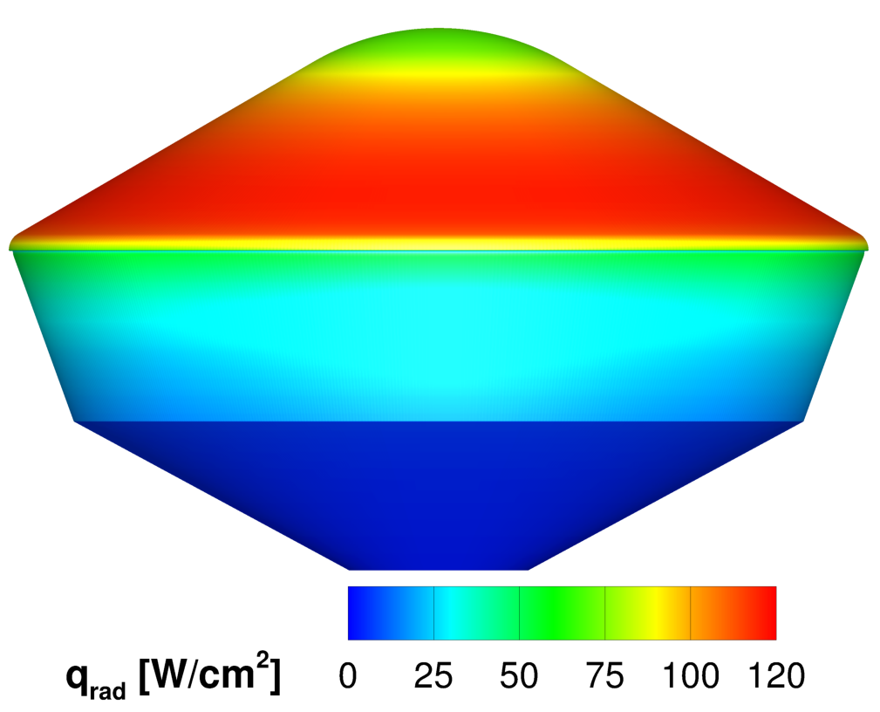
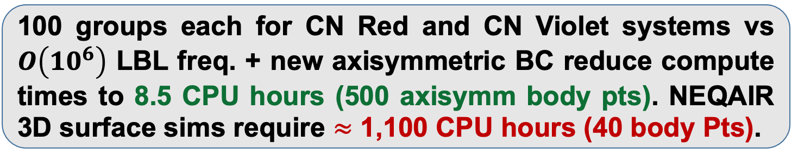
Results: CN Radiation for Dragonfly
100 groups each for CN Red and CN Violet systems vs $O\left(10^{6}\right)$ LBL freq. + new axisymmetric BC reduce compute times to 8.5 CPU hours (500 axisymm body pts). NEQAIR 3D surface sims require $≈$ 1,100 CPU hours (40 body Pts).

Slide 14
Conclusions and Future Work
Conclusions
New radiation solver under development with massive efficiency gains throughs reduced-order spectral models, FVM discretization, and Lebedev quadrature.
Developed methodology for creating portable, general-purpose reduced-order spectral databases.
Demonstrated efficacy on a diverse set of problems such as Mars Sample Return Lander, Orion, and Dragonfly.
Future Work
Continue incorporating additional radiative systems.
Examine overlapping radiative systems (e.g., O and N).
Explore different techniques for spatial-angular resolution – linear solvers, parallelization, M2 model.

Slide 16
Backup Slides: Reduced-order Models

Slide 17
Backup Slides: Planck-Averaging

Slide 18
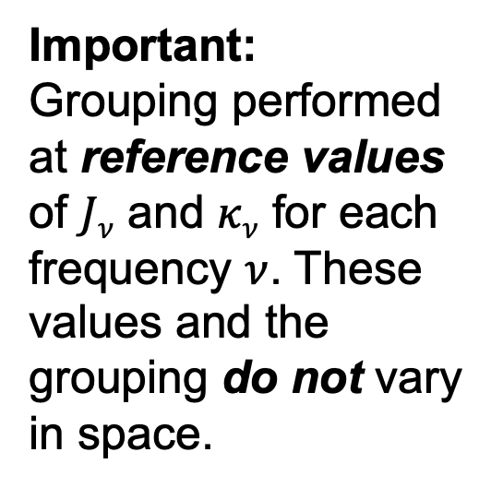
Backup Slides: Conventional Grouping
Important:
Grouping performed at reference values of $Jν$ and $κν$ for each frequency $ν$. These values and the grouping do not vary in space.

Slide 19
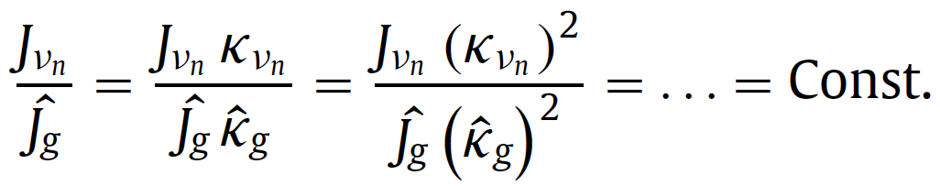
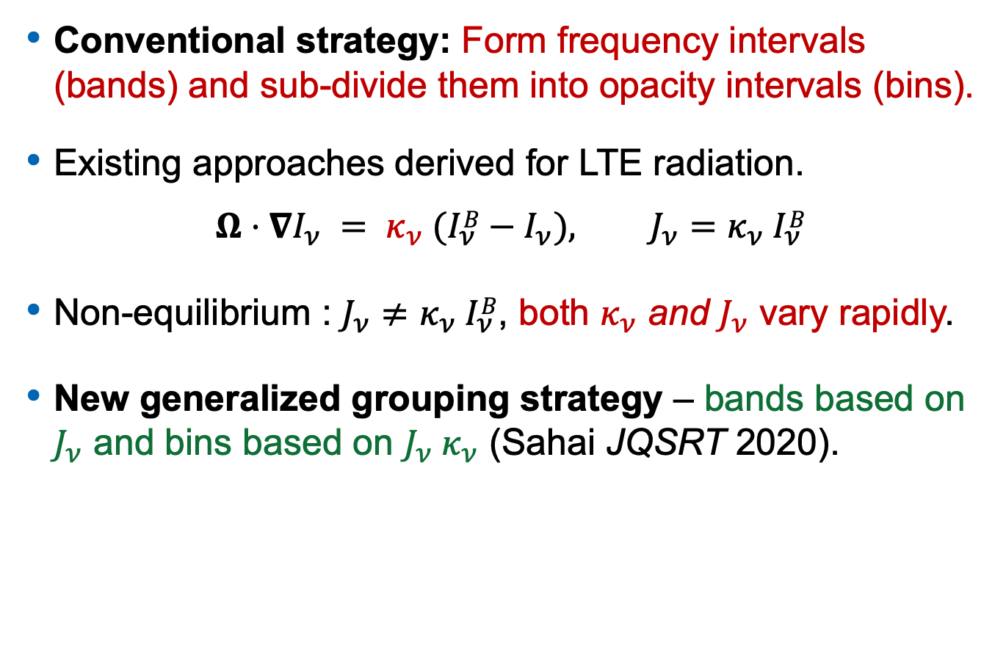
Generalized Grouping Strategy
Conventional strategy: Form frequency intervals (bands) and sub-divide them into opacity intervals (bins).
Existing approaches derived for LTE radiation.
$$Ω⋅∇I_{ν} = κ_{ν}{ (I}_{ν}B−I_{ν}), J_{ν}=κ_{ν}{ I}_{ν}B$$
Non-equilibrium : $J_{ν}≠κ_{ν}{ I}_{ν}B$, both $κ_{ν}$ and $J_{ν}$ vary rapidly.
New generalized grouping strategy – bands based on $J_{ν}$ and bins based on $J_{ν}{ κ}_{ν}$ (Sahai JQSRT 2020).

Slide 20
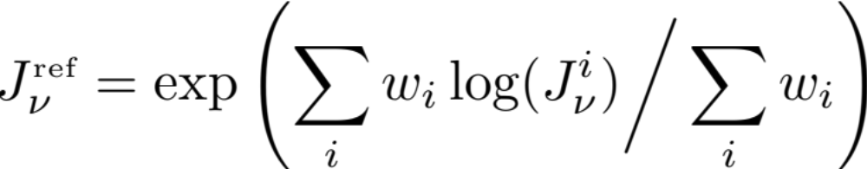
Backup Slides: Portable ROM Database
Requirements:
  Process completed before simulations (a priori).
  Flowfield-specific data not an input (generalizability).
  Output database easy to store/ evaluate (portability).
Identify reference state (“Process completed a priori” / “Flowfield-specific not necessary”):
  Input LBL data stored as look-up table for varying temperature, number density of electrons (or other physical quantities).
  Obtain absorption/emission coefficients on look-up table conditions and then the log-average to define reference state:

Slide 21
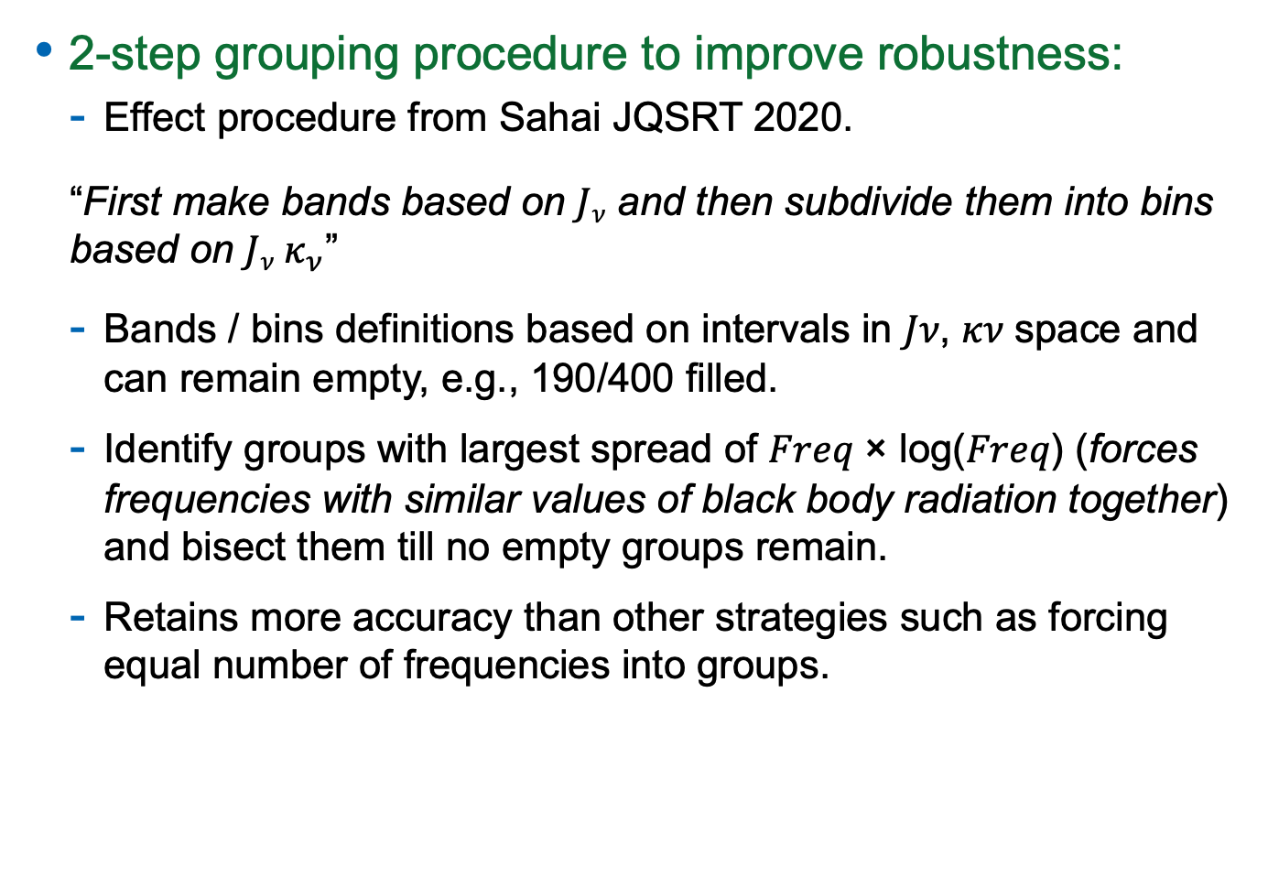
Backup Slides: Portable ROM Database
2-step grouping procedure to improve robustness:
  Effect procedure from Sahai JQSRT 2020.
  “First make bands based on $Jν$ and then subdivide them into bins based on $Jν κ_{ν}$”
  Bands / bins definitions based on intervals in 𝐽𝜈, 𝜅𝜈 space and can remain empty, e.g., 190/400 filled.
  Identify groups with largest spread of 𝐹𝑟𝑒𝑞 × log(𝐹𝑟𝑒𝑞) (forces frequencies with similar values of black body radiation together) and bisect them till no empty groups remain.
  Retains more accuracy than other strategies such as forcing equal number of frequencies into groups.

Slide 22
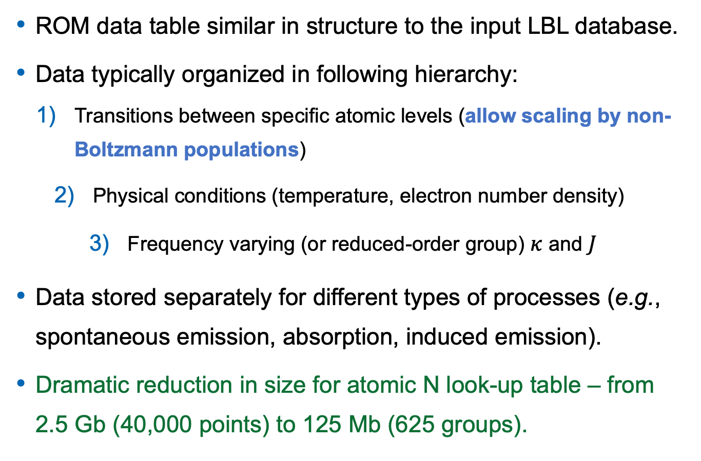
Backup Slides: Portable ROM Database
ROM data table similar in structure to the input LBL database.
Data typically organized in following hierarchy:
  Transitions between specific atomic levels (allow scaling by non-Boltzmann populations)
    Physical conditions (temperature, electron number density)
      Frequency varying (or reduced-order group) $κ$ and $J$
Data stored separately for different types of processes (e.g., spontaneous emission, absorption, induced emission).
Dramatic reduction in size for atomic N look-up table – from 2.5 Gb (40,000 points) to 125 Mb (625 groups).

