Slide 1
Mars Ascent Vehicle Flight Test Mission Design, Analysis, and Instrumentation
William W. Benson NASA KSC - VA-H1 (Presenting)
Michael Fritzinger NASA MSFC - EV42
Justin Costley NASA KSC - a.i. solutions
Brian Tibbets NASA WFF - NSROC
Brent Edwards NASA WFF - NSROC
Tim Kibbey NASA MSFC - ER62
2023 AAS GNC Conference

Slide 2
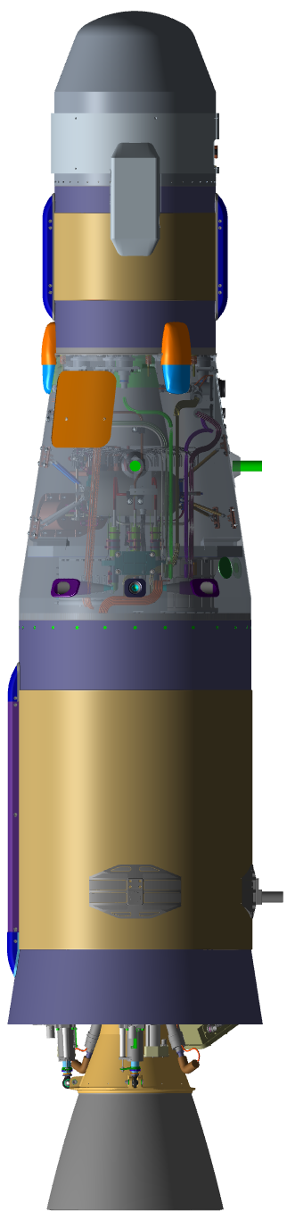
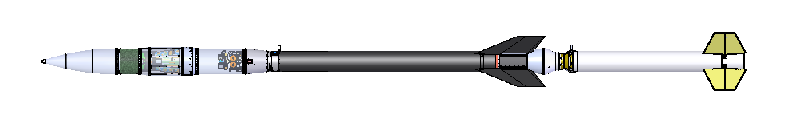
Background and Flight Test Objectives
The Mars Ascent Vehicle (MAV) will be the first rocket ever to launch off the surface of Mars, inserting Martian regolith samples into orbit.
Since the MAV vehicle is a two-stage all-solid rocket with no closed-loop shutdown capability, orbit insertion accuracy is heavily dependent on pre-flight predictions of the motor performance and dynamics of the spin-stabilized upper stage (MAV2).
Therefore, a flight test of the MAV2 as the final stage on a Black Brant IX sounding rocket from Wallops Flight Facility (WFF) is planned.
This presentation discusses the mission design, post flight reconstruction approach, and instrumentation package proposed to meet the relevant Flight Test Objectives (FTO’s)
  FTO #1: Reduce MAV2 motor impulse uncertainty
  FTO #2: Characterize MAV2 integrated dynamics
  FTO #3: Demonstrate MAV1/MAV2 separation system function

Slide 3
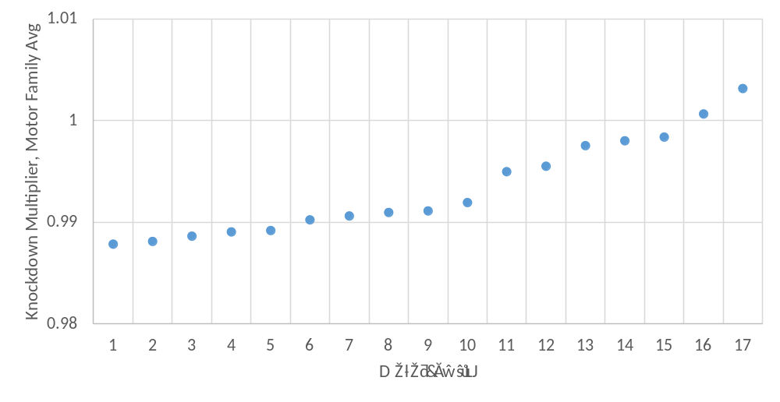
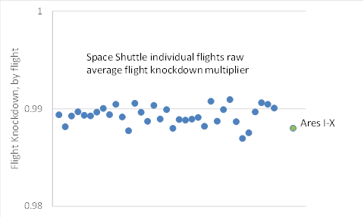
Knockdown Factor (FTO-1)
A well-known characteristic of SRM’s that a reduction in performance is sometimes observed in flight that was not observed in ground testing, known as a “flight knockdown factor,”
Expressed as a multiplier on thrust and thus impulse.
This has been observed in both launch booster and in-space/upper stage configurations.
Figures on right show In-Space motor raw knockdown factors and Space Shuttle Reusable Solid Rocket Motor(RSRM) performance
Note that Ares 1-X RSRM raw knockdown factor is in family with Shuttle performance, indicating that knockdown is independent of vehicle configuration
In-Space Motor Families’ Average Knockdowns
Space Shuttle and Ares I-X RSRM flight knockdown data

Slide 4
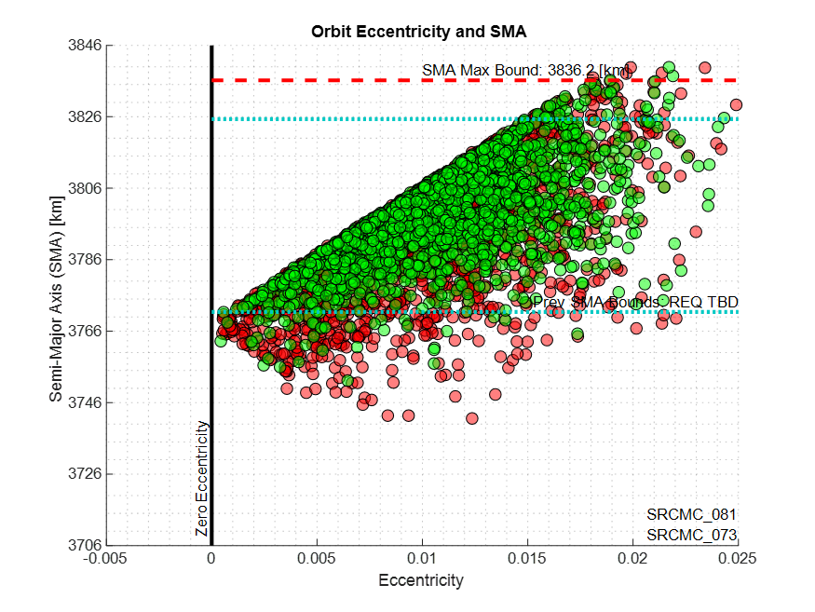
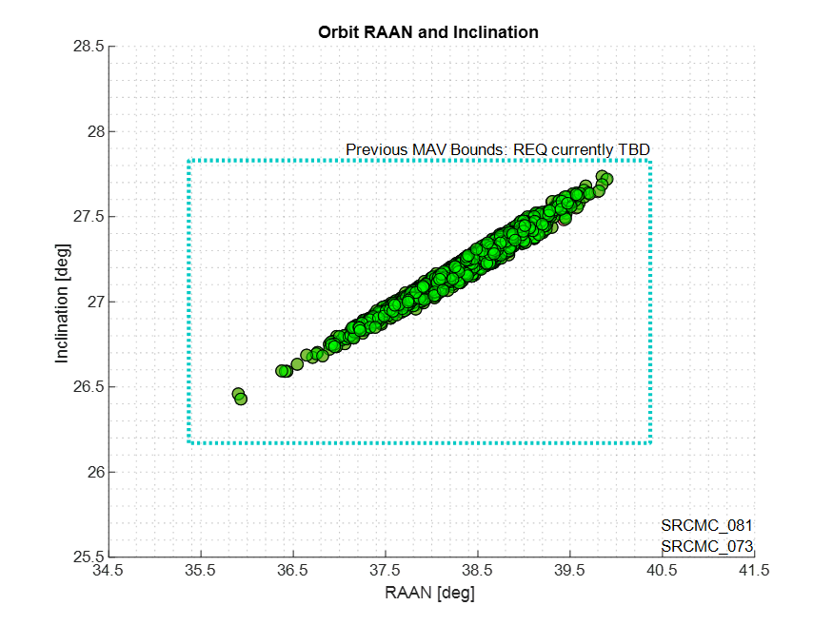
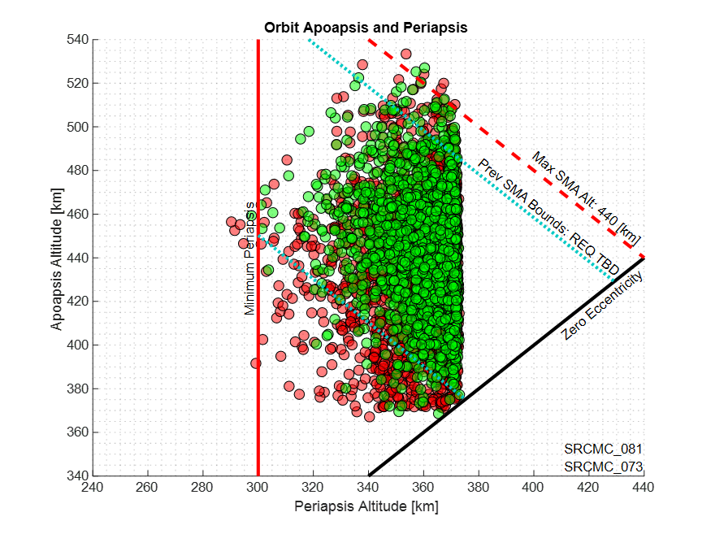

MAV Flight Test Reduces Motor Performance Uncertainty (FTO-1)
Motor Impulse dispersion model differences for 2nd stage motor between flight test and no flight test
Includes all currently modeled dispersions including thrust vector misalignments, mass proptery dispersions, stage separation dispersions, etc SRM and spin motor dispersions
Red = No Test Flight
Green = One Test Flight
Orbit plane results are similar
Expanded SMA dispersion without a test flight
Cases which fail to meet minimum periapsis
Expanded apoapsis dispersion without a test flight

Slide 5
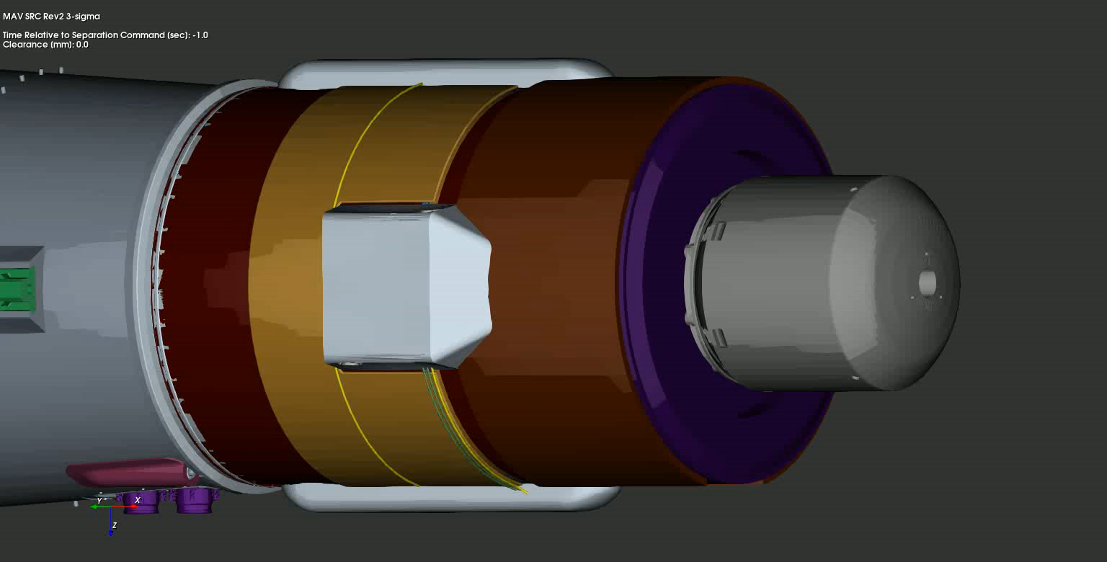
MAV Flight Test Characterizes Separation and Dynamics of Spin-Stabilized Stage (FTO-2 & 3)
Spin motor dispersions, including thrust vector, impulse and burn time, create additional disturbances on MAV2 which reduce the clearances between the nozzle and MAV1.
The current push-off spring energy and MAV2 spin-up timing are optimized to minimize the pointing error at MAV2 ignition while ensuring positive clearance margins are maintained.
Minimum 2 minutes flight time after MAV2 burnout to characterize spent motor spin dynamics
Fully integrated separation performance testing in a flight-like environment including the MAV2 spin-up is impractical to achieve through ground testing due to safety and instrumentation concerns.
Ground tests considered (and rejected)
Horizontal drop test (does not capture flex or clearance effects from spin rockets)
Horizontal air bearding test (same as 1, planar motion only)
Vertical drop test (same as 1)
Zero G test (same as 1)
Real-time animation of MAV2 Separation
(Special Thanks to Ben Burger at MSFC)

Slide 6
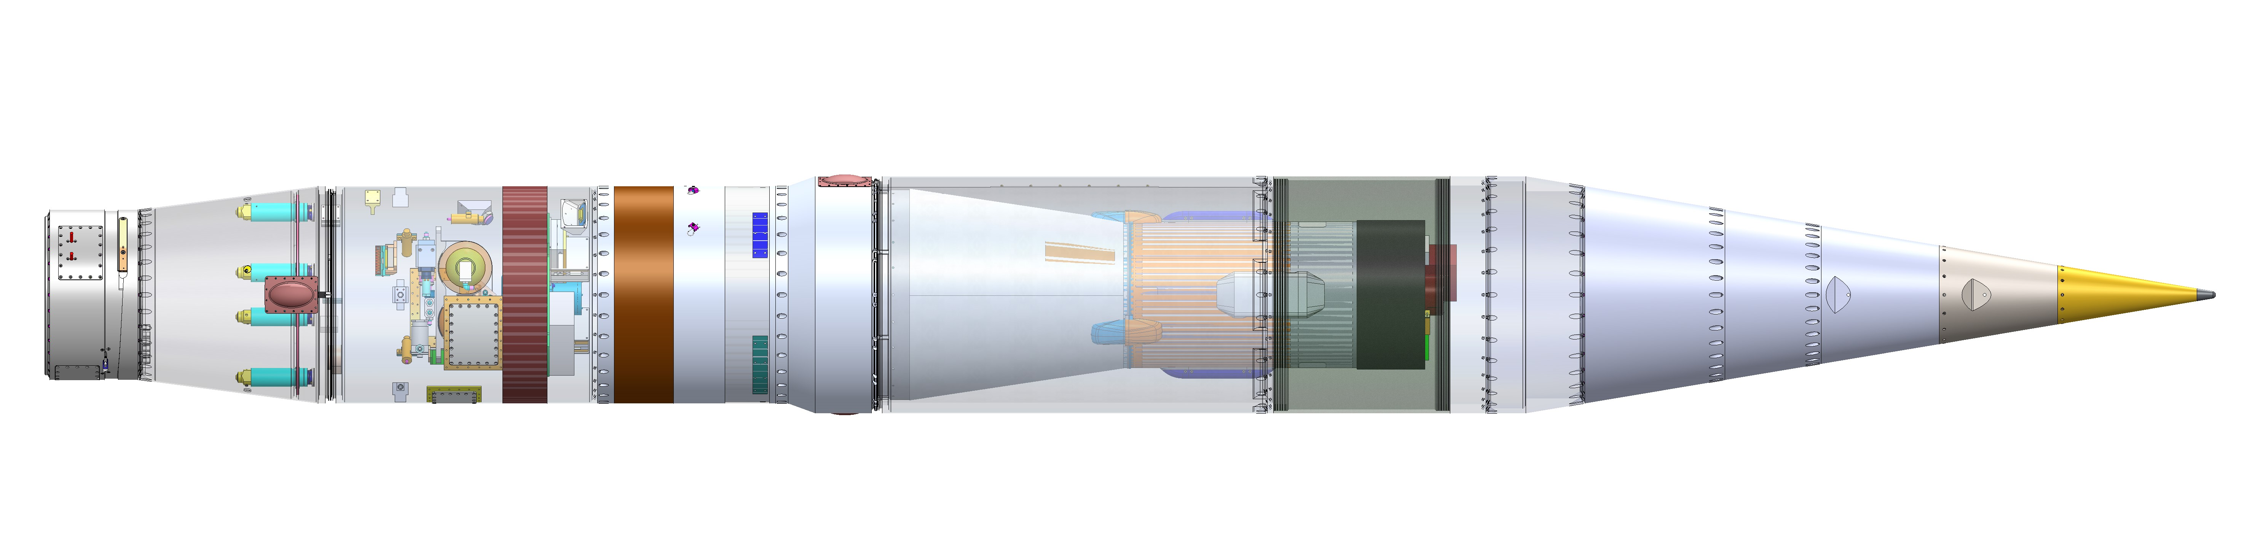

Sounding Rocket Plus Payload
Terrier Mk70
Black Brant
Payload
MAV1 Mass Simulator (GPS, TM, ACS, CMS, IMU1/TERN, Nosecone & MAV2 Sep Pyro Systems, Power*)
MAV Non-Flight Interstage (Cameras*)
Motor Adapter/Aft Transition (CDI/Payload Sep Event Control, De-spin*)
MAV2 FTV*
(TM, IMU2/TERN, GPS, Power, etc)
Y
X
Z
Origin = 3.389 m aft of MAV2 Sep Plane
Payload Separation Plane
SR Nosecone Separation Plane
Separating Nosecone
MAV2 Sep Plane
MAV1 FTV = SRM1 Mass Simulator + Interstage
MAV2 FTV = SRM2 + Forward Structure Element + MAV Instrumentation Module (MIM)
FT Interstage
MAV FTV

Slide 7
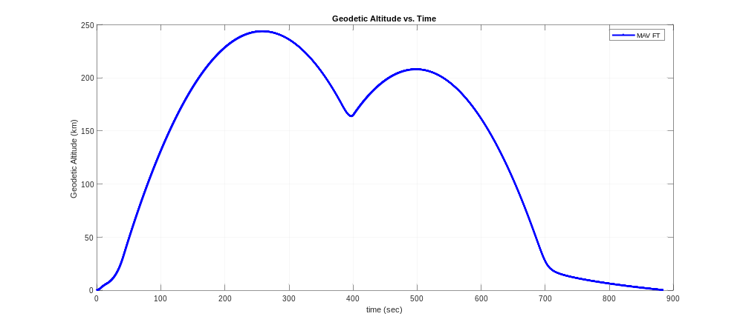





Flight Sequence
*Conceptual elements shown. Not to scale.
5
Separation and Spin-Up
Sep MAV1 at 180 km
Spinup at SEP+0.45 sec
MAV2 Ignition at SEP+3.0 sec
Sounding rocket injects MAV FTV into 240 km apogee trajectory
MAVs ignition occurs on the “Downleg” at ~176 km, which is a compromise between range safety constraints and maximizing flight time
7
2nd Apogee
Occurs at ~T+500 sec
208 km altitude
4
1st Apogee
Occurs at T+258.8 sec
243.8 km altitude
6
MAV2 Burn
Ign at T+381.3 sec
Burnout at Ign+18.8 sec
3
Coast to MAV2 Separation from MAV1
De-spin at T+65 seconds
Separate MAV FTV from SR at T+69 sec
Deploy nosecone at T+90 seconds
Re-orient to align with local vertical at T+95 sec
Coast past apogee
8
MAV2 Spindown
Minimum 2 minutes after burnout
SEP + 218 sec to ensure above 100 km for all dispersed cases
2
Black Brant Flight Phase
2nd stage burn at T+16 seconds
Black Brant IX Stage 2 burnout at T+43.5 sec
1
Launch and Terrier Flight Phase
Spin rocket ignition at T+0.9 sec
Terrier S1 burnout at T+6.2 sec

Slide 8
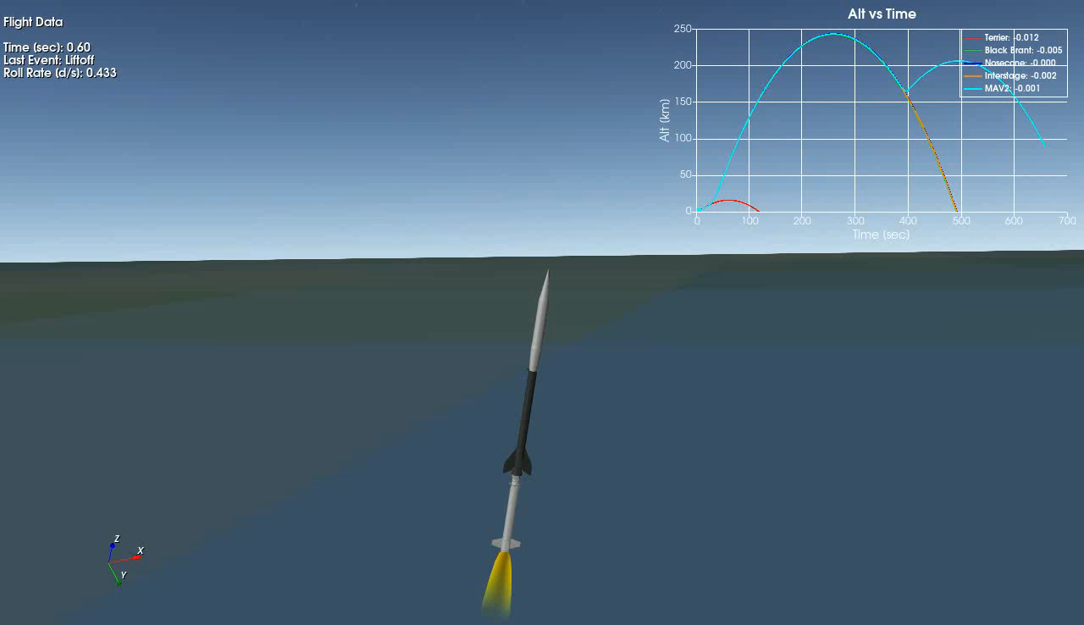
Ascent Animation

Slide 9
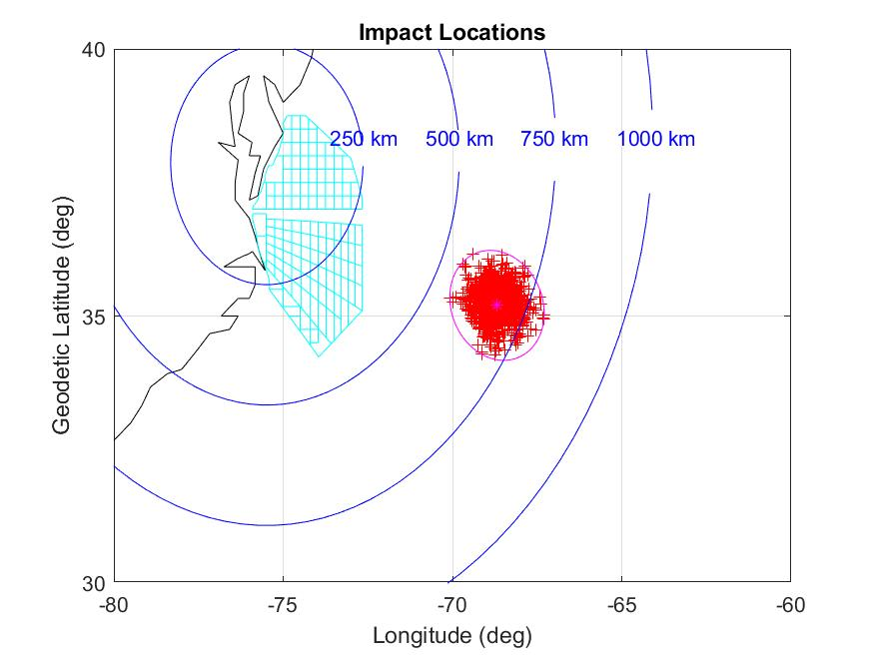
Range Safety
Launch will be conducted from Wallops Flight Facility (WFF) in Virginia and must be compliant with WFF Range Safety Manual 8009-T
MAV Flight Test trajectory is designed to avoid:
  Populated Land Areas
  “VACAPES” is made up of different zones called “Air-Areas” for aircraft and “Surface-Areas” for ships
    Designed to protect popular fishing locations along the continental shelf, mostly between longitudes -75 and -74 east longitude, where most boats can be found
    WFF Range Safety Manual 8009-T mentions minimum public notices (NOTMAR, NOTAM) to be based upon 2-sigma for nominal planned events.
Design Goal is to keep the 2-sigma non-failure mode impact dispersions East of VACAPES, to avoid needing surveillance.
  More hazard areas increases the cost of surveillance and is more difficult to get range clearance for a particular launch date
  A typical mission might cover 5 to 10 of the surface-areas and require a few participating boats and aircraft to help keep areas clear.
  WFF typically likes to avoid Air-K (VACAPES zones close to WFF) because the Navy frequently uses that area.
Parameter | Target | Tolerance
Sounding Rocket Apogee (km) | 240 | +/- 40
Geodetic Altitude (km) | 180 | +/- 5
Flight Path Elevation Angle (deg) | < 20 deg | N/A
Velocity Relative Flight Azimuth (deg) | 115 | +/- 30
Sounding Rocket MAV2 FTV Separation Targets
Non-Failure Mode MAV2 FTV Impact Locus

Slide 10
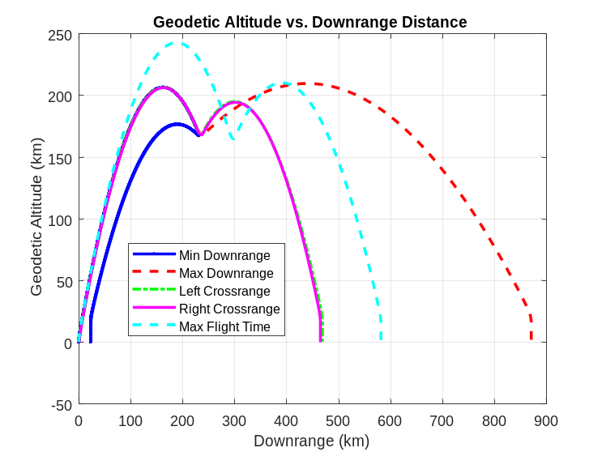
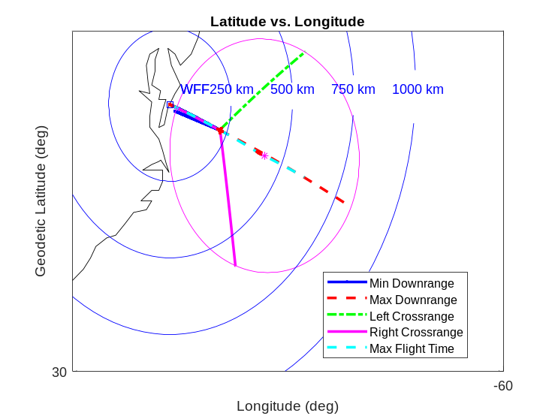
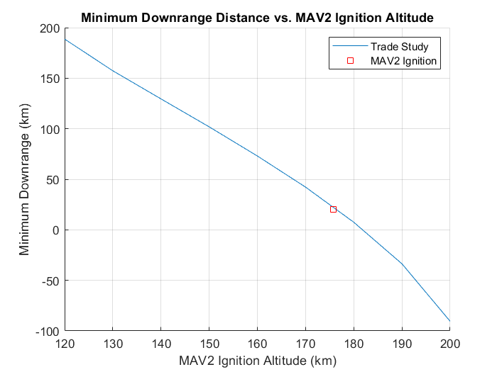
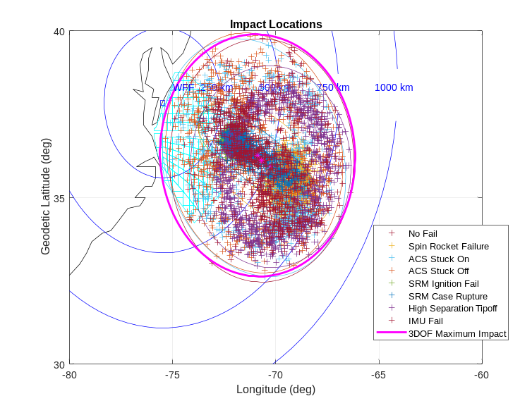
3DOF Trajectory Design
Use 3DOF (POST-2) to determine the impact limits assuming a worst case MAV2 FTV orientation at different ignition altitudes
Determines relationship between closest approach to land vs. ignition altitude
Downrange vs. Altitude for Bounding Cases
Worst-Case Impact Ellipse For “optimal” MAV2 FTV Ignition Altitude
Worst-Case Impact Ellipse w/6DOF Dispersed Failure Mode Impacts
Min Downrange vs. MAV2 FTV Ignition Altitude

Slide 11
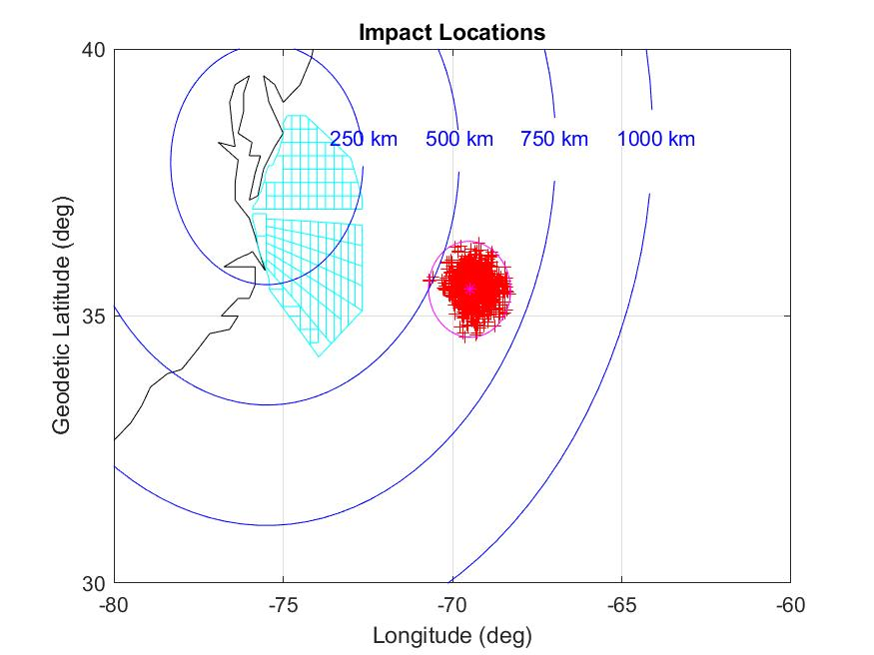
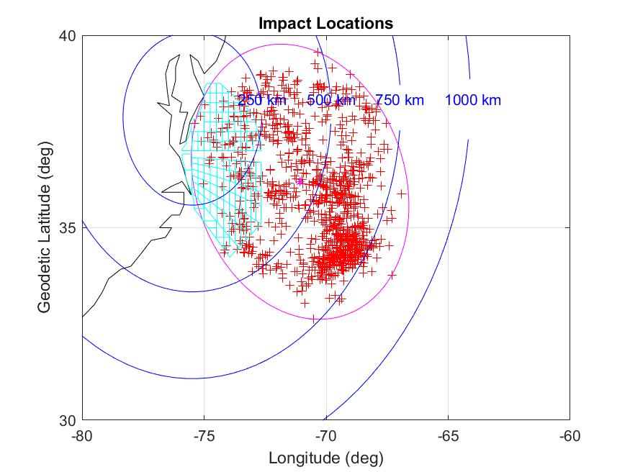
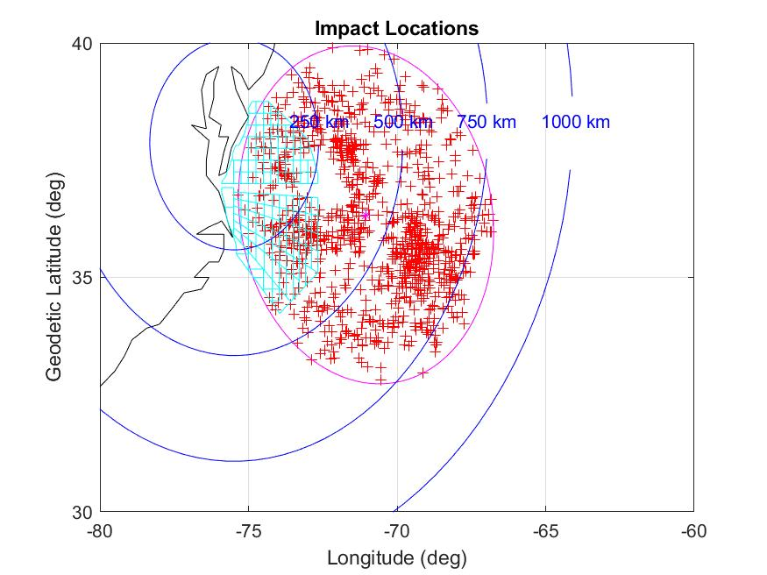
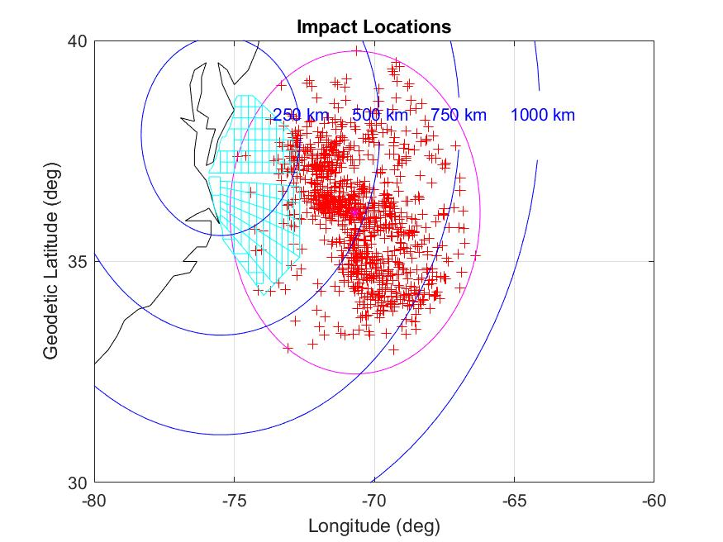
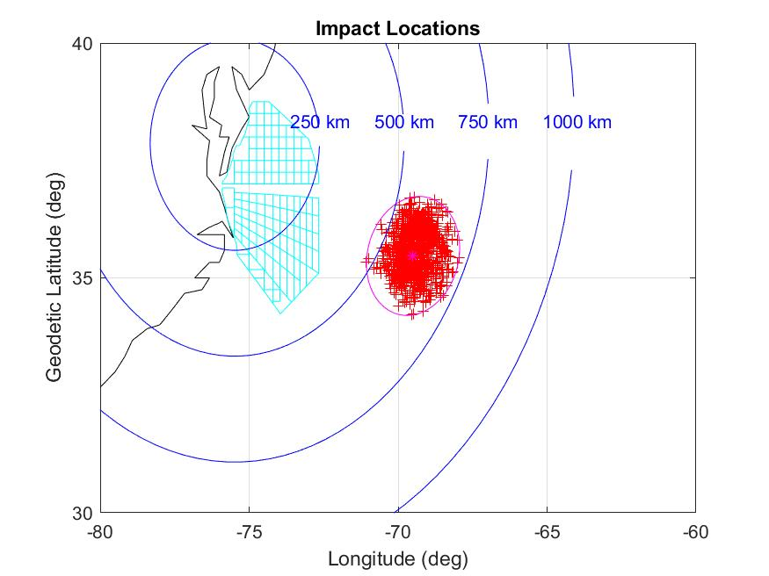
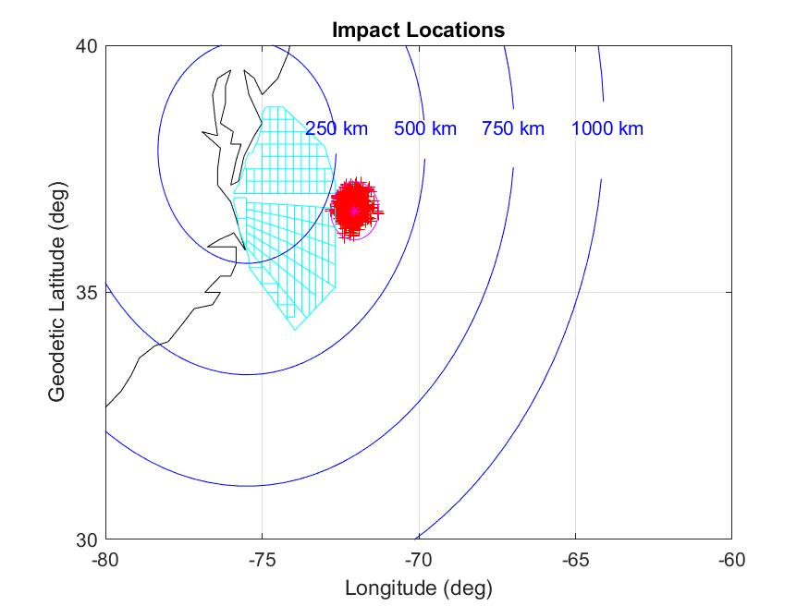
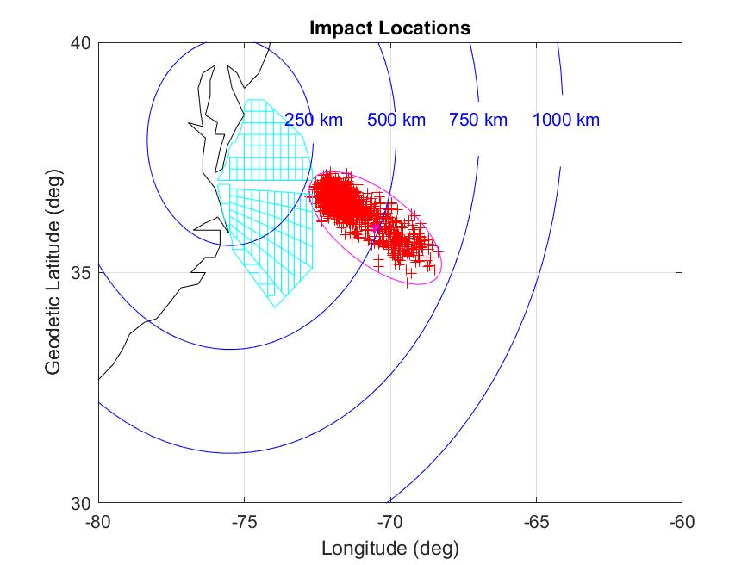
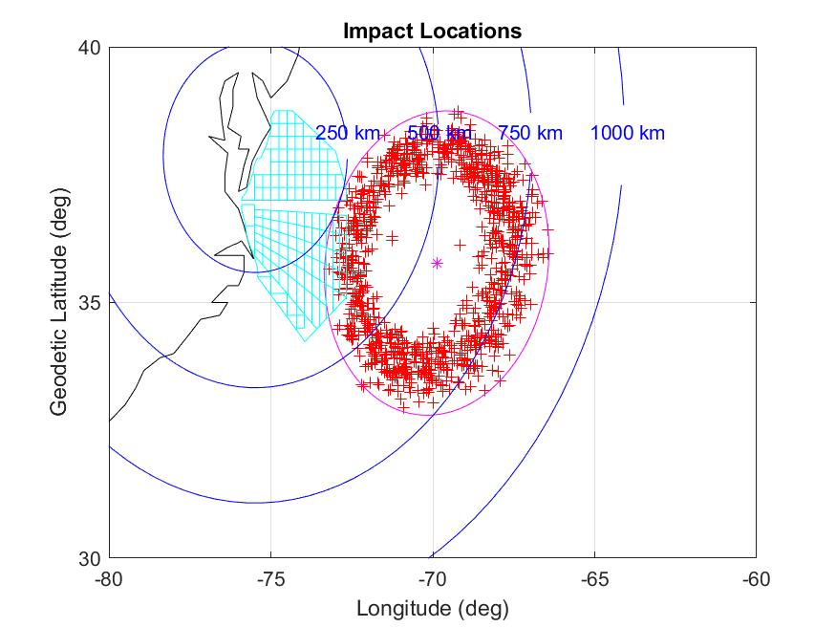
6DOF Failure Mode Impact Loci
Case 0, No Fail
Case 1, Failed MAV1 FTV ACS Thruster “on”
Case 2, Failed MAV1 FTV ACS Thruster “off”
Case 3, MAV1 FTV TERN Gyro Fail
Case 4, MAV2 FTV Spin Rocket Fail
Case 5 & 8, MAV2 FTV Ignition Fail or No Separation
Case 6, MAV2 FTV Case Rupture
Case 7, Sep Fail w/ High Tipoff

Slide 12
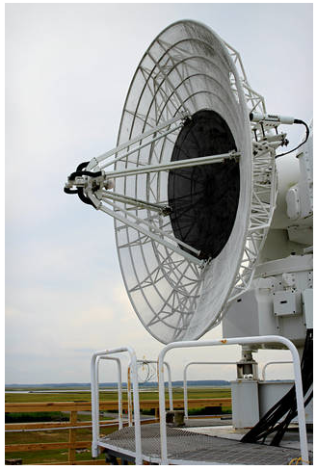
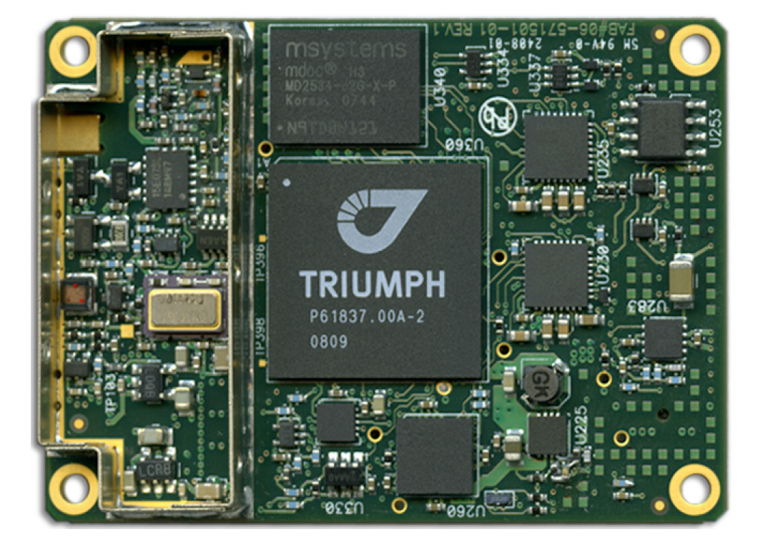
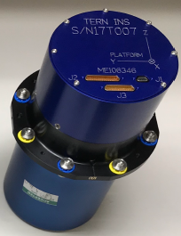
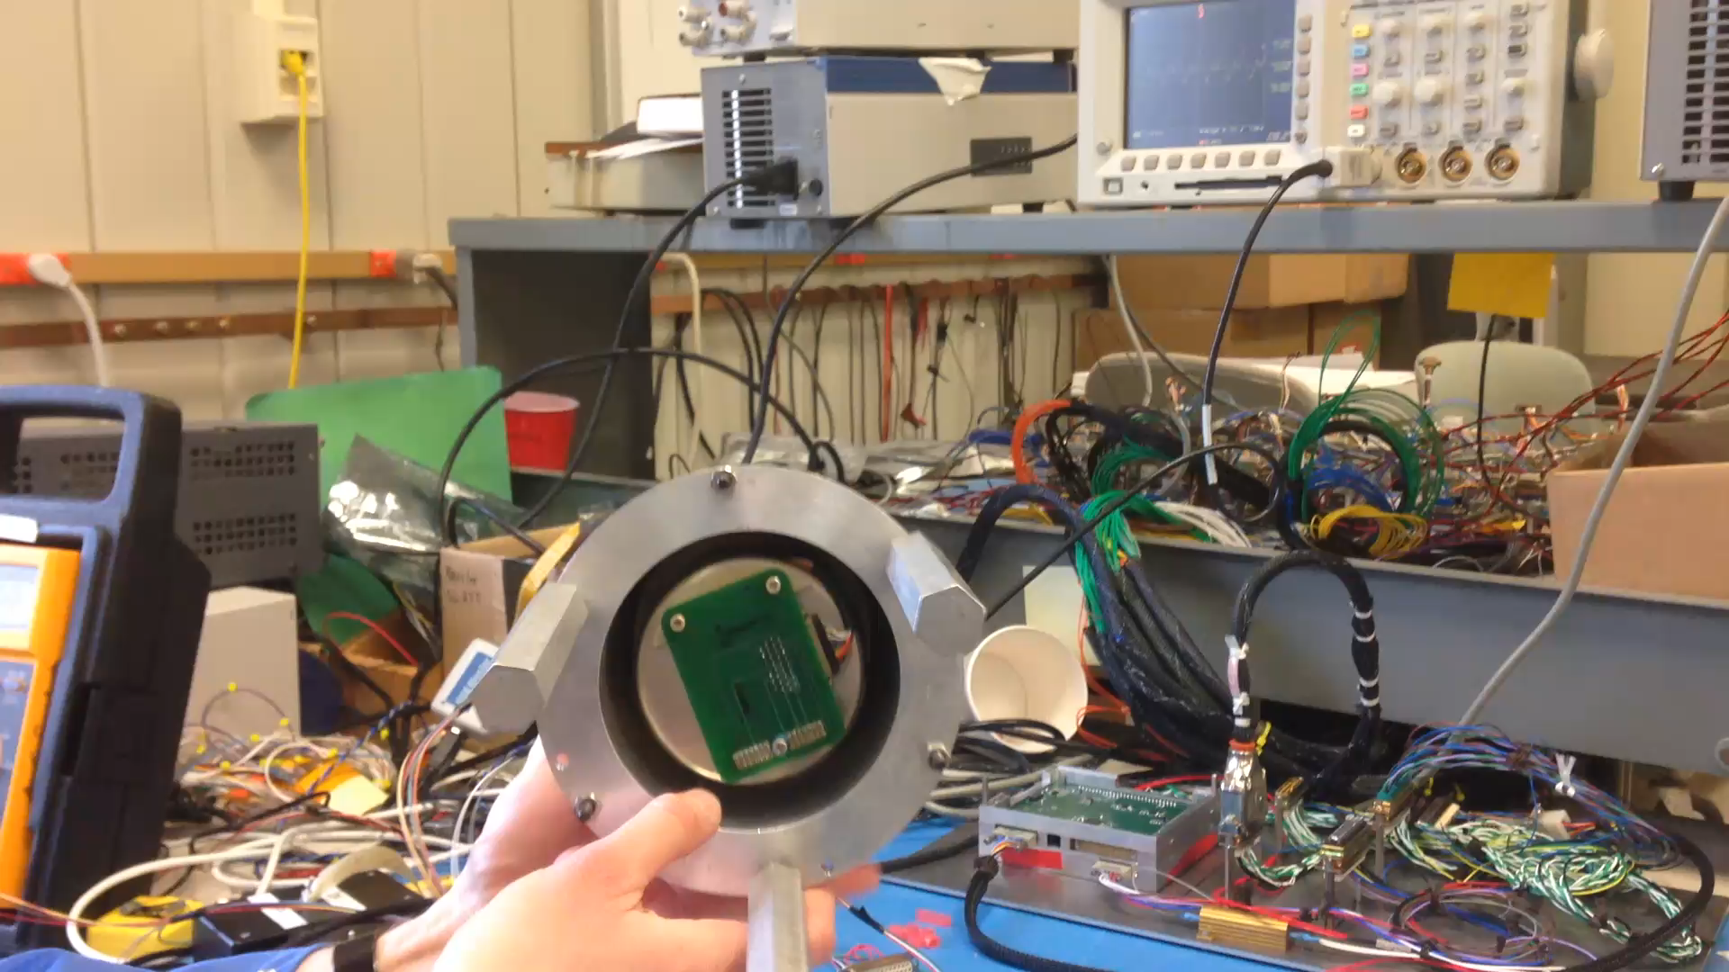
Instrumentation
Spin-stabilized launch vehicles impose unique instrumentation challenges for inertial navigation IMU components
  Gyro scale factor error drives attitude error that grows with time
  NSROC uses the roll-isolated TERN IMU, derived from the GLN-200 originally developed at Sandia National Laboratories
  TERN will be used on both the MAV1 FTV and MAV2 FTV
A Javad TRG2-HDA GPS receiver will be used to gather position and velocity measurements
Radar observations will be provided from WFF’s four fixed single object tracking sites and three mobile/transportable single object tracking Radars.
TRG2-HDA GPS
Tern INS
WFF Radar Tracking Station 3
TERN Bench Test Video

Slide 13
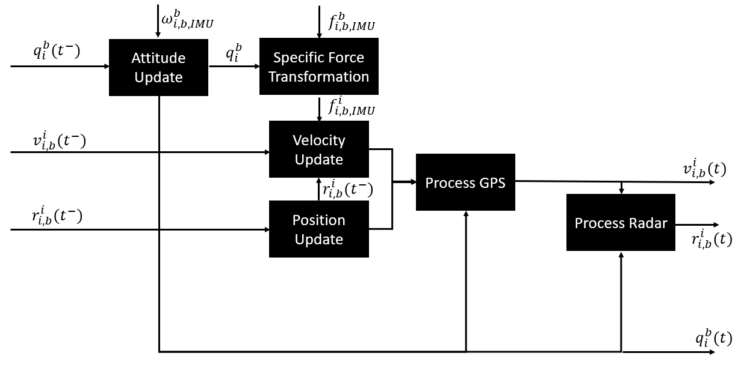
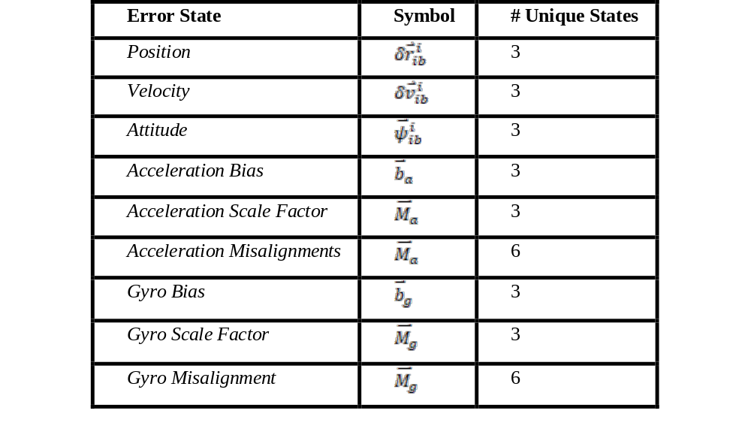
Best Estimate Trajectory (BET)
To generate the truth-reference trajectory for post-flight analysis, a Best Estimate Trajectory (BET) Extended Kalman Filter (EKF) was created based on a similar filtering approach to that used for the Artemis I mission
Data from across the vehicle will be incorporated into the Kalman filter, including
  Raw IMU body rates and accels from TERN INS,
  Position and velocity measurements from GPS Receiver
  S-Band radar tracking position data provided by WFF
The filter propagates the inertial state of the vehicle at the MAV2 FTV TERN mounting location, at the 400 Hz rate raw IMU data is received from the TERN INS.
GPS measurements are incorporated through a loosely coupled approach at 20 Hz, where observed position and velocity states are utilized over raw pseudo range observations.
Radar observations are incorporated to refine the position estimate at a low frequency when available and are utilized through mapping of measurements from a local-spherical frame at the radar site into an inertial frame
BET Filter Process
BET Filter States

Slide 14
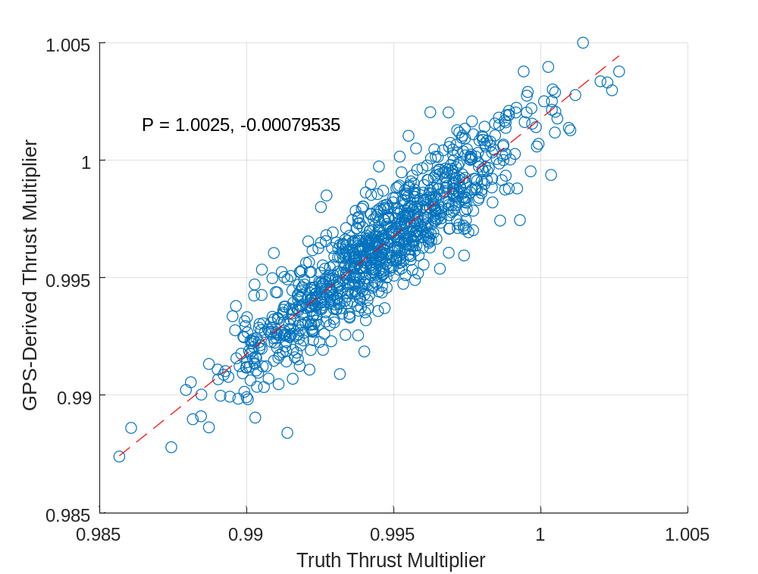
Postflight Reconstruction (Solved Attitude)
Using a model of MAV2 FTV implemented in POST2, a postflight reconstruction was conducted
  Attitude at ignition is a control (Euler Pitch and Yaw), assumed constant throughout burn
  State at ignition and burnout is from the telemetered GPS state
  Multiplier on thrust and burn attitude is varied until the energy state, orbit inclination and argument of perigee at burnout is satisfied (3 controls, 3 constraints)
Strong correlation of estimated vs. truth thrust multiplier
Correlation of Estimated vs. Truth MAV2 Knockdown Factors

Slide 15
Conclusions and Future Work
Conclusions
  GPS data is sufficient to satisfy the intent of FTO-1
  TERN will be necessary to satisfy FTO’s 2 and 3
  Trajectory meets WFF Range Safety requirements without a MAV2 FTV Flight Termination System, but including inhibits on separation based on verification of a 3-sigma sounding rocket trajectory
Future Work
  Begins in October 2023 when flight test effort resumes
  Flight Test scheduled for NLT 25 December 2025

Slide 16
Contact Info
William Benson: william.w.benson@nasa.gov
Mike Fritzinger: michael.a.fritzinger@nasa.gov
Justin Costley: justin.costley@nasa.gov
Brian Tibbets: brian.r.tibbetts@nasa.gov
Brent Edwards: brent.edwards@nasa.gov
Tim Kibbey: tim.kibbey@nasa.gov

