Slide 1
January 2022
Space Radiation Environments Overview for MSFC Programs
Rebecca Jenkins

Slide 2
Overview
Space Radiation Environment
Purpose: Provide overview of Space Radiation Environments
    Radiation Sources
      Solar Energetic Particles (SEP) and Solar Particle Events (SPE)
      Galactic Cosmic Rays (GCR)
    Radiation Environments
      Van Allen belts
      Beyond the belts
      Reference SLS-SPEC-159 Rev G: Design Specification for Natural Environment (DSNE)
    Interactions with Electronic Devices
      Ionizing
      Nonionizing
      Internal Charging
Notes:
DSNE pronounced Disney

Slide 3
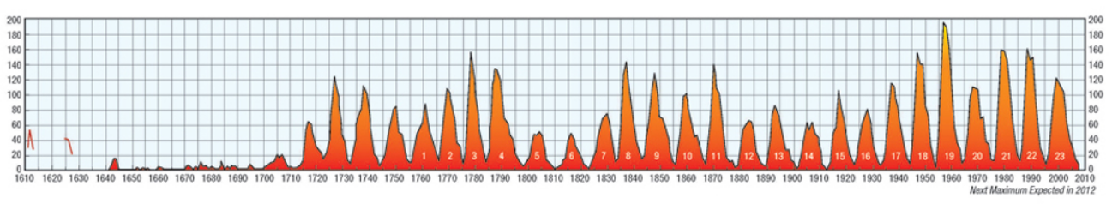
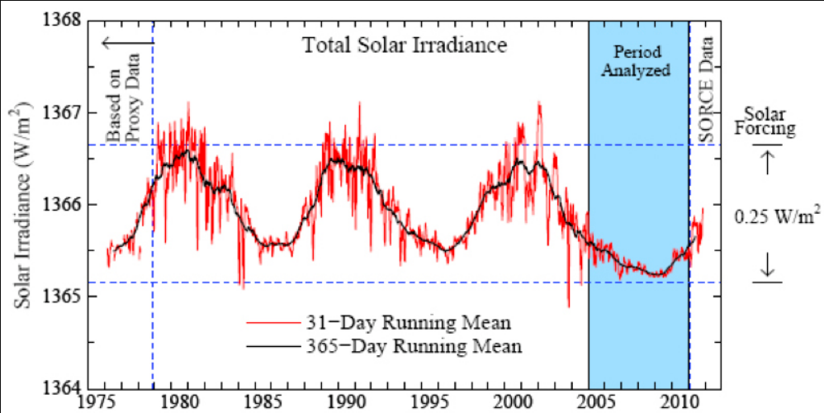
Radiation Sources
Space Radiation Environment
Solar Energetic Particles (SEP)
    Solar wind is electrically neutral with energy of particles ranging from 0.5-2.0 keV/nucleon.
    The solar activity wax/wanes in 11-year average cycles (range is 9 to 13 years) with a flip of the sun’s magnetic poles. The worst day fluence used is based on October 1989 event.
    Solar Maximum
      Trapped proton flux is lower, but the trapped electron flux is higher.
      GCR levels are lower.
      Neutron levels in the atmosphere are lower.
      Solar events are more frequent and are at a greater intensity.
Sunspot Count
      Magnetic storms are more frequent which can an increase in particle levels in the Van Allen belts.
    Solar Minimum
      Trapped protons flux is higher, but the electron flux is lower.
      GCR levels are higher.
      Neutron levels in the atmosphere are higher.
      Solar events are more rare.
https://www.nasa.gov/mission_pages/sunearth/spaceweather/index.html
https://www.nasa.gov/topics/earth/features/energy-budget.html
Notes:
Solar cycle, mag field flip every 11, total cycle 22 years

Slide 4
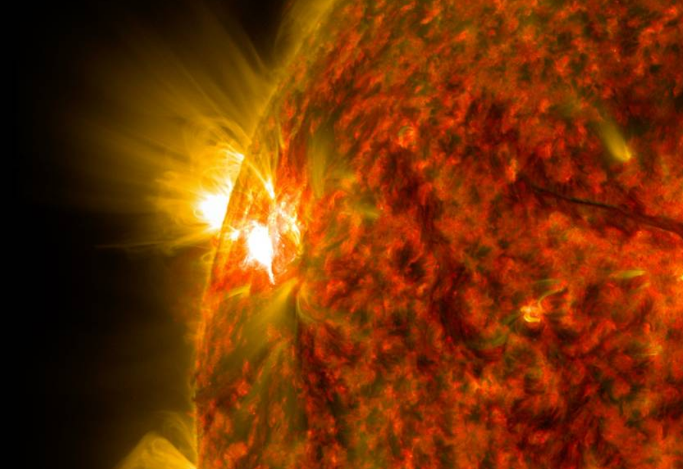
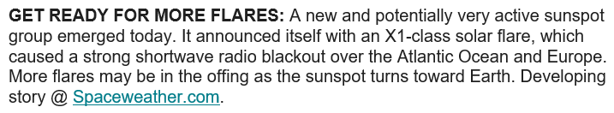
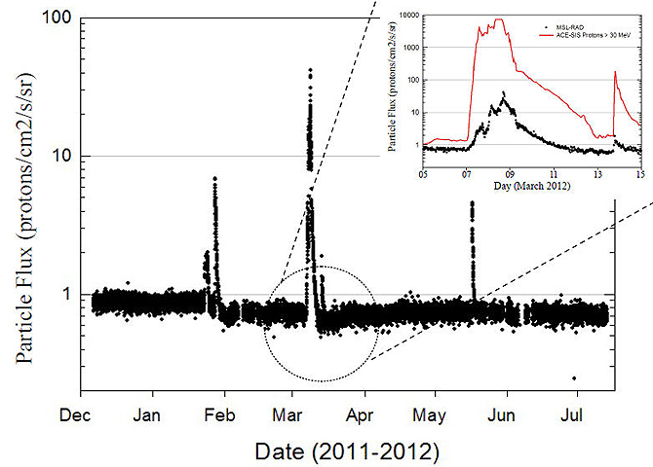
Radiation Sources
Space Radiation Environment
Solar Particle Events (SPE)
    There is greater activity, and greater occurrence of SPEs, during the solar maximum. This activity can result in permanent damage by both Total Ionizing Dose (TID) and Displacement Damage Dose (DDD).
    High-energy SEPs (solar energetic particles) can sometimes be energetic enough to penetrate all the way down to the surface of the Earth and thus be recorded on the ground as ground level enhancements (GLEs).
    Coronal Mass Ejections (CME)
      CMEs are a large directional eruption of plasma. They are proton rich and ~days long.
    Solar Flare
      Flares are more impulsive. They are heavy ion rich and ~hours long.
https://www.nasa.gov/content/goddard/new-sunspot-releases-second-m-class-flare
https://www.nasa.gov/mission_pages/sunearth/news/curiosity-daredevil.html
Notes:
Solar cycle, mag field flip every 11, total cycle 22 years

Slide 5
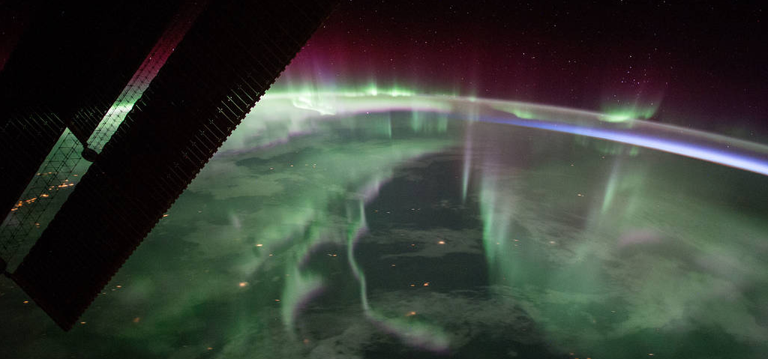
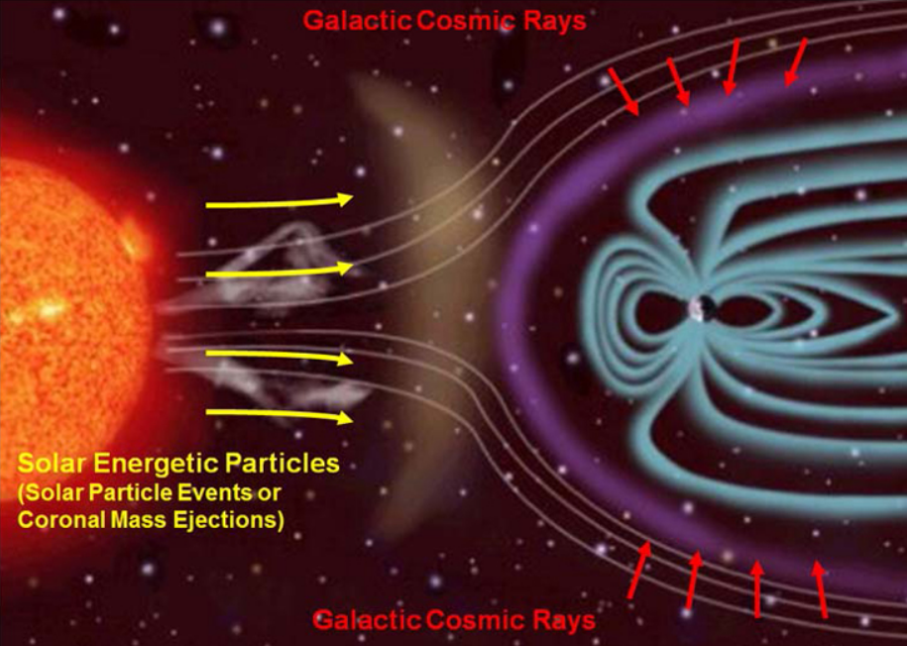
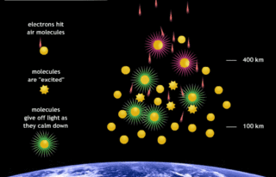
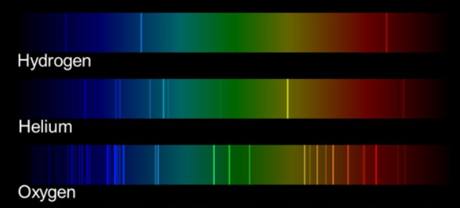
Radiation Sources
Space Radiation Environment
Solar Particle Events (SPE)
    Northern/southern lights are caused by SPE. Energetic particles are guided toward Earths poles. Interactions within the ionosphere results in the dancing lights.
    Since SPEs are at a max during a max solar cycle, the odd of seeing these lights are also maximized during that time.
https://www.nasa.gov/image-feature/northern-lights-over-canada-0
https://www.nasa.gov/mission_pages/msl/multimedia/pia16938.html
https://www.jpl.nasa.gov/edu/teach/activity/using-light-to-study-planets/
https://www.nasa.gov/mission_pages/themis/auroras/sun_earth_connect.html
Notes:
Solar cycle, mag field flip every 11, total cycle 22 years

Slide 6
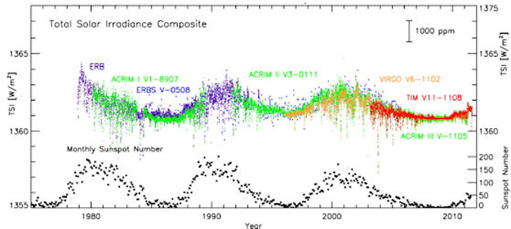
Radiation Sources
Space Radiation Environment
Galactic Cosmic Rays (GCR)
    GCR arrive in isotropic manner at a flux of ~4 particles/cm²/sec. Unit of measurement is in reference to the number of particles that would pass through the surface of a given sphere.
    Primary GCR are highly energetic charged particles originating from outside the solar system.
    Secondary GCR are those produced by the interactions of the primary rays in the atmosphere or in the earth.
    Anti-correlation with solar cycle due to source being from outside our solar system. GCR are moving upstream against the solar wind resulting in peak GCR when the solar activity is at a minimum.
https://www.nasa.gov/content/goddard/sdo/news/solar-variability-and-terrestrial-climate/

Slide 7
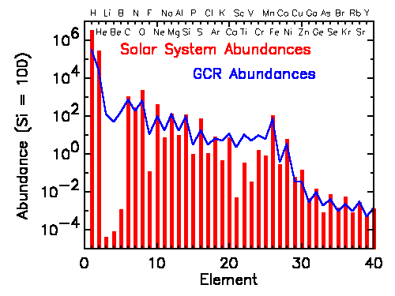
Radiation Sources
Space Radiation Environment
Galactic Cosmic Rays (GCR)
    Comprised of heavy ions being ~89% protons & ~10% helium and heavier nuclei the remaining ~1%.
    Common heavier elements (such as carbon, oxygen, magnesium, silicon, and iron) are present in nearly the same abundances as is naturally occurring.
    There is an overabundance of the rare elements (Li, Be, and B). These are produced by heavier GCR (ex: carbon, nitrogen, & oxygen) fragment into lighter nuclei during collisions with the interstellar gas.
https://imagine.gsfc.nasa.gov/science/toolbox/cosmic_rays2_orig.html

Slide 8
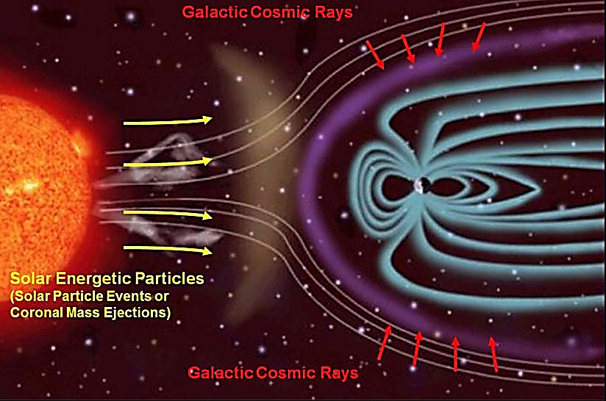
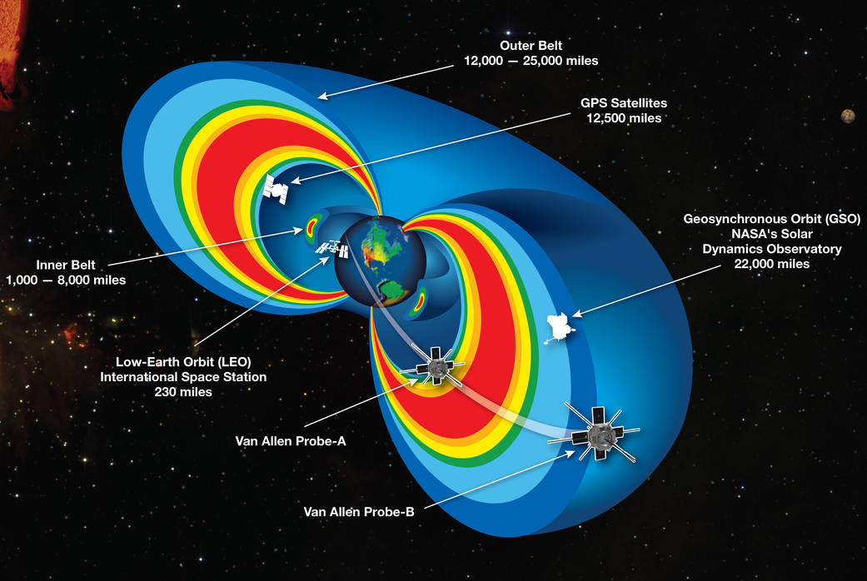
Radiation Environments
Space Radiation Environment
Van Allen Belts
    Geomagnetically trapped low energy charged particles from SEP & GCR.
    Low Earth Orbit (LEO) within inner belt up to an altitude of 2,000 km (1,200 mi).
    Going though the trapped belts, while significantly a larger effect than Ascent/LEO, is still very small percentage for overall radiation effects for longer missions.
    AE-8/AP-8 are standard static average models of electron and proton fluxes. They were used to generate the geomagnetic coordinate points used today. Most current data set listed in the most current version of the DSNE.
https://www.nasa.gov/mission_pages/msl/multimedia/pia16938.html
https://www.nasa.gov/mission_pages/sunearth/news/gallery/20130228-radiationbelts.html
Notes:
Two radiation belts filled with electrons and charged particles surround Earth. The inner one is fairly stable, but the outer one swells and shrinks over time.
The belts consist of protons (inner belt) and electrons (inner and outer belt), spiraling along magnetic field lines from pole to pole. Near the poles, the trapped radiation belts extend almost down to the surface.
AE-8/AP-8 are static average models giving proton and electron spectra at solar minimum and solar maximum at all geomagnetic coordinate points.

Slide 9
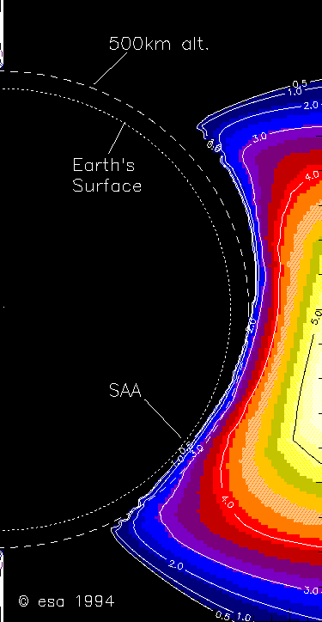
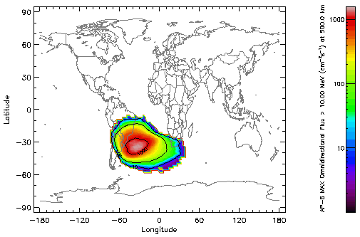
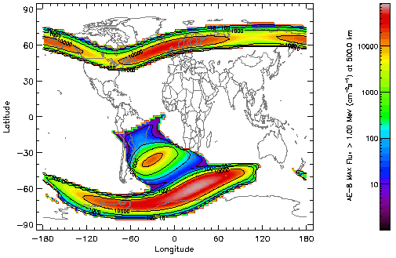
Radiation Environments
Space Radiation Environment
Van Allen – Inner Belt
    Where the Earth’s magnetic field is lowest, the inner belt is able to dip closer to Earth. The result is the South Atlantic Anomaly (SAA).
    When the solar cycle is in the declining phase, the trapped electron flux tends to be higher. When the solar cycle reaches minimum, the trapped protons fluxes reach their maximum.
https://image.gsfc.nasa.gov/poetry/tour/vanallen.html
https://image.gsfc.nasa.gov/poetry/tour/vanallen.html
Notes:
roughly between latitudes 5 and 40 degrees South, and between longitudes 0 and 80 degrees West
strength, shape and size of the SAA varies with the seasons
higher-than-normal radiance values

Slide 10
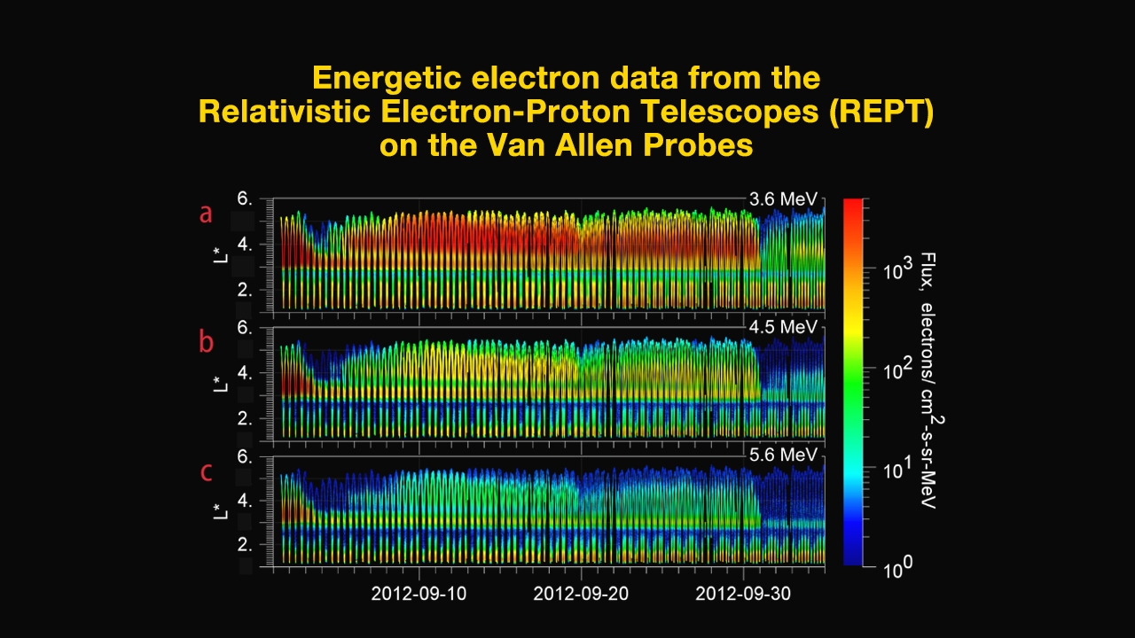
Radiation Environments
Space Radiation Environment
Van Allen – Outer Belt
    Primarily trapped electrons.
    Frequent injections and dropouts associated with storms and solar material interacting with magnetosphere.
https://svs.gsfc.nasa.gov/11212
Notes:
Dominates geostationary orbit and highly elliptical orbits

Slide 11
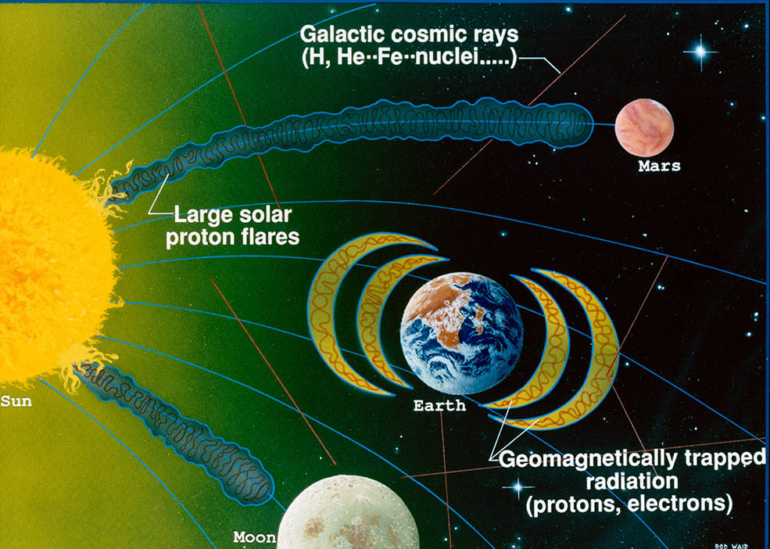
Radiation Environments
Space Radiation Environment
Beyond the Van Allen Belts
    Environment comprised of GCR and SPE.
    SPE is the main driver for SEE and TID.
    Even for 10-year missions, SPE is by far the majority of TID contribution.
https://www.nasa.gov/audience/foreducators/stem-on-station/learning_launchers_radiation

Slide 12
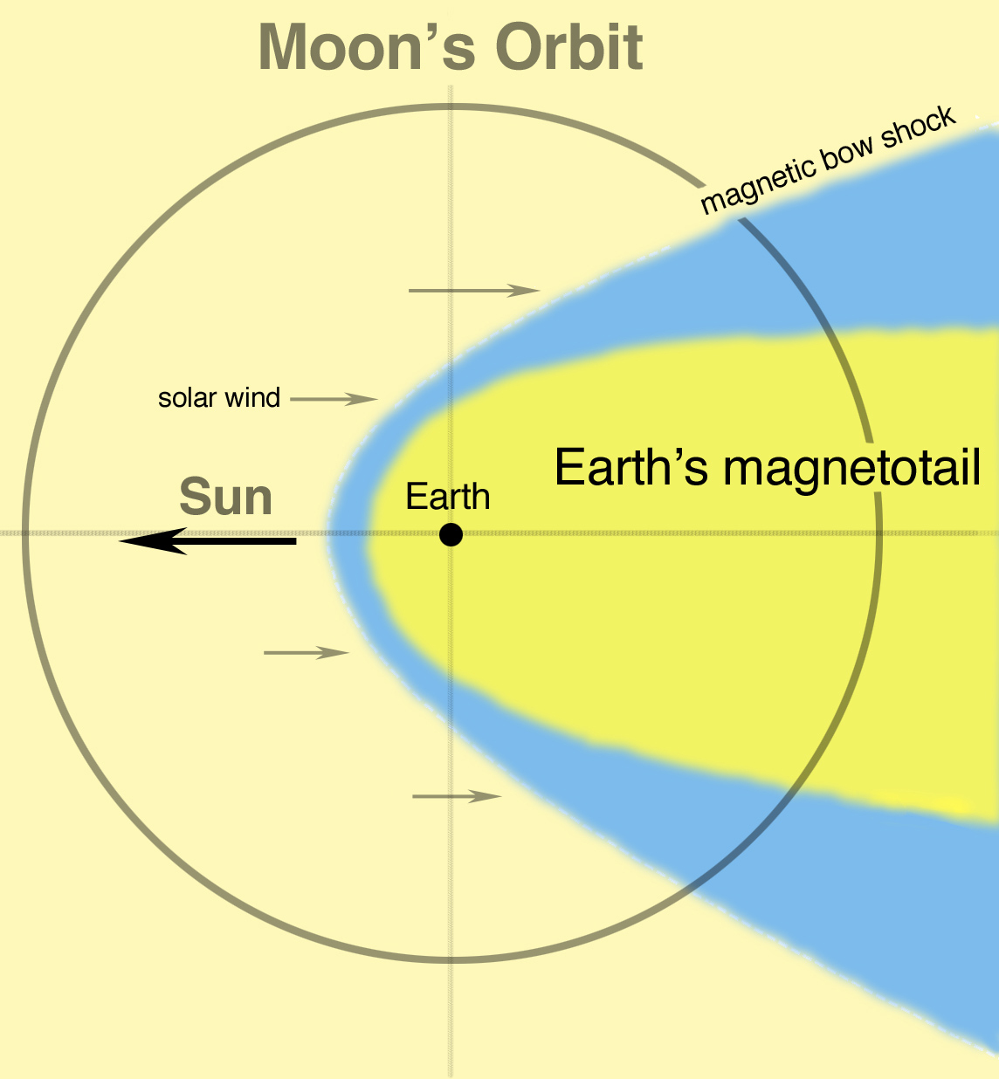
Radiation Environments
Space Radiation Environment
Beyond the Van Allen Belts
    Moon orbit spends majority of time outside geomagnetic shielding.
    Moon orbits outside the Van Allen belts.
https://www.nasa.gov/images/content/222898main_orbit2_20080416_HI.jpg
Notes:
Two radiation belts filled with electrons and charged particles surround Earth. The inner one is fairly stable, but the outer one swells and shrinks over time.
The belts consist of protons (inner belt) and electrons (inner and outer belt), spiraling along magnetic field lines from pole to pole. Near the poles, the trapped radiation belts extend almost down to the surface.
AE-8/AP-8 are static average models giving proton and electron spectra at solar minimum and solar maximum at all geomagnetic coordinate points.

Slide 13
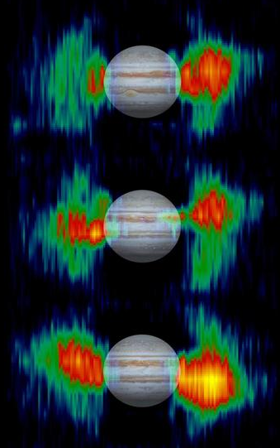
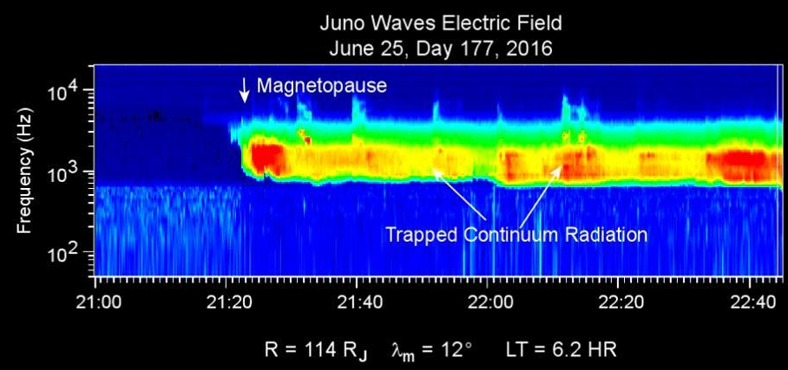
Radiation Environments
Space Radiation Environment
Jovian Radiation Belts
    High flux and high energy electrons (> 10 MeV) but stable.
    Limited data.
    Ganymede and Io complicate environment due to magnetic fields and volcanic ion emissions.
https://images-assets.nasa.gov/image/PIA03478/PIA03478~thumb.jpg
    Inner belts wobble as the magnetic field is offset from the poles
https://images-assets.nasa.gov/image/PIA20754/PIA20754~thumb.jpg

Slide 14
Radiation Environments
Space Radiation Environment
DSNE: SLS-SPEC-159 Rev G
    3.3.1.10.2: TID - Geomagnetic Unshielded
      This section specifies cumulative Total Dose environments. Total Dose consists of two components, Total Ionizing Dose (TID) and Displacement Damage Dose (DDD). To calculate these, the ionizing radiation environments must be defined.
    3.3.2.10.2: SEE - Geomagnetic Unshielded
      This section defines the ionizing radiation environments that may produce single event effects in electrical or electronic systems. Peak Galactic Cosmic Radiation (GCR) and Solar Particle Event (SPE) fluxes are encountered inside and outside Earth's magnetic field. In addition to these, inside the Earth's magnetic field, the peak trapped proton flux has to be included.
Notes:
3.2.2 pg151

Slide 15
Radiation Environments
Space Radiation Environment
DSNE Radiation Section
    3.3.1 Total Dose
      Multiplied by 2 to derive design SPE which has twice the flux of the October 1989 solar particle event as represented by the CREME96 model. Using a 97% confidence factor.
    3.4.7.1: Lunar Surface Total Ionizing Dose
      Since the Moon is situated outside of the shielding afforded by the Earth’s magnetic field, the total dose environment in 3.3.1.10.2 Geomagnetic Unshielded is appropriate to use for the lunar surface with a factor of 2 reduction in dose due to shielding by the Moon.

Slide 16
Interactions with Electronic Devices
Space Radiation Environment
When an energetic particle (photon, electron, proton, neutron, or heavy ion) passes through semiconducting material, the energy deposited to the lattice along its path may cause a disruption to the material’s electrical properties.
The type of particle interaction is categorized:
    Ionizing
      Total Ionizing Dose (TID)
      Single Event Effect (SEE)
    Nonionizing
      Displacement-Damage Dose (DDD)
    Internal Charging
      Deep Dielectric Charging (DDC)
Effects of radiation can vary depending on particle flux, type of radiation, type of incident material, and component structure.
Notes:
Deep dielectric charging (also called internal, or bulk charging) occurs when high-energy electrons and ions (MeV and higher) penetrate satellite shielding materials and deposit charge on internal spacecraft components. The terms “deep dielectric” or “bulk” charging refer to charge densities that accumulate within insulating (or dielectric) materials when exposed to penetration radiation.

Slide 17
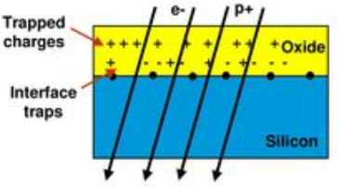
Interactions with Electronic Devices
Space Radiation Environment
Total Ionizing Dose (TID)
    Cumulative long term ionizing damage due to protons and electrons in keV to MeV range.
    Tested according to MIL-STD883E, METHOD 1019.4.
    Unit of interest is krads(material).
    Electronic Effects:
      Threshold Shifts
      Leakage Current
      Timing Changes
      Functional Failures
    Can partially mitigate with shielding.
      Reduces low energy protons and electrons.
1 unit of dose
1 unit of dose
Low LET radiation deposits energy more uniform
High LET radiation deposits energy more focused
https://slideplayer.com/slide/13154892/
Notes:
Deep dielectric charging (also called internal, or bulk charging) occurs when high-energy electrons and ions (MeV and higher) penetrate satellite shielding materials and deposit charge on internal spacecraft components. The terms “deep dielectric” or “bulk” charging refer to charge densities that accumulate within insulating (or dielectric) materials when exposed to penetration radiation.

Slide 18
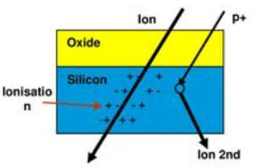
Interactions with Electronic Devices
Space Radiation Environment
Single Event Effects (SEE)
    Caused by a single charged particle as it passes through a semiconductor material of an electronic device.
    Unit of interest is LET (linear energy transfer)
      Higher energy particles penetrate deeper into materials and can result in a more focused energy deposition.
Low LET
High LET
    Electronic Effects:
      Soft errors
      - Single Event Upset (SEU)
      - Single Event Transient (SET)
      Hard errors
      - Single Event Latchup (SEL)
      - Single Event Burnout (SEB)
      - Single Event Gate Rupture (SEGR)
    Example transient:
    Ion track deposits energy into epitaxial layer
    Charge builds up
    Charge reaches turn-on threshold
    Transient error of turned-on transistor occurs
    Consequences need to be evaluated relative to the application
https://slideplayer.com/slide/13154892/
Notes:
Deep dielectric charging (also called internal, or bulk charging) occurs when high-energy electrons and ions (MeV and higher) penetrate satellite shielding materials and deposit charge on internal spacecraft components. The terms “deep dielectric” or “bulk” charging refer to charge densities that accumulate within insulating (or dielectric) materials when exposed to penetration radiation.

Slide 19
Interactions with Electronic Devices
Space Radiation Environment
Single Event Effects (SEE)
    Energy profiles of ions shift as they get heavier: higher LET & decreased depth dose
    As accelerator energy increases: lower LET & increased depth dose
    Bragg peak energy level is specific to the ion. It does not change with acceleration or by traveling through shielding.
      Acceleration or shielding will change how deep the ion travels before depositing the energy peak that is the Bragg peak.
Notes:
Deep dielectric charging (also called internal, or bulk charging) occurs when high-energy electrons and ions (MeV and higher) penetrate satellite shielding materials and deposit charge on internal spacecraft components. The terms “deep dielectric” or “bulk” charging refer to charge densities that accumulate within insulating (or dielectric) materials when exposed to penetration radiation.

Slide 20
Interactions with Electronic Devices
Space Radiation Environment
Single Event Effects (SEE)
    Shielding reduced the fluence but increases LET of the particles that reach the detector.
    Heavy ions will deposit the same amount of energy with or without shielding. With shielding, the energy is deposited at more shallow depth.
      If sensitive components are in area of that shallow depth, the shielding will worsen the radiation environment for those parts.
      Conversely, without shielding, the most energetic ions may fly right by the sensitive parts and deposit inconsequential amounts of energy.
Notes:
Deep dielectric charging (also called internal, or bulk charging) occurs when high-energy electrons and ions (MeV and higher) penetrate satellite shielding materials and deposit charge on internal spacecraft components. The terms “deep dielectric” or “bulk” charging refer to charge densities that accumulate within insulating (or dielectric) materials when exposed to penetration radiation.

Slide 21
Interactions with Electronic Devices
Space Radiation Environment
Displacement-Damage Dose (DDD)
    Cumulative long term non-ionizing damage due to neutrons, but also protons and electrons.
      keV to MeV range
    Unit of interest is particle fluence for each energy mapped to test energy.
      Non-ionizing energy loss (NIEL) is one means of discussing.
    Damage is a result of nuclear elastic interactions that result in atomic displacement.
    The electronic effects are due to a cumulation of defects which results in device degradation.
      May be similar to TID effects.
      Optocouplers, solar cells, charge coupled devices (CCDs), linear bipolar devices.
      Lesser issue for digital CMOS.
    Can partially mitigate with shielding.
      Reduces low energy protons and electrons.
Notes:
Deep dielectric charging (also called internal, or bulk charging) occurs when high-energy electrons and ions (MeV and higher) penetrate satellite shielding materials and deposit charge on internal spacecraft components. The terms “deep dielectric” or “bulk” charging refer to charge densities that accumulate within insulating (or dielectric) materials when exposed to penetration radiation.

Slide 22
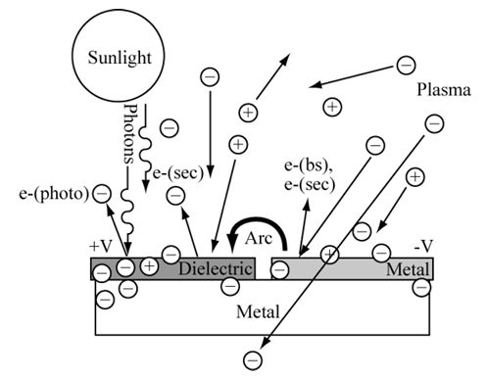
Interactions with Electronic Devices
Space Radiation Environment
Deep Dielectric Charging (DDC)
    DDC is an internal, or bulk, charging. Charge densities accumulate within insulating (or dielectric) materials.
      The induced electric field may exceed the breakdown threshold for the material, causing electrostatic discharge (ESD) in the insulating material.
    As DDC accumulates, electric fields within the spacecraft are generated. There is also a risk of arcing which can result in damage to components.
https://ntrs.nasa.gov/citations/20090021755
Notes:
Deep dielectric charging (also called internal, or bulk charging) occurs when high-energy electrons and ions (MeV and higher) penetrate satellite shielding materials and deposit charge on internal spacecraft components. The terms “deep dielectric” or “bulk” charging refer to charge densities that accumulate within insulating (or dielectric) materials when exposed to penetration radiation.

Slide 23
Radiation Environments
Space Radiation Environment
    Questions?
    rebecca.l.jenkins@nasa.gov

