Slide 1
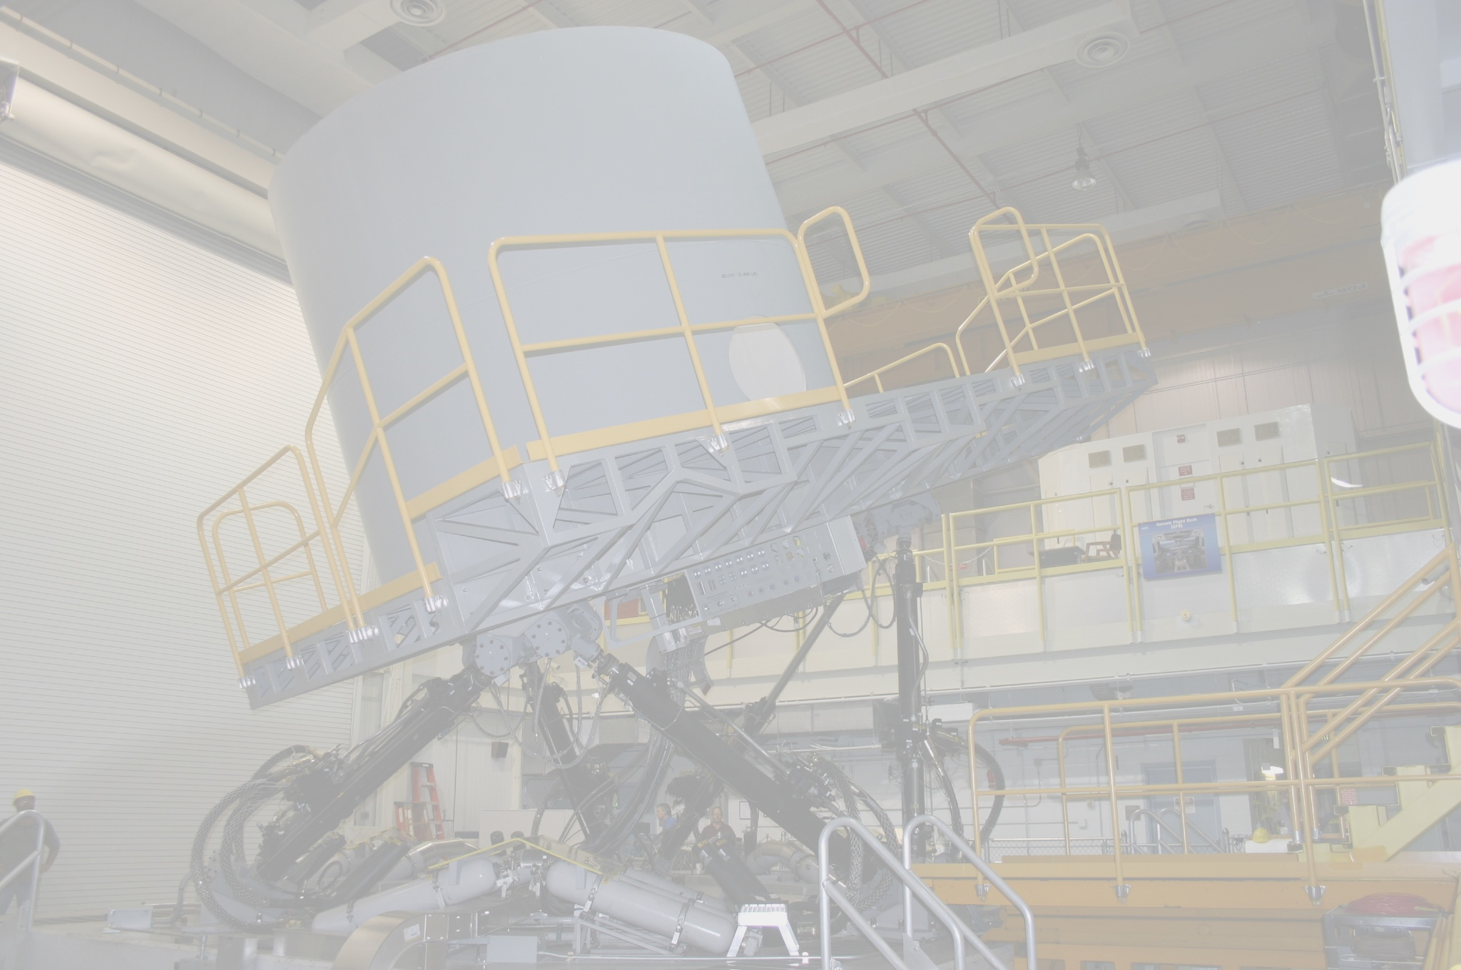
Hydraulic Isolation System PDR
CMB Hydraulic Isolation, Valve and Pump Modernization Project
Paul Davidson/NASA/LaRC
Research Services Directorate, Simulation Development and Analysis Branch
January 25, 2023
Paul Davidson/NASA/LaRC
Tom Stringer/AAG
Research Services Directorate, Simulation Development and Analysis Branch
December 18, 2014

Slide 2
AGENDA
Introduction
Hydraulic Isolation System
Servo-Electric Valve Upgrade
Hydraulic Power Unit (HPU) Upgrade
Q&A

Slide 3
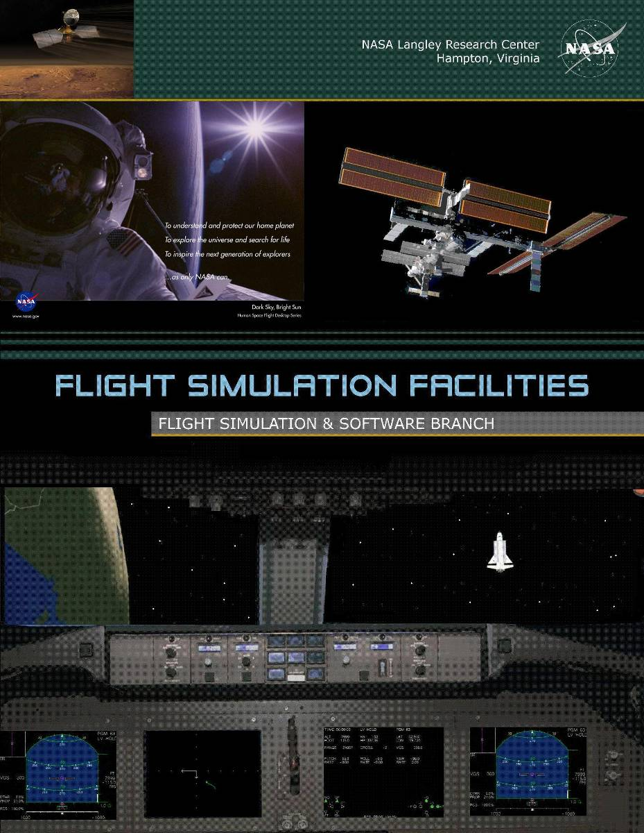
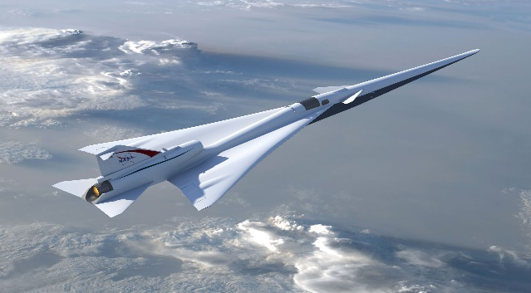
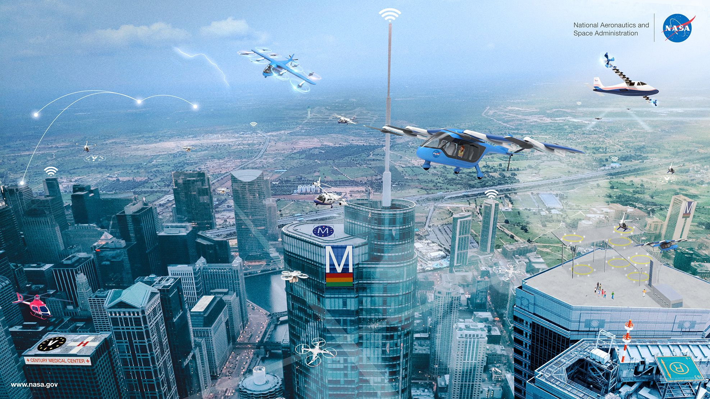
Flight Simulation Facilities (FSF)
Design and test concepts for aeronautics, space exploration, and scientific development since 1950s
Designated as national strategic assets for aerospace research
Users/customers
  Aeronautics – AAM, SWS, Flight Test Integration, Airspace, Aviation Safety, Subsonics, Supersonics, Hypersonics, and UAS
  Space Exploration – Artemis Orion, Human Landing System, Commercial Crew, Ares IX, Ares I, Altair, Mars Scout.
  NESC – verification and assessment
  Reimbursable – FAA, DoD, and academia
  Collaborate with industry for new flight simulation technologies
  Integration with labs at LaRC and other NASA Centers, DoD, FAA, industry, and universities to conduct large-scale multi-vehicle simulations

Slide 4
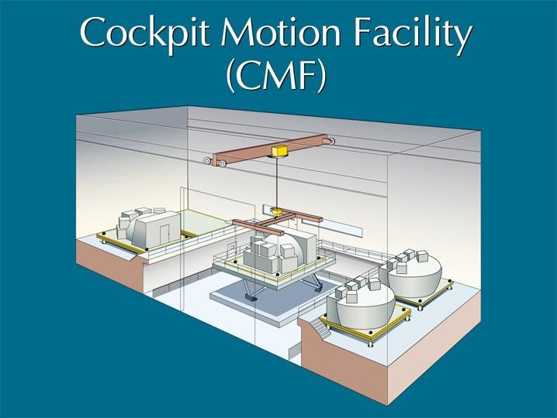
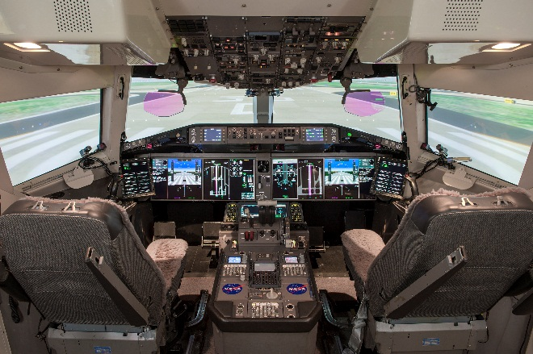
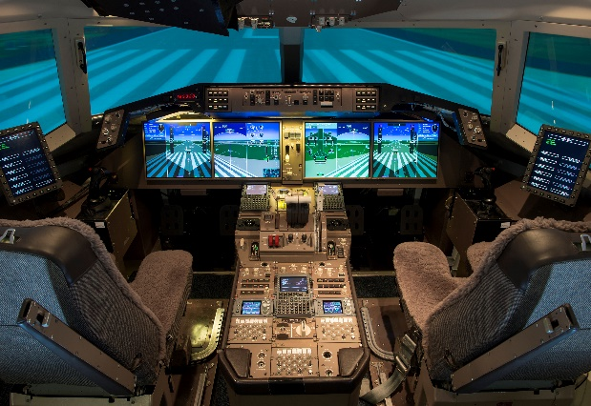
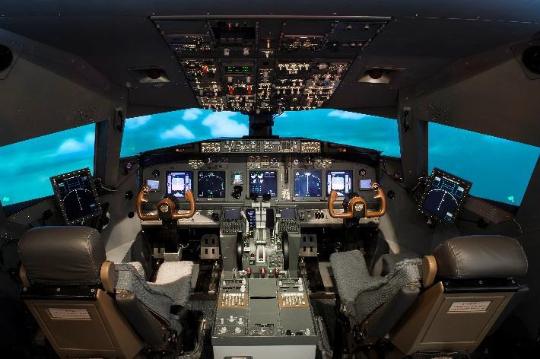
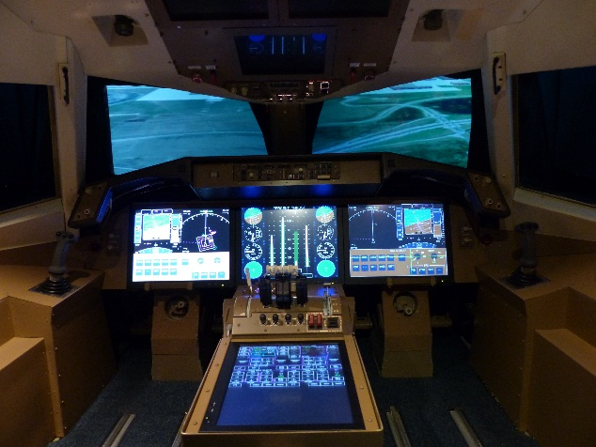
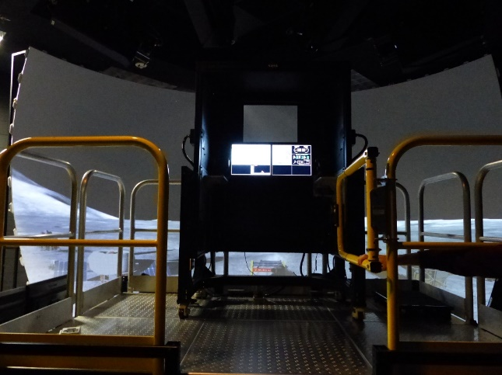
NASA Langley Flight Simulation Facilities
Cockpit Motion Facility
(CMF)
Research Flight Deck (RFD)
Development and Test Simulator (DTS)
Integration Flight Deck (IFD)
Generic Flight Deck (GFD)
Test and Evaluation Simulator (TES)

Slide 5

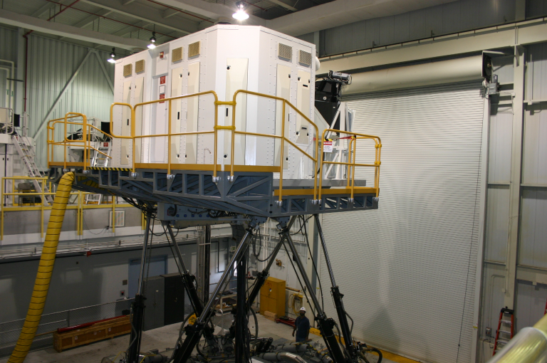
Cockpit Motion Facility (CMF)
Motion System
  6 degree-of-freedom synergistic motion system
  76-inch leg stroke
  22,000 pounds maximum payload
State-of-the-art motion cueing algorithms and advanced algorithms
Facility can support simultaneous operation of two fixed based simulators and one motion based simulator
  Research Flight Deck (RFD) Simulator
  Integration Flight Deck (IFD) Simulator
  Generic Flight Deck (GFD) Simulator
  Available space for a 4th simulator
Any of the simulators can be moved to the motion platform for motion simulation
State-of-the-art Infrastructure
  Real-time computers for aerospace vehicle and environment modeling
  Display and graphics computers for flight deck instrumentation
  High performance visual scene image generation computer systems for out-the-window scenery
  Fiber optic video distribution
  High speed fiber optic data communications
  Hydraulics and power systems
System Integration Laboratory (SIL) for hardware-in-the-loop testing and evaluation

Slide 6
CMF Timeline
Simulation Development for Supersonic Studies (SDSS) under performing
Performance Review Team (PRT) formed to support SDSS
  SDSS exceeding bandwidth and performance envelope
  “Excessive” Sway/Heave crosstalk (parasitic acceleration) observed by SDSS
Chartered CMF Motion Test Team (CMFMTT)
  Short Term Goal → Reduce crosstalk to an “acceptable” level within existing envelope
  → Increase performance
  Long Term Goal → present to management a CMF improvement plan
Revised Control Law
  NASA/TM-2014-218148
Research Valve and Leg (Hydraulic) non-linearity's
  NASA/CR-2014-218275 and NASA/TM-2014-218286
CMB Hydraulic Isolation System - completed
CMB Servo-Electric Valve Modernization Project – scheduling installation
CMB HPU Modernization Project – scheduled installation

Slide 7
Challenges
Analyzing the Problem
  Developing Bandwidth, Fidelity and Response measurement system
  Measure existing system
  Analyze TBs of data
Design the Solution
  Prioritize performance return Vs cost, risk and resource investment
  Design to be an In Situ installation
  Design to utilize smart hardware
Implement the Design
  NASA Design Process; ADR, PDR, CDR, IRB, etc.
  Manufacturing, QA and Acceptance
  Installation and testing
  Measure, Analyze, Tune and Report

Slide 8
Hydraulic Isolation System

Slide 9
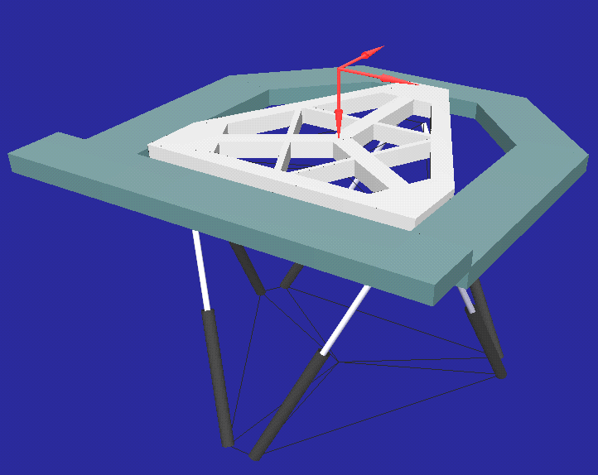
CMB HIS Coordinates
Surge Longitudinal
X
Sway
Lateral
Y
Heave
Vertical
Z

Slide 10
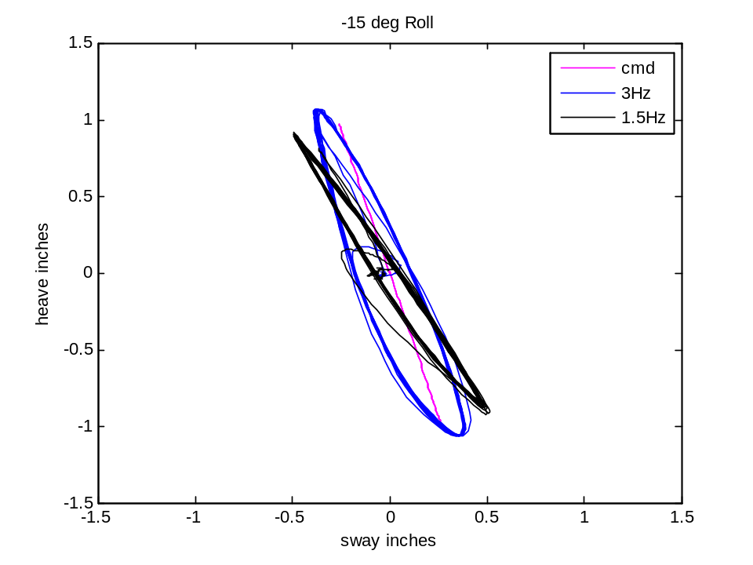
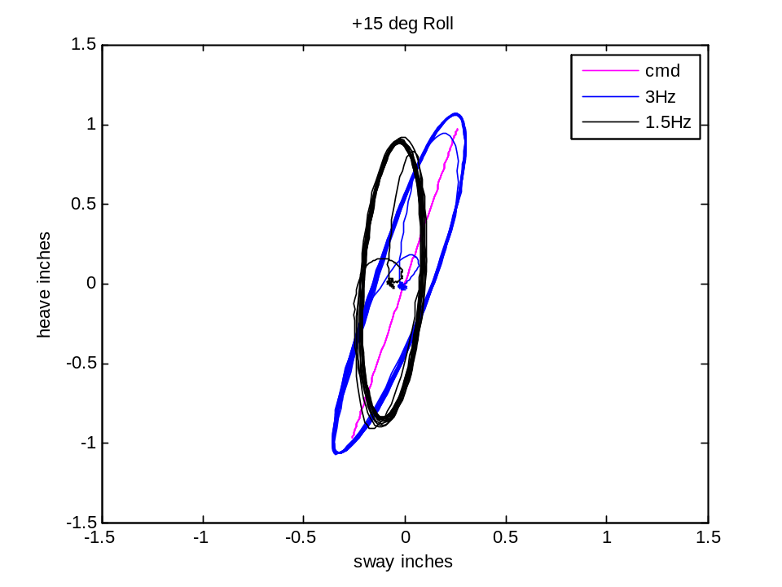
CMB HIS – The “Sweave”
DOF heave and sway commands coordinated to produce only platform normal acceleration
Case: 15 deg roll with 2hz sine wave

Slide 11
CMB Hydraulic Isolation System (HIS)
SDAB has reduced the parasitic acceleration or cross talk in the CMF motion base and increased capacity of the HPU.
SDAB has developed a unique in situ design that replaces existing CMF motion base leg manifolds and accumulator piping that provides for the hydraulic isolation of the six (6) individual leg actuators, accumulators and associated hydrostatic bearings.

Slide 12
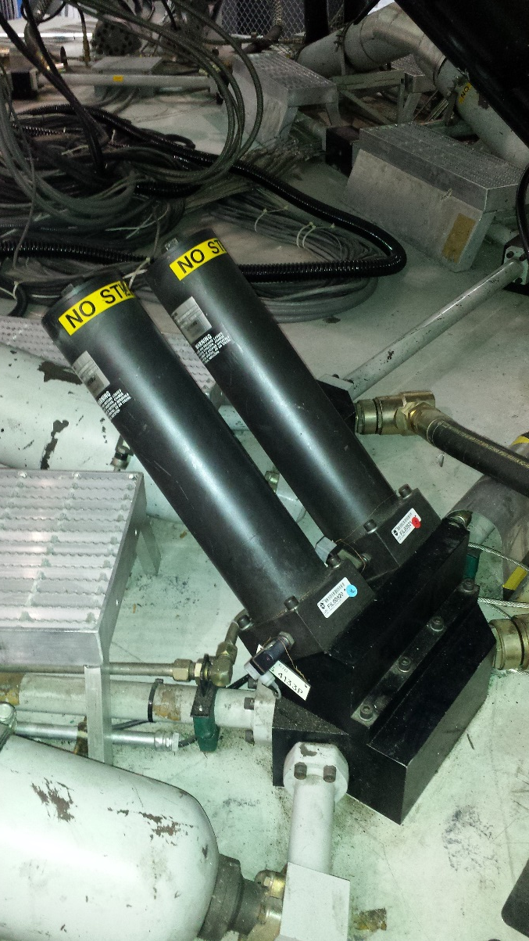
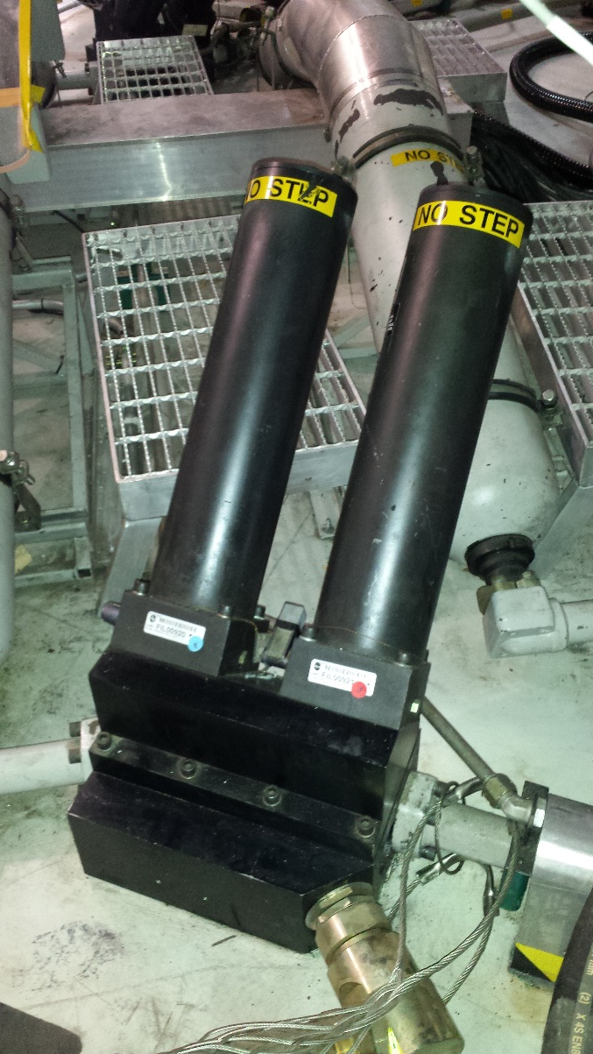
Original Filter Manifold Assembly

Slide 13
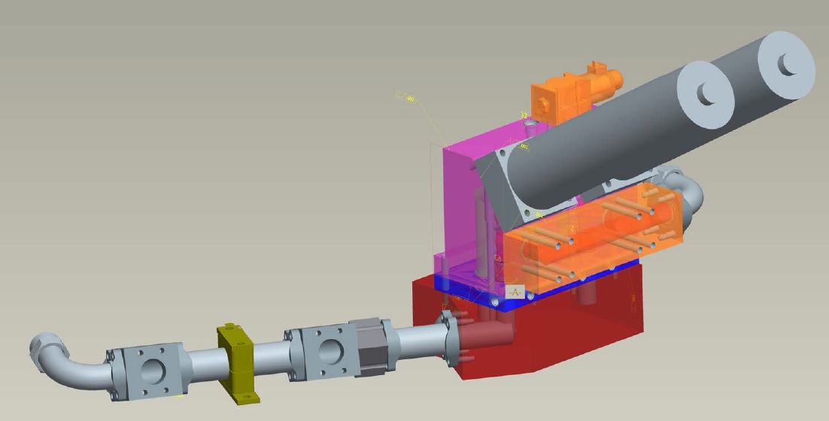
NASA LaRC CMB HIS
Manifold Design

Slide 14
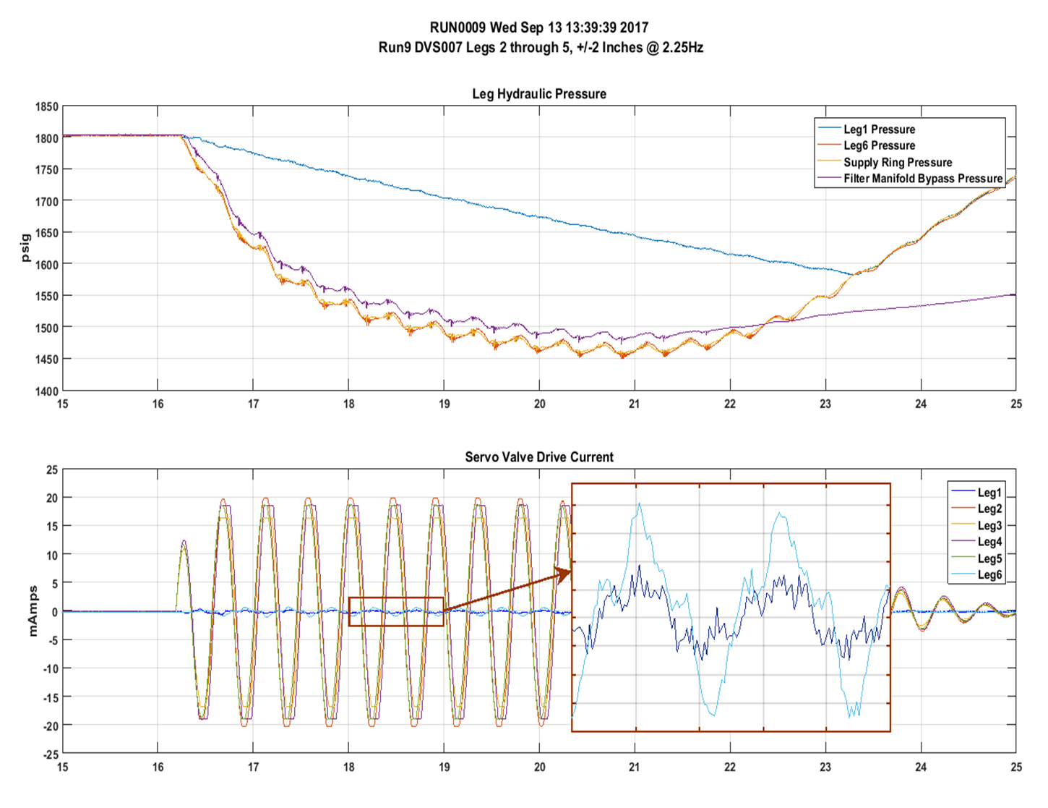
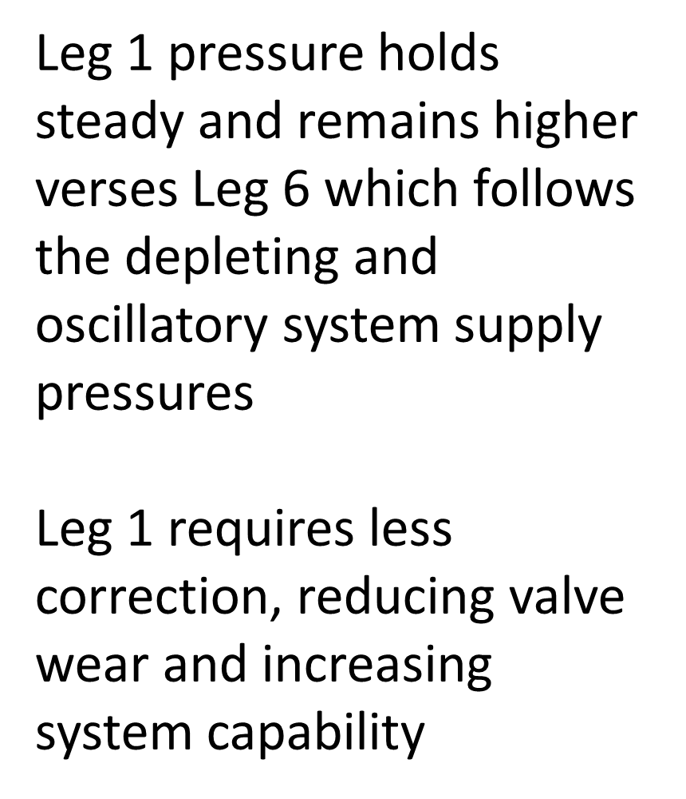
CMB HIS Verification

Slide 15
Servo-Electric Valve Upgrade

Slide 16
CMB Servo-Electric Valve Upgrades
Existing Servo Valves
  A major limiting factor to increased performance
  Legacy design and not replaceable
  Dual valve control complexity
Abort Valves
  Proprietary design
  No spares
Performance Goals
  Increase Bandwidth
  Increase Fidelity
  Increase Control

Slide 17
CMB Servo-Electric Valve Upgrades
Boundary Conditions
  Valve shall provide 180 GPM flow rate
  One (1) Valve per actuator
  Valve shall be self nulling (eliminate manual adjustment)
  Valve servo electronics shall have rate limiters integrated in hardware
  Replace abort valves on valve manifold
  Safety limits remain unchanged
  In situ design

Slide 18
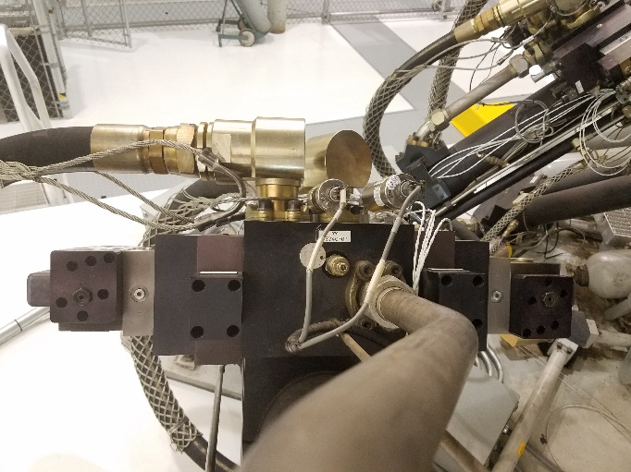
Valve Adaptor(2)
Abort Valves
Instrumentation Adaptor (2)
Distribution Manifold
Leg
Servo Valves

Slide 19
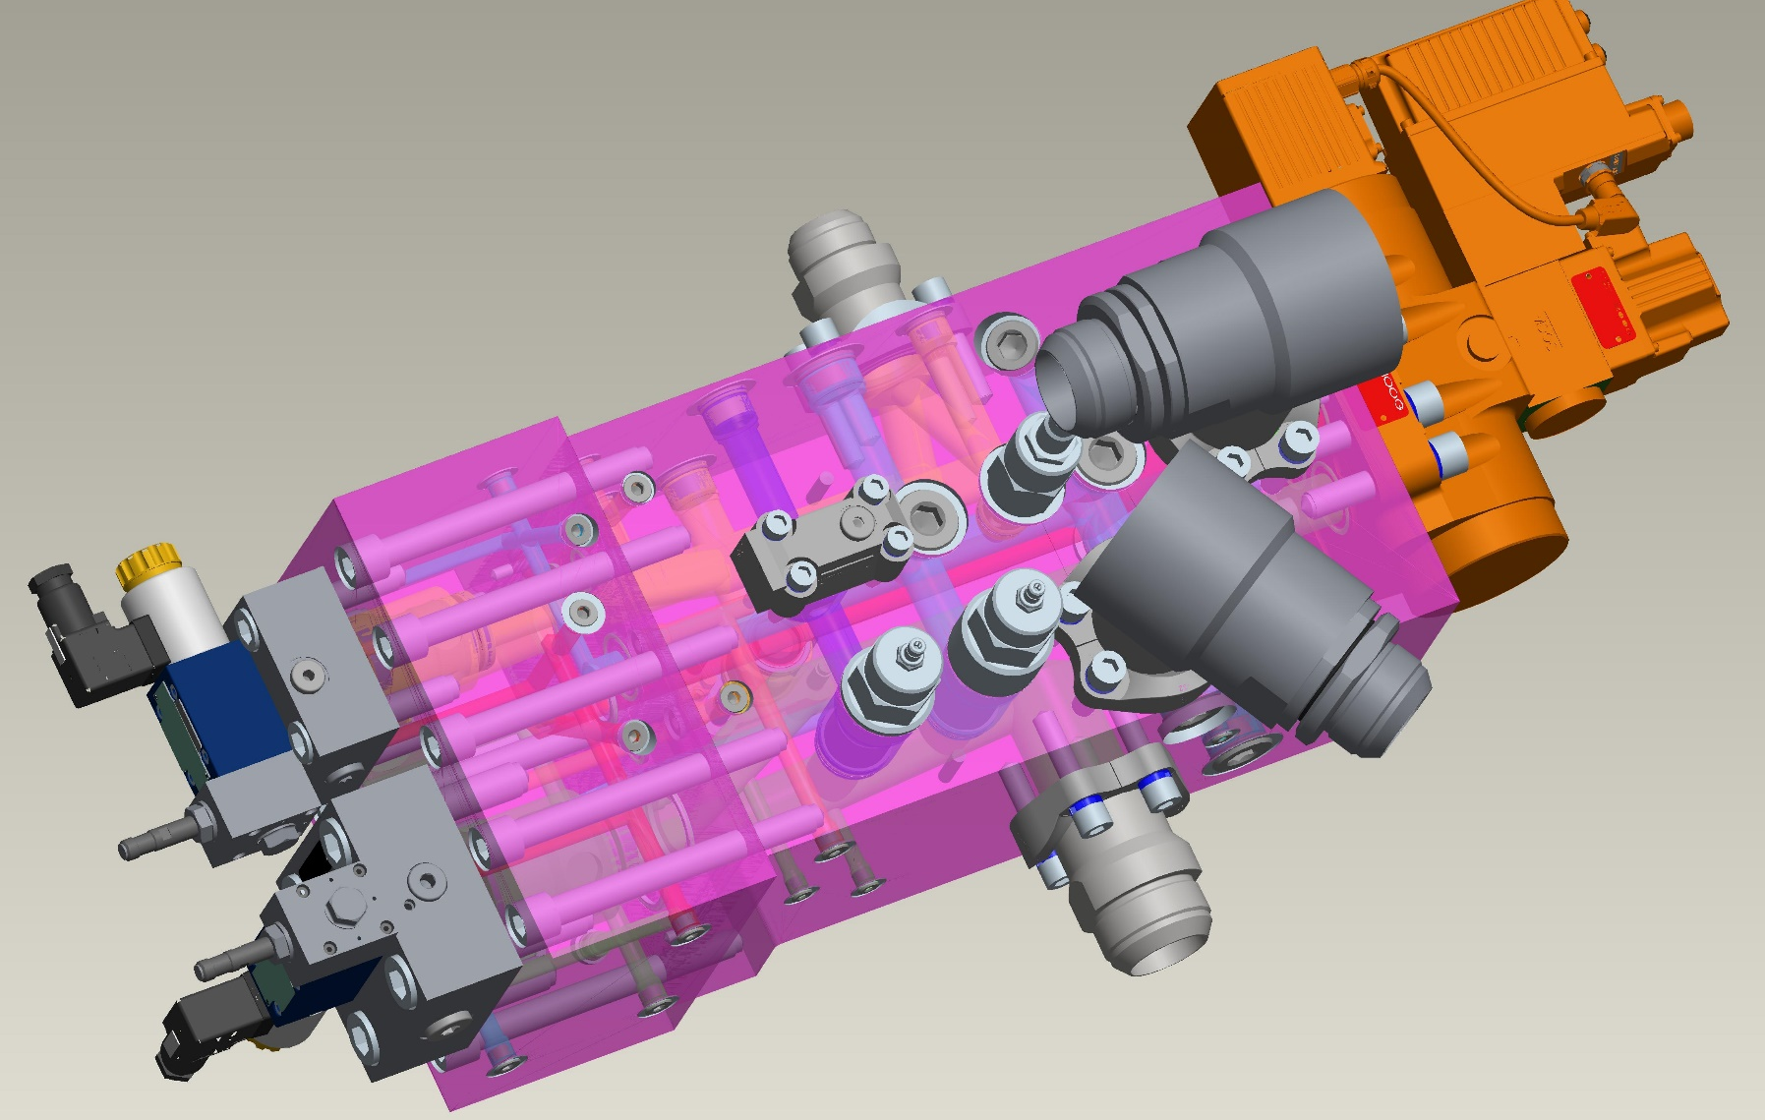
Redesigned CMB Servo-Electric Valve & Manifolds
PRIMARY MODIFICATIONS:
IMPROVE CMB FREQ RESPONSE & FIDELITY
DUAL VALVE TO SINGLE VALVE
REPLACE OBSOLETED COMPONENTS
4. ADDED DIGITAL TUNING FOR IMPROVED NULL & LEG EQUALIZATION
1. INCREASED PRESSURE CONTROL CAPACITY BY A FACTOR OF ≈ 2
3. INCREASED SERVO VALVE FREQUENCY RESPONSE BY A FACTOR OF ≥ 3:1
2. ADDED PRESSURE TEST POINTS FOR ALL PORT AND PRESSURE GALLERIES (14 Total)

Slide 20
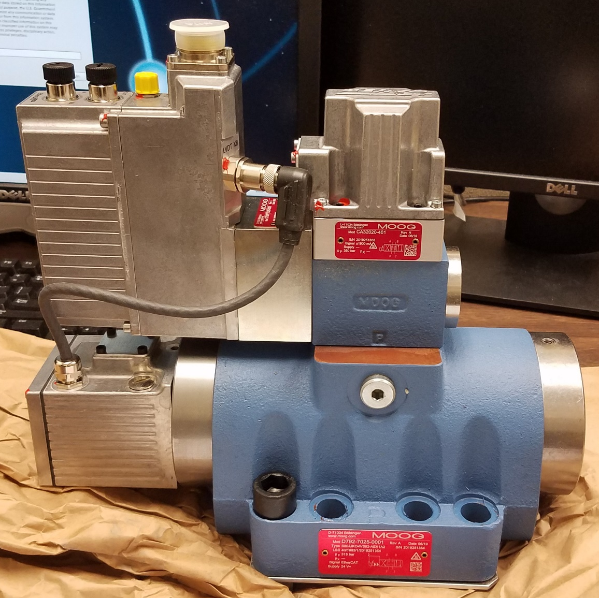
CMB Servo-Electric Valve Upgrades
MOOG
D792-7025-0001
3-Stage Valve
Digital Controls Electrical Position Feedback (LVDT)
Low Threshold & Hysteresis, excellent null stability
264 gal/min flow
Analog or digital control inputs

Slide 21
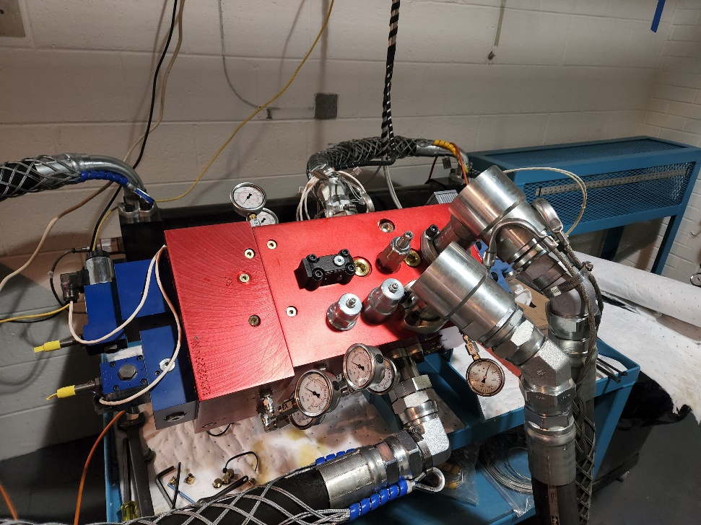
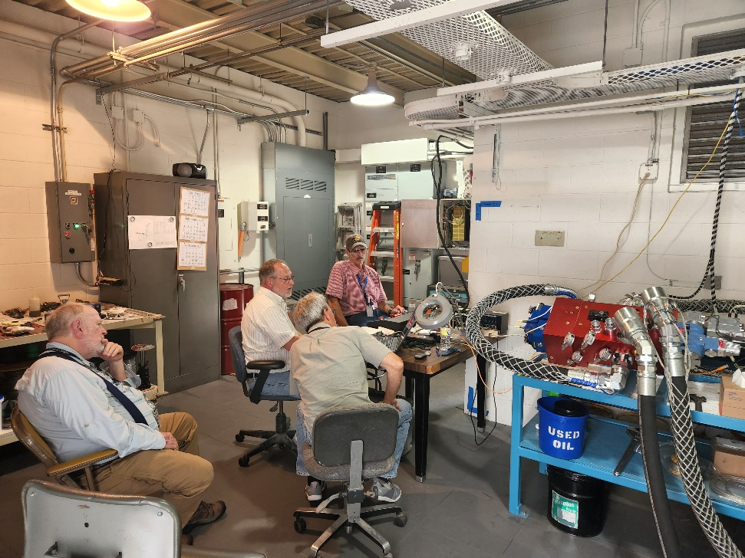
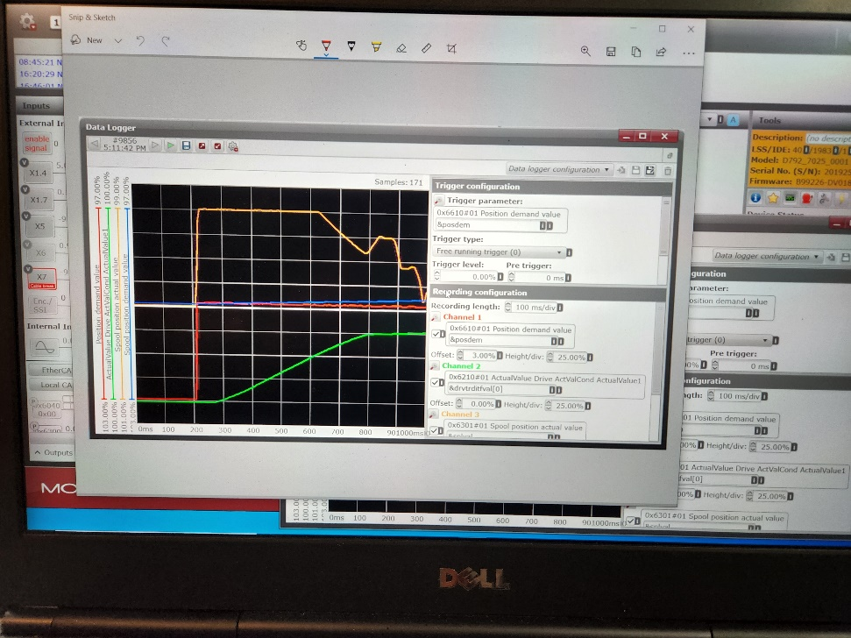
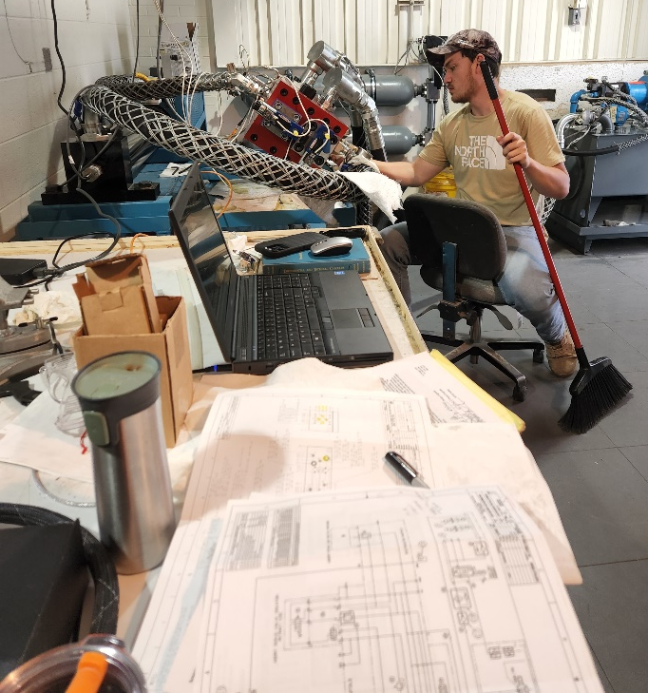
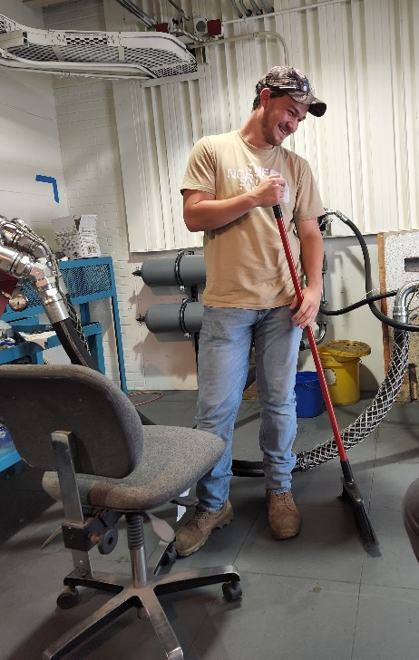
CMB Test Cell

Slide 22
Hydraulic Power Unit Upgrade

Slide 23
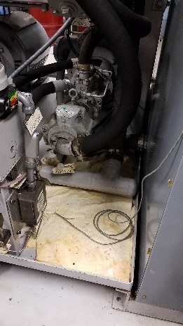
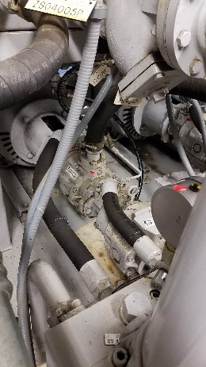
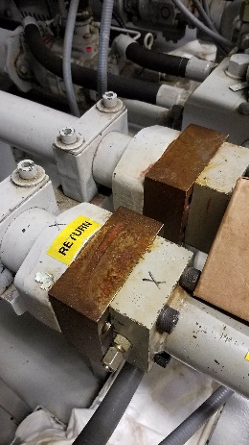
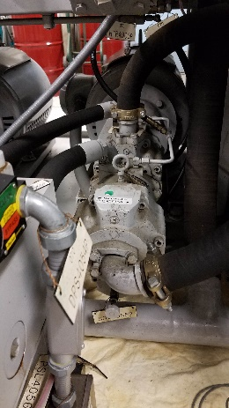
CMB HPU Upgrades
CMF hydraulic pump and main pressure ring

Slide 24
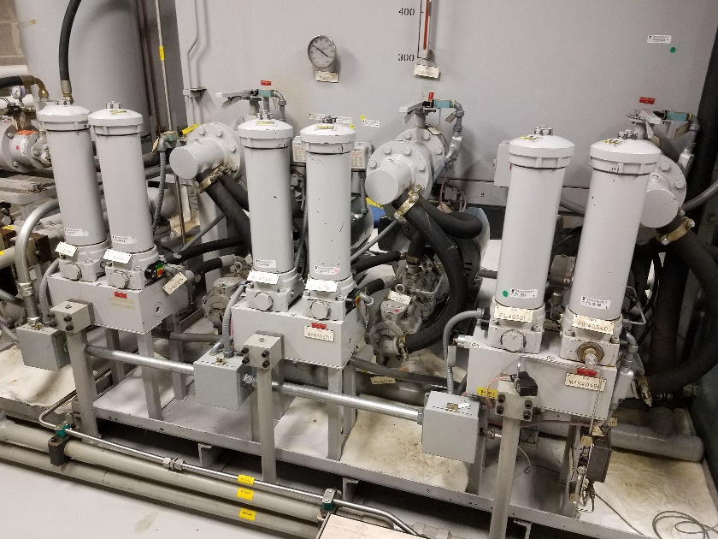
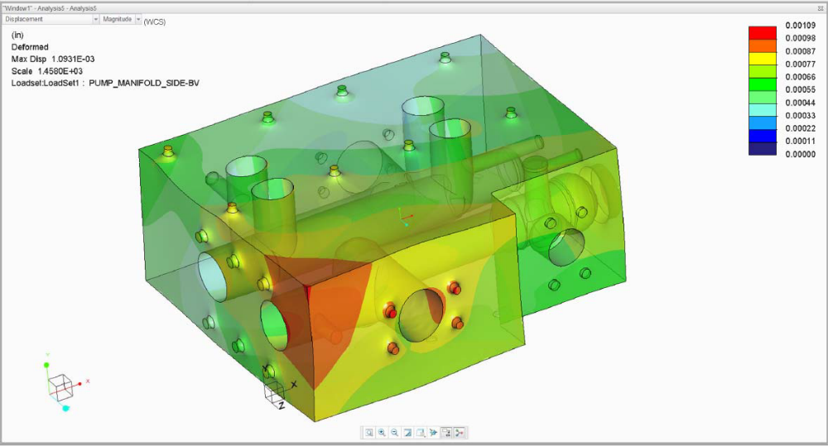
CMB HPU Upgrades
Replace six (6) existing CMF hydraulic pumps with three (3) new state of the art hydraulic pumps.
Replace six (6) existing CMF hydraulic pump compensators with three (3) new state of the art compensators.
Replace or upgrade existing CMF hydraulic pump manifold assemblies and plumbing.

Slide 25
Q&A

