Slide 1

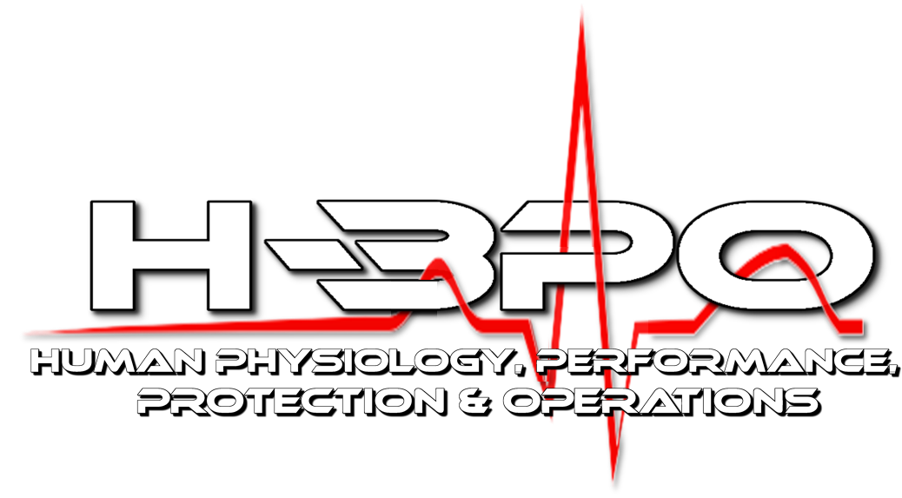

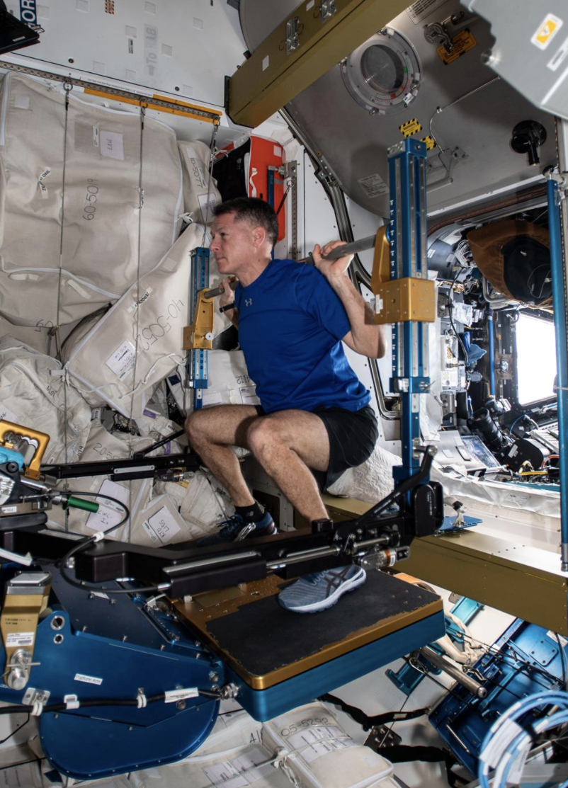
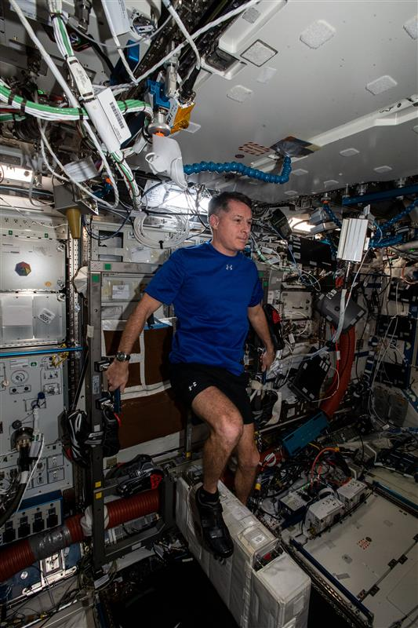
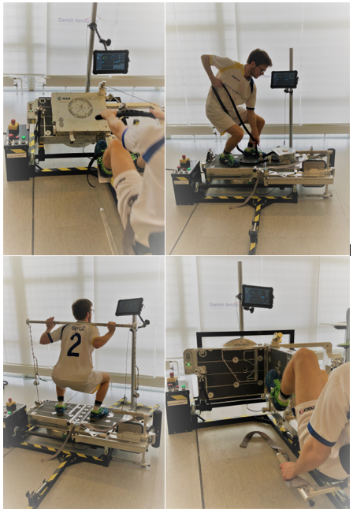
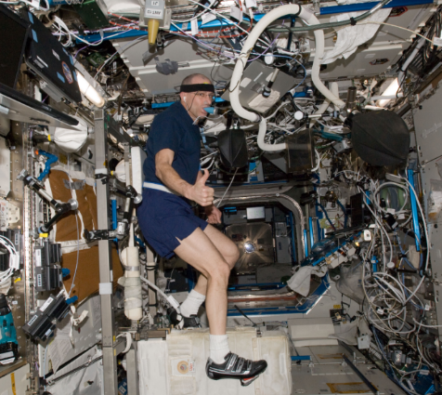
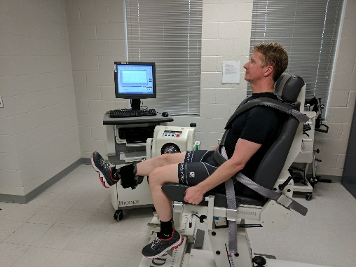
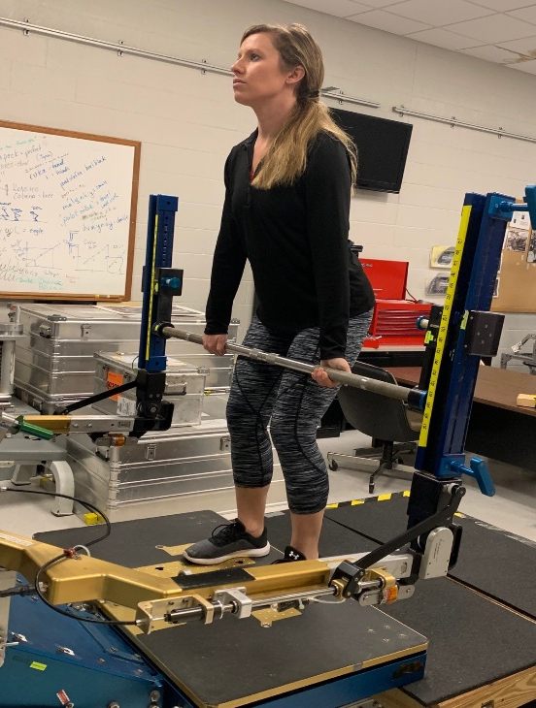
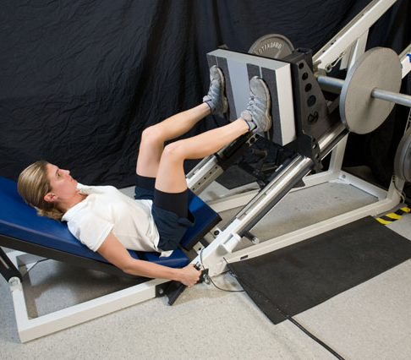
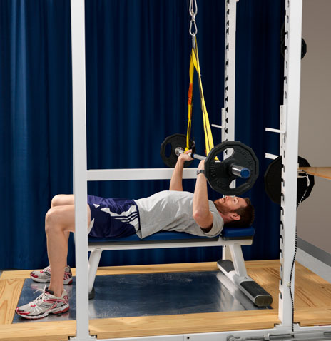
Effects of Replacing Treadmill Running with Alternative Exercise Countermeasures During Long-Duration Spaceflight
A.N. Varanoske¹, B.J. Prejean¹, N.C. Strock¹, D. Conly¹, B.T. Peters¹, E.S. Morant¹, J.D. Sibonga², S.M. Smith²,
S.R. Zwart³, E.R. Spector¹, M. Bishop¹, R.S. Fincke², K. Marshall-Goebel²
¹KBR, Houston, TX, USA; ² NASA Johnson Space Center, Houston, TX, USA; ³University of Texas Medical Branch, Galveston TX, USA
Abstract
Methods
INTRODUCTION: Current exercise countermeasures on the International Space Station (ISS), including treadmill running, cycle ergometry, and resistive exercise, are used to protect crewmember health and performance during long-duration spaceflight. However, exploration vehicles for Artemis and beyond will have volume and power restrictions, requiring exercise hardware to have a smaller footprint and use fewer resources. Thus, recent efforts have focused on developing exercise devices (such as the European Enhanced Exploration Exercise Device [E4D]) that provide both aerobic and resistive training on one platform without including a treadmill. It is critical to validate the efficacy of exploration-focused exercise modalities to preserve muscle strength, aerobic fitness, bone density, and sensorimotor performance. Thus, the aim of this study is to determine the physiological effects of spaceflight that occur with nominal ISS exercise prescriptions compared to exploration-forward exercise modalities to determine if a treadmill is required to maintain current levels of protection during long-duration missions.
METHODS: Crewmembers will be assigned to one of three groups: 1) Control Group (n ≥ 40), who will partake in nominal exercise on the ISS, including running on the Treadmill with Vibration Isolation and Stabilization 2 (T2), ergometry on the Cycle Ergometer with Vibration Isolation and Stabilization (CEVIS) device, and strength training on the Advanced Resistive Exercise Device (ARED); 2) Active Group 1, who will partake in CEVIS and ARED exercise only (n = 8); and 3) Active Group 2, who will partake in aerobic and resistive exercise on the E4D only (n = 8). For Active Group 1, nominal aerobic exercise on T2 will be replaced with corresponding exercise on CEVIS. For Active Group 2, a dedicated exercise prescription will be designed to maximize the capabilities of the E4D to include resistive exercise, cycle ergometry, rowing, and rope pulling. Crewmembers in both active groups will not be permitted to perform treadmill exercise. Health and performance markers including bone mineral density (dual-energy x-ray absorptiometry [DXA]), body composition (DXA), cardiovascular fitness (cycle VO_{2peak}), muscle strength and endurance (isometric/isokinetic testing, power endurance testing), sensorimotor performance (sit-to-stand, obstacle course), postural control (computerized dynamic posturography), and blood and urine biochemical markers of bone metabolism will be assessed before, during, and following spaceflight.
RESULTS: Eight subjects (2 Active [CEVIS + ARED], 6 Control) have been recruited for this study. Data collection is currently in progress.
CONCLUSIONS: This study will assess the efficacy of exploration exercise modalities, including the effects of removing the treadmill exercise capability or of exclusively using the E4D, compared to nominal ISS exercise across an entire mission on bone, muscle, aerobic, and sensorimotor health and performance. Findings from this study will help provide a recommendation on whether these exploration exercise modalities can sufficiently protect against physiological deconditioning during spaceflight or whether a treadmill may be required to maintain current levels of protection during future exploration class spaceflight missions.
Supported by the NASA Human Research Program and NASA Exploration Capabilities
Crewmembers will be assigned to one of three groups:
    Control Group (n ≥ 40), who will partake in nominal in-flight exercise on the ISS, including running on T2, cycling on CEVIS, and resistance exercise on ARED
    Active Group 1 (n = 8), who will partake in an exploration-focused exercise prescription in-flight including cycling on CEVIS and resistance exercise on ARED only (Figure 1)
      Exercise that would nominally occur on T2 will be replaced with exercise on CEVIS (no T2)
    Active Group 2 (n = 8), who will partake in an exploration-focused exercise prescription in-flight including aerobic and resistive exercise on the E4D only (Figure 2)
      Dedicated exercise prescription will maximize capabilities on E4D, including resistive exercise, cycle ergometry, rowing, and rope pulling (no T2)
Figure 1: Active Group 1 exercise equipment: ARED (left) and CEVIS (right; Source: NASA)
Figure 2: Active Group 2 exercise equipment: E4D (Source: DAC)
The following measures will be obtained in all subjects (Table 1): Blood biochemical markers, urine markers of bone metabolism, sensorimotor performance, isokinetic testing, aerobic capacity (VO_{2peak}) testing, computerized dynamic posturography, and dual-energy x-ray absorptiometry (data shared with MEDB and Standard Measures)
Additional outcome measures collected in Active Groups: Obstacle course, muscle strength and endurance testing (Figure 3), in-flight urine collections
Table 1: List of testing to be completed by study participants.
Test | Pre-flight | In-flight | Post-flight
Sensorimotor Performance
Sit-to-stand with walk & turn | L-180 (±45), L-60 (±30) | N/A | R+0 (landing and JSC*), R+5* (±1), R+9 (±2), R+14 (±2)*, R+30 (±3)*
Obstacle course | L-180 (±45)*, L-60 (±30)* | N/A | R+0 (JSC)*, R+5 (±1)*, R+9 (±2)*, R+14 (±2)*, R+30 (±3)*
Computerized dynamic posturography | L-270/180, L-90/30 | N/A | R+1*, R+8 (±2)
Blood and Urine Biochemistry, Body Composition, Bone
Blood collection | L-180/launch | FD30 (±15), R-30 (±30) | R+30 (±15)
48-hour (24-hour for in-flight) urine collection | L-90/30 | FD30 (±15)*, FD90 (±45)*, R-30 (±30)* | R+0, R+20/30
Dual-energy x-ray absorptiometry | L-21/18m, L-180/30 | N/A | R+5/30
Physical Performance
VO_{2peak} (cycle) | L-365 (±30), L-90/30 (±30) | FD14 (±2), FD75 (±7), R-14 (±5) | R+5 (±2), R+30 (±4)
Isokinetic testing | L-270/180 (±14), L-90/30 (±5) | N/A | R+5 (±1), R+14 (±1), R+30 (±2)
Isometric mid-thigh pull | L-180 (±45)*, L-60 (±30)* | FD14 (±2)*, FD45 (±2)*, FD60 (±2)*, monthly*, R-14 (±2)* | R+5 (±1)*, R+14 (±2)*, R+30 (±3)*
Leg press strength and power endurance | L-180 (±45)*, L-60 (±30)* | N/A | R+5 (±1)*, R+14 (±2)*, R+30 (±3)*
Bench press strength and power endurance | L-180 (±45)*, L-60 (±30)* | N/A | R+5 (±1)*, R+14 (±2)*, R+30 (±3)*
*Test conducted only on Active subjects, not as part of MEDB or Standard Measures; L: days prior to launch; FD: flight day; R: days prior to (-) or following (+) return; “/” indicates that test must be completed within this time frame.
Background
A
B
C
D
E
Microgravity exposure during long-duration spaceflight induces muscular and aerobic deconditioning, which can be mitigated using in-flight exercise countermeasures¹⁻⁴.
Historically, astronauts on the International Space Stations (ISS) have relied on in-flight exercise prescriptions that include treadmill running (Treadmill with Vibration Isolation and Stabilization 2 [T2]), cycle ergometry (Cycle Ergometer with Vibration Isolation System [CEVIS]), and resistive exercise (Advanced Resistive Exercise Device [ARED]) as countermeasures for protection¹⁻⁴.
However, exploration vehicles for Artemis and beyond will have significant volume and power restrictions, requiring exercise hardware to be lightweight, have a smaller footprint, and use fewer resources.
  Due to the large footprint of the treadmill and the ability to bundle cycling and resistive training into a single device, this has resulted in the development of exercises devices that both aerobic and resistive training on one platform, but do not have a treadmill.
  One such device is the European Enhanced Exploration Exercise Device (E4D), which provides rowing, cycling, rope-pulling, and resistive exercise capabilities in one device.
It is critical to validate the efficacy of this exploration-focused exercise modality of cycling and resistive exercise alone as well as other devices (i.e., E4D) on preserving muscle strength, aerobic fitness, bone density, and sensorimotor performance.
  Though no difference in changes to strength or aerobic fitness is expected between groups, without a treadmill, there is no means of ambulating or reinforcing the motor pattern of walking, and the total load applied to bones is reduced⁵⁻⁶. This study will allow us to provide a recommendation on whether cycling and resistive exercise are sufficient or if a treadmill is required to maintain current levels of countermeasure protection.
Figure 3: Physical performance assessments completed in the Zero T2 study. A) Cycle ergometer in-flight VO_{2peak} testing; B) Isokinetic testing; C) Isometric mid-thigh pull testing; D) Leg press strength testing; E) Bench press power endurance testing
Statistical Analyses:
Bayesian generalized linear mixed-effects models will be constructed in which each metric is regressed onto T2 usage and time along with nested random effects to account for data dependencies due to multiple measurements per crewmember and multiple control sources. A sensitivity analysis will be performed in which multiple prior distributions will be considered.
Results
Data collection for this study is currently in progress:
  n = 2 Active Subjects (Active Group 1, CEVIS +ARED) – Active Group 2 recruitment will begin once E4D is on the ISS (estimated 2025)
  n = 6 Control Subjects
HRP Risks Addressed
Risk of Impaired Performance Due to Reduced Muscle Mass, Strength & Endurance
Risk of Reduced Physical Performance Capabilities Due to Reduced Aerobic Capacity
Risk of Bone Fracture due to Spaceflight-Induced Changes to Bone
Risk of Impaired Control of Spacecraft/Associated Systems and Decreased Mobility Due to Vestibular/Sensorimotor Alterations Associated with Spaceflight
Risk of Injury and Compromised Performance Due to EVA Operations
Purpose
References
To determine the physiological effects of using exploration-focused exercise modalities and prescriptions during an entire ISS spaceflight mission compared to nominal ISS exercise to determine if a treadmill is required to maintain current levels of protection during long-duration spaceflight missions.
Sibonga J, Matsumoto T, Jones J, Shapiro J, Lang T, Shackelford L, Smith SM, Young M, Keyak J, Kohri K, Ohshima H. Resistive exercise in astronauts on prolonged spaceflights provides partial protection against spaceflight-induced bone loss. Bone. 2019 Nov 1;128:112037.
Levine BD, Lane LD, Watenpaugh DE, Gaffney FA, Buckey JC, Blomqvist CG. Maximal exercise performance after adaptation to microgravity. Journal of applied physiology. 1996 Aug 1;81(2):686-94.
Mulavara AP, Peters BT, Miller CA, Kofman IS, Reschke MF, Taylor LC, Lawrence EL, Wood SJ, Laurie SS, Lee SM, Buxton RE. Physiological and functional alterations after spaceflight and bed rest. Medicine and science in sports and exercise. 2018 Sep;50(9):1961.
Moore Jr AD, Downs ME, Lee SM, Feiveson AH, Knudsen P, Ploutz-Snyder L. Peak exercise oxygen uptake during and following long-duration spaceflight. Journal of applied physiology. 2014 Aug 1;117(3):231-8.
Sibonga J, Matsumoto T, Jones J, Shapiro J, Lang T, Shackelford L, Smith SM, Young M, Keyak J, Kohri K, Ohshima H. Resistive exercise in astronauts on prolonged spaceflights provides partial protection against spaceflight-induced bone loss. Bone. 2019 Nov 1;128:112037.
Sibonga JD, Evans HJ, Sung HG, Spector ER, Lang TF, Oganov VS, Bakulin AV, Shackelford LC, LeBlanc AD. Recovery of spaceflight-induced bone loss: bone mineral density after long-duration missions as fitted with an exponential function. Bone. 2007 Dec 1;41(6):973-8.

