Slide 1
Measurements and Computations of Natural Transition on the NASA Juncture-Flow Model with a Symmetric Wing
National Aeronautics and Space Administration
Andrew Leidy, Michael Kegerise, Judith Hannon, Meelan Choudhari
Balaji Venkatachari, Pedro Paredes
NASA Langley Research Center
Hampton, VA 23681
National Institute of Aerospace
Hampton, VA 23666
Session: CFD2030-02, Monday 4:00 PM to 5:40 PM
Copyright 2023 United States Government as represented by the Administrator of the National Aeronautics and Space Administration.
No copyright is claimed in the United States under Title 17, U.S. Code. All Other Rights Reserved.
Published by the American Institute of Aeronautics and Astronautics, Inc. with permission.

Slide 2
Introduction
The purpose of the NASA juncture-flow experiments is to produce validation data near the trailing edge wing/fuselage junction
Previous campaigns focused on surface and off-body measurements in that region (Kegerise et al., 2019; Jenkins et al., 2019)
IR measurements were also made but the precise transition front location was not determined
Wings were changed to a symmetric airfoil
Additional attention was placed on natural transition measurements in the present entry
Kegerise, M. A., Neuhart, D. H., Hannon, J. A., and Rumsey, C. L., “An Experimental Investigation of a Wing-Fuselage Junction Model in the NASA Langley 14- by 22-Foot Subsonic Wind Tunnel,” AIAA Paper 2019-0077, January 2019.
Jenkins, L. N., Yao, C. S., and Bartram, S. M., “Flow-Field Measurements in a Wing-Fuselage Junction Using an Embedded Particle Image Velocimetry System,” AIAA Paper 2019-0078, January 2019.

Slide 3
Motivation
Pretest analysis showed 2 dominant transition mechanisms (Venkatachari et al., 2021)
  Tollmien-Schlichting (TS) for positive α
  Increasingly stationary crossflow (CF) for more negative α
Improvement of transition models is the goal
  Some α are predicted to have regions of strong TS and CF
  These cases test the ability to predict transition in areas where TS and CF may potentially interact
  A robust data set is needed for future model calibration
Venkatachari, B. S., Paredes, P., Choudhari, M. M., Li, F., and Chang, C.-L., “Pretest Computational Assessment of Boundary Layer Transition in the NASA Juncture Flow Model with an NACA 0015-Based Wing,” AIAA Paper 2021-2502, July 2021.

Slide 4
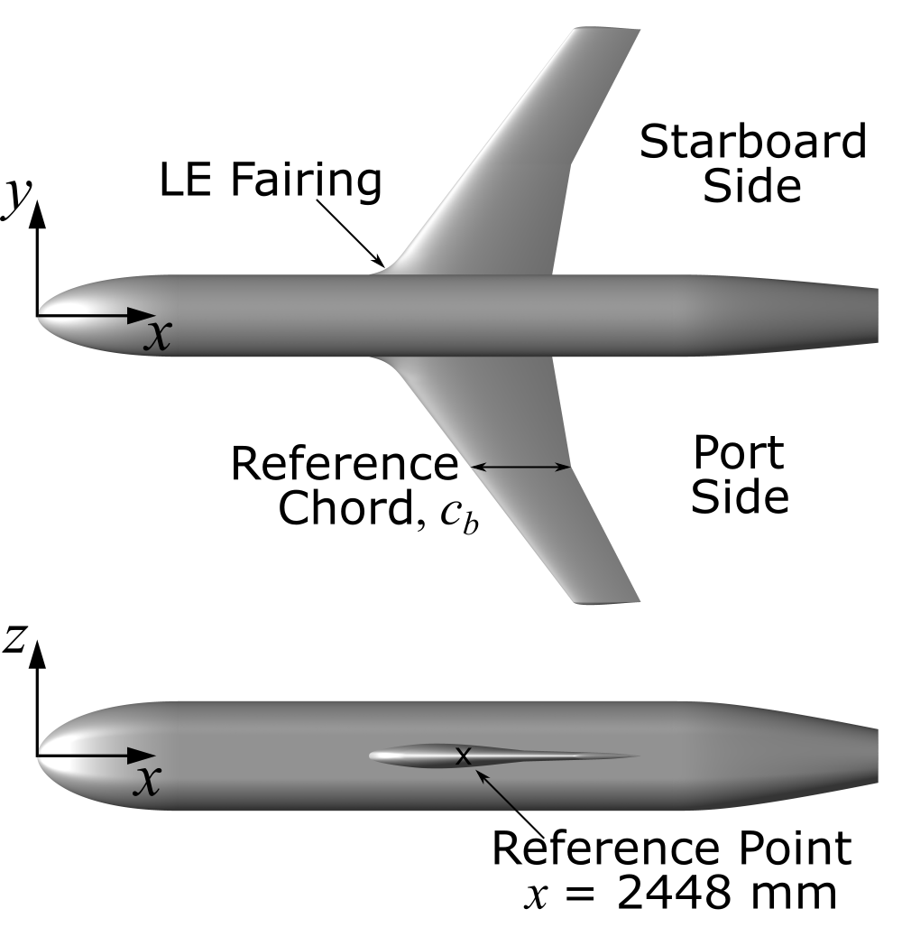
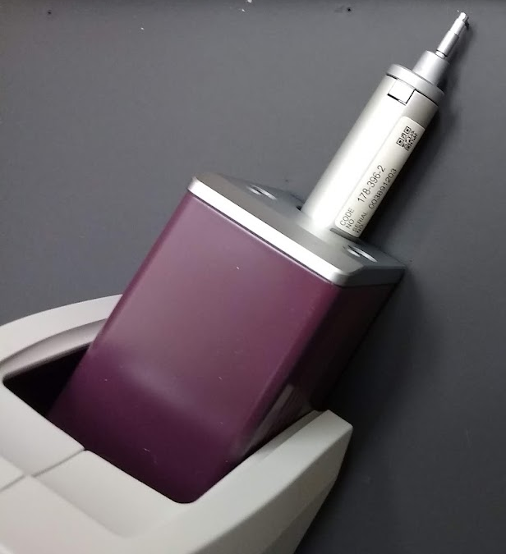
NASA Juncture-Flow Model
Symmetric airfoil wings, 37.3° sweep
Model coated with black, lusterless paint
  R_{q} = 3.104±0.016 μm on port wing
  Thickness is 254 to 330 μm
Top and side views of model
Stylus profilometer
Sample spectra from the port wing leading edge

Slide 5
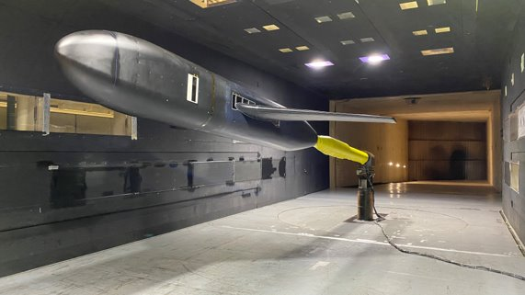
14- by 22-Foot Subsonic Tunnel
Closed circuit, atmospheric pressure (Gentry et al., 1990)
No temperature control
Re_{cb} held fixed at 2.4M
-10° ≤ α ≤ 10°
FSTI ≈ 0.08% (Neuhart & McGinley, 2004)
Testing conditions
​ | Nominal Value​ | Range​
Re_{cb}​ | 2.40 million​ | 2.3928 – 2.407​​2
M​ | 0.189​ | 0.174 – 0.192​
T_{a}​ | 288.84 K​ | 282 – 300 K​
U∞​ | 64.4 m/s​ | 58.4 – 66.6 m/s​
Q​ | 2385 Pa​ | 2115 – 2530 Pa​
Juncture Flow model in the NASA Langley 14x22
Gentry, G. L., Quinto, F. P., Gatlin, G. G., and Applin, Z. T., “The Langley 14- by 22-Foot Subsonic Tunnel,” NASA TP 3008, 1990.
Neuhart, D. H. and McGinley, C. B., “Free-Stream Turbulence Intensity in the Langley 14- by 22-Foot Subsonic Tunnel,” NASA TP 213247, 2004.

Slide 6
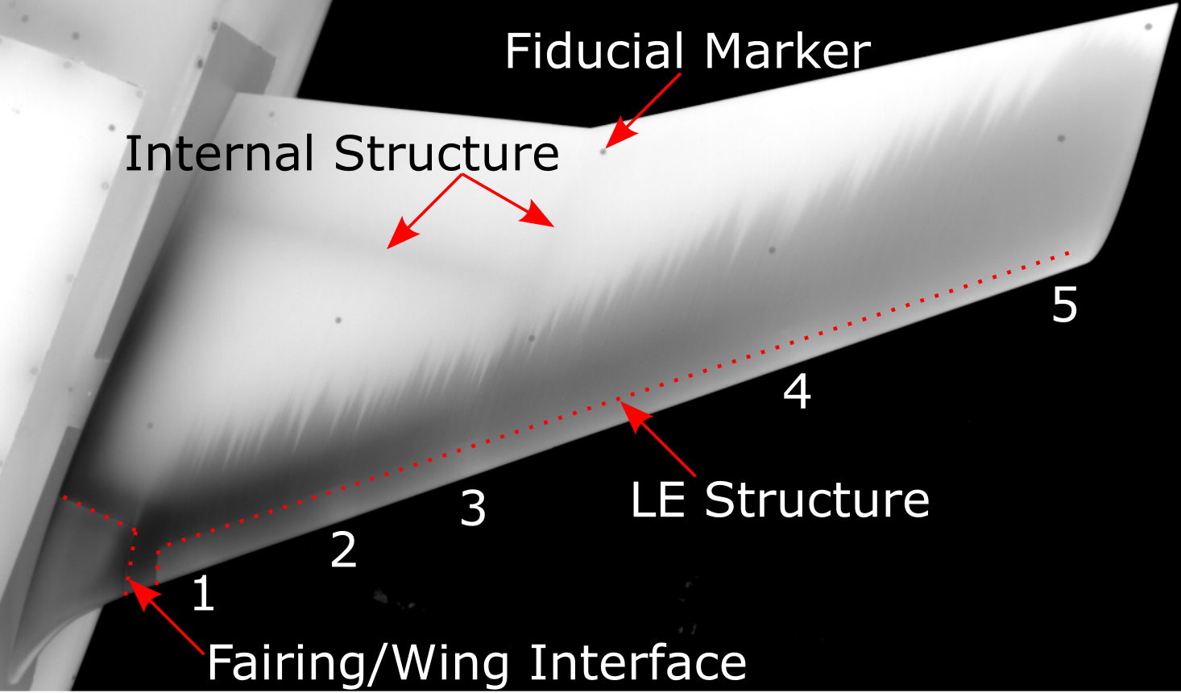
Influences on IR Images
Outdoor weather
Features specific to JF model
  Internal structure
  Fairing/Wing interface
  Fiducial markers
  Panels
  Fasteners
Port wing in IR: features specific to this test

Slide 7
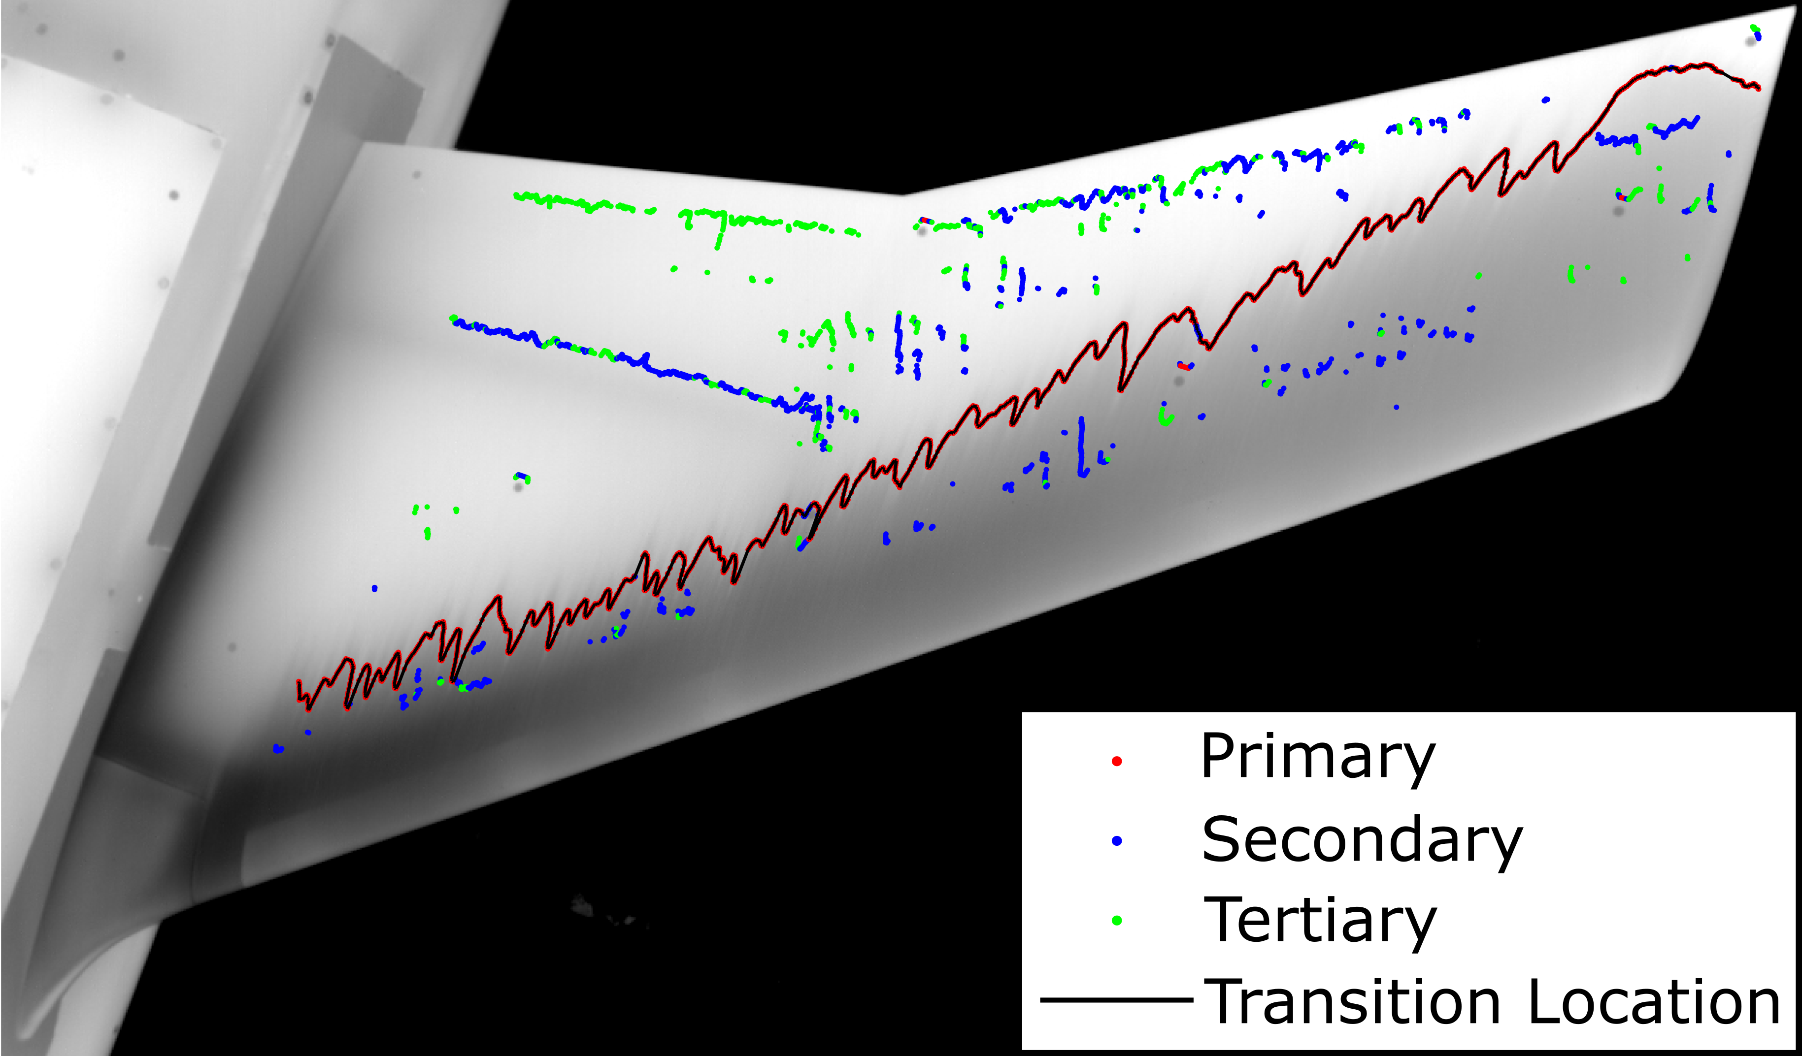
Processing IR Images
I(x) for each spanwise position (constant y)
Top 3 ∂I/∂x values were set as potential transition locations
An initial point on the transition front was set near the fuselage
Full transition front was defined by marching outboard on potential points within a threshold distance of previous points
Potential transition locations and detected transition front

Slide 8
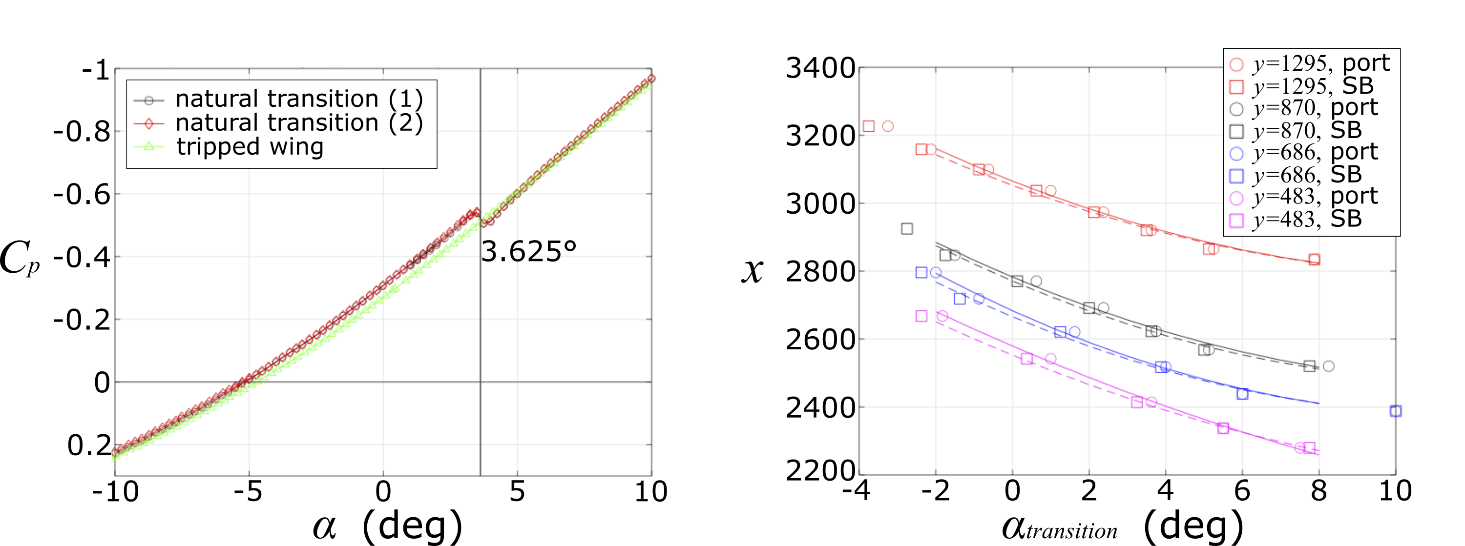
Processing Surface Pressure
C_{p} – α curves were generated at each port
The central portion of the “hitch” was identified as transition
For pressure ports along each line of constant y, the port x was plotted against the transitional α
A quadratic curve was fit through the points to estimate the x-transition location for a given value of α
Sample C_{p} – α curve at a port
Curves to estimate the transition location for a given α

Slide 9
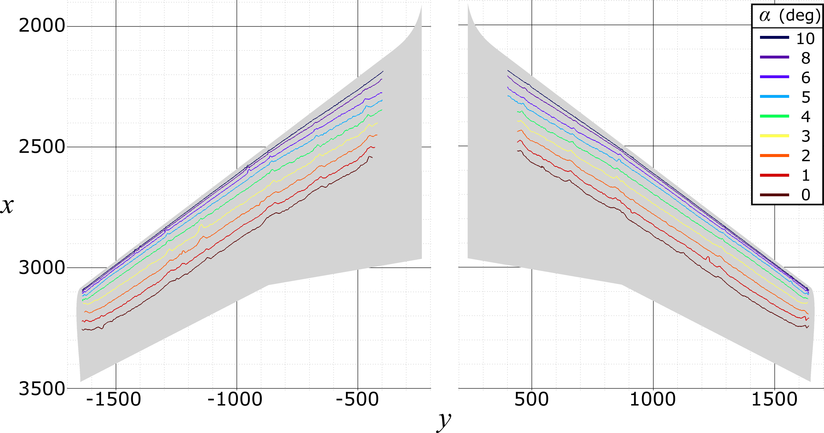
Transition Fronts for Positive α
Fronts are nearly parallel to the leading edge
Fronts move downstream as α decreases
Appears to be good symmetry across the fuselage
Transition fronts for positive α

Slide 10
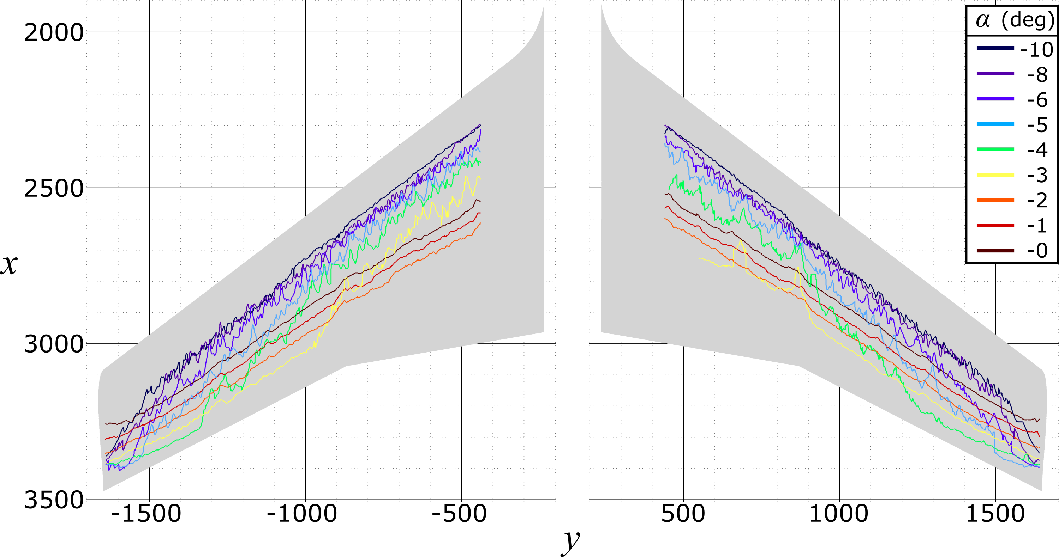
Transition Fronts for Negative α
-2° ≤ α ≤ 0°: trend continues from previous slide
-6° < α < -2°: inboard transition is farther upstream and jagged
α ≤ -6°: transition front continues to advance, local variability decreases
Transition fronts for negative α

Slide 11
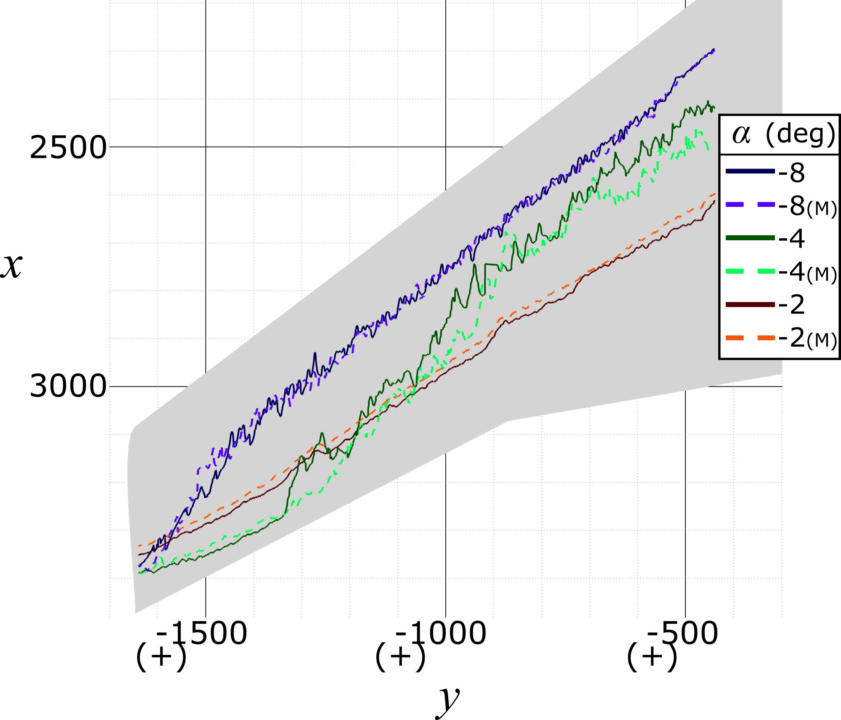
Wing Comparison
Transition fronts are shown for port and starboard (mirrored) wings
Starboard front is slightly farther upstream for α ≥ -2°
Largest differences for -6° < α < -2°
Transition front comparison between the port wing and mirrored starboard (M) wing

Slide 12
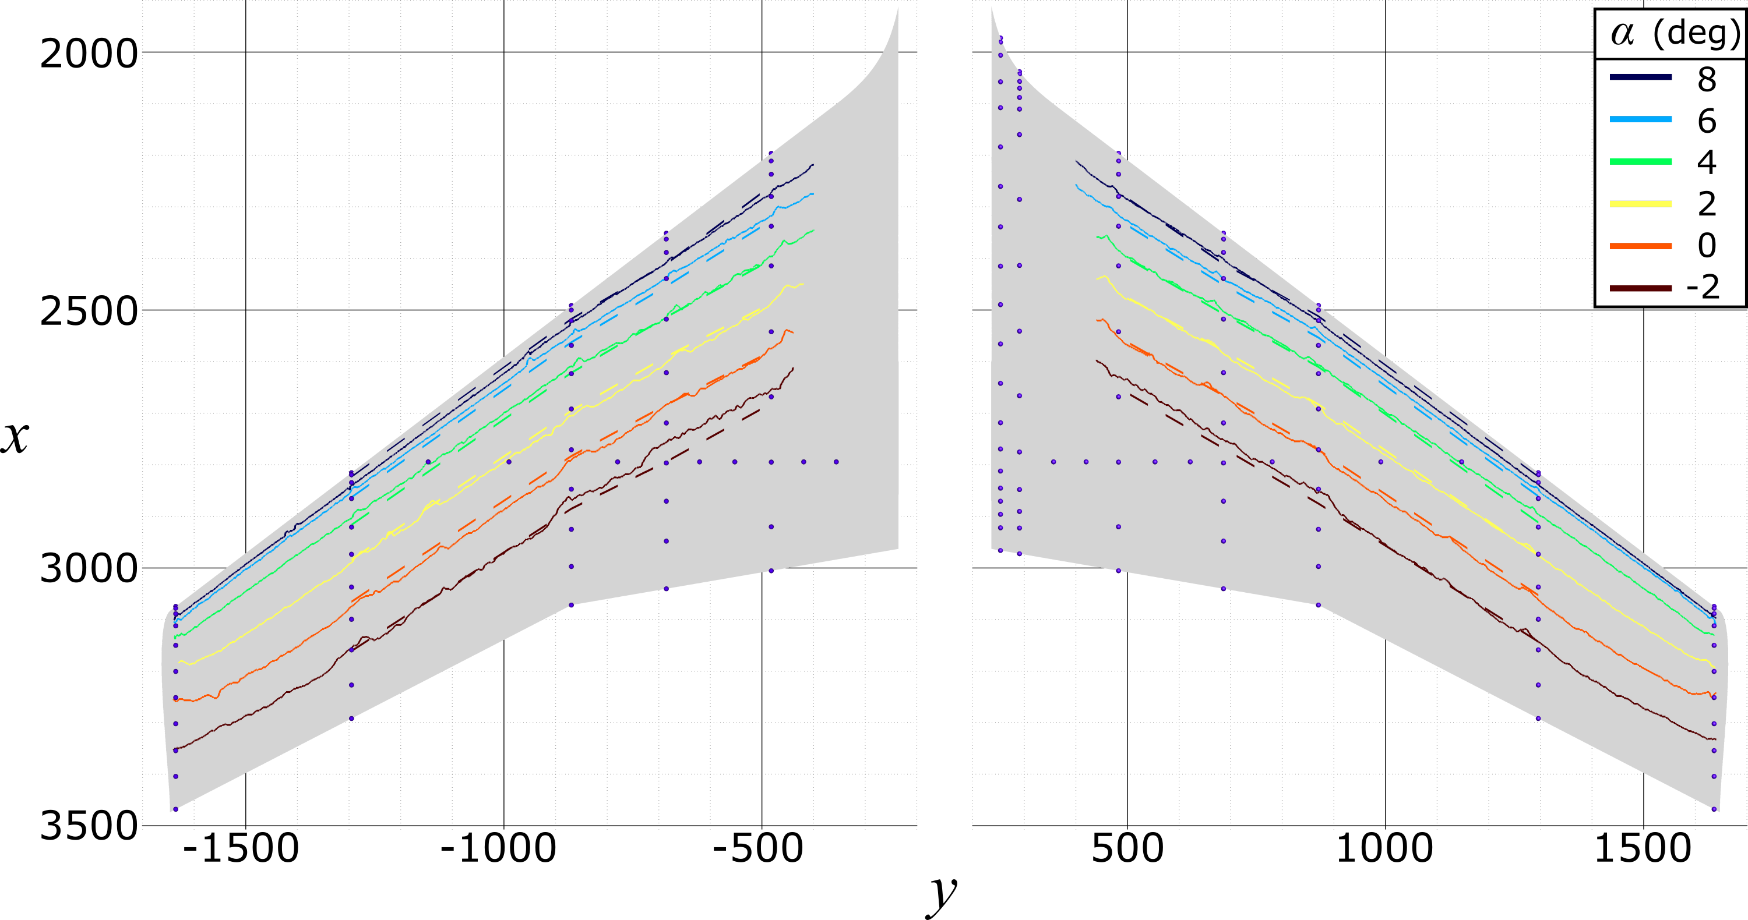
Transition Comparison: IR and Pressure
Comparisons made for -2° < α < 8°
Strong agreement between the diagnostics
Transition front comparison between methods of determination.
IR-based fronts are solid lines, while pressure-based fronts are dashed lines.

Slide 13
Details on CFD & Stability Analysis Tools
CFD Solver: OVERFLOW 2.3b (Nichols and Buning, 2019)
  Implicit structured overset grid Navier-Stokes solver
Stability Analysis Tool: LASTRAC 3.d Solver (Chang, 2004)
  Linear stability theory (LST), Parabolized stability equations (PSE)
  Mean flow computed using OVERFLOW and SA-turbulence model with an imposed transition front
RANS-based Transition Models: Variants of SST-2003-based Langtry-Menter (LM) Model
  LM2009: Tollmien-Schlichting, separation-induced, bypass transition
  LM2015: LM2009 + stationary crossflow through a correlation based on surface roughness level (Langtry et al., 2015)
  LMCFHE: LM2009 + local helicity-based implementation of stationary crossflow (Grabe et al., 2016)
Nichols, R. H, and Buning, P. G., “User’s Manual for OVERFLOW 2.3, Version 2.3,” NASA Langley Research Center, Hampton, VA, Oct 2019.
Chang, C.-L., “LASTRAC 3d: Transition Prediction in 3D Boundary Layers,” AIAA Paper 2004-2452, 2004.
Langtry, R. B., Sengupta, K., Yeh, D. T., and Dorgan, A. J., “Extending the Local γ−Reθt Correlation based Transition Model for Crossflow Effects,” AIAA Paper 2015-2474, June 2015.
Grabe, C., Nie, S., and Krumbein, A., “Transport Modeling for the Prediction of Crossflow Transition,” AIAA Journal, Vol. 56, No. 8, 2018, pp. 3167–3178.

Slide 14
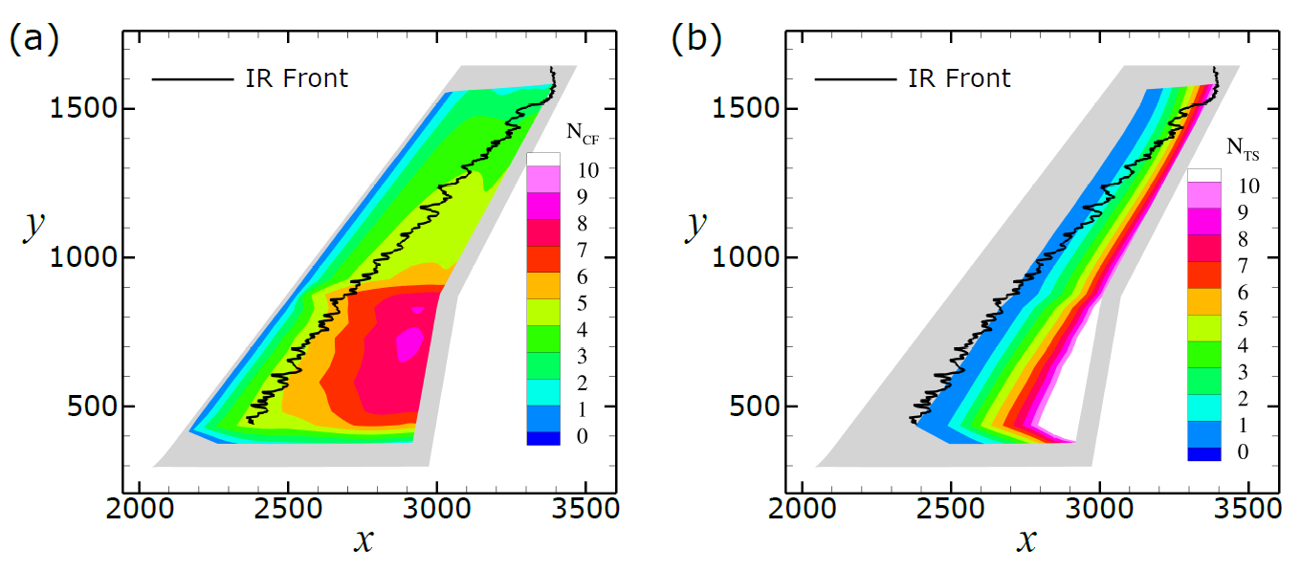
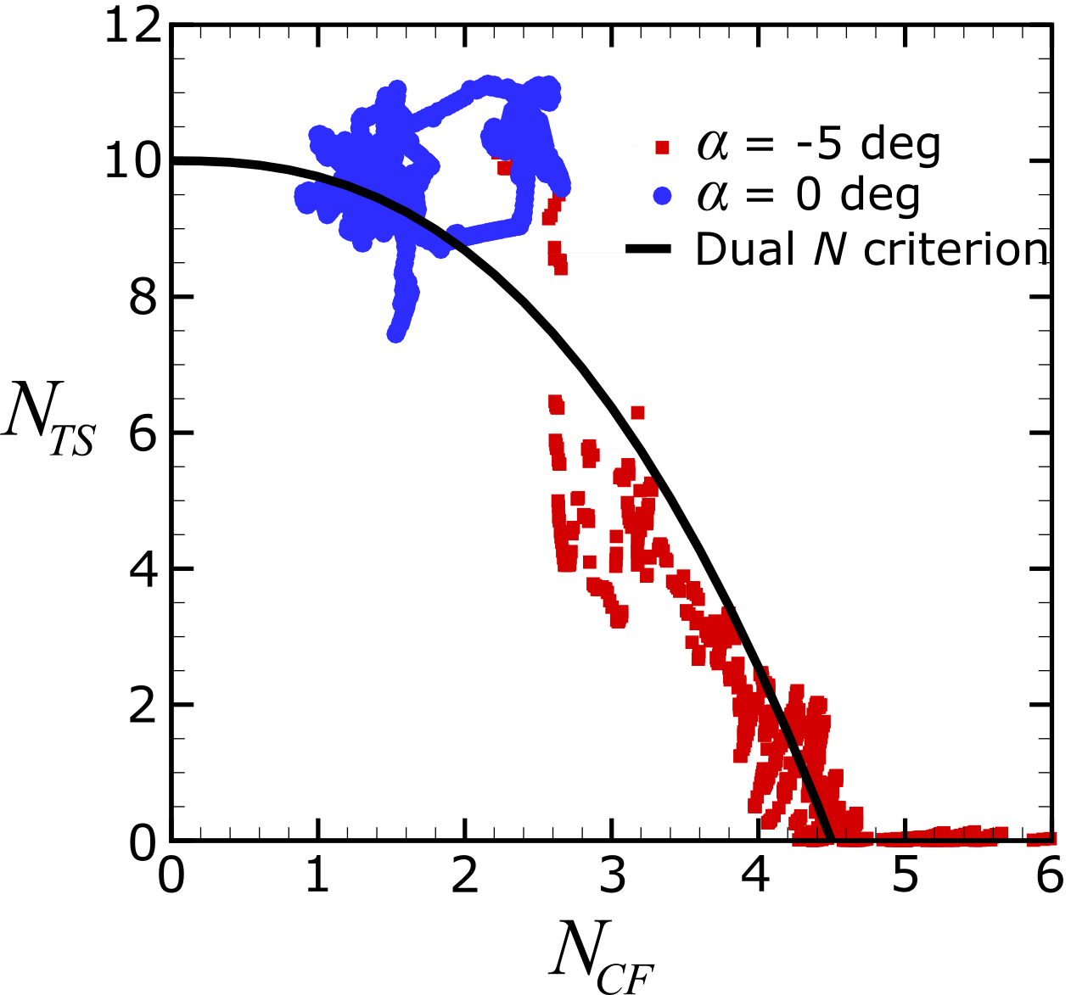
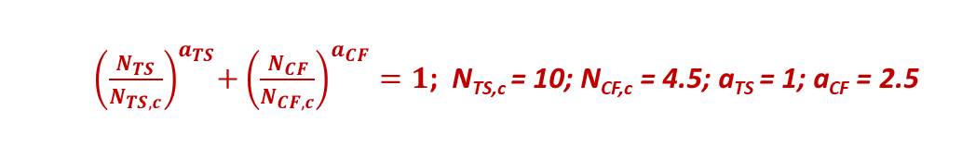
LPSE Results & Dual N_{TS}-N_{CF} Criterion
For α = -5°
  CF dominates inboard of the break
  CF and TS both have influence outboard of the break
TS is the dominant mechanism for α = 0° (not shown here)
Dual N_{TS}-N_{CF} Criterion (Arnal, 1994)
  Transition occurs when a function of N_{TS}-N_{CF} reaches a threshold
  N-factors from stability computations are projected onto the measured front and used to determine a relation
N-factor contours of (a) CF and (b) TS for α = -5°
${ \left(\frac{N_{TS}}{N_{TS,c}}\right)}^{a_{TS}}+{\left(\frac{N_{CF}}{N_{CF,c}}\right)}^{a_{CF}}=1$; N_{TS,c} = 10; N_{CF,c} = 4.5; a_{TS} = 1; a_{CF} = 2.5
Arnal, D. “Boundary layer transition: Prediction based on linear theory.” In: Special course on Progress in Transition Modeling. AGARD R-793. 1994, pp. 1–62.
N-factors at experimental transition locations for CF and TS

Slide 15
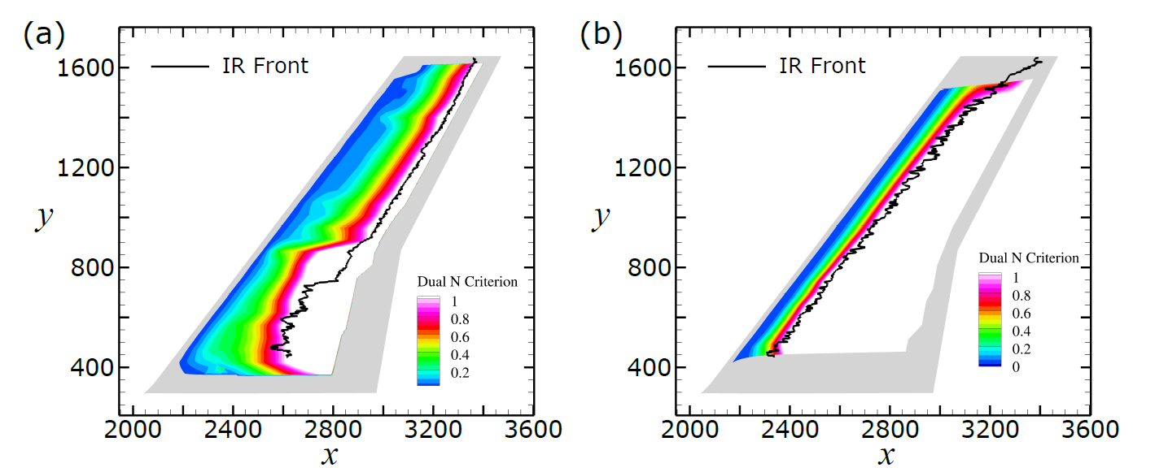
Predictions based on Dual N_{TS}-N_{CF} Criterion
Dual N-factor contour: >1 indicates transition
For α = -2.5°
  Predicted and measured fronts match closely except for close to the break
  Near the break, large spanwise gradients in the basic state could affect the accuracy of PSE
  CF and TS potentially interact inboard of break
For α = -7.5°
  Excellent agreement across the span
  Flow is entirely dominated by stationary CF
Computed contours of the dual N_{TS}-N_{CF} criterion
for (a) α = -2.5° and (b) α = -7.5°

Slide 16
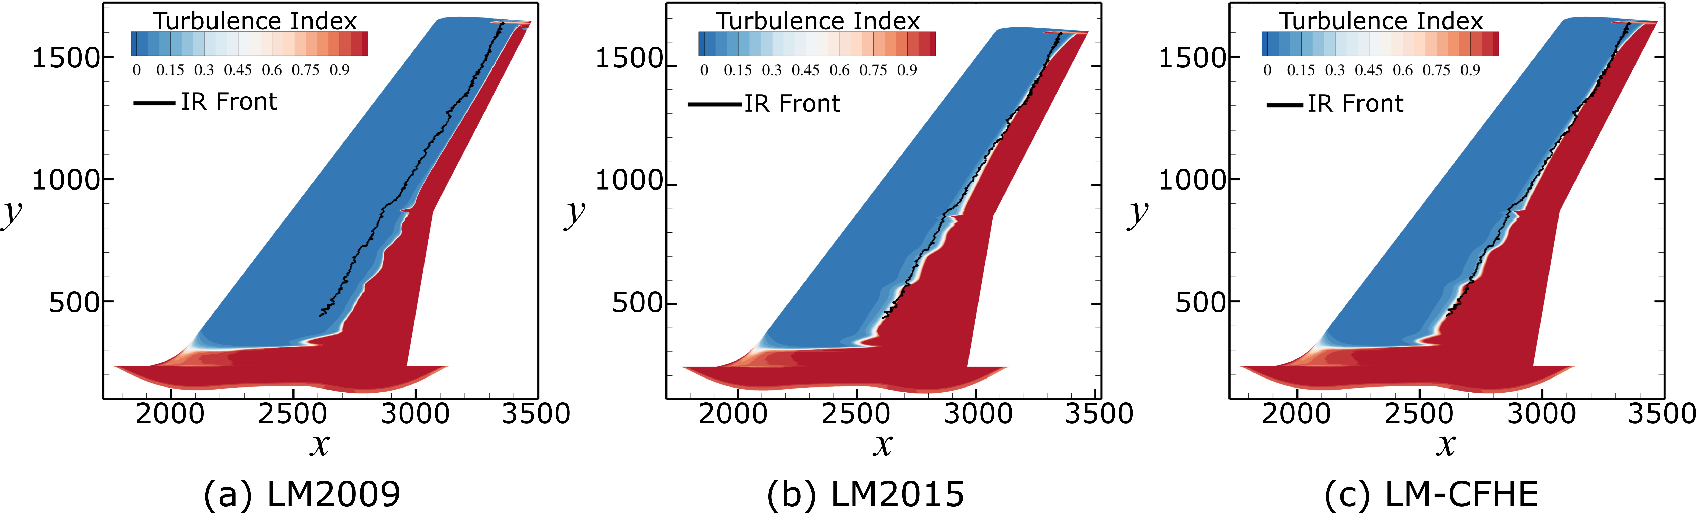
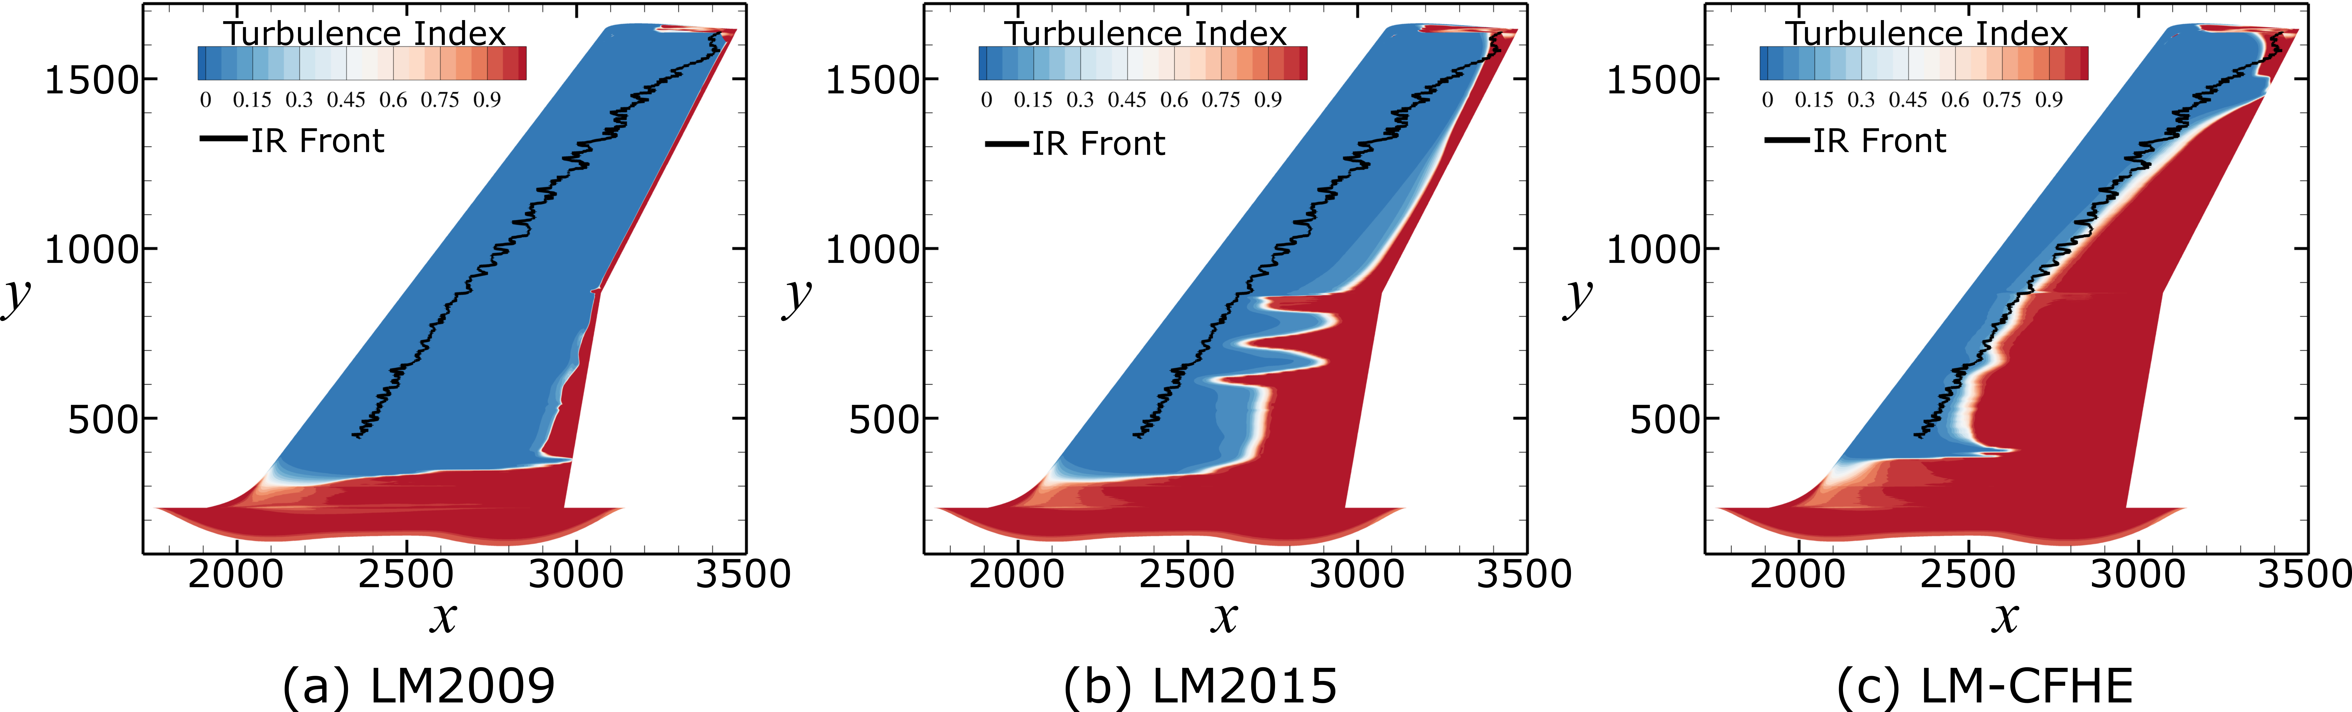
RANS-based Transition Models
α = -2°
FSTI = 0.08% R_{q} = 3.13 μm
All 3 models do reasonably well for α > -2.5°
The helicity-based LM-CFHE gives the best results for all conditions where CF is important, even though it doesn’t account for roughness
LM2009
LM2015
LM-CFHE
Turbulence index contours using different transition models for α = -2°
α = -6°
LM2009
LM2015
LM-CFHE
Turbulence index contours using different transition models for α = -6°
Neuhart, D. H. and McGinley, C. B., “Free-Stream Turbulence Intensity in the Langley 14- by 22-Foot Subsonic Tunnel,” NASA TP 213247, 2004.

Slide 17
Concluding Remarks
IR thermography was used to estimate transition fronts on the juncture flow model for -10° ≤ α ≤ 10°
The data revealed regions of strong TS and CF and potential interaction between the mechanisms
Measurements from the α = 0° and α = -5° cases were used to recalibrate a stability-based dual N-factor criterion for predicting transition
3 RANS-based transition models were evaluated, with the local helicity-based LM-CFHE model performing the best across all conditions
This data set will continue to be useful to assess transition models and for future model calibration
Provides a starting point for a subsequent transition-focused experiment

Slide 18
Acknowledgements
This work was supported by the NASA Transformational Tools and Technologies project of the Transformative Aeronautics Concepts Program
The last 2 authors were funded through the National Institute of Aerospace (NIA) under cooperative agreement 2A00 (Activity 201133)
The computational resources supporting this work were provided by the K cluster at NASA Langley Research Center and by the NASA High-End Computing (HEC) Program through the NASA Advanced Supercomputing (NAS) Division at the Ames Research Center
The authors thank all members of the Juncture-Flow Team for their dedication and insights throughout the course of this effort
The authors also thank the staff of the 14- by 22-Foot Subsonic Tunnel for their support during the test entry

