Slide 1
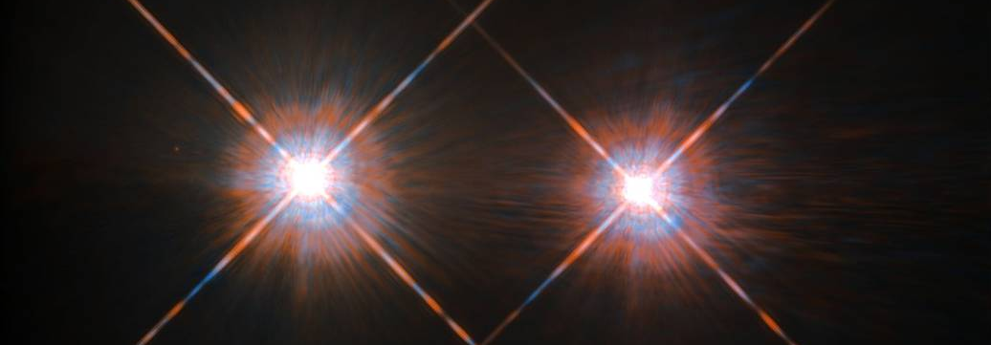

Multi-Star Wavefront Control: Update on Technology Development for Roman Space Telescope and Habitable Worlds Observatory
Dan Sirbu¹, Ruslan Belikov¹, Eduardo Bendek², Olivier Guyon³, Julien Lozi³,
David Marx²,Chris Mendillo⁴, Eugene Pluzhnik¹,
Camilo Mejia Prada² , A J Eldorado Riggs², Garreth Ruane²,
¹NASA Ames, ²JPL/Caltech, ³Subaru Telescope / Subaru , ⁴UMass-Lowell,
Image Credit: Hubble Picture of Alpha Centauri
241st AAS Meeting
January 9th, 2023
Funded by NASA ISFM Program
HCIT is funded by NASA’s Exoplanet Exploration Program (ExEP) Office

Slide 2
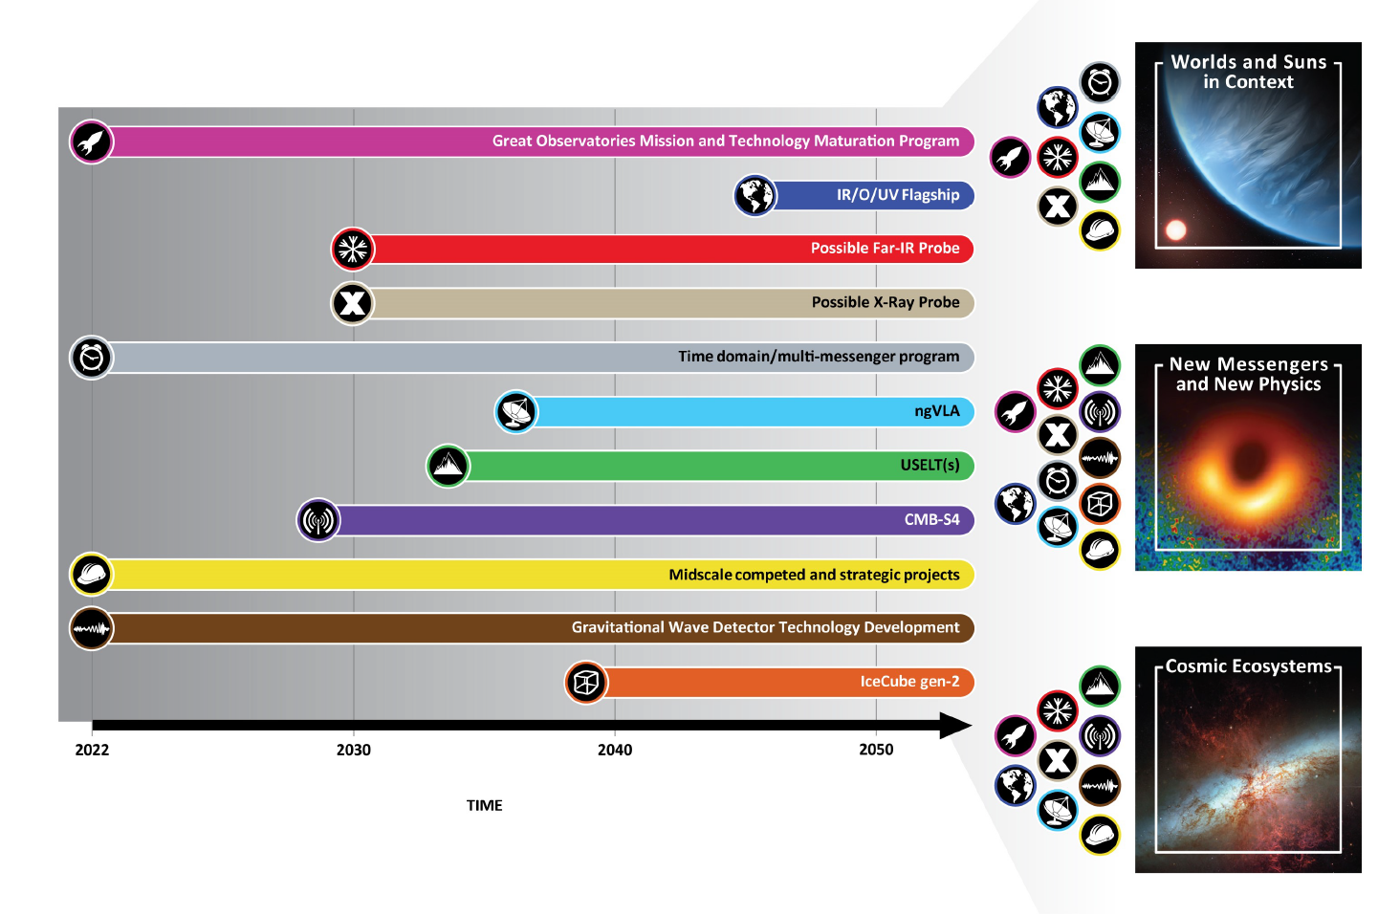
Astro2020 decadal survey recommendations for Habitable Worlds Observatory
illustration
Top two recommendations of
Astro2020 decadal survey:
Astro2020 flagship recommendation requires a statistically robust
~25 exoearth yield estimate. Increased instrument efficiency improves margin!
https://www.nationalacademies.org/our-work/decadal-survey-on-astronomy-and-astrophysics-2020-astro2020
Notes:
Bruce Macintosh: ~6m is very approximate
Scott Gaudi: most trades should be re-opened

Slide 3
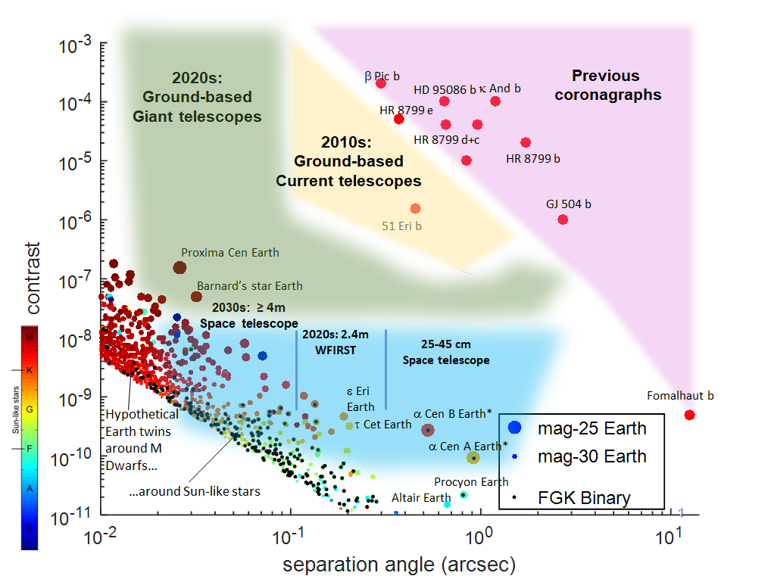
Multi-Star Systems increase quantity & quality of direct imaging targets
illustration
Binaries extend the discovery space for
the Astro2020 flagship
Plotting hypothetical exo-Earth
contrast for all stars within 20 pc
~1/2 of all FGK stars are in
binary systems
41 of 67 stars in 10 pc
259 of 519 stars in 20 pc
Alpha Centauri A & B is a special
science case:
3x closer than any other star system
3x better spatial/spectral resolution
Based on Guyon 2019
Notes:
Bruce Macintosh: ~6m is very approximate
Scott Gaudi: most trades should be re-opened

Slide 4
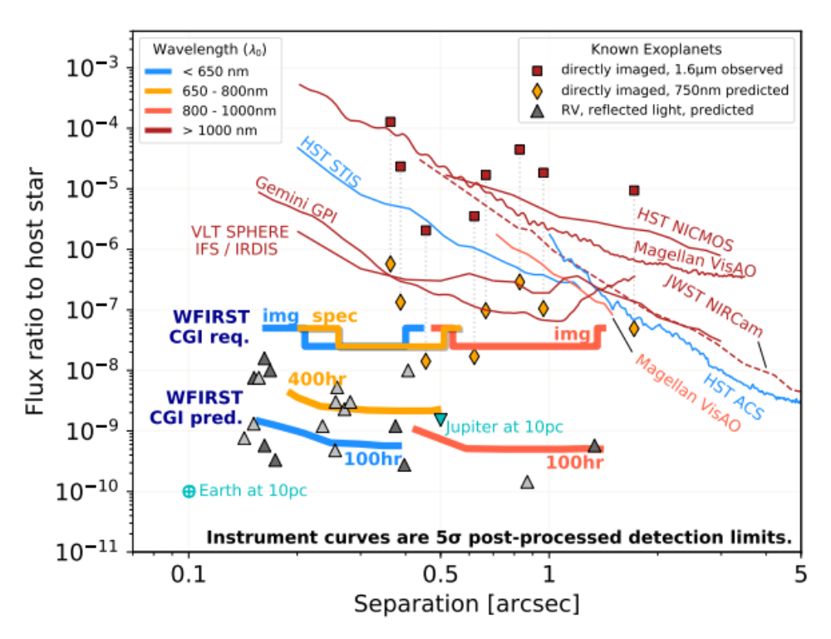

Alpha Cen Opportunities with Roman
illustration
Roman CGI may be able to image Earth twins
Due to unusual proximity, Alpha Cen breaks common-wisdom assumptions about what Roman can do:
1) NEAR candidate planet is within demonstrated lab contrast with SNWC
2) At gibbous phase, a large Earth-like planet around Alpha Cen B may be within CGI’s sensitivity limits (depending on final performance)
Roman SNWC
Lab Demo
: 7R_{E} @1.1AU, αCenA
(quadrature)
Roman MSWC
Simulations
: 1.4R_{E} in HZ of αCenB
(Gibbous phase)
Based on Bailey 2019
Notes:
Bruce Macintosh: ~6m is very approximate
Scott Gaudi: most trades should be re-opened

Slide 5
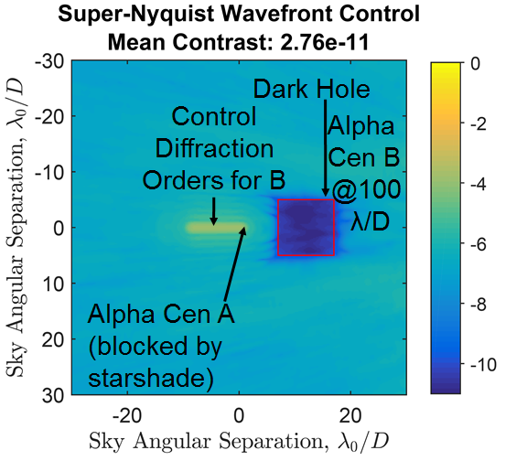
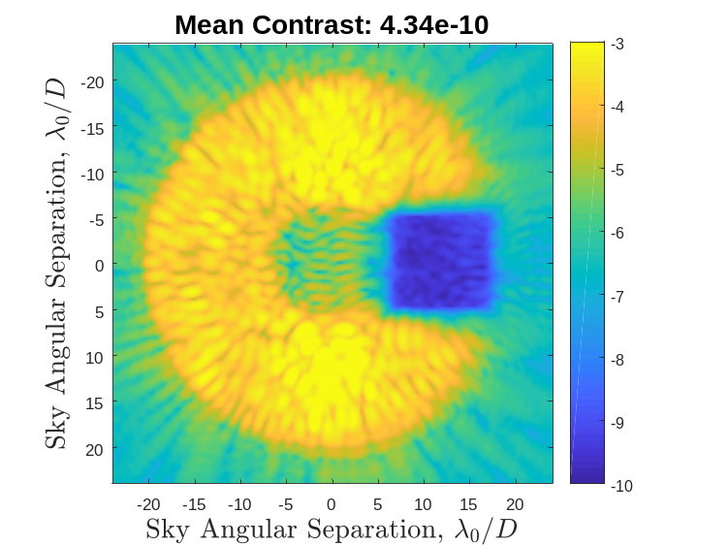
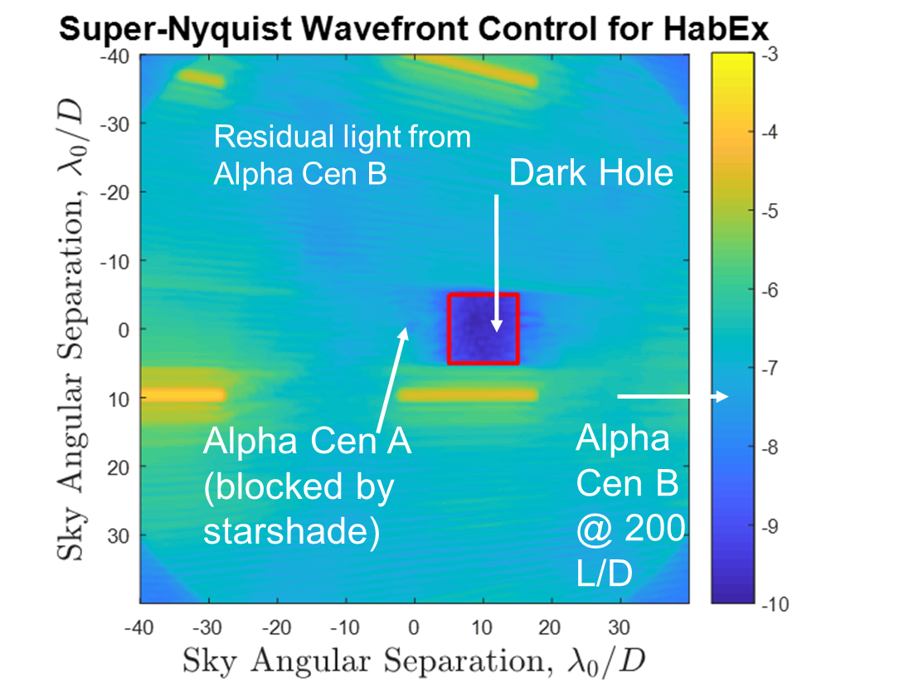
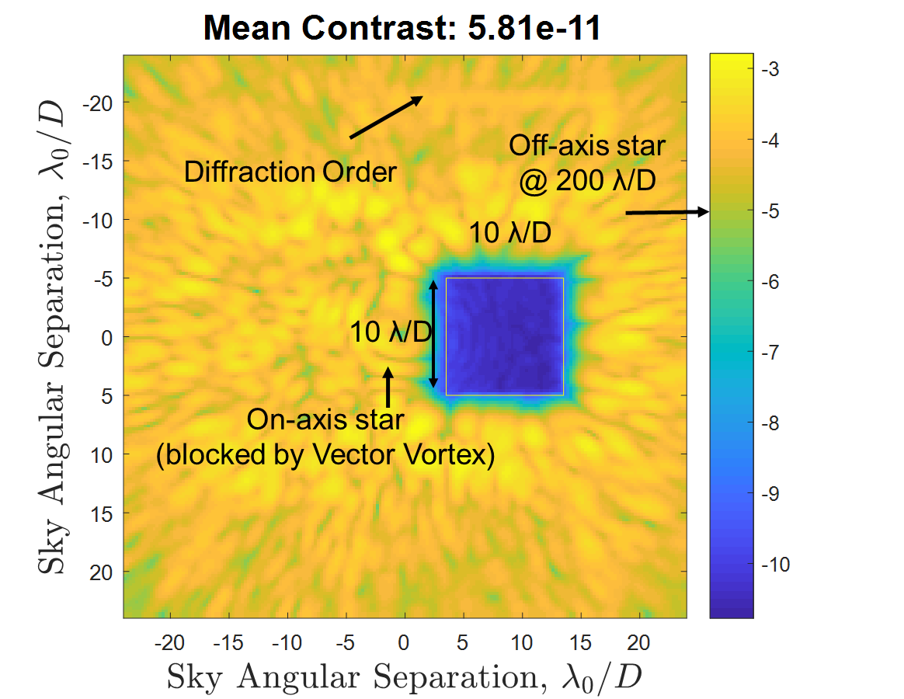
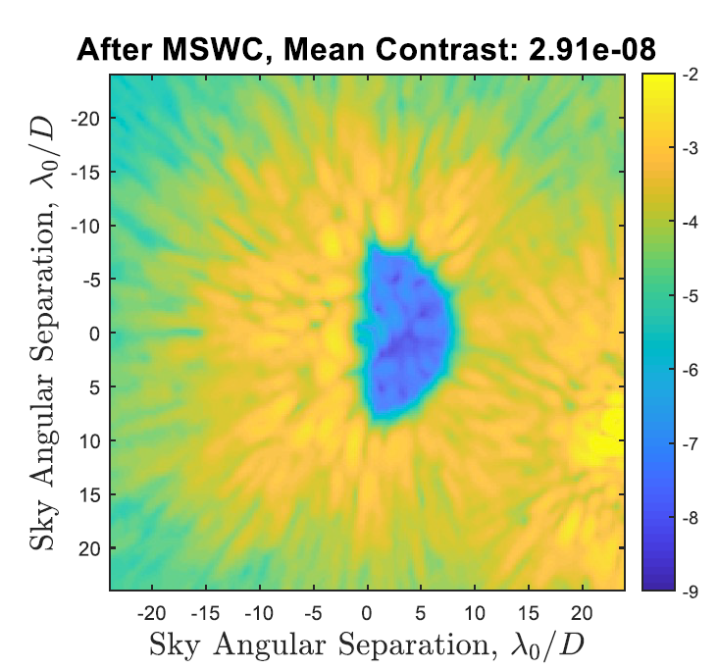
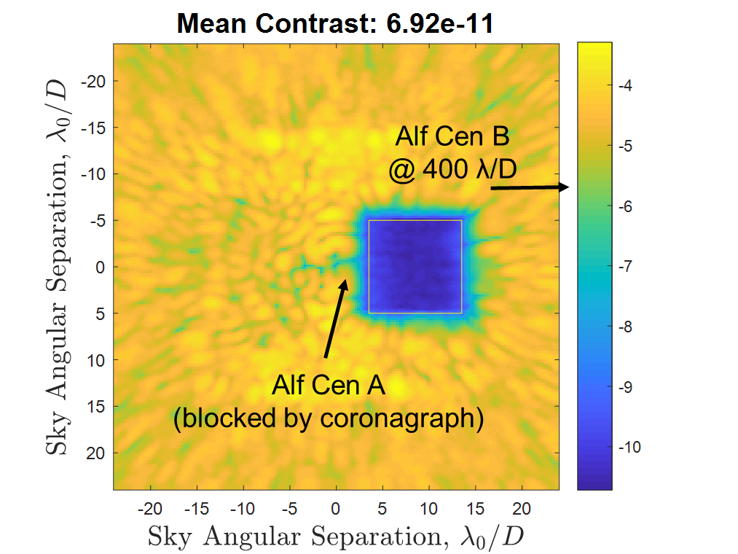
MSWC For Mission Applications (Simulations)
illustration
Roman (with starshade)
Roman (with coronagraph)
Habex (with starshade)
10 λ/D
10 λ/D
Alf Cen A
(blocked by coronagraph
Habex (with VVC)
LUVOIR-B/HWO (with VVC)
PICTURE-D (with VVC)
Castor B
Castor A
(blocked by coronagraph
Sirbu et al.,
SPIE 2019
Notes:
Bruce Macintosh: ~6m is very approximate
Scott Gaudi: most trades should be re-opened

Slide 6
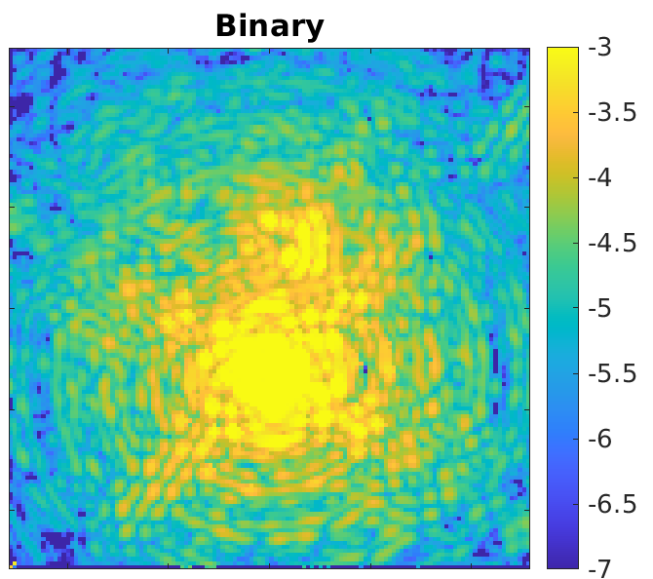
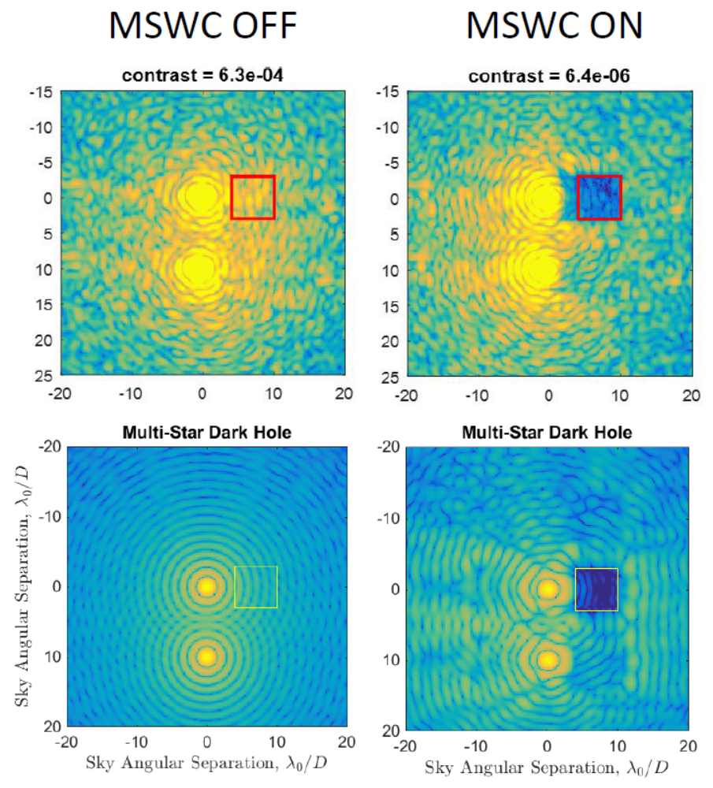
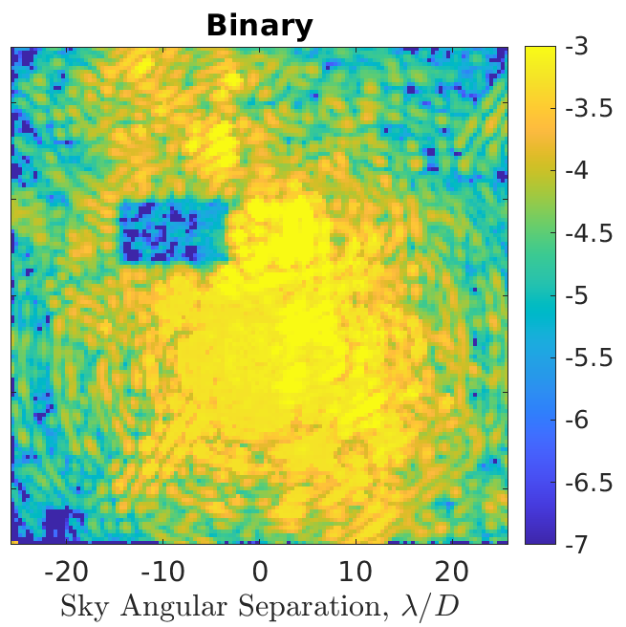
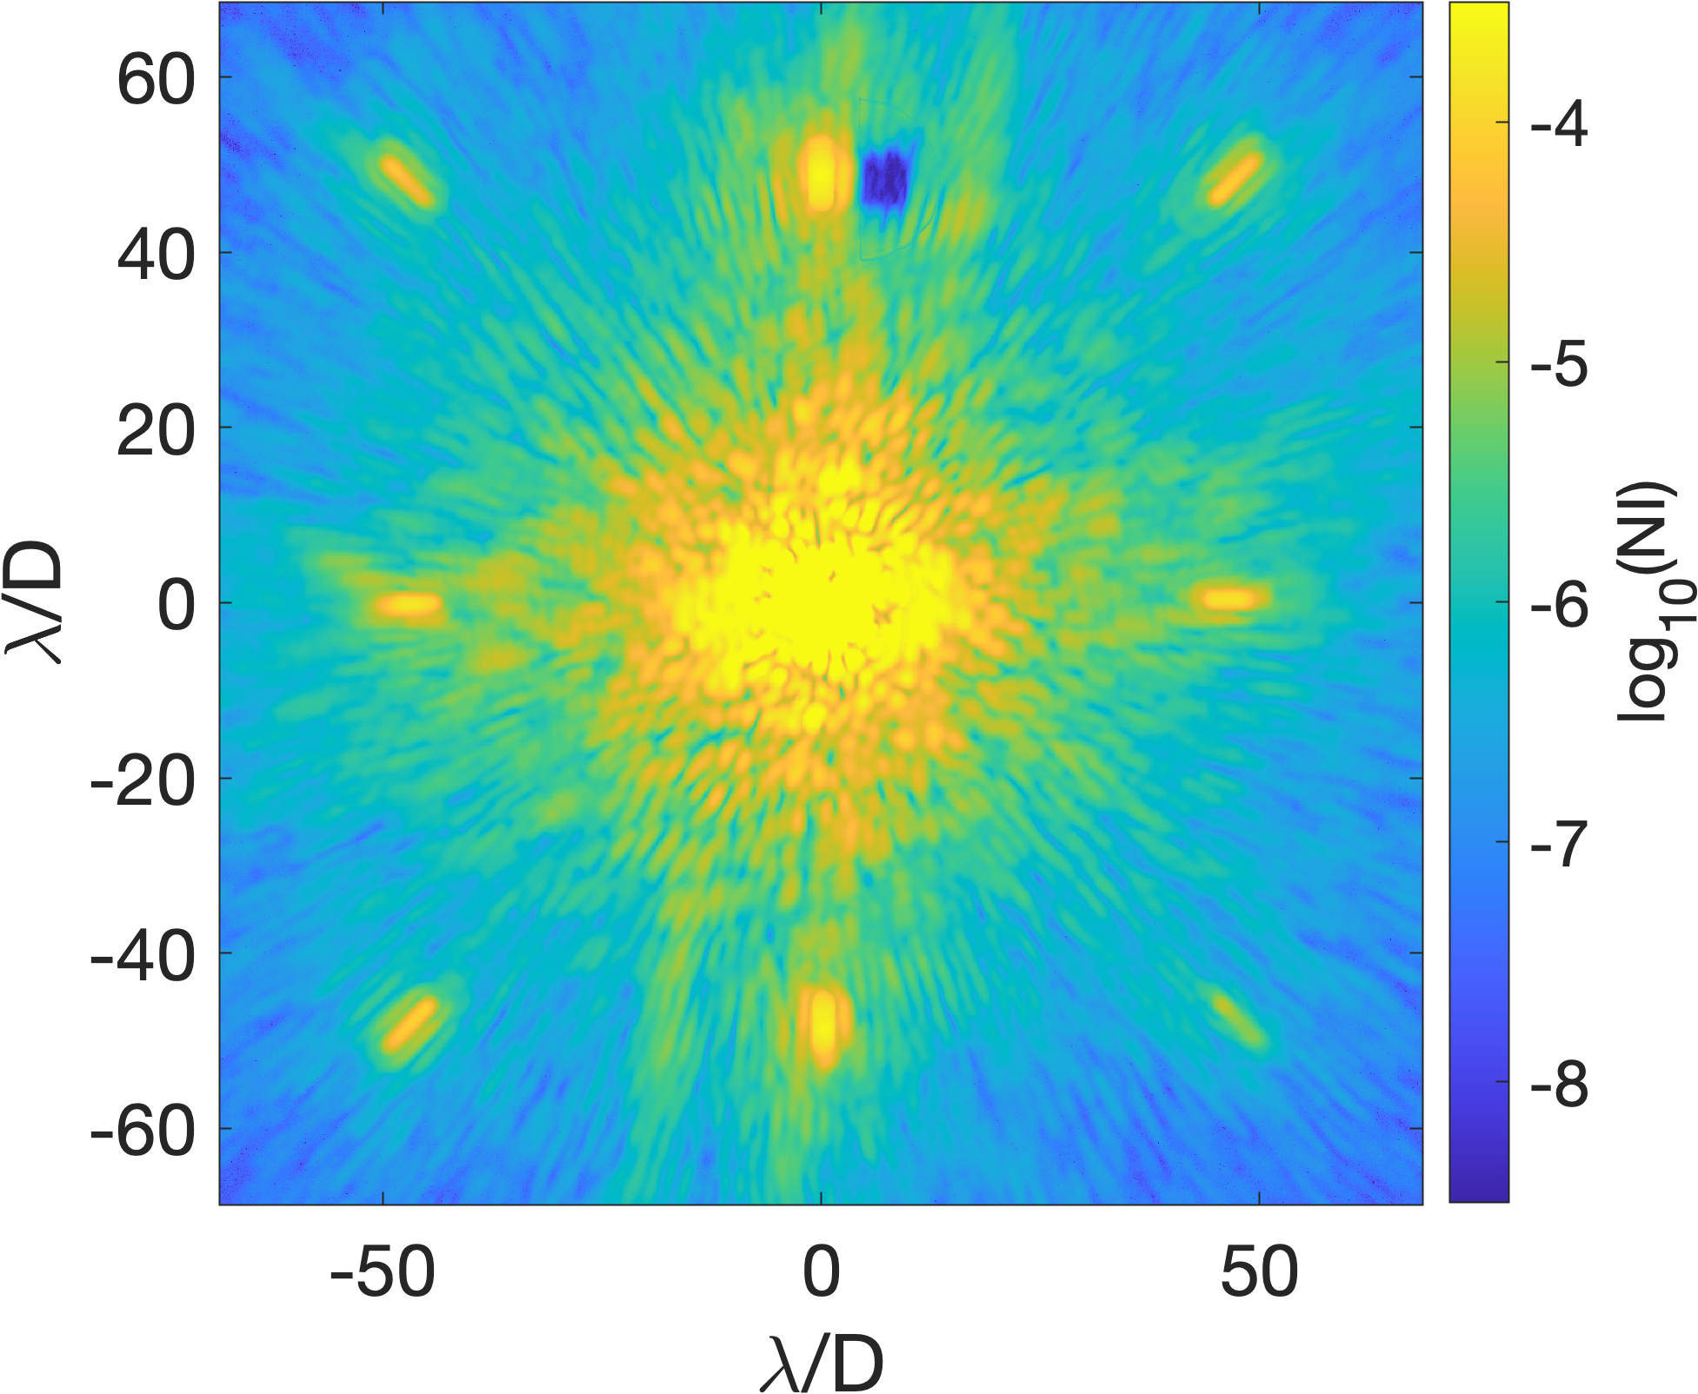
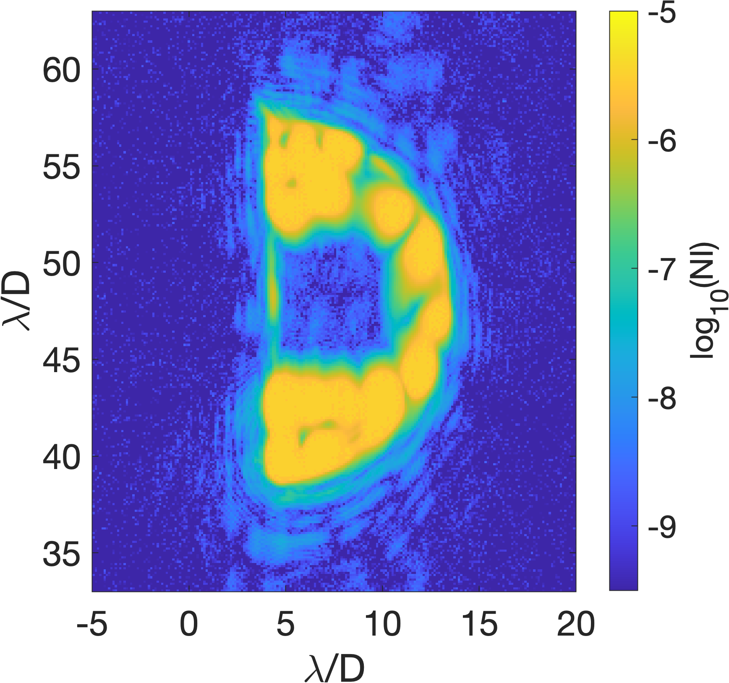
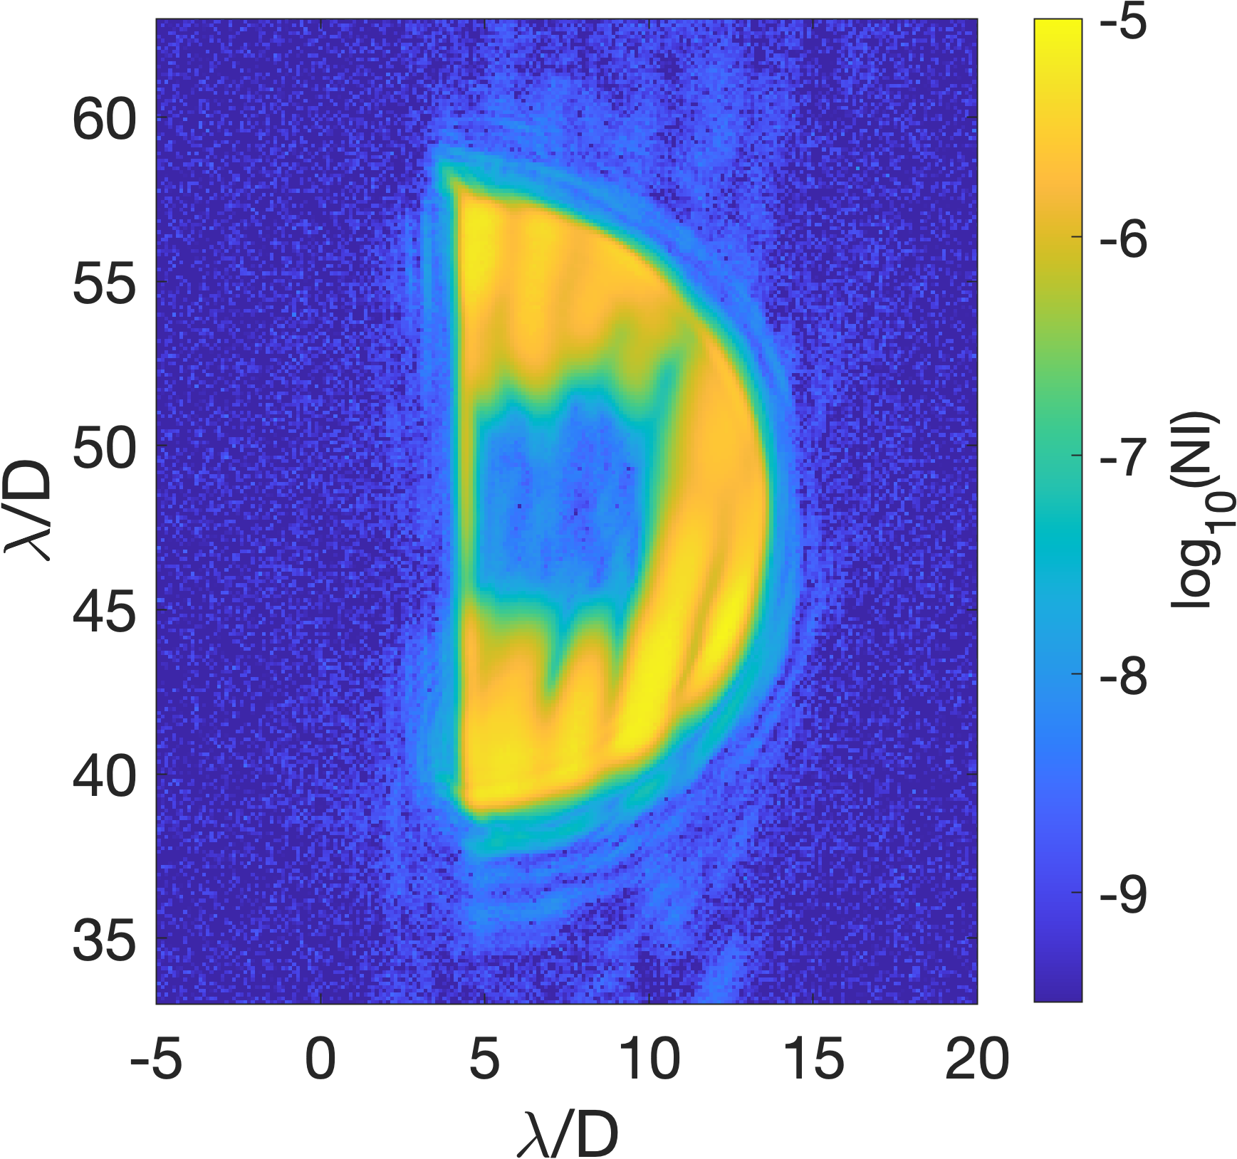
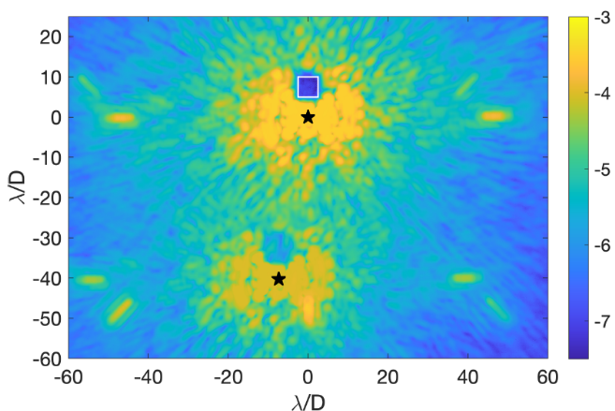
Previous Lab Demonstrations
Conventional (single-star)
Wavefront control
Multi-Star
Wavefront control
illustration
Multi-star laboratory image
(sub-Nyquist, no coronagraph)
(1) MSWC-0 demo at Ames (in-air testbed)
Belikov et al, SPIE 2016
(2) MSWC-0 demo at SCEXAO (internal source)
Pluzhnik et al, SPIE 2021
(3) SNWC and MSWC-s software binary demo at DST HCIT
Riggs et al., SPIE 2021
Primary star
Secondary star
(1)
(2)
Coronagraphic PSF
1% Bandwidth:
1.9e-9 contrast
10% Bandwidth:
8.6e-9 contrast
10% Bandwidth:
9.6e-8 contrast
MSWC solution with “software binary”
Note: images have a D-shaped field stop in place.
(3)
Notes:
Bruce Macintosh: ~6m is very approximate
Scott Gaudi: most trades should be re-opened

Slide 7
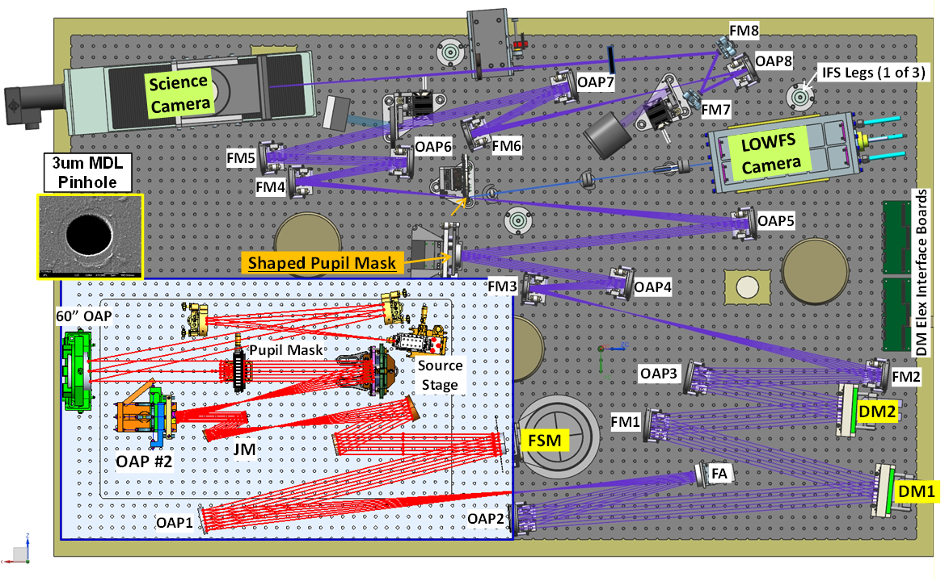
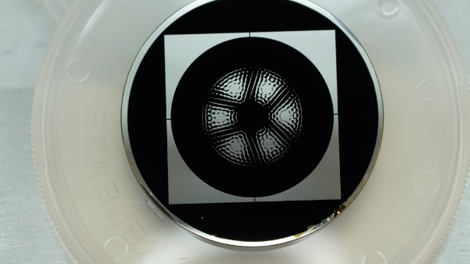
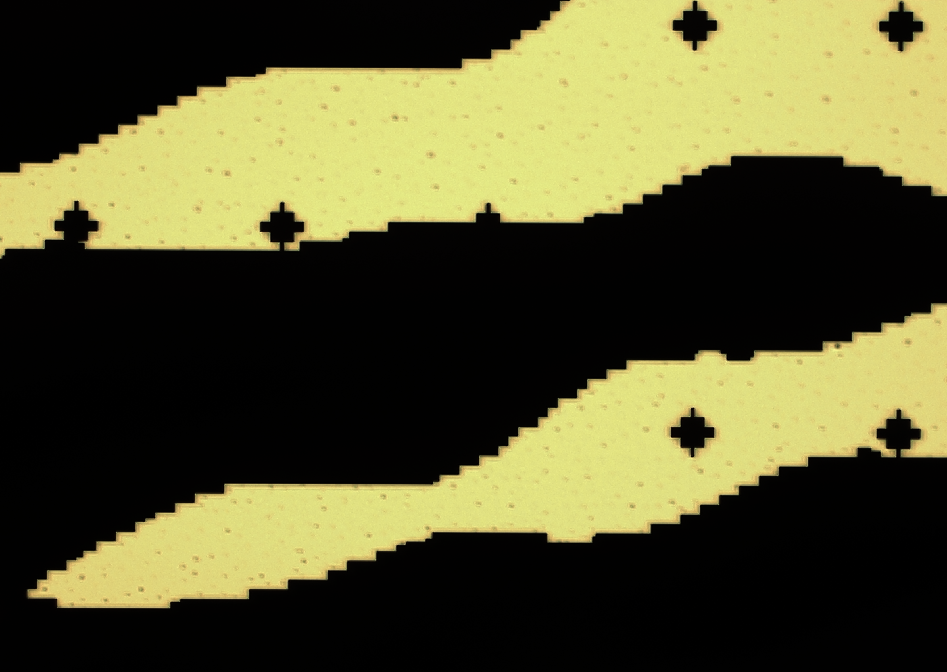
Occulting Mask Coronagraph (OMC) Testbed for Roman
John Hagopian
Planned insertion of binary source assembly
MSWC Shaped Pupil
Same design as Roman MSWC
mask (EXEP-contributed)
Manufactured with carbon nanotubes (by John Hagopian)
Seo et al, SPIE 2018
Microsocope imaging of detail
Notes:
Bruce Macintosh: ~6m is very approximate
Scott Gaudi: most trades should be re-opened

Slide 8
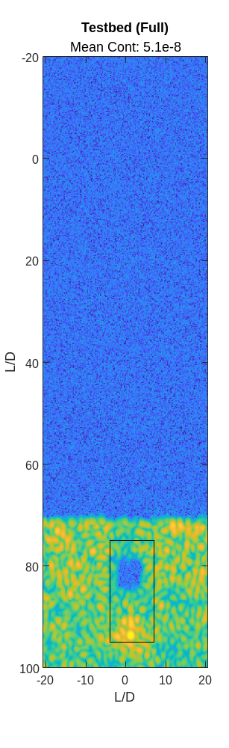
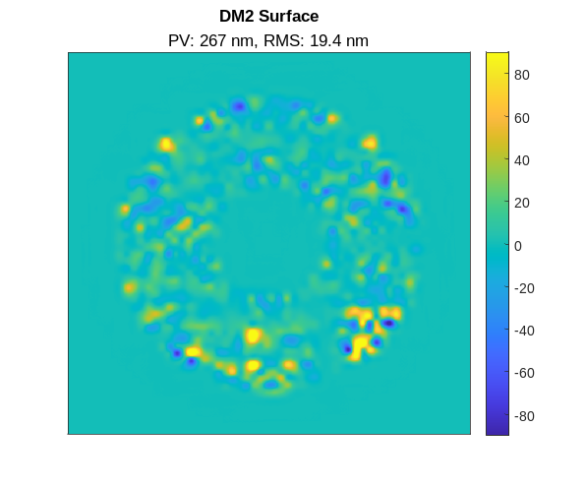
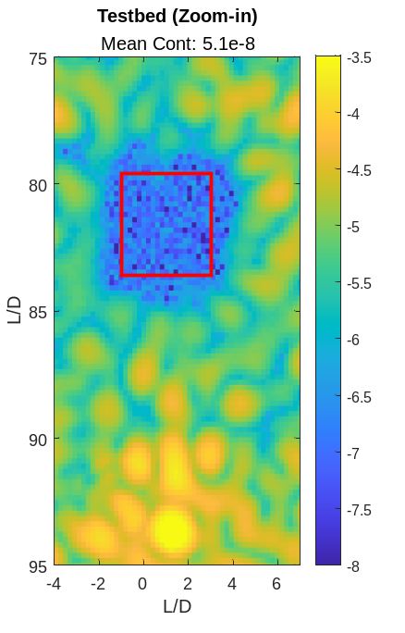
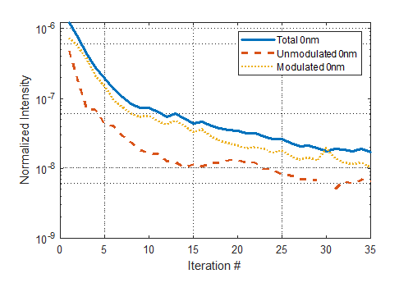
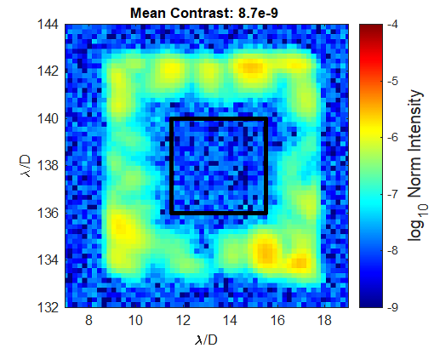
SNWC OMC Testbed Results
Sirbu et al, SPIE 2022
diffraction
Using only 1 DM and applying mild strokes (19.4 nm RMS)
Best total contrast at 2nd diffraction order is 5.1e-8 (~150x suppression of initial speckle field level of 7.6e-6)
Best total contrast at 3rd diffraction order is 8.7e-9 (~200x suppression of initial speckle field level of 1.7e-6)
Central star (behind field stop)
2nd diffraction order
3rd diffraction order
SNWC contrast history
Notes:
Bruce Macintosh: ~6m is very approximate
Scott Gaudi: most trades should be re-opened

Slide 9
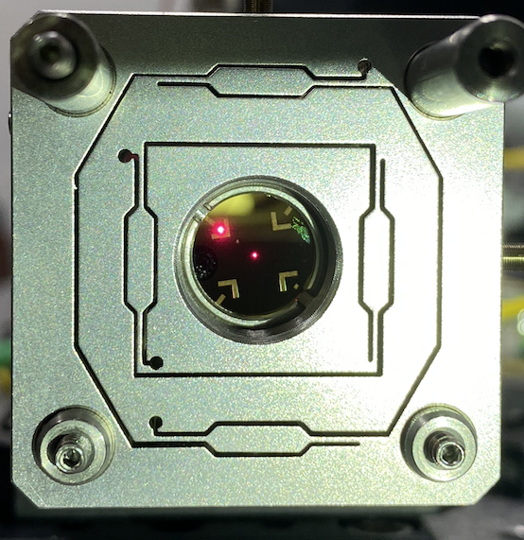
Conclusions
Binary Star Source (Nov. 2022)
  Binary
Binary star targets are important for direct imaging:
Improve science yield and quality of targets
Enable unique binary star science
Alpha Centauri is an unusually favorable outlier
(could potentially enable a large terrestrial planet with Roman coronagraph)
MSWC enables exoplanet imaging around binary stars
- Primarily an algorithm, but benefits from a mild grating in the system
- Selected as a contributed mode on Roman & Compatible with Habitable Worlds Observatory
TRL ~4 lab demonstrations at ACE, SCExAO, and HCIT
Best previous SNWC contrasts achieved in vacuum were around the 1st diffraction order (in single-star super-Nyquist mode): 1.9e-9 in monochromatic light, 8.6e-9 in 10% band
OMC demonstrations validated Roman MSWC mask design in vacuum and achieved 5.1e-8 SNWC contrast (2nd diffraction order), and 9.6e-9 (3rd diffraction order) in monochromatic
Recently installed binary star source will enable full MSWC demonstrations for Roman
Tech demonstrations on-sky with PICTURE-D and Roman will mature and reduce risk for Habitable Worlds Observatory
Off-axis
star
Eduardo Bendek
On-axis
star
Notes:
Bruce Macintosh: ~6m is very approximate
Scott Gaudi: most trades should be re-opened

