Slide 1


Stagnation Point Convective Heating Correlations for Entry into H₂/He Atmospheres
Alex T. Carroll
AMA at NASA Ames Research Center
Aaron M. Brandis
NASA Ames Research Center
January 23rd, 2023
Notes:
Hello, my name is Alex Carroll, and in this presentation, I will be giving an overview of the work I have done with Dr. Aaron Brandis from the NASA Ames Research Center on “Stagnation Point Convective Heating Correlations for Entry into H2/He Atmospheres”.

Slide 2
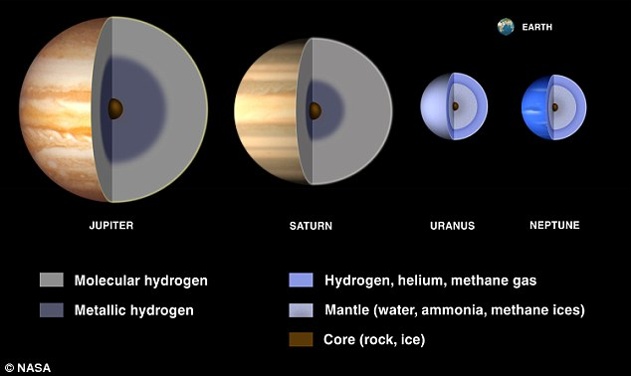
Introduction
2023-2032 planetary science decadal survey [1] identified probe missions to gas/ ice giants as priorities
Atmospheres composed primarily of H₂/He
Design of TPS requires accurate predictions of heating rates
CFD performed over large range of entry conditions to develop heating correlations
  Focus on Neptune, Saturn, and Uranus
  Limited to correlations of convective heating
[2]
[1] Origins, Worlds, and Life: A Decadal Strategy for Planetary Science and Astrobiology 2023-2032, The National Academies Press, 2022.
[2] JPL/Caltech, based on material from the Lunar and Planetary Institute
Notes:
Recent investigations of entry flows into the ice and gas giants have been motivated by the high-priority listing of Saturn and Uranus probe missions in both the 2013-2022 and 2023-2032 decadal surveys for planetary exploration [1, 2].
The atmospheres of these planets are primarily composed of molecular hydrogen (H2) and helium (He), with other trace species such as methane (CH4) [3, 4].
Mission design and trajectory studies for these probe missions rely on accurate predictions of the heat fluxes encountered by these vehicles upon hypersonic entry.
So, in this study, CFD calculations were performed over a large range of entry conditions to develop updated convective heating correlations for H2/He atmospheres.
The focus of this study is on entry environments for Neptune, Saturn, and Uranus, as these are the destinations investigated in the decadal survey, and the results presented here are limited to correlations of convective heat flux, and do not include predictions of radiative heat fluxes.

Slide 3
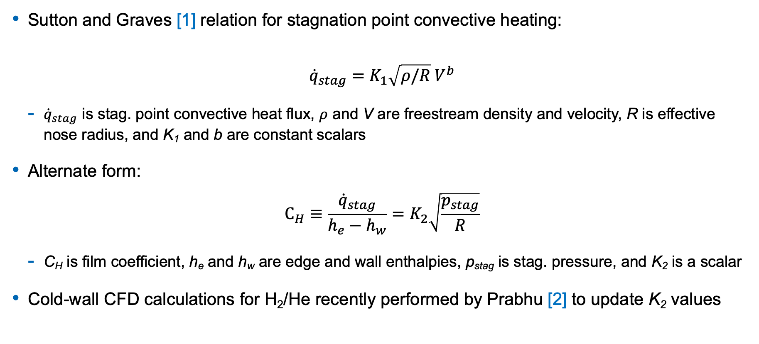
Existing Correlations
Sutton and Graves [1] relation for stagnation point convective heating:
$${\dot{q}}_{stag}=K_{1}\sqrt{ρ/R} V^{b}$$
  ${\dot{q}}_{stag}$ is stag. point convective heat flux, $ρ$ and V are freestream density and velocity, R is effective nose radius, and K₁ and b are constant scalars
Alternate form:
$$C_{H}≡\frac{{\dot{q}}_{stag}}{h_{e}−h_{w}}=K_{2}\sqrt{\frac{p_{stag}}{R}}$$
  C_{H} is film coefficient, h_{e} and h_{w} are edge and wall enthalpies, p_{stag} is stag. pressure, and K₂ is a scalar
Cold-wall CFD calculations for H₂/He recently performed by Prabhu [2] to update K₂ values
[1] Sutton, K., and Graves, R. A., 1971.
[2] Prabhu, D. K., FAR2019, Monopoli, Italy, 2019.
Notes:
One of the most commonly used correlations for convective heating was developed by Sutton and Graves in 1971. This relation is given at the top of this chart, where qstag is the stagnation point convective heat flux, rho and V are the free stream density and velocity respectively, R is the effective nose radius, and K1 and b are constant scalars.
This relation can equivalently be written in the alternate form given in the middle of this chart, which can be used to directly compute film coefficients. Here, CH is the film coefficient, he and hw are the boundary layer edge and wall enthalpies respectively, pstag is the stagnation pressure, and K2 is a constant scalar.
Recently, high-fidelity cold wall CFD calculations for H2/He entry flows were performed by Prabhu [14], and the results were fit to this relation to compute updated 𝐾2 values.
While a cold wall temperature boundary condition is convenient because it does not rely on any information about specific material properties or require any material response calculations, it can lead to less realistic gas transport properties, thereby affecting estimates of convective heat fluxes.
Therefore, to increase the range of applicability for the correlations and to provide hot wall heat flux estimates, updated correlations based on a comprehensive range of H2/He entry conditions were computed in this study using both a cold wall and a hot wall boundary condition.

Slide 4
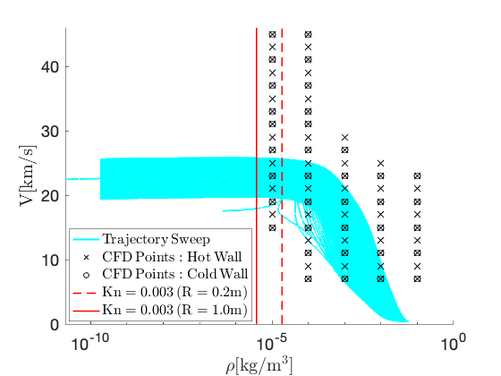
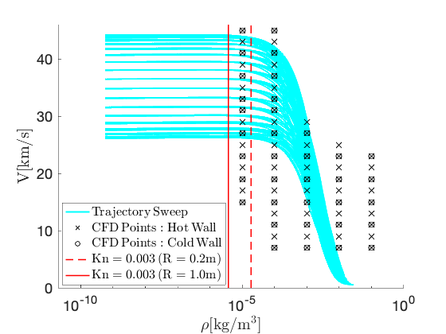
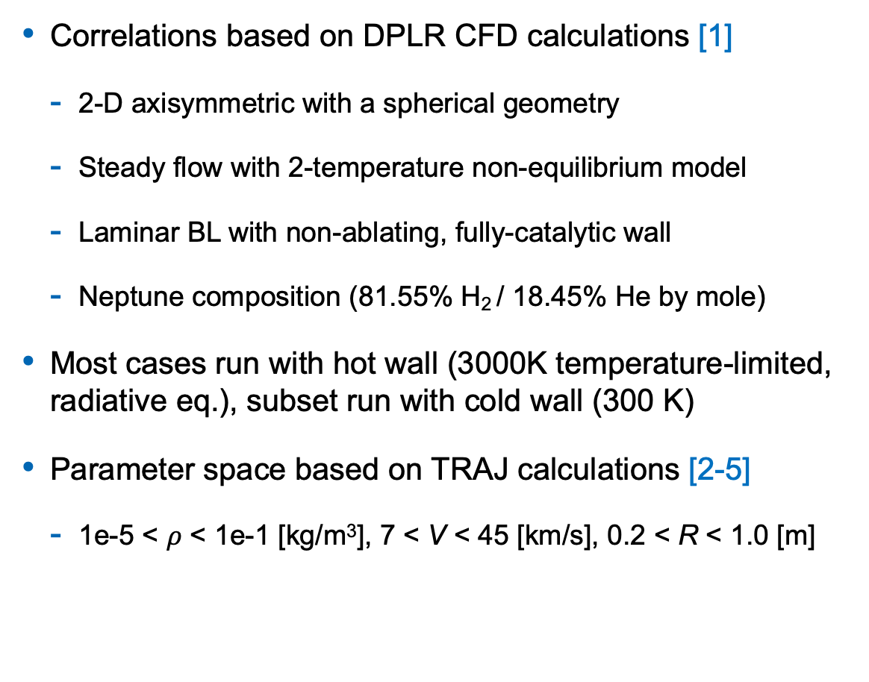
Methodology
Correlations based on DPLR CFD calculations [1]
  2-D axisymmetric with a spherical geometry
  Steady flow with 2-temperature non-equilibrium model
  Laminar BL with non-ablating, fully-catalytic wall
  Neptune composition (81.55% H₂ / 18.45% He by mole)
Most cases run with hot wall (3000K temperature-limited, radiative eq.), subset run with cold wall (300 K)
Parameter space based on TRAJ calculations [2-5]
  1e-5 < $ρ$ < 1e-1 [kg/m³], 7 < V < 45 [km/s], 0.2 < R < 1.0 [m]
Neptune
Saturn
[1] Wright, M., White, T., and Mangini, N. L., 2009.
[2] Allen Jr., W. M., G., and Gage, P., Tech. Rep. NASA TM 2005-212847, 2005.
[3] Hwang, H. H., Laurel, MD, 2018.
[4] Alpert, H. S., et al., LPI Contributions, Vol. 2686, 2022, p. 4012.
[5] Monk, J. D., et al., LPI Contributions, Vol. 2686, 2022, p. 4040.
Notes:
The updated correlations developed in this study are based on flowfield calculations produced using the data parallel line relaxation, or DPLR CFD code.
For all cases in this study, the flow field was assumed to be in a steady state with thermochemical non-equilibrium modeled using the two-temperature model. Solutions were computed as 2-D axisymmetric simulations for a spherical geometry.
As mentioned previously, most cases were run with a hot wall, or temperature-limited, radiative equilibrium BC, however, a subset of cases was also run with a cold wall boundary condition.
All cases in the parameter space for this study were computed using the atmospheric composition of Neptune at 81.55% H2 and 18.45% He (by mole). However, a sensitivity analysis was also performed to allow for the correlations developed in this study to be extended to varying H2/He atmospheric compositions. This sensitivity analysis will not be discussed here in the interest of time, but is discussed in section 5 of the paper.
The bounds of the parameter space were chosen to approximately cover the entire range of freestream conditions that were encountered in comprehensive trajectory sweeps computed using the trajectory code, TRAJ, as parts of recent investigations of Neptune, Saturn, and Uranus entry probe design studies. The density was varied from 1e-5 to 1e-1 kg/m3, velocity from 7 to 45 km/s, and nose radii from 0.2 to 1 m.
The figures at the bottom of this chart show the CFD parameter space points for both the hot wall and cold wall cases overlayed on top of the aforementioned trajectory sweeps for Neptune and Saturn.

Slide 5
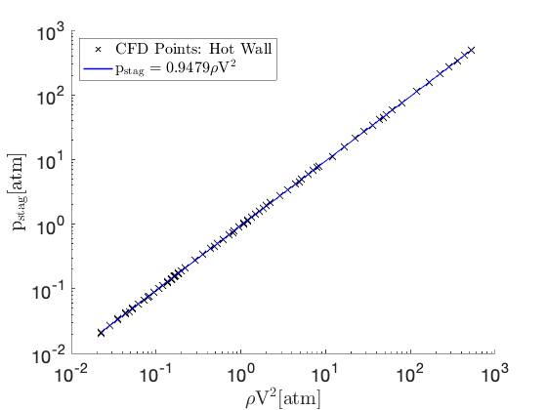
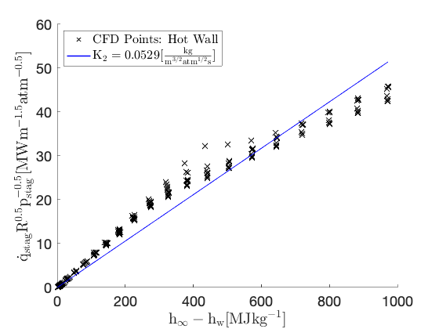
Simulation Results: Hot Wall Cases
Expected linear trend observed between freestream dynamic pressure and stag. pressure
Scaled heat flux did not follow expected linear trend of a constant K₂ value
  K₂ decreases as enthalpy increases
Notes:
The results of the CFD calculations are summarized in the two figures at the bottom of this chart, which show the scaled heat flux plotted as a function of the difference in freestream and wall enthalpies with corresponding linear fits in the solid blue lines.
The results are presented in this manner as the slope of the best fit linear curve through the CFD data points in these plots directly corresponds to the 𝐾2 scalar value for the Sutton-Graves correlation discussed previously.
From these plots, it is clear that the CFD data for both the hot and cold wall cases do not follow the expected linear trend of a constant 𝐾2 value from the Sutton-Graves relation. Instead, the slope of the CFD data points in these plots and therefore the 𝐾2 values decrease as the enthalpy increases.
Plotting the previous correlation by Prabhu for the cold wall cases, it was found that this correlation gave reasonable estimates of the heat flux for interpolated values with enthalpies less than 350 MJ/kg. However, when extrapolated, as shown by the dashed portions of the curves in the right figure, the relations over-predicted the CFD computed heat flux values.

Slide 6
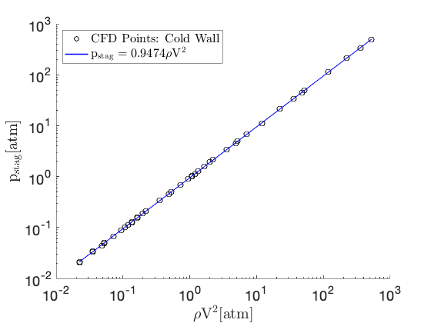
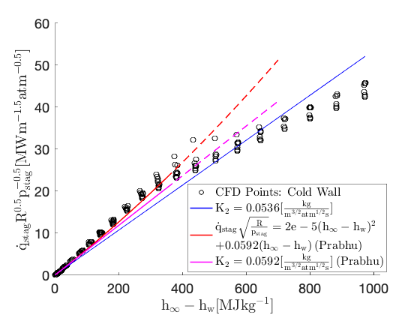
Simulation Results: Cold Wall Cases
Cold wall results display similar trends to those of the hot wall cases
  Expected linear trend for stagnation pressure, but not for scaled heat flux
Correlation by Prabhu overpredicts cold wall heat flux when extrapolated

Slide 7
Simulation Results: Cold Wall Cases
Cold wall results display similar trends to those of the hot wall cases
  Expected linear trend for stagnation pressure, but not for scaled heat flux
Correlation by Prabhu overpredicts cold wall heat flux when extrapolated
Scalar K₂ value is not able to predict convective heating across entire parameter space
Notes:
Ultimately, these results illustrate that a scalar K2 values is not able to predict convective heating accurately across the entire parameter space of interest.

Slide 8
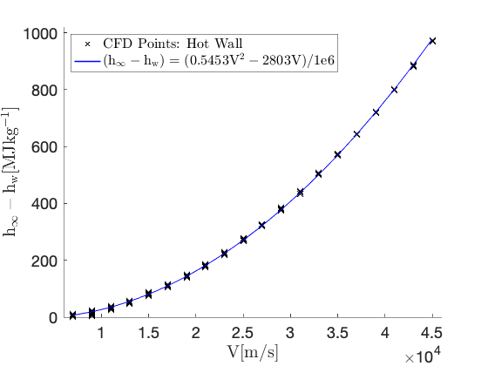
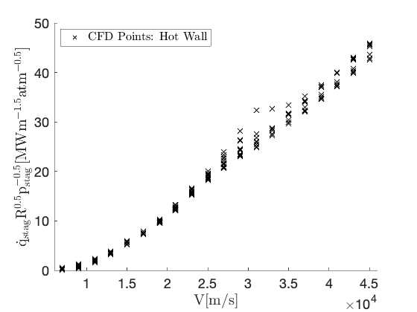
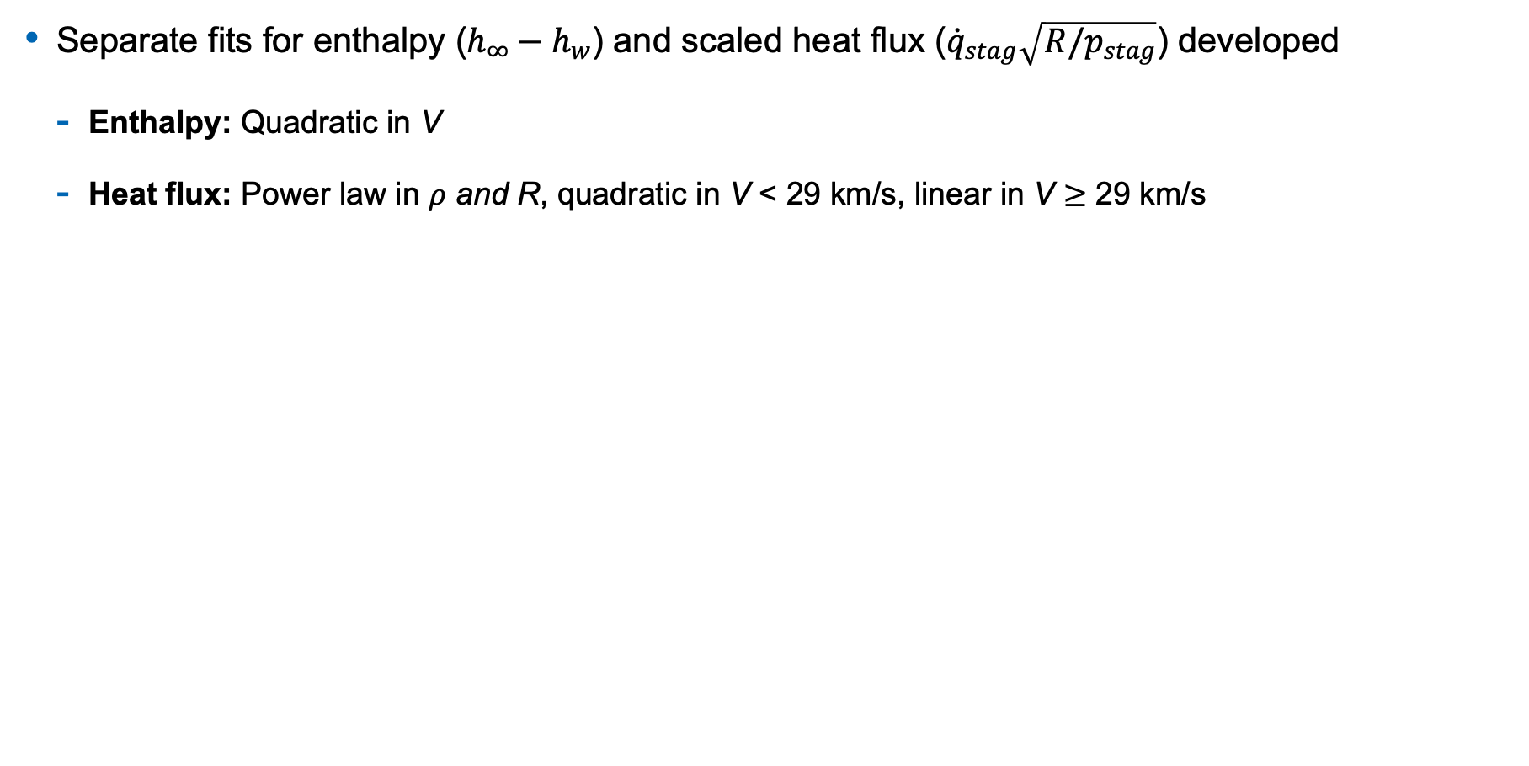
Simulation Results: Updated Correlations for K₂
Separate fits for enthalpy ($h_{∞}−h_{w}$) and scaled heat flux (${\dot{q}}_{stag}\sqrt{R/p_{stag}}$) developed
  Enthalpy: Quadratic in V
  Heat flux: Power law in $ρ$ and R, quadratic in V < 29 km/s, linear in V $≥$ 29 km/s
Notes:
Therefore, to allow for accurate estimates of stagnation point convective heat fluxes, a correlation was developed for the prediction of non-constant 𝐾2 values. This was done by first developing accurate fits of the scaled heat flux values and difference in freestream and wall enthalpy values separately, then getting estimates of 𝐾2 by taking the ratio of these respective fits.
For enthalpy, it was found that a quadratic fit in velocity was able to reproduce the CFD data accurately. For the scaled heat flux, a power law relation was used in density and nose radii, while either a quadratic of linear fit was used for velocity based on whether the velocity was less than or greater than 29 km/s. Further details on these fits are given in section 4c of the paper.

Slide 9
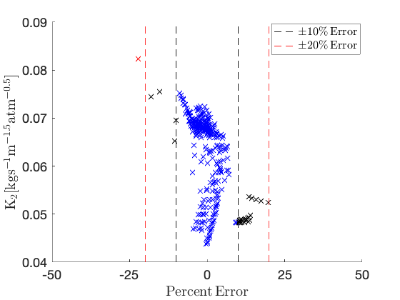
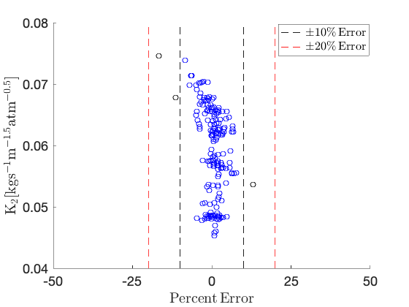
Simulation Results: Updated Correlations for K₂
Estimates of K₂ then computed by taking the ratio of enthalpy and scaled heat flux fits
Resulting K₂ estimates had errors < 10% for 91.9% of hot wall and 98.3% of cold wall cases
Hot Wall
Cold Wall
$$Percent Error=(K_{2,fit}−K_{2,CFD})/K_{2,CFD}×100$$
Notes:
The plots at the bottom of this chart show the corresponding error for these correlations, where percent error is computed as the difference in K2 values between the fits and CFD, divided by the CFD K2 value, as given in the relation at the very bottom of this chart.
These plots show that the fits for 𝐾2 provide accurate predictions of the corresponding CFD values across the entire parameter space of interest. For both the hot wall and cold wall cases, the majority of CFD data points fell within a 10% error margin.

Slide 10
Simulation Results: Updated Correlations for K₂
Estimates of K₂ then computed by taking the ratio of enthalpy and scaled heat flux fits
Resulting K₂ estimates had errors < 10% for 91.9% of hot wall and 98.3% of cold wall cases
Hot Wall
Cold Wall
Updated correlations provide accurate predictions of K₂ values across entire parameter space
$$Percent Error=(K_{2,fit}−K_{2,CFD})/K_{2,CFD}×100$$

Slide 11
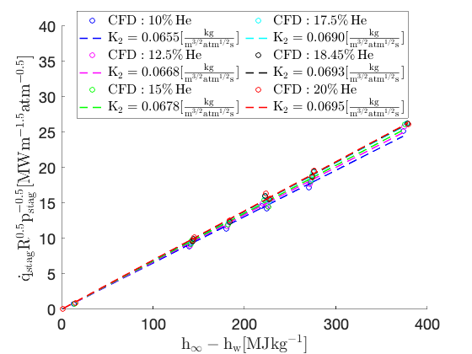
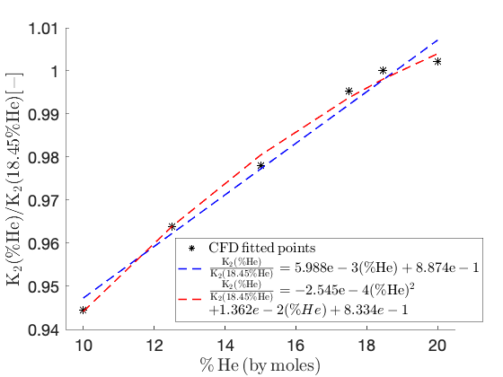
Sensitivity to Atmospheric Composition
10 additional CFD cases run for 5 different atmospheric compositions
  6 cases near peak heating, 2 cases each near beginning and end of nominal trajectories
  Compositions varied from 10% to 20% He by mole (covers Saturn, Uranus, and Neptune)

Slide 12
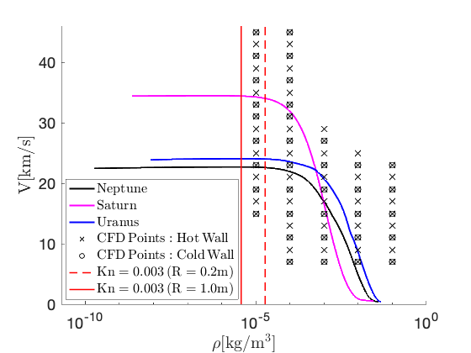
Test Cases: Setup
One test case each for Neptune, Saturn, and Uranus
K₂ computed in 5 ways:
  Baseline TRAJ correlation
  Hot and cold wall correlations
  Tabulated hot and cold wall cases
K₂ then used to compute C_{H} values
FIAT [1] used to compute heat fluxes, heat loads, and TPS thickness
  TPS material: 3MDCP
[1] Chen, Y.-K., and Milos, F. S., Journal of Spacecraft and Rockets, Vol. 36, 1999, pp. 475–483.
Notes:
Finally, to compare the updated correlations developed in this study to the correlation currently employed in the trajectory code TRAJ (which is based on the calculations by Prabhu), stagnation point convective heat fluxes were computed for three different test trajectories.
One test trajectory each was chosen for Neptune, Saturn, and Uranus, and the path of these trajectories through the 𝑉, 𝜌 parameter space is shown in the figure on the right of this chart.
For each of these three trajectories, 𝐾2 values were computed in five ways: using the baseline TRAJ correlation, using the hot and cold wall correlations discussed on the previous slide, and using a tabulated approach for the hot and cold wall CFD cases. The tabulated values of 𝐾2 were computed to serve as a more direct comparison of the correlations to the CFD computed values, as the tabulated 𝐾2 values are exact for trajectory query points that lie directly on the computed CFD points.
Corresponding film coefficient (𝐶𝐻 ) values were then computed from the predicted 𝐾2 values using the Sutton-graves relation.
Additionally, to assess the impact of these different film coefficient predictions on TPS sizing, the material response code, FIAT [22], was used to compute corresponding heat fluxes, heat loads, and required TPS thicknesses for a 3-D Mid Density Carbon Phenolic (3MDCP) heat shield.

Slide 13
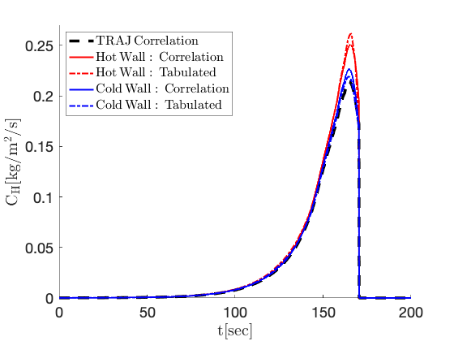
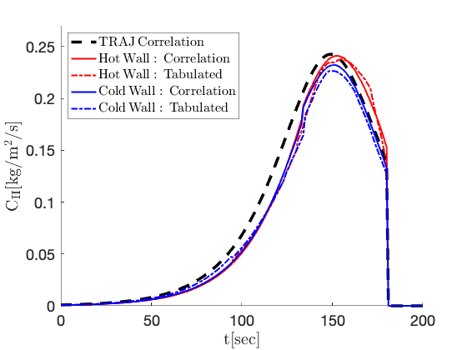
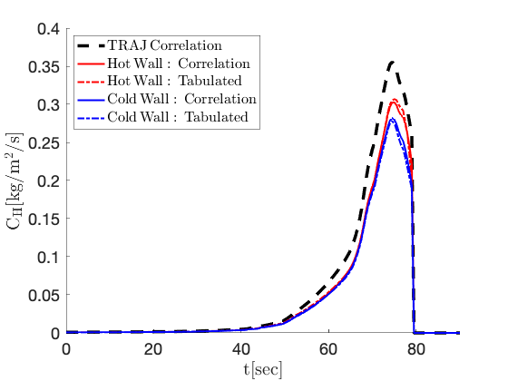
Test Cases: Film Coefficient Predictions
Hot wall estimates of C_{H} were consistently higher than cold wall estimates
Both hot and cold wall correlations were in good agreement with tabulated values
Updated correlations did not consistently under- or over-predict C_{H} of TRAJ
Neptune
Saturn
Uranus
Notes:
The corresponding plots of the film coefficient, CH, for each of the three tests cases is shown at the bottom of this chart.
For all three test cases it was found that the hot wall estimates of the film coefficient were consistently higher than the corresponding cold wall estimates. Additionally, it was found that for both the hot and cold wall cases the correlations predicted values of the film coefficient that were in good agreement with the tabulated values.
More interestingly however, it was found that the updated correlations did not necessarily consistently under- or over-predict the film coefficient values of the TRAJ correlation.
For the Neptune test case, the cold wall correlation was in good agreement with the TRAJ correlation, however, the hot wall correlation predicted a maximum 𝐶𝐻 value that was 17.1% higher than the TRAJ correlation.
For the Saturn test case, predicted maximum 𝐶𝐻 values were comparable between the TRAJ, hot wall, and cold wall correlations.
Finally, for the Uranus test case, both the hot wall and cold wall correlations under-predicted the maximum 𝐶𝐻 values of the TRAJ correlation by 14.6% and 20.6% respectively.

Slide 14
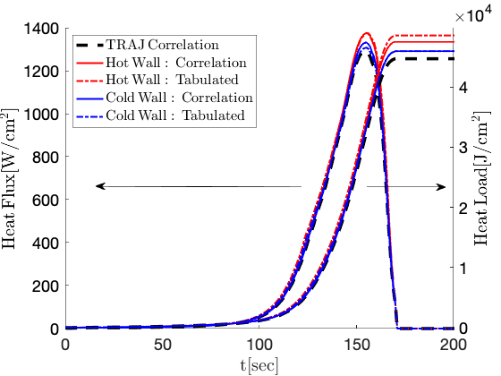
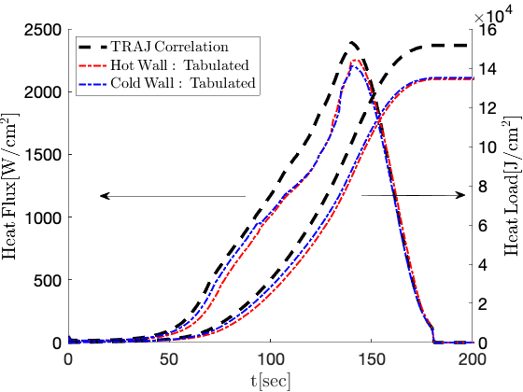
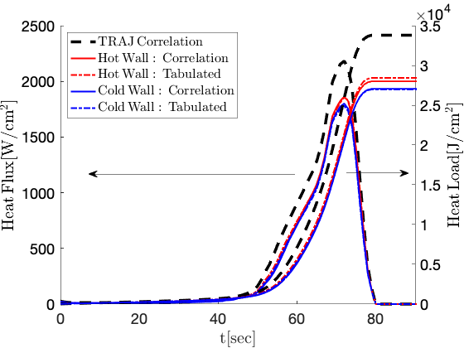
Test Cases: Heat Flux, Heat Load, and TPS Sizing
Neptune: negligible differences between new relations and TRAJ correlation
Saturn and Uranus: new relations under-predicted TRAJ heating values
  Decrease in TPS sizing of 12% for Saturn and 4% for Uranus
Neptune
Saturn
Uranus
Notes:
The plots at the bottom of this chart show the FIAT computed heat fluxes and integrated heat loads on the left and right axes respectively for the Neptune, Saturn, and Uranus test cases.
For the Neptune test case, the plotted values show that the differences in predicted heat flux and heat load between the new correlations when compared to the TRAJ correlation are fairly negligible. This was also reflected in the TPS sizing, where the differences between the new predictions of TPS thickness when compared to that of the TRAJ correlation were all within 1.5%.
The other two figures however, show that there are substantial differences between the new relations and the TRAJ correlation for the Saturn and Uranus test cases. For both of these test cases, it was found that while the predicted heat flux and heat load values were mostly comparable between the hot wall and cold wall correlations and tabulations, the new relations all under-predicted the heating values computed by the TRAJ correlations.
This led to a decrease in the TPS sizing by approximately 12% and 4% respectively for the Saturn and Uranus test cases when compared to the TRAJ correlation.

Slide 15
Conclusions
Updated H₂/He convective heating correlations developed using high-fidelity CFD results
Trends in CFD data were not well predicted by standard method of Sutton-Graves
  Slope between scaled heat fluxes and enthalpies was not constant
Non-linear correlations for K₂ were developed for both hot and cold wall cases
Updated correlations compared to TRAJ correlation for Neptune, Saturn, and Uranus test cases
  Negligible difference in TPS sizing for Neptune
  Decrease in TPS thickness for Saturn and Uranus by 12% and 4% respectively
Notes:
In conclusion, updated correlations for convective heating were developed over a large range of entry conditions into H2/He atmospheres using high-fidelity CFD simulations. The results of these simulations showed that the trends in the convective heating were not well predicted by the standard method of Sutton and Graves with a constant slope (or 𝐾2 value) between the scaled heat fluxes and enthalpies.
To address this deviation from the method of Sutton and Graves, separate non-linear correlations were developed for cases run with a hot wall and a cold wall boundary condition.
These updated correlations were then used to predict heat fluxes, heat loads, and required TPS thicknesses for three test cases in the Neptune, Saturn, and Uranus atmospheres.
While it was found that there was a negligible difference in TPS sizing for the Neptune test case when compared to the correlation implemented in TRAJ, required TPS thicknesses were approximately 12% and 4% smaller for the Saturn and Uranus test cases respectively.

Slide 16


Acknowledgements
This work was supported under an ESTRAD contract from the NASA Ames Research Center to AMA, Inc.
The authors would like to thank:
  Hannah Alpert (NASA Ames) and Joshua Monk (NASA Ames) for providing trajectory data and performing FIAT calculations
  Brett Cruden (AMA) and Jeffrey Hill (NASA Ames) for useful discussions and suggestions
Notes:
This work was supported under an ESTRAD contract from the NASA Ames Research Center to AMA, Inc.
The authors would like to thank Hannah Alpert and Joshua Monk for providing the trajectory data as well as for performing the FIAT calculations for the test cases presented in this study, as well as Brett Cruden and Jeffrey Hill for useful discussions and suggestions on this work.

