Slide 1
Transformational Tools and Technologies (T³) Project
A Robust Schema for Storing and Managing Machine Learning Data and Models
Brandon L. Hearley, Steven M. Arnold, Joshua Stuckner
NASA Glenn Research Center
2023 AIAA SciTech Forum, January 23-27
Notice for Copyrighted Information
This manuscript is a work of the United States Government authored as part of the official duties of employee(s) of the National Aeronautics and Space Administration. No copyright is claimed in the United States under Title 17, U.S. Code. All other rights are reserved by the United States Government. Any publisher accepting this manuscript for publication acknowledges that the United States Government retains a non-exclusive, irrevocable, worldwide license to prepare derivative works, publish, or reproduce the published form of this manuscript, or allow others to do so, for United States government purposes.

Slide 2
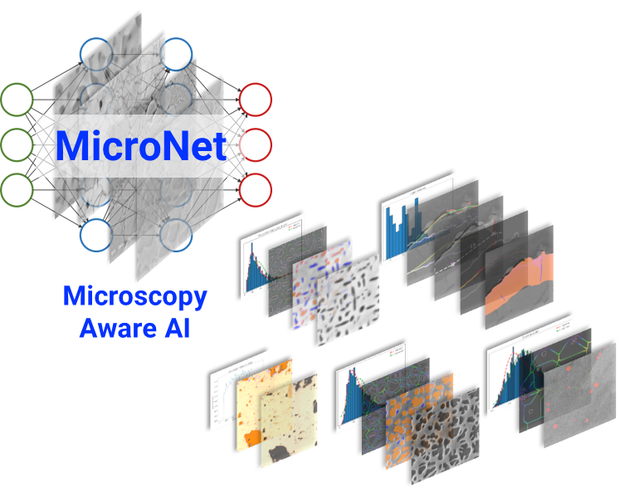

Motivation
Machine Learning (ML) has enabled models
that can improve efficiency and decrease computational cost
ML models are crucial in enabling Integrated Computational Materials Engineering (ICME)
Large data sets require robust means of storing ML data and models
MicroNet: Automatic segmentation of micrographs
NASMAT: Nasa’s Multiscale Analysis Tool used to train ML models

Slide 3

Database Management Best Practices
Best Practices for effective data management:
  Data should be easy to find / searchable
  Full traceability between data creation and model development
  Data should only be defined once and viewed elsewhere
  Access Control
Machine Learning schema presented in the context of Ansys Granta MI database software system
  Relational database for material information
  Overall schema/approach can be applied to any data management system

Slide 4
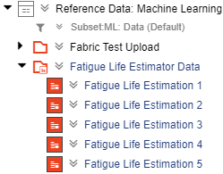
Granta MI Definitions
Table
  Highest level of organization in a database
  All records in the same table have the same schema
Folder
  Similar to computer directory
Record
  Collection of attributes used to define data
Generic Record
  Combination of a folder and record
1
1
2
2
4
3
4
3

Slide 5
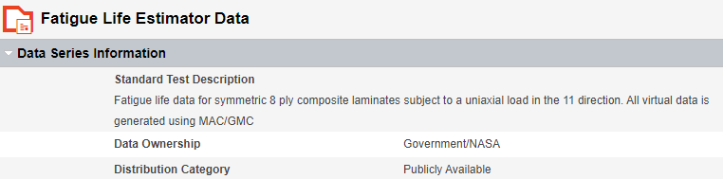
Granta MI Definitions (Continued)
Heading
  Layout organization of the attributes
Attribute
  Populatable field used to describe the data stored
5
6
5
6

Slide 6
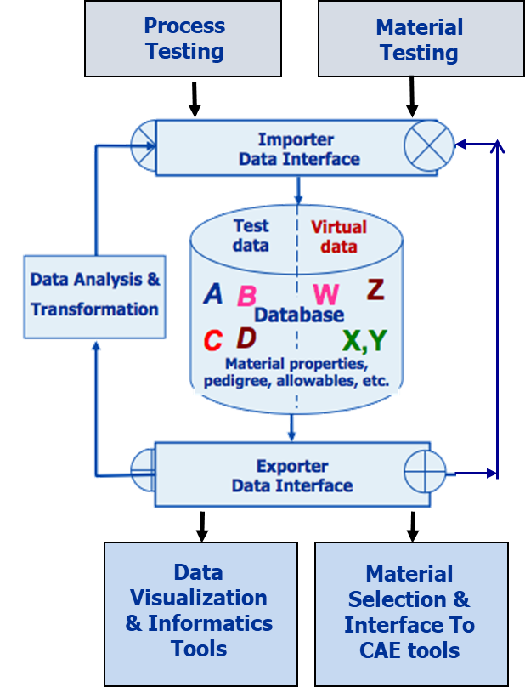
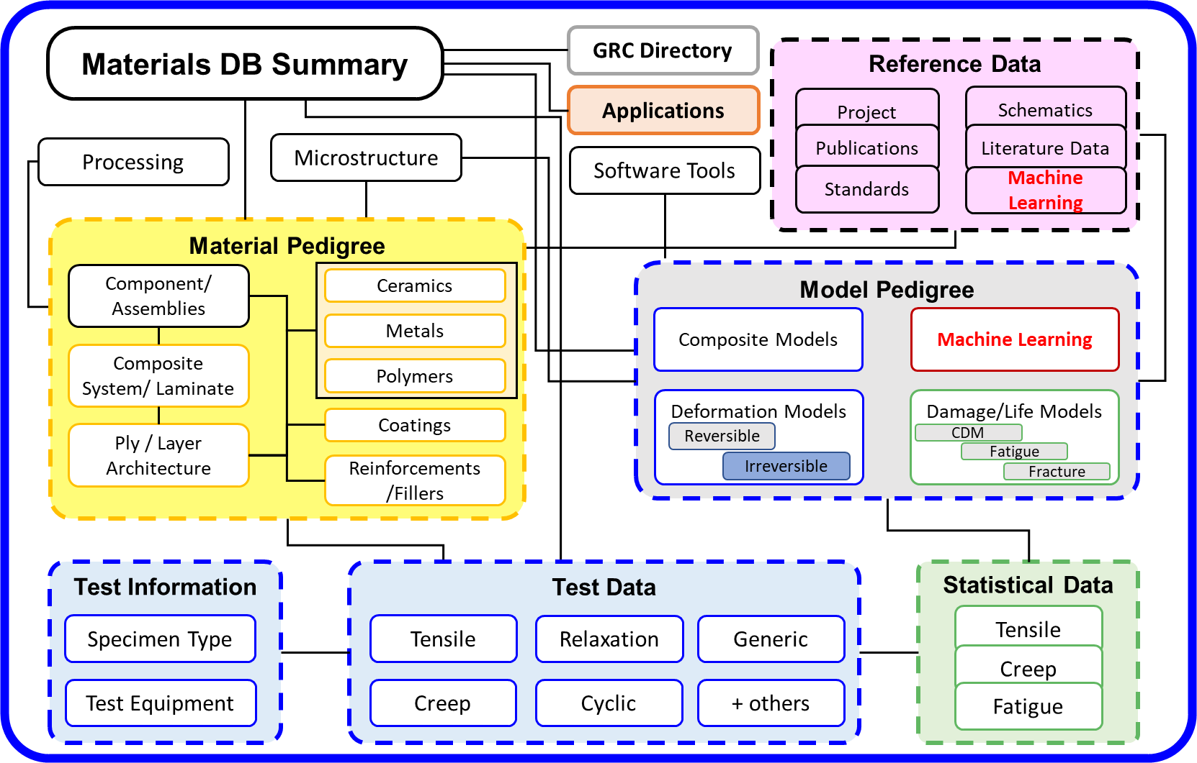
NASA GRC ICME Schema
ML Data and Models naturally fit within the current ICME schema

Slide 7
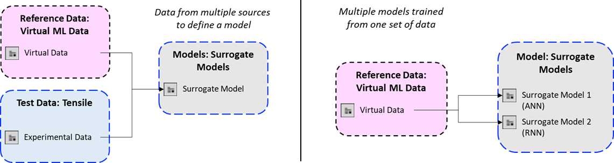
Motivation for Current Philosophy
Created two new tables in the NASA GRC Database
  Reference Data: Machine Learning
  Models: Machine Learning
  Flexibility in model definition prevents data from being duplicated multiple places in the database

Slide 8
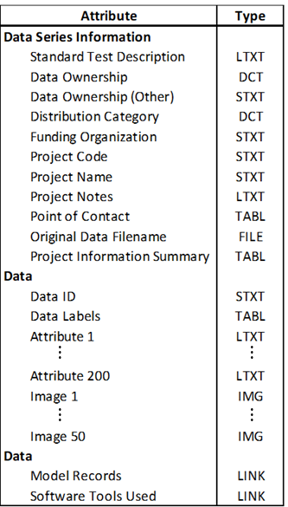
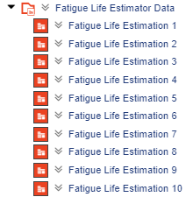
Reference Data: Machine Learning Schema
All members of a data set stored within the same generic record
Data Series Information stored in the generic record
  Records created for each member in the training set
  Generically named attributes for flexibility
File tree structure
Headings and Attributes

Slide 9
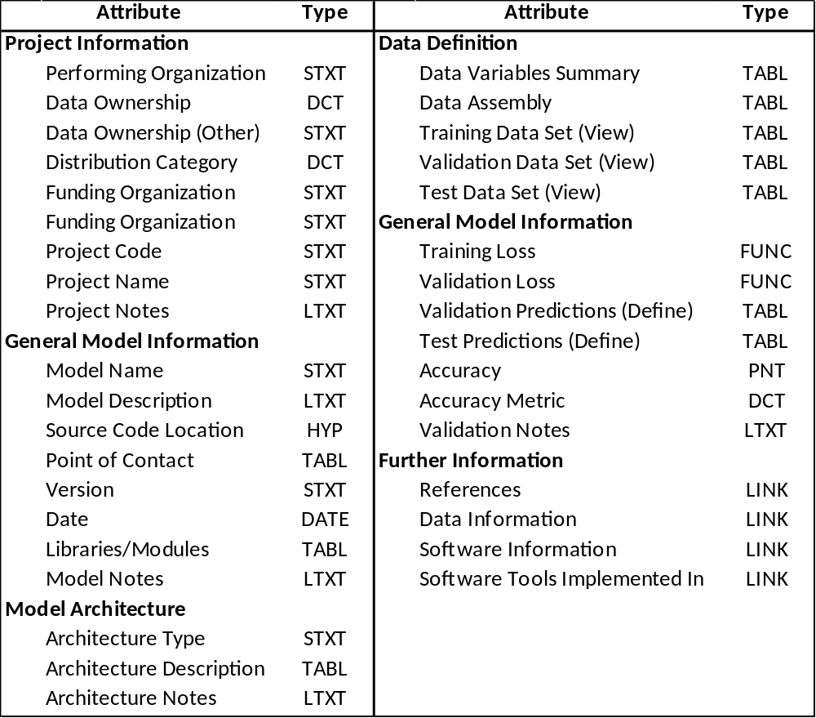
Models: Machine Learning Schema
Trained models are stored individual records
  Model information, accessibility, and required software, architecture, etc.
  Define how the data set was split into training, validation and testing
  Link to (View) data in the Reference Data: Machine Learning Table
  Define validation/test predictions made by the model
Headings and Attributes

Slide 10
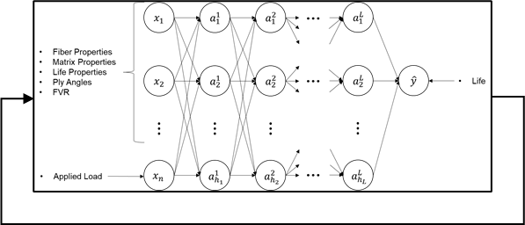
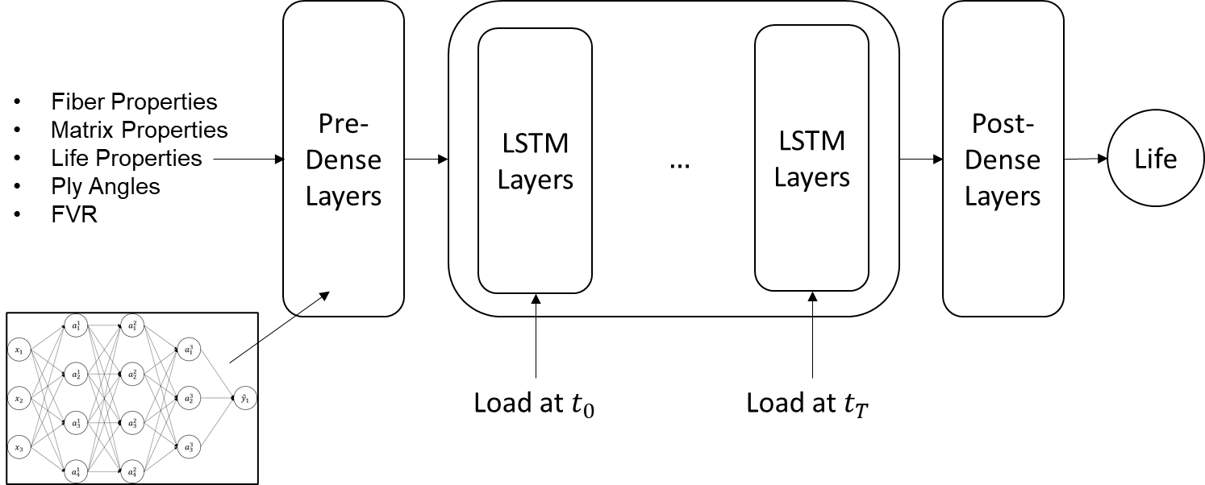
Demonstration Example
Trained two different ML Models for predicting fatigue life curves of composites from the same virtual data set (MAC/GMC)
Artificial Neural Network (ANN)
Model called in a loop to produce the fatigue life curve
Recurrent Neural Network (RNN)
Model predicts the fatigue life curve vector from an applied load vector
Repeat with different applied
loads to get a fatigue life curve
Applied load input as a vector, life prediction made at each load step

Slide 11
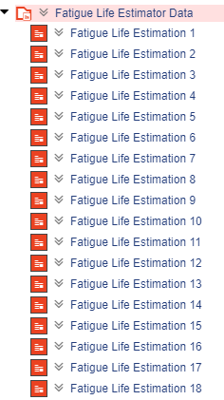
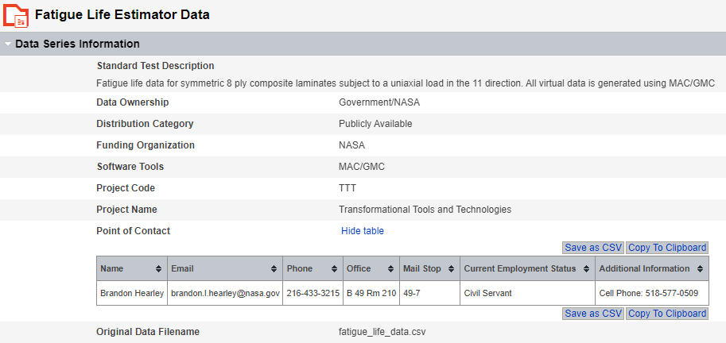
Storing Virtual Data: Generic Record
Virtual data defined once in the database in the Reference Data: Machine Learning Table
  Store general information in the generic record

Slide 12
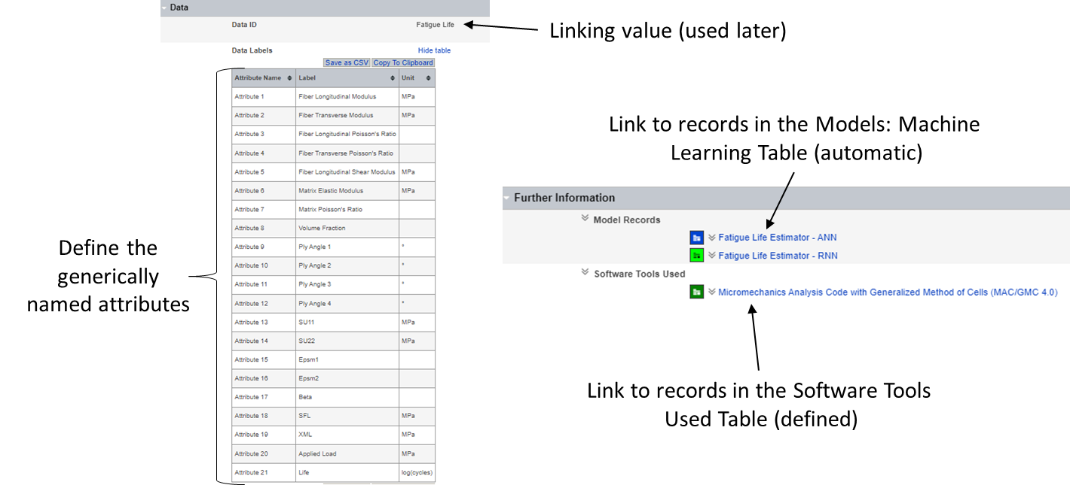
Storing Virtual Data: Generic Record

Slide 13
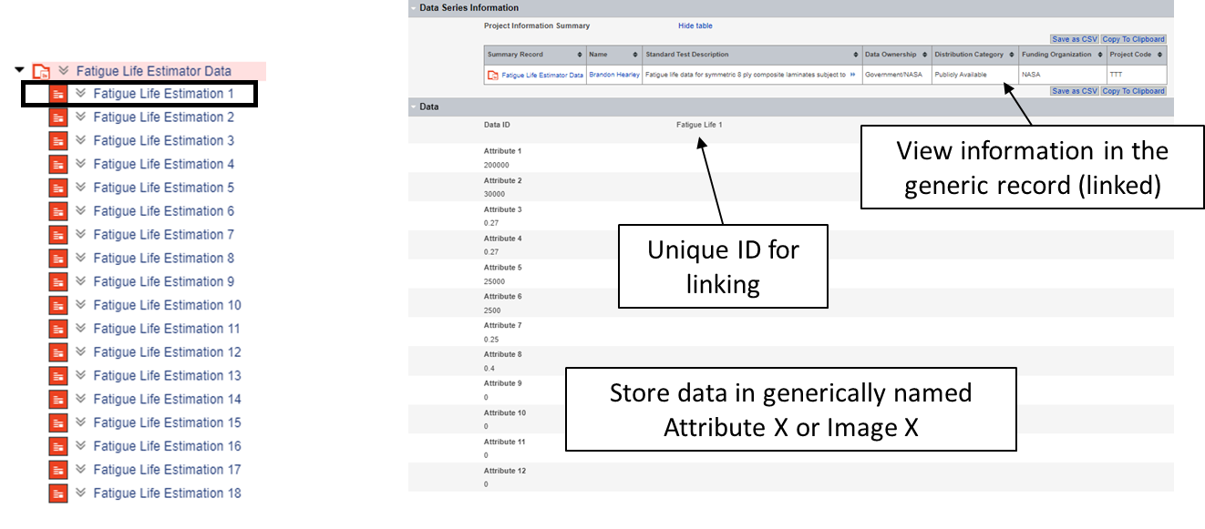
Storing Virtual Data: Data Record
Each example in the data set is stored in its own record
  Given a unique ID

Slide 14
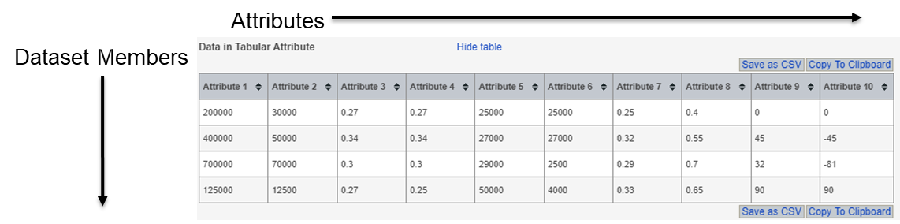
Granta Limitations for Linking (Viewing) Data
Why not store data in a single tabular attribute for all members in the data set?
Currently in Granta MI, there is no capability to link to an individual row in a tabular attribute
  No way to specify which dataset members were used for training, validation, and testing

Slide 15
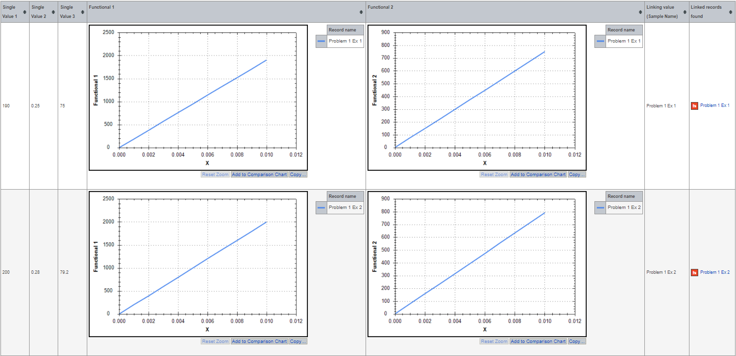
Proposed Enhancement to the Tabular Attribute
Current Granta Linked Table Capability for viewing
Modified Granta Linked Table Capability for viewing
Linked Row
1
Link
Val 1
Record 1
Link to a single tabular attribute in a single record. Columns take on same values as the columns in the linked record.
Each column is a different attribute in the different linked record
5
Link Val 2
Link Val 1
Record 2
Record 1

Slide 16
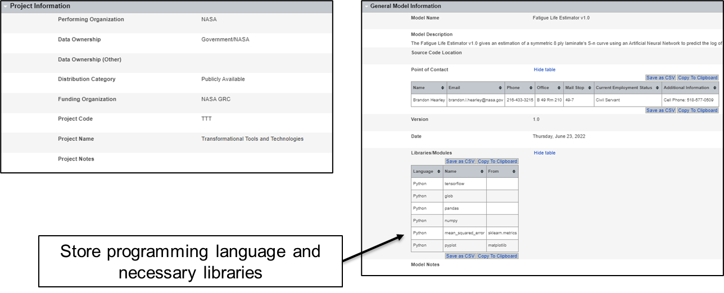
Storing ML Models: Model Information
Create separate records for each model
  Blue = ANN, Green = RNN, Black = Both

Slide 17
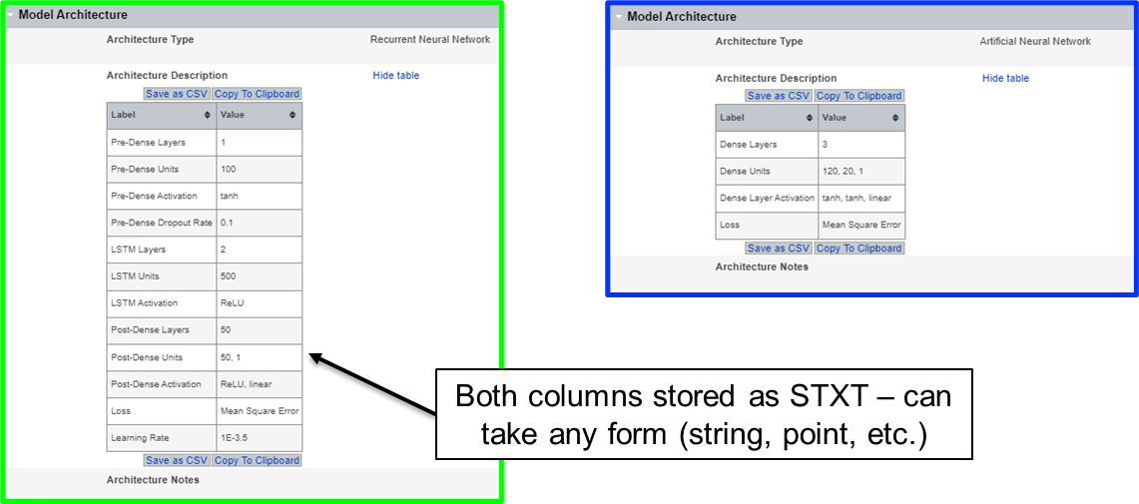
Storing ML Models: Model Architecture
Store the ML model architecture in a tabular attribute
  Can use this information to recreate the ML model in any programming suite (TensorFlow, PyTorch, etc.)

Slide 18
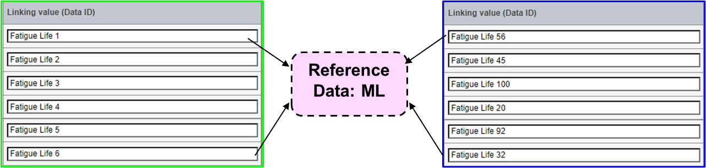
Storing ML Models: Data Definition
View data used for training, validation, and testing in two different model records without duplicating the data
Advantages
  User only defines the Data ID
  Data can be shuffled differently for each model

Slide 19
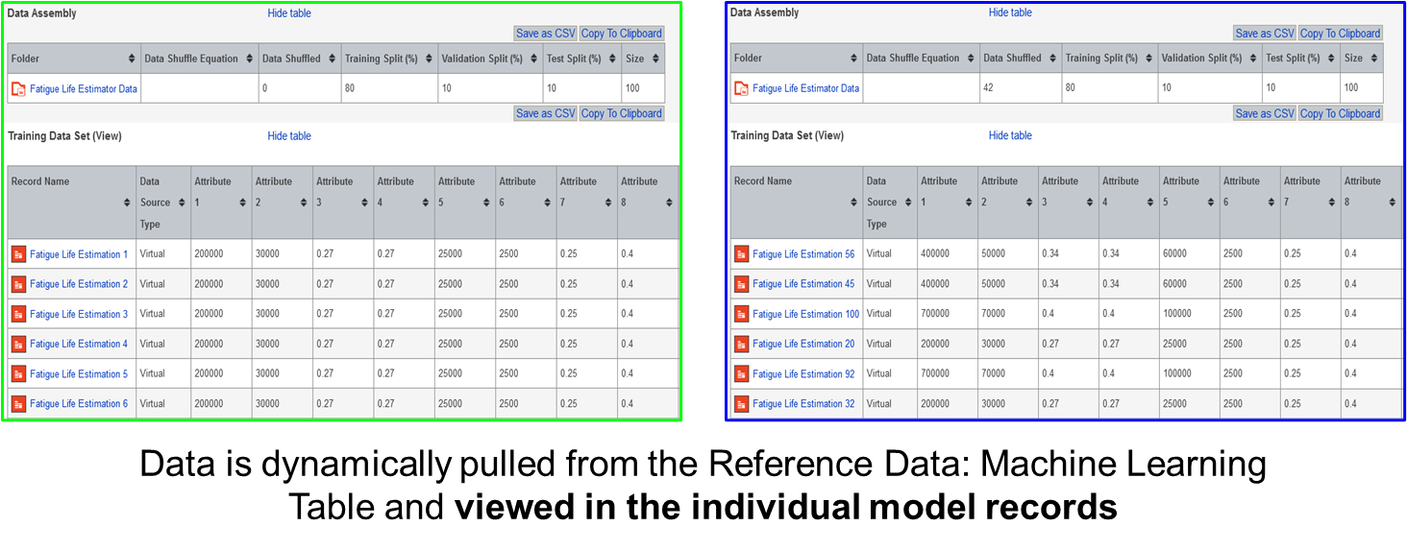
Storing ML Models: Data Definition
View data two different model records without duplication

Slide 20
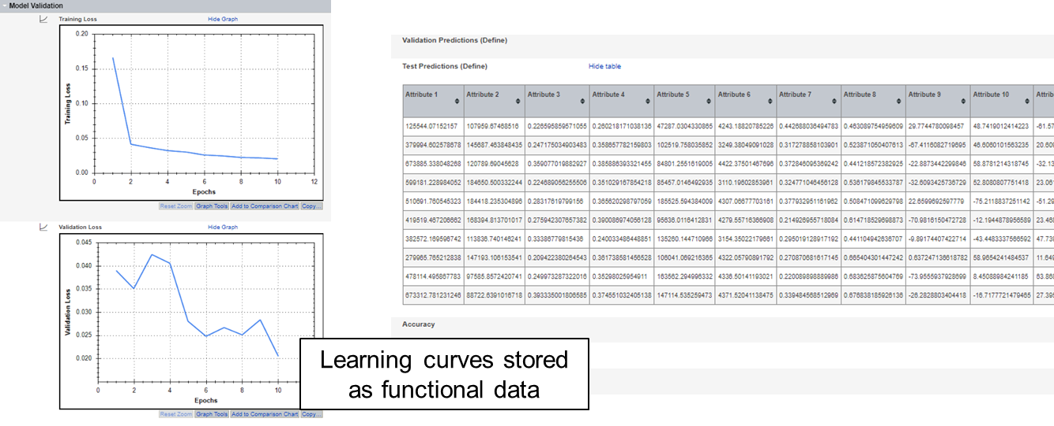
Storing ML Models: Model Validation
Model predictions are defined in the model record
  Specific to the model

Slide 21
Conclusion/Summary
Machine learning is critical to ICME
  Need for effective and efficient storage of data and models with full traceability
NASA GRC ICME schema separates data and models into two different tables
  Reference Data: ML stores virtual data created to train ML models
  Models: ML stores actual models
Each example in a training set is stored in its own individual record
  Necessary to follow database best practices within Granta MI
Identified feature requests that can enable machine learning data/models to be efficiently and effectively stored in the Granta MI platform

Slide 22


Thank You for Your Attention
Acknowledgements
The authors would like to acknowledge the support of the NASA Transformational Tools and Technologies (TTT) project within the Aeronautics Research Mission Directorate.

Slide 23
Outline
Motivation and Background on Database Management
  Overview of Granta MI Database Platform
NASA GRC ICME Schema and Machine Learning storage philosophy
  Overview of the database attributes and organization
Demonstration of the schema and philosophy
Conclusions/Summary

