Slide 1
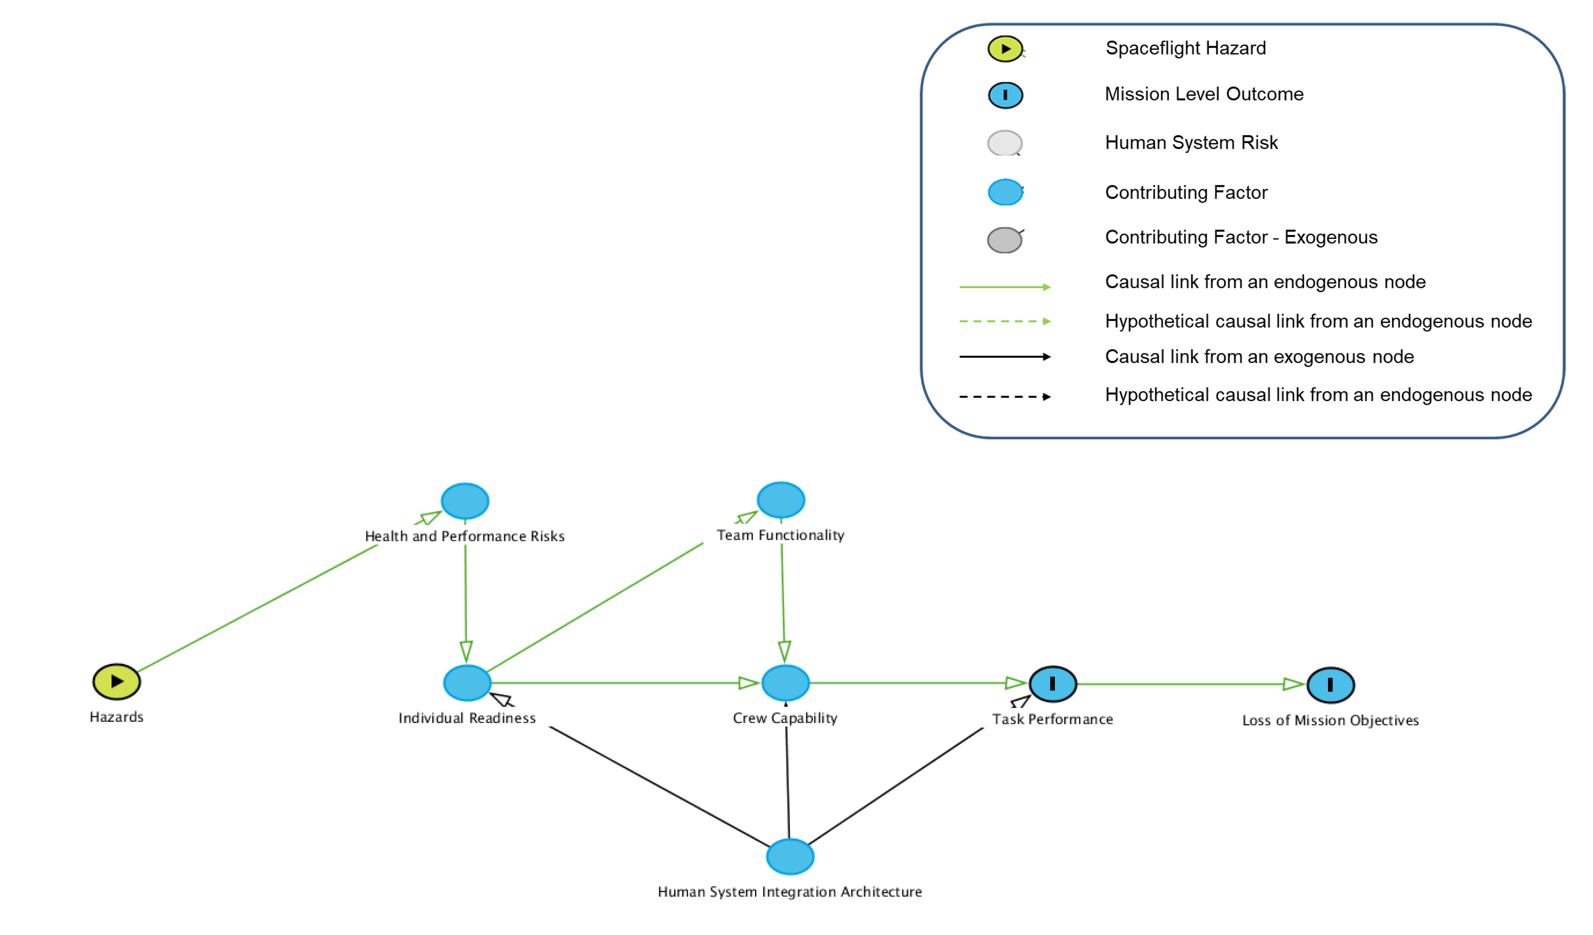
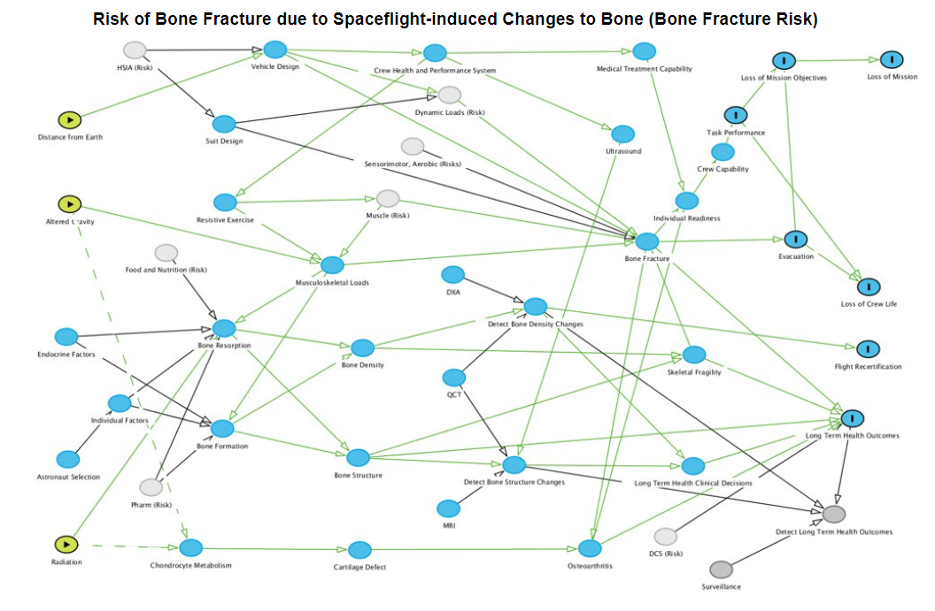
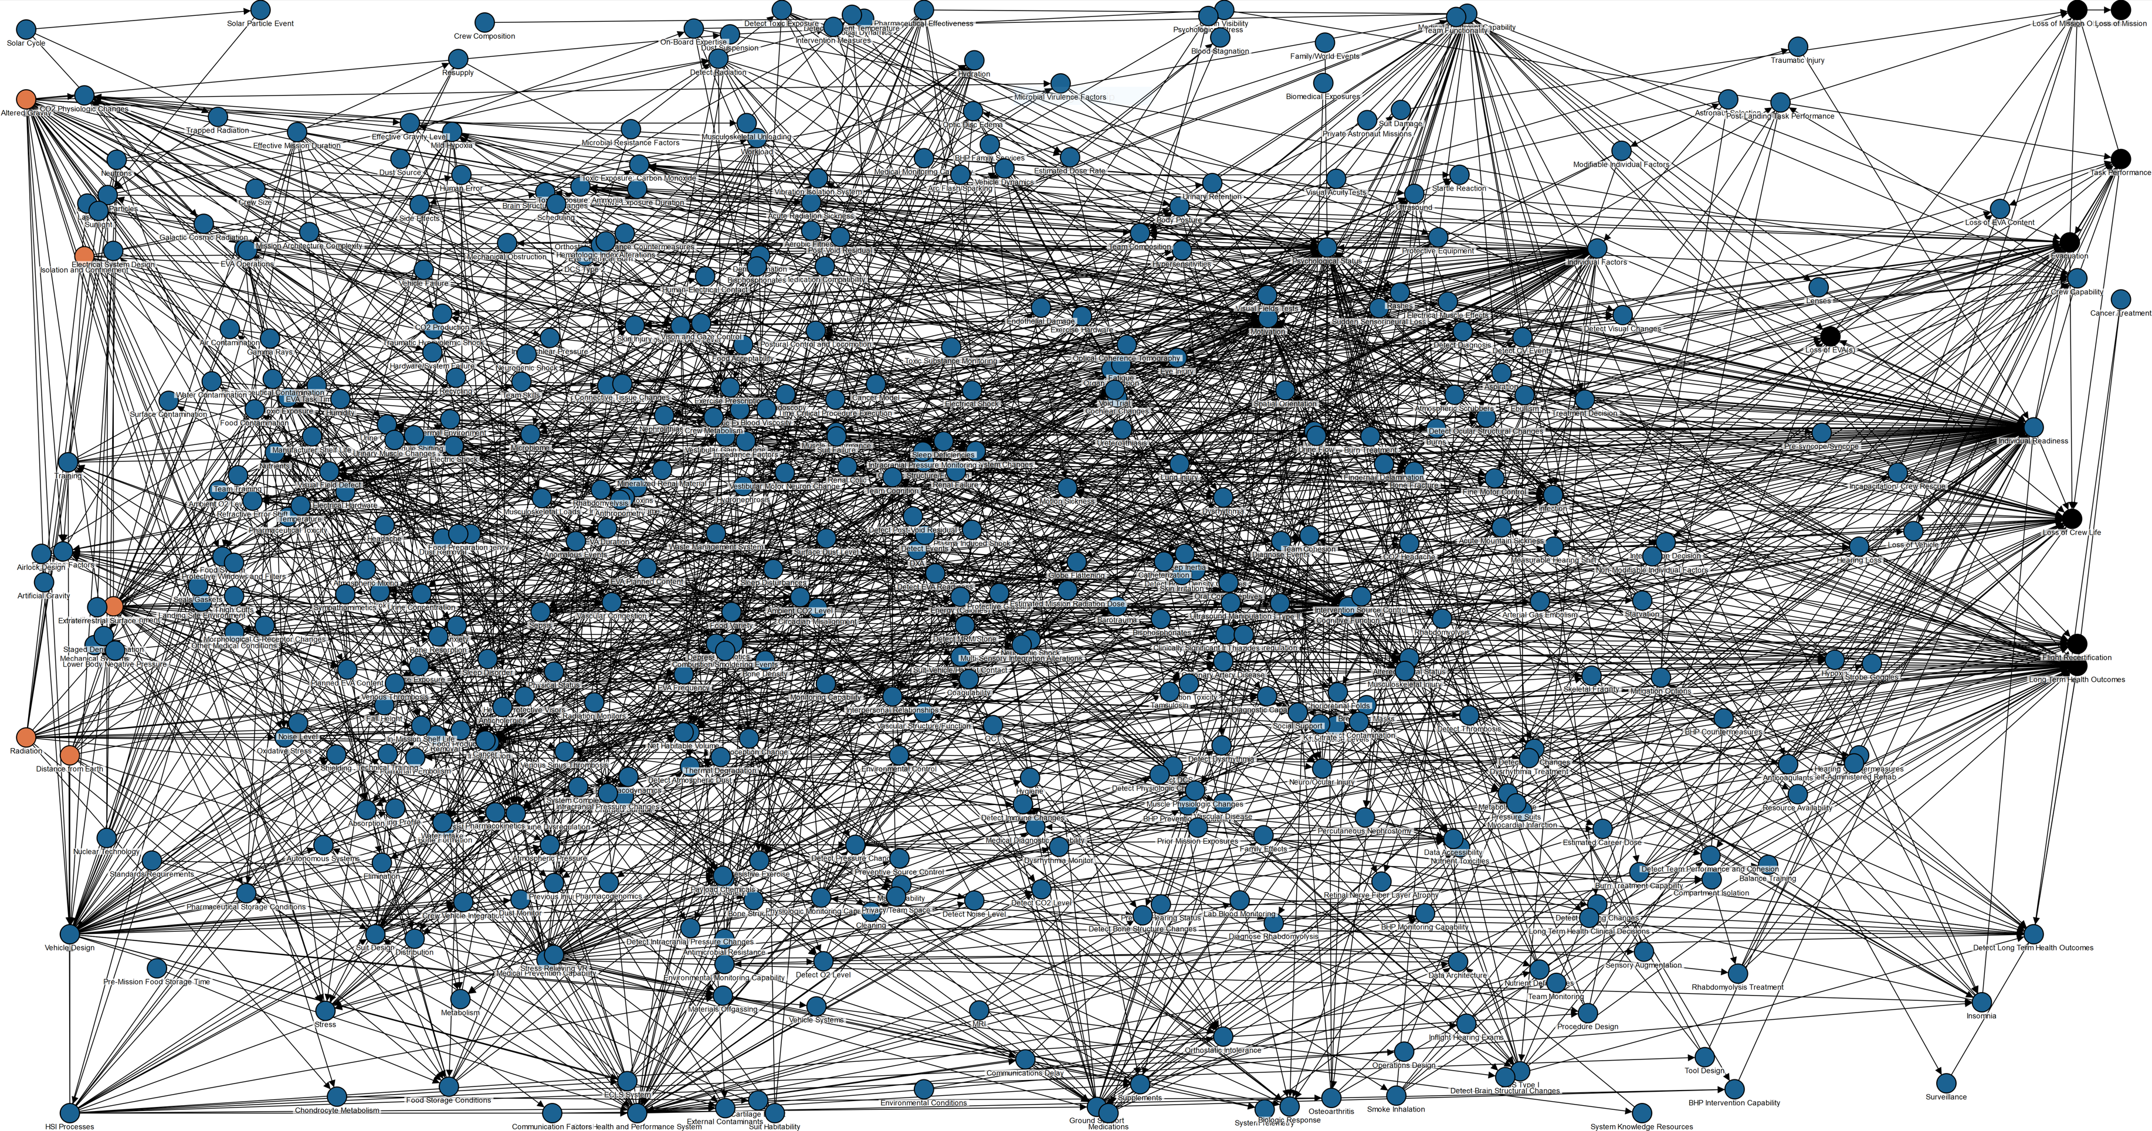
HUMAN SYSTEM RISK COMMUNICATION: DIRECTED ACYCLIC GRAPHS
E.L. Antonsen1, R.J. Reynolds2, E. Connell4, R. Scully3, A.A. Abukmail5, A.M. Monti6, J.M. Charvat3,
M. Van Baalen7, D.M. Buckland 7
1 Center for Space Medicine and Department of Emergency Medicine, Baylor College of Medicine, Houston, TX 77030
2Mortality Research and Consulting, City of Industry, CA 91748
3KBR, Houston, TX 77058
4Leidos, Houston, TX 77058
5Department of Computer Sciences, University of Houston, Clear Lake, Houston, TX 77058
6JES Tech, Houston, TX 77058
7NASA Johnson Space Center, Houston, TX 77058 – dan.buckland@nasa.gov
THE PROBLEM
DAG FRAMEWORK DEVELOPED
CONCLUSIONS
Elucidation of the complex interactions among agents affecting the Human System Risks, combined with the interrelationships among risks, requires a method of illustrating these relationships to enable a shared conceptualization of the risks and thus facilitates collaboration among the diverse disciplines engaged in efforts to refine the evidence base for the risks.
DAGs enable shared conceptualization of human system risks among those involved in refining the evidence that characterizes the risks and supports the risk management processes.
DAGs and their narratives are baselined and are available publicly via the QR code and link below.
DAGs are being used in human system risk discussions. This includes program managers, systems engineers, and operators in addition to the Human Health and Performance Directorate.
Forward work involves refinement of the MegaDAG
80
75
BACKGROUND
RESULTS
48
The Human System Risk Board (HSRB) is responsible for the management of a portfolio of 30 human system risks that NASA tracks and configuration manages to mitigate for future crewed exploration missions.
The HSRB has been exploring the concept of causal diagrams (in the form of Directed Acyclic Graphs or DAGs) as an approach to creating knowledge graphs for each risk to enable shared mental models of causal flow from spaceflight hazards to mission outcomes among HSRB Stakeholders.
These diagrams are intended to improve insight and communication of risk across the myriad subject matter experts and management interested in human system risk reduction. This includes program managers, systems engineers, and operators in addition to the Human Health and Performance Directorate.
The DAG project was intended to create the foundation for composition of the 30 baselined DAGs into a single risk network and software is being developed in parallel to enable this forward work.
Bone DAG
27
21
REFERENCES
Directed Acyclic Graph Guidance Documentation - NASA/TM 20220006812
Directed Acyclic Graphs: A Tool for Understanding the NASA Human Spaceflight System Risks - NASA/TP 20220015709
Mega DAG
https://www.nasa.gov/hhp/hsrb

