Slide 1


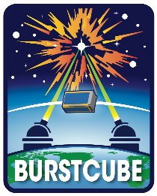

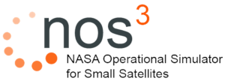
NASA GSFC SmallSats –
A NOS³ Case Study
Mark Suder
Systems Engineer
TMC Technologies
NASA’s IV&V Program

Slide 2
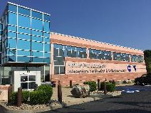
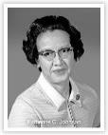
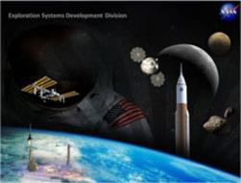


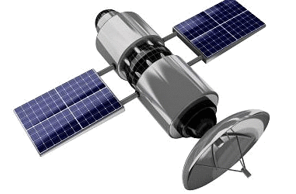

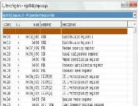

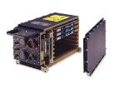
NASA IV&V JSTAR/ITC –
Who we Are
NASA – National Aeronautics and Space Adm.
  NASA’s Software IV&V Program
      Software Independent Verification and Validation +
      Primarily NASA, also a few closely related organizations/missions
      Ensuring primarily NASA Class A Mission Success since 1993
      Full Development Lifecycle – Software (and related System) Requirements, Design, Code, Test, Assembly/Integration&Test, etc.
    JSTAR/ITC
      JSTAR (see logo); ITC = Independent Test Capability, the personnel team for the lab (sometimes used interchangeably)
      Experts in software only simulation of hardware and hardware emulation
        Especially, but not limited to, CPU instruction set simulation so flight binary executables can execute on commodity hardware
        Also, emulation of flight peripherals, buses, etc.
        And more…

Slide 3
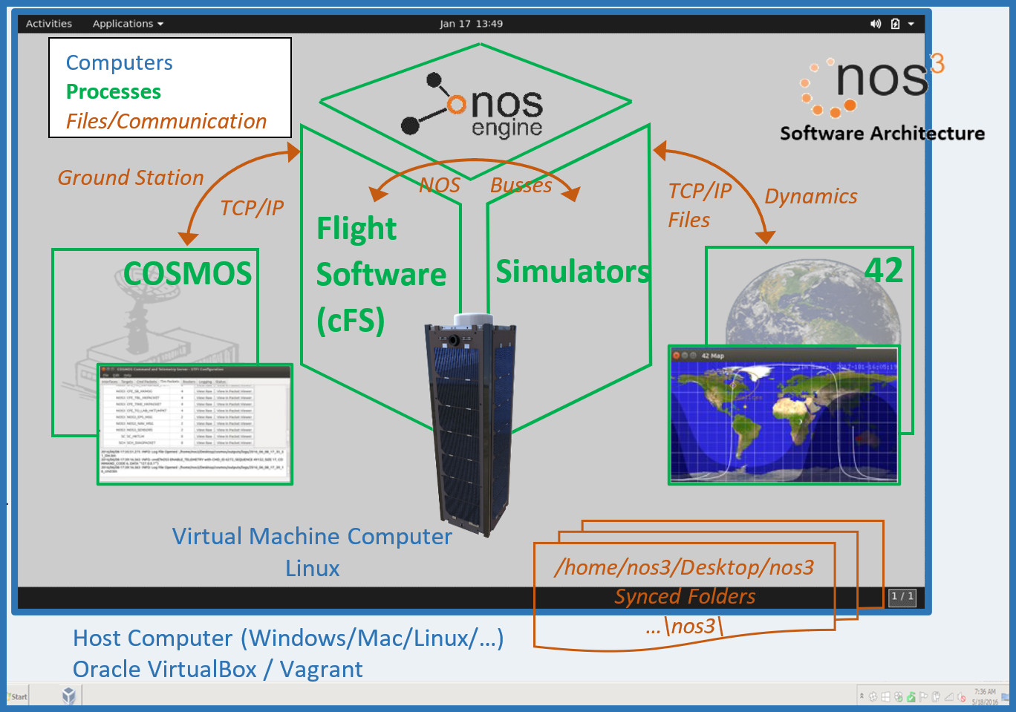
NOS³ Architecture
NOS³ = NASA Operational Simulator for Small Satellites
Combination of multiple pieces of open-source software
  A virtual spacecraft!
Flight Software
  Core Flight System (cFS) based
Ground Stations
  Ball Aerospace COSMOS
Dynamics Engine
  42
  Provides visualization
NOS Engine
  Communication protocols
  Hardware abstraction layer
Component simulators

Slide 4
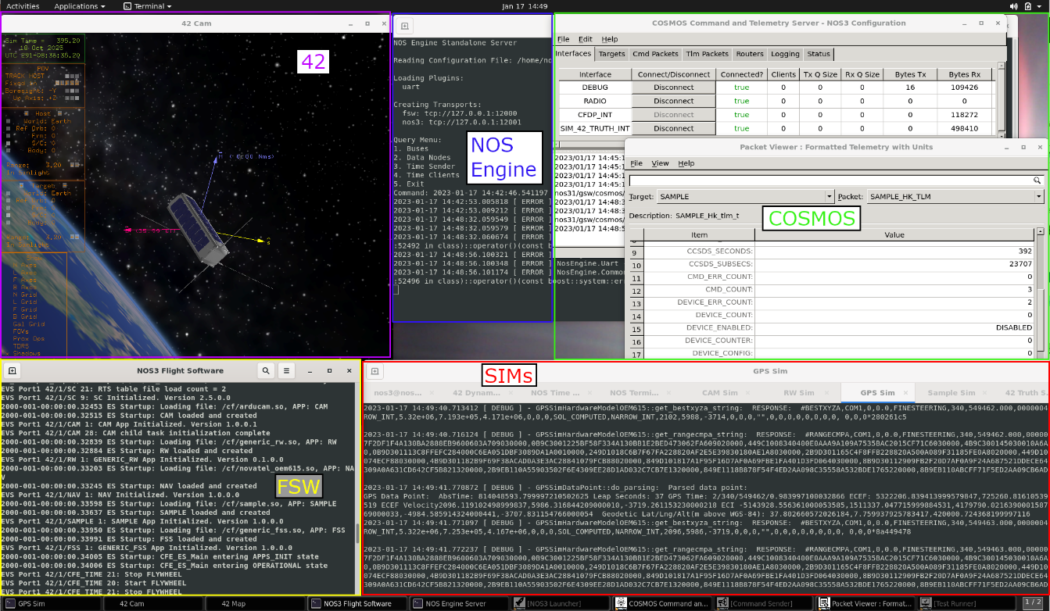
NOS³ Virtual Machine

Slide 5
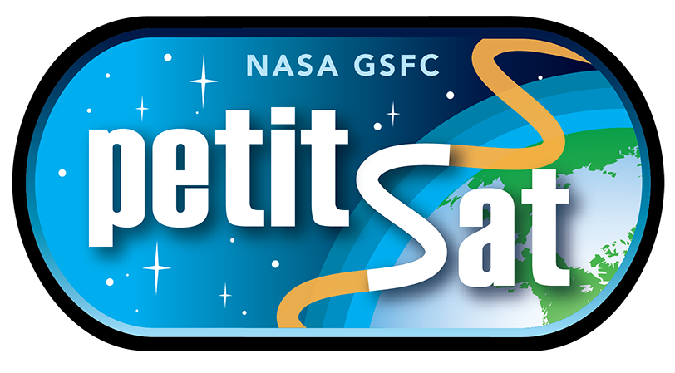
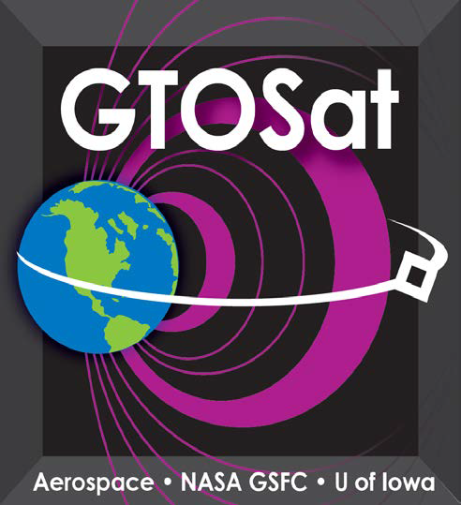
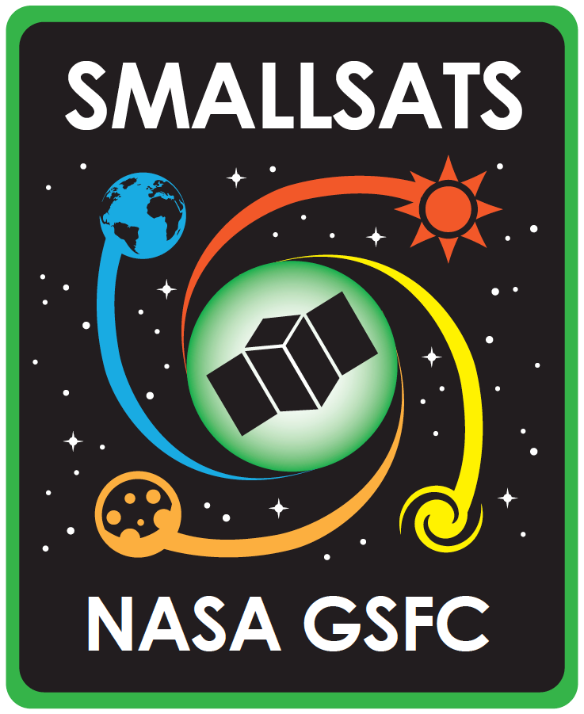


GSFC SmallSats In Development

Slide 6
GSFC SmallSat HW Platforms
LEO Bus
  Low Earth Orbit Bus is based on the Spacecube Mini Z processor
    Xilinx Zynq 7020 Dual Core ARM A9 running the Linux OS
GEO Bus
  Geosynchronous Equatorial Orbit Bus is based on a GSFC In-House developed C&DH (MARES)
    RTG4 FPGA w/ LEON3-FT softcore running the RTEMS RTOS
Desktop Linux NOS³ Target
  Along with platform support for our two flight architectures, all flight software is built for the Linux NOS³ target for development and testing
NOS³ builds FSW for all of these environments

Slide 7
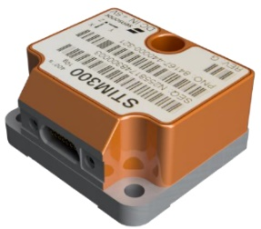
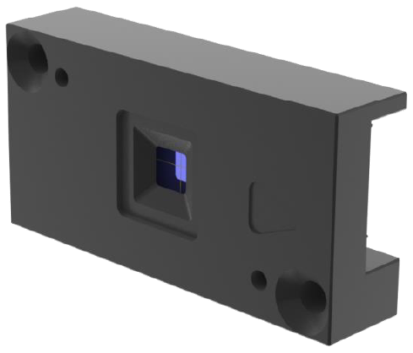
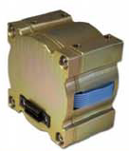
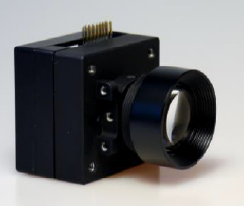
GSFC SmallSat Common Components
Attitude Determination & Control System (ADCS)
  Reaction Wheels
  Inertial Measurement Unit
  GPS
  Star Tracker
  Magnetometer
  Fine Sun Sensor
Command and Data Handling
  LEO Bus: Spacecube Mini-Z
  GEO Bus: MARES Leon3
Communications
  Wireless S-Band Radio
Power
  EPS and Batteries

Slide 8

GSFC SmallSats – Reuse Approach
Reuse Artifacts
(Develop once)
Mission FSW Pipeline
Mission Specific Artifacts
(Develop for each Mission)
For Mission Specific
Instruments
42 Dynamic Sim
Instrument cFS Apps
For New and
Mission
Specific
Devices
cFE Core
(6.7)
Device cFS Apps
GSFC cFS
Reuse Apps
SmallSat Software Baseline
Mission Specific
Software
Device NOS³ Sims
GSFC
SmallSat Apps
NOS³ Sim
COSMOS Ground System
COSMOS
Database
Completed Missions

Slide 9
Component SW Development
Receive component spec sheet (and maybe component)
Develop standalone checkout application (NOS³ for development environment)
Test checkout application with component (flatsat)
Develop cFS application reusing code from checkout application (NOS³ for dev env)
Develop NOS³ hardware simulator (NOS³ for dev env)
Test cFS application (flatsat/real sat and NOS³ env)
Integrated FSW testing (flatsat/real sat and NOS³ env)

Slide 10
NOS³ Uses
Development environment
  Toolchains, etc. – build for target and NOS³ environment
Test component apps
  Including commands/telemetry
  Interaction with hardware using NOS³ sims and real hardware
Test integrated apps / flight software
  E.g. Verify closed loop ADCS algorithm control using simulated sensors/actuators/42 dynamics
Develop operator tools and procedures

Slide 11
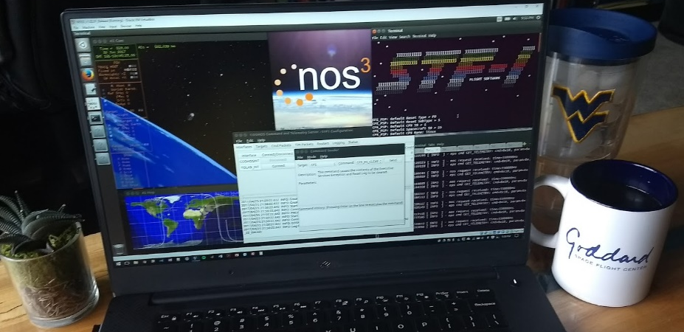
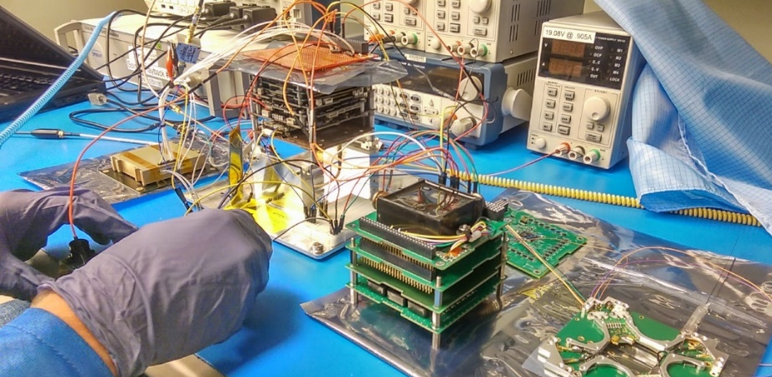
NOS³ Benefits
Invaluable during COVID for enabling remote work
Development
  Earlier flight software development
  Provides a workflow for iterative work
  Reduces “works for me” issues
  Develop and dry-run procedures safely
Testing
  Enables testing that is not physically possible
  Increases available testing resources
  Software integration testing
Operations
  Long duration testing
  Failure scenarios
  System / mission familiarization and training

Slide 12
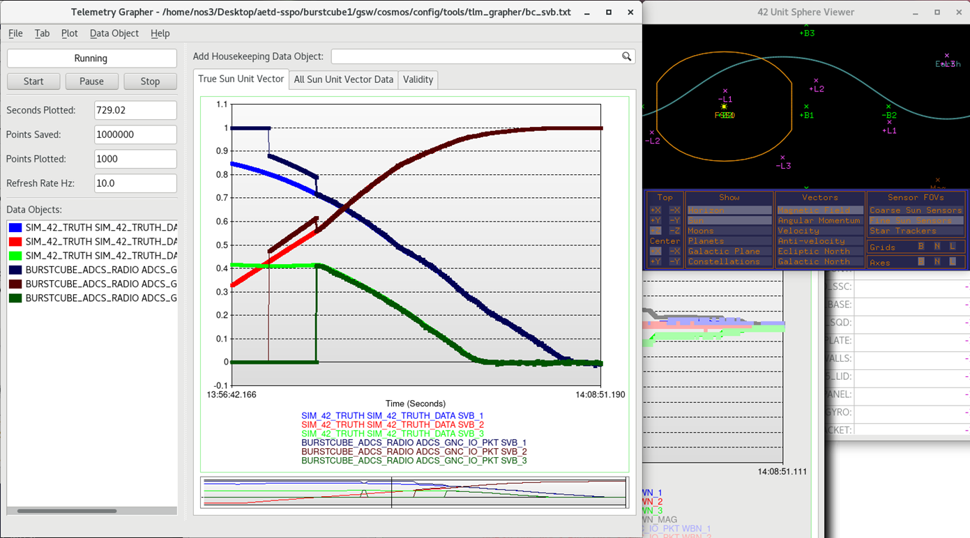
NOS³ ADCS Benefit Example
COSMOS Telemetry Grapher
+Y to Sun!
42 Unit Sphere Viewer (shows truth)
Slewing
Lighter =
42 Truth
Darker =
ADCS estimate
from sensors
CSS
FSS
Closed loop ADCS testing
  Not possible on Earth with real hardware
  NOS³ with 42 provided dynamics inputs/outputs
  E.g. Verified BurstCube sun safe mode slewed to and tracked sun

Slide 13
Open Source NOS³ – Path Forward
Lessons learned from GSFC SmallSats and NOS³ being fed into open source NOS³ (https://github.com/nasa/nos3)
  E.g. component (single repository) = FSW/GSW/Sim/Checkout app
Wanted to open source FSW/GSW/Sim/Checkout App for GSFC SmallSat common components (FSS, GPS, etc.)
  Not feasible
  So “generic” components being created in open source
Eventually (summer 2023?) have design reference mission including:
  A full suite of generic components
  ADCS algorithms

Slide 14
Thank You!
Questions?
  Answers?
https://github.com/nasa/nos3
https://www.nasa.gov/centers/ivv/jstar/JSTAR.html
mark.suder@tmctechnologies.com

