Slide 1
The Big Plunge at Venus:
The DAVINCI Descent Phase
March 4, 2023
Matt Garrison, Dr. Giada Arney, Arlin Bartels, Vince Elliott, Dr. Jim Garvin, Dr. Stephanie Getty, Colby Goodloe, Chetan Sayal, Richard Saylor, Ken Schwer, Dr. Michael Sekerak, NASA GSFC
Dr. Soumyo Dutta, NASA LaRC

Slide 2
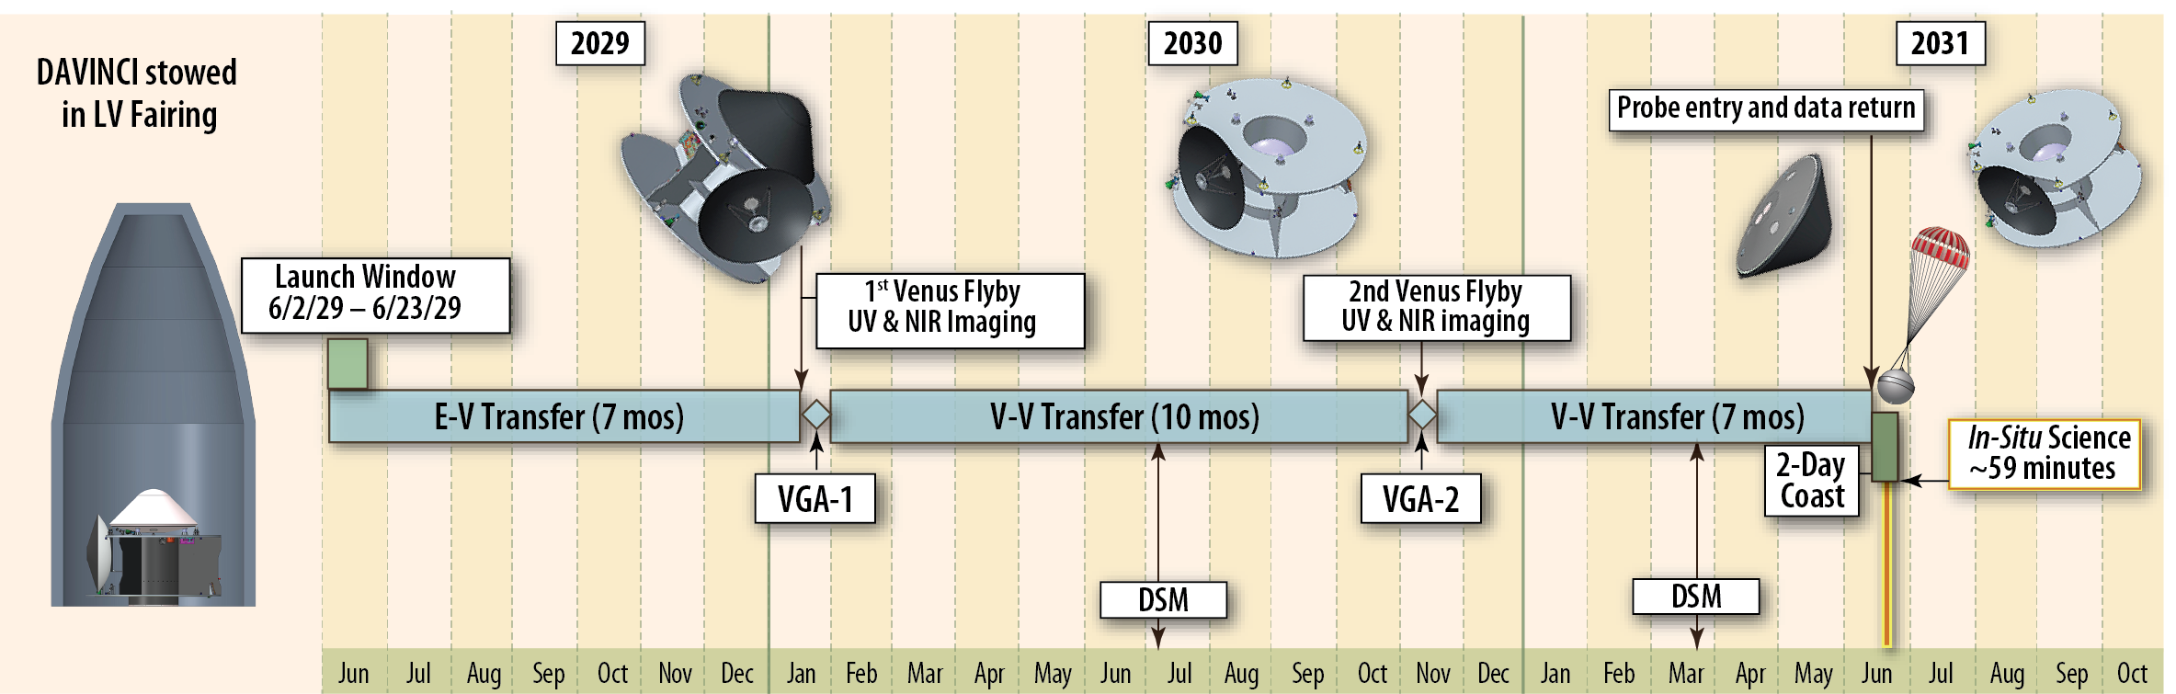
Intro to DAVINCI
Discovery mission selected for launch in 2029
Goal is to investigate the evolution of Venus’ atmosphere through remote sensing, in-situ chemistry measurements, and near-surface imaging.

Slide 3
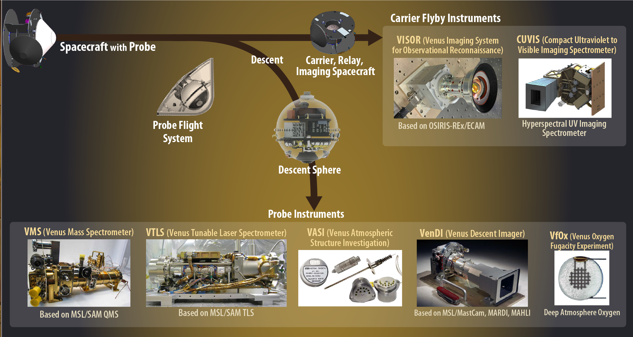
DAVINCI Flight System

Slide 4
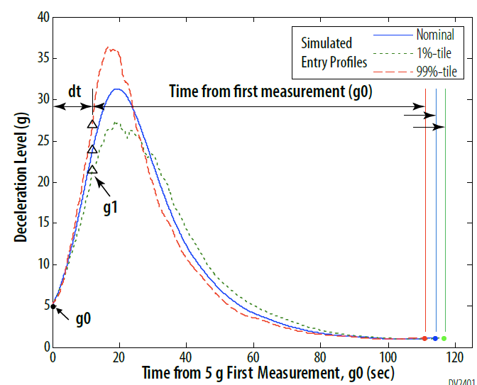
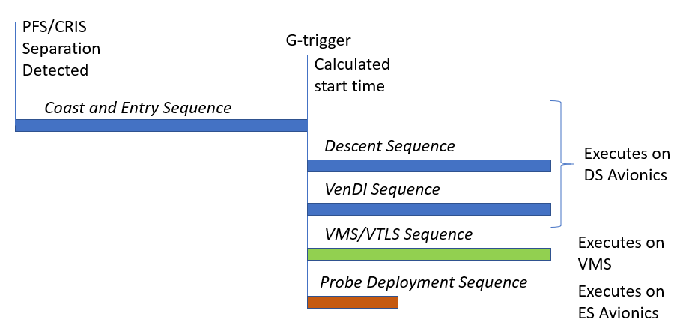
Descent Phase ConOps (1)
Addresses the majority of the project’s science goals:
  Atmospheric composition including noble gases
  Atmospheric structure
  Sub-cloud imaging for structure and composition
Begins with Consent to Deploy based on analysis of in-flight checkouts
~2d coast after separation
Descent over Alpha Regio Tessera
G-trigger measurement initiates scripted activities for PFS deployment and descent operations. This is the only feedback in the sequences after separation from CRIS.
~70km: Backshell separates, main parachute deploys, heat shield separates

Slide 5
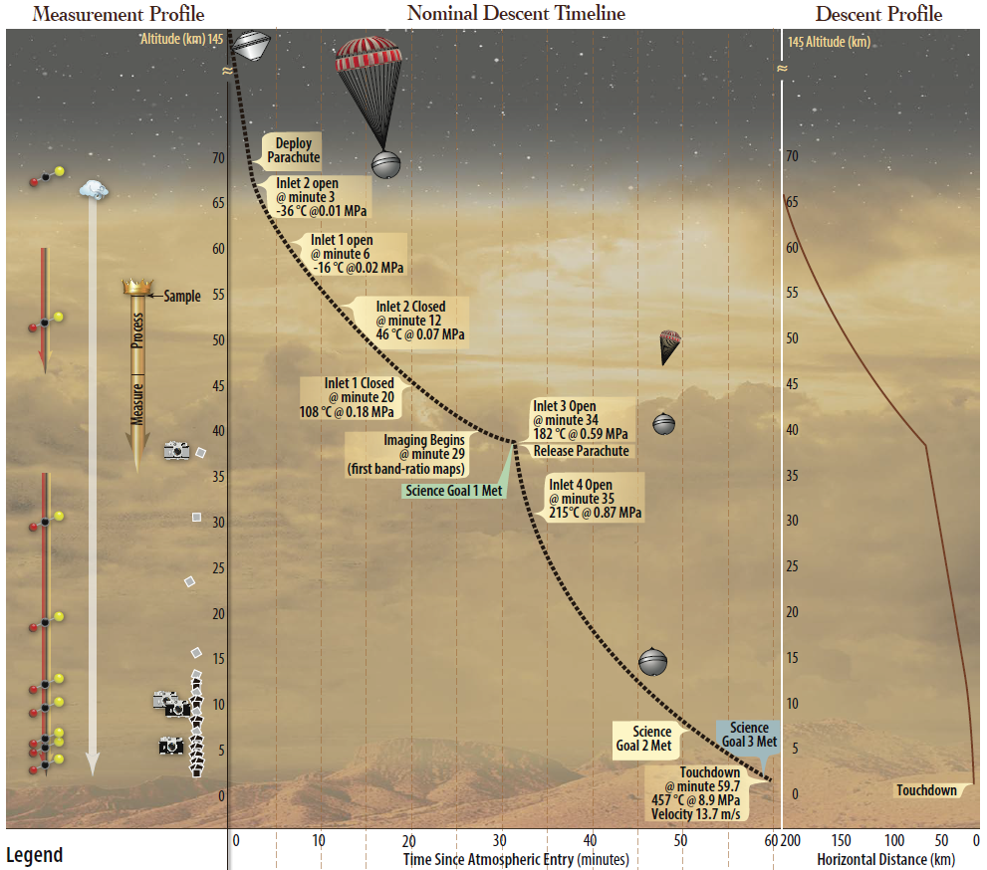
Descent Phase ConOps (2)
Total descent time ~1 hour
~65km: Begin sampling gas from upper-altitude inlets
~37km: Parachute release, descent imaging begins
~35km: Begin sampling gas from lower-altitude inlets
~2km: Measurements increase for near-surface gradients, sub-meter geomorphology from descent imaging
Ends when the CRIS spacecraft goes below the horizon, severing communication with DS.
DS is not required to survive landing so all requirements must be met before touchdown. Continued observations and transmissions will be scripted just in case the DS survives

Slide 6
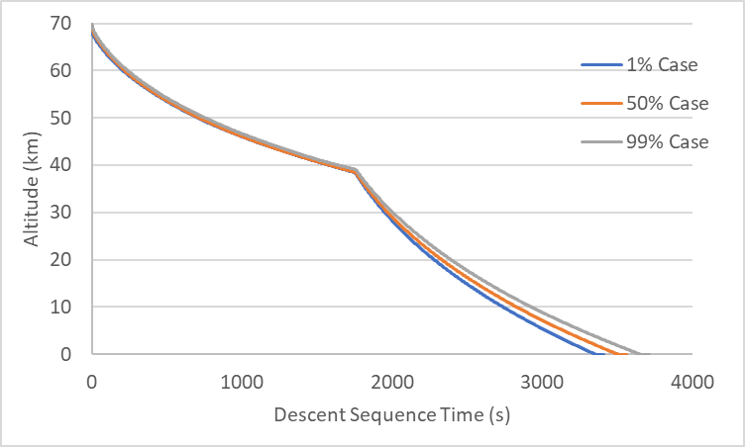
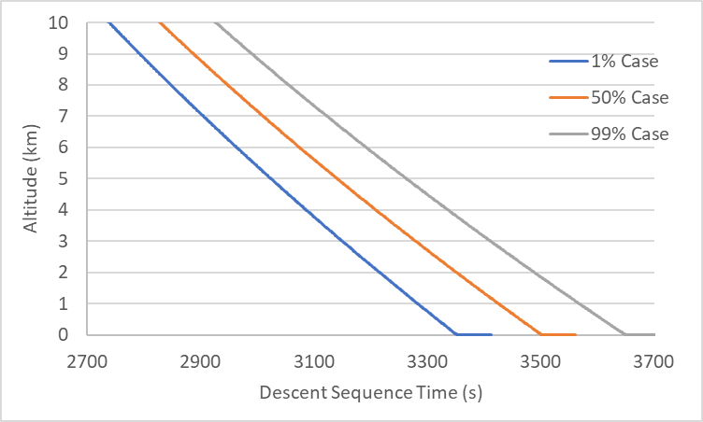
Challenges – Altitude Uncertainties
The descent phase timeline is influenced by multiple uncertainties: atmospheric properties, aerodynamics, delivery trajectory, etc
G-trigger used to detect top of atmosphere but otherwise all activities are time-determined with no in situ knowledge
Results in altitude uncertainty that grows with time, up to about 4km uncertainty at touchdown (1%-99%)
Most science measurements are required based on altitude so DAVINCI will oversample to make sure we are getting the right measurements in the right altitude bands given that uncertainty.

Slide 7
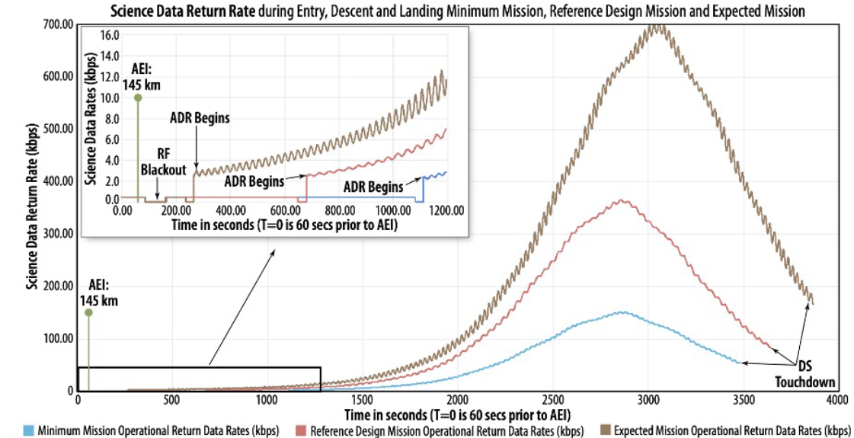
Challenges – Data Rate Uncertainties
Adjustable Data Rate radio senses link margin and adjusts data rate to maximize transition during descent
Systemic uncertainties impact that realizable data rate like probe attitude, atmospheric properties, and relative positions of probe and CRIS.
Result is a wide variety of total data transmitted and rates available at key altitude ranges.
DAVINCI generates more science data than needed and uses a prioritization algorithm to guarantee the minimum L1 science in the worst case but provide extra valuable science in the best case.

Slide 8
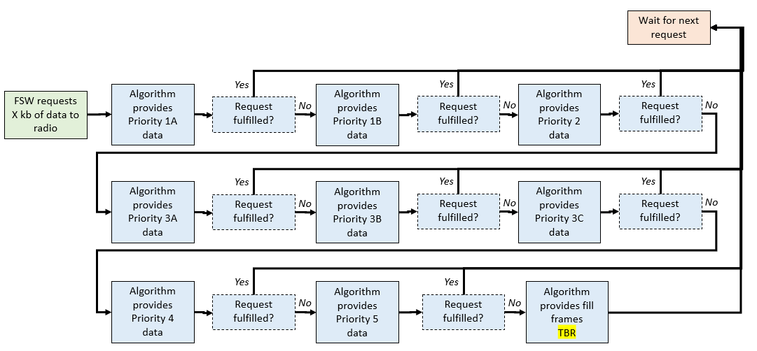
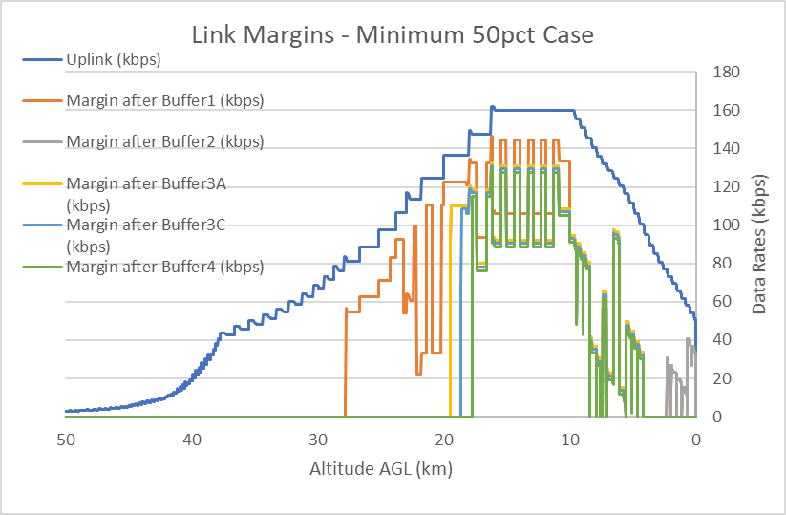
Data Prioritization
Data generated during descent is routed to priority queues within the DS:
  1A = Single set of all science data required to meet L1s
  1B = Second copy of 1A data that only has no redundancy (noble gas, ESI)
  2 = Extra copy of all 1A data available for retransmission
  3 = Extra science data not needed for L1s; VTLS (3A), VenDI (3B), VASI (3C)
  4 = Housekeeping
  5 = Engineering data
Retransmission (priority 2) is disabled part-way through descent to allow prioritization of extra science lower in the atmosphere
Radio requests data from the priority queues, request is fulfilled starting at the highest priority and cascading down as-available.

Slide 9
EDL Analysis
Series of inter-related models used to simulate the descent phase
All inputs and parameters include error bars or variance. The POST2 model incorporates those into a Monte Carlo simulation.
Quantified requirements are checked on each run and report out results two ways:
  1% or 99% worst case
  % of cases that meet the requirement
Model V&V:
Inspections
Tests
Independent Analyses
Inputs:
Atmospheric Properties
Incoming Trajectory
Sequences
Inter-Related Models:
EMTG, MIRAG
ADAMS
Simulink
POST2
MAP, LAURA, FUN3D, Empirical
Results:
Entry/Descent Environments
Altitudes of key measurements
Data transmitted to CRIS
Parameters:
Mass Properties
Aero Databases
Radio Link Properties

Slide 10
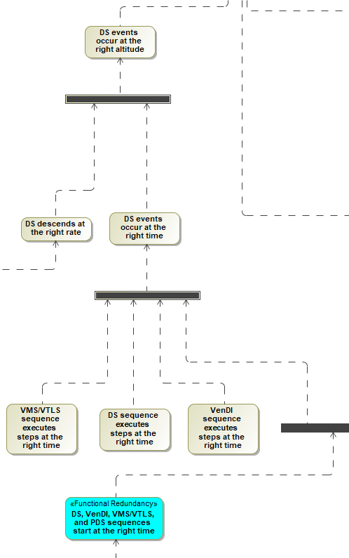
Validation
Built a descent phase success tree down to the level of “element does a thing”
  Provides a framework for decomposing and framing a successful descent.
  Mapped L1, L2, and L3 requirements to those nodes on the success tree to ensure that all necessary functions are adequately described by requirements.
  Will be used to structure validation tests going forward
Significant amount of design and verification relies on the descent model, so we need to validate that as well.
  Every sub-model and input gets checked against test results or independent analysis before launch
  No end-to-end model V&V available

Slide 11
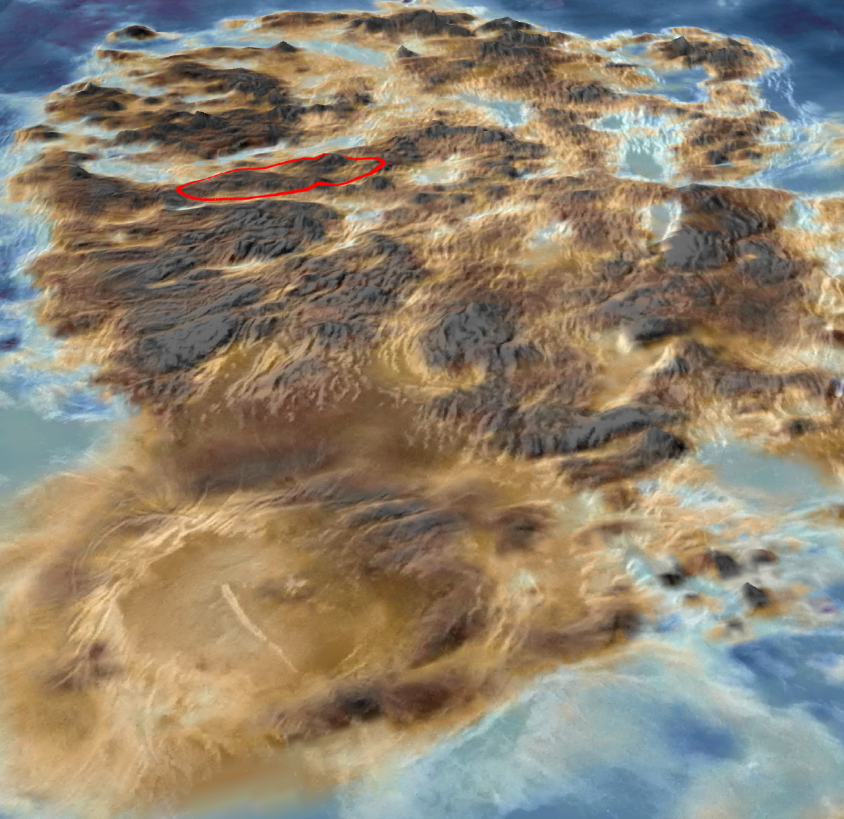
Summary
The Descent Phase is the heart of the DAVINCI mission
  Single attempt to acquire and transmit level 1 science data
  Has to be tolerant to uncertainties in timing, atmospheric properties, link performance, and flight system behavior
DAVINCI team is using Model Based Systems Engineering, an inter-related set of models, and strategic V&V planning to make sure we meet all mission goals as we descent to the surface of Alpha Regio.
ALPHA REGIO
2x size of Texas
300 km

