Slide 1



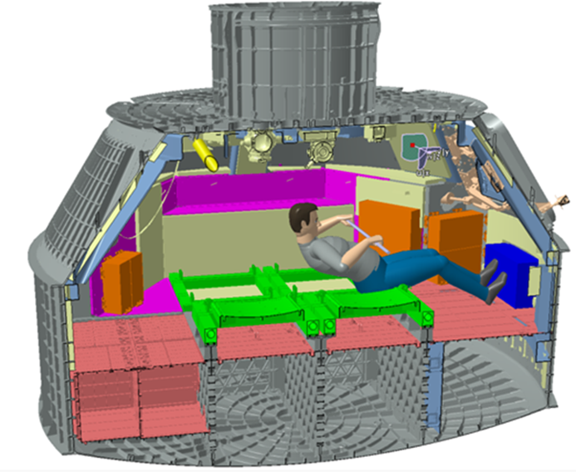
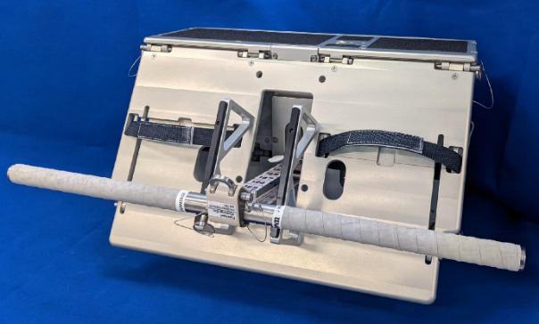
FLYWHEEL DEVELOPMENT AND EVALUATION
J. Boyer¹ , L. Gomes² , M. Roper¹, R. Schulte¹
¹NASA Johnson Space Center, Houston, TX, ²KBRwyle, Houston, TX
OVERVIEW
As part of the effort to mitigate the effects of spaceflight on the human body, an exercise device is in development for use on Orion as required by the MPCV Human System Integration Requirements (HSIR) document. HS6032 states that the system shall provide the capability for aerobic and resistive exercise training for 30 continuous minutes each day per crew member for missions greater than 8 days. The concept for the flywheel exercise device was developed to satisfy the exercise capability requirement as well as to provide a mobility aid for ingress and egress of suited crew members (a step). As the overall Artemis architecture evolves, so does the role of Orion and its crew. This evolution, along with the inherent challenges of new hardware development resulted in changes to the Flywheel project plan, driving resource impacts that this request helped to mitigate.
DESIGN
Figure 2. CAD representation of Orion Flywheel Exercise
The flywheel design is comprised of the device itself (which will be hard mounted to the vehicle), the software system, and the auxiliary hardware. The device will provide the crew with the ability to perform aerobic exercise and/or resistive exercise for a total of 30 mins per day for each crew member. It will do so as a function of user input based on the inertial characteristics of the rotating mass. The device will also double as a step to assist ingress and egress via the side hatch. The software system will work by having software in the flywheel and software in the Portable Computing Device (PCD). The flywheel software will receive sensor data and transmit it to the PCD for data calculation, display, and archival purposes. The display in the PCD will provide real time feedback to the crew and allow for optimization of their exercise routines. In addition to the flywheel device that is mounted to the Orion spacecraft, other hardware will be included to allow for proper performance of the different modes of exercise. The system will include an exercise bar, foot guard, foot restraint, squat harness, USB cable and heart rate monitor. These will allow the astronauts to row for aerobic exercise and to perform harness squats, deadlifts, deadlift high pulls and bent over rows for resistance. During the course of the mission, the flywheel will allow for 500 load setting changes and no power will be required to perform the exercise itself (only for data collection via the PCD). In terms of the system architecture, the flywheel is comprised of the mechanical assembly, the software system and the electronics assembly, which also contains the sensors.
DEVELOPMENT/EVALUATION
The flywheel project is currently working to complete qual, limited lifecycle testing and delivery of a flight unit for Artemis II. Mitigations for certain requirements non-compliances (i.e. Acoustics) are being investigated and a decision gate with the Orion Program to approve a project plan for an Artemis III+ hardware design that implements changes to address the non-compliances is targeted for early 2023. The Artemis III+ project plan will include a proposal for longer duration lifecycle testing of 5 missions of 21 days with 19 days of 30 mins of exercise per crew member.
PROGRESS
Artemis II flight unit build completion is scheduled for February 2023. Artemis II flywheel acceptance testing is set to take place in March 2023. Artemis II qual testing is set to be finished by the end of February 2023. Flight unit is scheduled for delivery for Artemis II by May 12th 2023. Working with Orion Program to finalize plan for Artemis III+ Flywheel design.
In late 2022, HRP provided additional funding to build a Class III Flywheel ground unit to support future crew training and research. Manufacturing began in Dec 2022 and is expected to take 8-10 months to complete.
ACKNOWLEDGEMENTS
Funded by NASA Human Research Program as a Rapid Response Project.
Figure 1. Hardware: Flywheel Exercise Device

