Slide 1
Space Radiation (SR) Welcome
THE STATE OF THE SPACE RADIATION ELEMENT
S. Robin Elgart
TRANSCRIPTOMICS-BASED MACHINE LEARNING ANALYSIS PREDICTS SPACE EXPOSED MURINE LIVERS
Parastou Eslami
VERIFICATON OF NASA GALACTIC COSMIC RAY SIMULATOR FOR LARGE ANIMAL MODELS
Shirin Rahmanian
NSRL USER GROUP: BIOLOGY, PHYSICS & OPERATIONS
Peter Guida
NCRP SC 1-27: EVALUATION OF A SEX-SPECIFIC DIFFERENCE IN LUNG CANCER RADIATION RISK AND APPROACHES FOR IMPROVING LUNG CANCER RADIATION RISK PROJECTION
Kathryn Held

Slide 2
THE STATE OF THE SPACE RADIATION ELEMENT
S. Robin Elgart, Ph.D.
Space Radiation Element Scientist

Slide 3
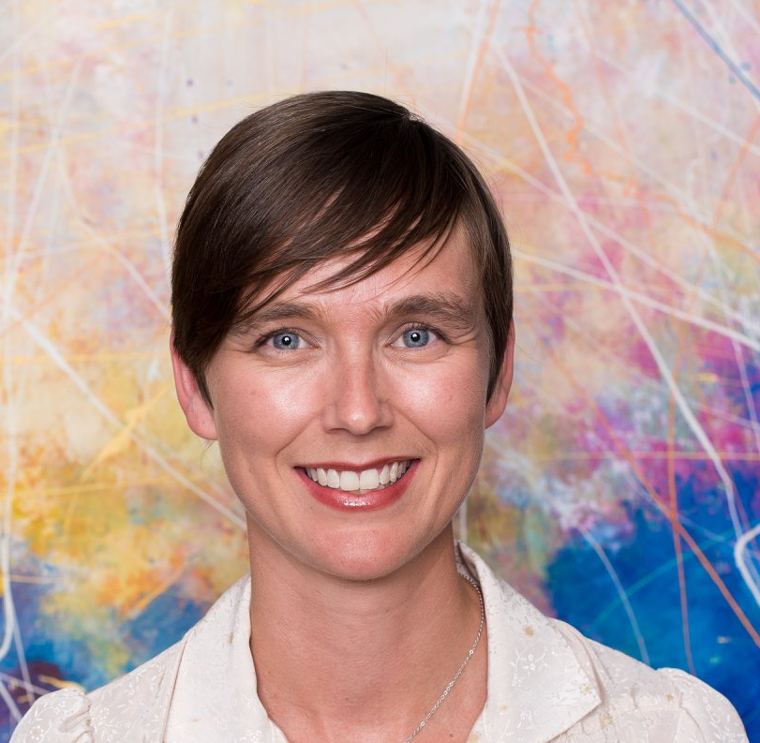
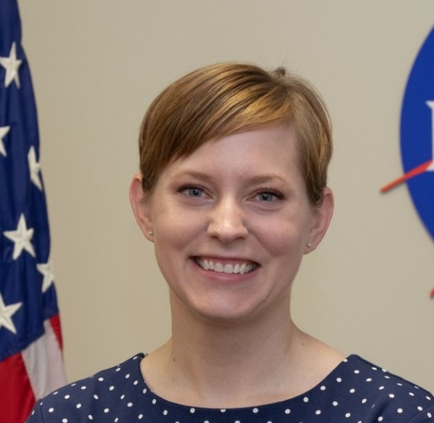
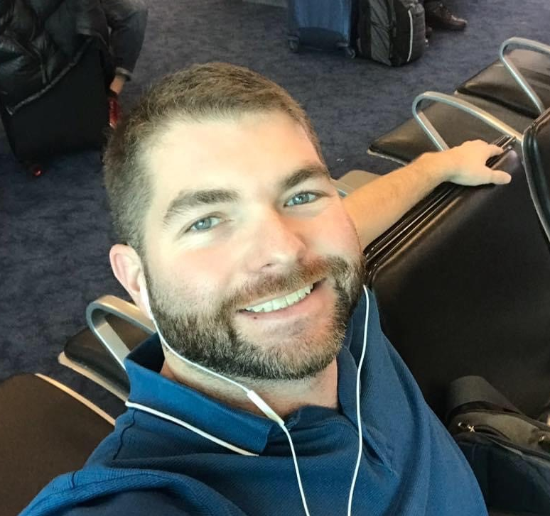
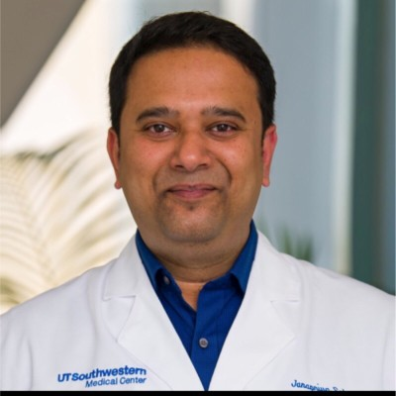
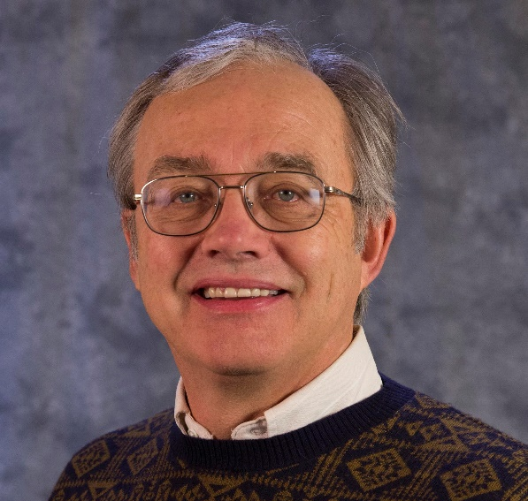
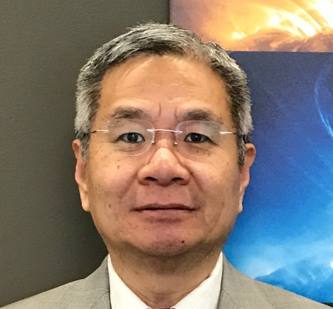
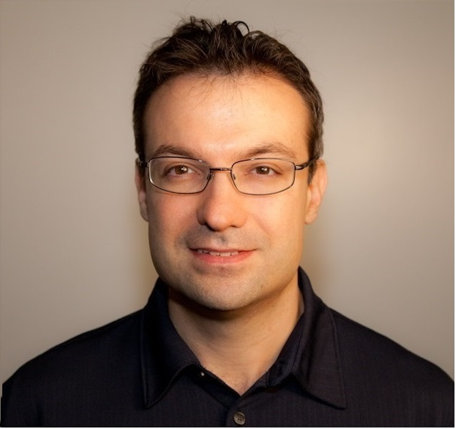
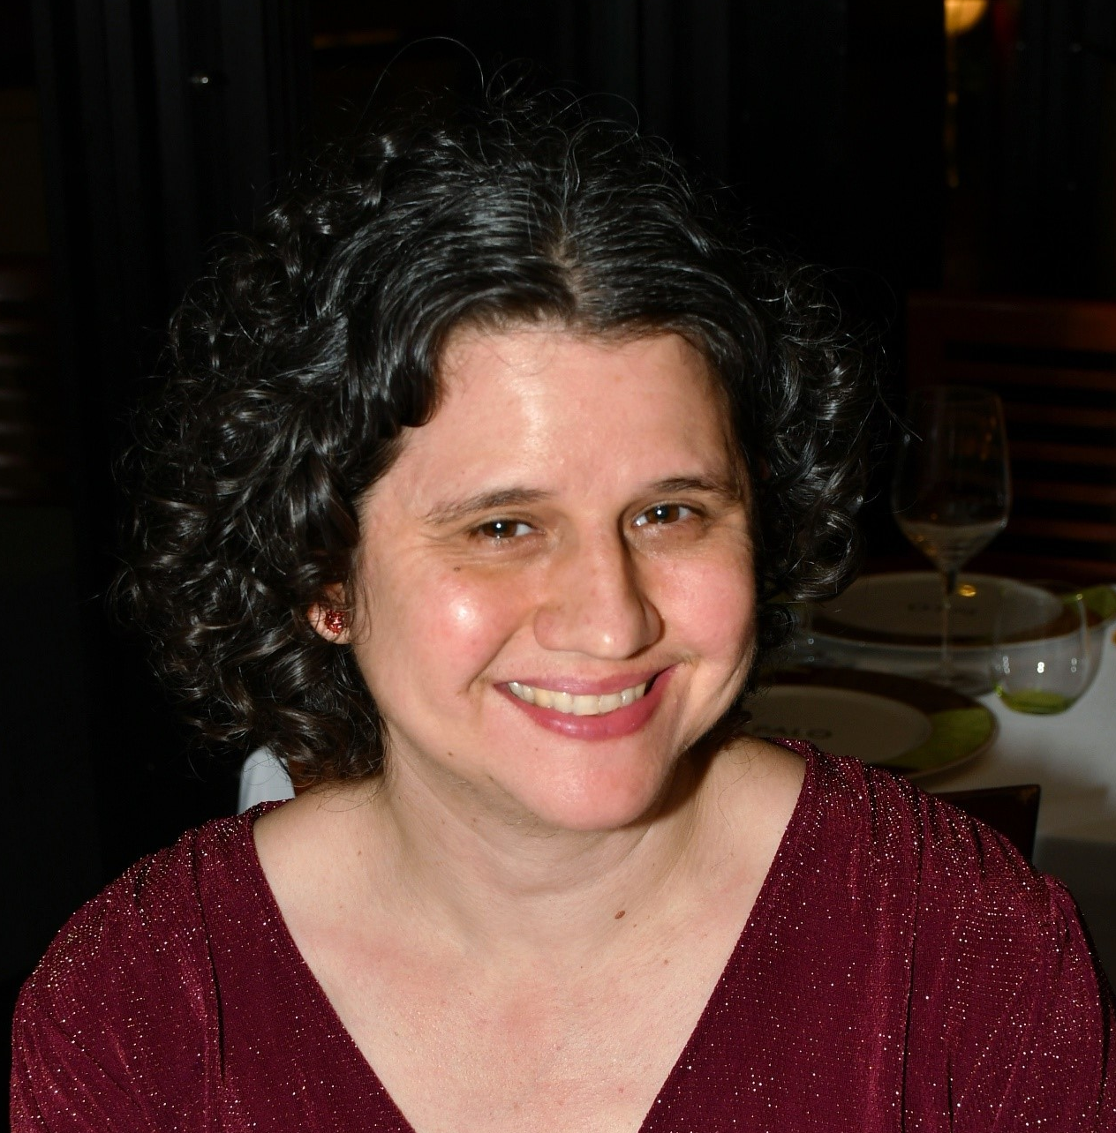
Science Team at Johnson Space Center (JSC)
Robin Elgart
SRE Scientist
Janice Zawaski
SR Deputy Element Scientist
Brock Sishc
Cancer Discipline Lead
Janapriya Saha
CVD Discipline Lead
Greg Nelson
CNS Discipline Lead
Honglu Wu
Sr. Research Scientist
Ianik Plante
Sr. Research Scientist
Lori Chappell
Statistician

Slide 4
Highlights
TISSUE
LSSR edition
Robin live Artemis interview/podcast

Slide 5
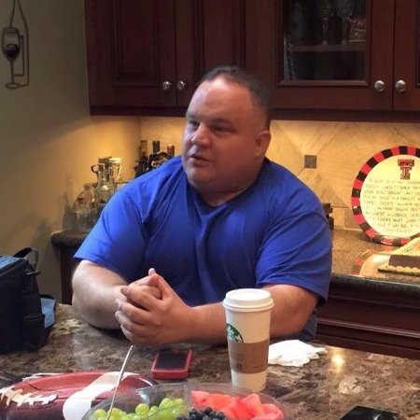
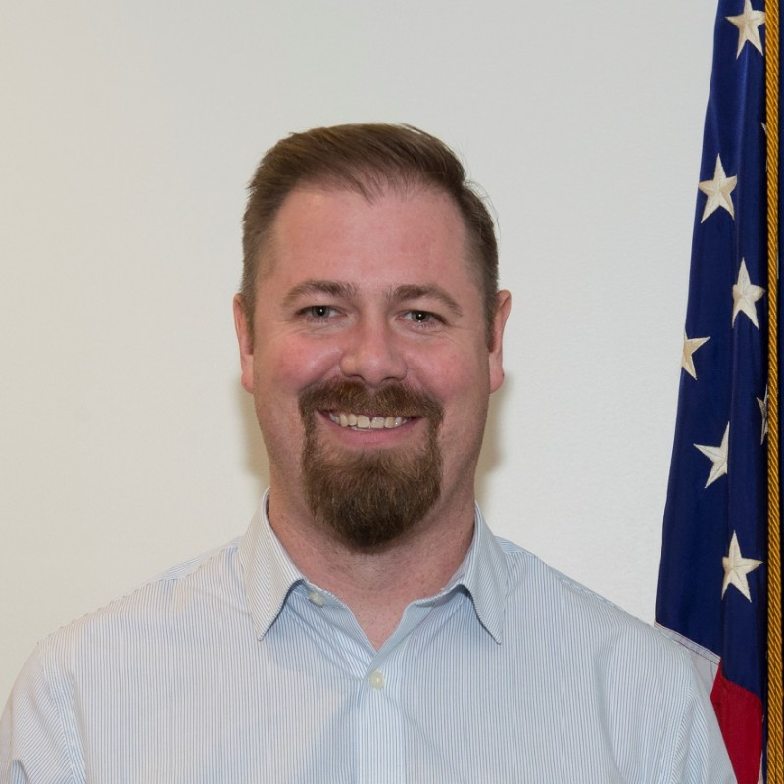
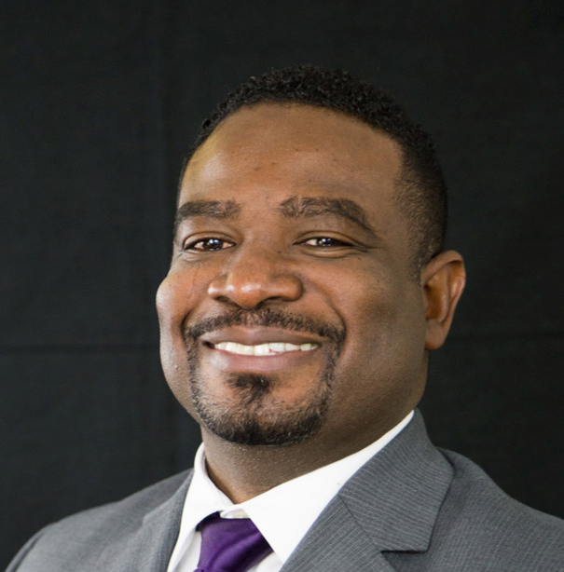
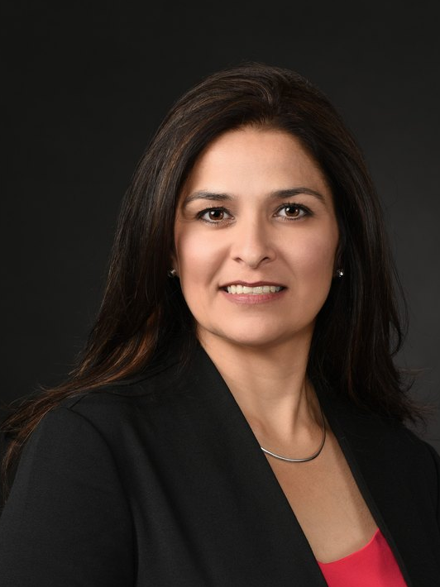
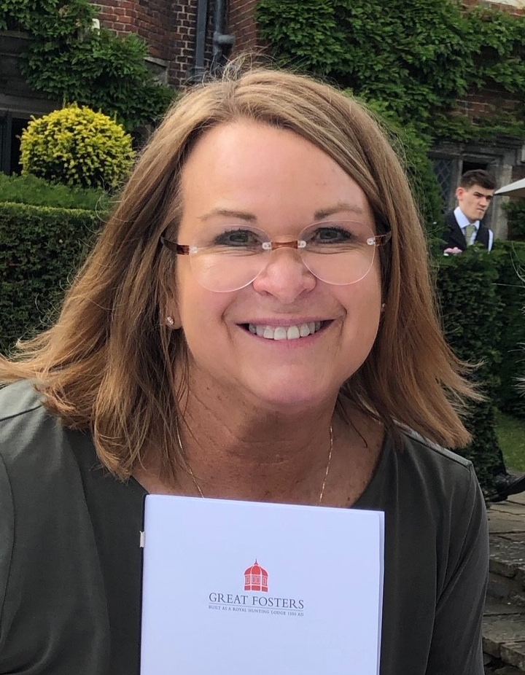
Space Radiation Management Team
Jason Weeks
SRE Manager
Ryan Normal
Acting SR Deputy Element Manager
Jordan Rhone
Science Integrator
Keli Woolery
Financial Analyst
Jennifer Lett
Scheduler

Slide 6
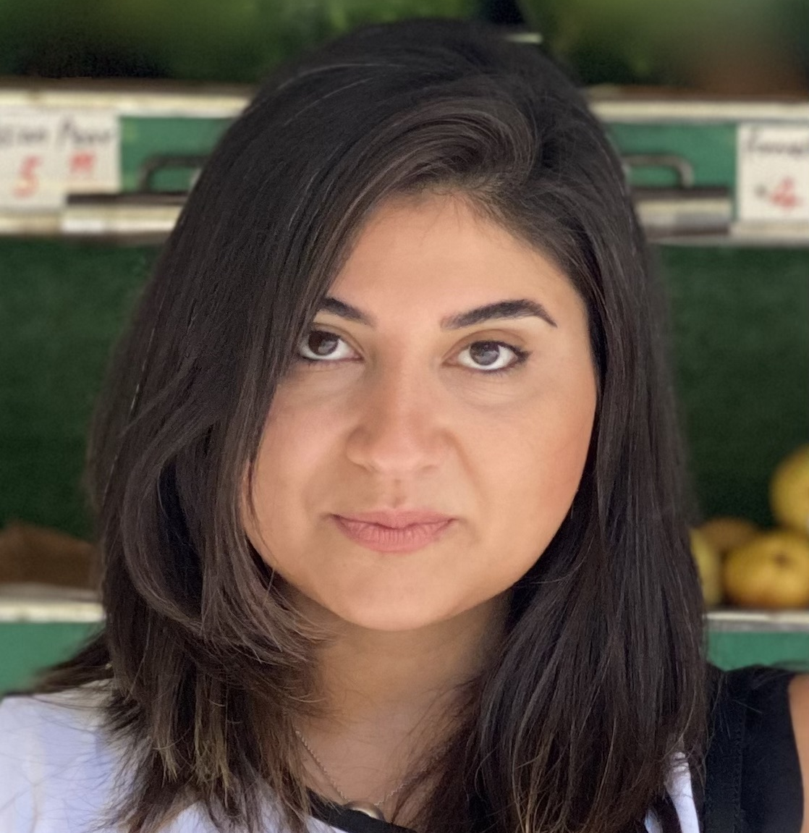
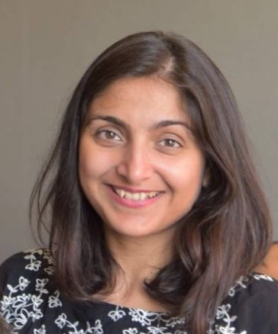
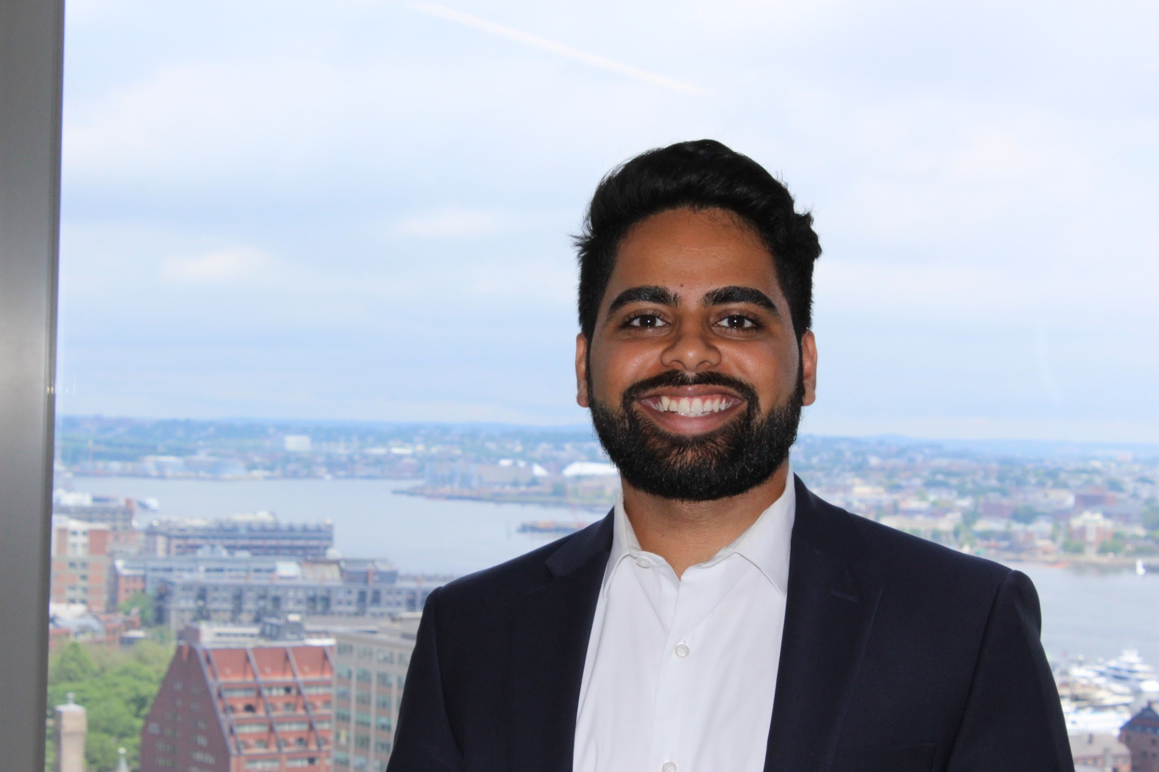

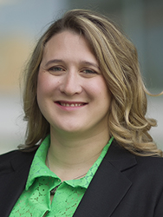

TRRaC – Translational Radiation Research and Counter Measures
Studies effect of space radiation on system biology and identifies molecular pathways and changes caused by radiation
Parastou Eslami
Project Scientist
Prachi Kothiyal
Computational Biologist
Hari Ilangovan
Data Scientist
Greg Eley
Subject Matter Expert
(translational research)
Katherine Hoadley
Cancer Genomicist

Slide 7
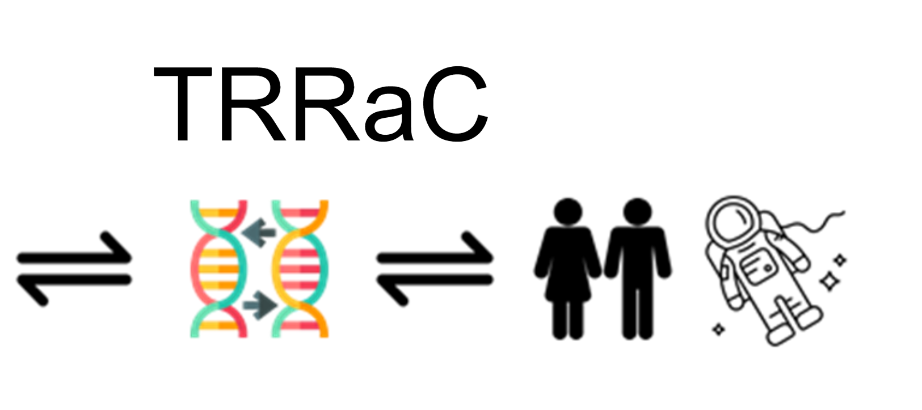
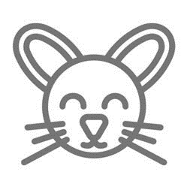
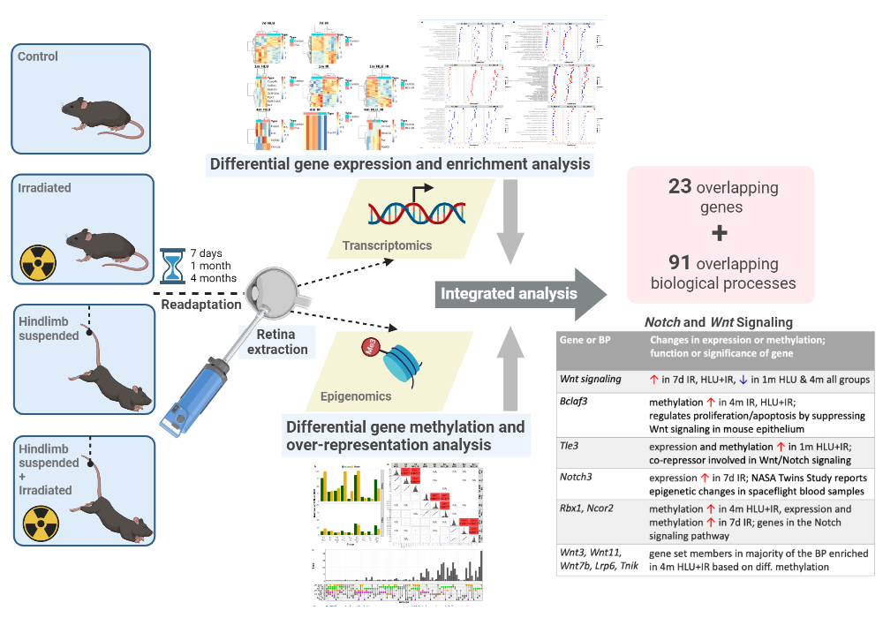
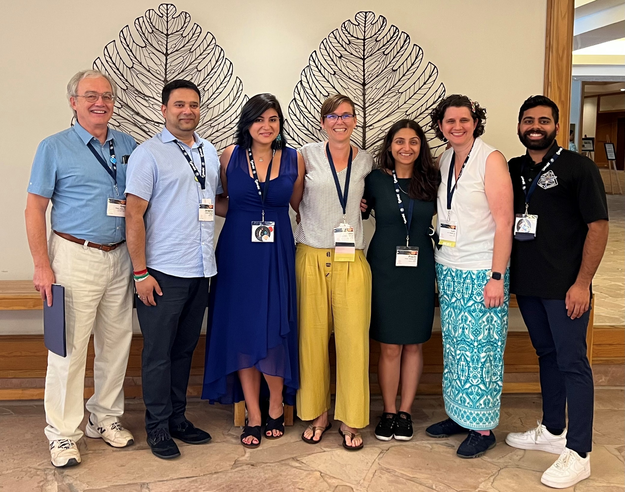
Deliverables:
Published findings on longitudinal effects of space radiation and microgravity on murine retina in Scientific Report Journal. DOI: 10.1038/s41598-022-19360-9
    Open-source code available for the pipe-line developed for the retina paper tinyurl.com/ykn6889e
      Developed methods to harmonize and curate omics related data for machine learning analysis (methods to be published) on 6 different space-flight liver studies.
Presentations:
  IWS 2022 & Rad Res 2022 (both one oral and one poster)
Developing and establishing cloud-based data transfer architecture and pipeline development
Collaborated with two external PIs on the in vivo data

Slide 8
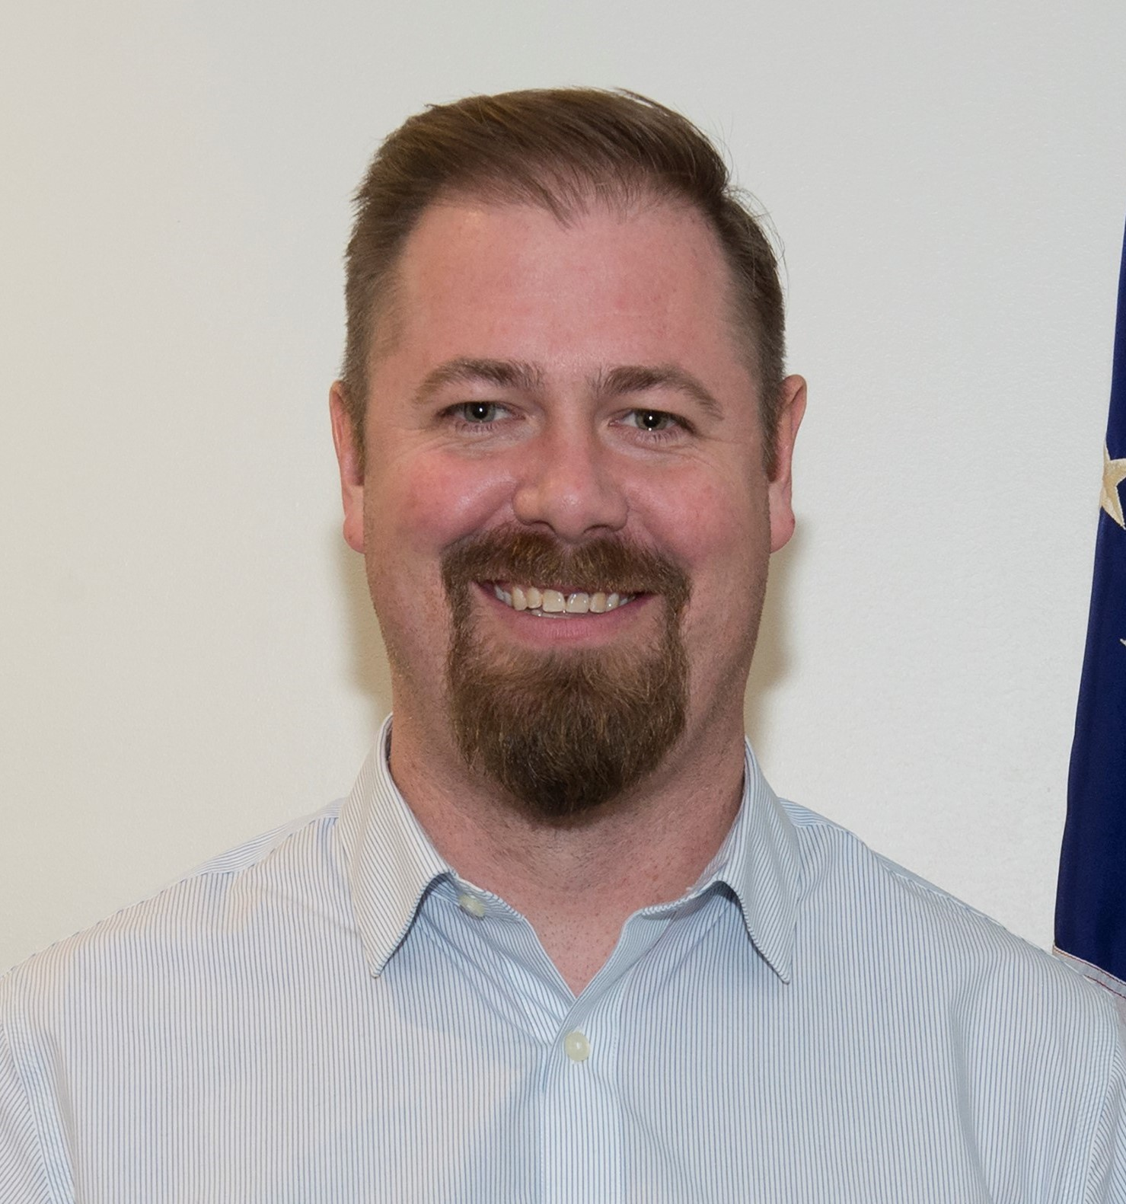
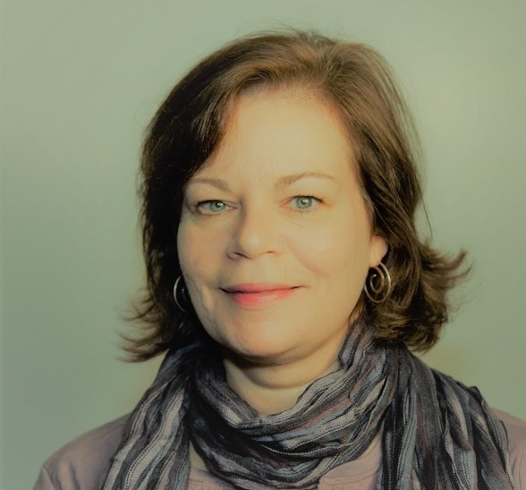

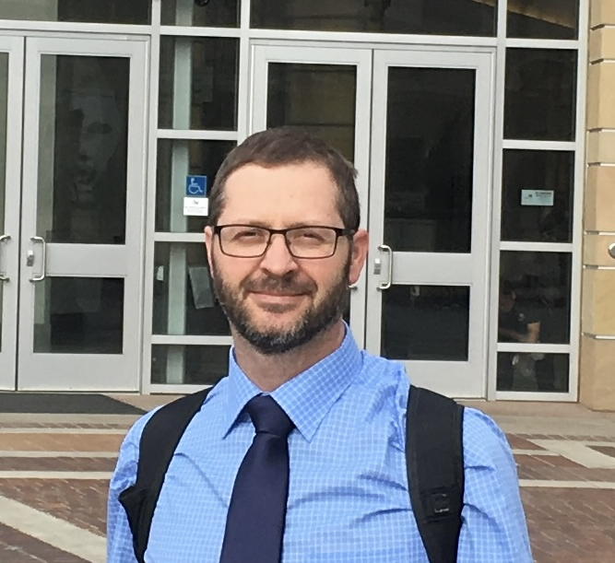
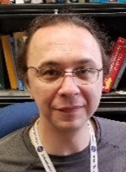
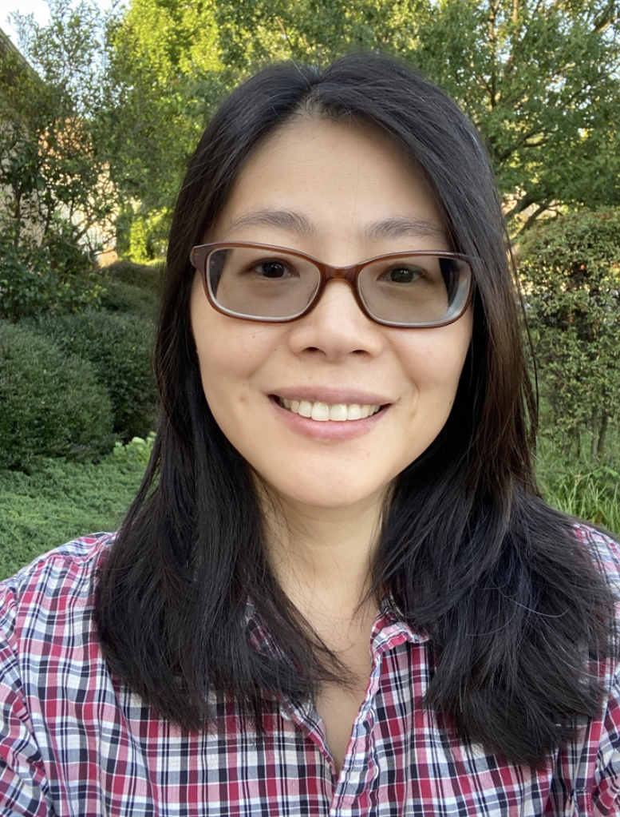
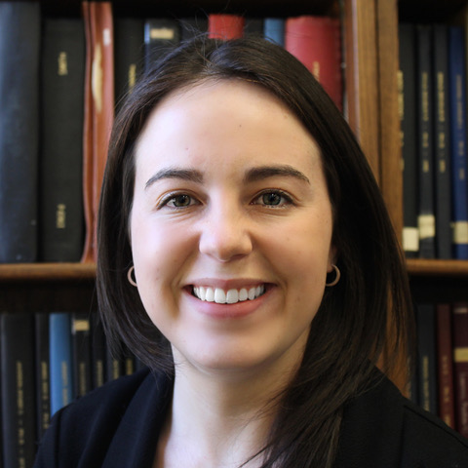
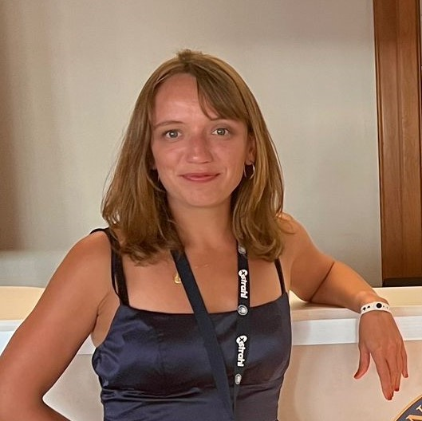
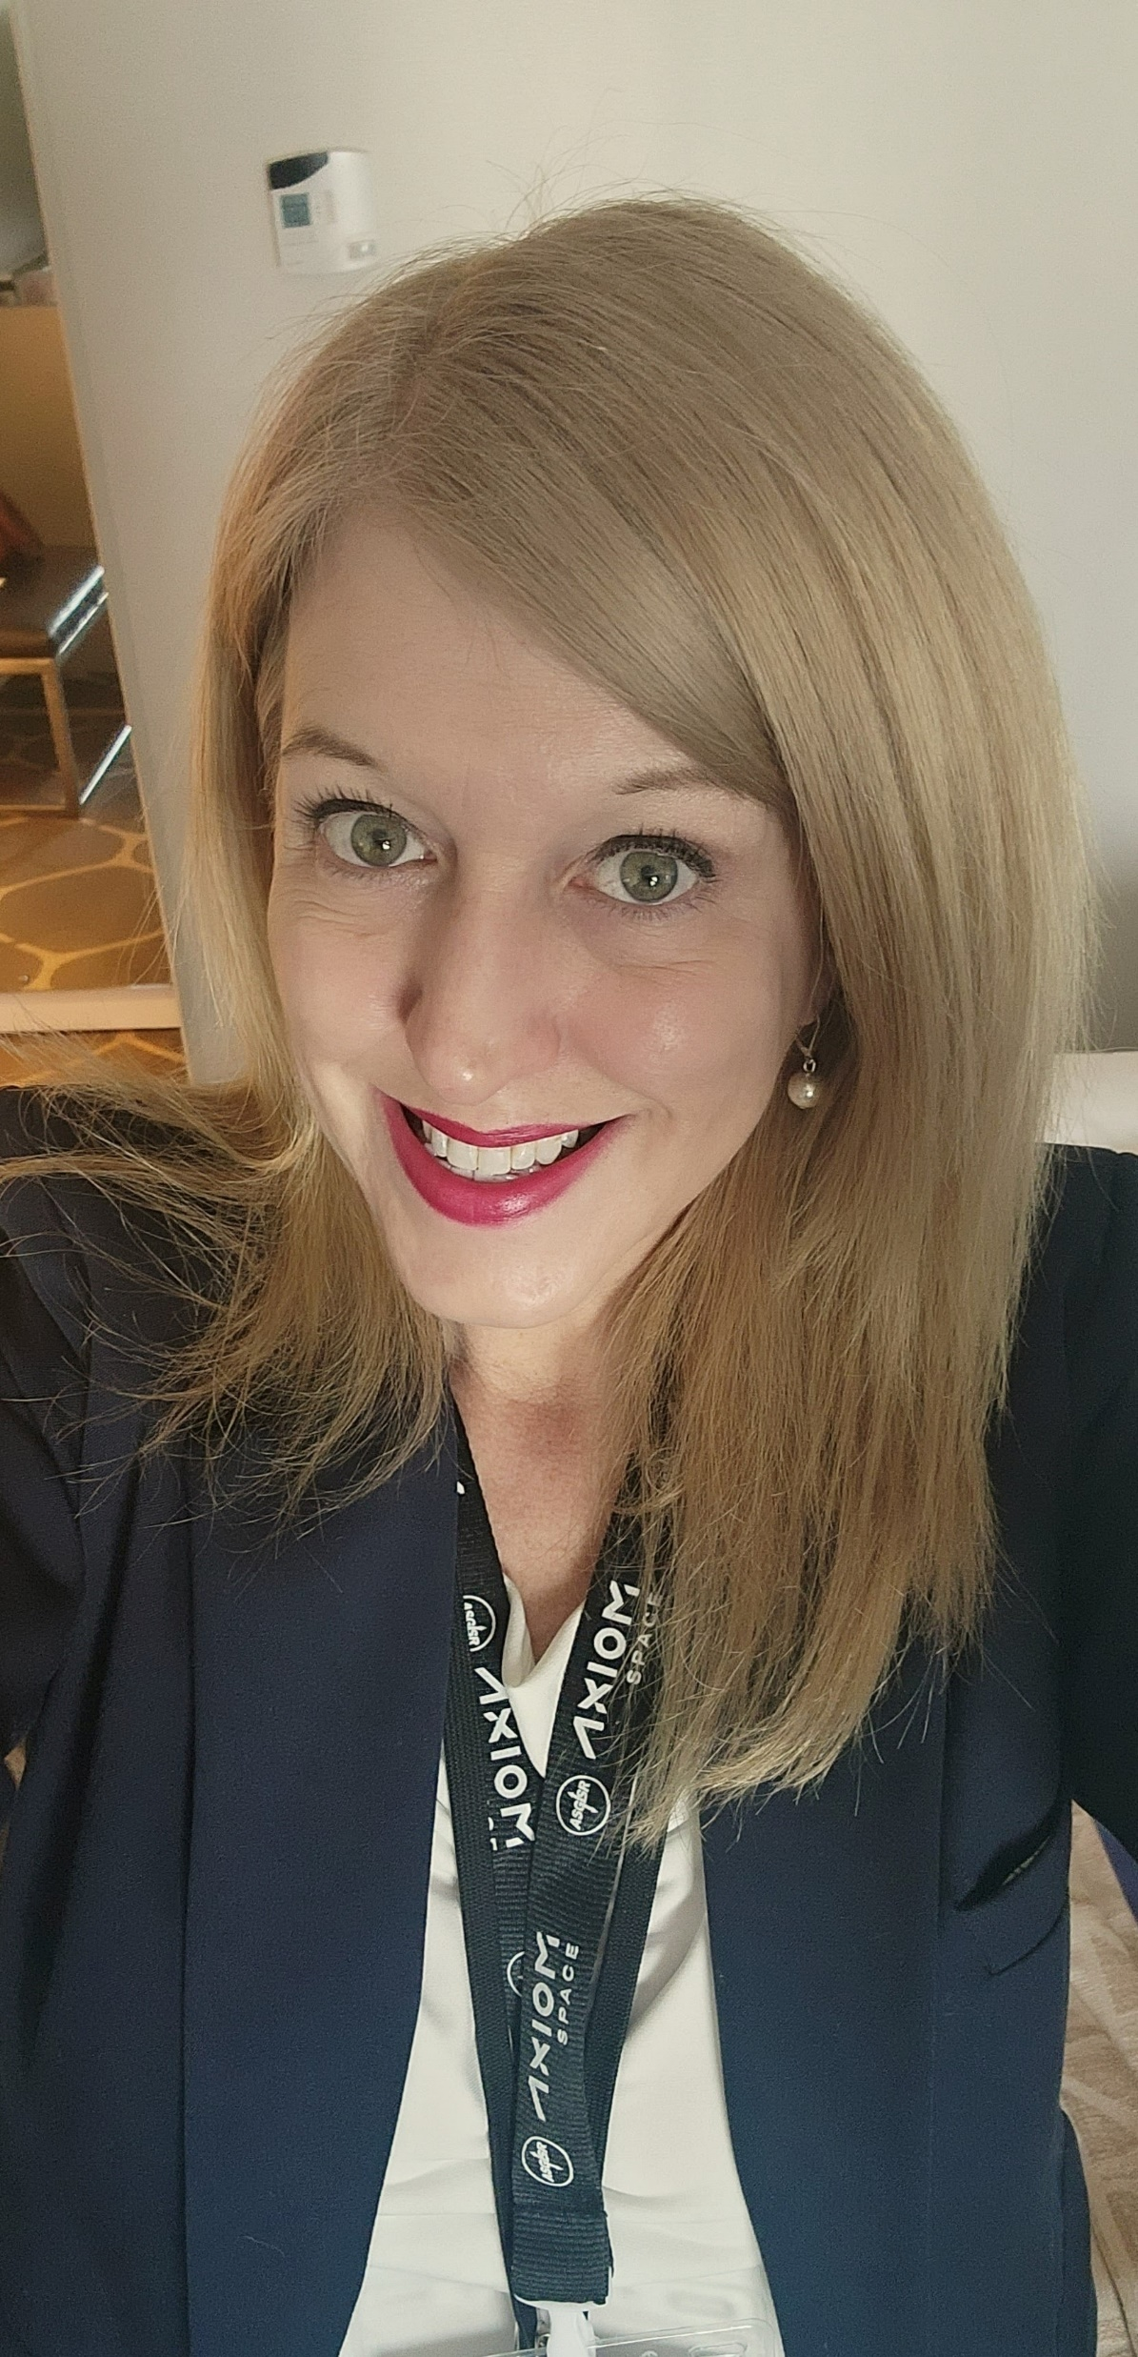
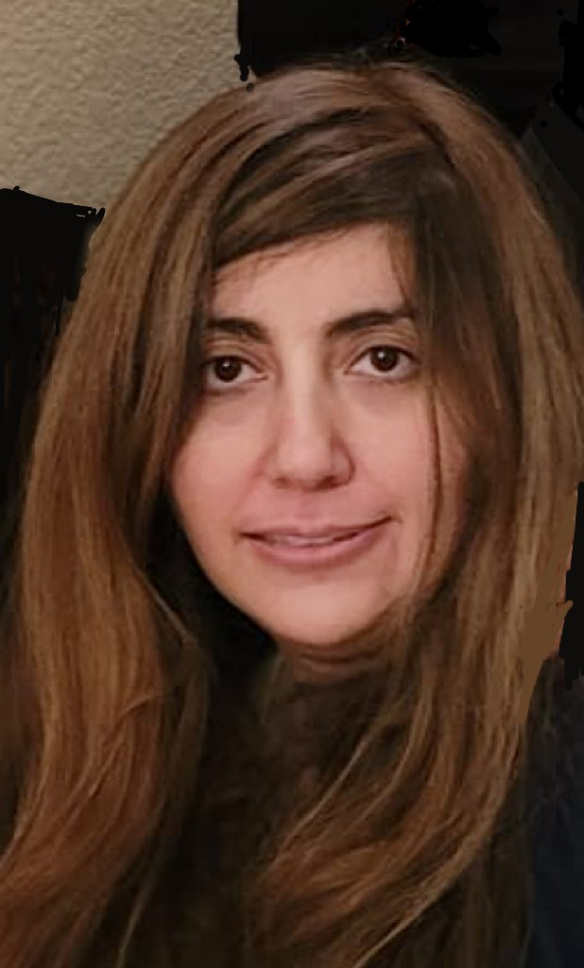
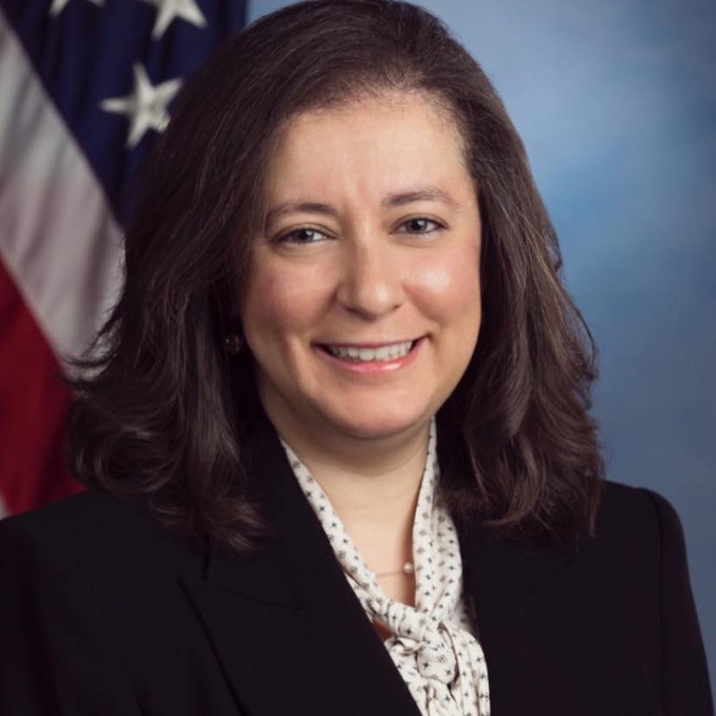
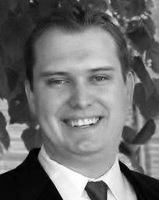
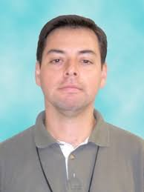
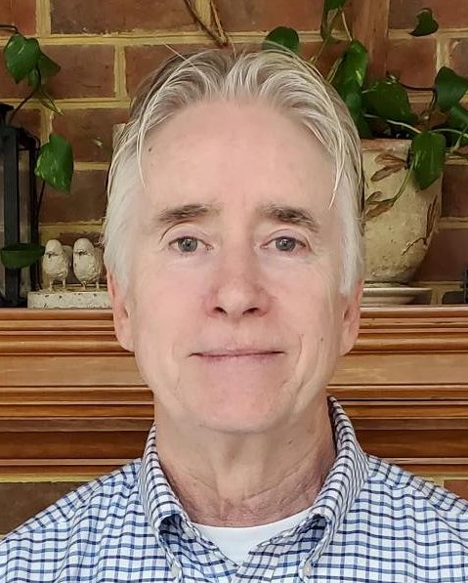
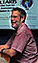
Multi-model Ensemble Risk Assessment (MERA)
Developing space radiation risk models and tools
Ryan Norman
Project Manager
Janice Huff
Individualized Risk Lead
Tony Slaba
Cancer Lead
Charles Werneth
Countermeasures Lead
Steve Blattnig
Cardiovascular Lead
Xiaojing Xu
Research Scientist
Ianik Plante
Sr. Research Scientist
Kathleen Miller
Research Scientist
Floriane Poignant
Research Scientist
Jennifer Butler
Research Scientist
Shirin Rahmanian
Research Scientist
Rania Ghatas
Research Engineer
Ron Daiker
Research Engineer
Luis Crespo
Research Engineer
Sean Kenny
Research Engineer
Chris Sandridge
Research Engineer
Notes:
Most important is to give us a headshot and name and title. We may move it around after we receive it.

Slide 9

2022 MERA Team Accomplishments
Milestones:
  MERA: External Project Review Completed
  MERA CVD: AstroCHARM implemented for Individualized RICVD risk
  MERA Cancer: Cancer Ensemble Beta Software implemented
Presentations:
  Miller et al., Synthesis of the Evidence Base Relevant to the Space Radiation Environment: Exploring Vascular and Neurovascular Contributions to Dementia. International Society of Neurovascular Disease
  Butler et al., An Approach to Quantitative Risk Assessment for Combined Spaceflight Hazards: Evaluating the Impact of Short Sleep Durations on Crew Cardiovascular Health. ASGSR, Dec 2022.
  Miller et al., Framework for Neurovascular Contributions to Dementia in Space Radiation Relevant Exposures. Rad. Res., Oct 2022.
  Poignant et al., Chromosome intermingling favors the formation of radiation-induced chromosome aberrations, Rad. Res., Oct 2022.
  Rahmanian et al., Applicability of NASA Galactic Ray Simulator for Large Animal Experiments, Rad Res., Oct 2022.
  Plante et al., Evaluation of spaceflight cardiovascular risk using the clinical prediction model AstroCHARM and the NASA radiation risk model, Rad. Res., Oct 2022.
  Huff et al., Considering the Combined Hazards of Spaceflight and Implications for Comprehensive Radiation Risk Assessment. COSPAR, July 2022.
  Werneth et al., Clonal Hematopoiesis of Indeterminate Potential and the Risk of Exposure Induced Death for Mars Mission Scenarios, Health Phys., July 2022.
  Werneth et al., Inflight and lifetime risk of radiation exposure induced death associated with clonal hematopoiesis of indeterminate potential for Mars mission scenarios, COSPAR, July 2022.

Slide 10

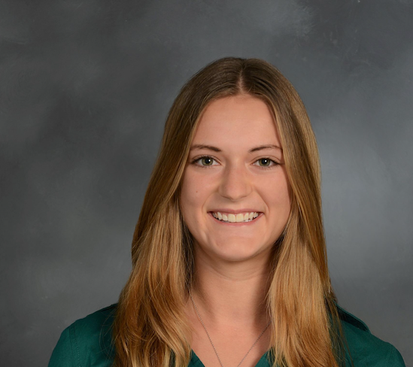
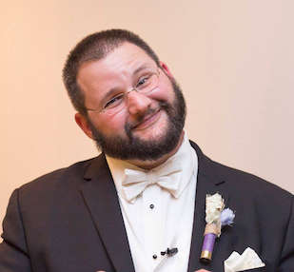
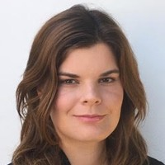
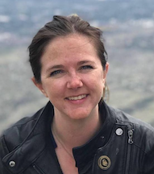
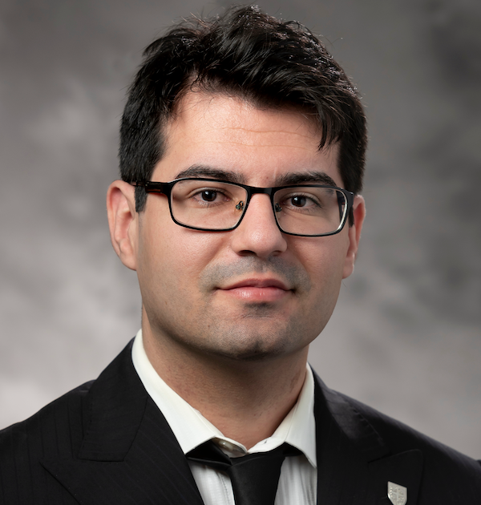
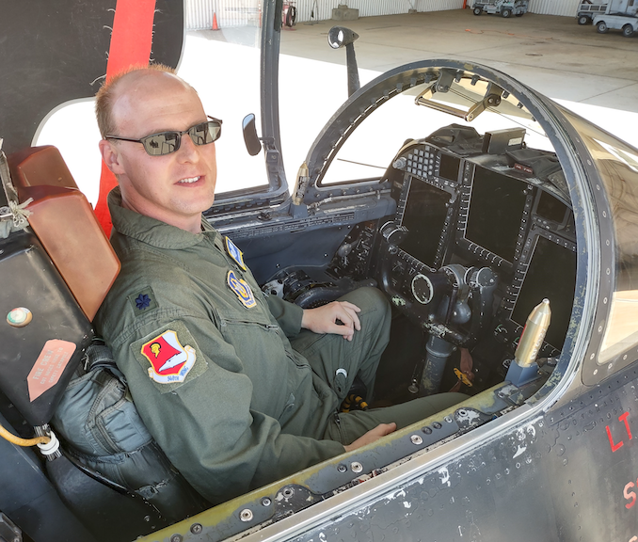

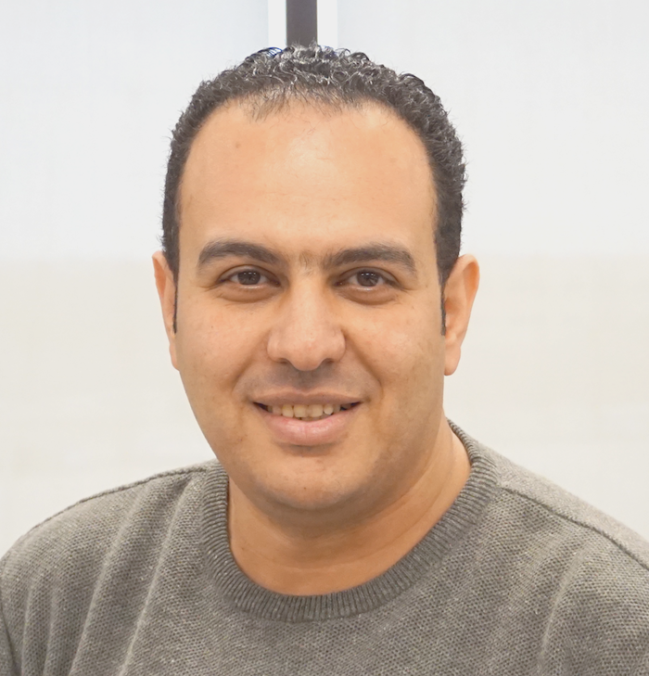
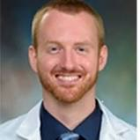
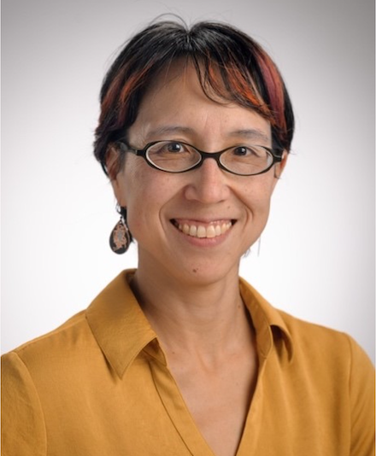

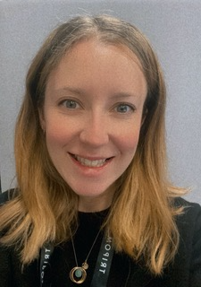
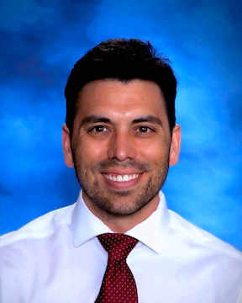
SHINE 2023 Participants
Developing space radiation risk models and tools
Borja Barbero Barcenilla Post-Doctoral Fellow, Texas A&M
Marissa Burke
Ph.D. Candidate, Weill Cornell Graduate School and Houston Methodist
Walter Cromer, Ph.D.
Assistant Professor, Texas A&M University
Victoire DeJean, Ph.D.
Post-Doctoral Fellow, UCLA
Lena Heffren, Ph.D.
Post-Doctoral Fellow, Southwest Research Institute
Jordan Houri, MS
Lead Scientist, Space Exploration, StemRad, Inc
Joseph Clayton Hudson, MD, Coordinating Doctor/Flight Surgeon, International SOS/USAFR
Anna Jurga, Ph.D.
Research Assistant,, Wroclaw University of Science and Technology
Khaled Y Kamal, Ph.D.
Assistant Research Scientist, Texas A&M University
Stephen Kunkel
MD-PhD Candidate
UTMB Galveston
Jessica A. Lee, Ph.D.
Research Scientist NASA Ames
Sneha Mehta
MPH Candidate, Columbia U.
Kathleen Miller, Ph.D.
Research Scientist, Nationa
l Institute of Aerospace
Dr. Samantha Moore
Anaesthetic ST5 Doctor & Honorary Researcher, Lancaster University
Nicolas G. Nelson
Medical Student (MS4), Thomas Jefferson Universityd
Notes:
Most important is to give us a headshot and name and title. We may move it around after we receive it.

Slide 11
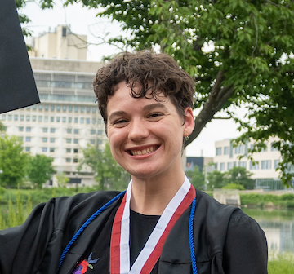
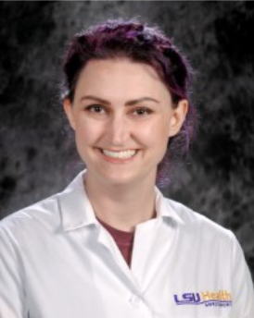
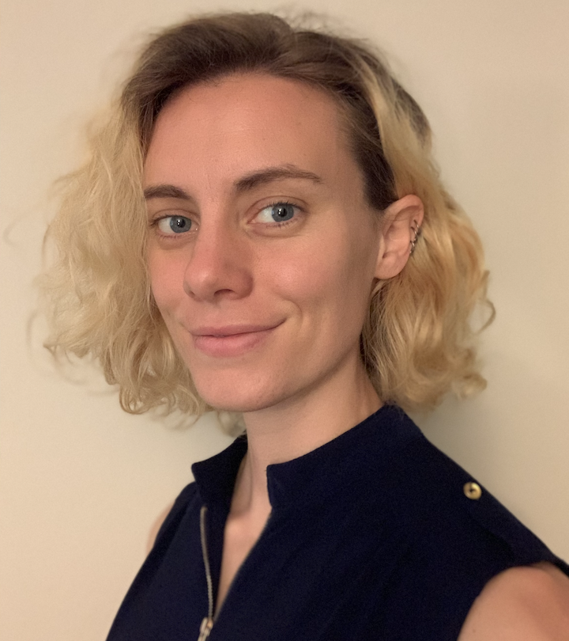
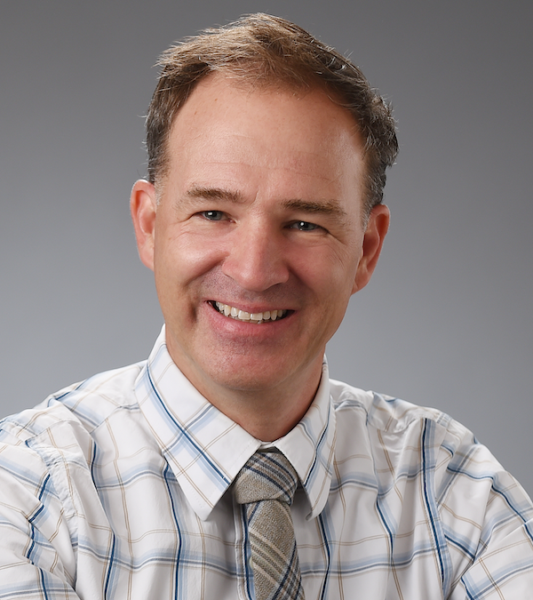





SHINE 2023 Participants
Developing space radiation risk models and tools
Kat NIlov
Ph.D. Candidate, Northeastern University
Floriane Poignant, Ph.D.
Research Scientist II, National Institute of Aerospace
Shirin Rahmanian
Research Scientist, National
Institute of Aerospace
Erika Reece, Ph.D.
Post-Doctoral Fellow, LSU Health, Shreveport
Kira Rienecker, Ph.D.
Staff Scientist, Blue Marble Space Institute of Science, NASA Ames
Hansjorg Schwertz, MD-Ph.D.
Adjunct Assistant Professor, Billings Clinic Bozeman
Samuel Shin, MD-Ph.D.
Assistant Professor, University of Pennsylvania School of Medicine,
Molika Sinha, M.S.
Research Scientist, Stanford University
Adrian Specogna, MSc, PhD
Executive Director, Lead Scientist, Prolatent Health Technologies Inc.
Corin Williams, Ph.D.
Principal Member of the Technical Staff, The Charles Stark Draper Laboratory, Inc
Sigrid Reinsch, Ph.D.
Director SHINE Program
NASA AMES Research Center
Notes:
Most important is to give us a headshot and name and title. We may move it around after we receive it.

Slide 12

SHINE
(SHINE) Training Program – Virtual Space Radiation Curriculum
Virtual training program, to learn about the relevant scientific elements of the HRP, targeted to graduate students to potential new investigators with an emphasis on early career investigators.
Aims to educate participants in
  scientific aspects of space radiation
  agency risk management strategies
  Coffee hours for less formal networking
  Opportunity to develop a beam time proposal
  with guidance/office hours
Future years, will include a competitive practicum sessions to plan and conduct space radiation research at the NASA Space Radiation Laboratory (NSRL)

Slide 13





The Health Risk of Extraterrestrial Environments
Viktor Stolc
NASA
Bill Dynan
Emory University
Amelia Eisch
Children’s Hospital of Pennsylvania
George Fornace
Georgetown University
Marianne Sowa
NASA

Slide 14









Scientific Advisory Committee for Radiation Research (SACRR)
SACRR reviews and evaluates all PI BNL beam time proposals
Polly Chang
SRI International
Bill Dynan
Emory University
Sandeep Burma
University of Texas,
San Antonio
Marjan Boerma
University of Arkansas
for Medical Science
Cynthia Lemere
Brigham and Women’s
Hospital
Catherine Davis
Uniformed Services University of the Health Sciences
Manuela Buonanno
Columbia University
Peter Grabham
Columbia University
Helio Takai
Pratt Institute
James (Jim) Kierstead
Brookhaven National Laboratory
Notes:
Most important is to give us a headshot and name and title. We may move it around after we receive it.

Slide 15





THANK YOU’S
Walter Schimmerling
THREE
Edward Azzam
SACRR
Dudley Goodhead
THREE
Derek Lowenstein
THREE
Stanley Curtis
THREE

Slide 16
omnibus future budgets
Applied research program
REMINDERS

Slide 17




Other Granting Opportunities
NASA Space Technology Graduate Research Opportunities (NSTGRO)
  tinyurl.com/3sppk24b
  Technology Taxonomy TX6 Overlaps with HRP
Translational Research Institute for Space Health (TRISH)
  tinyurl.com/2p86t9d5
Space Biology tinyurl.com/2uvm4vkw
Small Business Innovative Research (SBIR) (No topics for 2022)
  tinyurl.com/4s9dys5p
Established Program to Stimulate Competitive Research (EPSCoR)
              tinyurl.com/4tyt7cft

Slide 18



Other Granting Opportunities
Future Investigators in NASA Earth and Space Science and Technology (FINESST)
  tinyurl.com/2dymnfhh
  Graduate student opportunity
Established Program to Stimulate Competitive Research (EPSCoR)
  tinyurl.com/4tyt7cft
  Eligible Jurisdictions: Alabama, Alaska, Arkansas, Delaware, Guam, Hawaii, Idaho, Iowa, Kansas, Kentucky, Louisiana, Maine, Mississippi, Montana, Nebraska, Nevada, New Hampshire, New Mexico, North Dakota, Oklahoma, Puerto Rico, Rhode Island, South Carolina, South Dakota, U.S. Virgin Islands, Vermont, West Virginia, Wyoming
NASA Postdoctoral Program (March, July, and November)
  https://npp.orau.org/
Minority University Research and Education Project
  https://www.nasa.gov/stem/murep/home/index.html

