Slide 1



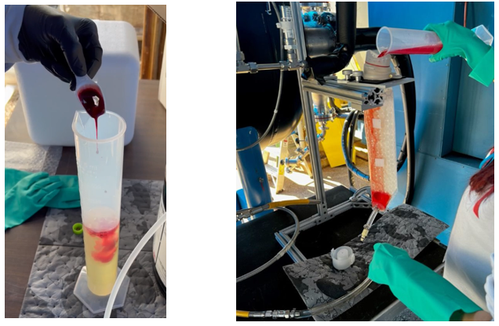
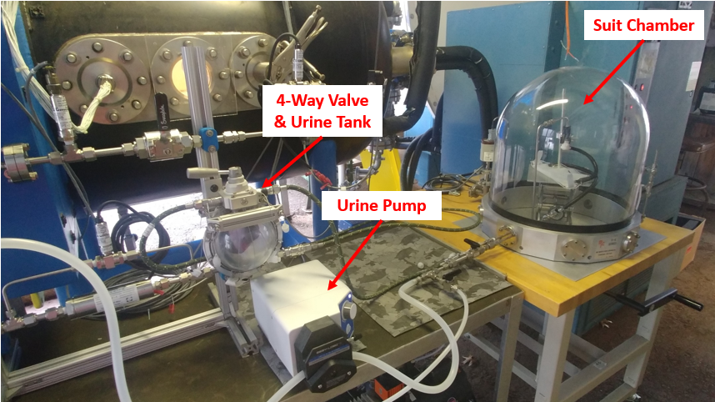
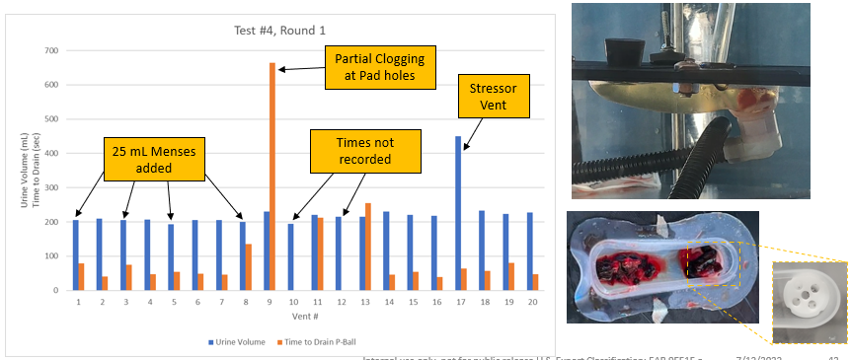
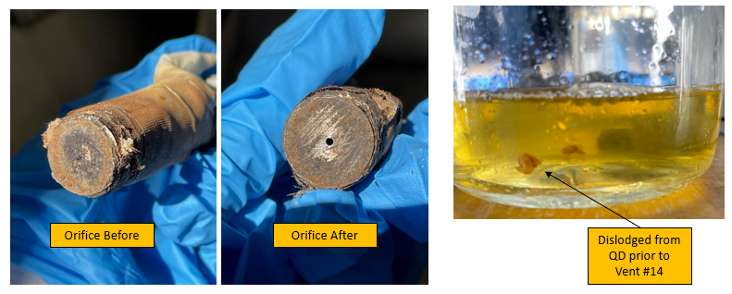
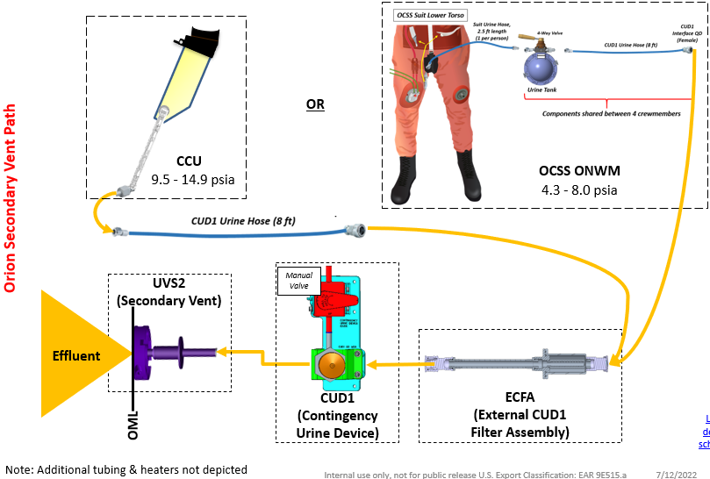
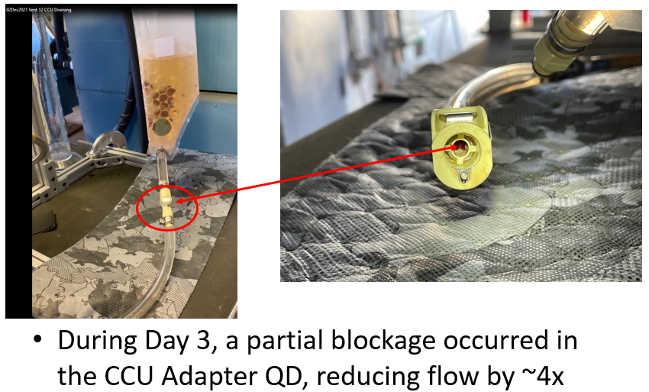
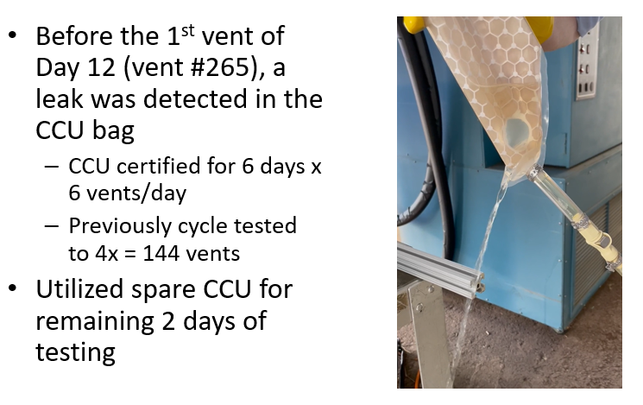
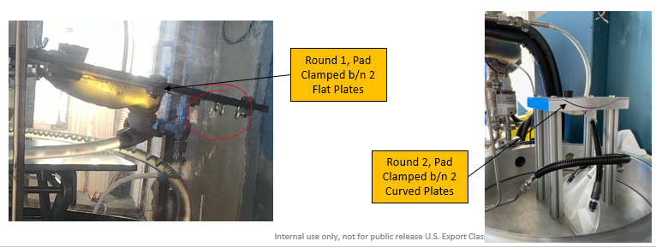
ORION MENSES DISPOSAL TEST PLAN
Ahmed³, K. Berry¹, T. Byrd², C. Haas¹, B. Johnson¹, K. Johnson¹,
E. Klee¹, A. Naids¹, C. Wijeratne, L. Taylor², L. Gomes², and J. Boyer¹
¹NASA Johnson Space Center, Houston, TX, ²KBRwyle, Houston, TX, ³Boeing, Houston, TX
BACKGROUND
TEST SETUPS
OCSS ONWMS RESULTS
In order to support the ability to fly female crew members, menses accommodations were added to the Multi-Purpose Crew Vehicle (MPCV) Human System Integration Requirements (HSIR). Three requirements were added that addressed collection and containment of menses, sanitary products, and consumable wipe materials for menses. Nominally, these requirements will be met through the Universal Waste Management System (UWMS) via a filter the crew places on the urine hose. For off-nominal scenarios, adding these requirements after the hardware design was completed created a gap in knowledge on the hardware’s capability to vent menses overboard. The first off-nominal scenario is the case of a failure of the UWMS toilet for urine collection and/or failure of urine tank venting. This failure would result in the use of the Collapsible Contingency Urinal (CCU) for urine and menses collection, which would be connected to the Contingency Urine Device (CUD1) interface for overboard venting. The second case is a cabin depress scenario in which the 144-hour return contingency plan would be implemented. In this case, the crew members will don their Orion Crew Survival System (OCSS) suit, which includes a waste management system that connects to the CUD1 (off nominal waste management system, ONWMS). In both cases, it is unknown whether the addition of menses to the urine will result in clogging at any portion of the urine flow path overboard. The risk is particularly concerning for the suited scenario as the waste management hardware being worn inside the suit is inaccessible. A clogged filter could result in urine backing up to the crew themselves or an inability of the crew to urinate while suited.
      CCU (Figure 2): The CCU design was modified such that the human interface no longer encompasses the vagina, so the possibility of menses entering the CCU is minimal. Thus, the amount of menses recommended for this testing by the medical operations community was reduced to 60 mL per crewmember and was inserted into the system in multiple doses (see results for details).
      Test Terminated
1st Attempt:
Completed 20 vents total - 4 included menses (25 mL each)
    Test Terminated due to hardware leakage and excessive menses clogging at Female Pad and quick disconnect (QD, Figure 6)
            Large clots were present in menses simulant and likely contributed to clogging at female pad
            After troubleshooting ONWMS clogs and allowing system to sit over weekend (not realistic to flight), Vent Nozzle was observed to have dry residue obstructing 0.056” orifice – scraped off with knife
            Still no flow after removing residue indicates blockage was upstream (later confirmed, Figure 7)
Figure 2. CCU Test Setup
      OCSS ONWMS (Figure 3): Planned to insert 100mL per crewmember into the test setup on day one but distribute the amount over the day in multiple doses (3-4) instead of inserting 100mL all at one time. The next day, planned to insert the remaining 15mL per crewmember in the same fashion.
Figure 3. OCSS ONWMS Test Setup
Figure 6. OCSS ONWMS Menses Clogging
CCU RESULTS
SPECIFIC AIM
      Passed
Modified protocol from baseline plan to increase duration to 13 Days (per Orion Program, adding margin: 7 days in near-rectilinear halo orbit [NRHO] + 6 for Return)
Urine was added to the system at 333 mL/vent x 24 vents/day x 13 days = 312 total vents, with a flight-like CCU
Menses simulant was added per the following:
  Day 1: 5 mL x 6 vents
  Day 2: 5 mL x 12 vents
  Day 3: 5 mL x 6 vents
Total Volume vented (urine + menses) = ~105 L
Observations:
  Partial blockage due to menses observed on Day 3 (later cleared on its own after sitting the weekend, Figures 4 and 6)
  CCU Leaked after vent #264 (hardware is only certified for 36 cycles, so not considered Fail, Figure 5)
  Non-flight like orifice developed excessive ice buildup but did not impede venting
Thus, the primary specific aim of this project is to determine if a urine-menses flowrate can be maintained through the system that equals the expected input from the crew in the suited case or that equals an acceptable minimum flowrate in the CCU case.
Figure 7. OCSS ONWMS Vent Orifice Clog
2nd Attempt - Test setup and protocol updated with lessons learned from 1st attempt:
      Redesigned fixture for Female interface to be more representative of human body (Figure 8)
            Curved rather than flat (fixed leakage issue)
      Screened out any clots larger than “nickel-size” from simulant prior to inserting into test (more representative)
      Reduced menses schedule to the following:
            Day 1: Inserted 50 mL per crewmember (x2)
    Distributed over multiple doses (12.5 mL each x 8)
            Day 2: Inserted the remaining 15 mL in the same fashion (x2)
      New Objective:
            Determine capability of current hardware (stressor vents)
METHODS
Test setup included either the CCU or the OCSS ONWMS flight-like or representative hardware attached to the External CUD1 Filter Assembly (ECFA) with a MISO valve, tubing, and an orifice. See Figure 1.
Figure 1. Test setup: Equipment Overview
Figure 8. OCSS ONWMS: Redesigned Female Interface
The menses requirements specify that the system shall be capable of collecting and containing a maximum of 115 mL of menses per female crew member per cycle and a maximum volume of 100 mL per female per day. With these values in mind, the test set up assumed two female crew members are on cycle simultaneously which would result in a total capacity of 230 mL of menses simulant (Cocalico Biologicals, Inc.) over the test period. The amount was distributed with urine over any given day in multiple doses to reflect real-life conditions more closely. The test occurred over a period of 6 days with the option to extend further should signs of degradation be seen at the end of the test period. A vacuum source was used to mimic space vacuum for both tests with a second source to keep the OCSS suited waste management hardware at either 4.3 psia or 8 psia. Flow measurements were conducted via a scale to measure urine volume, and vent time was measured with a timer, which were then used to calculate an average flow rate for each vent. Delta-pressure sensors monitored flow resistance to inform any clogging.
2nd Attempt - Results: Experienced degraded system performance (long drain times) and ultimately a clog on vent #11, thus testing was terminated. The team flushed the system with water and proceeded to stressor vents.
Figure 4. CCU Partial Blockage
Figure 5. CCU Leak
OCSS ONWMS CONCLUSIONS
CCU CONCLUSIONS
The CCU was able to vent the required volume and flowrate. Although a partial blockage was observed due to menses, it was easily cleared manually or cleared on its own over time. This indicates that the overboard vent system is capable of venting a urine-menses mixture.
The OCCS ONWMS encountered clogging that was not able to be resolved. The test hardware was shipped back to JSC for disassembly and inspection of individual components, but no clogs were identified in the system most likely due to flushing and stressor vents. The root cause of the clogging is under investigation. Given the conservatism in the testing (2 females menstruating at a time, with the max amount of menses entering the system on one day), and the off-nominal occurrence of a cabin depress event, the risk to the mission is very low. The design of the ONWMS to flow waste for 6 days while minimizing the health risks to the crew will need to be balanced against any design changes to accommodate urine-menses flow.
ACKNOWLEDGEMENTS
Funded by NASA Human Research Program as a Rapid Response Project. Special thanks to Marshall Space Flight Center’s Environmental Test Facility (ET20) for conducting the testing and to Cocalico Biologicals, Inc. for developing and customizing the menses simulant.

