Slide 1
NASA Wildland Fires
–
Notes:
- National policy mandates that federal agencies focus on the protection of life, property, and resources by a risk-based and shared-stewardship approach while leveraging emerging technologies.
- Evolving approaches to wildland fire management – integrating pre-planned
control lines and operational decisions with quantitative risk assessment –
support a safer and more strategic response to fire-prone landscapes.

Slide 2
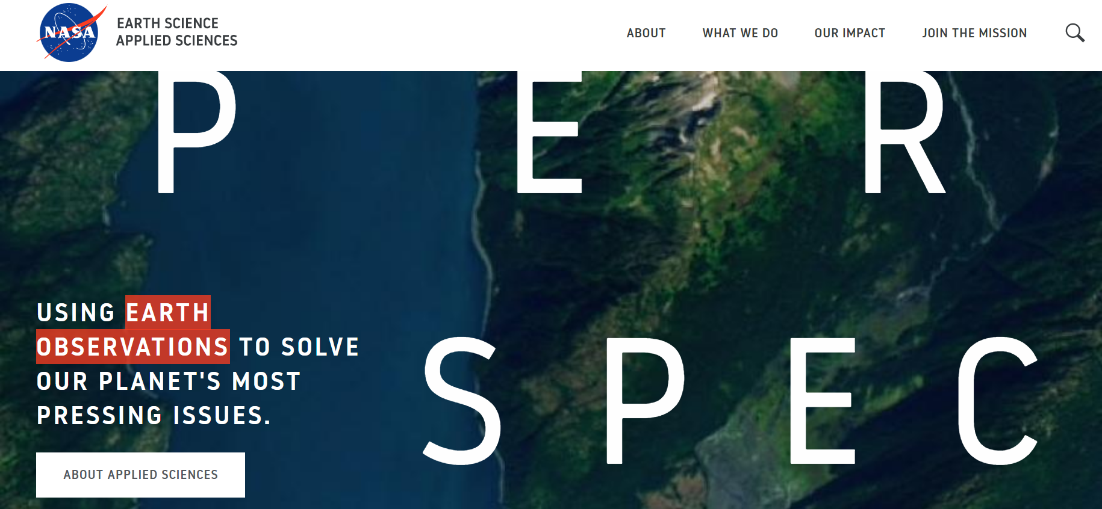
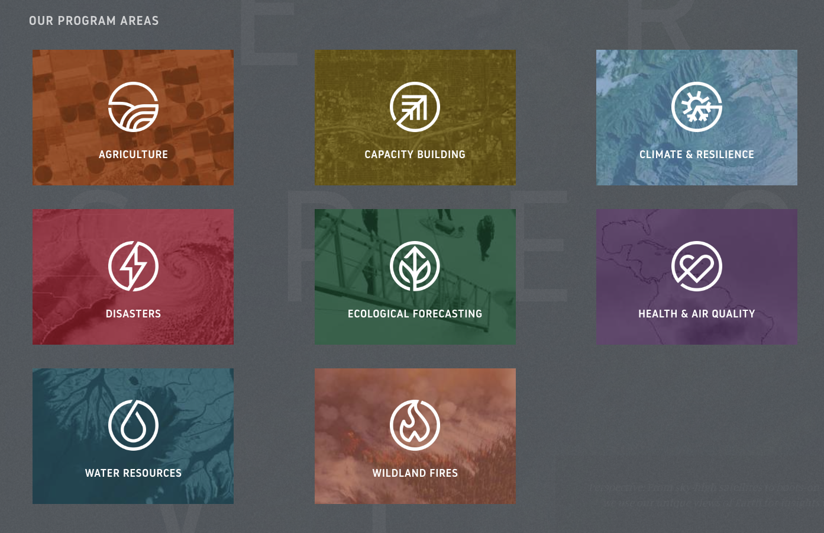

Slide 3
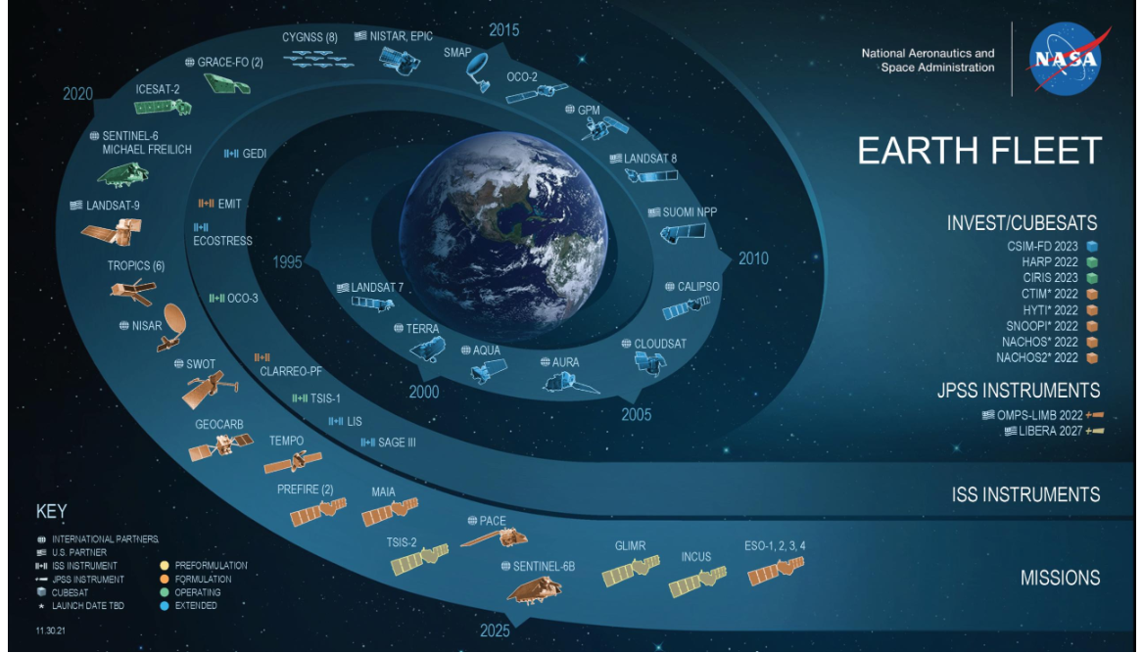

Slide 4
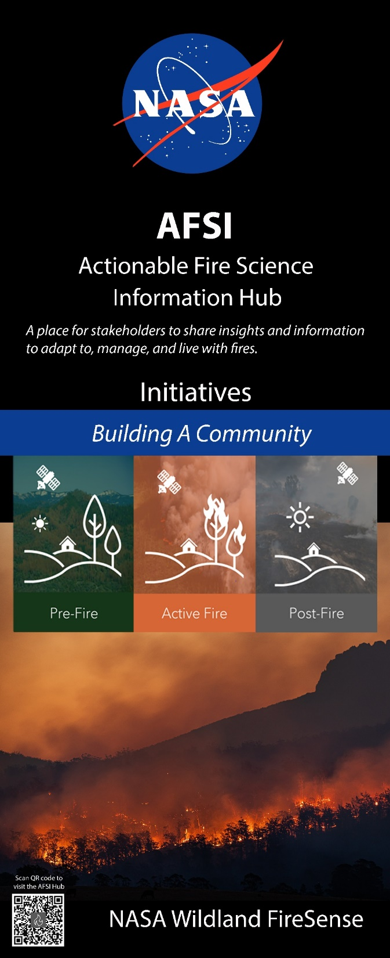
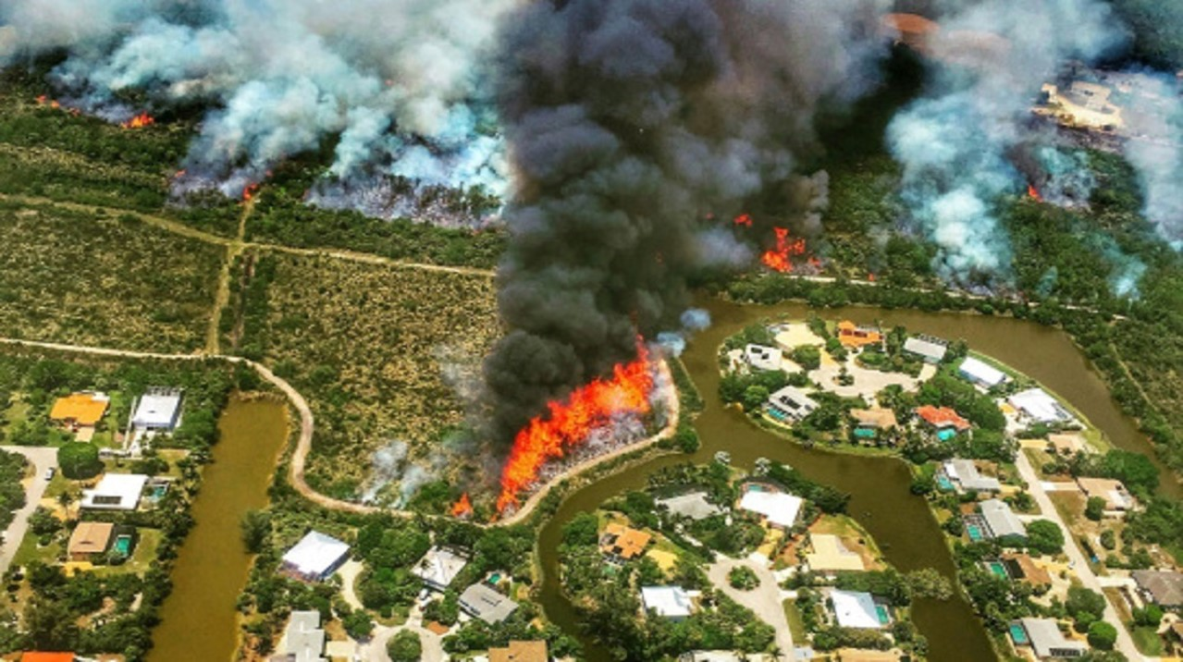
Solving the “Impossible”
Science for Action
  Learning to Manage and Thrive with Fires
  Collective Outcomes Thriving with Fire
Adaptative Fire Management via NASA S&T
    Sharing and co-developing scalable techniques and integrated system solutions to improve adaptation in fire-prone areas and functional resilience
  Priorities and Opportunities
    Projects, Tools and Decision Support
    Communities-of-Practice
    S&T Wildland Fire Showcase

Slide 5

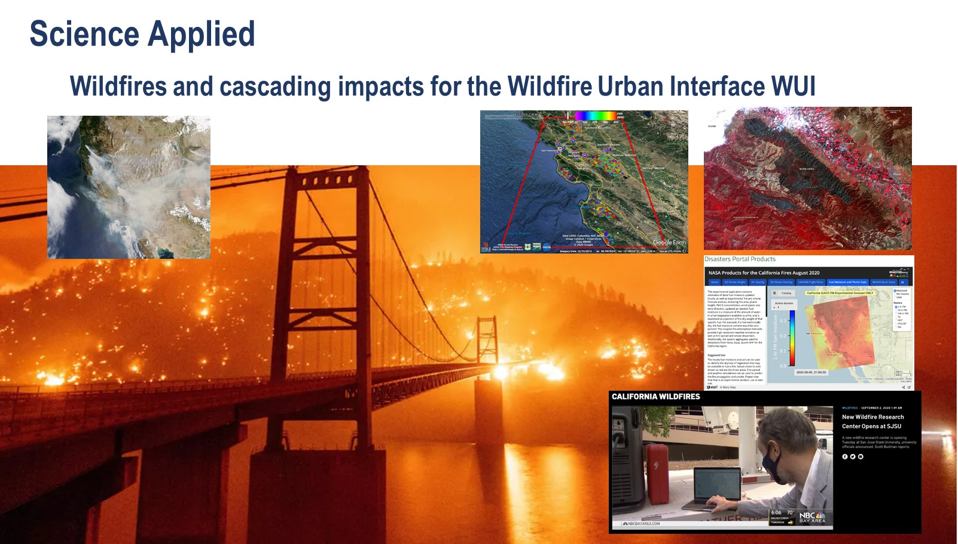
Enabling new perspective on the Wildland-Urban Interface:
Merging Satellite and Socio-Economic Data to quantify defensible space,
invasive species and vulnerability in the WUI
It is estimated that the wildland-urban interface is the fastest growing land-use type in the conterminous United States
Notes:
The severity of the current wildfire season and historical wildfire trends reinforce the need to continue on-going cooperative efforts to reduce wildfire risk through active fire management.
It is estimated that the wildland-urban interface is the fastest growing land-use type in the conterminous United States (Radeloff et al., 2018).
Active management goals for reducing wildfire risk aim to protect people, communities, and watersheds, and to promote health and resilient forests, rangelands, and other lands (federal, private tribal…).

Slide 6
