Slide 1
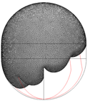
Modeling Low Bond Number (Microgravity) Slosh
David Benson
Associate Branch Head – GSFC Propulsion Branch

Slide 2
Sloshing Regimes
Microgravity
Transition
Low-g and High-g
Bond Number =
1
Bond number (Bo) describes the balance between the surface tension and body acceleration forces
Microgravity – Slosh behavior dominated by surface tension (Bo <<1)
Transition – Slosh in which both the body acceleration and surface tension are both influential (Bo ~ 1) - may also include settling of slosh due to surface tension when the propellant is moving significantly from a previous high-g sloshing event
Low-g and High-g – Slosh behavior dominated by the body acceleration of either gravity or the spacecraft acceleration (Bo >> 1)

Slide 3

Surface Evolver
Surface Evolver looks for local minimal energy solution
Surface tension is viewed as a surface energy for this modeling approach
  Liquid-gas surface energies (γ_{la})
  Liquid-solid surface energies (γ_{ls})
  Solid-gas surface energies (γ_{sa})
  Equilibrium contact angle (θ)
Body accelerations are included as potential energy
User defines mathematical constraints to constrain geometry and define surface energies
  Equations are either inequalities or equalities
  Vertices must be in a physical location that satisfy the inequality or equality
  Energies, volumes, and the center of mass are calculated from surface or line integrals
There is good agreement between Surface Evolver and experimental results
Source: https://en.wikipedia.org/wiki/Surface_tension

Slide 4
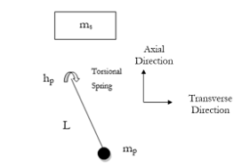
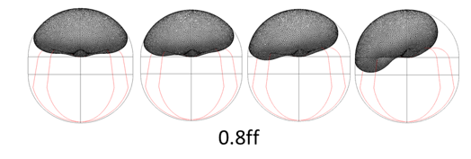
How to model low bond number slosh
Model the slosh at various fill fractions and over a range of transverse accelerations
  Result is a series of steady state solutions
Calculate the pendulum mass, torsional spring constant, hinge location, pendulum length, static mass, and static mass location from center of mass movement
Damping cannot be determined from this method

Slide 5
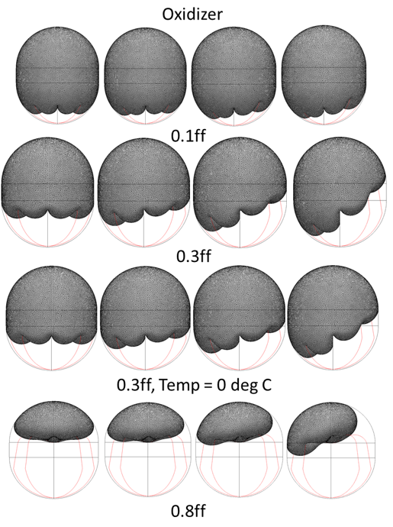
Europa Clipper– Low-g Slosh
Approach used on Cassini and Europa Clipper^{1,2}
Surface Evolver Model
  Use simplified PMD
  Assume 0-deg contact angle
  Model the gas bubble
Lateral accelerations are 0 m/s^2 to 11.08e-5 m/s^2
Fill fractions from 10% to 80%
Enright, P.J., Wong, E.C., “Propellant Slosh Models for the Cassini Spacecraft”, AIAA-94-3730-CP.
Beckman, E.A., Benson, D.J., Cataldo, D.J., Ng, W.W., “Europa Clipper Preliminary Design Review Propellant Slosh Analysis”, AIAA Propulsion and Energy Forum 2018.

Slide 6
Issues and Future Work
Damping would need to be guessed at because Surface Evolver doesn’t give dynamic results and there isn’t experimental data
As with CFD, the lack of experimental data at these acceleration levels leads to uncertainty about the accuracy of deriving a dynamic models from steady-state solutions

