Slide 1
Transcriptomics-based Machine Learning (ML) Analysis Predicts Space-Exposed Murine Livers
Hari Ilangovan
Prachi Kothiyal
Katherine Hoadley
Robin Elgart
Newton Campbell
Greg Eley
Parastou Eslami
SAIC | NASA Langley Research Center
Scimentis LLC
University of North Carolina - Chapel Hill
University of Houston
AROSE
Scimentis LLC
Universal Artificial Intelligence LLC

Slide 2







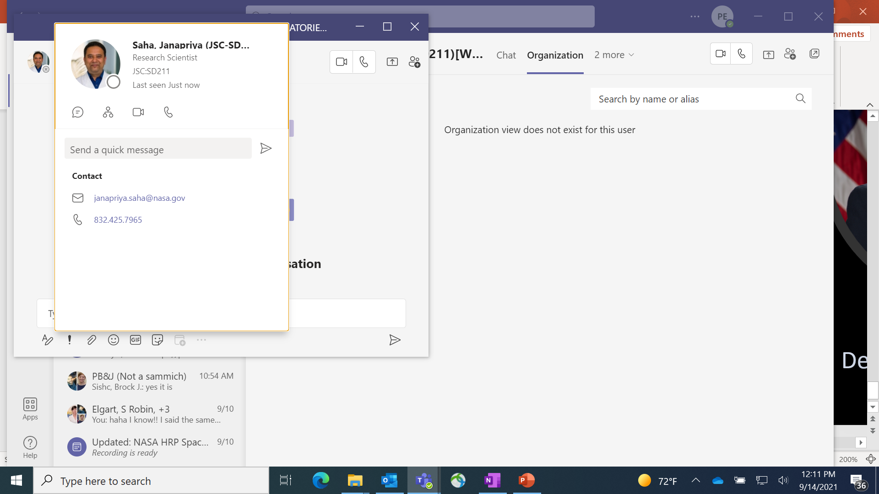
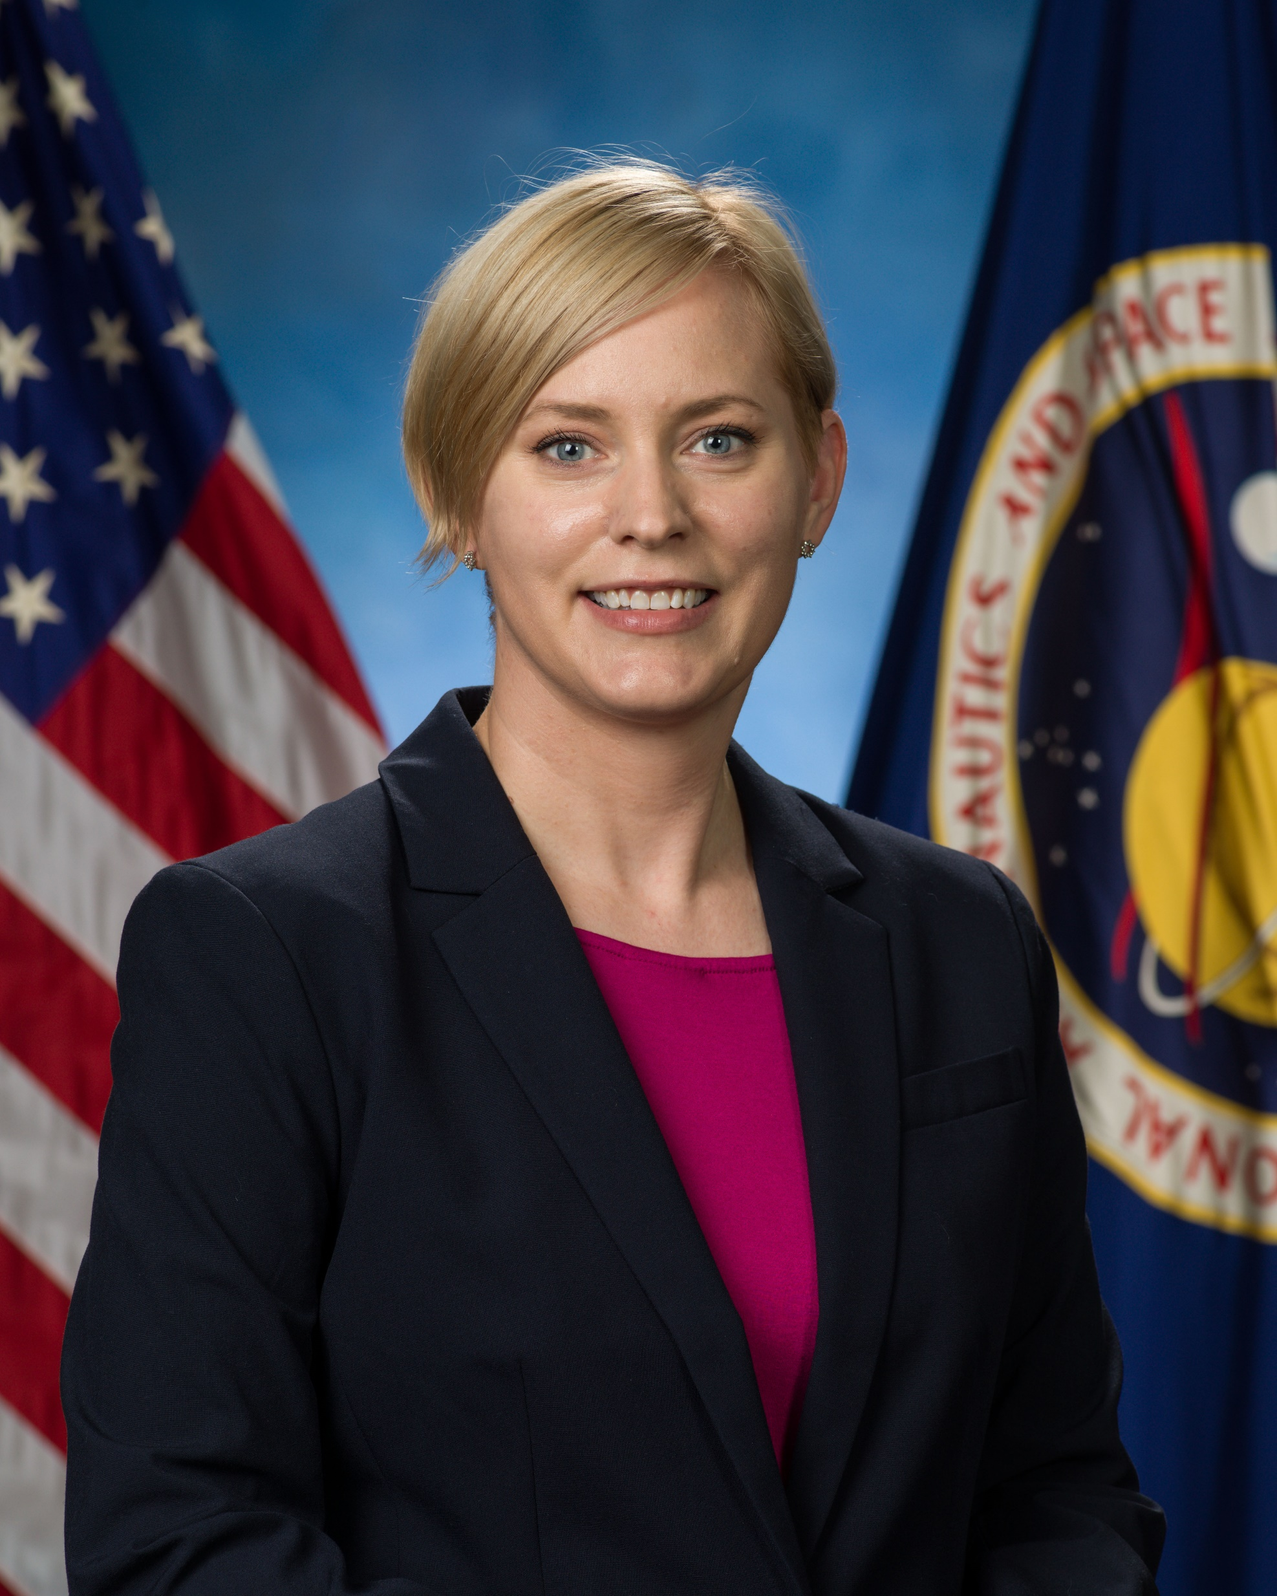

Translational Radiation Research and Countermeasures
Formed by the Space Radiation (SR) Element under authority of the NASA Human Research Program (HRP)
Mission: translate radiation research results based on animal studies to humans using bioinformatics and computational modeling
Cross disciplinary team: SR Element Scientists, NASA Information Data & Analytics Services (IDAS) Data Scientists, Bioinformaticians & Computational biologists
Parastou Eslami
Project Scientist
Prachi Kothiyal
Bioinformatician
Hari Ilangovan
Data Scientist
Greg Eley
Bioinformatician
Katherine Hoadley
Computational Biologist
Ryan Norman
Element Scientist
Brock Sishc
Cancer Discipline Scientist
Janapriya Saha
CVD Discipline Scientist
Janice Zawaski
Deputy Element Scientist
Robin Elgart
Element Scientist

Slide 3
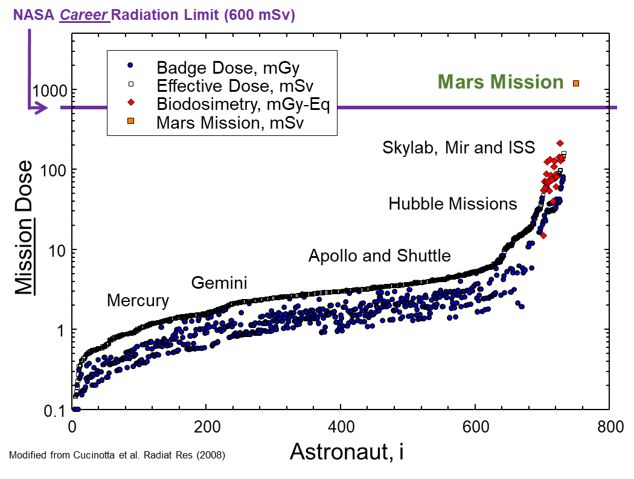



Mission Radiation Environments
Long duration spaceflight (or even repeated short missions) will exceed current career radiation limits meant to minimize cancer risk
Cancer can seriously and permanently impact astronaut long-term health
Galactic Cosmic Radiation (GCRs) and microgravity are being studied using biological endpoints from rodent based models
Cucinotta, Francis A, Myung-Hee Y Kim, and Lori J Chappell. “Space Radiation Cancer Risk Projections and Uncertainties – 2012,” 2012, 186.
Sishc, Brock J., Janice Zawaski, Janapriya Saha, Lisa S. Carnell, Kristin M. Fabre, and S. Robin Elgart. “The Need for Biological Countermeasures to Mitigate the Risk of Space Radiation-Induced Carcinogenesis, Cardiovascular Disease, and Central Nervous System Deficiencies.” Life Sciences in Space Research, June 14, 2022. https://doi.org/10.1016/j.lssr.2022.06.003.

Slide 4
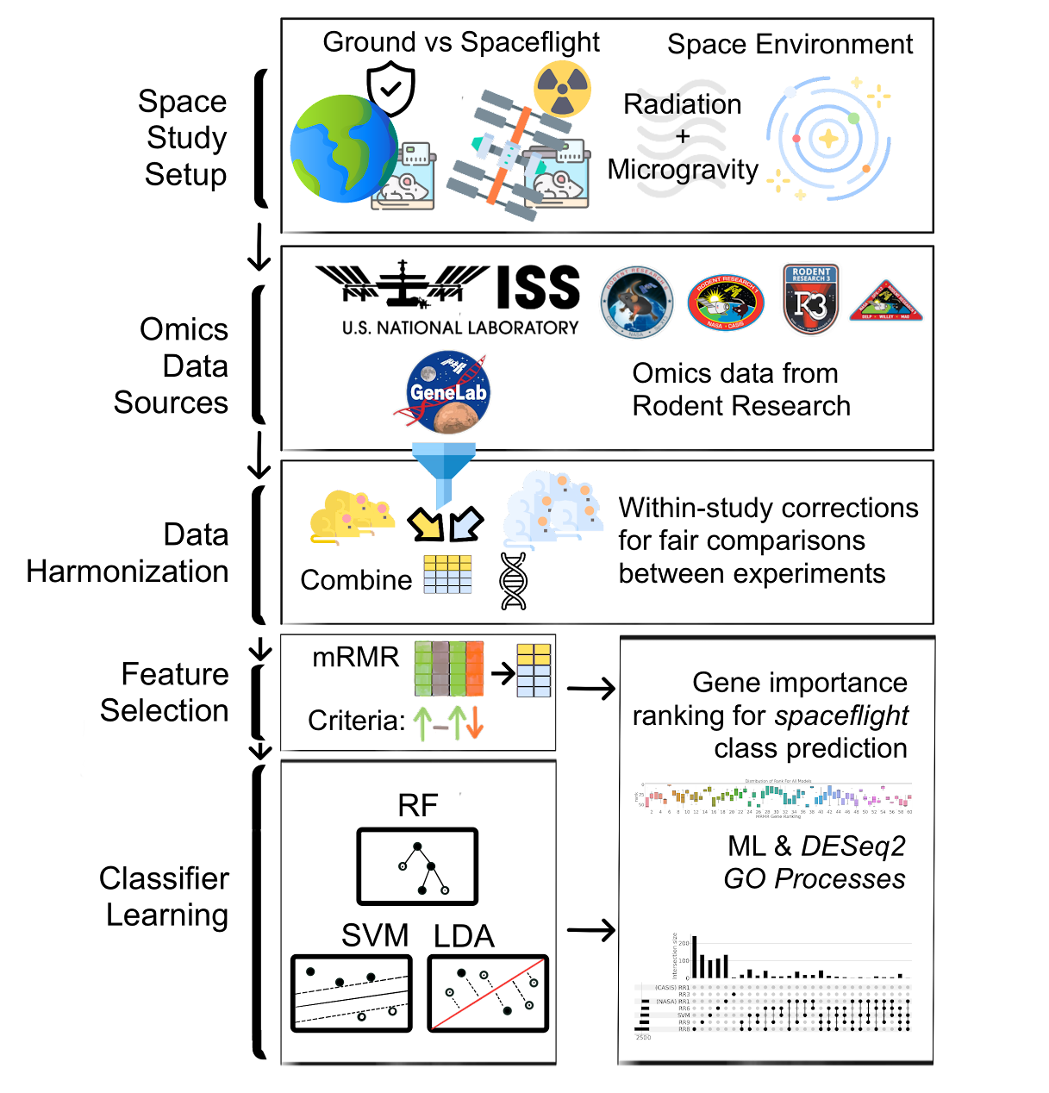
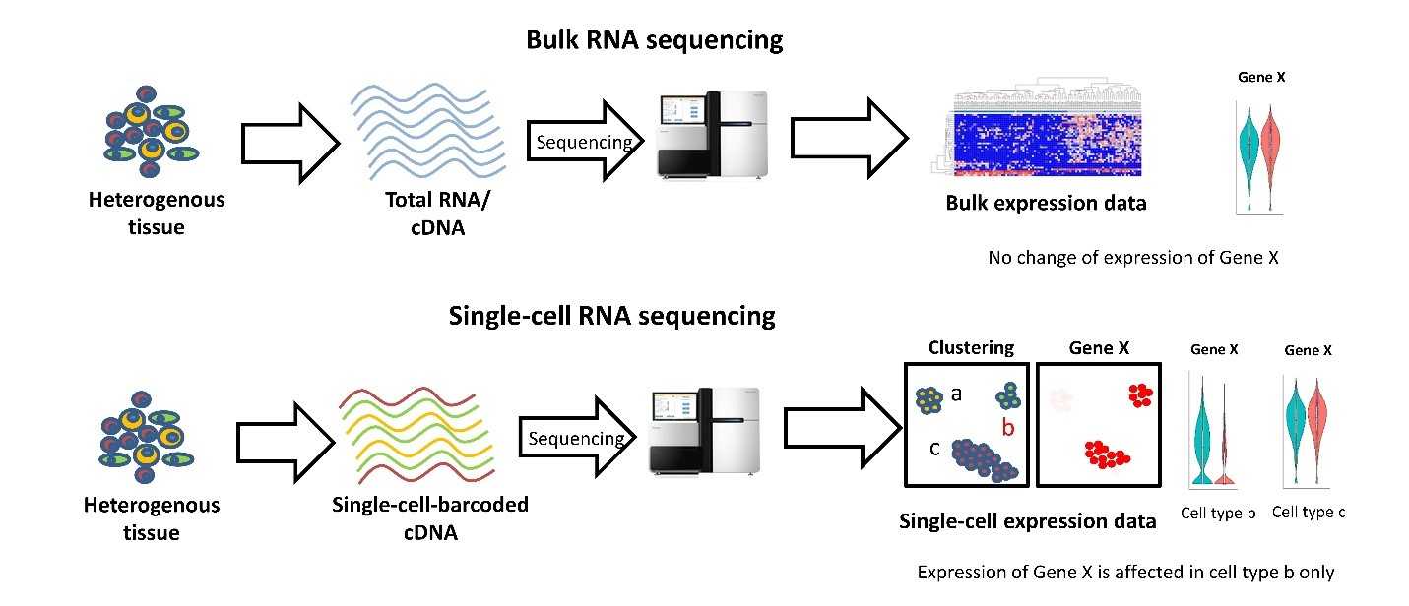
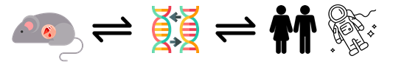
Space Studies & Bulk RNA-Seq Data
Heterogeneous Experiments
Systemic Study Effects
Biological and Technical Variability
Translate results to astronaut relevant data sets
Genomics Research from Technology Networks. “Recent Advances in Single-Cell Genomics Techniques.” Accessed October 5, 2022. http://www.technologynetworks.com/genomics/articles/recent-advances-in-single-cell-genomics-techniques-324695.

Slide 5
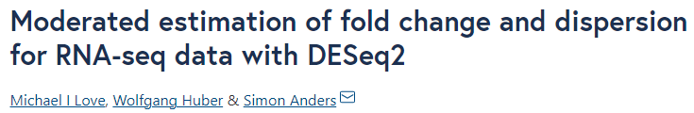
Space Studies & Bulk RNA-Seq Data
Differential Gene Expression Analysis & Meta Analysis
Characteristics of Studies with RNA-Seq Data
x₁ | x₂ | x₃ | ... | x_{n} | y
 |  |  | ...
 |  |  | ...
Sample Size, n
x₁ | x₂ | x₃ | ... | x_{n} | y
 |  |  | ...
 |  |  | ...
Between Studies:
1) D >> n
2) n₁ ≠ n₂ ≠ n₃
Sparsity
Leverage best practices, lessons learned (data handling, model assumptions, etc.)
x₁ | x₂ | x₃ | ... | x_{n} | y
 |  |  | ...
 |  |  | ...
Dimensionality, D
high D small n
How can we apply Machine Learning techniques?
Genomics Research from Technology Networks. “Recent Advances in Single-Cell Genomics Techniques.” Accessed October 5, 2022. http://www.technologynetworks.com/genomics/articles/recent-advances-in-single-cell-genomics-techniques-324695.

Slide 6
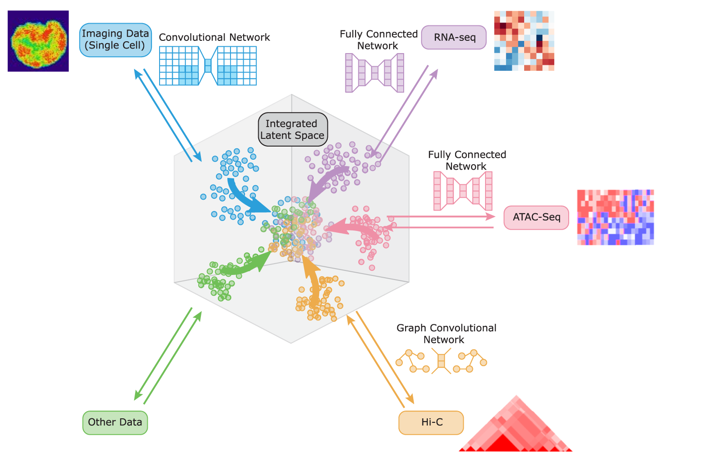
ML Applications to Omics Data & Space Biology
Scope: Predicting space-exposed murine livers using transcriptomics data
Dimensionality Reduction
Supervised ML Methods
Generalization
Interpretability
Transform or subset features
Classification SF vs GC
Independent Reproduced Validation
How do you validate results from a ML analysis?
Kernels
Prediction Performance
Comparison to Current Standards
Feature Importance
Balanced Testing
Gene Ontology / Knowledge Bases
Yang, Karren Dai, Anastasiya Belyaeva, Saradha Venkatachalapathy, Karthik Damodaran, Abigail Katcoff, Adityanarayanan Radhakrishnan, G. V. Shivashankar, and Caroline Uhler. “Multi-Domain Translation between Single-Cell Imaging and Sequencing Data Using Autoencoders.” Nature Communications 12, no. 1 (January 4, 2021): 31. https://doi.org/10.1038/s41467-020-20249-2.
Notes:
Animate

Slide 7
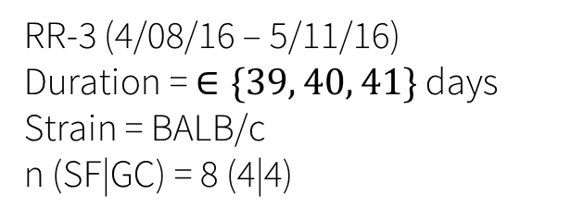
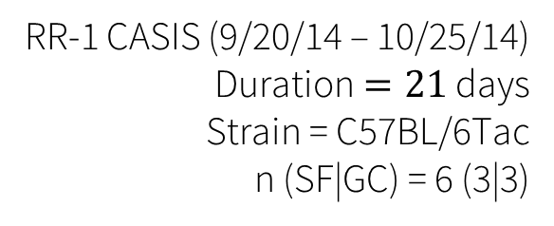
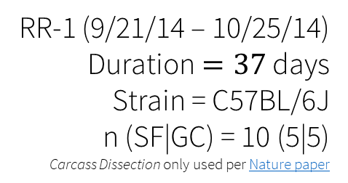
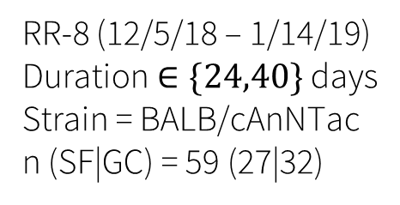
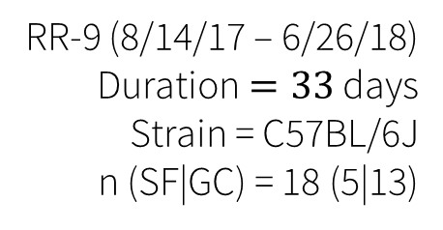
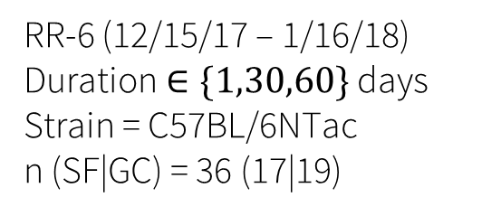
Murine Liver Datasets
Samples subset to
Spaceflight & Ground Controls
All Studies:
n (SF|GC) = (61|76)
Tissue = Liver
RR-1 (9/21/14 – 10/25/14)
Duration $=37$ days
Strain = C57BL/6J
n (SF|GC) = 10 (5|5)
Carcass Dissection only used per Nature paper
RR-3 (4/08/16 – 5/11/16)
Duration = $∈\{39, 40, 41\}$ days
Strain = BALB/c
n (SF|GC) = 8 (4|4)
48
137
RR-1 CASIS (9/20/14 – 10/25/14)
Duration $=21$ days
Strain = C57BL/6Tac
n (SF|GC) = 6 (3|3)
RR-6 (12/15/17 – 1/16/18)
Duration $∈\{1,30,60\}$ days
Strain = C57BL/6NTac
n (SF|GC) = 36 (17|19)
47
245
242
379
RR-9 (8/14/17 – 6/26/18)
Duration $=33$ days
Strain = C57BL/6J
n (SF|GC) = 18 (5|13)
RR-8 (12/5/18 – 1/14/19)
Duration $∈\{24,40\}$ days
Strain = BALB/cAnNTac
n (SF|GC) = 59 (27|32)
Beheshti, Afshin, Kaushik Chakravarty, Homer Fogle, Hossein Fazelinia, Willian A. da Silveira, Valery Boyko, San-Huei Lai Polo, et al. “Multi-Omics Analysis of Multiple Missions to Space Reveal a Theme of Lipid Dysregulation in Mouse Liver.” Scientific Reports 9, no. 1 (December 16, 2019): 19195. https://doi.org/10.1038/s41598-019-55869-2.

Slide 8
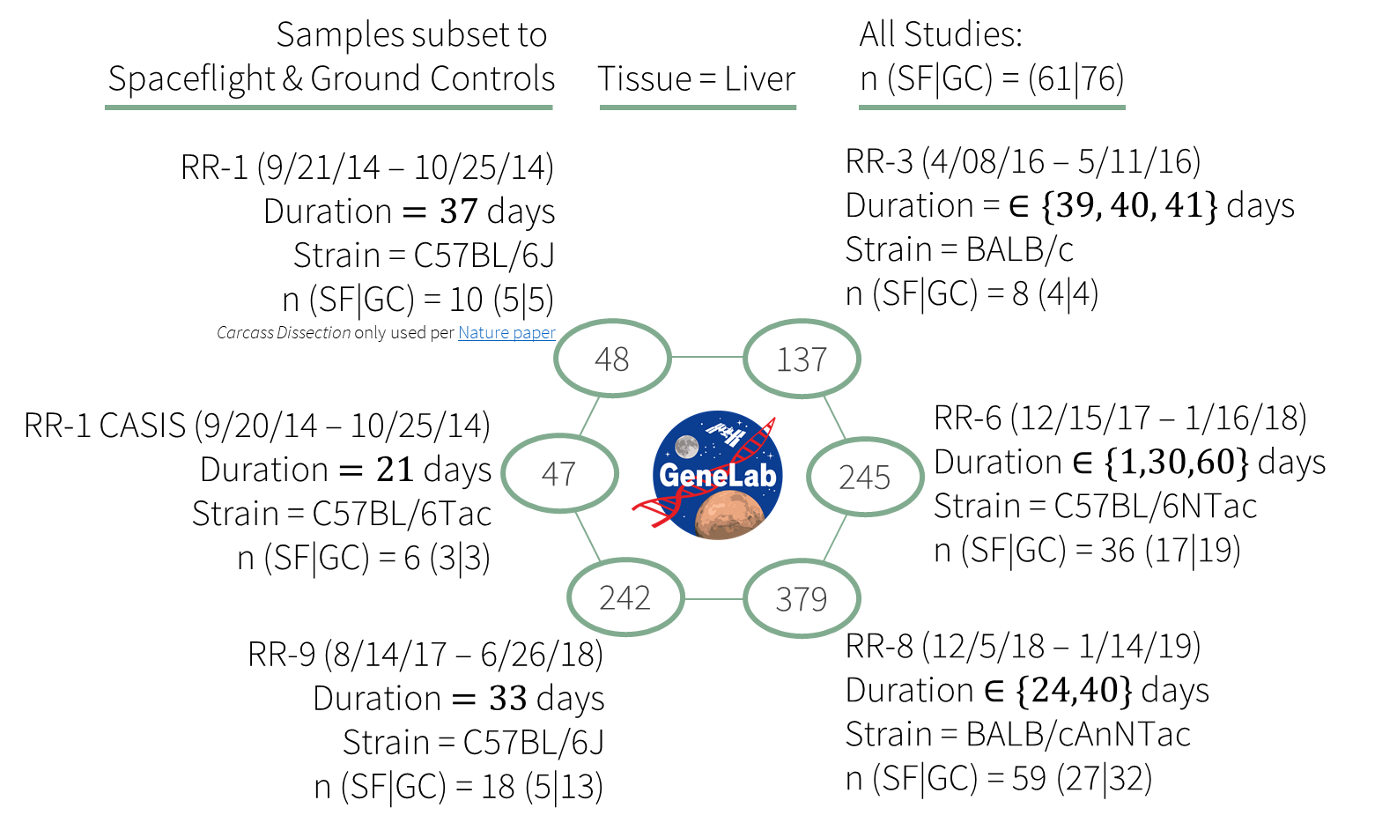
Any single study too small to fit ML models
Murine Liver Data Sets
Why combine studies?
Sample Size
Applicable Models
Generalization
Heterogeneity
Heterogeneity needs to be addressed before model training
Beheshti, Afshin, Kaushik Chakravarty, Homer Fogle, Hossein Fazelinia, Willian A. da Silveira, Valery Boyko, San-Huei Lai Polo, et al. “Multi-Omics Analysis of Multiple Missions to Space Reveal a Theme of Lipid Dysregulation in Mouse Liver.” Scientific Reports 9, no. 1 (December 16, 2019): 19195. https://doi.org/10.1038/s41598-019-55869-2.
Mission | n | Strain | Age (wks) | Sex | Library Prep.
RR-1 (CASIS) | 6 | C57BL/6NTac | 32 | F | mRNA enrichment
RR-1 (NASA) | 10 | C57BL/6J | 16 | F | Ribo-depletion
RR-3 | 8 | BALB/c | 12 | F | Ribo-depletion
RR-9 | 18 | C57BL/6J | 10 | M | Ribo-depletion
RR-6 | 36 | C57BL/6NTac | 32 | F | Ribo-depletion
RR-8 | 59 | BALB/cAnNTac | 10-32 | F | Ribo-depletion

Slide 9
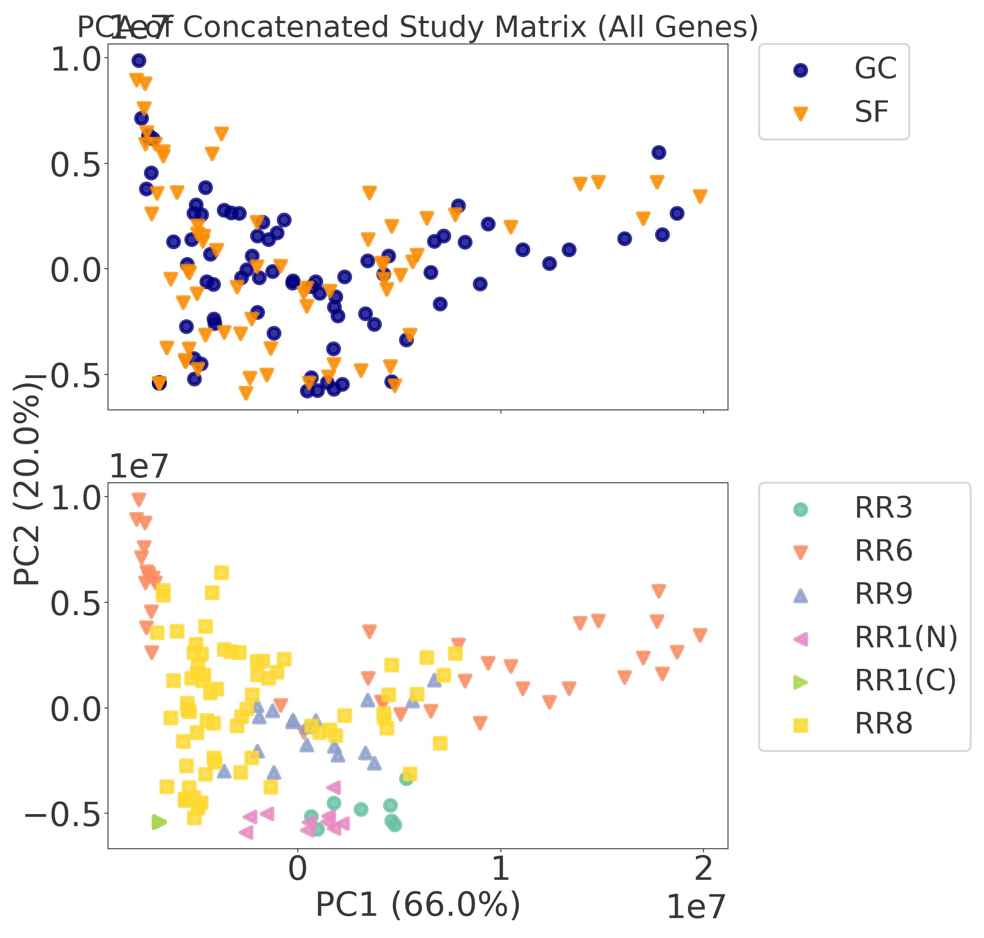
Raw Data cluster by Experiment
Pre-Filtering & Normalization
1
Non-Pseudogenes
PC2
Count Sample Coverage
PC1
Within-Study Normalization
Concatenation-Based Integration
Notes:
Animation

Slide 10
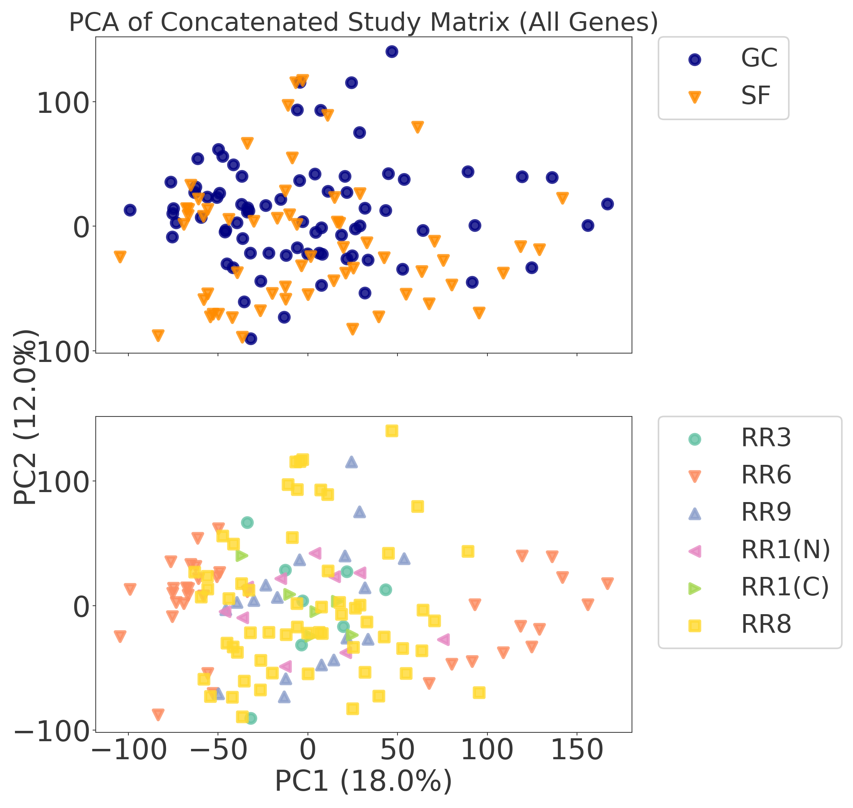
Dampened Experiment Clustering
Pre-Filtering & Normalization
1
Non-Pseudogenes
PC2
Count Sample Coverage
PC1
Prefilter & Transform
Within-Study Normalization
2
PC2
Concatenation-Based Integration
PC1
Notes:
Animation

Slide 11
Label by Space Flight ( ) vs Ground Control ( )
1
3
PC2
PC1
Prefilter & Transform
2
PC2
PC1
Notes:
Animation

Slide 12
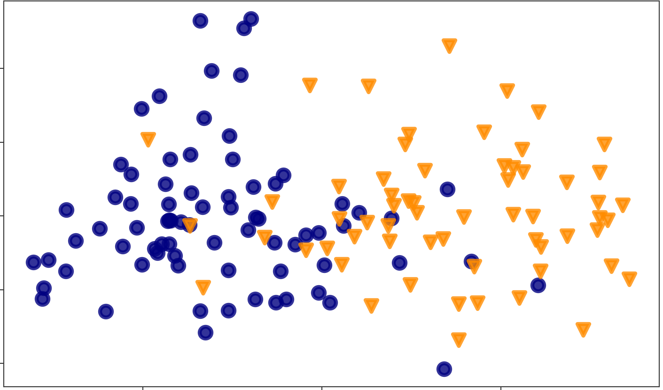
n now greater than any individual study
1
3
PC2
PC1
Prefilter & Transform
Dimensionality Reduction
2
4
PC2
PC1
Notes:
Animation

Slide 13
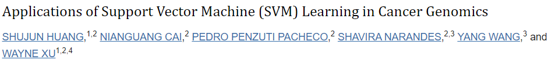
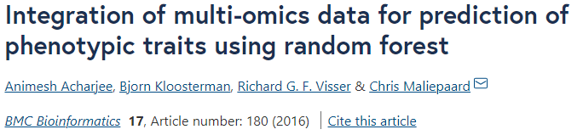
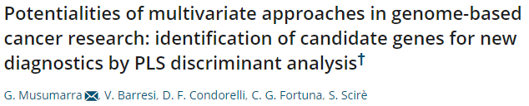
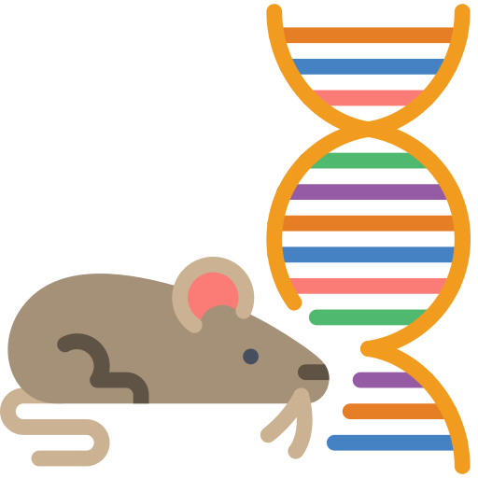

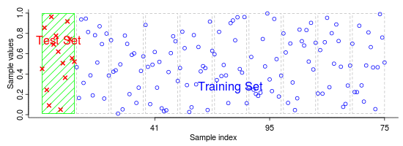
Classification as Space Flight or Ground Control
Methods selected based on previous application to NGS data sets
...
Support Vector Machines (SVM)
Random Forest (RF)
Linear Discriminant Analysis (LDA)
K-Fold Cross Validation
Balanced between treatments

Slide 14
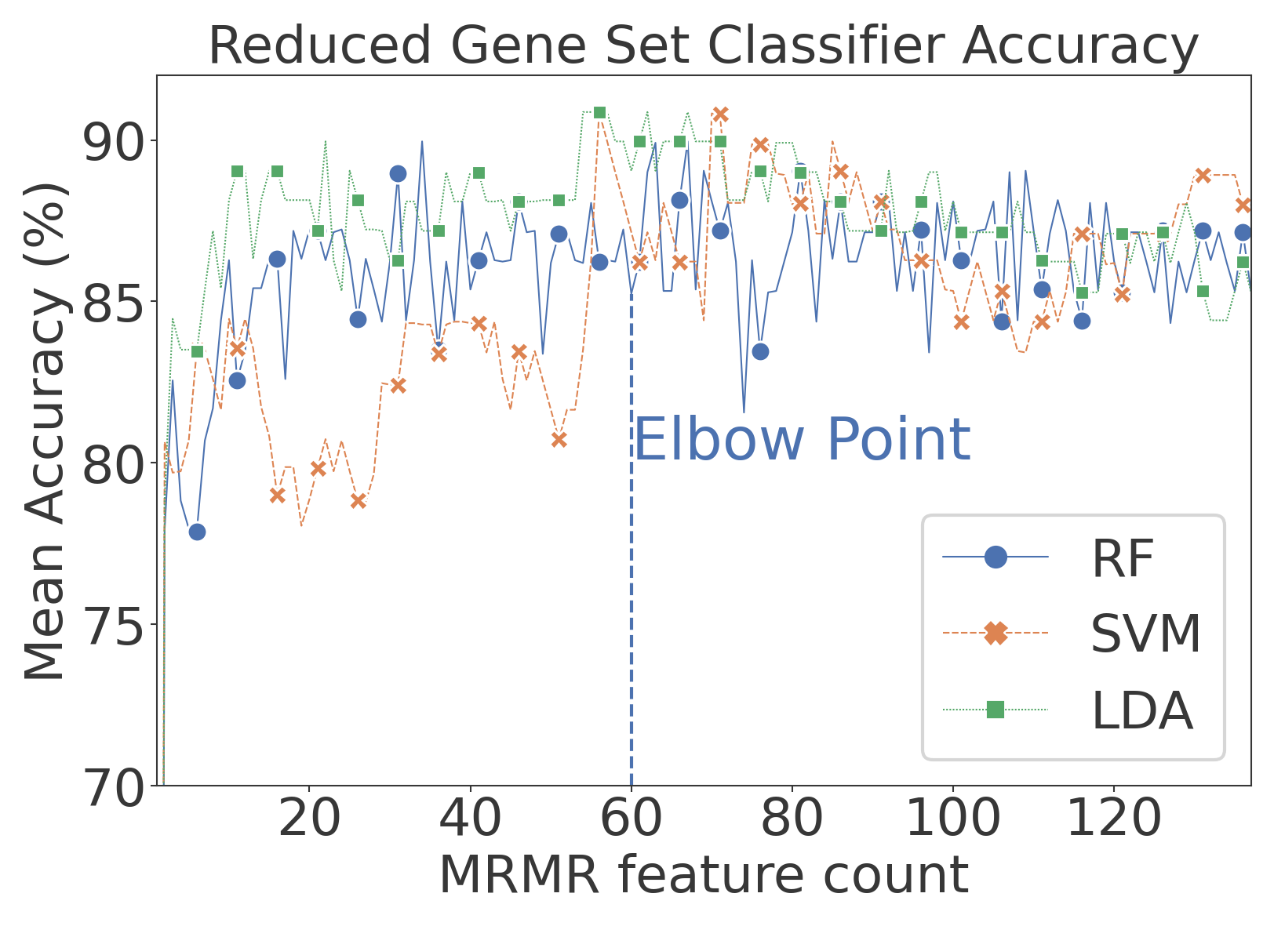
Models Trained without overfitting
Min. prediction accuracy of 87%
Model parameters modified for small sample size (even with concatenated studies)
RF Tree Depth
SVM Regularization (c)
LDA Shrinkage
Notes:
Why SVM? When w/ DESeq2. RF not great coef. and LDA training sensitive to covariance

Slide 15
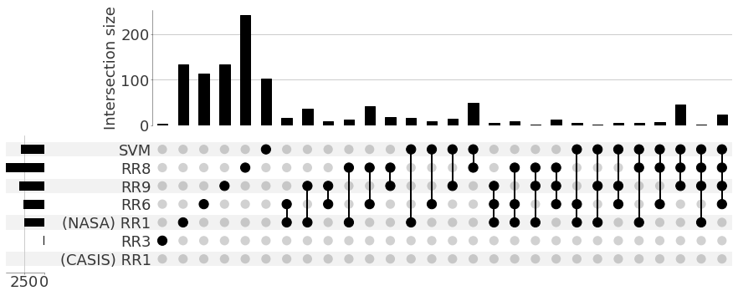
BP Interpretation of ML with DESeq2
Gene Set Enrichment Analysis (BPs)
Min. prediction accuracy of 89%
Accuracy similar between methods, but SVM output better for interpretation
Model parameters modified for small sample size (even with concatenated studies)
RF Tree Depth
SVM Regularization (c)
LDA Shrinkage
Notes:
Why SVM? When w/ DESeq2. RF not great coef. and LDA training sensitive to covariance

Slide 16
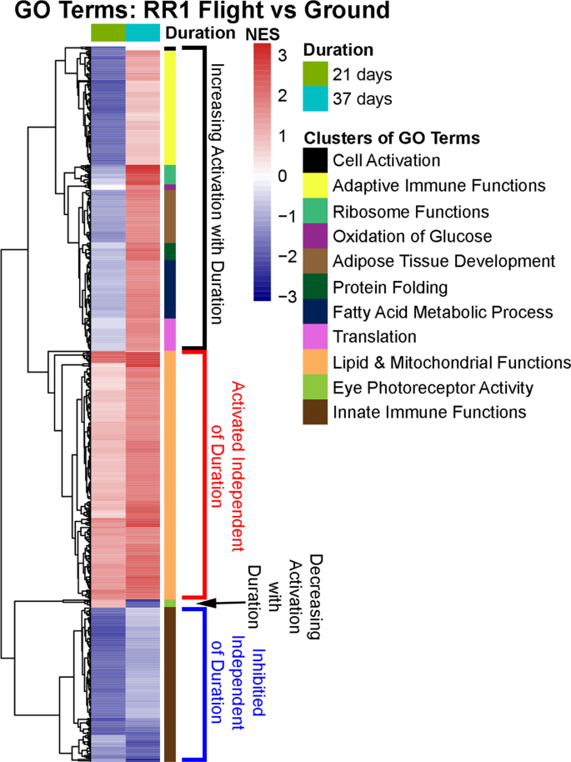
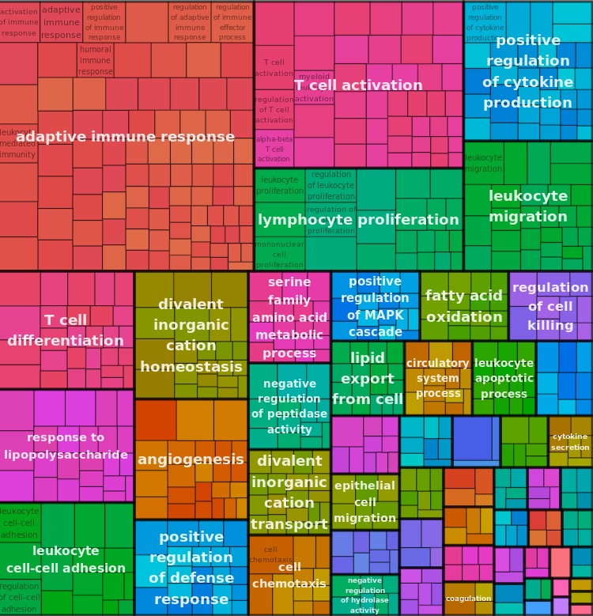

Enhanced Confirmation of Results
Support Vector Machines
RR1
Studies:RR1 + RR3 + RR6 +
RR8 +
RR9 +
Results from GeneLab study
RR1 Signal not squashed by other studies
Studies: RR1 + RR6 + RR9
GO BPs from independent DESeq2 Gene Set Enrichment
Beheshti, Afshin, Kaushik Chakravarty, Homer Fogle, Hossein Fazelinia, Willian A. da Silveira, Valery Boyko, San-Huei Lai Polo, et al. “Multi-Omics Analysis of Multiple Missions to Space Reveal a Theme of Lipid Dysregulation in Mouse Liver.” Scientific Reports 9, no. 1 (December 16, 2019): 19195. https://doi.org/10.1038/s41598-019-55869-2.
Notes:
double check boxes and arrow mapping, legend key , remove 0,1,1,0 header

Slide 17
Conclusions
Combined study view & data preprocessing are necessary for ML applications in Space Studies
Validation through intersection between classical analysis and ML methods
Machine learning methods can complement classical omics if data is handled appropriately
DESeq2
ML
Classifiers may show similar performance, but SVM more useful for interpretation
Non intersecting set may indicate area for further exploration
Notes:
Feature importance, custom MRMR, parameterizing classifiers

Slide 18
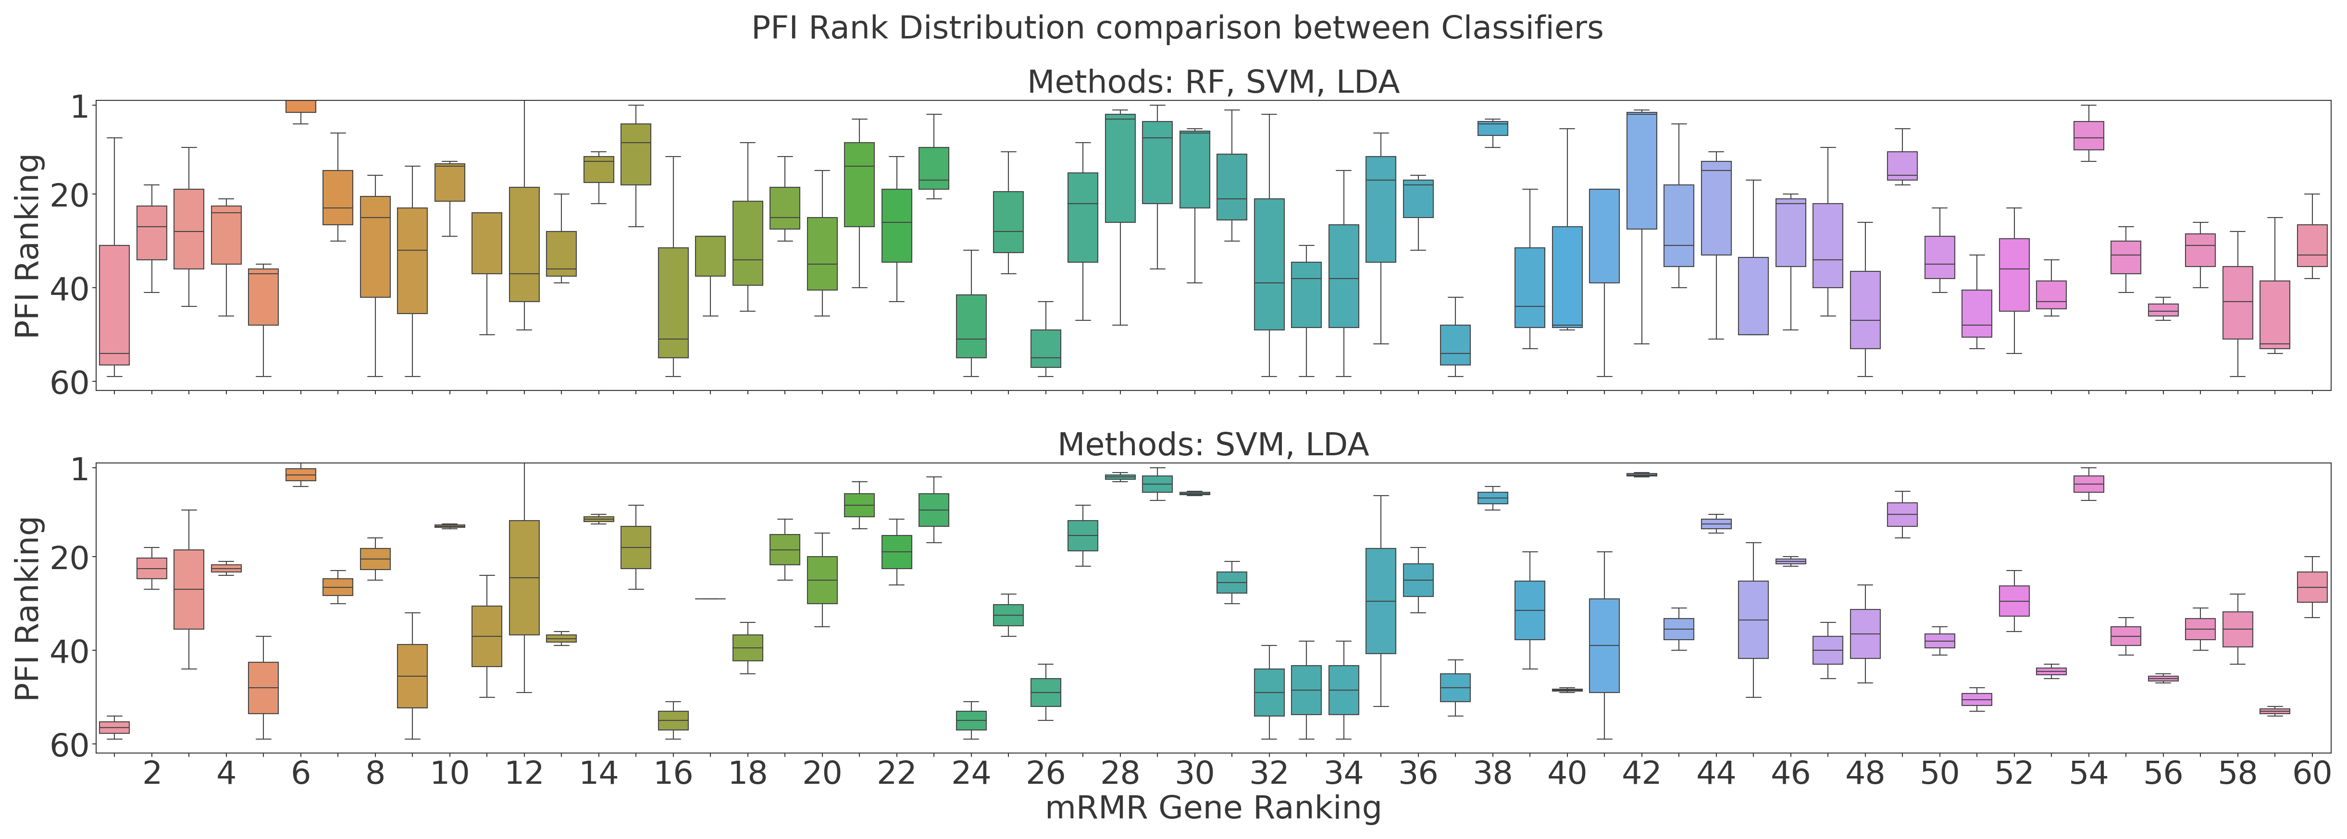

Conclusions - Novel Analysis Methodology
Combined study view & data preprocessing are necessary for ML applications in Space Studies
Validation through intersection between classical analysis and ML methods
Machine learning methods can complement classical omics if data is handled appropriately
DESeq2
ML
Classifiers may show similar performance, but SVM more useful for interpretation
Non intersecting set may indicate area for further exploration
Future work
Independent Validation with External Data Set
Notes:
Feature importance, custom MRMR, parameterizing classifiers

Slide 19
Thank you!
NASA
Space Radiation Element
Human Research Program
Johnson & Langley Centers
NASA GeneLab
LaRC OCIO Data Science Team
Parastou Eslami
Project Scientist
Prachi Kothiyal
Bioinformatician
Hari Ilangovan
Data Scientist
Greg Eley
Bioinformatician
Katherine Hoadley
Computational Biologist
Ryan Norman
Element Scientist
Brock Sishc
Cancer Discipline Scientist
Janapriya Saha
CVD Discipline Scientist
Janice Zawaski
Deputy Element Scientist
Robin Elgart
Element Scientist
Notes:
Feature importance, custom MRMR, parameterizing classifiers

Slide 20
Appendix: Process Flow Diagram
Pre-Filtering & Normalization
Feature Selection
Classifier Training
Classifier Inference Interpretation
Non-Pseudogenes
MRMR Selection
Random Forest
Receiver Operator Characteristic
Feature Importance
Min. Counts and Sample Coverage
Full Selection
Support Vector Machines
Ranking Analysis
Overlapping Set Analysis
Within-Study Normalization
Linear Discriminant Analysis
Gene Ontology (BPs)
Concatenation-Based Integration

Slide 21

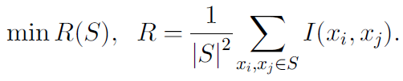

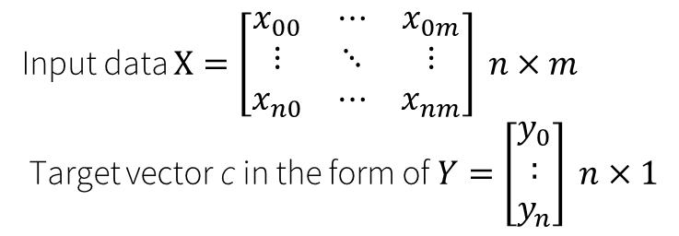
Feature Selection Methods
Input data $X=\left[\begin{matrix}x_{00} & ⋯ & x_{0m} \\ ⋮ & ⋱ & ⋮ \\ x_{n0} & ⋯ & x_{nm}\end{matrix}\right] n×m$
Target vector c in the form of $Y=\left[\begin{aligned}y_{0} \\ : \\ y_{n}\end{aligned}\right] n×1$
Minimum Redundance Maximum Relevance (mRMR) Feature Selection
Relevant Features
Max Relevance
Useless Features
Min-Optimal Subset
Min Redundancy
Redundant Features
All Relevant Subset

Slide 22
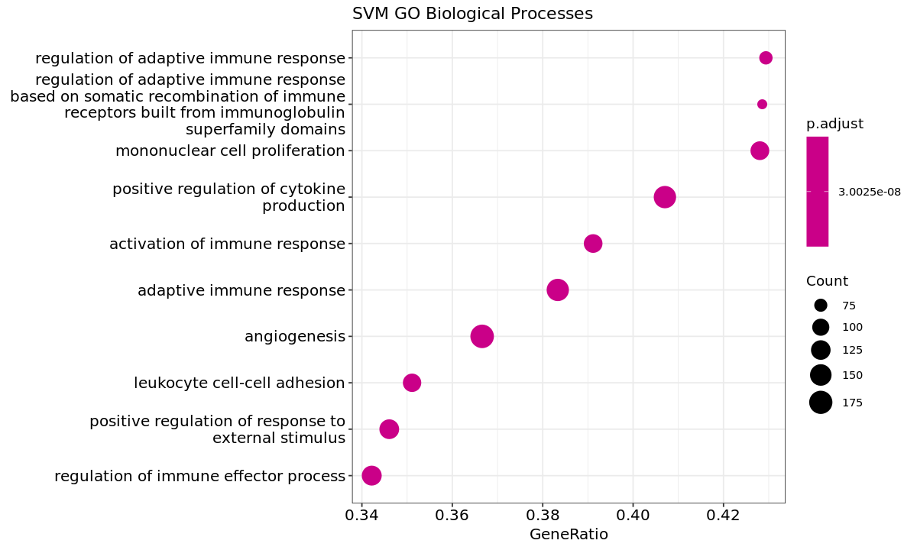
Appendix: SVM GO Biological Processes
Notes:
for take home

Slide 23
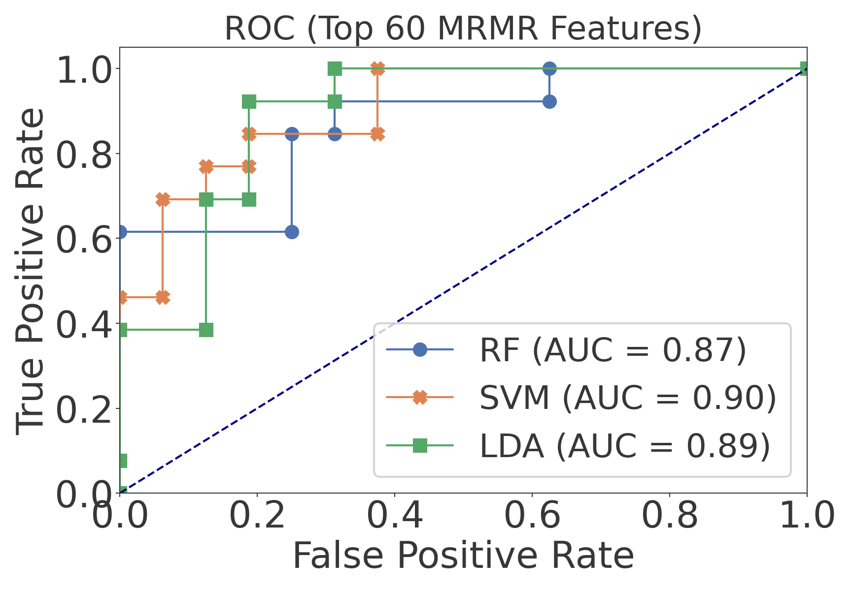
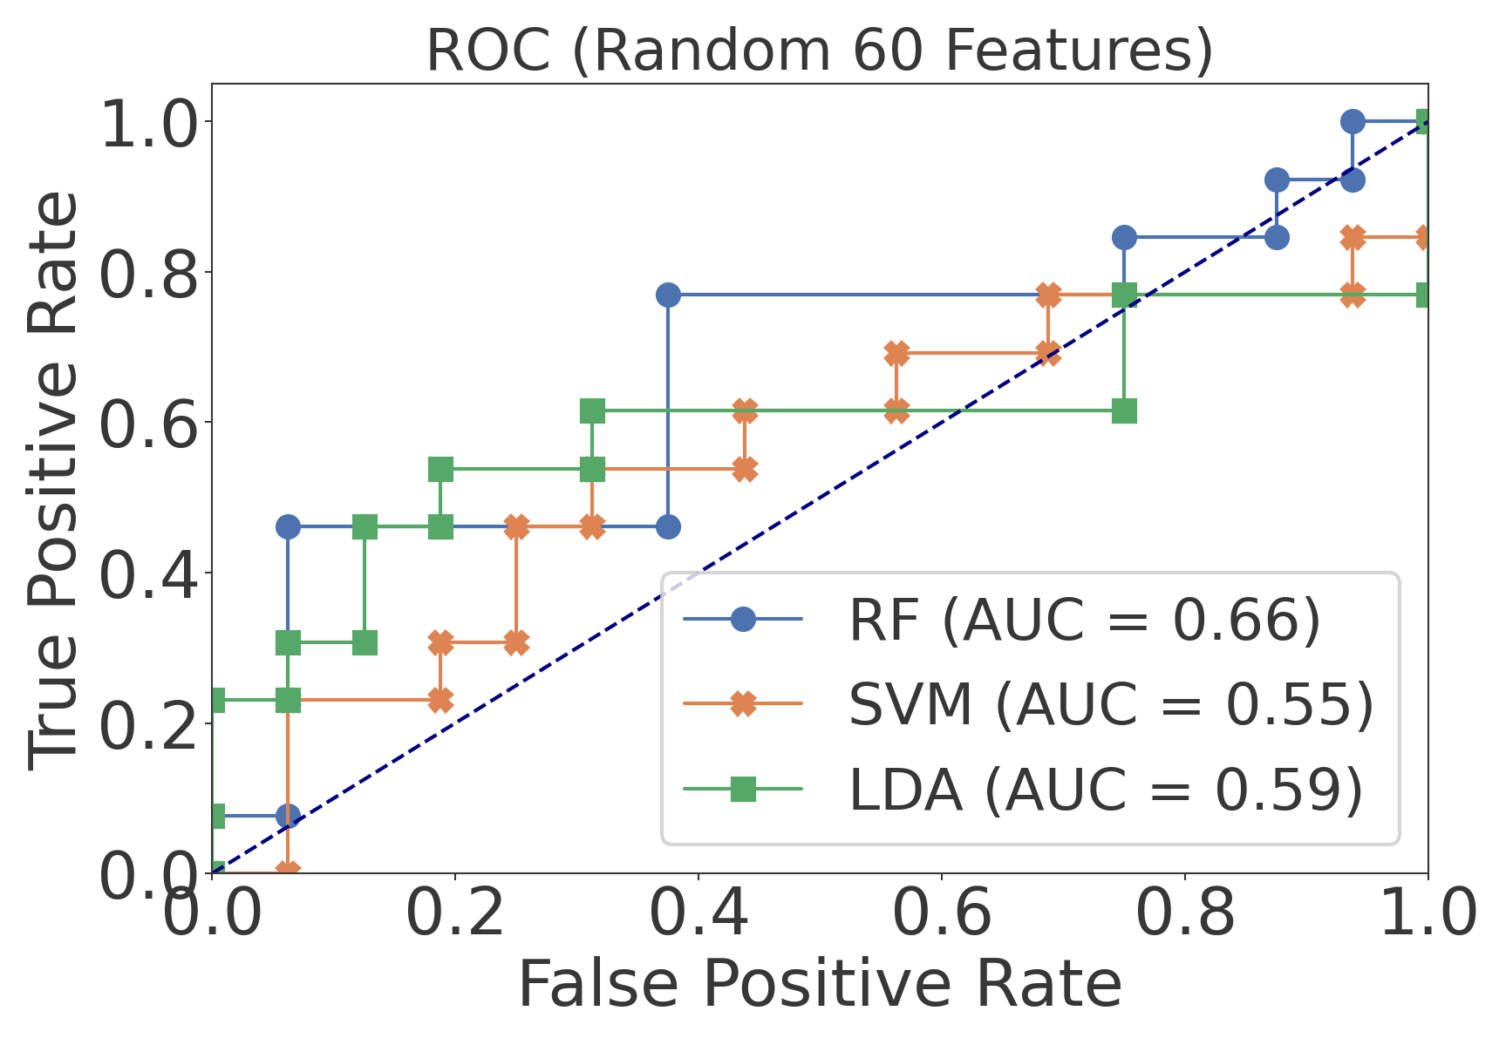
Appendix: AUC
Notes:
for take home

Slide 24
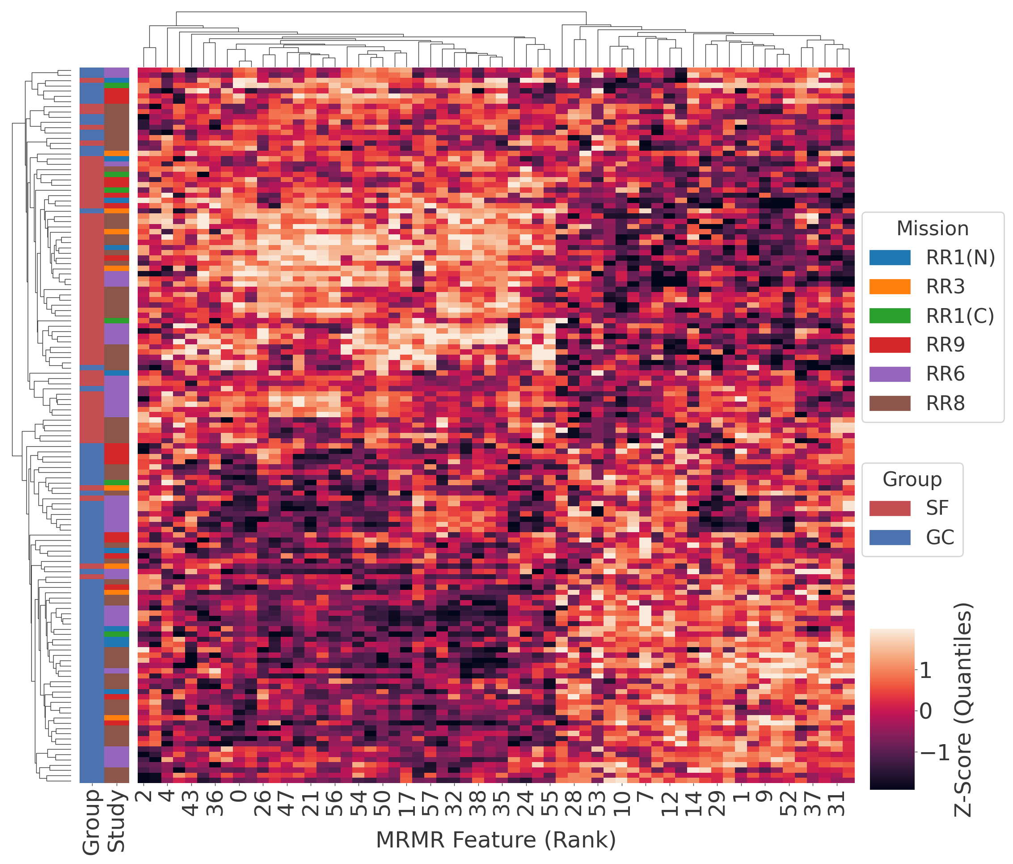
Appendix: Cluster Map
Notes:
for take home

Slide 25
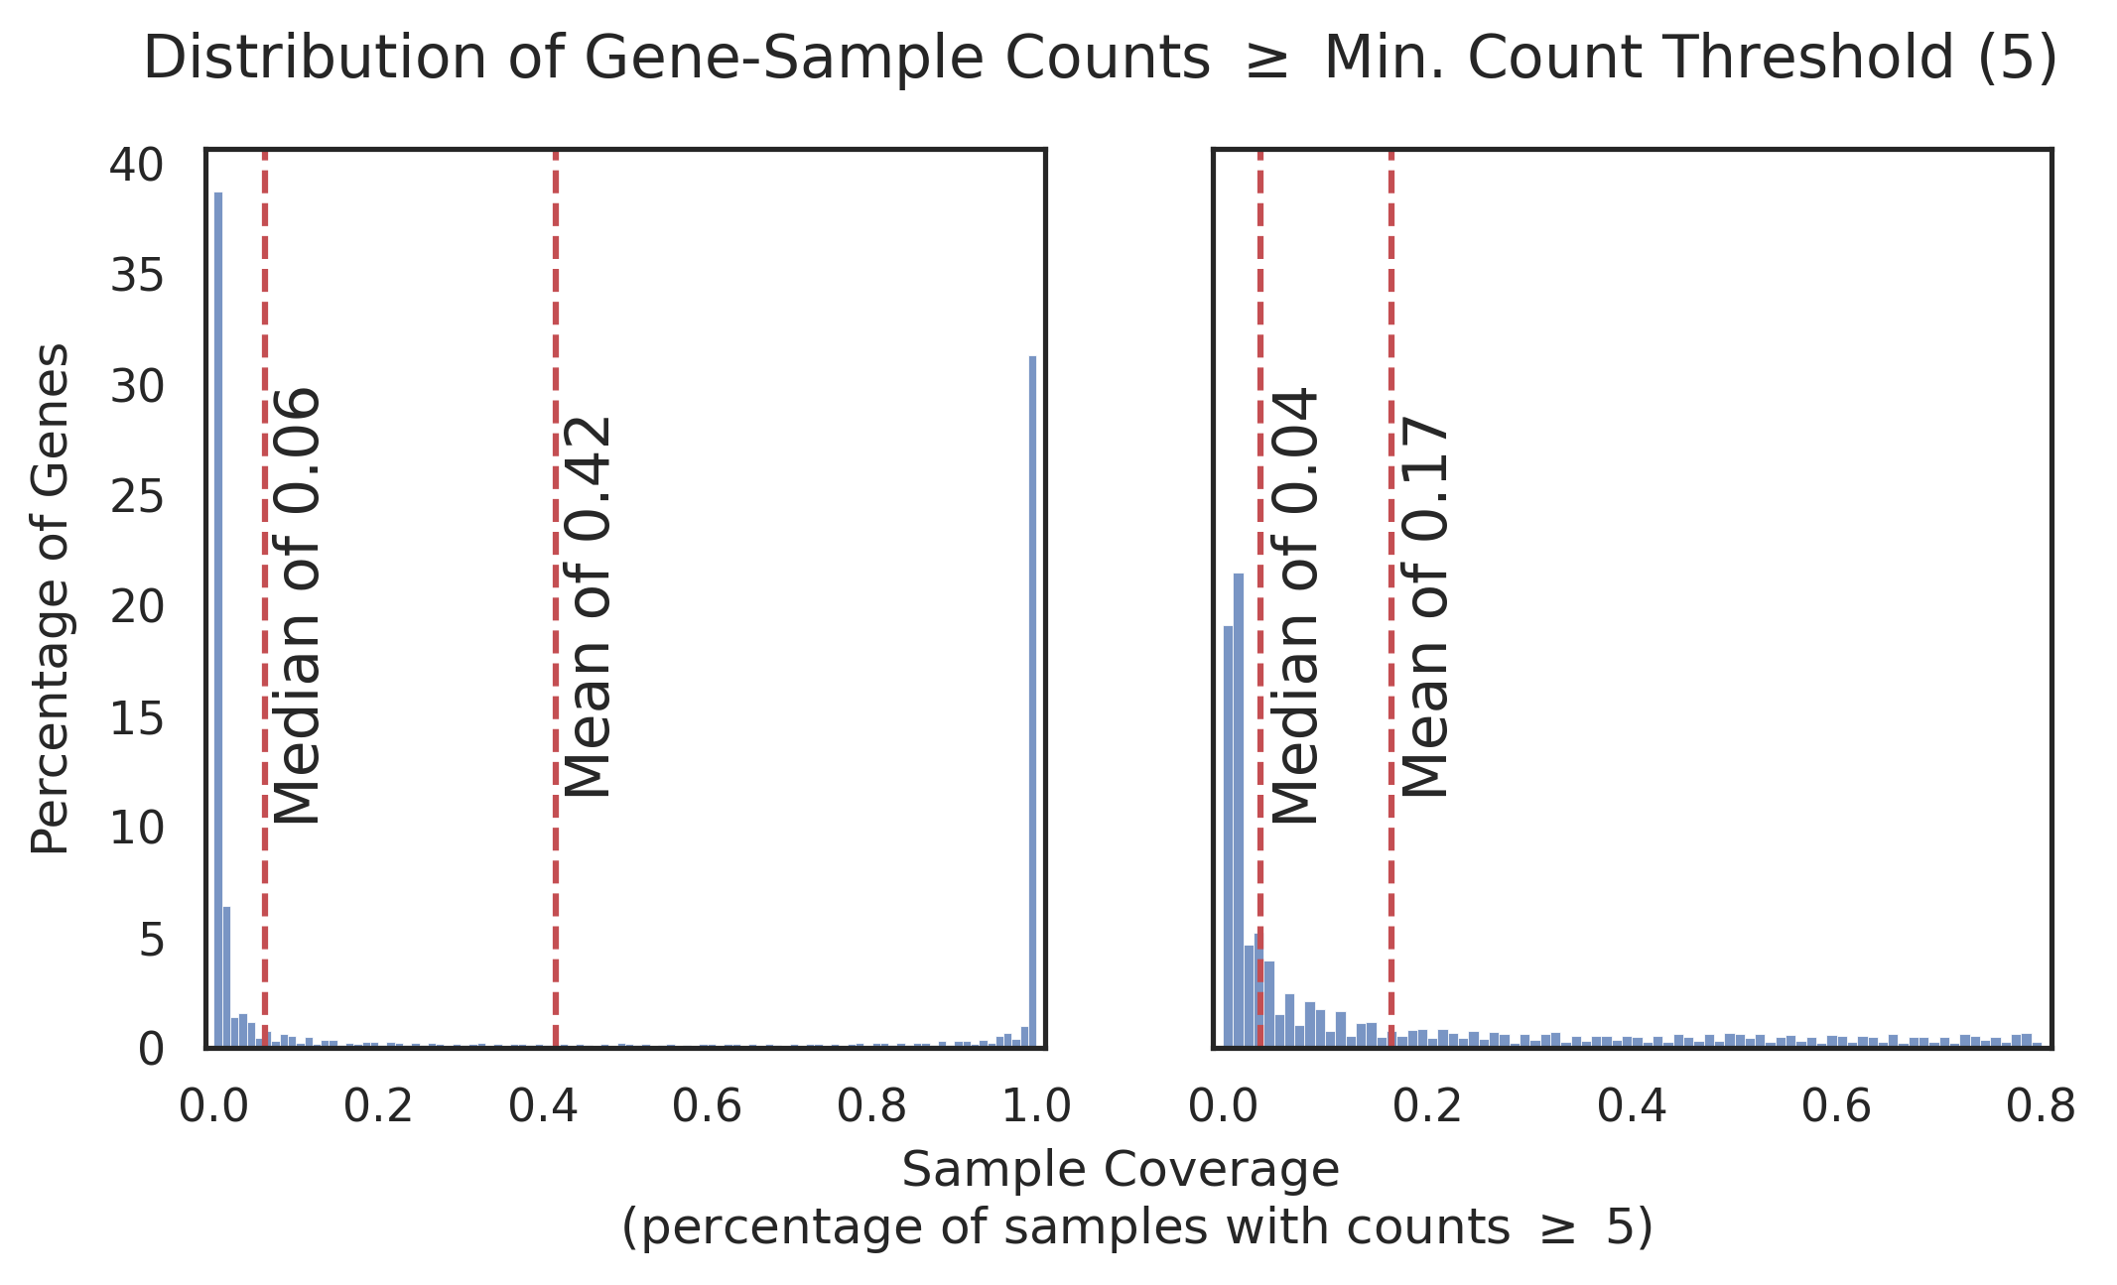
Appendix: Gene-Sample Prefiltering
Notes:
for take home

