Slide 1
CryptoLib
Software-Only Key Management and Cryptography (KMC) for Spacecraft Command Encryption
Cody Cutright & Robert Brown
System Engineers
TMC Technologies
NASA IV&V's JSTAR Program

Slide 2
Key Management & Cryptography
JPL has developed the Advanced Multi-Mission Operations System (AMMOS)
Enterprise ground system
Entire suite of applications
Free license from Caltech/JPL for NASA robotic missions
No third-party software costs
Runs on Linux (tested on RHEL)
AMMOS KMC is the module that provides interfaces to:
Key management for cryptographic keys
Security Associations: mapping of keys to uplink/downlink channels
KMC encryption and decryption functions are powered by CryptoLib
Discussed later in this presentation

Slide 3
Key Management & Cryptography
AMMOS KMC
Cryptography Keys
CryptoLib
Command Encryption Processing
Ground System Software

Slide 4
Who Are We?
NASA Katherine Johnson Independent Verification and Validation Program
Ensuring Class A Mission success since 1993
Full Development Lifecycle
Software Requirements, Design, Code, Test, I&T
Located in West Virginia
Independent Test Capability / JSTAR Team
Specialize in modeling, simulation, and digital twins of NASA missions
Subset of IV&V Facility
Part of the Jon McBride Software Testing & Research Laboratory
ITC / JSTAR often used interchangeably

Slide 5
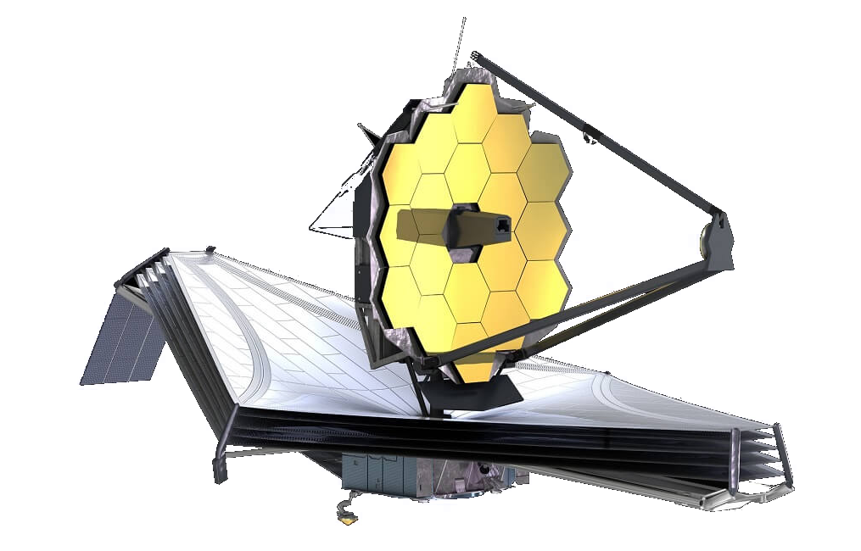
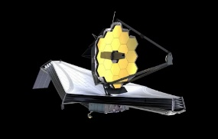
What Do We Do?
Experts in software only simulation of hardware
Experts in hardware emulation
We provide simulated hardware so flight binaries can be executed, unmodified, on commodity hardware
This enables unique, challenging, and otherwise difficult to create test cases
Virtual testbeds allow development to proceed without immediate access to a flatsat
In some cases, code can essentially be finalized prior to hardware integration
Shortens development timelines
FSW, Physics, Avionics

Slide 6
What Do We Do?
JSTAR integrates the operational ground system with our sims
Allows for user familiarity with the software
Supports better PROC testing
Supports better day-in-the-life scenarios
Through work such as this began collaboration with JPL
First collaboration was connecting JPL's AMMOS Mission Data Processing and Control System (AMPCS) with NASA's cFS
Led to the CryptoLib collaboration

Slide 7
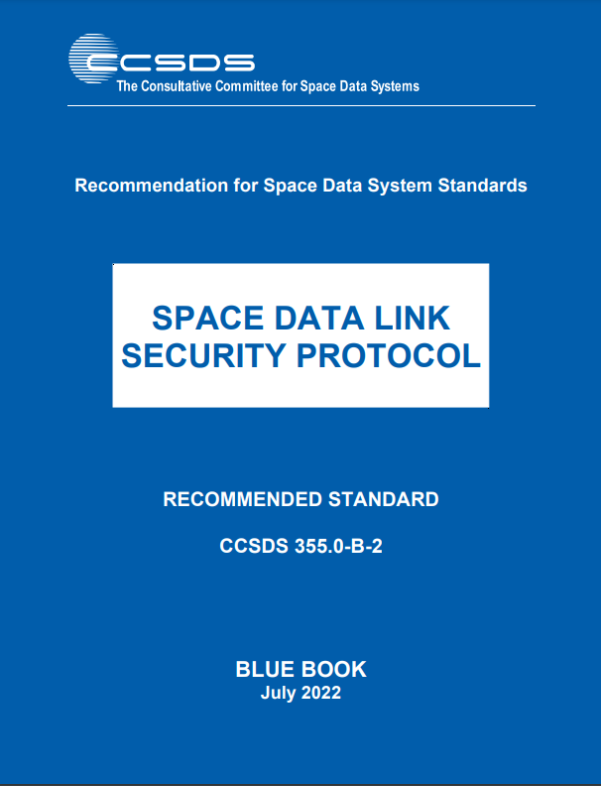
What is CryptoLib?
CryptoLib is an open-source implementation of the CCSDS Space Data Link Systems (SDLS) and SDLS-Extended Procedures (SDLS-EP) Standards
Encrypts/decrypts Telecommand Transfer Frames
Original implementation by John Lucas at IV&V
Open-sourced library
Utilizes LibgCrypt
C Based
https://github.com/nasa/CryptoLib
*From ccsds.org

Slide 8
CryptoLib: Enabling Flight and Ground
Ground Station
Spacecraft
Ground Station Software
KMC-CryptoLib
CryptoLib
Software Bus
App 1
Apply Security
CI
Process Security
App 2
Process Security
TO
Apply Security
…
App N
Tables
Tables

Slide 9
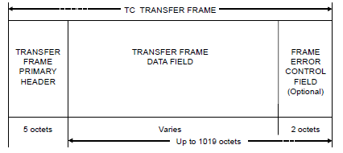
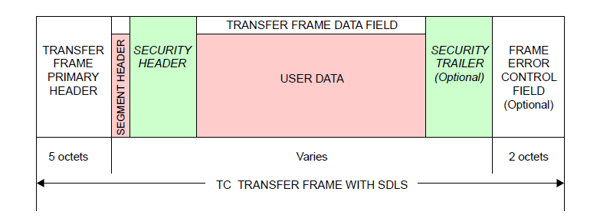
Telecommand Transfer Frames
ProcessSecurity
ApplySecurity
*From CCSDS 232.0-B-4

Slide 10
Why CryptoLib?
NASA-STD-1006A
CubeSats - Missions are not exempt based on size or budget
CCSDS Protocols already in use
Telecommand and telemetry protocols are in wide usage
Additional standards provide guidance for encryption / authentication
An unencrypted command link has implications for other missions
No PhD Required – Minimal Encryption Knowledge necessary!
Open-Source - No black box, transparent handling of the process
No Vendor Lock in
Save $$$

Slide 11
NASA-STD-1006A
"Programs/projects shall protect the command stack with encryption that meets or exceeds the Federal Information Processing Standard (FIPS) 140, Security Requirements for Cryptographic Modules, Level 1. "
[…] iii. Deep space missions may choose to limit controls applied to the space link if certain controls (e.g., encryption and authentication) pose significant burden to operability or mission success, and if the threat to the space link is low.
iv. Category 3/Class C or Class D missions may authenticate without encryption if they have no propulsion.

Slide 12
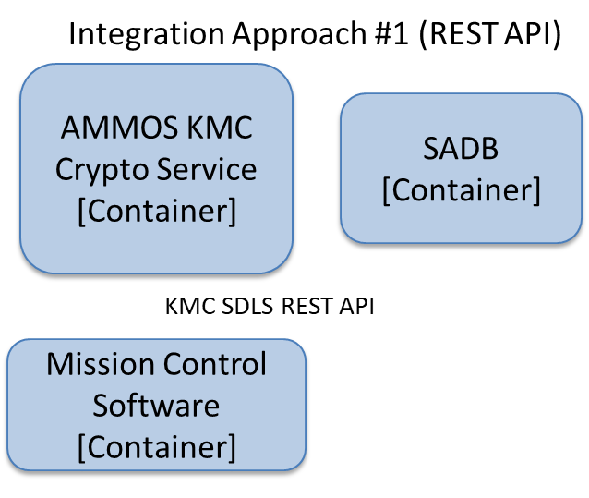
Current Status
Functional Telecommand Uplink
CCSDS Telecommand (TC) Transfer Frames
Encryption Options
Authentication
Encryption
Authenticated Encryption
Implemented algorithms
AES GCM 256
AES CBC 256
SHA 256/512 Hashing
Basic Key Management
Interoperability tested with JPL's Lunar Trailblazer
and SunRISE

Slide 13
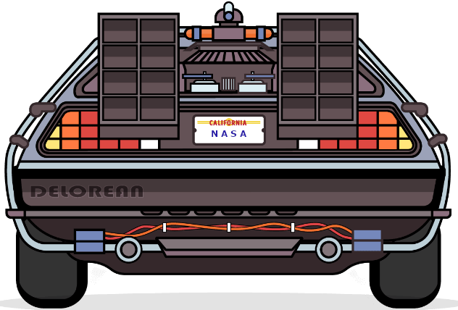
The Future
Downlink development
Telemetry (TM) Frames
Advanced Orbiting System (AOS) Frames
Addition of Extended Procedures
Over The Air Rekeying (OTAR)
Key lifecycle management
Security Association Management
Integration with flight software
NASA's core Flight System
Integration with additional ground systems
ASIST / FEDS
ITOS
COSMOS

Slide 14
Major Contributors
Robert Brown, Systems Engineer, NASA IV&V, Robert.J.Brown@nasa.gov
David "Cody" Cutright, Systems Engineer, NASA IV&V, David.C.Cutright@nasa.gov
John Lucas, Systems Engineer, NASA IV&V, John.P.Lucas@nasa.gov
Michael Pajevski, AMMOS Architect, NASA JPL, Michael.J.Pajevski@jpl.nasa.gov
Ibraheem Saleh, Software Engineer, NASA JPL, Ibraheem.Y.Saleh@jpl.nasa.gov
Scott Zemerick, Chief Systems Engineer, NASA IV&V, Scott.A.Zemerick@nasa.gov

Slide 15
Questions / Answers

Slide 16
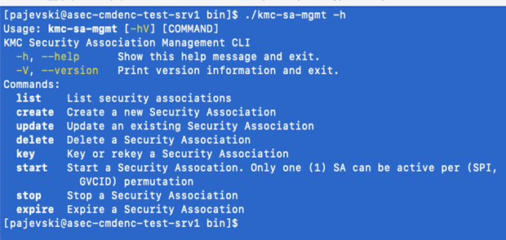
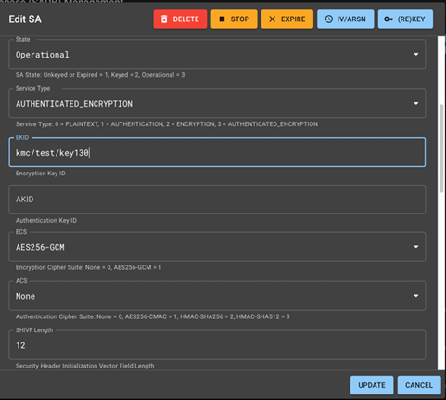
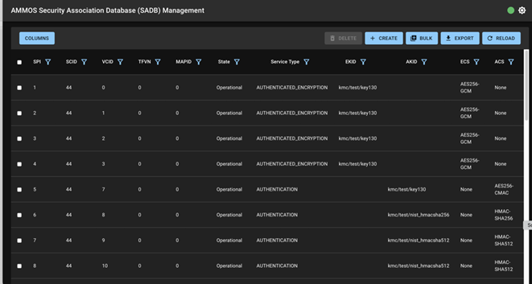
Backup
Web GUI

