Slide 1

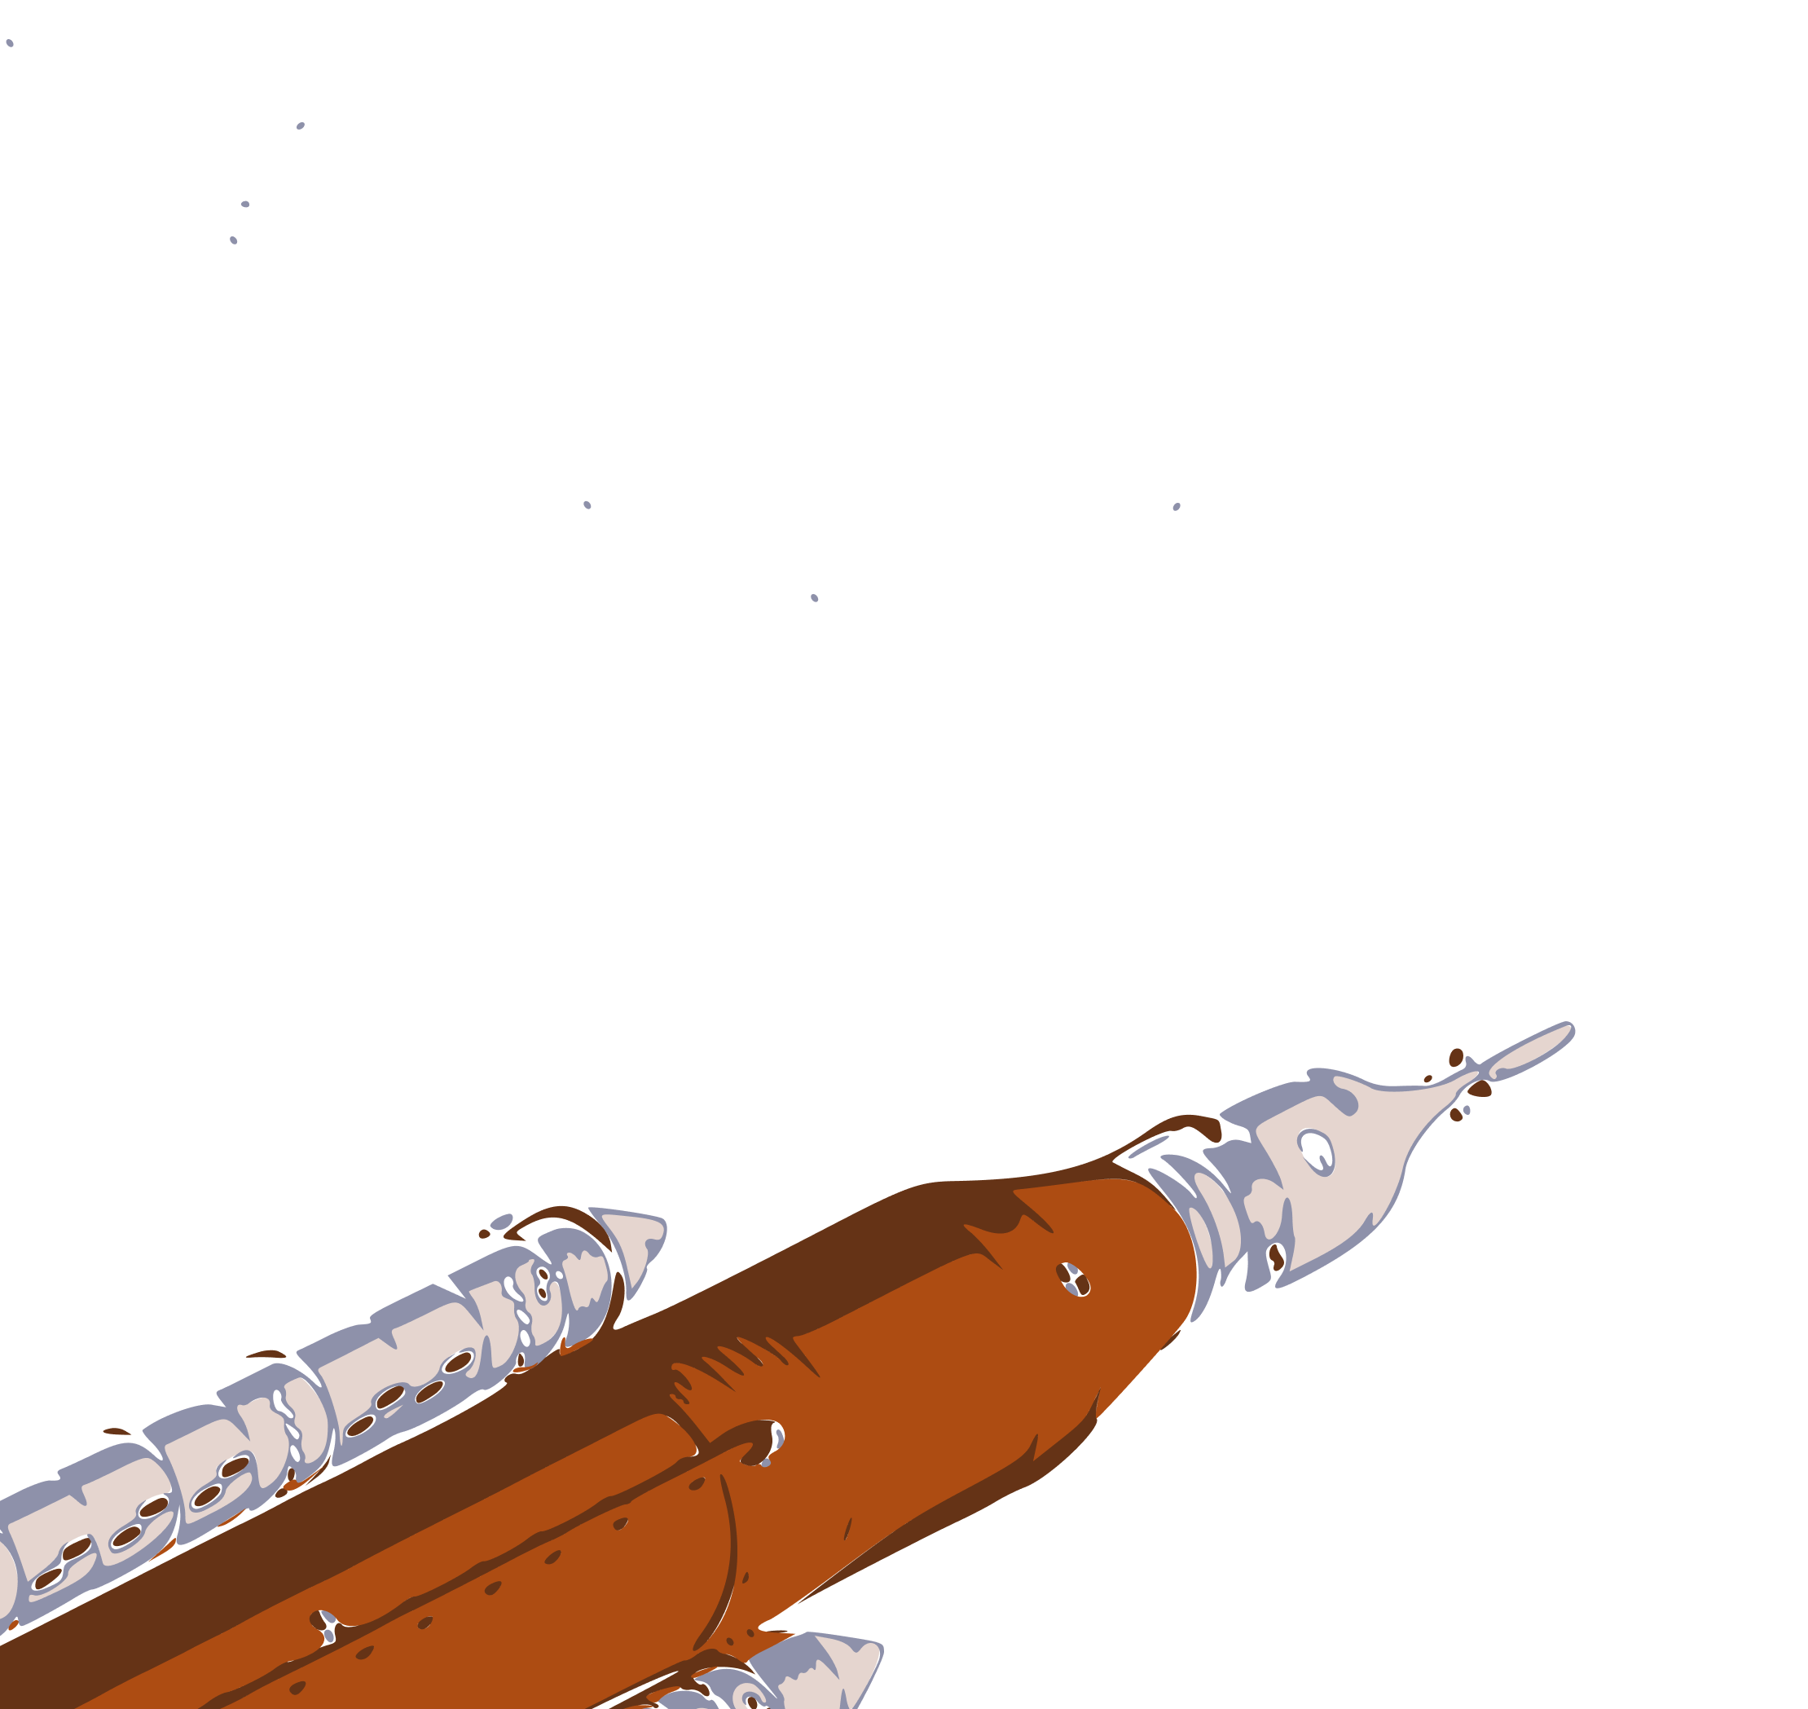

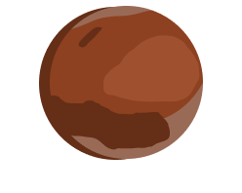


HRP
State of the Program
David Baumann
Director | HRP

Slide 2

HRP Vision & Mission
Drive advances in scientific research to enable human space exploration to the Moon, Mars, and beyond.
HRP will deliver critical components for an evolvable Crew Health and Performance System by 2032. HRP will demonstrate and mature this system in ground analogs, in LEO, and on and around the moon to support a 2039 Mars mission. This system will enable crews to thrive during missions and protect their long-term health

Slide 3
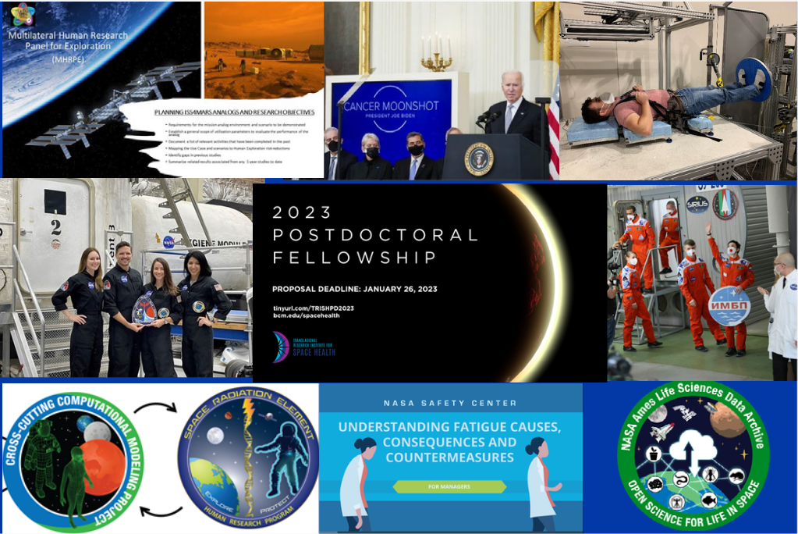
THANK YOU!

Slide 4
Since IWS 2020…
1103 during Inc 62-67, Feb 2020 – Sep 2022
125 during Inc 68 thru Jan 2023
ISS Research Hours
Analog Missions Completed
Papers Published
Active Principal Investigators
11 (4 HERA, 1 SIRIUS, 2 bedrest, 1 parabolic flight,
3 Antarctic winter-overs)
FY20: 197 FY22: 266
FY21: 282 FY23 Q1: 65
FY20: 91 FY22: 87
FY21: 86 FY23 Q1: 48

Slide 5


Human Research Program (HRP)
Charles Lloyd
Pharm. D.
Associate Director
Kristin Fabre, Ph.D.**
Deputy Chief Scientist
Steven Platts, Ph.D.
Chief Scientist
Jancy McPhee, Ph.D. *
Associate Chief Scientist
Nancy Fleming +
Deputy Director
David Baumann
Director
Rebeca Perez*
Senior Administrative Assistant
Igor Kofman*
Russian Science Integration Manager
Updated 1/31/2023
Maturation and Integration Office (MIO)
Program Office
Program Planning and Control Office (PP&C)
Baraquiel Reyna, D. Eng
Manager
Laurie Abadie
External Programs Lead
Brad Stewart
Manager (Acting)
Macresia Alibaruho
Deputy Manager (Acting)
Nancy Wilson
Agreements Manager (Acting)
Tim Travis
Resource Lead
Supporting Center Leads
GRC
Kelly Gilkey
JSC
Darby Magruder
KSC
Ralph Fritsche
LaRC
Ryan Norman, Ph.D.
ARC
Egle Cekanaviciute, Ph.D.
James Hury*
Deputy Director
Dorit Donoviel, Ph.D. *
Director
Translational Research Institute for Space Health (TRISH)
+ Rotation
** IPA
*Contractor

Slide 6
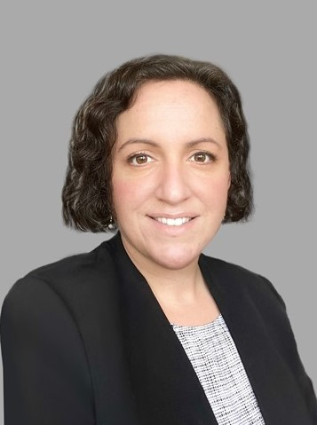
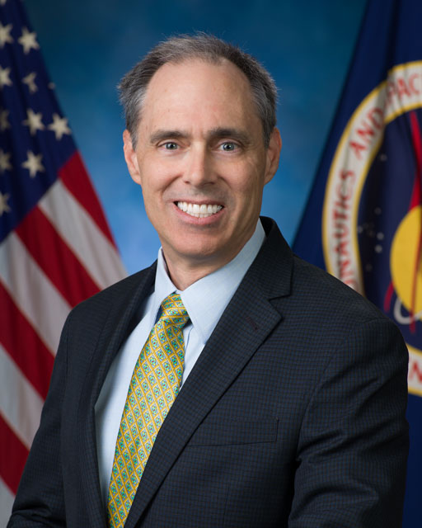
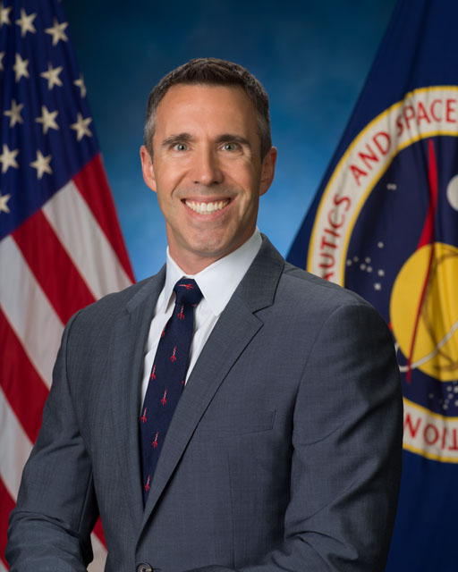
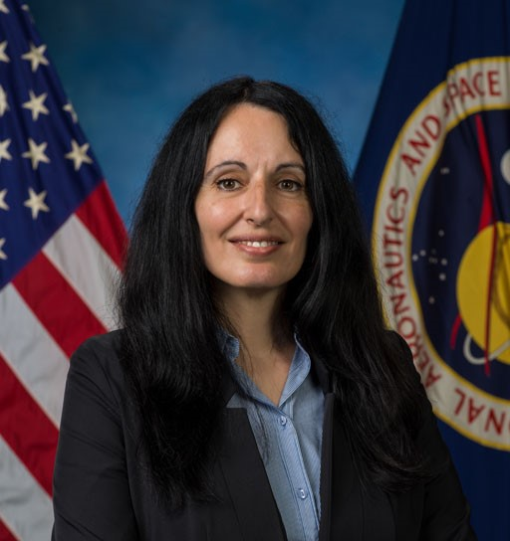

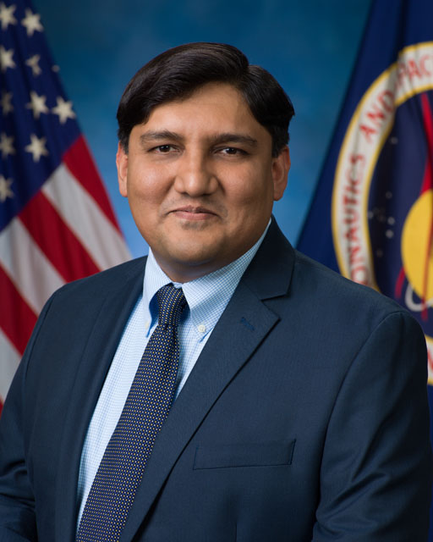
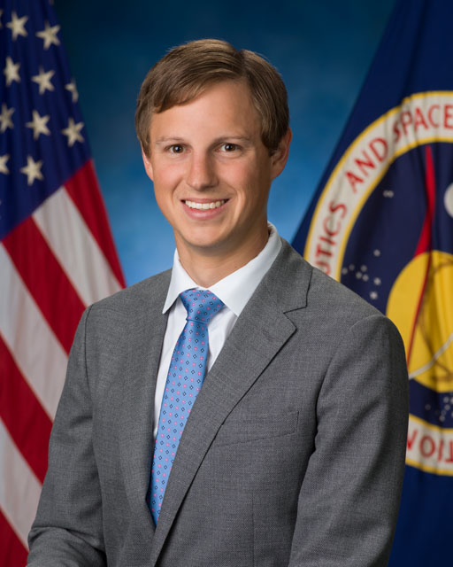
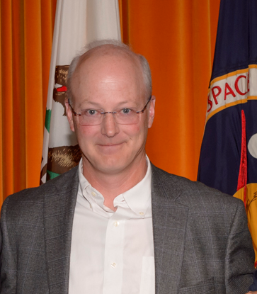
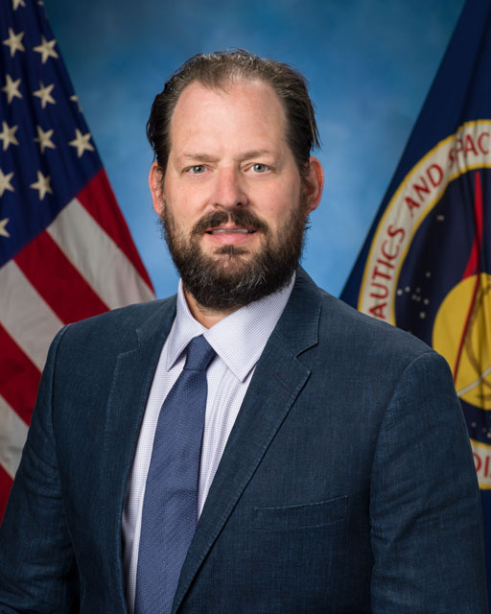
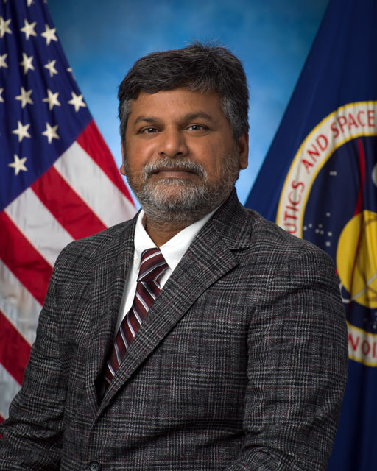
Human Research Program (HRP)
Element Offices
Suzanne McCollum
Manager
Brandon Vessey, Ph.D.
Scientist
Research Operations and Integration (ROI)
Space Radiation (SR)
Human Health Countermeasures (HHC)
Exploration Medical Capability (ExMC)
Human Factors & Behavioral Performance (HFBP)
Andrea Marchica
Manager (Acting)
Aaron Allcorn
Manager
Jason Weeks
Manager
Robin Elgart, Ph.D.**
Scientist
TBD
Deputy Manager
Janice Zawaski, Ph.D.
Deputy Scientist
Laura Bollweg
Manager
Michael Stenger, Ph.D.
Scientist
Maneesh Arya, Ph.D.
Deputy Manager
Becky Brocato, Ph.D.
Deputy Scientist
Kris Lehnhardt, M.D.**
Scientist
Sandra Whitmire, Ph.D.
Scientist
Nicole Schwanbeck
Deputy Manager
Cherie Oubre, Ph.D.
Deputy Scientist
Kelle Pido
Deputy Manager
Sara Whiting, Ph.D.
Deputy Scientist
Vacant
Deputy Manager
Sheikh Ahsan
Deputy Manager
Flight
Analog
Ben Easter, M.D.**
Deputy Scientist
Brian Gore, Ph.D.
Deputy Scientist
Jay Lemery, M.D.**
Associate Scientist
Ajit Mulavara, Ph.D.
Associate Scientist

Slide 7
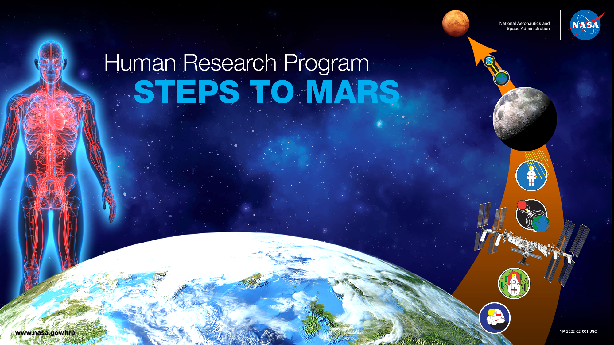
LUNAR MISSIONS:
Orion
Gateway
Human Landing System
Lunar Outposts and Rovers
LOW EARTH ORBIT:
International Space Station
Commercial Spaceflight Vehicles
Commercial Space Stations
EARTH:
Ground Analogs of Spaceflight

Slide 8
Analog Missions

Slide 9
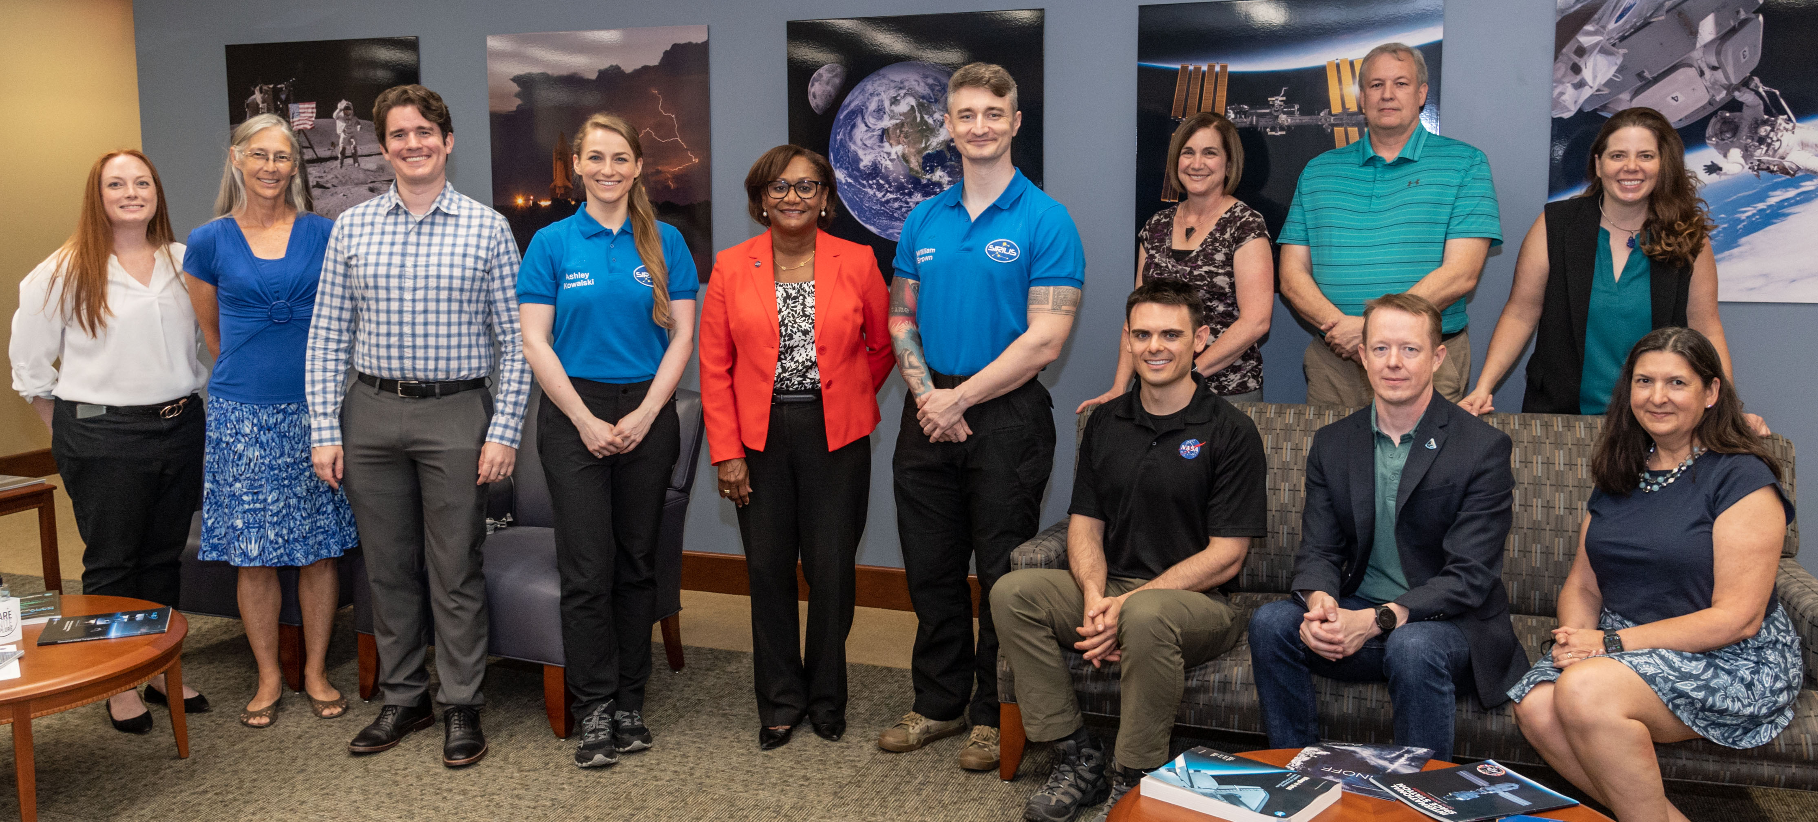
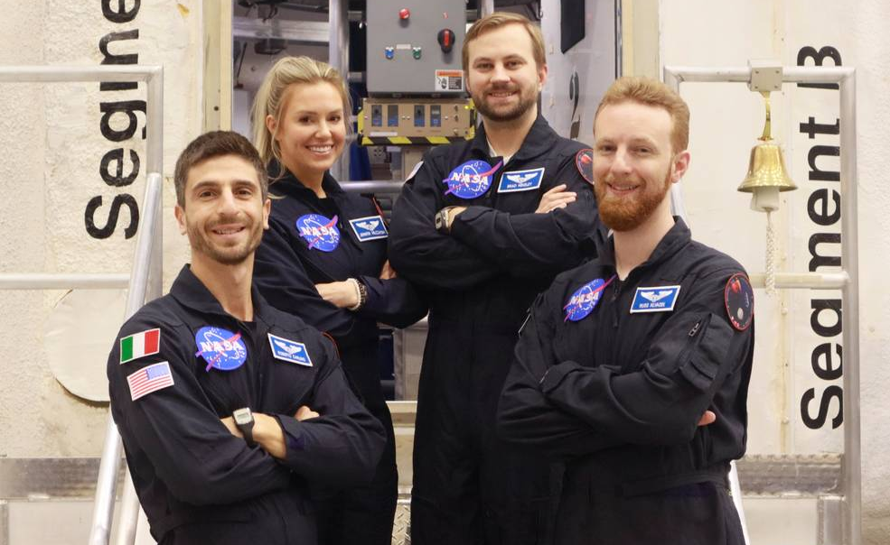
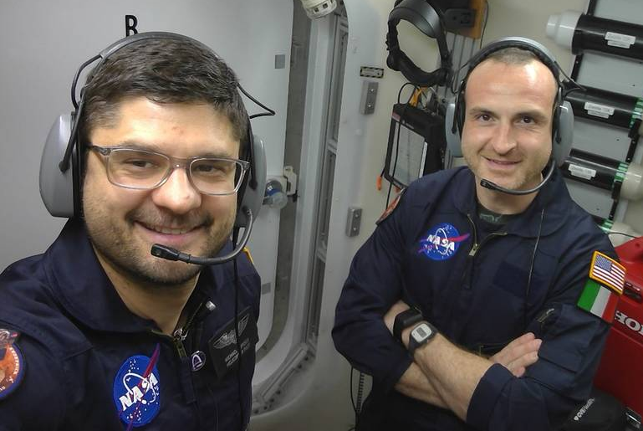
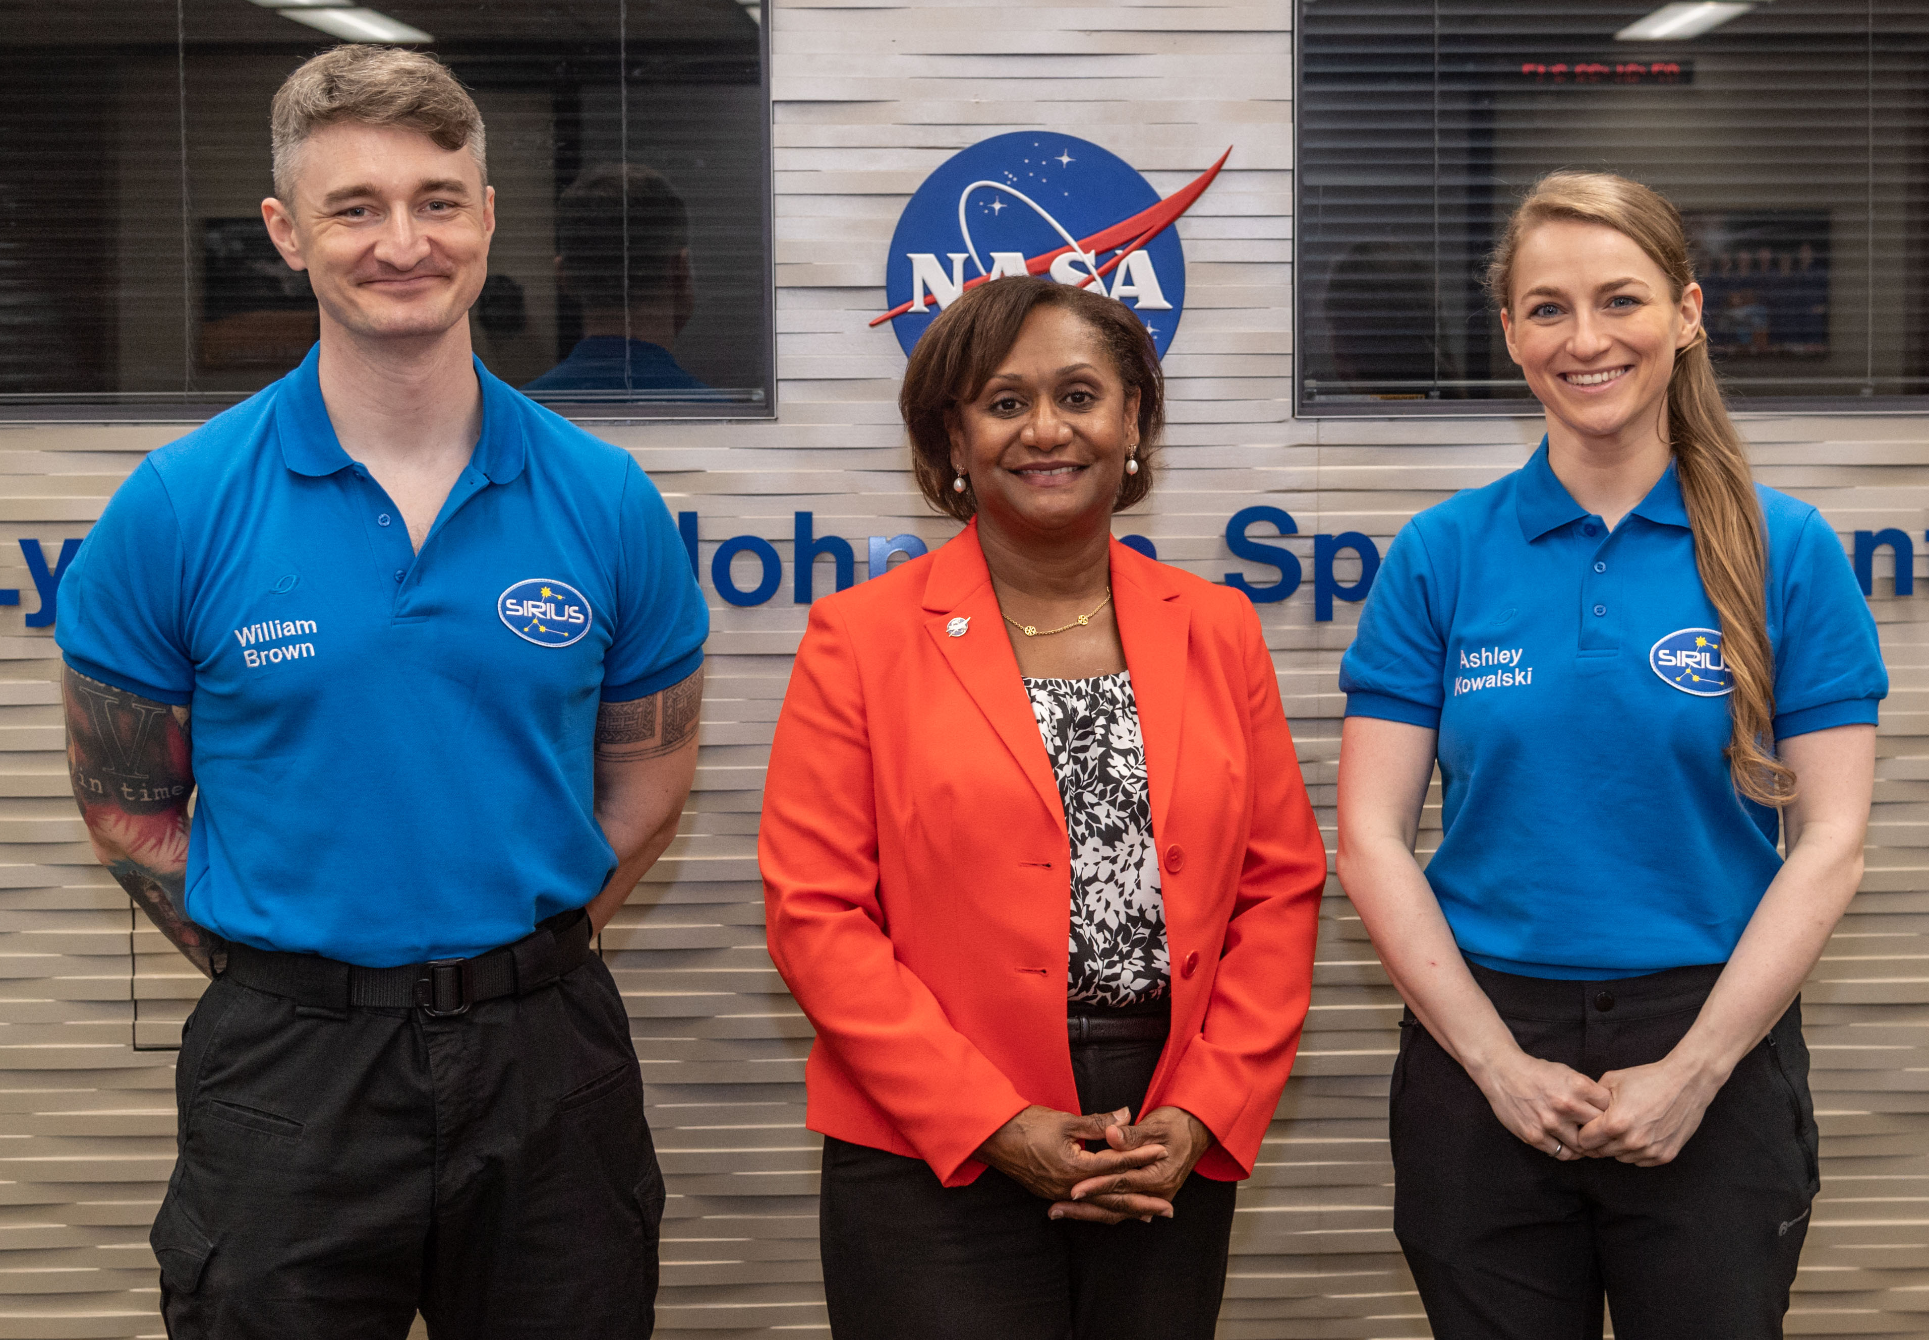
SIRIUS-21
HERA Campaign 6
Effects of long-duration isolation and confinement in an autonomous mission on individual, team, and multi-team functioning in a multi-national crew
Completed July 2022
NEK Facility, Moscow
Risk characterization and countermeasures to support autonomous crew operations and behavioral health and performance
Mission 2 & 3 completed, 4 underway
Johnson Space Center

Slide 10
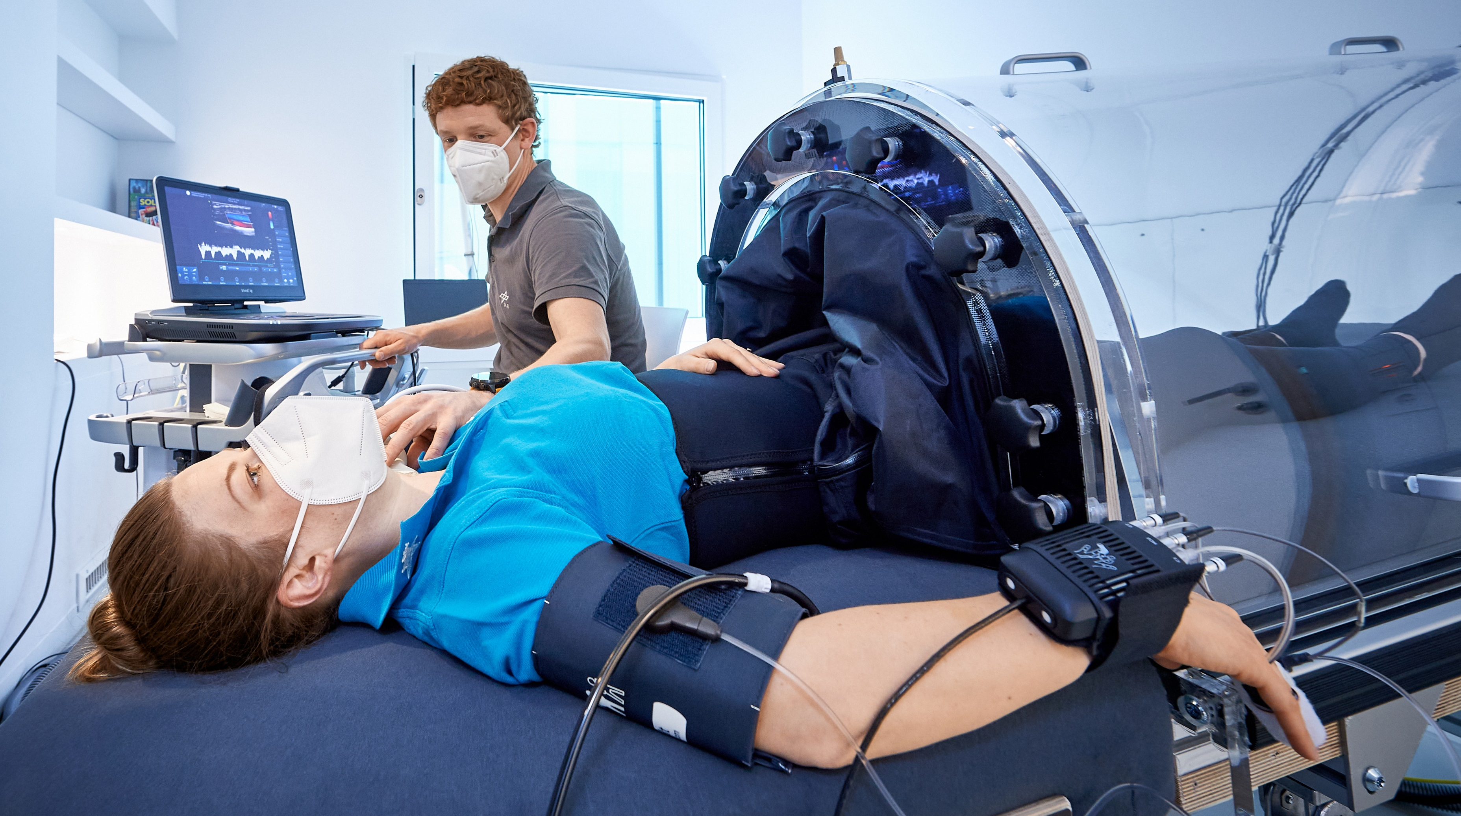
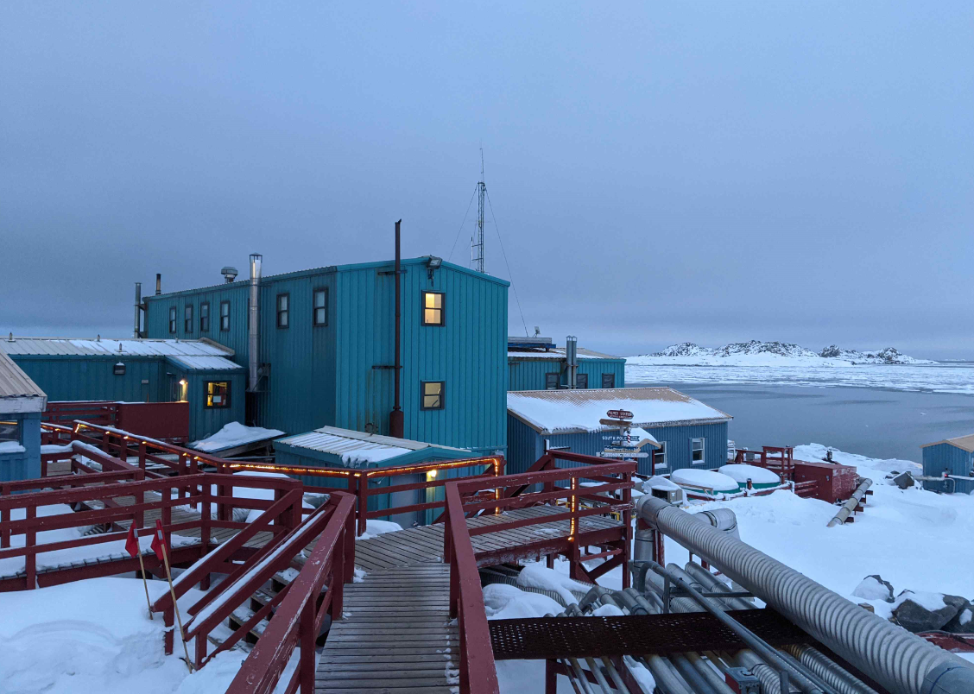
:envihab
Palmer Station
SANS Countermeasures
Campaign 3 underway, Campaign 4 in May
DLR Cologne, Germany
Immune Countermeasures
Antarctica

Slide 11
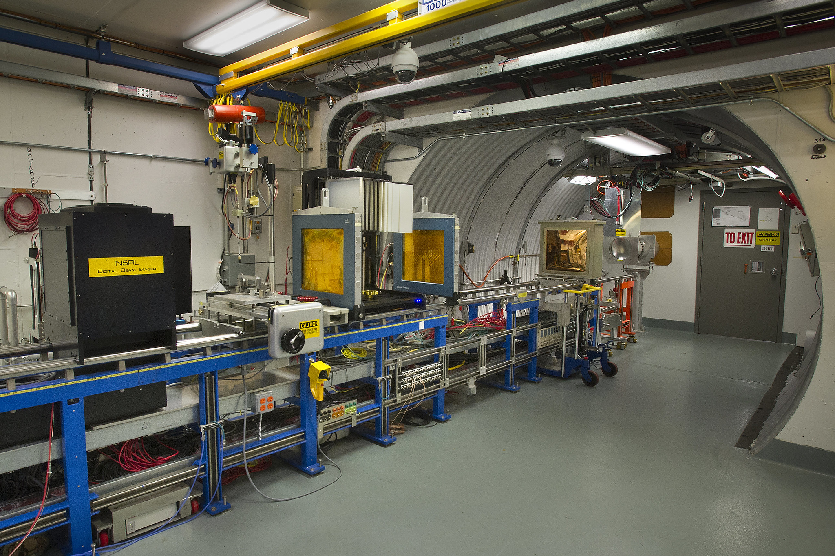
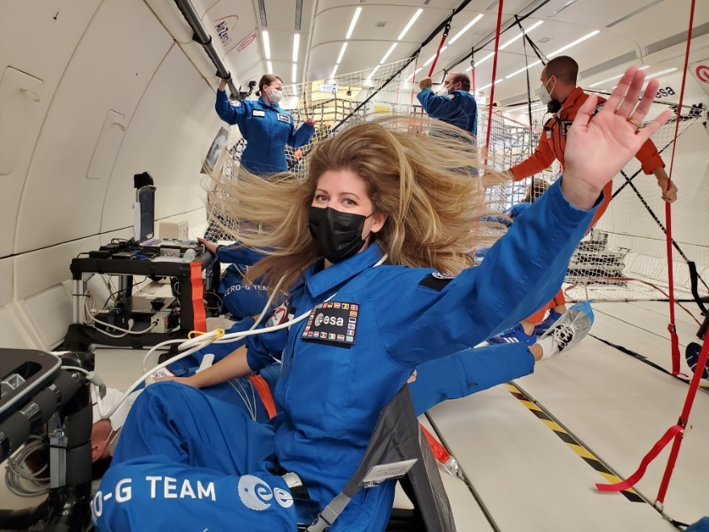
NSRL
Parabolic Analog
Finishing first round of Galactic Cosmic Ray simulator studies
NASA Space Radiation Lab at Brookhaven National Laboratory
Parabolic Analog Flight Study
Completed study characterizing jugular venous flow during acute weightlessness
Novespace in Bordeaux, France
Notes:
NSRL words confirmed by SRE and words from HHC included in Parabolic Analog section. Results from Parabolic Analog study will be presented at IWS.
“Five experiments will be performed in parabolic flight to examine cardiovascular and sensorimotor responses to a range of reduced gravity levels between 0 and 1 G”
Unique thing about upcoming parabolic campaign with five PIs/studies will be investigating range of partial gravities (0, .25, .5, .75)

Slide 12
Spaceflight Missions

Slide 13
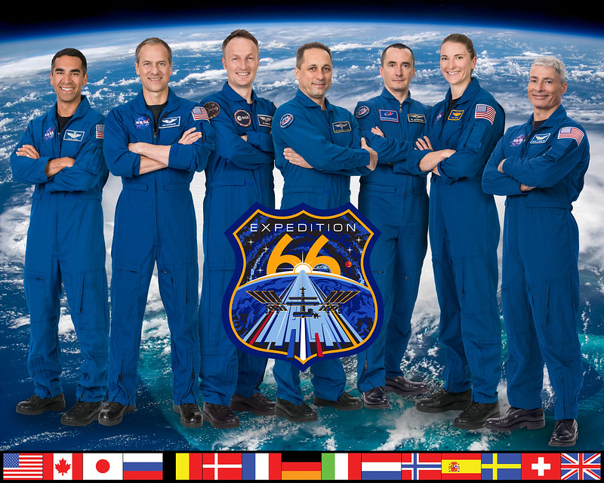
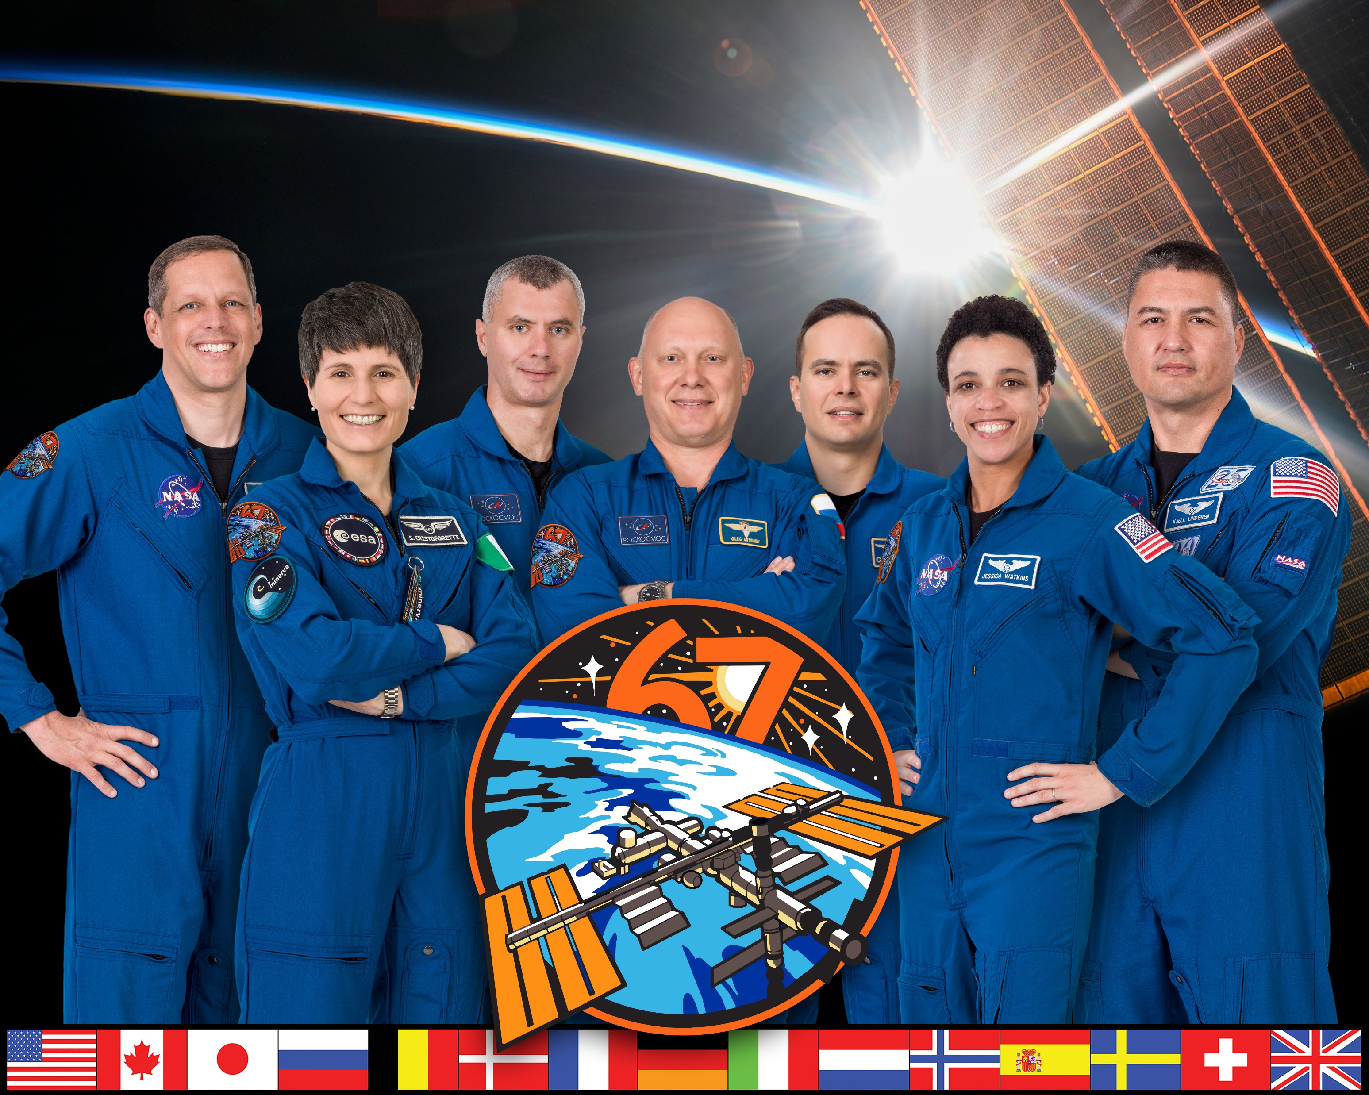
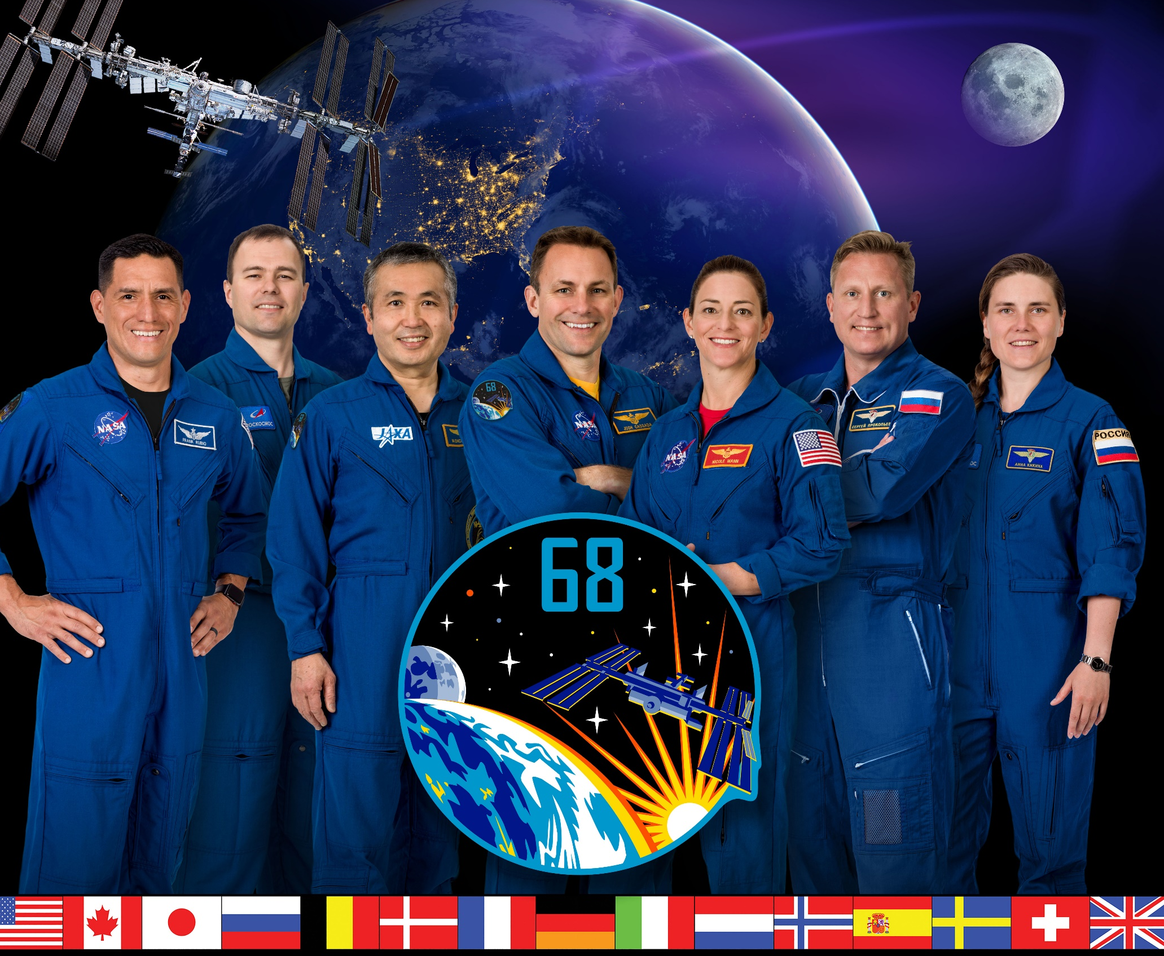
Increment 66
Increment 67
Increment 68
October 2021 to March 2022
11 HRP studies
March 2022 to September 2022
12 HRP studies
September 2022 to March 2023
9 HRP studies

Slide 14
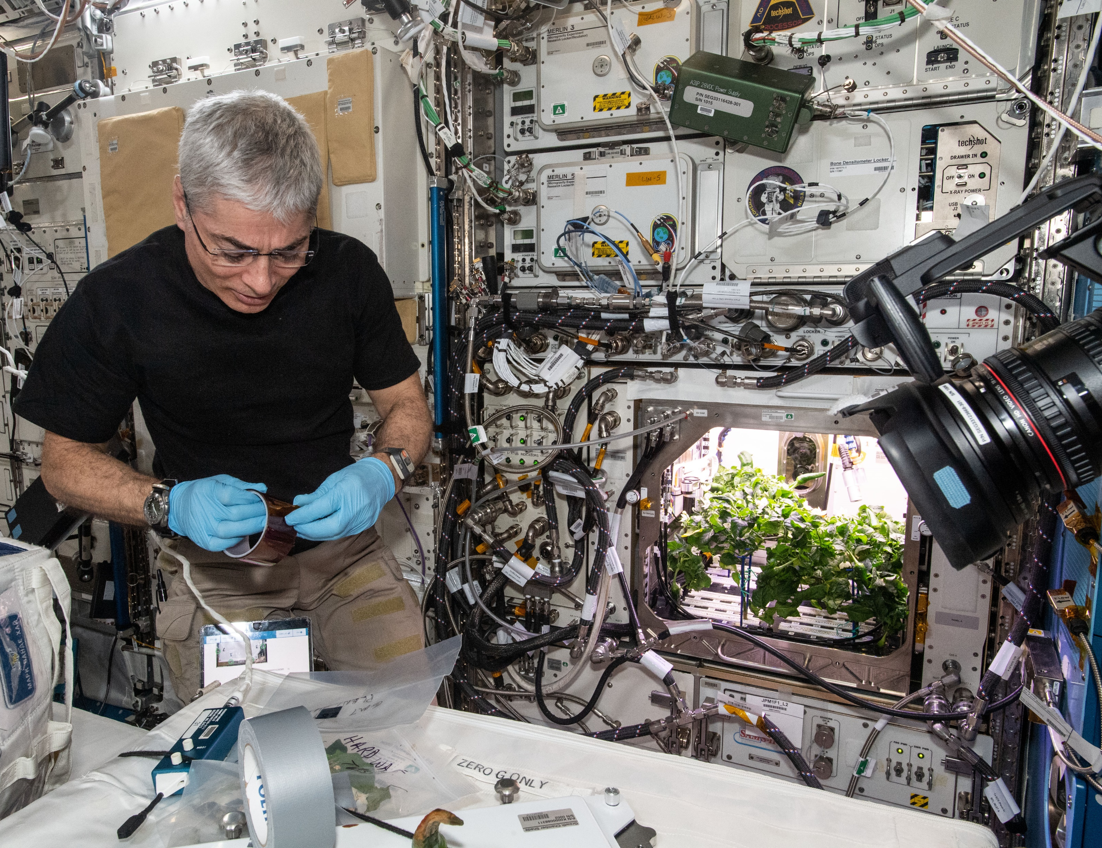
Vande Hei Long Duration Mission
Food Physiology
Food Acceptability
Soyuz Occupant Risk
Veg-04/05
Standard Measures
Repository
Med B’s

Slide 15
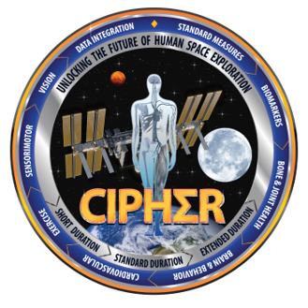
CIPHER
First subject Summer 2023
The 14 CIPHER studies examine:
  Bone and joint health
  Brain and behavior
  Cardiovascular system
  Exercise performance
  Sensorimotor systems
  Vision
  Biomarkers
More information at nasa.gov/cipher

Slide 16
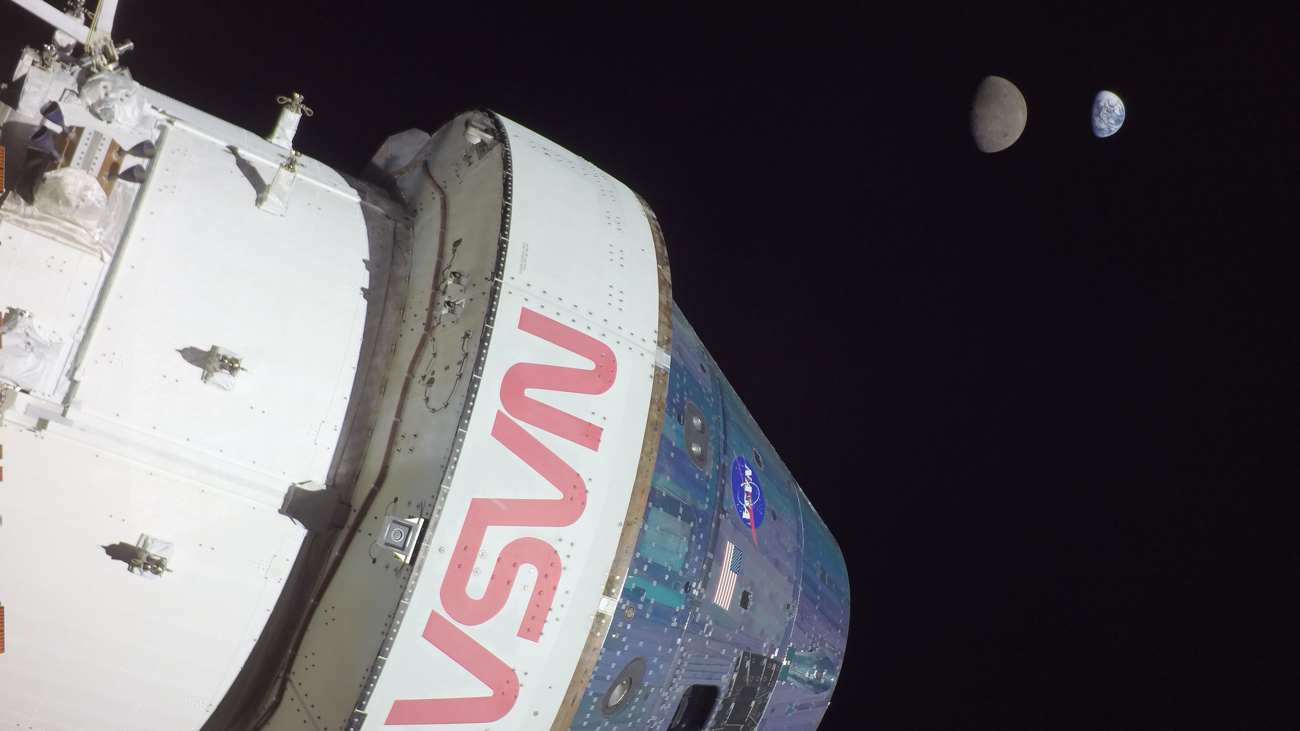
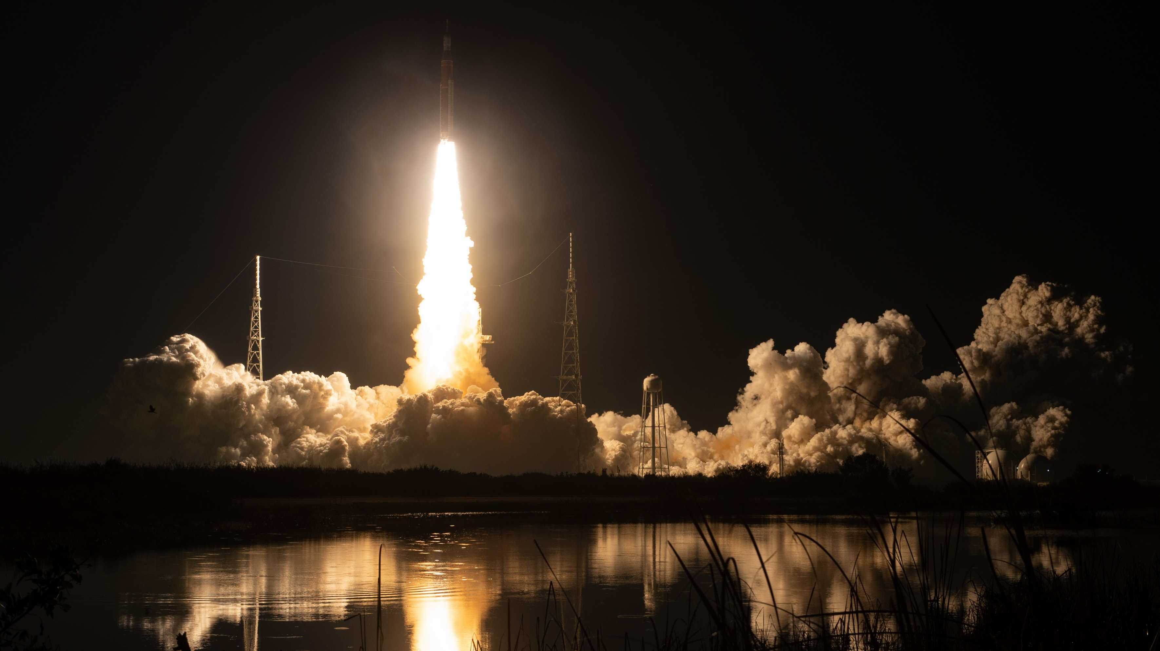

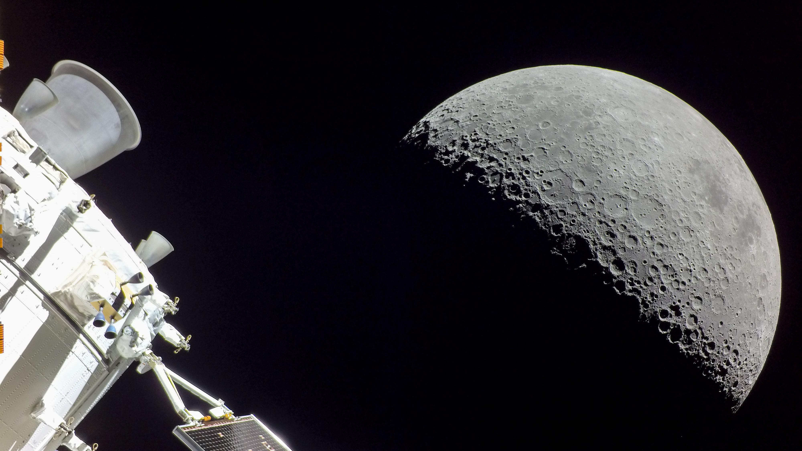

Slide 17
Tools & Partnerships

Slide 18
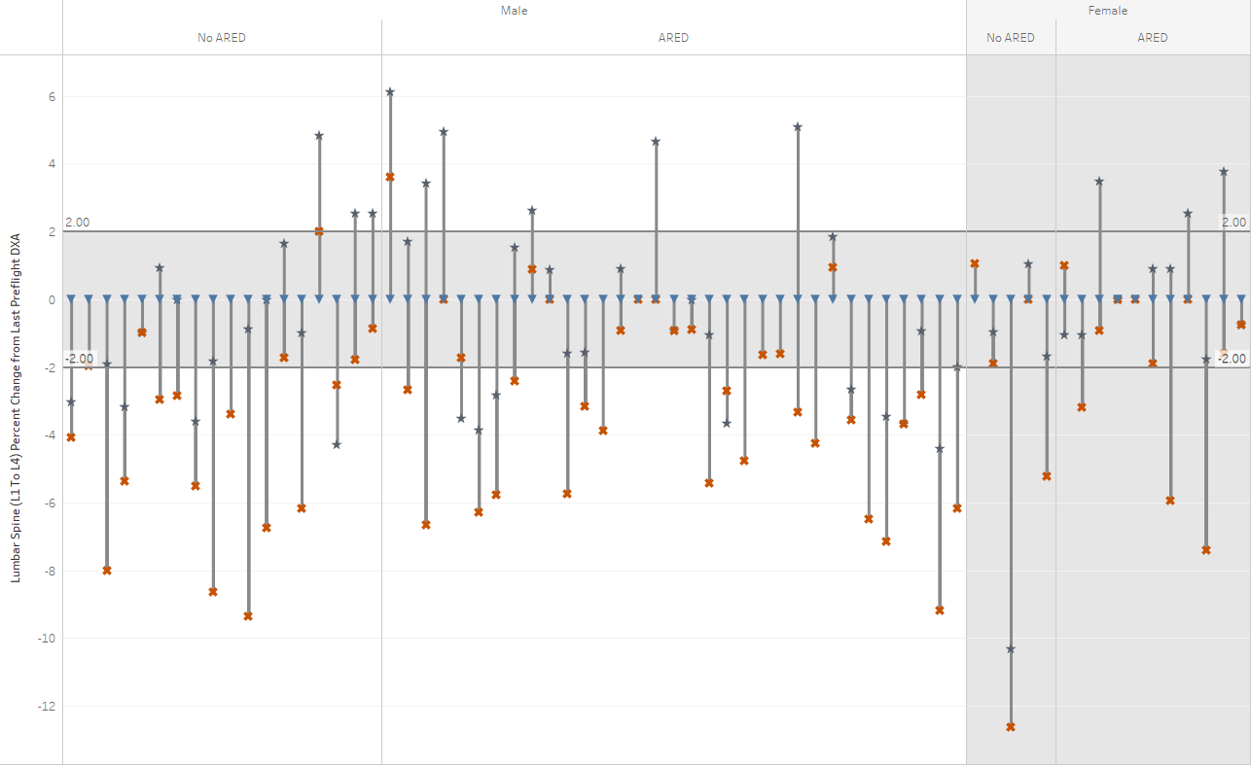
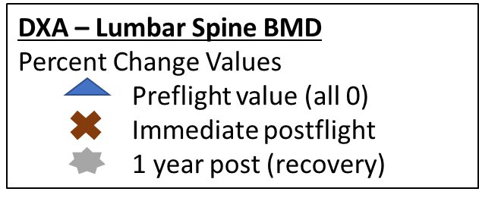
Data Visualization - EDDIE
Extended Duration Data Investigation & Evaluation
Visualize research & medical data from ISS NASA astronauts
Explore mission duration impacts
Notes:
Example graph is Lumbar Spine Bone Mineral Density Percent Change from Last Preflight Measure
by Astronaut Mission, Relative Day, Sex and ARED Status
Ordered Randomly
The purpose of EDDIE to visualize research and medical data from ISS NASA astronauts to explore impact of mission duration
Long Duration 100 - 215 days (n=59)
Extended Duration > 215 days (n=4)
Categories based on natural breaks in the data
IRB approved and consented research study. Extended duration crew have not provided consent for potentially identifiable data to be shared outside of NASA
The visualization shows the percent change in BMD of the lumbar spine (L1-L4) as measured by DXA (bounded by 2% which is the level of measurement error.
The data are categorized by sex and access to ARED (but did not include the exercise frequency, duration or intensity actually exercised over the course of their mission).
Each bar has three symbols. The down blue triangle indicates the preflight value (hence all zero). The red-orange X indicates the immediate postflight value (typically within first week following return from ISS). The grey star represents the one year following return measurement.
DXA measurements do not address bone quality, which is better measured by QCT.
These measurements also do not take into account rate of bone loss which is also a concern during long and extended duration space flight. These visualizations also do not take into account additional countermeasure use (e.g., bisphosphonates). This visualization only includes data on the Lumbar Spine. Different patterns for different body parts (e.g., hip) may be seen.

Slide 19
Directed Acyclic Graphs (DAGs)
Causal diagrams to illustrate risks
Guidelines for creation/use of DAGs as risk tools are now available.
HSRB team will be available to discuss DAGs at Tuesday Poster Session
Public Website: https://www.nasa.gov/hhp/hsrb
Poster: Antonsen et. al. HUMAN SYSTEM RISK COMMUNICATION: DIRECTED ACYCLIC GRAPHS
Notes:
NASA has been exploring the concept of causal diagrams to illustrate NASA’s thinking of the risks
Using Directed Acyclic Graphs
Formal guidelines for creation and use of DAGs as risk tools are now publicly available.
Poster during the Tuesday poster session where members of the HSRB team will be available to discuss the DAGs

Slide 20
NLSP – NASA Life Science Data Portal
nlsp.nasa.gov
Next Gen LSDA
Cloud-based archive
Central, searchable data repository
More information at:
  Data Management (DS09)
  10:15 – 11:45
  Grand Ballroom B
Notes:
Next-Gen LSDA
NLSP is designed to help the space life science community conduct research, collaborate, and share knowledge. The platform is a cloud-based archiving solution that acts as a central, searchable repository for data – simplifying secured discovery, regulatory compliance, and end-user data submission and access.
By tackling the information-management challenges particular to HRP, the NLSP will reduce the risk of data loss, breaches of privacy, and make finding information more efficient.

Slide 21






















CURRENT PARTNERSHIPS
NASA Programs
and Affiliates
International
Domestic OGA
Industry / External
Biological & Physical Sciences (BPS)
Health & Medical Technical Authority (HMTA)
Advanced Exploration Systems (AES)
NSRL Outside Users
Commercial Space Providers
TRISH industry partners
Others
SBIR-STTR
Notes:
This list is not exhaustive, but includes partners that advance our objectives

Slide 22
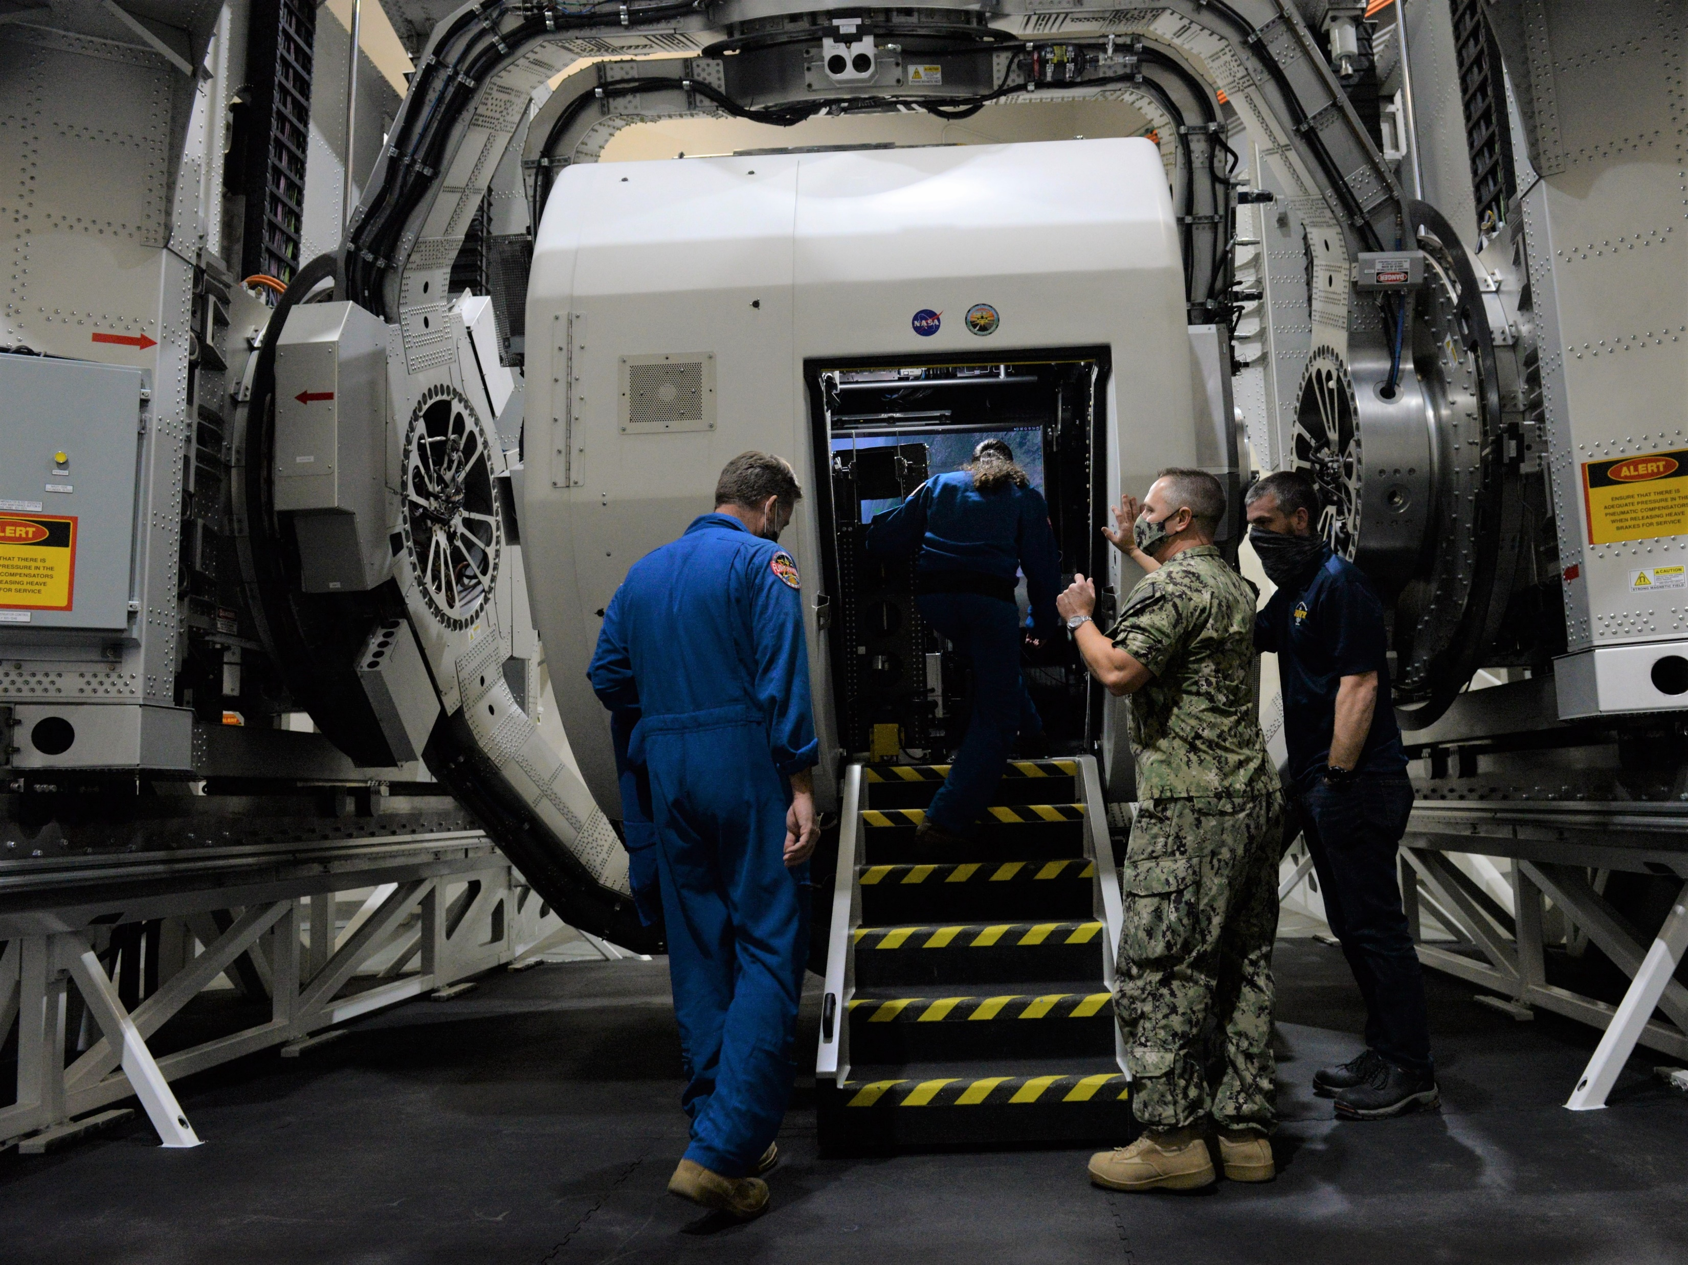
New Collaborations
Naval Medical Research Unit – Dayton
  Kraken Disorientation Device
HERA Campaign 7
  UAE Research & crewmembers
Indian Space Research Organisation
Commercial Partners
  Private Astronaut Missions & Free Flyers
  Commercial Crew Program Flights
  Commercial LEO Development Service Requirements Team

Slide 23
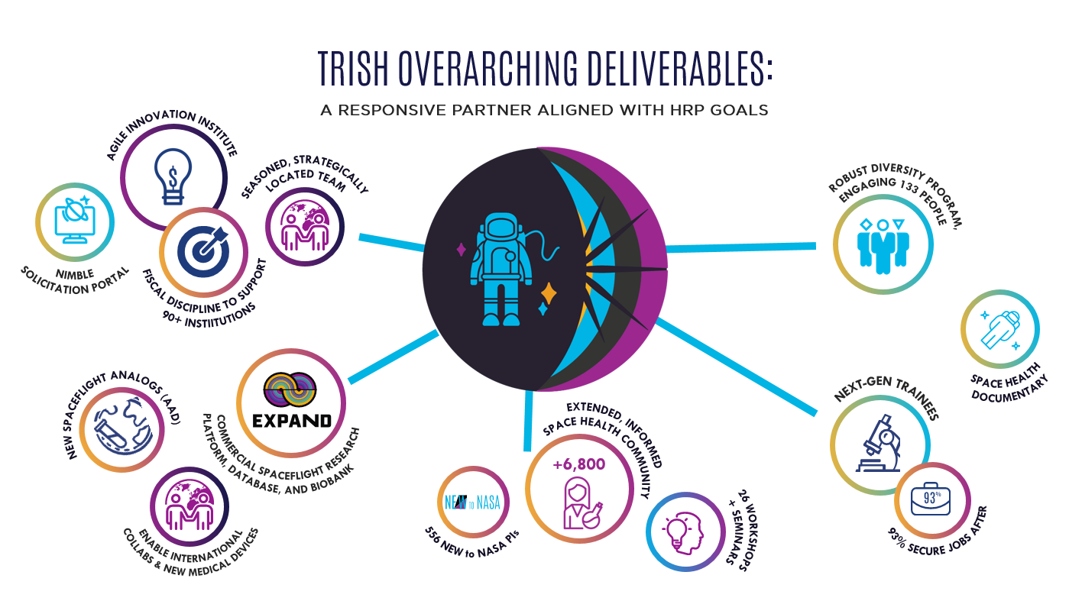
TRISH
(reach out to Dorit)

Slide 24
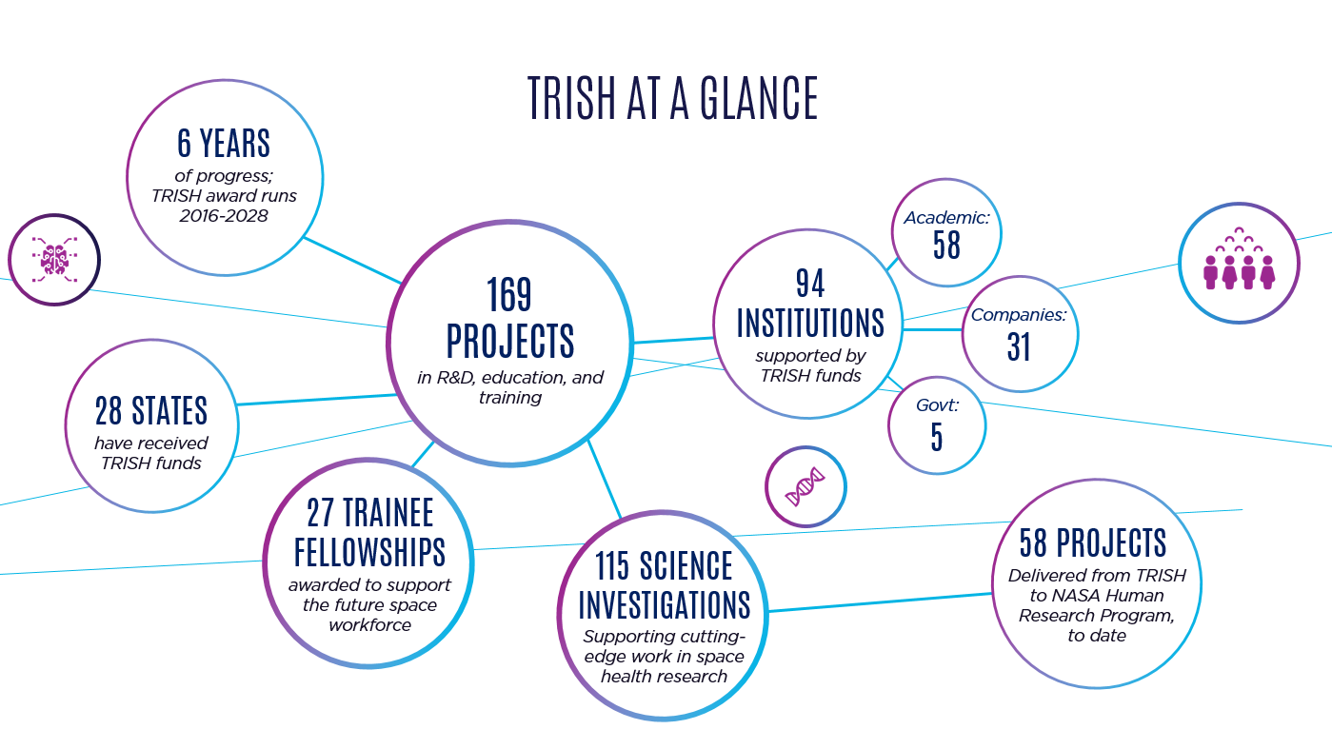
TRISH
(reach out to Dorit)

Slide 25
2023 In-Mission Timeline
Parabolic
Analog
Antarctica Winter Over
:envihab SANS CM C3
:envihab SANS CM C4
HERA Campaign 6
HERA Campaign 7
Jan
Feb
Mar
Apr
May
June
July
Aug
Sept
Oct
Nov
Dec
Flight
Crew-5
Crew-7
Crew-6
CIPHER
Ax-2
70S
68S/69S

Slide 26
NASA Human Research Program Investigators’ Workshop
To The Moon: The Next Golden Age of Human Spaceflight
Thank You, Steering Committee!!
Laurie Abadie, M.S., M.Eng. | Jay Lemery, M.D.
Maneesh Arya, Ph.D. | Charles Lloyd, Pharm.D.
Becky Brocato, Ph.D. | Jon McFather
Lisa Carnell, Ph.D. | Jancy McPhee, Ph.D.
Rachel Dempsey, MBA | Lisa Milstead, M.S.
Catherine Domingo, PMP | Cherie Oubre, Ph.D.
Benjamin Easter, M.D. | Steven Platts, Ph.D.
S. Robin Elgart, Ph.D. | Michael Stenger, Ph.D.
Kristin Fabre, Ph.D. | Judy Tate-Brown, M.S.
Brian Gore, Ph.D. | Corey Theriot, Ph.D.
Madison Hever | Jennifer Turner
Erik Hougland, PMP | Brandon Vessey, Ph.D.
Jennifer Jadwick | Sara Whiting, Ph.D.
Kris Lehnhardt, M.D. | Alexandra Whitmire, Ph.D.
 | Janice Zawaski, Ph.D.

Slide 27
Thank you!

Slide 28
Backup

Slide 29
Metrics Since IWS 2020 …
ISS Research Hours | - 1103 during Inc 62-67, Feb 2020 – Sep 2022 - 125 during Inc 68 thru Jan 2023
Number of Analog Missions Completed | - 11 (4 HERA, 1 SIRIUS, 2 bedrest, 1 parabolic flight, 3 Antarctic winter-overs)
Number of Papers Published | - FY20: 197 FY22: 266 - FY21: 282 FY23 Q1: 65
Number of Active Principal Investigators | - FY20: 91 FY22: 87 - FY21: 86 FY23 Q1: 48

