Slide 1
Recent Advances for the
CDISC Aerodynamic Design Method
Brett Hiller, Richard Campbell, Michelle Banchy
Configuration Aerodynamics Branch
NASA Langley Research Center
NASA/Gulfstream Technical Interchange Meeting
Feb. 7, 2023

Slide 2
CDISC Overview
CDISC is similar to other design methods
  Like inverse methods, CDISC determines geometry that produce specified pressure distributions
  Like gradient-based numerical optimization methods, CDISC uses a direct-iterative approach to minimize a flow quantity based on sensitivity derivatives
Constrained Direct-Iterative Surface Curvature (CDISC) is a knowledge-based design method
  Prescribed sensitivity derivatives
  Target pressures automatically generated from flow constraints
  Geometry constraints for robustness and multidisciplinary requirements
Originally created in the 1980s, CDISC was rewritten in 2021
  Improved compatibility with updates in flow solvers
  More user-friendly code
  Added extensions to design capabilities
Notes:
Transferred to gulfstream originally in ____ (Dick to look up)

Slide 3
Knowledge Needed for Knowledge-Based Design
What are the physics related to drag?
  Induced drag ➔ shed vorticity
  Wave drag ➔ shock strength
  Form drag ➔ boundary layer (BL) state
How are the flow characteristics specified to get the desired flow physics?
  Elliptical spanload ➔ minimum induced drag
  Adverse rooftop C_{P} gradient ➔ weaken shock
  Favorable rooftop C_{P} gradient ➔ delay BL transition
How is the geometry modified to get the desired flow characteristics?
  Iterative approach coupled with flow solver
  Geometry changed according to prescribed sensitivity derivatives
Notes:
If you’re going to build a knowledge-based code, you need to understand these questions

Slide 4
CDISC Design System
Flow Solver
USM3D, FUN3D, etc.
New Grid
Flow/Geometry
Extraction
Design Module
CDISC

Slide 5
CDISC Sensitivity Derivatives
An aerodynamic sensitivity derivative is the change in a flow parameter relative to a change in geometry
Methods for computing sensitivity derivatives
  Finite difference ➔ design takes hundreds of flow analyses
  Adjoint ➔ design takes tens of flow analyses
  Prescribed ➔ design takes 1-2 flow analyses
∆C_{p} ∝ ∆Curvature
∆C_{p} ∝ ∆Slope
Subsonic
Supersonic
Local Mach number
Notes:
Most people have gone to adjoint (very few use finite difference).
Key point is that prescribed cuts down the design time significantly.
Part of the time savings is coming from not having to converge the flow solution all the way (can converge as you progress in the design)

Slide 6
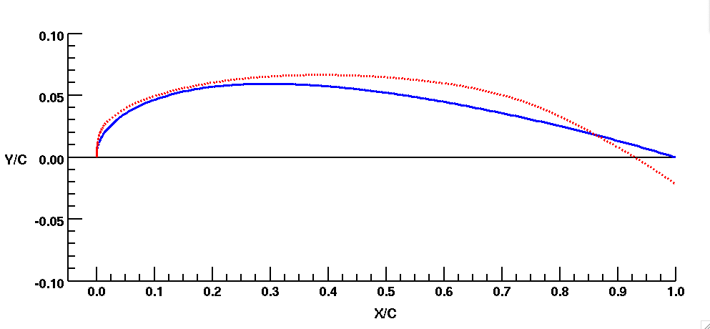
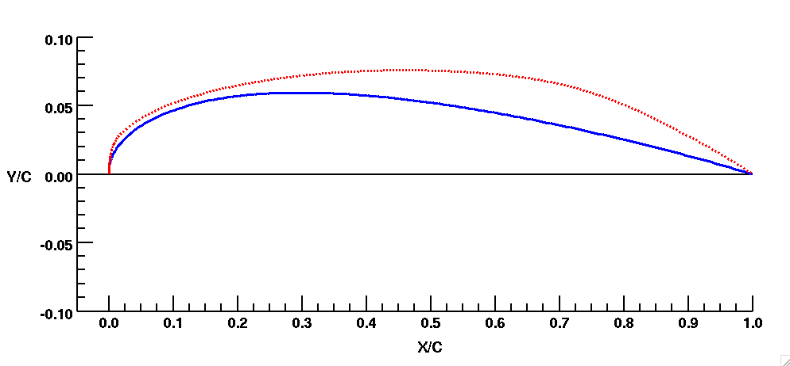
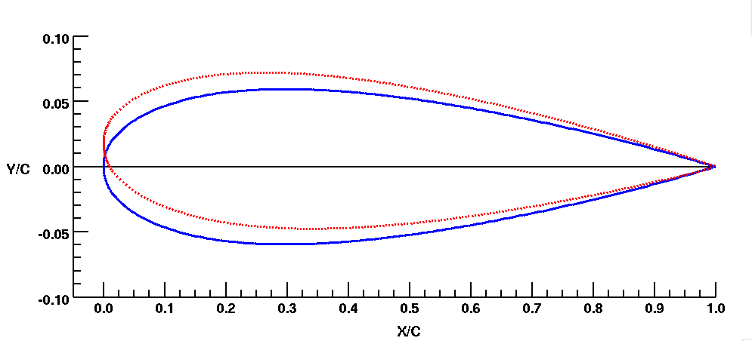
CDISC Geometry Change Process
Step 1:
Change curvature by rotating downstream points
Step 2:
Accumulate curvature changes
Baseline
Design
Step 3:
Rotate surface back to original trailing edge
Step 4:
Twist airfoil based on ΔC_{P} at leading edge
Notes:
Can verbally mention we are not using shape functions, we’re moving each point. One of the results of that is we have more control/freedom over geometry (may pay off for laminar flow stuff where we need a lot of control at the leading edge than may be possible with splines/shape functions). Downside is it can introduce more high-frequency geometry stuff (not smooth).

Slide 7
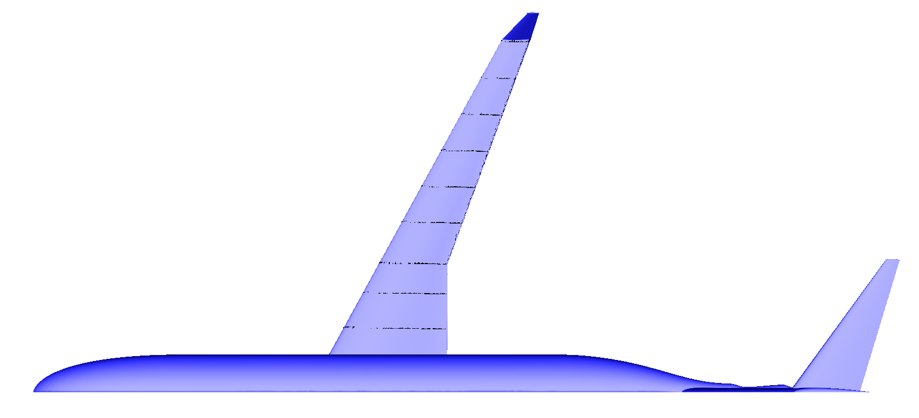
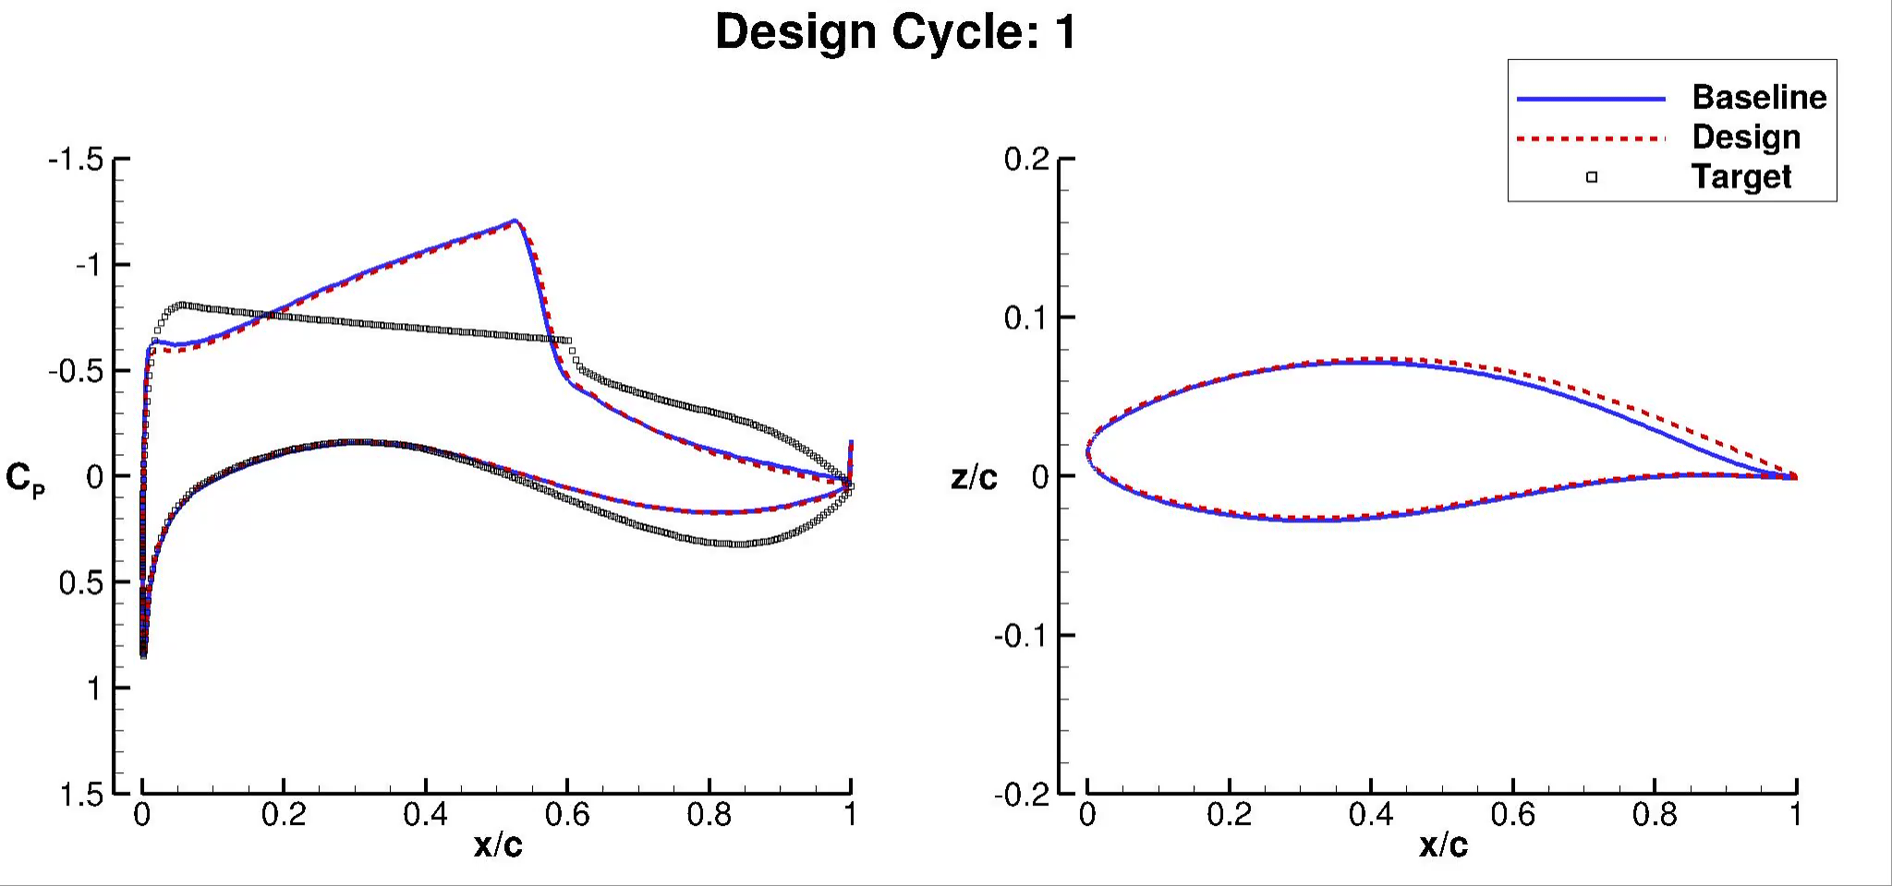
CDISC Design Example
Wing Station
NASA STARC-ABL Configuration
Notes:
Might want to explain the targets versus baseline (like weaker shock stuff) before you hit play

Slide 8
CDISC Design Applications
Aircraft components
  Lifting surfaces (wing, winglet, canard, tail, pylon, multielement, strut)
  Bodies (fuselage, nacelle)
  Fillets
Flight conditions
  Subsonic, transonic, supersonic
  High-lift, cruise, buffet
  Turbulent, laminar flow
Remote design
  Sonic boom reduction
  Replicating interference effects
Internal flows
  Wind tunnel walls
  Inlets

Slide 9
Compatibility with Different Flow Solvers
Current auxiliary codes use b8.ugrid and surface_patch.dat files
  USM3D-ME
  FUN3D
Converters available for other solvers
  Legacy USM3D (.cogsg,.flo)
  Cart3D (.triq)
  Structured grid solvers (PLOT3D .grid and .q files)
  MSES (blade and cpwall files)
Notes:
may require minor modifications for the converters, but capability is there. Do we want to add Kestrel?

Slide 10
CDISC Status
CDISC is a knowledge-based design module that couples with a flow solver to alter the geometry to change the aerodynamic characteristics
Software release process has been initiated for new version of CDISC to be available to US citizens (targeting Summer 2023 for release)
CDISC team offers trainings and/or collaborative work to help new users apply CDISC to their specific geometry or design cases
Notes:
Emphasis on applied aerodynamic design application, either mention or add text about how in the past we’ve added features in CDISC to accomplish a unique design goal (even if it’s not listed in the design applications slide) (modifying or adding constraints or capabilities)

Slide 11
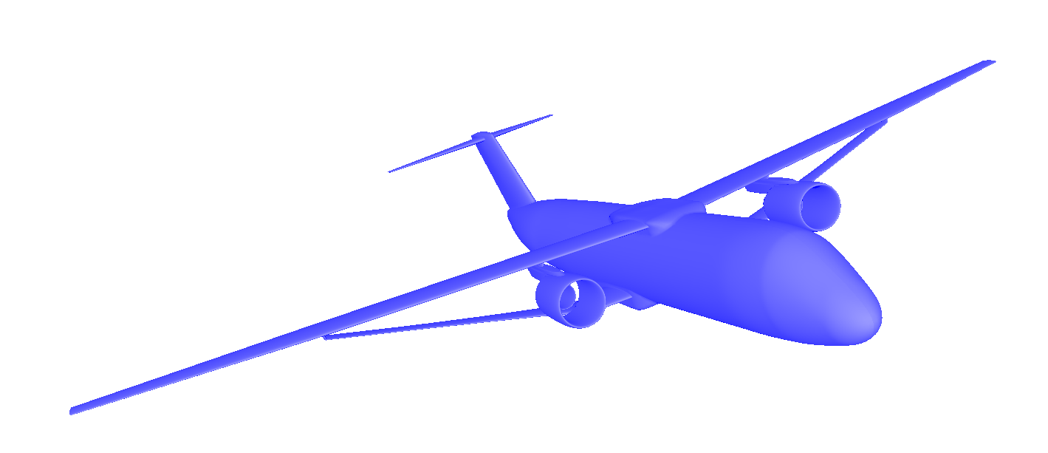
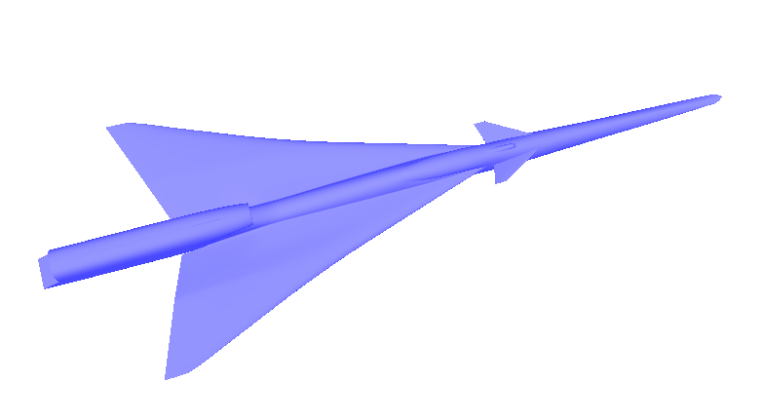
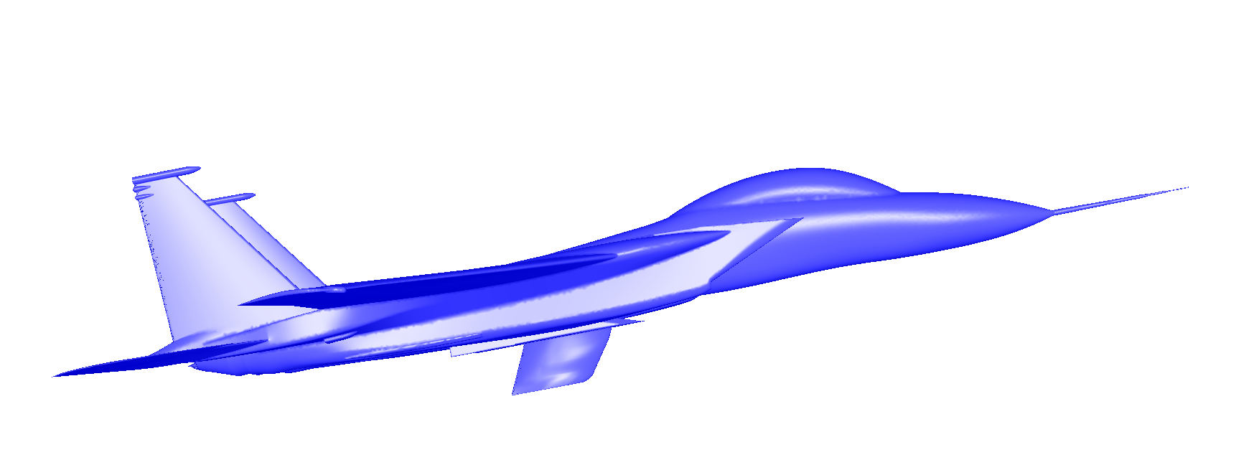
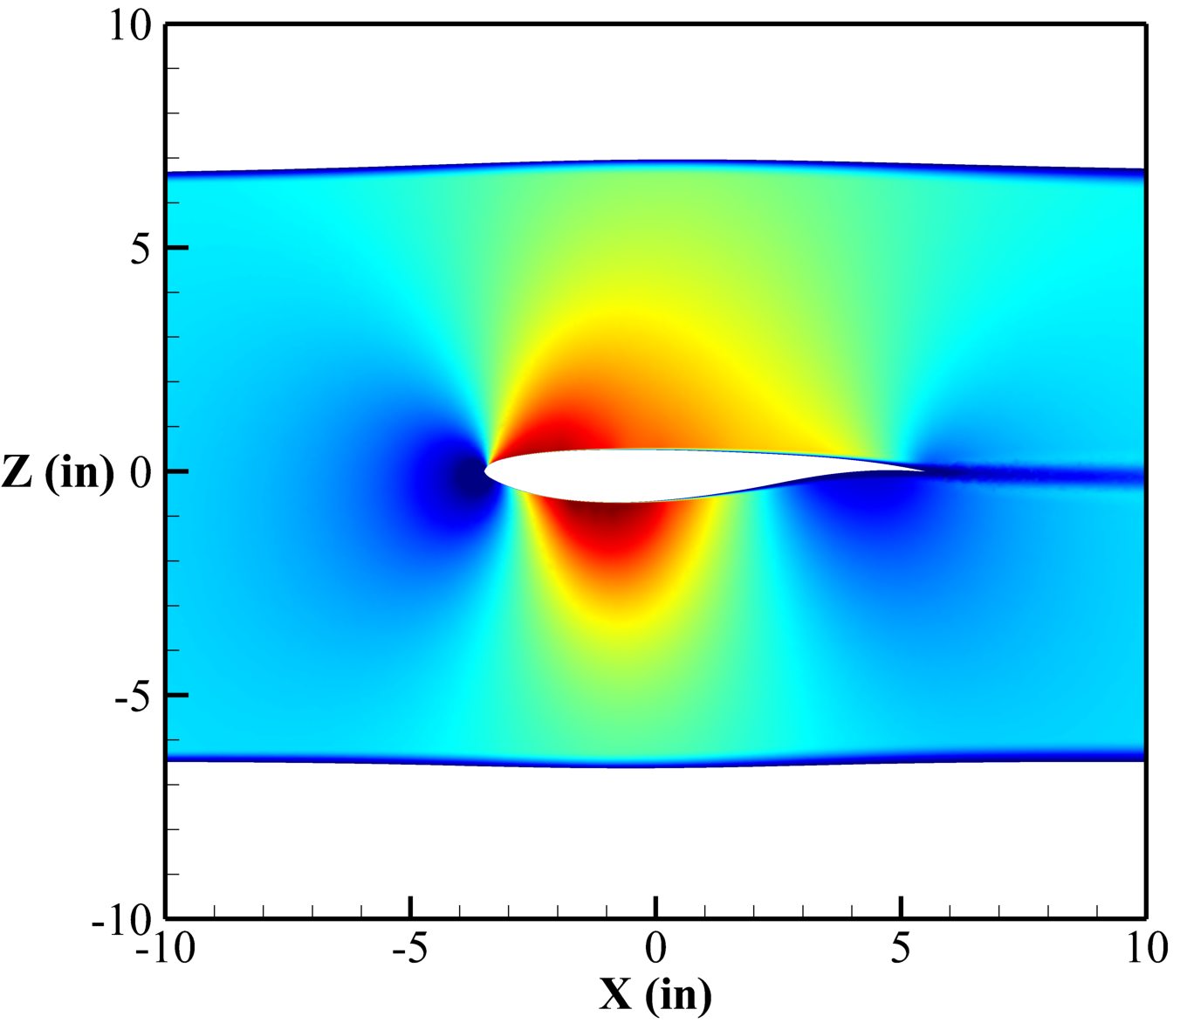
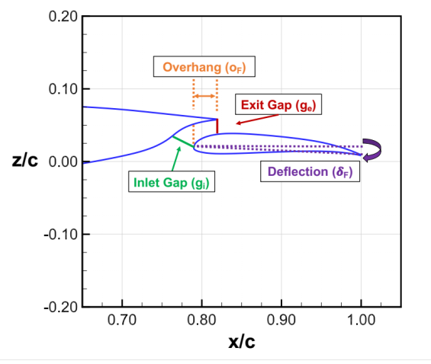
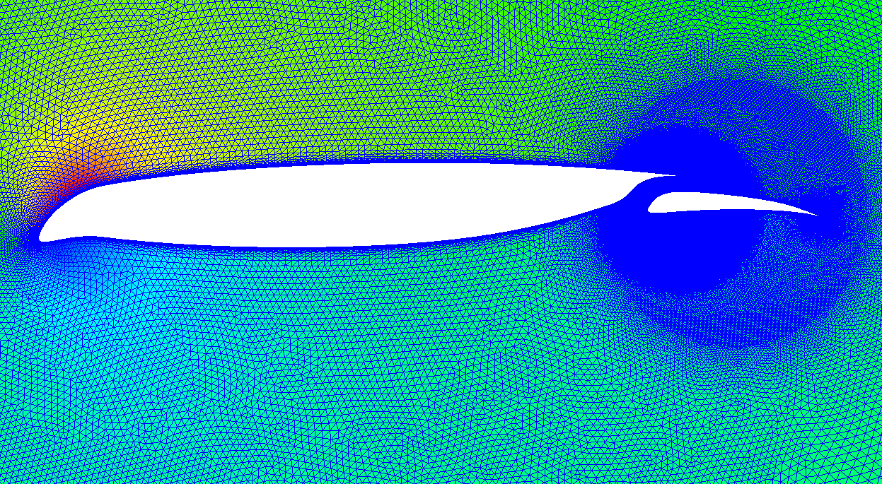
Questions?
Transonic Truss Braced Wing & Strut
Laminar Flight Test Article
Supersonic Laminar Wing
Multielement Low-Speed Airfoil
Wind Tunnel Wall Shaping
Cruise Slotted Wing

