Slide 1
Multimodal Alert Design
Kritina Holden, Leidos
Ian Robertson, KBR
Ryan Lange, Geologics
Durand Begault, NASA
Tyler Duke, Leidos
Ryan Z. Amick, KBR

Slide 2
Safety-Critical Alerts at NASA
  Alert Types
    Emergency - time-critical event that requires immediate action and crew survival procedures (Fire, Pressure Loss, Rapid Depress, Toxic Atmosphere)
    Warning - an event that requires immediate action
    Caution - an event that needs attention, but not immediate action
    Advisory - A message that imparts information for routine action purposes
  Auditory and Visual Annunciation
    When an alert tone is annunciated, a message with more detail is displayed on a hardware panel or a computer display

Slide 3
Alert Requirements across Artemis
Artemis Vehicles
  Orion – exploration vehicle that will carry the crew into space
  Gateway – outpost or space station that will orbit the moon and serve as a staging point for future deep space exploration
  Human Landing System (HLS) – vehicle to land humans on the moon
Alert Tones for Orion, Gateway and HLS
  Emergency (Fire: siren, Pressure Loss/Toxic Atmosphere: klaxon)
  Warning – alternating tone
  Caution – continuous tone
  Advisory – 2 beeps, self-terminating (optional tone for select use)
Gateway and HLS requirement to allow for tone and speech alerts

Slide 4
Speech Alerts
Past NASA HRP research (2009/2010) on speech alerts found:
  Speech alerts were recognized more quickly and were preferred
  Crew advocacy for speech alerts
  Too late in the Orion development cycle for inclusion
In recent years, ISS crew have asked for enhanced alerting, including voice
  Tones are hard to distinguish in first seconds, especially when waking up
  To gain situation awareness, they must float to a panel or computer for more information, potentially losing critical response time
  Crew running on treadmill or in visiting vehicle could miss the signal

Slide 5
HRP Alert Design Research
Project Team
  HRP team plus Artemis stakeholders
  Informal partnership with Embry-Riddle
Research Questions
  How does performance with a multimodal alert (tone + speech) compare to performance with a tone alert?
    How is addition of a speech component impacted by type of task? (computer-based, speech-based)
  Do context-specific tones (different set for each location) or a common set of tones (across all locations) yield faster and more accurate responses?

Slide 6
Experiment 1 – Speech Alerts
How does performance differ when using Tone-only alerts vs. Tone+Speech alerts?

Slide 7
Voice Type and Exemplar Messages
Exemplar Messages
  Collaborated with Stakeholders to develop representative alert messages
Voice Type
  Synthetic speech – because easiest to modify
  Speech messages with realistic (e.g., fan) background noise
  Used accessibility features – macOS “VoiceOver” utility, edited with Adobe Audition
    Team selected 2 male and 2 female voices for use in exemplar messages (Matt, Tom, Sam, Ava)
Preference test with 21 stakeholders
  Listen to each speech alert message as many times as you want
  Focus on the sound, not the content (although you can comment on that)
  Provide ratings about suitability and intelligibility, and provide free-form comments

Slide 8
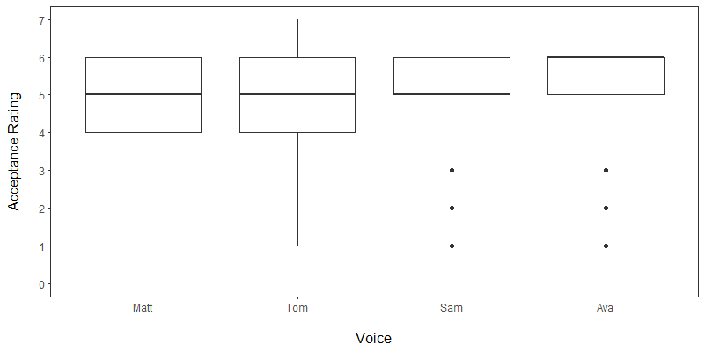
Preference Test Results
Participants preferred female voices to male voices
  Easier to hear in noisy environments due to higher pitch (Ji et al. 2019)
  May have advantage in portraying varying levels of urgency (Edworthy et al., 2003)
Overall preference for the Ava voice
Decision: Proceed with use of Ava voice for alert studies.

Slide 9
Opportunity!
Gateway and HLS Requirements Documents Opened for Revision

Slide 10

Detailed Speech Alert Requirements
Opportunity: provide more specific speech alert requirements to Gateway and HLS
Content based on literature, talking with stakeholders and experts, and preference test
Alert message structure recommended:
  Tone + signal word + type of emergency and location + repetition of key information + repetition of entire alert string until terminated by crew
  Example:
  tone – Warning – Radiation HALO – Radiation HALO / Warning – Radiation HALO – Radiation HALO

Slide 11
Alerts Study 1 – Speech Alerts
25 Crew-like participants
Semi-realistic, procedure-driven task – configuring a backup Electrical Power System
  Time pressure
  Alerts were triggered at certain points in the procedure, with delays (unknown to the participant)
2X2 within subject design – participants used two types of alerts and two types of procedures
Alert conditions
  Tone-only condition – alert message details shown on the computer
  Tone+Speech condition – alert message details only heard in speech alert message
Procedures conditions
  Electronic procedures shown on the display
  Procedures read by MCC (confederate) – (potential interference with speech alerts)

Slide 12
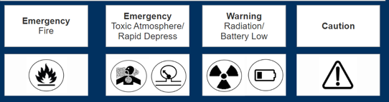
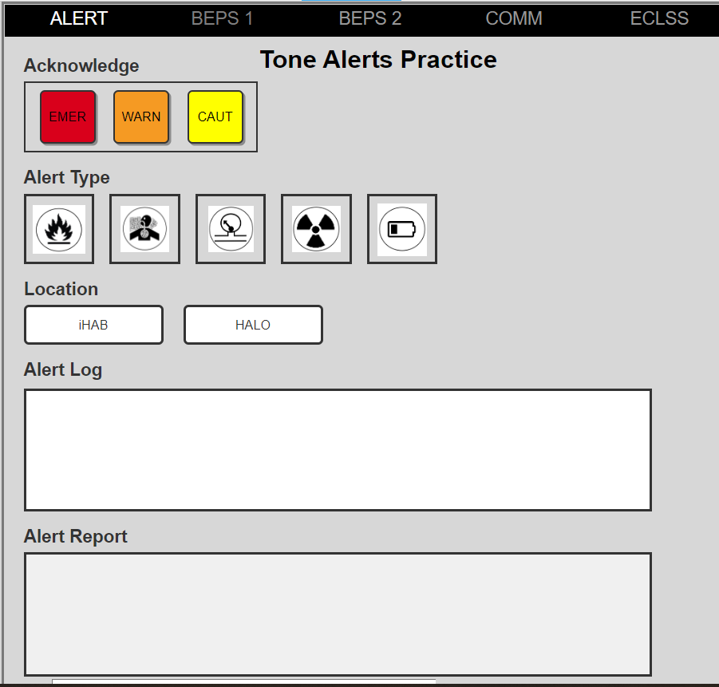
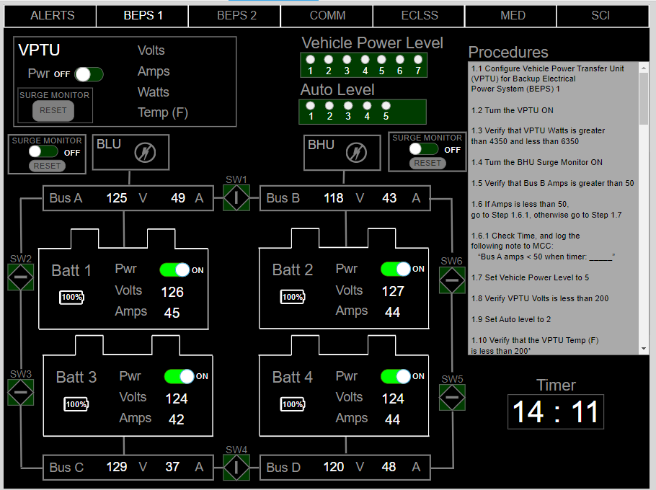
Experimental Session Agenda (2 days)
Familiarization – Learn the alert tones and messages, and how to respond by clicking on the relevant icons.
Training – Learn how to respond to alert messages using the Alerts display.
Experiment Trials – Perform procedure-based Electrical Power System configuration task and respond to alerts as they arise.

Slide 13
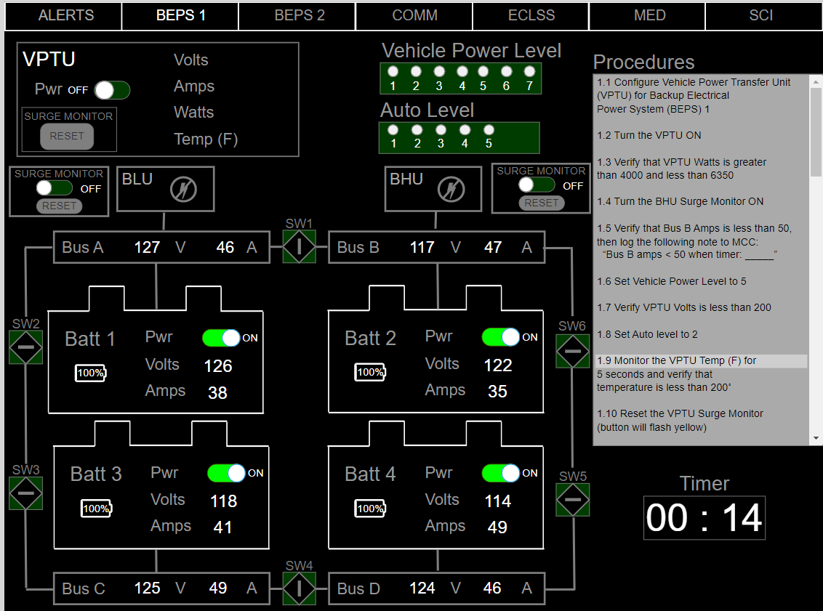
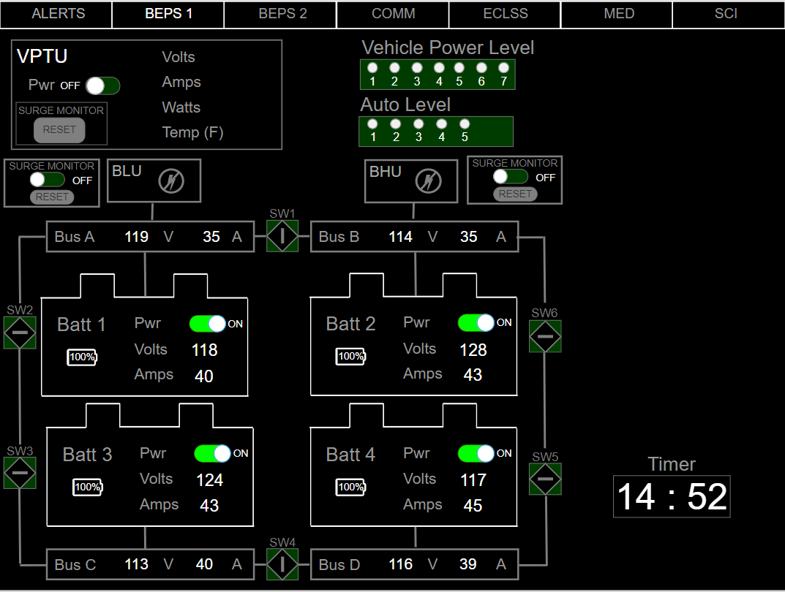
Experimental Task Displays
Electronic Procedures (Eproc)
MCC-read Procedures

Slide 14
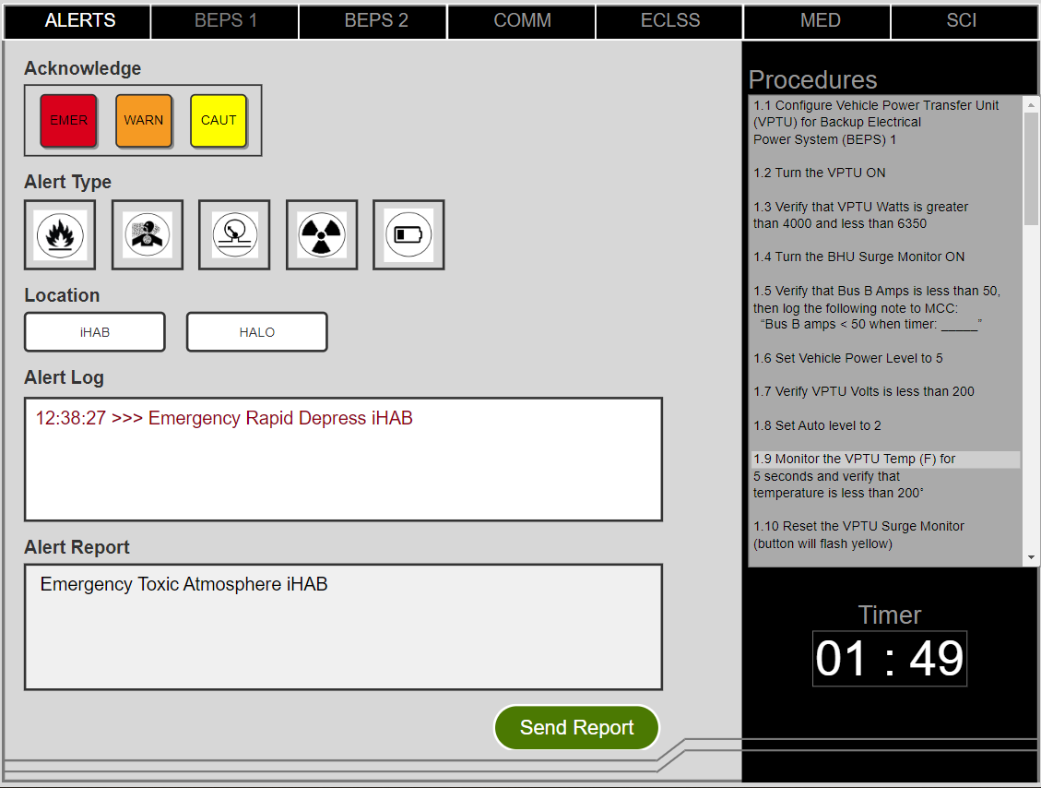
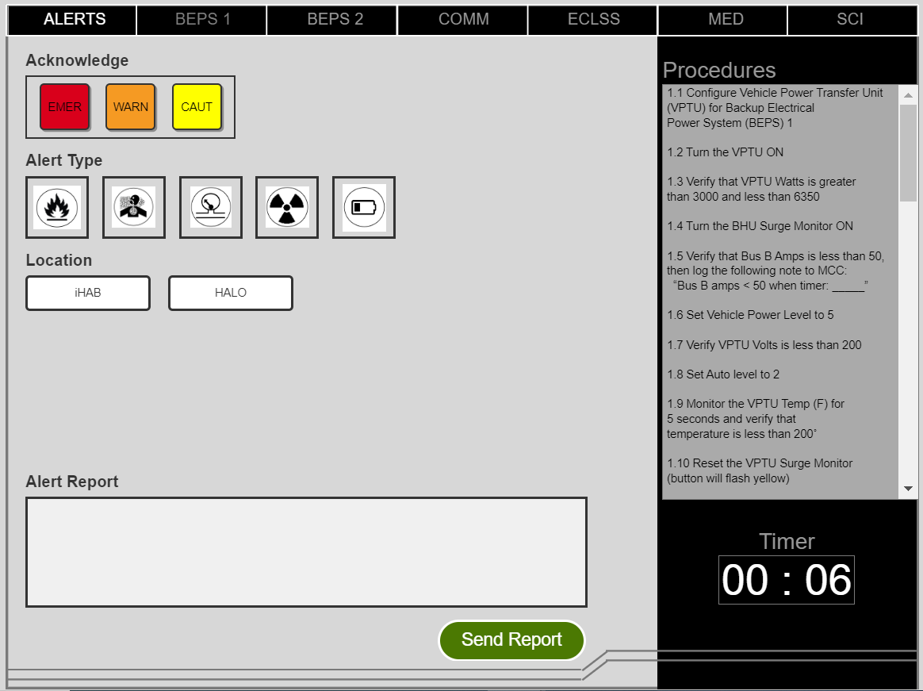
Alert Response Differences
Tone-Only
Tone+Speech
Response rules:
Press Ack button to indicate class of alert. If Caution – no report/action is required.
Press button/icon associated with type of alert, then location of alert.
Press Send to send the report generated by the button presses.

Slide 15
Study 1 – Results Summary
20 of 25 preferred Tone+Speech
Tone+Speech – slightly slower task time, but slightly more accurate.
Reminder: Tone+Speech requires listening to the entire message at least once before responding.
 | Overall Task Time (In minutes) |  | Overall Accuracy
 | Eproc | MCC-read
Tone+Speech | 5.18 (1.18) | 5.54 (0.81) | 95%
Tone-Only | 4.88 (1.42) | 5.48 (1.18) | 92%

Slide 16
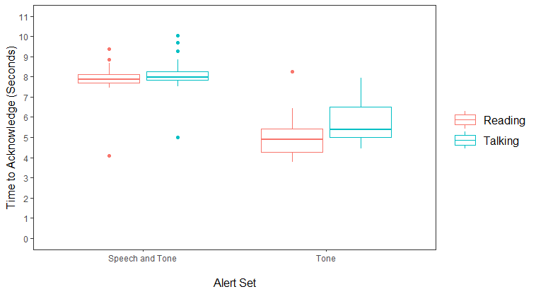
Time to Acknowledge Alert
Alert Set Comparison
*p<.001
Interaction,*p = .03
Eproc
Tone+Speech slower to acknowledge
Reminder: Tone+Speech requires listening to the entire message at least once before responding.
MCC-read
Tone+Speech
Tone-Only

Slide 17
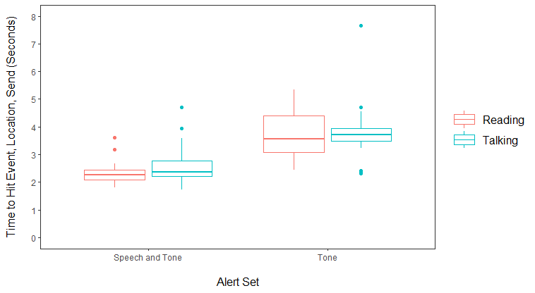
Time to Categorize Alert and Send Report
Alert Set Comparison *p < .001
Eproc
Time to ID Type and Location and Send (s)
MCC-read
Tone+Speech condition faster to correctly identify event and location.
Tone+Speech
(both auditory)
Tone-Only
(tone+text)

Slide 18
Select Participant Comments
    Tone+Speech vs. Tone-only Alerts
      “Workload is greatly increased when there is not a voice notification with the alerts”
      “Too focused on trying to remember what each tone meant”
      “The amount of time taken to mentally switch back to recall meaning behind the alert took an undesirable amount of time and effort”
      “The additional auditory information allowed me to reduce workload while I was shifting between tasks”
    Electronic procedures vs. MCC-read procedures
      “Easier when reading the procedure vs. waiting for MCC to read it to me”
      “Quicker to perform reading from a list, I think mostly because verification steps were quicker”
      “Having the list of instructions makes it easier for me to jump back into the task after leaving the page”

Slide 19
Conclusions
Tone+Speech Alert Messages
  Slightly longer task time, but slightly higher accuracy
  Faster interpretation/understanding of the alert situation, once acknowledged
  Overwhelmingly preferred by participants (20 of 25)
Realizations and Surprises
  It takes longer to listen to a message than to hear a tone
  Mixing alerts that have messages with those that don’t (e.g., Caution) may cause delays/annoyance as it is difficult to break the response pattern.
Operational advantages of speech
  When not in front of computer – allows crew to mentally prepare or take action prior to getting to a computer to see details

Slide 20
Experiment 2 – Alert Commonality and Context
How does performance differ when using a common alert set across vehicles vs. multiple alert sets?

Slide 21
Alerts Study 2 – Commonality and Context
Participants (19) drawn from first alert study to decrease training time
Between subject design
Groups/Conditions
  Common set of alert tones across two “vehicles” (Vehicle A and Vehicle B)
  Multiple tone sets – one for A and a different set for B
Data collected
  Response time
  Errors
  Bedford Workload Scale
  Comments

Slide 22
Experimental Task Details
Task
  Electrical Power System configuration task and alert reporting – highly similar to Study 1
Task locations
  One room had signage that said “Vehicle A” – and interfaces had a black/green theme
  One room had signage that said “Vehicle B” – and interfaces had a blue theme
Primary difference from Study 1: the decision making and responding instructions - based on location (A vs. B)
  If an alert occurs in a vehicle where you are located:
    Acknowledge alert, log alert type, and send to MCC (as in Study 1)
  If an alert occurs in the other vehicle or is a Caution:
    Acknowledge the alert, and then send to MCC (no logging of details)

Slide 23
Study 2 - Alert Sets
Common Alert Set
Multiple Alert Sets
Same as in Study 1, whether in Vehicle A or Vehicle B
  Emergency
    Fire – siren
    Pressure Loss/Toxic Atmosphere – klaxon
  Warning – alternating tone
  Caution – continuous tone
In Vehicle A – Alert Set A (same as Experiment 1)
  Emergency
    Fire – siren
    Pressure Loss/Toxic Atmosphere – klaxon
  Warning – alternating tone
  Caution – continuous tone
In Vehicle B - Set B (new alert set)
  Emergency – low-pitched beeps
  Warning – higher pitched beeps
  Caution – continuous tone

Slide 24
Study 2 – Results Summary
 | Overall Task Time (In minutes) | Accuracy to ID Alert
Common Alert Set Group | 4.6 (1.63) | 93%
Multiple Alert Sets Group | 4.16 (1.07) | 90%
High accuracy for both tone sets

Slide 25
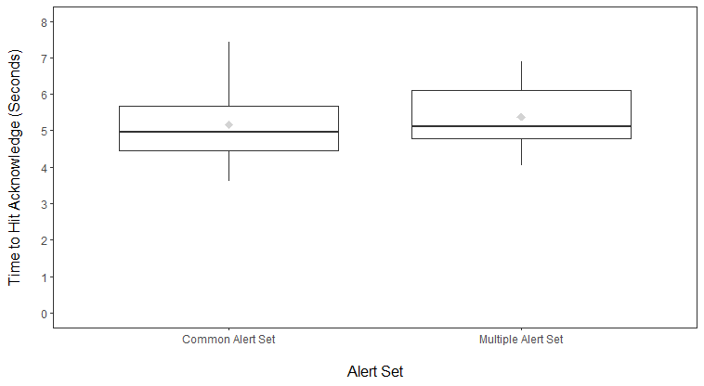
Time to Acknowledge Alert
ns, p = .70
Common set was slightly faster to Acknowledge
Time to Press Ack (Seconds)

Slide 26
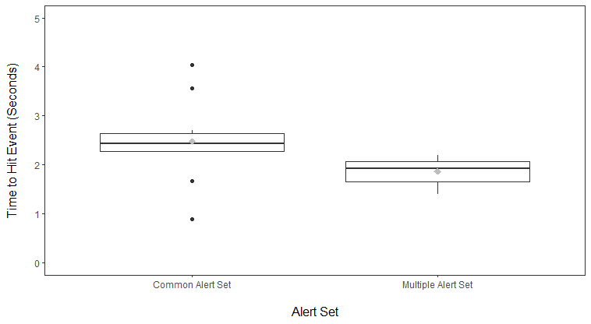
Time to Identify Alert Type - Their Location
*p = .02
Common alert set slower to ID Alert Type (alert in their location)
Time to ID Alert Type (Seconds)

Slide 27
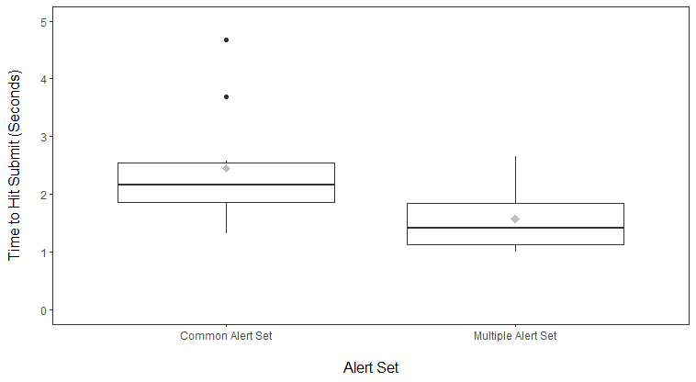
Time to Recognize Alert from Other Location
*p = .01
Time to Press Send (Seconds)
Common alert set slower to determine location and press Send

Slide 28
Select Comments
    Workload and lack of speech alerts
      “There was a lot of cognitive workload having to recall information about how to respond to two different tone sets
      “Mental capacity was mostly differentiating between the two sets. I miss the speech alerts from last time. Those would be helpful in determining the module you are currently in.”
      “I think having the same alerts for each vehicle would be helpful with the added spoken alert of which vehicle it was in”
    Multiple sets of alerts
      “I like that the alerts were distinguishable”; they had good differentiation
      “Just the two alert sets was manageable, but more than that may get difficult.”
      “The more information you are asking crew to assimilate into a pattern of behavior, the higher the probability of them making a mistake”

Slide 29
Conclusions
Common and Multiple tone sets provided for accurate performance and equal workload
Common Alert Set – slightly faster to acknowledge and slightly more accurate
Multiple Tone Set condition – faster to identify alert type and recognize location
Realizations and Surprises
  Working with two tone sets did not significantly increase workload or negatively impact performance
    Two distinct alert sets provided an additional bit of information “for free” – location
    Those using the common set had to read location information from the alert message
Overall, results indicate that the effect of using multiple alert sets is dependent on multiple factors
  Number of different sets of tones (only 2 tested in this study)
  Distinctiveness of the different sets (not manipulated in this study, but the sets were distinct)

Slide 30
Remaining Questions
Alert Tone Sets
  What is the limit of number of different alert sets that can be successfully used in a spaceflight environment?
  How can distinctiveness or other techniques be used to mitigate multiple alert sets and indicate source of the alert?
As the number of unique spacecraft grows, further research is needed to address these important questions.

Slide 31
Questions?

