Slide 1

Snorre Stamnes, Vianni Ricano Cadenas
Marilee Roell, Yongxiang Hu, Adam Bell
PolCube Mission Goals and Science Overview
Tuesday, February 14, 2023
10:15am – 12:00pm
Notes:
STILL

Slide 2
We would like to welcome all of you to NASA Langley and Virginia.
Please let Vianni, Marilee or myself know if you have any questions during your visit.
I am extremely passionate about PolCube and look forward to working with all of you on polarimetric remote sensing – the next frontier in passive remote sensing of the Earth and the solar system.

Slide 3
Background
The NASA Langley PolCube team has received seed funding from NASA Langley, the Earth Science and Technology Office (ESTO) and the Earth Science Division (ESD) within NASA’s Science Mission Directorate (SMD) to detail and cost the PolCube mission.
The goal of this Technical Interchange Meeting is to collect the information we need about the PolCube instrument and the BusanSat spacecraft so that we can secure funding for PolCube to become an official 3-year NASA mission.

Slide 4
Mission goals and science objectives overview

Slide 5
Overview
What is PolCube? Why polarimetry? RSP and PolCube
PolCube Science Traceability Matrix (provisional)
PolCube mission goals
  Aerosol optical and microphysical properties (PolCube paper)
  Ocean wind speed / surface roughness and Chla (PolCube paper)
  Thin cirrus properties (Wenbo Sun et al., 2015)
  Air quality products with Hampton University (PM2.5, UVA paper)
  3d and 4d neural network lidar-polarimeter aerosol/cloud capabilities (Yongxiang Hu, Ali Omar)
  Deep learning / neural networks (PACE-MAPP paper, in prep.)
Observing modes
Funding timeline and schedule
References

Slide 6
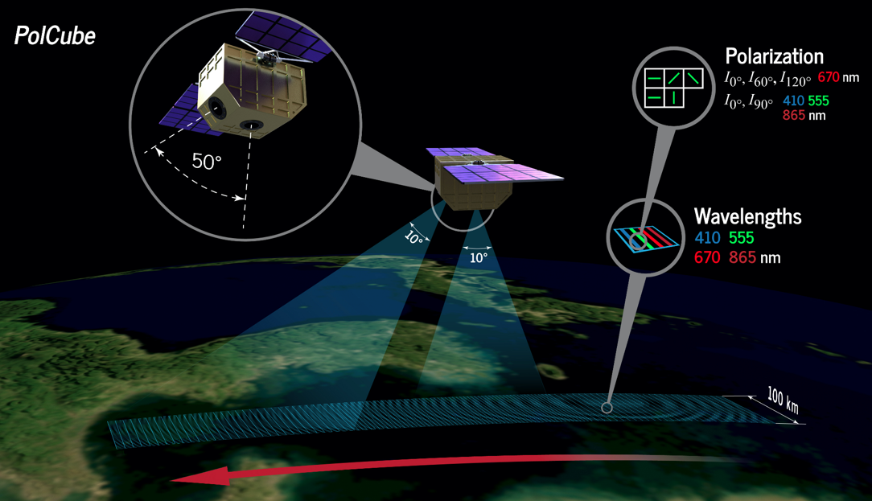
What is PolCube?
PolCube is a contributed, flight-ready instrument & spacecraft
PolCube polarimeter instrument
12U CubeSat bus
Collaboration between NASA Langley with the Korea Astronomy and Space Science Institute (KASI) for Earth Science and its partner Busan City
PolCube is based on the PolCam polarimeter onboard the Korean Pathfinder Lunar Orbiter (KPLO)
Polarimeters like PolCube measure light not only at multiple wavelengths, but also measure both the intensity and polarization at multiple angles

Slide 7
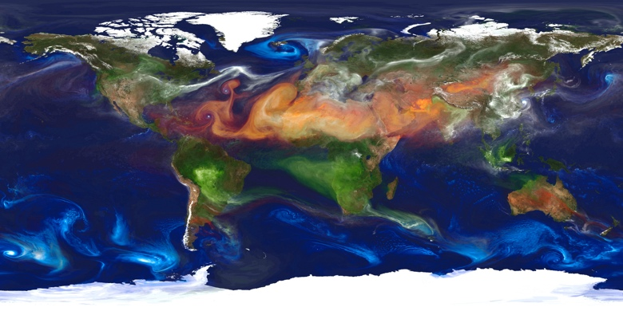
Why polarimetry?
Aerosol absorption is a key climate geophysical variable (GV) that polarimeters can quantify
Polarimetry is vital to understanding the impacts of aerosols and clouds on climate and weather
Incredible advances in aerosol and cloud remote sensing using polarimetry are possible using machine learning (Stamnes et al., 2018; Gao et al., 2021; Stamnes et al., 2023, in prep.)

Slide 8
Science objectives and questions (provisional) | Scientific Measurement Requirements (GVs) | Instrument Functional Requirements (observables) [1-sigma uncertainty] | Investigation Functional Baseline Requirements | Modeling and Analysis Activities/Tools
Objective 1. Quantify aerosol and ocean product capability of PolCube including PM2.5. Question: How do Na-CCN relationships and PM2.5 depend on aerosol optical/microphysical properties? Deliverable: Improved aerosol optical and microphysical and ocean products and PM2.5 at fine spatial resolution across the Earth. | Aerosol optical and microphysical properties: fine-mode (0.08), sea salt (0.04), dust AOD at 555 nm (0.04); fine/sea salt/dust effective radius (0.06, 1.3, 1.2 um); aerosol top height (1.4 km); fine-mode SSA (0.036). Ocean products: wind speed (1.1 m/s) and chlorophyll-a concentration (2.4 mg/m^3). Quantify PM2.5 products. (Expected 1-sigma performance in parenthesis.) | Multispectral deep blue VIS-NIR, multiangle polarimeter measurements of the total radiance [2%] and degree of linear polarization [0.005] from PolCube. | 1. 3 months of PolCube polarimeter data in the ACTIVATE region 2. Collocated HSRL-2 and RSP data from the following airborne campaigns: ACTIVATE, ORACLES, NAAMES, and CAMP2Ex 3. Collocated CALIOP and POLDER-3/PARASOL data 4. Collocated airborne HSRL or satellite lidar data from ICESat-2 or EarthCARE for validation | PolCube-MAPP algorithm: Stamnes et al., 2018; Stamnes et al., 2021; Stamnes et al., 2023 (to be submitted)
Objective 2. Quantify capability of 4d cloud property retrievals using an advanced AI remote sensing algorithm. Question: Can we verify the Na-Nd-CCN model relationships established by ACTIVATE? Deliverable: 4-dimensional cloud properties across the Earth | Cloud top height, cloud top pressure, cloud optical depth, cloud motion vector, cloud top droplet effective radius | Same as Objective 1. Collocated POLDER-3/PARASOL and CALIOP cloud data Airborne HSRL-2 lidar cloud top height Airborne RSP polarimeter data, subsetted to PolCube |  | Hu et al., 2021, Stamnes et al., 2018b.
Objective 3. Assess advanced AI remote sensing capability to retrieve lidar-like 3d aerosol and cloud properties for aerosol transport and atmospheric dynamics studies. Question: How do profiles of aerosol location and absorption influence atmospheric chemistry? Deliverable: 3-dimensional lidar-like aerosol properties across theEarth | Vertically-resolved lidar-like backscatter and extinction | Same as Objective 2. Collocated airborne HSRL-2 vertically-resolved extinction coefficient and lidar backscatter coefficient and depolarization

Slide 9
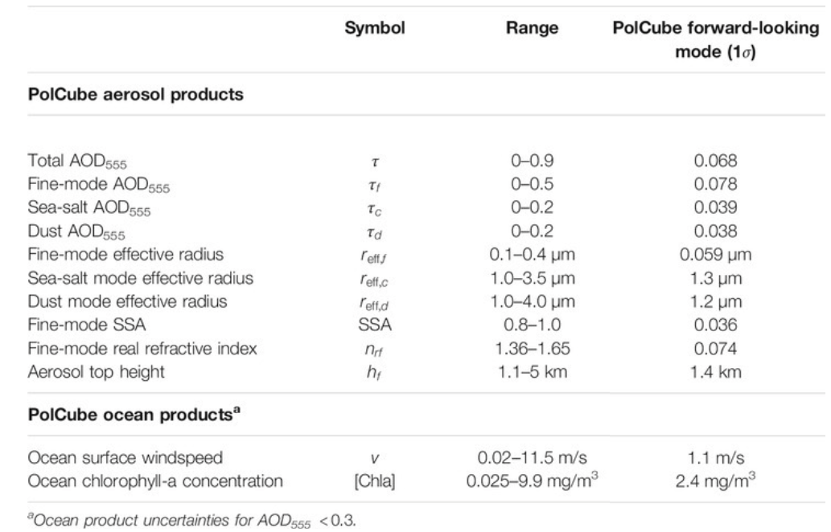
Objective 1. Quantify aerosol and ocean product capability of PolCube including PM2.5.
Question: How do Na-CCN relationships and PM2.5 depend on aerosol optical/microphysical properties?
Deliverable: Improved aerosol optical and microphysical and ocean products and PM2.5 at fine spatial resolution across the Earth.
Stamnes et al., 2021, Simultaneous aerosol and ocean properties from the PolCube CubeSat polarimeter. Frontiers in Remote Sensing, 2, p.709040
Briggs, Causey, Cawdery, Entner et al., Use of Satellite Polarimeter Observations in Air Quality Monitoring (University of Virginia Capstone paper)

Slide 10
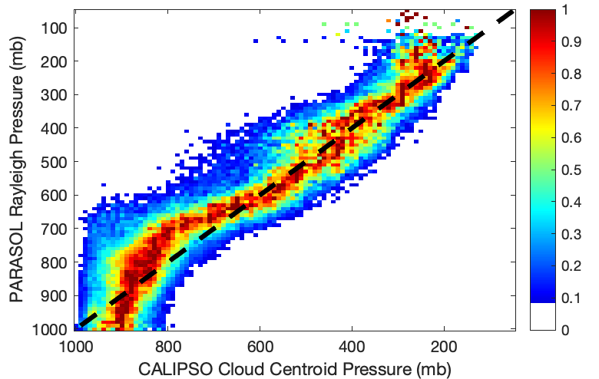
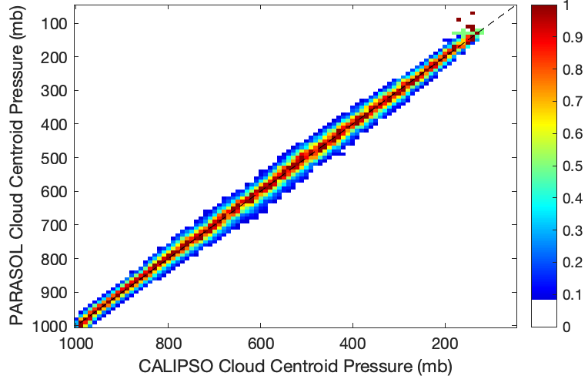
Objective 2. Quantify capability of 4d cloud property retrievals using an advanced AI remote sensing algorithm.
Question: Can we verify the Na-Nd-CCN model relationships established by ACTIVATE?
Deliverable: 4-dimensional cloud properties of the entire Earth
Polarimeters like PolCube provide accurate cloud top height and pressure measurements: neural network approach is far better than conventional retrievals
Ali Omar, presented at AMS 2023

Slide 11
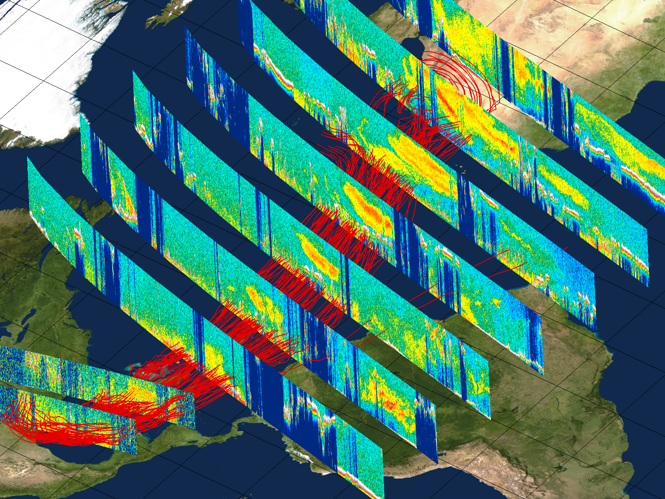
Objective 3. Assess advanced AI remote sensing capability to retrieve lidar-like 3d aerosol and cloud properties for aerosol transport and atmospheric dynamics studies.
Aug 17
Ali Omar, dust transport as measured by CALIOP, presented at AMS 2023
Aug 18
Aug 19
Aug 20
Aug 21
Aug 25
Aug 28
Aug 22
Aug 23
5 km
3 km

Slide 12
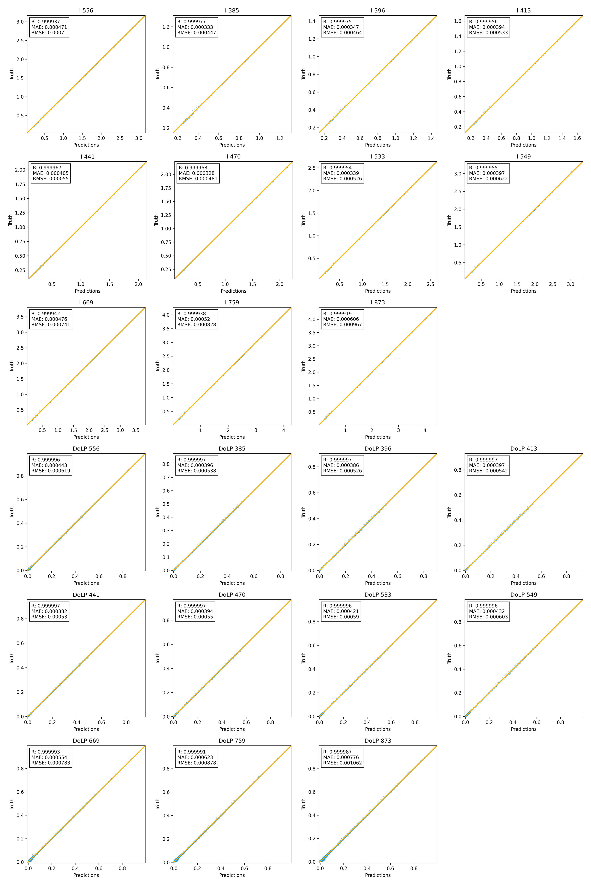
Deep learning / neural networks
Solutions are possible in 1 second compared to 1 hour (Gao et al., 2021; Stamnes et al., 2023, in prep.)
Furthermore, lidar data can be used to train polarimeter data (Ali Omar, AMS 2023)
Significant potential improvements are possible across multi-pixel (2d) and vertical domains that can enable 3d retrievals of aerosol and cloud properties

Slide 13
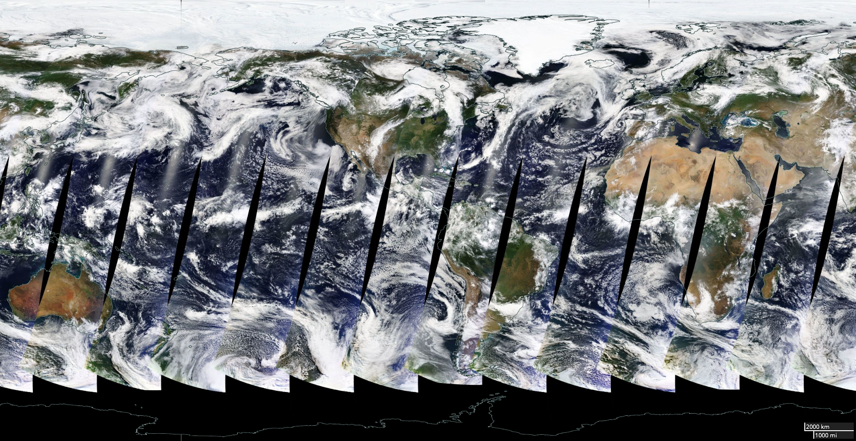
PolCube observing modes
Develop “Yellow Sea observing mode” into a capability to dynamically observe cloud-free areas in the ACTIVATE region and the world to develop global aerosol property statistics?
Subvisual cirrus will automatically be captured using this observing methodology.

Slide 14
Funding strategy and timeline

Slide 15
Funding strategy and timeline
Initiate PolCube study task 09/22
PolCube team assembled 10/22
Meeting with KASI and stakeholders 11/22
International Framework Agreement Abstract 12/22
PolCube presentation at AMS 2023 01/23
Hold technical interchange meeting 02/23
PolCam on KPLO first light 02/23
Complete instrument test and calibration plan 03/23
Complete project plan, CONOPS, costing 03/23
Complete risk matrix 03/23
Final presentation 04/23
Space Act Agreement with Hampton University 04/23
Begin 3-year PolCube mission (if funded) 05/23
Finalize PolCube MAPP retrieval algorithm 09/23
PolCube calibration 02/24
PolCube launch 09/24
PolCube commissioning 10/24
PolCube operations 11/24
PolCube 1-year operations complete 08/25
Completion of 3-year PolCube mission 05/26
Items in blue are notional pending funding from NASA SMD.

Slide 16
References
Stamnes et al., 2021, Simultaneous aerosol and ocean properties from the PolCube CubeSat polarimeter. Frontiers in Remote Sensing, 2, p.709040
Stamnes et al., 2018, Simultaneous polarimeter retrievals of microphysical aerosol and ocean color parameters from the “MAPP” algorithm with comparison to high-spectral-resolution lidar aerosol and ocean products. Applied optics, 57(10), pp.2394-2413
Sun et al., 2015, A method to retrieve super-thin cloud optical depth over ocean background with polarized sunlight. Atmospheric Chemistry and Physics, 15(20), pp.11909-11918.
Stamnes et al., 2018, Advantages of measuring the Q Stokes parameter in addition to the total radiance I in the detection of absorbing aerosols. Frontiers in Earth Science, 6, p.34
Gao et al., 2021, Efficient multi-angle polarimetric inversion of aerosols and ocean color powered by a deep neural network forward model. Atmospheric Measurement Techniques, 14(6), pp.4083-4110
Chemyakin et al., 2023, Efficient single-scattering look-up table for lidar and polarimeter water cloud studies. Optics Letters, 48(1), pp.13-16
Chemyakin et al., 2021, Improved Lorenz-Mie Look-Up Table for Lidar and Polarimeter Retrievals. Frontiers in Remote Sensing, 2, p.711106
Schlosser et al., 2022, Polarimeter + Lidar–Derived Aerosol Particle Number Concentration. Front. Remote Sens. 3:885332. doi: 10.3389/frsen.2022.885332
Ali Omar, NASA’s Space-based Lidar Observations of the 3D Structure of the Earth System, American Meteorological Society, 2023

