Slide 1
An Analysis of Exploration Capability Gaps for Future Habitation Systems to Inform Risk Assessment and Development Priorities
Presenter: Tracie Prater, NASA Marshall Space Flight Center
Paper co-authors: Quincy Bean¹, Tiffany Nickens¹, Andrew Choate², Alexander Burg³, Matthew Simon⁴, Paul Kessler¹, Danny Harris¹
NASA Marshall Space Flight Center
NASA Marshall Space Flight Center, Jacobs ESSCA
NASA Headquarters (Bryce Space and Technology)
NASA Langley Research Center

Slide 2
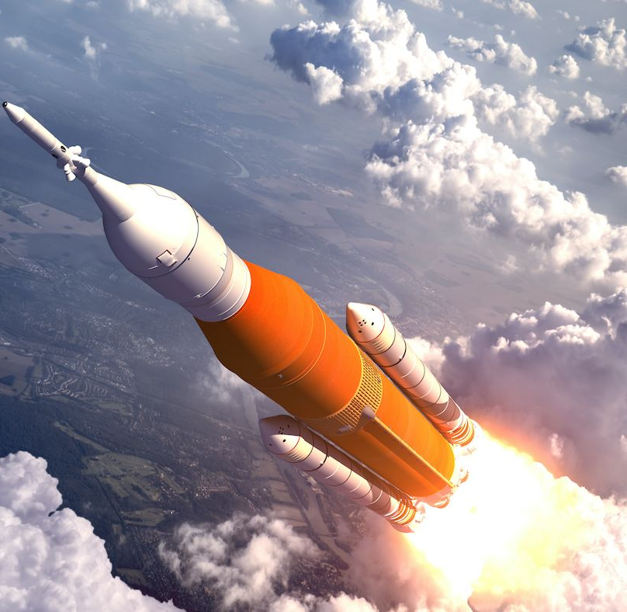
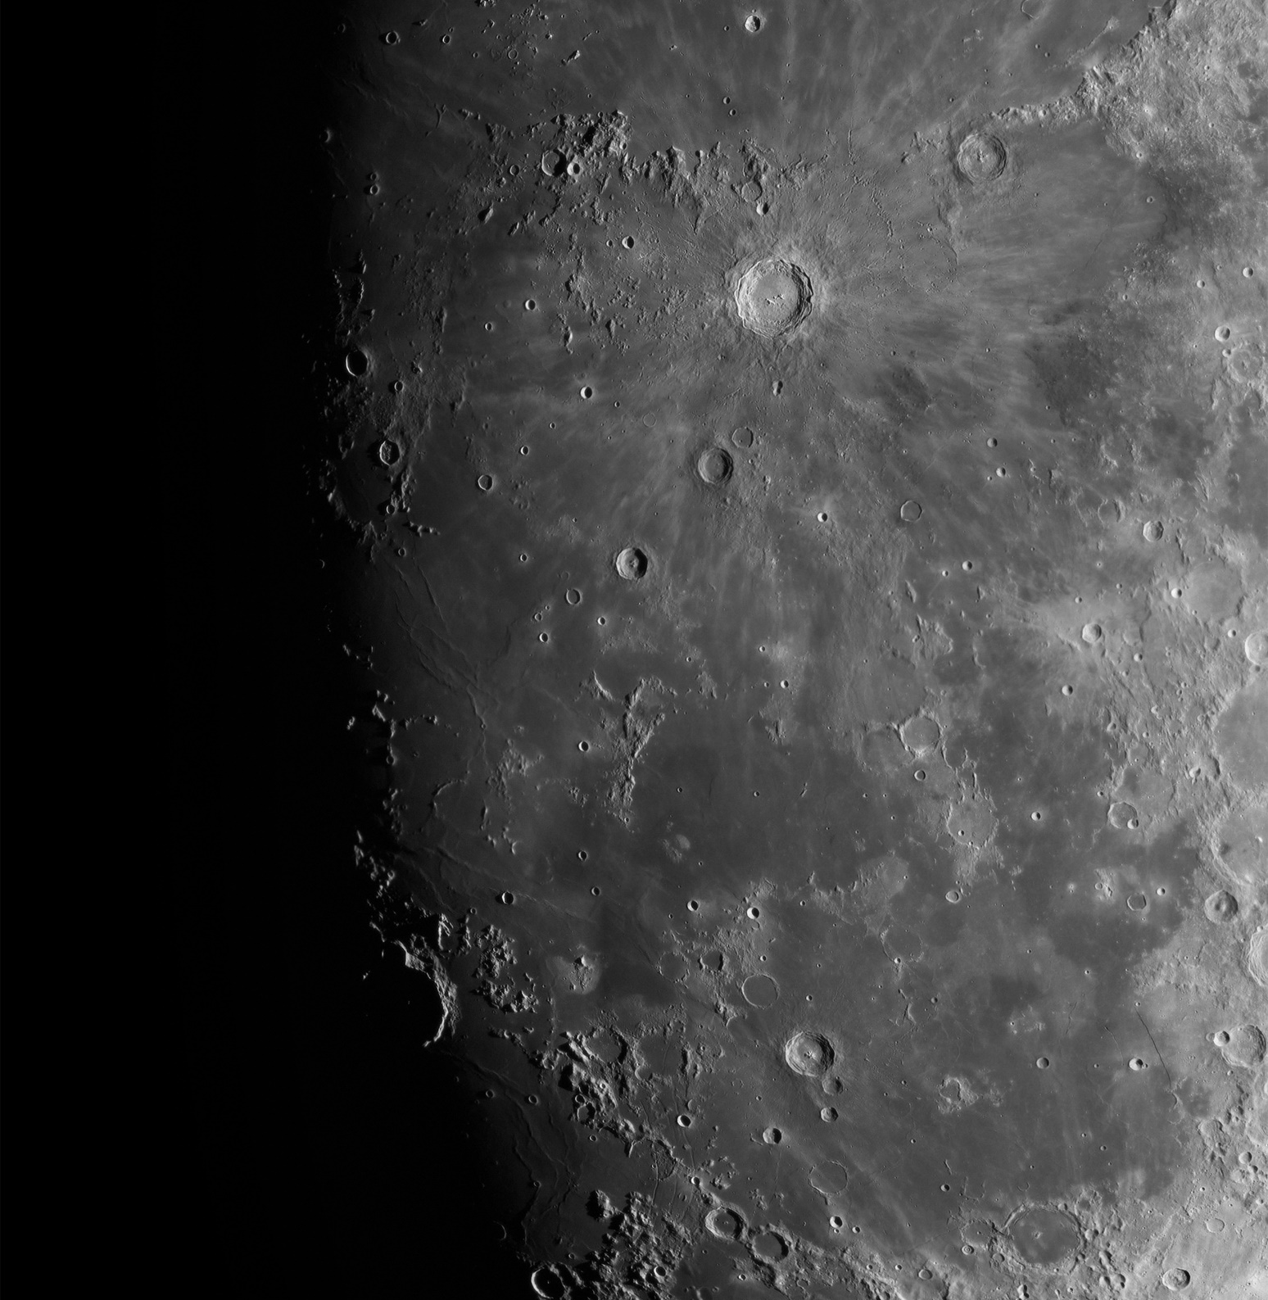
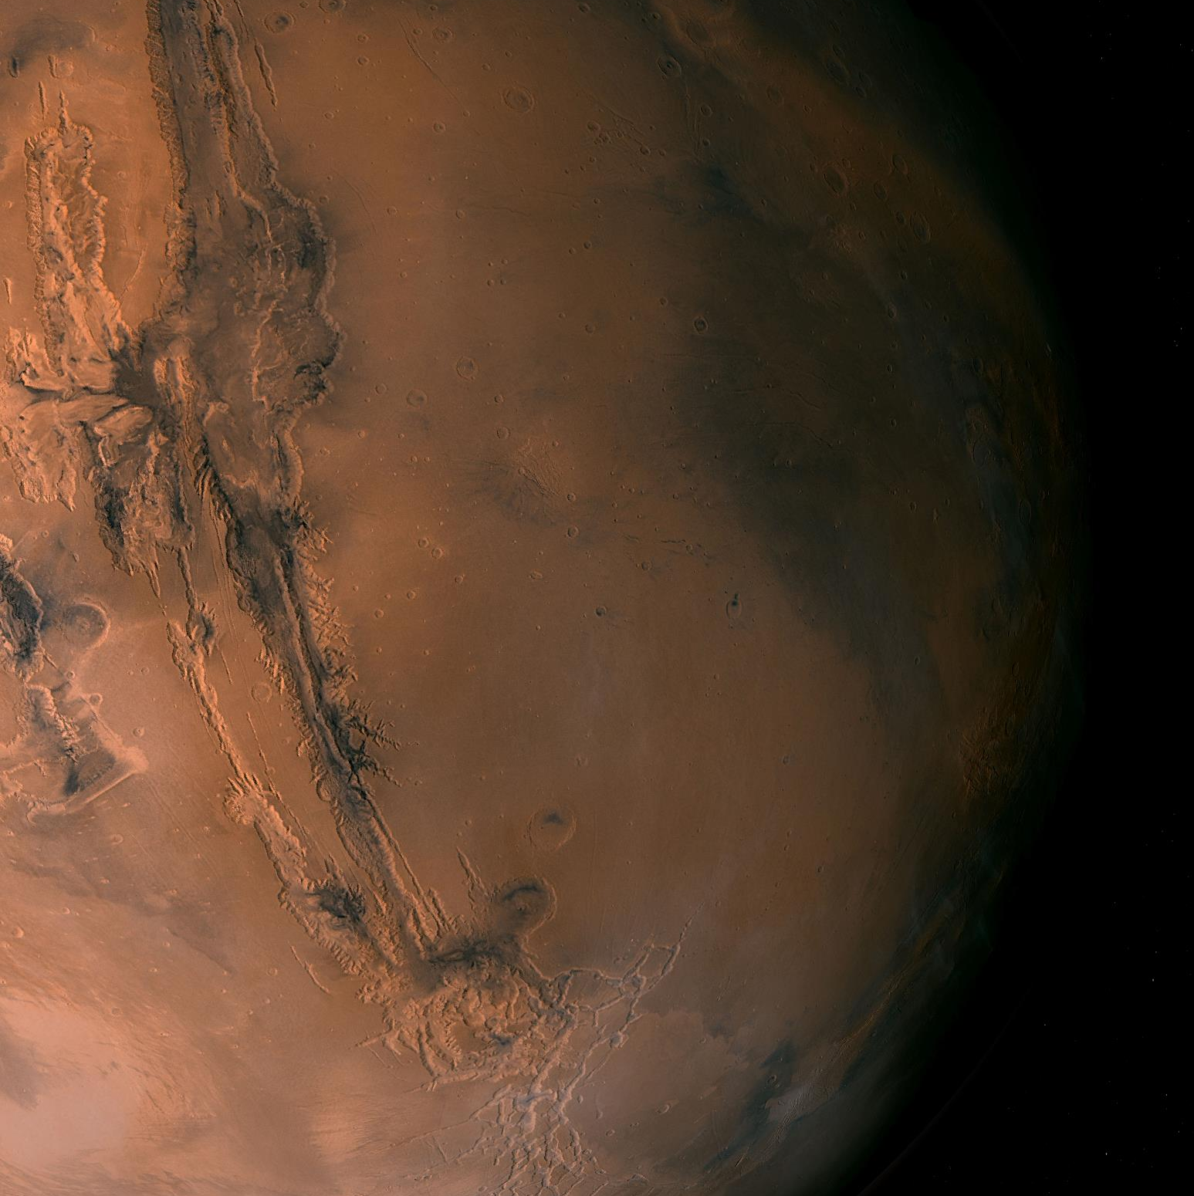



Enable sustainable exploration of the Lunar surface
Leverage moon to develop and advance technologies to support eventual Mars exploration

Slide 3
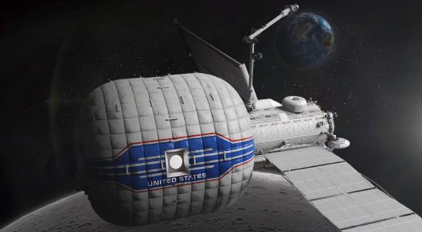
Mars Transit Habitat
Key element for future Mars missions
Initially docked at Gateway for outfitting and shakedown/analog missions
Supports 4 crew for up to 1,200 days
Notes:
Mention relationship between lunar surface habitat and Mars transit habitat – study of adaptation of crew in transitioning from micro-g to partial g
May also mention assumptions around Gateway operations…closed hatch vs. open-hatch

Slide 4
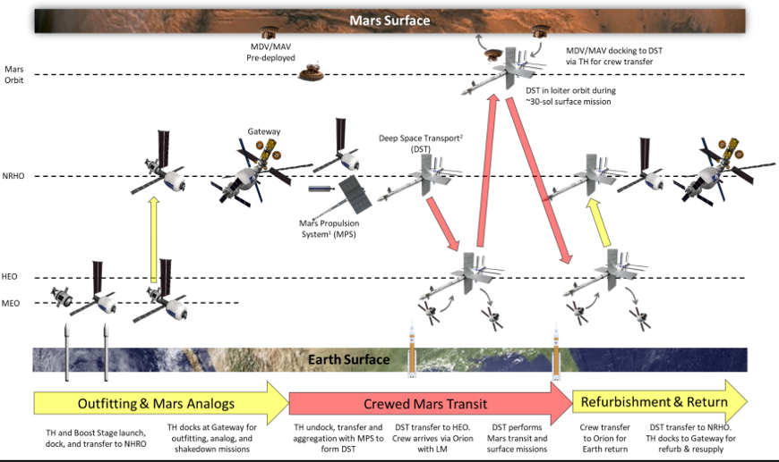
Concept of Operations for Mars Transit Habitat
Notes:
Transit to NRHO via boost stage (mates with Mars TH in earth orbit); docks at Gateway for a series of outfitting, shakedown, and analog missions, aggregation in HEO with DST and Orion/cargo module; departure for Mars orbit; Mars Descent Vehicle docks with TH in Mars orbit; crew return via MAV; departure for earth…TH can return to Gateway for refurbishment
Emphasize that propulsion trades are still ongoing; Prop here shown as NEP/chemical

Slide 5
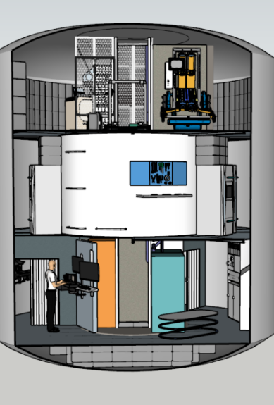
Mars Transit Habitat: A Closer Look
Inflatable softgoods with central core passageway
Metallic airlock for contingency Extravehicular Activity (EVA)
Three story layout
  Private crew quarters
  Exercise areas and recreation
  Research stations/science utilization
  Galley
  Command and control
  Logistics stowage
  Trash Management
A. Choate, D. Harris, T. Nickens, P. Kessler, M. Simon, “NASA’s Moon to Mars (M2M) Transit Habitat Refinement Point of Departure Design,” IEEE Aerospace, 2022.

Slide 6
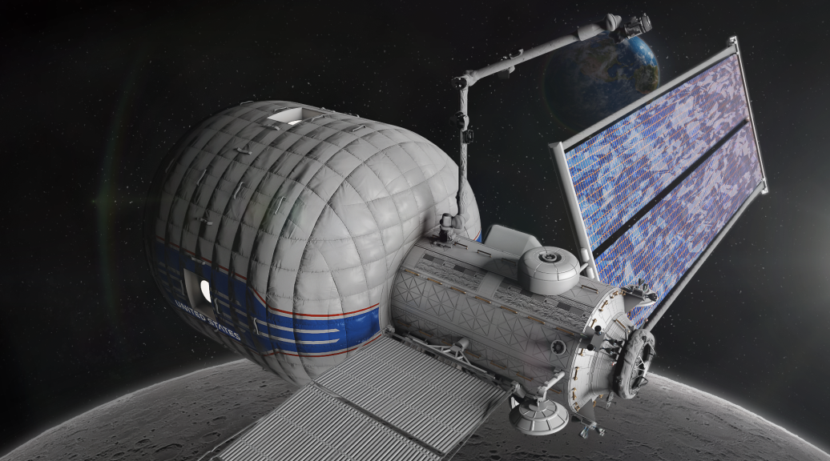
Capability Gaps
Characterize difference between current state of the art and future needs
Mars mission challenges
  Communication delays
  No abort or resupply opportunities
  Extended exposure to microgravity and radiation hazards
Analysis assesses
  Gaps identified for Mars Transit Habitat
  Likelihood of near-term closure
Notes:
The International Space Station (ISS) is example of current state of the art, which is also a very old system in many respects.

Slide 7
Gap Classification
Importance to architectural element
  “Need” - Architecture cannot be executed without gap closure*
  “Want” - Architecture significantly enhanced by gap closure
  “Not Required”
Gaps are further classified into one of the following categories:
Technology
requires development of new technology
Development
additional work needed to assess feasibility of technology
Engineering
technology requires engineering development for a specific mission
Knowledge
unknown data that will drive requirements; requires scientific research to close
Architecture
unknown mission parameters; requires further architecture development and stabilization for gap closure
Operations
gaps in training and flight operations
Policy
policy or management issues must be addressed for gap closure
Gap Type | Description
Technology | Requires development of new technology
Development | Additional work needed to assess feasibility of technology
Engineering | Technology requires engineering development for a specific mission
Knowledge | Unknown data that will drive requirements; requires scientific research to close
Architecture | Unknown mission parameters; requires further architecture development and stabilization for gap closure
Operations | Gaps in training and flight operations
Policy | Policy or management issues must be addressed for gap closure
*Analysis here restricted to enabling (“need”) gaps
**Analysis for Mars TH does not consider knowledge, architecture, operations, or policy gaps
Notes:
Not required does not mean gap does not provide value to architecture, just that closure is not needed to enable mission

Slide 8
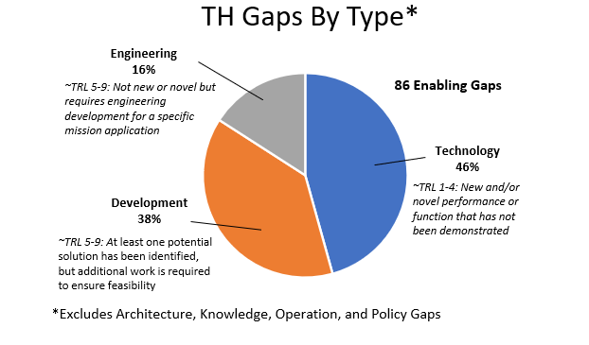
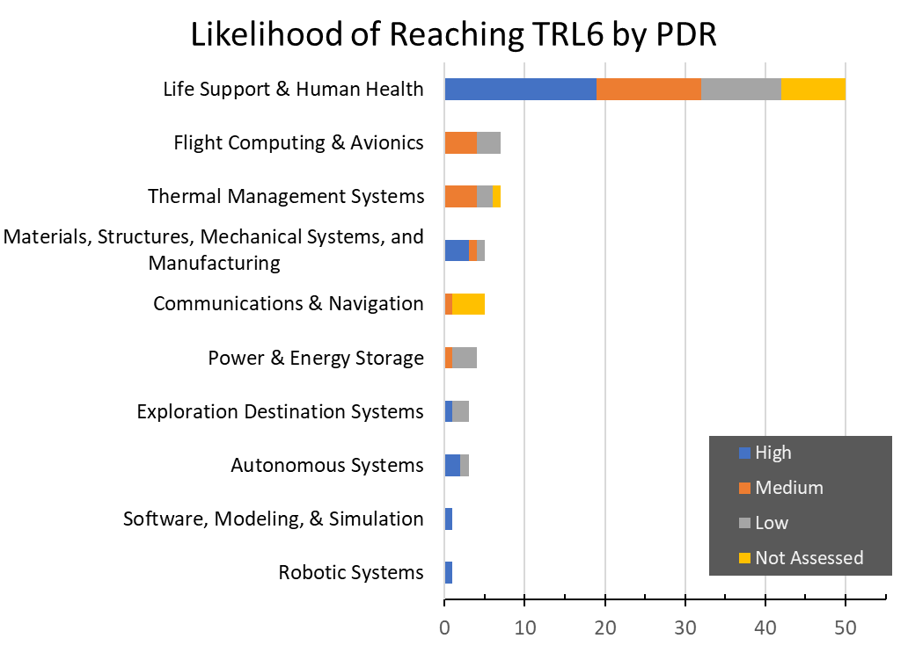
Breakdown of Transit Habitat Gaps by Type
Technology categories for gaps (bar chart) largely consistent with NASA technology taxonomy

Slide 9
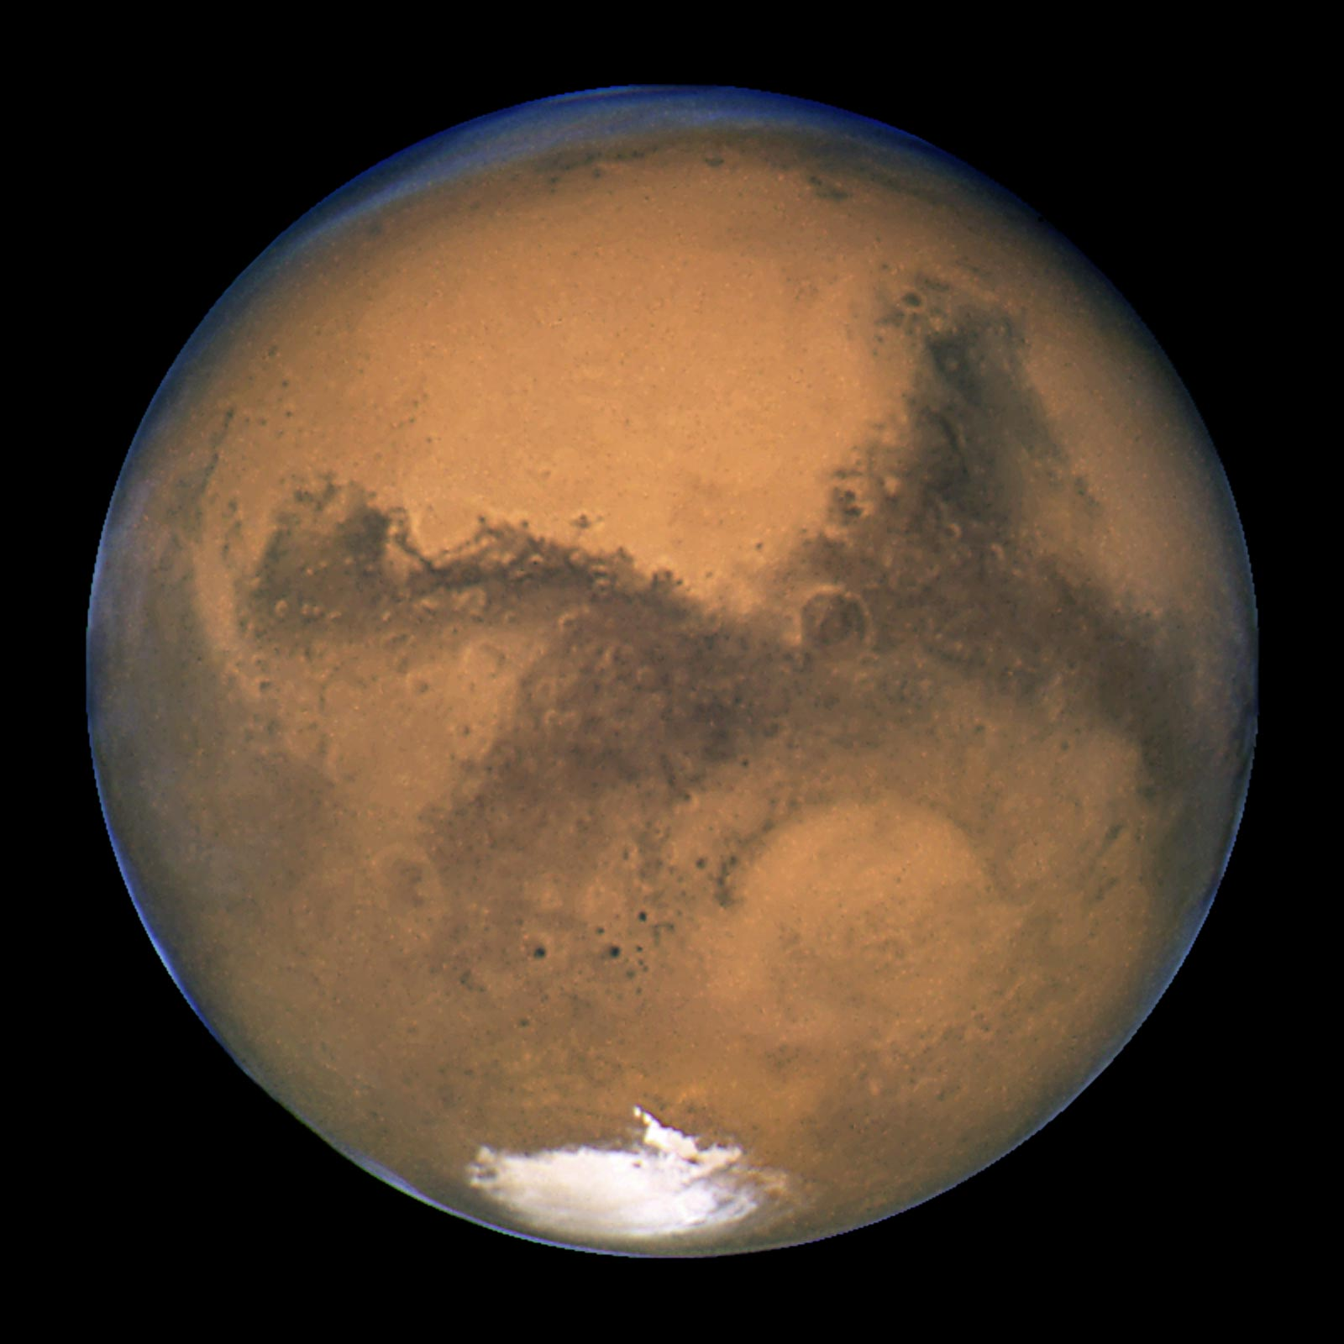
Why are some gaps unlikely to close by PDR?
Technology
No current technology options exist
Development
Technology options need significant improvement and specific testing/characterization
  Unlikely to meet schedule with current funding and activities
Flight demonstrations planned, but too late to meet TH timeline or technology development lagging
Engineering
Gaps in requirements/use case for Mars TH (i.e. gap linked to architecture/knowledge gap)
Funded work and demonstrations do not align with Mars TH-specific needs
Notes:
Give examples of each that link to prior gap list
No technology – radiation countermeasures for GCR
Tech options exist but need significant improvement for TH -- verification and validation tools, development of EVA suits and tools for Mars TH, hard/soft structure integration
Flight demos downstream -- and recycling additional oxygen from metabolic carbon dioxide, food system evaluation, in-flight water quality monitors, habitat outfitting
Lack of definition – EVA
Needs alignment with TH specific needs -- perform in-situ coolant health assessments, automated coolant leak locating, in-flight waste mass jettison

Slide 10
High priority gaps with low likelihood of closure
Gap category | Gap list
Avionics | Autonomy High speed networks Enhanced graphics processing systems High speed networks Verification and validation of autonomous systems
Life support and human health | Integrated system for management of crew health and performance data Food system (includes food storage and preservation) Prevention of microbial growth Radiation monitoring and shielding for deep space environments Reliability testing Design for maintainability (and repairability) Enhanced Oxygen and water recovery and food hydration reduction Operations during and following quiescence Design and testing for lower pressure environments In-flight water quality monitors Waste jettison technologies
Notes:
Will pick out a few to highlight/talk in brief detail (refer people to paper for more detailed information)
-verification and validation of autonomy
-food system
-design for maintainability and repairability
-lower pressure ops
-waste jettison

Slide 11
High priority gaps with low likelihood of closure
Gap category | Gap list
Exploration Destination Systems | Extravehicular tools and mobility aids Outfitting of inflatables
Power | Power management systems with high reliability and radiation tolerance Development of maintainable power management systems built from common components and common modular building blocks for energy storage
Thermal | In situ analysis of coolant fluids Location of coolant leaks
Materials and structures | Hard and soft structure integration

Slide 12
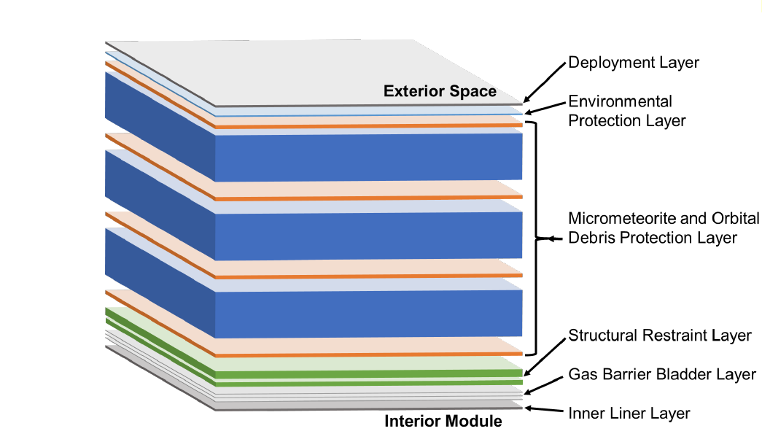
Engineering Gap: Inflatable Softgoods Maturation
Baselined for both Mars Transit Habitat and Lunar Surface Habitat to meet habitable volume
Requires stepwise progression of testing to close engineering gaps
Testing outlined in recently released document “Certification Guidelines for Crewed Inflatable Softgoods Structures” (JSC-67221)
Notes:
Testing includes characterization of burst pressure; long term deformation under stress (creep);
Gap is likely to close by PDR with stepwise testing indicated and work to do so underway with commercial partners, but wanted to highlight this since it is one gap where we have developed a detailed maturation plan to help close gap within timeframe needed
Softgoods are also extensible to multiple platforms beyond Mars TH

Slide 13
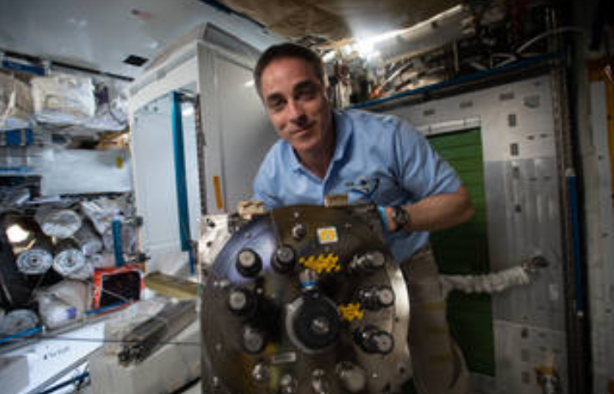
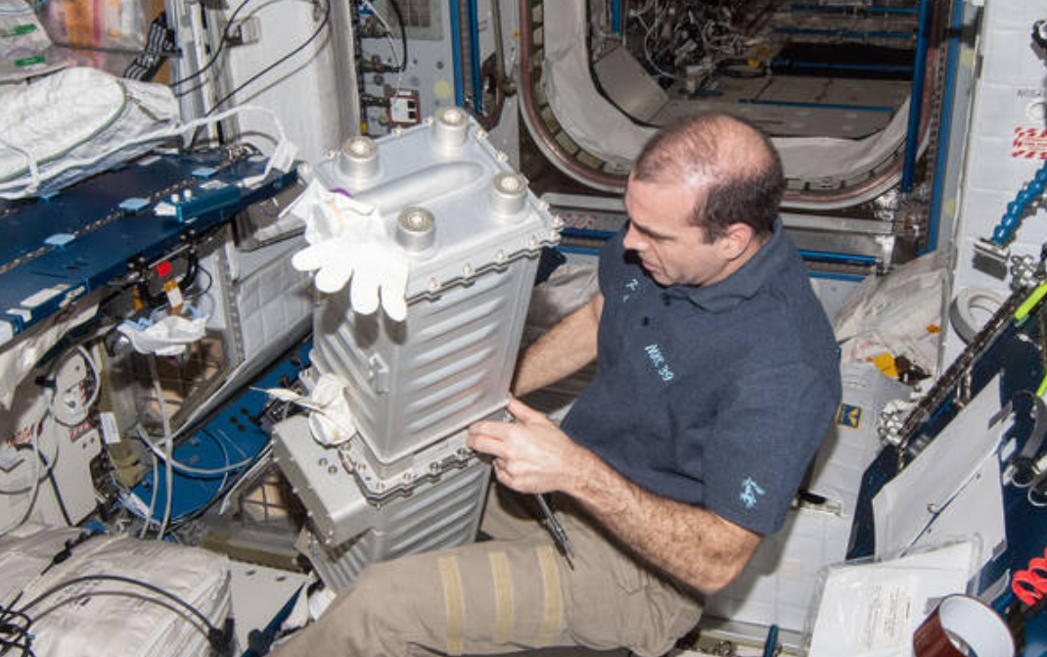
Environmental Control and Life Support Systems (ECLSS) Options and Testing
ECLSS suite and loop closure is currently being traded
Regenerative ECLSS reduces consumables delivery with higher initial mass and associated spares mass
Need more reliable and less complex systems for Mars missions
Systems assessed as highly likely to meet Mars TH implementation:
  Enhanced Oxygen Generation Assembly
    Electrolyzes water to supply Oxygen
  Water Processing Assembly
    Purifies grey water into potable water
  4-Bed Carbon Dioxide Removal Assembly
    Removes CO₂ from the atmosphere via passive sorbent beds
  Urine Processing Assembly
  Brine Processing Assembly
  Plasma Pyrolysis Assembly
  Environmental monitoring

Slide 14
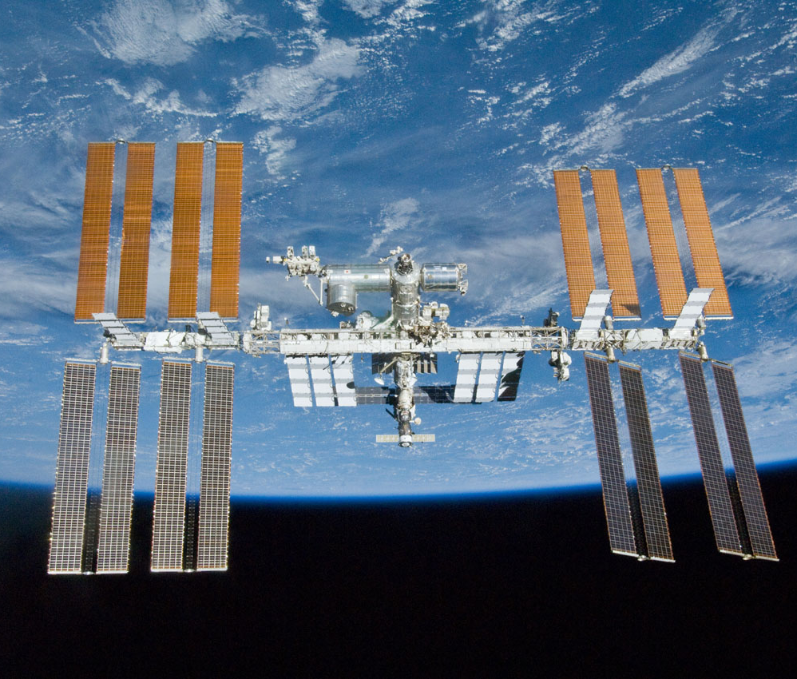
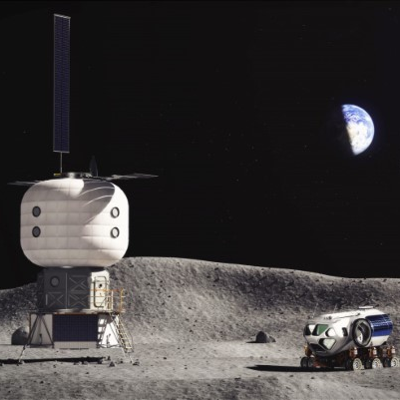
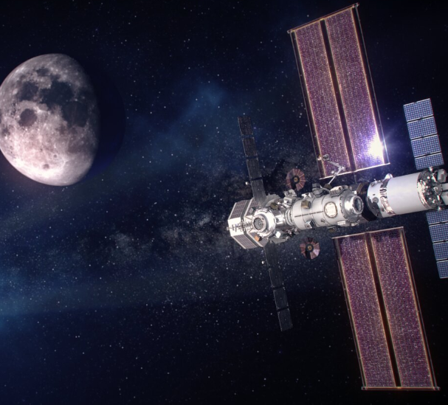
Maturation Platforms
International Space Station (ISS) (Operational)
Regenerative ECLSS maturation and validation
Assessing countermeasures for crew health
Advancing exploration medical capabilities
Gateway (In Development)
Will test power management and distribution, quiescent operations, environmental monitoring, exploration medical
Commercial Low Earth Orbit Platforms (Early Concept)
In early concept development through NASA’s Commercial LEO Destinations Program
Lunar Surface Habitat (Early Concept)
Strong linkage to closure of many gaps
Lunar surface habitat
International Space Station (ISS)
  critical testbed for regenerative ECLSS maturation and validation, assessment of the efficacy of countermeasures for radiation, and advancing exploration medical capabilities
Future commercial platforms in low earth orbit
  Early in concept development through NASA’s Commercial LEO Destinations Program
Gateway
Lunar surface habitat
Notes:
Note that commercial LEO capabilities are TBD at this time; testing of systems and gap closure can be more closely linked to these platforms as their development matures
Will explore link to Lunar surface habitat on next slides

Slide 15
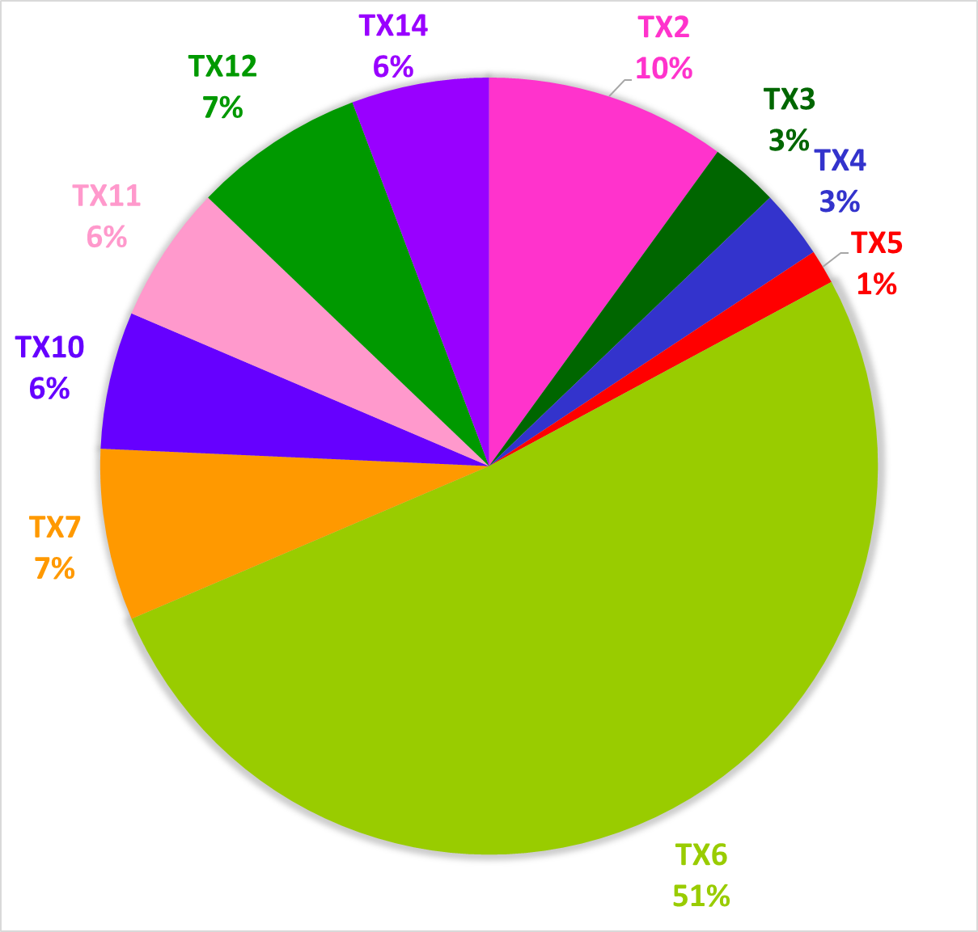
Link between Lunar Surface Habitat and Mars Transit Habitat Capability Gaps
TX2- Flight computing/avionics
TX3- Power and energy storage
TX4- Robotic systems
TX5- Communications and navigation
TX6- Human health, life support, and habitation systems
TX7- Exploration Destination Systems
TX10- Autonomous systems
TX11- Software, modeling, and simulation
TX12- Materials/structures/mechanical systems/manufacturing
TX14- Thermal systems
Overlapping Gaps Needed to Close Between Lunar Surface Habitat and Mars Transit Habitat by Taxonomy Classification. In terms of gaps that are solely needed by both elements, approximately 61% of the gaps applicable to Mars TH have closure pathways that may be addressed earlier by closing gaps with the Lunar SH.

Slide 16
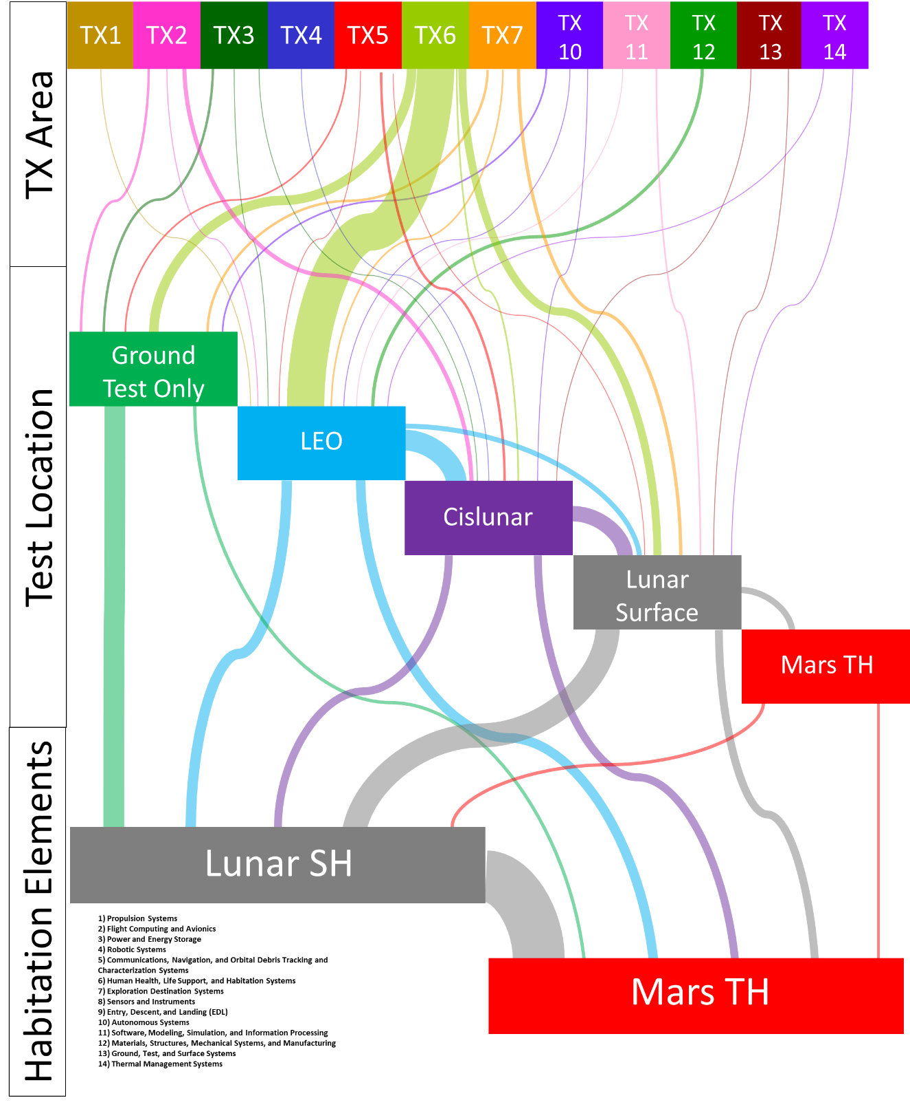
Sankey diagram demonstrating capability gaps by TX, testing locations, and elements enabled
The size of the flow lines correspond with how many gaps are tested, demonstrated, or validated at the various gap closure platform locations in the middle section.
Notes:
Notes from paper:
We can see in the top section how gaps that either Lunar SH or Mars TH need to be closed are broken down by TX area. The size of the flow lines correspond with how many gaps are tested, demonstrated, or validated at the various gap closure platform locations in the middle section. Note that some gaps require testing, demonstrating, or validating at multiple platform locations, which can be seen by the flow lines from one test location to another. While some gaps require only ground testing before being closed for Lunar SH or Mars TH, most require in-space testing. TX06 – human health, life support and habitation systems – has the most applicable gaps for both the Lunar SH and Mars TH. Most of these gaps are expected to be tested demonstrated, or validated in LEO. Some of these tests are satisfactory for gap closure of Lunar SH and Mars TH, but many others will require follow-on tests in cislunar, the lunar surface, or on the Mars TH itself before the gap is closed. Finally, we can see based on the size of the flow lines that while many gaps for Mars TH are closed at the various test platform locations, the majority of gaps closed for Mars TH are previously closed on the Lunar SH,as shown by the thick flow line from Lunar SH to Mars TH in the bottom habitation elements section, thus validating the discussion earlier in this section. Overall, gap closure for Mars TH will require tests across the rest of the human spaceflight architecture.

Slide 17
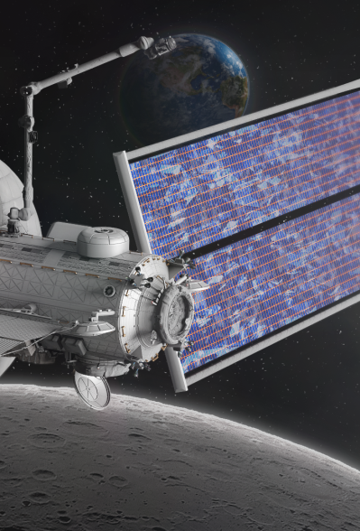
Summary
Mars Transit Habitat presents new and unprecedented challenges due to the duration of the anticipated missions it will support and the operational environment
Technology assessment and maturation plan in development for Mars TH
  identify critical technologies needed to close gaps, assess the maturity of these technologies, and maturation activities required for Mars TH implementation within currently envisioned timeline
This analysis has identified high priority gaps for Mars TH, with a focus on those evaluated as having a low likelihood of closure by PDR
Testing on ISS, potential CLD platforms, Gateway, and lunar surface habitat can “feed forward” into Mars TH technology development

Slide 18
Acknowledgments
Bill Cirillo and Andrew Owens, NASA Langley Research Center
Doug Litteken, NASA Johnson Space Center
Tom Jones, NASA Langley Research Center
David Hitt, NASA Marshall Space Flight Center

