Slide 1
Biogeochemistry, Planetary Protection, and Astromaterials Curation:
A Story of Environmental Microbiology at NASA
Aaron B. Regberg
02/09/2023 Texas A&M Galveston

Slide 2
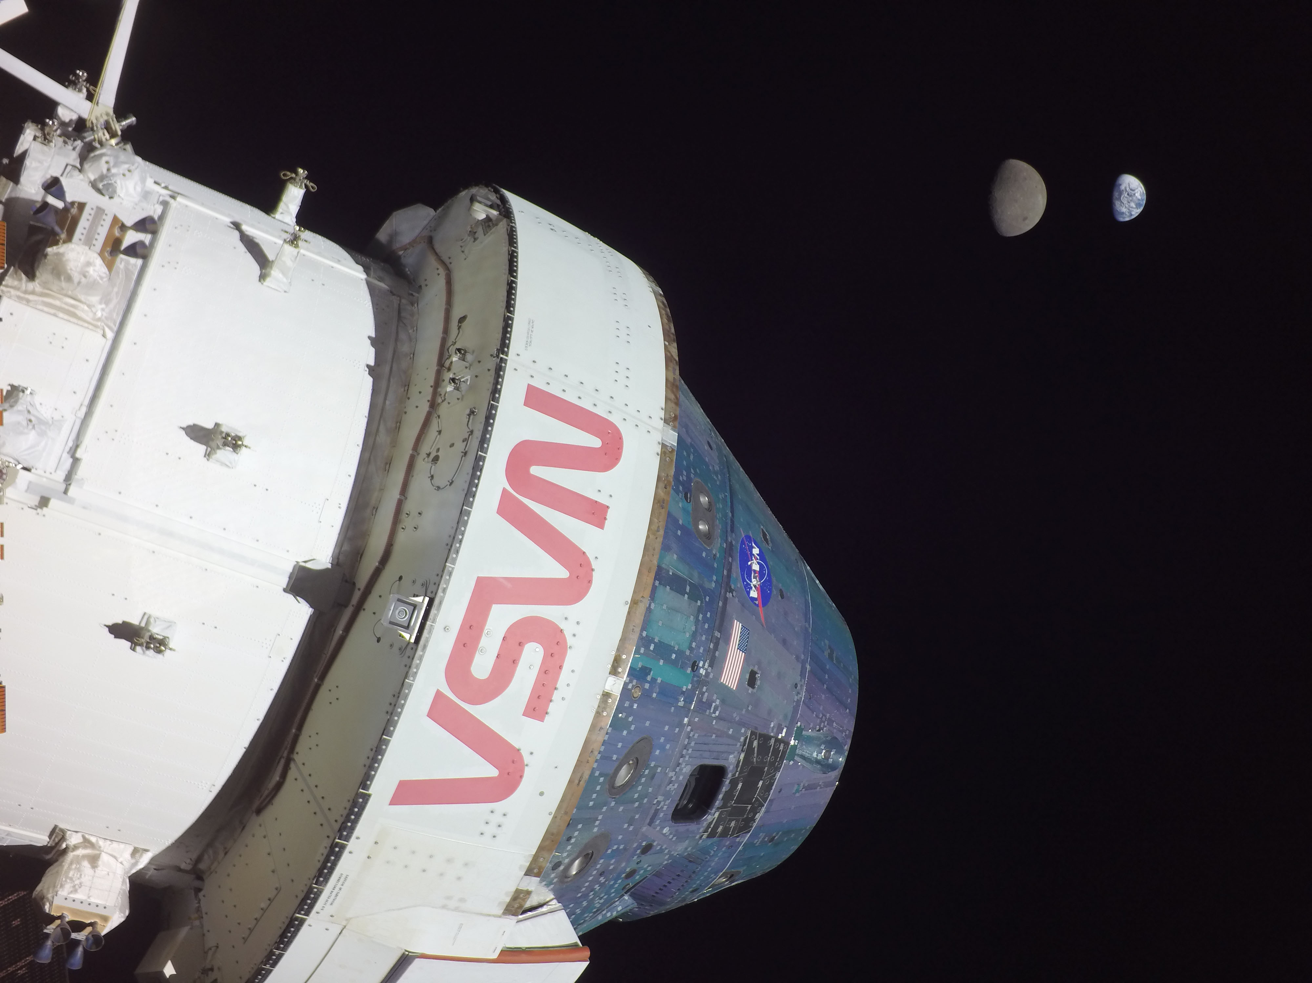
Outline
Introduction to ARES (Astromaterials Research and Exploration Science)
Geomicrobiology and Curation
  Microbial Monitoring
  Rapid Identification
  Biodegradation of Meteorites
Planetary Protection Research
https://www.flickr.com/photos/nasa2explore/52530824918/in/album-72177720303788800/

Slide 3
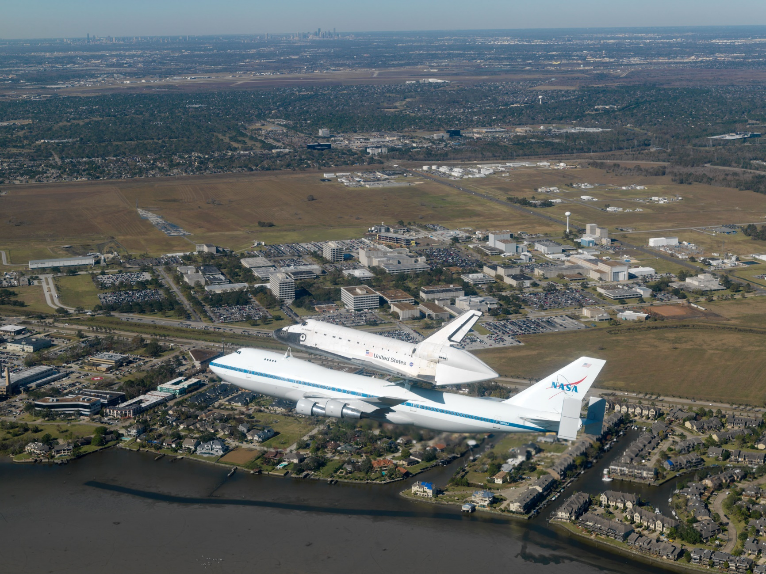
Astromaterials Research and Exploration Science Division
Scientists and engineers responsible for:
  Collecting and Curating extraterrestrial samples
  Studying extraterrestrial samples to understand the origins of earth and the solar system
  Monitoring orbital debris and protecting spacecraft from hypervelocity impact
  Remote sensing from The International Space Station and image analysis.

Slide 4
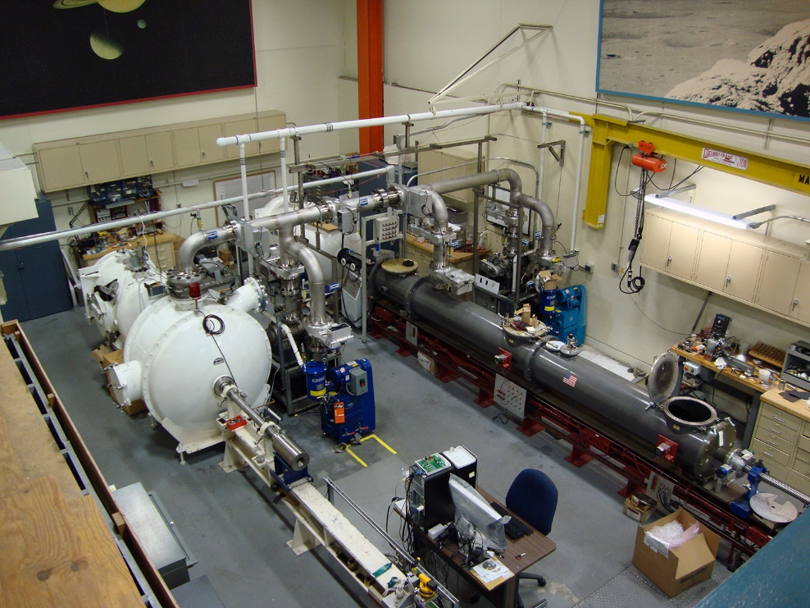
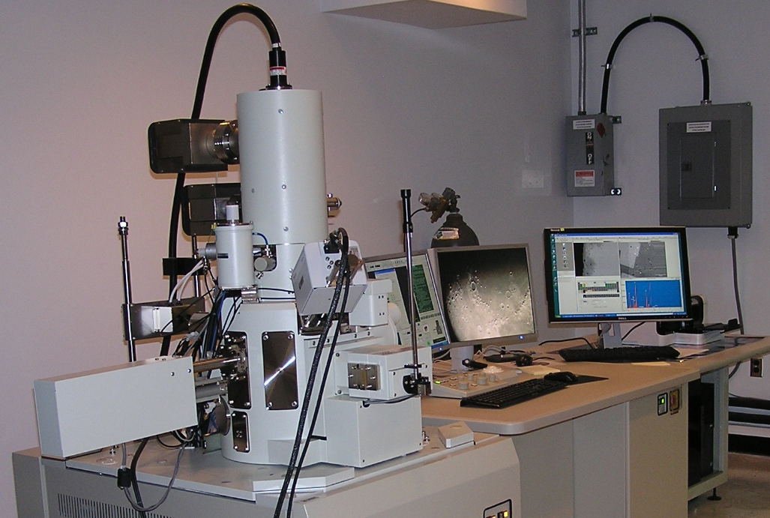
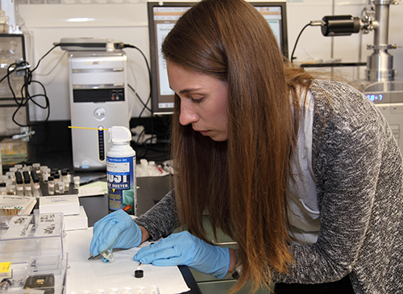
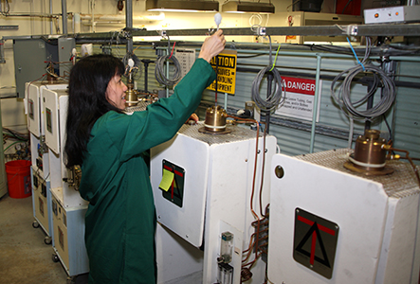
RESEARCH AND ANALYSIS
Specialized laboratories enable ARES scientists to conduct world-class research.

Slide 5
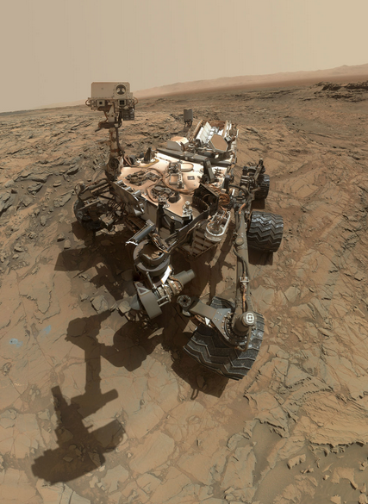
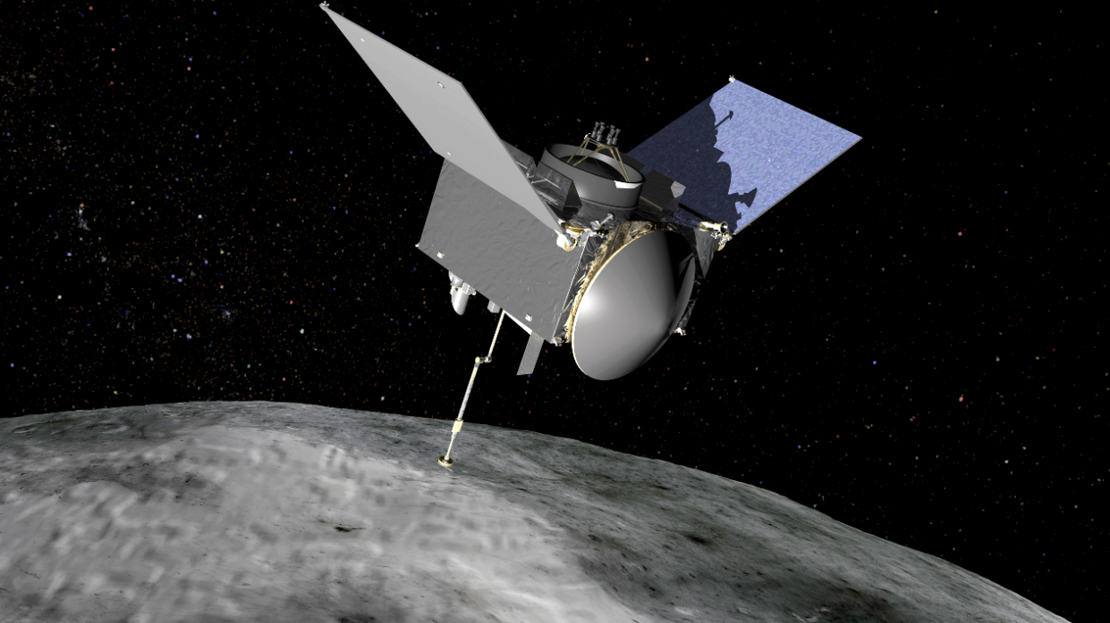
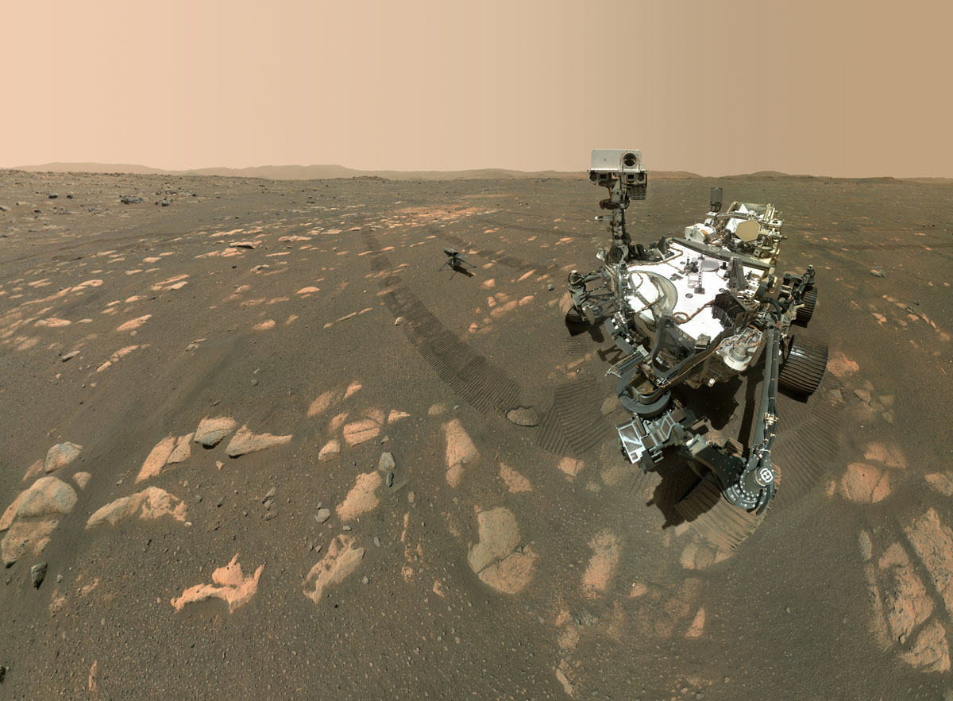
EXPLORING PLANETARY WORLDS
Our scientists participate in robotic missions
Mars Science Laboratory (Curiosity)
Mars Exploration Rover
Exploring asteroid Bennu (OSIRIS-REx)
Mars2020 (Perseverance)
Phoenix Lander

Slide 6
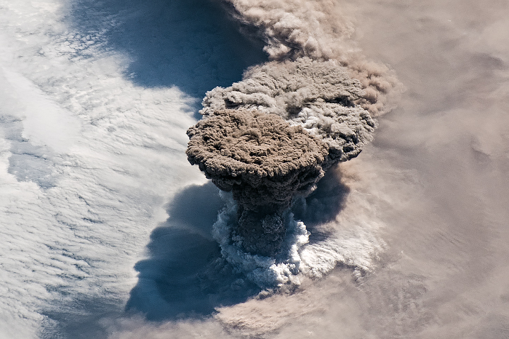
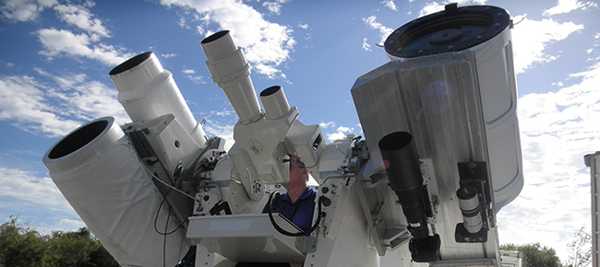

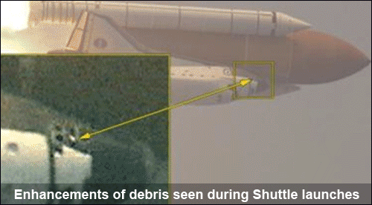
Remote Sensing and Imagery Analysis
Volcanic eruption in the Kuril Islands 2019 (ISS059-E-119250)
Hurricane Harvey: [ISS052-E-78913]

Slide 7
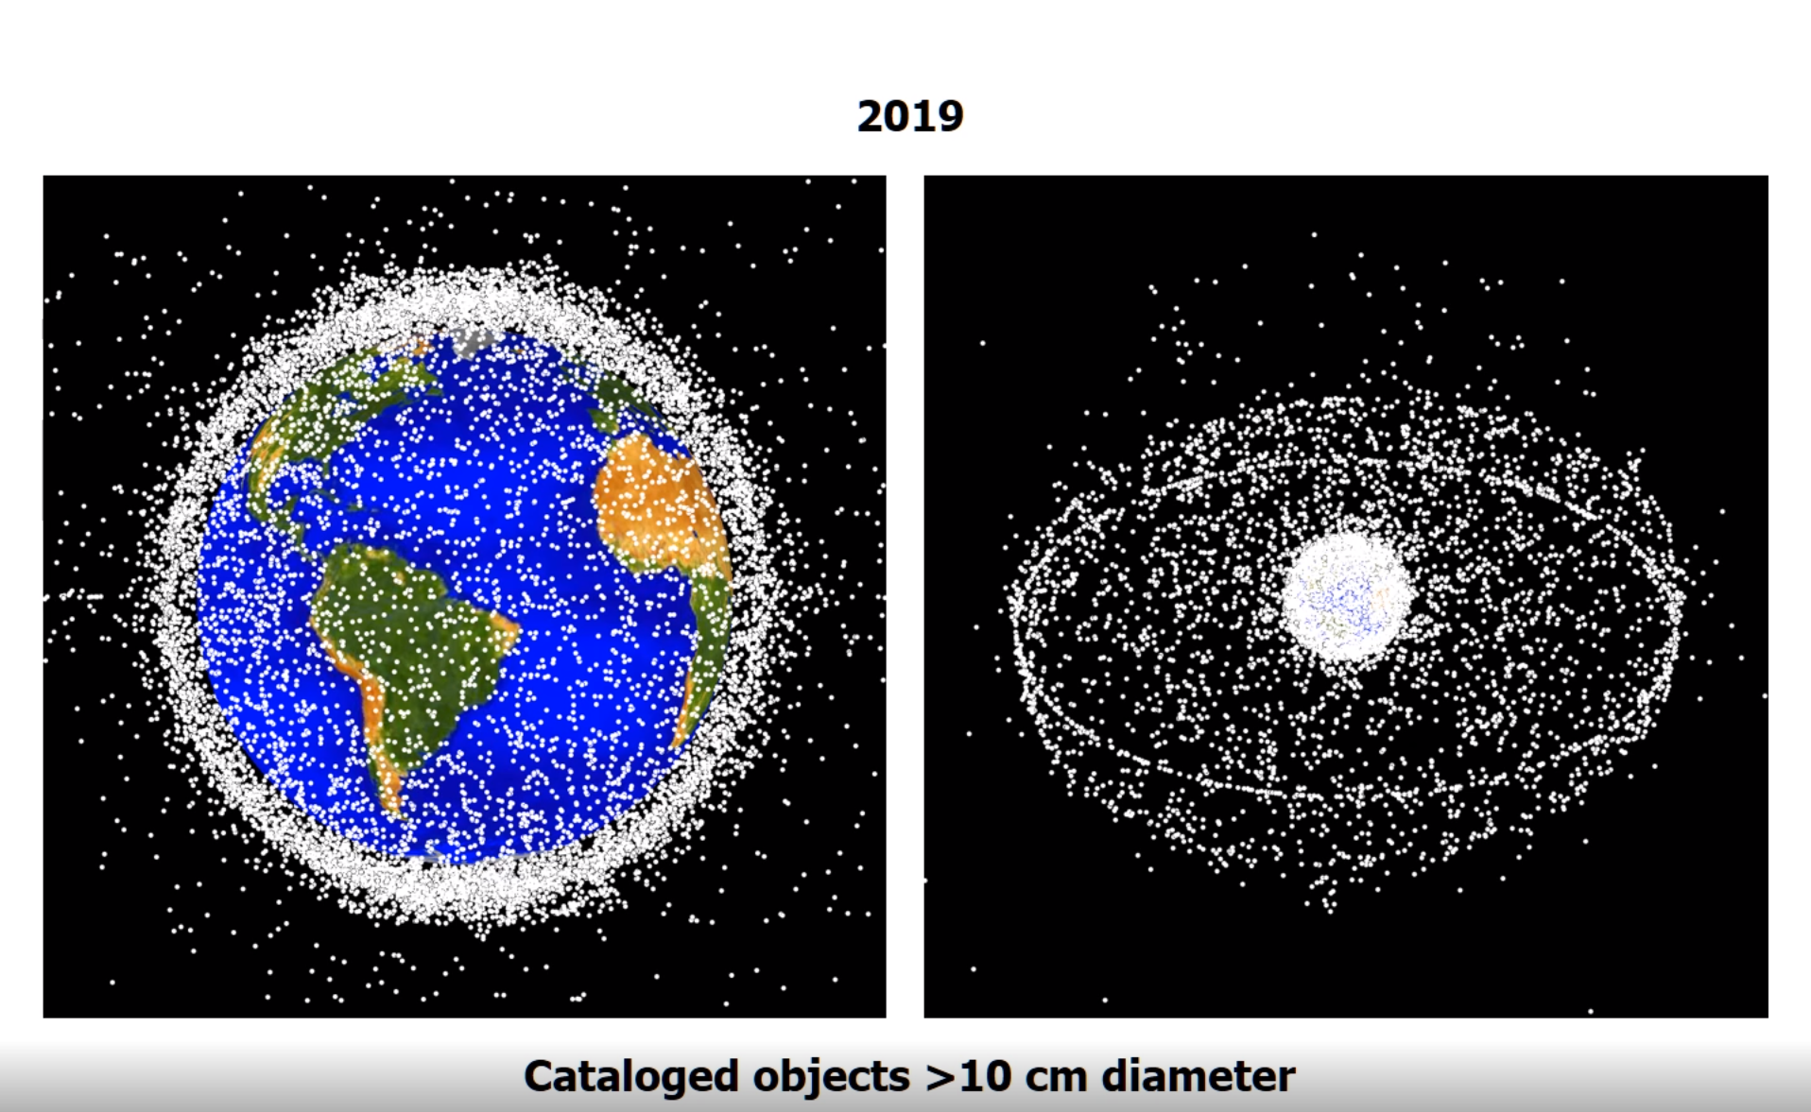
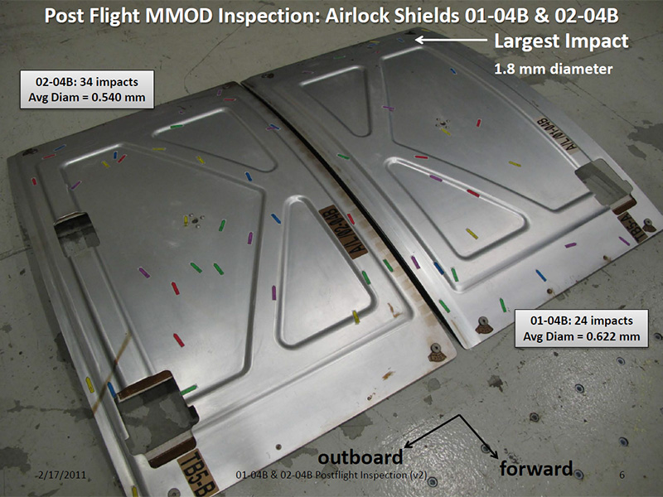
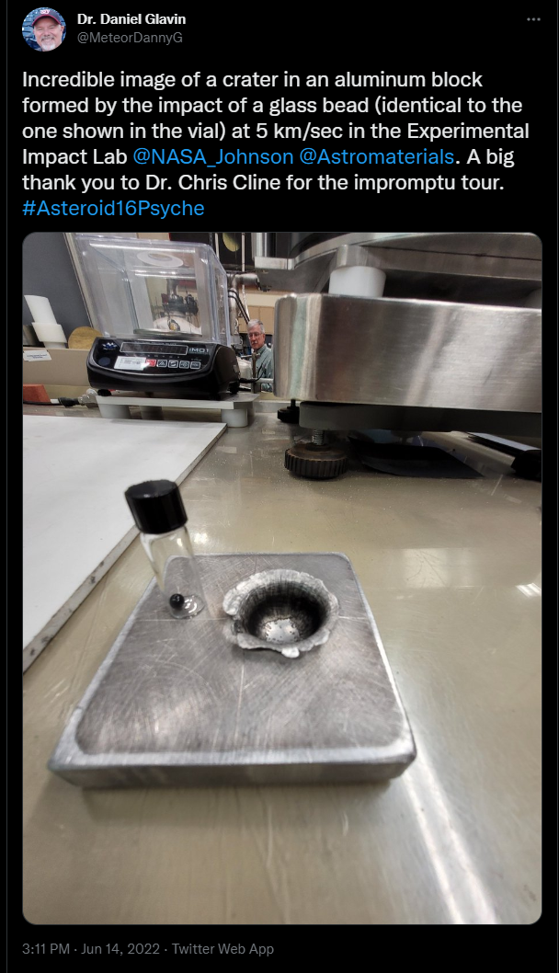
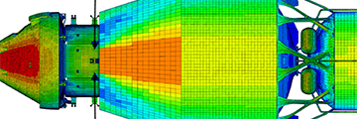
Monitoring Orbital Debris and Protecting Equipment and Astronauts from Hypervelocity Impact

Slide 8
Outline
Introduction to ARES (Astromaterials Research and Exploration Science)
Geomicrobiology and Curation
  Microbial Monitoring
  Rapid Identification
  Biodegradation of Meteorites
Planetary Protection Research
https://www.flickr.com/photos/nasa2explore/52530824918/in/album-72177720303788800/

Slide 9
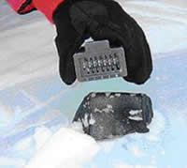
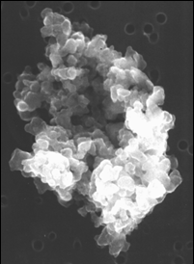
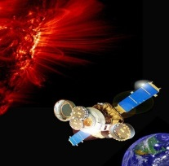
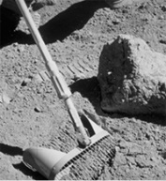
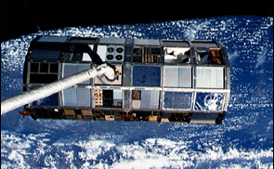
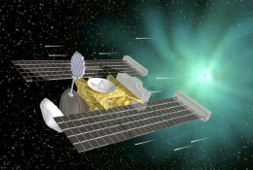
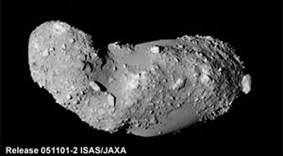
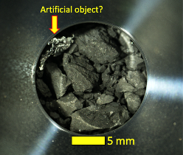
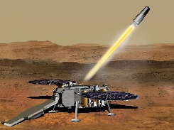
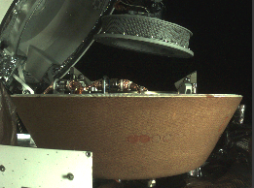

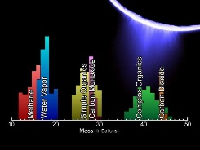
The Astromaterials Acquisition and Curation Office
Our Past 50 years – planning for and curating multiple collections
Lunar
(1969)
Apollo program lunar rocks and soils; Luna samples
Meteorite
(1977)
Antarctic Search for Meteorites (ANSMET) program
Cosmic Dust
(1981)
Cosmic dust grains from Earth’s stratosphere from high altitude aircraft
Micro-particle
(1985)
Space exposed hardware from spacecraft
Genesis
(2004)
Genesis solar wind samples at Earth-Sun L1 point
Stardust
(2006)
Cometary and interstellar samples from Comet Wild 2
Hayabusa
(2012)
Samples collected from JAXA asteroid mission to Itokawa
Hayabusa II
(2020)
Subset of samples collected from JAXA asteroid mission to 162173 Ryugu
Our Near Future . . .
Our More Distant Future . . .
OSIRIS-REx
( 2023)
Asteroid sample return from 101955 Bennu
Artemis
( 2025)
Lunar South Pole. Cold Sample return?
Mars
(~2030s )
(est. 1964)
Comet
Enceladus
Europa
Ceres
Notes:
Emphasize rational for monitoring here

Slide 10
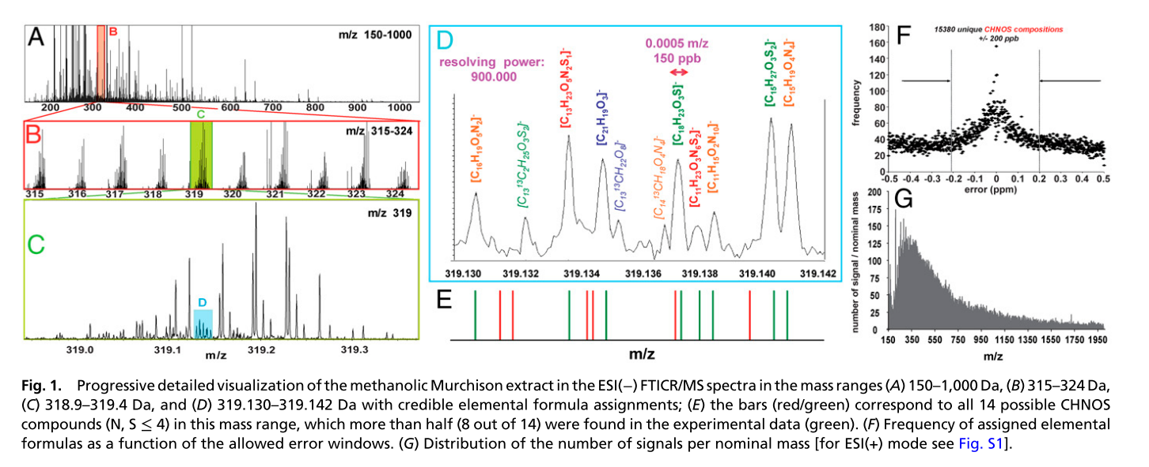
Scientists Study These Samples to Answer Questions Like…
Did meteorites deliver the building blocks of life to Earth?
Schmitt-Kopplin, P., Gabelica, Z., Gougeon, R. D., Fekete, A., Kanawati, B., Harir, M., Gebefuegi, I., Eckel, G., & Hertkorn, N. (2010). High molecular diversity of extraterrestrial organic matter in Murchison meteorite revealed 40 years after its fall. Proceedings of the National Academy of Sciences of the United States of America, 107(7), 2763–2768. https://doi.org/10.1073/pnas.0912157107

Slide 11
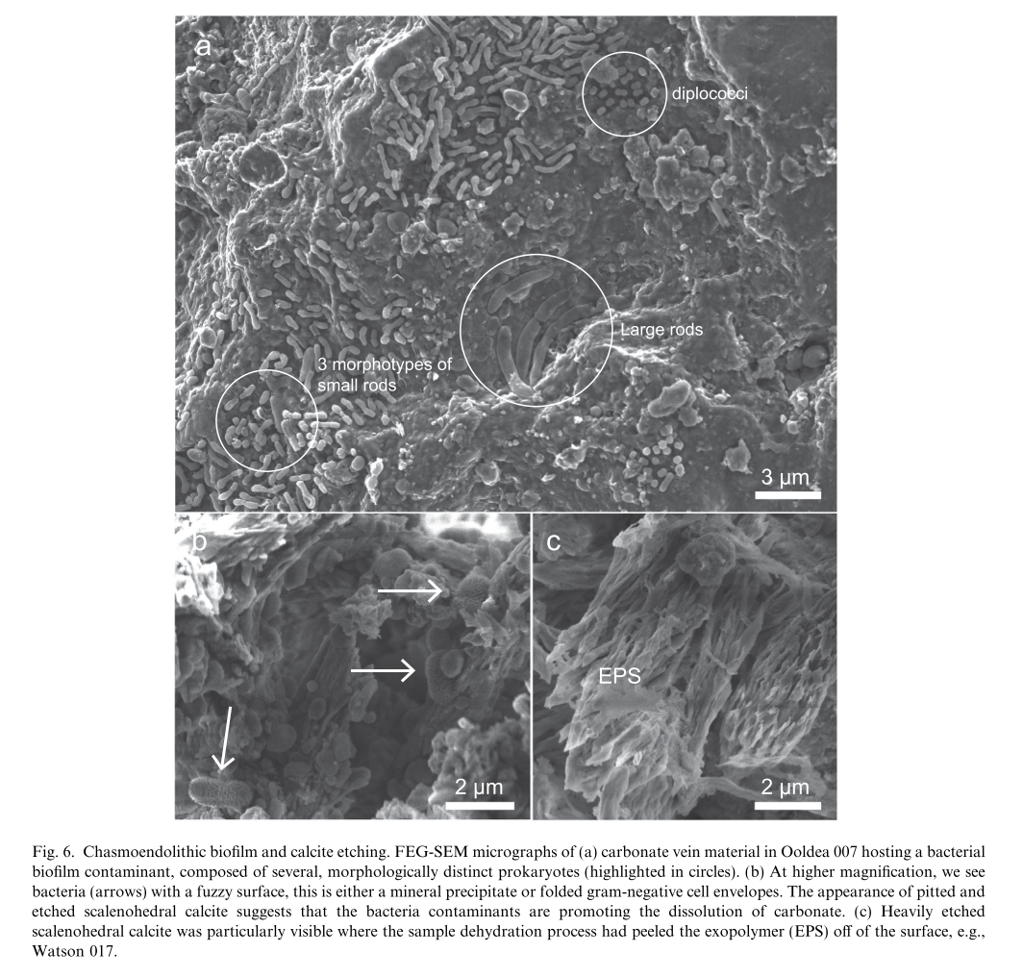
Scientists Study These Samples to Answer Questions Like…
Did meteorites deliver the building blocks of life to Earth?
Schmitt-Kopplin, P., Gabelica, Z., Gougeon, R. D., Fekete, A., Kanawati, B., Harir, M., Gebefuegi, I., Eckel, G., & Hertkorn, N. (2010). High molecular diversity of extraterrestrial organic matter in Murchison meteorite revealed 40 years after its fall. Proceedings of the National Academy of Sciences of the United States of America, 107(7), 2763–2768. https://doi.org/10.1073/pnas.0912157107
Tait, A. W., Wilson, S. A., Tomkins, A. G., Gagen, E. J., Fallon, S. J., & Southam, G. (2017). Evaluation of meteorites as habitats for terrestrial microorganisms: Results from the Nullarbor Plain, Australia, a Mars analogue site. Geochimica et Cosmochimica Acta, 215, 1–16. https://doi.org/10.1016/J.GCA.2017.07.025

Slide 12
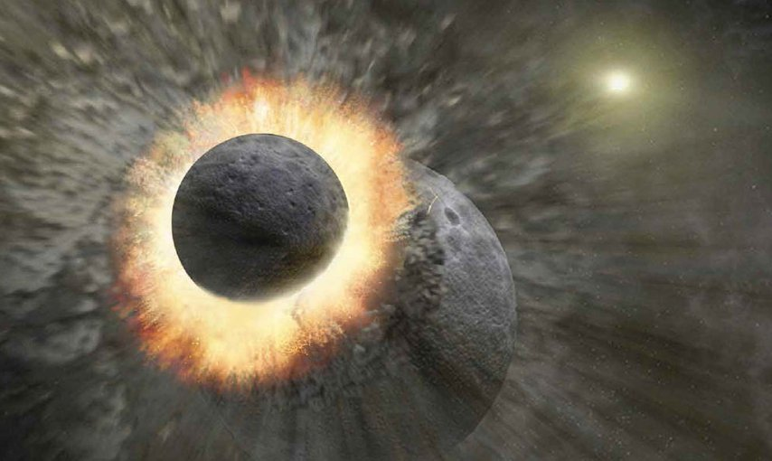
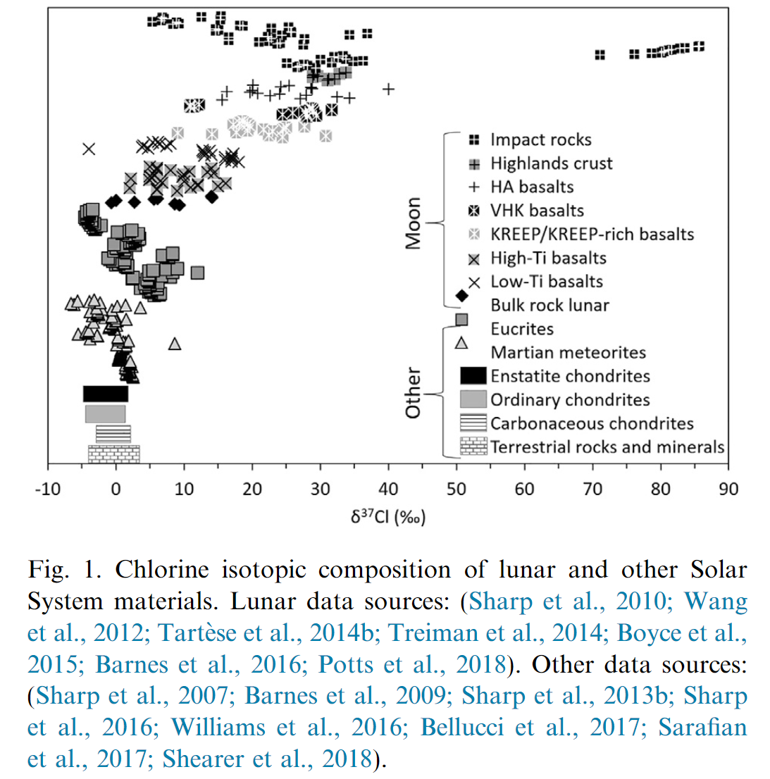
Scientists Study These Samples to Answer Questions Like…
How and when did the moon form?
IMAGE CREDIT: NASA/JPL-CALTECH/T. PYLE.
Barnes, J. J., Franchi, I. A., McCubbin, F. M., & Anand, M. (2019). Multiple reservoirs of volatiles in the Moon revealed by the isotopic composition of chlorine in lunar basalts. Geochimica et Cosmochimica Acta, 266, 144–162. https://doi.org/10.1016/J.GCA.2018.12.032

Slide 13
Scientists Study These Samples to Answer Questions Like…
How and when did the moon form?
Bleach
NaOCl
IMAGE CREDIT: NASA/JPL-CALTECH/T. PYLE.
Barnes, J. J., Franchi, I. A., McCubbin, F. M., & Anand, M. (2019). Multiple reservoirs of volatiles in the Moon revealed by the isotopic composition of chlorine in lunar basalts. Geochimica et Cosmochimica Acta, 266, 144–162. https://doi.org/10.1016/J.GCA.2018.12.032

Slide 14
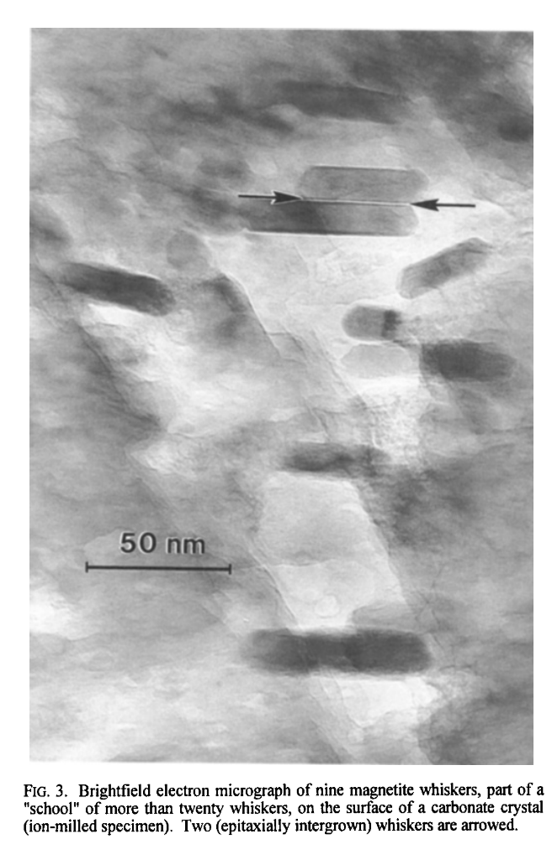
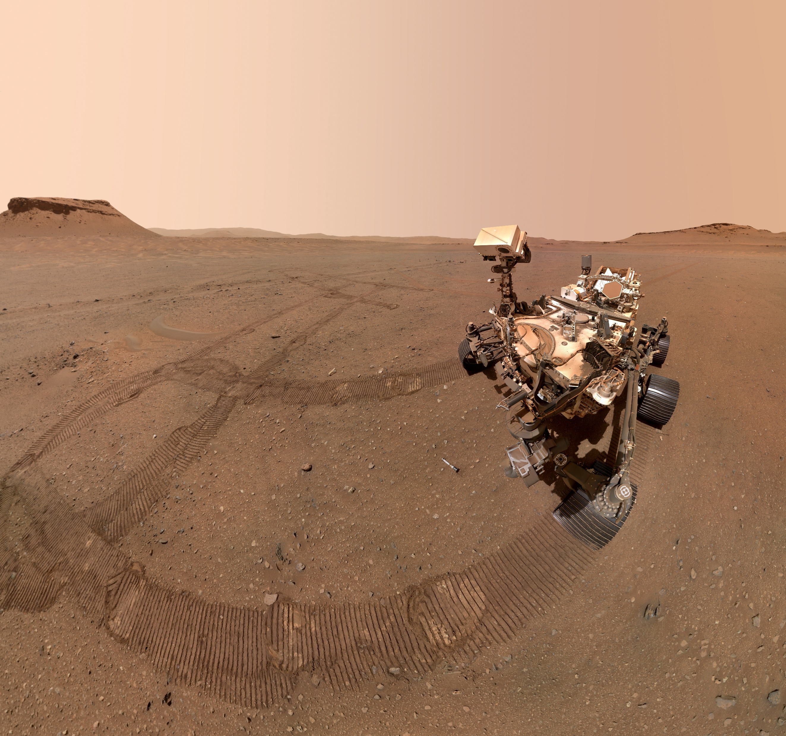
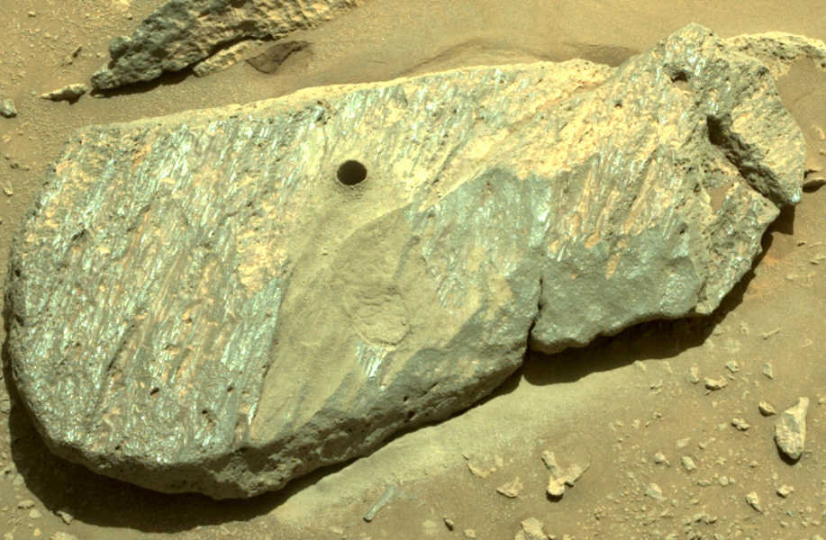
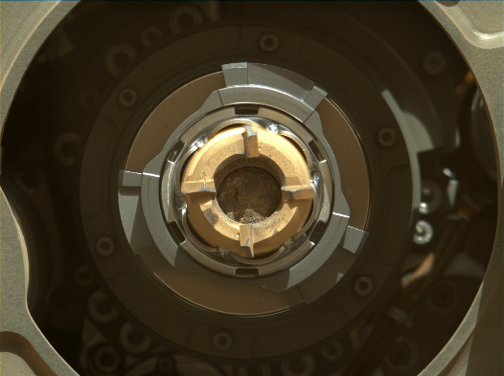
Scientists Study These Samples to Answer Questions Like…
Was there ever life on Mars?
NASA/JPL-Caltech
BRADLEY, J. P., MCSWEEN, H. Y., & HARVEY, R. P. (1998). Epitaxial growth of nanophase magnetite in Martian meteorite Allan Hills 84001: Implications for biogenic mineralization. Meteoritics & Planetary Science, 33(4), 765–773. https://doi.org/10.1111/j.1945-5100.1998.tb01682.x

Slide 15
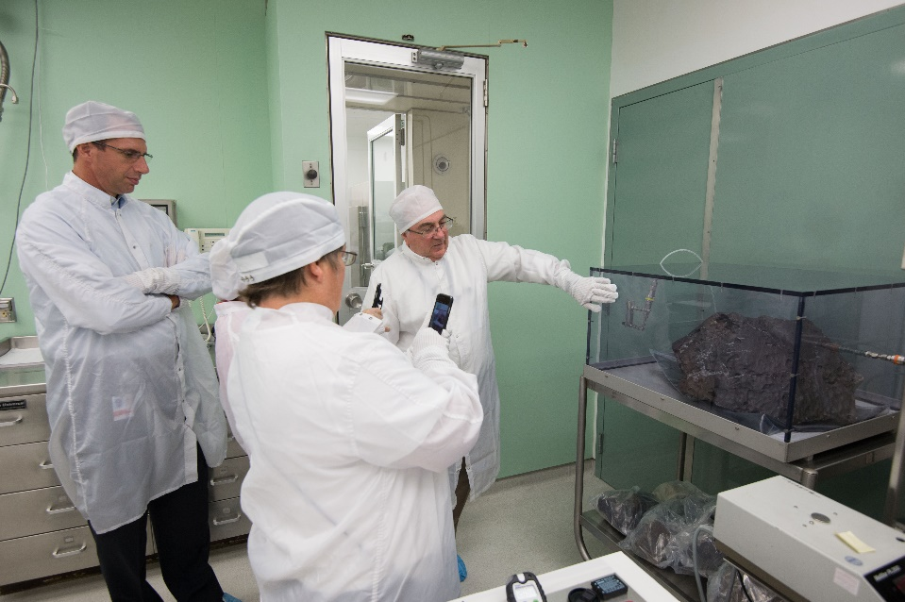
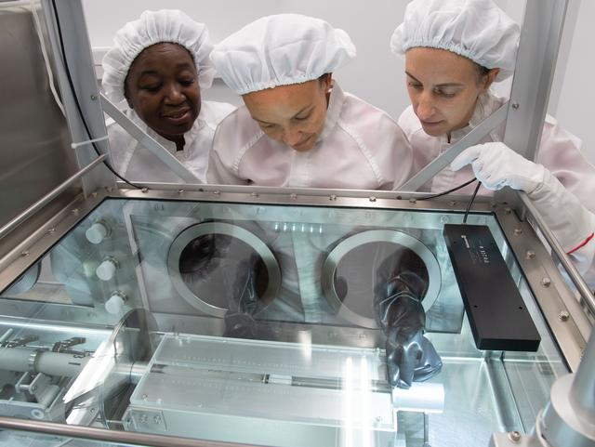
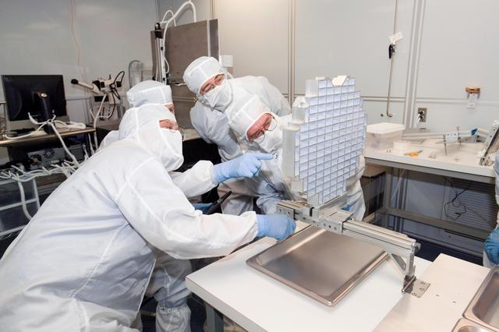
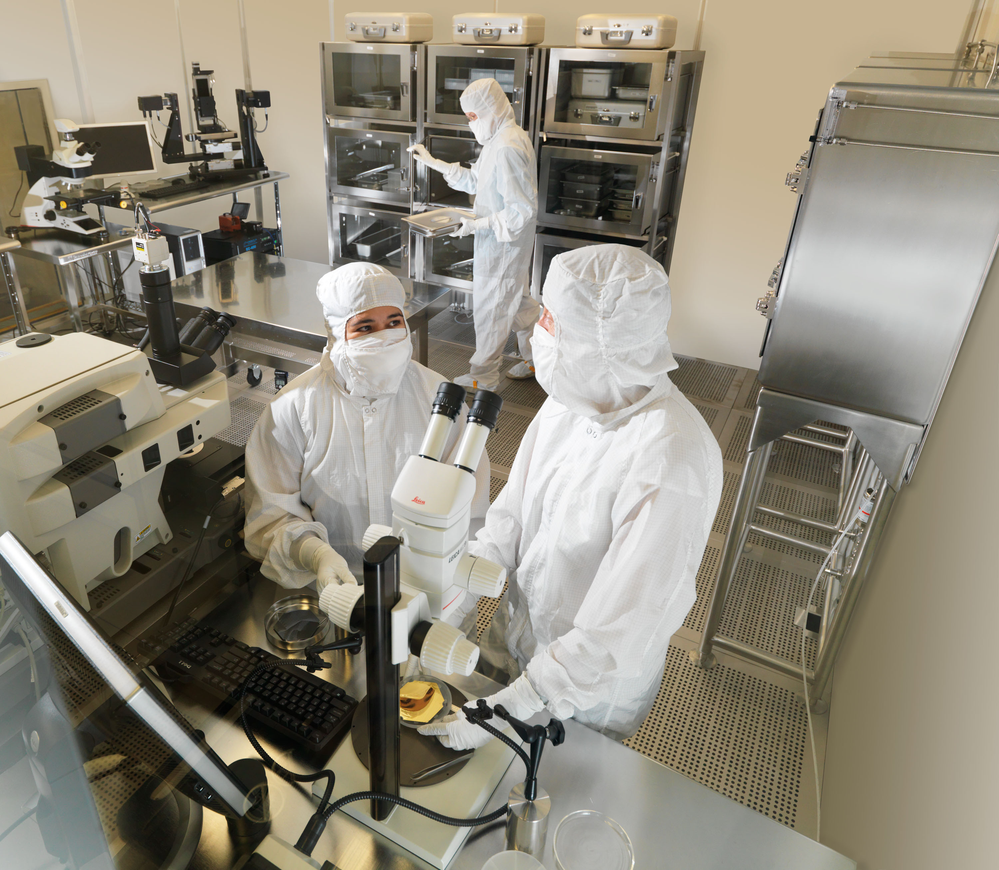
Each Collection Is Stored in a Separate Cleanroom
Meteorite (ISO 7 equivalent)
Lunar (ISO 6 Equivalent)
Stardust (ISO 5 Equivalent)
Genesis (ISO 4 Equivalent)

Slide 16
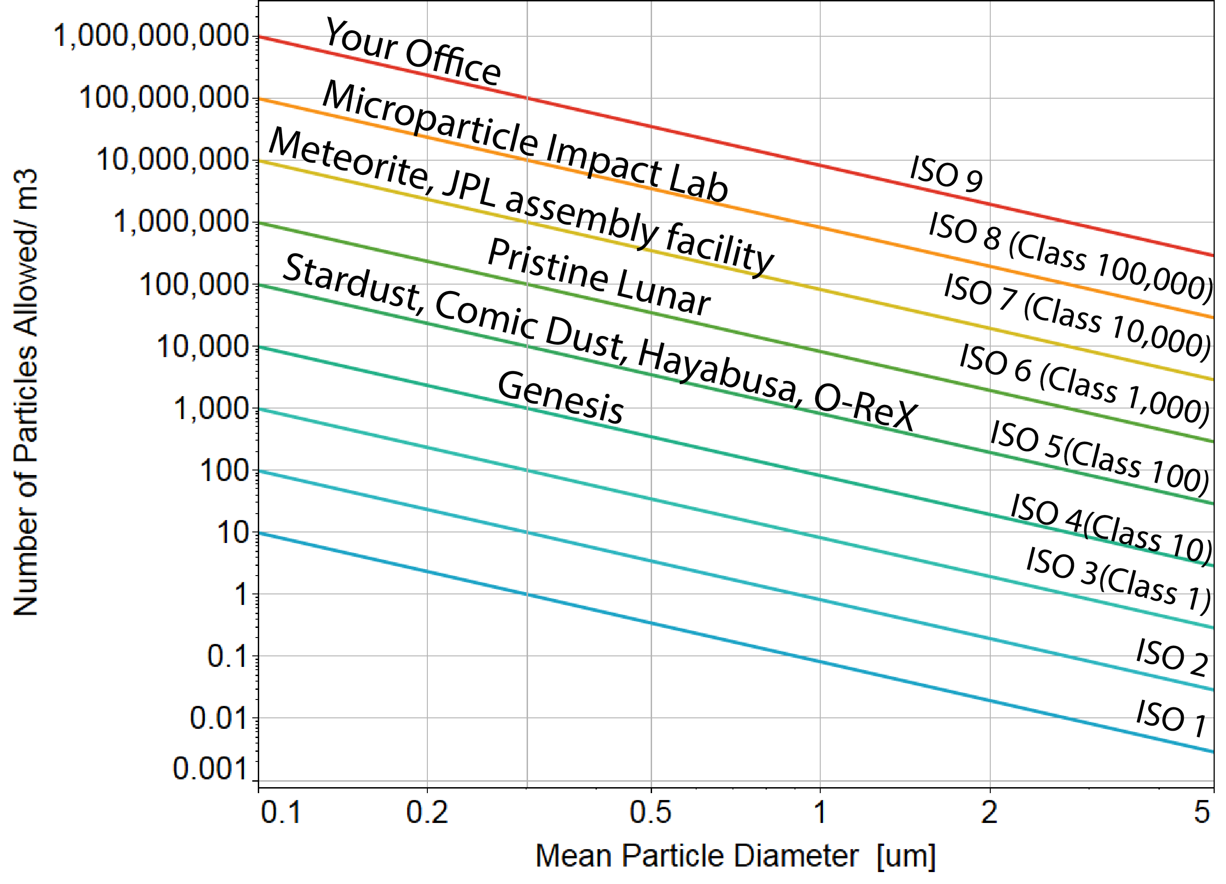
Clean room standards limit particle numbers but not particle type

Slide 17
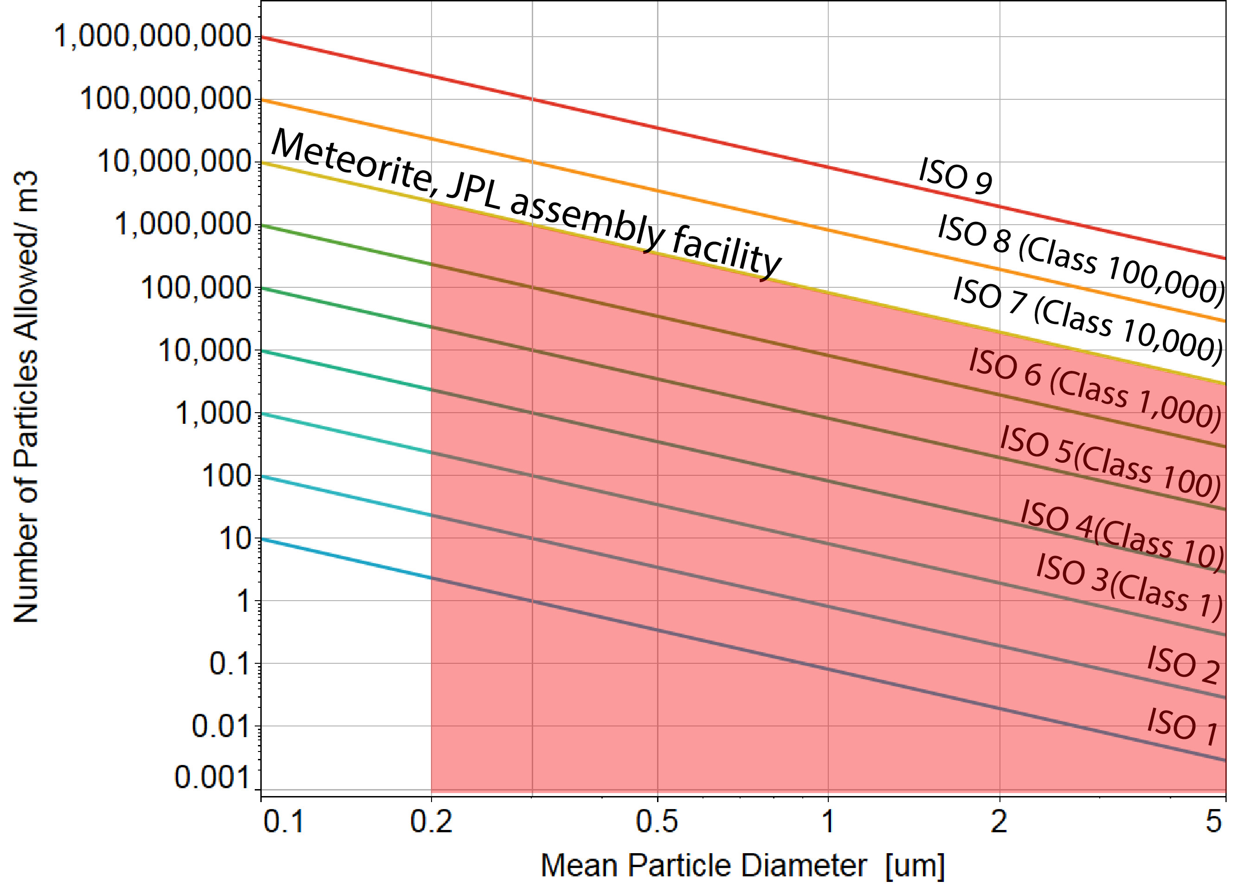
Clean room standards limit particle numbers but not particle type
Range of microbial cell sizes

Slide 18
Clean room standards limit particle numbers but not particle type
3,828,130 cell sized particles /m³ of air
Range of microbial cell sizes

Slide 19
Clean room standards limit particle numbers but not particle type
ISO 7
3,828,130 cell sized particles /m³ of air
ISO 4
3,828 cell sized particles /m³ of air
Range of microbial cell sizes

Slide 20
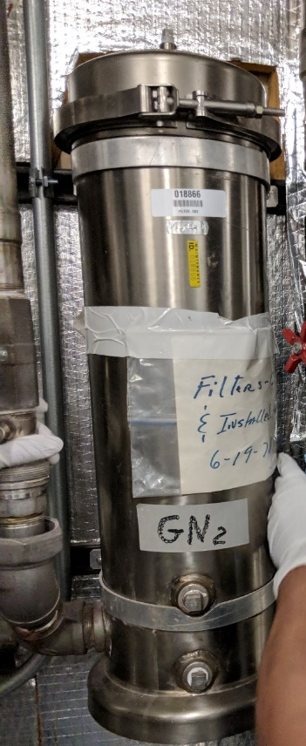
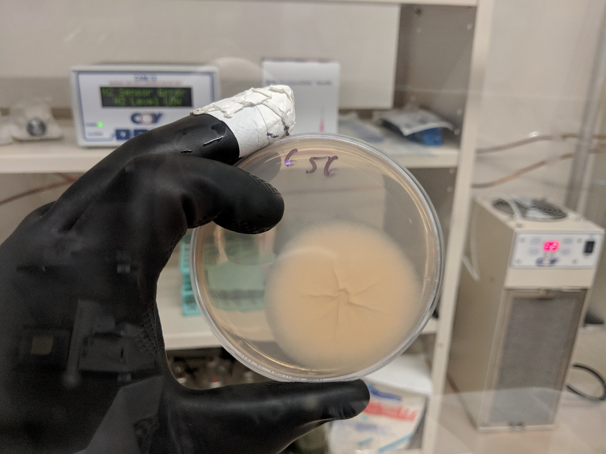
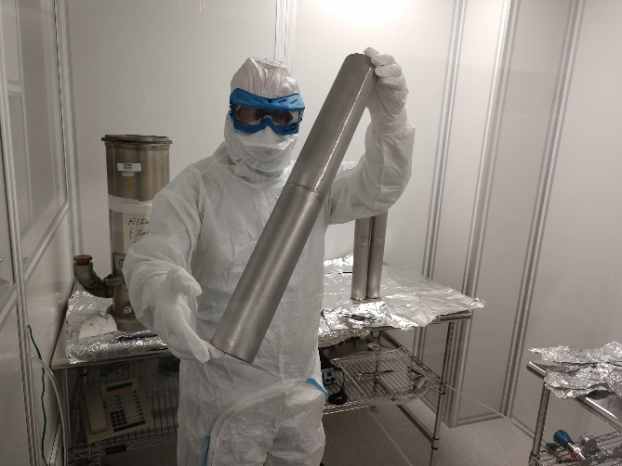
Microbial “Particles” are self-replicating
7 Days
Fusarium, oxysporum
Notes:
Lignin degrading fungi

Slide 21
What’s in our labs?
Could these organisms alter our samples?

Slide 22
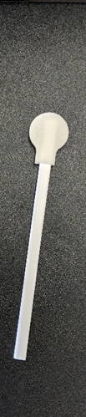
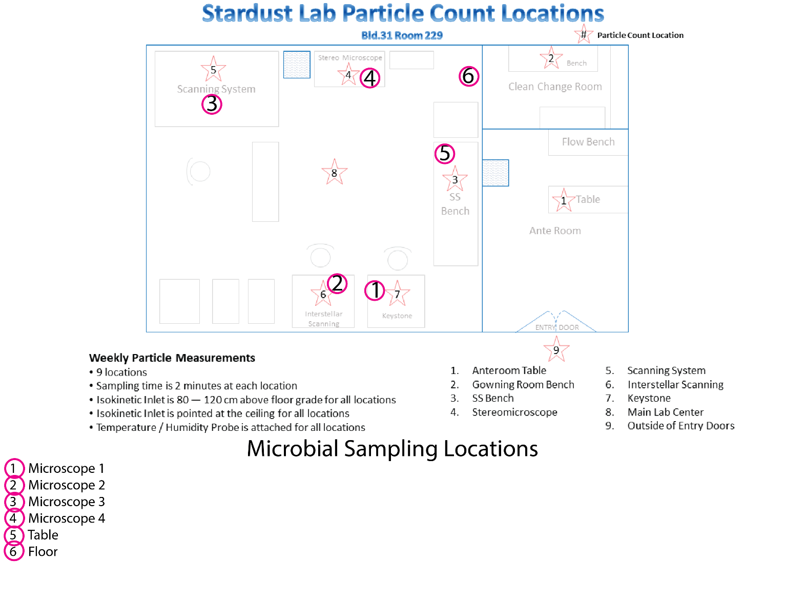
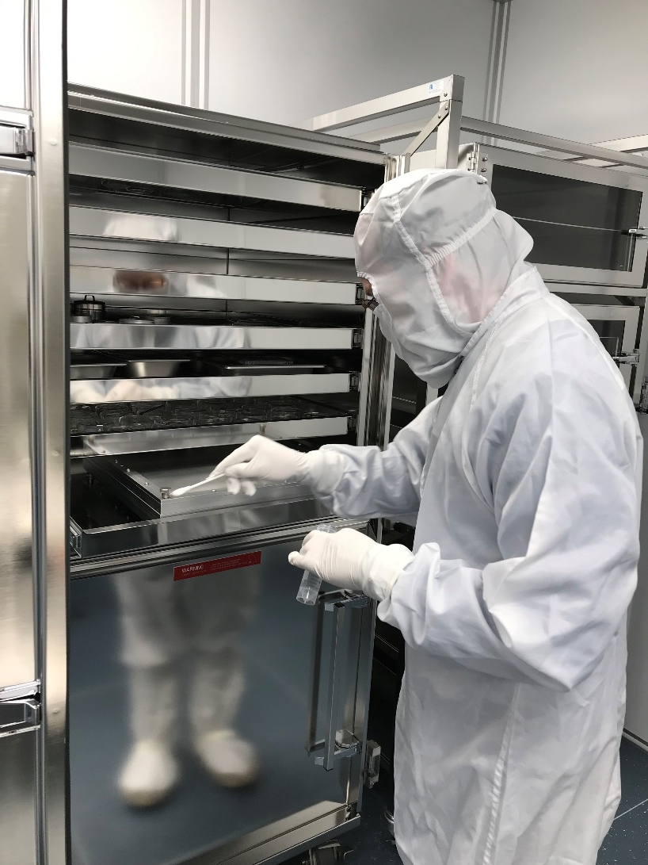
Microbial Sampling

Slide 23
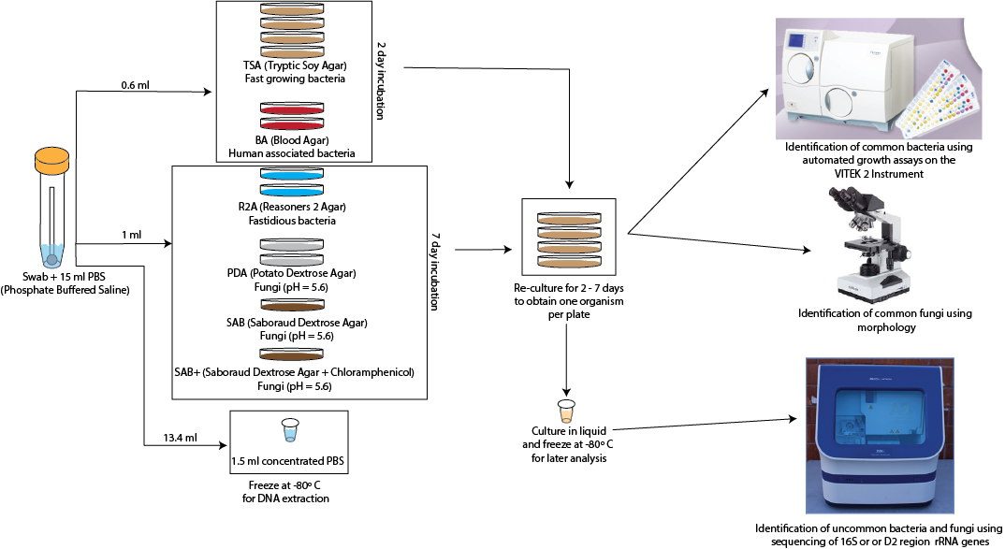
Use culture-based and culture-independent methods to characterize clean lab microbiology

Slide 24
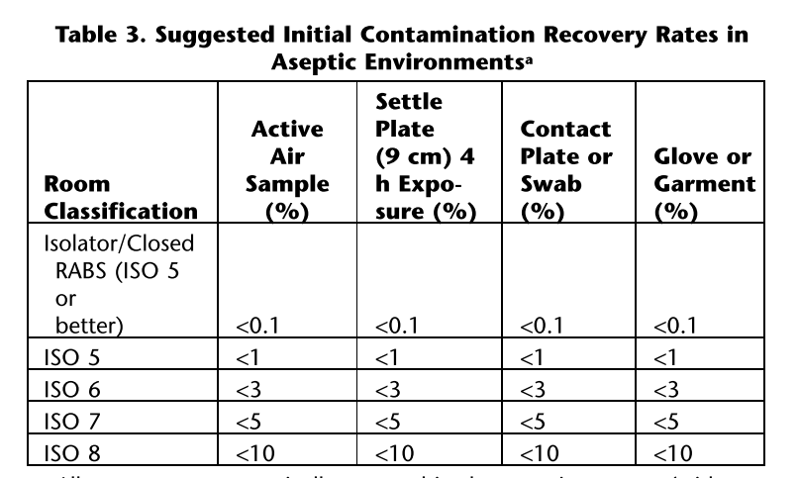
Recovery Rate is our preferred monitoring metric
Recovery Rate = $\frac{\# of samples with>0 CFU}{\# total number of samples collected during a sampling event}$
The United States Pharmacopeial Convention. 2013. “USP General Chapter <1116> Microbiological Control and Monitoring of Aseptic Processing Environments, 2013” 17 (2): 784–94.

Slide 25
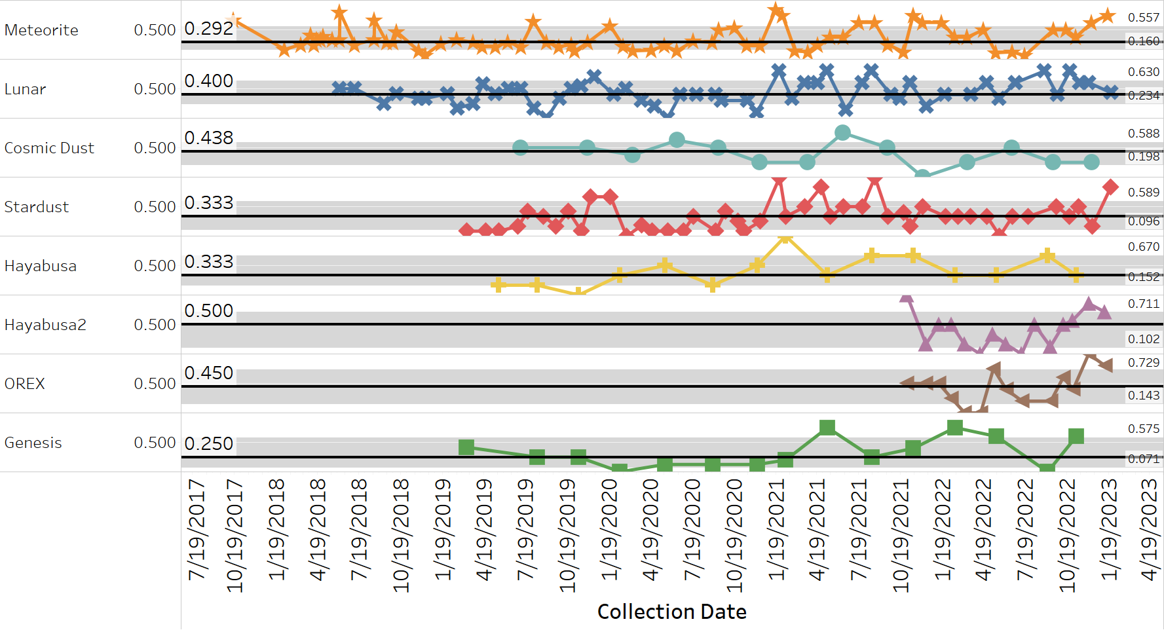
Facilities Issues and Seasonal Patterns Affect Lab Microbiology
ISO 7
ISO 4

Slide 26

Facilities Issues and Construction Can Explain Some of the high Recovery Rates

Slide 27

Is there a Seasonal Pattern?

Slide 28

We Repeatedly Observe the Same Organisms
426 Different Organisms

Slide 29

We Repeatedly Observe the Same Organisms
426 Different Organisms
426 Different Organisms
Only 29 Occur more than 10 times

Slide 30

We Repeatedly Observe the Same Organisms
426 Different Organisms
Only 29 Occur more than 10 times
Only 12 genuses

Slide 31



Particulate Cleanliness does Not Correlate Well to Biological cleanliness
Air Samples

Slide 32


Alpha Diversity Correlates to Cleanliness for Culture Based Results
Culture Based
Sequence Based
119 unique organisms

Slide 33

Preliminary Amplicon Sequencing (16S) Results Do Appear to Cluster by Lab
PCOA Weighted UNIFRAC
Stardust ISO 5
Meteorite ISO 7
Clean Gloveboxes
Lunar ISO 6
Glovebox Prior to Cleaning

Slide 34
Outline
Introduction to ARES (Astromaterials Research and Exploration Science)
Geomicrobiology and Curation
  Microbial Monitoring
  Rapid Identification
  Biodegradation of Meteorites
Planetary Protection Research
https://www.flickr.com/photos/nasa2explore/52530824918/in/album-72177720303788800/

Slide 35

Whole Genome sequencing and Mass Spectrometry Can Help Differentiate Bacillus Isolates in Astromaterials Clean Rooms
Species Diversity
Harmful Natural products
Whole Genome Sequencing
Illumina + Nanopore
Hybrid assembly approach
Antibiotics
Siderophores
MALDI-TOF
(Matrix Assisted Laser Desorption/Ionization – Time of Flight Mass Spectrometry)
Oxidation/ Reduction of metals

Slide 36


We are Using WGS to Build a Better MALDI Database
Mass Spectra Similarity
Genetic Similarity

Slide 37
Outline
Introduction to ARES (Astromaterials Research and Exploration Science)
Geomicrobiology and Curation
  Microbial Monitoring
  Rapid Identification
  Biodegradation of Meteorites
Planetary Protection Research
https://www.flickr.com/photos/nasa2explore/52530824918/in/album-72177720303788800/

Slide 38





The role of quorum sensing in bacterial-fungal interactions on the colonization and degradation of meteorites
Rebecca D. Prescott^{1,2}, Richard Davis¹, William Nelson3, Joseph R. Boro³, Aaron Regberg¹, Patrick S.G. Chain⁴, Stuart P. Donachie²
1Astromaterials Research and Exploration Science (ARES), NASA Johnson Space Center
2University of Hawai‘i at Mānoa, School of Life Sciences
³University of Hawai‘i at Mānoa, Department of Earth Sciences
⁴Los Alamos National Laboratory, Biosciences Division

Slide 39

Preliminary data: EDS of H5 chondrite before and after growth with Fusarium oxysporum
A Iron and Carbon EDS (Energy Dispersive Spectroscopy) map of a thin section of an H5 chondrite (ALH 78085) before and after anaerobic incubation at 30℃ for 13 days in the presence of Fusarium oxysporum, in liquid media.
Image taken by Kaydra Barbre, NASA undergraduate intern
Questions:
What QS-related gene expression is involved in the breakdown of meteorites?
What changes are observed in the mineralogy of a rock surface when fungi and bacteria are grown on the rock, and with exogenous QS molecules?
Notes:
Bradyrhizobium bl16a

Slide 40




Experiment design: Meteorites
CM: Jbilet Winselwan (found in Western Sahara 2013)
H5: Bassikounou (sighted fall southeast Mauretania)

Slide 41



Foxy only on H5 chondrite: H5-10-29
01/19/2023
12/22/2022
12/29/2022

Slide 42
Outline
Introduction to ARES (Astromaterials Research and Exploration Science)
Geomicrobiology and Curation
  Microbial Monitoring
  Rapid Identification
  Biodegradation of Meteorites
Planetary Protection Research
https://www.flickr.com/photos/nasa2explore/52530824918/in/album-72177720303788800/

Slide 43



Do we need to worry about microbes leaking from our suits and habitats?
BACKGROUND
Some organisms can survive exposure to space!
ISSUE
But we don’t know what’s actually leaking/venting from our current systems, how long those organisms could survive, or how far they may travel under destination conditions
  Cyano-bacteria, lichen and fungi survived up to 500+ days outside ISS
  Does proximity to a warm spacecraft matter?
images-assets.nasa.gov/image/iss018e039227/iss018e039227~orig.jpg
  Tardigrades survived extended ISS exposure…and then reproduced
  How close can crew get without compromising science?
  How far could our hitchhikers spread?
  The answers will drive element design (i.e. closed vs. open ECLS), where we place elements, and who/how we collect science samples
  We also know that all crewed, pressurized volumes will leak or vent
https://www.nasa.gov/sites/default/files/atoms/files/moon-investments-prepare-us-for-mars.pdf

Slide 44



Prototype Payload
8-Sample EVA Swab Kit
6 on top, 2 on bottom (not shown)
0.22 micron pore Microbial filter in bottom of each container to accommodate pressure changes
Repurposed Shuttle tile repair handle
Rucker, Michelle A., Drew Hood, Mary Walker, Kasthuri J. Venkateswaran, and Andrew C. Schuerger. 2018. “EVA Swab Tool to Support Planetary Protection and Astrobiology Evaluations.” In 2018 IEEE Aerospace Conference, 1–9. IEEE. https://doi.org/10.1109/AERO.2018.8396381.

Slide 45

Ground Testing With Flight Like ISS and Orion Suits
OCSS
  Orion Crew Survival System
Swab Tool
Swab Tool
Sample Caddy
Sampling suit joints during pre-breathe
Internal suit pressure is 4.2 psig (29.6 Kpa) above atmospheric pressure
Sample Caddy
Sampling suit at vacuum in the 11 ft. chamber at Johnson Space Center
Internal suit pressure is 4.2 psia 29.6 Kpa)
NOTE: we would NOT expose EMU wrist joints on ISS

Slide 46


Microbes on Spacesuits are similar to Microbes from Human Skin and Airways
We used Shotgun metagenomic sequencing to further characterize the microbial community in these samples
Spacesuits are cleaner than human skin but external surfaces are not sterile.
Danko, D., Malli Mohan, G. B., Sierra, M. A., Rucker, M., Singh, N. K., Regberg, A. B., et al. (2021). Characterization of Spacesuit Associated Microbial Communities and Their Implications for NASA Missions. Frontiers in Microbiology, 12, 1900. https://doi.org/10.3389/fmicb.2021.608478
David Danko

Slide 47

Hardware Design was Updated Based on Ground Testing Results and NASA EVA Safety Requirements
5 years
Delivered for launch in April (I hope)

Slide 48

Sample Locations Around the Airlock

Slide 49

Sample Non-Propulsive Vents on Node 3

Slide 50

Sample Non-Propulsive Vents on Node 3

Slide 51






Thanks!
Christian Castro
Rick Davis
Farnaz Mazhari

