Slide 1
Notes on Validation of Prognostics Algorithms
Diagnostics and Prognostics Group

Slide 2
Diagnostics and Prognostics Group
Algorithm Design
Prototyping
Simulation
Benchmarking
Validation
Fault Detection
Diagnostics
Prognostics
Mitigation
Resilient Design
Performance Metrics
Research Areas
Physics-based diagnostics and prognostics algorithms and models
Data-driven diagnostics and prognostics algorithms
Hybrid prognostics approaches/ Physics Informed Machine Learning (PIML)
Uncertainty representation and management
Resource-constrained prognostics
Surrogate modeling
Testbed development and automated testing for prognostics
Human-machine interaction (HMI)
Software Architectures for Prognostics
Health-informed decision-making under uncertainty
Verification and validation (V&V) of prognostics and health management (PHM) systems
In support of NASA Space Missions & Ground Support
In support of NASA Aeronautics and Air Traffic Management
In support of building a robust and capable PHM community

Slide 3
Notes on Validation of Prognostic Technologies
The group did work on formal validation approaches in the past ⁴:
  α-λ Performance: quantifies prediction quality by determining if the prediction falls within specified limits at times with respect to a performance measure.
  Relative Accuracy: Relative Accuracy (RA) is defined as a measure of error in RUL prediction relative to the actual RUL r*(i_{λ}) at a specific time index i_{λ}.
  Validation Techniques⁸, and systems engineering processes⁹
Now, we do not generally have a standard approach that’s used for every case, since our work is often exploratory (research). Instead, we validate to the degree necessary on a case-by-case basis, depending on the technology and scope of validation.
Generally, validation is not seen as binary decision point, but rather a scale of validation (like TRLs) corresponding to confidence that we can have in a technology.
Validation also has a specific scope. For example- validating a battery model for use on 18650s is very different than validating a battery model for all Lithium-Ion Batteries.
Validating in laboratory environment is useful, but not a substitute for validation in a relevant operational environment.
Frequently Used Tools & Approaches
Lab Testbeds
Fault Emulation/Injection
Operational Tests
Input - predicted output correlation analysis
True output – predicted output correlation analysis
Confidence interval at specific confidence levels
Specific Prognostics Metrics: Alpha/Lambda, Prognostics Horizon, etc.

Slide 4
Notes on Validation of Prognostic Technologies
Validation Confidence
Data Coverage: degree to which the data covers the breadth of configurations, environments, and conditions within the validation scope. For example, high data-coverage for a Lithium Ion battery model would require:
  Data from many different Lithium Ion batteries of different sizes and configurations
  Data for these batteries in various environmental conditions (temperature, pressure, etc.) within the validation scope
  Data for these batteries with various loading profiles within the validation scope
  Data for these batteries with various faults within the validation scope
  etc.
Validation Environment: The environment in which the validation has occurred and how well it represents the full operational environment (lab, relevant environment, full operation)
High
Moderate Confidence | High Confidence
Low Confidence | Moderate Confidence
Data Coverage
Low
Lab
Field
Validation Environment

Slide 5
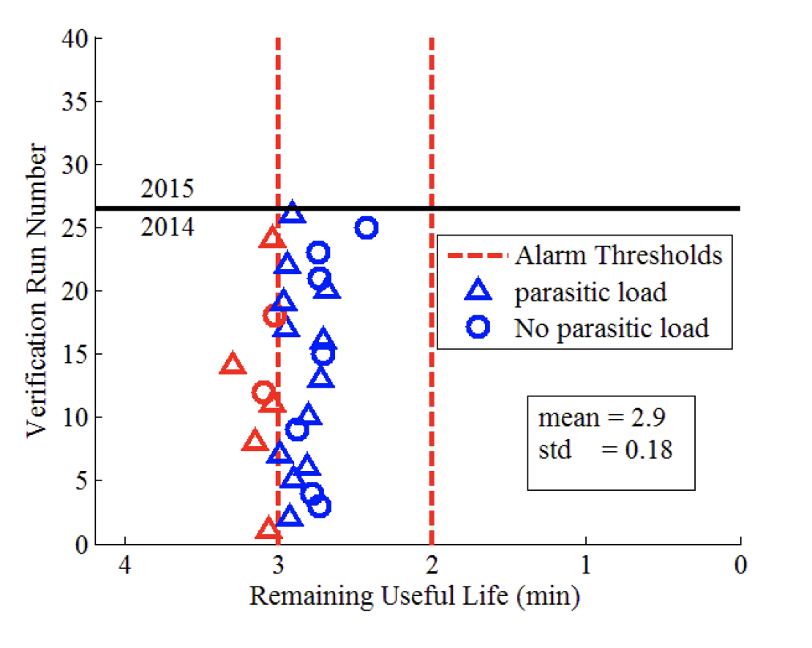
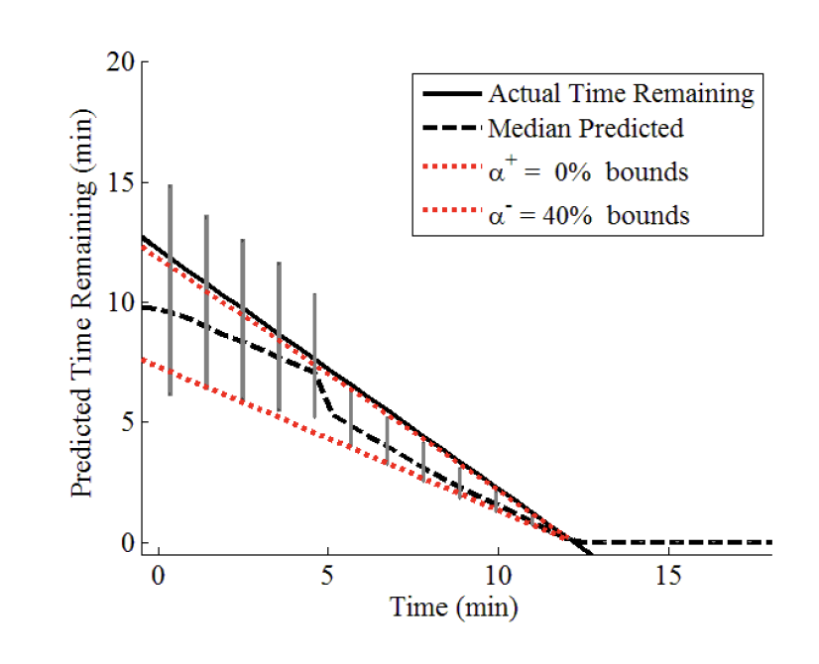
Example: Batteries - Chetan
Battery model development with LaRC team
  Verification and validation of equivalent ckt and electro-chem models
  Validation performed on fixed wings* and multi-rotor UAV's – online and offline
Lab (MACCOR) & Operational Validation
  Perform characterization tests for operational validation
  Data from characterization used for model development and verification on lab as well as field data
Edge work – safety team – approval to fly - at this point a threshold is added
  Flights tests conducted on autonomous fixed wing UAV*
  2-minute warning alarm for 26 flight runs
  Validation of the SOC algorithm for piloted/autonomous flights.
Validate RUL estimation with metrics
  Fig.2 shows plot of α-λ performance metric for RUL estimation for a UAV flight profile.
Fig.1. Two-minute alarms for 26 runs
Fig.2. Predicted remaining flying time using α-λ performance metric

Slide 6
References
Hogge, E., Kulkarni C., Bole, B., Vazquez, S., Celaya, J., Strom, T., Hill, B., Smalling, K. & Quach, C. (2021)"Verification of Prognostic Algorithms to Predict Remaining Flying Time for Electric Unmanned Vehicles", International Journal of Prognostics and Health Management, ISSN 2153-2648, 2018 021
Hogge, E., Bole, B., Vazquez, S., Celaya, J., Strom, T., Hill, B., Smalling, K. & Quach, C. (2015). "Verification of a remaining flying time prediction system for small electric aircraft". Annual Conference of the Prognostics and Health Management Society.
Daigle, M., Kulkarni, C. (2013). "Electrochemistry-based battery modeling for prognostics". Annual Conference of the Prognostics and Health Management Society.
Saxena, A., Celaya, J., Saha, B., Saha, S., & Goebel, K. (2010). Metrics for offline evaluation of prognostic performance. International Journal of Prognostics and Health (IJPHM), Vol. 1, 2010.
Bole, B., Daigle, M., Gorospe, G.,(2014). "Online prediction of battery discharge and estimation of parasitic loads for an electric aircraft". European Conference of the Prognostics and Health Management Society.
Daigle M. and Kulkarni C.,"A battery health monitoring framework for planetary rovers," 2014 IEEE Aerospace Conference, Big Sky, MT, USA, 2014,
Bole, B., Teubert, C., Quach, C., Hogge, E., Vazquez, S., Goebel, K., & Vachtsevanos, G. (2013). "SIL/HIL replication of electric aircraft powertrain dynamics and inner-loop control for V&V of system health management routines". Annual Conference of the Prognostics and Health Management Society.
Balaban, Edward, et al. "Experimental validation of a prognostic health management system for electro-mechanical actuators." Infotech@ Aerospace 2011. 2011. 1518.
Saxena, Abhinav, et al. "Towards requirements in systems engineering for aerospace IVHM design." AIAA Infotech@ Aerospace (I@ A) Conference. 2013.

