Slide 1
NASA’s Moon to Mars (M2M) Transit Habitat (TH) Refinement Point of Departure (PoD) Design
Presenter (EPH): Andrew Choate
Date: March 3, 2023
NASA Marshall Space Flight Center (MSFC)
Andrew Choate (Jacobs Space Exploration Group)
Paul Kessler
Tiffany Nickens
Danny Harris
NASA Langley Research Center (LaRC)
Matthew Simon

Slide 2
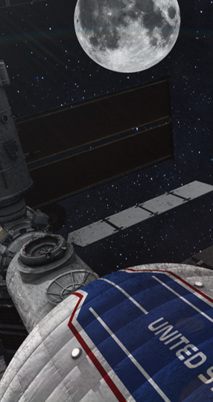
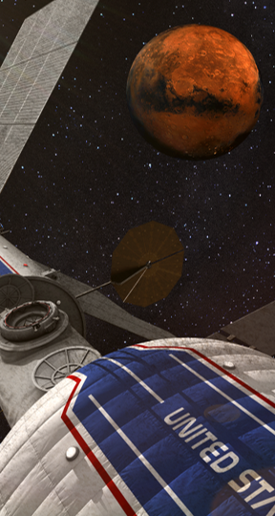
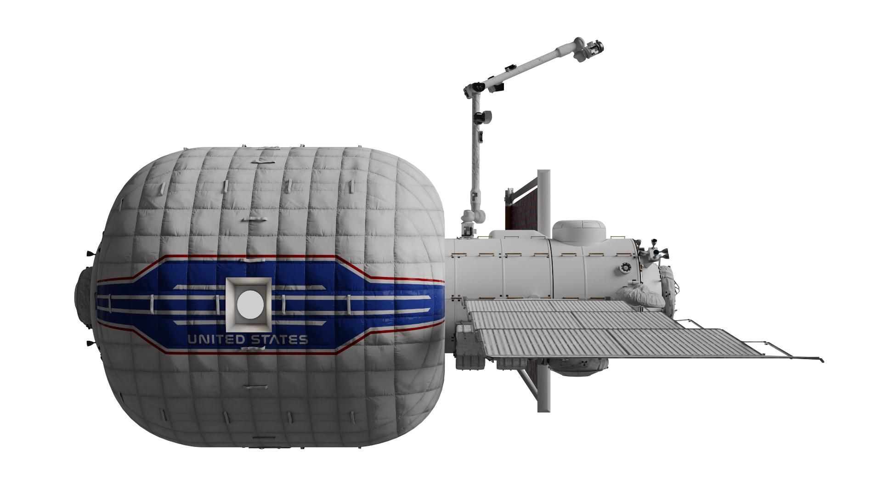
Objective
What is the TH?
-
GR&A/Functional Allocations
-
CONOPS & Considerations
-
Moon to Mars (M2M) Integration

Slide 3
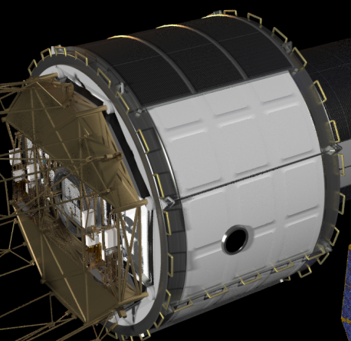
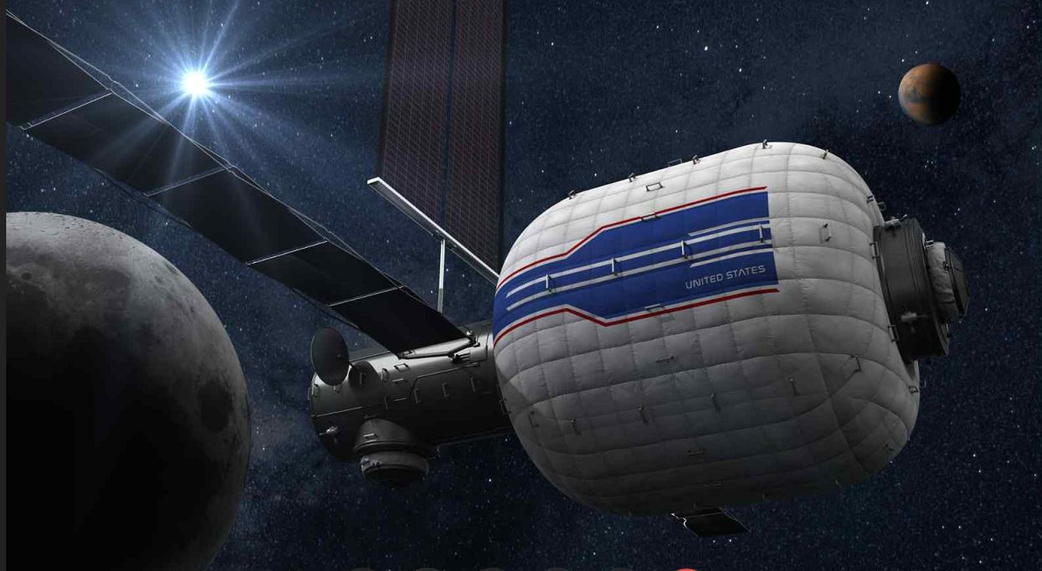
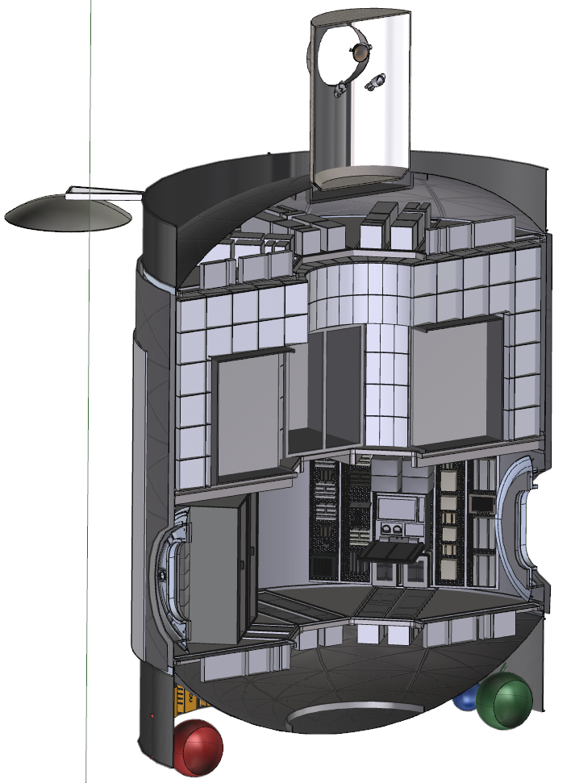
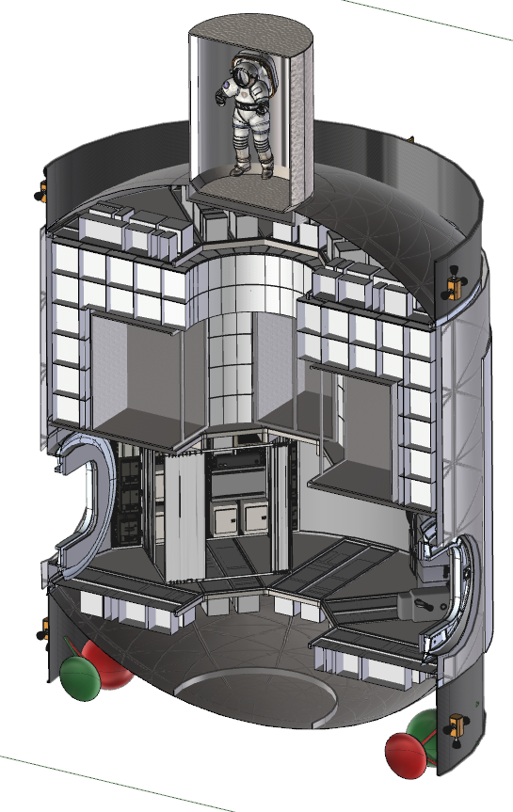
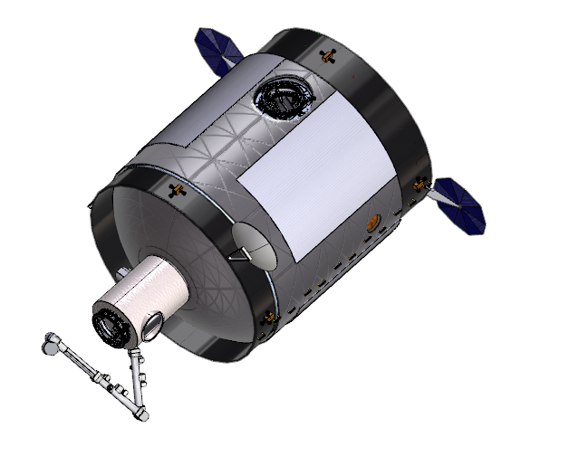
Brief History of TH Concept (2015+)
2015 8.4m Common Hab for TH, Phobos, Mars Surface Habitat
2020 Shift to Metallic/Softgoods
Current 2022 concept
2018 TH Refinement
(Previous IEEE Paper)
Notes:
All supporting a crew of 4 and capable of the current TH mission of 1000-1200 day mission
2015 EMC was 8.4m fairing, SLS launched with 43 mt mass cap
2018 Refinement was mettalic SLS 8.4 m fairing with 43 mt mass cap
Current Transit Habitat design has evolved over the last 5-10 years through multiple cycles, design missions, study teams
Habitation SE&I understanding of current habitat designs requires understanding this history, assumptions evolution, and resulting subsystem estimates
This presentation shows evolution from ~2015 to 2021; identifying key studies and assumptions differences and a basis of estimate for the latest TH design for review

Slide 4
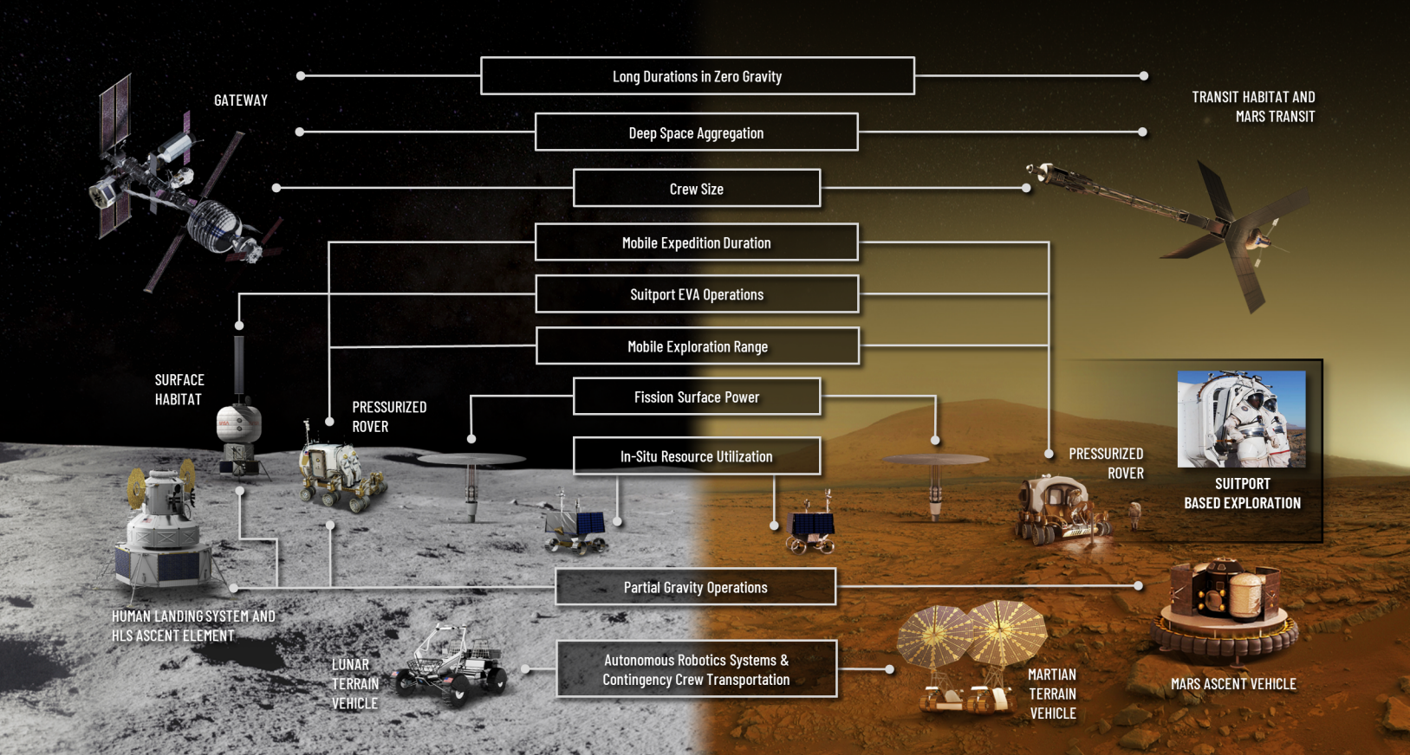
M2M Exploration Element Concepts
Notes:
Campaign elements and systems have common applications, enabling versability across missions.
TH is a dual (plus!) use concept

Slide 5
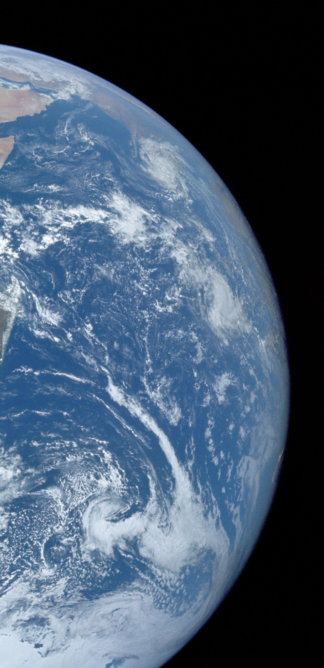
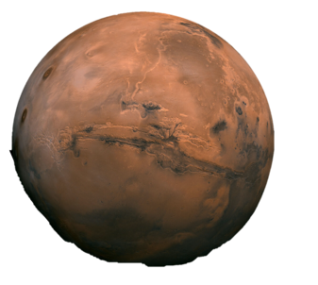
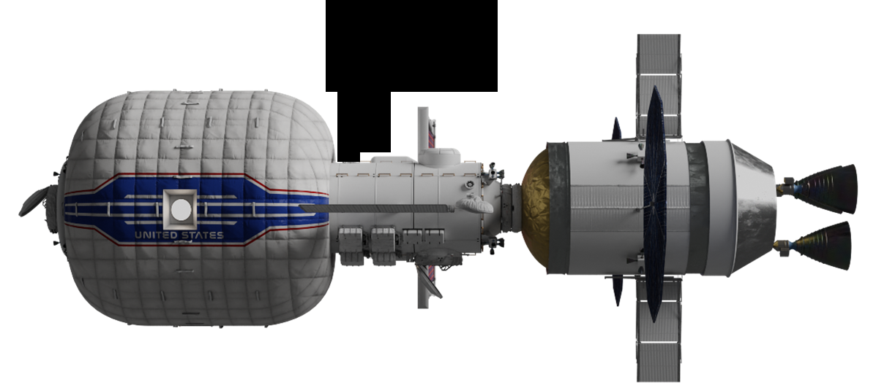
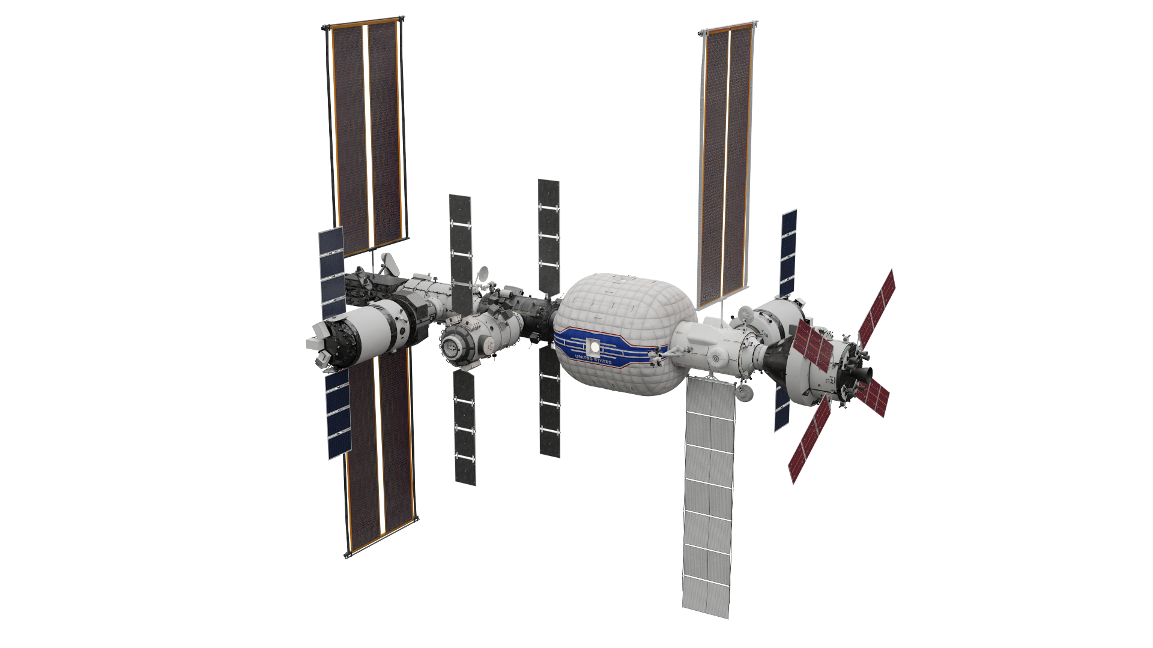
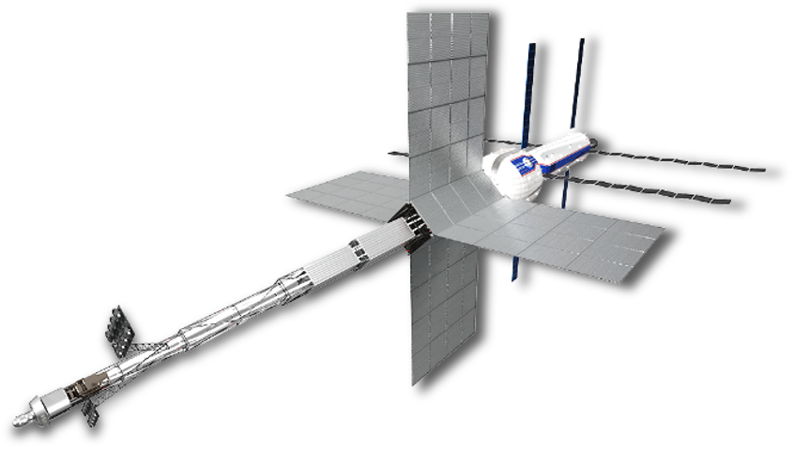
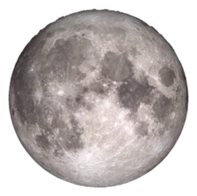
M2M Integration & CONOPS Phases
Launch, Outfitting & Mars Analogs
Crewed Mars Transit
Refurbishment & Return
Notes:
Obviously not to scale!

Slide 6

Transit Habitat Overview
Hybrid inflatable-metallic habitat with dry mass (26.4 metric tons) capable of being launched commercially and supplied with logistics in cis-lunar orbit (NRHO)
Support 4-crew during Lunar-Mars Analog missions leading up to a 700-1110-day Mars mission
Dock w/ an interim propulsion bus or Gateway for first ~5 years until Mars Propulsion System (MPS) elements available
Extends Gateway operations beyond 60 days
10.2 psia (26.5% O2) atmosphere for Gateway ops
14.7 psia (21% O2) atmosphere for transit and analog missions
Contingency Airlock and EVA capability
Planned reuse for multiple missions over 15-year lifetime
Builds on ISS and commercial investment in deep space habitation
Mid-2030s launch with late 2030s Mars Departure

Slide 7
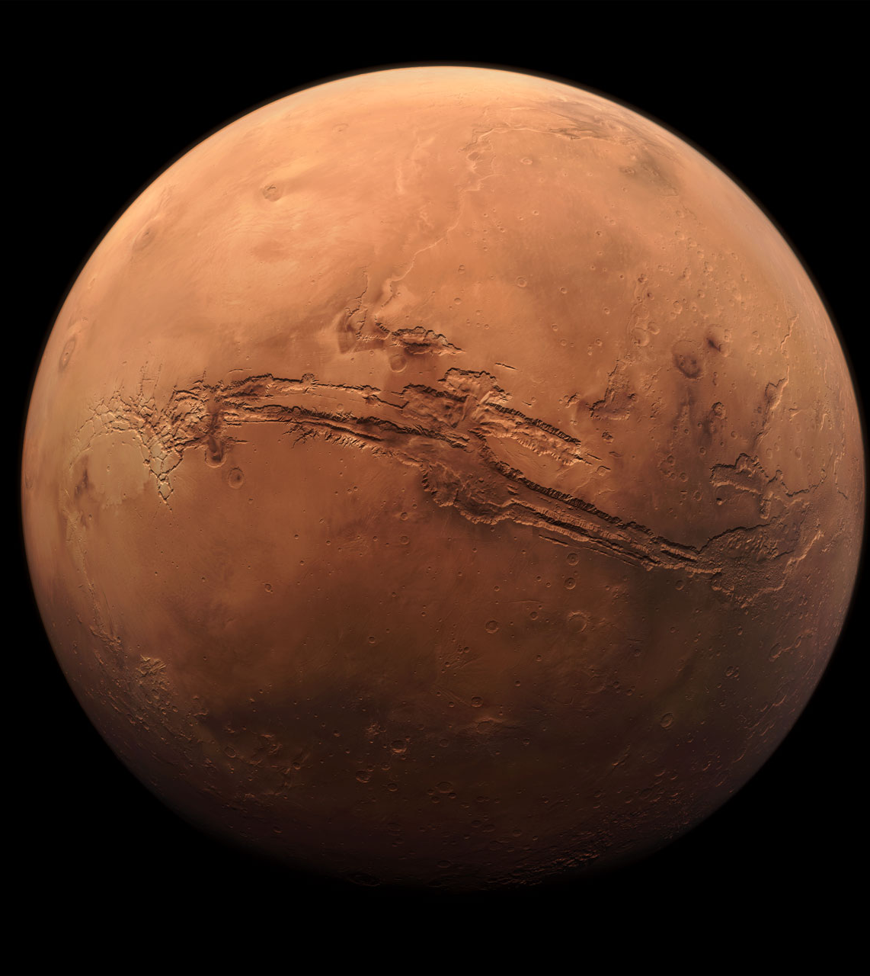
Key Mission & Functional Challenges
No spares resupply chain during transit
Impact on propulsion element size
Waste and trash management in transit/loiter orbits
Logistics storage capacity for mission
Human health and performance for long duration missions
Long duration shakedown
Radiation & MMOD protection
Communication delays/blackouts
Ability to recover from major habitation failures

Slide 8
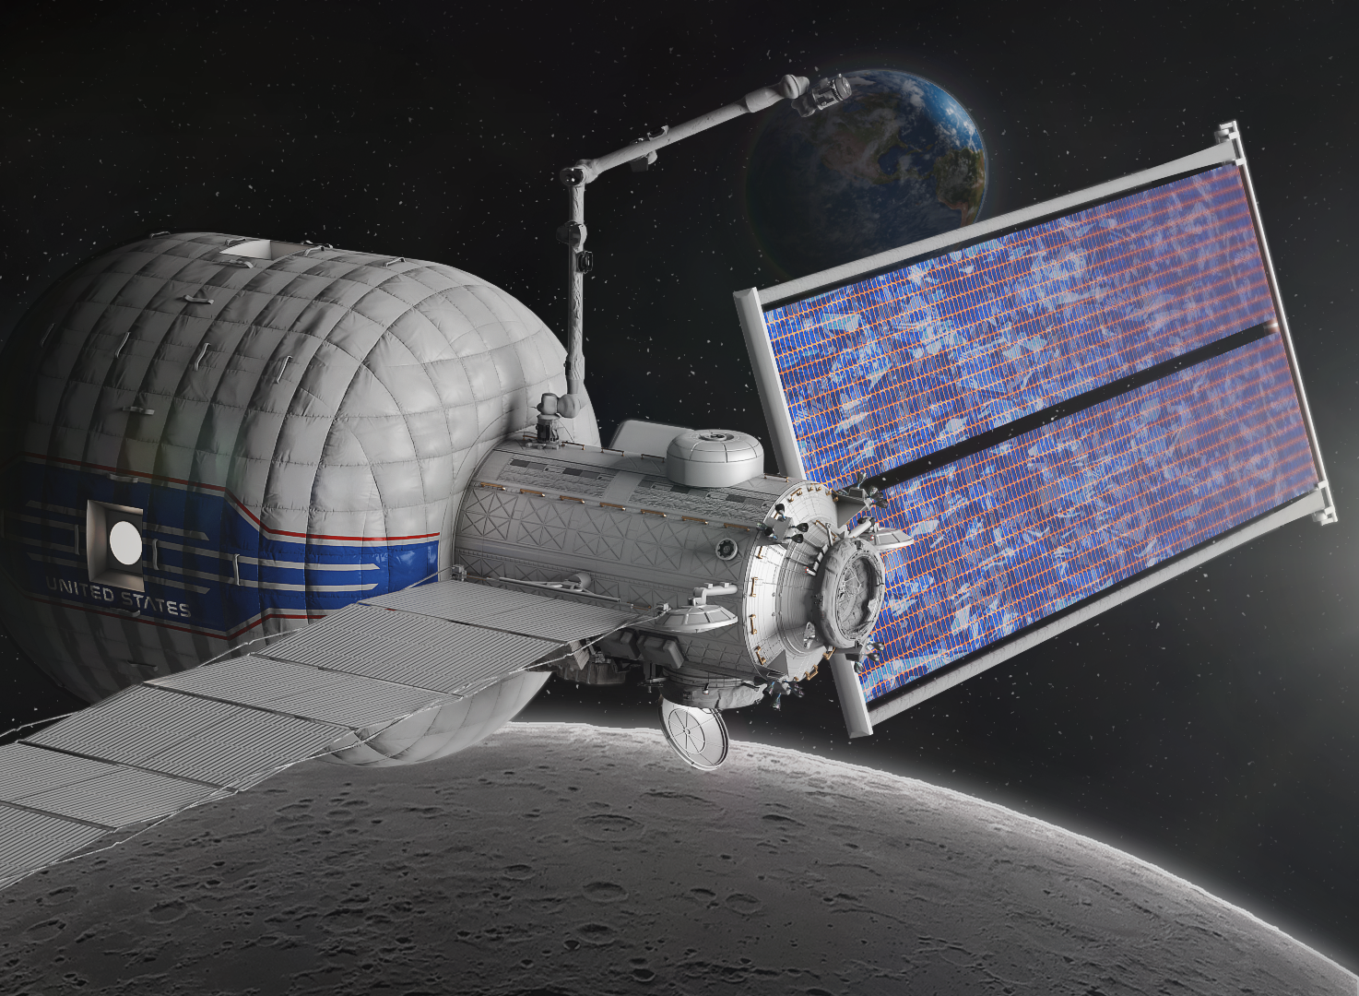
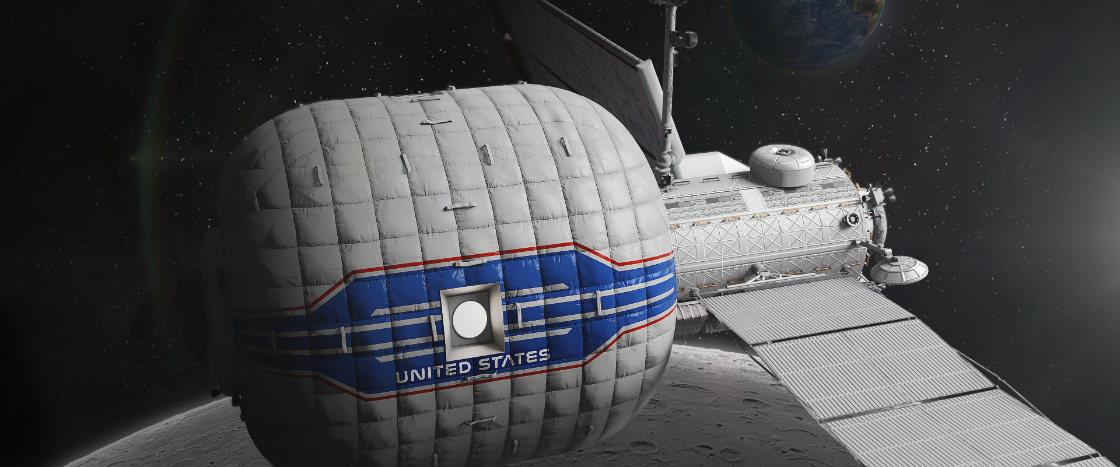
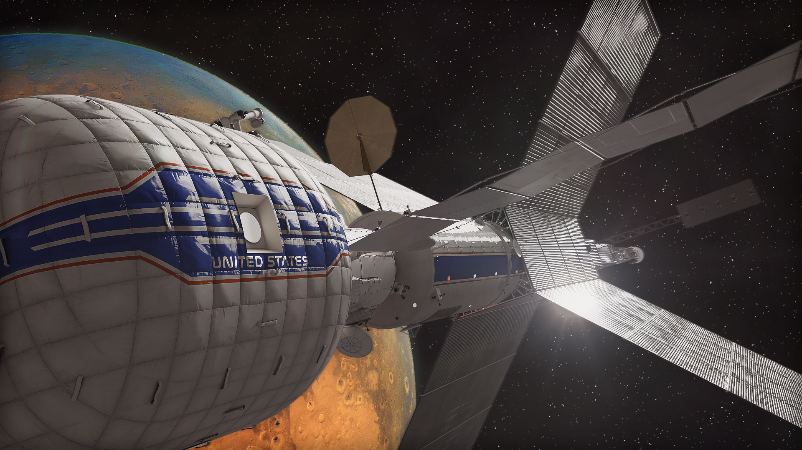
2022 NASA Government Reference Transit Habitat Concept Overview

Slide 9
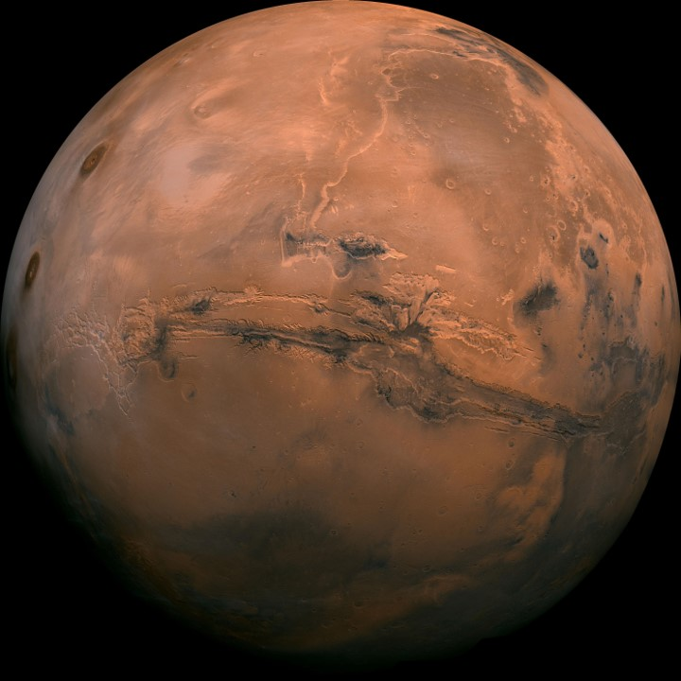
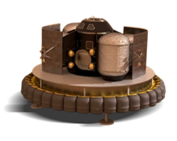

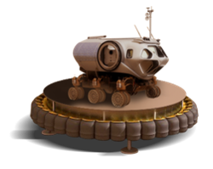
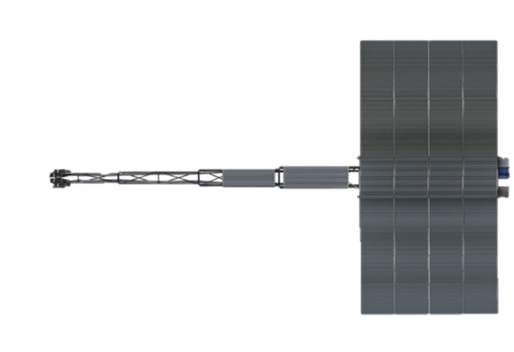
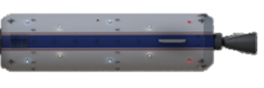
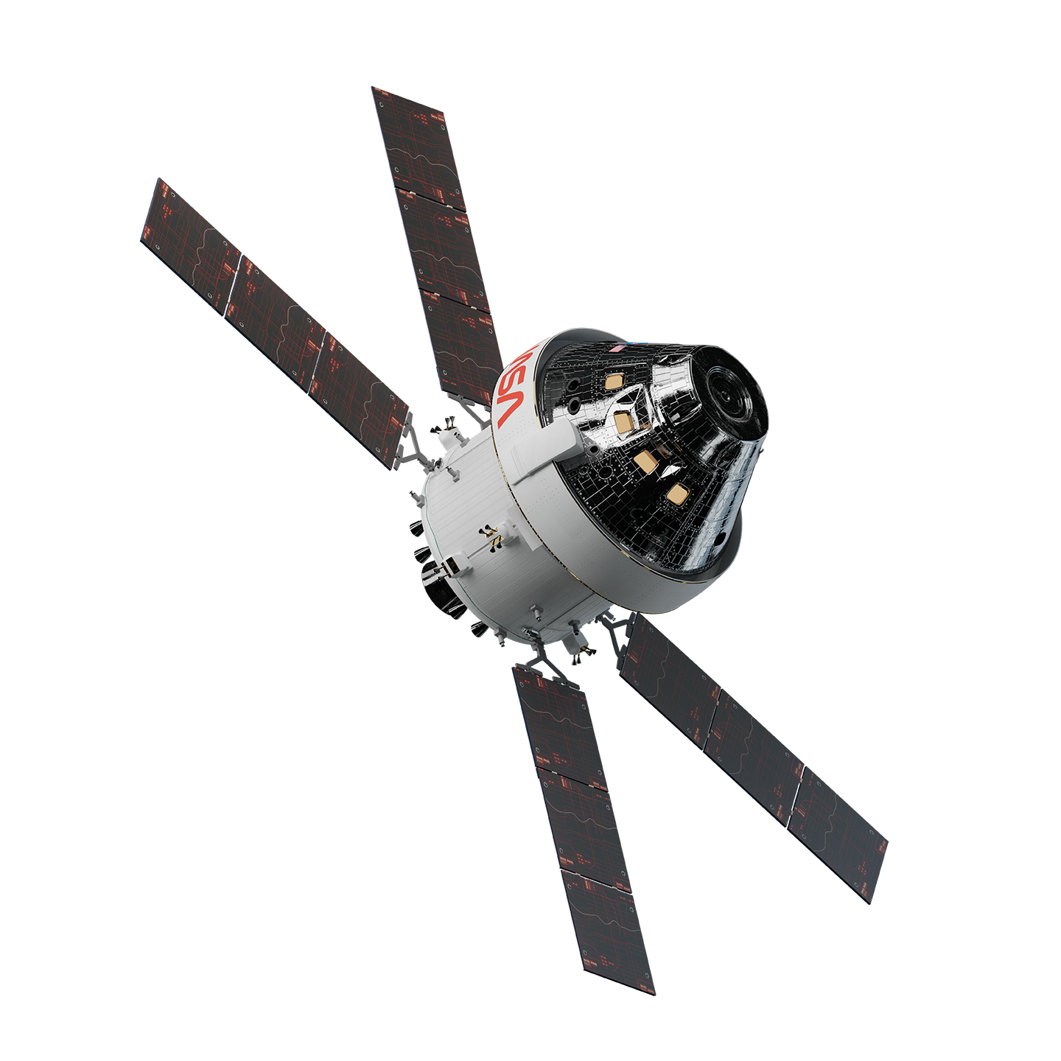
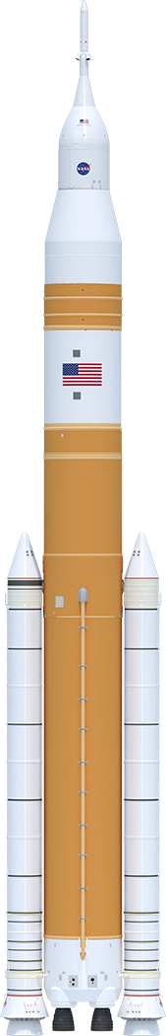
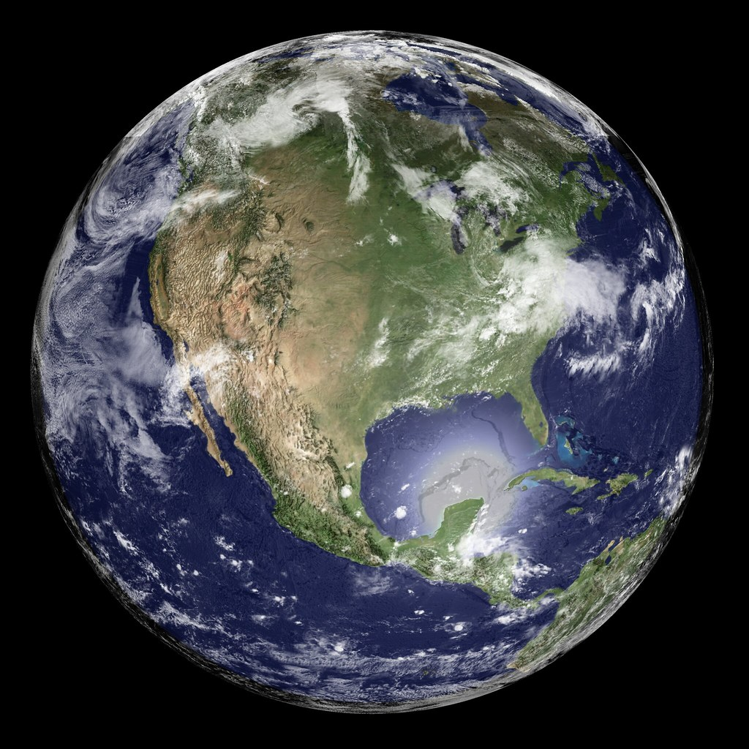
Notional CONOPS
Mars Surface
MDV/MAV
Pre-deployed
MDV/MAV docking to DST via TH for crew transfer
Mars Orbit
DST in loiter orbit during ~30-sol surface mission
Gateway+TH+Orion
Deep Space Transport²
(DST)
NRHO
Mars Propulsion System¹ (MPS)
HEO
MEO
¹ MPS notionally shown as NEP/Chem. SEP/Chem, NTP, all-Chem also in trade space
² DST shown as notional MPS/TH configuration
Earth Surface
Outfitting & Mars Analogs
Crewed Mars Transit
Refurbishment & Return
TH and Boost Stage launch, dock, and transfer to NHRO
TH docks at Gateway for outfitting, analog, and shakedown missions
TH undock, transfer and aggregation with MPS to form DST
DST transfer to HEO. Crew arrives via Orion with LM
DST performs Mars transit and surface missions
Crew transfer to Orion for Earth return
DST transfer to NRHO. TH docks to Gateway for refurb & resupply

Slide 10
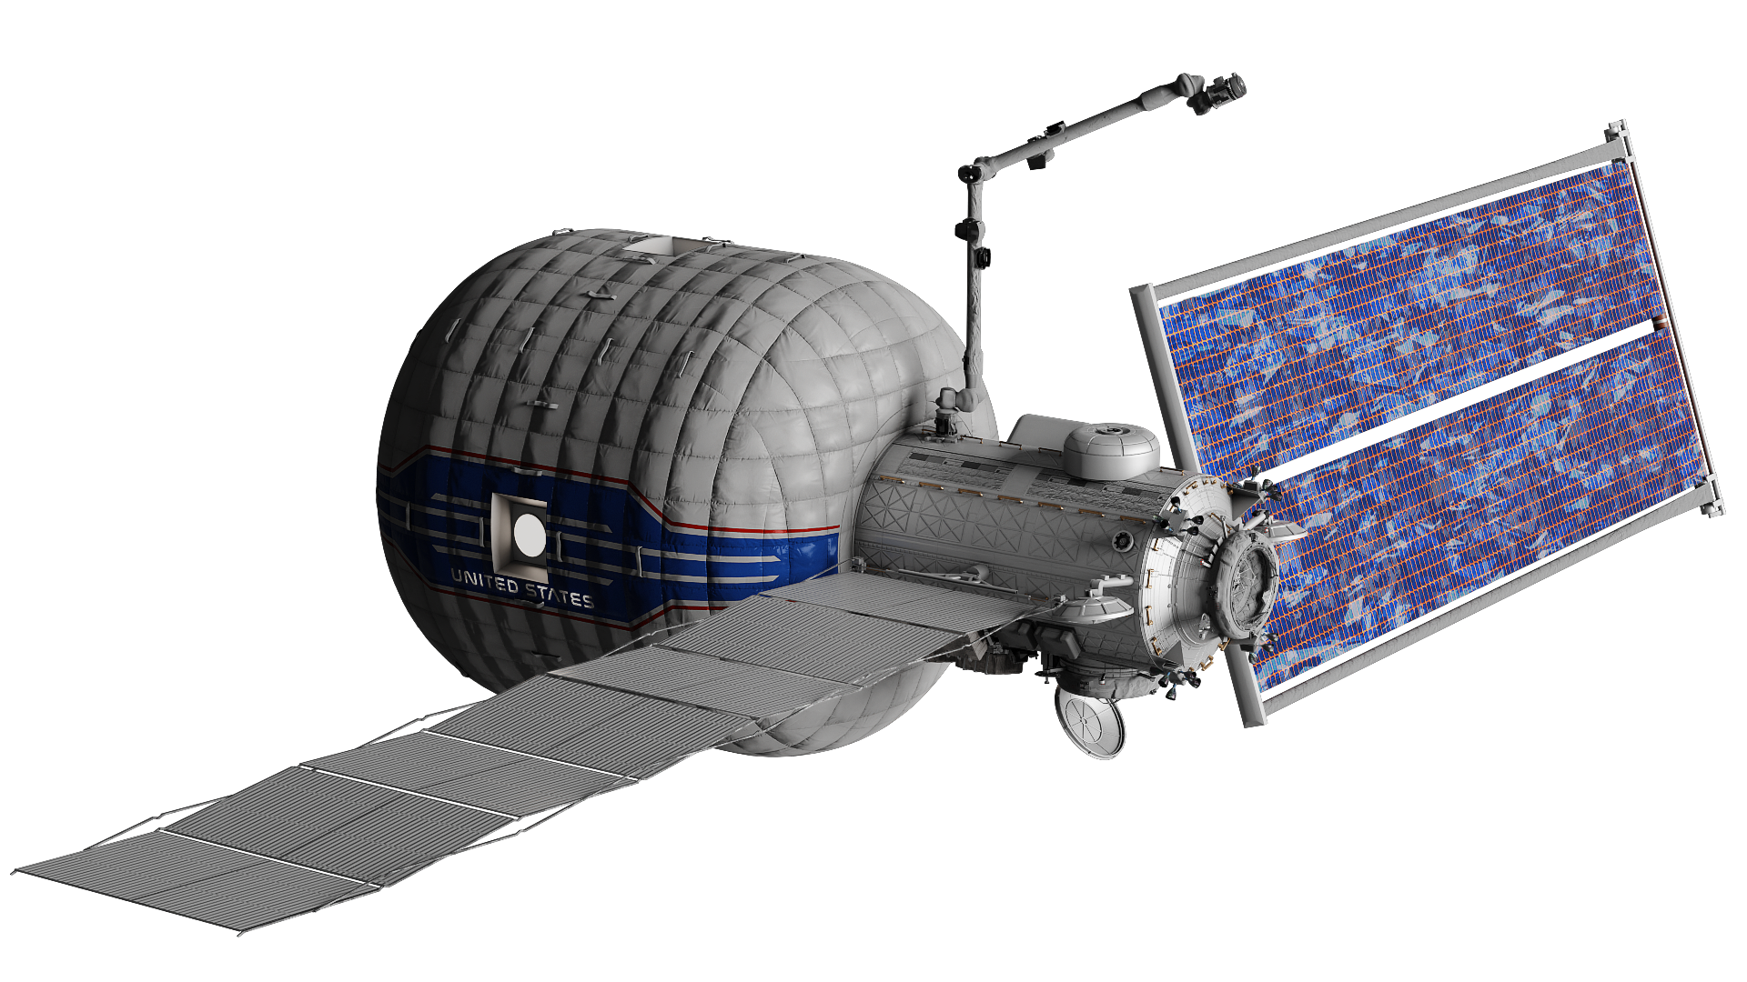
Ground Rules & Assumptions
Significant GRs:
4 crew for up to 1,200-day Mars Transit mission duration
26.4 mt target dry mass (including MGA and margin)
Autonomous operation when uncrewed
Max uncrewed dormancy of up to 3 years
Minimum of 2 axial and 1 radial docking ports
Performs a series of up to ~180d Mars Analog missions while docked at Gateway
Self-sufficient habitat once fully deployed at orbits up to 1.0 AU, capable of receiving power from Mars propulsion system beyond 1.6 AU
14.7 psia 21% O2 atmosphere nominal, capable of 10.2 psia 26.5% O2 during Gateway docked open-hatch ops
Safe Haven and Solar Proton Event (SPE) Shelter
15-year life with multiple missions of increasing duration
TH Sparing and Maintenance - Manifested to achieve 99% system availability
Significant Assumptions:
Near-Rectilinear Halo Orbit (NRHO) via Commercial Launch Vehicle(s)(CLV). Options for SLS cargo delivery are possible but should feed cost assessments.
Early 2030’s launch with Mars mission in late 2030’s
Replenishable Reaction Control System (RCS) through docking or Gateway interface between mission phases (analogs, Mars Propulsion System (MPS) shakedown, Mars transit)
Contingency EVA airlock
Trash/waste removal (11.6 kg/day avg)
Accommodate 1000 kg of science and utilization payloads
M2M Habitation Considerations Technical Memo.pdf

Slide 11
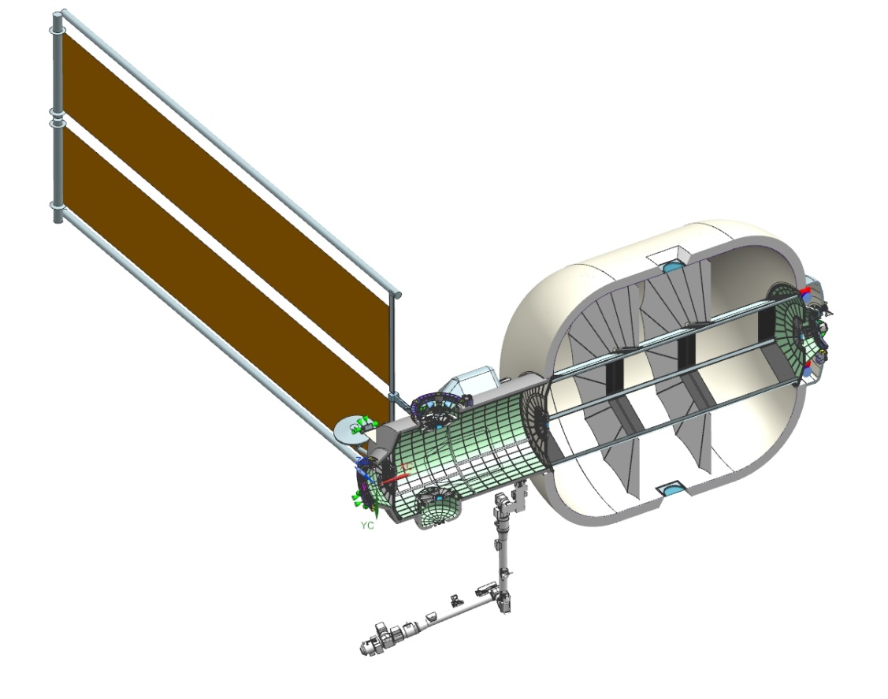
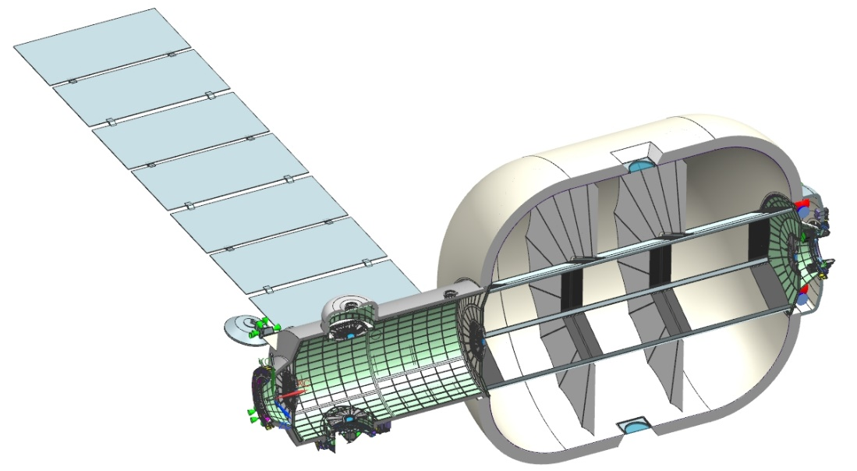
TH Concept OML Features
Deployable radiators:
2x4m panels (7)
Deployable solar arrays:
2.76m x 17.83m
ROSA (2)
TH Overall Pressurized Volume: ~400 m³
Inflatable: ~365 m³, Metallic: ~35 m³
Internal hatch
Integrated Windows
Radial EVA docking port & Trash A/L
RCS Thrusters
Comm.
Antennas
Three partitioned levels
Axial docking hatches
External Robotic Arm
Radial Docking Hatch

Slide 12
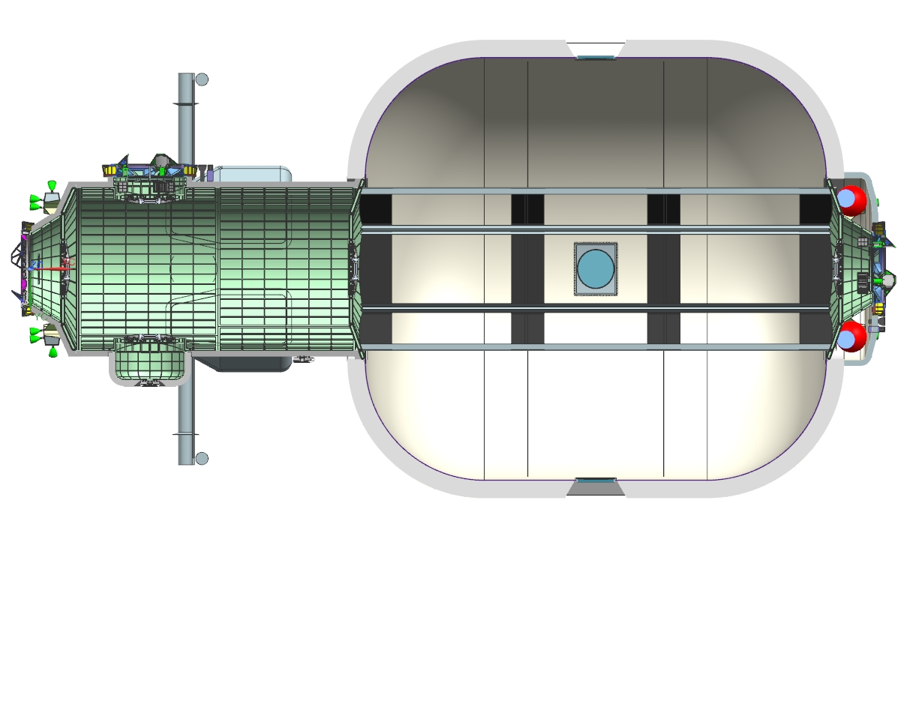
TH Concept Size
8.94 m
5.30 m
0.80 m
8.50 m
5.30 m
4.10 m
0.86 m
0.65m
Ø7.80m
Ø3.22m
2.55m
Ø3.00 m
Ø3.40m
3.00m
Ø1.90 m
0.43m
2.37 m
Ø8.44m
15.90 m

Slide 13
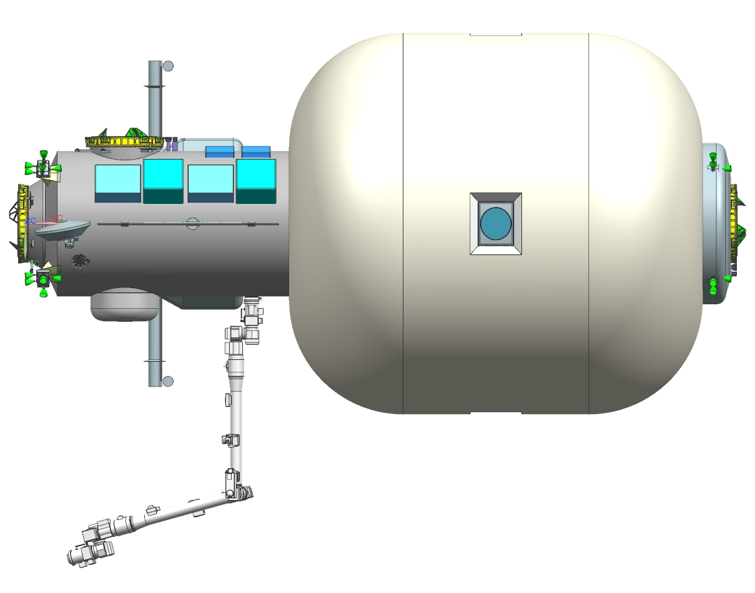
TH Concept Pressurized Volume
Metallic
Volume
(~35m³)
Soft Goods
Volume
(~365m³)
TH Overall Pressurized Volume: ~400 m³
Similar to
1700 ft² home
ISS Pres. Vol.:
~1000 m³
(~390 m³ habitable)
Mir's Pres Vol.:
350 m³
15.90 m

Slide 14
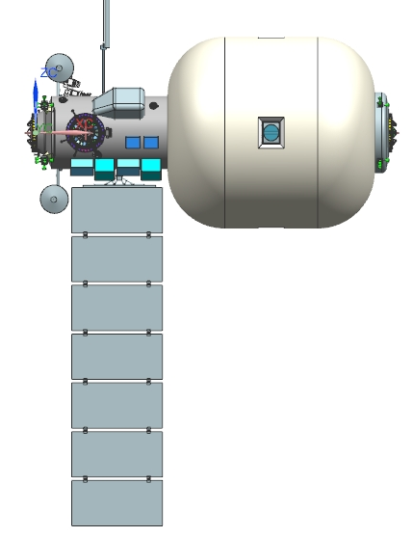
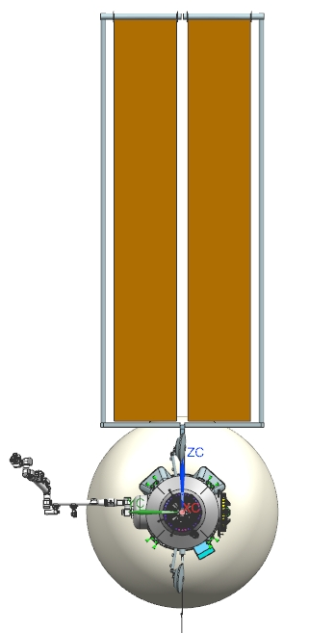
TH Concept OML Features
7.2 m
2.76m x 17.83m
ROSA (2 PL)
ROSA capacity:
20 kW
98 m²
22.0m
18.2m
Integrated Windows (x4)
17.3m
14.9m
7x 2.00m
Radiator area:
56 m²
7x 4.00 m

Slide 15
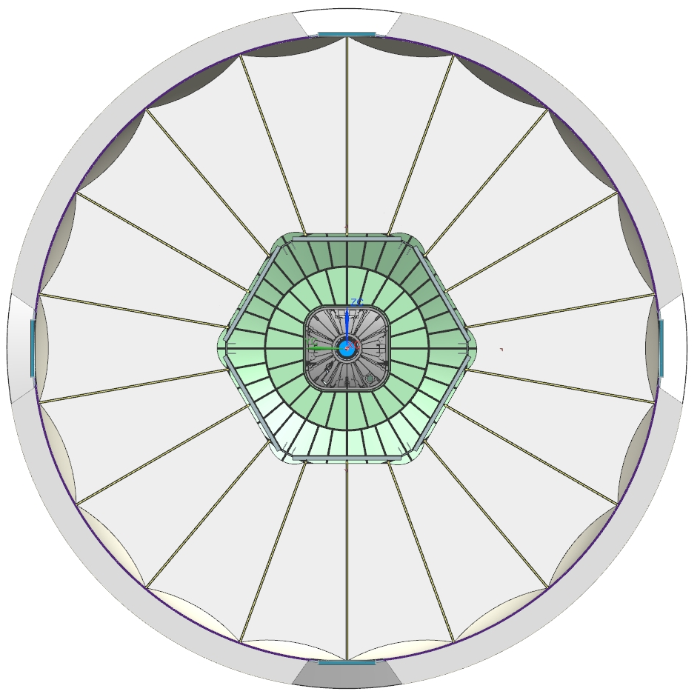
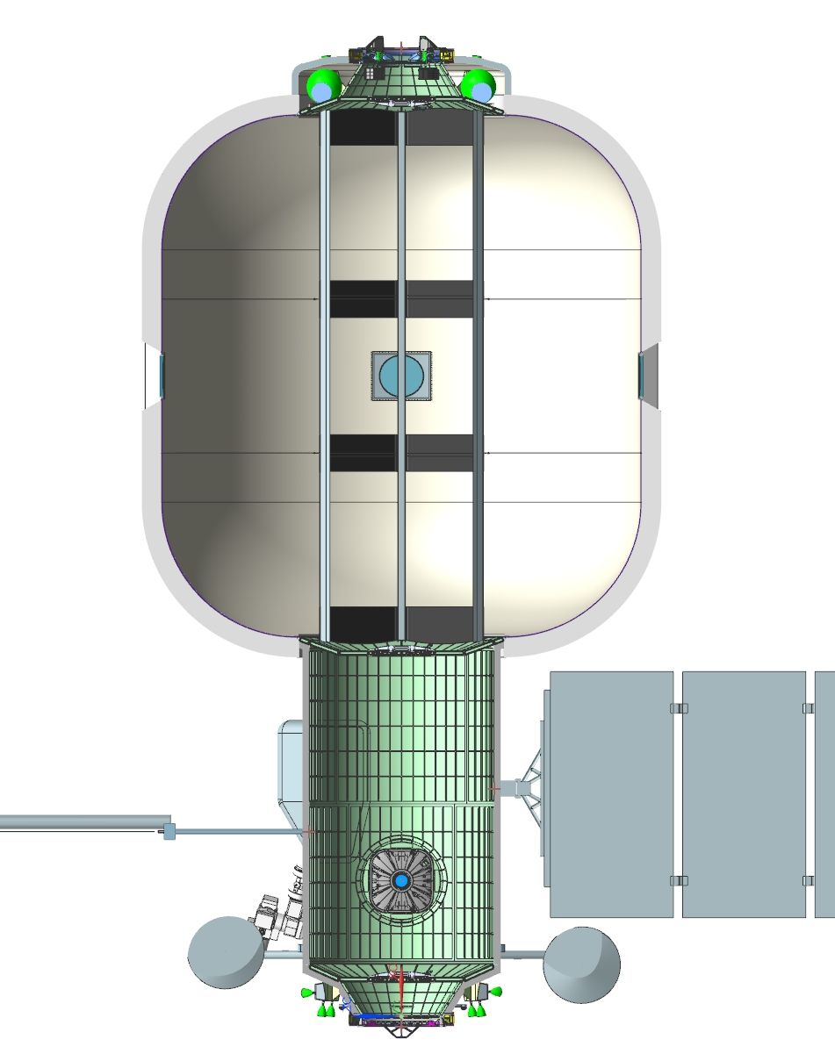
TH Concept OML Features
0.95 m Square Opening
Common Hatch
(3 places)
Ø8.44m OML
Ø7.75m IML
Soft Goods Internal Vol.
2.67m
1.39m
3.00m

Slide 16
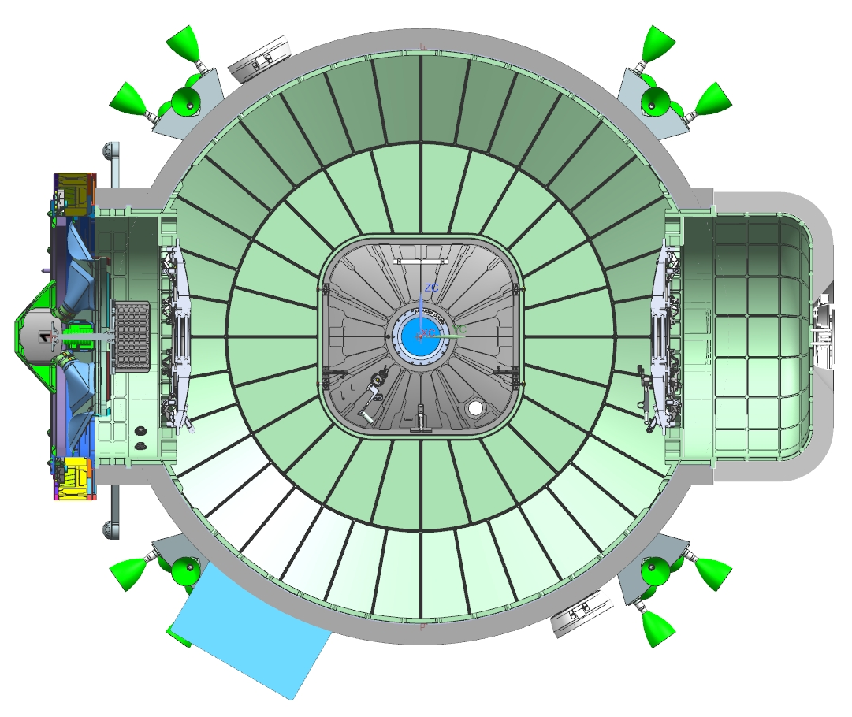
TH Concept OML Features
Ø3.22m OML
Ø3.00m Structure OML
RCS Thruster Pods
0.95m Square Opening
Common Hatch
(3 places)
Metallic Internal Vol.
Ø1.26 m IML
Ø1.51 m OML
0.65m
Radial EVA Hatch/Trash A/L
0.56m
2.55m

Slide 17
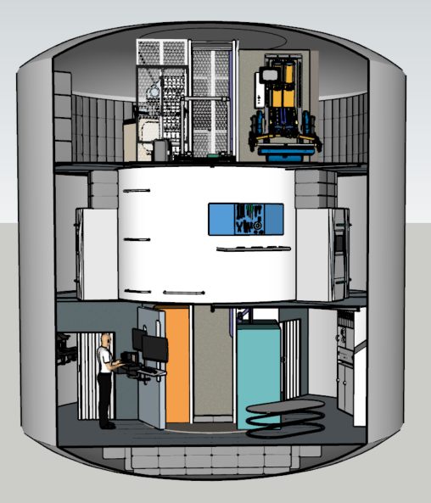
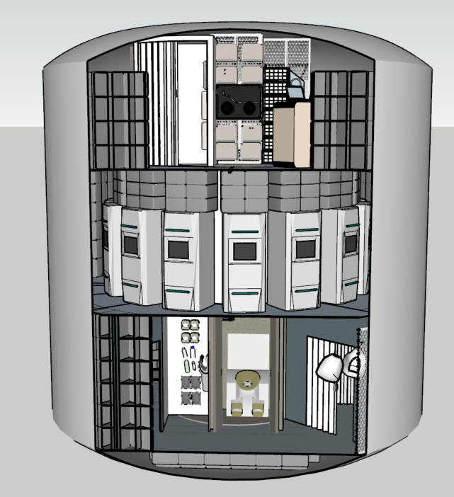
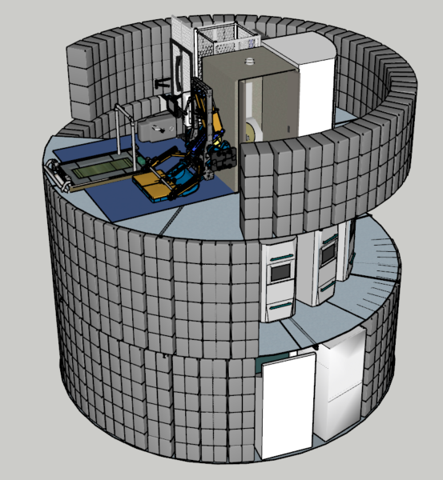
TH Concept Interior Features
Level 1 – Galley, Command & Control, Medical, Hand Washing Station, UWMS (1 of 2), Logistics Management, Trash Management
Level 2 – Crew Quarters, Sub-Systems, Maintenance Stations
Storage – CTBs lining the outer wall, additional storage below Level 1
Level 3 – Exercise, Utilization, UWMS (2 of 2), Hygiene Station
Floor Heights
2.5m
2.65m
2.55m
0.8m

Slide 18
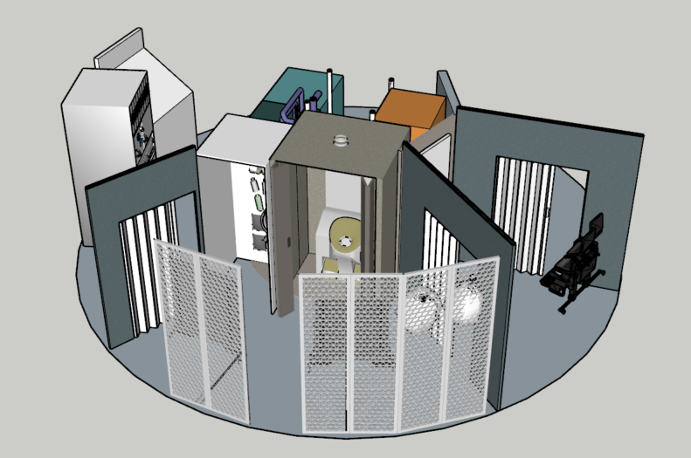
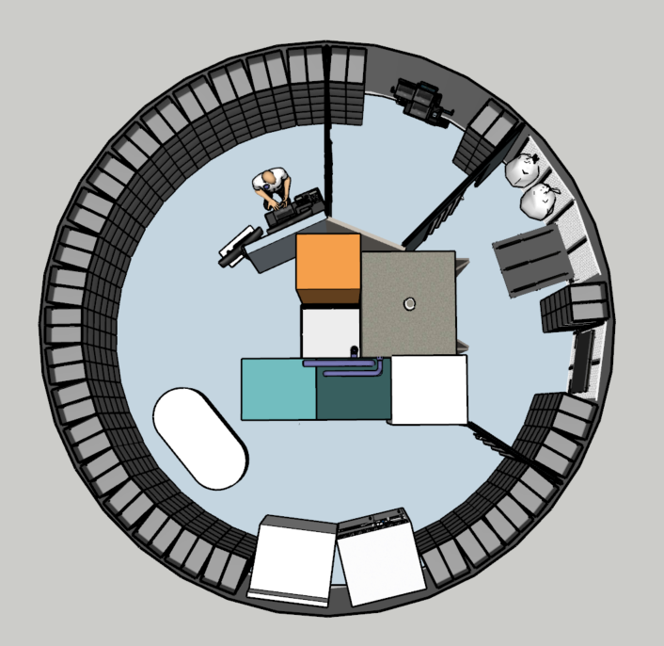
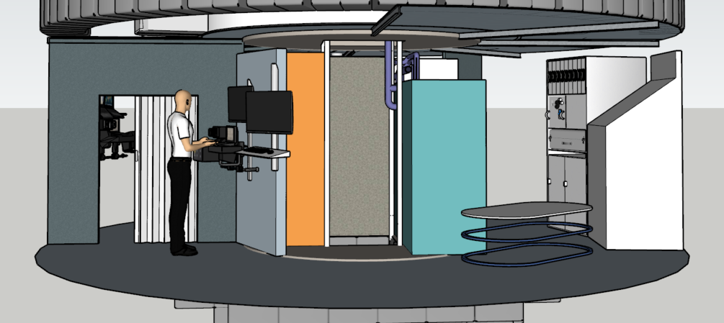
TH Concept Interior Features
Logistics Stowage
Vertical Access (above & below)
Hand washing station
Private Medical Area
Waste Management
Computer & Avionics
Logistics Management
UWMS
2 ISPRs (Thermal & Additional Systems)
Open space above Systems & UWMS/ Hygiene for Pipes
Galley & Meals
Computer Station: Command & Control
Open Area (open to second level above) for Group Recreation, etc.
Food Processing

Slide 19
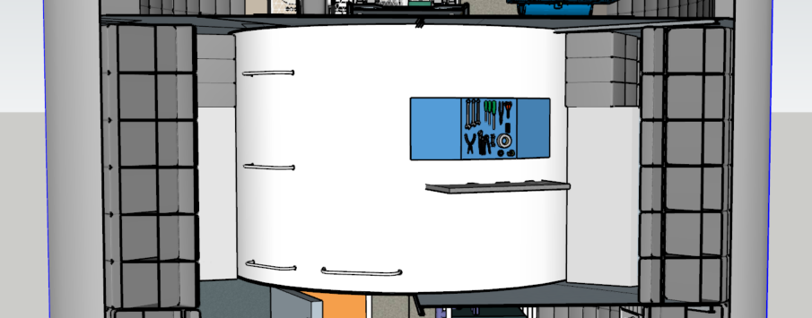
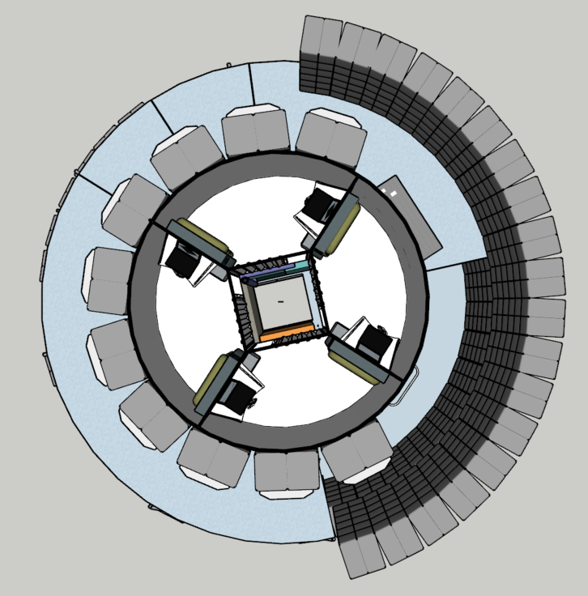
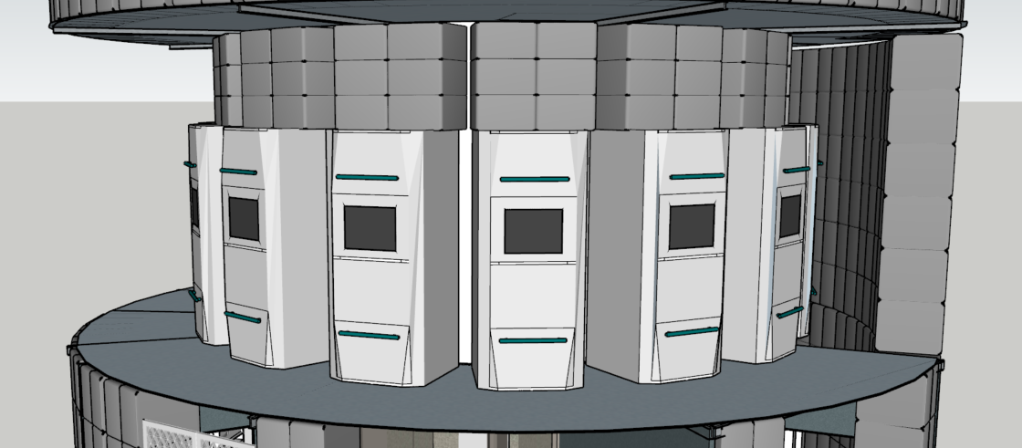
TH Concept Interior Features
Vertical Access
Crew Quarters – open to passageway in middle
Maintenance Area
Open to level 1 & 3 to provide additional space
Radiation protection from logistics and sub-systems
Area for sub-systems and maint. clearance

Slide 20
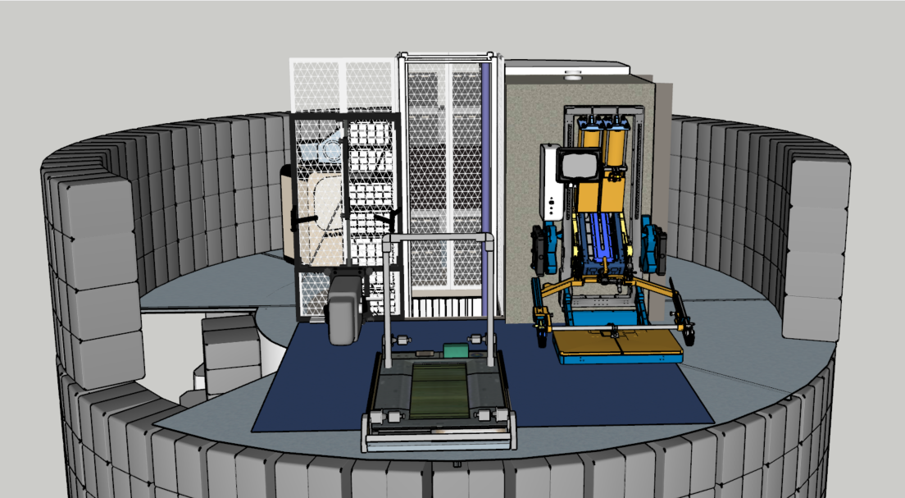
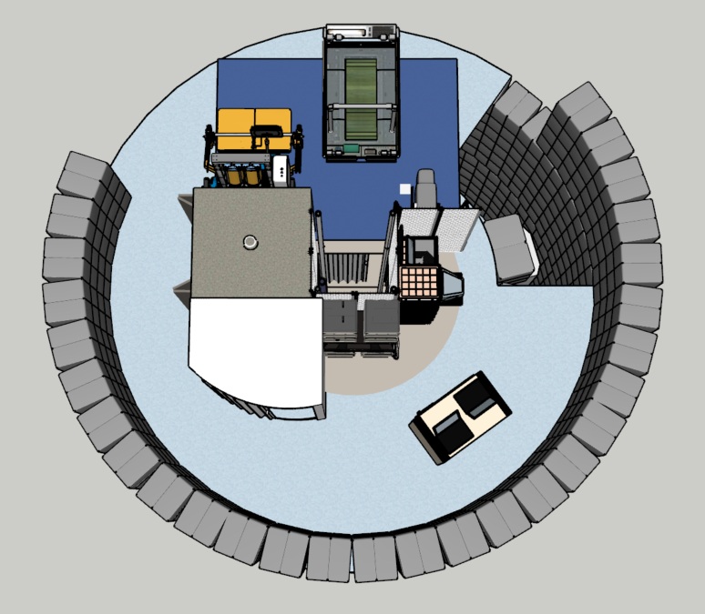
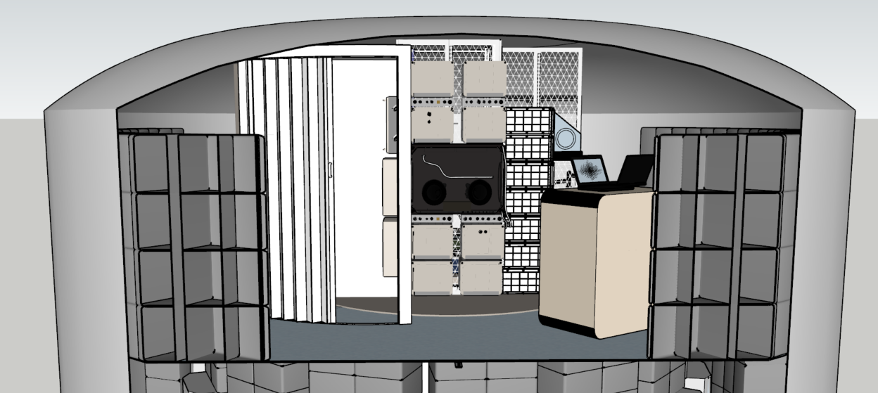
TH Concept Interior Features
Exercise Area
Space above UWMS/Hygiene for Piping/Ducts
UWMS
Open to Levels 1 & 2
Utilization
Vertical Access
Hygiene Station

Slide 21
TH Concept: Mass Summary
Key mass drivers:
Mission duration
Spares philosophy
Planned maintenance
  Crew size (currently 4)
  Technology selection (Power storage, Regen ECLSS, etc.)
  Reliability and maintainability criteria
  Risk posture
  MGA and margin requirements (only MGA shown)
Control mass target: 26,400 kg
Note: Mass margin & PMR approach defined in HEO-MD-1010, but not included within this publication.
Departure mass currently ~50 tons!
Notes:
More detail later in slides

Slide 22
Future Work
Continued concept refinement alongside M2M architecture
  Further CONOPS definition within each operational phase
    Phase 1: TH in cis-lunar NRHO with Gateway and MPS integration
    Phase 2: Crewed Transit Time and Mars Surface Mission support
    Phase 3: Refurbishment activities for subsequent crewed Mars missions
  Interior outfitting optimization activities
    Stowed and frozen food management
    Crew health and performance optimization (exercise/countermeasure systems)
  Mass refinement and logistics loading plans
Continued focus on technology development and maturation activities
  Deep dive provided in 2023 IEEE Paper “An Analysis of Exploration Capability Gaps for Future Habitation Systems to Inform Risk Assessment and Development Priorities” (T. Prater et al.)
Continued public/industry engagement and cross-agency integration

Slide 23
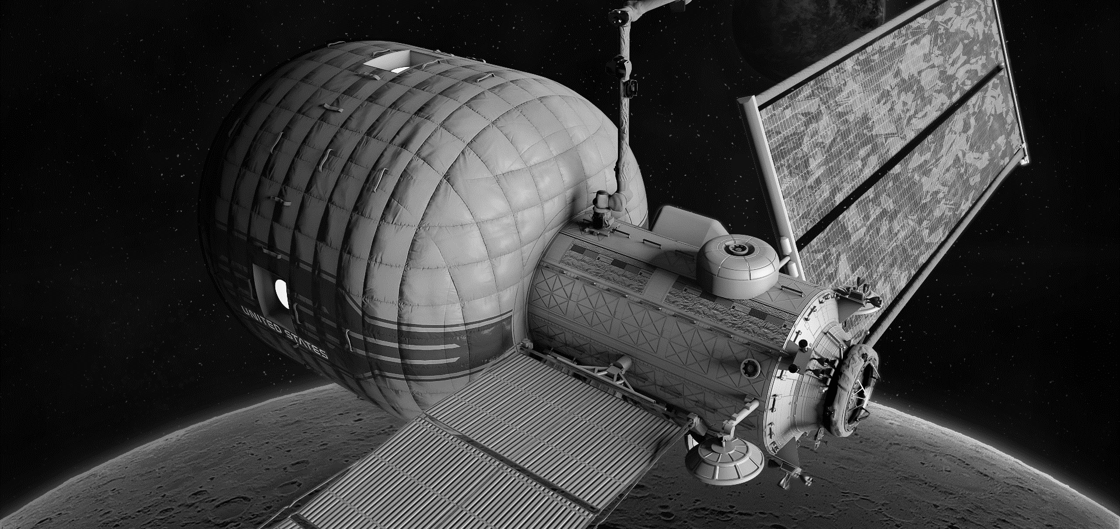





Authors & Contributors
NASA Marshall Space Flight Center – Habitation Systems Development Office
Tiffany Nickens
Habitation Concepts/Pre-Formulation Deputy Lead
Andrew Choate
Transit Habitat Technical Lead
Paul Kessler
Surface Habitat Technical Lead
Danny Harris
Habitation Concepts/Pre-Formulation Lead
NASA Langley Research Center
Special Thanks!
James Meehan, James Owens, Quincy Bean, Greg Schunk, Brian Evans, David Howard, Robert Howard, Callie Burke,
Zachary Bryant, Allison Quesenbery, and Tracie Prater.
Matthew Simon
Deputy Lead, Capability Integration Group

