Slide 1
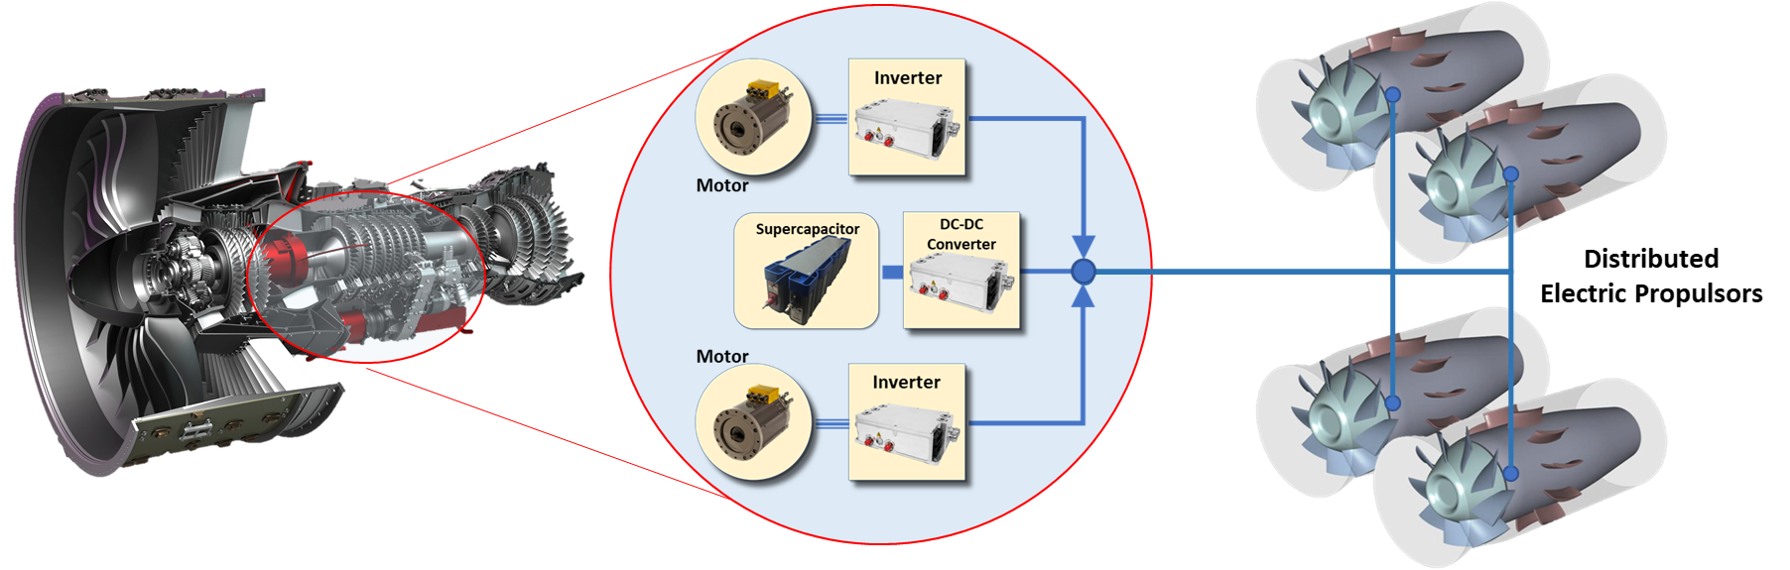
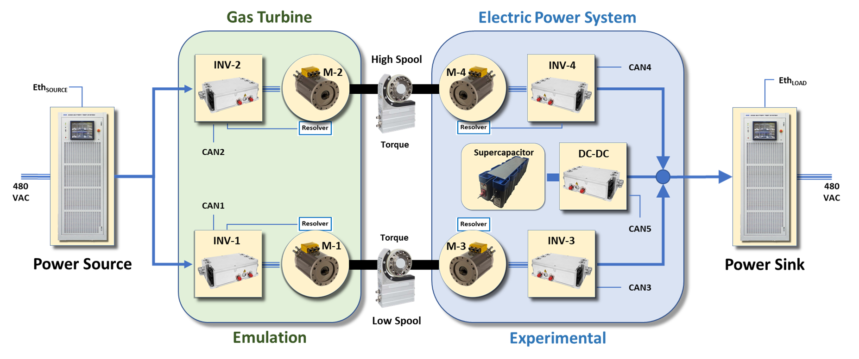
Hybrid Propulsion Emulation Rig (HyPER)
Aircraft have always provided electric power off-take from the engines to power various systems on the vehicle. However, the electrification of vehicles requires very large amounts of electric power to feed electric propulsors that provide thrust. The power balance (thrust to electric) can present operability issues with the turbine engine that will make it unstable. Propulsion Control is developing technologies that not only resolve these problems but exploit the flexibility of Electrified Aircraft Propulsion (EAP) architecture to increase propulsion efficiency while improving engine size, weight and power (SWAP).
HyPER is a hardware-in-the-loop laboratory that was designed specifically to investigate the dynamic interactions between turbomachinery, the electric power system, and the constantly varying loads of electrified aircraft. It is a small-scale lab capable of rapid reconfiguration through software. This allows the emulation of new engines using simulation models that are easily replaced and then appropriately scaled for power and inertia to the test hardware.
The test article employs four identical pairs of permanent magnet traction motors and their controllers (inverters). These are arranged on two spools with each spool pairing a set of two electric machines that typically provide opposing motoring and generating forces. The spools provide mechanical system isolation to the two separate DC electrical power busses connecting two inverters on either end. Both DC busses are energized using identical bidirectional regenerative power supplies, therefore each spool is capable of having power flow in either direction, including power flow in opposite directions on the two spools simultaneously. The regenerative power supplies are also capable of real-time adjustment at turbomachinery time scales to emulate vehicle power loads.
One DC power bus is also connected to a DC-to-DC converter that is energized by a supercapacitor energy storage element. This system is capable of regulating the DC bus voltage and sourcing an independent electrical power stream for affecting engine transient dynamics.
The system is well-instrumented to monitor electrical and mechanical power flow using various wide-bandwidth measurements of voltage, current, torque and shaft speed.
Electric Machines (350 VDC)
Rated Speed: 5910 RPM
Rated Shaft Power: 66 kW
Inverters
Voltage: 50 to 400 VDC
Continuous Current: 300 Amps
Supercapacitor
43 Farads
186 Volts
Power Supplies
Modes: Source, Sink, Battery
Voltage: 0 to 600 VDC
Continuous Current: 333 Amps
Power: 100 KW
Torque Meters
Range: 500 N-m
Speed: 12,000 RPM
POC: Dennis Culley, NASA Glenn Research Center
NASA.gov
Point of Contact: Santino J. Bianco
nasa.gov

