Slide 1
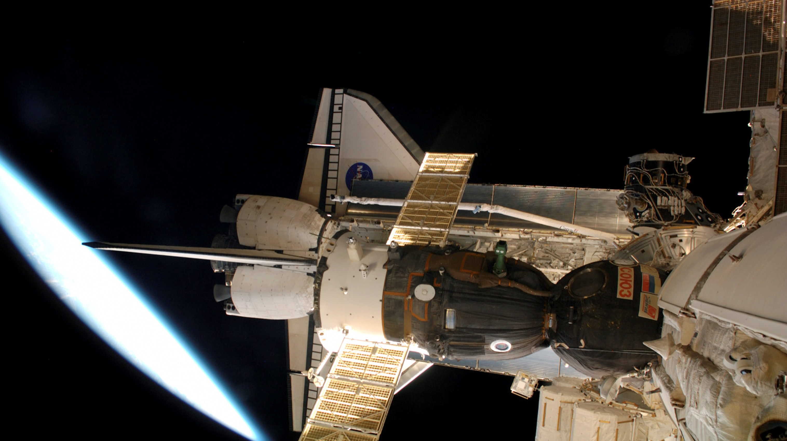



NASA Operational Processes for Human Spaceflight The Story of STS-117/ISS 13A
Kara Pohlkamp
Chief of Trajectory Operations for Human Spaceflight
NASA Johnson Space/Flight Operations Directorate
KARI Lecture Series
March 2023
Approved for Public Release in NASA STRIVES 20230002147

Slide 2
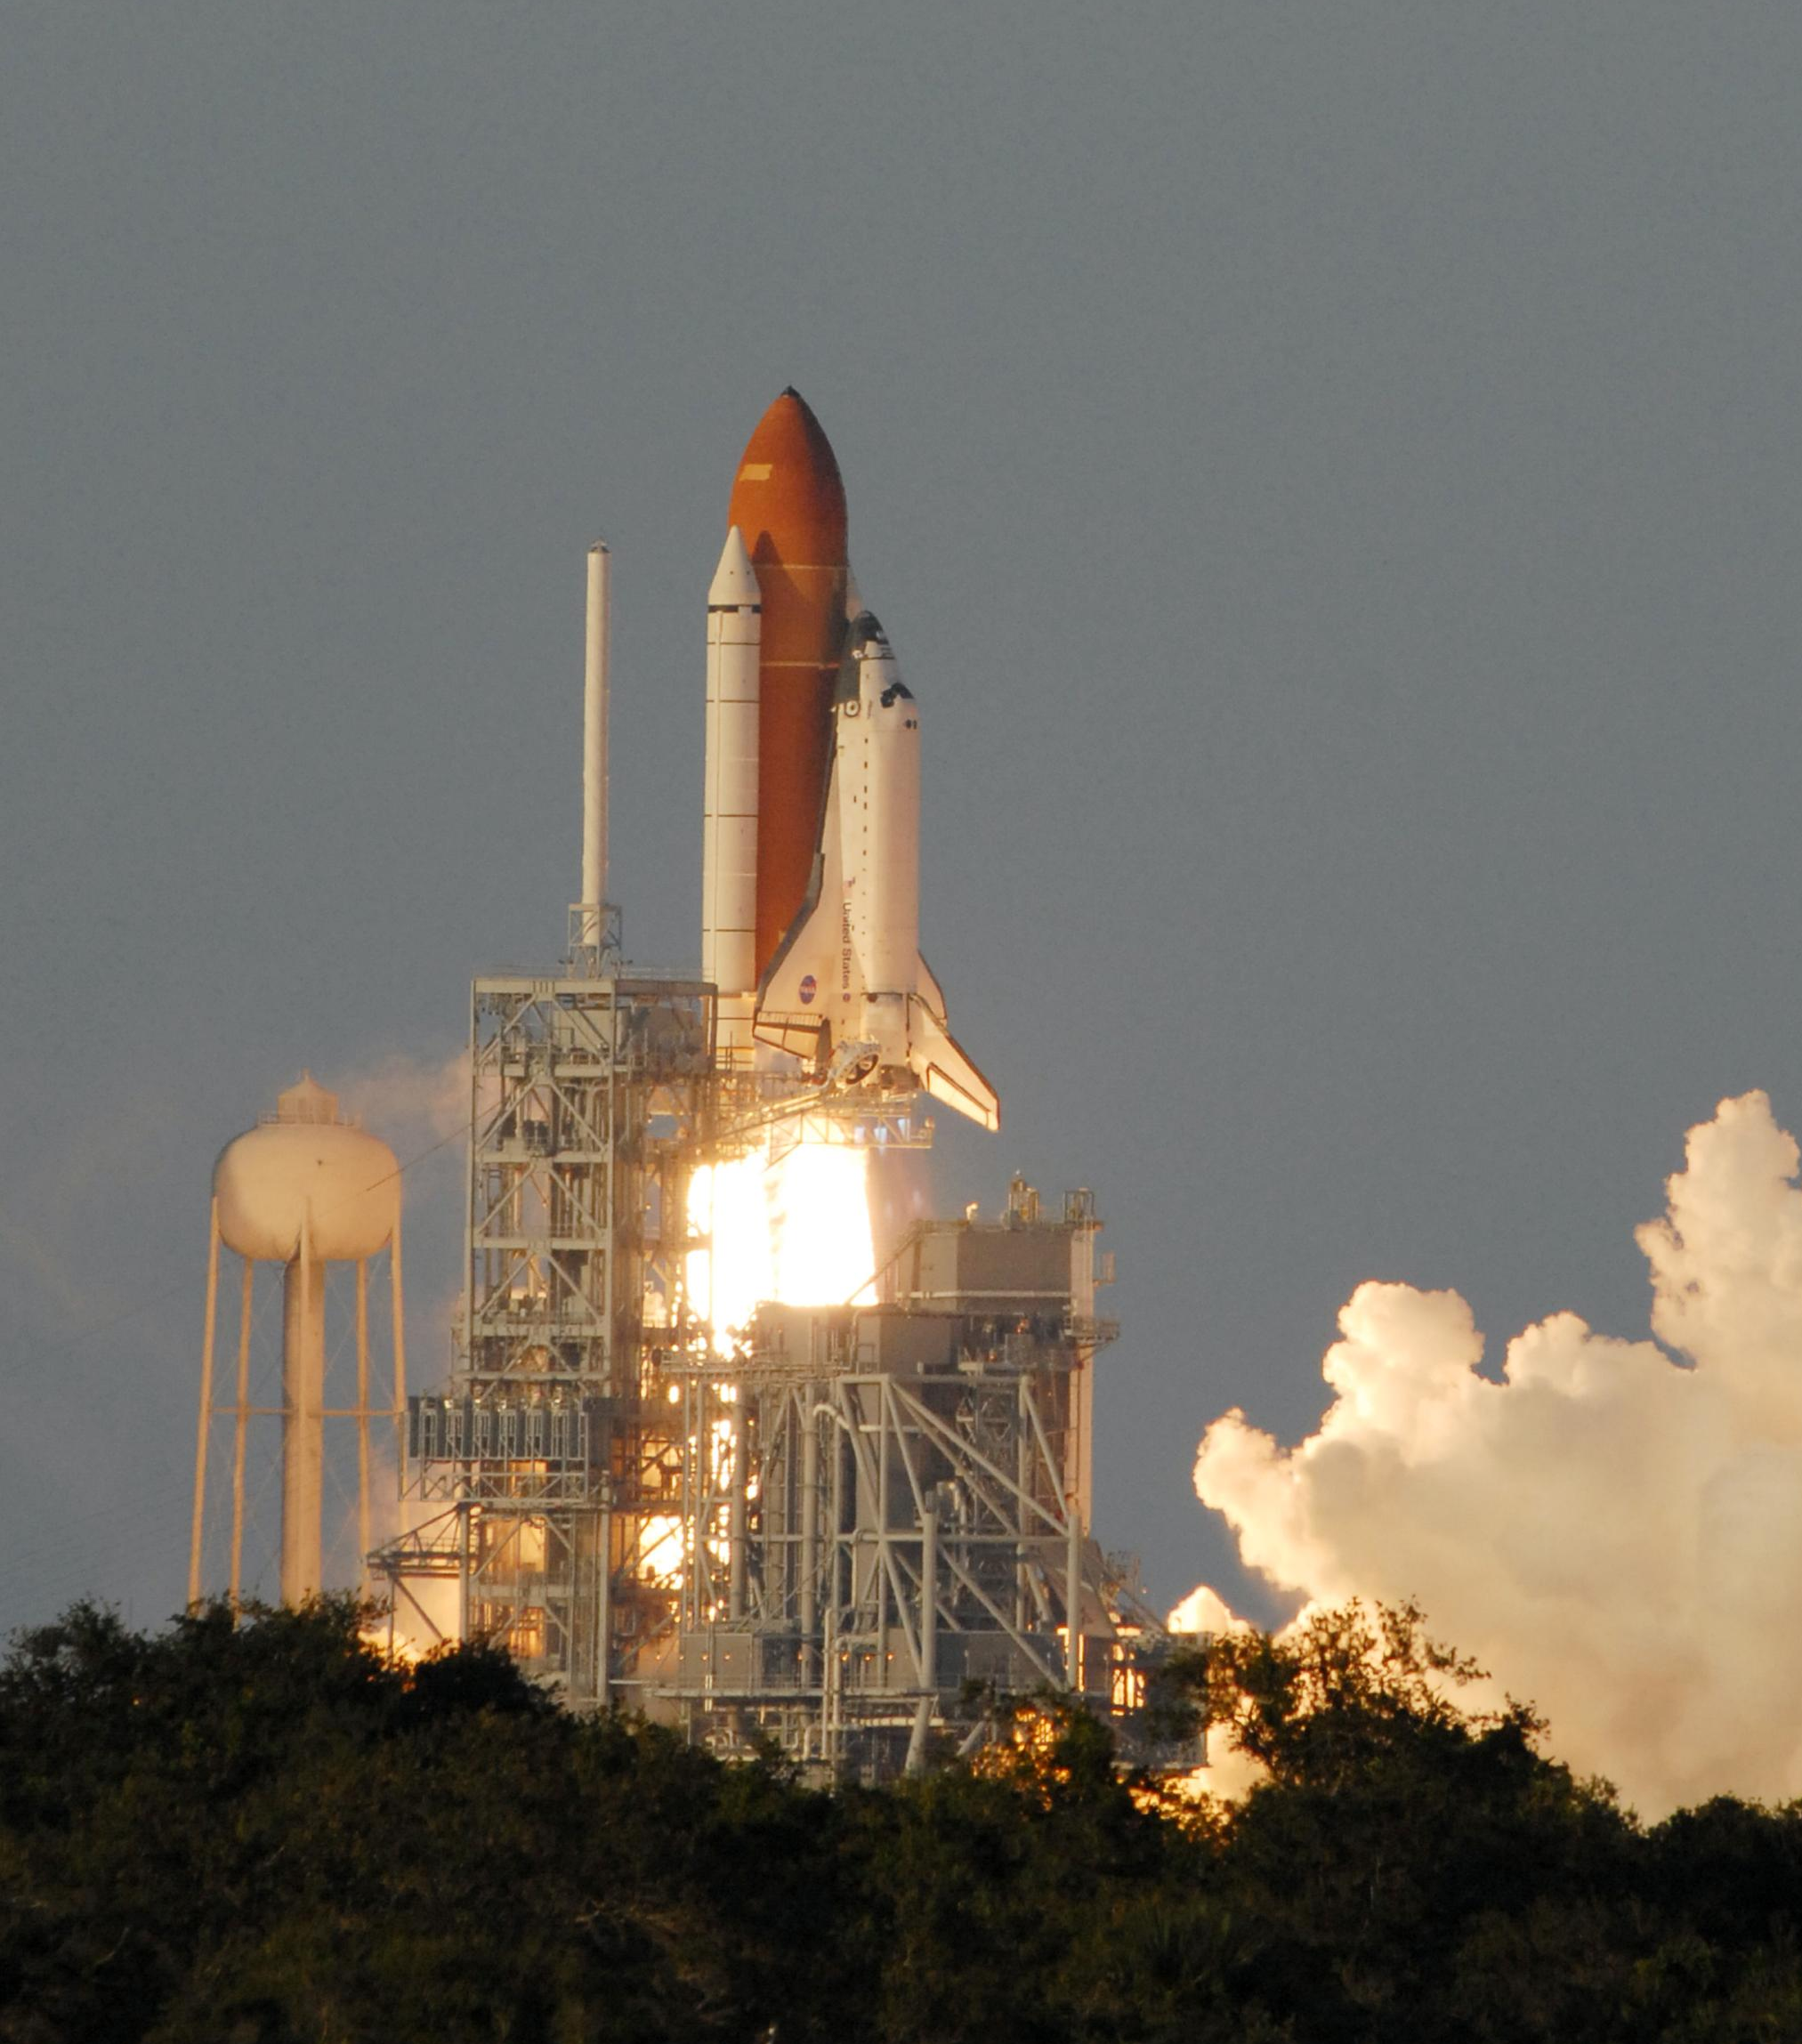
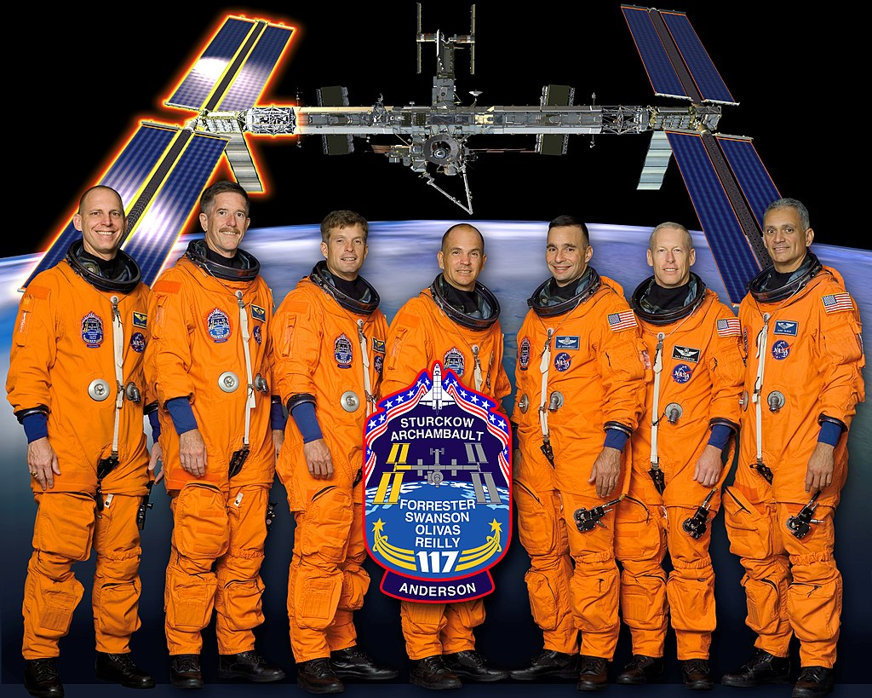
The 250th Orbital Human Spaceflight (Any nation)
STS-117 (ISS Assembly Flight 13A)
28th flight of Space Shuttle Atlantis
Launch: June 8, 2007
Landed: June 22, 2007 (Edwards)
Commander: Frederick Sturckow
Pilot: Lee Archambault
Mission Specialists: Patrick Forrester, Steven Swanson, John Olivas, James Reilly
ISS rotation: Clayton Anderson (Up), Sunita Williams (Down)
Notes:
250th human spaceflight of any nation
149th for the US
118th Shuttle mission
21st mission to ISS
28th flight of Atlantis
Originally was to launch March 15, 2007 but a hailstorm in Florida in February caused a mission delay. The hail was the size of golf balls and pelted the tank with 1,000-2,000 divots. The Shuttle stack was rolled back to the VAB for inspections and repairs.
Finally launched June 8, 2007. First launch from pad 39A since the fated Columbia mission.

Slide 3
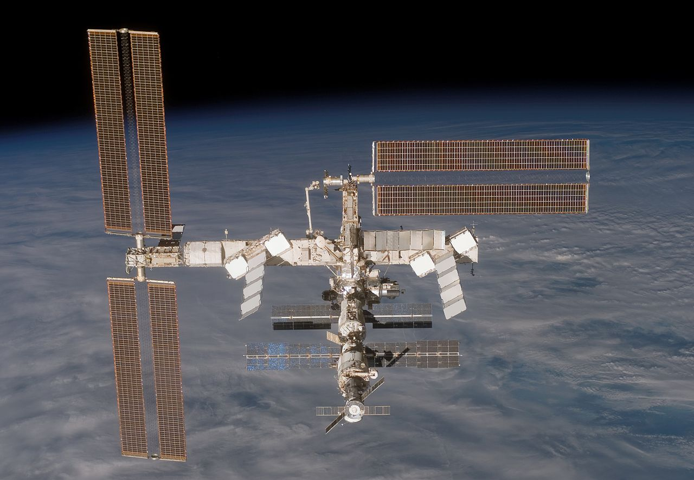
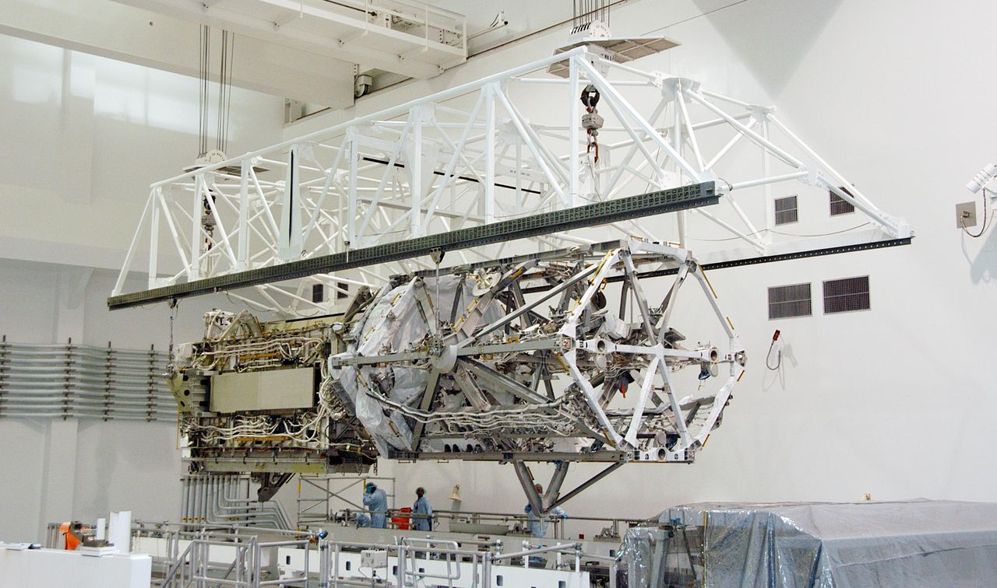
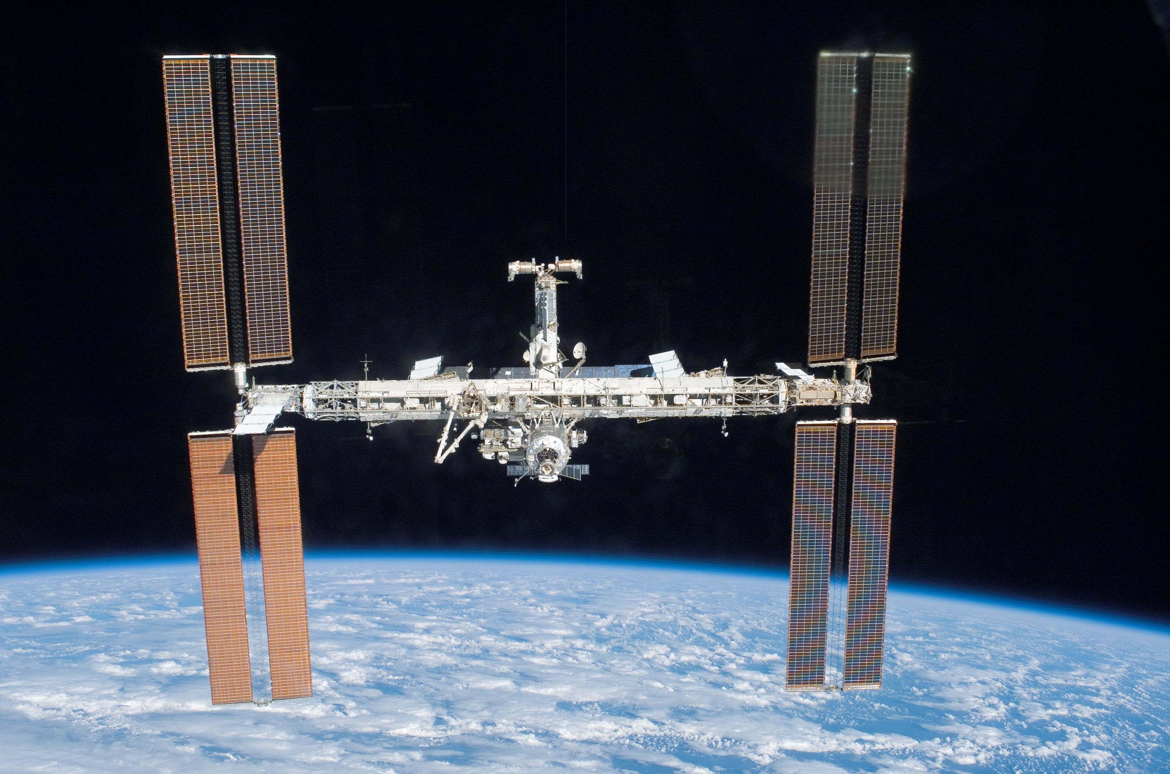
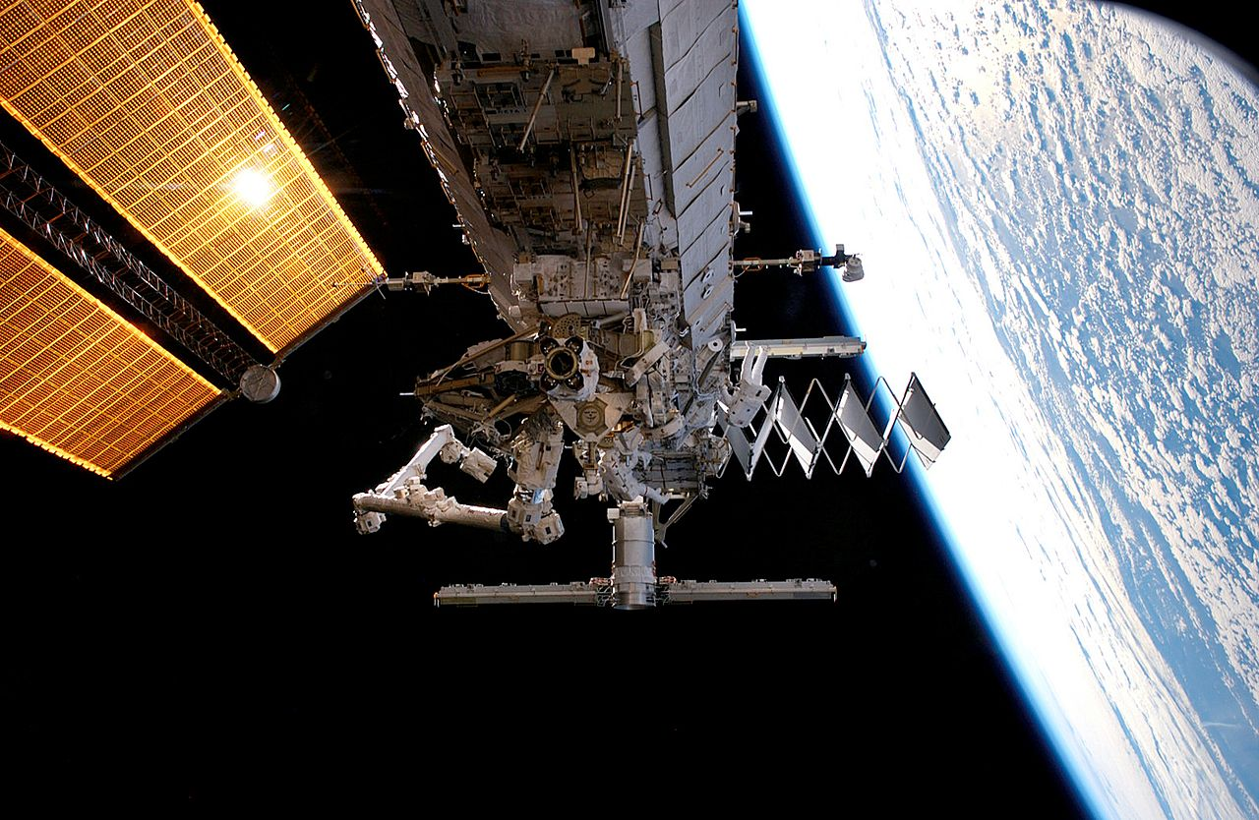
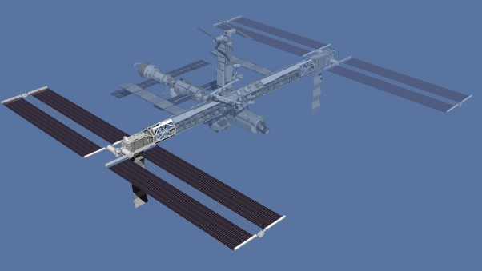
S3/S4 Truss
Pre STS-118/13A Photo
Post STS-118/13A Photo
Notes:
Delivered the second starboard truss segment (named S3/S4), hexagonal shape. Made of stainless steal, it was heaviest station payload the Shuttle had carried to date. S3/S4 measures 44’9” (13.6 m) long, roughly 4.6 m in diameter, 35,678 lbs (16,183 km).
Installed the truss segment, retracted one set of solar arrays in preparation to be repositioned on a later flight and unfolded the new arrays on S4
Longest mission of Shuttle Atlantis because of an on-orbit mission extensions and weather waive offs prior to landing.

Slide 4
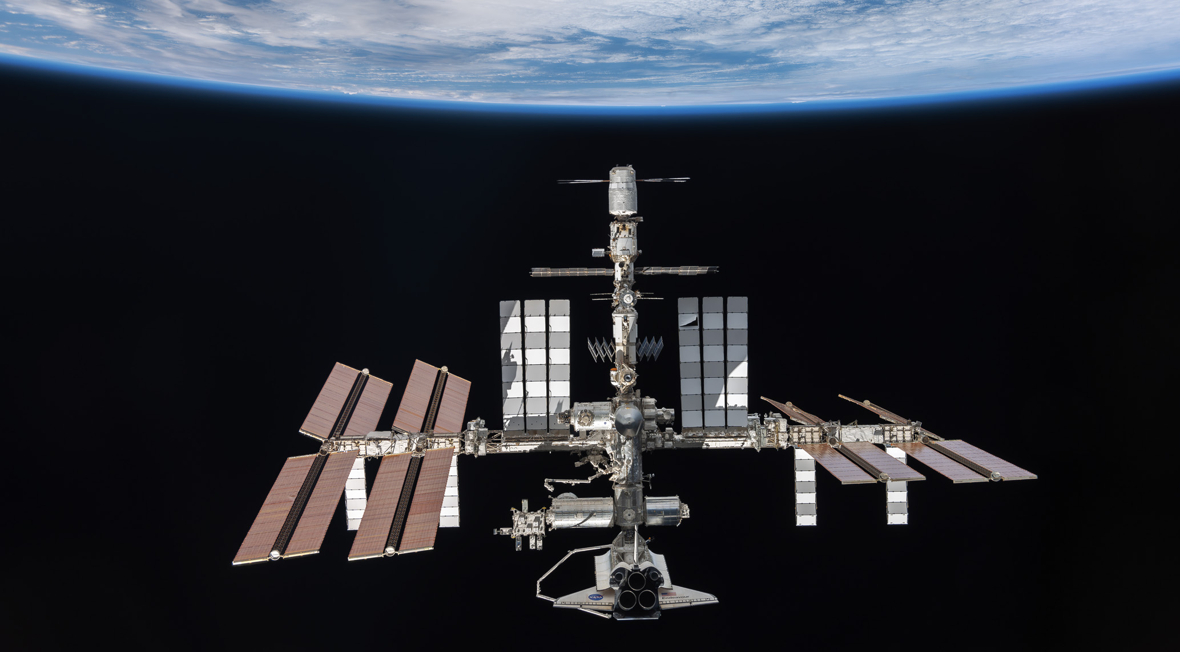
Mated Stack (ISS and Orbiter) Attitude Control
The (Shuttle) Orbiter could maneuver the entire mated stack (propellant expensive). Rate errors were 0.01-0.02 d/s; attitude deadband = 3 deg.
ISS can control via Russian Thrusters and US Momentum Management (Control Moment Gyros, CMGs)
CMGs can also be augmented with Russian Thrusters (CMG TA, Thruster Assist)
CMG controller naturally settled out into a TEA (Torque Equilibrium Attitude)
CMG initialization requires low attitude and rate errors (≤0.001 d/s). Russian Thrusters are used to damp rates to maintain CMG Control (CMG TA)
Russian thrusters were required to handover control from Orbiter to CMG
No attitude control is called “FREE” Drift
ISS Nadir as taken by departing Soyuz (ISS assembly complete)

Slide 5

Fight Day (FD) 5
Atlantis docked to ISS on FD3 and successfully installed S3/S4 on FD5
At MET (Mission Elapsed Time) 3/17:45, the Orbiter assumed attitude control of the mated stack due to perturbations imparted by solar array deploy. During the actual deploy Orbiter went FREE Drift (no attitude control) and then recovered post deploy at MET 3/18:14.
Failure: During the maneuver back to the TEA attitude (Thermal Equilibrium Attitude), the ISS Russian computers failed due to power issues.
Impact: Attitude control could not be handed back over to CMGs and the Shuttle has limited propellant, some of which is needed to return home.

Slide 6
A caveat…
Notes:
During this presentation I am going to take you through some operational philosophies and processes NASA uses for human spaceflight. Many of these processes have been refined through difficult lessons learned and incidents that have occurred over the last decades of human spaceflight. I do not mean to imply our philosophies and processes are the only or most efficient way of conducting business, rather, I hope by sharing some of our operations KARI might be able to pick up ideas that might best fit into how your organization conducts operations.

Slide 7

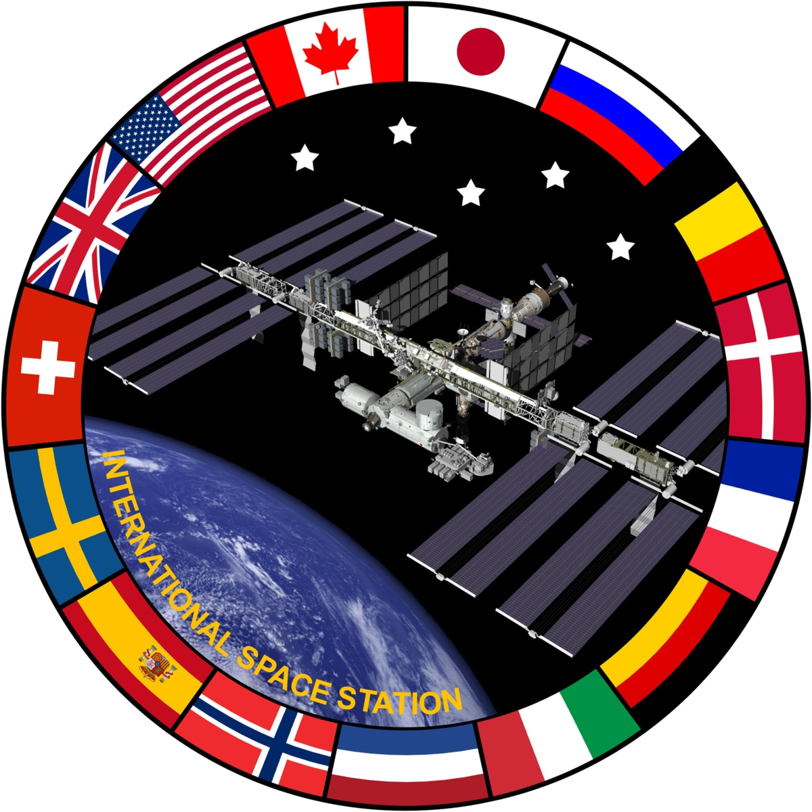
Human Space Flight Delegation of Authority
NASA HQ
Mission Vision
ISS Program Office
Project Management
Shuttle Program Office
Project Management
Flight Operations Directorate (includes Astronauts)
Plan/Train/Fly (launch to Crew extraction)
Engineering Organizations
Notes:
Explain Our Org Structure
Same today with Orion, Lander, Gateway programs

Slide 8
Operations Plays a Role in the Entire Engineering Life Cycle
Requirement and Mission Definition
Manufacturing, Testing, Analysis, Mission Planning
Mission Execution
Lessons Learned
What flexibilities/contingencies might we need?
Fail-Ops, Fail-Safe
Crew perspective
Unexpected system interactions often become operational workarounds
Simulations
Operational limit
Operational tools (ground and onboard)
Notes:
Operations involved in early mission conception, requirement definition, system design, just like engineering. Important to build in operational flexibility into the design to have the tools to solve programs.
FOD looks at “Next Worst Failure”

Slide 9
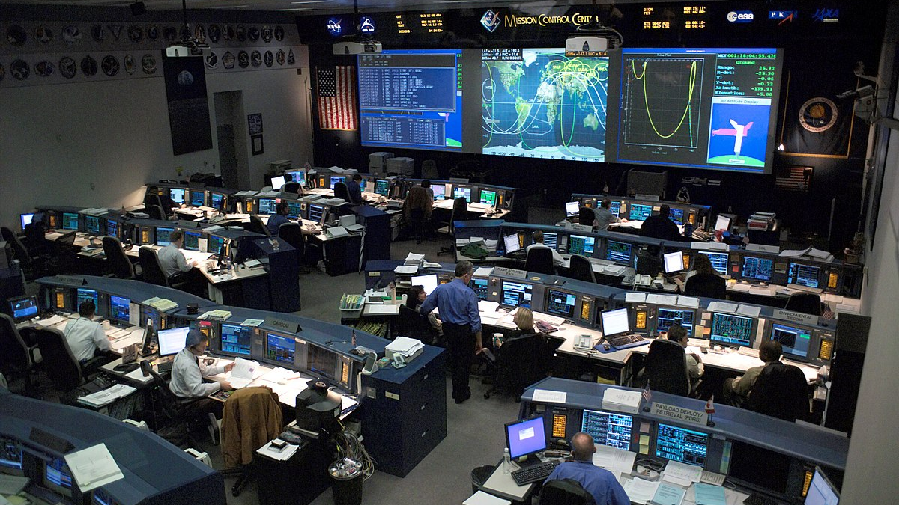
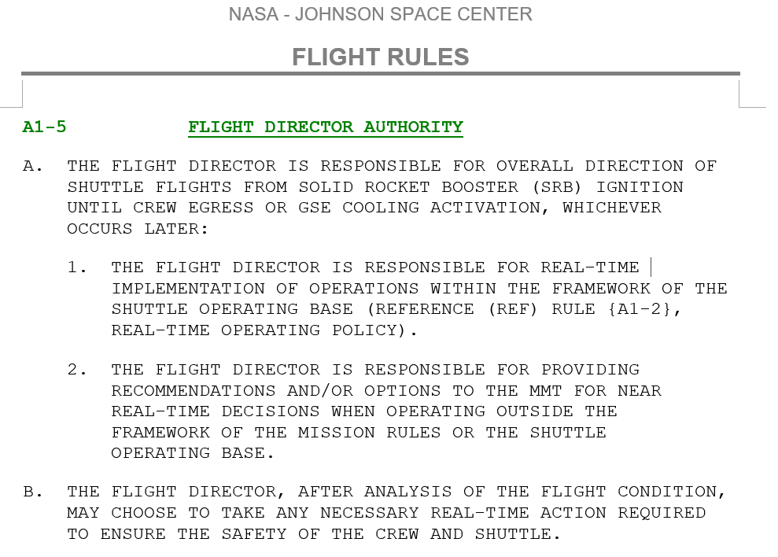
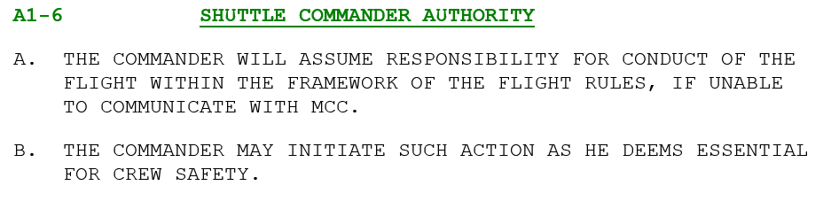
Delegation of Authority and Flight Rules
At NASA, human spaceflight mission execution authority is delegated from the Programs to FOD (both the crew and real-time ops team in Mission Control).
Terms of this delegation are documented in hundreds of “Flight Rules” which are pre-fight decisions of how the vehicle will be operated in nominal and contingency conditions.
Mission Management Team
(When there is time to consult)
Flight Director
Crew Commander
24/7 support divided into three 9-hr shifts
FCR (Discipline Lead)
Built in check system and personnel development
MPSR
(Discipline Support)
MER (Engineering Support)

Slide 10
On-Orbit Flight Control Teams (Front Room “Console” Positions during STS-117)
Shuttle (Alphabetical) | Station (Paired with Shuttle Counterpart)
Flight | ISS Flight
ACO – Assembly and Checkout Officer
DPS – Data Processing System | ODIN – Onboard Data Interfaces and Networks
EECOM – Emergency, Environmental and Consumables Management | ECLSS – Environmental Control and Life Support System
EGIL – Electrical Generation and Integrated Lighting | PHALCON – Power, Heating, Articulation, Lighting Control Officer
EVA – Extravehicular Activity Officer
FAO – Flight Activities Officer | OPS PLAN – Operations Planner
FDO – Flight Dynamics Officer | TOPO – Trajectory Operations and Planning Officer
GC – Ground controller | ISS GC
GNC – Guidance, Navigation and Control | ADCO – Attitude Determination and Control Officer
INCO – Instrumentation and Communications Officer | CATO – Communication and Tracking Officer
MMACS – Mechanical, Maintenance, Arm and Crew Systems | OSO – Operations Support Officer
PDRS – Payload Deployment and Retrieval System | ROBO- Robotics Operations Systems Officer
PROP – Propulsion
Surgeon | BME – Biomedical Engineer
 | ISO – Inventory and Stowage Officer
 | RIO – Remote Interface Officer (Russian Liaison)

Slide 11
Procedures
Procedures help ensure correct operations
Procedures are authored to ensure operations stays within Flight Rule permissions
All Procedures are authored in a standard format to prevent errors and exist under configuration management
All procedures are thoroughly tested in appropriate hardware/software rigs and exercised in pre-flight simulation practice sessions
Best practice: never operate without a procedure (if possible). Acquire permission to operate outside of procedures.
Notes:
FOD tracks command errors, procedure errors…

Slide 12
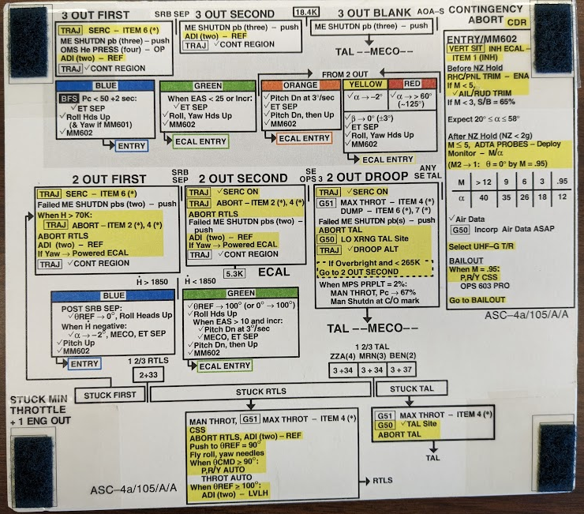
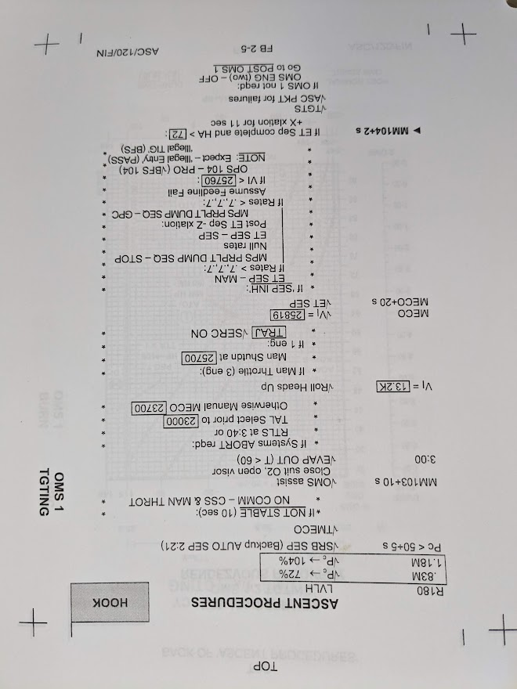
Types of Procedures (Shuttle was old-school paper)
Standard Flight Data File (FDF)
Ascent/Entry
Cue Cards
Notes:
Meant for quick memory joggers, not intuitive, require training

Slide 13
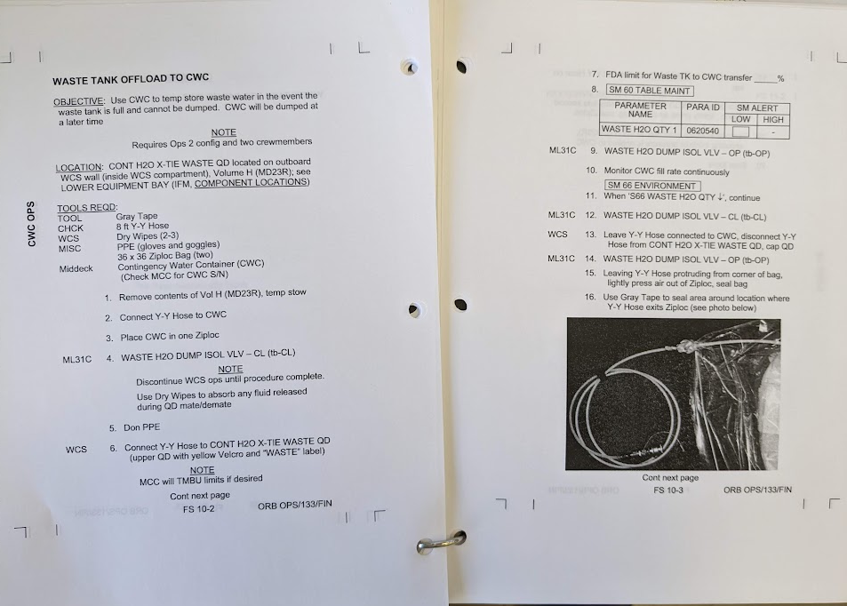
Types of Procedures
Standard Flight Data File (FDF)
Ascent/Entry
Cue Cards
Orbit
Notes:
Organized into several books depending upon phase of flight (EVA, RNDZ, free flight) and criticality (Nominal vs. Off-Nominal vs. Emergency)

Slide 14
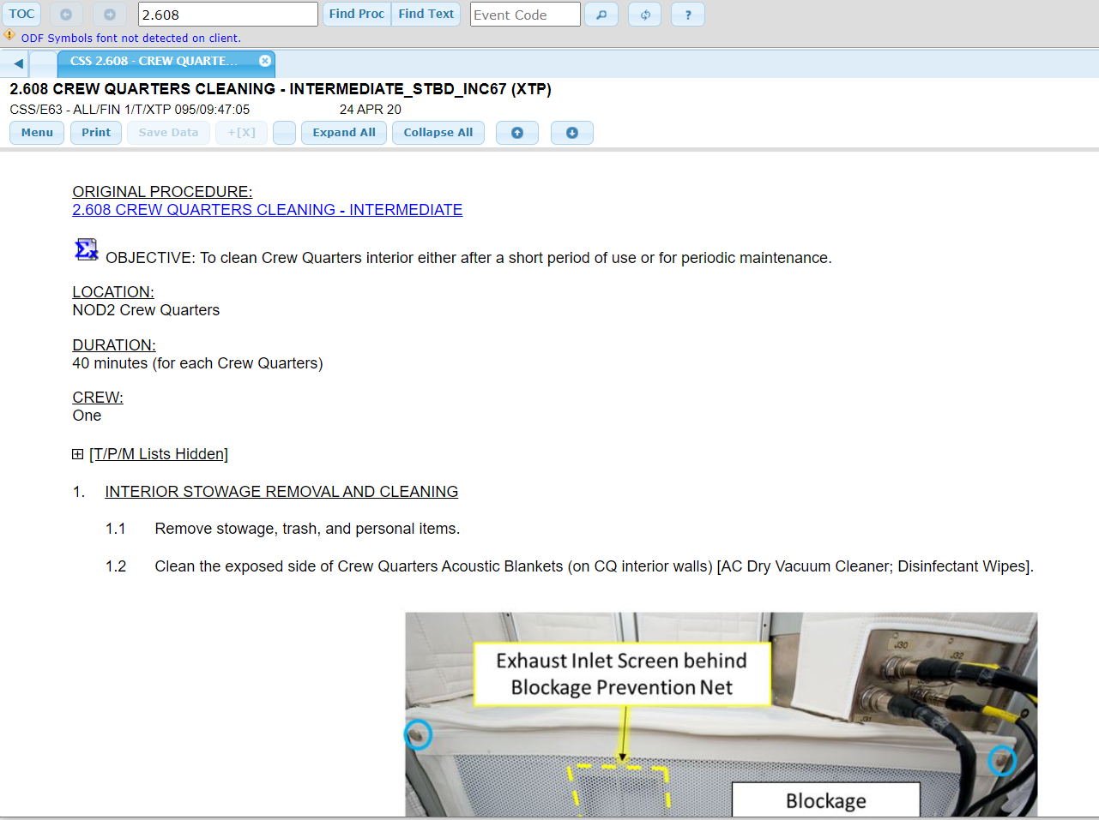
Types of Procedures
(what a procedure looks like electronically for ISS today)
Standard Flight Data File (FDF)
Ascent/Entry
Cue Cards
Orbit
Notes:
What it looks like today on ISS with International Procedure Viewer (IPV). Procedures migrating to cockpit for Orion with EPROC, integrated with command and control

Slide 15
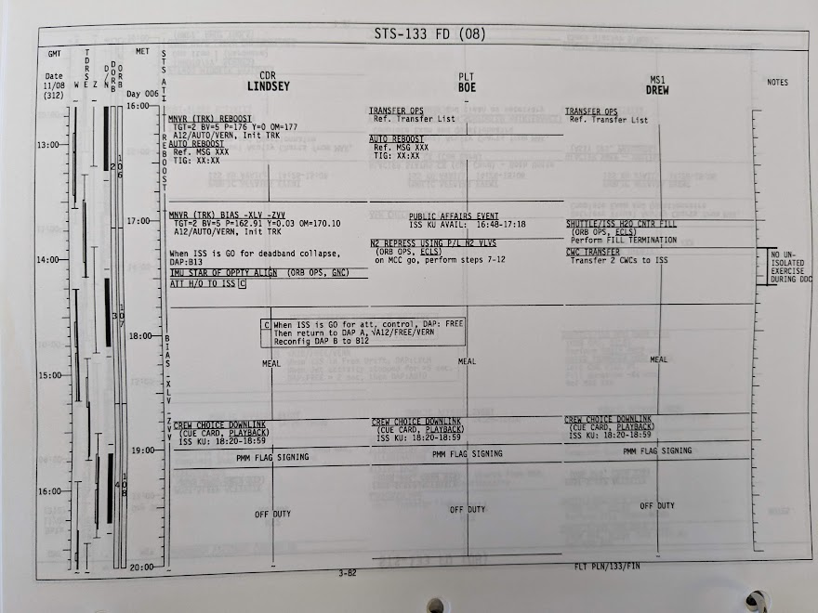
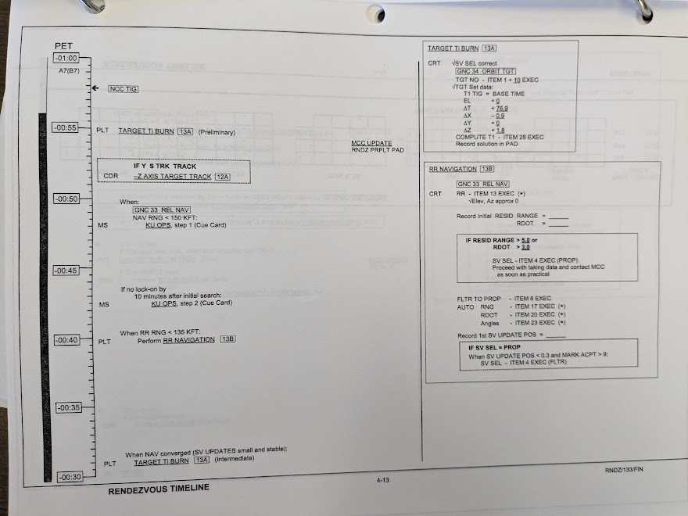
Types of Procedures
Standard Flight Data File (FDF)
Ascent/Entry
Cue Cards
Orbit
Flight Plan
Notes:
Provide the crew a timeline of events for each flight day and sometimes phase specific timelines (like Rndz and undock and EVA)
Flight Plan updated each morning in a “Daily Execute Package” and then reviewed with crew in a daily tag-up with the ground team

Slide 16
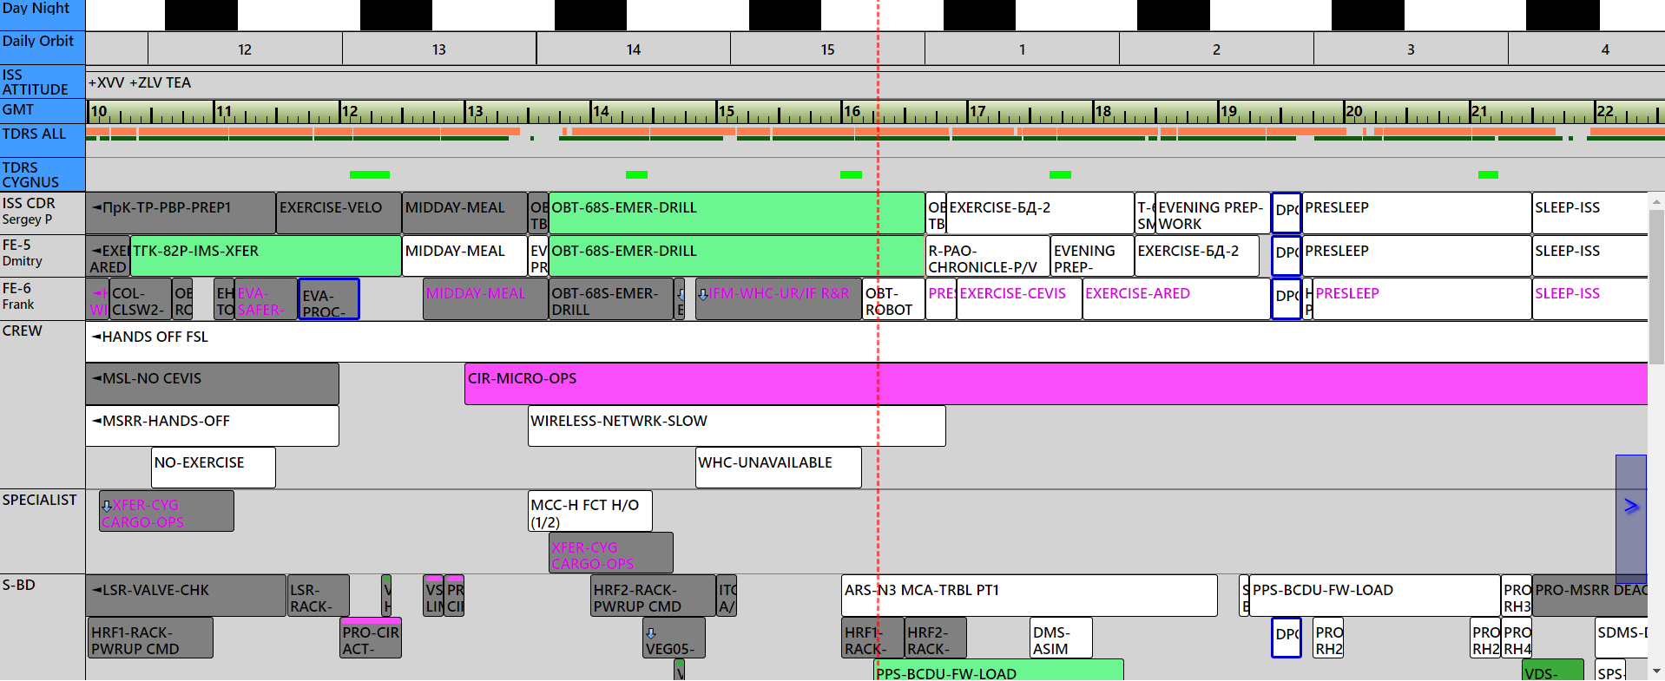
Types of Procedures
Standard Flight Data File (FDF)
Ascent/Entry
Cue Cards
Orbit
Flight Plan
(What the flight plan looks like electronically today)

Slide 17
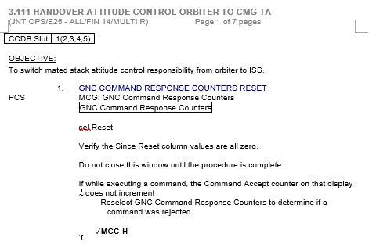
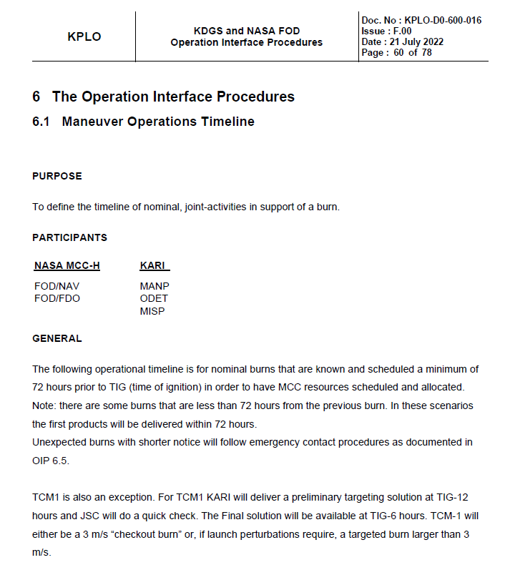
Types of Procedures
Standard Flight Data File (FDF)
Ascent/Entry
Cue Cards
Orbit
Flight Plan
Joint Operational Procedures (JOIP) – Procedures with an external entity (other programs/vehicles)
More verbose
The concept of KPLO OIPs are derived from this practice to document procedures between KMOC and MCC

Slide 18
Types of Procedures
Standard Flight Data File (FDF)
Ascent/Entry
Cue Cards
Orbit
Flight Plan
Joint Operational Procedures (JOIP) Operational Interface Procedures (OIP) – Procedures to interface with external entities
KPLO OIPs are derived from this practice to document procedures between KMOC and MCC
Notes:
Procedure standards vary based on phase of flight. Ascent/Entry/Critical time frame procedures serve as memory joggers.
Orbit procedures are more verbose with caution blocks and extra aids

Slide 19
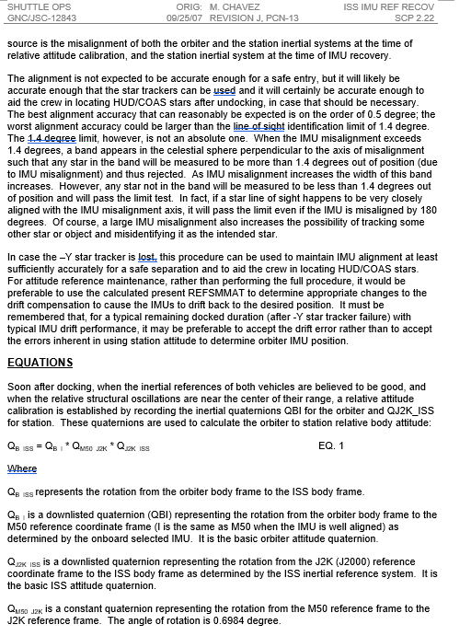
Types of Procedures
Standard Flight Data File (FDF)
Ascent/Entry
Cue Cards
Orbit
Flight Plan
Joint Operational Procedures (JOIP)
Operational Interface Procedures (OIP)
Console Handbook – Procedures used by a specific discipline to operate tools at their console
Most verbose, often has equations
Often used to capture the “why”
Meant for ground operations

Slide 20
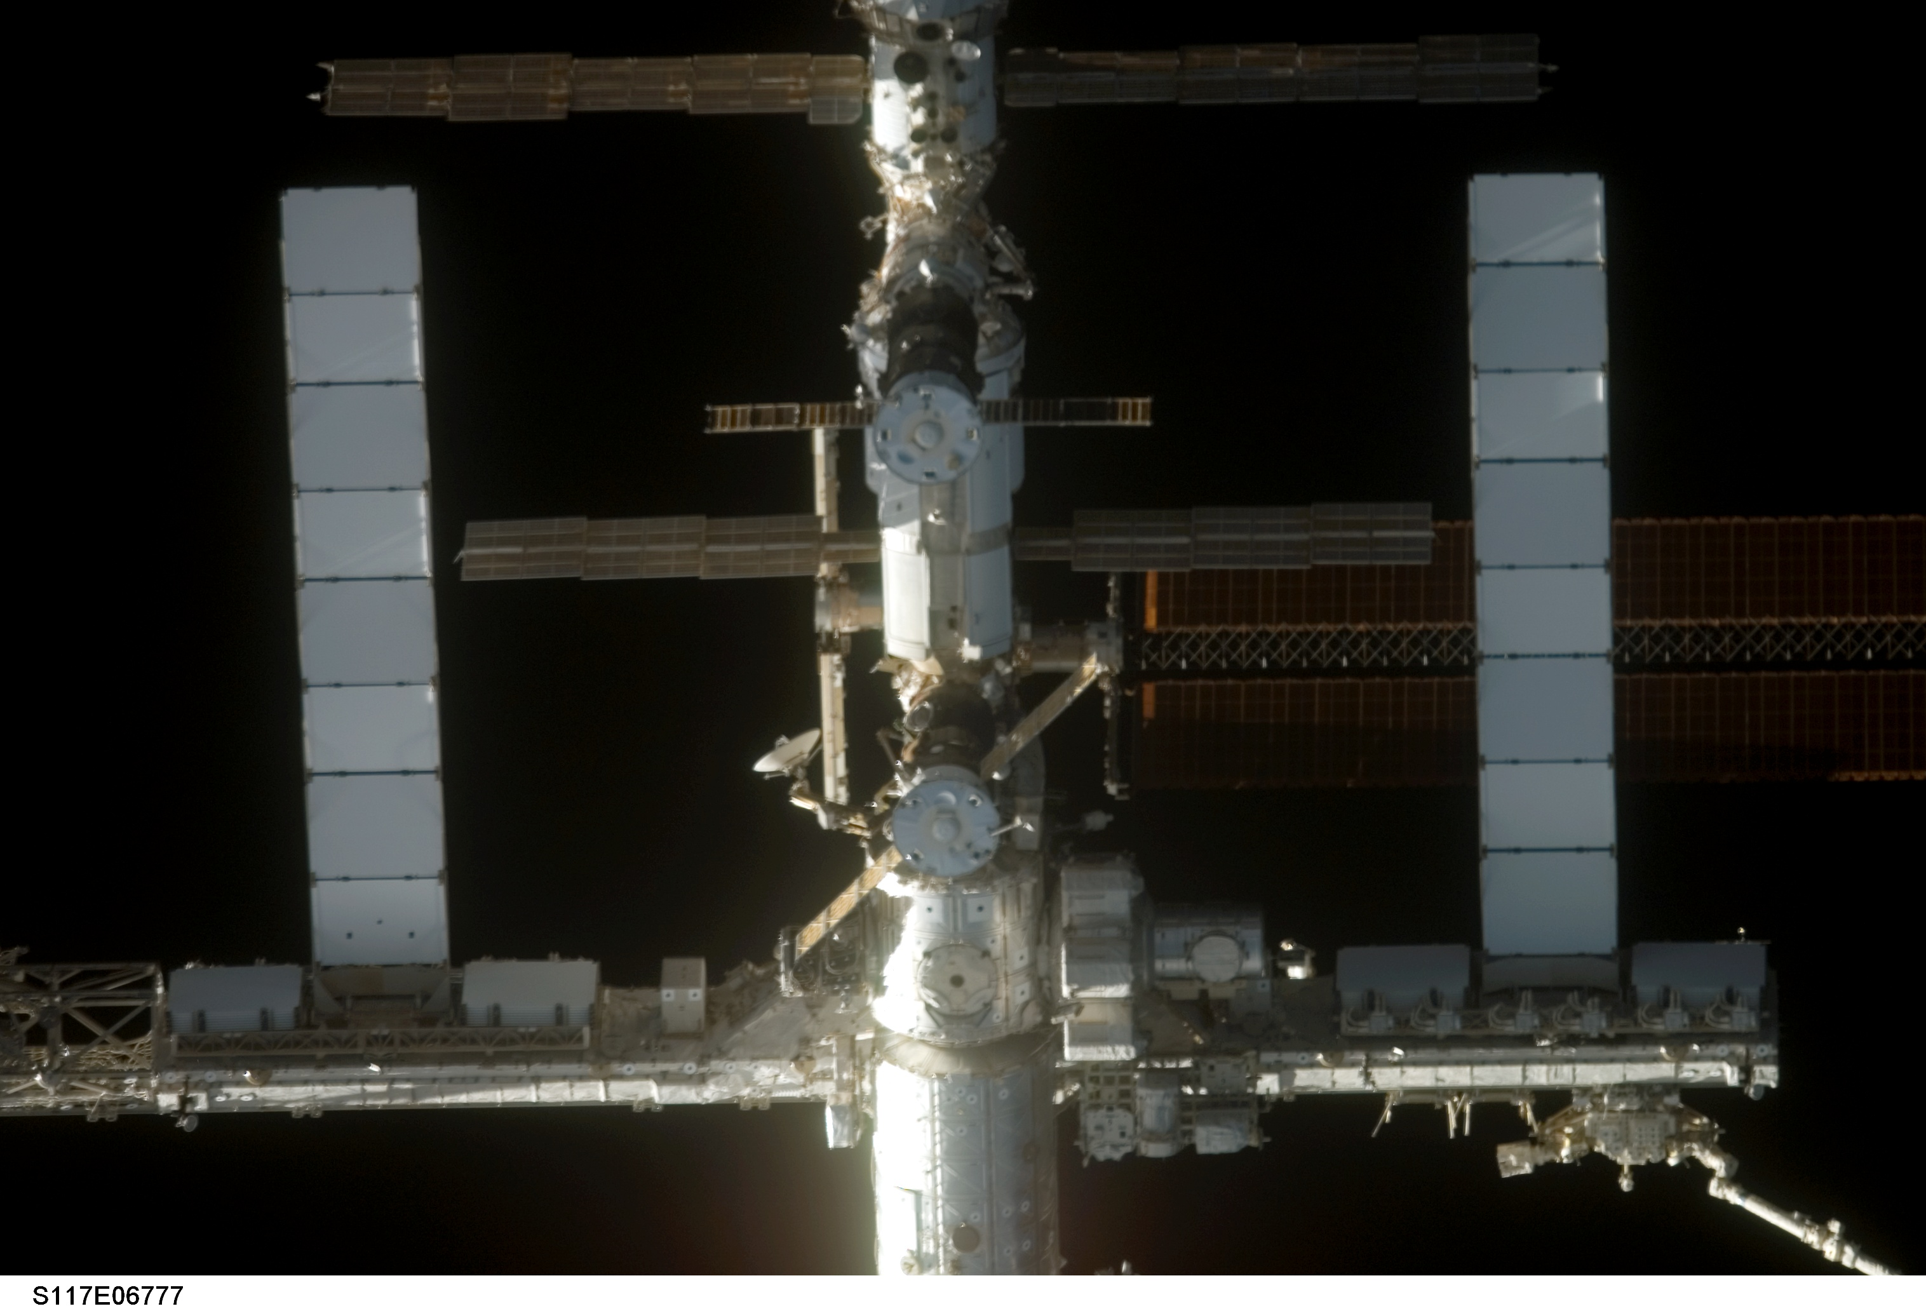
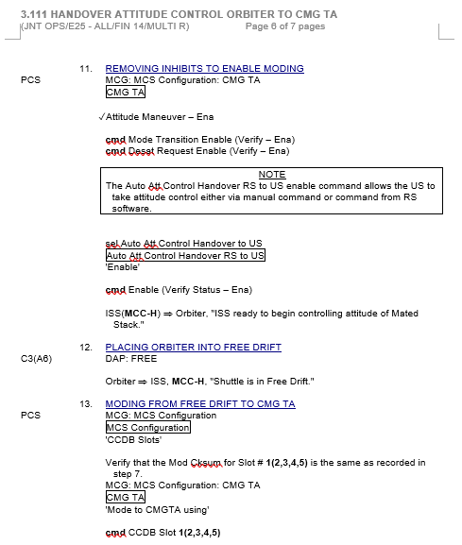
Attempts to Recover Attitude Control
With the matted ISS-Orbiter stack stuck on Shuttle attitude control, the team found themselves beyond the scope of flight rules and documented procedures
Elapsed Time (hh:mm) | Event
0:00 | Russian computers failure while Shuttle in control
5:38 | Attempt to hand over directly to CMG CMG saturation 4 minutes later due to high rates Shuttle resumes control
6:18 | Russian computers recovered
7:30 | Attempt to handover control Orbiter > USTO > CMG CMGs saturate 43 minutes later ISS batteries are now in a state of discharge, team decides to stay in FREE to allow solar arrays to track the sun
9:30 | Shuttle resumes control
10:07 | Successful handover Orbiter > USTO > CMG (Momentum reached 95% of saturation but settled out)
Russian computers failed again that night…
Notes:
When Shuttle was in control the solar arrays were locked in an approved position due to plume loading

Slide 21
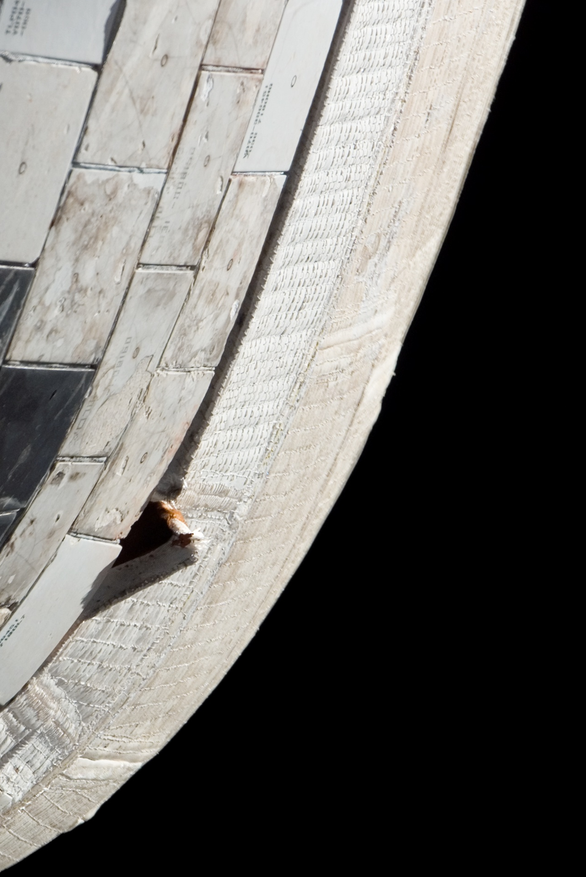
Without Russian Computers
How would ISS regain attitude control after Shuttle undocked?
What happens if CMGs saturate again?
How can disturbances on the mated stack be minimized to prevent saturation?
Shuttle was using 18 lbs of fuel/hr to hold attitude on FD5 (pre-flight predictions were between 5-6 lb/hr)
ISS could not update its attitude knowledge and ISS attitude error was growing (ISS US GPS units happened to be failed at this time due to an independent failure)
Could the Shuttle mission be extended?
4x6” corner of insulation around the orbit engine pod had pulled away from adjacent heat-shield tiles needed for re-entry
How can the Russian computers be recovered?
To answer these questions, MCC turned to “Team 4” and “Chits”

Slide 22
“Team 4”
MCC supports in three, nine-hour shifts: Orbit 1, 2 and 3.
1 hour hand-overs between each shift with a team pre-brief prior to taking over operations
Shift handovers include a written handover log at each console
In contingency situations MCC will stand up at “Team 4” to work the problem “off console” and allow the real-time team to focus on safe operations and continuing mission milestones
Team 4 meetings are led by a Team 4 FD and include representatives from each discipline as well as engineering support and program representatives.
Notes:
Allows on console team to focus on safe operations
Team 4 brings in discipline experts, engineering support

Slide 23
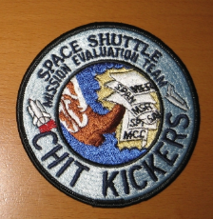
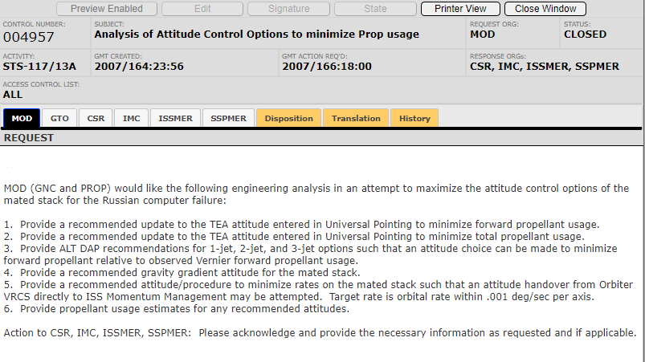
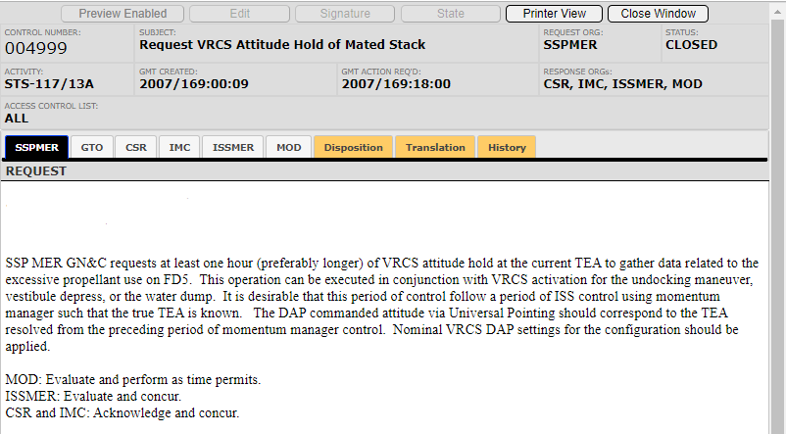
Chits
Formal requests between the real time ops team and engineering are documented in “Chits”
Formally documentation reduces ambiguity to help ensure safe operations and allows transparency among all stakeholders.
Notes:
Chit is a military term carried over to NASA in the early days for a piece of paper which is an official letter requesting some privilege
Chit to request more time to understand increased prop usage and also update shuttle procedures to reduce propellant and handover without RS

Slide 24
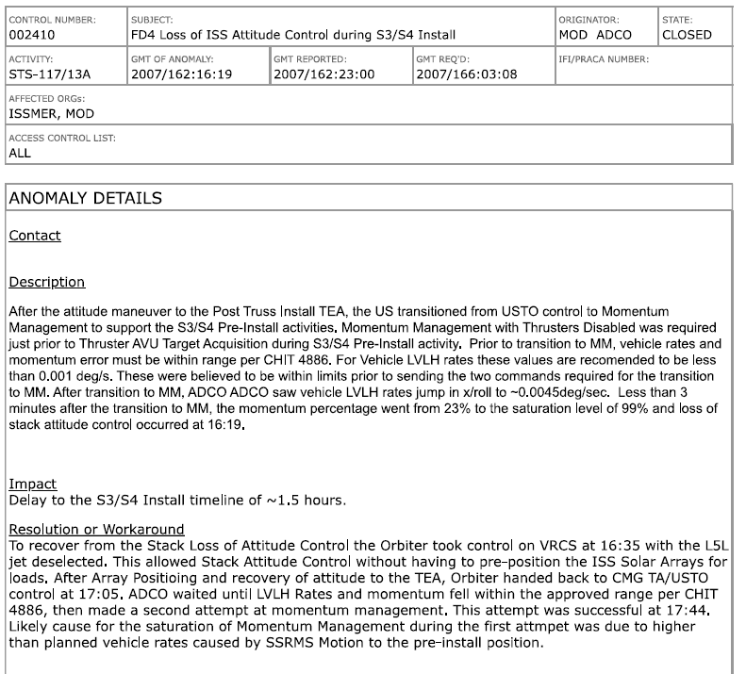
Anomaly Reports
Documents off-nominal conditions and associated resolution plans
Helps identify trends

Slide 25
Without Russian Computers
How would ISS regain attitude control after Shuttle undocked?
What happens if CMGs saturate again?
How can disturbances on the mated stack be minimized to prevent saturation?
Shuttle was using 18 lbs of fuel/hr to hold attitude on FD5 (pre-flight predictions were between 5-6 lb/hr)
ISS could not update its attitude knowledge and ISS attitude error was growing (ISS US GPS units happened to be failed at this time due to an independent failure)
Could the Shuttle mission be extended?
4x6” corner of insulation around the orbit engine pod had pulled away from adjacent heat-shield tiles needed for re-entry
How can the Russian computers be recovered?
To answer these questions, MCC turned to “Team 4” and “Chits”

Slide 26
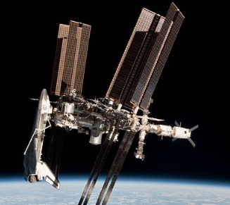
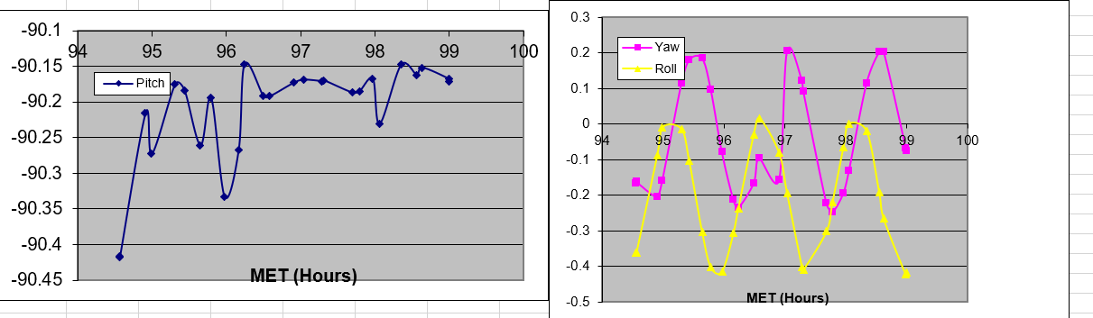
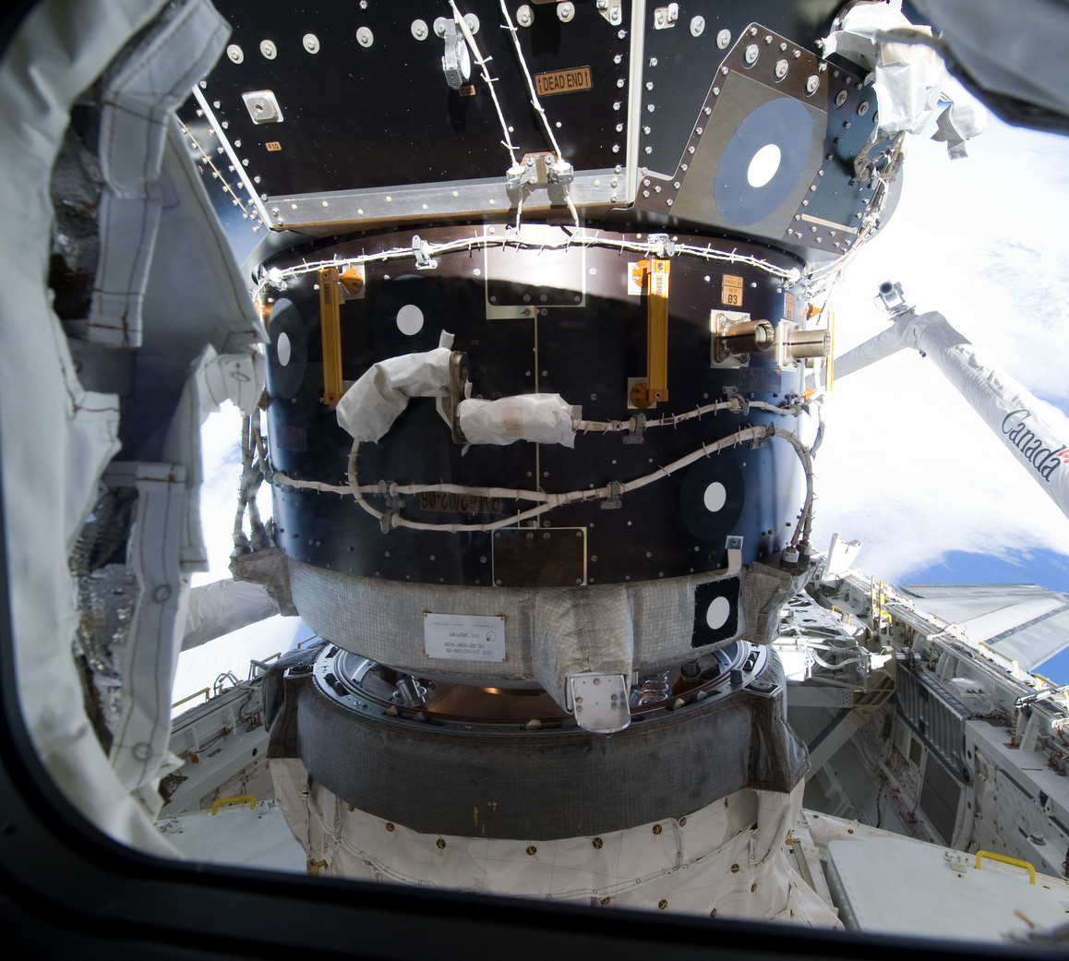
Transferring Attitude Knowledge Between Vehicles (ODS Offset, Q_{Body_ISS})
Q_{Body_ISS} over time immediately after docking
ODS to ISS on STS-133
Q_{Body_ISS} = Q_{Body_M50} · Q_{M50_J2K} · Q_{J2K_ISS}
_{From telemetry}
_{Constant}
Notes:
With US GPS units the US segment was propagating nav knowledge with RGAs and then getting periodic resyncs from the Russian Segment
Connection was a small cylindrical tunnel to the air lock in the PLB, docking was not at exactly 90 deg.
Lots of structural flex after docking which would settle out/pressurize and were actually vehicle specific – offset from 90 deg called ODS offset (Orbiter Docking System)
Angle also shifted as ISS was assembled over time
Snap shot attitudes of both vehicles once settled to define the attitude frame converstion between vehicles, orbiter dependant due to small differences in docking mechanicsm clocking

Slide 27
Manual Piloting the Mated Stack
Initial transients during momentum management startup could be reduced by handing over attitude control as close as possible to the attitude momentum management would settle in.
Analysis repeated during STS-117 showed the Shuttle control system was instable with commanded rate error deadbands of 0.001 d/s
The Shuttle control system could not reduce errors low enough for direct handover to ISS momentum management
…But what about a human?

Slide 28
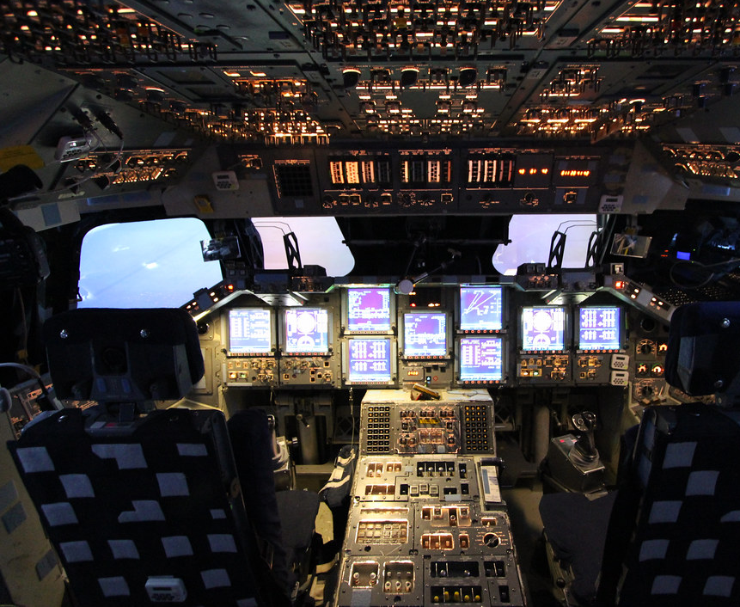
Manual Piloting the Mated Stack
Expected TEA was converted to Orbiter commands using the ODS offset to be as accurate as possible.
Crew then commanded an attitude deadband collapse from 3 deg to 1 deg and then to 0.5 deg.
Crew commanded FREE
Crew used the Rotational Hand Controller (RHC) to manually fly out remaining rate errors
Procedure successfully demoted on STS-117
Improved on STS-129 to deadband collapse to 0.1 deg and no longer required RHC

Slide 29
Solution!
On FN8 the source of the Russian computer failures were isolated to a common power protection circuit that was bypassed via IFM (In-flight maintenance).
Orbiter -> ISS Attitude:
After several days of verification, the contingency procedure to transfer attitude knowledge from Shuttle to ISS was ready but thankfully no longer needed.
As a DTO (Detailed Test Objective), ISS attitude derived from Shuttle was updated to an inactive attitude state onboard ISS on FD10 and found to have 0.35 deg RSS error compared to the Russian states
Resulted in a new SCP
Published Paper: https://arc.aiaa.org/doi/10.2514/6.2011-7195
Direct Attitude Control Handover:
New procedure “Handover Attitude Control Orbiter to CMG Only without RS SMTC” was developed and successfully executed as a DTO on STS-118 and then improved on STS-120 to no longer need hand controller inputs

Slide 30
Operations Plays a Role in the Entire Engineering Life Cycle
Requirement and Mission Definition
Manufacturing, Testing, Analysis, Mission Planning
Mission Execution
Lessons Learned
What flexibilities/contingencies might we need?
Fail-Ops, Fail-Safe
Crew perspective
Unexpected system interactions often become operational workarounds
Simulations
Operational limit
Operational tools (ground and onboard)
The Failure of all Russian Computers was never imagined – Operators must build flexibilities into the design to respond to the unexpected
The ODS offset was used in ways it was never imagined – Operators need to understand their spacecraft and the full extent of its capabilities
Spaceflight leaves no margin for error- Even if you have all the technical correct and every procedure checked, that is not enough.
Notes:
The hardest failures that occur are the ones you have not thought of, else there would be a procedure or a FR or an operations constraint to prevent or help you out

Slide 31
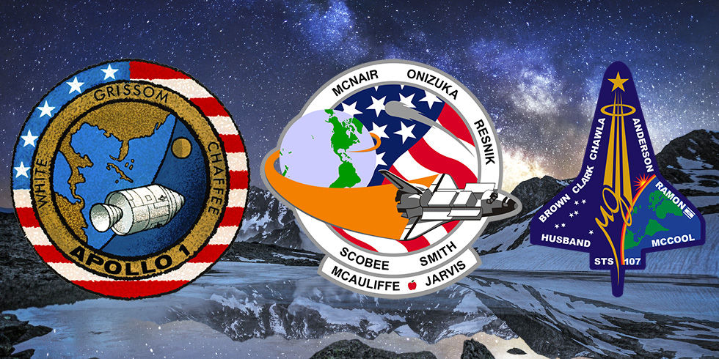
Notes:
All were a failure of communication

Slide 32
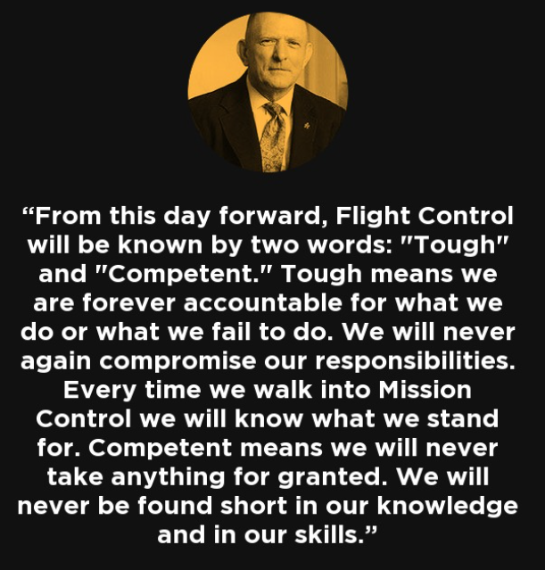
- Gene Kranz following Apollo 1
Notes:
We work hard to instill a culture within FOD and most of that has a legacy in Gene Kranz who helped develop the concept of MCC with Chris Kraft….
Touch and Competent on white boards…
Led to Foundations…

Slide 33
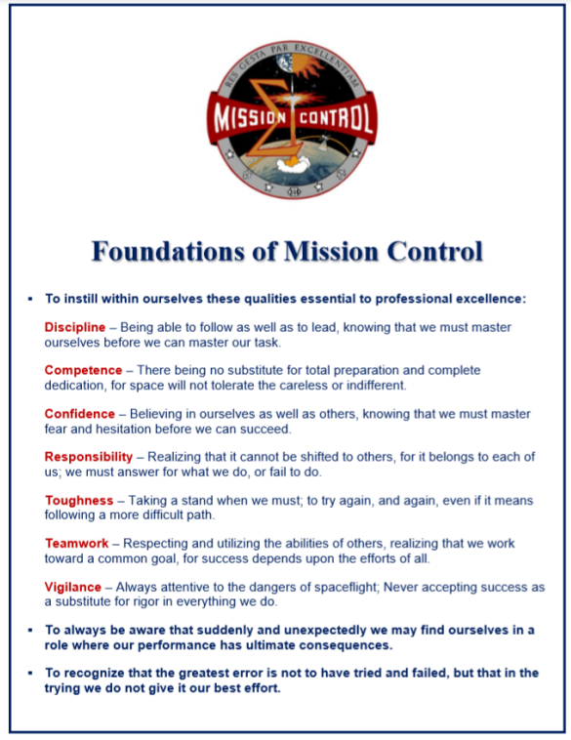
Notes:
Vigilance added after Columbia
Wary of deviation bias, oh it’s always that way. But was it designed to be that way

Slide 34
