Slide 1
Shape, Sizing, and Topology Design of an Aeroelastic Wingbox
Bret Stanford
NASA LaRC, Aeroelasticity Branch

Slide 2
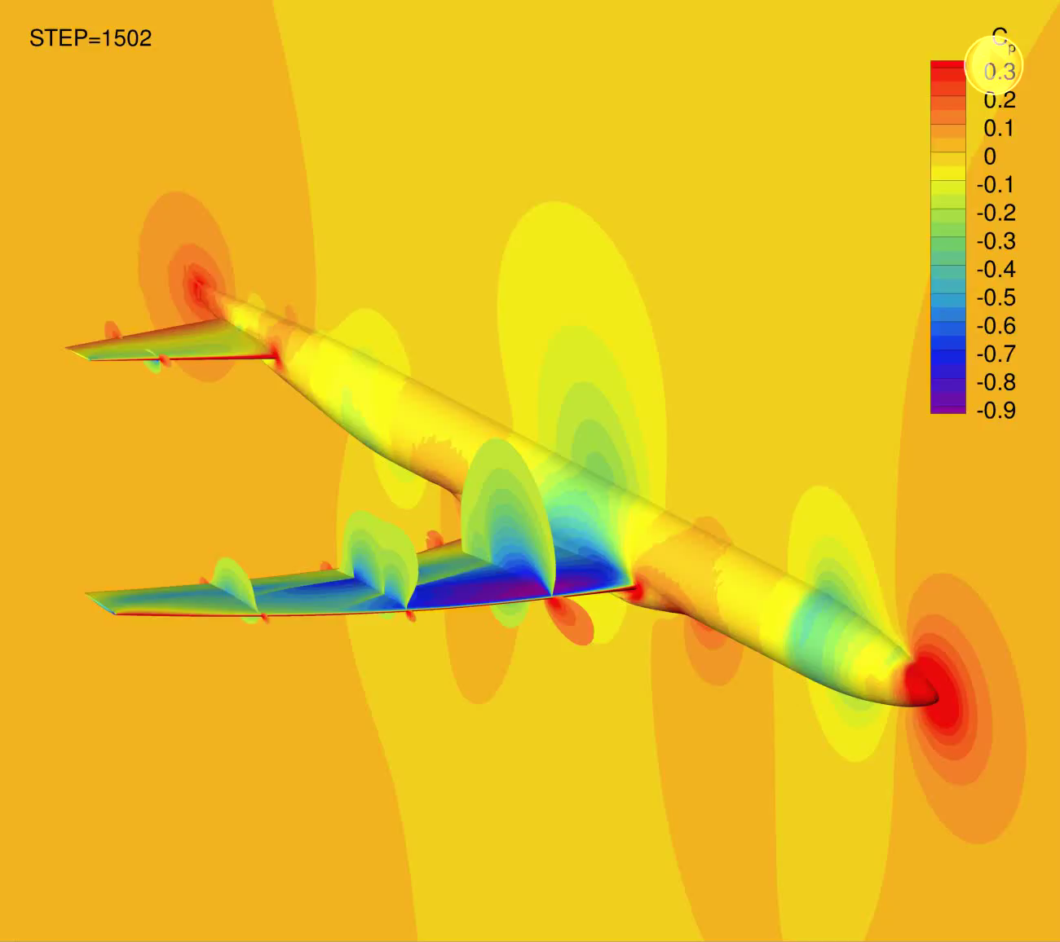
Aeroelasticity
Coupled interactions between aerodynamics and structures:
  The aerodynamic load on a flexible wing is not known a-priori
aerodynamics
structures

Slide 3
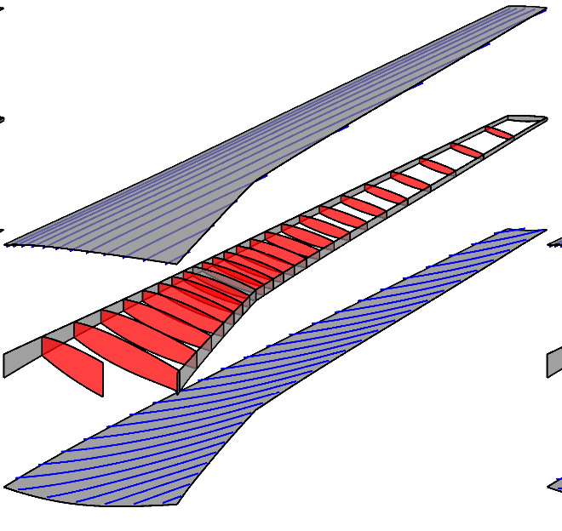
Wingbox Structures
Upper and lower skin panels (covers)
  Support most of the load path
Internal web members:
  Spars, ribs, skin stringers
  A major role of these members is to ward off skin buckling

Slide 4
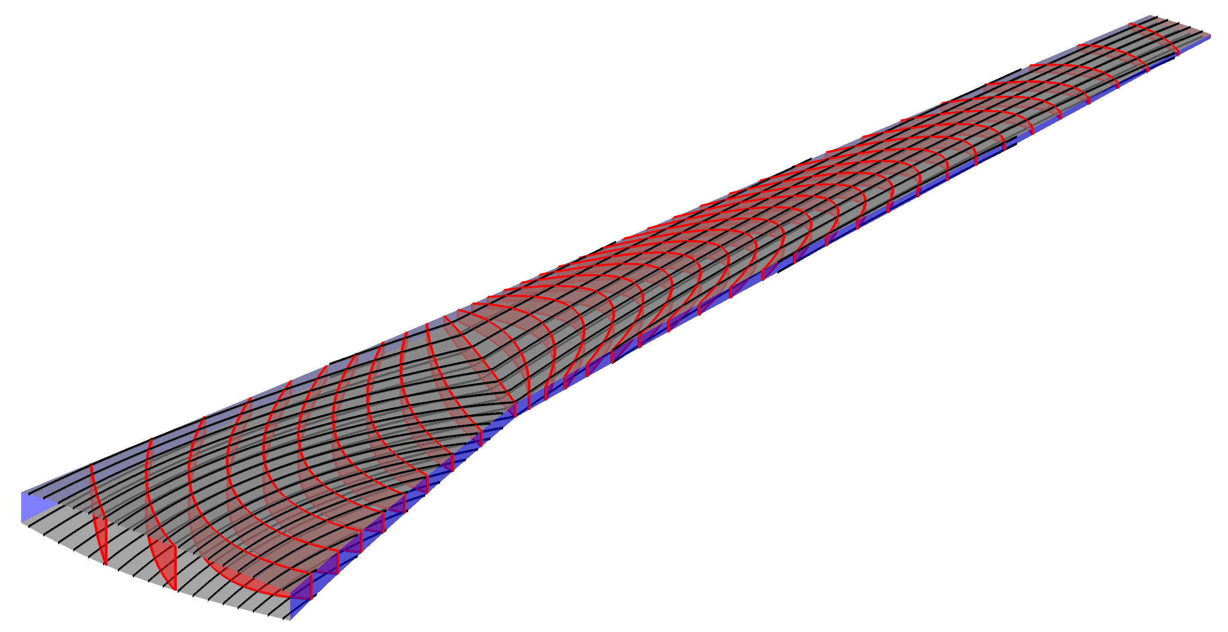
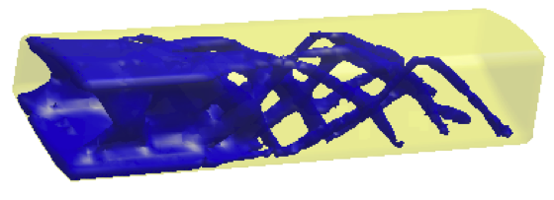


Topology Optimization of Wingboxes
Identify the optimal distribution/layup of support material within a wingbox (through-depth)
Skin buckling is a key design driver
Three topology optimization ideas:
location, orientation, connectivity, curvilinearity of ribs/spars/stringers?
distribution of material within the shell structures?
distribution of 3D material within the wing box?
Oktay et al., 2011
James et al., 2014
simultaneous or sequential optimization

Slide 5
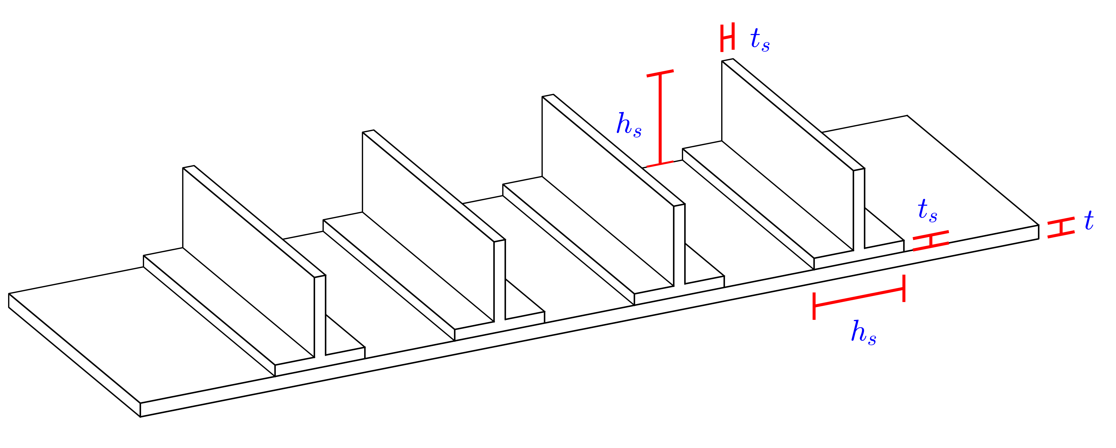
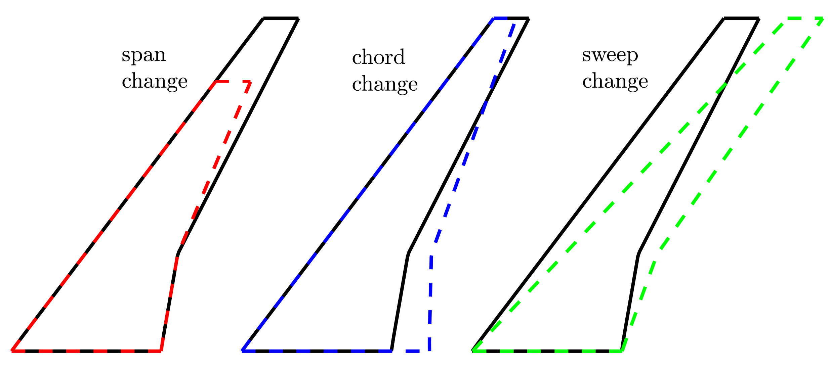
Wingbox Design Variables
Structural sizing: ribs, spars, skins
Wing shape: planform, twist, t/c
Topology/layout of ribs and skin stringers

Slide 6
Research Questions
How can we optimize all three design variables types at once?
  Sizing and shape design can be handled with gradient-based optimization
  Layout design cannot:
    Some integer design variables
    Some continuous design variables, but adjoint derivatives cannot be easily computed, or the design space is messy
  Large MINLP (Mixed Integer Nonlinear Programming) problem
What difference does it make?
  Are the design synergies between the 3 groups strong enough to matter?

Slide 7
Nested Optimization
done
non-GBO global optimizer
not done
topology DVs via surrogate in-fill based optimization
identify a candidate x_{global}
evaluate aeroelastic response of x_{global}
GBO local optimizer
done
freeze x_{global}, initialize x_{local}
sizing and shape DVs via gradient-based optimization: GCMMA
not done
update x_{local} parameters
evaluate aeroelastic response

Slide 8
Optimization Problem Definition
Want to find the Pareto front between aerodynamic drag and structural weight
  More specifically: the Pareto front between fuel burn (FB) and landing weight (LGW)
Constraints:
  Stress and buckling margins from static aeroelastic load cases
  Gust and flutter margins from dynamic aeroelastic load cases
  Buffet margin

Slide 9
Pareto Trade-Off Curves
Minimum FB designs: small benefit to including layout variables
  Could just optimize shape and sizing variables with a frozen layout/topology
Minimum LGW designs: large benefit to including layout variables
  Strong synergies among 3 design variable sets

Slide 10
Optimal Designs
skin thickness (mm)
lower skins
upper skins
minimum fuel burn (FB)
minimum landing weight (LGW)

Slide 11
Benefits of Including Curved Members
Minimum FB designs: some benefit to including curved topologies
  But could they buy their way onto the airplane?
Minimum LGW designs: no benefit to using curved topologies here

Slide 12
Optimal Designs
skin thickness (mm)
lower skins
upper skins
minimum fuel burn (FB)
minimum landing weight (LGW)

Slide 13
Conclusions
Have shown that nested procedures can be used to capture design synergies between shape, sizing, and layout design variables
For low-weight designs (minimum-LGW), these synergies matter:
  Optimizing with only shape and sizing parameters gives an inferior result
For low-drag designs (minimum-FB), the advantages are minor
  But these designs do benefit from the use of curvilinear topologies

Slide 14
bret.k.stanford@nasa.gov

