Slide 1
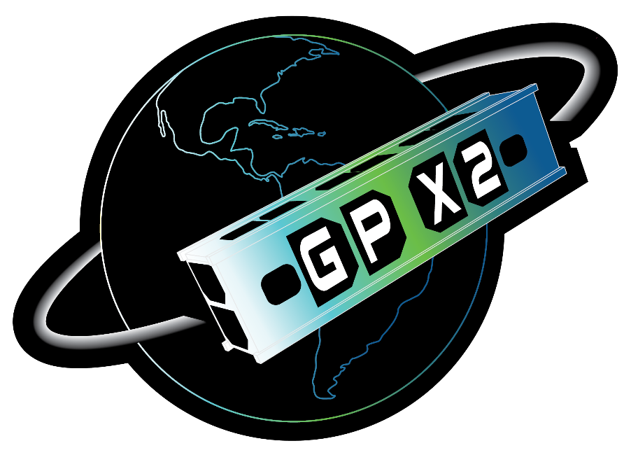
Lessons Learned Developing Flight, Ground, and Mission Operations Software for the GPX2 Technology Demonstration 3U CubeSat
Mark Banchy & David Keck
GPX2 Flight and Ground Software Leads
http://engineering.larc.nasa.gov/

Slide 2
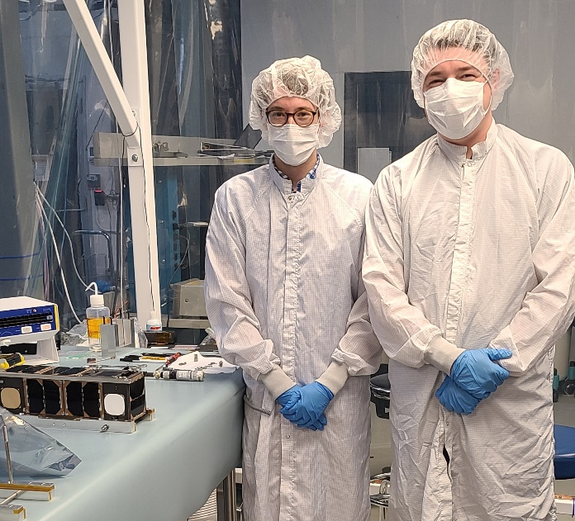
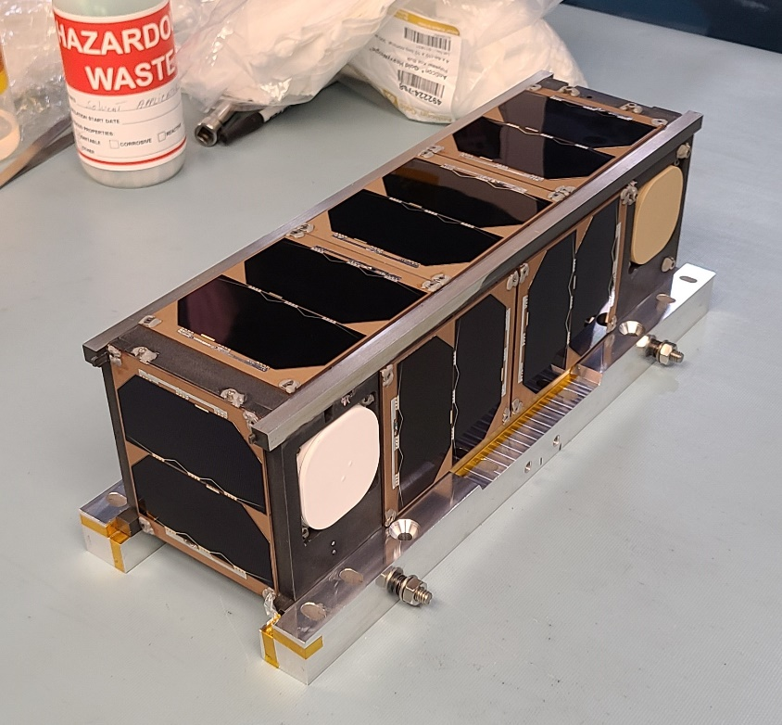
Agenda
GPX2 Project Overview
  Mission Objectives
  Project Status
  Flight Software/Hardware Architecture
  Ground Software/Hardware Architecture
Software Lessons Learned
  Design
  Development
  Integration/Test
  Operations
Questions

Slide 3
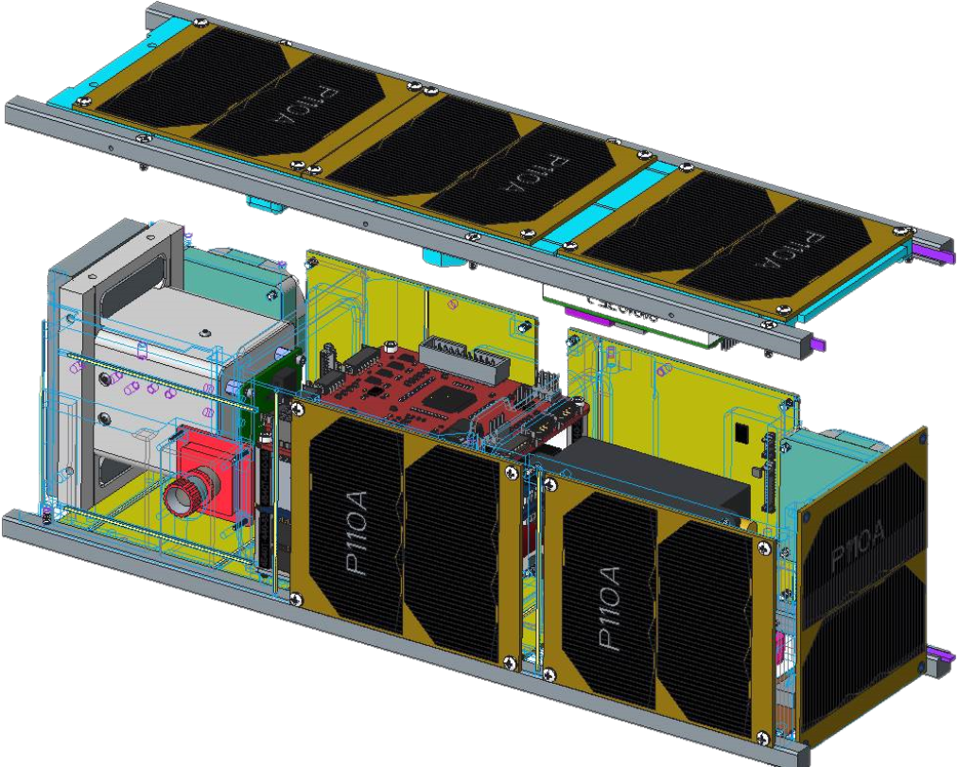
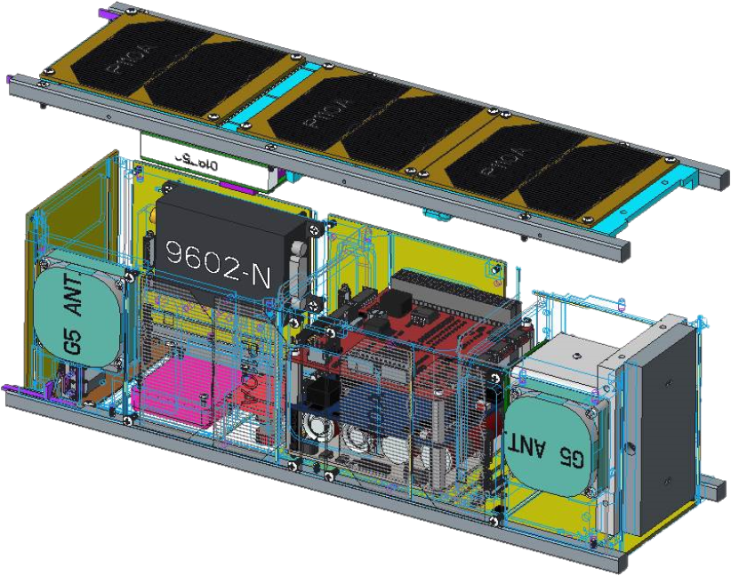
Mission Objectives
What is GPX2?
  3U technology demonstration CubeSat
    Increase the Technology Readiness Level (TRL) of hardware components
      LaRC Flight Computer Processing Unit (FCPU), uCAM-III cameras, and chassis made from Windform XT 2.0
    Increase knowledge/experience utilizing Iridium Short Burst Data (SBD) communications
      Build on NASA Ames experience utilizing SBD
    Attempt an off-the-shelf Align experiment via the NovAtel OEM719 GPS Receivers
      Aimed at measuring a known distance between the G5 Antennae via Align relative positioning
    Workforce development (small and young team)!

Slide 4
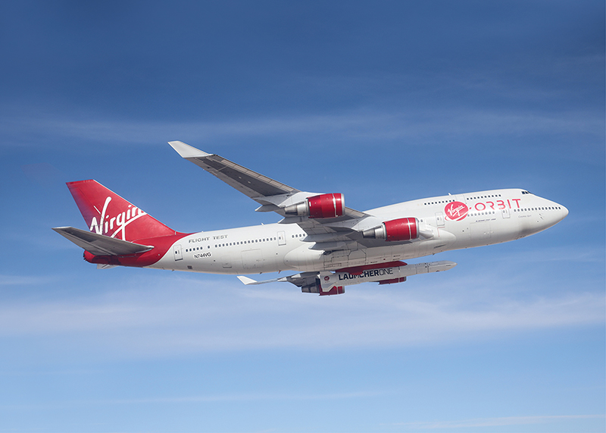
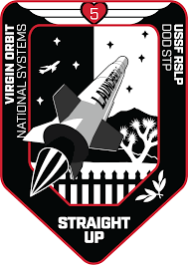
Project Status
Launched July 2nd 2022 on Virgin Orbit’s LauncherOne as part of the “Straight Up” mission
  Successfully reached a ~500km circular orbit
  Received first health and status beacon ~45 minutes after deployment
  Demonstrated Iridium SBD transmissions and are working to further characterize them
    >1MB through Iridium SBD thus far
  Demonstrated uCAM-III camera operates on orbit
    26 images from orbit transmitted thus far
  Demonstrated NovAtel OEM719 receivers are operational, unfortunately an Align mode lock has not been achieved
  Have been operating nominally since launch!
Credit: NASA

Slide 5
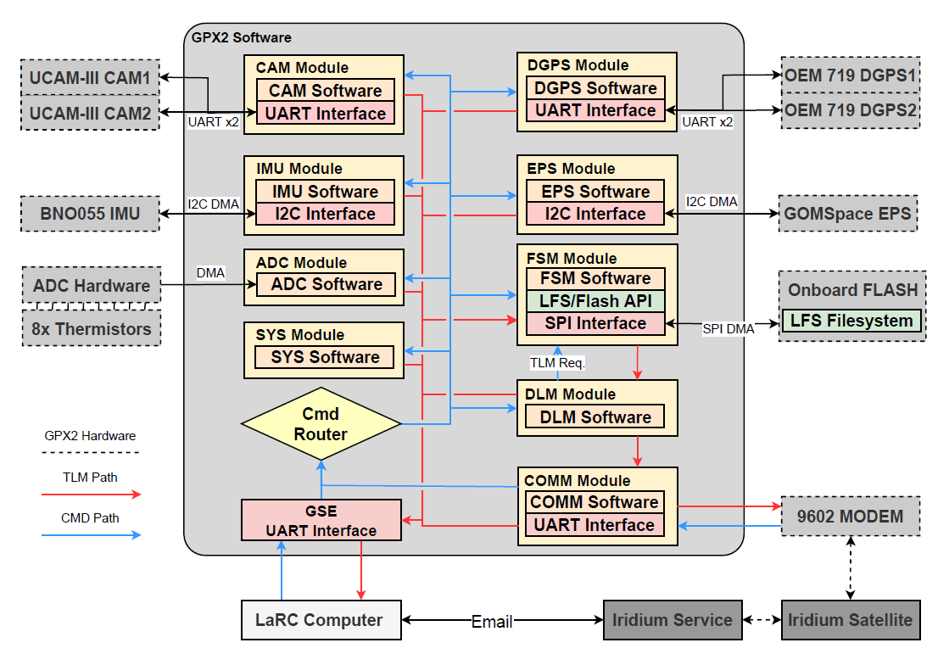
GPX2 Flight Software/Hardware Architecture
LaRC developed flight hardware and software
  LaRC Flight Computer Processing Unit (FCPU) design utilizing STM32F407VG chip
    16MHz Internal Clock, 196KB RAM, 1MB Internal Flash, Direct Memory Access (DMA) controller
    32MB external flash chip running Little File System (LFS)
  LaRC flight software (FreeRTOS) and ground software (Python/COSMOS)
GPX2 Flight Software Architecture

Slide 6
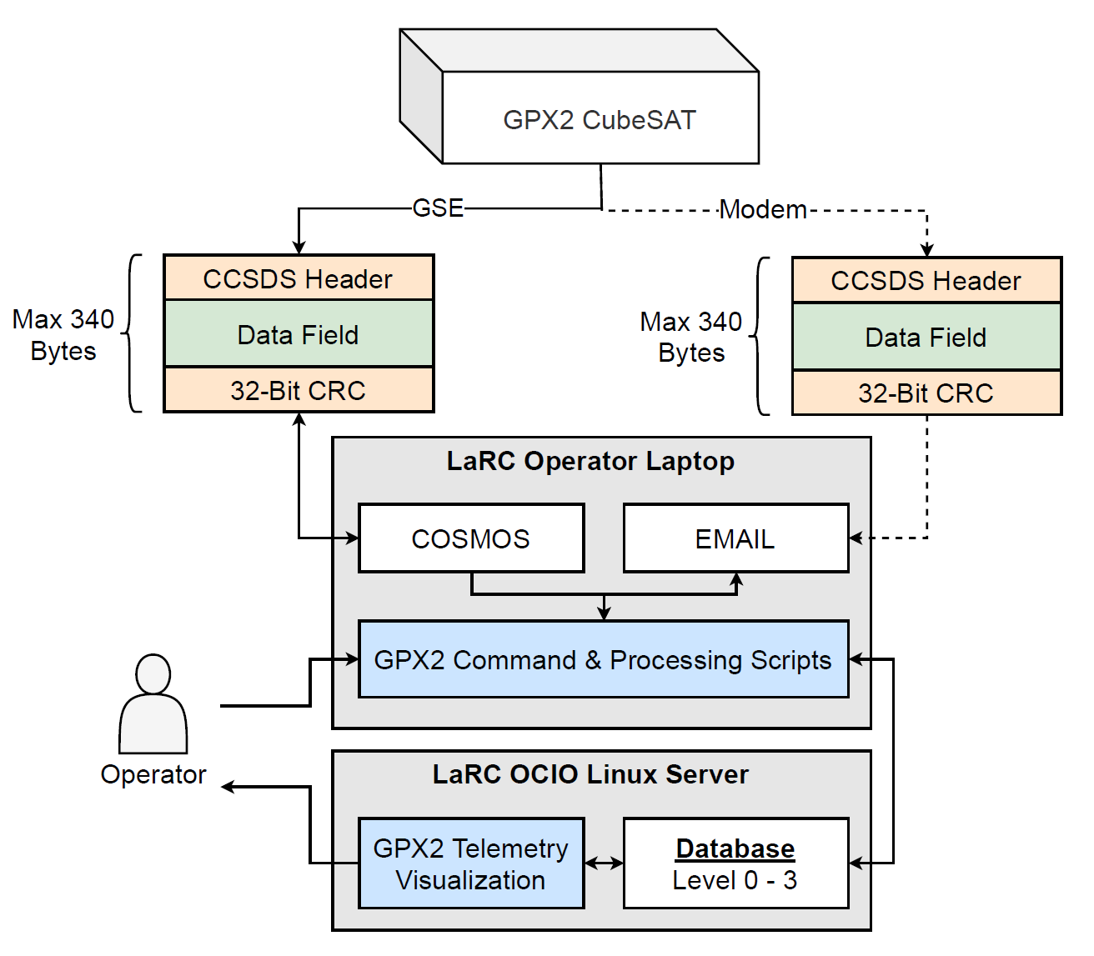
GPX2 Ground Software/Hardware Architecture
Two data interfaces into GPX2
  GSE: COSMOS utilized as primary ground testing/development software
    LaRC Python scripts leveraging COSMOS interface for definitions for database logging.
    COSMOS utilized heavily for development and testing (test script running, limits monitoring, telemetry logging, etc.)
  MODEM: (Iridium) Interfaces via email
    LaRC Python GUIs for command crafting and telemetry processing (stitching packets back together)
GPX2 Ground Software Architecture

Slide 7
Lessons Learned (Design & Development)
Leverage open-source tools to allow for quick and flexible design and development
  Flight Software
    FreeRTOS
    Little File System (LFS)
    LUA
  Ground Software
    COSMOS
    Python
    Grafana
    MariaDB
    DearPyGUI
  Static Analysis
    Cppcheck
    Sourcemonitor
    Cobra
Neither the U.S. Government nor NASA endorse or recommend any commercial products, processes, or services. Reference to or appearance of any specific commercial products, processes, or services by trade name, trademark, manufacturer, or otherwise, in NASA materials does not constitute or imply its endorsement, recommendation, or favoring by the U.S. Government or NASA.

Slide 8
Lessons Learned (Design & Development)
Leveraging DMA controller optimized capabilities of the resource limited microcontroller
  DGPS, IMU, EPS, ADC, and Flash interfaces all heavily utilize the onboard DMA controller
    2x UART, 2x I2C, 1x ADC, and 1x SPI
Utilizing Little File System (LFS) onboard for long term telemetry storage added flexibility and data integrity to GPX2
  LFS performs dynamic wear-leveling, power-loss resilience, CRC checking, and bounded RAM/ROM usage
GPX2 Flight Software Architecture

Slide 9
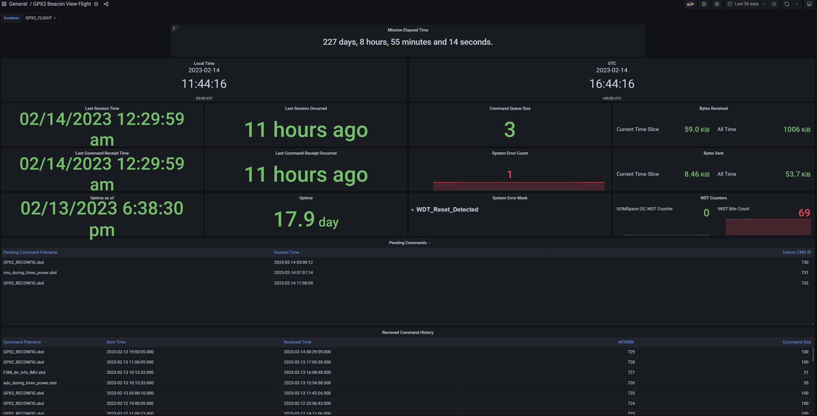
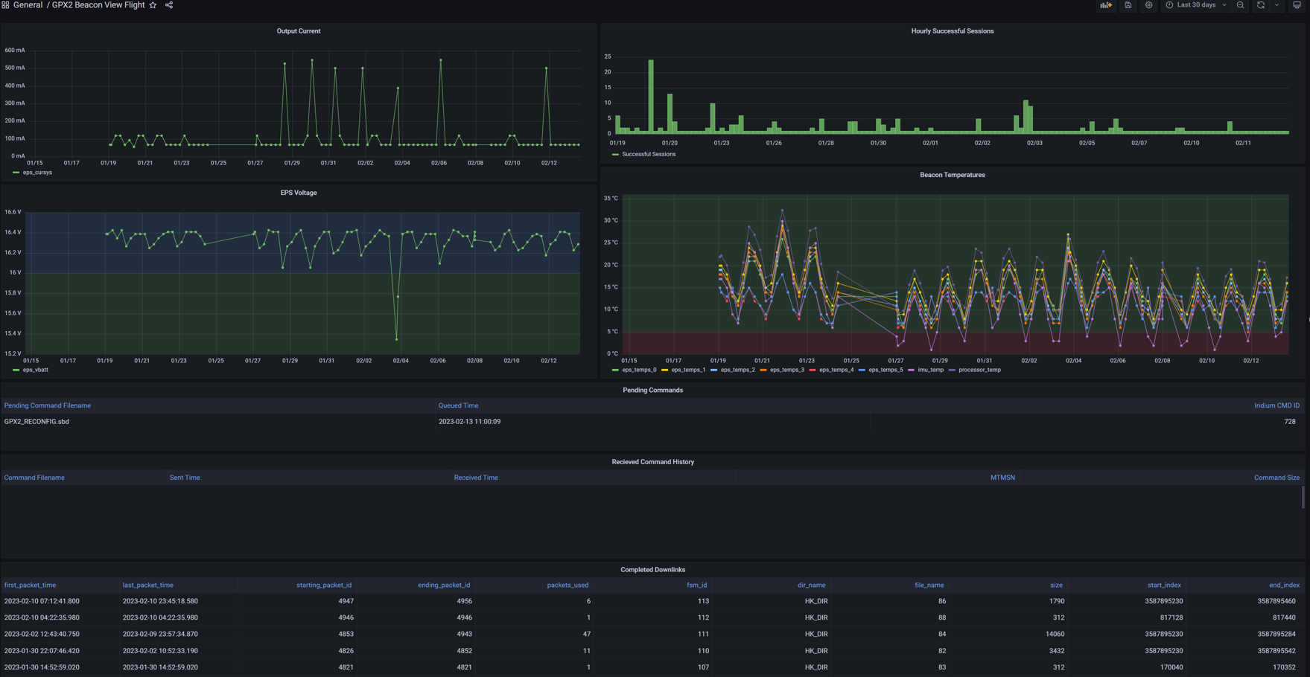
Lessons Learned (Design & Development)
Flexible ground software design allowed for sharing and collaboration of test and flight data
  Ground software populates a MariaDB database via a Python script that pulled from COSMOS
    Flexible Python “glue” with a single point of truth for telemetry and command definitions
  Utilizes LaRC hosted Grafana database viewer
    Easily able to add users and customize their views
    Remote viewing/sharing of test data for project members and management during integration, testing, and operations activities
    Great for timestamped time-series data
    Not ideal for viewing images
GPX2 Grafana Page Examples

Slide 10
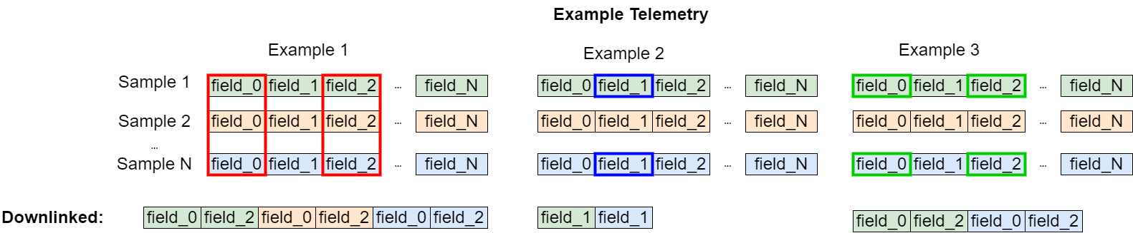
Lessons Learned (Design & Development)
Utilize telemetry indexing to reduce data bandwidth and increase flexibility
  GPX2 Iridium SBD bandwidth is extremely limiting (average throughput ~3.5kB per day)
  The software team devised a way to splice and index the system’s logged telemetry
    Late addition to the software development effort
    Able to implement this feature quickly (< 1 week) and it has proven invaluable on-orbit

Slide 11
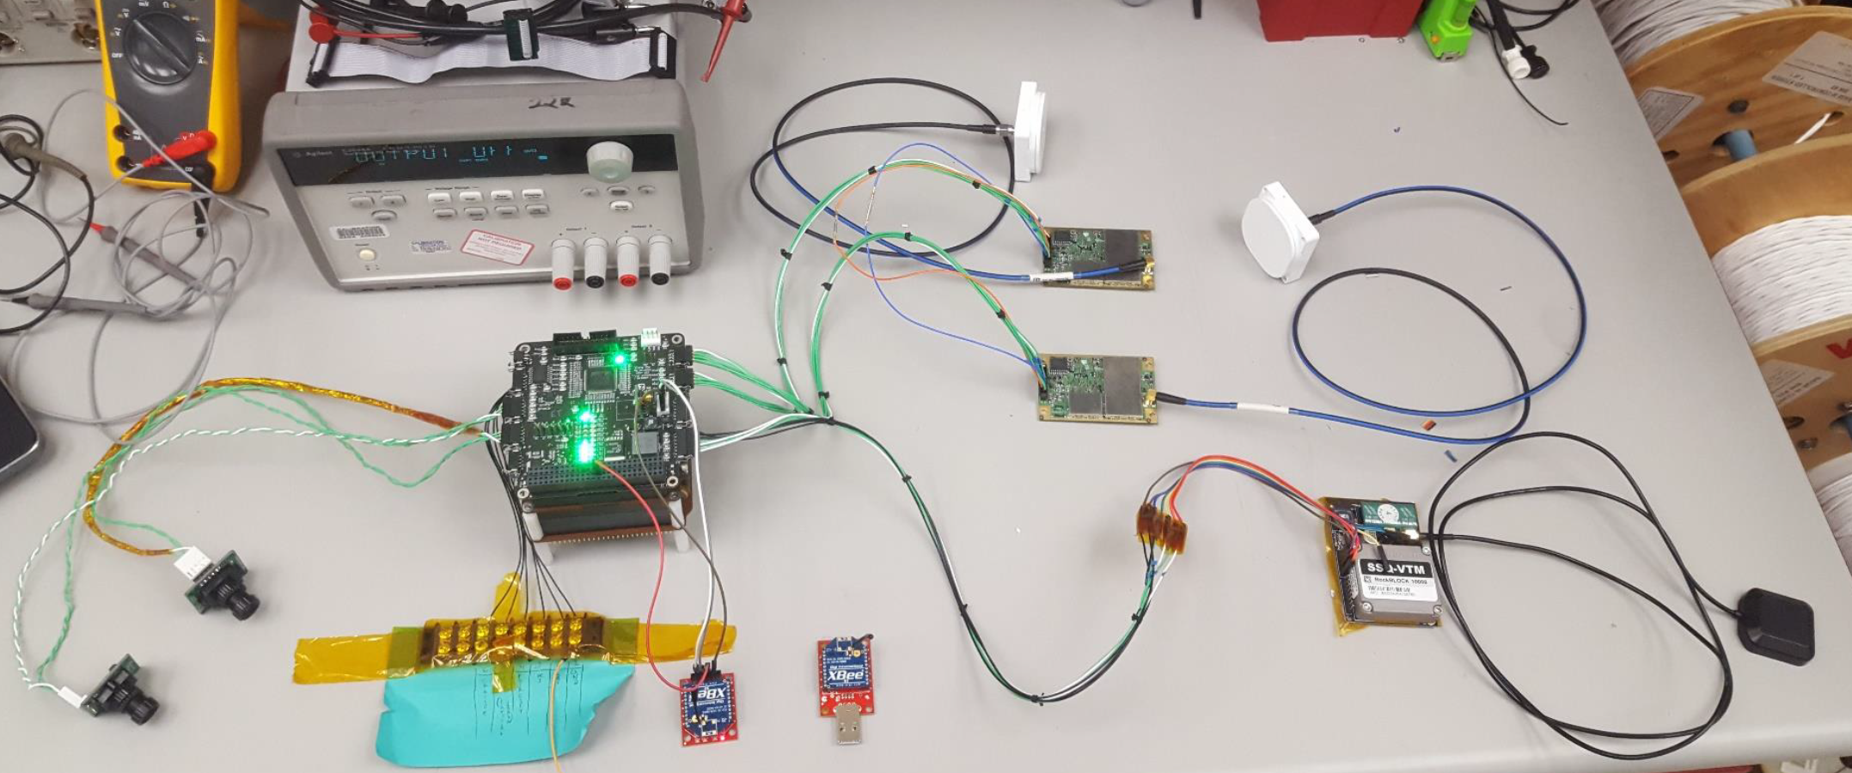
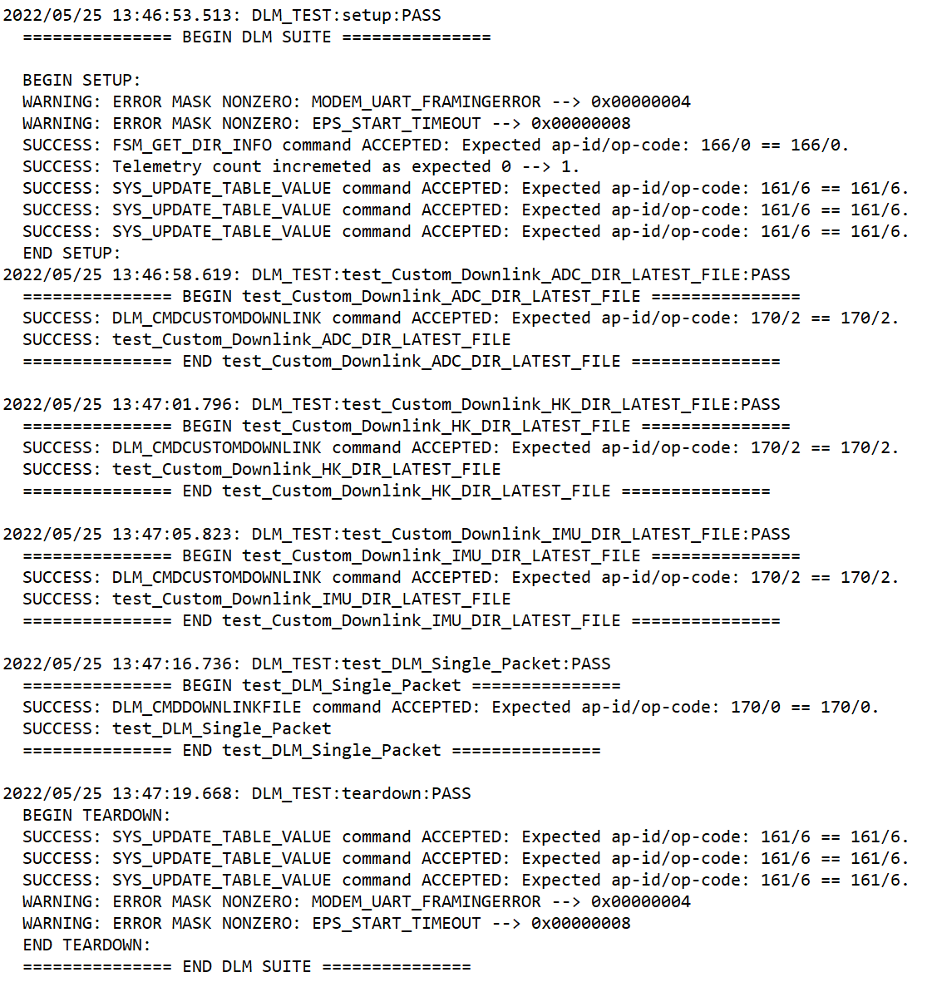
Lessons Learned (Integration & Test)
Importance of flight-like flatsat for software development and testing
  Complete system with flight-like hardware
    Able to run end-to-end testing years before launch
    Caught a lot of issues early!
Importance of utilizing automated system level testing
  Wrote system level tests via COSMOS “TestRunner” framework
    Sends every command within the system, checks for correct number of Rx/Tx bytes, relevant counters incrementing, and reports all error masks before/after command processing
    Produced output logs that proved invaluable
      Could go back and check historical test runs as needed
    Allowed automation of TVAC testing!
      Every TVAC test point ran 33 tests in ~5min
GPX2 Flatsat
COSMOS “TestRunner” Sample Output

Slide 12
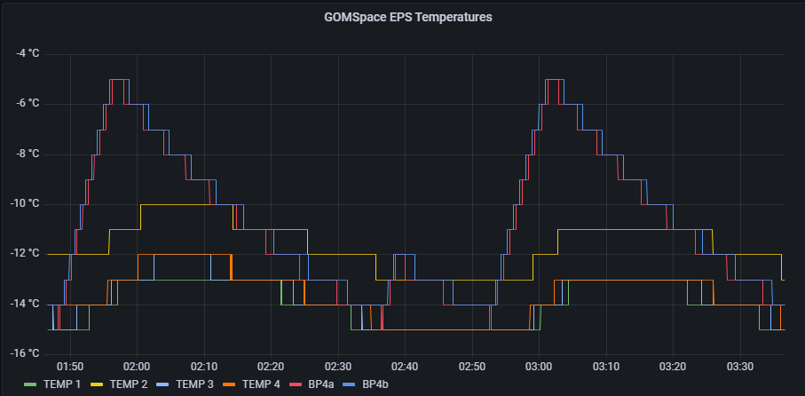
Lessons Learned (Integration & Test)
Stay connected with hardware/software vendors regarding the project specific configuration details
  Spurious watchdog reset discovered on GOMSpace Electrical Power System (EPS) during TVAC
    This meant random unintended power cycles
    Evidence of this reset was found in archived test data
  The vendor admitted to having knowledge of this
    They even had a patch for it!
      It was too late for GPX2 to apply this patch
  The software team quickly developed a FSW patch that allowed for mitigation of reset on-orbit
    Problem continues to occur ~6hrs on orbit without hindering the mission
    This issue could have been mitigated if there was better communication with the vendor
Manifestation of GOMSpace EPS Reset

Slide 13
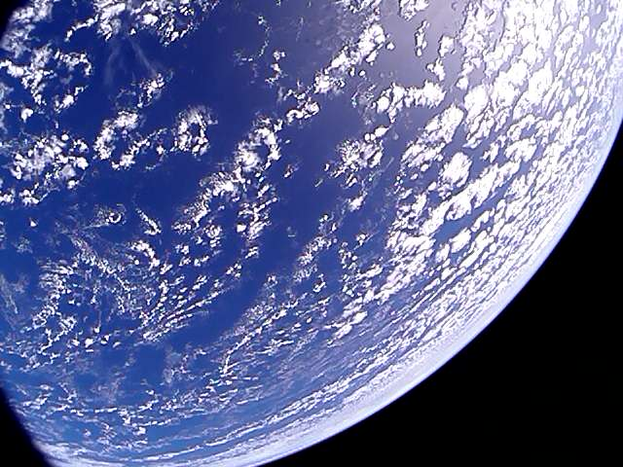
Lessons Learned (Operations)
Have a detailed operations plan including who will staff this phase of the project
  FSW engineers often become operators
  Secure funding for software team
Automate operations as much as feasible
  The team quickly learned it was clunky to manually operate the way it was originally planned
    Over time, various scripts/tools have been developed for quality-of-life improvements
Enjoy the view!
First Image From GPX2

Slide 14
Concluding Remarks
GPX2 is a 3U technology demonstration CubeSat developed by LaRC
  Successfully launched via Virgin Orbit’s LauncherOne and operational since July 2nd, 2022
Key Lessons Learned
  Leverage tools that are available to you (first step is to learn what tools are even available!)
  Good software designs pay dividends
  Automate things in an efficient way (work smart not hard)
  Embrace being able to “fix-it-in-software”
  Stay connected with vendors
Next Steps
  Continue operations of GPX2 and monitor its health and status
    Continue attempting Align experiments and characterizing Iridium SBD transmissions
  Apply these software lessons to other LaRC projects and future CubeSat projects
    Software reuse is already underway for some GPX2 software

Slide 15
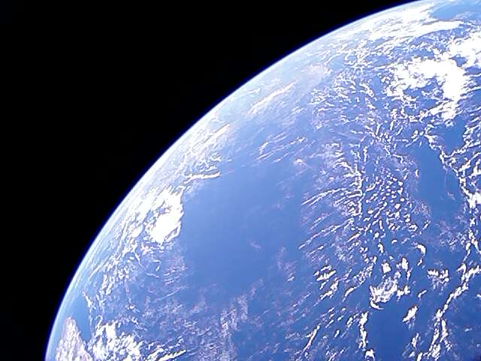
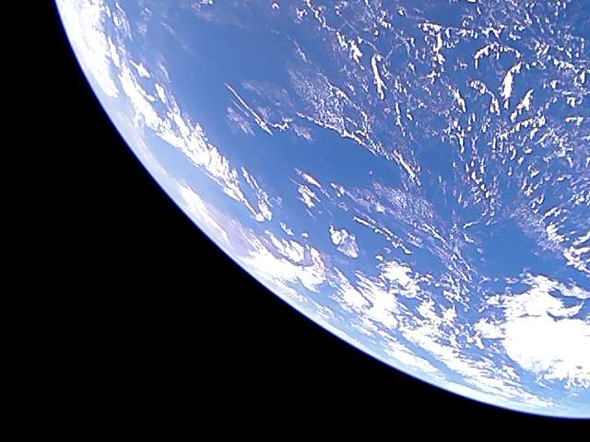
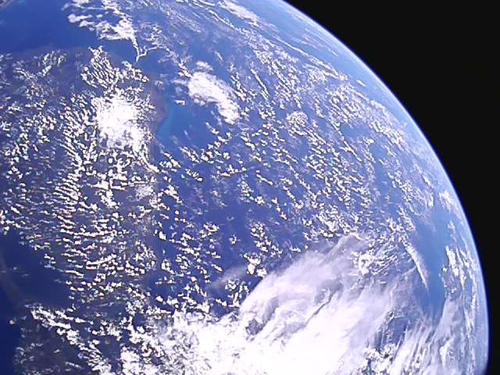
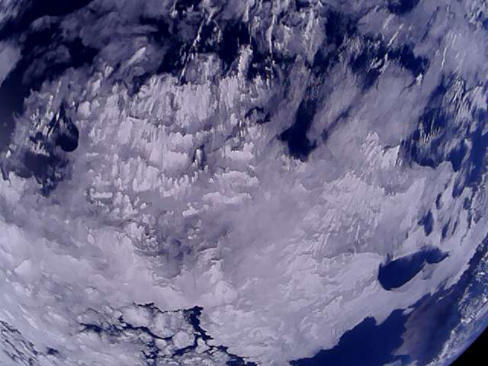
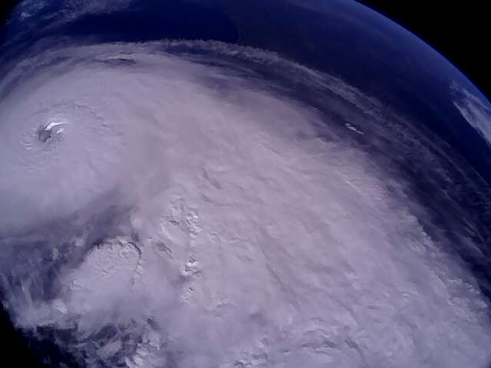
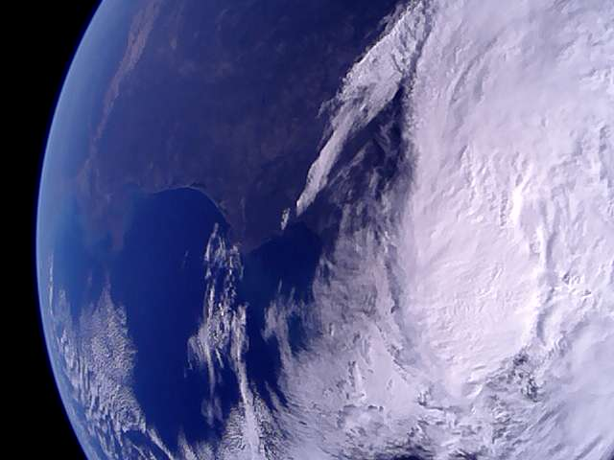
Questions?
Sample Pictures Taken From GPX2

Slide 17
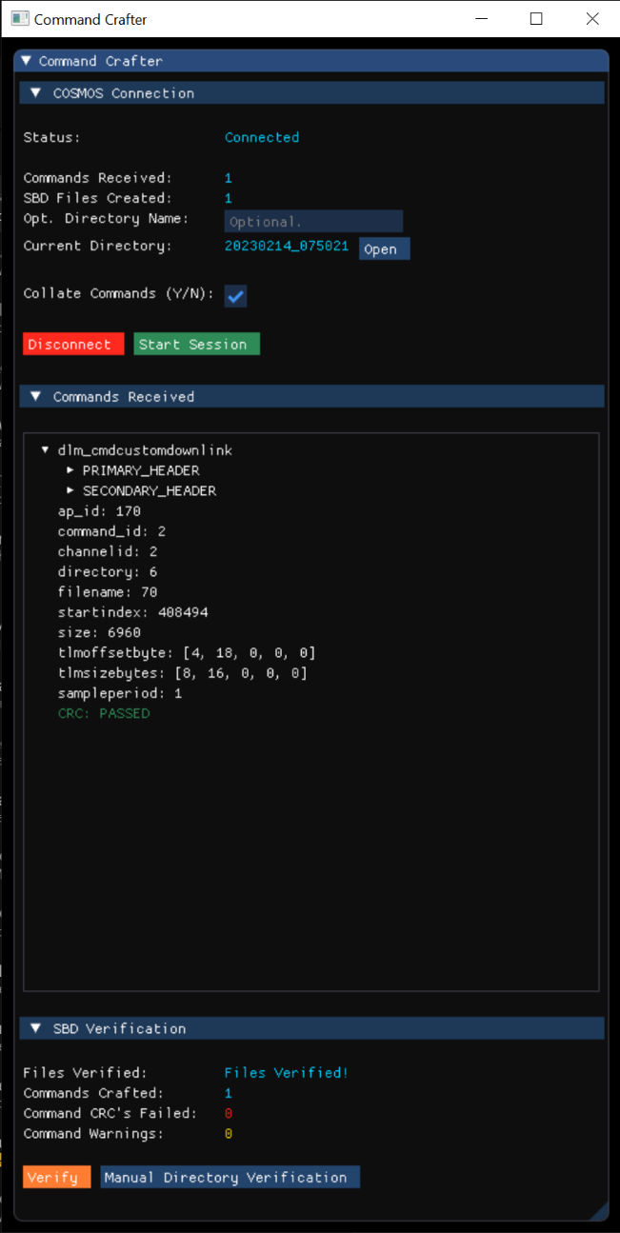
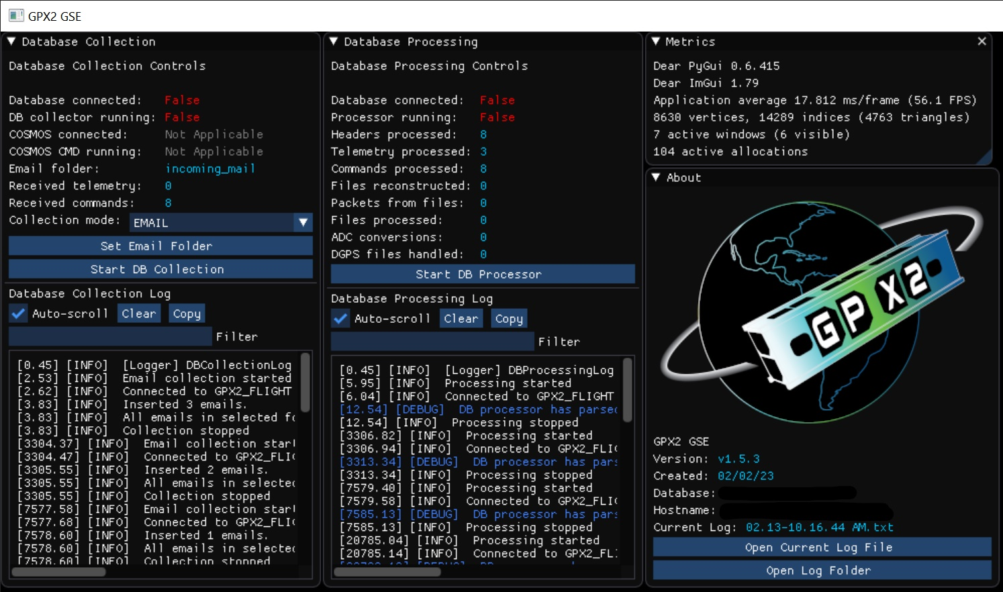
Ground Software Python GUIs

Slide 18
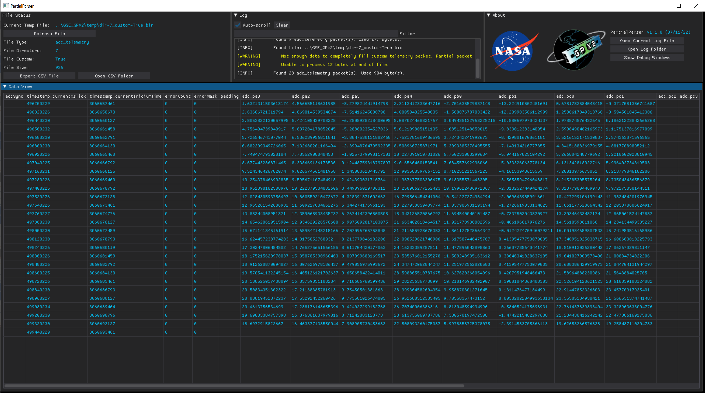
Ground Software Python GUIs

