Slide 1
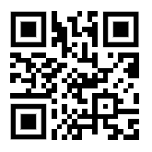
NASA – JSC Wearable Robotic Technologies
on behalf of the
Software, Robotics, and Simulation Division
NASA/Johnson Space Center

Slide 2

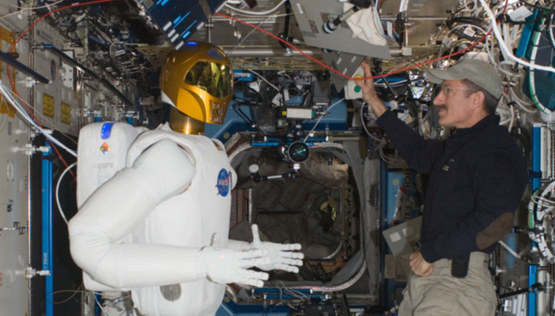
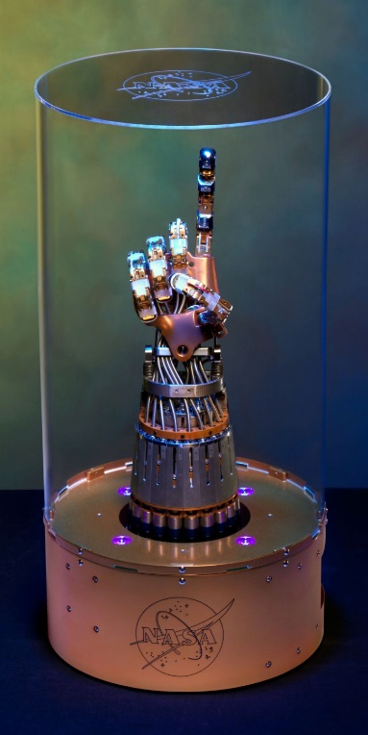
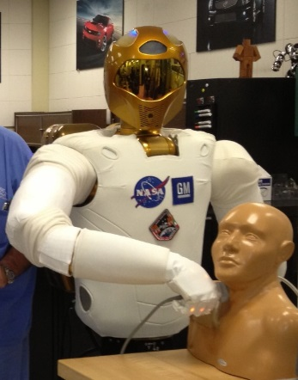
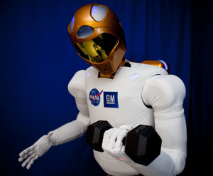
Robonaut 2 (R2): NASA-JSC Wearable Robotic Technologies’ common ancestor
Humanoid robot designed to assist humans on Earth and in space
  Partnership with General Motors
Technologies developed, and now leveraged:
  Series Elastic arm joints
  Embedded electronics
  Tendon-driven dexterous hands
  Custom internal communication bus
  Fault-tolerant safety system approved for space
Multiple spinoffs, including wearable robotic applications

Slide 3
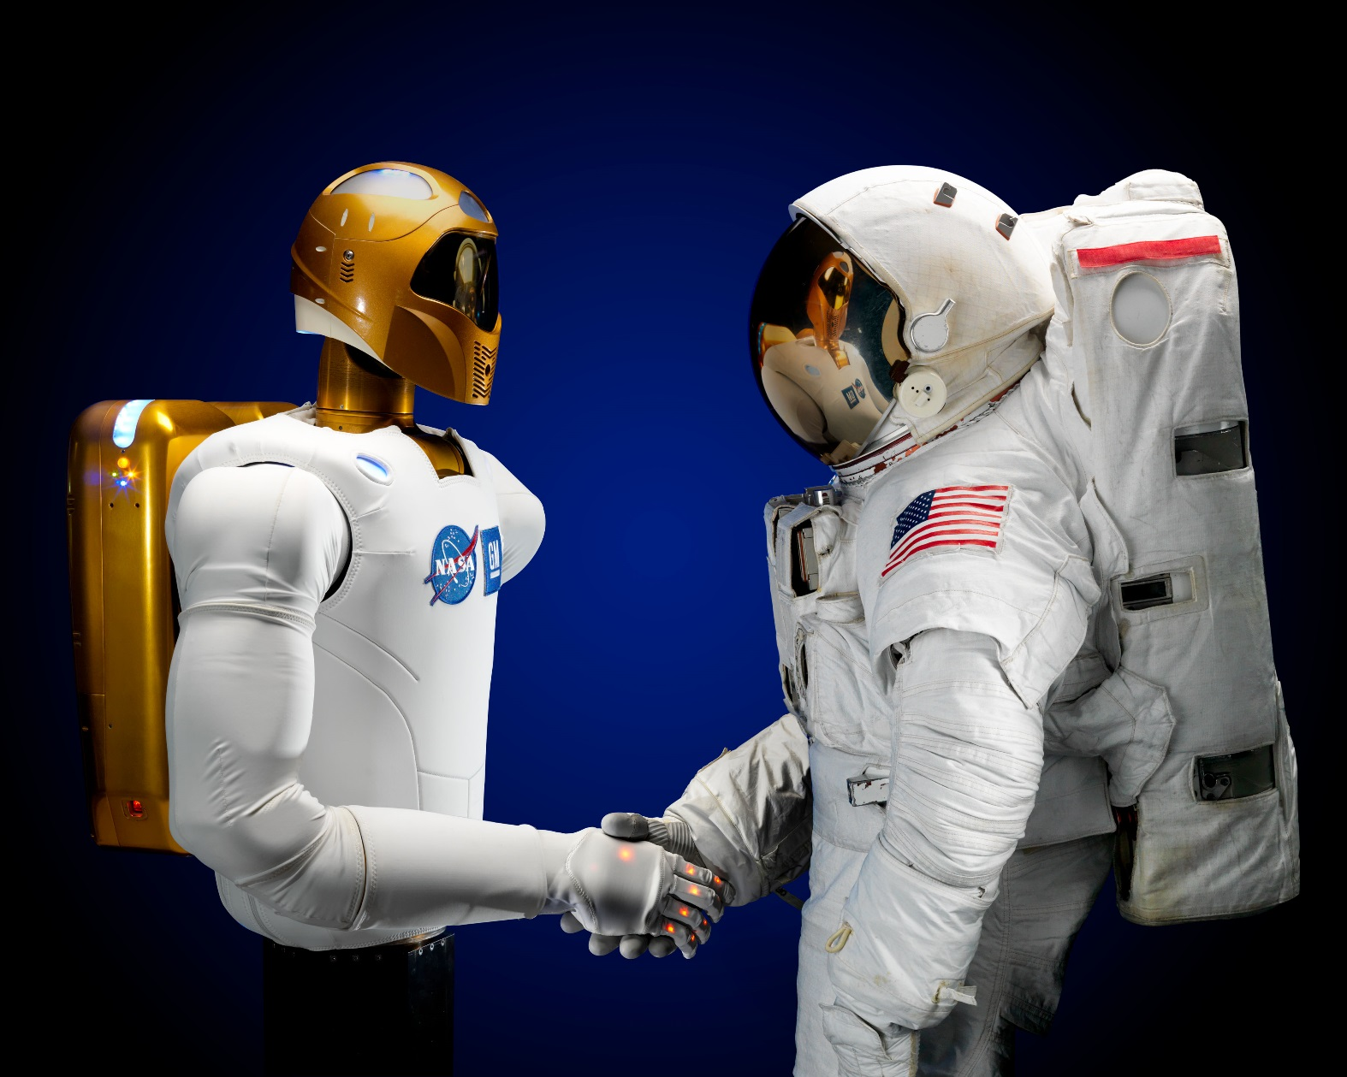
JSC Wearable Robotics Development
Robonaut 2 Technology – wearable spinoffs
  X1 Lower Extremity Exoskeleton
  Hopper
  RoboGlove
  Space Suit RoboGlove
  Armstrong Garment
  Force Shoe
  MED-2
  Portable Dynamometer
  Sensorimotor Countermeasures Device
  Upper Extremity Offload Device for Gravity Offload System

Slide 4
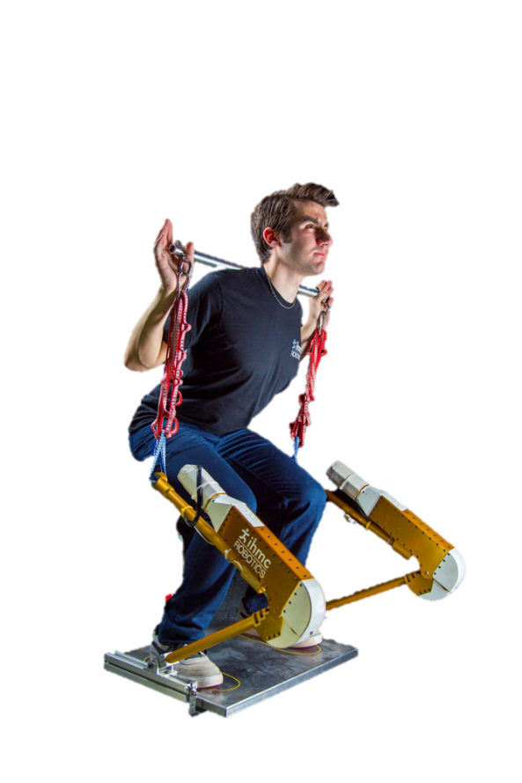
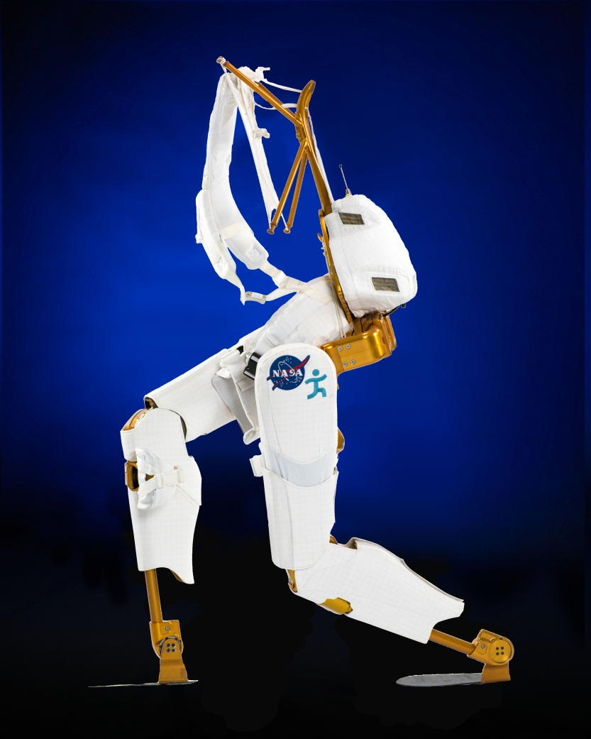
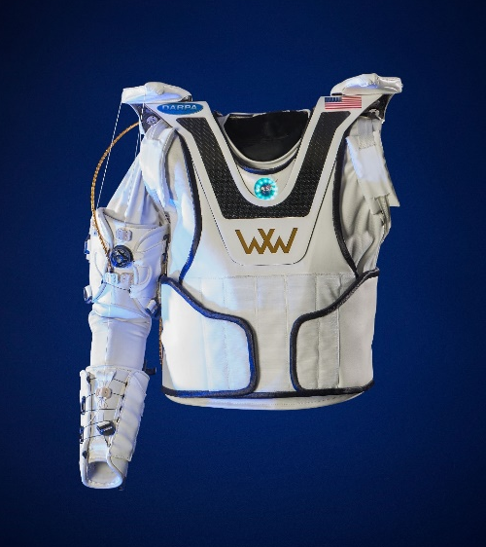
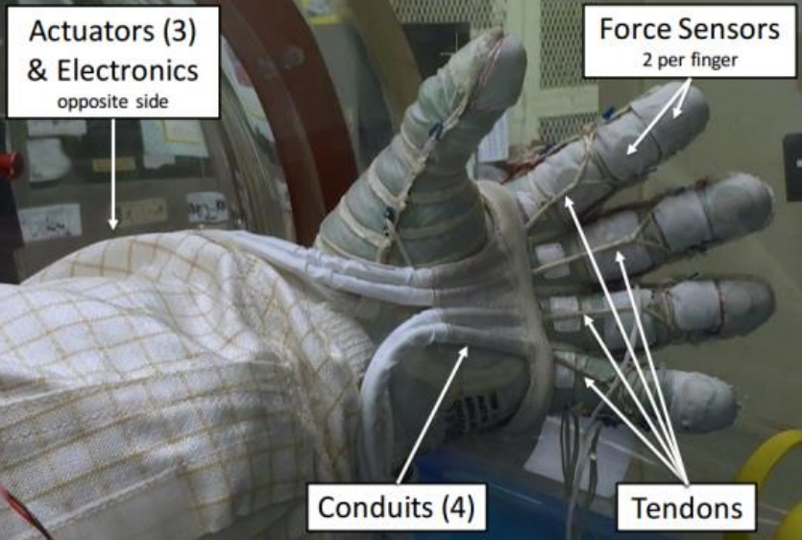
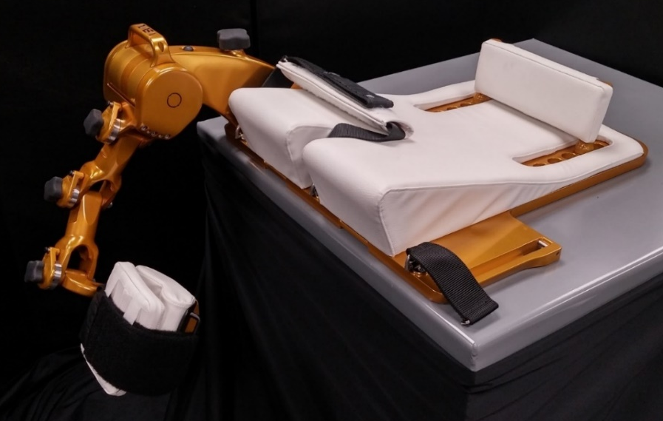
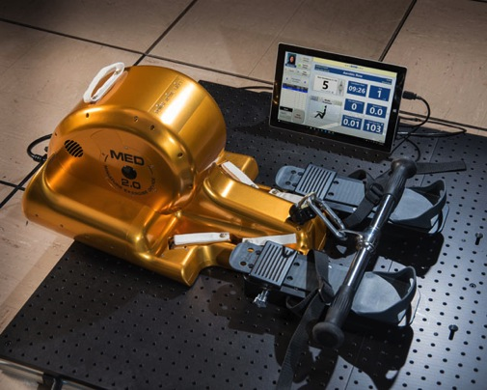
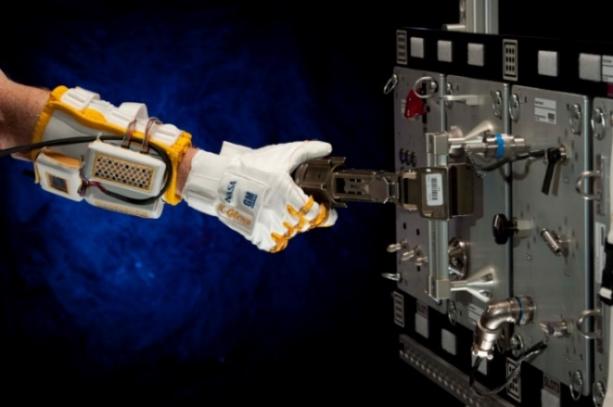
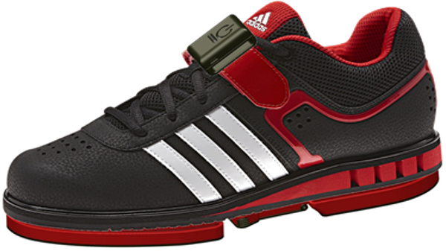
JSC Wearable Robotics Development

Slide 5
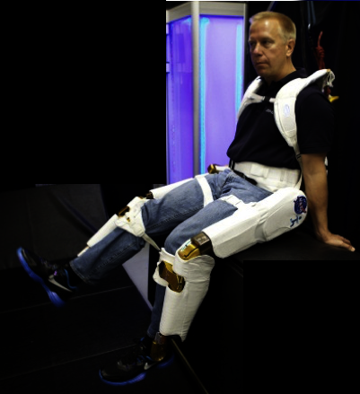
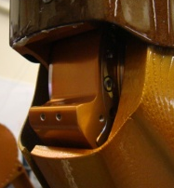
X1 Technology Description
A multi-joint actuated lower-extremity robotic exoskeleton, designed for a wide range of applications
  Mobility assistance, augmentation, exercise, dynamometry, rehabilitation
Adjustable
comfort fit
harness
Adjustable Backpack
Brainstem and safety system
(R2-derived firmware/software)
Adjustable thigh and shin
interface to accommodate a
large range of user
Passive hip DOFs for abduction & adduction
And internal & external rotation
Integrated Hardstops
Powered hips and knees with
real-time joint feedback
Passive ankle shown; powered ankle available
R2 Softgoods and composite materials

Slide 6

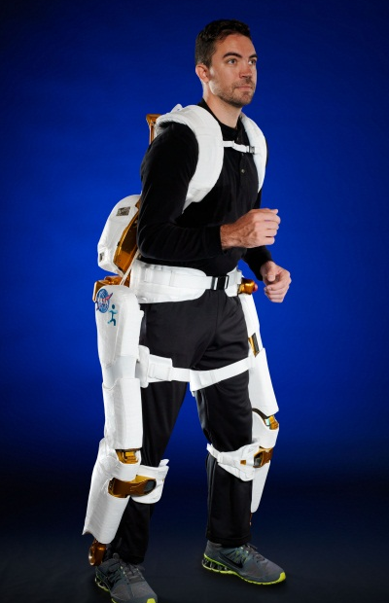
X1 Technology, continued
Designed to accommodate 5th to 95th percentile anthropometrics
Device mass 26 kgs
  weight of device shunted to ground
Leverages Series Elastic Actuation, Robonet communication, safety, and electronics architecture from R2
  300+ Nm peak torque at each joint
  360+ deg/s velocity at each joint
  Demonstrated capabilities
    Assisted walking, sit-to-stand, stand-to-sit, dynamometry, resistive exercise, data recording

Slide 7
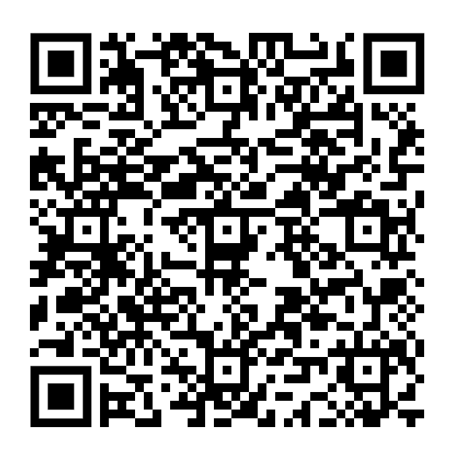
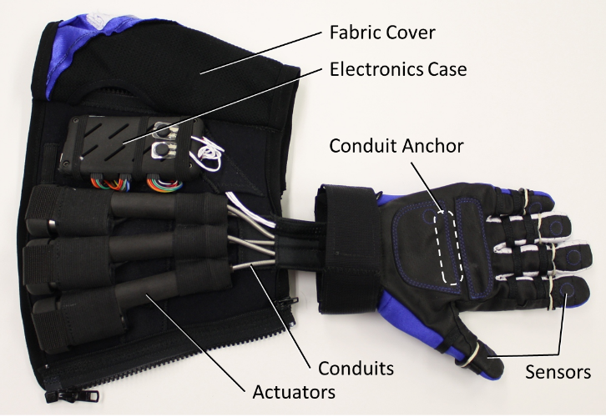
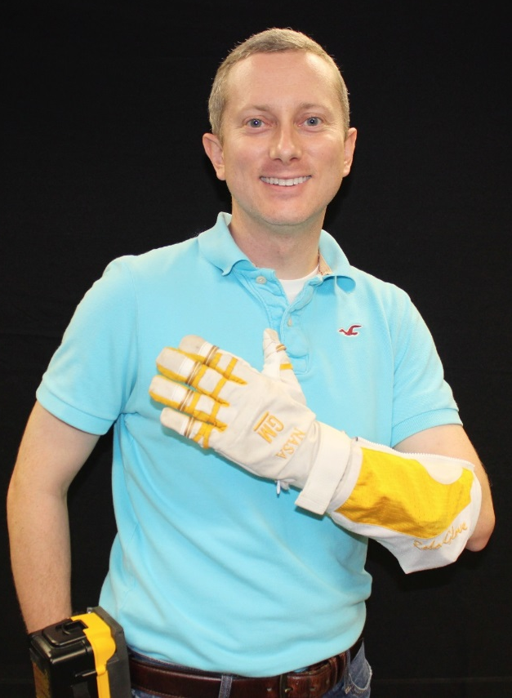

RoboGlove
Grasp assist device
  Reduce ergonomic strain and fatigue
Based on R2 hand technology
  Tendon-based actuation
  Similar drivetrain
Multiple modes
  Contact sensing for actuating
    Force Sensitive Resistors (FSRs) used as threshold switches for closing fingers
  Programmable
Applications
  Spacesuits
  Manufacturing floor
  Rehabilitation

Slide 8
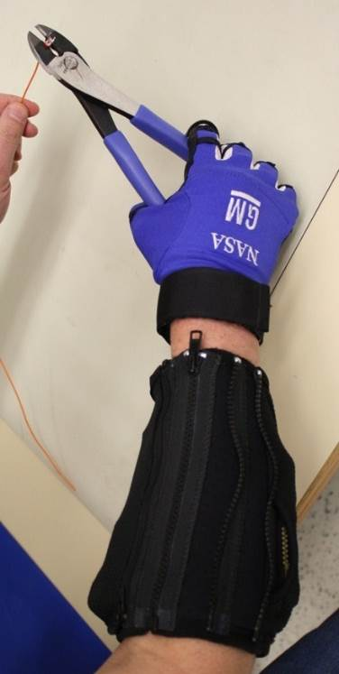
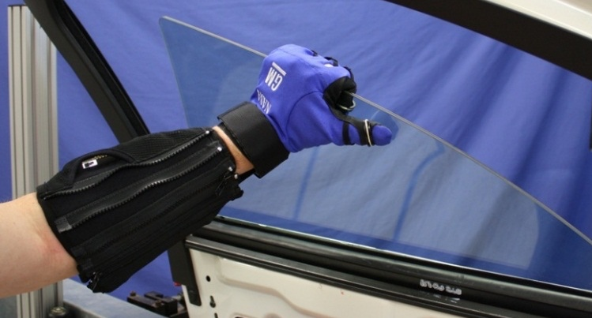
RoboGlove Applications
Moving heavy objects with difficult handholds
  Door glass installation
Maintaining a tight grasp while moving wrist
Snapping components together during assembly
Wire harness crimping
Manipulating pressurized space suit gloves

Slide 9
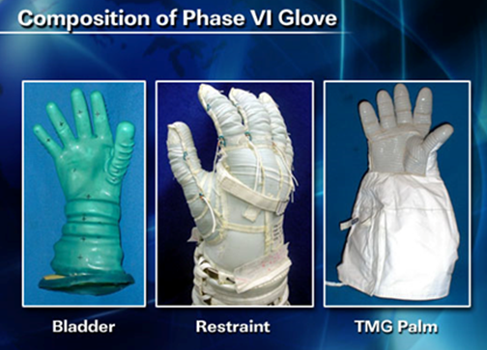

Space Suit RoboGlove (SSRG)
Reduce pressure differential effect on closing the space suit glove
  Approximately 4 PSI
  Fatigue, injury
Unique integration challenges
  Pressurized system
  Flammability
Initial prototype places mechanism between restraint layer and TMG (thermal micrometeoroid garment)
  Electronics and motors would be in vacuum
Madden et al., ICES 2017

Slide 10
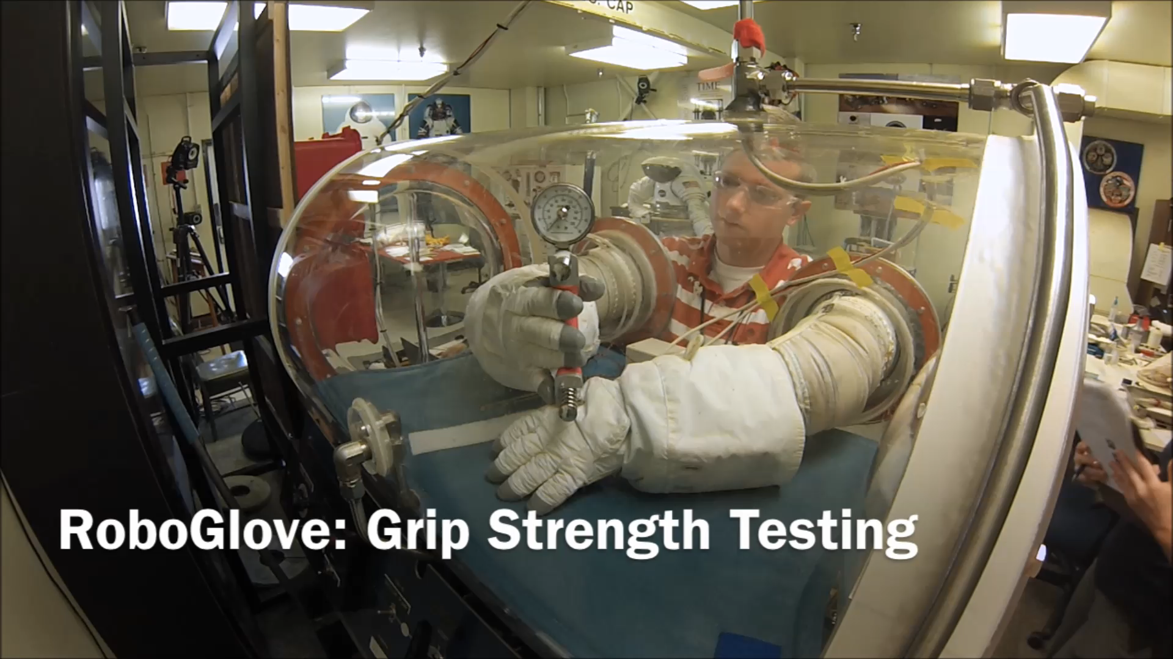
SSRG Initial Testing

Slide 11
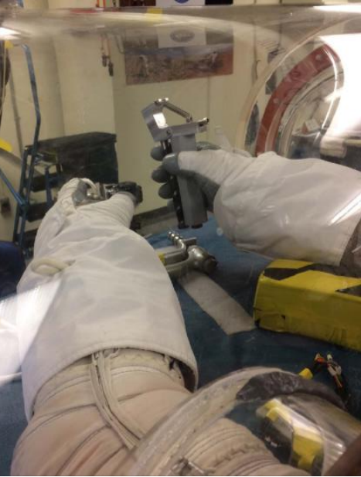
SSRG Fatigue Study
Six subjects performed repetitive dynamic-gripping interspersed with isometric grip-holds under three conditions
  Barehanded
  Wearing pressurized Phase VI EVA SSG
  Wearing pressurized SSRG
Results showed that the SSRG successfully reduced the neuromuscular effort needed to close the fingers of the space suit glove in more than half of subjects during two types of tasks
  However, the SSRG required more neuromuscular effort to extend the fingers compared to a conventional SSG in many subjects
Subjects using SSRG stated they felt less fatigued during short periods of intense work compared to the SSG
Results show the potential of the SSRG as a grasp-assist device that can improve astronaut performance and reduce injury risk by reducing effort
Madden et al., ICES 2017

Slide 12
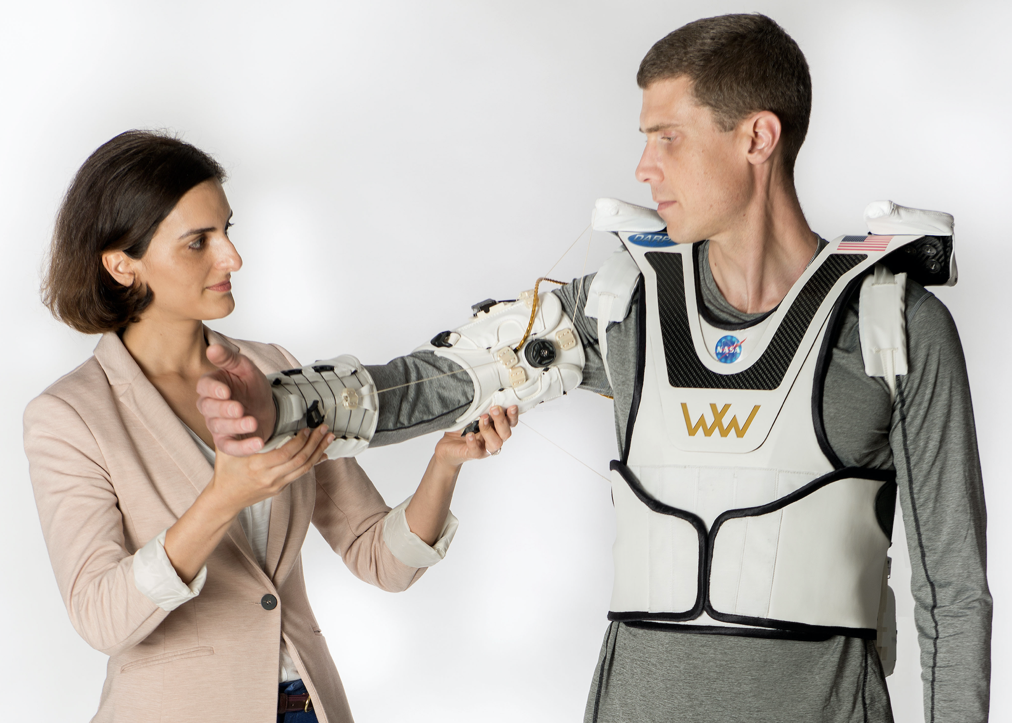
Armstrong Technology Description
Co-funded by DARPA with the intent to advance rehabilitation for soldiers with traumatic brain injury (TBI)
Soft, portable, wearable robotic device
Actively controls shoulder and elbow
  Joint speeds >30 deg/s
  Custom force-controllable tendon actuators, capable of >100 lbf pulling force
  Battery compatible
  Component technologies translatable to other DOFs, such as hip and knee
  Hybrid approach: soft with thoughtfully placed rigid components where necessary
  pHMI effectively distributes loads away from joints, minimizing pressure points and interface migration

Slide 13
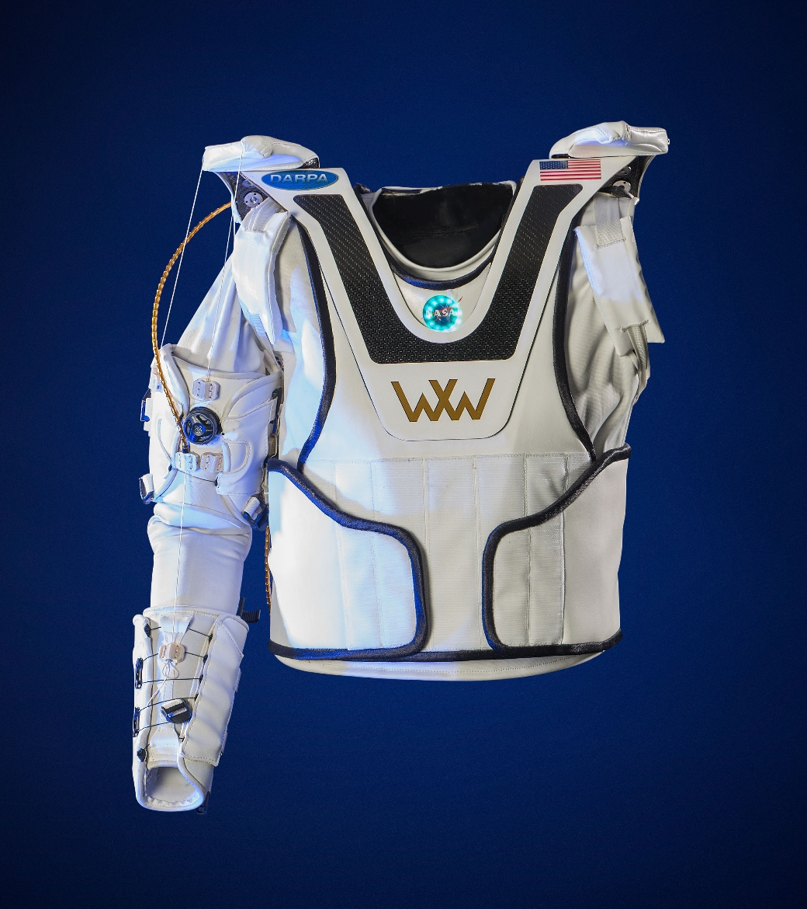
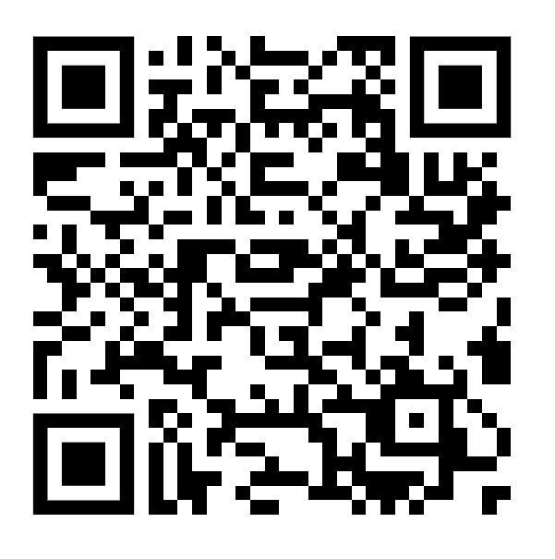
Armstrong Technology, continued
Capable of manipulating a 95th percentile arm
Device mass under 8.5 kgs (right arm; no battery)
Ability to mix and match multiple control modes among DOFs
  Active mode – device doing all the work
  Assist-as-needed mode – device and wearer share the work
    Sharing ratio tunable
  Passive mode – wearer does all the work; actuators are passive
Software safeties consistent with our other wearable technology
Has been evaluated with two subjects with TBI
  Joint isolation demonstrated, as well as safety, comfort, don/doff, wheelchair compatibility

Slide 14
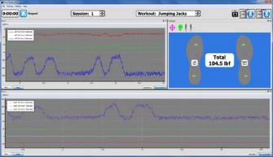
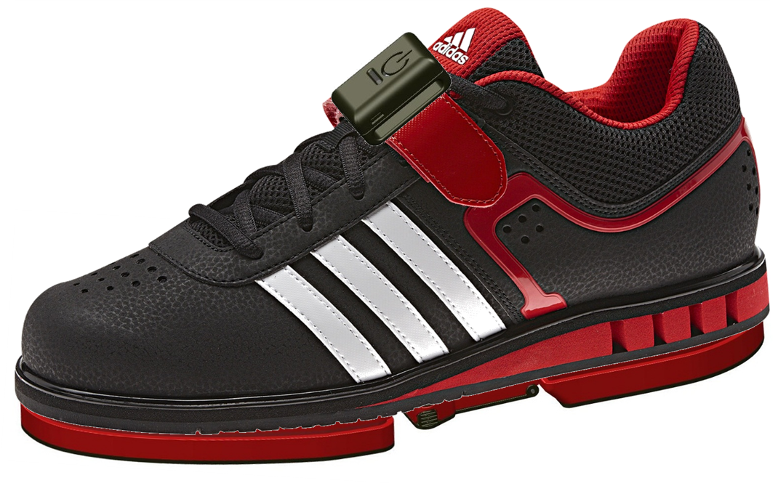
ForceShoe 2.1
Graphical User Interface/
Real-time Data Display
Specification | Value*
Load measurement | 600 lbf total (300 lbf per shoe)
Overload | 1000 lbf total (500 lbf per shoe)
Data rate | 200 Hz (Bluetooth)
Power supply | (4) AAA batteries per shoe
Battery life | 5 hours
Bluetooth | Version 2.1 (backwards compatible), RN-41 Class I RF module, 240 Kbps
Human Health and Performance need for understanding crew health
  Ground reaction force data during squats
  Pressure distribution on feet
Daily-use device
  Comfortable
  Wireless
  Exercise form not impacted
Multi-use device
  Shoe not tied to specific exercise device
Applications
  Exercise monitoring
  Rehabilitation
  Athletics
*Values represent those from previous ForceShoe version

Slide 15
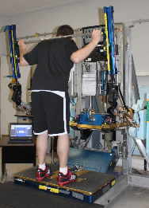
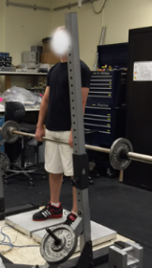
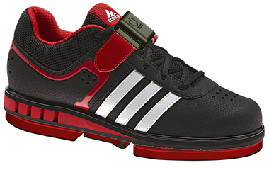
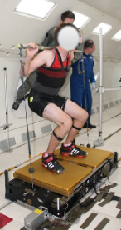
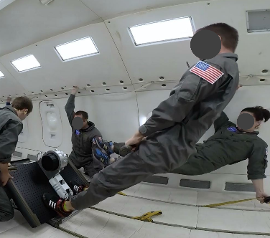
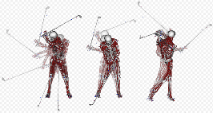
ForceShoe 2.1
Modified COTS Exercise Shoes
Power switch with LED indicator
Data storage onboard
Bluetooth communication with computer
Integrated Lithium ion Battery and Electronics compartment
Embedded six-axis load cells for force/moment data (heel and toe)
Data from the Force Shoes together with Motion Capture data will be used to develop computer simulation models to assess human performance and optimization efforts.

Slide 16

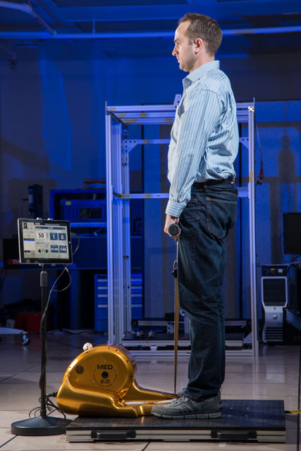
Miniature Exercise Device (MED)-2
A small, compact, and lightweight apparatus capable of providing aerobic and resistive exercises in one piece of hardware
Tested Engineering Development Unit aboard C-9 parabolic flight
Currently being evaluated on ISS
Exercise capabilities:
  Rowing (aerobic)
  Deadlifts, squats, biceps curls, … (resistive)

Slide 17
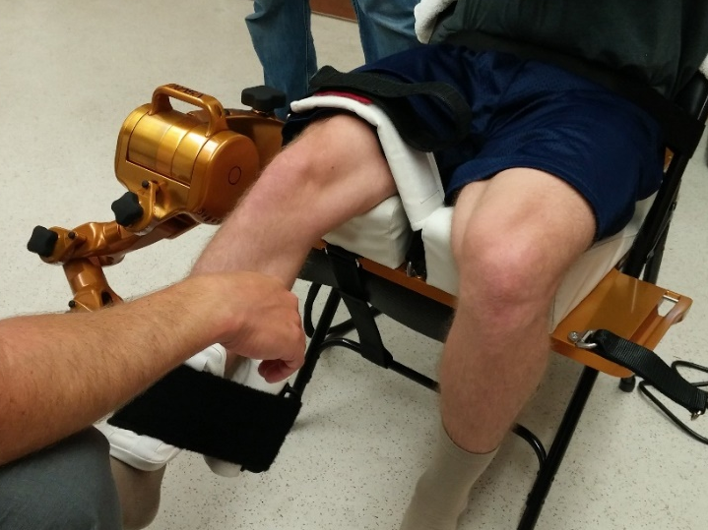
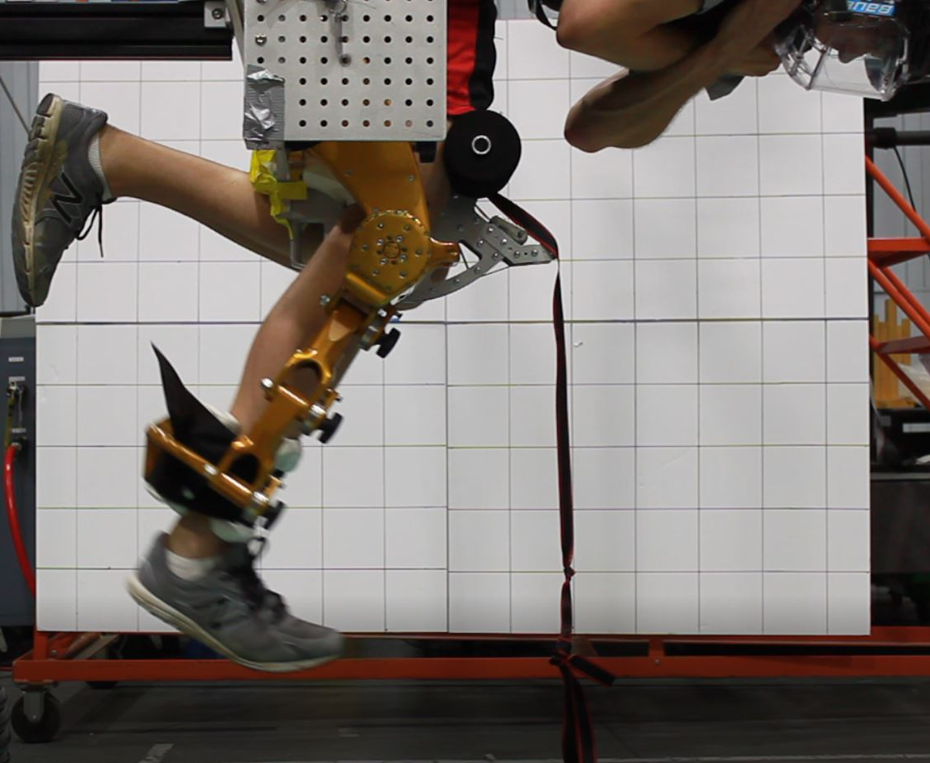
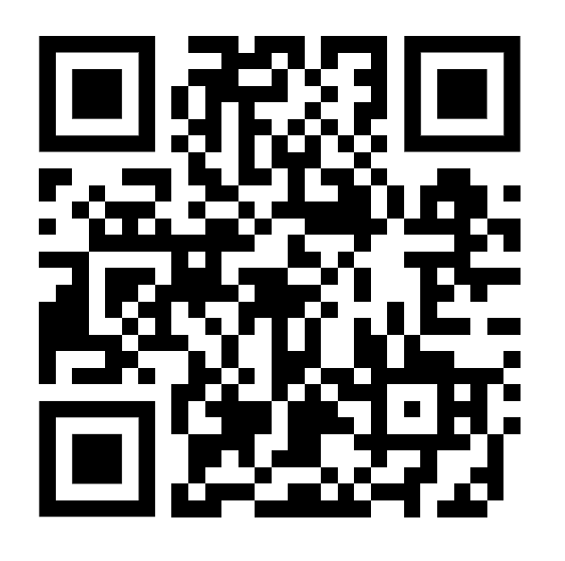
Portable Dynamometry
Joint strength assessments serve an important role in the medical rehabilitation domain, granting clinicians better insight into the progress of their patients
Similar assessments could be utilized by exercise physiologists, strength and conditioning specialists, and flight doctors to help maintain astronauts’ muscle function during missions
Isokinetic dynamometry is an accepted method of joint strength assessment in clinical settings, and NASA uses it as a tool to assess strength changes from pre- to post-flight
However, currently no practical means of obtaining individual joint strength data exists during spaceflight, precluding the ability to track changes in strength during missions
We developed a portable knee version to fill this gap
Comparison testing has shown that the Portable Knee Dynamometer has analogous repeatability to the state-of-the-art ground system and, overall, the peak knee torque measured by the PKD agrees very well for isometric and isokinetic contractions.
Device has been evaluated for proof-of-concept in microgravity

Slide 18
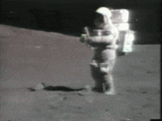
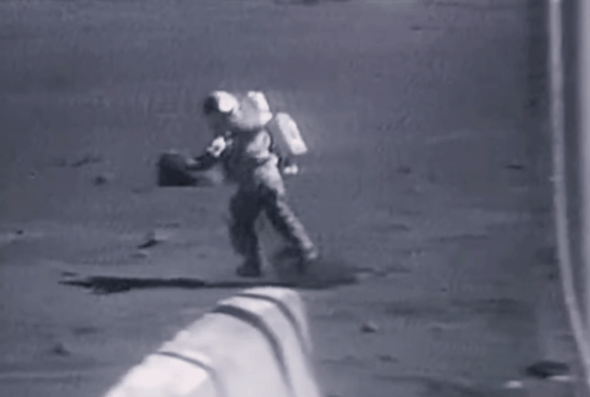
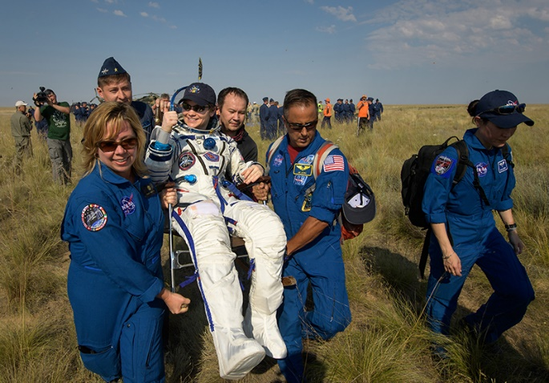
Additional Developments
Sensorimotor Countermeasures Device
  Sensorimotor system adapts to microgravity
    Useless vestibular inputs
    Main proprioceptive stimuli from treadmill
  Future long-duration transit vehicles might not have a treadmill, so alternative sensorimotor training will be necessary
  We are developing a Balance Board with pulldown actuation via a harness
  The latest prototype has been evaluated for microgravity feasibility during a parabolic flight suite
  Working toward an ISS technology demonstration unit

Slide 19
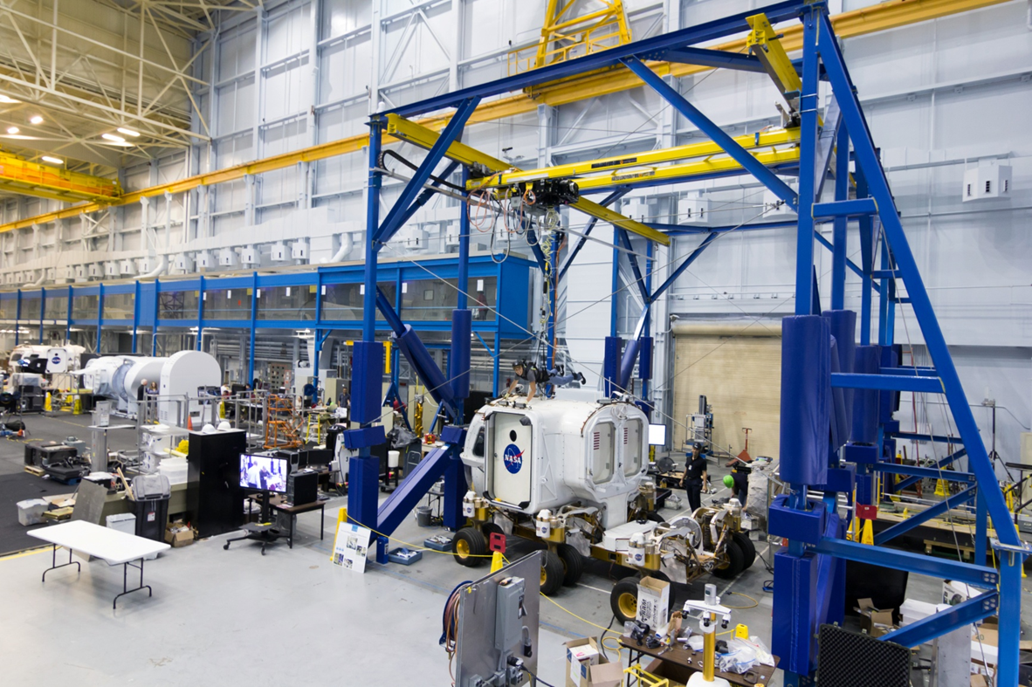

Additional Developments
Upper Extremity Offload Device for Reduced Gravity Analog
  Analog system capable of actively offloading the weight of a person (e.g. wearing spacesuit) or hardware to simulate alternate gravitational environments
  Extremities still feel the pull of 1g, which can be fatiguing and/or uncomfortable, and provides an imperfect analog which could misinform suit design, etc.
  We have developed a passive arm offload device to simulate the desired gravitational environment on the limbs
  Now investigating making it “smart” with actuation and sensing

Slide 20
Future Work
X1 Exoskeleton
  Continue to use as testbed to further other technologies
  Pursue next generation for integration with Exploration space suit
RoboGlove
  Explore medical applications (stroke rehabilitation, ADLs)
  Extend technology to assist with full arm motion
SSRG
  Increase capability, fatigue reduction
  Integrate with full space suit
Armstrong
  Pursue integration of component technologies for space suit augmentation
  Explore further medical rehabilitation and ADL applications
Force Shoe
  Fly it and evaluate it
  Explore additional terrestrial uses, partnerships
MED-2
  Further evaluation on ISS
  Potential Exploration exercise solution
Portable Dynamometer
  Adapt to other joints
  Integrate with biofeedback for training
Sensorimotor Countermeasure Device
  Evaluate on ISS
Upper Extremity Offload Device
  Make it “smart” through sensing, actuation, and control

Slide 21
Thank you!

