Slide 1


Commercial Crew Program & Considerations for Composites Reusability
Christine Mills, NASA
2/22/23

Slide 2


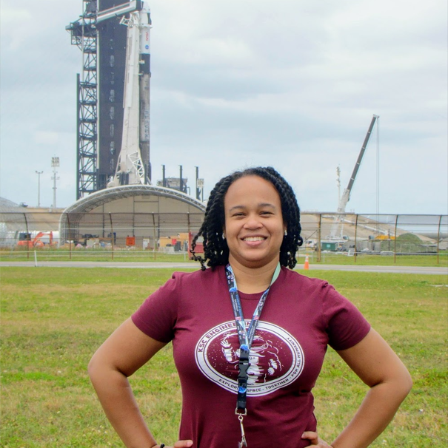

Christine Mills
Materials Engineer, NASA
MS in Chemical Engineering from Georgia Tech
BS in Chemical Engineering from Florida Tech
Previous jobs
  Embraer Executive Jets, Melbourne, FL
  Cummins Emission Solutions, Columbus, IN
  Ground → Sky → Space
Originally from the Caribbean island of Barbados

Slide 3
Agenda
Overview of Commercial Crew Program
Composites Reusability

Slide 4
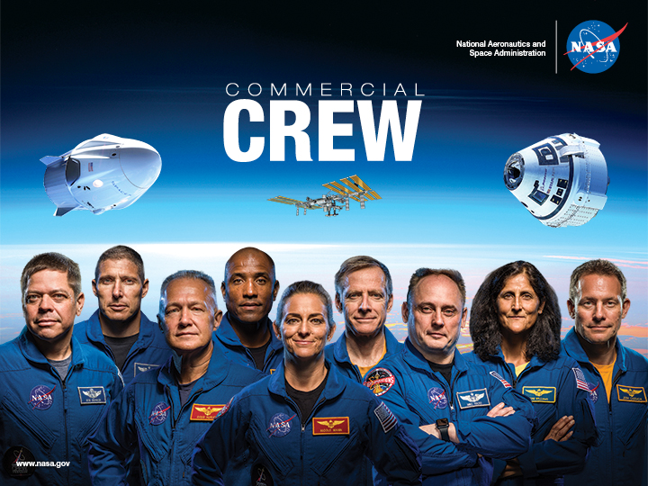
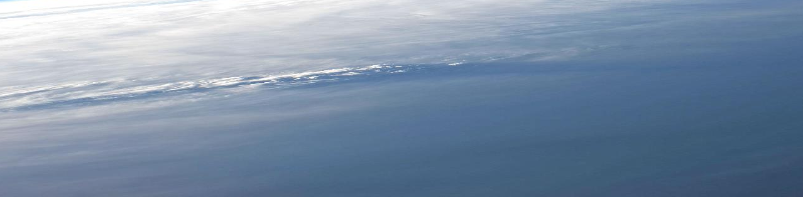
SpaceX Dragon Spacecraft
Boeing Starliner Spacecraft
www.nasa.gov

Slide 5
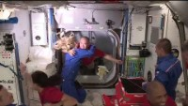
LEADING THE WAY IN HUMAN SPACEFLIGHT

Slide 6
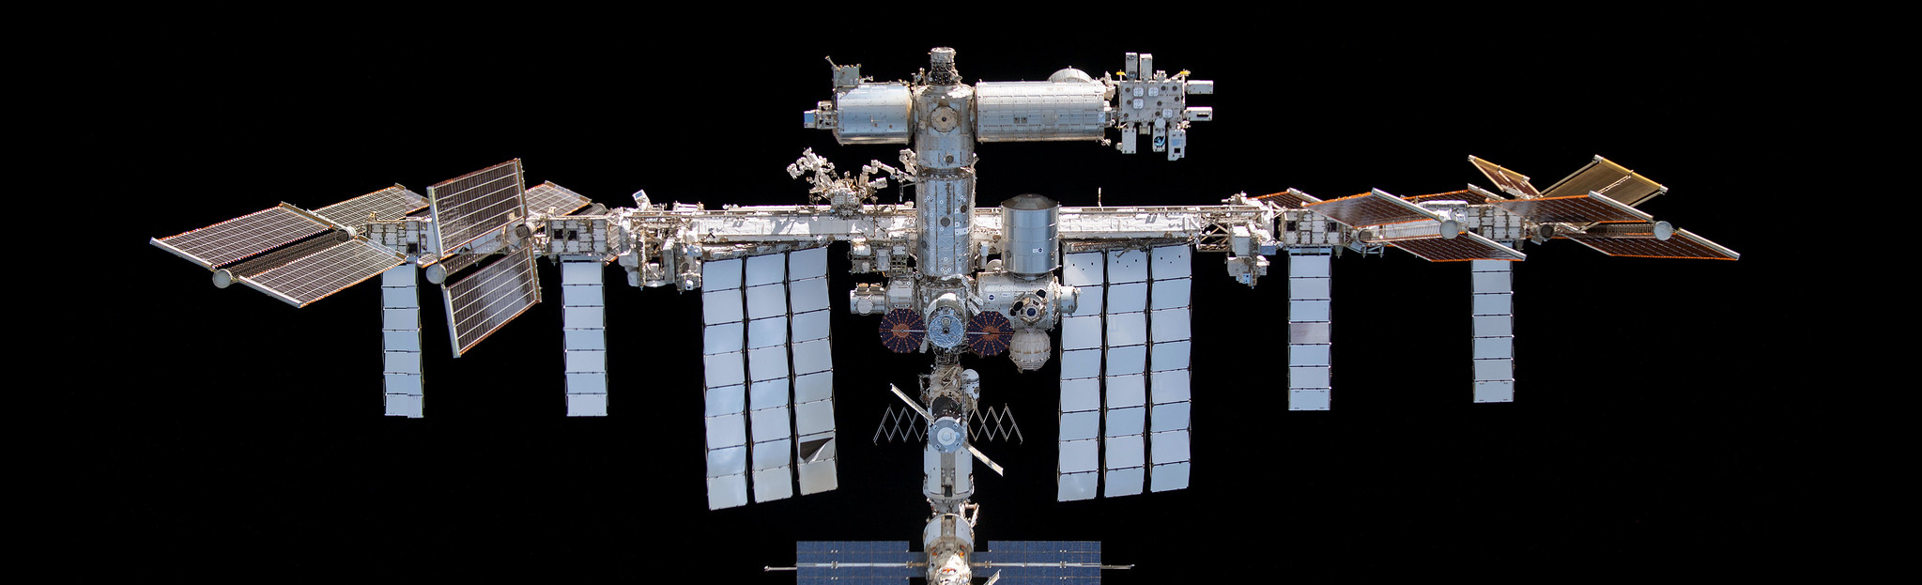
https://spotthestation.nasa.gov/
SUPPORTING STATION
Celebrating 22+ years of human presence on the International Space Station:
International partners: NASA, Roscosmos, CSA, ESA, and JAXA
250+ individuals from 19 countries have visited the ISS
Astronauts have conducted more than 255 spacewalks since 1998
5 Cargo vehicles: Northrup Grumman's Cygnus, SpaceX’s Dragon, JAXA’s HTV, Russia’s Progress, ESA’s ATV
3 Crew transportation vehicles: SpaceX’s Crew Dragon, Boeing’s Starliner, Russia’s Soyuz
1 Crew and Cargo transportation: Space Shuttle
ISS has hosted over 3,000 research investigations from researchers in over 100 countries and counting
6
Notes:
*ISS photo taken by Crew-2 astronauts during the first ISS fly-around of a commercially made vehicle.
Orbits the Earth every 90 minutes, approximately 260 miles above the planet’s surface
International partnership between NASA, Roscosmos, the European Space Agency (ESA), Canadian Space Agency (CSA), and Japan Aerospace Exploration Agency (JAXA)
Inhabited continuously since November 2000 and hosted over 253 individuals from 19 countries
Orbiting outpost and National Laboratory advancing science and technology and inspiring the world

Slide 7

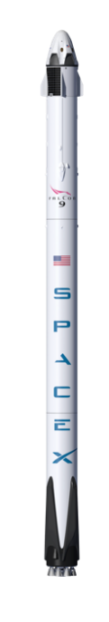
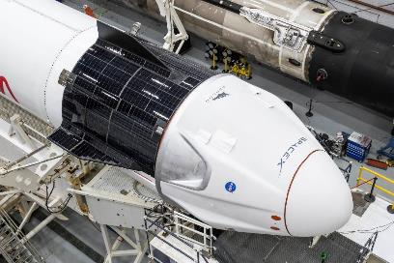
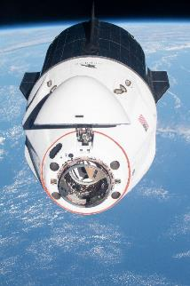
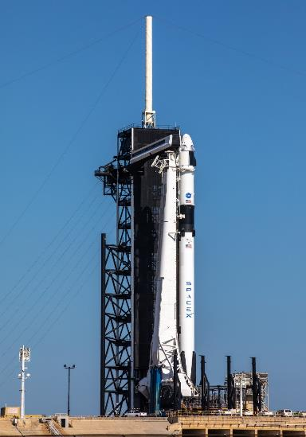
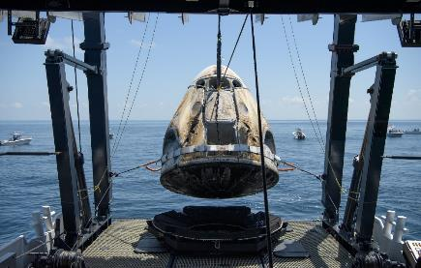
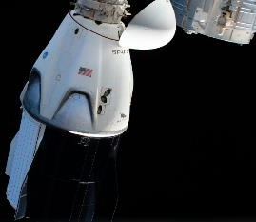
SPACEX CREW TRANSPORTATION SYSTEM
Spacecraft
Crew Dragon
Launch Vehicle
Falcon 9
Launch Pad
Launch Complex 39A
Landing
Atlantic Ocean
7

Slide 8
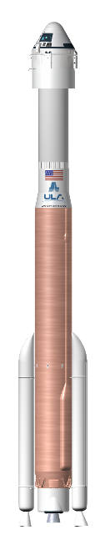
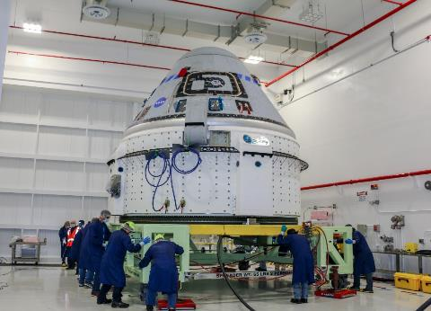
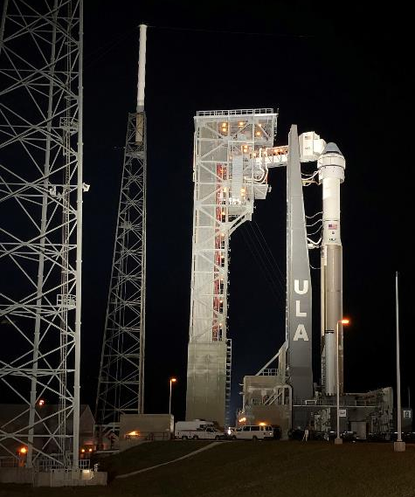
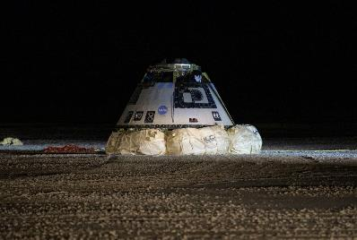
BOEING CREW TRANSPORTATION SYSTEM
Spacecraft
CST-100 Starliner
Launch Vehicle
ULA Atlas V
Launch Pad
Space Launch Complex 41
Landing
Western United States
8

Slide 9
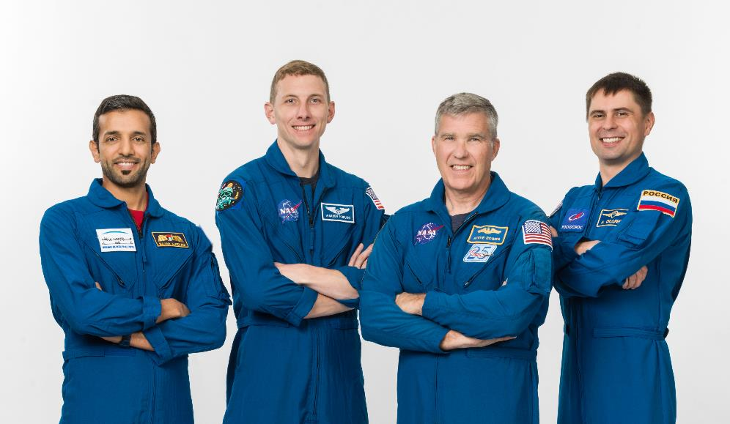

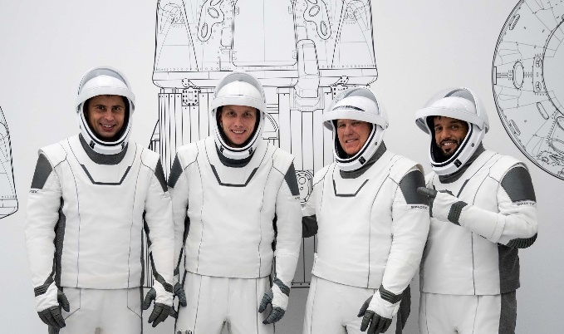
CREW-6
Crew-6 Mission: NET Feb 26, 2023
Crew: Stephen Bowen, Warren "Woody" Hoburg, Andrey Fedyaev, Sultan Al Neyadi
Launch Vehicle: Falcon 9 (first flight), Kennedy Space Center, Pad 39A
Docked to ISS: Crew Dragon Endeavour (fourth flight) up to 180 days planned
Crew recovery planned in Atlantic Ocean or Gulf of Mexico
First flight of a United Arab Emirates astronaut, Sultan Al Neyadi
First four-time reuse of a Crew Dragon capsule
9

Slide 10
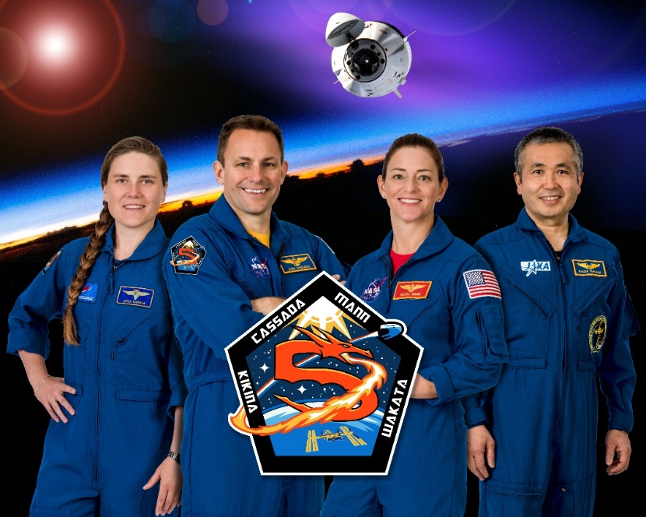
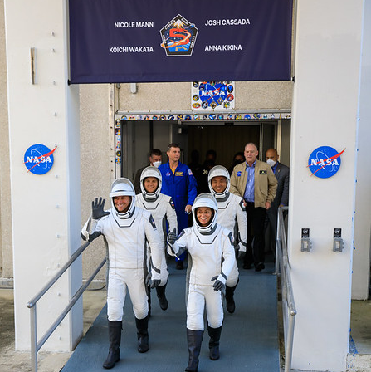
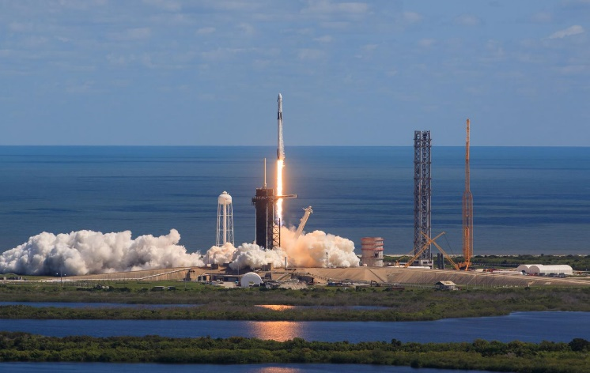
CREW-5
Crew-5 Mission: Launched October 5, 2022
Crew: Nicole Mann, Josh Cassada, Koichi Wakata, Anna Kikina
Launch Vehicle: Falcon 9 (first flight), Kennedy Space Center, Pad 39A
Docked to ISS: Crew Dragon Endurance (second flight) up to 180 days planned
Crew recovery planned in Atlantic Ocean or Gulf of Mexico
First female commander of a CCP mission (Nicole Mann)
First NASA flight of an indigenous woman (Nicole Mann, Wailacki Round Valley Indian Tribe)
First flight of a Russian cosmonaut on a US commercial spacecraft, Anna Kikina
  First mission as a part of the crew swap system of keeping at least one NASA astronaut and one Roscosmos cosmonaut on each of the crew rotation missions, ensuring the ability to maintain ISS if either NASA or Roscosmos are unable to fly for an extended period
10

Slide 11
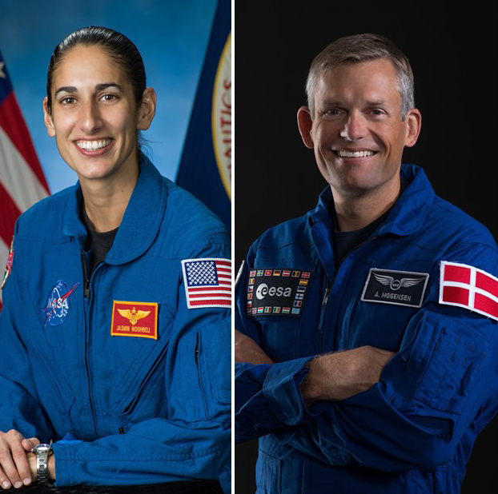
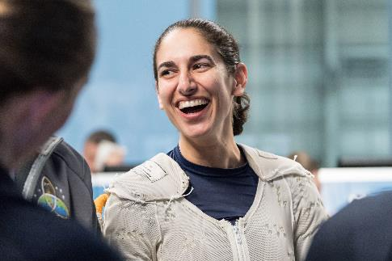
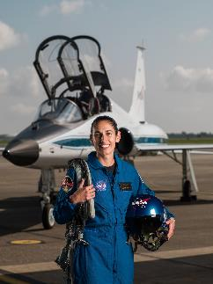
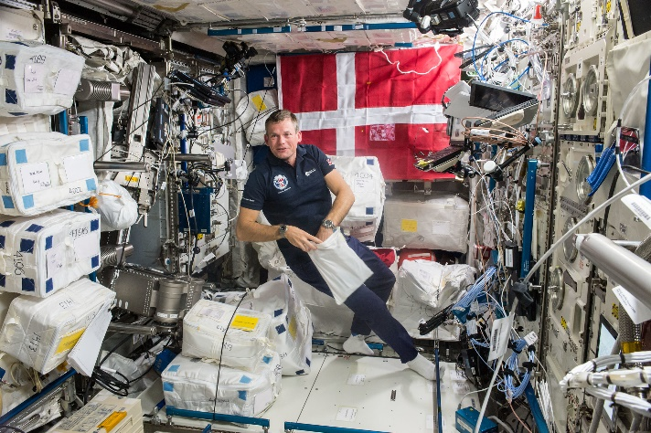
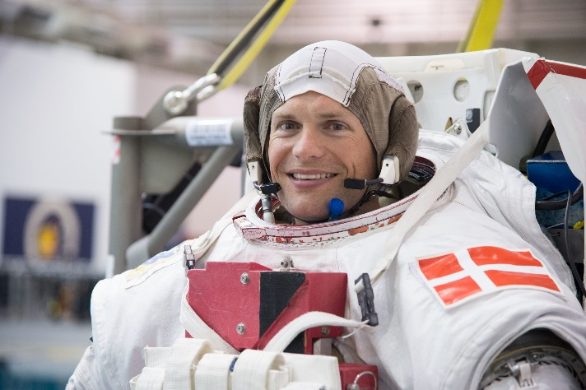
CREW-7
Crew-7 Mission: NET Fall 2023
Crew: Jasmin Moghbeli, Andreas Mogensen and two mission specialists not yet assigned
Launch Vehicle: Falcon 9, Kennedy Space Center, Pad 39A
Docked to ISS: Crew Dragon up to 180 days planned
Crew recovery planned in Atlantic Ocean or Gulf of Mexico
11

Slide 12
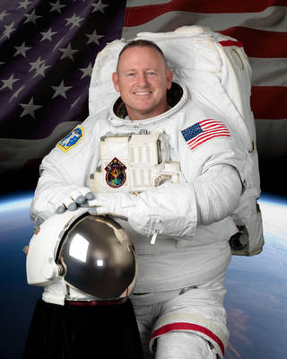
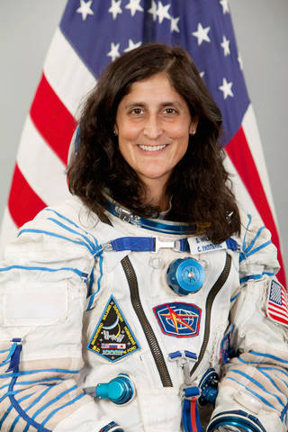
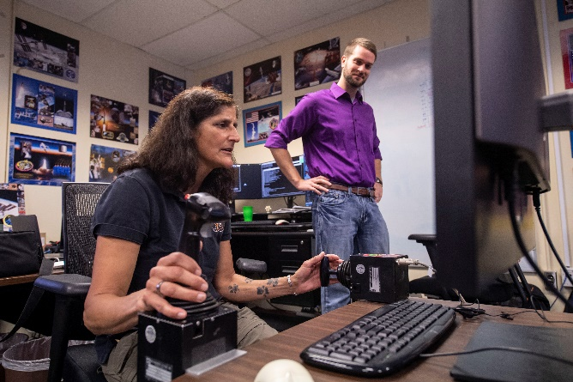
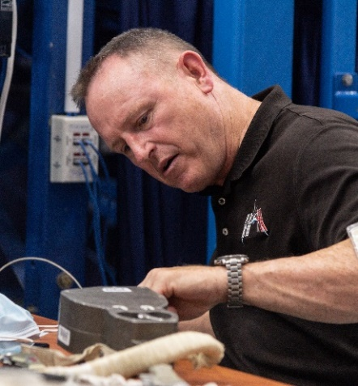
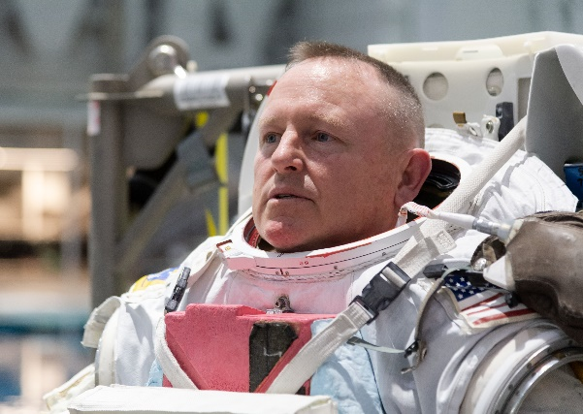
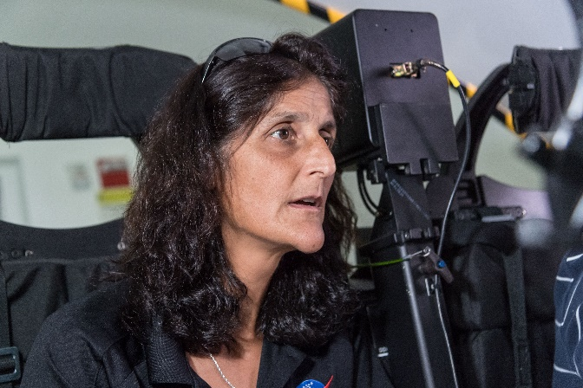
CREW FLIGHT TEST
CFT Launch: NET April 2023
Crew: Barry (Butch) Wilmore, Sunita (Suni) Williams
Launch Vehicle: United Launch Alliance Atlas V, Cape Canaveral, SLC-41
Dock to ISS: Starliner Calypso for approximately 14 days or up to 180 days if needed
Landing: White Sands Missile Range
First Starliner mission to carry crew
12

Slide 13
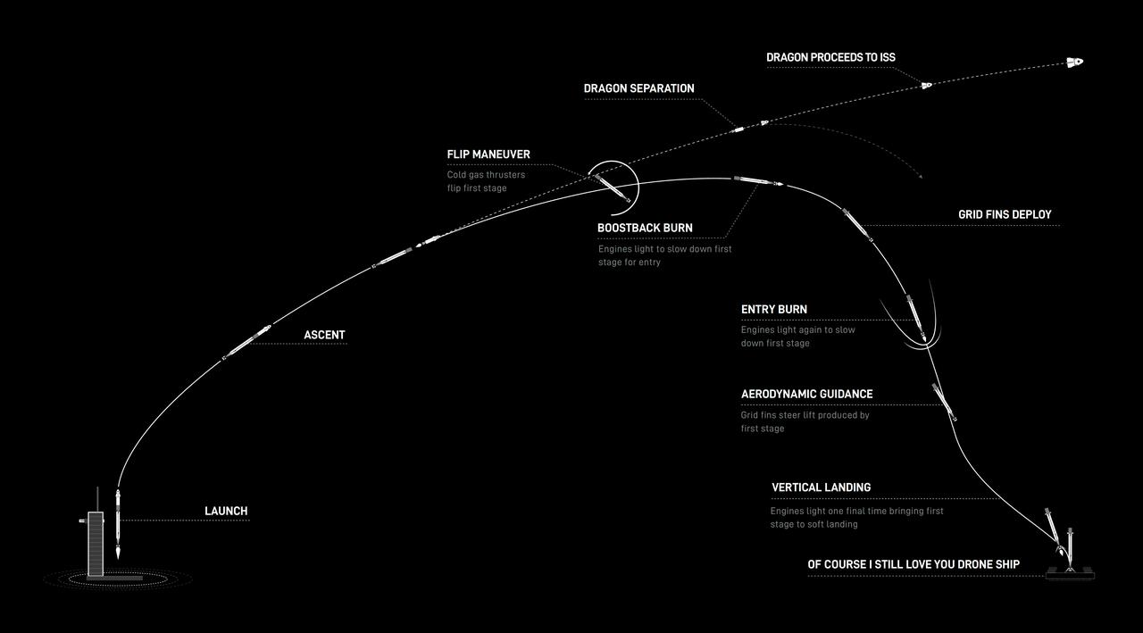
Notes:
Liftoff: https://twitter.com/SpaceX/status/1558206930316697601?s=20&t=7FEPNhKQjs7Jh02_Q_GCsQ
Landing: https://twitter.com/SpaceX/status/1558208986603593728?s=20&t=7FEPNhKQjs7Jh02_Q_GCsQ

Slide 14
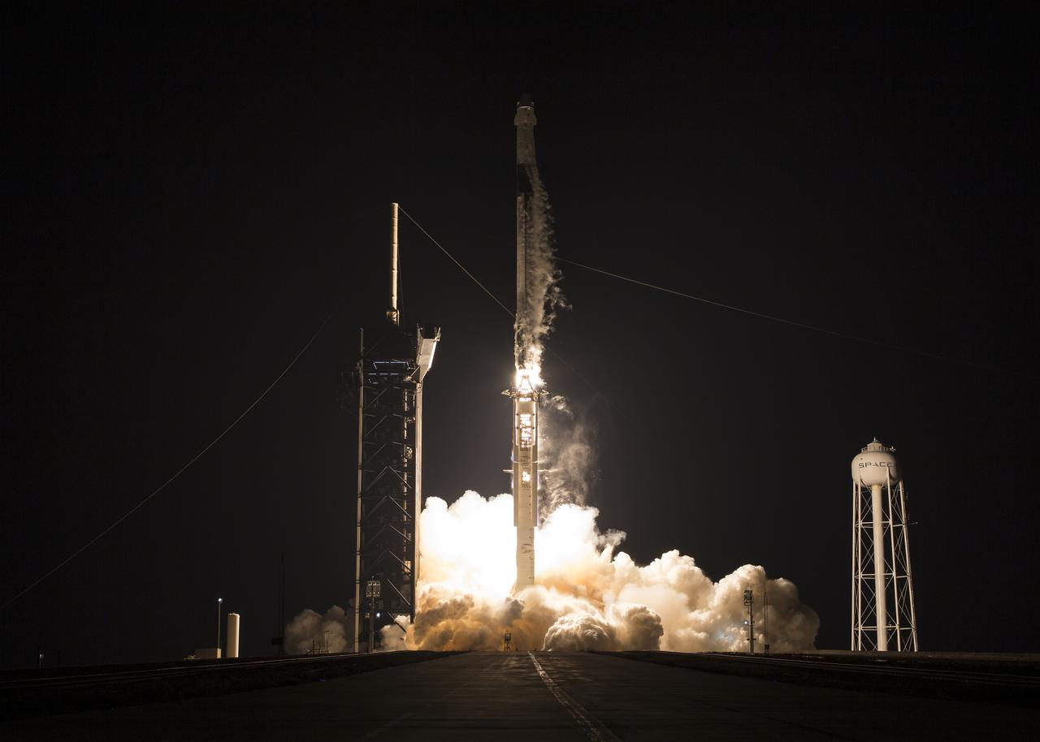

Slide 15
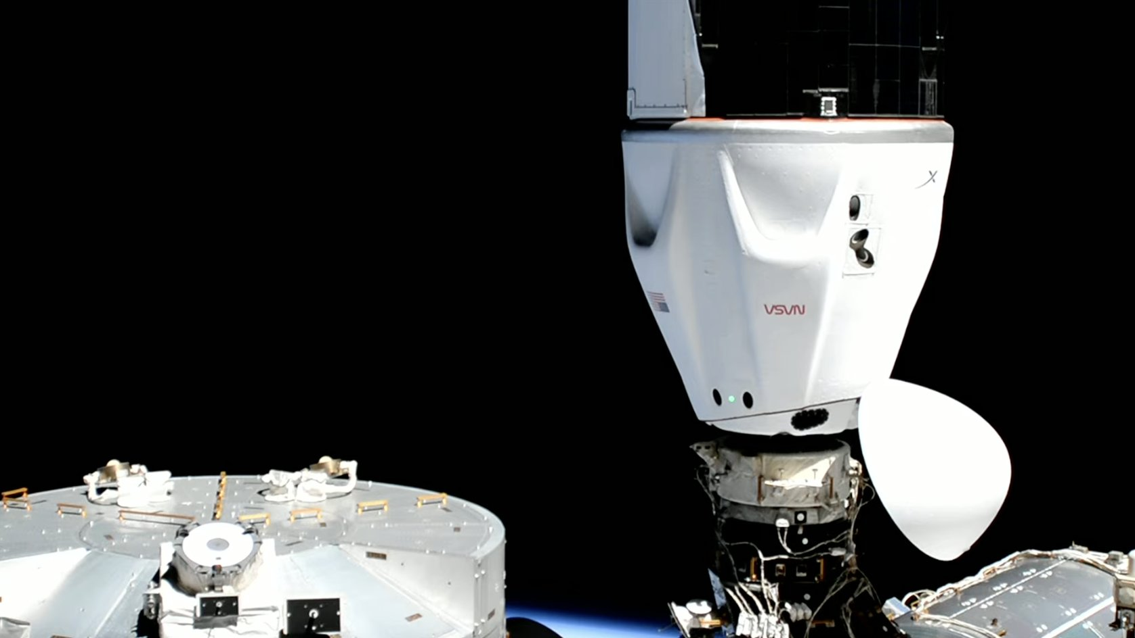

Slide 16
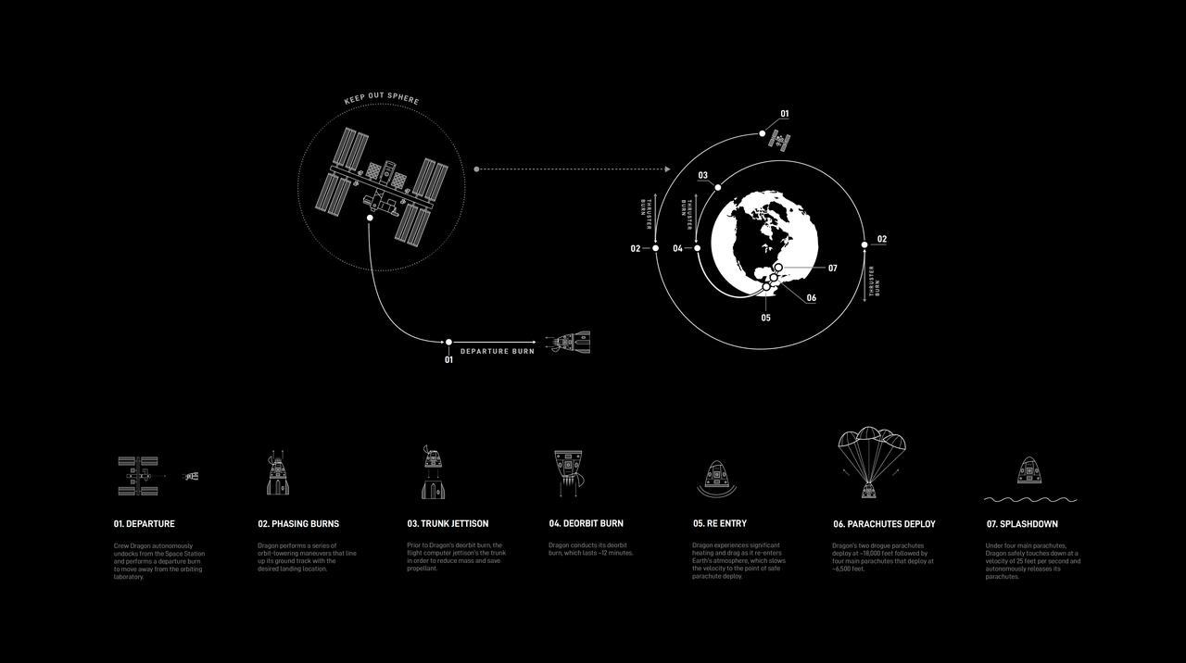

Slide 17
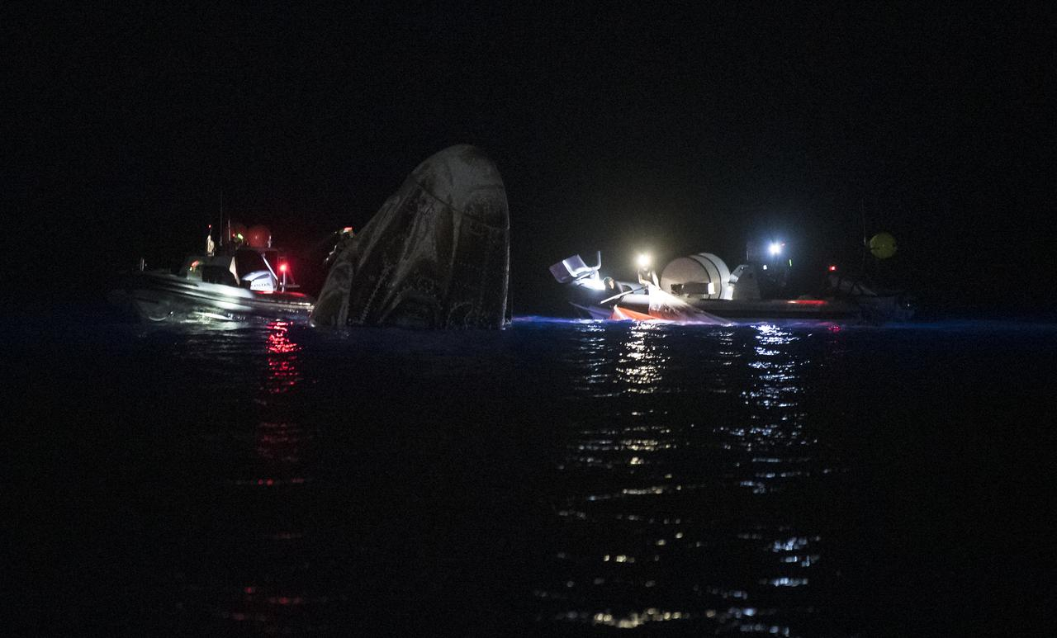

Slide 18
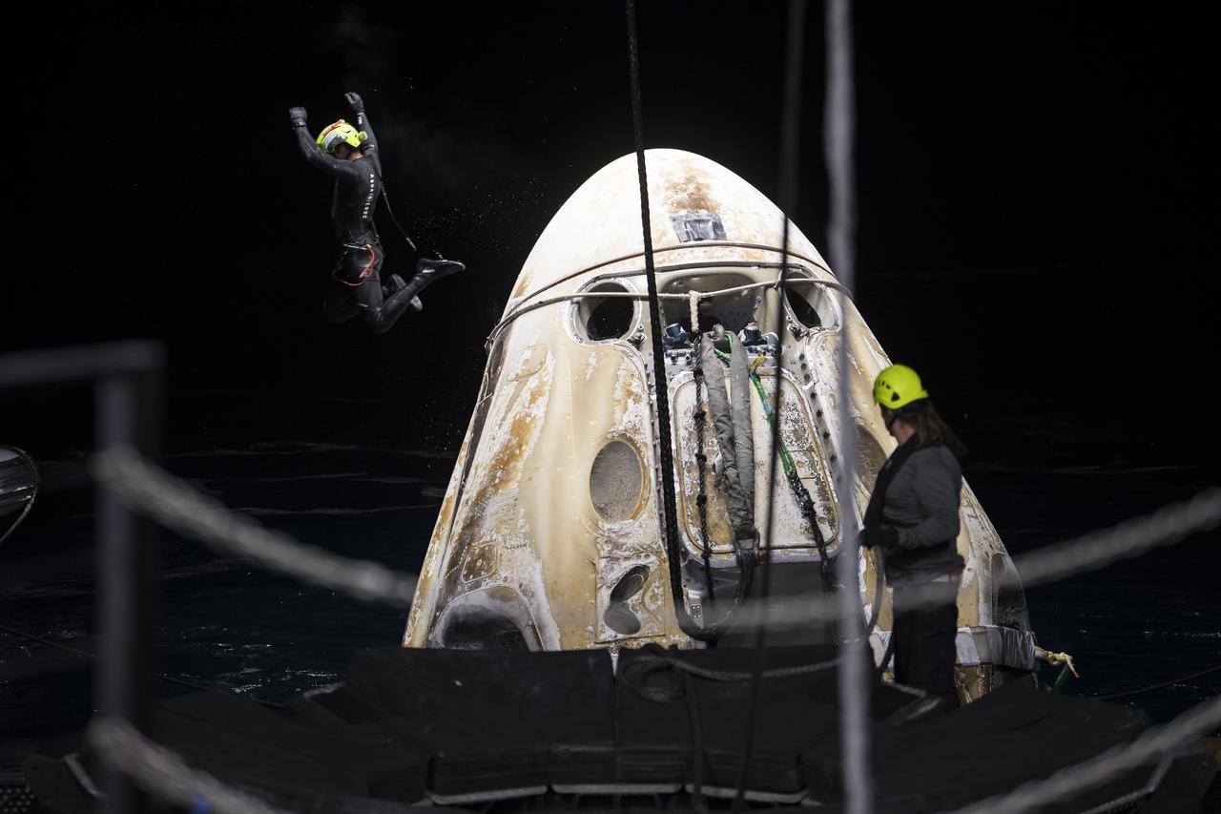
Notes:
Splashdown:
https://twitter.com/SpaceX/status/1522437106882080769?s=20&t=7FEPNhKQjs7Jh02_Q_GCsQ

Slide 19
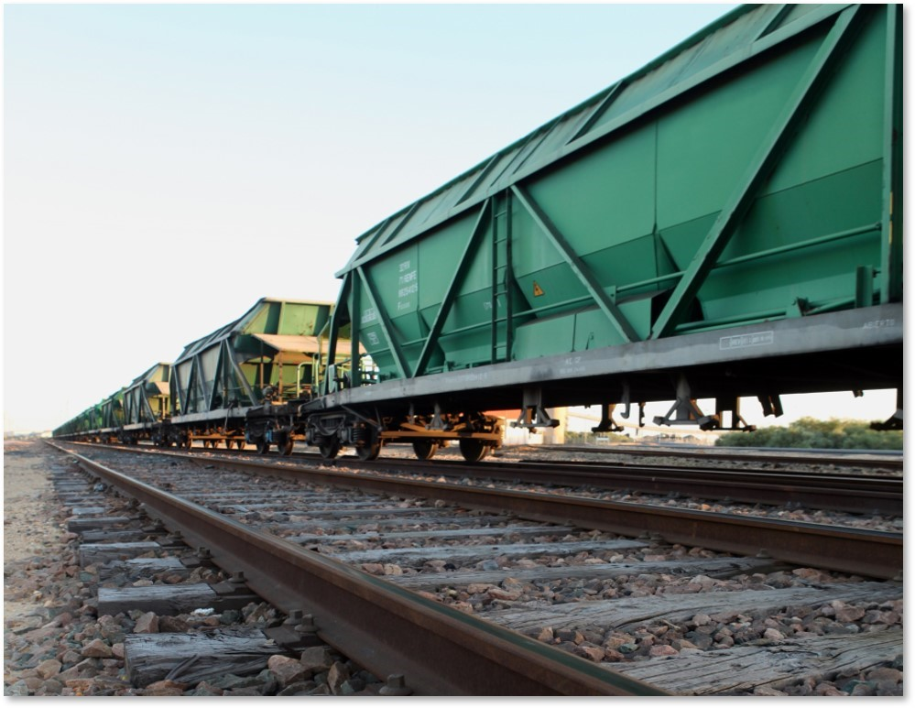
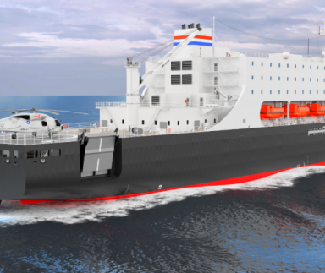
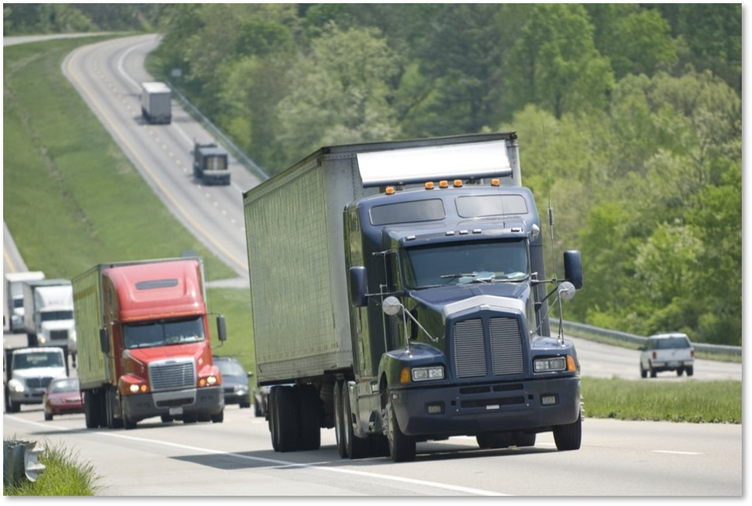

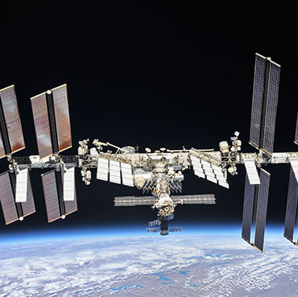
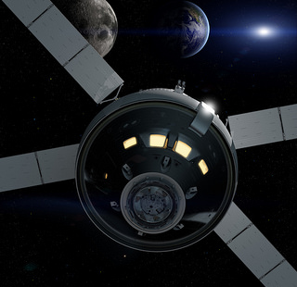
A NEW ERA
Notes:
Following in the footsteps of other modes of transportation (rail, maritime, motor carrier and air), NASA is working with industry to build safe transportation methods to space.
Next space transportation will be enabled to the Gateway, to the moon, Mars and other planetary bodies.

Slide 20
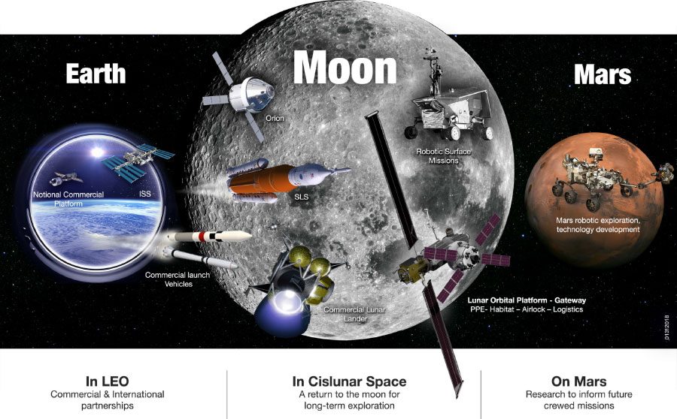
Artemis Missions/In Cis-Lunar
20

Slide 21
Considerations for Composites Reusability

Slide 22
Composites is a Cross-Functional Area
Materials & Processes
NASA-STD-6016
Structures
NASA-STD-5001
Fracture Control
NASA-STD-5019
MSFC-RQMT-3479
Composites
Standards.nasa.gov

Slide 23
Motivation for Composite Re-use
  Cost
  Increased launch frequency as refurb process takes less time that a new build process

Slide 24
Considerations for Designing for Reusability
Loading configuration
  In-plane loading is less sensitive to fatigue/cyclic loading
Dissimilar materials and environmental exposure
  Landing conditions
  Storage conditions and time between flights
Access for post-flight inspections
  Abilities to perform NDE (non-destructive evaluation)
Damage Protection
  More refurb = more potential for damage
Repairability
Solid laminates are less concerning than sandwich structures

Slide 25
Follow us on Social Media
Twitter: @NASA, @NASAKennedy, @NASASocial, @Space_Station, @ISS_Research, @ISS National Lab, @SpaceX, @Commercial_Crew
Facebook: NASA, NASAKennedy, ISS, ISS National Lab
Instagram: @NASA, @NASAKennedy, @ISS, @ISSNationalLab, @SpaceX

Slide 26

Thank you

Slide 27
