Slide 1
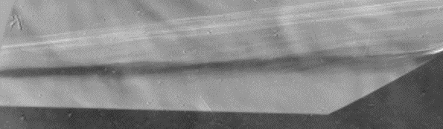
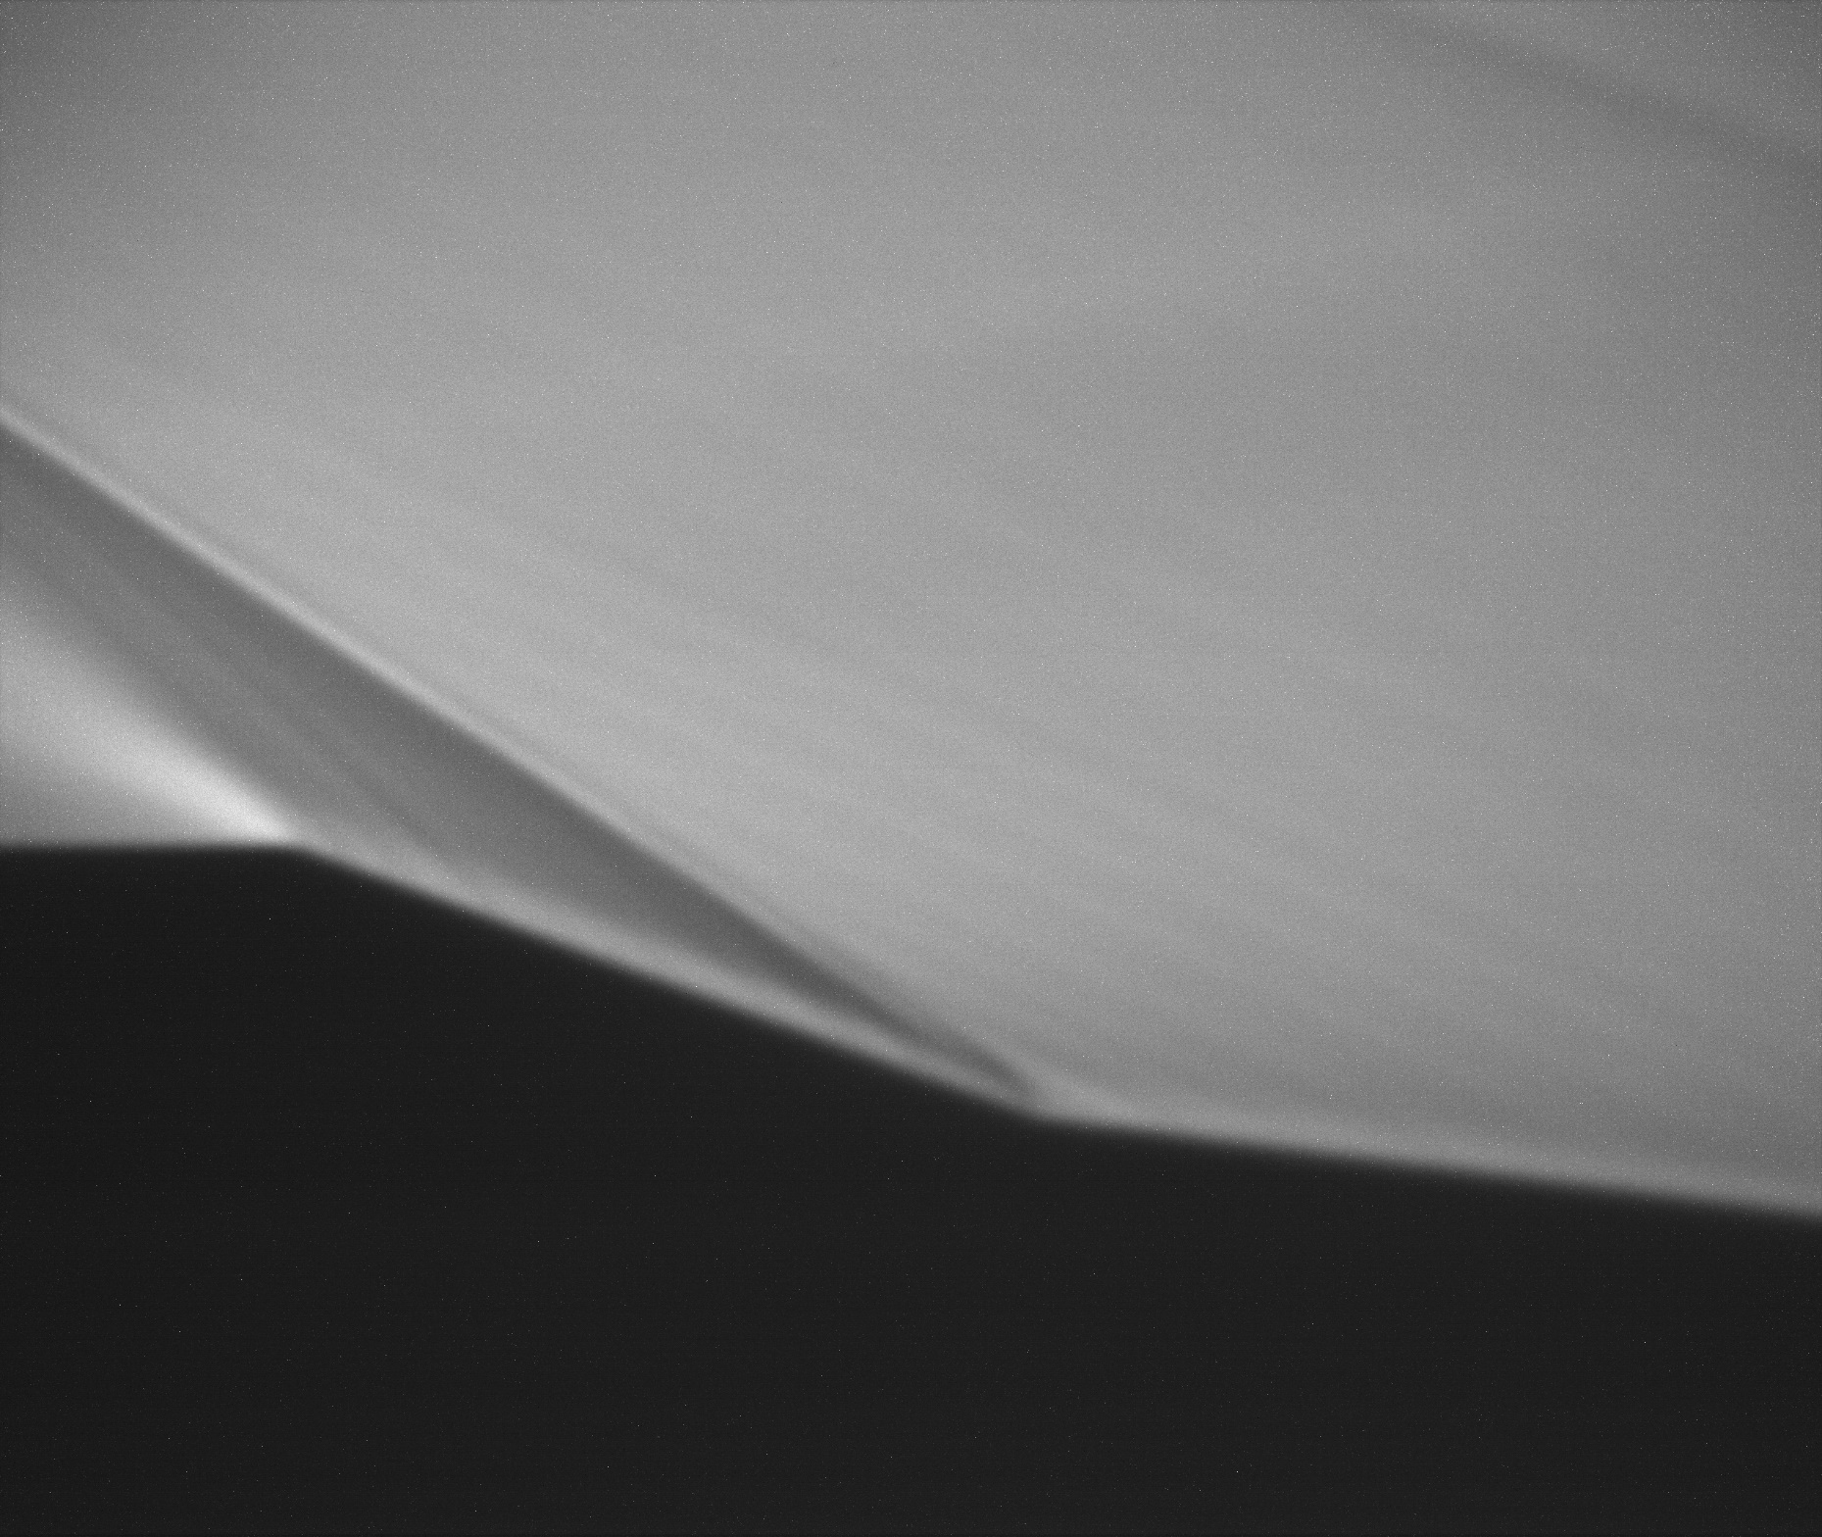
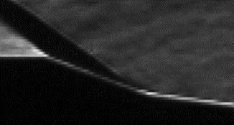
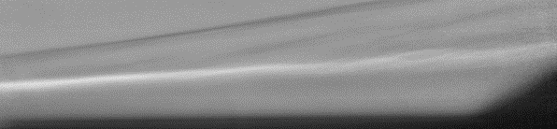
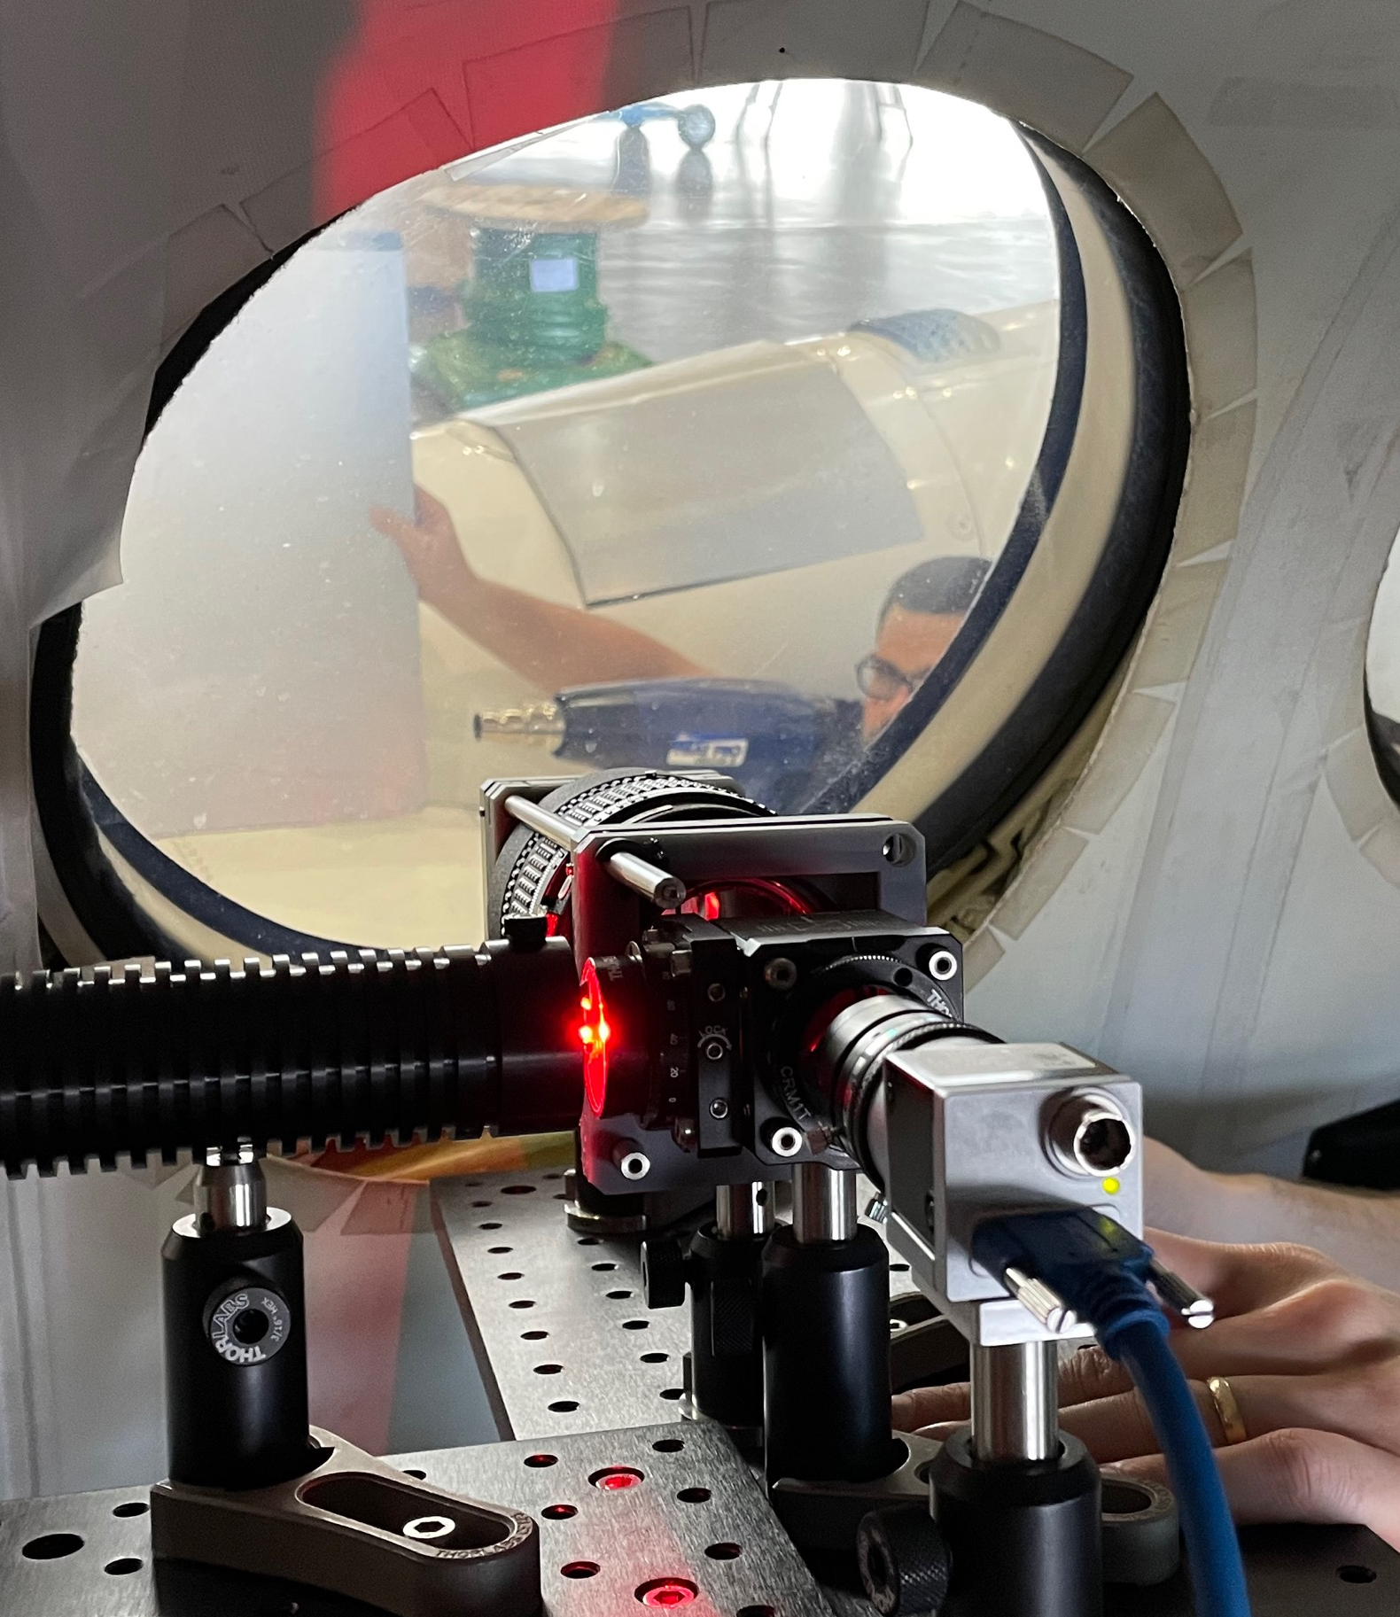
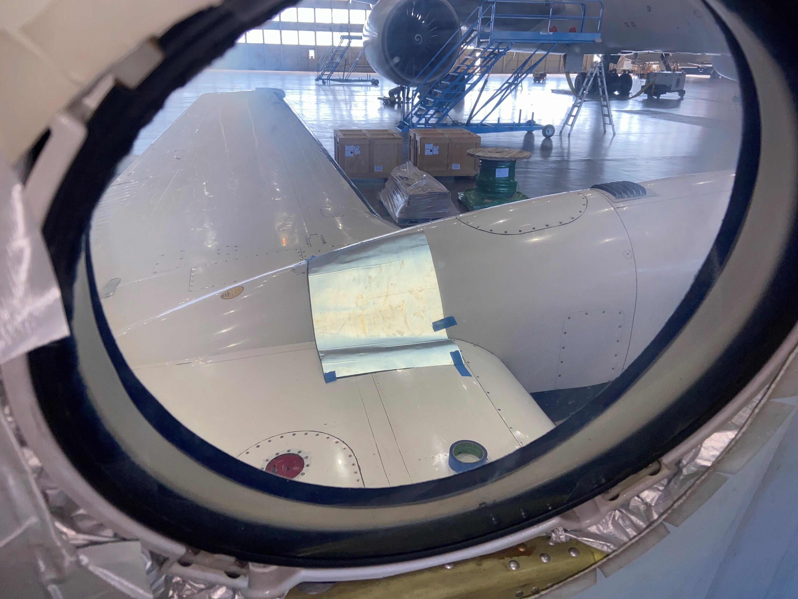
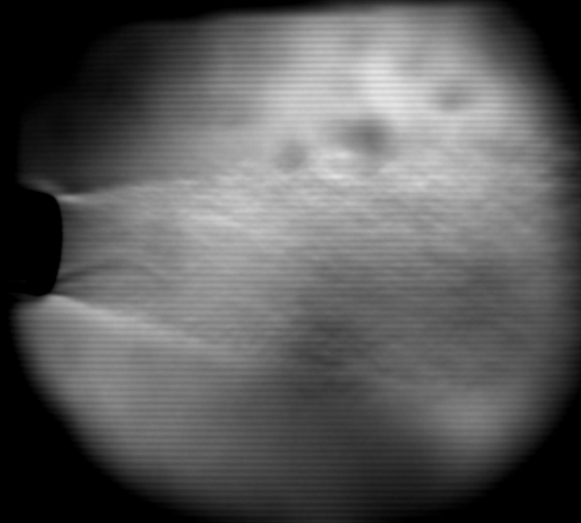

Self-Aligned Focusing Schlieren (SAFS) Flow Visualization Technique
A compact, low-cost, easy-to-use flow visualization tool
Challenge
Understand how fluid flow interacts with bodies of interest
  Simple wind tunnel models: Further understanding of fundamental physics
  Aircraft/spacecraft: Measure flow field to evaluate full vehicle designs
Requires non-intrusive, off-body measurement
  Sensitive, compact, inexpensive, easy to align and adjust, quick setup time
Expected Impacts
CFD: High-quality flow visualization images for CFD simulation comparison/validation
Researcher: Focusing schlieren now available as a tool for any researcher regardless of experience
Flight testing: Simple flow visualization tool for flight testing and aircraft integration
Big picture: May replace many existing conventional schlieren systems
Solution
SAFS system significantly reduces complexity of traditional focusing schlieren systems
  Uses only one source/cutoff grid instead of two
  Manipulates polarization of light for maximum light intensity throughput and window glare elimination
Results
Compact, with quick setup time
Insensitive to vibration
Requires only single-sided optical access
High-quality windows not needed
Narrow depth-of-focus isolates only relevant flow features
Resolution and sensitivity comparable to conventional schlieren
Uses polarized light to eliminate window glare
Non-orthogonal imaging for limited optical access facilities
High-speed imaging possible (> 1 MHz)
Conventional
SAFS
Conventional
SAFS
Comparison of SAFS (left) and conventional schlieren (right) images, cone-flare at Mach 3, with Mach waves from model’s 3D printed layer lines visible in SAFS images
Comparison of conventional schlieren (top) and SAFS (bottom), demonstrating elimination of window defects, path integration, HVAC thermals, and window boundary layers
Next Steps
Quantify sensitivity of system
Develop software to aid in preliminary system design
Implement system in flight vehicle
Aid other researchers in their own design applications
Retroreflective Material
Participants
Brett F. Bathel, NASA LaRC, D304
Joshua M. Weisberger, NASA LaRC, D304
Technology is patent pending, LAR-TOPS-348
SAFS installed inside Beechcraft B200 King Air, with curved retroreflective material on engine cowling
Heat gun flow at propeller tip vortex position, demonstrating SAFS feasibility
POC: Joshua Weisberger, NASA Langley Research Center

