Slide 1
Flight Software for the LOFTID Re-Entry Vehicle
Paul Brewster, Software Lead
March 21st, 2023

Slide 2
Agenda
Project Introduction
Avionics Overview
PDSU Software
Camera Controller Software
Data Recorder Software
Conclusions

Slide 3
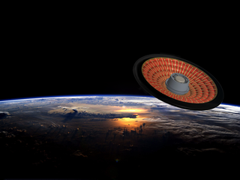
Project Introduction
Hypersonic Inflatable Aerodynamics Decelerator (HIAD)
  Aeroshell designed to protect and decelerate a spacecraft entering from Low-Earth orbit
  Inflatable, allowing Aeroshell to be larger than the rocket’s shroud
  6-meter diameter
First Demonstration from Low-Earth orbit
  Launched in November from Vandenberg on ULA’s Atlas V
  Secondary payload to JPSS-2
  Orbited the Earth once, splashing down near Hawaii
  2.5 hours between launch and splash down, powered on for about an hour

Slide 4
Agenda
Project Introduction
Avionics Overview
PDSU Software
Camera Controller Software
Data Recorder Software
Conclusions

Slide 5

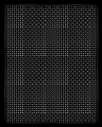



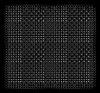





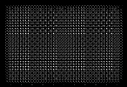














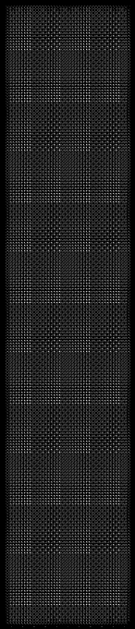



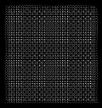



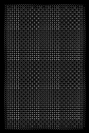





Avionics Overview
DAS
GPS
Data Switch
Sensors
Aeroshell
Pyro
Pyro
Ethrnt
DAS
Battery
PDSU
ADAU
LNA
15
V Pwr
Ethrnt
Ethrnt
FOSS
System
28
V
28
V
Up
-
DC
Look
/
DC
5
Battery
Pyro
V
Camera
PDSU
LV Sep
PDSU
Ethrnt
Interface Adapter
PAS Sep
Modular Avionics Control Hardware
28
IDR
Iridium
Pwr
V
-
LV
On Cmd
Board
LV Sep Loop
Serial
RTB
PAS Sep Loop
+
15
V
Ethrnt
Camera
(
X
6
28
)
V
Pod
(
X
6
)
5
Serial
IMU
V
+
15
V
-
15
GSE
28
PDSU
V
V
ISPS
PDSU
Pyro
Pyro Btry Chrgr
Pyro
Pyro
Parachute
Sys Btry Chrgr
28
V
Pyro
5
V
12
GSE FSW Ethrnt
V
Pyro
Relay
Pyro
GSE Ethrnt
Ethrnt
Recovery Lights
EDR
Ejection
GSE
EDR Serial
System
EDR Btry Chrgr
LEGEND
LB Serial
Power
LB
Serial
/
LB Btry Chrgr
Ethrnt
Discrete Cmds
/
Sig
Analog
Inflation System
Subsystems
,
/
Components

Slide 6
Avionics Components with Flight Software
DAS
GPS
Data Switch
Sensors
Aeroshell
Pyro
Pyro
Ethrnt
DAS
Battery
PDSU
ADAU
LNA
15
V Pwr
Ethrnt
Ethrnt
FOSS
System
28
V
28
V
Up
-
DC
Look
/
DC
5
Battery
Pyro
V
Camera
PDSU
LV Sep
PDSU
Ethrnt
Interface Adapter
PAS Sep
Modular Avionics Control Hardware
28
IDR
Iridium
Pwr
V
-
LV
On Cmd
Board
LV Sep Loop
Serial
RTB
PAS Sep Loop
+
15
V
Ethrnt
Camera
(
X
6
28
)
V
Pod
(
X
6
)
5
Serial
IMU
V
+
15
V
-
15
GSE
28
PDSU
V
V
ISPS
PDSU
Pyro
Pyro Btry Chrgr
Pyro
Pyro
Parachute
Sys Btry Chrgr
28
V
Pyro
5
V
12
GSE FSW Ethrnt
V
Pyro
Relay
Pyro
GSE Ethrnt
Ethrnt
Recovery Lights
EDR
Ejection
GSE
EDR Serial
System
EDR Btry Chrgr
LEGEND
LB Serial
Power
LB
Serial
/
LB Btry Chrgr
Ethrnt
Discrete Cmds
/
Sig
Analog
Inflation System
Subsystems
,
/
Components

Slide 7
Software Components
Class D Mission, Class C Software
PDSU Software
  Sequence Mission Timeline
  Data Acquisition
  Component Control
  Telemetry
Camera Controller Software
  6 Camera Controllers
  Each Controller Interfaces with 1 Visual and 2 IR Cameras
  Receives Camera stream, processes, records locally, sends to Data Recorders
Data Recorder Software
  Captures all network traffic and records the traffic to an SD card
  Identical software on the Internal and Ejectable Data Recorders
FOSS Software
  CPU/FPGA hybrid to sample laser return along multiple fiber optic strands measuring temperature
  FPGA used to perform 40K FFTs per second on the laser return signal

Slide 8
Agenda
Project Introduction
Avionics Overview
PDSU Software
Camera Controller Software
Data Recorder Software
Conclusions

Slide 9
PDSU Software
Target Hardware
  Modular Avionics Control Hardware (MACH) compute system
  Procured from Northrup Grumman
Target Processor
  Power PC 8280 Processor
Target OS
  LynxOS
    POSIX compliant
    Real-Time Operating System
Software Framework
  cFS 6.5

Slide 10
PDSU Software
Architecture
Control
Telemetry
Data Acquisition
Recovery
Light
Data Recorder Interface
Real-Time Beacon
Interface
Analog I/O
Interface
IMU Interface
DAU Interface
GPS Interface
Inflation System
Interface
Digital I/O Interface
Software Bus
Ordnance
Control
Calculation
Nav
Filter
Power Transfer
Control
Power
Control
cFS Apps
cFE Apps
House-keeping
Telemetry
Output
Command
Ingest
Scheduler
Stored
Command
Event
Services
Executive
Services
Time
Services
Table
Services

Slide 11
Major Changes for LynxOS
Based on posix OSAL and pc-linux PSP
OSAL
  Threaded Signal Handler behavior ambiguity
    POSIX does not define which thread receives a given signal
    Created dedicated Timer Thread to do signal handling
    Used msg queue for other threads to add and remove signals
  Pthread Mutexes were not recursive
    Added recursive functionality to OS_mutex
  Dynamic Object Loader API inconsistent
    Switched to using a module id for all shared object symbol lookups
PSP
  Shared Memory inconsistent
    Switched to POSIX real-time shared memory
  Reworked Timer Thread to reflect OSAL changes

Slide 12
Minor Changes for LynxOS
OSAL
  Implemented os_vsnprintf since vsnprintf didn’t exist
  Changed setschedparams to setschedprio
  Added const to buffer variables being passed into a write function
  Replaced statvfs structure with statfs structure
  Removed gethostid
  Linked to netinet instead of pthreads and rt
PSP
  Switched away from long command line options
CFE
  Added _STDC_LIMIT_MACROS defines
  Modified network include files
  Fixed byte swapping in CCSDS header

Slide 13
Agenda
Project Introduction
Avionics Overview
PDSU Software
Camera Controller Software
Data Recorder Software
Conclusions

Slide 14
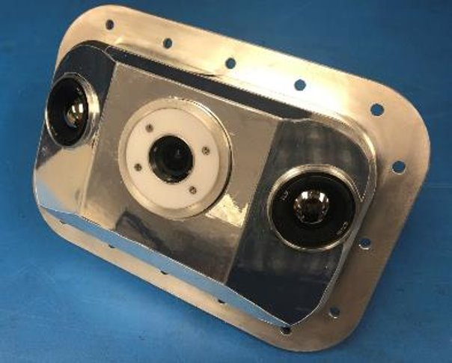
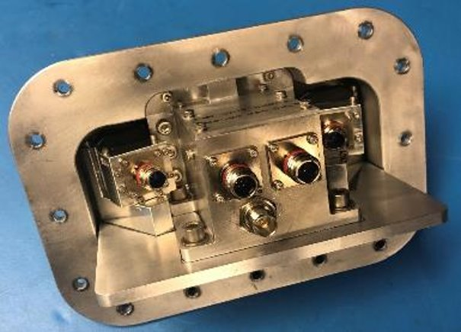
Camera Pod
Each Camera Pod consists of
  Camera Controller
    On-board data storage
    Network Connection to Data Recorders and GSE
  IMPERX Cheetah camera connected via HD-SDI
  Two FLIR BOSON Infrared Cameras connected via USB

Slide 15
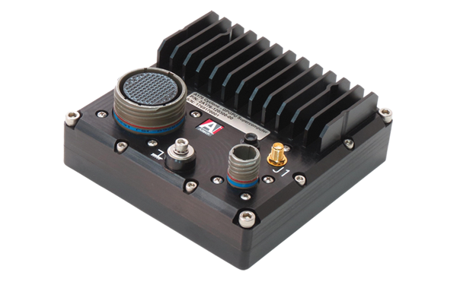
Camera Controller Software
Target Hardware
  AiTech A176 based on NVIDIA Jetson TX2 hardware
Target Processor
  ARM Cortex-A57 CPU
  Nvidia Pascal GPU
Target OS
  Jetson Linux
    Ubuntu based Linux
Framework
  Gstreamer media pipeline
Image courtesy of AiTech Systems

Slide 16
Camera Controller Software
Functionality
Receives
  Two IR Video streams (640x512 at 10Hz)
  One Visual Video stream (1920x1080 at 30 Hz)
Decodes/Encodes
  Uses the on-board GPU for real-time video encoding and decoding
Records
  Full resolution streams to on-board storage
Sends
  Visual Video to Data Recorders as H265 video at 12Mbs bitrate
  IR Video to Data Recorders as PNG compressed images at 1Hz

Slide 17
Agenda
Project Introduction
Avionics Overview
PDSU Software
Camera Controller Software
Data Recorder Software
Conclusions

Slide 18
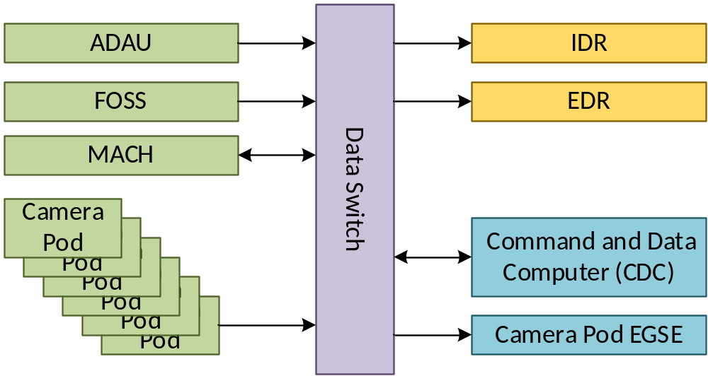
Data Recorder
Two Data Recorders
  Internal Data Recorder
  Ejectable Data Recorder
Each Data Recorder contains
  A Single Board Computer
  A separate ejectable SD card
Data Sources
  PDSU
  6 Camera Pods
  Aeroshell Data Acquisition Unit (DAU)
  FOSS
Data Subscription
  All data is sent using multi-cast UDP
  Each source sends data just once to their respective multi-cast address
  The IDR, EDR, and GSE subscribe to the multicast addresses to receive the data
Data Storage
  Data is stored unprocessed on the SD card in PCAP format to maintain network information

Slide 19
Data Recorder Software
Target Hardware
  AiTech A176 based on NVIDIA Jetson TX2 hardware
Target Processor
  ARM Cortex-A57 CPU
  Nvidia Pascal GPU
Target OS
  Jetson Linux
    Ubuntu based Linux
Framework
  libpcap
Image courtesy of AiTech Systems

Slide 20
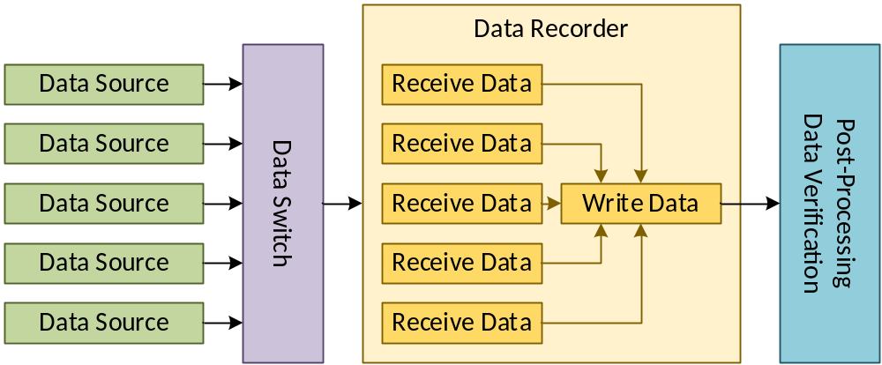
Data Integrity
Extensive Testing was done to ensure data integrity
  Specifically looking for dropped or corrupted packets
Issues were found in four places in the data pipeline
  Data not properly routed at the Data Switch
  Data not properly received by the Data Recorder
  Data not properly written to the SD card by the Data Recorder
  Data not properly verified during post-process integrity checks

Slide 21
Data not properly routed at the Data Switch
Issue:
  In testing, significant chunks of data were dropped at the Data Switch once every few minutes
  The Data Switch drops packets due to high traffic load
  By analysis, average network bandwidth was well under data switch limits
    Overall network bandwidth was 20Mbps and the Data Switch was tested up to 60Mbps
Two Solutions
  Enable Internet Group Management Protocol (IGMP)
    Without IGMP, multicast packets are routed to all connected devices
    Each device is expected to drop the packet if it isn’t subscribed to that multicast packet
    Resulted in over x6 the bandwidth usage
  Camera Pod Controllers sending IR Video
    Each of the 6 Camera Controllers sends two IR images at 1Hz
    If the images are all sent at the same time, there is a sudden spike in traffic, even though average bandwidth is very small, causing dropped packets
    By staggering the image sends, there is never a sudden spike in traffic

Slide 22
Data not properly received by the Data Recorder
Issue:
  The software does not receive the data from the network kernel buffer fast enough, resulting in data being lost in the buffer
Solution:
  A thread is created for each multicast address
  Each thread does a non-blocking poll to receive data from that address
  When no data is available, the thread sleeps to allow another thread to go
Other Attempts:
  Using a single thread to receive all of the multicast traffic. Design was simpler, but the libpcap filter was complex, which slowed overall execution time
  Using blocking polls to receive data. Reduced CPU usage but was overall slower.
  Using non-blocking polls with a timeout-based select function. Reduced CPU usage but was overall slower.

Slide 23
Data not properly written to the SD card
Issue:
  Writing to the SD card is a slow process, although theoretical bandwidth is sufficient for the data
  Occasional multi-second delays in writes
Solution:
  A separate thread for writing data to the SD card
  Write data in 10MB chunks, optimizing the throughput
  Write each chunk as a separate file
  Use a ring buffer to handle the isolated delays

Slide 24
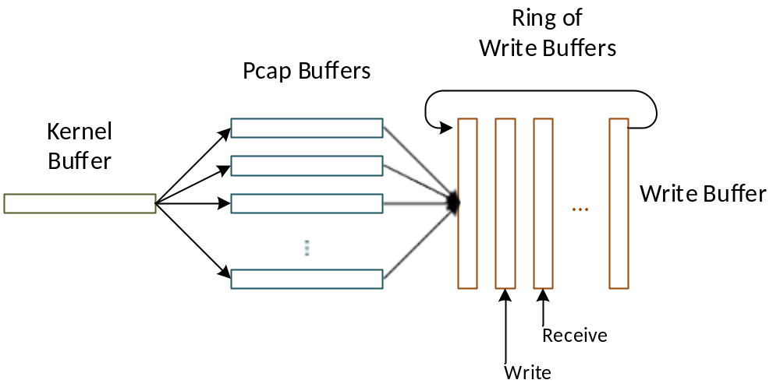
Data Pipeline

Slide 25
Data not properly verified during post-process integrity checks
Compare data from IDR, EDR, and GSE Data Recorder simulator to verify integrity
Issues
  Data Recorders are not started at the same time
  Data Recorders are not stopped at the same time
  The order of packets in the data file is not guaranteed
Process
  Merge the chunk files into one large data file for each Data Recorder
  Filter out non data from the network capture
  Separate each packet by their source
  Write the checksum for each packet into a checksum summary file corresponding to that source
  Compare the checksum summary files between two Data Recorders
  Search for differences in summary files, ignoring the cases where one has extra packets at the beginning or extra packets at the end

Slide 26
Agenda
Project Introduction
Avionics Overview
PDSU Software
Camera Controller Software
Data Recorder Software
Conclusions

Slide 27
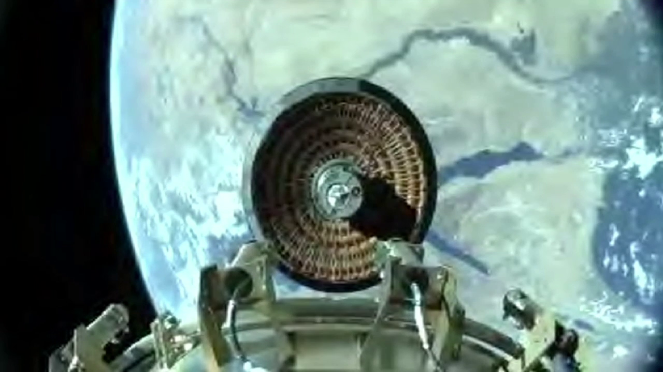
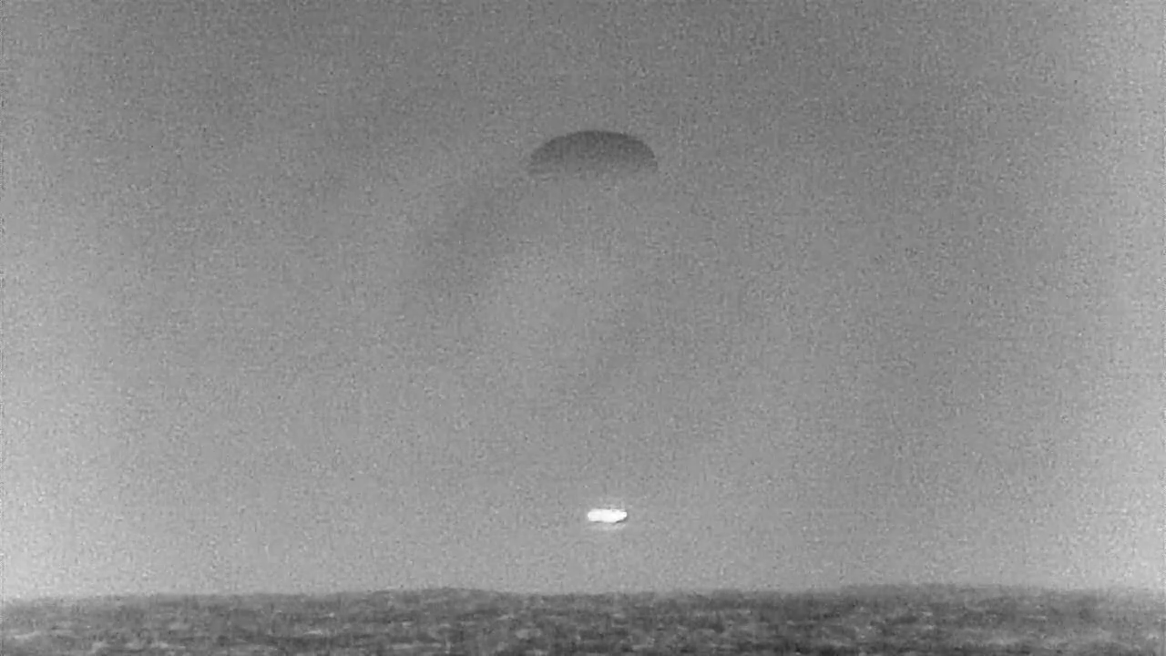
Conclusions

Slide 28
Credits
PDSU Software – Langley Research Center
  Matt Rodgers
  Jacob Cassidy
  Joel Amert (MSFC)
  David Keck
  Peter Huynh
Camera Controller Software – Marshall Space Flight Center
  Derek Moody
  Darrell Gaddy
  Brent Beabout
Data Recorder Software – Langley Research Center
  Matt Rodgers
FOSS Software – Armstrong Flight Research Center
  Allen Parker
Testing & QA
  Mark Wehman
  Shane Wolf

