Slide 1
The Dragonfly Entry and Descent System
AIAA SciTech 2023
January 23, 2023
Michael Wright (Dragonfly EDL Phase Lead)
Karl Edquist (Dragonfly Deputy EDL Phase Lead)
Notes:
APL led
EDL Partners include : NASA ARC&LaRC, Lockheed Martin, U. Central Florida, Airborne Systems, Vorticity LTD, Spirit/FMI

Slide 2
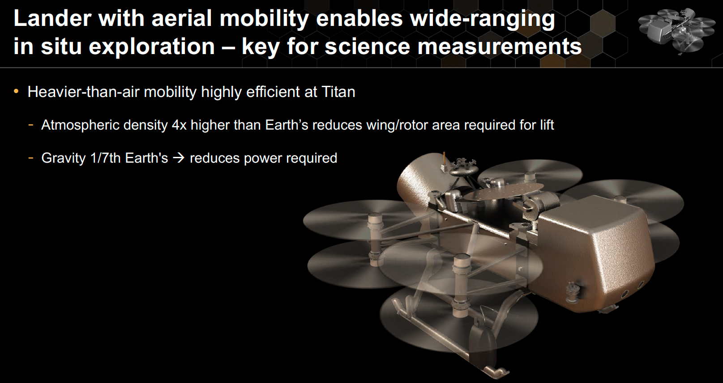
Launch: 2027
Arrival: 2034
2

Slide 3
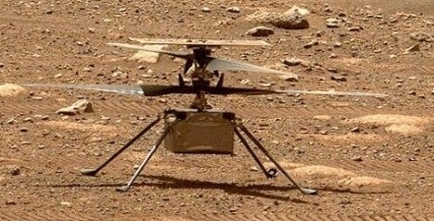
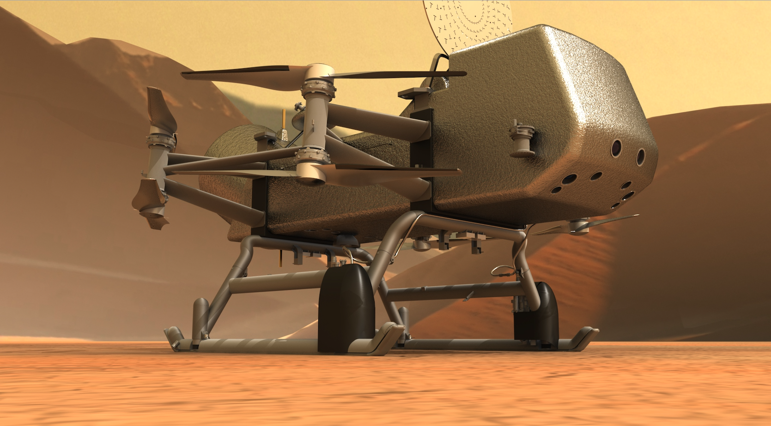
A Note on Scale
Ingenuity
Dragonfly
Key Dimensions:
Fuselage: 13.6x19.5x16.3 cm
Rotor Diameter: 1.2 m
Total Mass: 1.8 kg
Key Dimensions:
Fuselage: ~3.85 m long
Rotor Diameter: ~1.35 m
Total Mass: ~900 kg
3

Slide 4
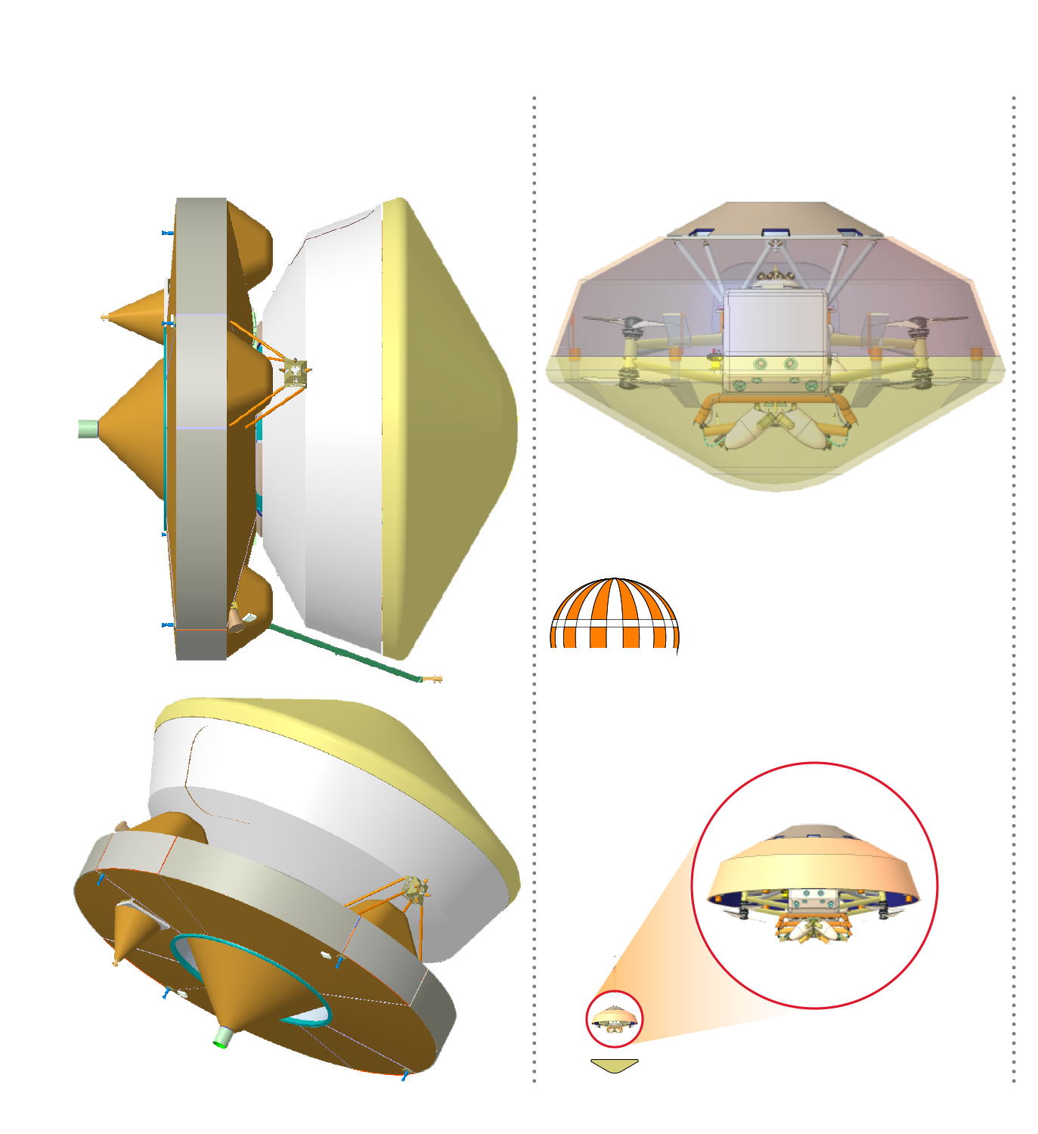
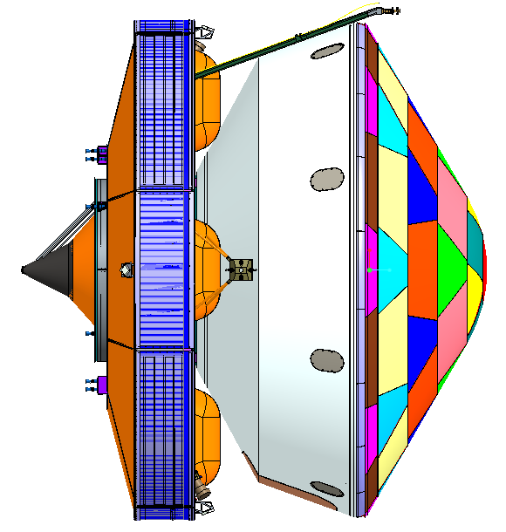
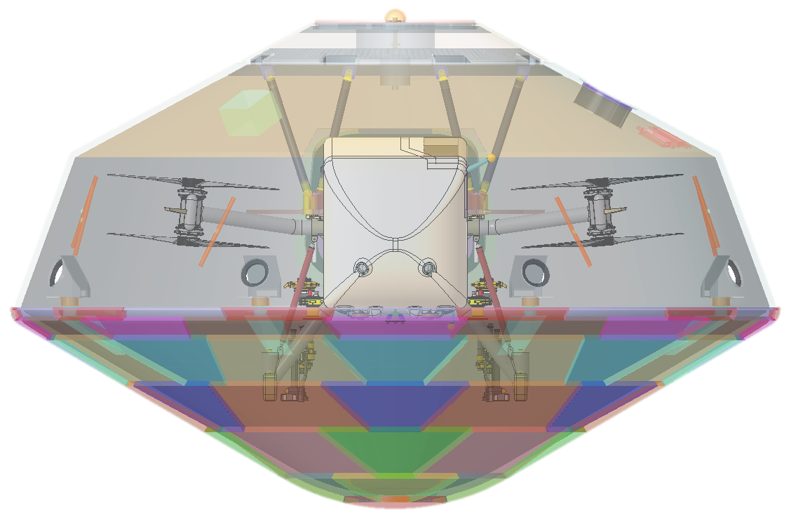
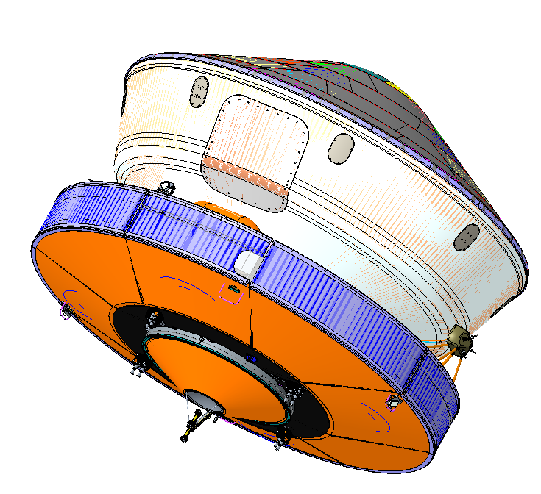
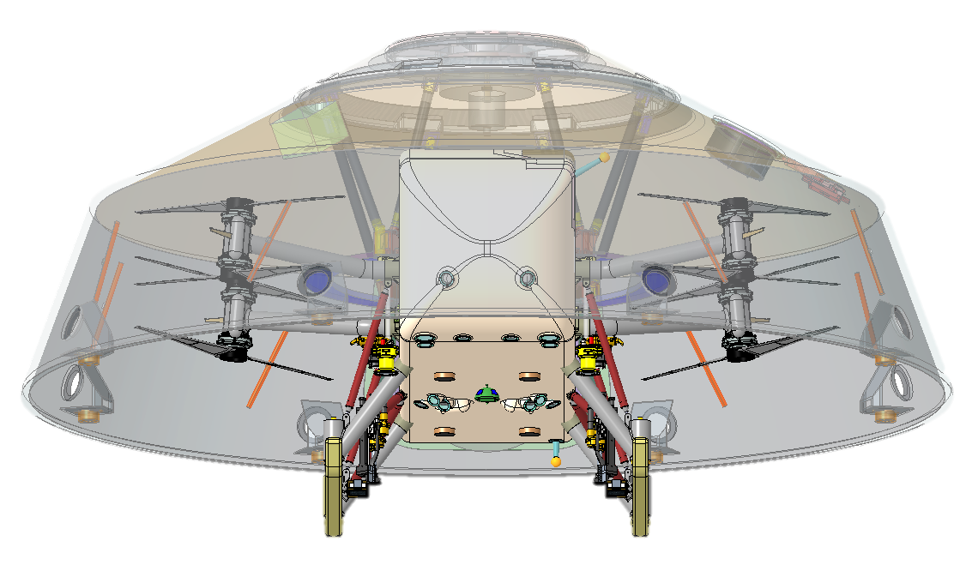
Flight System Elements
Rotorcraft Lander
Flight configuration with HGA stowed
Cruise stage provides functions needed for travel between Earth and Titan
Propulsion, guidance & control, (attitude control) and telecommunications
EDL Assembly provides functions needed for safe descent through Titan’s atmosphere
Heatshield, backshell, parachute system, separation systems, and LGA
(Rotorcraft) Lander provides functions needed for surface exploration at Titan
Octocopter for mobility (flight) at Titan
Science instruments for studying Titan’s surface and atmosphere
Note: Images above are used to delineate elements and may not reflect current configuration

Slide 5
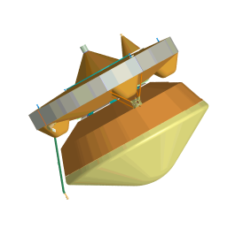
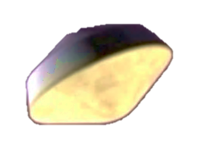
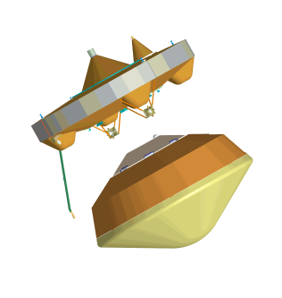
Wake up; E-190 min
Entry
Turn to entry, spin up to 2 rpm; E-27 min
Cut thermal loop; E-16 min
MDNav to EDL Handoff (7800 km); E–10 min
Cruise Stage Separation; E–10 min
Peak heating
254 km; E+227 s
Peak deceleration
232 km; E+241 s
See talks by Brandis (Aerothermal) and Stern (TPS) in this session
* Times referenced to DAC1b CBE Mean
Notes:
Wake up from hibernation EI-3h
Entry beta = 106 kg/m2, FPA = - 47.8°
Very Mars-like to this point. Peak heating about 4m after EI, pushing 300 W/cm2 with a large contribution from shock layer radiation.
Peak deceleration 15s later, about 10.5g predicted, comfortably under 12g requirement

Slide 6
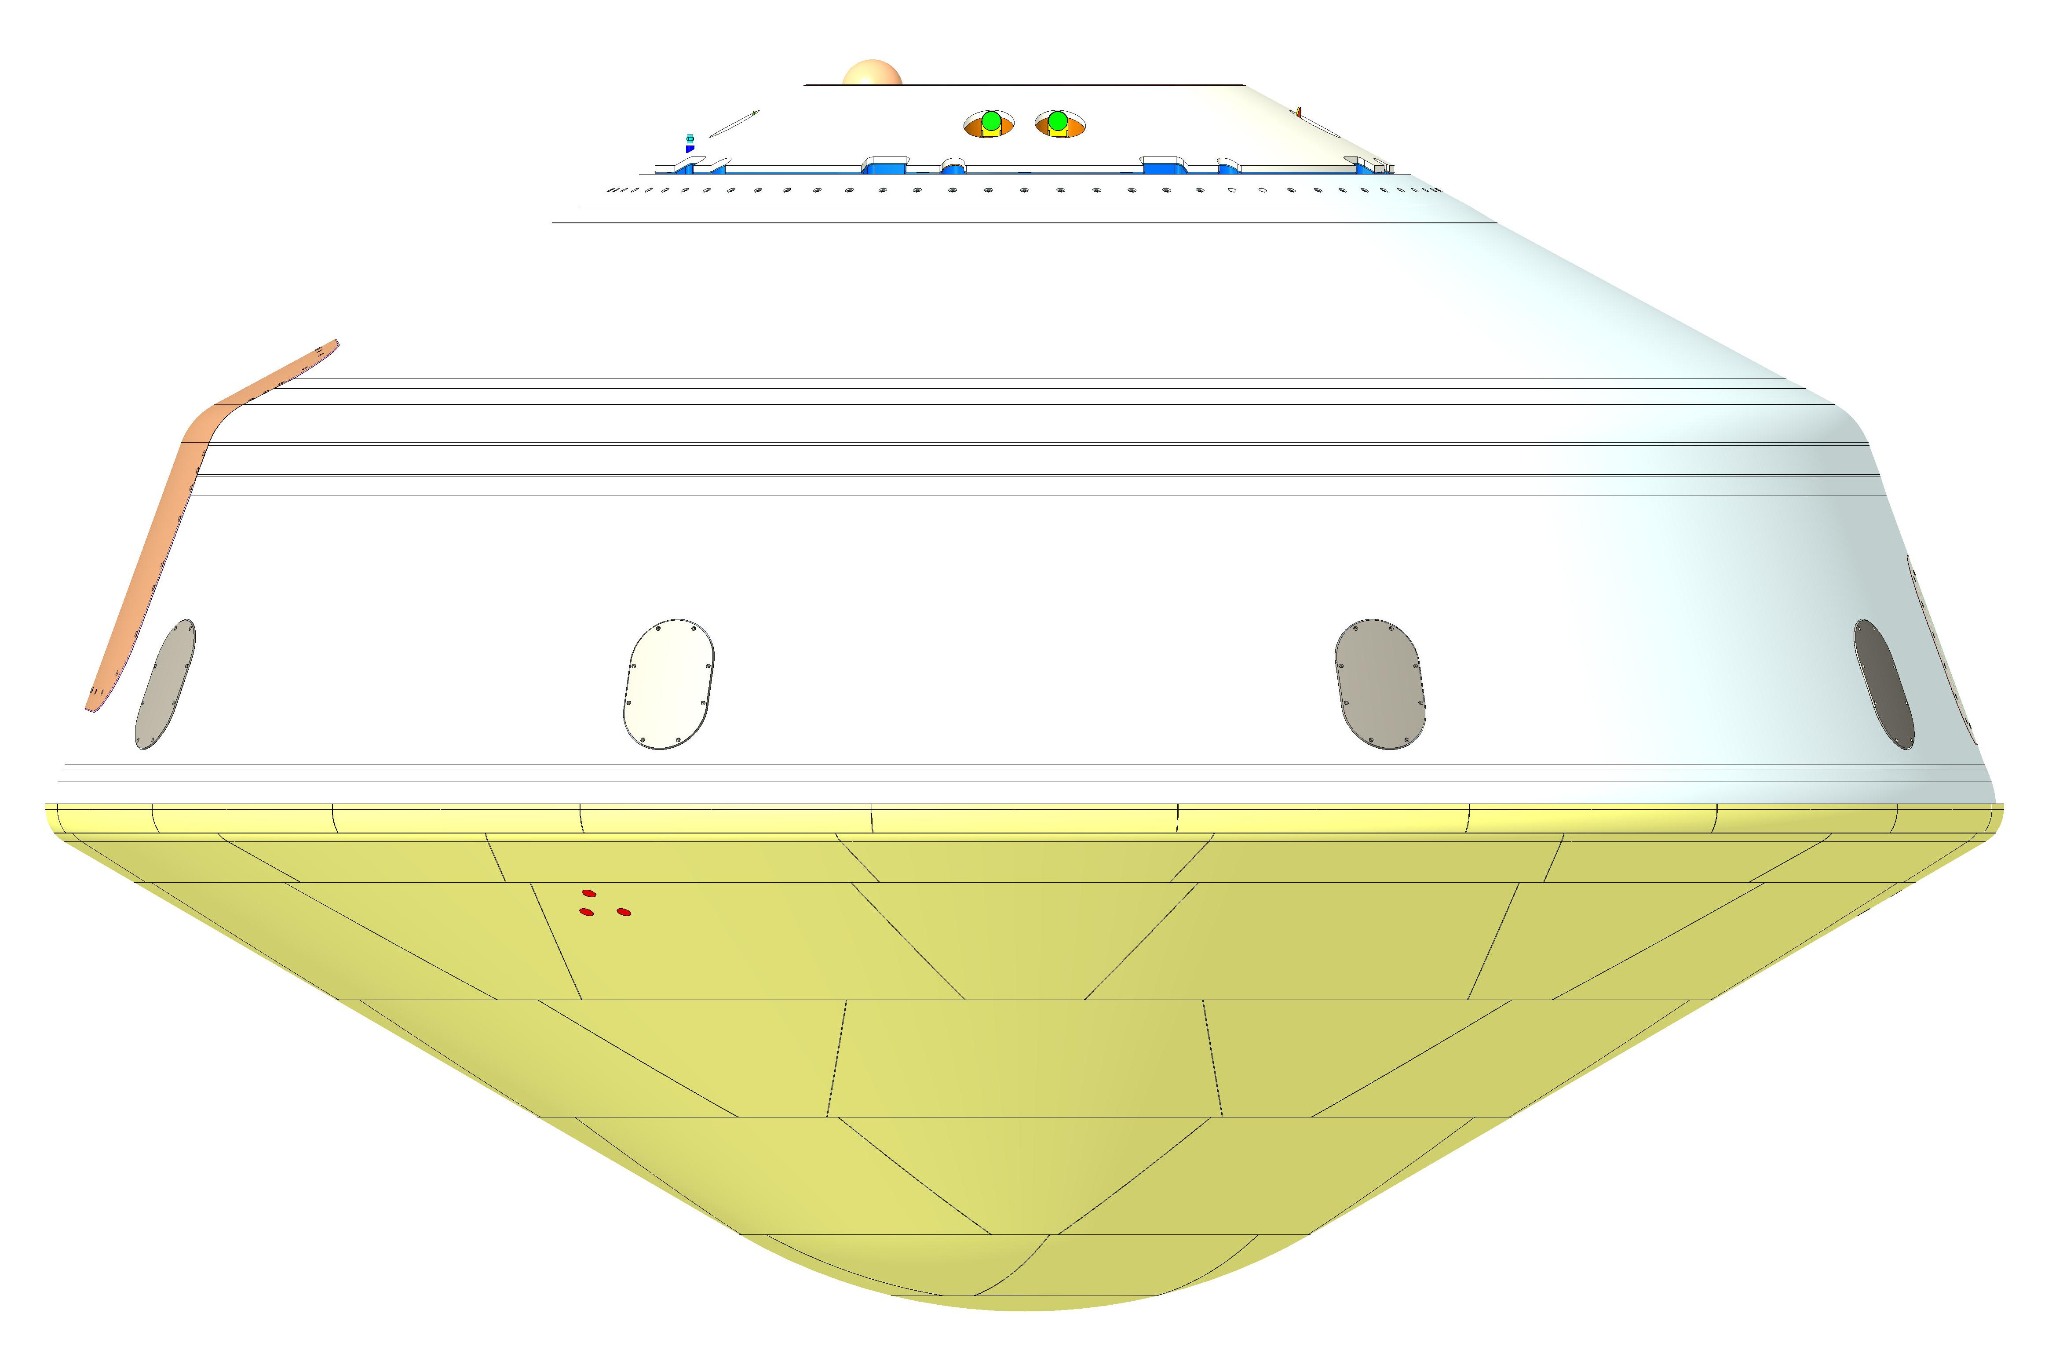
Dragonfly Aeroshell
ELGA Radome (SLA-220)
Parachute Cone
SLA 561V
Backshell
EDL
Assembly
Aeroshell
Heatshield
PICA-D
4.5m Diameter
6
Notes:
Not shown: Vent, Parachute lid/cover, access doors

Slide 7
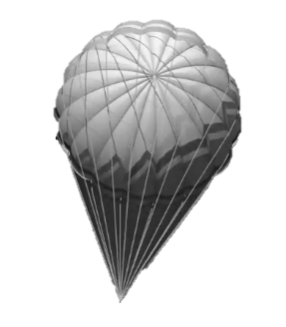
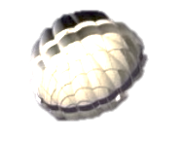
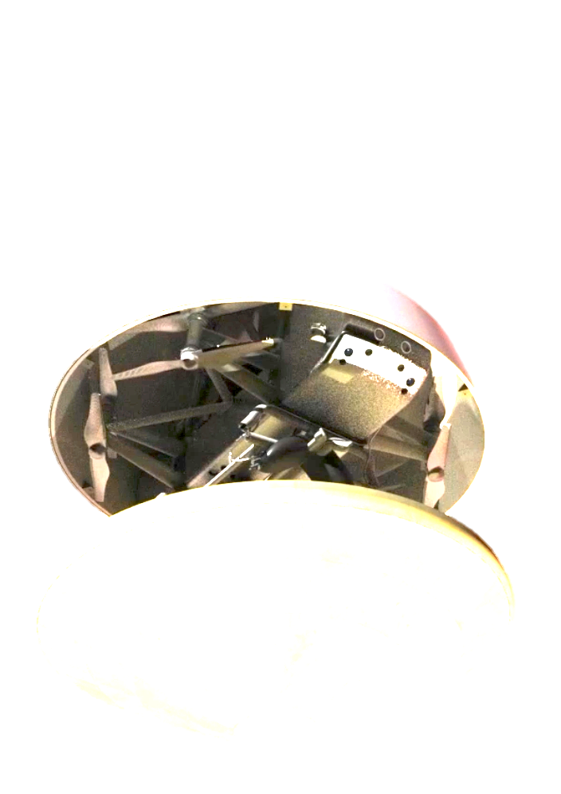

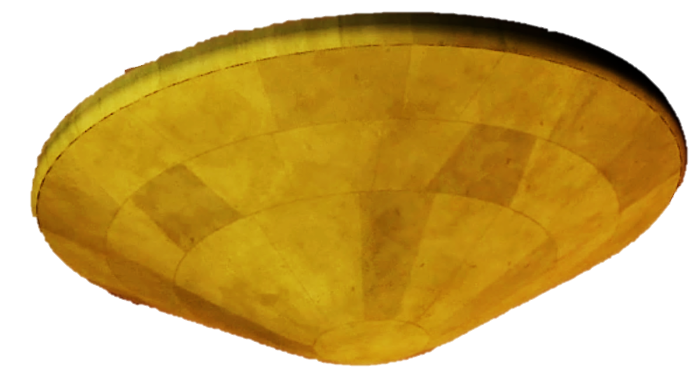
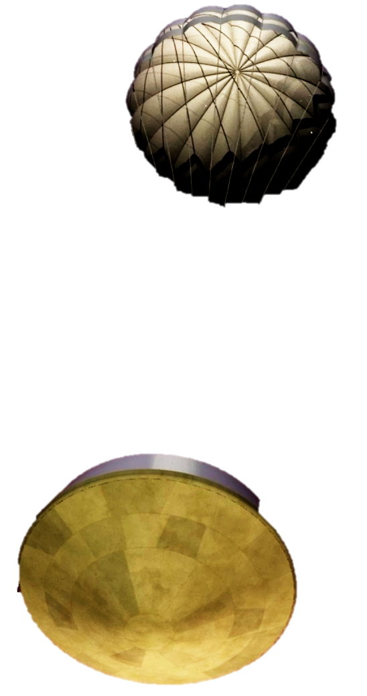
Descent
Entry Interface (1270 km); E=0
Main parachute deployment 5km; E+92 min
Heatshield separation
4.5 km; E+94 min
Drogue deployment
157 km; E+374 s
90 min Descent under drogue
See talk by Winski (Flight Mechanics) in this session
* Times referenced to DAC1b CBE Mean
Notes:
This is where the time dilation begins; drogue is deployed at EI+6m, but then we are on it for 86 minutes
Drogue: 5.4m DGB, opening load < 14.7kN, deploy M=1.5, ~9s above 1.4, ~30s supersonic
Three functions: stability, deceleration, deploy the main
Main: 16.55m DGB, opening load < 8kN, low speed deploy @5km
Functions: stability, deceleration, facilitate heat shield and lander release

Slide 8
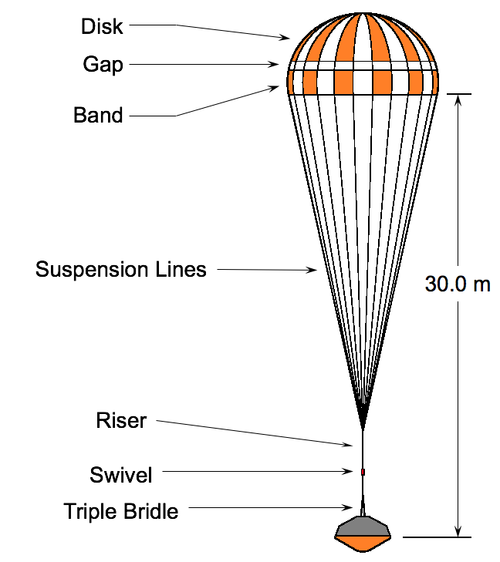
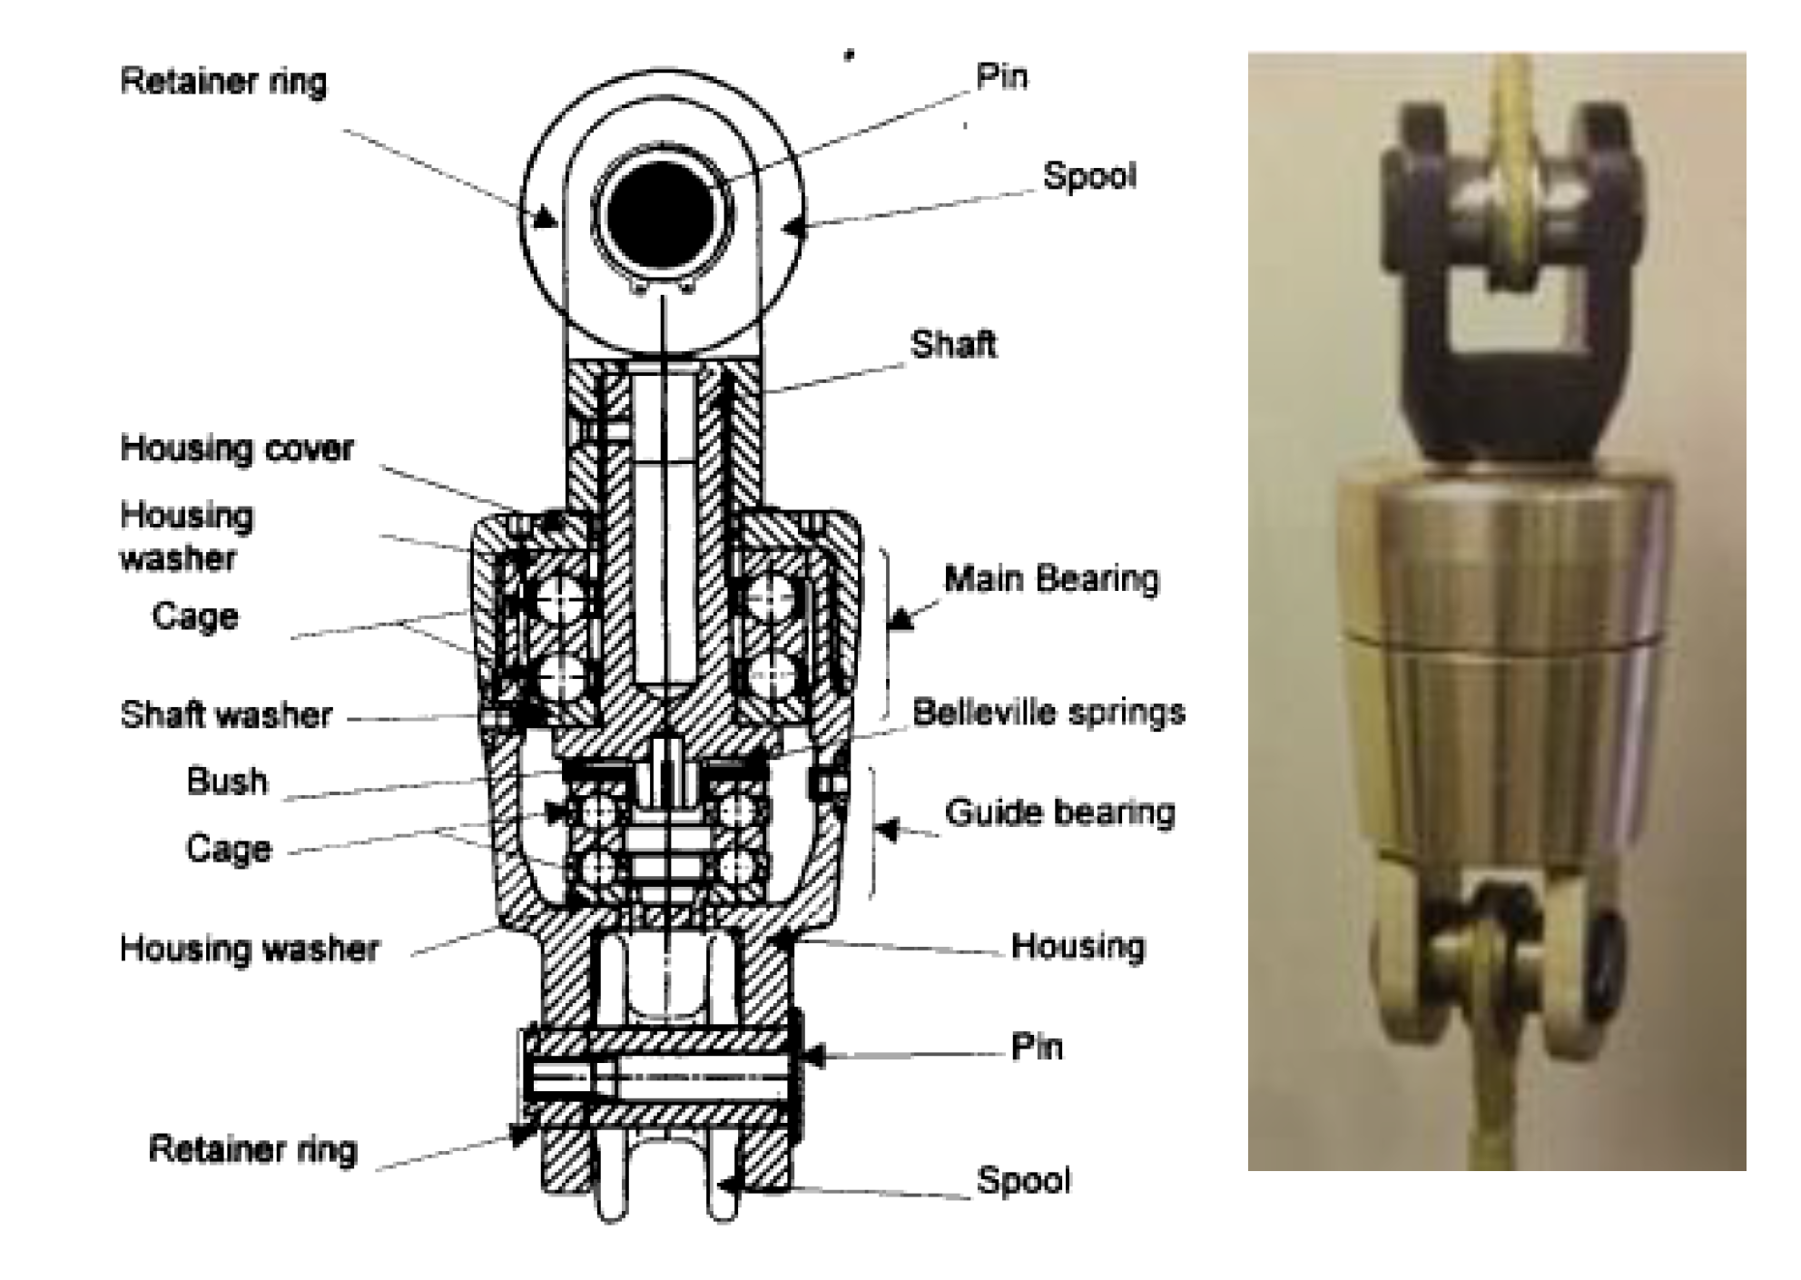
Parachute Deceleration System (Airborne / Vorticity)
Drogue Parachute (5.4 m DGB)
Mortar deploy via trigger at Mach 1.5
Functions: stabilize capsule, decelerate through atmosphere, extract main chute
Main Parachute (16.55 m DGB)
Low speed subsonic deploy
Functions: stabilize capsule, facilitate heat shield and lander release
Exploring alternate canopies (inflation & stability)
36.0 m
45.0 m
37.5 m
Huygens heritage swivels
Prevent line twisting
Notes:
MSL parachute design for peak load of 286 kN as opposed to 14.7 kN for the drogue and 6.1 kN for the main
Drogue:4.5m DGB (M2020 fabric, Kevlar lines, 10 diameter trailing distance); Main 16.55 m DGB (M2020 fabric, Kevlar lines, 8 diameter trailing distance)
Note that the parachute vendor is currently conducting a trade study for the main canopy (inflation and stability)
Swivel: Molybdenum disulphide dry film lubricant

Slide 9
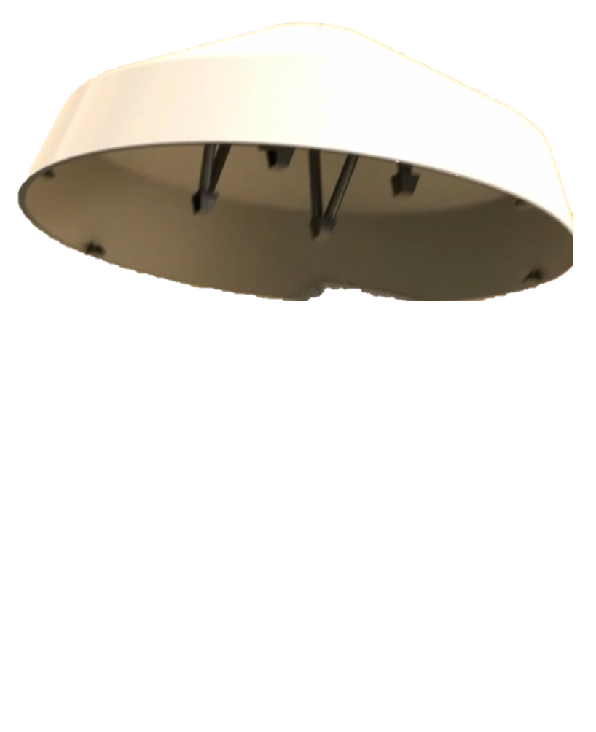
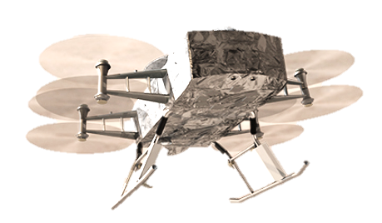
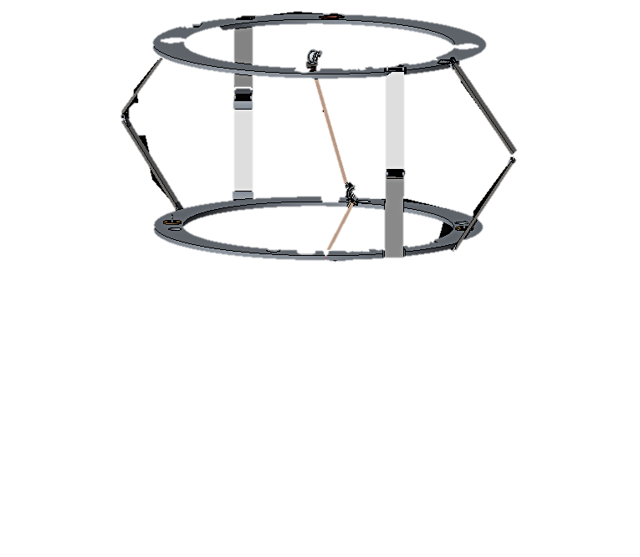

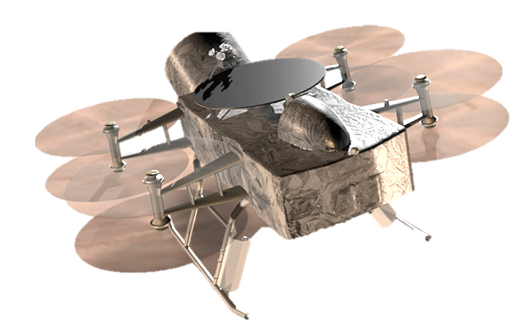
Preparation for Powered Flight
Reconfigure EDL thermal loop;
2.3 km; E+107 min
Lander Pose
2.2 km; E+109 min
Despin
2.1 km; E+110 min
Lidar Ground Lock
2 km; E+111 min
Lander Separation
0.8 km; E+118 min; 2.9 m/s
Transition to Powered Flight
Release + 1 s
* Times referenced to DAC1b CBE Mean
Notes:
This is the “new” part. We have a whole series of activities who’se purpose is to release the lander in a state from which it can successfully transition to powered flight
EDL should probably be “EDR” for this mission; our responsibility ends once this goal is achieved and the lander will locate its first safe landing site and complete its first landing under the auspices of the onboard mobility system

Slide 10
Wake up; E-190 min
Entry and Descent Con-Ops
Turn to entry, spin up to 2 rpm; E-27 min
Cut thermal loop; E-16 min
MDNav to EDL Handoff (7800 km); E–10 min
Cruise Stage Separation; E–10 min
Entry Interface (1270 km); E=0
Peak heating
254 km; E+227 s
Peak deceleration
232 km; E+241 s
Main parachute deployment 5km; E+92 min
Heatshield separation
4.5 km; E+94 min
Reconfigure EDL thermal loop;
2.3 km; E+107 min
Lander Pose
2.2 km; E+109 min
Drogue deployment
157 km; E+374 s
90 min Descent under drogue
Despin
2.1 km; E+110 min
Lidar Ground Lock
2 km; E+111 min
Lander Separation
0.8 km; E+118 min; 2.9 m/s
Transition to Powered Flight
Release + 1 s
* Times referenced to DAC1b CBE Mean
Notes:
Wake up from hibernation EI-3h
Entry beta = 106 kg/m2, FPA = - 47.8°
Drogue: 5.4m DGB, opening load < 14.7kN, deploy M=1.5, ~9s above 1.4, ~30s supersonic
Main: 16.55m DGB, opening load < 8kN, low speed deploy @5km

Slide 11
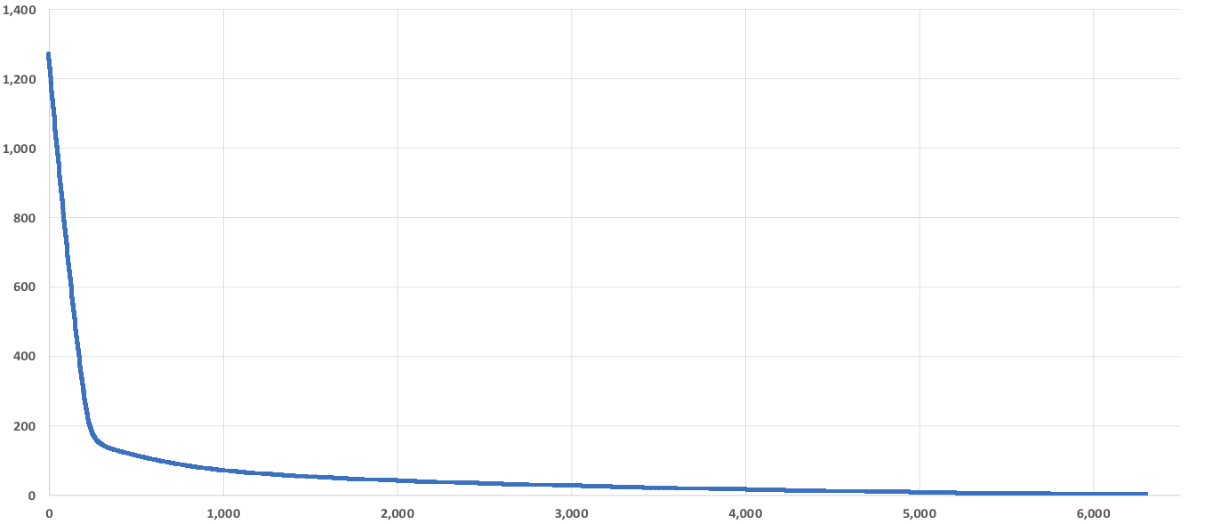
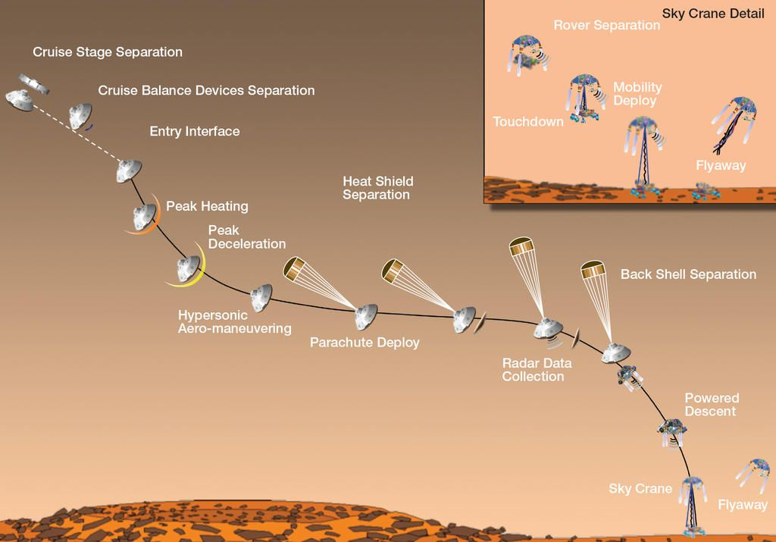
EDL Timeline Comparison
Altitude (km)
Max Deceleration
This is MSL…
Drogue Deploy
Lander Release
Main Chute
Time (s)
Notes:
Seven minutes of terror became “2 hours of mild discomfort” for proposal purposes
As we learn more it is becoming more like “an interminable time of considerable angst”

Slide 12
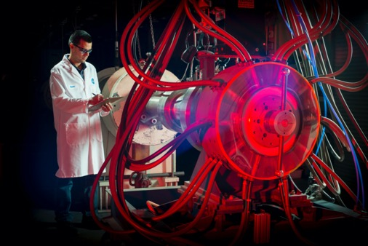
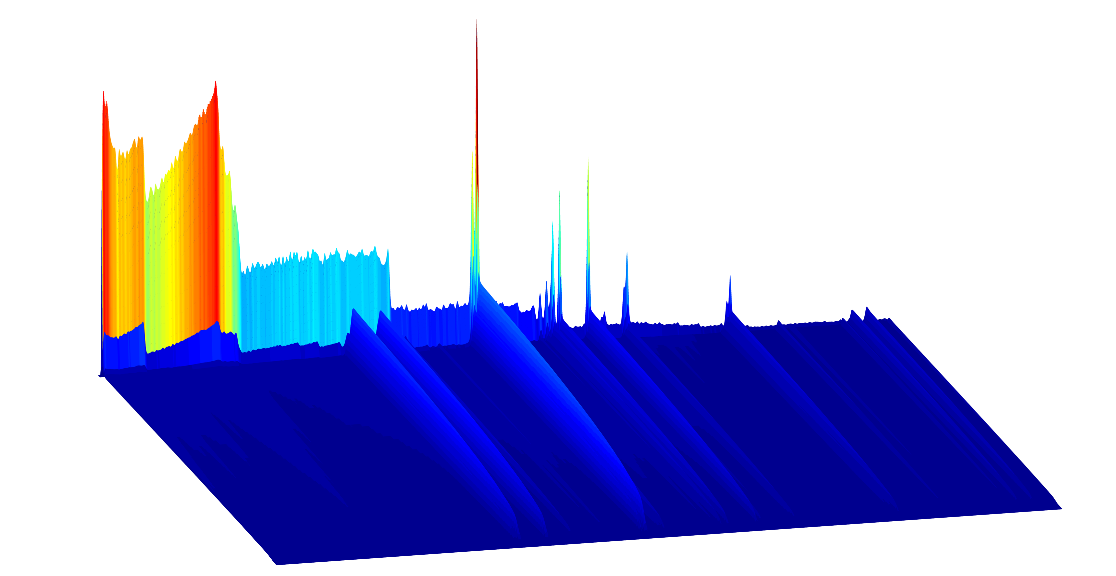
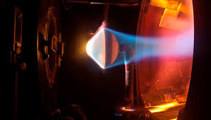
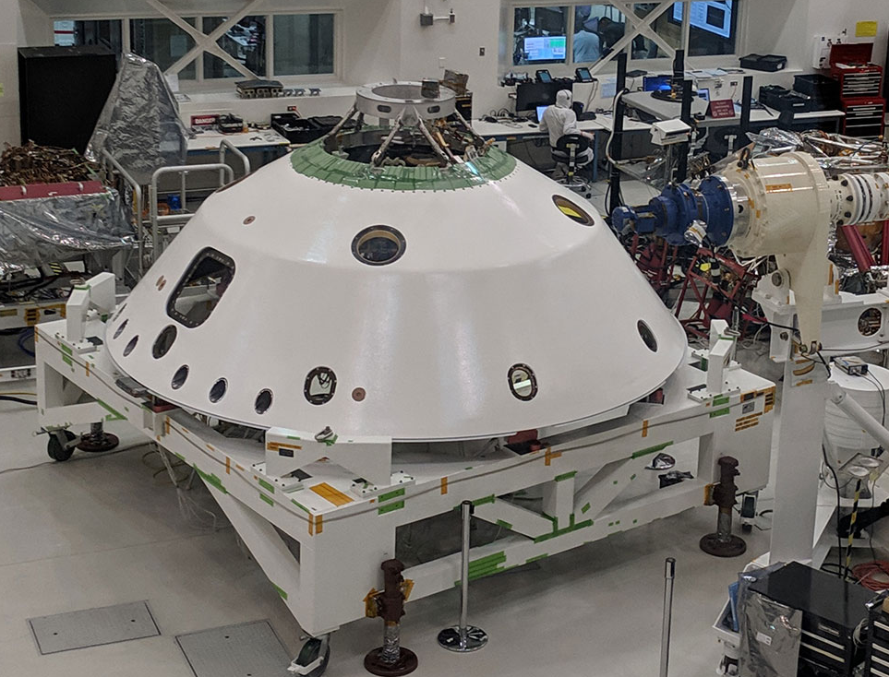
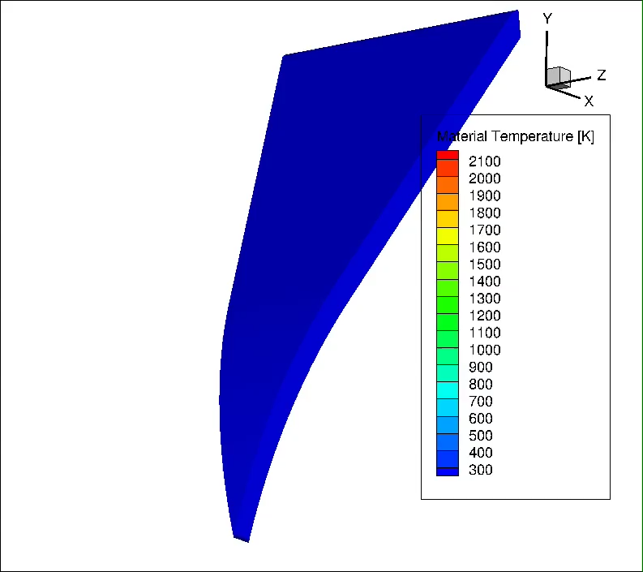
Key Entry Phase Challenges
Quantifying heating due to shock layer radiation
dominated by CN-red and violet emission
Less validated than air or CO2
NASA/ESM has completed a test series in EAST focused on refining shock tube informed bias uncertainties.
TPS material qualification
Non-oxidizing environment, radiation dominated heating
Performance of RTV gap filler in such an environment
Singularities
Radiative heating on main seal
RF transparency of radome materials
Heating on backshell singularities
EDL Phase thermal analysis
Long descent time, cryogenic exterior, internal heat source
EAST Testing
Arc Jet / Lamp Testing
3D Material Response
M2020 Closeouts

Slide 13
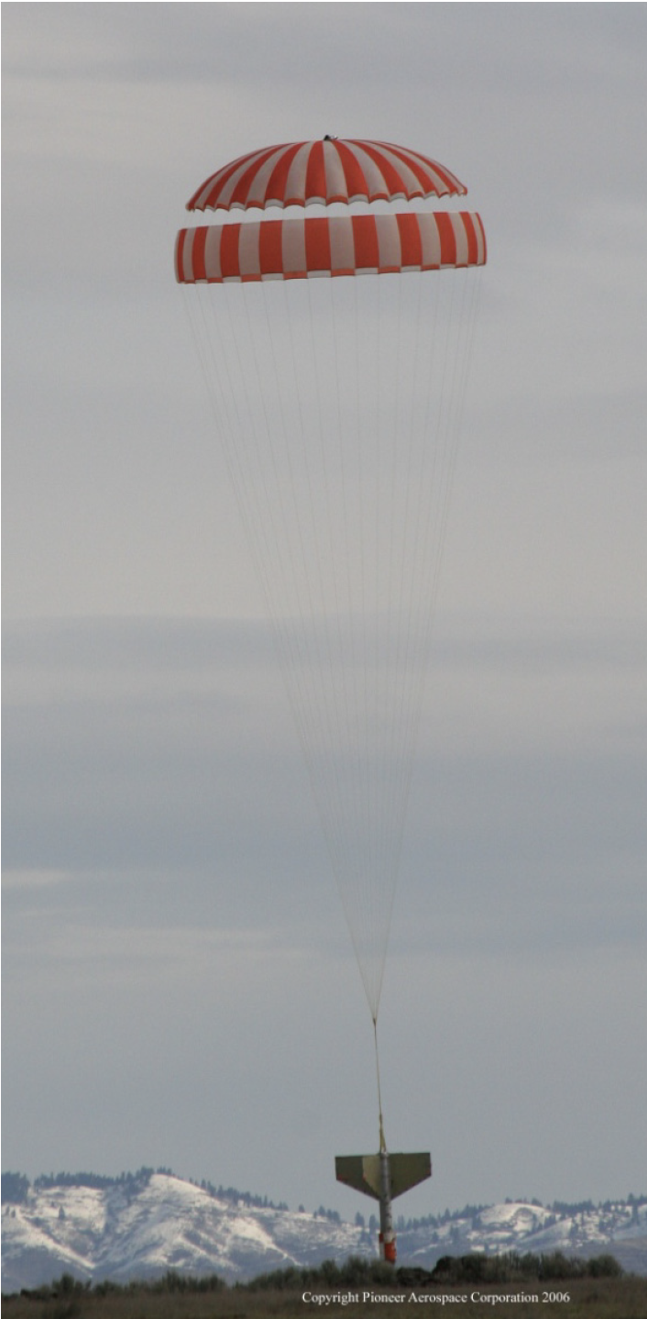
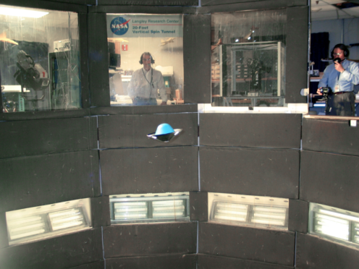
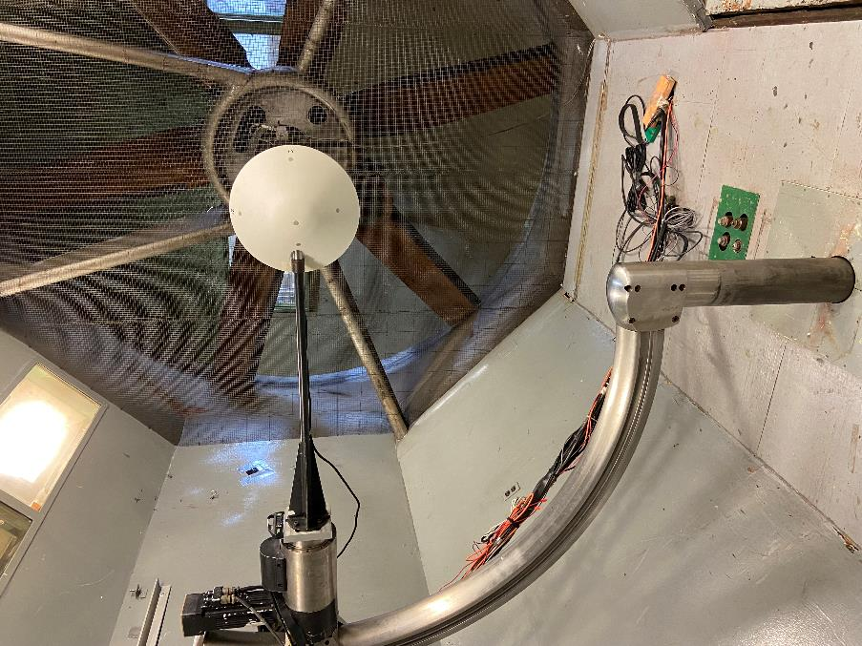
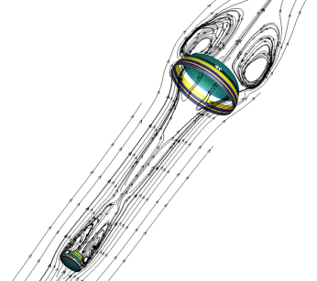
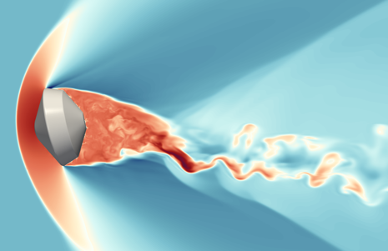
Key Descent Phase Challenges
Roll Coupling
Initial roll rate of 2RPM, but over 100min for that to change
Very difficult to assess potential sources of pitch-roll coupling
Transonic-subsonic aerodynamics
Drogue chute is relatively smaller than that for Genesis
Initial analysis shows that capsule dynamics dominates system dynamics
Considerable time spent with an open backshell
Very long inflation time and possible high angle of attack at deploy for main chute
Anti-inversion netting baselined
Drop testing is planned
Thermal Analysis
Once the heatshield is released, our “hot” problem immediately becomes a cold problem
Exposed mechanisms require heaters
VST/TDT/12’ Testing
Drop Test
Parachute FSI
Free Flight CFD

Slide 14
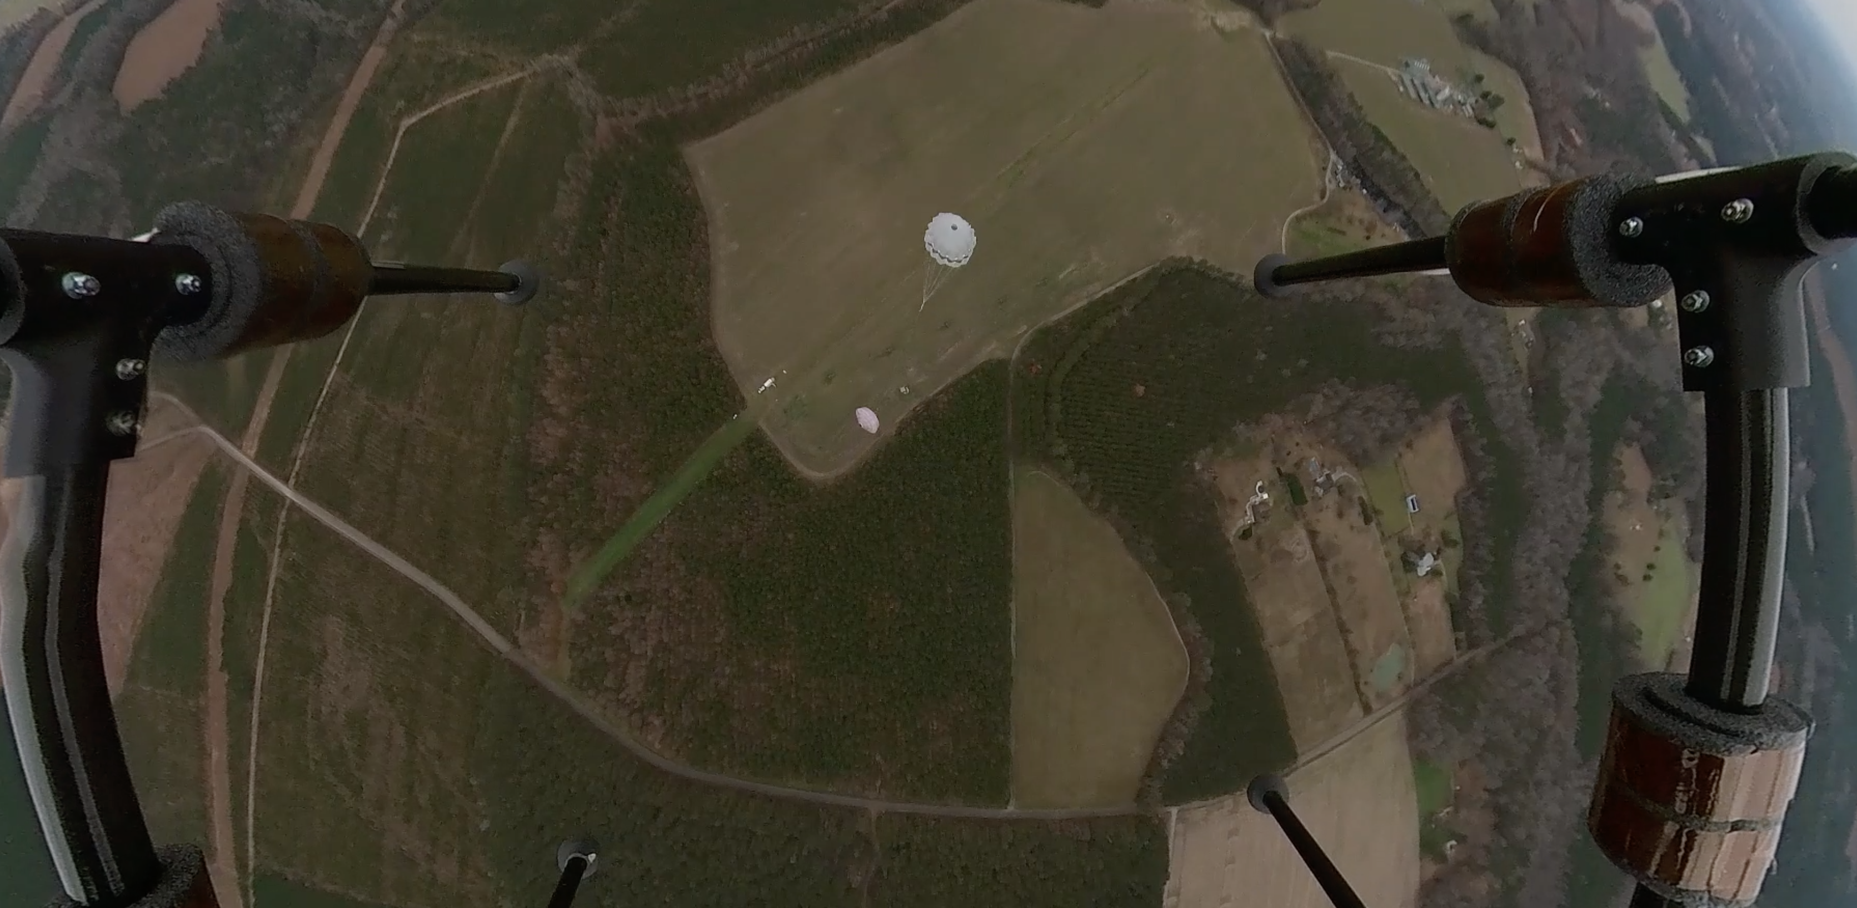
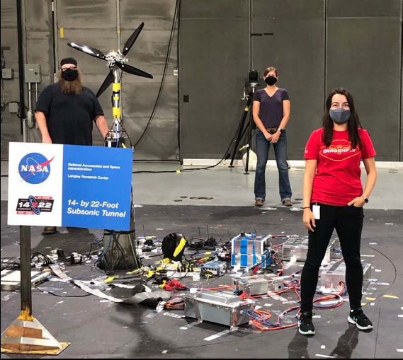
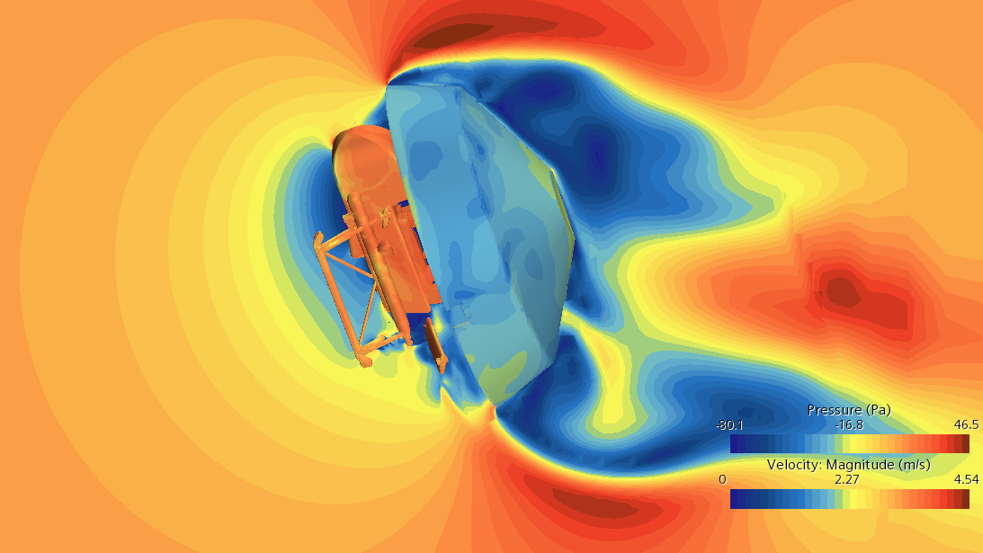
Key Preparation for Powered Flight Challenges
Open Backshell Dynamics
Considerably amount of time spent on chute with no heatshield
Two configurations: stowed and posed
Rotor-Backshell Aero Interactions
Operating rotors at 1100RPM while attached to backshell
Highly dynamically coupled problem
Altitude Knowledge
We have no rangefinding until Lidar lock (potentially as low as 1km AGL
Releasing lander in a state from which it can transition to powered flight
Requires specific range of yaw moment, strongly prefers pitch down rate at release
12’ Testing
Posed Lander
Drop Testing
14x22 Testing
TPF CFD

Slide 16
Backup
16

