Slide 1
Effects of dose error and sample size on sonic boom dose-response curves
Will Doebler
NSET Team Meeting
2/22/2023
Notes:
I’m really happy to be presenting for you all today, thanks for the invite.
This is a slightly modified version of a presentation I gave at the Acoustical Society of America in December, So if I say ASA it isn’t the stats ASA, but the acoustical ASA. The original audience probably had a lot less stats experience than those on this call, and I tend to lean heavily on my stats colleagues, so I hope you’ll bear with me.

Slide 2
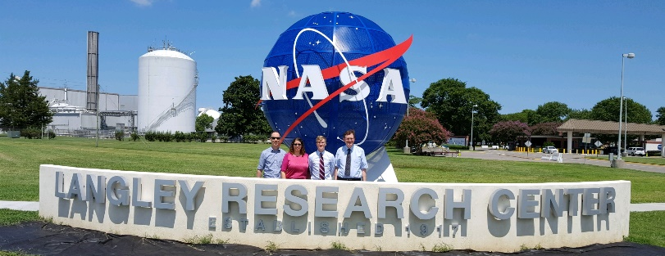
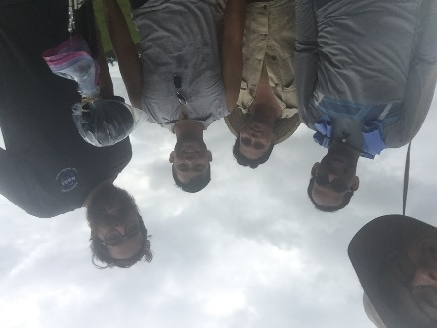
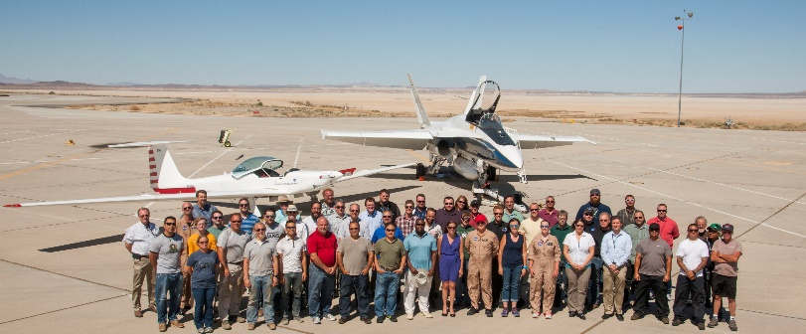

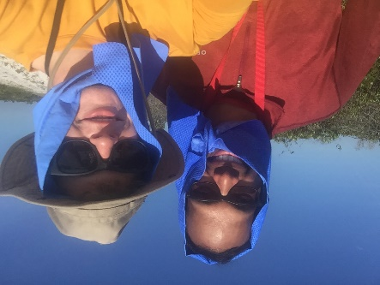

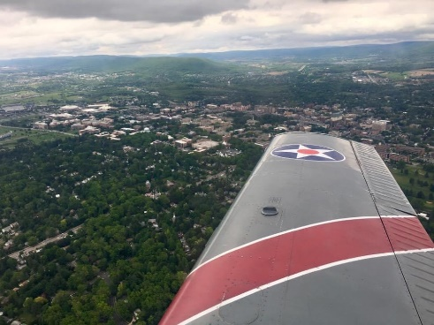
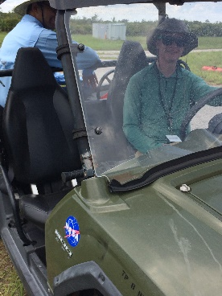
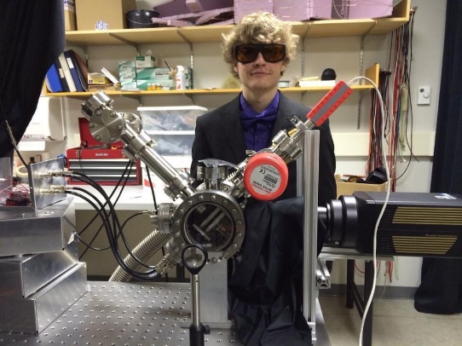
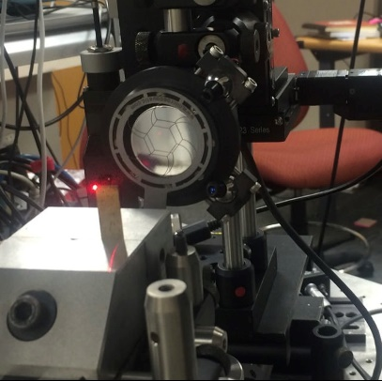
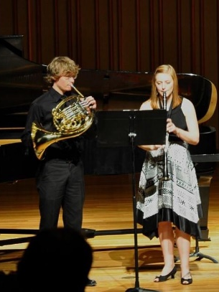
About Me
Research Aerospace Engineer, D321 Structural Acoustics Branch, LaRC, 2018
Sonic boom propagation research
Working on PhD in Acoustics from PSU via NASA Advanced Degree Program
Recently started full-remote work from Saint Paul, MN
M.S. in Acoustics from Penn State, Dec. 2017
Supported FAA Ascent Program 2015-2016
NASA Fellowship 2016-2018 included spending summer at NASA Langley
Summer Intern at Naval Surface Warfare Center, Port Hueneme, CA
Automatic speech recognition performance in noisy environments for augmented reality ship repair tasks
B.A. in Physics from Gustavus Adolphus College, Saint Peter, MN
Air-coupled ultrasound research for jet turbine blade crack detection
Ion trap lab building a mass spectrometer
Grew up in northwestern Indiana
Notes:
Just thought I’d include some quick info about me so you can get to know my background – I’m a Research Aerospace Engineer and I do acoustics research in D321 the structural acoustics branch at NASA Langley. I recently started working fully remote from Minnesota.
I am pursuing my PhD from Penn State through NASA’s Advanced Degree Program. Prior to starting at NASA I earned a Master’s degree in acoustics from Penn State. The first summer I was a student, I was lucky to be sent to NASA Armstrong for about a week to support acoustic measurements of sonic booms for a NASA research flight test program called SonicBAT, Sonic Booms in Atmospheric Turbulence. We set up microphones in the hottest part of the days in the Mohave desert to record sonic booms. It turns out that turbulence in the atmospheric boundary layer near earth’s surface has a big impact on the variability in sonic boom loudness.
I was also on a NASA fellowship, which allowed me to spend the summer at NASA Langley where I got to know the D321 team and management. During the fellowship, I found out a NASA position would be opening and I applied.
All these flight-related research opportunities made me interested in flying myself, so I took lessons and got my license at the airport near Penn State. You can see campus off the wing of the airplane.
Before grad school I had a summer internship at a naval base in California investigating the performance of automatic speech recognition platforms for augmented reality ship repair tasks in the presence of high ambient noise.
For undergrad, I went to a small liberal arts college in Minnesota for my bachelors degree in physics. I got to do various research activities there, and a lot of my time was spent playing French horn in band and orchestra. Music is part of what got me interested in acoustics.

Slide 3
Effects of dose error and sample size on sonic boom dose-response curves
Will Doebler, Aaron Vaughn, Nathan Cruze, Kathryn Ballard, Jonathan Rathsam, and Pete Parker
183rd Meeting of the Acoustical Society of America (ASA)
Nashville, TN
December 6, 2022
Notes:
Alright enough about me. Let’s get into the technical portion of the talk. I would like to acknowledge my coauthors on this work assessing noise dose error effects on dose-response models.

Slide 4
Outline
“Bottom line up front” key takeaways of the talk
Sonic boom information and brief history of supersonic flight
Quesst Mission
Previous NASA sonic boom community noise flight tests
Noise dose error
Dose-response modeling results
Simulation experiment to assess impact of dose error and number of survey participants on dose-response models
Setup
Population model
Dose experimental design
Injecting dose error
Modeling approach
Simulation results
Dose error mitigation strategies
Simulation extrapolation, regression calibration, Bayesian methods, data cloning
Summary
Notes:
Here’s the talk outline, aiming for around 25 to 30 minutes or so. I will first provide a bottom line up front summary of the key takeaways from the talk. Then I will quickly give some information on sonic booms and their history. Then I’ll brief the NASA Quesst Mission and its low loudness sonic boom community noise survey goals. Next, I’ll show some information from previous risk reduction NASA sonic boom community noise flight tests and initial noise dose/ perceptual response survey modeling efforts.
Then the main portion of the presentation is a dose-response simulation experiment to assess and quantify the impact of dose error and number of participants on dose-response models.
The simulation results are directly applicable to the X-59 community responses tests and may aid in selecting the number of survey participants and also suggestions for when the dose error is too great to ignore. The simulation also uses slightly more complex modeling techniques than simple logistic regression, which is commonly used in the literature.
I’ll conclude by briefing some dose error mitigation techniques that our team is assessing for the Quesst Mission.

Slide 5
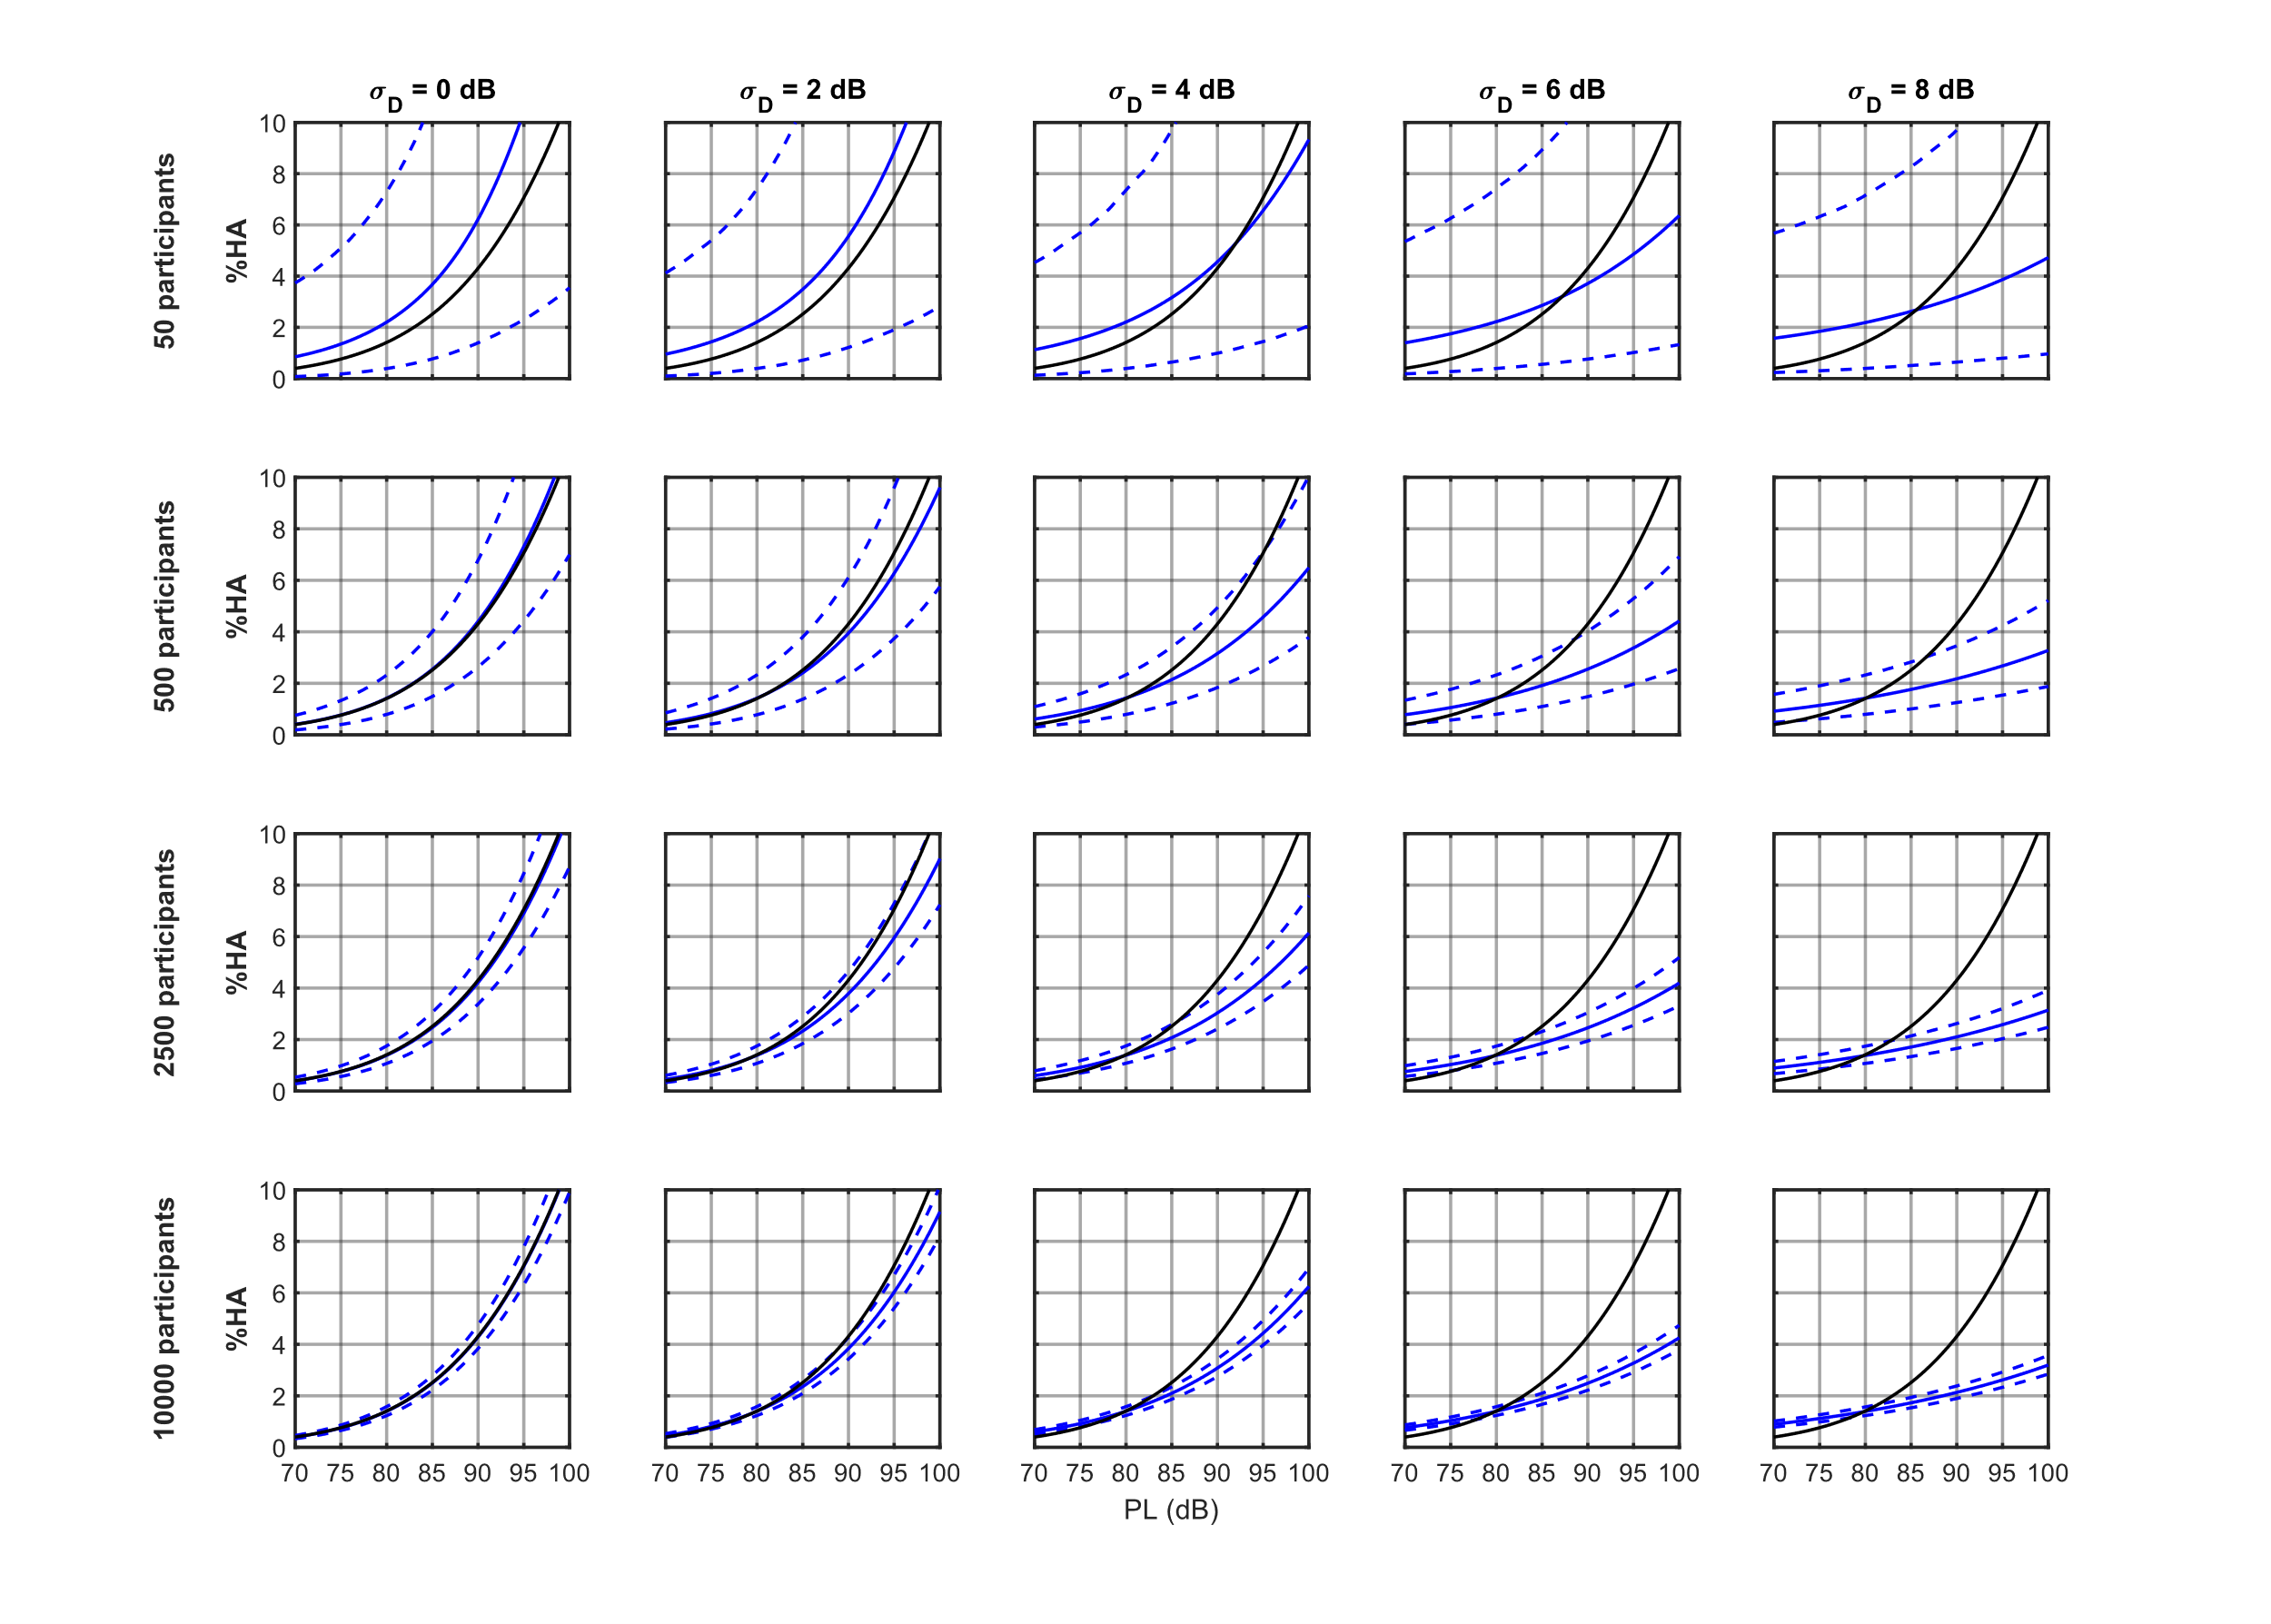
Key Takeaways: Noise Dose Error Effect
Noise dose error (uncertainty in the x-axis data) in sonic boom community noise surveys can arise from many sources: e.g., sparse noise recordings and turbulence effects
Noise dose error causes attenuation or flattening of the slope of dose-response models:
The attenuation cannot be alleviated by recruiting additional participants
Methods exist to correct the effects of error in the noise dose
No dose error
With dose error
True
Percent Annoyed
Modeled
Noise Dose (dB)
Notes:
These are the key takeaways from this talk. First, terminology. When I say noise dose I am referring to the loudness of a sonic boom. When I say response, I will be talking about the probability that a person will be highly annoyed to a noise dose, or the percentage of people that respond highly annoyed to a noise dose.
When noise doses are estimated in community noise surveys, there is error or uncertainty in the estimated doses for the survey respondents from many sources. For example sparse acoustic recordings of the sonic boom level throughout the community or error in dose estimation due to the effects of turbulence on the loudness of a sonic boom.
Traditional statistical modeling of these community noise surveys assumes there is no error in the noise dose.
However, error in measuring or estimating the noise dose causes the modeled dose-response curve to flatten and not match the true underlying population.
[describe the plots]
This attenuation is not alleviated by recruiting additional participants, it just shrinks the confidence interval around the inaccurate attenuated curve. Also note that this attenuation does not have the same definition as acoustic attenuation of sound it’s just describing the slope reduction.
At the end of the talk, some methods will be briefed that we are looking into that can account and correct for the attenuation due to dose error.

Slide 6
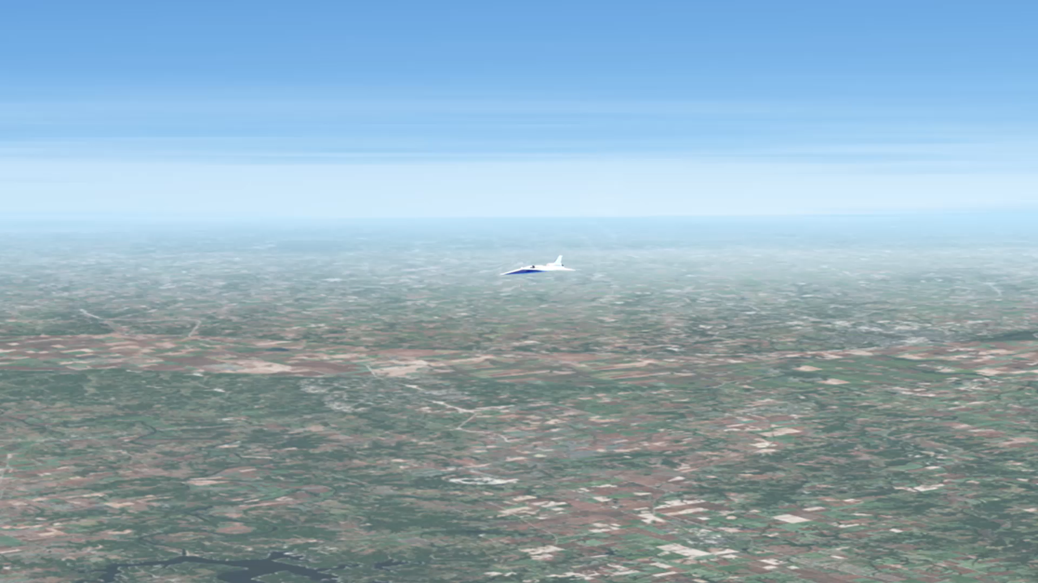
How large is the noise exposure region from a supersonic overflight?
Notes:
Supersonic flight over land is currently prohibited in part due to the noise disturbance of sonic booms, but implementation of new technology that reduces the loudness of sonic booms from a loud bang to a quiet thump may help change these regulations.
The entire time an aircraft is flying faster than the speed of sound, it continuously generates a pressure wave around it that propagates through the atmosphere to the ground called a sonic boom. Traditional sonic booms have a pair of loud bangs corresponding to the front and rear of the aircraft. Many people are unaware that the sonic boom is continuously generated and isn’t just a single event when the plane first accelerates through Mach 1. The sonic boom sound appears to be a single event to the stationary observer on the ground as the plane passes over, but people along the entire flight path are exposed to the sound.
[click]
As the aircraft flies, it drags this so-called “carpet” of impulsive sound behind it that can be 20 to 50 miles wide depending on the altitude and weather.
A 50 mile wide noise exposure region along a flight path that is hundreds or thousands of miles long can ensonify many millions of people, especially away from areas typically associated with aviation or transportation noise.
That’s one reason why it is important for NASA to collect dose-response survey data from a large and geographically diverse population in order to aid aviation regulation agencies in potentially overturning the supersonic flight prohibition.

Slide 7
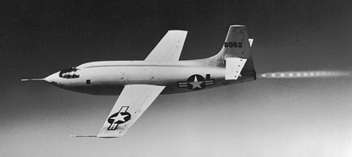
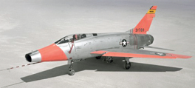
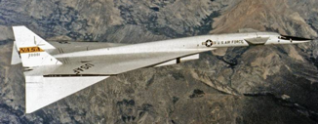
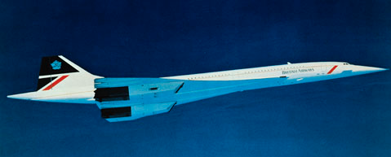
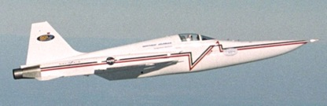

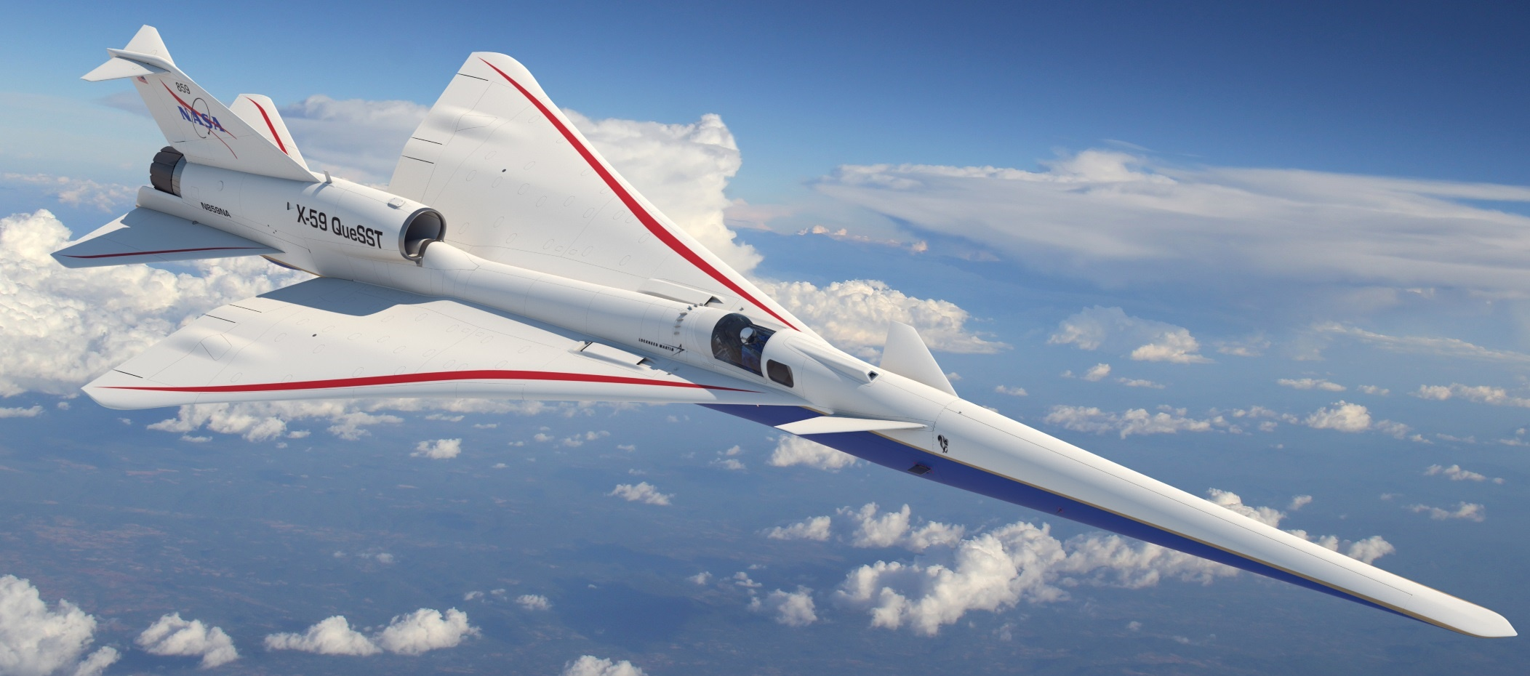
Supersonic Flight and Sonic Boom: A Brief History
1947 First supersonic flight
Sonic boom a novelty
1950s Rapid development of supersonic military aircraft
Noise and damage concerns
1960s Supersonic commercial aircraft proposed
Community studies determine sonic boom exposure is unacceptable
1973 US federal ban, international limits
1976 – 2003 Concorde commercial service
Supersonic operations only over the ocean
2003 DARPA-NASA Shaped Sonic Boom Demonstration
First flight demonstration of sonic boom “shaping” theory
2018 – 2027 NASA Quesst Mission First flight demonstration of low noise supersonic design
Community studies to gauge public reaction
Bell X-1
F-100
XB-70
Concorde
SSBD
X-59
Notes:
Supersonic flight has been around for more than 75 years.
In the 1960s supersonic commercial aircraft were proposed, and several major community studies occurred. Supersonic aircraft were flown many times per day over Oklahoma City and Saint Louis, and a sonic boom noise annoyance survey was conducted to learn how the communities responded to sonic booms. The results of the tests showed that conventional sonic booms were too loud to be acceptable.
Thus, in 1973 commercial supersonic flight was banned overland in part due to the loudness of sonic booms.
Despite this overland ban, from 1976—2003 Concorde flew passengers supersonically over water, but had to slow down to subsonic speeds over land.
Presently, NASA’s Quesst mission is building a low noise supersonic experimental aircraft, the X-59, to enable survey data collection from the public on reactions to low noise supersonic overflight.

Slide 8
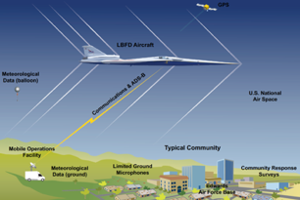
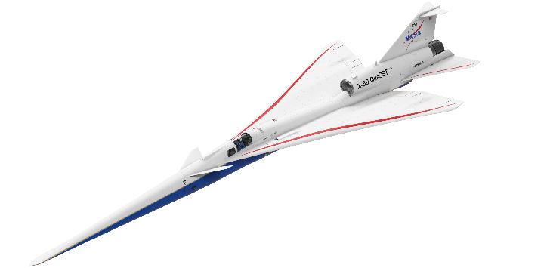
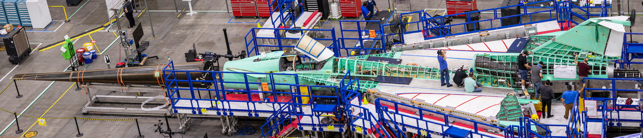
Quesst Mission: Goal is to provide dose-response data to regulators
Phase 1: Construction, First Flights, and Planning
Phase 2: Acoustic Validation
Phase 3: Community Noise Testing
Notes:
NASA’s Quesst Mission has a goal of providing dose-response data to the Federal Aviation Administration, the FAA, and International Civil Aviation Organization, ICAO, for use in informing potential new noise certification standards for low-boom aircraft in supersonic cruise.
The mission is broken into 3 phases. First is construction of the aircraft, its first flights and safe flight envelope expansion, as well as planning for the future phases. The second phase is acoustic validation where we ensure the X-59’s sonic thump has achieved its target sound level goal and to validate our physics-based prediction tools. The last phase is flying the X-59 over up to 5 communities across the US for about one month, introducing community members to up to 6 sonic thumps per day from 6 X-59 supersonic overflights. A longitudinal community noise survey will be administered to collect the perceptual response of the communities, and this noise dose versus perceptual response will be provided to the regulators.
A longitudinal survey means participants will respond to many surveys reporting their annoyance to sonic thumps throughout the community test, ideally they would respond to a survey for each X-59 overflight and one additional survey at the end of each day to describe their annoyance for the day’s booms in a cumulative sense. Longitudinal surveys differ from a cross sectional survey where each participant only responds once, such the FAA’s recent neighborhood environmental survey that was conducted to assess annoyance to subsonic aircraft noise near airports. The X-59 longitudinal survey lasting about a month means survey fatigue is possible, but is hopefully mitigated by a cash incentive for participating. It also means that there is correlation in each participant’s response data, so simple logistic regression may not be appropriate, and a multilevel model to account for the correlation should be used.

Slide 9
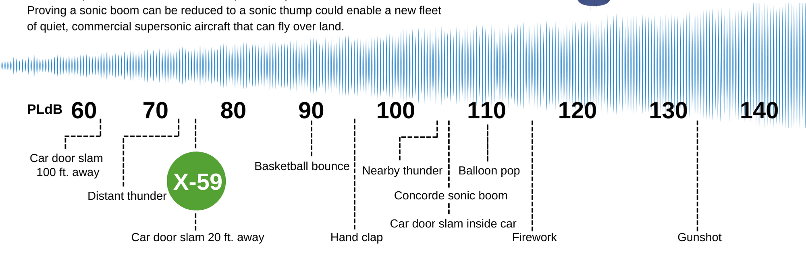
Just how quiet will the NASA X-59 be?
PL (dB)
W. Doebler and J. Rathsam, Proc. Mtgs. Acoustics 36, 040005 2019.
9
Notes:
It had been a challenge for us to communicate to the public how loud the X-59’s sonic thump will be because it is a new type of sound that is difficult to reproduce over loudspeakers due to the low frequency dominance of its noise spectrum. Additionally, traditional loudness metrics such as A-weighted sound pressure level in decibels has been shown not to be a good metric in predicting a person’s response to sonic boom noise.
Psychoacoustic research on sonic booms has shown that a different metric, the Perceived Level decibel scale, does correlate well with human perception of impulsive sonic boom noise. This is different than other decibel scales that work well for continuous noises such as the A-weighted sound level.
The Perceived Level metric computation process is more complex than other metrics that have a single frequency weighting curve like A-weighting. For PL, the sound waveform is broken into the loudness of its discrete frequency bands. Then a weighting procedure is applied to the level of each frequency band. The weighting changes depending on the loudness of the band and the band itself, and after the weighting procedure, a summation of the weighted band levels occurs finally resulting in the PL value in decibles.
To put values of PL in context of other impulsive sounds, the conventional sonic booms from Concorde or other traditional loud sonic-boom-generating aircraft were on the order of 105 dB Perceived Level, which is comparable to nearby thunder or a car door slam from inside the car. These types of sounds can be very startling when you are not expecting them.
By contrast, X-59’s sonic thump is designed to be 75 dB, which is comparable to distant thunder, or a car door slam heard from across the street.

Slide 10
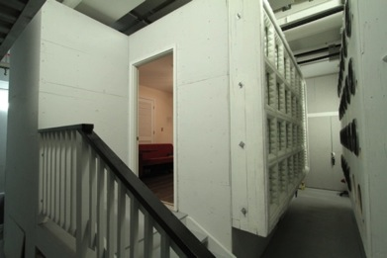
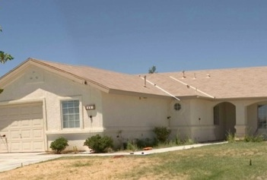
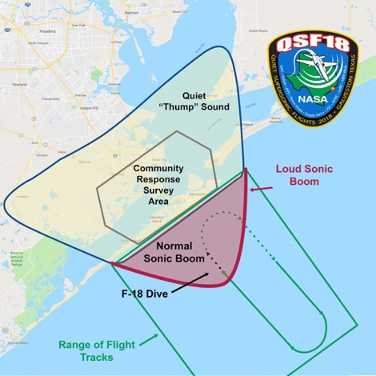
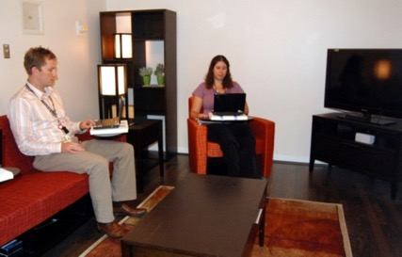
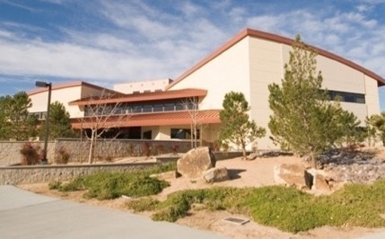
Scaling up the NASA community surveys from lab-scale to national-scale
Human response and annoyance, particularly indoors, is the key concern.
Quiet Supersonic Flights 2018
Galveston, Texas
Laboratory Tests
Small Community Test
Large Community Test
Tests of increasing complexity have provided preparation and confidence
Ready to take the next step with flight testing over very large communities
Notes:
The Quesst mission builds on years of previous research. We’ve conducted laboratory psychoacoustics tests, community noise survey tests in small communities near AFRC, and most recently a risk reduction community noise survey test in a larger community, Galveston TX, that was not used to hearing sonic booms.
In the community noise surveys, microphones are placed sparsely throughout the community to record sonic booms and compute their loudness. Participants respond to surveys reporting their annoyance to the sounds. Finally, a statistical model is fit to the noise dose, perceptual response data.
These risk reduction tests of increasing complexity show that NASA is ready to collect noise and survey data to aid in development of a noise limit. These earlier tests have prepared NASA to take the next step with flight tests over very large communities.
The next slide shows an example noise dose – perceptual response model of the data collected during these small and larger community tests, although it should be noted that these community tests were for reducing risk for the Quesst Mission, not necessarily to estimate the national dose-response curves and data that will be provided to regulators.

Slide 11
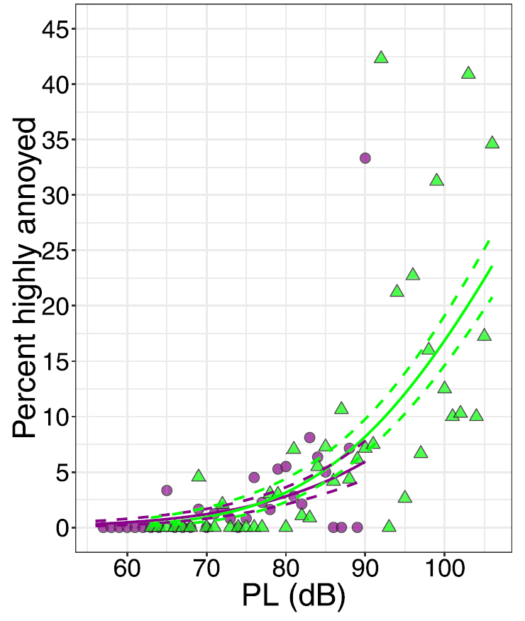
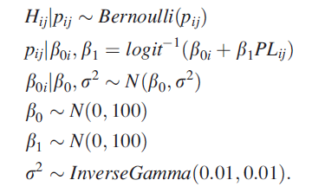
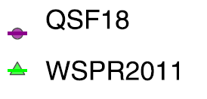

Previous modeling efforts assumed no dose error
Bayesian Multilevel Logistic Regression Model Results
Shared slope $β_{1}$
Random intercept $β_{0i}$
Large Community Test
Small Community Test
J. Lee et al. J. Acoustical Soc. Am., 147:2222, 2020.
Notes:
The previous modeling efforts of the past dose-response survey tests are shown in the plot for the small and large community noise surveys. The dose is given in perceived level decibels and the response is given as the percentage of people highly annoyed. You can see that the prevalence of high annoyance is very low, with the large community test in purple only going up to about 5 to 10% highly annoyed.
A Bayesian multilevel logistic regression model was used for these datasets assuming the participants had the same slope or rate of onset of annoyance but a random individual intercept of onset of annoyance. The modeling approach assumes there is no dose error. H is the response binary highly annoyed or not for participant i to dose j. Each participant’s probability of responding highly annoyed is modeled as a logistic function with the random intercept beta0 i and shared slope beta1. The random intercept for each participant is a draw from a normal distribution of mean beta0 and variance sigma squared. Beta0, beta1, and sigma squared come from noninformative prior distributions.

Slide 12
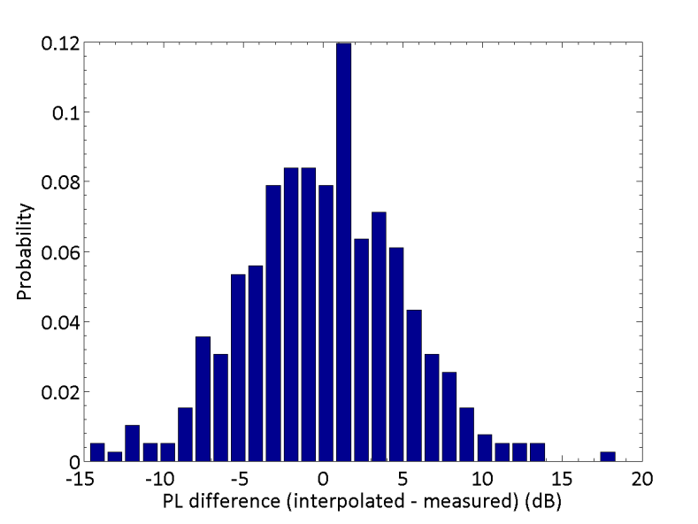
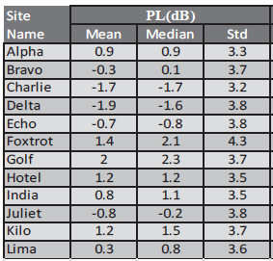
Previous low-boom flight test dose error
Small Community Test (1 sq. mi.)
Edwards Air Force Base “WSPR”
PL Error Standard Deviation: ~3.7 dB
Larger Community Test (10 sq. mi.)
Quiet Supersonic Flights 2018 “QSF18”
PL Error Standard Deviation: ~4.9 dB
Standard deviation of difference between dose estimate and measured dose using a leave-one-out method:
Histogram of differences between dose estimate and measured dose using a leave-one-out method:
J. Page et al., NASA/CR–2014-218180
J. Page et al., NASA/CR–2020-220589/Volume I
Notes:
Despite the previous modeling efforts neglecting dose error, we know there was considerable dose error and it was quantified in the community test reports.
The two previous community tests are known as WSPR, which took place over Edwards AFB and QSF18, which took place over Galveston, TX.
These communities were instrumented with a sparse array of noise monitors or microphones, and an F-18 aircraft produced low-amplitude sonic booms by means of a special low-boom dive maneuver.
A leave-one-measurement-out technique was employed to see how well the estimated doses matched the measured doses for each test. For the WSPR test, the table shows the different noise monitors and the standard deviation of difference between the estimated dose and the measured dose that was left out for the leave-one-out procedure. The dose error standard deviation is about 3.7 dB on the Perceived Level scale.
On the right are the results of a similar procedure for the QSF18 test. The plot shows the difference between the estimated and measured doses. The QSF18 test had greater dose error standard deviation at about 4.9 dB. The aggregate dose error is approximately normally distributed and unbiased.
For future X-59 testing, it is anticipated that the dose error will be less than that of the previous tests due to the X-59 being in steady cruise flight rather than the previous tests where the aircraft performed a special diving maneuver resulting in more variable loudness across the survey area.
For X-59 testing, we wanted to understand the impact of dose error and number of participants on the dose-response curve, since I showed you at the beginning the flattening effect that the dose error has on the dose response curve. One way to assess the dose error effect is to set up a simulation experiment where the annoyance probability of the population is known exactly. Additionally, the doses the population is subject to are also known exactly. The dose-response simulation we analyzed is outlined in the rest of the talk.

Slide 13
Simulated dose-response dataset with error overview
Goals:
Assess impact of dose error on dose-response curves for future X-59 tests
Assess impact of number of participants on dose-response curves for future X-59 tests
Approach:
Generate dataset of simulated participants based on a known underlying population model
Expose the simulated population to true doses and record their true responses
Perturb the true doses to simulate dose error
Fit models to the perturbed dose, true response data
Assess the accuracy and precision of the models to the known underlying population model
Vary the dose error
Vary the number of participants
Next slides:
Population model
Dose schedule and error
Modeling approach
Results
Notes:
The goals of our simulation are to assess the impact of dose error and number of participants on dose-response curves for future X-59 community tests.
The approach is to generate a dataset of simulated survey participants from a known underlying population annoyance model, which is based on the QSF18 modeling results. We expose the simulated participants to noise doses that we know exactly, and record their simulated annoyance responses.
The true noise doses are then perturbed by additive normal error to simulate the dose error that creeps into the noise dose estimates made during the real community test.
We then fit a multilevel logistic regression model to the perturbed dose, true response datasets and note how the model fit dose-response curve matches the known population dose-response curve. We vary the dose error and the number of participants to see how each impact the results.
We included realism when practical in the simulation, including use of the notional X-59 noise dose exposure schedule and realistic survey response rates from the previous sonic boom surveys.
There are some limitations such as looking at only additive gaussian error with fixed variance. Each simulated participant receives the same true dose. And we do not include carry-over effects or other non-acoustic factors that might affect a real person’s annoyance in the population model.
The next slides outline the population model, the dose schedule and error, the modeling approach, and the results of the simulation

Slide 14
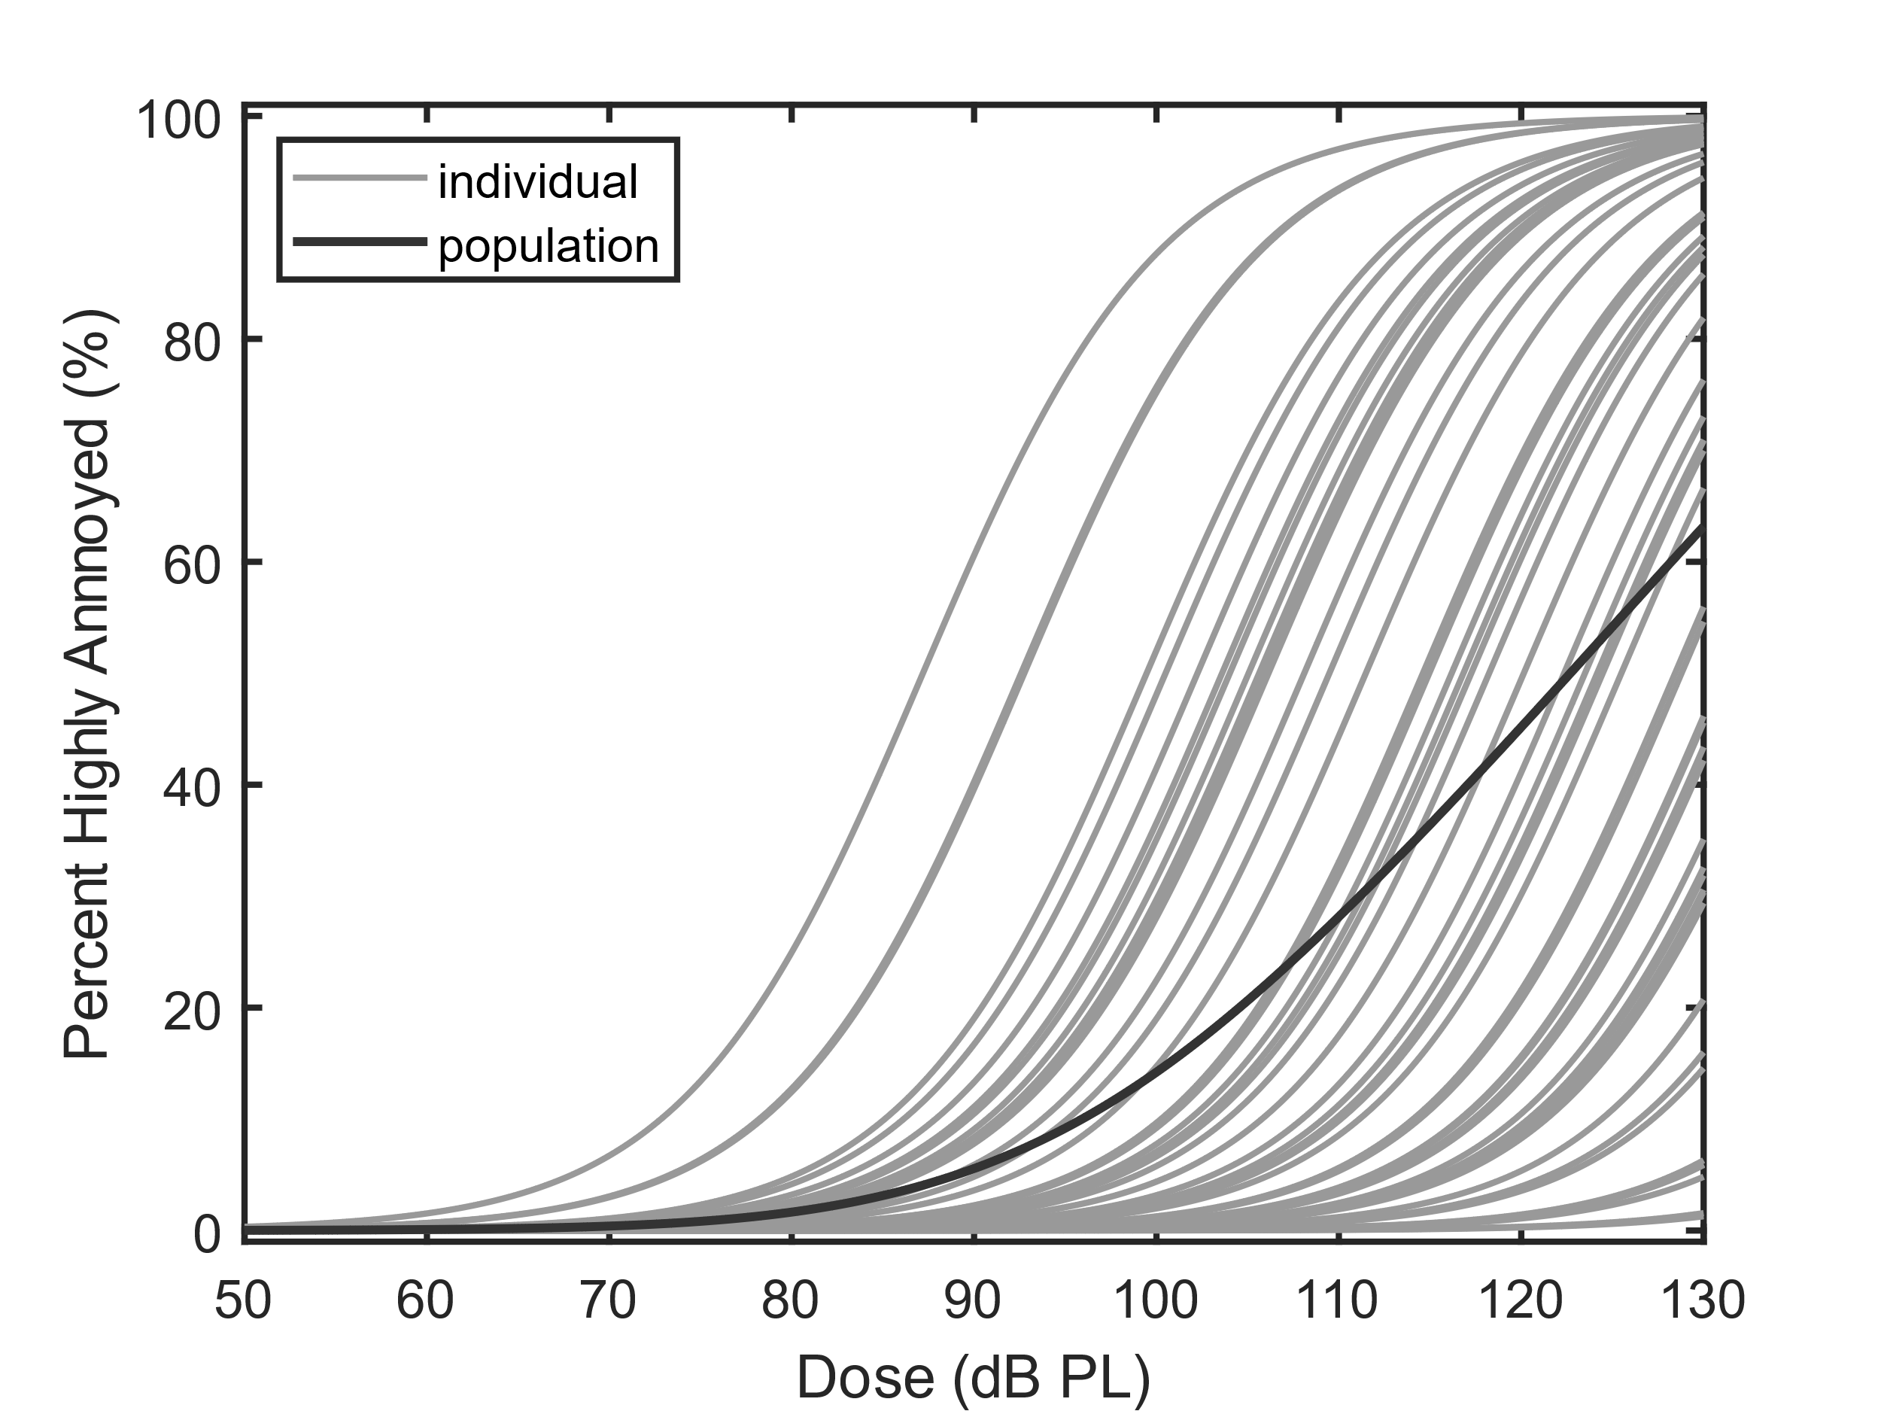
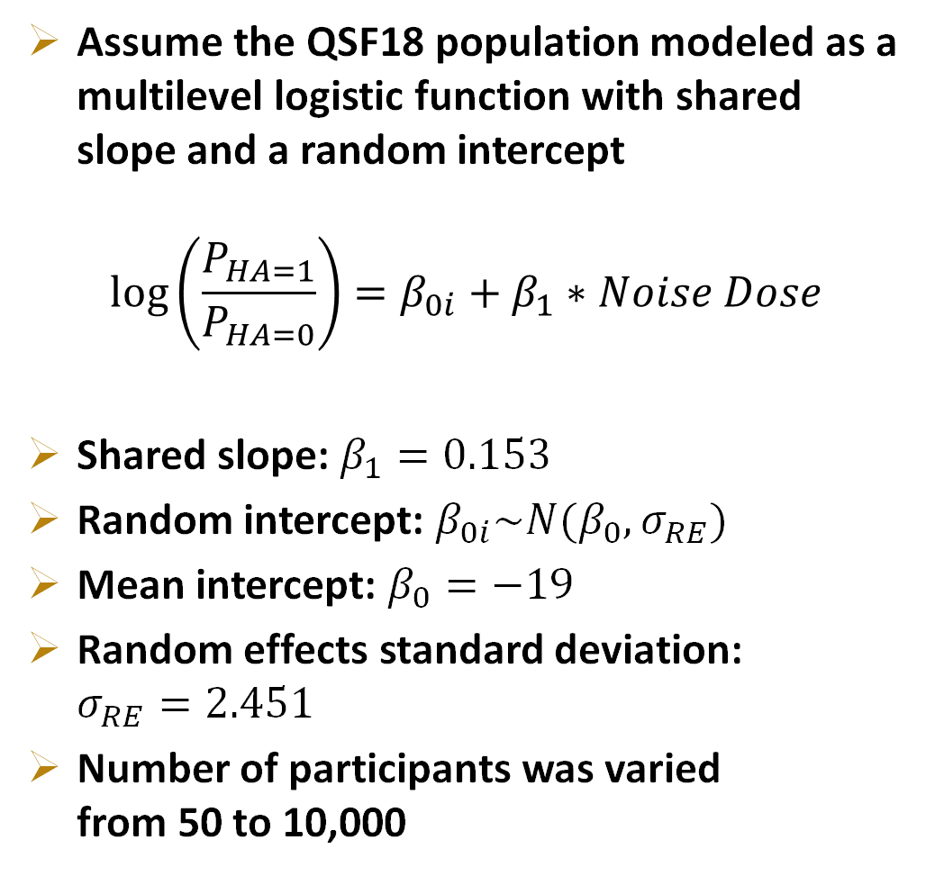
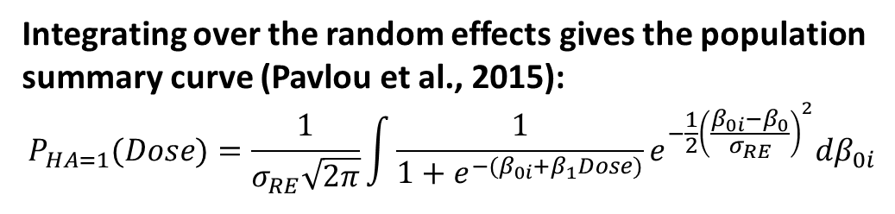
Simulated dose-response dataset: population model
Assume the QSF18 population modeled as a multilevel logistic function with shared slope and a random intercept
$$\log\left(\frac{P_{HA=1}}{P_{HA=0}}\right)=β_{0i}+β_{1}∗Noise Dose$$
Shared slope: $β_{1}=0.153$
Random intercept: $β_{0i}\sim N(β_{0},σ_{RE})$
Mean intercept: $β_{0}=−19$
Random effects standard deviation: $σ_{RE}=2.451$
Number of participants was varied from 50 to 10,000
Integrating over the random effects gives the population summary curve (Pavlou et al., 2015):
$$P_{HA=1}(Dose)=\frac{1}{σ_{RE}\sqrt{2π}}\int{\frac{1}{1+e^{−(β_{0i}+β_{1}Dose)}}e^{−\frac{1}{2}{\left(\frac{β_{0i}−β_{0}}{σ_{RE}}\right)}^{2}}dβ_{0i}}$$
Notes:
For the simulation population, we assume the fit parameters from the QSF18 study using the Bayesian multilevel logistic model. Each participant can be thought of as an “S” curve of probability of being highly annoyed or not to a given dose. Each participant has same shared slope, beta1, which can be thought of as the rate of increase of annoyance. And a random intercept, beta0 i, which is the intercept of onset of annoyance. Each participant’s random intercept is a draw from a normal distribution of known mean and standard deviation.
We ran multiple simulations varying the number of participants from 50 to 10,000.
To arrive at the population summary curve, we use the integration method of Pavlou et al., which integrates out the random effects for a logistic function multiplied by a normal distribution of the random effects. This gives the percentage of the population highly annoyed by a given noise dose.
[click]
As an example, consider the leftmost S-shaped curve as an individual’s dose-response curve. Say that this participant is subject to a true dose of 87 dB. There is about a 50% chance the subject responds as highly annoyed to this dose. The response that is recorded in the simulated dataset is either a 0 or 1 based on the outcome of a random number generator simulating the 50/50 chance.

Slide 15
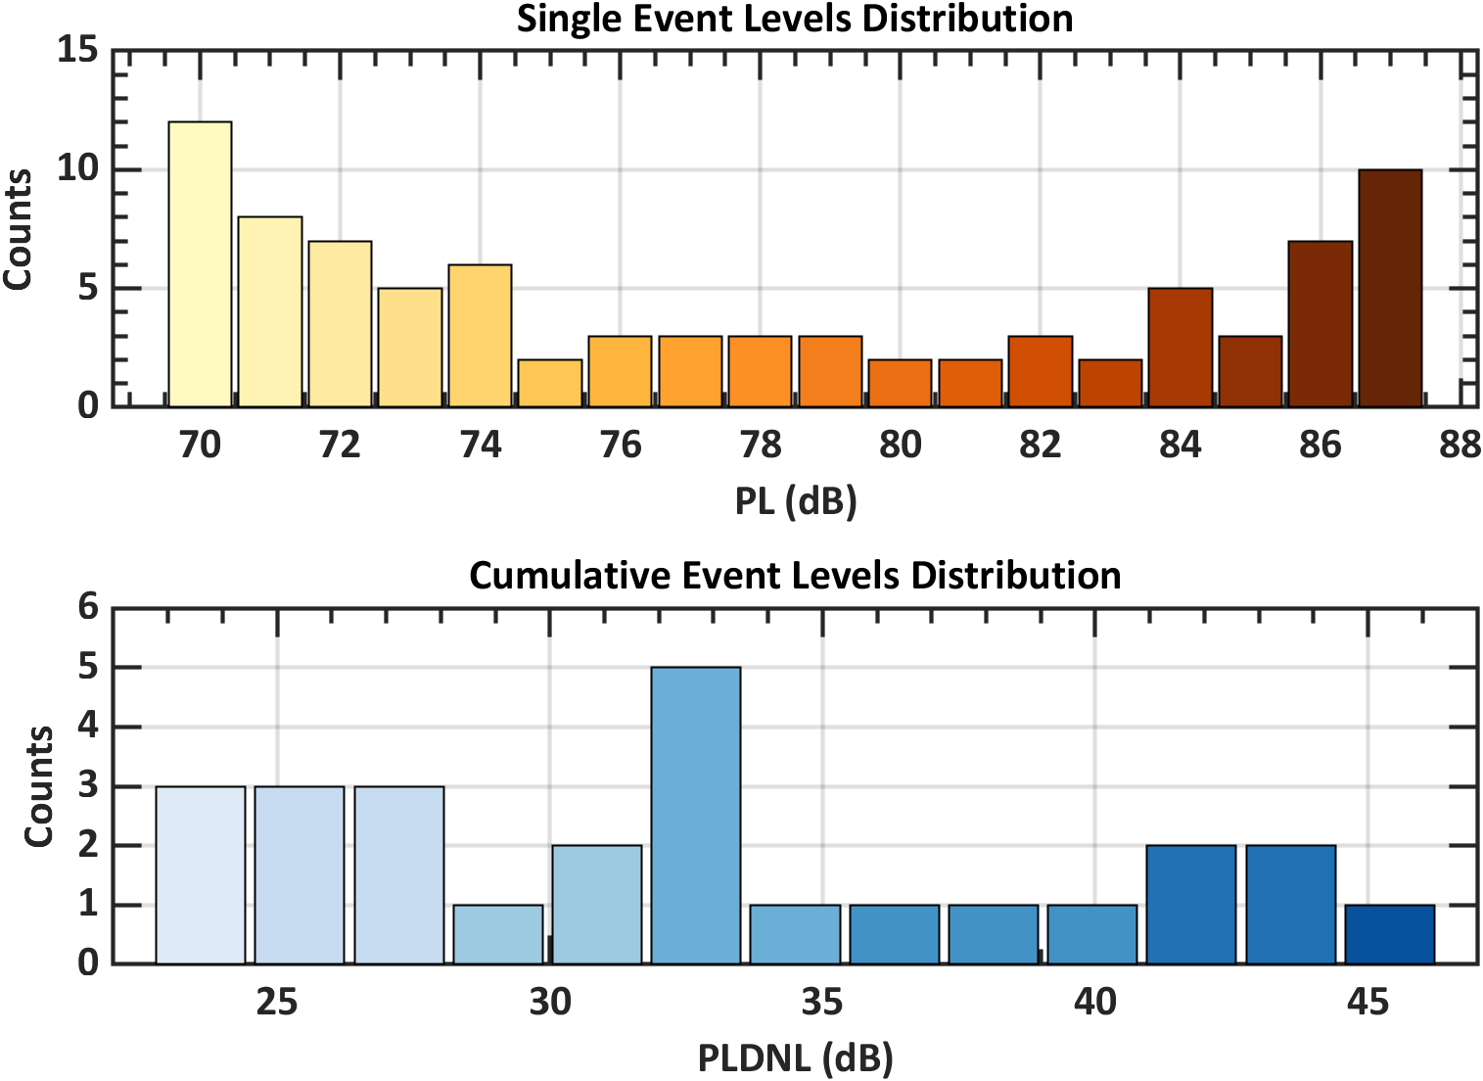
Simulated dose-response dataset: dose design and error
Each simulated participant is subject to 86 true single event doses
True doses were perturbed by a draw from normal distribution with standard deviation of 2, 4, 6, or 8 dB.
Also created datasets for the cumulative noise dose
Each participant is subject to 26 true cumulative doses, corresponding to the loudness of the collection of single events experienced in one day
From J. Page et al., “Noise Exposure Planning Report,” Interim Contract Deliverable (2021).
Notes:
Now that the population model is defined, the simulated participants must be subjected to known noise doses. The doses that the simulation population is exposed to come from the notional noise exposure schedule for the X-59 tests, which includes 86 single event noise exposures across 26 days. The simulation experiment is split into single event annoyance responses to assess annoyance to a single X-59 supersonic flyover, and into cumulative annoyance responses to assess annoyance to all the noise doses they were exposed to in a day.
The participants respond as highly annoyed or not to these true doses, and then the doses are perturbed by a draw from a normal distribution to simulate dose error. We varied the dose error standard deviation from 2 to 8 decibels so that the observed dose error from WSPR and QSF18 are encompassed. We fit models to the perturbed dose, true response datasets to see how the dose error impacts the dose response curve compared to the true dose response curve.

Slide 16
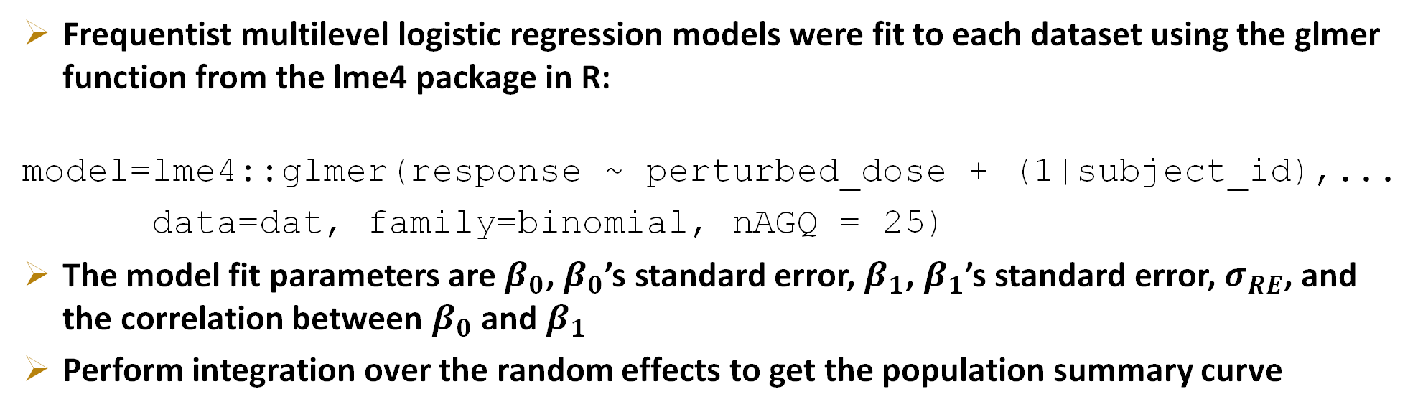
Simulated dose-response dataset: Model fitting
Example dataset
subject_id | boom | perturbed_dose | response
1 | 1 | 70 | 0
1 | 2 | 75 | 0
…
2 | 1 | 73 | 1
2 | 2 | 74 | 1
…
Frequentist multilevel logistic regression models were fit to each dataset using the glmer function from the lme4 package in R:
model=lme4::glmer(response ~ perturbed_dose + (1|subject_id),...
data=dat, family=binomial, nAGQ = 25)
The model fit parameters are $β_{0}$, $β_{0}$’s standard error, $β_{1}$, $β_{1}$’s standard error, $σ_{RE}$, and the correlation between $β_{0}$ and $β_{1}$
Perform integration over the random effects to get the population summary curve
Notes:
Here is an example of what the simple simulation datasets may look like. We keep track of the subject ID number, the boom number, the perturbed dose, and the binary response of highly annoyed or not to the true dose.
Then to each of these datasets we fit a frequentist multilevel logistic regression model with shared slope and random intercept in R using the glmer function from the lme4 package. The model outputs estimates of beta0, which is the intercept of the average participant, beta1, which is the shared slope, and finally the random effects standard deviation. These we can compare to the known population parameters.
The model fits also provide the standard errors and correlation of the estimated parameters that we use to bootstrap the confidence interval around the dose-response curve.
Finally, using these parameters we integrate over the random effects to get the final population summary curve that we can compare to the known population summary curve.

Slide 17
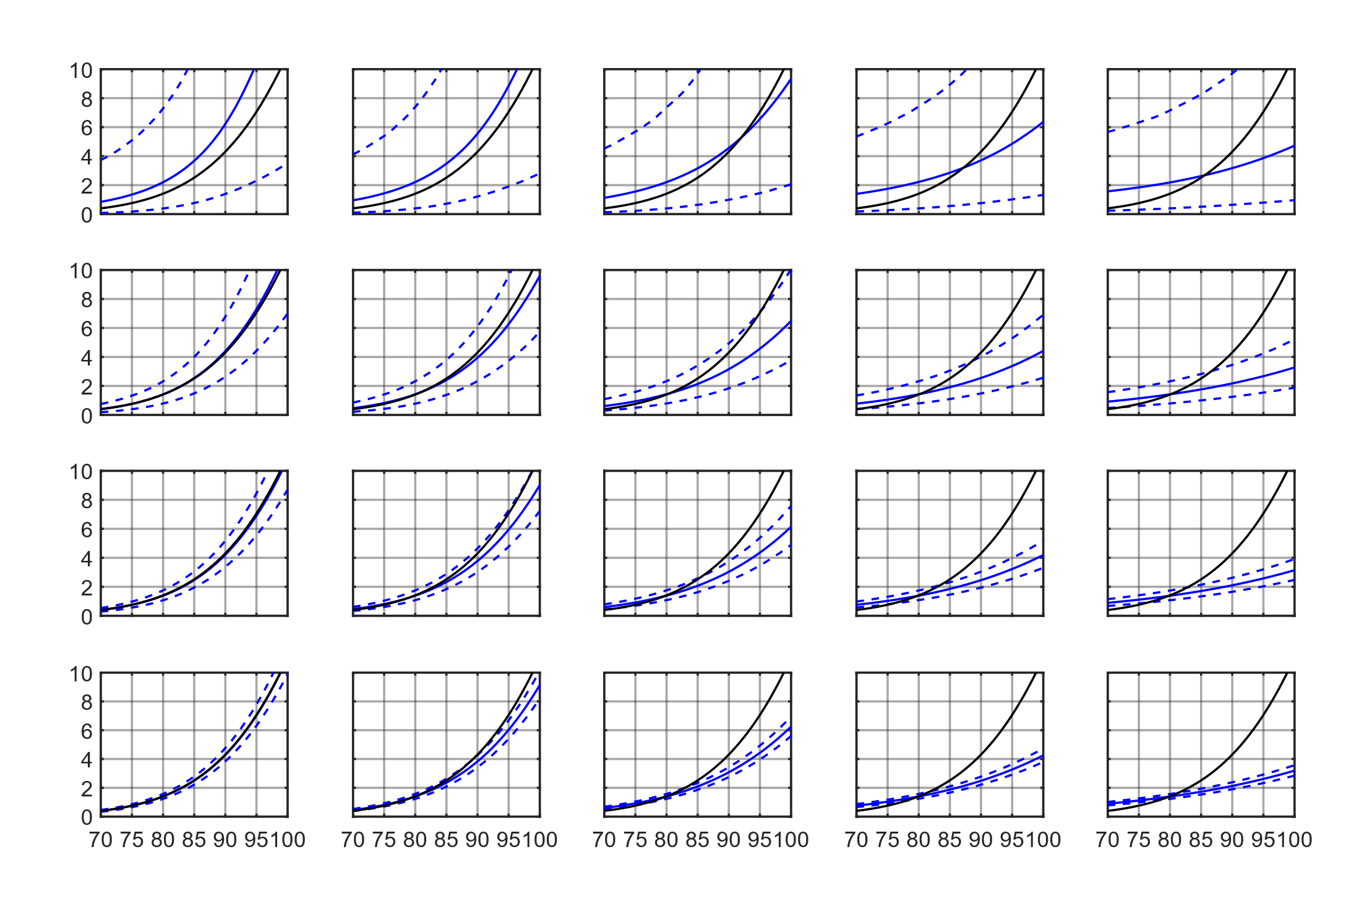
Simulation results: Effects of error and sample size
No Dose Error
2 dB Error SD
4 dB Error SD
6 dB Error SD
8 dB Error SD
True
50 Participants
Modeled
500 Participants
SD: standard deviation
Percent Highly Annoyed
2500 Participants
10000 Participants
Noise Dose, PL (dB)
Notes:
Here are the population summary results for the single event simulation dataset. Each plot shows the noise dose in decibels versus the percentage of people highly annoyed. As you move down the rows, the number of simulated participants increases from 50 to 10,000. The columns show the impact of increasing dose error. The black curve shows the true population summary curve, and the blue curve is the modeled result with its 95% confidence interval. When there is no dose error, by 500 participants, the modeled and true curve match quite well. As you continue to add participants the confidence interval decreases.
You can also see that as the dose error increases, the attenuation or flattening effect is visible regardless of the number of participants. Above about 2 dB dose error, the flattening effect is visually evident, so 2 dB dose error is probably the highest we can accept without attempting to account for dose error.
[remind people where WSPR 3.7 dB and QSF18 4.9 dB lie on this chart.

Slide 18
Simulation results: Effects of error and sample size
Improve accuracy by reducing dose error
No Dose Error
2 dB Error SD
4 dB Error SD
6 dB Error SD
8 dB Error SD
True
50 Participants
Modeled
500 Participants
Improve precision by increasing number of participants
SD: standard deviation
Percent Highly Annoyed
2500 Participants
10000 Participants
Noise Dose, PL (dB)
Notes:
Thus, whenever possible, it is best to reduce the dose error to improve the accuracy of the dose-response curve. Adding participants does not fix the flattening problem, it just reduces the size of the confidence interval about the inaccurate curve.
Reducing the noise dose error could be accomplished by placing more noise monitors in the communities, but that increases the cost both to purchase the equipment and deploy and maintain them in the communities.
There are approaches to account for dose error in modeling that we are looking into, so another approach is to understand the dose error as well as possible if it is unable to be reduced.

Slide 19
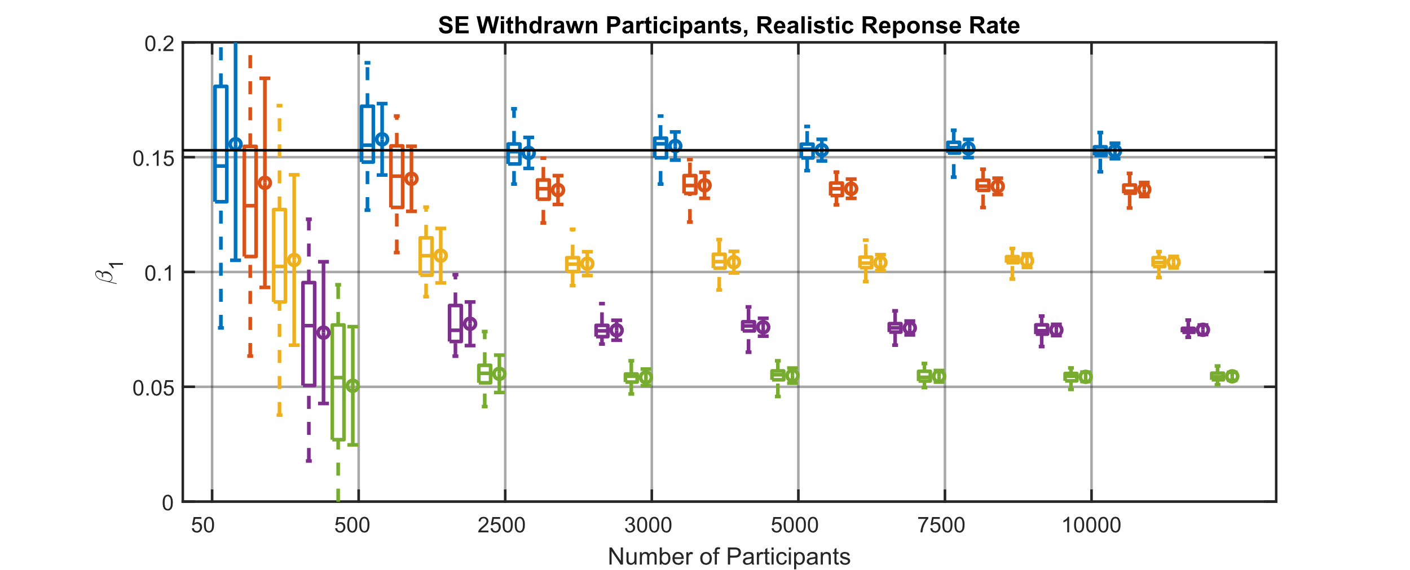

Slope term decreases linearly with increased dose error
Takeaway: under ideal conditions, it is possible to back-correct for impact of dose error
True $β_{1}$
Slope
Increasing Dose Error
50
500
2500
3000
5000
7500
10000
Number of Participants
Box and whiskers show data from 30 replicates
Dot and error bar show the mean and the standard deviation of the 30 replicates
Notes:
Another example result of modeling the sim datasets is that the slope term decreases linearly with increasing dose error from 0 to 8 dB. The modeled slope term is shown in the plot for increasing numbers of participants. We replicated each condition 30 times, and all the modeled slope data are shown in the box and whisker plots and then we also plot the mean and standard deviation of the replicates to show how variable each replicate of the same condition was.
Because the slope term decreases linearly with increasing dose error, if you know the dose error standard deviation, you can back-correct or extrapolate to the 0 dose error condition. The other model parameters have similar simple relationships with increases in dose error. This is a principle of the simulation extrapolation approach to account for dose error, which is one technique we are looking into.

Slide 20
Ongoing work: researching methods to account for dose error
Simulation Extrapolation (Carroll et al., 2006 Chapter 5)
For known or estimated dose error, further perturb the doses and observe the effect on the model parameters. Extrapolate (“back-correct”) to the 0 dose error parameters.
Regression Calibration (Carroll et al., 2006 Chapter 4 and Horonjeff, 2022 following this talk)
Knowing or estimating the dose distribution and dose error distributions, compute the condition with 0 dose error
Bayesian Methods (Carroll et al., 2006 Chapter 9; Xiang, 2020 and Doebler et al., 2022)
Probabilistic modeling using estimated dose and estimated dose error variance to ascertain the true dose
Data Cloning (Torabi, 2013)
A Bayesian MCMC method using a likelihood corresponding to clones of the observed data yields maximum likelihood estimates
Notes:
We have ongoing work to apply and assess several methods that account for dose error in dose response modeling for the X-59 tests.
I showed the principle of simulation extrapolation on the previous slide, but for this method you have knowledge of the measured dose error. First fit your model to the original estimated doses whose error you understand. And then you further perturb the doses and fit the model again noting how the parameters change with increasing dose error. This allows you to fit a line or function extrapolating to the 0 dose error condition.
Regression calibration is another technique where you have knowledge or estimate of the true dose distribution and the dose error distribution, which allows you to estimate the 0 dose error dose-response curve.
Additionally, we’ve presented a Bayesian approach to accounting for dose error at a previous ASA meeting. The estimated doses and error are supplied as data, and the probabilistic model estimates the true dose.
Finally there is a data cloning approach, which uses clones of the data in its maximum likelihood estimate and is supposed to eliminate the effect of the choice of the prior distribution in Bayesian models.
If appropriate, these methods may be applied to X-59 dose-response data.
The methods that correct for dose error are subject to errors themselves if the error distribution is mis-specified, so knowledge of the error distribution is also important. It would be unfortunate to attempt to account for dose error incorrectly and end up with a worse dose-response curve than using the original doses.

Slide 21
Summary
Supersonic flight over land is currently prohibited in part due to noise from sonic booms, but new technology has been developed to significantly reduce the loudness
NASA will soon be flying its X-59 over communities across the USA
A community noise survey will be administered to measure perception of X-59 sonic thumps
Error in the noise dose causes attenuation in dose-response curves
The attenuation is not alleviated by recruiting additional participants
There are modeling methods to account for dose error, which may be applied to X-59 community survey data
Ongoing work assessing the methods on other datasets prior to X-59 testing
If you are aware of other methods to account for dose error in dose-response models, please let me know!
Notes:
In summary, supersonic flight over land is currently prohibited.
We will soon be flying the X-59 for a series of longitudinal community noise surveys to low-booms or sonic thumps. We are interested in understanding and quantifying the impact of dose error on dose-response curves. We showed that the dose error attenuates or flattens the curves and that the flattening effect is not alleviated by recruiting more participants. Finally, we have ongoing work to apply the methods that account for dose error to our dose-response datasets. If you are aware of other methods to account for dose error in dose-response models, please let me know!
Thank you and I can take any questions

Slide 22
References
Carroll, R., Ruppert, D., Stefanski, L., and Crainiceanu, C. (2006). Measurement Error in Nonlinear Models: A Modern Perspective (2nd ed.). Chapman and Hall/CRC. https://doi.org/10.1201/9781420010138
Doebler, W. J., Vaughn, A. B., , Ballard, K. M., and Rathsam, J. (2022). Simulation and Application of Bayesian Dose Uncertainty Modeling for Low-Boom Community Noise Surveys. Proceedings of Meetings on Acoustics. https://doi.org/10.1121/2.0001592
Horonjeff, R. (2021). An examination of dose uncertainty and dose distribution effects on community noise attitudinal survey outcomes, The Journal of the Acoustical Society of America 150, 1691. https://doi.org/10.1121/10.0005949
Lee, J., Rathsam, J., and Wilson, A. (2020). Bayesian statistical models for community annoyance survey data. The Journal of the Acoustical Society of America, 147(4), 2222–2234. https://doi.org/10.1121/10.0001021
Pavlou, M., Ambler, G., Seaman, S., and Omar, R. Z. (2015). A Note on Obtaining Correct Marginal Predictions from a Random Intercepts Model for Binary Outcomes. BMC Medical Research Methodology, 15(59). https://doi.org/https://doi.org/10.1186/s12874-015-0046-6
Torabi, M. (2013). Likelihood Inference in Generalized Linear Mixed Measurement Error Models. Computational Statistics and Data Analysis, 57(1), 549–557. https:/doi.org/10.1016/j.csda.2012.07.018
Xiang, N. (2020). Model-Based Bayesian Analysis in Acoustics—A Tutorial. The Journal of the Acoustical Society of America, 148(2), 1101–1120. https://doi.org/10.1121/10.0001731

Slide 23

nasa.gov/quesst
william.j.doebler@nasa.gov

Slide 24
Additional material

Slide 25
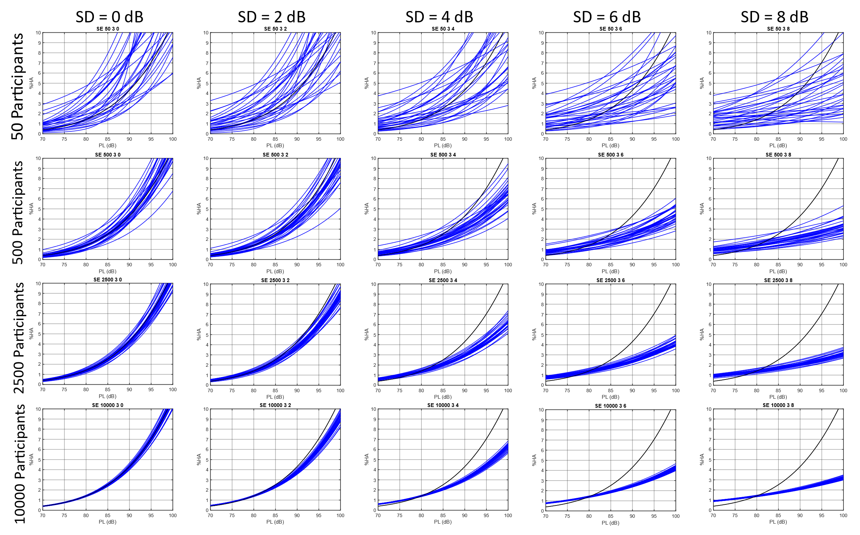
30 replicate variability

Slide 26
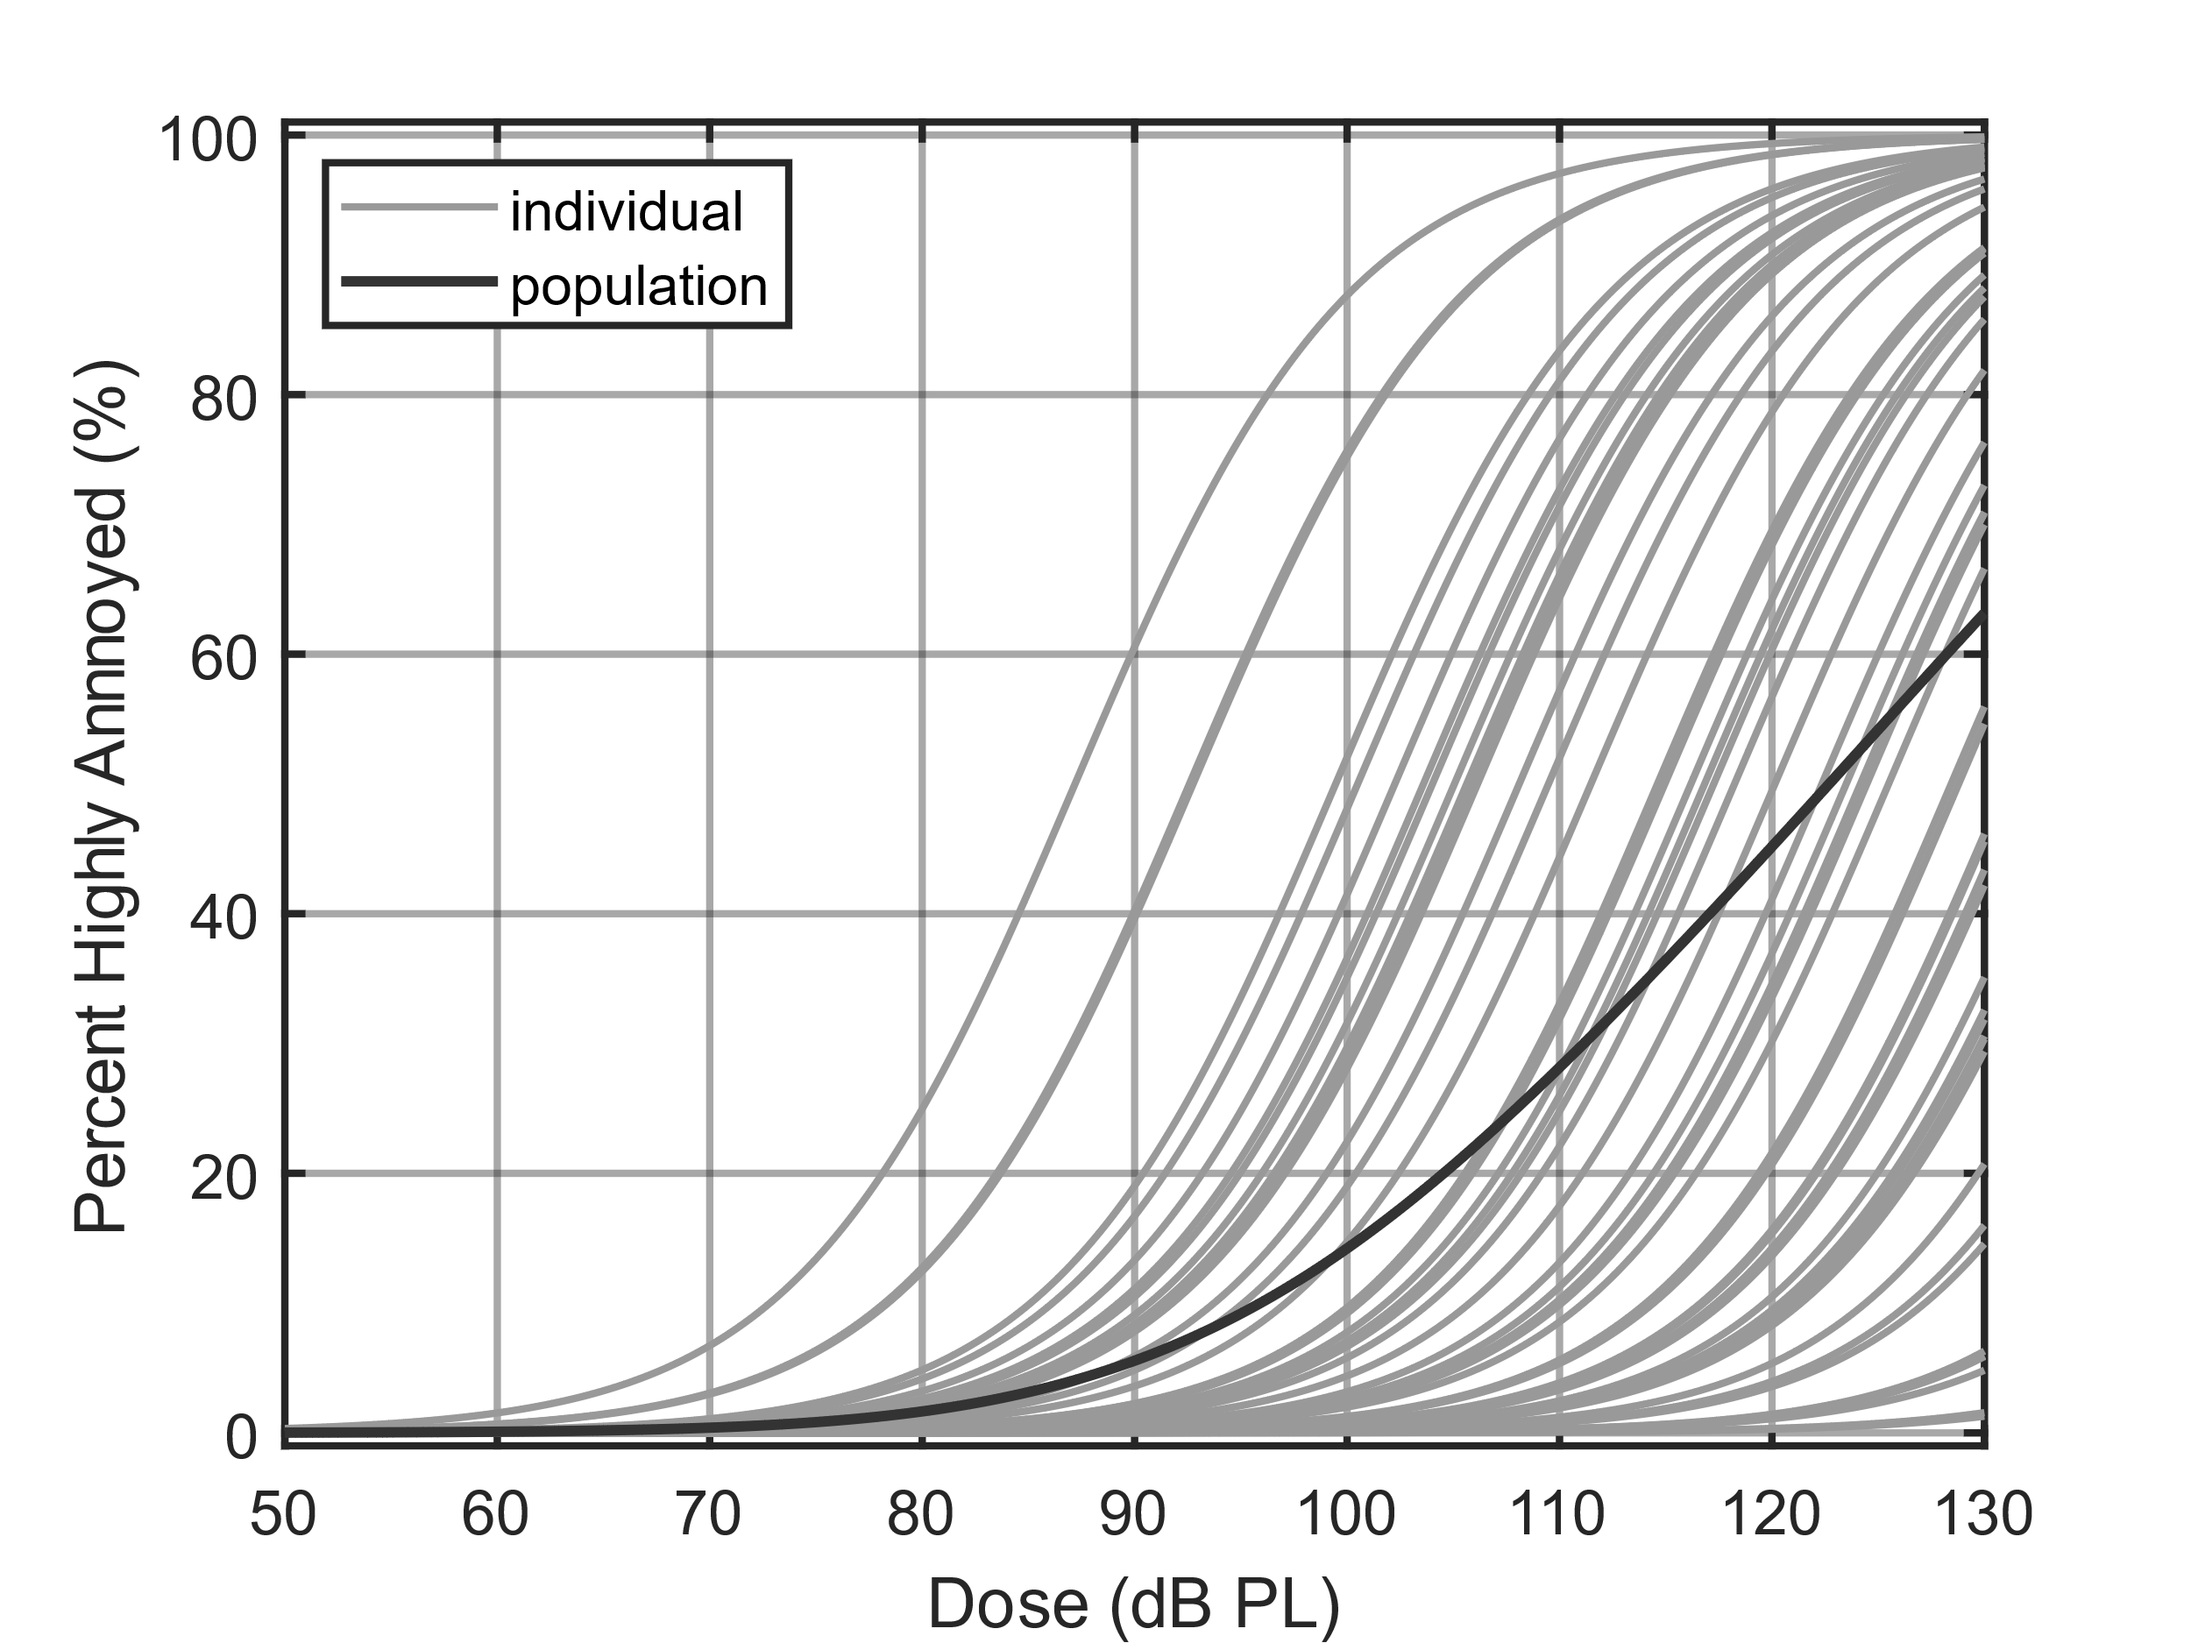
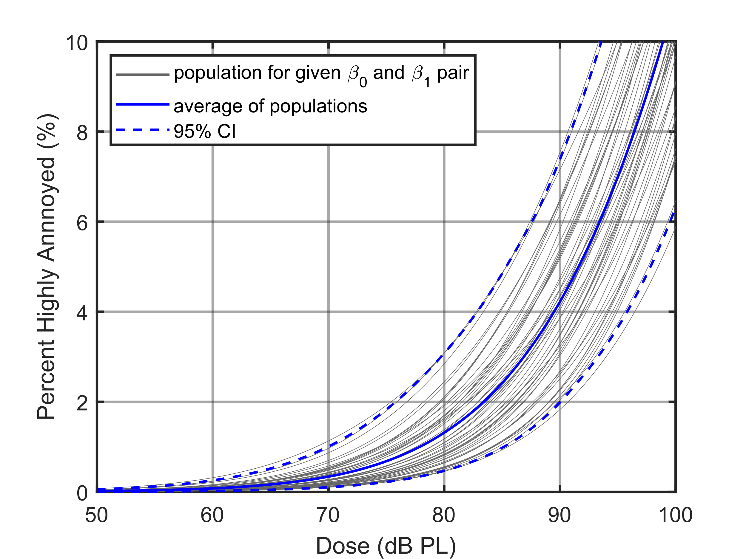
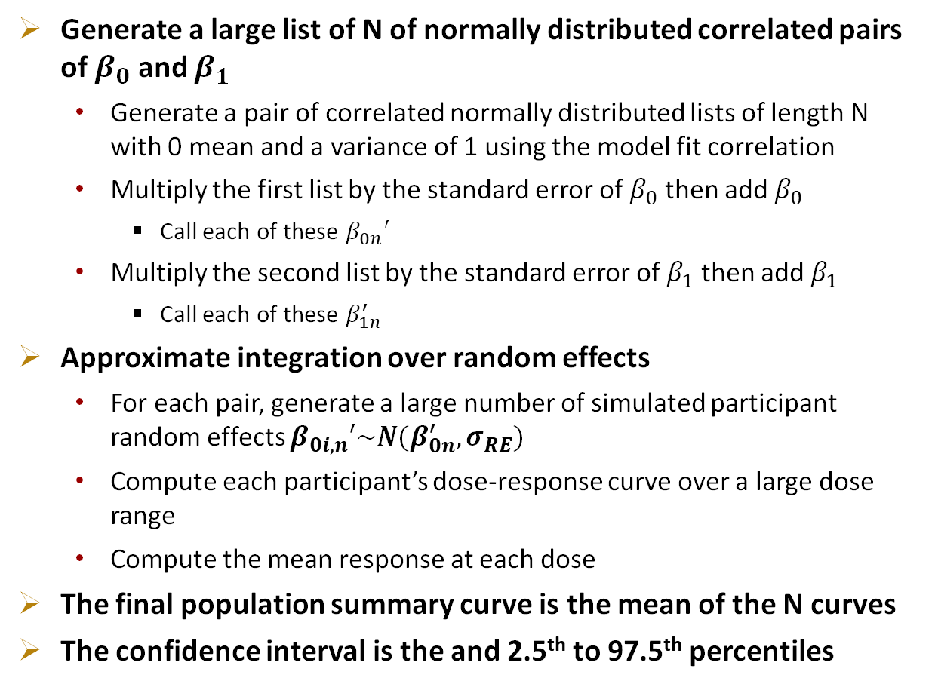
Population summary curve and confidence interval: Accounting for model fit parameter error and correlation
Generate a large list of N of normally distributed correlated pairs of $β_{0}$ and $β_{1}$
Generate a pair of correlated normally distributed lists of length N with 0 mean and a variance of 1 using the model fit correlation
Multiply the first list by the standard error of $β_{0}$ then add $β_{0}$
Call each of these $β_{0n}′$
Multiply the second list by the standard error of $β_{1}$ then add $β_{1}$
Call each of these $β_{1n}^{′}$
Approximate integration over random effects
For each pair, generate a large number of simulated participant random effects $β_{0i,n}′\sim N(β_{0n}^{′},σ_{RE})$
Compute each participant’s dose-response curve over a large dose range
Compute the mean response at each dose
The final population summary curve is the mean of the N curves
The confidence interval is the and 2.5th to 97.5th percentiles

Slide 27
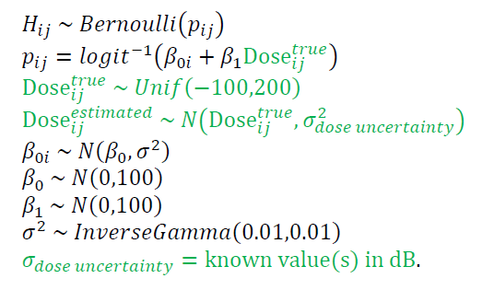
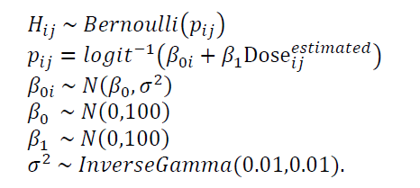
Extended model to account for dose error
Original model
https://doi.org/10.1121/2.0001592
Proceedings of Meetings on Acoustics, Vol. 45, 040004 (2022)

