Slide 1
SpaceOps 2023
Video That’s Out of This World
A Snapshot of Video Distribution from Across the Solar System
March 2023
NASA / MSFC / HP27 / Jennifer Christopher

Slide 2
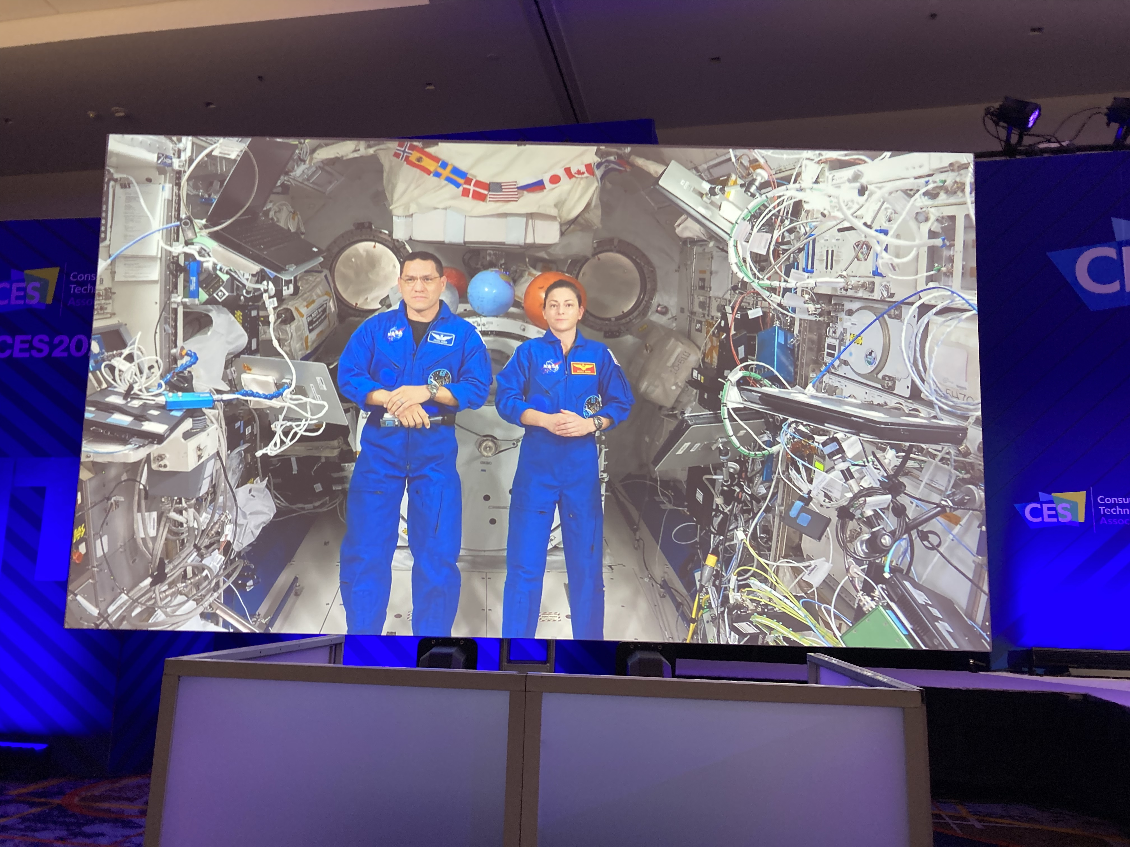
Space to Ground Architecture & Video Distribution Evolution
76 years ago, we captured the first images of Earth from space. Retrieving them only after the camera made it back to Earth.
Figure 1: Imagery Taken by US Army in 1946 from Captured V2 Rocket
Today we can stream live ultra high-definition video from the International Space Station in low Earth Orbit.

Slide 3
Space to Ground Architecture & Video Distribution Evolution
The first images from space were taken from a captured V2 rocket launched by the U.S. in 1946.
The first 26m antenna in what would become the DSN was built in 1958 at the Goldstone Complex in California.
3 DSN antennas supported the Ranger 1 launch in 1961.
As Space to Ground Architecture Evolves, Video Distribution Across the Solar System Advances

Slide 4
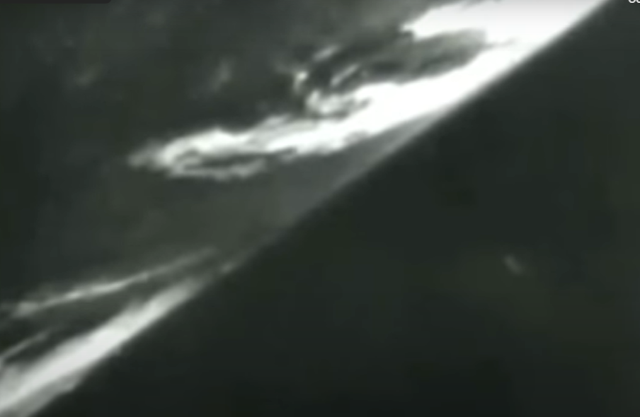
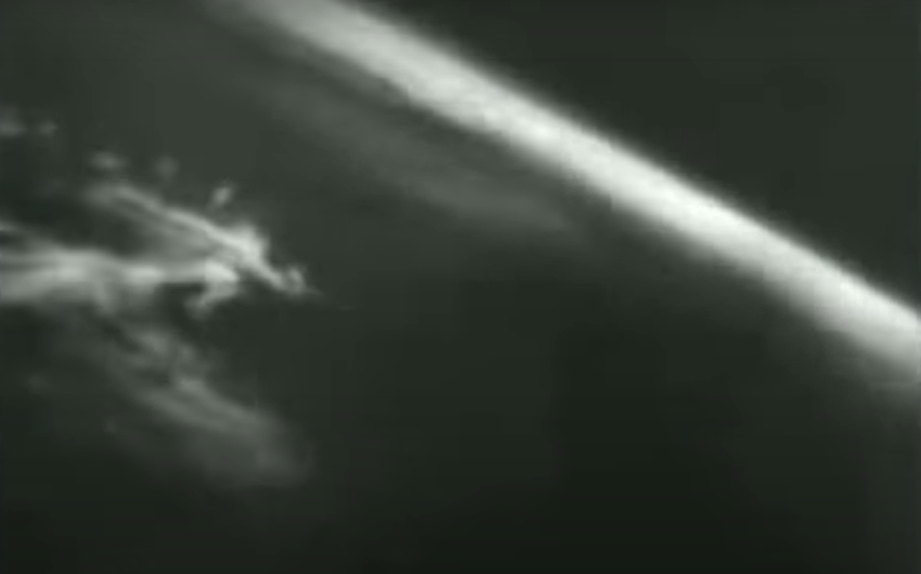
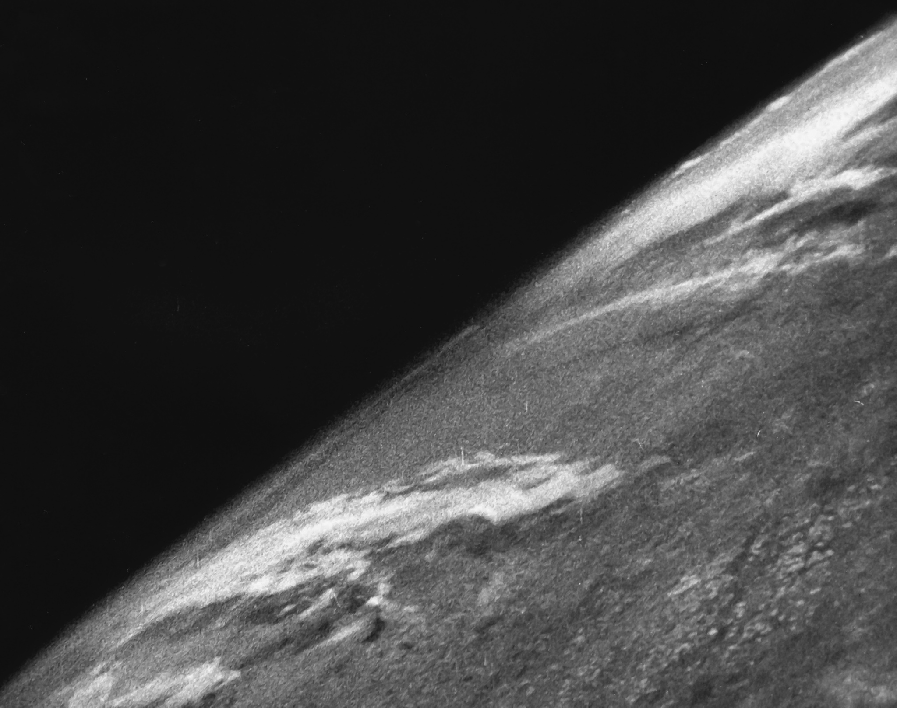
Space to Ground Architecture & Video Distribution Evolution
Figure 1-1: Imagery Taken by US Army in 1946 from Captured V2 Rocket

Slide 5
Space to Ground Architecture & Video Distribution Evolution
In 1968 during the Apollo 7 mission, television audiences saw the first live television broadcast from space.
Two Voyager spacecrafts flew by Mars and returned the world’s first closeup imagery of the red planet.
As Space to Ground Architecture Evolves, Video Distribution Across the Solar System Advances

Slide 6
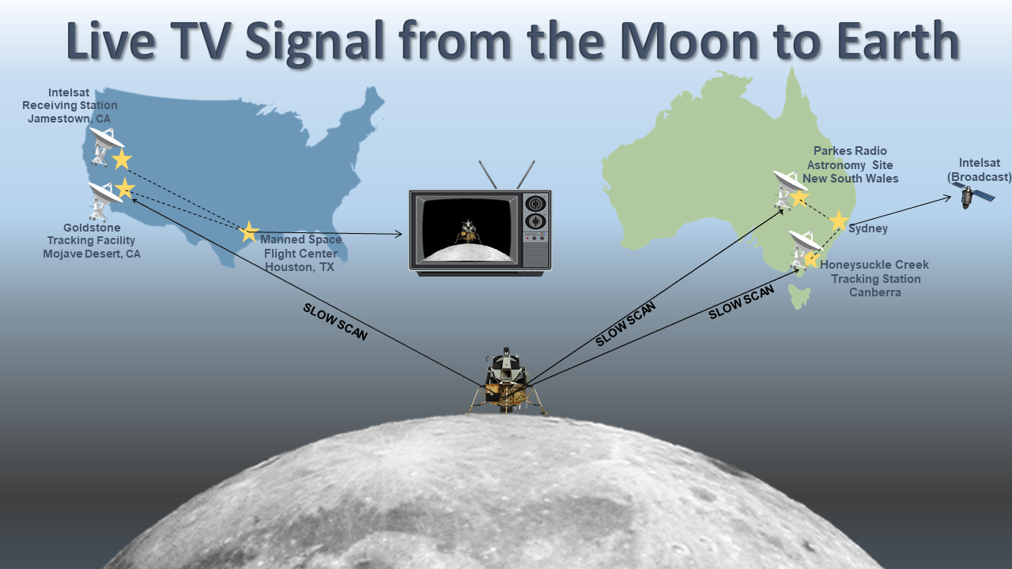
Space to Ground Architecture & Video Distribution Evolution

Slide 7
Space to Ground Architecture & Video Distribution Evolution
Three additional first generation TDRSs became operational between 1991 and 1995, for a total of six.
The Hubble space telescope was launched into LEO in the early 90s and remains in service today.
In 2005, the Mars Reconnaissance Orbiter (MRO) was launched
As Space to Ground Architecture Evolves, Video Distribution Across the Solar System Advances

Slide 8
Space to Ground Architecture & Video Distribution Evolution
By 2017 the last of the third generation TDRSs became operational giving missions in LOE the ability to relay signals with nearly 100% coverage.
In 2017, NASA teamed with AWS Web Services, the National Association of Broadcasters, AWS Elemental, and RED to add to NASA’s exceptional history in imagery and show the world the first live digital cinema quality discussion with astronauts in space.
As of January 2023, MSFC had introduced DTN Marshall Enterprise (DTNME), a CCSDS-compliant implementation of DTN to increase ISS DTN bandwidth from 100 to 400Mbps.
As Space to Ground Architecture Evolves, Video Distribution Across the Solar System Advances

Slide 9
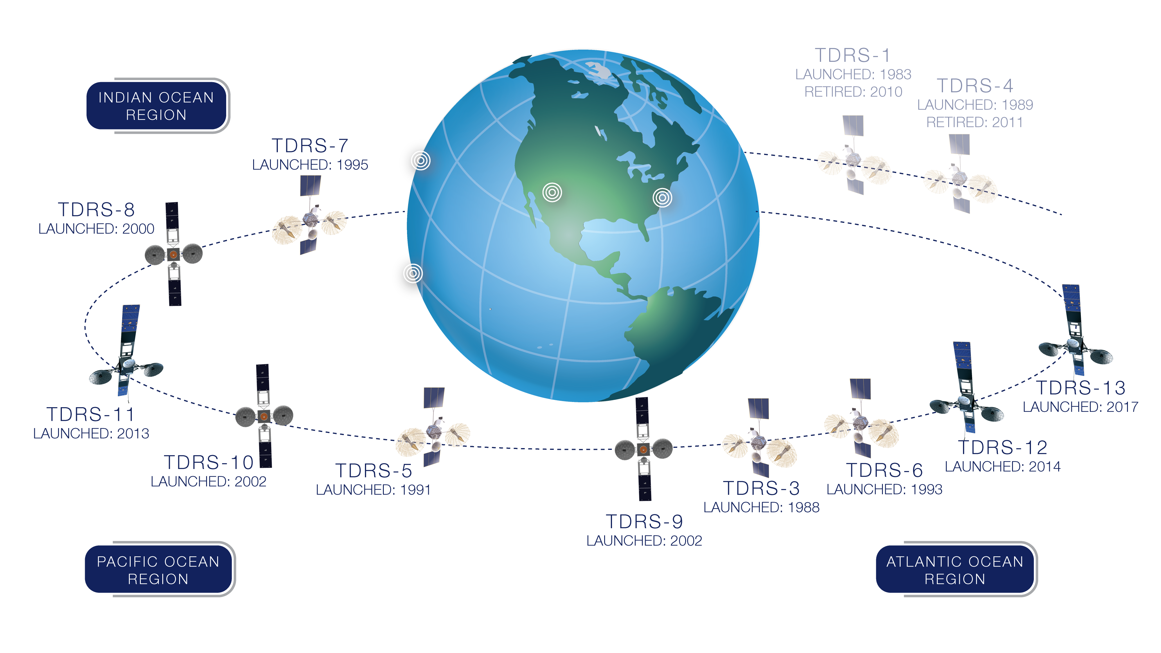
Space to Ground Architecture & Video Distribution Evolution
Figure 2 Tracking and Data Relay Satellite System Configuration

Slide 10
Space to Ground Architecture & Video Distribution Evolution
As NASA makes plans to safely travel beyond the bounds of the Earth, back to the moon, and ultimately to Mars, engineers and scientists are working to develop the next generation of network and communications technology.
As Space to Ground Architecture Evolves, Video Distribution Across the Solar System Advances

Slide 11
It's exciting to see how far we've advanced through the years and even more exciting to think about where we'll be in the future.

Slide 12
References
NASA, 2022, Apollo 11 Mission Overview website, US Government, accessed 1/10/2023, <https://www.nasa.gov/mission_pages/apollo/missions/apollo11.html>.
F. Carrico, 2022, Artemis 1 Mission to the Moon website, Streams Charts, accessed 1/10/2023, <https://streamscharts.com/news/artemis-1-launch-sets-scenario-return-moon>.
T. Reichhardt, 2006, Smithsonian Air & Space Magazine website, Smithsonian, accessed 1/10/2023, <https://www.smithsonianmag.com/air-space-magazine/the-first-photo-from-space-13721411/>.
NASA, 2020, What is the Deep Space Network website, US Government, accessed 1/1//2023, <https://www.nasa.gov/directorates/heo/scan/services/networks/deep_space_network/about>.
Waff, C., 1993, "The Origin and Evolution of the Deep Space Network", accessed 1/10/2023, <https://hdl.handle.net/2014/34915>.
Hall, R.C., 1977, Lunar impact: A history of Project Ranger (Vol. 4210). Scientific and Technical Information Office, National Aeronautics and Space Administration.
NASA, 2014, First Image of the Moon Taken by a US Spacecraft website, US Government, accessed 1/10/2023, < https://www.nasa.gov/content/first-image-of-the-moon-taken-by-a-us-spacecraft >.
Coan, P. M., 1973, "Apollo Experience Report – Television System" (PDF), in Jones, Eric M.; Glover, Ken (eds.), Apollo Lunar Surface Journal, Washington, DC: NASA (published 1996–2013), archived (PDF) from the original on 17 November 2004, accessed 1/10/2023, Originally published by NASA HQ as NASA Technical Note TN-A7476.
Lebar, S.; Hoffman, C. P., 3/6/1967, "TV show of the century: A travelogue not atmosphere" (PDF), in Jones, Eric M.; Glover, Ken (eds.), Apollo Lunar Surface Journal, Washington, DC: NASA (published 1996–2013), archived (PDF) from the original on 8 August 2006, accessed 1/10/2023, Originally published in ELECTRONICS, published by McGraw Hill (1967).
Wood, B., 2005, “Apollo Television” (PDF), accessed 1/10/2023, <https://www.hq.nasa.gov/alsj/ApolloTV-Acrobat7.pdf>.
NASA, “The Origin and Evolution of the Deep Space Network” (PDF), <https://ntrs.nasa.gov/citations/20060038690>
Sagan, C. and Druyan, A., 2011, Pale blue dot: A vision of the human future in space. Ballantine book.
NASA, Advanced Communications Capabilities for Exploration and Science Systems (ACCESS) website, accessed 1/10/2023, <https://esc.gsfc.nasa.gov/projects/ACCESS>.
NASA, HubbleSite | Quick Facts website, accessed 1/10/2023, <http://hubblesite.org/the_telescope/hubble_essentials/quick_facts.php>.
NASA, 2023, Solar System Exploration | Cassini website, accessed 1/10/2023, <https://solarsystem.nasa.gov/missions/cassini/overview/>.
The Planetary Society, The Mars Reconnaissance Orbiter, studying the Red Planet’s climate and geology website, accessed 1/10/2023, <https://www.planetary.org/space-missions/mars-reconnaissance-orbiter>.
NASA, Mars Reconnaissance Orbiter website, accessed 1/10/2023, <https://mars.nasa.gov/mro/mission/overview/>.
NASA, 2008, First HDTV Broadcast From Space website, accessed 1/10/2023, <https://www.nasa.gov/multimedia/imagegallery/image_feature_698.html>.
NASA, 2019, Tracking and Data Relay Satellite (TDRS) Fleet website, accessed 1/10/2023, <https://www.nasa.gov/directorates/heo/scan/services/networks/tdrs_fleet>.
Amazon Web Services, A History First - Streaming 4K Live from the International Space Station Using AWS Technology website, accessed 1/10/2023, <https://www.youtube.com/watch?v=AExVC9RqIyc>.
RED, 2018, “EPIC DRAGON Specs” (PDF), accessed 1/10/2023, <https://support.red.com/hc/en-us/articles/360011398413-EPIC-DRAGON-Specs>.
Israel, D.J., Edwards, B., Hayes, J., Knopf, W., Robles, A. and Braatz, L., 2019, October. The Benefits of Delay/Disruption Tolerant Networking (DTN) for Future NASA Science Missions. In International Astronautical Congress (IAC) 2019 (No. GSFC-E-DAA-TN74214).
CCSDS, Delay Tolerant Networking Working Group, accessed 1/10/2023, <https://cwe.ccsds.org/fm/Lists/Charters/DispForm.aspx?ID=43>.
NASA, 2020, “International Communication System Interoperability Standards (ICSIS)” (PDF), accessed 1/10/2023, <https://nasasitebuilder.nasawestprime.com/idss2/wp-content/uploads/sites/45/2020/10/communication_reva_final_9-2020.pdf>.
Burleigh, S., 2007. Interplanetary overlay network: An implementation of the dtn bundle protocol.
NASA, 2022, HOSC DTN Overview (PPTX).
NASA, 2018, ILLUMA-T: 2023 website, <https://www.nasa.gov/directorates/heo/scan/opticalcommunications/illuma-t/>.
Via Satellite, 2022, NASA’s TBIRD Mission Demonstrates 1.4TB Optical Downlink website, accessed 1/10/2023, <https://www.satellitetoday.com/technology/2022/12/06/nasas-tbird-mission-demonstrates-1-4tb-optical-downlink/>.
NASA, LASER ENHANCED MISSION COMMUNICATIONS NAVIGATION AND OPERATIONAL SERVICES PIPELINE (LEMNOS) website, accessed 1/10/2023, <https://esc.gsfc.nasa.gov/projects/LEMNOS?tab=overview>.
Hamilton, S.A., Boroson, D.M., Dixon, P.B., Grein, M.E., Hardy, N.D., Howe, T.R., Lee, C., Murphy, R.P., Rao, H.G., Spellmeyer, N.W. and Cornwell, D.M., 2019, October. Overview of NASA’s national space quantum laboratory program. In Proc. IAC (pp. 1-12).

