Slide 1

The Ocean Color Instrument Performance Summary

Slide 2
Overview
Analysis and material in this presentation was generated by Gerhard Meister, Gene Eplee, Fred Patt, Shihyan Lee and Jeff McIntire at NASA GSFC. Brian Cairns from NASA GISS is presenting.
Calibration equation, GSD, IFOV, FoR, B2B registration (Gerhard Meister)
Center wavelengths, spectral sampling, OOB (Gerhard Meister)
SNR, RVS, polarization, linearity (Jeff McIntire)
Straylight/crosstalk, temperature sensitivity (Shihyan Lee)
Striping, absolute gain, Gain trending, spectral
on-orbit trending (measurements during tilt) (Gene Eplee)
SWIR band hysteresis correction, SPCA measurements (Fred Patt)
Backup: OCI uncertainty matrix (Gerhard Meister)

Slide 3
Radiance Calibration Equation
L_{t} = K1*K2(t)*(1-K3(T-T_{ref}))*K4(θ) *K5(dn)*Kp*dn
K1 = absolute gain factor; unit: radiance/dn
K2(t) = relative gain factor as a function of time t; unitless
K3 = temperature correction ; unitless
T = Temperature measured at relevant locations (TBD)
T_{ref} = Reference Temperature [deg C]
θ =scan angle [deg]
K4 = (θ) response versus scan ; unitless
K5 = nonlinearity factor ; unitless
dn = dark-corrected instrument counts
Reference: OCI-SCI-PLAN-0124; Kp: polarization correction applied in L2 code

Slide 4
Reflectance Calibration Equation
ρ_{t} = L_{t} * π * d²_{ES} / (F₀ * cos(θ))
ρ_{t} = TOA reflectance for earth view pixel
L_{t} = TOA radiance for earth view pixel (calculated from OCI dn via equation 1.1 from OCI-SCI-PLAN-0124)
d²_{ES} = earth-sun distance (normalized)
F₀ = extraterrestrial solar irradiance (solar constant from Thuillier 1998 or other source, probably LASP hybrid spectral reference)
θ = solar zenith incidence angle on earth view pixel
Above equation is derived from:
BRDF equation: f_{r} = L_{r}/E_{i}
L_{r} = reflected radiance
E_{i} = incoming irradiance
Bidirectional Reflectance Factor: ρ_{t} = f_{r} * π

Slide 5
OCI Spatial Performance (GSD, IFOV, FoR)
Ground Sampling Distance (GSD) along scan/track: 0.0888deg/0.0881 deg (distance between pixel centers)
Instantaneous Field of View (IFoV) along scan/track: 0.0889deg/0.0929deg (area imaged by a pixel)
Effective spatial resolution for PACE orbit including 20deg tilt at ‘nadir’: 1.2km (similar to SeaWiFS, larger than MODIS (1km))
Field of Regard (FoR) : - 56.0deg to +56.5deg
Swath width on the ground: ~2700km
2-day global coverage (almost daily global coverage)
Tilt (-19.9deg and +19.9deg) will be staggered (like SeaWiFS)

Slide 6
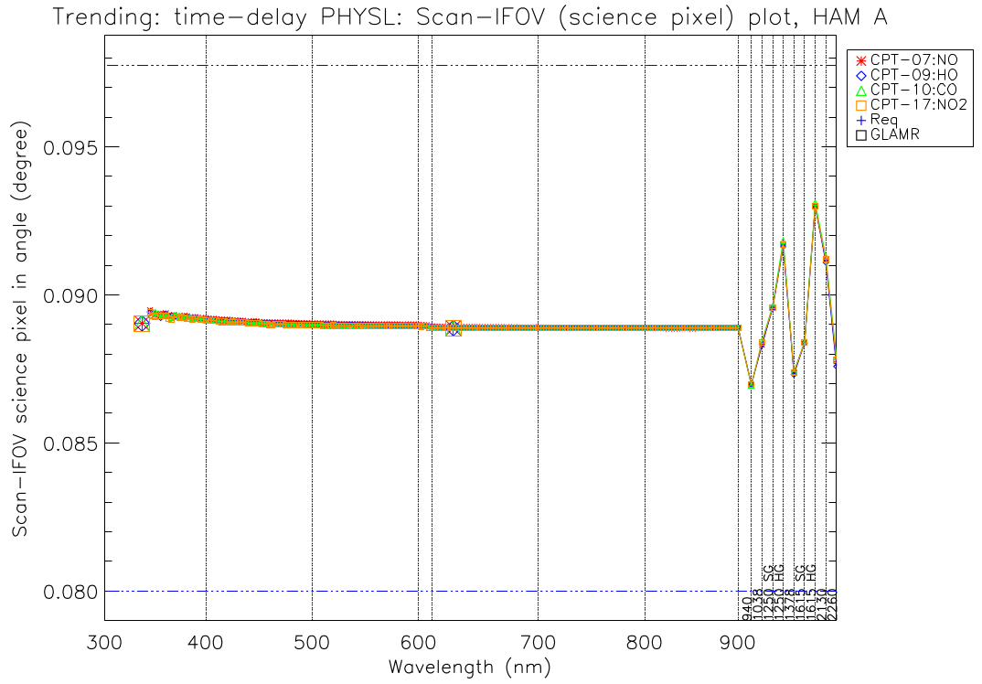
IFoV along scan variation in the SWIR (hysteresis)
No variation with temperature
Variation in SWIR bands due to hysteresis that will be corrected in L1 processing (see later slides)

Slide 7
Band-to-band registration (BBR)
Ideally, each band views the same pixel on the ground
OCI design: no along track variation, but area along scan varies with band
Worst band combination in OCI for all bands: 72% overlap
Worst band combination in OCI for bands below 900nm: 94% overlap
ΔΤ
ΔS

Slide 8
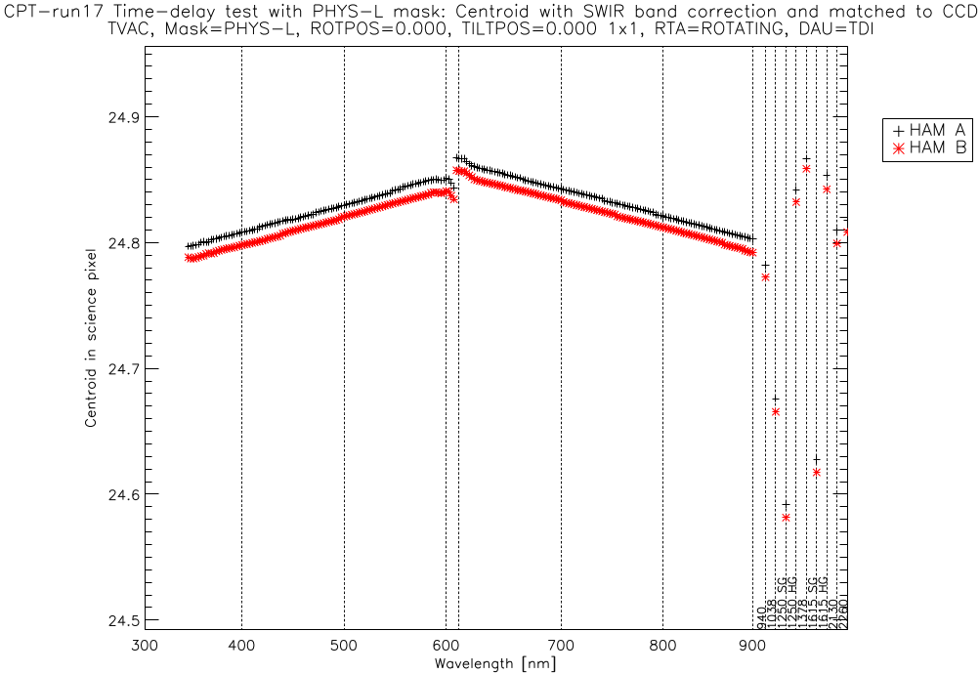
Band-to-band registration: along scan pixel centroids
Outliers: 1038nm, 1250nmSG (worst), 1615nmSG,
Reason: SWIR bands have band specific electronic readout delays

Slide 9
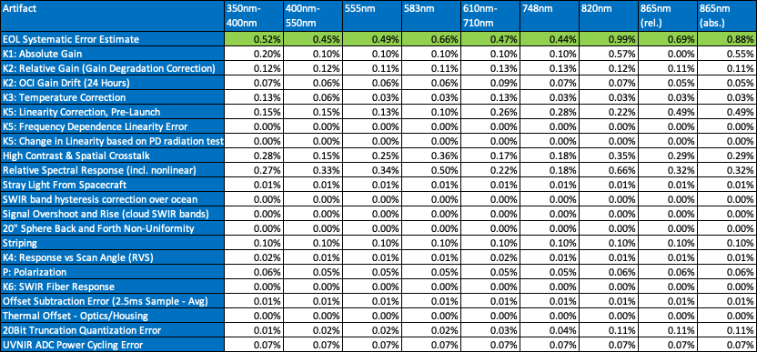
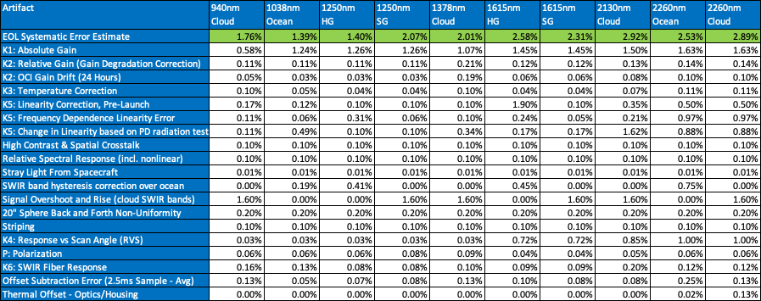
TOA radiance Systematic Uncertainty Bottom Line
(350nm-865nm: after vic. cal. except for ‘abs.’)
(SWIR: no vic. cal.; Note that ‘Cloud’ and ‘SG’ are evaluated for cloud application, ‘Ocean and ‘HG’ for ocean
application (different L_{typs}; ocean has hysteresis correction; cloud has overshoot uncertainty)
Complete uncertainty matrices provided in backup slides for this presentation

Slide 10
OCI relative spectral response: spectral coverage
Blue FPA baseline aggegation: 119 L1B bands from 314.9nm to 605.7nm
- 116 L2 bands up to 598.3nm
- Bands below 340nm have reduced radiometric accuracy (TBD on-orbit)
Red FPA baseline aggregation: 163 L1B bands from 600.5nm to 894.6nm
9 SWIR bands (see later slide) at 7 wavelengths from 940nm to 2260nm

Slide 11
OCI relative spectral response: spectral sampling
Blue FPA: 5nm bandwidth, constant spectral sampling of 2.5nm
Red FPA: 5nm bandwidth, spectral sampling either 2.5nm or 1.25nm (for fluorescence and oxygen A-band)
Data below 340nm is preliminary/unreliable

Slide 12
OCI relative spectral response: blue FPA
Scattered light contribution at less than 10⁻² for bands in blue FPA around central peak
A few ‘ghosts’ (e.g. back reflections off field lens at ~ 380 nm in plot below) can be seen, peaking around 10⁻³

Slide 13
OCI relative spectral response: red FPA
More RSR variation (electronic crosstalk) on red FPA, but at a very low level (often negative)
Decline from peak to less than 10⁻³ much faster than in blue FPA
Ghosts much smaller than in blue FPA

Slide 14
OCI relative spectral response: SWIR bands
SWIR bands use spectral filters
Out-of-band (OOB) and steepness of the ramps (quick drop to less than 10⁻⁴) are very good

Slide 15
OCI relative spectral response: out-of-band
OOB response (i.e. RSR<0.01) will be refined later (by summer 2023); current results do not use high intensity measurements that are available for a few select wavelengths
OOB response is the ratio of integral of OOB RSR response divided by in-band RSR response
OOBR for SWIR bands is excellent
OOBR can be high for blue bands
OOBR values >5% at wavelengths <340nm (not shown) are likely wrong; may need to rely on modelling below 340nm

Slide 16
Signal to Noise Ratio (SNR)
Notes:
16

Slide 17
SNR Fits
SNR (412 nm and 555 nm)
Measured SNR plotted versus radiance.
Data – symbols; Lines – function fit (Noise Power = Floor + Shot = a +b*L_{t})
Notes:
17

Slide 18
SNR Fits
SNR (655 nm and 865 nm)
Measured SNR plotted versus radiance.
Data – symbols; Lines – function fit
Notes:
18

Slide 19
SNR Fits
SNR (1250 nm SG and 2260 nm)
Measured SNR plotted versus radiance.
Data – symbols; Lines – function fit
Notes:
19

Slide 20
SNR at L_{TYP}
Comparison of different SNR estimates over tests (HAM A shown; HAM B is consistent)
All multispectral and SWIR bands well above the baseline requirement
Blue FPA
Red FPA
SWIR
Notes:
20

Slide 21
Polarization
Notes:
21

Slide 22
Fourier Analysis
Fourier analysis of polarization measurements – scan angles -49, -25, 0, 2, 25, 49
The Fourier components are plotted over the measured data (normalized)
For a well-designed test, expect a pure 2-cycle oscillation
2-cycle reproduced the measurements well for scan angles -90, 0, 25, and 49
Large 4-cycle observed in -52, -49, -25
2- and 4-cycle are orthogonal, so does not affect assessment
Notes:
22

Slide 23
Polarization Amplitude
Polarization amplitude measured at different scan angles
Amplitude generally less than 0.4 % except in UV (below about 350 nm)
Oscillations in red FPA a feature of the depolarizer
Phase angle also determined – Mueller matrix components derived from amplitude and phase
Blue FPA
Red FPA
SWIR
Notes:
23

Slide 24
Polarization Uncertainty
Uncertainty on the polarization measurement assessed
Total uncertainty generally less than 0.1 %
Assumes on-orbit that scenes will be less than 50% polarized.
Blue FPA
Red FPA
SWIR
Notes:
24

Slide 25
Response Versus Scan Angle (RVS)
Notes:
25

Slide 26
RVS vs Scan Angle
Example of RVS measurements (symbols) and fits (lines)
Repeated measurement agreed well for Blue and Red FPAs
Some differences between motor control electronics side for SWIR
Solar Cal angle does not always agree with the fit
Notes:
26

Slide 27
RVS vs Scan Angle
Variation of the RVS over bands and scan angle
Here RVS is normalized to 0 degrees scan angle.
RVS shape varies across each focal plane.
Blue FPA
Red FPA
Notes:
27

Slide 28
SWIR RVS
3D view of RVS vs MLA position (reflective on left; transmissive on right)
Reflective positions correspond to bands from 940 nm – 1250 nm
Transmissive position correspond to bands from 1378 nm – 2260 nm
Modeled from reflective positions and component measurements (except 1378 nm)
Reflective
Transmissive
Notes:
28

Slide 29
RVS Uncertainty
Total RVS uncertainty
Maximum over scan angle range
Generally less than 0.03 % -- RVS well defined
Blue FPA
Red FPA
SWIR
Notes:
29

Slide 30
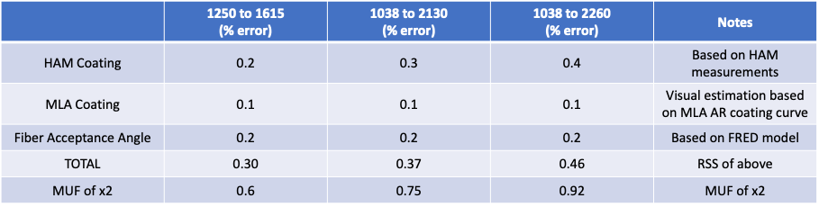
RVS for HgCdTe (MCT) bands
Table below shows model uncertainties related to prediction of MCT band RVS from InGaAs band measurements, provided by OCI Optics team. For the total uncertainty, these uncertainties should be combined with the measurement uncertainties of the respective InGaAs RVS band (maximum: 0.029% 1-sigma (0.058%, 2-sigma), and the prediction error for the 1378nm from the 940nm measurements (0.4%).
The RMS sum of all contributors (the total RVS uncertainty for the earth view angle range) for the 1615 nm, 2130 nm, and 2260 nm bands is 0.72% [sqrt(0.058^2+0.4^2+0.6^2)], 0.85%, and 1.00%, respectively (2-sigma).
Notes:
30

Slide 31
Linearity
Notes:
31

Slide 32
Linearity Measurements
Comparison of white light progressive time-delay integration (PTDI) and GLAMR power stepping
Generally, results are comparable for Red and Blue FPAs
No PTDI for SWIR bands – GLAMR data used
Notes:
32

Slide 33
Non-Linearity After Correction
Used a model to fit measured data and estimate non-linearity after correction from residual
Model fits data from about 0.5 L_{LOW} – saturation; total non-linearity before correction up to 6 %
Maximum non-linearity after correction generally small (0.1 % -- 0.3 %)
Higher values usually occur at very low radiances (below or near L_{LOW})
SWIR bands also generally have low non-linearity after correction (exception 1615 HG)
Blue FPA
Red FPA
Notes:
33

Slide 34
Saturation
Notes:
34

Slide 35
Saturation
Saturation estimates for all bands
Above L_{MAX} (or L_{CLIP}) for most bands, indicating expected science data range to be met
Some bands saturate a little early in blue FPA; this was expected
Blue FPA
Red FPA
SWIR
Notes:
35

Slide 36
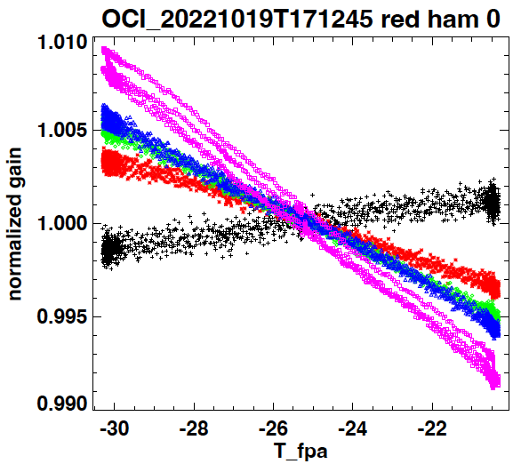
Temperature sensitivity
OCI detector response vs. temperature is characterized using data taken during various temperature cycles while looking at a constant source.
Temperature sensitivity is linear
OCI detector is sensitive to Focal Plane Assembly (FPA) and grating (MOB) temperature
Left: OCI response vs. FPA temperature

Slide 37
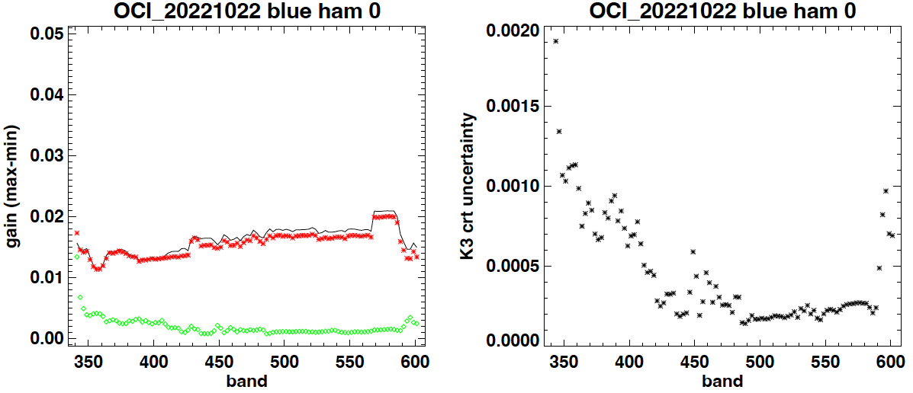
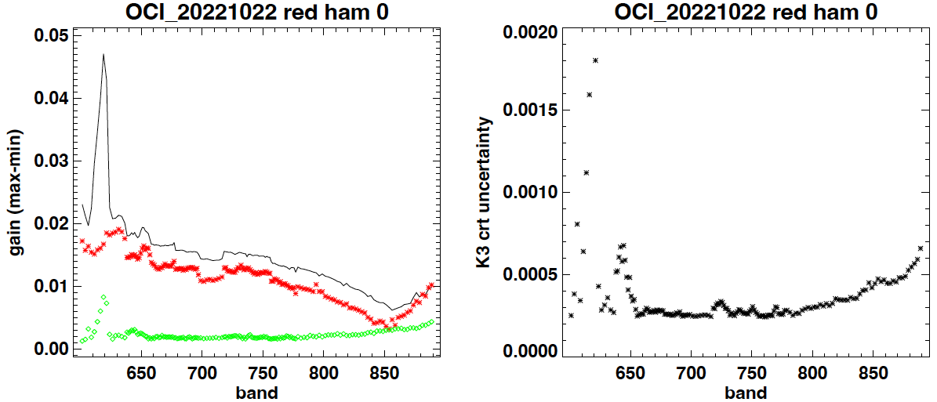
Hyper-spectral (5nm) bands
Left: total gain variation within operational temperature range
  Red: uncorrected
  Green: corrected
Right: correction uncertainty.
GSE uncertainty ~620nm
Higher uncertainty at dichroic edge (~ 600 nm) due to spectral temperature sensitivity

Slide 38
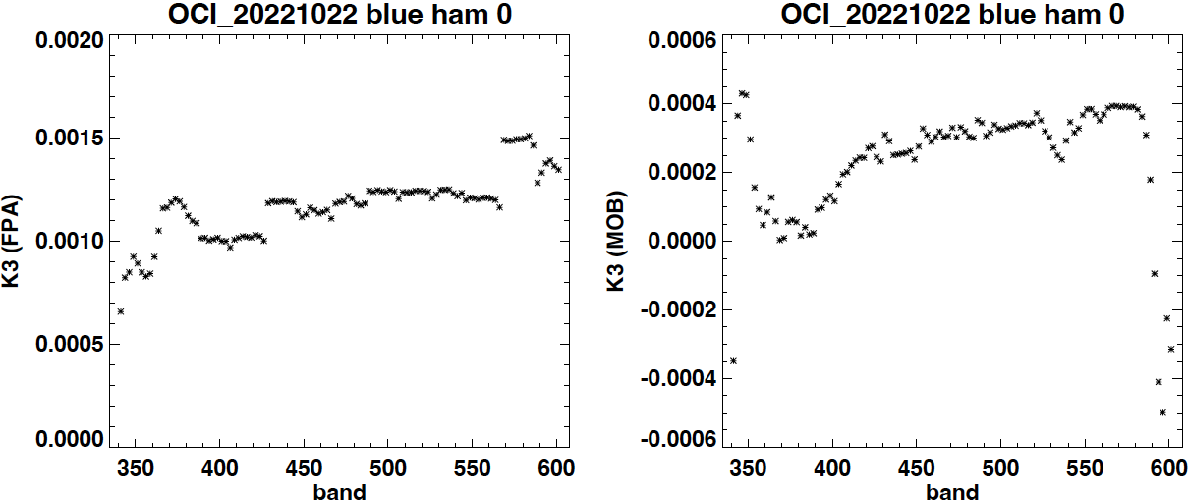
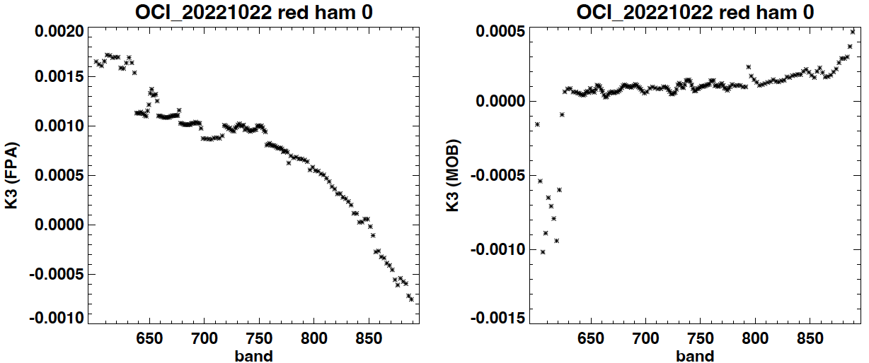
Multi-spectral (5nm) bands
K3: temperature correction coefficients (per degree C)
Linear correction
FPA temp driven
GSE uncertainty ~620nm
Higher uncertainty at dichroic edge due to spectral temperature sensitivity

Slide 39
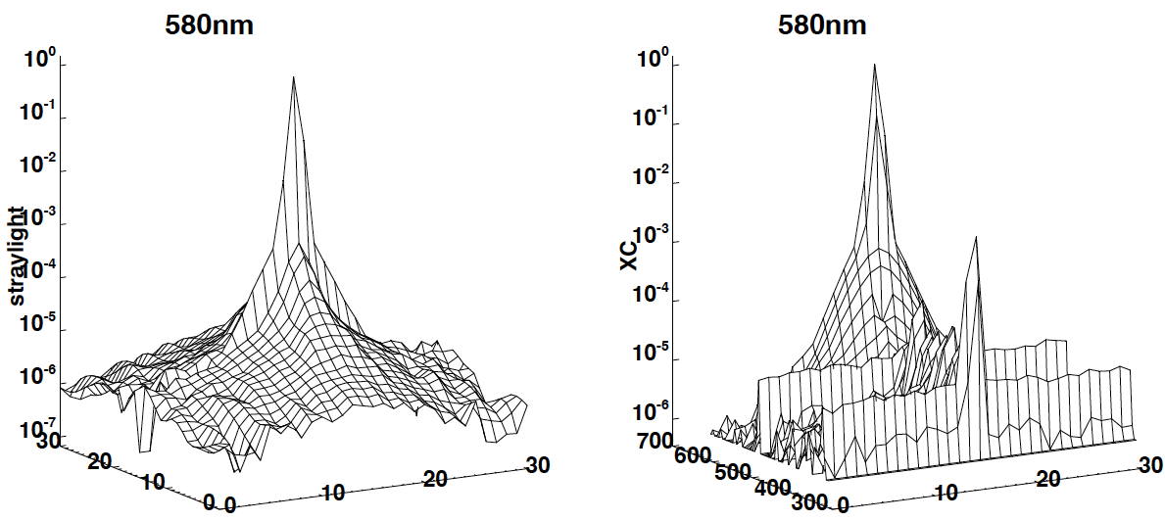
Straylight / Crosstalk
GLAMR cross-track
Crosstalk sender bands (Ghost)
GLAMR along-track
Track pixel
Band
Scan pixel
Scan pixel
Straylight: contamination from the same wavelength (scan and track direction)
Crosstalk: contamination from different wavelengths (scan and wavelengths)
OCI straylight (spatial) is characterized using collimated 1-science pixel slit monochromatic source.

Slide 40
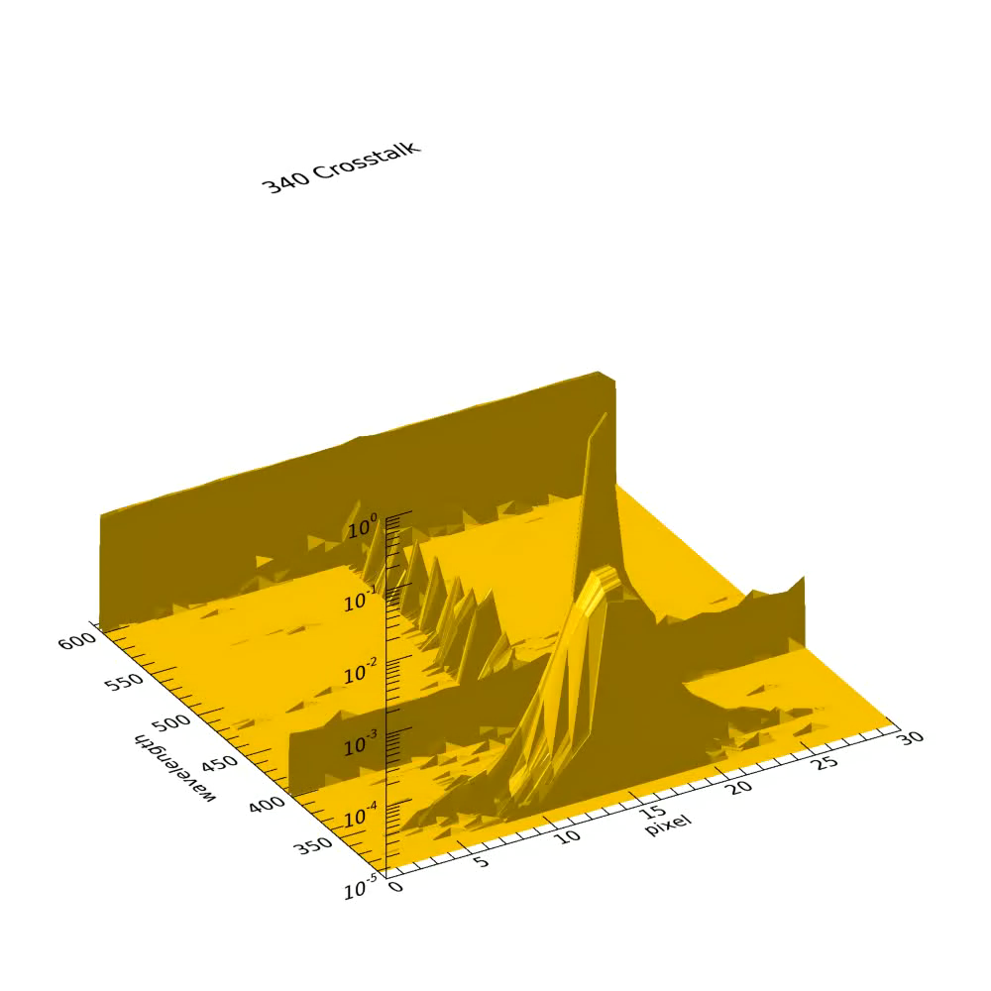
Straylight / Crosstalk
OCI crosstalk model
Based on collimated light source measurements from selected wavelengths (8 wavelengths per focal plane)
Use fine step (1-nm) monochromatic flood light source to fill the gaps (i.e. ghost wavelengths and magnitudes)
No significant ghost features in red CCD bands

Slide 41
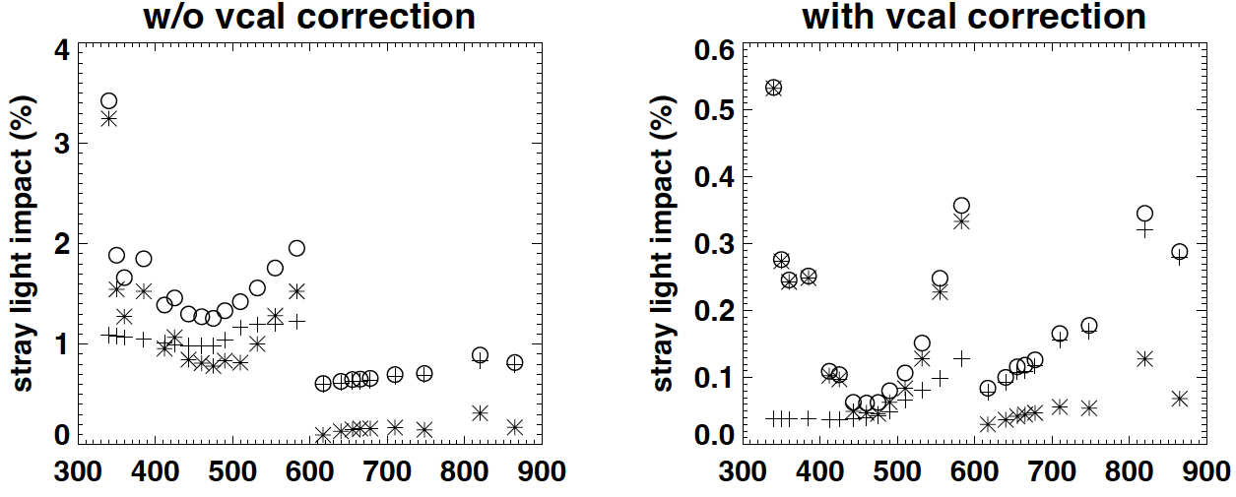
Straylight/Crosstalk Science Impact
Average global impact on ocean data
Higher in blue than red CCD bands before Vcal
Vicarious calibration offsets large portion of impact

Slide 42
Striping
Slides:
  Mirror-side differences: Data for Blue FPA, Red FPA, and SWIR Detector Assembly
    Primary mitigation is mirror-side specific calibration.
    Corrected mirror-side differences are less than 0.1% for most channels.
  Noise spikes in dark scenes: BFPA and RFPA 1x8 data
  Broad noise features in single dark scans: RFPA 8x8 data

Slide 43
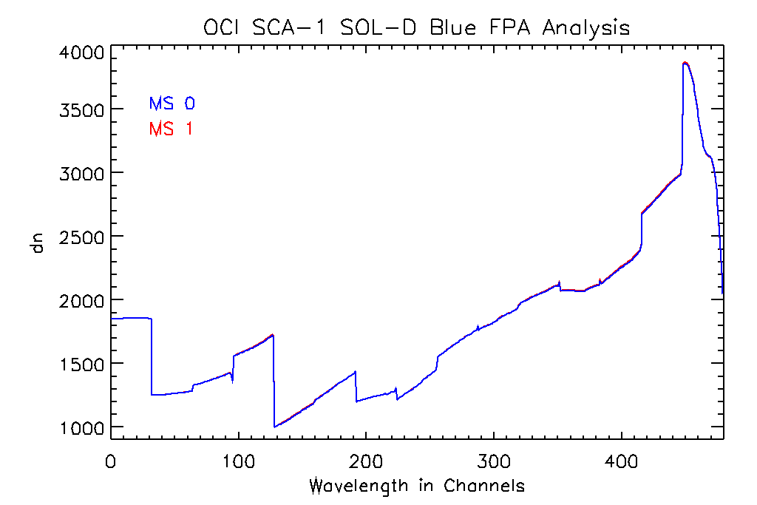
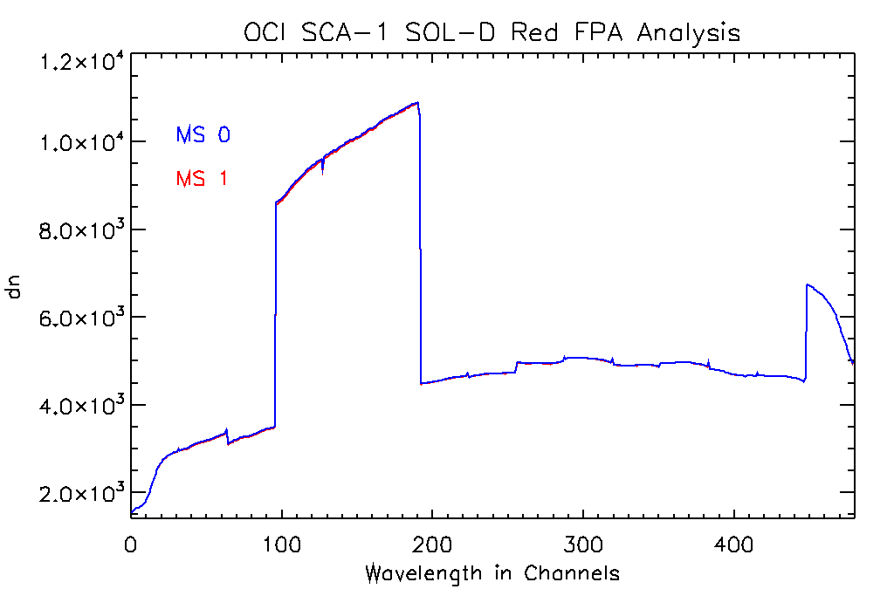
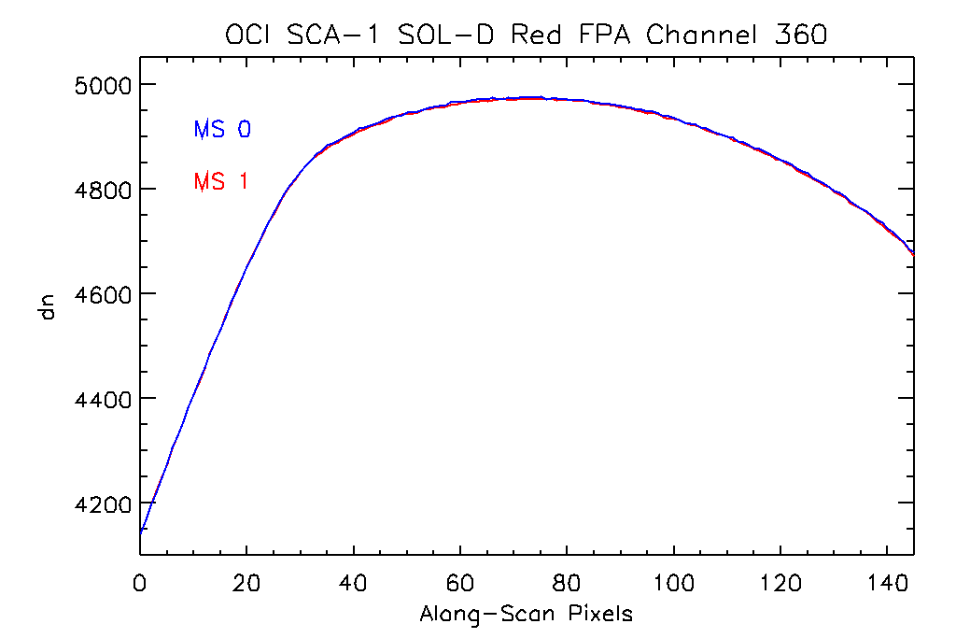
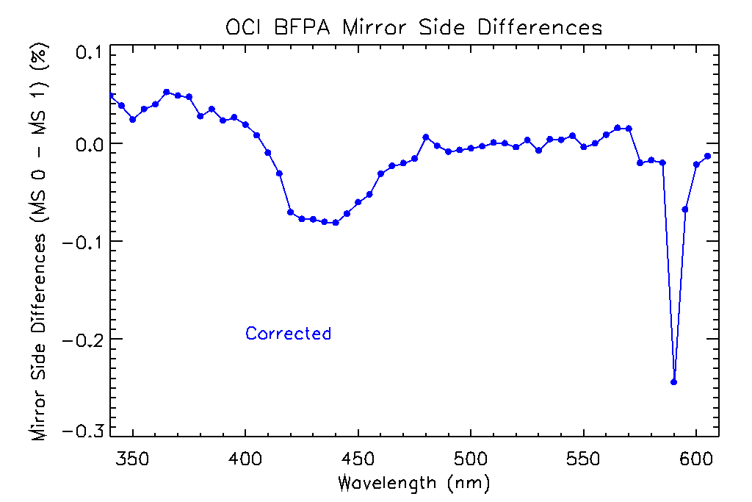
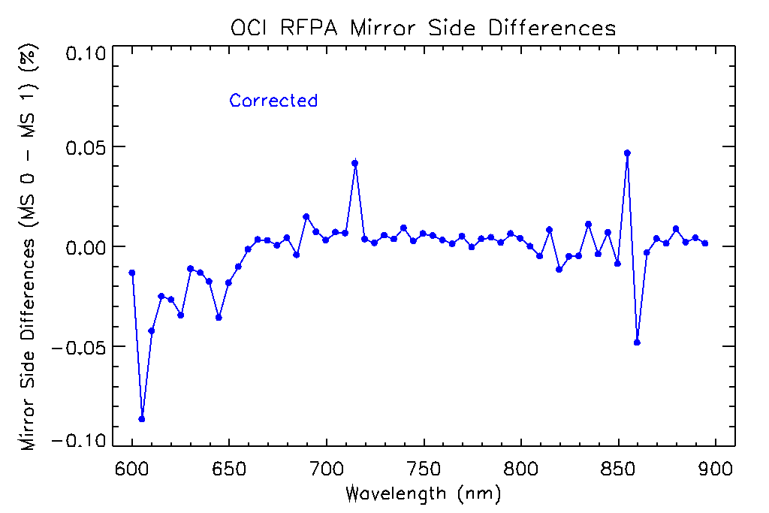
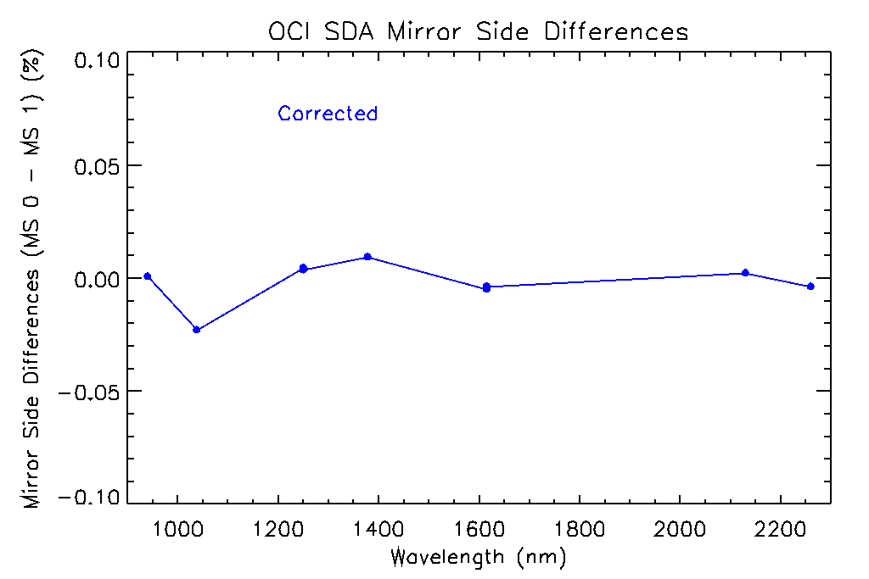
Mirror-Side Differences
Red FPA 825 nm
Notes:
43

Slide 44
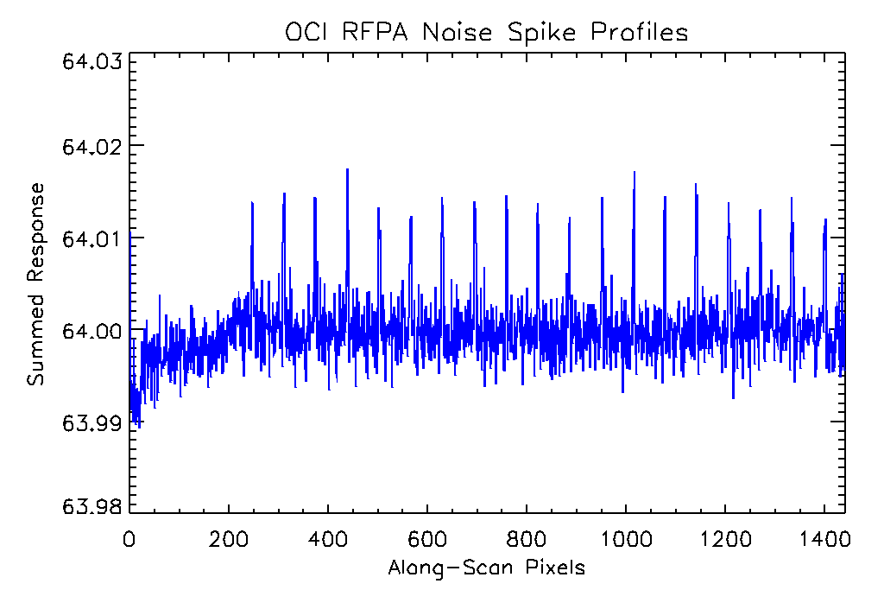
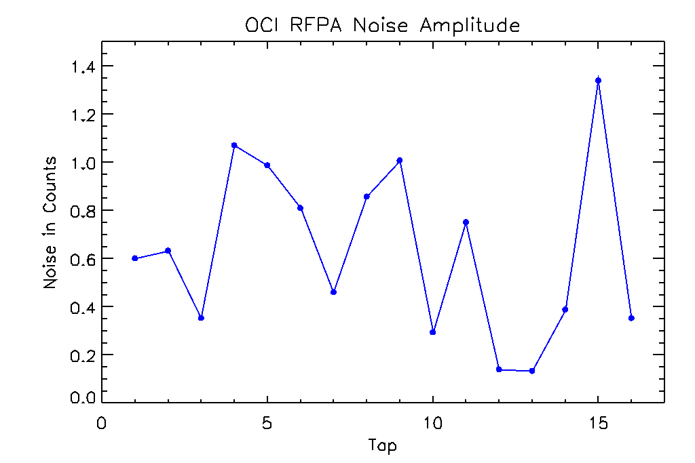
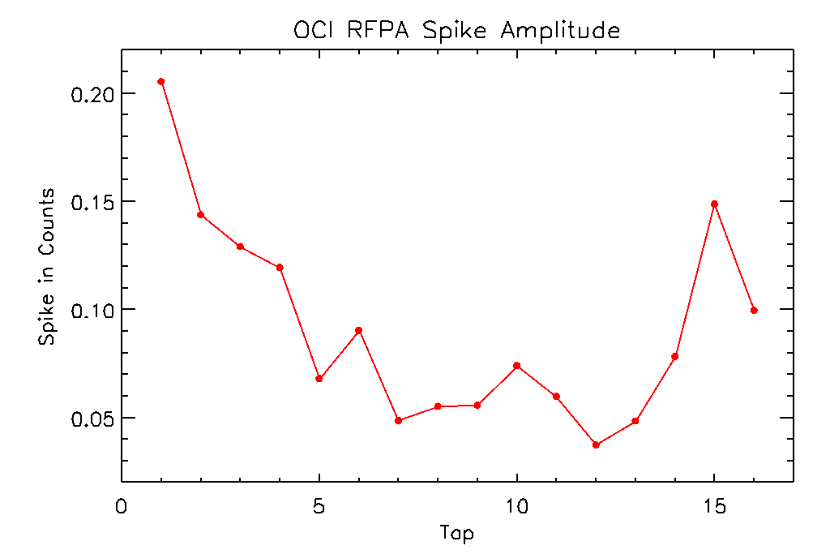
Noise Spikes in some Dark Scenes
Blue FPA
Red FPA
Spectral Channel
Along-Scan Pixels
Spikes were observed for some dark scenes after averaging 10 minutes of data: OCI design artifacts.
Spike amplitudes are 4-10 times smaller than noise amplitudes, so spikes are insignificant in the presence of signals, aggregation of data in the along-scan direction.
Notes:
44

Slide 45
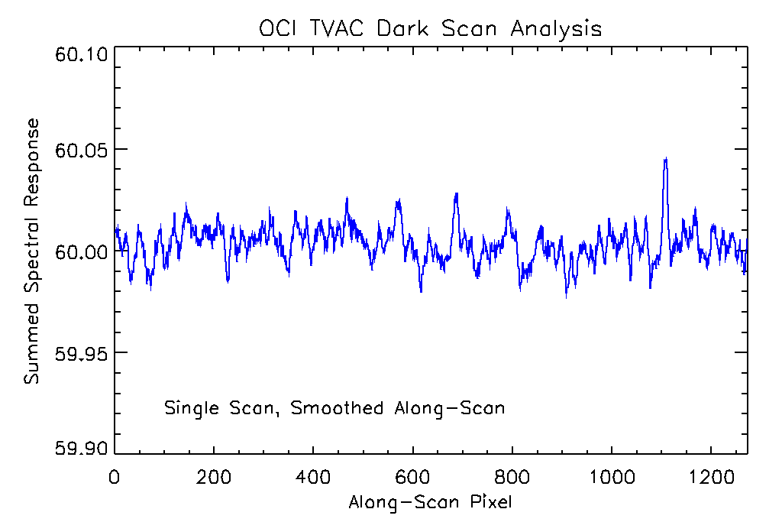
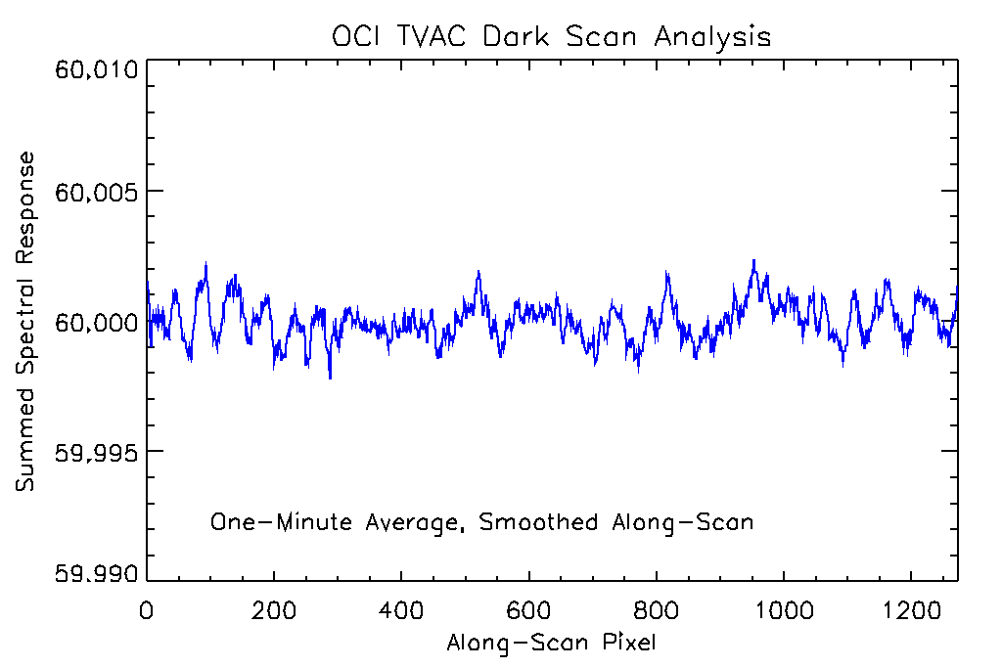
Broad Noise Features at Tvac Qual Temps
Random noise features in some dark scenes for
single scans in RFPA data.
One-minute average for RFPA data.
The features are averaged to insignificance very quickly.
Notes:
45

Slide 46
Absolute Gain
Slides:
  Solar Diffuser Radiance Equations: Recasting of the OCI calibration equation
  Example of correcting OCI observations for Angle of Incidence, diffuser BRDF
  Diffuser BRDF measurements: performed by TNO, GSFC

Slide 47
Absolute Gain
Radiance reflected by the solar diffuser:
L_{r} (θ_{i},θ_{r},ϕ_{i},ϕ_{r} ) = f_{r}(θ_{i},θ_{r},ϕ_{i},ϕ_{r}) * F₀ * cos(θ_{i}) / d_{ES}²
where f_{r} is the diffuser BRDF.
Radiance from the solar diffuser, as measured by OCI:
Lr = K1 * K2 * K3 * K4 * K5 * K6 * dn
The OCI absolute gain factor:
K1 = (f_{r}(θ_{i},θ_{r},ϕ_{i},ϕ_{r}) * F₀ * cos(θ_{i}) / d_{ES}²) / (K2 * K3 * K4 * K5 * K6 * dn)
K1 will be computed from the on-orbit solar diffuser observations and compared to the prelaunch values:
  Tracking of solar diffuser BRDF degradation over time is required
  Tracking of instrument response over time (K2) is required

Slide 48
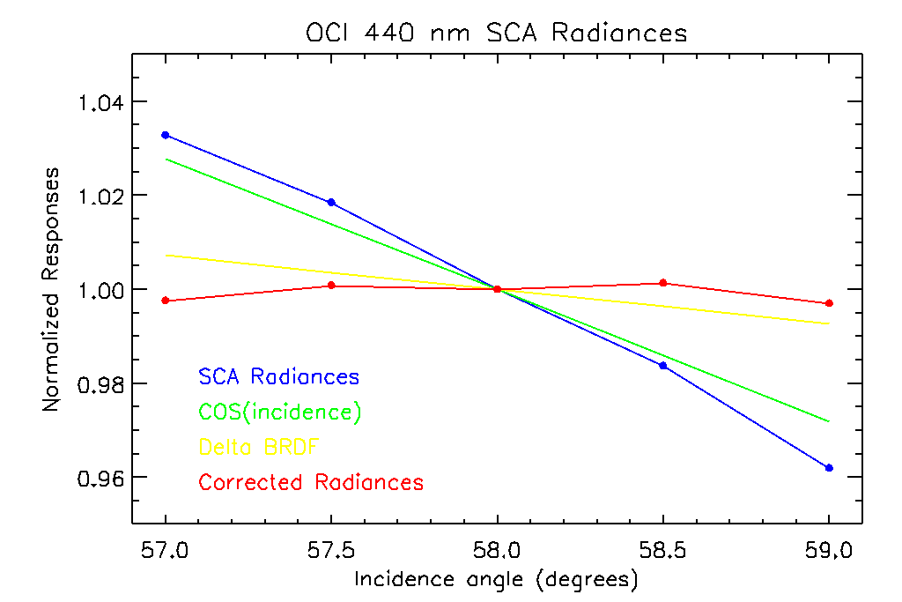
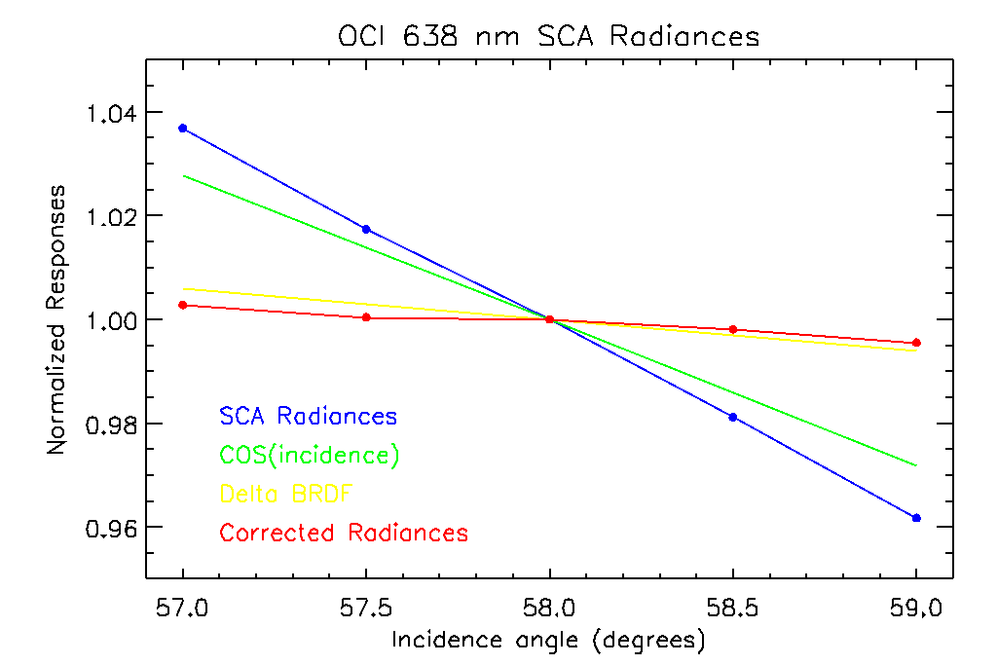
Corrections to OCI for Viewing Geometry
Example of corrections to OCI observations for viewing geometry:
  Blue curves show OCI observations of the diffuser as the AOI changes
  Green curves show the COS(AOI) dependence
  Yellow curves show the BRDF dependence on AOI
  Red curves show the observations corrected for COS(AOI) and BRDF
Notes:
48

Slide 49
Quasi-Volume Diffuser BRDF
QVD BRDF measured for four flight units:
  Measured by TNO, the manufacturer of the diffusers
  Measurements repeated at GSFC, validating the TNO results
  Diffuser BRDF measurements:
    Incidence Angles of 55.0, 57.0, 58.0 (nominal), 59.0, 61.0 degrees
    Viewing Angles of 36.0 (nominal), 36.08, 36.25, 36.30, 37.08 degrees
  Incidence Angle determined on orbit by the spacecraft pointing the Solar Calibration Assembly at the Sun
  Viewing Angle determined on orbit by the position of the diffuser within the Solar Calibration Assembly
Notes:
49

Slide 50
Gain Trending
Slides:
  Gain Trending Equations: Recasting of the OCI calibration equation.
  Gain Trending Data Flowchart
  SNPP VIIRS Solar and Lunar Gain Trending example:
    OCI will perform Daily and Monthly solar diffuser observations using two diffusers
    OCI will perform two lunar calibrations per month at +/- 7 degrees phase.

Slide 51
Gain Trending
Radiance reflected by the solar diffuser:
L_{r} (θ_{i},θ_{r},ϕ_{i},ϕ_{r} ) = f_{r}(θ_{i},θ_{r},ϕ_{i},ϕ_{r}) * F₀ * cos(θ_{i}) / d_{ES}²
The OCI Solar-derived temporal correction factor:
K2_{S}(t) = (f_{r}(θ_{i},θ_{r},ϕ_{i},ϕ_{r}) * F₀ * cos(θ_{i}) / d_{ES}²) / (K1 * K3 * K4 * K5 * K6 * dn(t))
Radiance reflected by the Moon:
L_{M} (phase,libration) = A_{M}(phase,libration) * F₀ * cos(θ_{i}) ∗/ (d_{ES}² * d_{EM}²)
The lunar albedo (A_{M}) is provided by the ROLO model for the time and geometry of the observation.
The OCI Lunar-derived temporal correction factor:
K2_{M}(t) = (A_{M}(phase,libration) * F₀ * cos(θ_{i}) / (d_{ES}² * d_{EM}²)) / (K1 * K2_{S}(t)* K3 * K4 * K5 * K6 * dn(t))
The lunar-adjusted solar-derived temporal correction factor becomes:
K2(t) = K2_{M}(t) * K2_{S}(t)

Slide 52
OCI Gain Trending Approach
The Solar K2 is the 1st order temporal response correction for OCI.
The Lunar Gain is a 2nd order correction to the Solar-derived K2.
Daily
SD Obs
Monthly
SD Obs
Solar K2
Lunar-Adjusted Solar K2
K2 Lookup Table
Semi-Monthly
Lunar Obs
Calibrated Lunar Obs:
Lunar Gain
The lunar adjustment to the Solar K2 is necessary to mitigate uncertainties in tracking degradation of the solar diffuser BRDF.

Slide 53
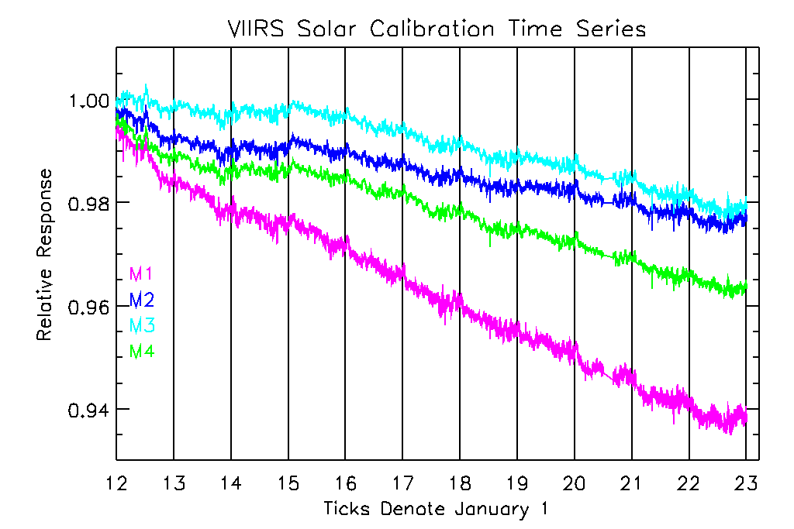
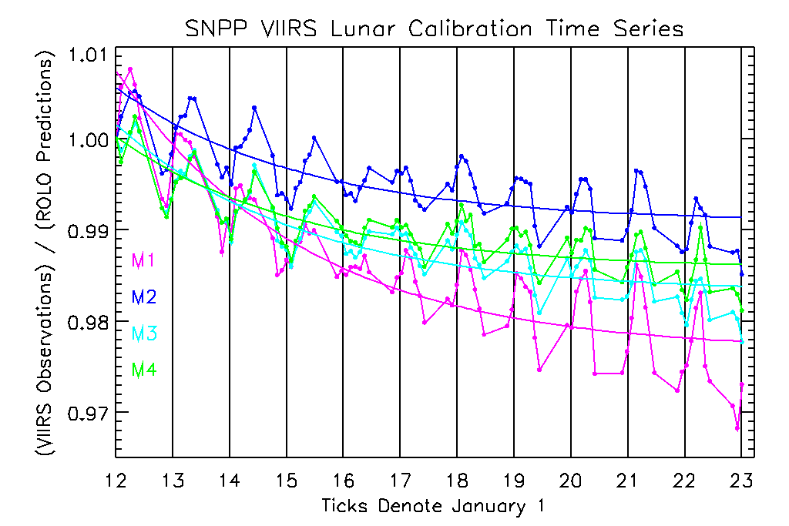
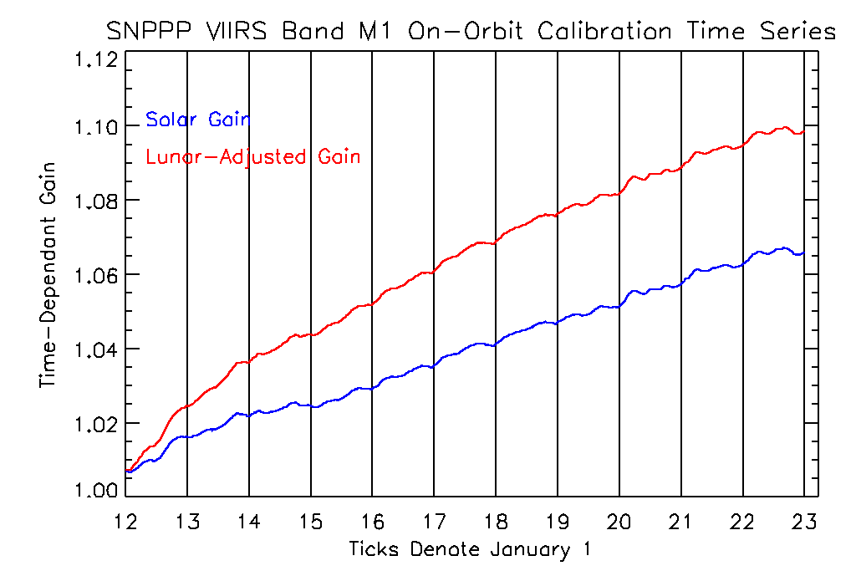
SNPP Calibration Time Series (as example)
The Solar K2 f-factors apply the 1st order temporal response correction to the lunar observations.
Lunar trends over time arise from uncertainties in tracking degradation of the solar diffuser BRDF.
The Lunar Gain is a 2nd order correction to the solar-derived K2.
53

Slide 54
Spectral Response Trending
Slides:
  Dispersion of the blue and red gratings can possibly change over time on orbit:
    Dispersion is derived from fits to solar emission lines, atmospheric absorption lines
    Any changes in dispersion will lead to adjustments in RSRs
  Solar Spectrum plot
  Sample solar emission lines, atmospheric absorption lines

Slide 55
Spectral Calibration
For the red and blue gratings, the wavelength for any spectral channel k is given by:
λ(k) = λ₀(k₀) + Δλ(k-k₀)
The dispersion of the grating is defined as:
Δλ(k-k₀) = (λ(k) - λ₀(k₀)) / (k-k₀)
The dispersion for each grating is determined on orbit by simultaneous fits to multiple emission or absorption line profiles.
The derived on-orbit dispersions are compared to the prelaunch values and the relative spectral responses of the bands are adjusted as needed to account for changes in the dispersion of the grating.

Slide 56
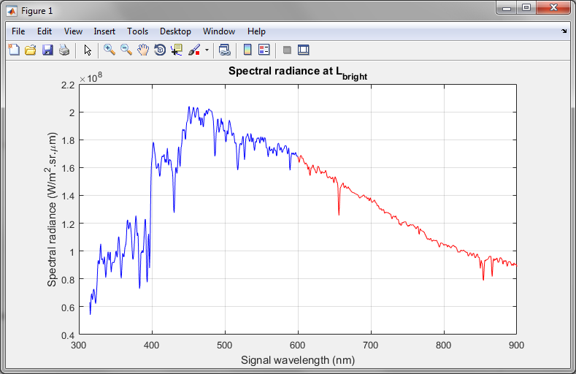
Solar Spectrum with Lines
Notes:
56

Slide 57
Example Line Profiles
Emission and Absorption line profiles:
  Fraunhofer solar emission lines:
    Will use at least two lines per focal plane
    434.048 nm (Hγ), 588.997 nm (Na D₂), 656.281 nm (Hα), 866.217 nm (Ca II)
  Atmospheric absorption lines:
    For the red focal plane
    686.719 nm (O₂ B), 759.370 nm (O₂ A), 822.696 nm (O₂ Z), 898.765 nm (O₂ y)
Notes:
57

Slide 58
SWIR Impulse Response Issue
The SWIR bands require quite large gains in order to meet SNR and this is provided by a large resistance value and controlling capacitance on the cold, detector package.
The uncompensated time constant for this circuit is quite slow, of order 5-35 science pixels.
This slow response (pole) is compensated by a matching amplification (zero) of the attenuated higher frequencies in the warm side electronics/amplifier that eliminates the slow time constant response.
If the pole and zero are not perfectly matched, then the slow time constant response remains (with a magnitude proportional to the difference in the time constants of the pole and zero) and will create a particular problem in clear skies in the vicinity of clouds and coastlines and more generally over land.

Slide 59
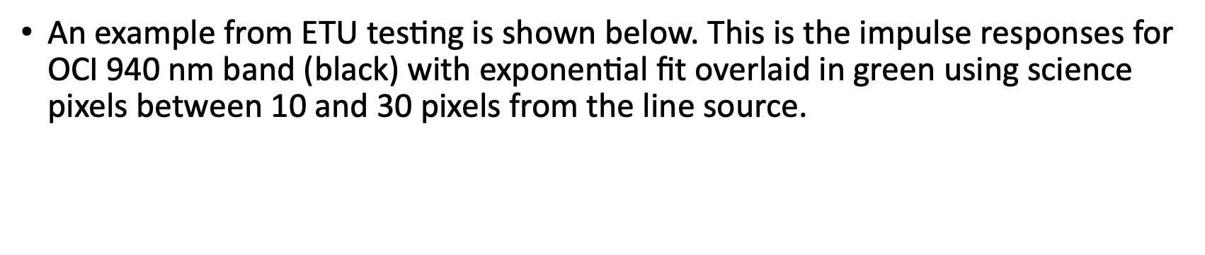
$\text{A}\text{n} \text{example} \text{from} \text{ETU} \text{testing} \text{is} \text{shown} \text{below}\text{. }\text{This} \text{is} \text{the} \text{impulse} \text{responses} \text{for} \text{OCI}\text{ 940 }\text{nm} \text{band}\text{ (}\text{black}\text{) }\text{with} \text{exponential} \text{fit} \text{overlaid} \text{in} \text{green} \text{using} \text{science} \text{pixels} \text{between}\text{ 10 }\text{and}\text{ 30 }\text{pixels} \text{from} \text{the} \text{line} \text{source}\text{.}$

Slide 60
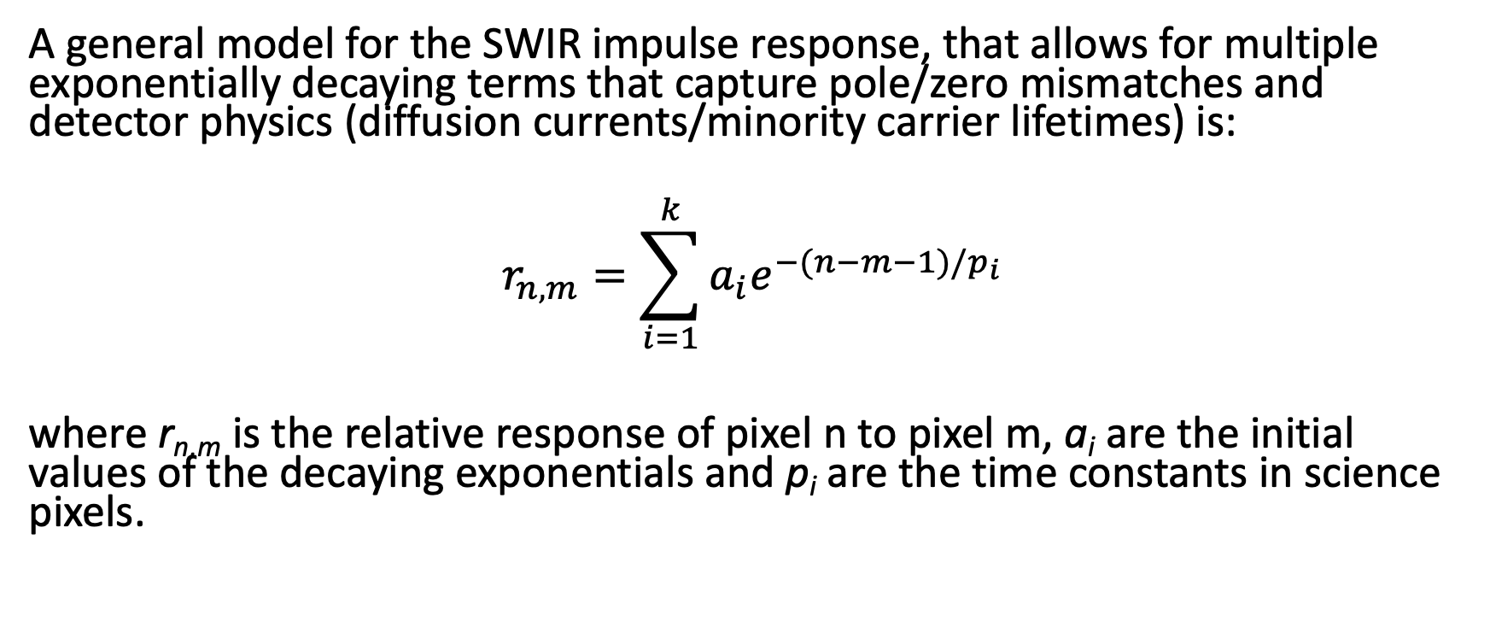
A general model for the SWIR impulse response, that allows for multiple exponentially decaying terms that capture pole/zero mismatches and detector physics (diffusion currents/minority carrier lifetimes) is:
$$r_{n,m}=\sum_{i=1}^{k}{a_{i}e^{−(n−m−1)/p_{i}}}$$
where r_{n,m} is the relative response of pixel n to pixel m, a_{i} are the initial values of the decaying exponentials and p_{i} are the time constants in science pixels.

Slide 61
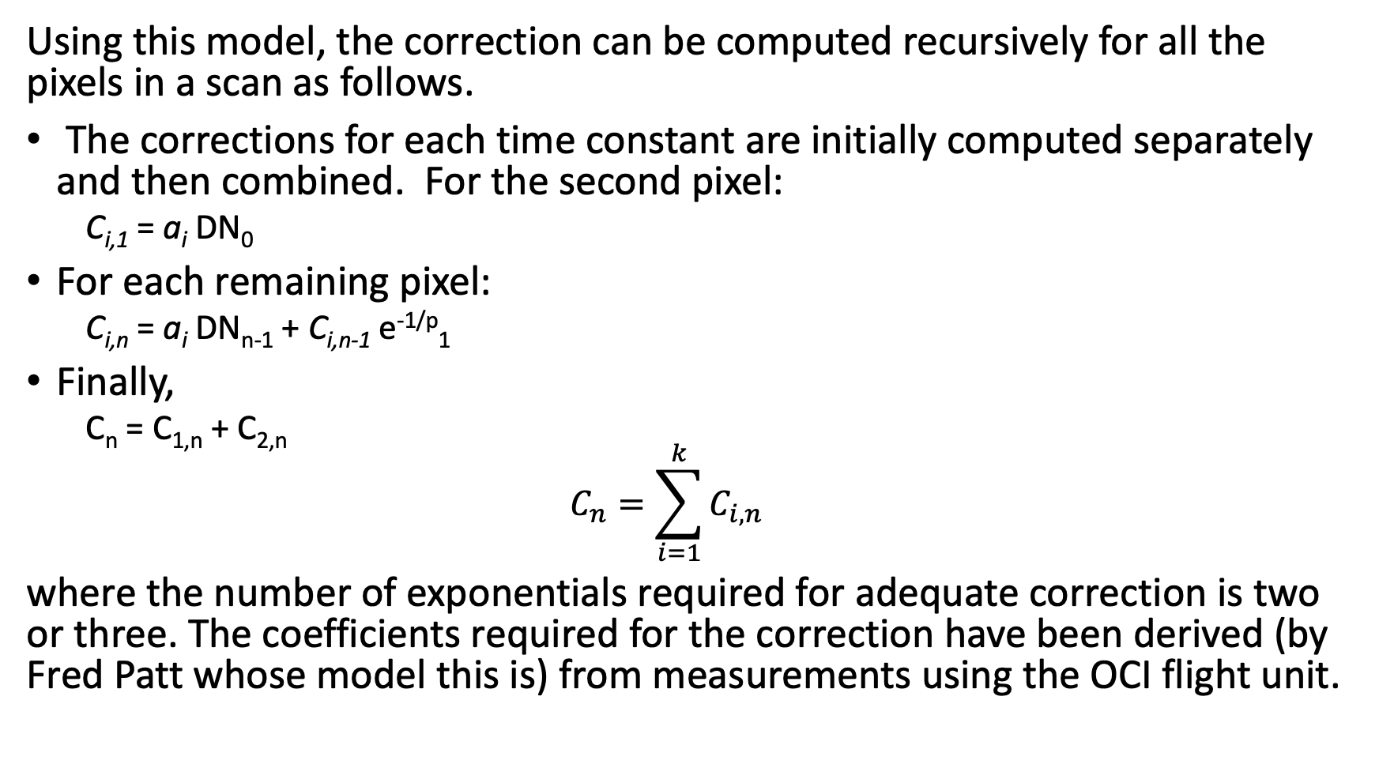
Using this model, the correction can be computed recursively for all the pixels in a scan as follows.
The corrections for each time constant are initially computed separately and then combined. For the second pixel:
  C_{i,1} = a_{i} DN₀
For each remaining pixel:
  C_{i,n} = a_{i} DN_{n-1} + C_{i,n-1} e^{-1/p}₁
Finally,
  C_{n} = C_{1,n} + C_{2,n}
  $$C_{n}=\sum_{i=1}^{k}{C_{i,n}}$$
where the number of exponentials required for adequate correction is two or three. The coefficients required for the correction have been derived (by Fred Patt whose model this is) from measurements using the OCI flight unit.

Slide 62
Correction Function Coefficients

Slide 63
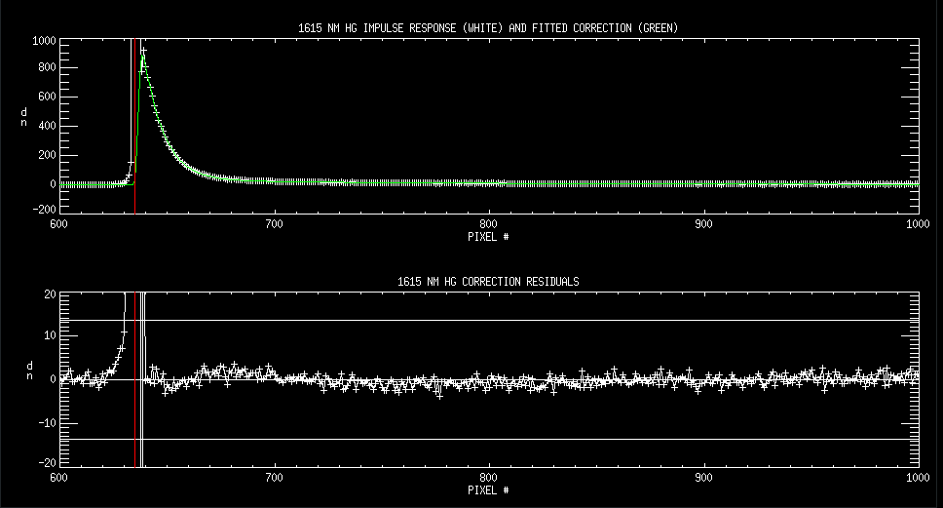
1615 NM HG example (other figures in backup)

Slide 64
Observations
For all bands except 940, 1250 SG and 1378, three exponential terms were needed to fit the impulse response.
Oscillation and short-period response prevented the fits from correcting the response to within noise at 3 pixels from the peak for most bands.
  Fits might be improved by adding additional terms, but the fact that a 3rd order Butterworth filter is part of the instrument response and this is not well resolved at the science pixel level complicates improving results within 3 pixels of a bright target.
1250 SG response continues to be entirely negative.
1615 SG, 2130 and 2260 bands have very small impulse responses.
2130 and 2260 have very long time constants.

Slide 65
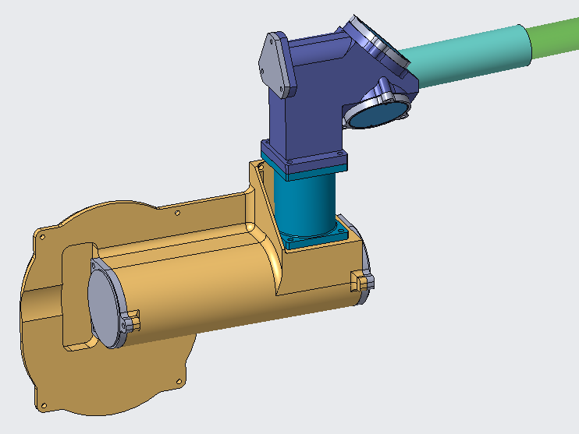
SDA Pulse Calibration Assembly (SPCA)
Physics of the impulse response suggests that while magnitudes of exponential decay terms may change as parts degrade time constants should remain relatively stable.
SPCA allows both magnitudes and time constants of exponential impulse response terms to be tracked on orbit.
Final Design Architecture: Monolithic Telescope
Mass: < 3kg

Slide 66
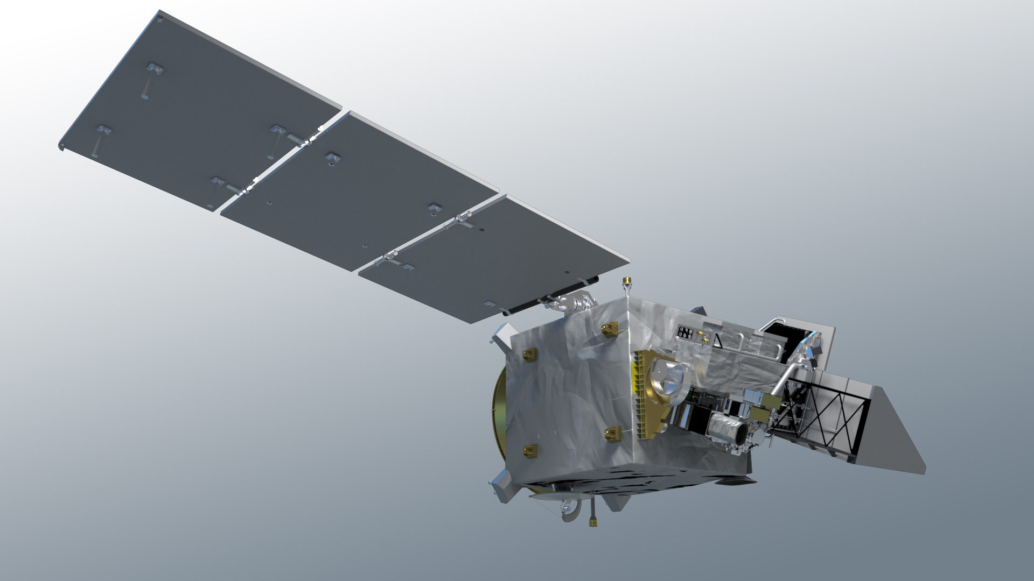
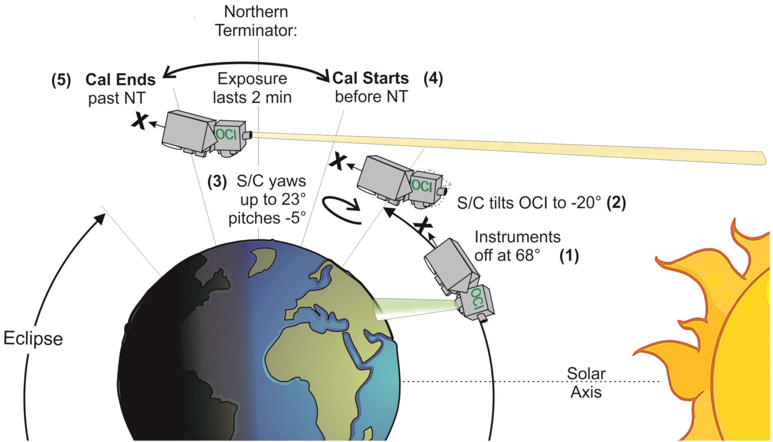
Solar Calibration Pointing
  The solar calibration assembly (SCA) boresight pointing budget is 900 arcseconds total
  The SCA boresight is referenced to the OCI star trackers for spacecraft GNC pointing & control
  The SPCA boresight will be co-registered with the SCA boresight such that both image the sun during the planned S/C maneuver (PACE-SYS-TN-0047)
OCI Star Tracker
Sun: 0.53º
SPCA iFOV: 0.17º
SPCA Absolute Pointing Requirement: 954 arcsec
Y
SPCA
X
SCA
Z

Slide 67
Conclusions
Comprehensive and extremely high-quality testing of OCI has been performed under ambient conditions and in TVAC.
OCI meets all performance requirements, generally with significant margin.
There is still some work to go on finalizing the evaluation of straylight and spectral responses in the UV as a result of limitations with the ground support equipment.

Slide 68
Backup

Slide 69
TOA radiance Systematic Uncertainty Matrix: 350nm-865nm
(after vic. cal. except for ‘abs.’)

Slide 70
TOA radiance Systematic Uncertainty Matrix: SWIR bands
(no vic. cal.; Note that ‘Cloud’ and ‘SG’ are evaluated for cloud application, ‘Ocean and ‘HG’ for ocean application (different Ltyps; ocean has hysteresis correction; cloud has overshoot uncertainty)

Slide 71
Initial Results of OCI FU TVac
SWIR Impulse Response Correction
Fred Patt
October 4, 2022

Slide 72
Overview
The SWIR band GLAMR 1 SP measurements were collected on 15 and 16 September
The SWIR impulse response was examined and initial fits of the correction function were performed for all bands.

Slide 73
Measurement Statistics

Slide 74
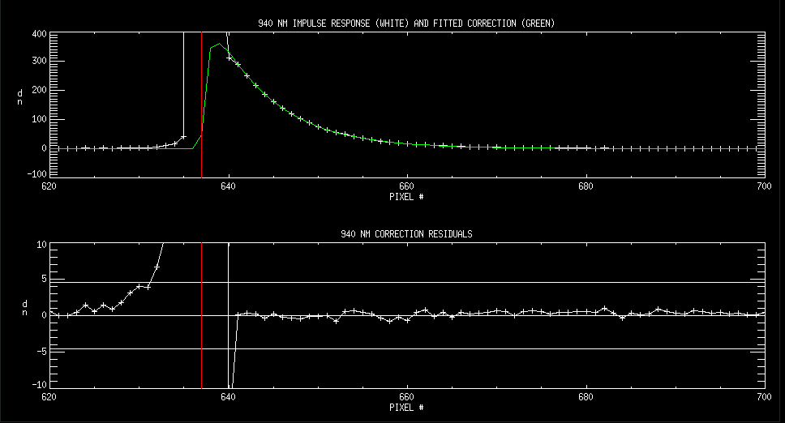
940 NM

Slide 75
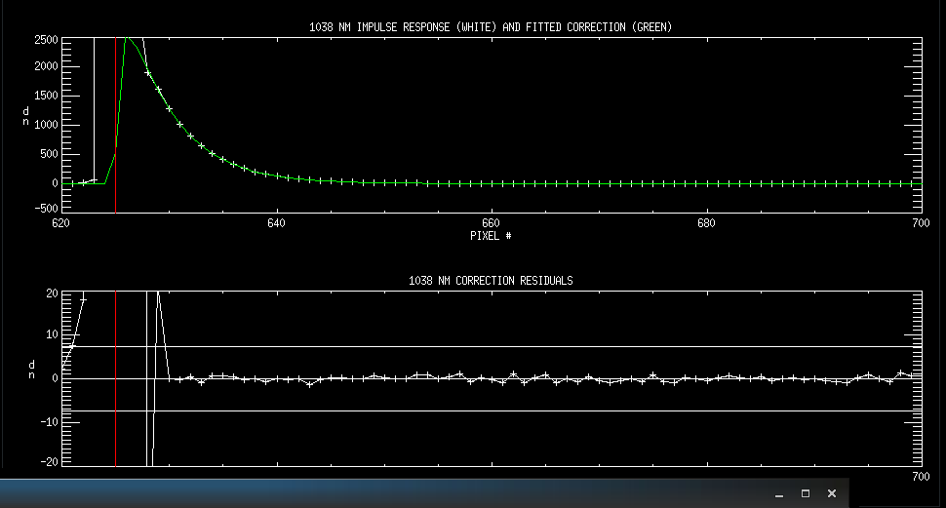
1038 NM

Slide 76
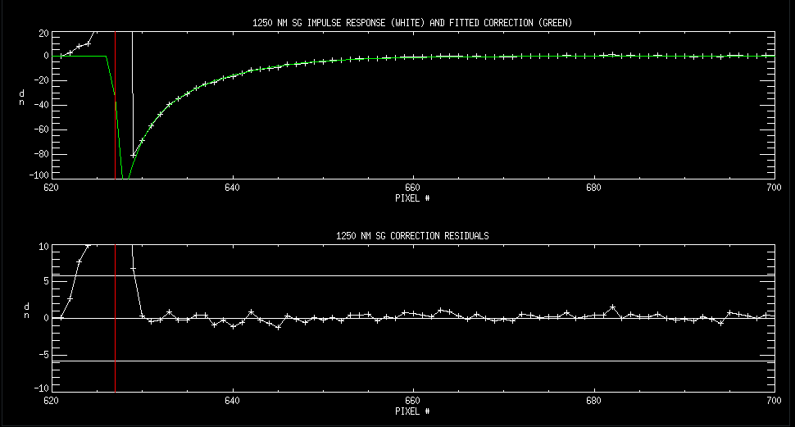
1250 NM SG

Slide 77
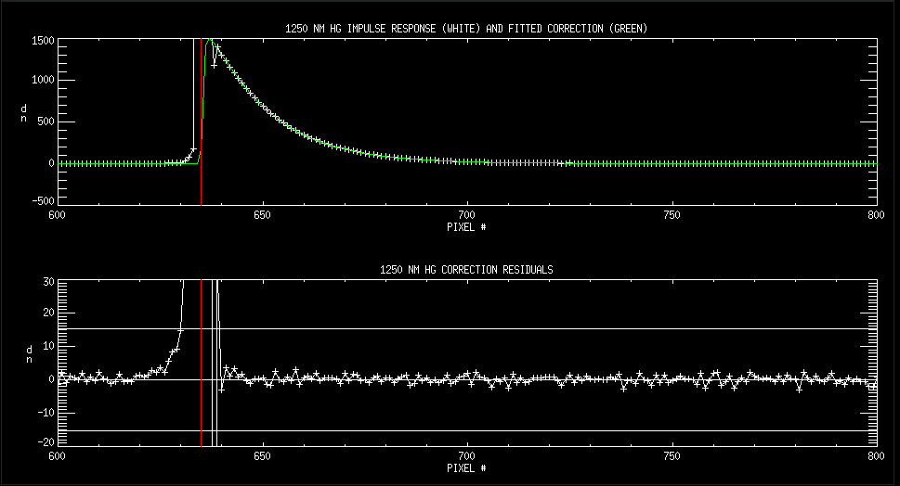
1250 NM HG

Slide 78
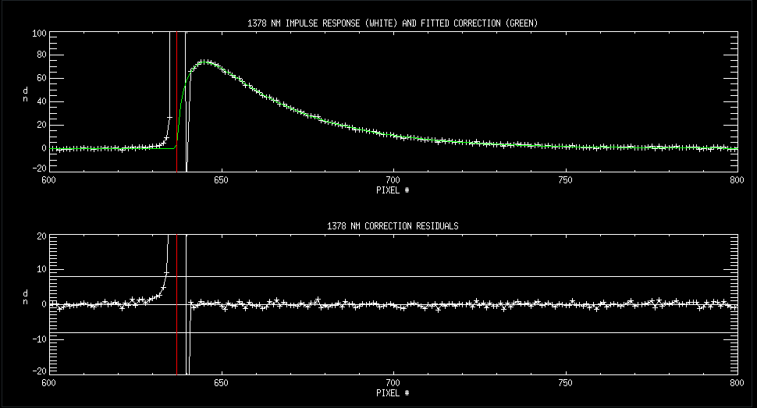
1378 NM

Slide 79
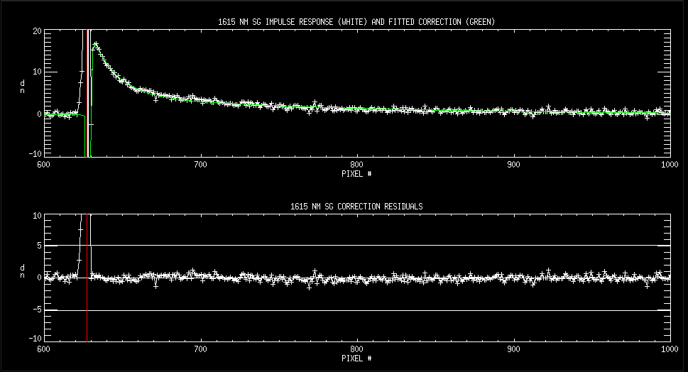
1615 NM SG

Slide 80
1615 NM HG

Slide 81
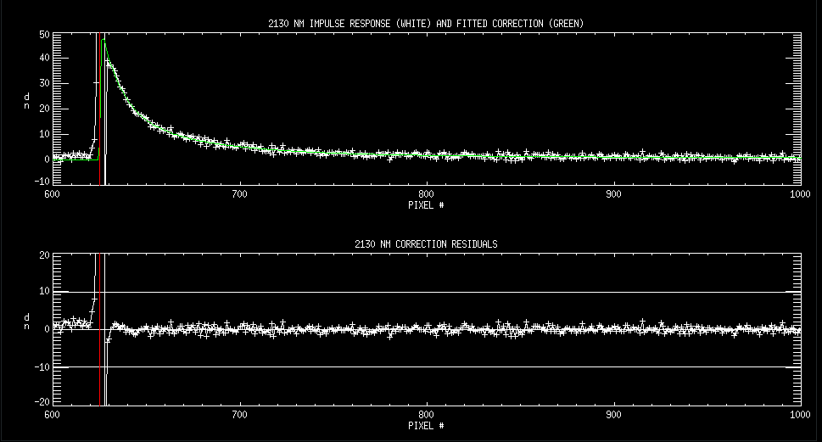
2130 NM

Slide 82
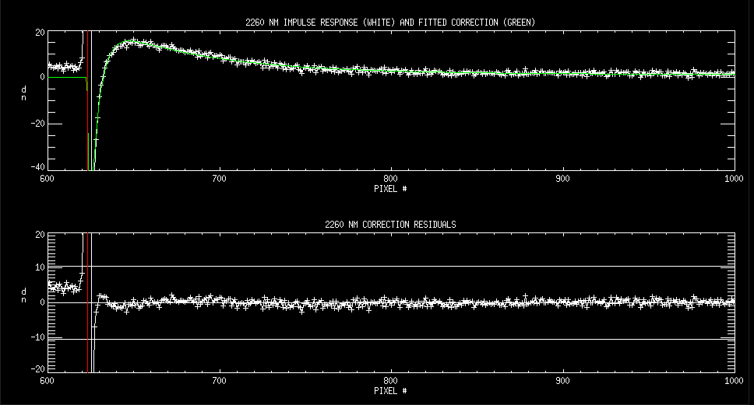
2260 NM

