Slide 1
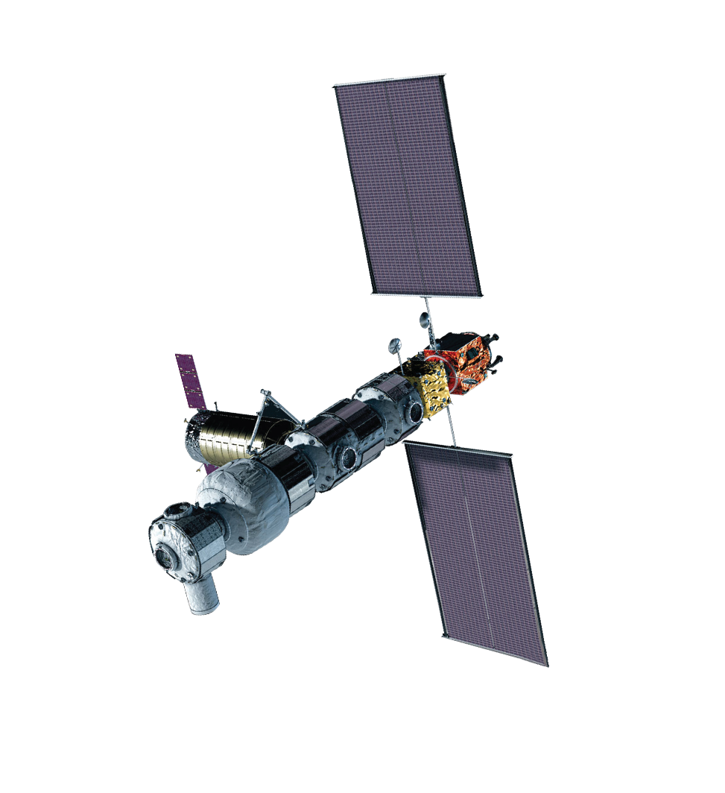
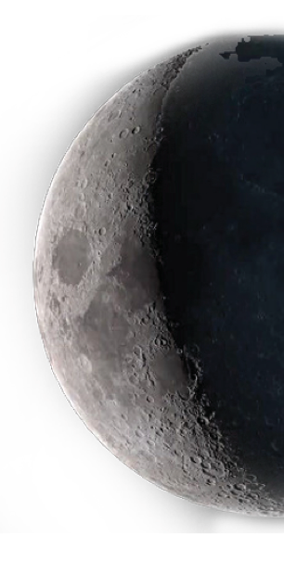

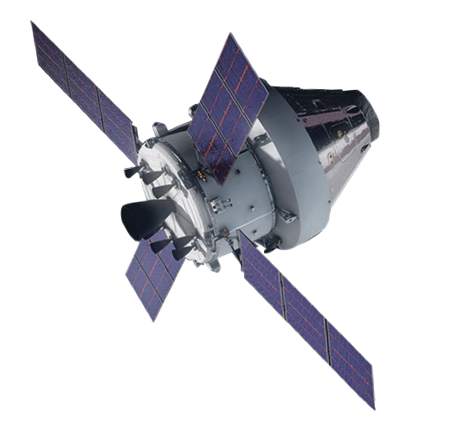
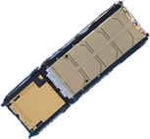
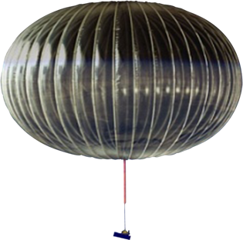
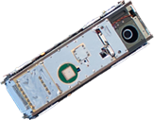
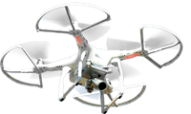
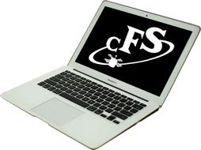
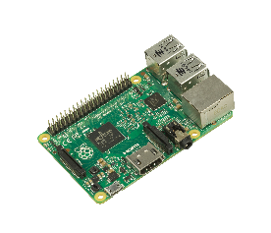
The Core Flight System (cFS)
NASA quality flight software to power science and exploration available to the world
Presenter:
Dan Knutsen NASA/GSFC
Acting cFS PDL
Notes:
Quick aside

Slide 2
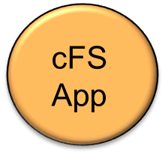
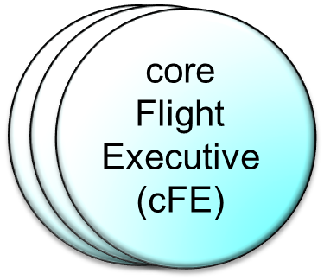
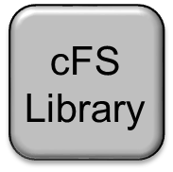
cFS Overview (1 of 2)
core Flight System (cFS)
  A Flight Software Architecture consisting of an OS Abstraction Layer (OSAL), Platform Support Package (PSP), cFE Core, cFS Libraries, and cFS Applications
core Flight Executive (cFE)
  A framework of mission independent, re-usable, core flight software services and operating environment
  Each element is a separate loadable file
core Flight System (cFS)
cFS
App

Slide 3
cFS Overview (2 of 2)
A platform and project independent reusable software framework and set of reusable software applications
  Abstraction supports portability
  Applications provide mission functionality
  Compile-time configuration parameters and run-time command/table parameters add flexibility and scalability
Key aspects:
  Dynamic run-time environment
  Layered architecture
  Component-based design
  Provides consistent Application Programmer Interfaces (API)

Slide 4
Goals/Objective
Provide a reusable framework that will allow projects to reduce schedule and cost to deploy high quality flight software.
  Enable collaboration across projects, centers, and agencies
  Facilitate formalized software reuse
  Simply sustaining engineering
  Streamline development and ground system tools

Slide 5
cFS Use at NASA Centers
ARC
  Bio Sentinel
  DSA
  LADEE
  Starling
  VIPER
GRC
  RFC
GSFC
  ATLAS
  autoNGC
  BITSE
  CCRS
  CeREs
  Dellingr
  GEDI
  GPM
  LRO
  MMS
  Navcube
  NICER
  OCI
  OPIS
  OSAM-1
  PACE
  RST
  STF-1
  STP-H9
  WFI
JSC
  AA-2
  ASPECT
  EM-1
  EM-2
  Gateway
  Kenobi
  Morpheus
  Seeker
  SPLICE
  xEMU
LARC
  ICAROUS
  LOFTID
  SWS
  UTM
GRC
  MAV
*Info based largely on email solicitation from Haven Carlson to cFS users via community mailing list

Slide 6
Recent Accomplishments
Released Draco Release Candidate-4 (rc4) in February of this year.
  With the Draco development cycle, we started to release each rc w/all the artifacts associated with a complete build - updated VDD(s), User’s Guide(s), Unit/Functional Test Result(s), Requirements Document(s), Build Verification Test (BVT) Result(s) and Design Documentation.
  Draco - Noteworthy updates (abbreviated list)
    Significant unit/functional/BVT test creation/updates
    Cleanup of hundreds of static analysis issues
    Reached 100% masked MCDC coverage on the 10 open-source GSFC apps
    Significant refactor of CFDP v3.0
    Significant refactor of Doxygen-generated User’s Guides
Submitted NTRs for Draco dev cycle, Scheduler (SCH), and File Commander (FCx)
  All are planned to be open sourced under an APACHE license.
Type | cfe | osal | psp | cf | cs | ds | fm | hk | hs | lc | md | mm | sc | Total
Issues | 85 | 55 | 18 | 162 | 18 | 32 | 28 | 7 | 25 | 19 | 17 | 18 | 22 | 506
PRs | 111 | 81 | 29 | 119 | 16 | 26 | 24 | 11 | 20 | 16 | 17 | 20 | 24 | 514
Bugs | 9 | 8 | 1 | 33 | 2 | 3 | 4 | 0 | 2 | 2 | 1 | 2 | 2 | 69
Draco Development Cycle Metrics

Slide 7
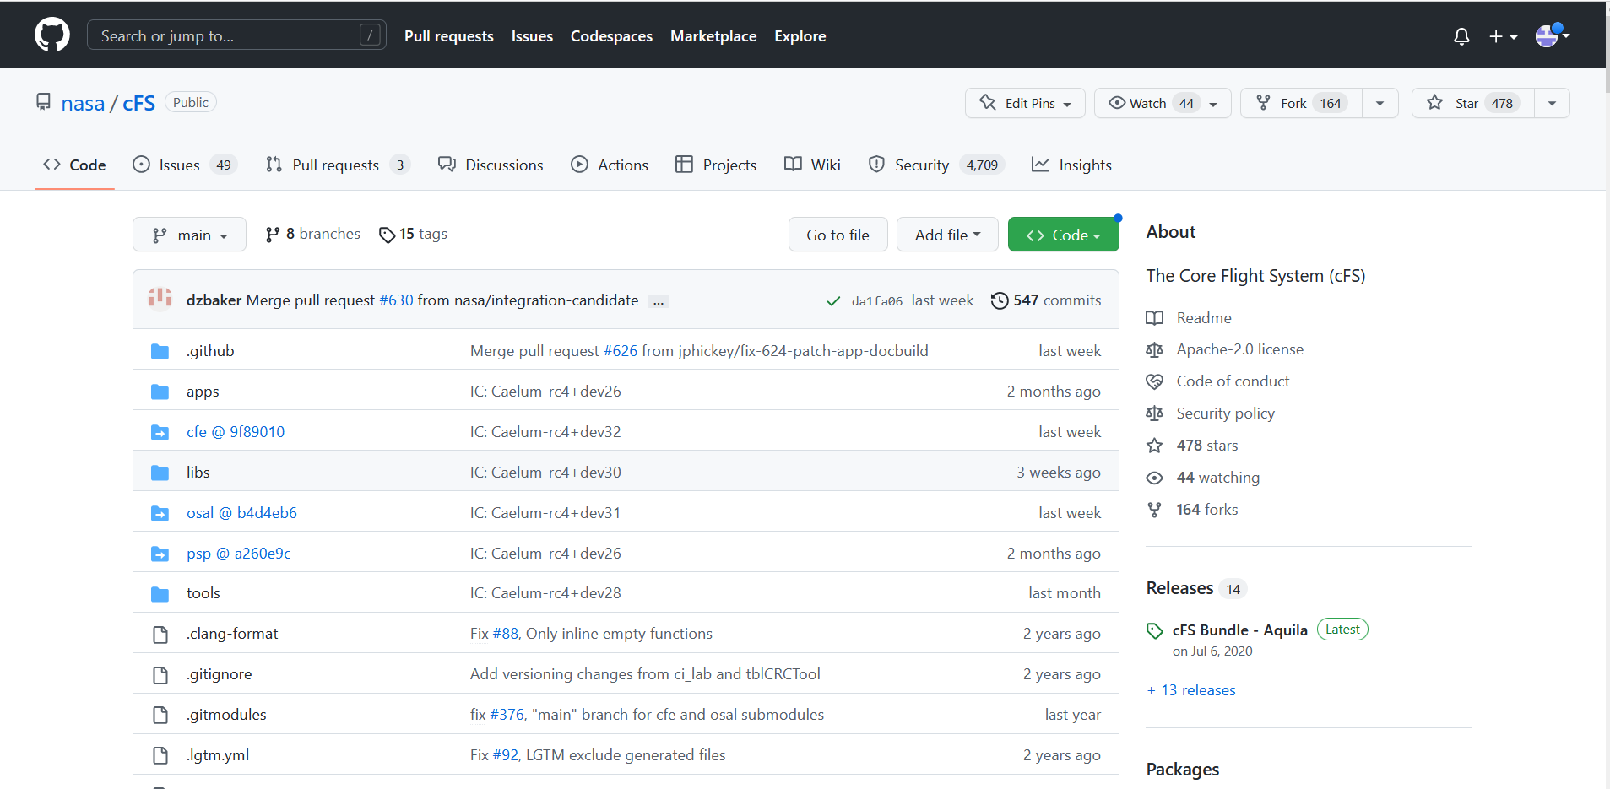
Main GitHub Repo
cFS Main Rep

Slide 8
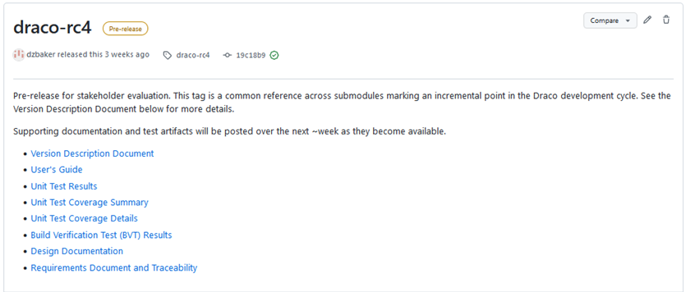
Current Build Release Artifacts
https://github.com/nasa/CF/releases/tag/draco-rc4
Provide the software itself, Version Description Documents (VDDs), user’s guides, unit, functional and build verification test results, design documentation, and requirements documents for cFE + the 10 open-source apps that we tag in a release

Slide 9
GSFC Open-Source Apps
Application | Function
Data Storage (DS) | Records housekeeping, engineering and science data onboard for downlink
File Manager (FM) | Interface to the ground for managing files
Housekeeping (HK) | Collects and re-packages telemetry from other applications.
Health and Safety (HS) | Ensures critical tasks check-in, services watchdog, detects CPU hogging, calculates CPU utilization
Memory Dwell (MD) | Allows ground to telemeter the contents of memory locations. Useful for debugging
Checksum (CS) | Performs data integrity checking of memory, tables and files
Limit Checker (LC) | Provides the capability to monitor values and take action when a given threshold is exceeded
Memory Manager (MM) | Provides the ability to load and dump memory
Stored Command (SC) | Onboard Commands Sequencer (absolute and relative)
CFDP (CF) | Transfers/receives file data to/from the ground

Slide 10
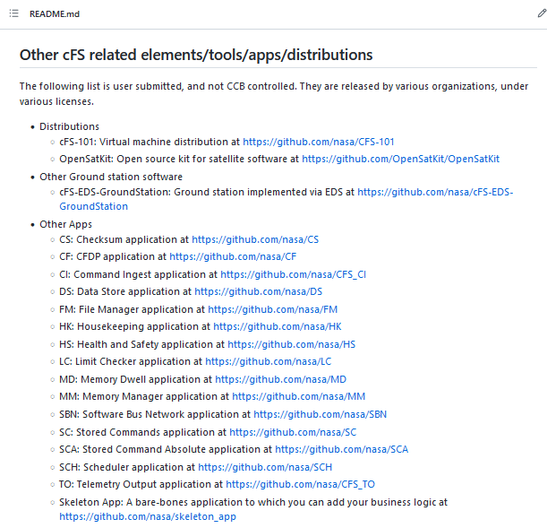
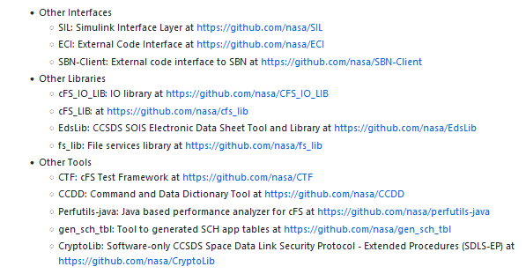
Additional Open-Source Tools/Resources

Slide 11
Focus of Today’s Discussion - EDS and CTF

Slide 12
Focus of Today’s Discussion - EDS and CTF
Going to build on two (EDS – Electronic Data Sheets and CTF – cFS Test Framework) topics/tools presented at previous workshops and discuss how we plan to use the tools to reduce the overhead of deploying cFS.
David McComas – EDS
  FSW 2022: core Flight System Application Tutorial
Jonathan Wilmot – CCSDS
  Integrating CCSDS Electronic Data Sheets into Flight Software
Merek Prochazka – EDS
  FSW 2021: Using EDS for Spacecraft Avionics
Aly Shehata – CTF
  FSW 2021: cFS Test Framework (CTF)

Slide 13
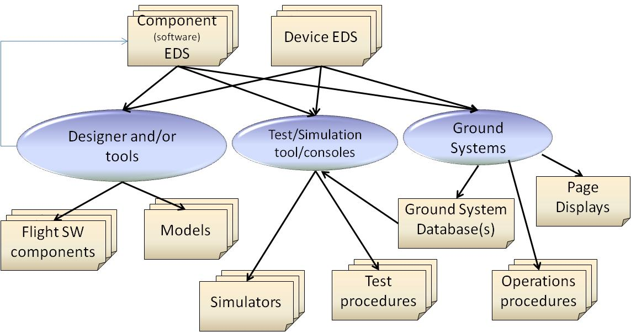
EDS Development and Operational Use Cases
Models
NASA, ESA and spacecraft suppliers have developed tools demonstrating each of these use cases
Models
Models

Slide 14
CCSDS Electronic Data Sheets (EDS) in cFS
EDS is used to define message exchange formats for all software components
  Data sheets may contain elements that are filled in by tools at system configuration/deployment time
  Each component is configuration managed with it’s corresponding data sheet(s) in the software product line library
EDS defines binary formats of messages “on the wire”:
  Defined as sequence of integers, strings, floats, etc. of varying sizes
  Defines symbolic names for enumerated integer values in messages
  Defines parameter limits/constraints, engineering unit conversions, and other data attributes
EDS can define interfaces at multiple communications stake layers
  Software application down to link layer
Both EDS and cFS are required in NASA’s International Deep Space Interoperability Standards being used for the Artemis Program https://www.internationaldeepspacestandards.com/

Slide 15
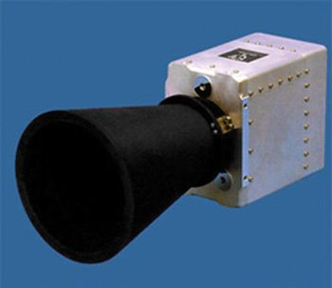
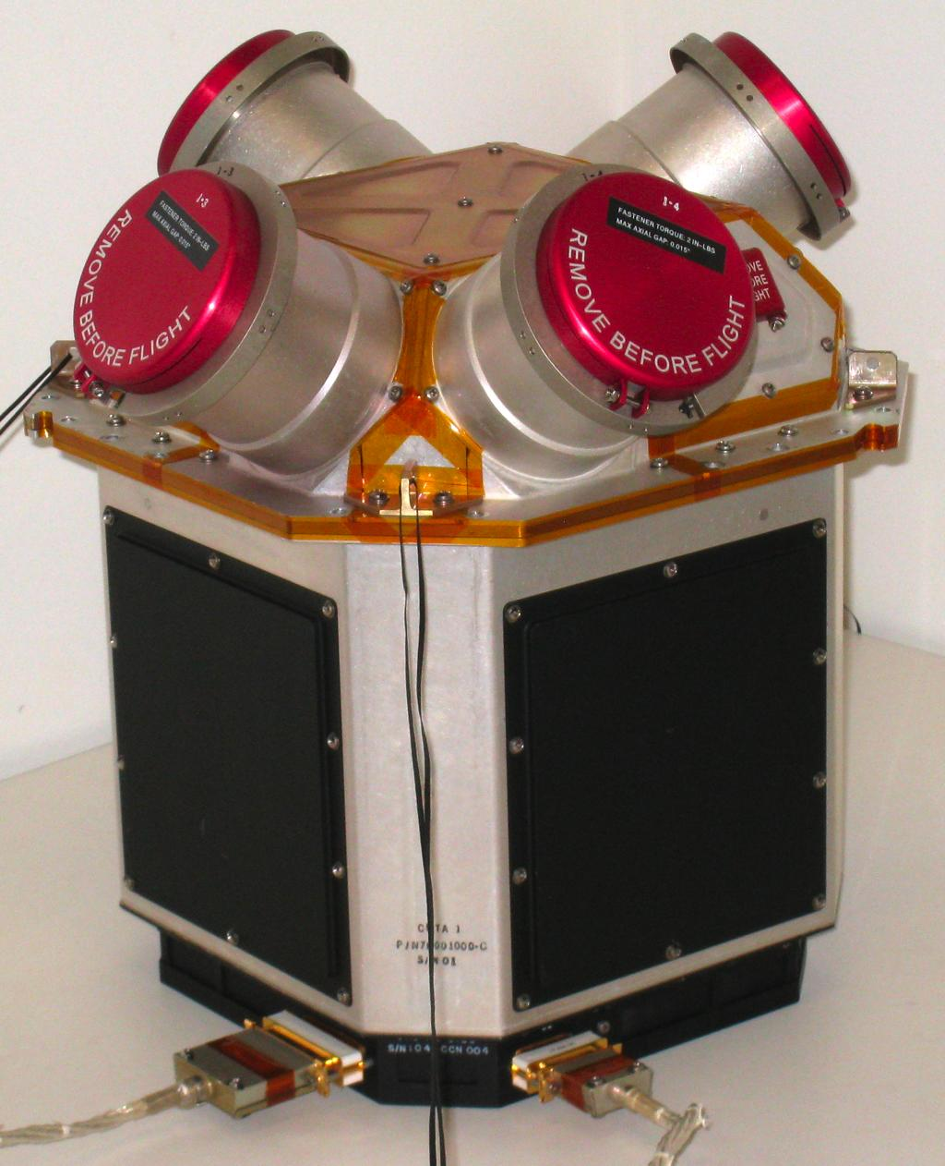
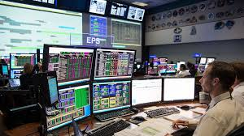
Device and Software Component SEDS
Software Component
Software Component
Software Component
Star trackers
Thrusters
Sun sensors
EDS
EDS
EDS
EDS
EDS
EDS
Software tools
A SOIS EDS is used to specify both hardware devices and software component interfaces

Slide 16
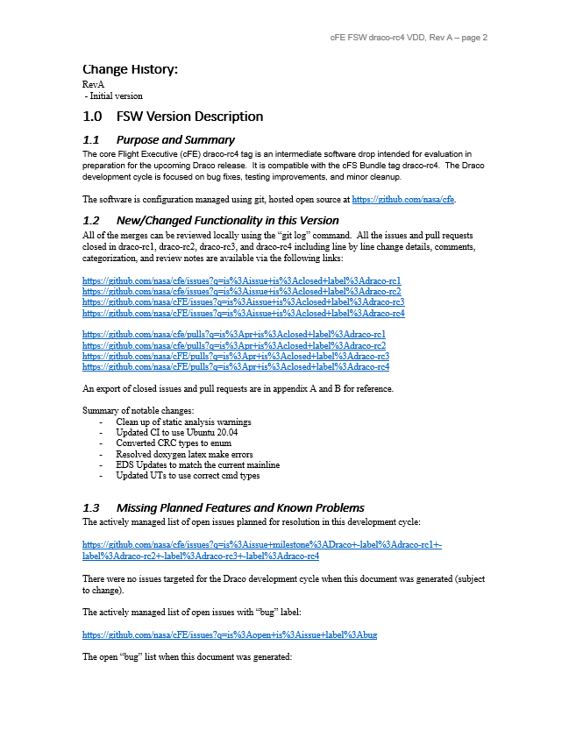
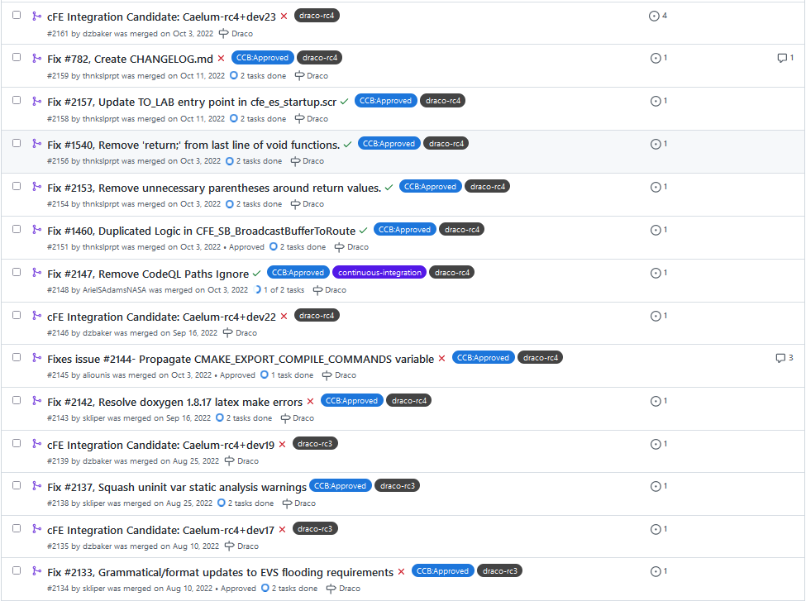
Inefficiency in our Current Process (1 of 2)
For each release - users use VDD and GitHub Issues/Pull Requests to identify changes needed to be made to a given projects database/ground tools.
cFE VDD
GitHub - cFE Closed Pull Requests

Slide 17
Inefficiency in our Current Process (2 of 2)
Often changes are missed during the evaluation process and ultimately result in test failures during FSW verification + Integration and Testing.
  Fixes are then required to update command and tlm database or ground system tooling.
  The later issues are identified, the longer it tends to take to turn around updates because of the natural increase in configuration management needed as a project gets closer to launch.
  This overhead exists for every project that uses cFS.

Slide 18
Plans for Equuleus
Plan to release formal command, telemetry, and load/dump file/table definitions using Electronic Data Sheets (EDS) for cFE + our 10 open-source apps.
  This will provide a single source of truth for projects using cFS and will minimize the overhead required to configure/maintain project databases and ground systems.
  We will also be providing a mechanism to convert from EDS files to the JSON format needed to functionally verify EDS definitions via the cFS Test Framework (CTF).
  Team will be open source releasing the CTF test scripts necessary for project independent verification.

Slide 19
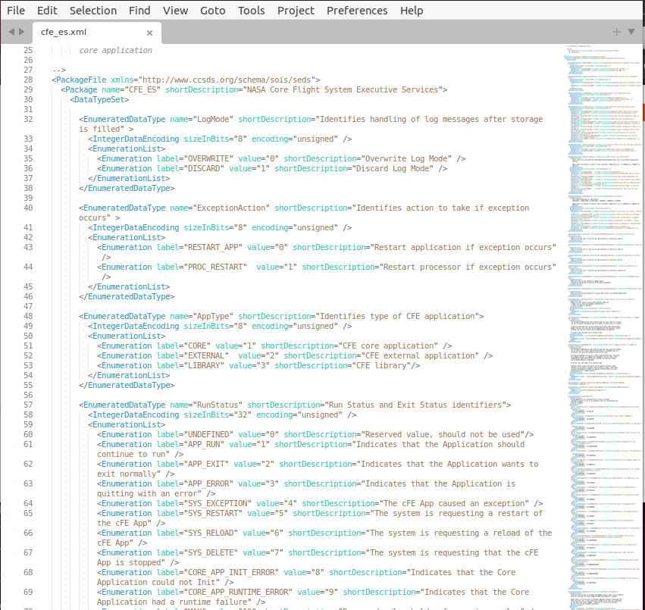
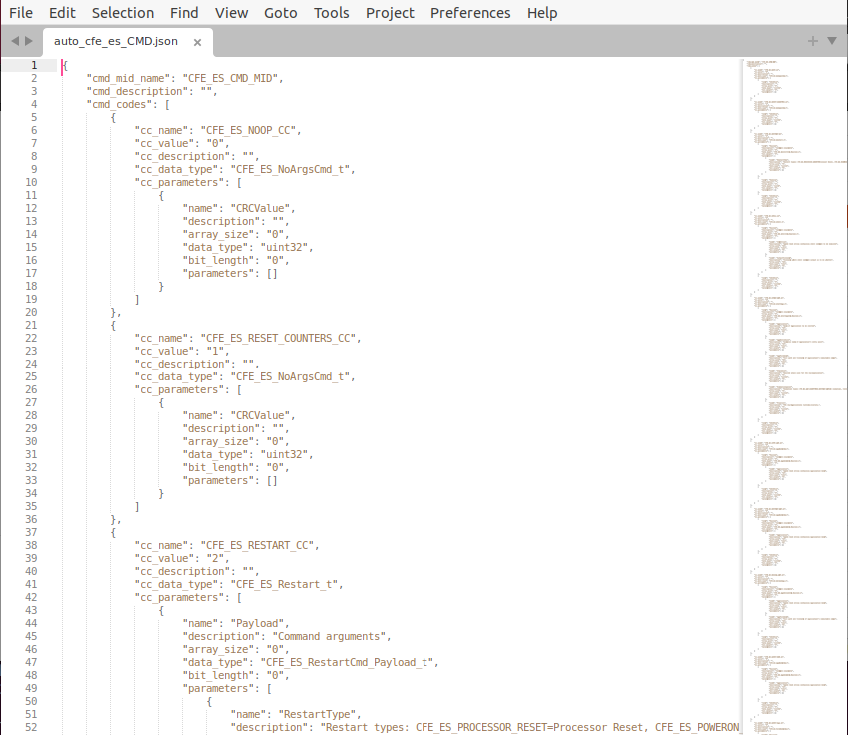
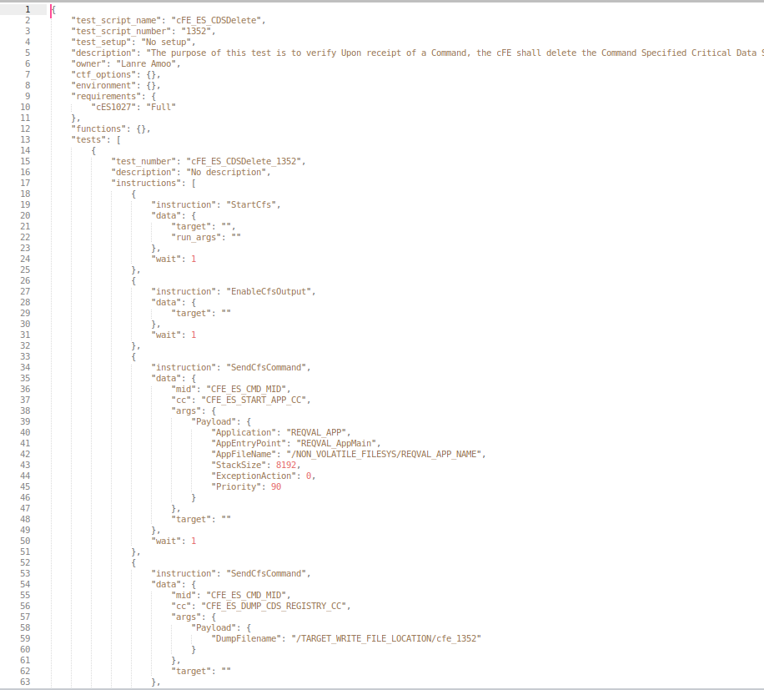
Plans for Equuleus – EDS Verification/Open-Source Release
Convert EDS to JSON
Electronic Data Sheet
JSON Cmd/Tlm Database
Rinse and Repeat -
Update EDS files until we get a clean run
Functionally Verify Database via CTF Testing
CTF Test Script
Verification of Electronic Data Sheets will be an iterative process

Slide 20
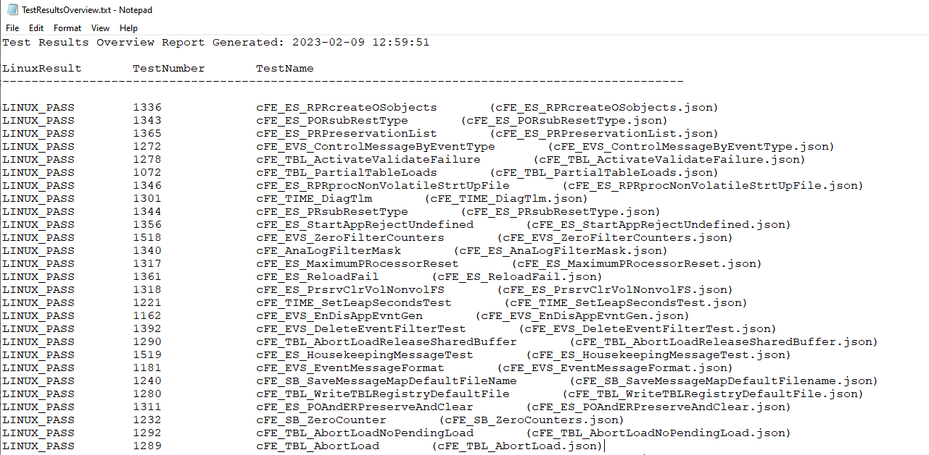
Plans for Equuleus – EDS Verification/Open-Source Release
Build Verification Test (BVT) artifacts were released as part of the package for Draco-rc4
using Gateway’s CCDD database + versions of CI, TO, and SCH. A challenge for Equuleus will be integrating the BVT testing using EDS generated database + CI_lab, TO_lab, and SCH_lab

Slide 21
Future Benefits of EDS
Once EDS definition files are defined/vetted, numerous future enhancements are possible.
  Lua scripting engine
  Python scripting engine
  JSON conversion
  CMD/TLM becomes architecture agnostic

Slide 22
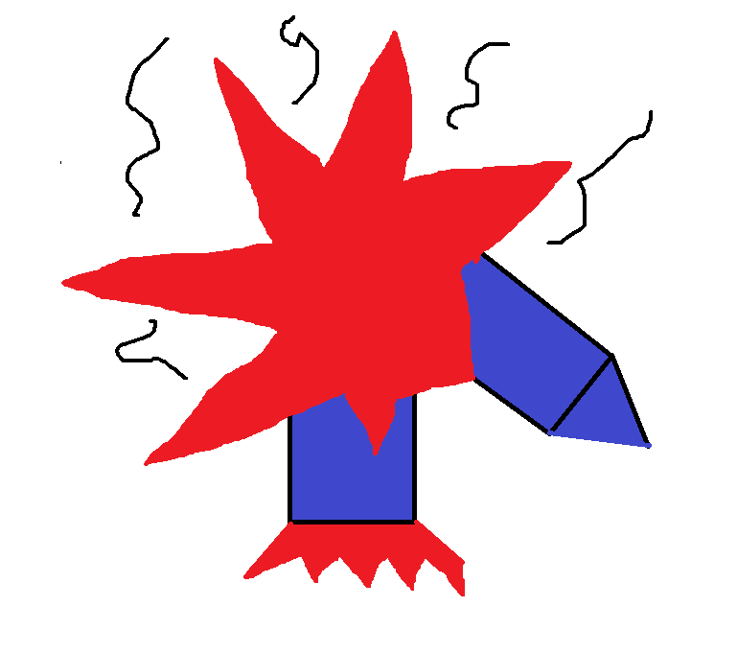
Questions?
Decided not to use cFS...
“Command data encoding mismatch”

Slide 23
Background Information

Slide 24
Acronyms
BSP | Board Support Package
BVT | Build Verification Test
CCDD | cFS Command and Data Dictionary
CFDP | CCSDS File Delivery Protocol
cFE | Core Flight Executive
cFS | Core Flight System
CI/CD | Continuous Integration/Continuous Development
CTF | cFS Test Framework
FCX | File Commander
FSW | Flight Software
HALO | The Habitation and Logistics Outpost
I-Hab | International Habitat
MCDC | Modified Condition/Decision Coverage
MMS | Magnetospheric Multiscale

Slide 25
Acronyms cont.
NICER | Neutron Star Interior Composition Explorer
NTR | New Technology Report
OCI | Ocean Color Instrument
OSAL | Operating System Abstraction Layer
OSAM-1 | On-orbit Servicing, Assembly, and Manufacturing 1
PACE | Plankton, Aerosol, Cloud, ocean Ecosystem
POSIX | Portable Operating System Interface
PPE | Power and Propulsion Element
PSP | Platform Support Package
RST | Roman Space Telescope
RTEMS | Real-Time Executive for Multiprocessor Systems
SCH | Scheduler
SPLICE | Safe and Precise Landing with Integrated Capabilities Evolution
TO | Telemetry Output
VIPER | Volatiles Investigating Polar Exploration Rover
WFI | Wide-Field Instrument

Slide 26
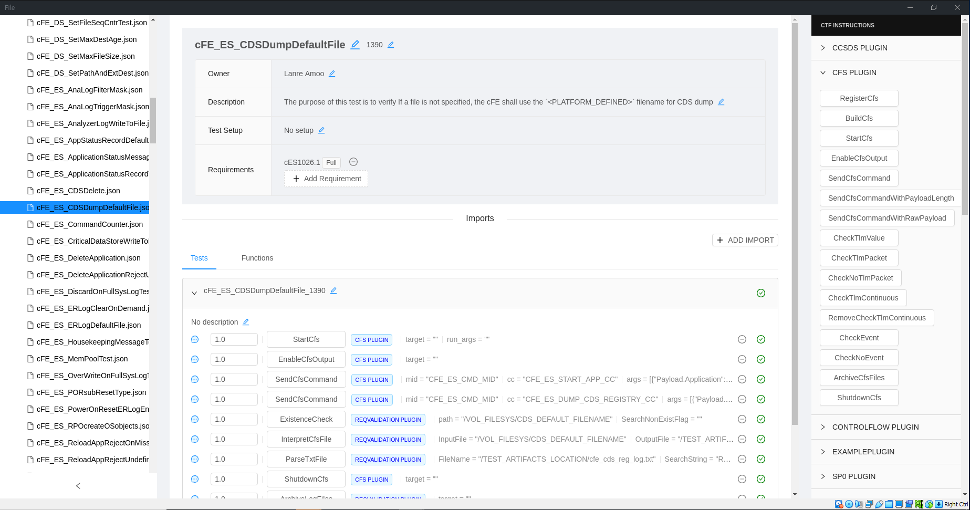
cFS Test Framework (CTF) GUI

Slide 27
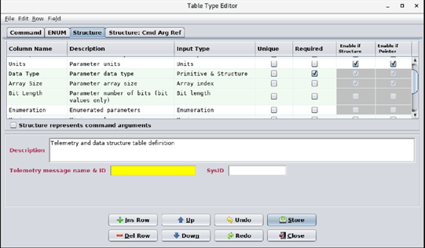
cFS Command and Data Dictionary (CCDD) GUI

