Slide 1
James Webb Space Telescope(JWST) EEE Parts Program Report
contained in this document is subject to export controls under the International Traffic in Arms Regulations (Title 22, CFR
Presented by Basil Jeffers
JWST Project Lead EEE Parts Engineer

Slide 2
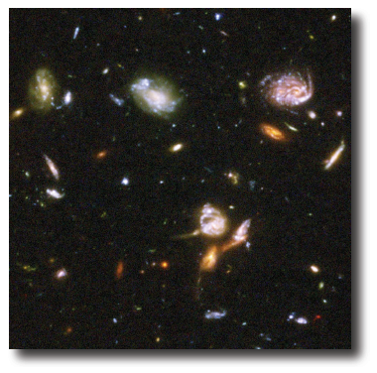
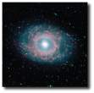
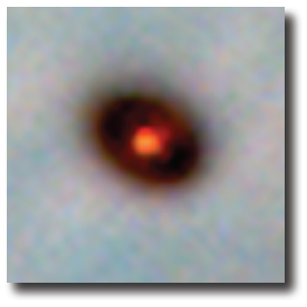
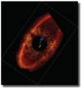
JWST Worldwide Team/Partners.
Organization
Mission Lead: Goddard Space Flight Center
International collaboration with ESA & CSA
Prime Contractor: Northrop Grumman Space Technology
Instruments:
Near Infrared Camera (NIRCam) – Univ. of Arizona
Near Infrared Spectrograph (NIRSpec) – ESA
Mid-Infrared Instrument (MIRI) – JPL/ESA
Fine Guidance Sensor (FGS) – CSA
Operations: Space Telescope Science Institute at John Hopkins U in Baltimore
Description
Deployable infrared telescope with 6.5 meter diameter segmented adjustable primary mirror
Cryogenic temperature telescope and instruments for infrared performance
Launched Dec 25, 2021 on an ESA-supplied Ariane 5 rocket to Sun-Earth L2
5-year science mission (10-year goal)
JWST Science Themes
End of the dark ages: First light and reionization
The assembly of galaxies
Birth of stars and proto-planetary systems
Planetary systems and the origin of life

Slide 3
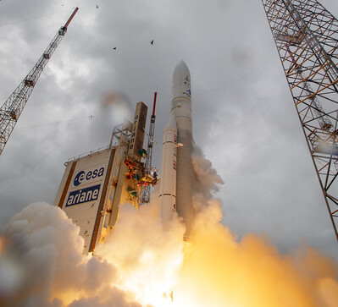
James Webb Space Telescope (JWST)
For JWST Information r
www.JWST.nasa.gov
https://blogs.nasa.gov/webb/
Launched Dec 25, 2021 on an ESA-supplied Ariane 5 rocket to Sun-Earth L2
JWST Status
On Jan 8, 2022 at 1:17 p.m. EST, NASA’s James Webb Space Telescope completed all of its large-scale deployments with the extension and latching of its starboard primary mirror wing.
Now that the telescope is structurally fully deployed – Webb was commissioned July 22, 2022.

Slide 4
JWST Status -10-24-2023
Webb Links : All information available to Public
https://blogs.nasa.gov/webb
https://webbtelescope.org/
Latest Observations – Globular Cluster M92 (NIRCam Detail)
JWST Team Phase E Team
Supporting the software systems located around world to ensure JHU Mission Operation Center and it Investigators can provide the images.
For ~ end of year the A Team of investigators will continue to showcase the capabilities of the Webb telescope.
JWST Webb is Showcasing it amazing capabilities
Notes:
.

Slide 5
JWST Programmatic Challenges
₁
:
The scope of EEE parts for JWST is > 6000 unique line items in over 60 Sub systems .
2) The program spans over 20 years. Issues of obsolescence and design changes were constantly mitigated. I have been a member of the team for ~ 12 years.
3) International Traffic and Arms Regulations (ITAR) and Export Administration Regulations (EAR) had to be managed with foreign partners, i.e. ESA and CSA, and their respective contractors and subcontractors.
4) The JWST NIRSpec instrument developed components for use at cryogenic temperatures, 38 K- 40K (-235°C to -233°C).
JWST encountered various unique challenges

Slide 6
JWST Programmatic Challenges-continued
5) EEE Parts problems averaged 1 every 6 weeks for ~ 13 years
6) Government Industry Data Exchange Reports (GIDEP) had to be assessed in a timely manner. They averaged ~10 per month for EEE Parts.
7) NASA GSFC EEE Parts Analysis Lab directly handled over 600 JWST parts jobs over the past decade including screening, qualification, Destructive Physical Analysis, and Failure Analysis.
8) Long Lead Devices, Material – Greater than 4 months availability was a significant challenge/problem.
JWST encountered numerous challenges

Slide 7
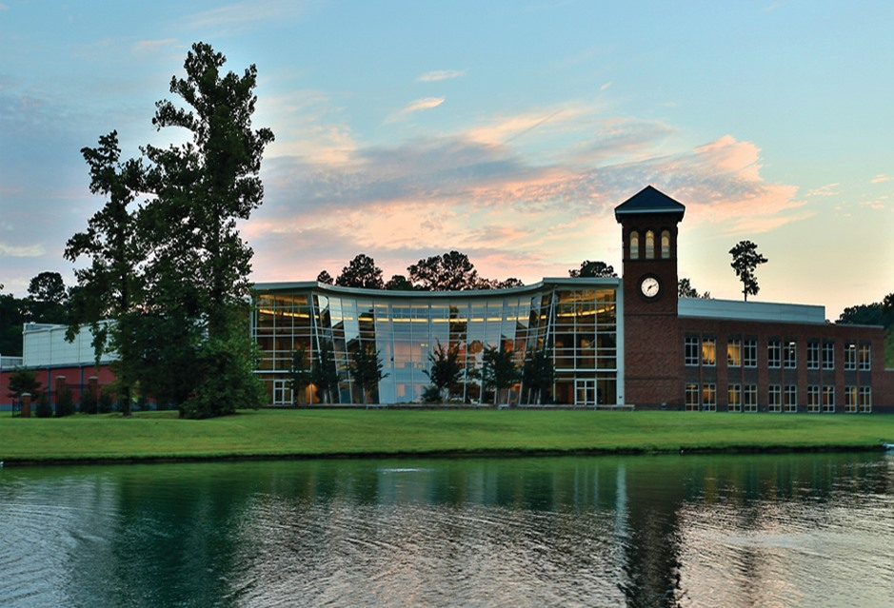
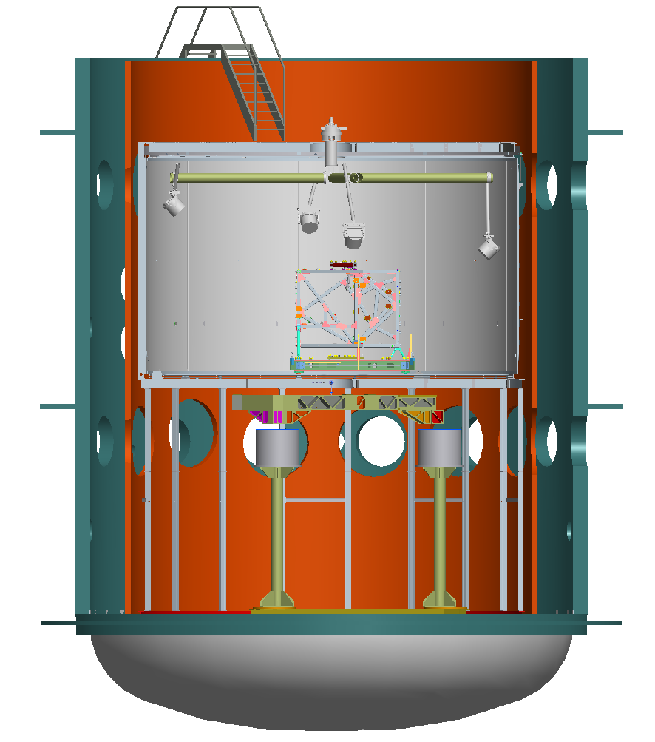
JWST Test Sites T
Chamber A and part of the JSC JWST team
Hampton University Proton Therapy Institute
ISIM Element Cryo-Vac testing at GSFC
JWST performed tests to mitigate potential risks.

Slide 8

JWST EEE Parts Problems Encountered
DC DC Converters – QCI Conformance
OP AMP – Radiation Risk
Detectors Anomaly
ASICs Long Lead & Firmware concerns
Magnetics
Harnesses Workmanship Anomalies
Resistor Fabrication Issues
Capacitors Fabrication Issues
Long Lead Devices and Material

Slide 9
JWST EEE Parts Problem - Magnetics
Problem: JWST encountered communication loss between a key assembly.
Root Cause : There was an opening in one of the primary windings of the a HV magnetic coil.
-it was diagnosed using IR camera, DPA, CT scans tools/process.
Resolution: It was resolved via extensive teamwork between, manufacturer, NASA and one of its partners.
Conclusion: It is extremely important to establish an excellent relationship with your team and partners.

Slide 10
JWST EEE Parts Problem- ISIM Harnesses
Problem: The harness performance was changed between ETU and flight and more noise was detected during verification testing.
Root Cause : A material and possible workmanship event impacted the cable’s performance.
Resolution: GSFC worked with harness manufacturer an critical material supplier to ensure system compliance.
Conclusion: The problem(s) were resolved by 1. Supplier integrity 2. Establishing a great rapport with harness supplier and material manufacturer.

Slide 11
JWST EEE Parts Problems - OP AMP – Radiation Risk
Problem: Due to microcircuit’s packaging material – it was potentially prone to radiation damage during the mission.
Root Cause : Due to the gold plated lids – a Single Event Effects there where proton nuclear interactions with gold plating on the part package caused high LET secondary particles that caused damage in the sensitive part.
Resolution: With great support by John’s Pandolf‘s Langley team – GSFC was able to use the Proton beam at Hampton U by Dr Ray Ladbury, GSFC.
Conclusion: The post testing proved that the device can function during potential Proton radiation. Risk low.

Slide 12
JWST EEE Parts Problem - Long Lead EEE Devices and Material
Problem: Due to demanding schedule and potential costs impacts associated with delays – EEE parts availability delays posed a serious problem .
Key problem: Hardware failures may require rebuilds and consequently schedule delays .
Resolution: JWST initiated the ISIM EEE Spares Implementation program – Critical Long Lead EEE parts and material were procured kitted and/or stored if needed.
Conclusion: The program allowed JWST ISIM to be integrated and released with no significant schedule delays.

Slide 13
JWST ISIM EEE Parts Spares Implementation Program
Key program guideline was to order adequate Spares for Critical assemblies and Harnesses.
Implemented the Radio Frequency Identification ( RFID) technology to track hardware & Material
Provided schedule Integrity – addressing Long Lead EEE devices and material .
Enabled JWST project to be a good steward of NASA’s assets
Due to the size and scale of the project, it is necessary to track the location and status of every critical component.
JWST Long Lead Items was a significant Issue - possible show stopper!

Slide 14
JWST ISIM EEE Parts Spares Implementation Program-Contd
JWST is a NASA Flagship Program
JWST Spares program was implemented to target EEE Parts assemblies removal & builds to ~ 4 months - ~ 50% schedule reductions.
To be a good steward of NASA’s assets
Due to the size and scale of the project, it is necessary to track the location and status of every critical component.
JWST Long Lead Items -- potential show stopper – The ISIM Spares program – mitigated the risk!

Slide 15
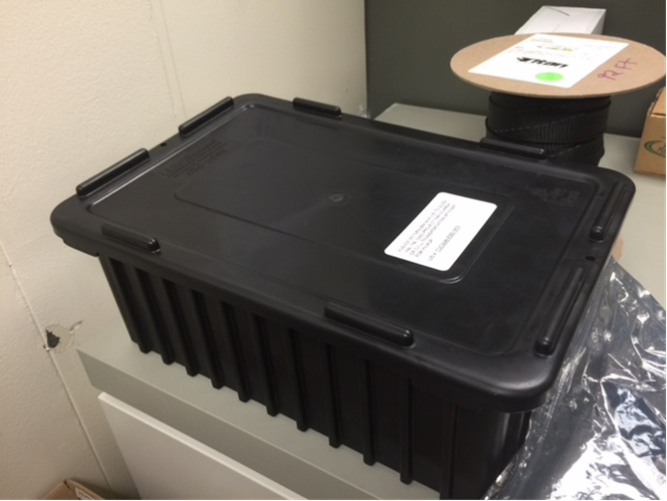
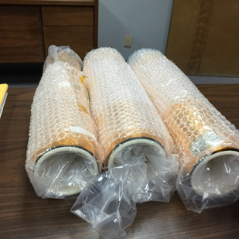
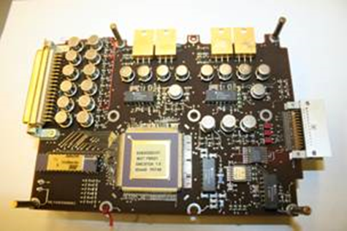
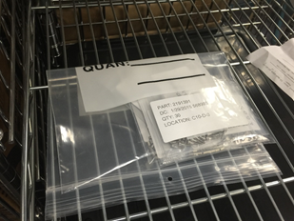
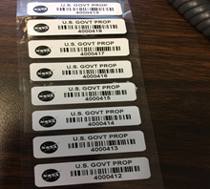
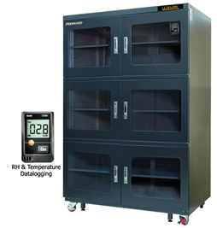
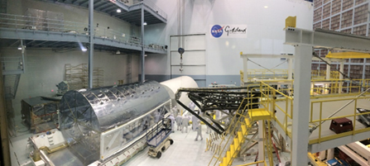
JWST Spares Stored Items & Storage Locations
ESD Bins storage of EEE Kits
Gold Shield for Harnesses
Critical Assemblies &/or kits
Radio Freq ID Tags
Long Lead fasteners
EEE Parts Kits are stored in Cleanrooms at NASA, NGAS, & Vendor in California .
Dry box in NASA Lab
JWST ISIM Spares Implementation Plan received RFID Awards and presented at RFID and Artificial Intelligence Technology Conferences in Phoenix, AZ & Orlando, FL & London, England, respectively.

Slide 16
Common Resolution Trends
Impacted team member’s timely identification of an anomaly.
Established relationship with suppliers and troubleshooters.
Integrity shown during problem analysis.
Trust and respect manifested during analysis and subsequent resolution
The Spares Program was a great plan.
Team work was critical during problem resolution

Slide 17
Summary
Problems do not go away overnight. Some problems took 1-3 weeks to resolve while other problems took 2-3 months or longer.
Team work and establishing relationships was critical to success of the JWST EEE Parts Program
James Webb Space Telescope is a complex system. There were many EEE Parts challenges – even during the week of the launch.
EEE Parts Engineers worked with the vast and dedicated JWST team to mitigate technical and non-technical issues- it was a TEAM Effort!!
JWST EEE Parts Engineering Program – Establishing Relationships was Our Most Important Part!

Slide 18
Acknowledgements
We would like to acknowledge the many persons and or groups supporting the JWST EEE Parts Engineering Team, Bill Ochs, Alix Duvalsaint, Mary Morrow, Adam Smith, Andrew Mamangakis, Alison Nordt, Beverly Settles, Bob Woodward, Bruce Meinhold, Carletta Carter, Chris Dailey, Chris Greenwell, Chris Green, Chris Tiu, Chuck Magurany, Chuck Powers, Code 562 Parts Analysis Lab, Cristina Doria-Warner, Deane Carlers, Debbie Jeffers, Denise Ratcliff, Donna Wilson, Doug Warren, Ed Rutkowski, Eileen Mitchell, Gregory Griffin, Dr. Henning Leidecker, Jamie Dunn, Jay Brusse, Joanna Rojsirivit, Joe Radich, Joe Rosol, John Durning, Ken Label, Keyvan Mortazavi, Kimberly Kirschke, Dr. Kusum Sahu, Kyle Holt,Lakita Sanders, John Abraham, Lou Fetter, Lyudmyla Ochs, Julie Van Campen, Marcia Stanley, Mark Voyton, Massimo Falcolini, Dr. Matt Greenhouse Maurice Coates, Michelle Scott, Mike Sampson , Noosha Nowrouzi, Nathaniel Forgotson, Nathan Smith, Paul Geitner, Lynn Chandler, Karen Smith, Edward (Ted) Wilcox, Dr. Ray Ladbury, Richard Hunter, Rich Williams, Rick Schnurr, Rob Hodge, Rudy Ivancic, Scott Lambros,John McCloskey, Jason Rooney, Imran Khan, Shri Agarwal, Shahana Pagen, Dr. Shaune Allen, Shirley Paul, Silvia Massetti, Sandy Sumner, Stephanie Watts, Suong Le, Steve Kim, Tina Schappell, TRAX Procurement, Will Thangawng.
We would especially like to acknowledge our team members who are no longer with us; Terry King, Thomas Duffy, Donnel Curtis GSFC, Wally Foster -UTC, Mark Cooper- JPL.

Slide 19
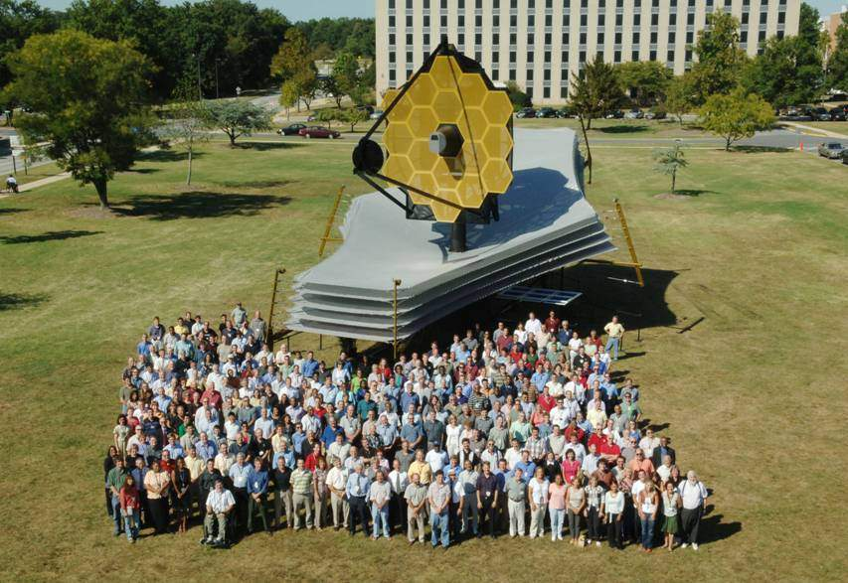
JWST Team – Remember the Faces

Slide 20
Reference
[1] Muzar Jah, Basil Jeffers
Challenges with Electrical, Electronic, and Electromechanical Parts for
James Webb Space Telescope August 24, 2016

