Slide 1


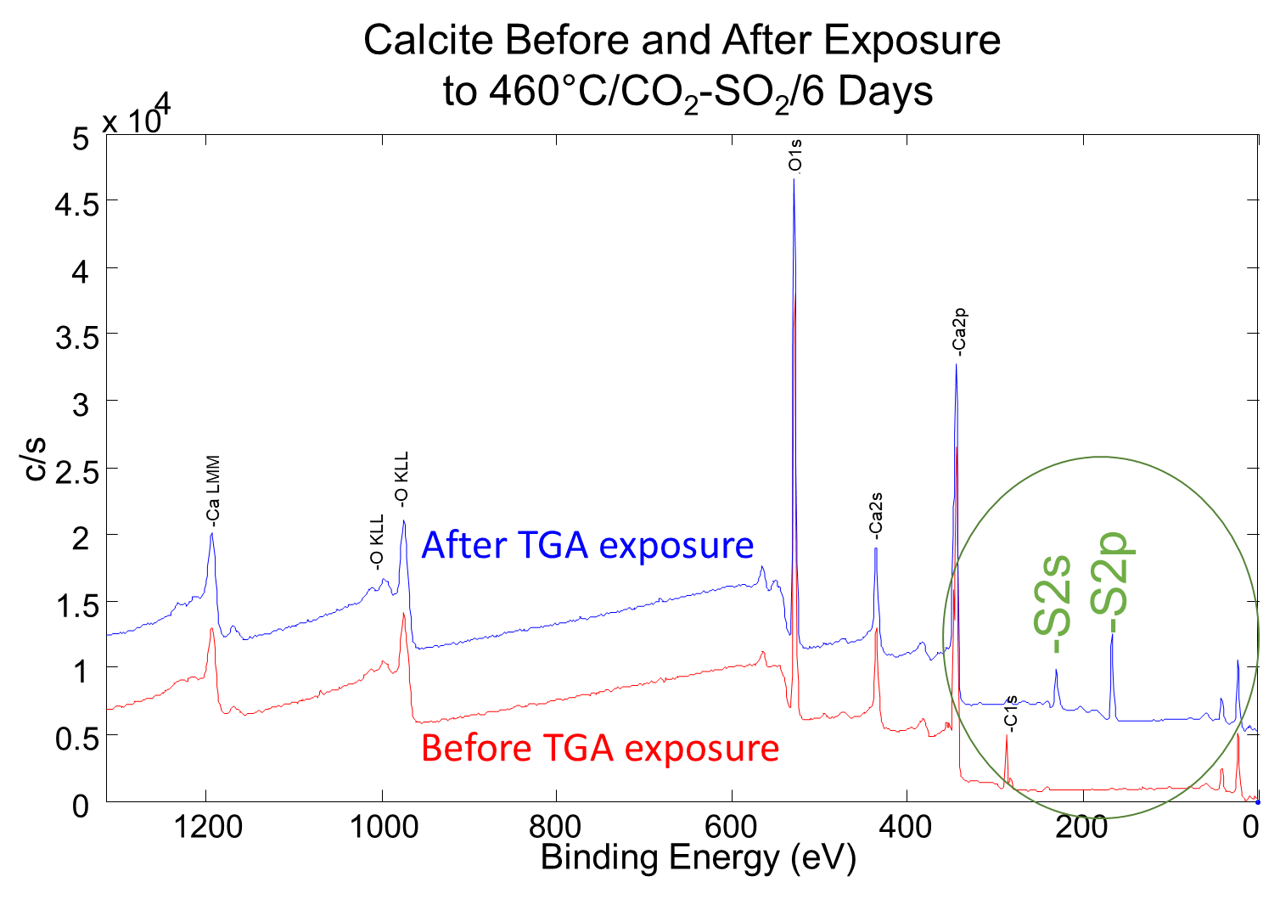
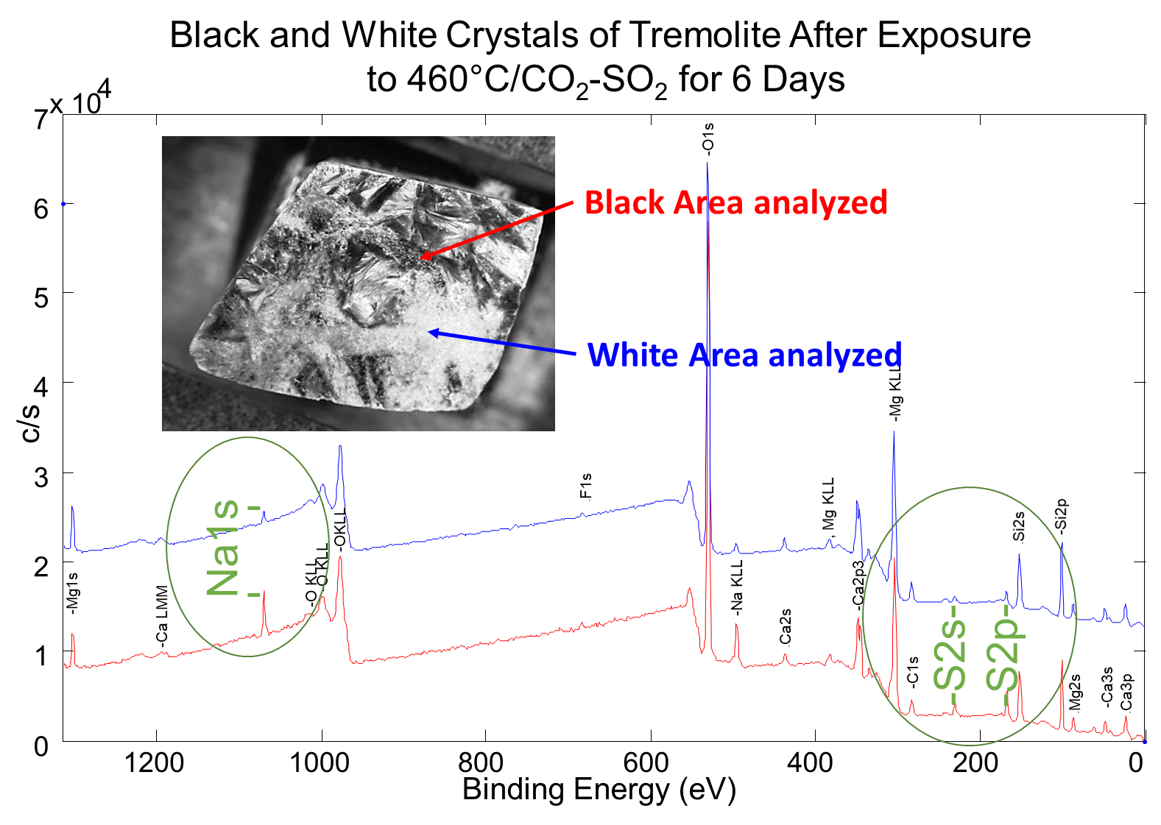
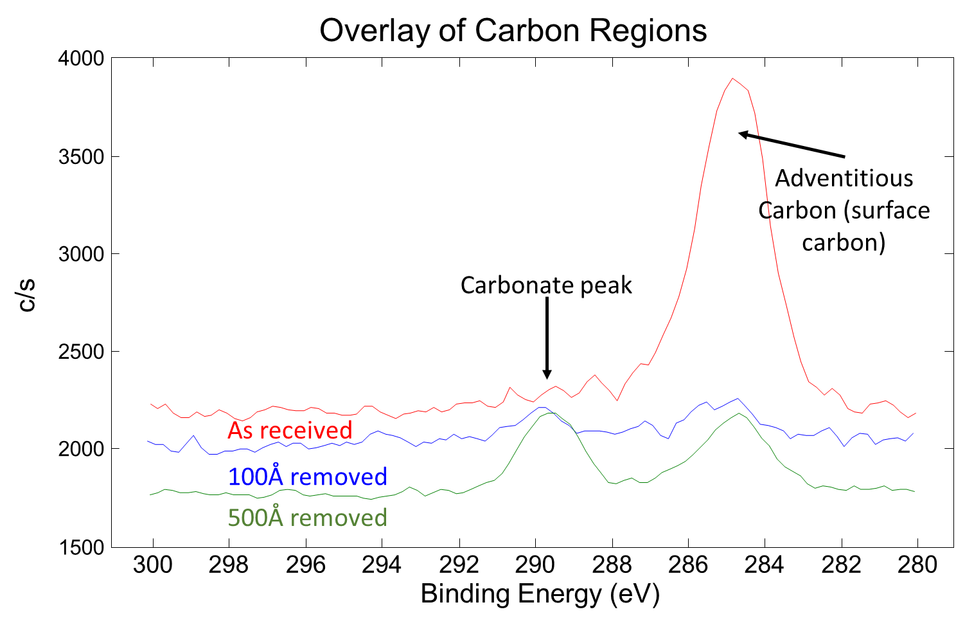
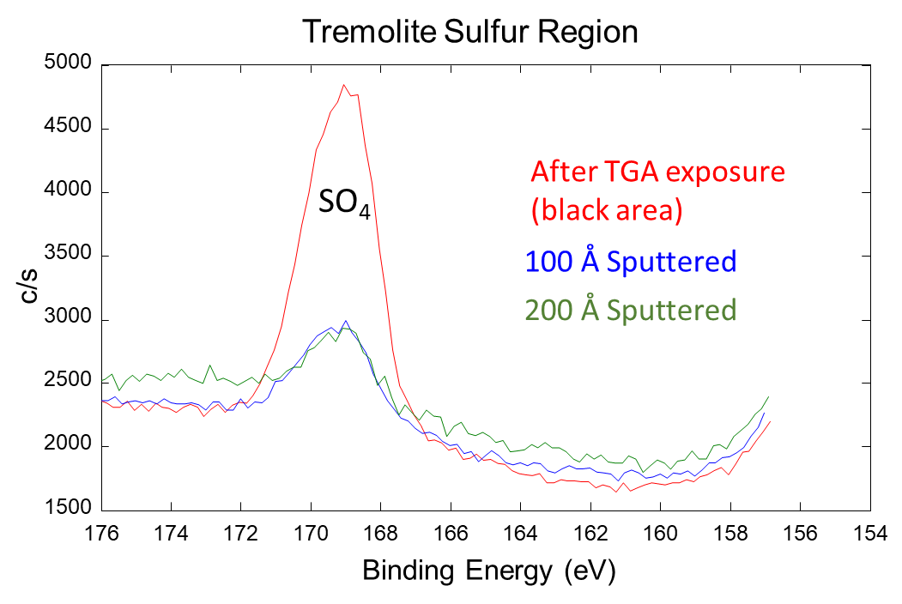
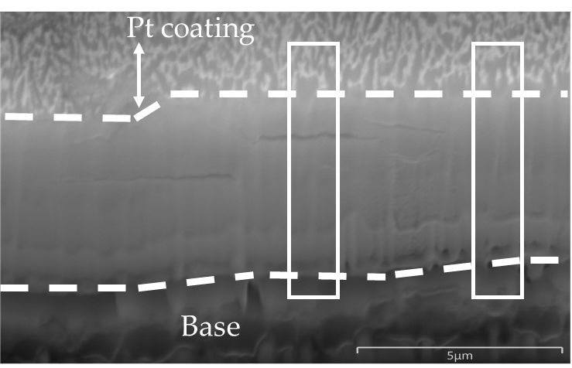
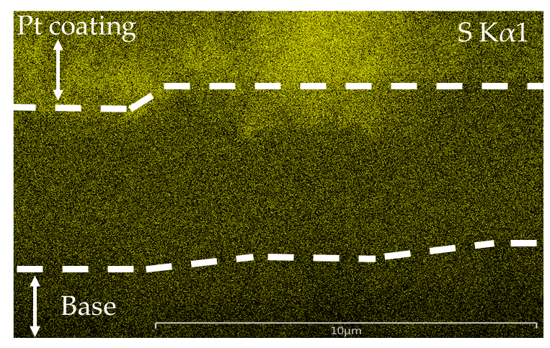
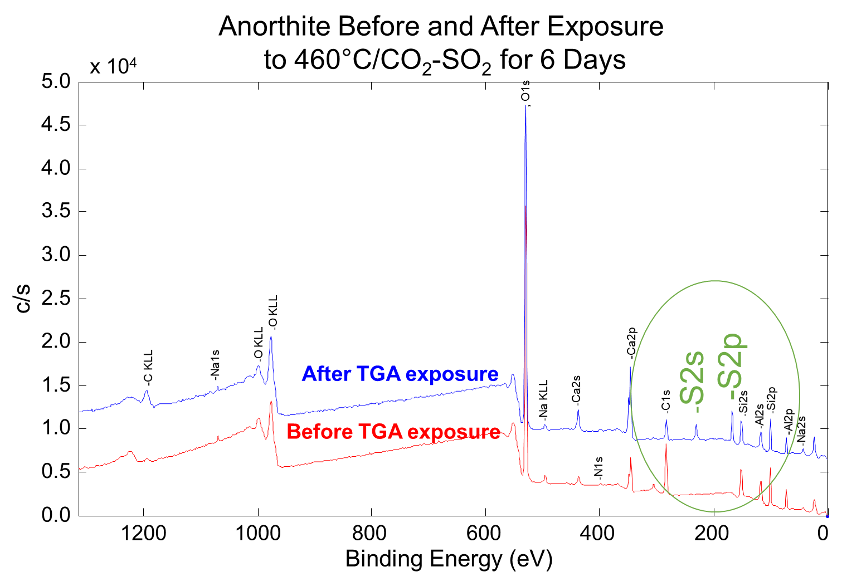
EXPERIMENTAL INVESTIGATION OF THE REACTIVITY OF CALCIUM-BEARING MINERALS WITH SO2 UNDER SIMULATED VENUS CONDITIONS
S. T. Port¹, A. R. Santos², D. Lukco³, T. Kremic⁴, G. W. Hunter⁴
¹Oak Ridge Associated Universities, ²Department of Earth and Environmental Sciences, Wesleyan University, Middletown, CT 06459, ³HX5, LLC, ⁴NASA Glenn Research Center, 21000 Brookpark Road, Cleveland, OH 44135
Introduction
The objective of this project is to investigate the reactivity of calcium-bearing minerals with SO₂ in simulated Venus conditions. Due to calcium’s known reactivity with SO₂ [1-3], the project will focus on isolating the reaction rates between calcium minerals that were formed under different geologic processes, and thus have different crystal structures and bonding strengths, with the SO₂ abundance on Venus. The results have important implications for understanding the past and current state of Venus such as determining if minerals formed under water-rich conditions in the past could be present today [4-5]. Furthermore, the thickness of secondary minerals on the surface of our samples may assist in interpreting surface emissivity data that will be collected by EnVision and VERITAS [6-7].
Methods
Experiment
  Sample is hung in the center of ceramic tube in TGA
  (Thermogravimetric Analyzer)
  Tested Temperatures:
    460°C: average lowland temperature on Venus
    700°C: to decrease experiment time
  Tested Gas:
    CO₂/1.5% SO₂: SO₂ abundance similar to molecular
    number density as on Venus
    99.99% CO₂
  Temperature and mass of sample are collected in real-time
Analysis
  Mineralogy confirmed with X-Ray Diffraction (XRD)
  Surface chemistry analyzed with X-ray Photoelectron Spectroscopy (XPS)
  Milled using a Focused Ion Beam (FIB)
  Surface chemistry analysis and visual confirmation of any physical changes completed with Scanning Electron Microscope/Energy Dispersive X-Ray Spectroscopy (SEM/EDS)
Calcite after 460°C, CO₂-1.5% SO₂ for 6 days
Tremolite and anorthite after 460°C, CO₂-1.5% SO₂ for 6 days
Figure 1: XPS spectra showing sulfate [(SO₄)²⁻] present on the surface of the calcite sample after the experiment
Figure 5: XPS spectra of a light colored and dark colored patch on tremolite. The dark patch had elevated abundances of sodium and sulfur
Figure 2: XPS spectra showing carbonate [(CO₃)²⁻ ]is not present at the surface of calcite after the experiment, but reemerges after the removal of 0>x≥100Å
Figure 6: Sulfate is present on the surface of the tremolite sample and decreases with depth
1
2
Results
1
2
1
2
3
Mineral | Chemistry | Temp | Gas | Time
Calcite | CaCO₃ | 460°C | CO₂/SO₂ | 6 days
Calcite | CaCO₃ | 700°C | CO₂ | 5 days
Calcite | CaCO₃ | 700°C | CO₂/SO₂ | 5 days
Wollastonite | CaSiO₃ | 460°C | CO₂/SO₂ | 6 days
Anorthite | CaAl₂Si₂O₈ | 460°C | CO₂/SO₂ | 6 days
Tremolite | Ca₂Mg₅Si₈O₂₂(OH)₂ | 460°C | CO₂/SO₂ | 6 days
Figure 7: XPS spectra showing sulfate present on the surface of anorthite after the experiment
Figure 3: SEM (left) and EDS (right) image of the cross section into calcite after the experiment. Sulfur is not uniformly present across the top of the cross section
Table 1: Summary of all experiments completed at this time
Conclusions
All samples formed sulfate on the surface
According to XPS results, wollastonite, anorthite, and tremolite are less reactive to SO₂ than calcite (460°C in CO₂ -1.5% SO₂ for 6 days)
The abrupt decrease in sulfur with depth in anorthite suggests a very surficial reaction and could be due to its crystal structure
Longer experiments will be completed in the future
This information combined with the dimensions of the sample and the known change in mass will be used to constrain the reaction rate
Mineral | Location | S/Ca ratio | S (at %)
Calcite | Surface | 1.08 | 15.7
 | Sputtered 1 min (100Å) | 0.75 | 13.7
 | Sputtered 5 min (500Å) | 0.51 | 10.7
Wollastonite | Surface | 0.69 | 6
 | Sputtered 1 min (100Å) | 0.21 | 2.3
 | Sputtered 2 min (200 Å) | 0.11 | 1.3
Anorthite | Surface | 0.84 | 5.9
 | Sputtered 1 min (100Å) | 0.03 | 0.2
Tremolite | Surface (dark grey) | 1.13 | 4.3
 | Sputtered 1 min (100Å) (dark grey) | 0.27 | 1.2
 | Sputtered 2 min (200 Å) (dark grey) | 0.23 | 0.9
 | Surface (white) | 0.70 | 3.1
Distance (µm)
Figure 4: Uncalibrated EDS line scans of the cross section into calcite after the experiment. More counts of sulfur are present at the top of the cross section
References
[1] Fegley, B. and Prinn, R. G. (1989) Nature, 337, 6202, 55-58 [2] Radoman-Shaw B. G. (2019) Exposure of Basaltic Materials to Venus Surface Conditions using the Glenn Extreme Environment Rig (GEER). Case Western Reserve University. [3] Santos, A. R. et al., (2023), JGR: Planets, Meteorit. Planet Sci., 57, 10 [4] Johnson N. M. and Fegley B. (2003) Icarus, 164, 317-333. [5] Fegley Jr., B., Treiman, A. H. (1992) Venus and Mars: Atmosphere, Ionospheres, and Solar Wind Interactions, Geophysical Monograph, 66, 7-72. [6] Dyar, M. D., et al. (2021) Icarus, 358, 114139. [7] Helbert, J. et al. (2021) Science Advances, 7, 3.
Acknowledgements
The PI was supported by an appointment to the NASA Postdoctoral Program at the NASA GRC, administered by ORAU under contract with NASA. The authors would like to acknowledge Nathan S. Jacobson (NASA Glenn), John Setlock (Univ. of Toledo/NASA Glenn), and Peter Bonacuse (NASA Glenn) for their assistance in the lab.
Table 2: XPS analysis of samples that were exposed to 460°C in CO₂-1.5% SO₂
for 6 days. Some samples, such as anorthite, had very little sulfur after sputtering indicating little reactivity.

