Slide 1
Evaluation of Ultrasonic Battery Inspection Techniques
Matt Webster¹, Erik Frankforter¹, Peter Juarez¹, and Andrew Campbell²
¹NASA Langley Research Center, Hampton, VA
²University of South Carolina, Columbia, SC
SPIE Smart Structures + NDE
March 13, 2023

Slide 2
Motivation
Higher energy density batteries are needed to meet aerospace demands
Many high energy density configurations use lithium (Li) metal anodes
Non-uniform Li anode plating can lead to dendrite growth, short circuit, and thermal runaway
Research Goal: Identify local changes in structure that could lead to thermal runaway through nondestructive evaluation (NDE)
Illustration of lithium dendrite growth leading to internal short circuit
Increasing Charge Cycles

Slide 3
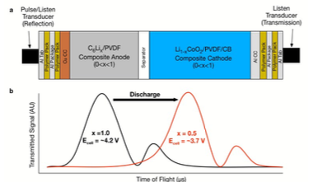
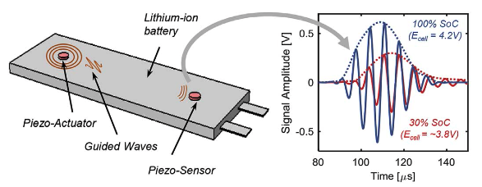
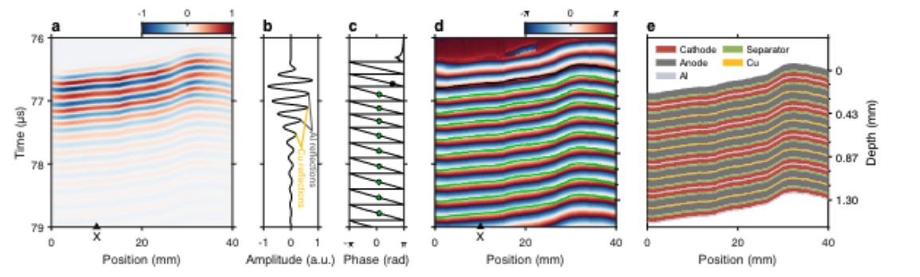
Prior Work on Ultrasonic Testing (UT) of Batteries
Hsieh¹ used elastic property changes due to ion transport to assess state of charge (SOC) and state of health (SOH)
Ladpli² applied guided wave UT using external piezoelectric sensors to detect SOC and SOH
Huang³ applied time domain and resonance analysis to track changes in structure as a function of SOC and SOH
¹A. G. Hsieh, et al., Energy and Environmental Science, 2015
²P. Ladpli et al., Journal of Power Sources, 2018
Battery NDE is an emerging field mostly focused on SOC and SOH
³M. Huang et al., Journal of Energy Storage, 2022
Notes:
Hsieh pronounced “SHAY”
Nde of batteries is a relatively emerging field, but there has been significant progress over the past decade or so. Apart from monitoring electrical properties and temperature to deduce battery health, ultrasound has been the primary area of focus due to sensitivity to both changes in internal structure and mechanical properties
Hsieh et al in 2015 demonstrated the ability to monitor changes in elastic properties that occur during ion transport in operando in order to determine the state of charge and health in lithium ion batteries
Ladpli et al applied guided wave ultrasound using externally mounted piezoelectric wafers to determine state of health and

Slide 4
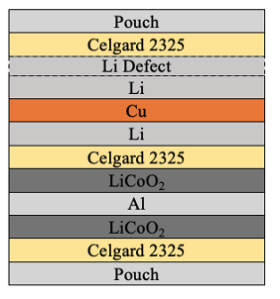
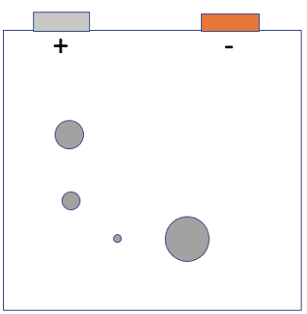
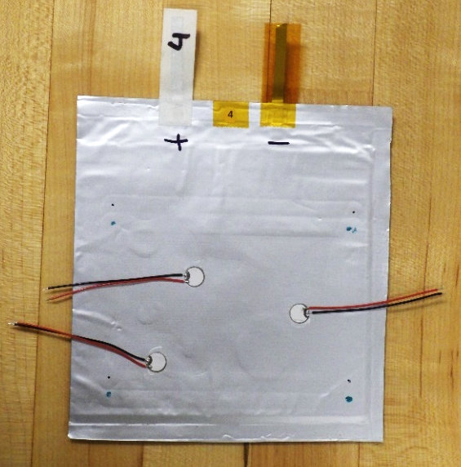
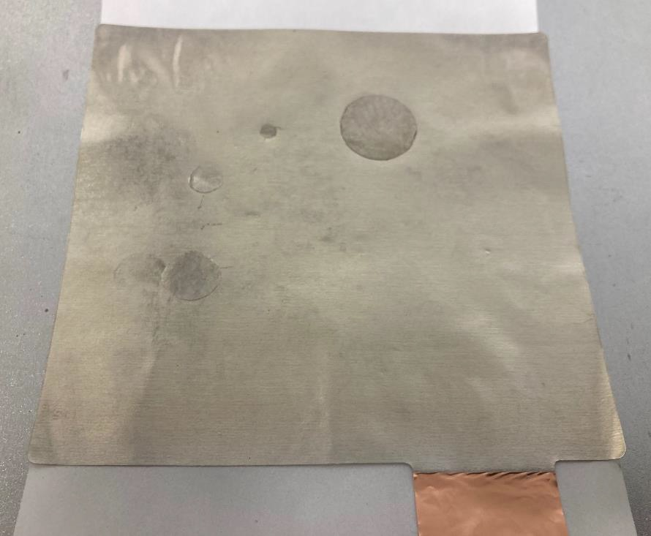
Specimens for Evaluating Flaw Sensitivity
A pouch cell Li-metal battery was seeded with anode defects to test sensitivity of ultrasonic approaches
Pouch cell structure:
  Single battery cell (one anode/cathode pair)
  LiCoO₂ cathode material
  Porous polymer separator
  Li metal anode with 80 um Li chips pressed onto the surface
  Liquid electrolyte
Pouch cell layup:
Focus area for inspections
Li chip Defects
Li metal anode with 80um thick lithium chip defects
Illustration of pouch cell defect locations
Image of Battery

Slide 5
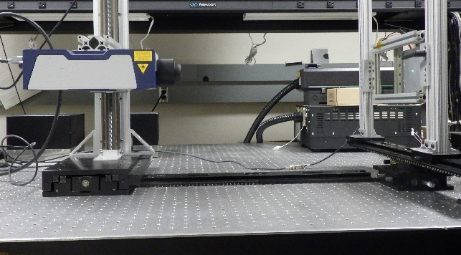
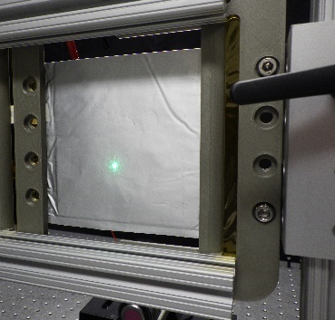
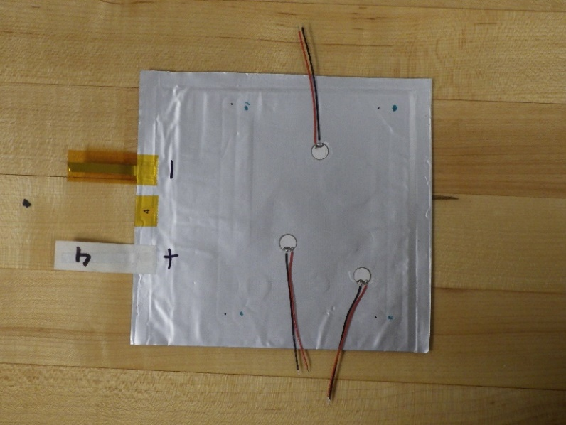
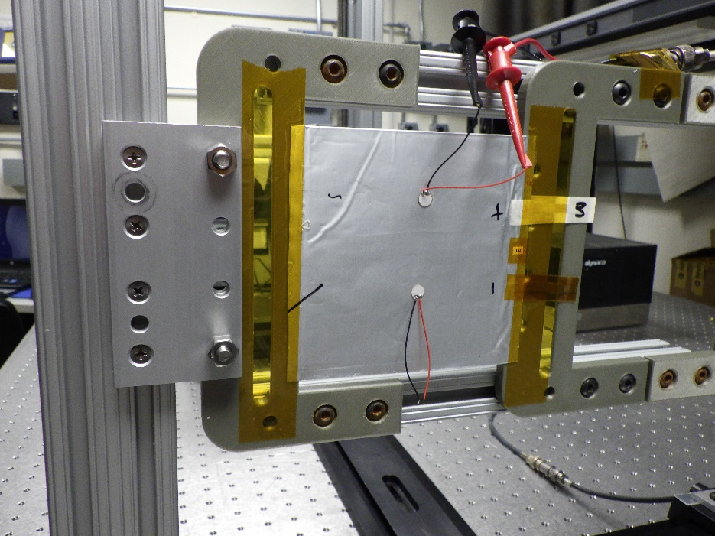
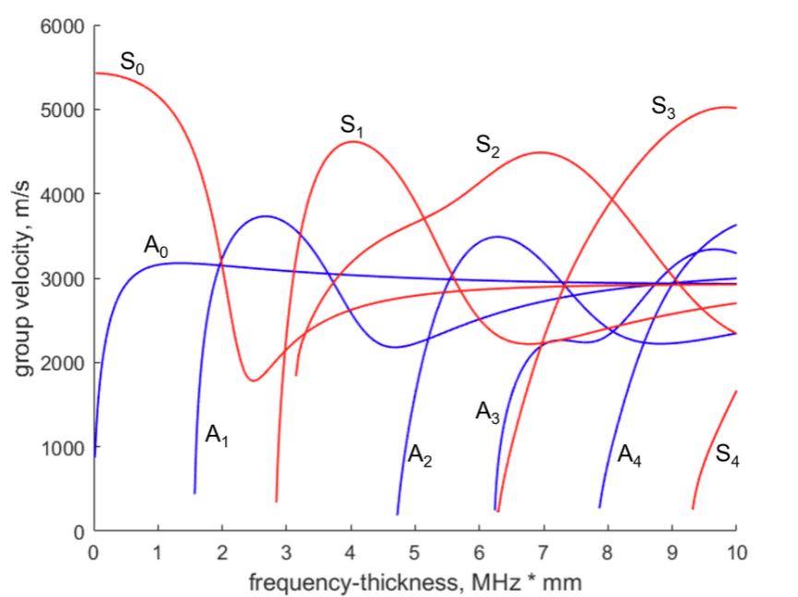
Overview of Guided Wave Approaches
LDV Experimental Setup
Guided wave ultrasound involves propagation of waves along boundaries
Two guided wave ultrasound methods:
  Pitch-catch testing via piezoelectric wafer active sensor (PWAS)
  Laser Doppler vibrometry (LDV) – line scans
Defective Cell
Baseline Cell
x
x
x
x
Example group velocity dispersion curve

Slide 6
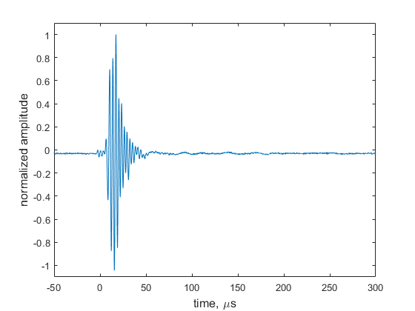
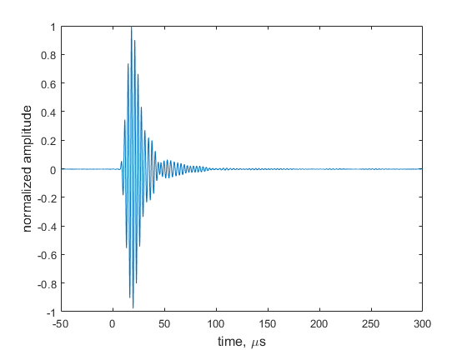
Pitch-Catch Guided Waves
Transmitter
Receiver
Receiver
Transmitter
Embedded Lithium Chip Defects
Pristine pouch cell
Defective pouch cell
PWAS bonded to battery pouch using cyanoacrylate adhesive
Excited using a 20 V_{pp} 300 kHz, 3-count sine wave
Clear wave mode measured at receiver with high signal-to-noise ratio (SNR)
  ‘Ringing’ observed due to large Li chip next to receiver in defective pouch cell

Slide 7
Laser Doppler Vibrometry - Line Scans
PWAS excited by a 5 V_{pp}, 5-count Hanning windowed sine wave
LDV line scans
  Detection of out-of-plane velocity
  100 µm steps, 128 averages per point
Two wave modes present in pristine pouch
  Identified by two distinct slopes/velocities
Three wave modes present in defective pouch
  Rippling present for propagation over aberrations, may be due to factors such as defects and pouch wrinkling
Pristine
excitation
excitation
Defective
Line scan across black dotted lines, in direction of purple arrow
LDV B-Scans

Slide 8
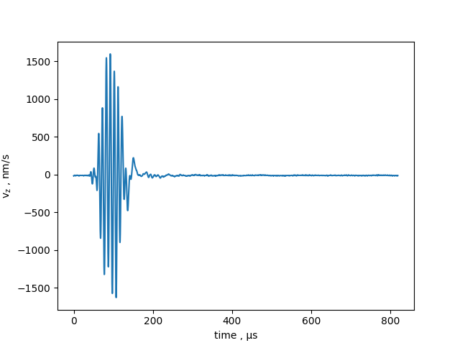
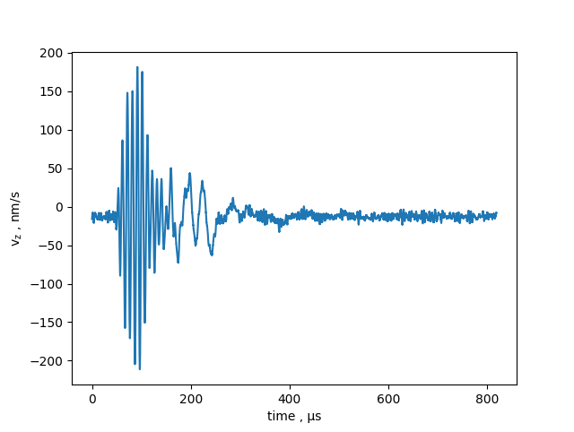
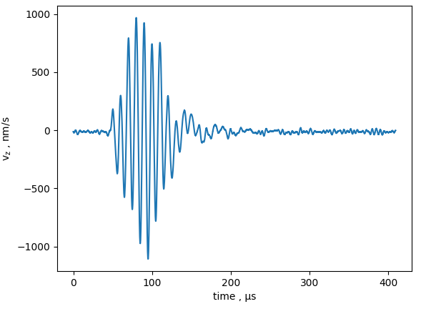
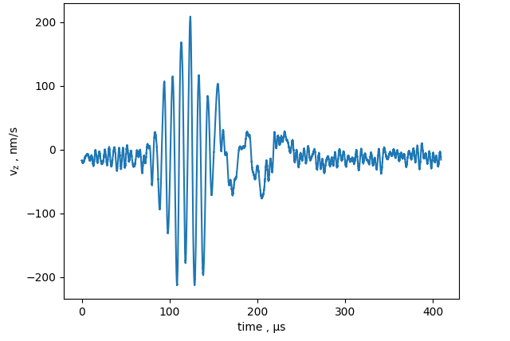
Laser Doppler Vibrometry – Waveforms
Waveforms via LDV at individual locations
  x=0 location beginning of scan line
Wave mode separation observed (probable fundamental symmetric / antisymmetric)
Significant attenuation over small propagation distances – electrolyte viscous effects
  Tradeoff with PWAS pitch-catch – LDV obtaining spatial data at lower SNR
Pristine
x = 80 mm
x = 95 mm
Defective
x = 60 mm
x = 50 mm

Slide 9
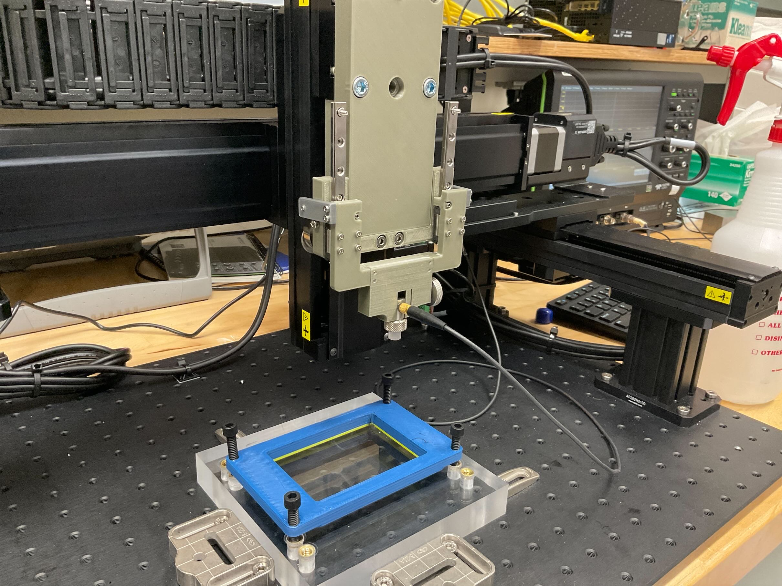
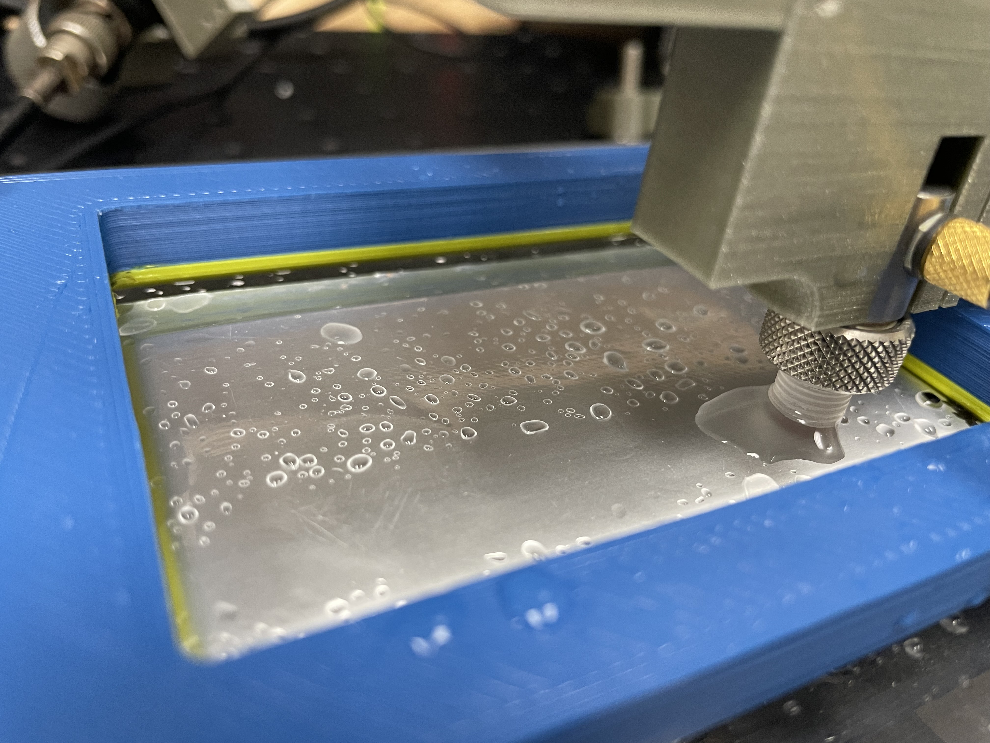
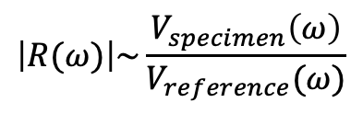
Local Ultrasonic Resonance Spectroscopy (LURS)
Scanning gantry and custom fixturing used for collecting contact data
Assesses through-thickness resonances, which are affected by layup and constituent properties
Demonstrated by Rus and Grosse⁴ on plate specimens and applied to battery inspection by Nelson⁵
Constant force measurement probe
Transducer with delay line
Frequency-dependent reflection coefficient
Resonant frequencies
$$\left|R(ω)\right|\sim \frac{V_{specimen}\left(ω\right)}{V_{reference}(ω)}$$
⁴ J. Rus and C. Grosse, “Local Ultrasonic Resonance Spectroscopy: A Demonstration on Plate Inspection”, J. NDE, 2020.
⁵ W. Nelson, "Local Ultrasonic Resonance Spectroscopy of Lithium Metal Batteries for Aerospace Applications." Master’s Thesis, University of Virginia (2021).

Slide 10
Time-domain Amplitude
TG1
TG2
TG3
Time domain analysis data shows signatures from embedded flaws
Surface and edge effects present early in the received signal

Slide 11
Resonance Frequency Analysis
Flaw cause shift in first and second resonance frequency with most dominant effects in second resonance
  Most dominant shift in the second resonance frequency (f2)
Some areas without known defects show signs of differences in structure as well

Slide 12
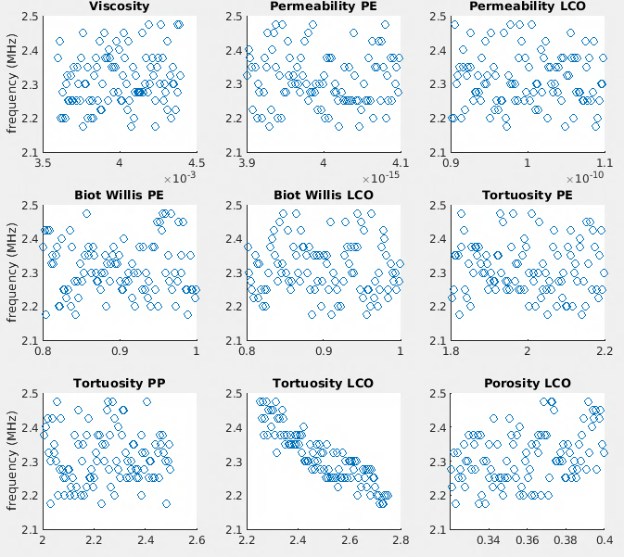
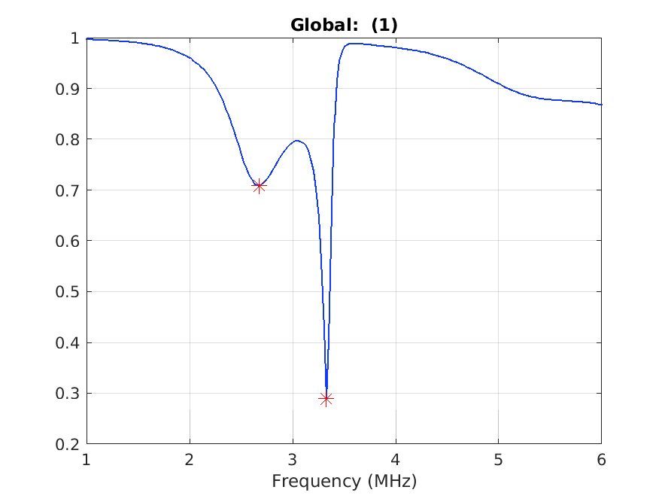
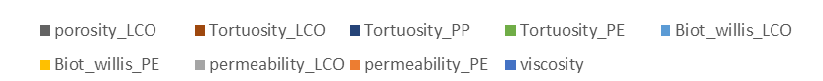
Emerging Techniques – Model Parametric Exploration
Linking forward model with Dakota software, from Sandia National Laboratory https://dakota.sandia.gov/
  Simulated reflection spectrum in COMSOL using two-dimensional elastic-poroelastic media, technique via Nelson⁵
Sensitivity analysis, surrogate modeling, and inversion techniques for applications like material property, geometry, and flaw inverse analysis
Sensitivity of resonance to material parameters
Resonance spectrum –
2D elastic-poroelastic simulation in COMSOL
Fundamental resonance,
partial rank correlation
⁵Nelson, William Charles. "Local Ultrasonic Resonance Spectroscopy of Lithium Metal Batteries for Aerospace Applications." Master’s Thesis, University of Virginia (2021).

Slide 13
Discussion
This study demonstrates two candidates for identifying local changes in structure in lithium-metal batteries
Guided wave ultrasound is viable for in situ inspection, with pitch catch showing particularly good signal/noise and sensitivity to lithium defects
LURS provides much more information on the local structure than available from conventional pulse-echo inspection
  Inverse modeling framework established for calibration and sensitivity analysis
  Still needs to be implemented for inspection data
Currently working with battery subject matter experts to develop realistic damage so that these techniques can be evaluated for prognostic capability

Slide 14
Acknowledgements
Funding provided by the NASA Convergent Aeronautics Solutions Project
Specimen development and management by Daniel Perey
Specimens manufactured by Cornerstone Research Group

