Slide 1
Space Health Impacts for the NASA Experience (SHINE)
2023 Space Radiation Didactic Curriculum

Slide 2
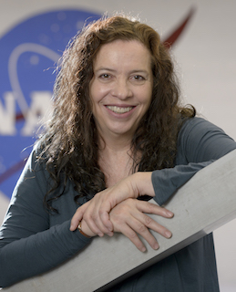
Welcome!
Introductions
What to Expect
Space Radiation Element Overview
Human Research Program
Space Radiation Element
Useful Websites and Resources
Acronyms
Questions?
Sigrid Reinsch, Ph.D.
Director SHINE Program
NASA AMES Research Center

Slide 3
Introductions

Slide 4
SHINE Training Program
Provide important information about the relevant scientific elements of the Human Research Program (HRP)
Space Radiation is hopefully just the first to provide a curriculum
Targets graduate students to potential new investigators with an emphasis on early career investigators
Virtual program meant to improve inclusion

Slide 5
Didactic Space Radiation Curriculum
Program objectives:
Provide an overview of the fundamental scientific concepts to understand the space radiation environment and how it impacts human health
Introduce participants to NASA experts to broaden scientific understanding and promote collaboration and networking opportunities
Educate participants on the Human Research Program grant application process and potential funding opportunities
Familiarize participants with internal NASA processes that impact radiation risk management and research
Future years will include a seperate competitive practicum session to plan and conduct space radiation research at the NASA Space Radiation Laboratory (NSRL)

Slide 6

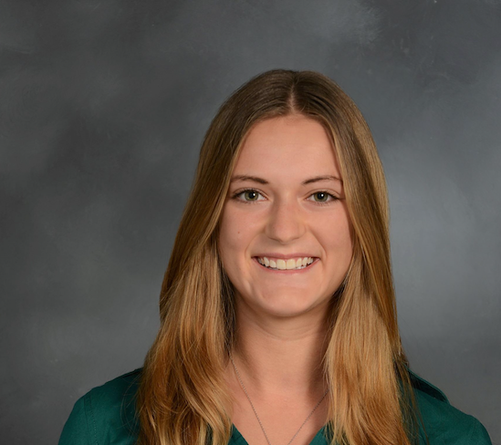

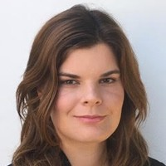

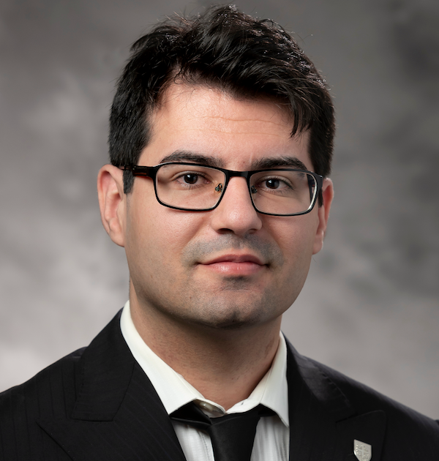
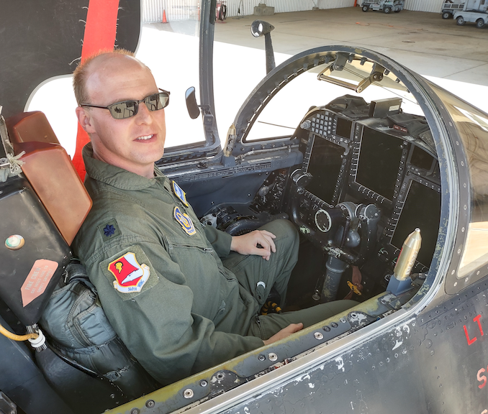

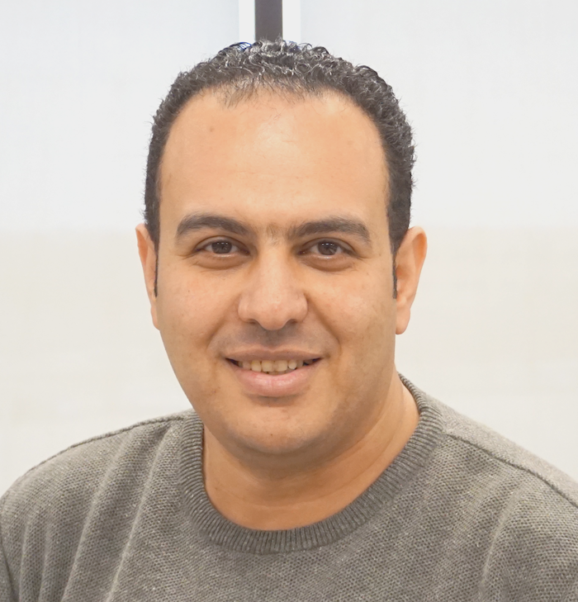
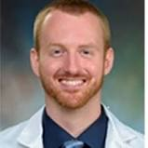



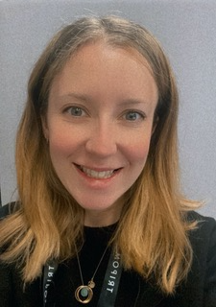

SHINE 2023 Participants
Borja Barbero Barcenilla Post-Doctoral Fellow, Texas A&M
Marissa Burke
Ph.D. Candidate, Weill Cornell Graduate School and Houston Methodist
Walter Cromer, Ph.D.
Assistant Professor, Texas A&M University
Victoire DeJean, Ph.D.
Post-Doctoral Fellow, UCLA
Lena Heffren, Ph.D.
Post-Doctoral Fellow, Southwest Research Institute
Jordan Houri, MS
Lead Scientist, Space Exploration, StemRad, Inc
Joseph Clayton Hudson, MD, Coordinating Doctor/Flight Surgeon, International SOS/USAFR
Anna Jurga, Ph.D.
Research Assistant,, Wroclaw University of Science and Technology
Khaled Y Kamal, Ph.D.
Assistant Research Scientist, Texas A&M University
Stephen Kunkel
MD-PhD Candidate
UTMB Galveston
Jessica A. Lee, Ph.D.
Research Scientist NASA Ames
Sneha Mehta
MPH Candidate, Columbia U.
Kathleen Miller, Ph.D.
Research Scientist, National
l Institute of Aerospace
Dr. Samantha Moore
Anaesthetic ST5 Doctor & Honorary Researcher, Lancaster University
Nicolas G. Nelson
Medical Student (MS4), Thomas Jefferson University

Slide 7

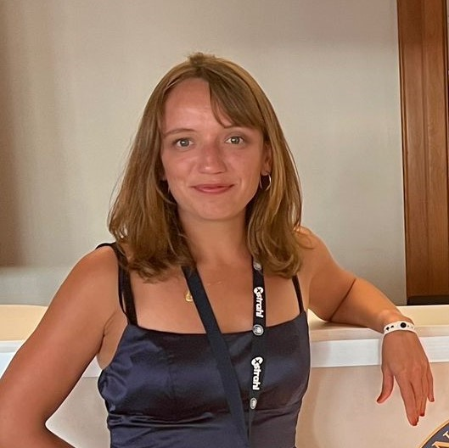
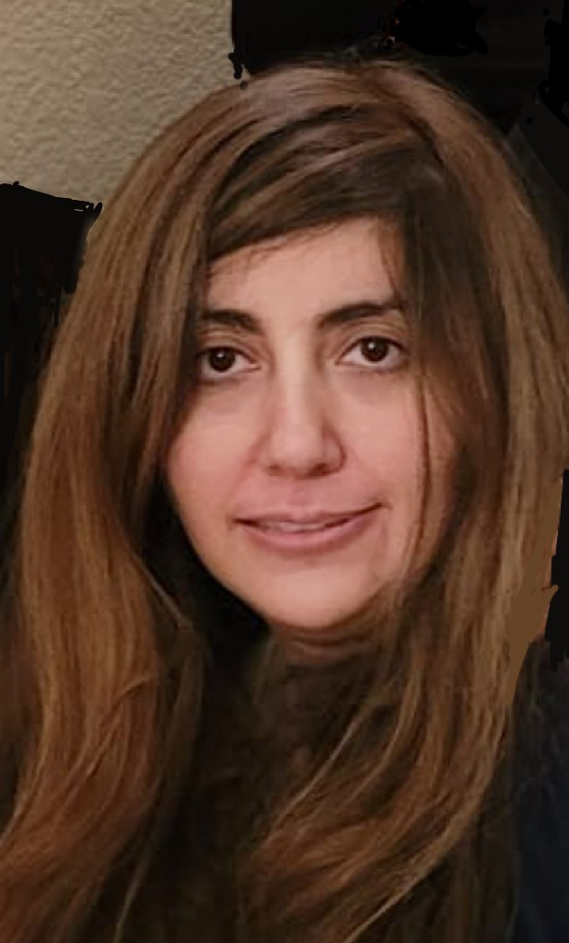
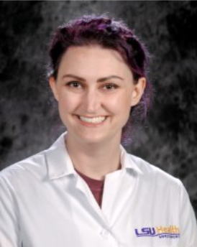

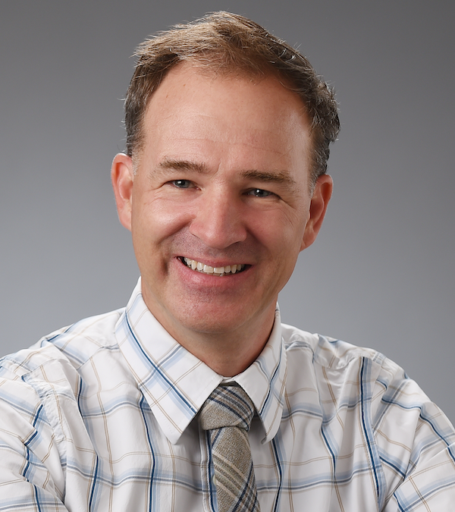
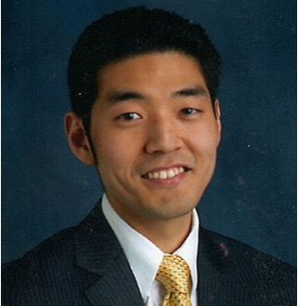



SHINE 2023 Participants
Kat Nilov
Ph.D. Candidate, Northeastern University
Floriane Poignant, Ph.D.
Research Scientist II, National Institute of Aerospace
Shirin Rahmanian
Research Scientist, National
Institute of Aerospace
Erika Reece, Ph.D.
Post-Doctoral Fellow, LSU Health, Shreveport
Kira Rienecker, Ph.D.
Staff Scientist, Blue Marble Space Institute of Science, NASA Ames
Hansjorg Schwertz, MD-Ph.D.
Adjunct Assistant Professor, Billings Clinic Bozeman
Samuel Shin, MD-Ph.D.
Assistant Professor, University of Pennsylvania School of Medicine,
Molika Sinha, M.S.
Research Scientist, Stanford University
Adrian Specogna, MSc, PhD
Executive Director, Lead Scientist, Prolatent Health Technologies Inc.
Corin Williams, Ph.D.
Principal Member of the Technical Staff, The Charles Stark Draper Laboratory, Inc

Slide 8

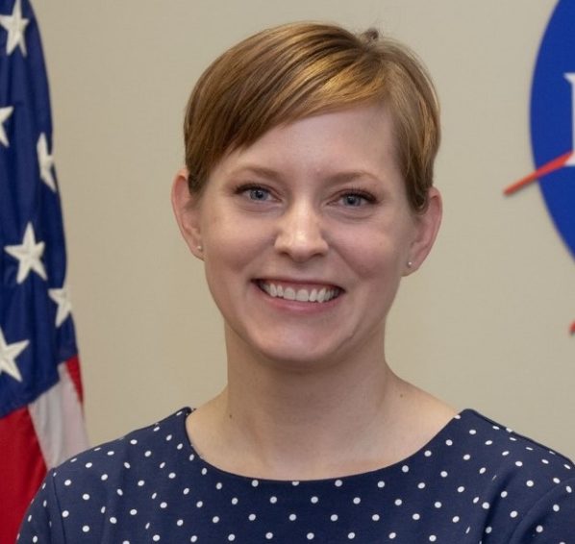


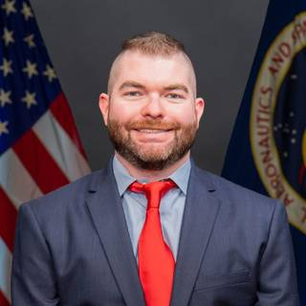
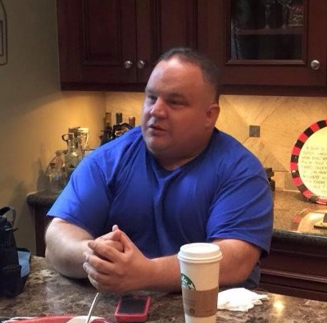
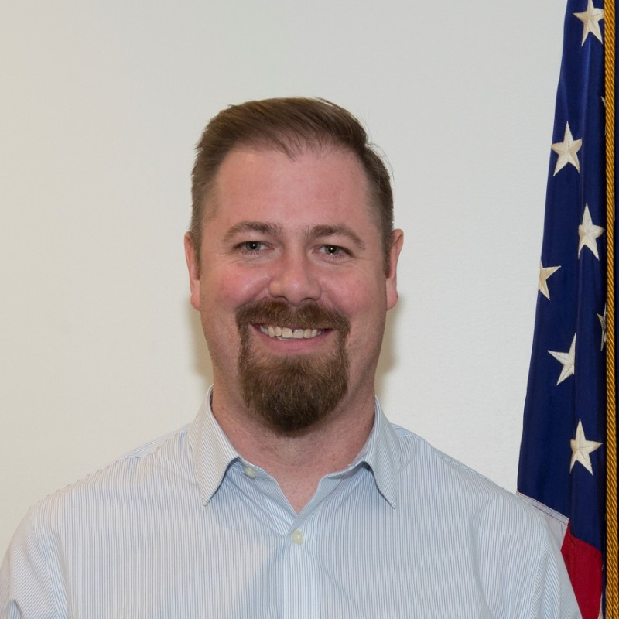



Space Radiation Element Team
Robin Elgart
SR Element Scientist
Janice Zawaski
SR Deputy Element Scientist
Greg Nelson
CNS Discipline Lead
Janapriya Saha
CV Discipline Lead
Brock Sishc
Cancer Discipline Lead
Jason Weeks
Element Manager
Ryan Norman
Acting Deputy Element Manager
Jordan Rhone
Science Integrator
Keli Woolery
Financial Analyst
Jennifer Lett
Scheduler

Slide 9
What to Expect

Slide 10
Weekly Activities Tuesdays 10a-12p Central
Didactic Lectures/Seminars
Invited speakers from NASA, academia, industry, etc.
1-2 hours depending on content
Coffee Hours
Informal interaction with an invited guests
Speaker may present ~10 minutes to stimulate conversation and questions
Office Hours
Informal session to interact with Space Radiation Element (SRE) personnel
Answer questions about mock beam-time proposals or anything else!

Slide 11
Other Activities
Mock Beam-Time Proposal
“Beam-time” to use of the NASA Space Radiation Laboratory (NSRL) is requested by submitting a proposal to the Brookhaven National Laboratory (BNL) Science Advisory Committee for Radiation Research (SACRR)
Proposal is in addition to that submitted to acquire funding
Participants will develop and present a “mock” beam-time proposal
Suggested Readings
Foundational or important papers in the field collected from speakers
Surveys
Gauge participants understanding and to improve sessions in the future

Slide 12
Course Outline
Month | Type | Topic
May 2023 | Coffee Hour | HSRB overview
 | Seminar | Biomarkers
 | Office Hours
 | Seminar | Radioprotectants & Mitigation
 | Coffee Hour | NASA Open Science
June 2023 | Seminar | Experimental Models I
 | Seminar | Experimental Models II
 | Office Hours
 | Seminar | Radiation Epidemiology and Biostatistics
July 2023 | Seminar | Bioinformatics & Data Modeling
 | Coffee Hour | Grants
 | Presentations | Mock Beam Time Proposals
August 2023 | Seminar | Funding Opportunities
Month | Type | Topic
February 2023 | Seminar | Space Radiation Element
March 2023 | Seminar | Radiation Physics and Dosimetry
 | Coffee Hour | HRP/element
 | Seminar | Space Radiation Environment
 | Coffee Hour | Protons/Therapy
 | Seminar | Space Radiation Analogs
April 2023 | Coffee Hour | STAR/Space Biology
 | Seminar | Mechanism of Damage and Repair
 | Office Hours
 | Seminar | Mechanism of Damage and Repair – Oxidative Stress

Slide 13
Space Radiation Element Overview

Slide 14
Human Research Program

Slide 15
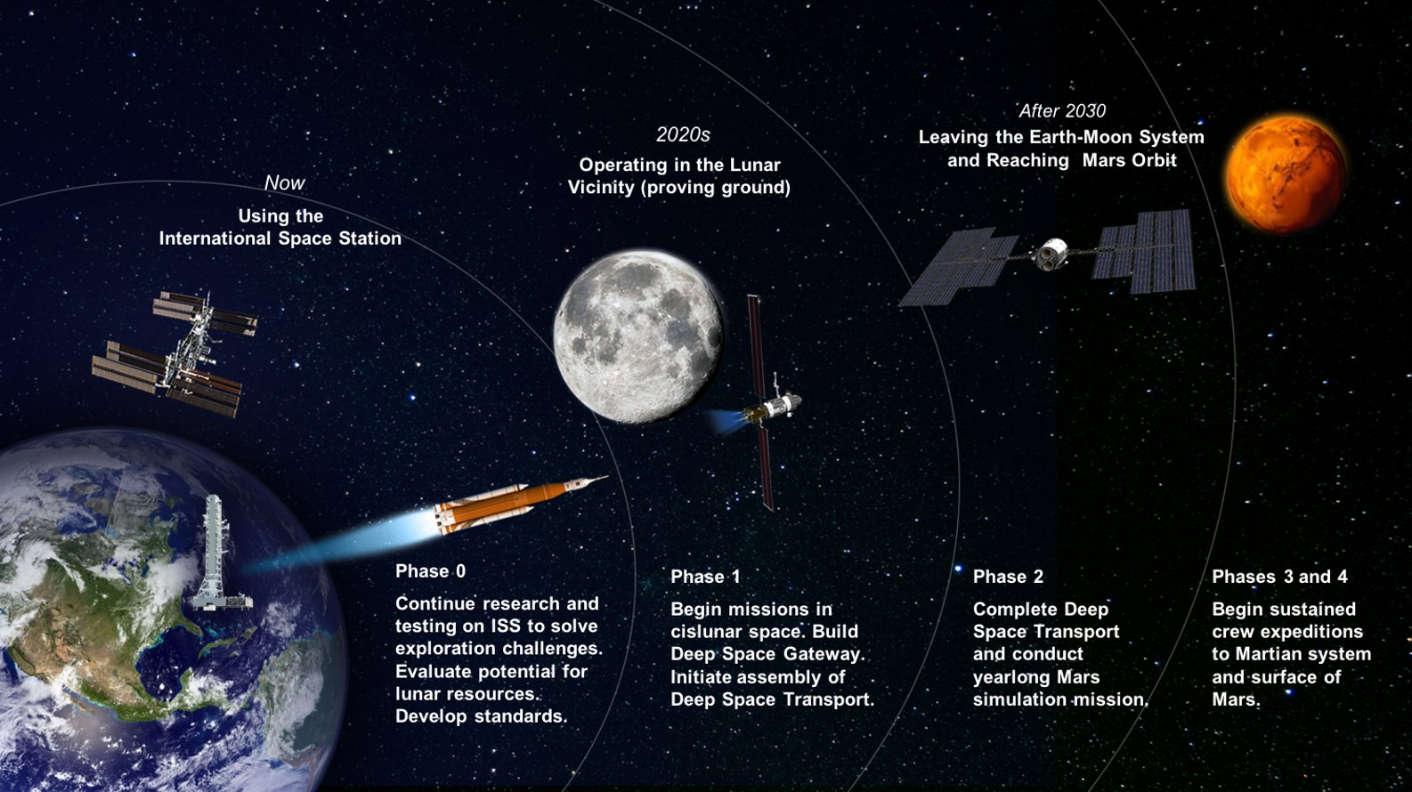

Slide 16
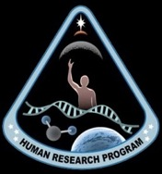
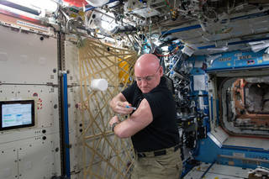
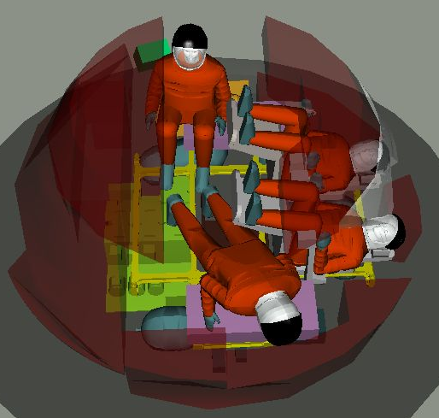
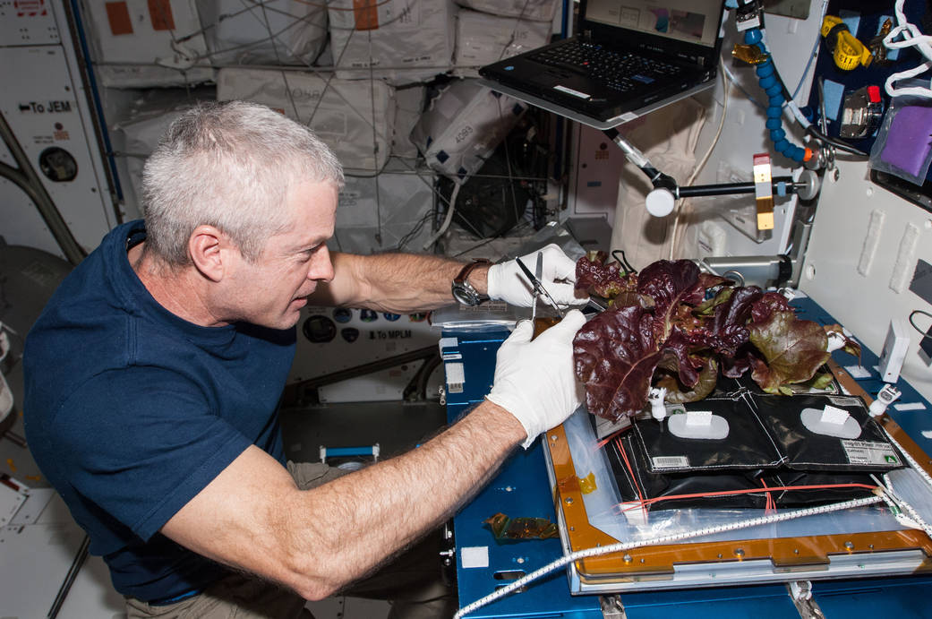
An Applied Research Program
Scientific Goals
Understand and mitigate human health and performance risks due to the five known hazards of spaceflight
Enable development of human spaceflight medical and human performance standards
Develop and validate technologies that serve to characterize and reduce health risks associated with human spaceflight

Slide 17


Hazards of Human Spaceflight
Notes:
Drive advances in scientific research to enable human space exploration to the Moon, Mars, and beyond.
Applied Res Program and 5 main hazards for future space exploration: radiation, isolation and confinement, distance from Earth, altered gravity, hostile closed environs. Operational focus.
Deliver critical components for an evolvable CHP System by 2032.
Demonstrate and mature CHP System in ground analogs, in LEO, and on and around the moon to support a 2039 Mars mission.
Develop, Deliver, and Validate an Exploration Crew Health and Performance System to enable crews to thrive during exploration missions and protect their long-term health.

Slide 18





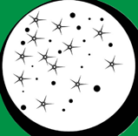


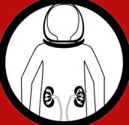

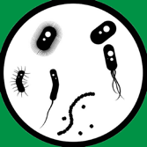

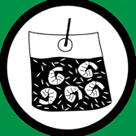

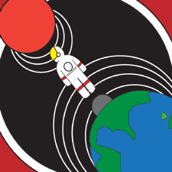
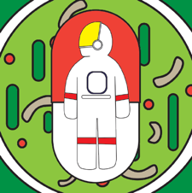

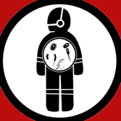

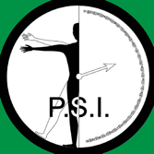

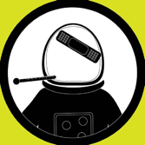






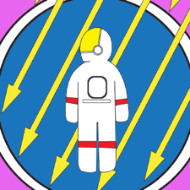
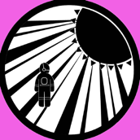






Inadequate Psychosocial Adaptation within a Team
Adverse Cognitive or Behavioral Conditions
Bone Fracture
Reduced Muscle Size
Toxic Exposure
Celestial Dust Exposure
Hypoxia
Cardiac Rhythm Problems
Renal Stone Formation
Carbon Dioxide Exposure
Altered Immune Response
Inadequate Human Systems Integration Architecture
THE
HUMAN
SYSTEM
RISKS
Inadequate Food and Nutrition
Host-Microorganism Interactions
Sensorimotor Alterations
Decompression Sickness
Reduced EVA Performance
Inflight Medial Conditions
Ineffective or Toxic Medications
Orthostatic Intolerance
Spaceflight-Associated Neuro-ocular Syndrome (SANS)
Electrical Shock
Sleep Loss
Cardiovascular Adaptations
Non-Ionizing Radiation
Radiation Carcinogenesis
Injury from Dynamic Loads
Reduced Aerobic Capacity
Urinary Retention
Crew Egress
Hearing Loss
18
Notes:
Seated icon is isolation and confinement
Each hazard results in different possible risks to the human
How severe the risk is different design ref missions = e.g. Moon and Mars; red highest concern
assess risk posture and gaps
Research to understand risk, and dev and test technologies and countermeasures to mitigate to acceptable levels.

Slide 19
Translating Basic Science to Applications
(Example in Biomedicine)
Space Biology
Human Research
Basic
Translational Research
Applied
Study how life responds, adapts, develops, interacts and evolves in the space environment and across the gravitational continuum:
Cell and Molecular Biology
Microbiology
Animal Biology
Plant Biology
Developmental & Reproductive Biology
Scientific data and findings that foster research and development across biological systems
Animal Research
Cells and tissues
Immunology
Wound healing and fracture repair
Bone and muscle
Radiation/micro-g interactions
Microbiome of the built environment
Identify, characterize and mitigate the risks to human health and performance in space:
Exercise Countermeasures
Physiological Countermeasures
Space Radiation Biology
Behavioral Health and Performance
Space Human Factors and Habitability
Exploration Medical Capability
Environmental Monitoring
Basic Science
Medical Operations
Science Exploring
the Unknown
Science Addressing
The Known Risks
← Critical Link! →

Slide 20

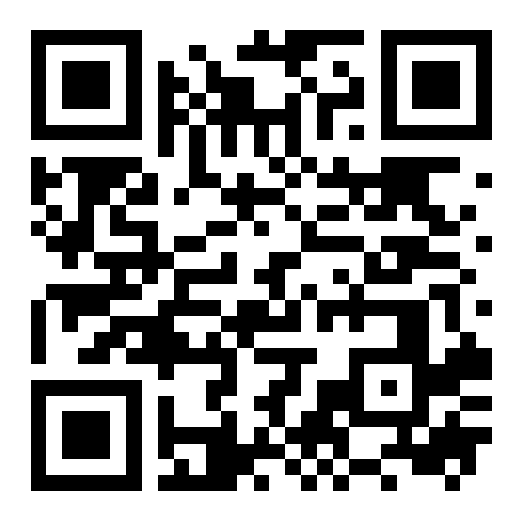
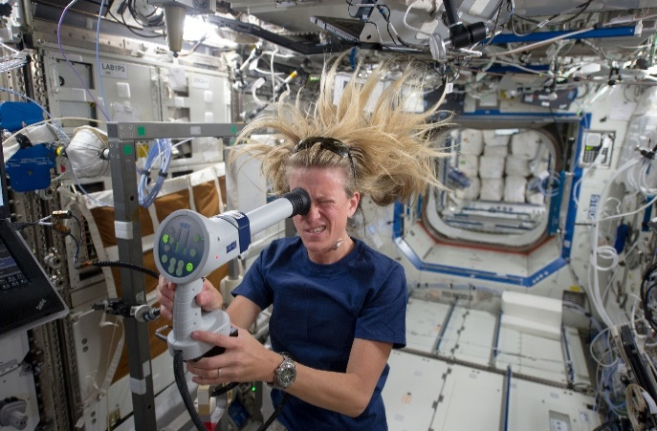
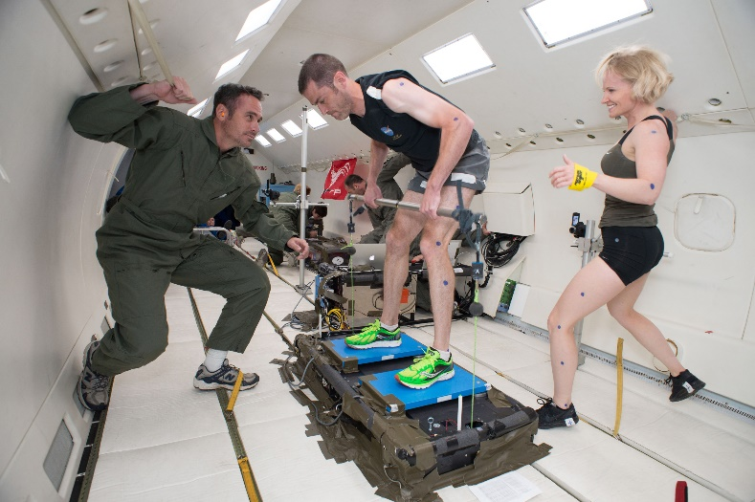
Addressing Health Risks
https://humanresearchroadmap.nasa.gov/
Five HRP Elements and 23 active risks :
Exploration Medical Capability (ExMC)
Medical care for deep-space missions
Human Factors and Behavioral Performance (HFBP)
Interfaces between humans, vehicles, and habitats
Individual and interpersonal
Human Health Countermeasures (HHC)
Physiology
Space Radiation (SR)
Biological effects of radiation exposure
Research Operations and Integration (ROI)
Infrastructure for flight and analog experiments
Funds Translational Research Institute for Space Health (TRISH) to pursue disruptive, breakthrough approaches that reduce risks to human health and performance
Collaborates with NASA Space Biology program to understand causal cellular and other mechanisms that underlie adaptation to spaceflight in cells, microorganisms, plants, and animals

Slide 21
Space Radiation Element

Slide 22
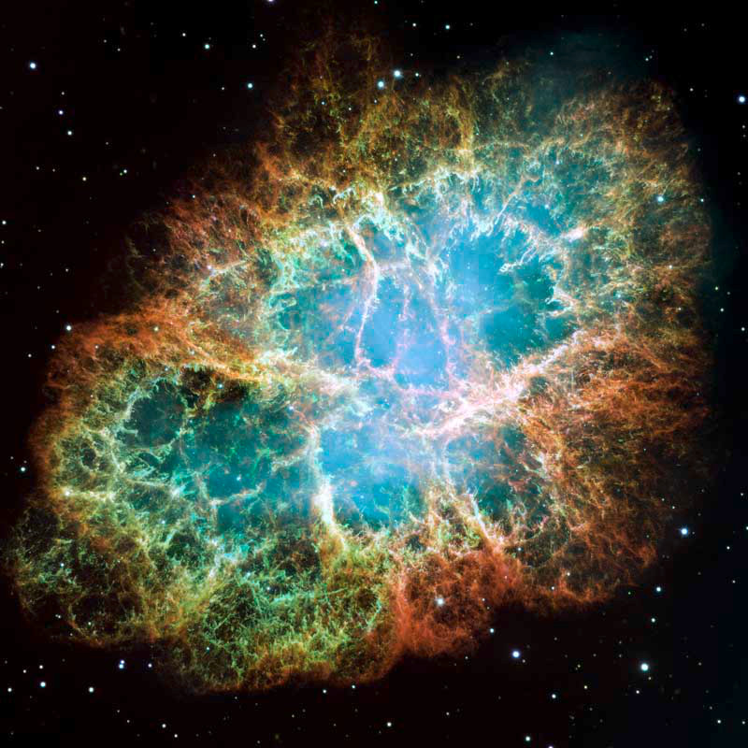
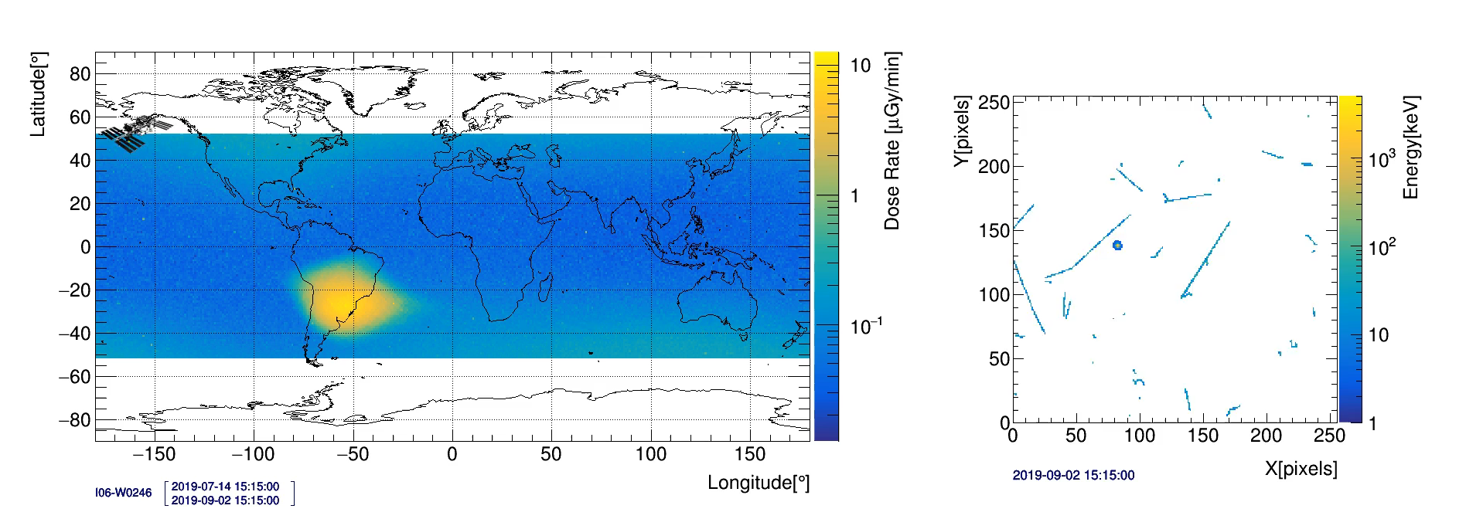
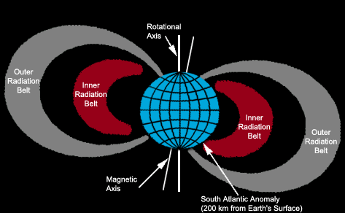
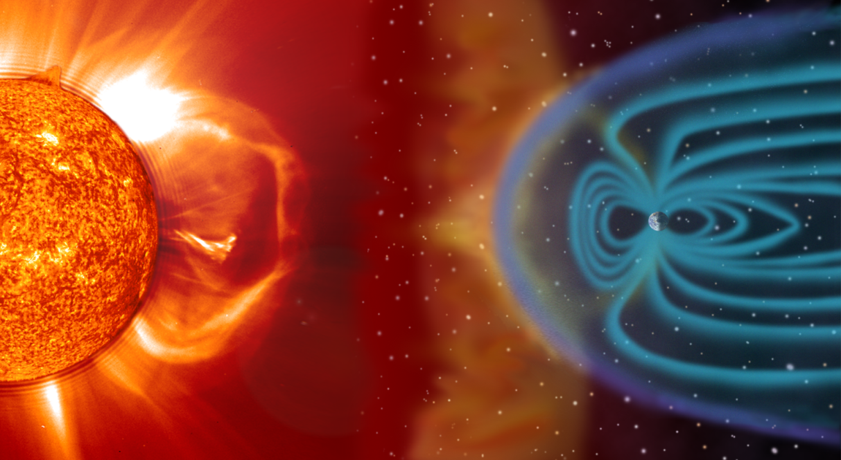

Space Radiation
More on the Space Radiation Environment in Seminar #3!
NASA/ESA/Arizona State University
Why does NASA care about radiation?
Radiation can cause damage when it interacts with cellular components
Space is a “radiation environment” → Workplace hazard
Astronauts are radiation workers
Space radiation is different than terrestrial radiation
Mainly high energy particles
Galactic Cosmic Rays (GCR)
Trapped Radiation
Solar Particle Events (SPE)
Crab Nebula
gif by Crazy Picture/CC BY-SA 3.0

Slide 23
Historical NASA Crew Mission Doses
Badge Dose, mGy
650 mSv
NCRP Lifetime Radiation Worker Guidance for 65yo
600 mSv
NASA Career Radiation Limit
Effective Dose, mSv
1000
Mars Mission, mSv
Mars Mission
Skylab, Mir and ISS
100
50 mSv/yr
Annual NRC Radiation Worker Limit
Hubble Missions
10
Apollo and Shuttle
Mission Dose
Gemini
3.6 mSv
Annual Average US Background Dose
Mercury
1
NOTE: Log Scale
0.1
0
200
400
600
800
Astronaut
Modified from Cucinotta et al. Radiat Res (2008)

Slide 24
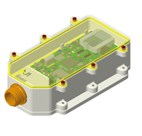
Instrument Suite for Crewed Artemis Missions
More on Dosimetry in Seminar #2!
Function | HERA | ARES | CAD | ARD
Measurement | Charged Particle Detector Area monitoring of flux/species and dose | Charged Particle Detector Area monitoring of flux/species and dose | Crew member dose rate/total dose | Crew member dose rate/total dose
Proposed mission(s) | Orion/Artemis | Gateway, Lander (HERA heritage hardware) | Personal dosimetry | Personal dosimetry
Use | Real time radiation environmental monitoring On-board alerting | Real time monitoring On board alerting | Real-time dose at crew Worn by crew at all times inside crewed vehicles Post mission crew risk assessment Re-flight determination | Real time dose at crew EVA, integrated with xEMU On-board alerting Post mission crew risk assessment
Mass | ~3kg | <2kg | 35g | 430g
Dimensions | HPU: 19.3 cm x 17.5 cm x 4.6 cm HSU (2 each): 13.5 cm x 10.7 x 5.3 cm | 9.9 cm x 17.8 cm x 4.6 cm | 5.7 x 3.4 x 2.6 cm | 7 cm x 6 cm x 3 cm

Slide 25
Space Radiation Health Risks
Mission Success
Long Term Health
Acute effects
Very large high-energy solar events
Estimate ~ 200 – 400 mSv (unsheltered) for 1972 Event
MILD symptoms IF they occur at all given doses
Potential early neurological effects
Behavior or memory decrements
Observed only in animal models
Cancer
Space radiation may cause unique impacts
Degenerative
Cardiovascular disease
Cataracts
Immune
Potential late neurological decrements
Behavior or memory decrements
Neurodegenerative disease
Observed only in animal models

Slide 26
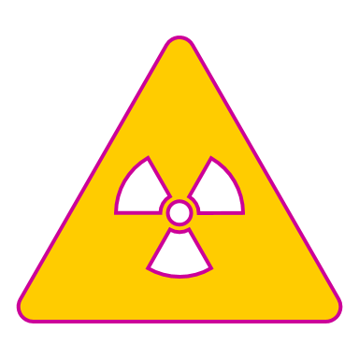


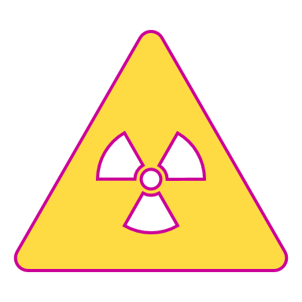

The Space Radiation Protection Challenge
Traditional terrestrial protection strategies fall short in space:
Time
At some point you will always reach a limit
Distance
There is no point source to move away from
Shielding
Energetic particles are penetrating
Secondary particles
NASA is exploring other protection strategies
Individualized risk characterization
Health surveillance including early disease detection
Compound-based countermeasures
Dose Limits
A L A R A
As Low As Reasonably Achievable
Time
Distance
Shielding
Dose Optimization

Slide 27
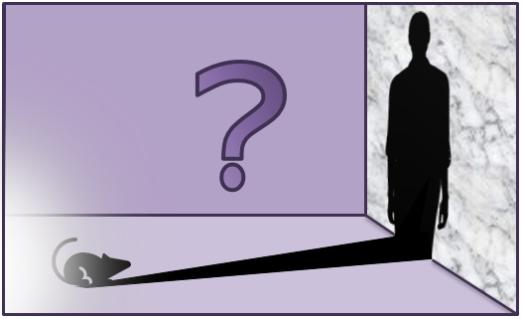
Research Challenges
Limited observed outcomes in astronauts
Small population
Low doses and dose rates
Common outcomes
Healthy worker and generally healthy
Limited knowledge of biological effects of space radiation
Heavy reliance on animal studies
Space radiation is unique

Slide 28
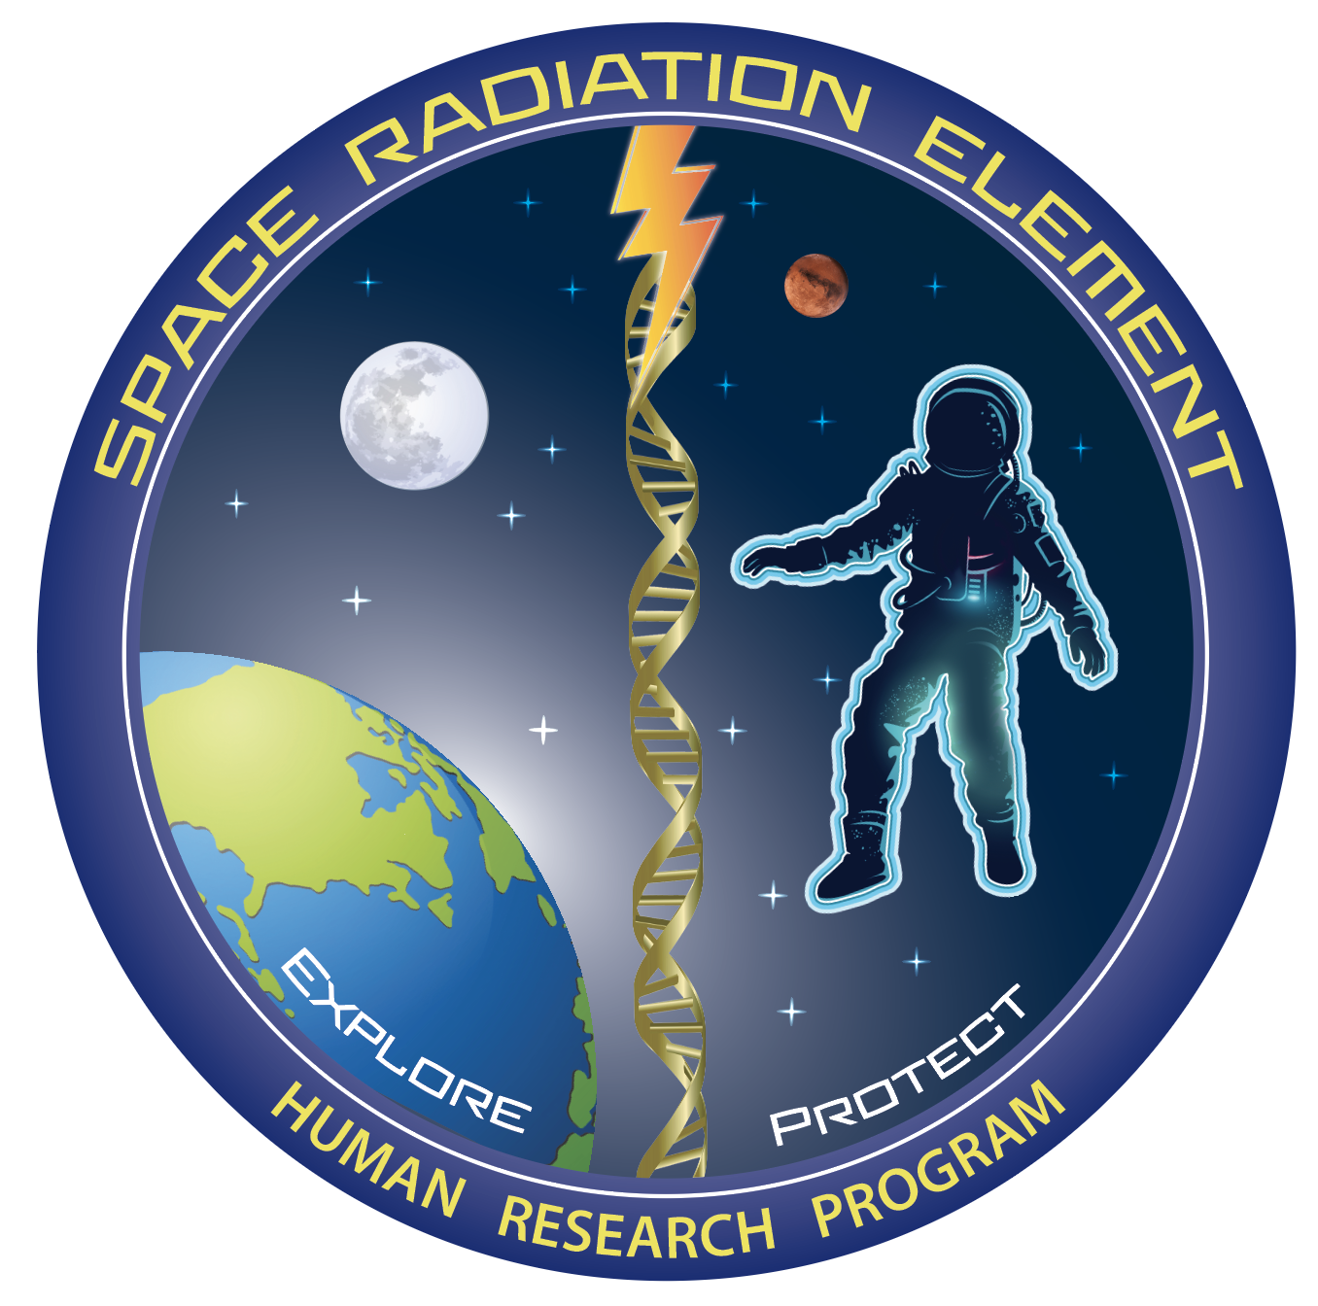
Space Radiation Element Research
Mission: Characterize and facilitate the management of the human health outcomes associated with space radiation exposure to protect astronaut health and wellbeing to enable human spaceflight
Carcinogenesis
Cardiovascular and Immune
Central Nervous System
Characterization |  | Mitigation
Dose and Dose Rate Effects | Biomarkers | Countermeasure Identification
Radiation Quality | Individual Susceptibility | Countermeasure Validation
Cross-Species Translation | Combined Stressors

Slide 29
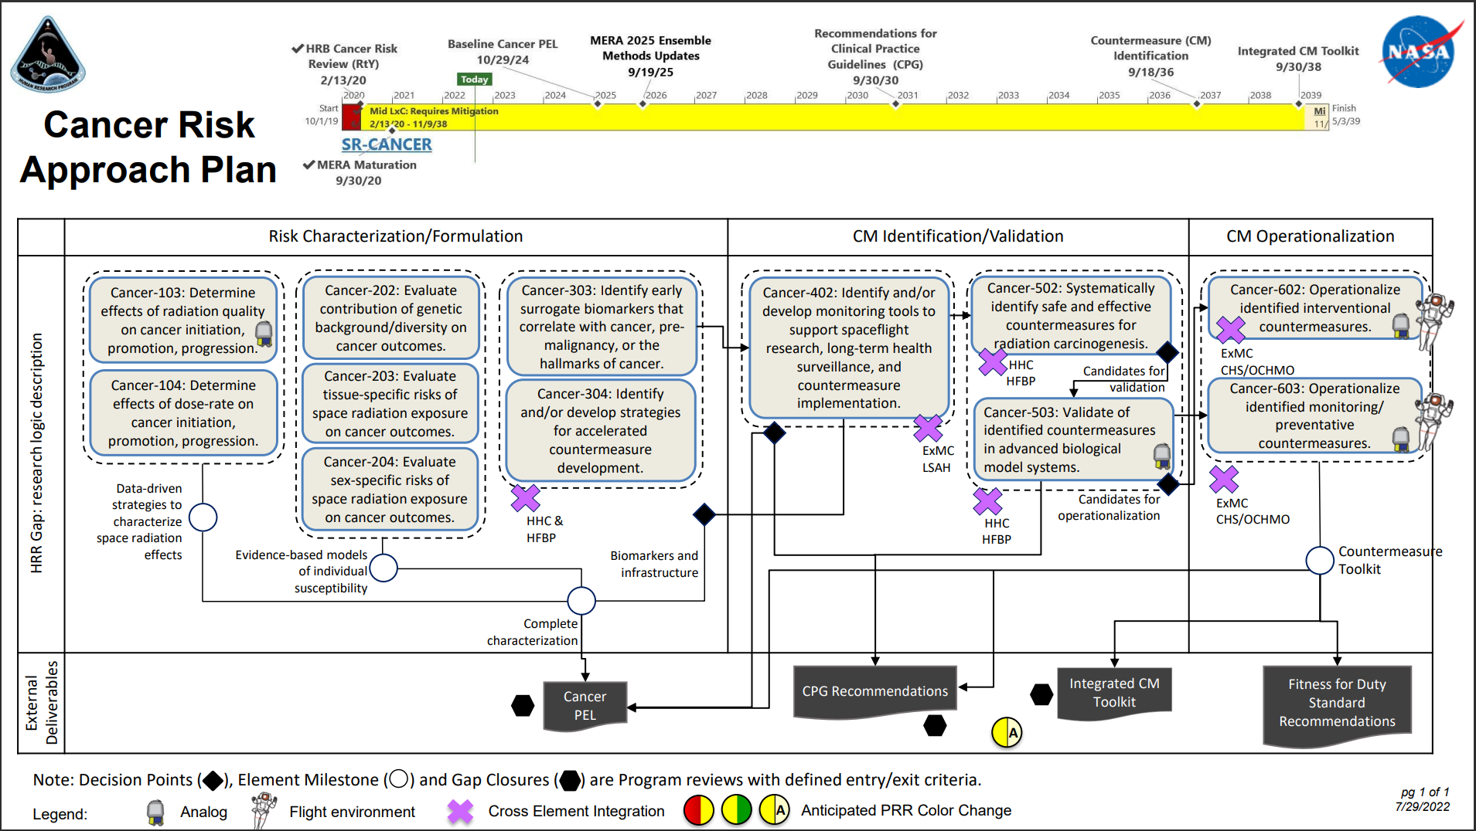
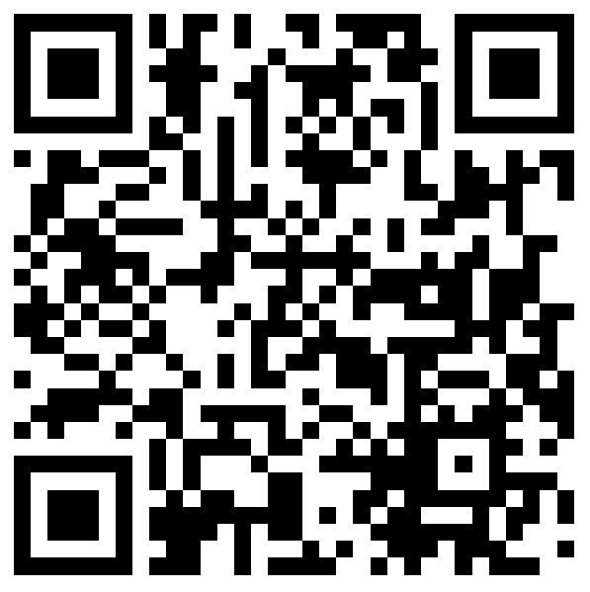
https://humanresearchroadmap.nasa.gov/Risks/risk.aspx?i=96
Cancer risk

Slide 30
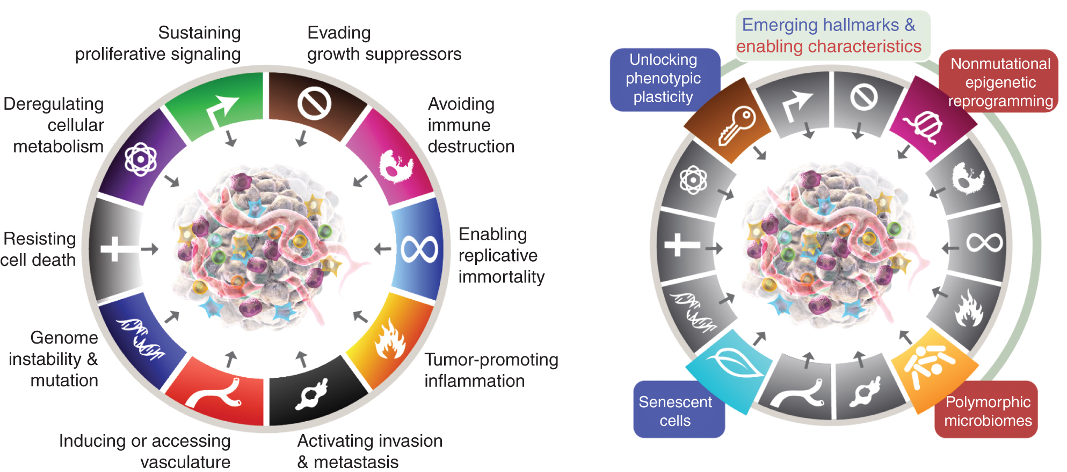
What is Cancer?
Cancer is defined as a cluster of diseases characterized by the uncontrolled proliferation of cells that spread to other parts of the body.
Hanahan 2022 (Cancer Discovery)

Slide 31
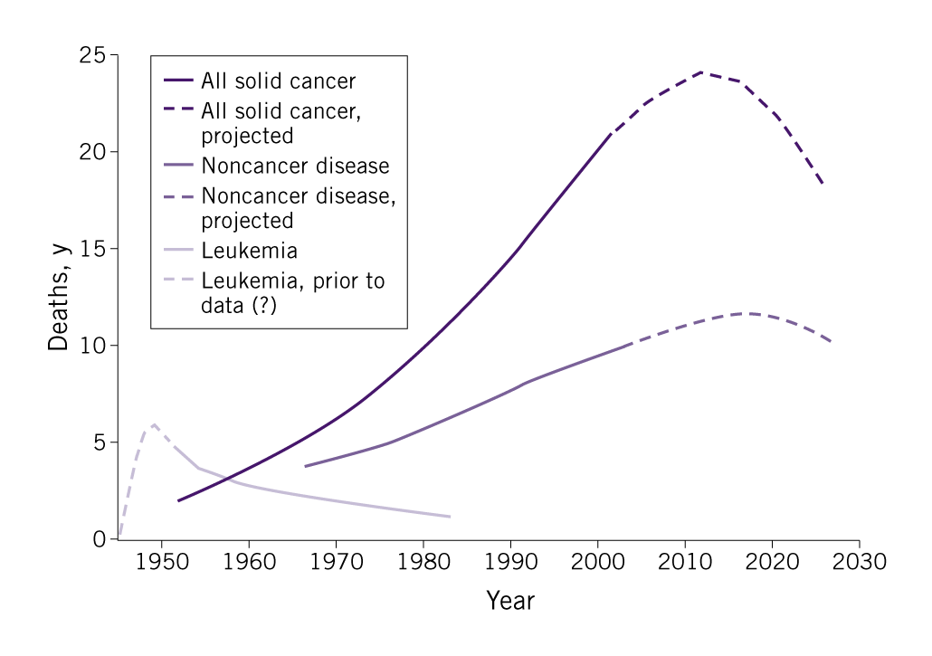
Why Does NASA Study Carcinogenesis?
Epidemiological studies of human populations exposed to ionizing radiation (IR) indicate an increased lifetime risk of cancer dependent on dose received.
The tumor spectrum produced by IR is not necessarily different than those tumors that occur spontaneously.
Douple et. al. (2013, Disaster Medicine and Public Health Readiness)

Slide 32
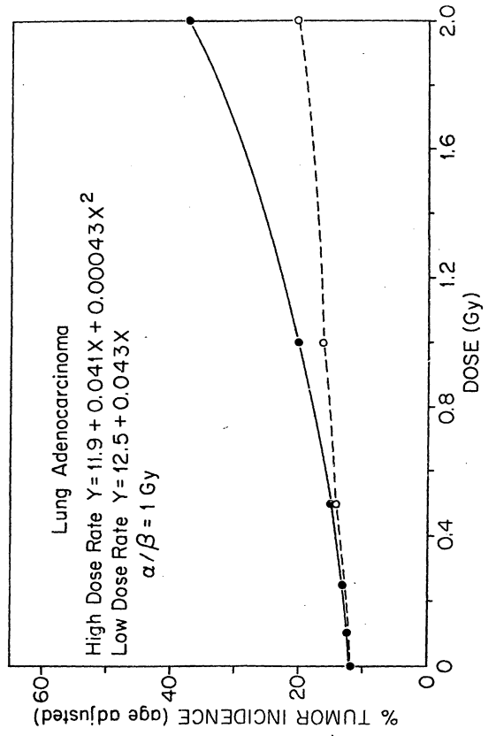

Radiation Quality and Dose Rate Effects
Weil et. al. (2014, PLOS One)
Ullrich (1986, Oakridge National Lab Annual Report)

Slide 33


Individual Sensitivity
Story, M.D., et al, (2012, Health Physics)
Edmonson et. al. (2020, Science Advances)

Slide 34


https://humanresearchroadmap.nasa.gov/Risks/risk.aspx?i=179
Cardiovascular risk

Slide 35


Risk of Cardiovascular Disease (CVD) from Radiation Exposure
67-year-old patient with severe adventitial fibrosis (*) with intimal plaque (p) causing 75% luminal narrowing of coronary artery, 7 years post RT.
Cardiovascular disease, like cancer, has been associated with radiation exposure at high doses.
Ionizing radiation at high doses as used for radiotherapy produces direct damage to the heart and major arteries and increases the risk of cardiovascular diseases.
In contrast, the evidence for a causal relationship between long-term risk of cardiovascular diseases after moderate doses (0.5–5 Gy) is suggestive, and weak after low doses (<0.5 Gy).
Meta-analyses of epidemiologic studies show a small but statistically significant increase in CVD mortality risk with increasing radiation exposure at low doses.
ERR/Sv values in the Table.
Since epidemiological findings for low and moderate doses are suggestive and not persuasive, their use in dose risk assessment is limited.
Yang EH et al. (2021)
Front. Cardiovasc. Med. 8:652761.
doi: 10.3389/fcvm.2021.652761
Cardiovascular Risk from Low Dose Radiation Exposure Review and Scientific Appraisal of the Literature
Electric Power Research Institute. Technical Report 2020
Janapriya (JP) Saha | Janapriya.saha@nasa.gov
35
Notes:
Histologic section of the left circumflex coronary artery from a 67-year-old patient who received radiation therapy for carcinoma of the lung 7 years prior to sudden death. Low power view (A) demonstrates severe adventitial fibrosis (*) and focally extensive destruction of the media (arrowheads) with intimal plaque (p) causing 75% luminal narrowing. The plaque consists mostly of necrotic core that is rich in cholesterol clefts.

Slide 36
Putative Mechanisms of CVD induction after IR Exposure
Knowledge gaps exist in mechanistic understanding of radiation-induced CVD, including underlying molecular and biological mechanisms.
Characterizing CV risk from low dose radiation exposure is complicated by confounders such as diet, smoking, lifestyle and/or genetic risk factors.
Meerman M, et al. (2021) Front. Cardiovasc. Med. 8:631985.doi: 10.3389/fcvm.2021.631985
Janapriya (JP) Saha | Janapriya.saha@nasa.gov
36
Notes:
This figure shows the changes that have been observed in the cardiovascular system of animal models that are exposed to different components of space radiation. Space radiation has been shown to cause endothelial dysfunction in the aortic wall, as shown on the right. In the myocardium, exposure to space radiation has several effects. It leads to influx of immune cells and increased NF-kB activity, increased reactive oxygen species (ROS) production and xanthine oxidase (XO) activity, increased cellular apoptosis and decreased DNA methylation levels. IL, interleukin; ROS, reactive oxygen species; PARP, poly adenosine diphosphate-ribose polymerase.

Slide 37


https://humanresearchroadmap.nasa.gov/Risks/risk.aspx?i=99
Behavioral Medicine risk

Slide 38
Changes to the Central Nervous System after Space-Like Radiation Exposure
Reduction in neuron arborization and synapse number (dendritic spines)
Persistent reductions for > 1 year after doses of high Linear Energy Transfer (LET) nuclei below 5 cGy
Significantly reduced production of new neurons in brain
Increased activation of microglia (signaling neuroinflammation)
Deficits in neurocognitive performance for several mouse and rat behavioral paradigms
High-LET nuclei at low doses (<10 cGy, with 1 cGy sensitivity reported in one study)
Dose threshold for performance deficits following exposure to high-LET nuclei depends on
Physical particle characteristics, strain, sex, age at exposure, and evaluation time after exposure
Male mice appear to be more radiosensitive than female mice in several studies
Notes:
Reduction in neuron arborization and synapse number (dendritic spines)
Persistent reductions for > 1 year after doses of high- Linear Energy Transfer (LET) nuclei below 5 cGy
Significantly reduced production of new neurons in brain
Increased activation of microglia (signaling neuroinflammation)
Deficits in neurocognitive performance for several mouse and rat behavioral paradigms
High-LET nuclei at low doses (<10 cGy, with 1 cGy sensitivity reported in one study)
Dose threshold for performance deficits following exposure to high-LET nuclei depends on
The physical characteristics of the particles, strain, sex, age at exposure, and evaluation time after exposure
Male mice appear to be more radiosensitive than female mice in several studies.

Slide 39



Structural Changes
The complexity of dendritic arborization and the number of dendritic spines are reduced after
exposures to charged particles. This will change the connectivity of neuronal networks.
Reduced Dendritic Spine Number 8 weeks post
¹⁶O or ⁴⁸Ti ions exposure revealed by confocal microscopy of GFP-expressing neurons.
Reduction of dendritic complexity revealed by Golgi silver stain and Sholl analysis.
0 Gy
1 Gy ¹⁶O
Parihar et al. Sci. Adv. 2015;1:e1400256
Swinton et al. Behav. Brain Res. 407: 113257 2021
Notes:
Neuronal GFP expression and confocal microscopy used to score dendrite branching and spines. Decrease indicates fewer synapses and less connectivity which impairs information processing. Such spine and dendrite reductions are seen in neurodegenerative diseases.
Parihar et al. Sci. Adv. 2015;1:e1400256 1 May 2015
Swinton
This is an extension of work from male to female mice by the Allen laboratory looking at effects of oxygen on cognition, hippocampal neuron morphology and adds a mutation measurement. Three months after 0, 10 or 25 cGy 600 Mev/n Oxygen exposure there were reductions in dendritic complexity and spine number, impaired recognition memory but normal spatial memory and a surprizing absence of expected mutations based on single nucleotide polymorphism (SNP) analysis.
Dendritic complexity in female animals matches that seen previously for males at 10 and 25 cGy in both dentate gyrus and CA1 region of hippocampus.

Slide 40




Physiological and Functional Changes
Electrophysiological and ion channel changes indicate persistent synaptic plasticity changes. These are accompanied by neuroinflammation and activation of microglia which can also regulate plasticity.
Hippocampal Slice Recordings at 2 Months after ⁵⁶FeExposure at 0, 10, 50 & 100 cGy Results in Reduction of Long Term Potentiation in Female Mice
U-shaped dose responses for three glutamate receptor ion channels and a presynaptic marker. mRNA levels relative to controls for 10, 25 & 100 cGy ¹⁶O ions.
Sex differences: Microglia Activation (Red) in the Hippocampus (Nuclei Blue)
0 cGy
50 cGy
Male
Female
Miry et al. Scientific Reports (2021) 11:4292
Kiffer et al. 2018. Radiat Res 189: 53–63
Krukowski et al. (2018) Brain, Behavior, & Immunity
S0889-1591(18)30417-3
Notes:
Impairments in Schaffer collateral-CA1 LTP and spatial learning two months after exposure to 56Fe particle radiation (a, b) Time course and magnitude (inset bar graph) of LTP in slices from mice exposed to 10 cGy, 50 cGy, or 100 cGy radiation, compared to sham-irradiated controls (0 cGy). After a 15 min baseline, LTP was elicited by two high-frequency TBS stimulus trains (arrows), and magnitude of LTP between 35 and 40 min post TBS (perforated box) was compared across doses in (a) male mice and (b) female mice. n = 12–16 slices per dose per sex. LTP is a tissue level model of memory trace formation based on synaptic plasticity.
Miry et al. Scientific Reports (2021) 11:4292 https://doi.org/10.1038/s41598-021-83447-y
Kiffer et al showed differences in glutamate receptor ion channels and a synaptic marker n mouse hippocampus at 2 weeks after exposure to oxygen ions. This is a measure of synaptic composition changes.
Sex difference following GCR-like exposures. Male mice had in increase in microglia phenotypes (Iba-1 staining) compared to females in the dentate gyrus Representative images for 0 cGy and 50 cGy exposures.

Slide 41



Behavioral Responses
Persistent behavioral changes in cognitive, emotional and sensorimotor domains are observed
in rats and mice after single or multi-ion exposures and neutrons.
In a high-fidelity human analog paradigm, psychomotor vigilance is impaired in rats after proton irradiation
Object in Place Test Reveals Impairments in Spatial Memory after 18 cGy Neutron Exposure
Movement topography is altered in the fine motor skill “string-pulling” test in rats after Si exposure.
Spatial memory behavior is perturbed by acute neutron irradiation in Object in Place (OiP) test to differentiate objects relocated to alternative locations.
Davis et al. (2014) Radiat. Res. 181, 258–271
Klein et al. (2021) Int. J. Mol. Sci. 22:9020
Blackwell et al. (2020) Behav. Brain Res. 400, 113010
Notes:
Examples of performance accuracy for rats trained to push lighted button for food reward. Timing interval critical for reward and animals must be attentive to light on signal and not push button without cue. Reaction time and attention to task assessed. The percent correct scores are shown as a function of days post-exposure, with each dot representing a separate session. Data points to the far left on each graph indicate baseline performances prior to exposure. Shaded areas indicate the range of a 95% confidence interval around the pre-exposure baseline performances of all nonexposed control animals. Closed circles: Animals identified by cluster analysis as being radiation-sensitive; open circles: Average performances of all nonexposed control animals. Davis et al. Radiat. Res. 181, 258–271 (2014).
Acute 18 cGy neutron exposure of 6-month old male C57Bl6 mice resulted in negative behavioral and electrophysiological changes and results serve as controls for chronic neutron exposure previously reported that address low dose rate issues. Contrary to expectations, the acute exposures resulted in less impairment than the 180 day 18 cGy chronic exposures reported previously
Blackwell
This study represents the first evidence for changes in fine motor skills following high LET radiation (5 cGy Si ions) in rats at ~ 4 months post irradiation
Other measures such as rotorod, gait analysis, wire hang, and balance beam impact larger muscle groups.
Complex kinematic analysis of movements was performed via video and software.
Balance and posture as well as food reward motivation were not significantly affected.
This system may be useful for inter-species scaling and important to address CBS project sensorimotor issues
String-pulling behavior is organized similarly in rodents [28,29] and humans [30] and may provide a quick and simple behavioral assessment to aid in the identification of SR-induced impairments. The skill can be tested in primates and humans and is related to "rotary following" tasks in NHPs and touch screen tasks in the human COGNITION battery. Additional, application of open-source machine learning algorithms to estimate body position from videos may yield a low cost and efficient analysis of string-pulling behavior [68,69].

Slide 42


https://humanresearchroadmap.nasa.gov/Risks/risk.aspx?i=85
Immune risk

Slide 43
NASA Space Radiation Laboratory (NSRL)

Slide 44

A Ground Analog for Space Radiation
More on Analogs and NSRL in Seminar #4!
Capabilities
Acute or fractionated exposures (chronic)
Single ions
Multiple ions
Simplified GCR sim [6 beams 5 ions: H (2 energies), Si, He, O, & Fe]
GCR sim [33 beams, 7 ions: H (14 energies), He (14 energies), C, O, Si, Ti, Fe]
Personnel
NSRL physicist, Michael Sivertz
Biology support scientist, Dr. Peter Guida (guida@bnl.gov) ​
NSRL Management, Lisa Simonsen Ph.D.​
NASA Space Radiation Lab
https://www.bnl.gov/nsrl/
44
Notes:
44

Slide 45
NSRL Beam-Time Proposals
Required to request access to the NSRL facility (one step of many…)
Separate and additional application to funding proposal
Reviewed by the SACRR
Approved experiments can then be scheduled
Do not have to be NASA funded to apply for NSRL beam-time
Describes experimental proposal to justify beam-time request
Apply for beamtime: https://www.bnl.gov/nsrl/facility-users
Forms: https://nsrl.bnl.gov/Forms/FormsHome.aspx

Slide 46
NSRL Beam-Time Proposals Experimental Proposal (Section 11A)
Provide sufficient detail to justify why beam-time is needed to successfully fulfill the funded project objectives
Limited to three (3) pages maximum
Title
Project summary/overview
Background and significance
Progress Report for renewal proposals OR Preliminary Results for new proposals
Renewals may submit the most recent funding agency grant progress report
Include progress accomplished in prior runs, problems encountered and lessons learned, any deferrals, and responses to previous SACRR review
List of three (3) publications (to evaluate previous work/experience and project feasibility)
Description of PI and team’s previous accelerator experience (1 paragraph maximum)
Format as Word or PDF attachment

Slide 47
NSRL Beam-Time Proposals Beam-Time Request (Section 11B)
Detailed experimental plan for those to be conducted during the beam-time run
Provide sufficient detail to justify the amount of beam-time required
Demonstrate prior beam time was efficiently and judiciously used (if applicable)
Demonstrate current amount of time requested is sufficient and necessary
Justify ion species requested
Beam-time calculations
Include the total time requested for all ions and energies in Section 5 (times requested must match)
Calculations must account for the dose, dose rate, total number of samples, and logistical considerations
Incomplete/inaccurate beam time calculations may require re-submission in a following review period if SACRR reviewers are not able to account for total requested time
See Section 12 for an example beam time calculation table
Other information that may be helpful in justifying your beam time request to SACRR (optional)

Slide 48
NSRL Beam-Time Proposals Logistical Items to Note
Allow 30 min for experimental setup and beam tuning/dosimetry
Allow 3 min for target room (cave) access per sample change
Standard NSRL dose rates range from 0.1–1.0 Gy/min
Consult the NSRL physicists if dose-rates outside this range are desired
Report doses in either Gy or cGy, dose rates in Gy/min or cGy/min

Slide 49
Resources

Slide 50
Useful Websites and Resources
NASA Human Research Roadmap – Link to risks, gaps, and evidence books
https://humanresearchroadmap.nasa.gov/
NASA Taskbook – Summaries of current and previously funded projects
https://taskbook.nasaprs.com/tbp/welcome.cfm
Life Science Data Archive – Can request past data and search tissue registry
https://lsda.jsc.nasa.gov/
https://lsda.jsc.nasa.gov/Biospecimen
Instructions - https://www.nasa.gov/hrp/elements/radiation/tissue-sharing
NASA GeneLab – space-related omics database; users can upload, download, share, store, and analyze spaceflight and spaceflight-relevant data from experiments
https://genelab.nasa.gov/
The Health Risks of Extraterrestrial Environments – open access space radiation literature
https://three.jsc.nasa.gov/#section=main
50

Slide 51
Acronyms
ALARA | As Low As Reasonably Achievable
ARD | Active Radiation Dosimeter
ARES | Active Radiation Environment Sensor
BMed | Behavioral Medicine Risk
BNL | Brookhaven National Laboratory (where NSRL is located)
CAD | Crew Active Dosimeter
CNS | Central Nervous System
CV | Cardiovascular
CVD | Cardiovascular Disease
DDREF | Dose & Dose Rate Effectiveness Factor
EVA | Extravehicular Activity
ExMC | Exploration Medical Capabilities
FDA | Food and Drug Administration
GCR | Galactic Cosmic Rays
GCRsim | Galactic Cosmic Ray Simulator (full 33-beam mixture)
Gy | Gray
HERA | Hybrid Electronic Radiation Assessor
HFBP | Human Factors and Behavioral Performance
HHC | Human Health Countermeasures
HRP | Human Research Program
IM | Immune risk
IND | Investigational New Drug
mGy | milliGray (measure of ABSORBED dose)
mSv | millisievert (measure of EFFECTIVE or EQUIVALENT dose)
NCRP | National Council on Radiation Protection and Measurements
NSRL | NASA Space Radiation Laboratory
ROI | Research Operation and Integration
SACRR | Scientific Advisory Committee for Radiation Research
SHINE | Space Health Impacts for the NASA Experience
SimGCRSim | Simplified Galactic Cosmic Ray Simulator (6-beam mixture)
SRE | Space Radiation Element
TRISH | Translational Research Institute for Space Health

Slide 52
QUESTIONS? Thank you for your attention!
Knowledge Surveys: Will be sent out today and at the end of the course to gauge how well WE did
Simple self-assessment in the different knowledge areas
Speaker Reviews: Please respond at the end of each seminar to let us know how the speaker(s) did and the value of that lecture
All Lecture Materials will be made available

