Slide 1


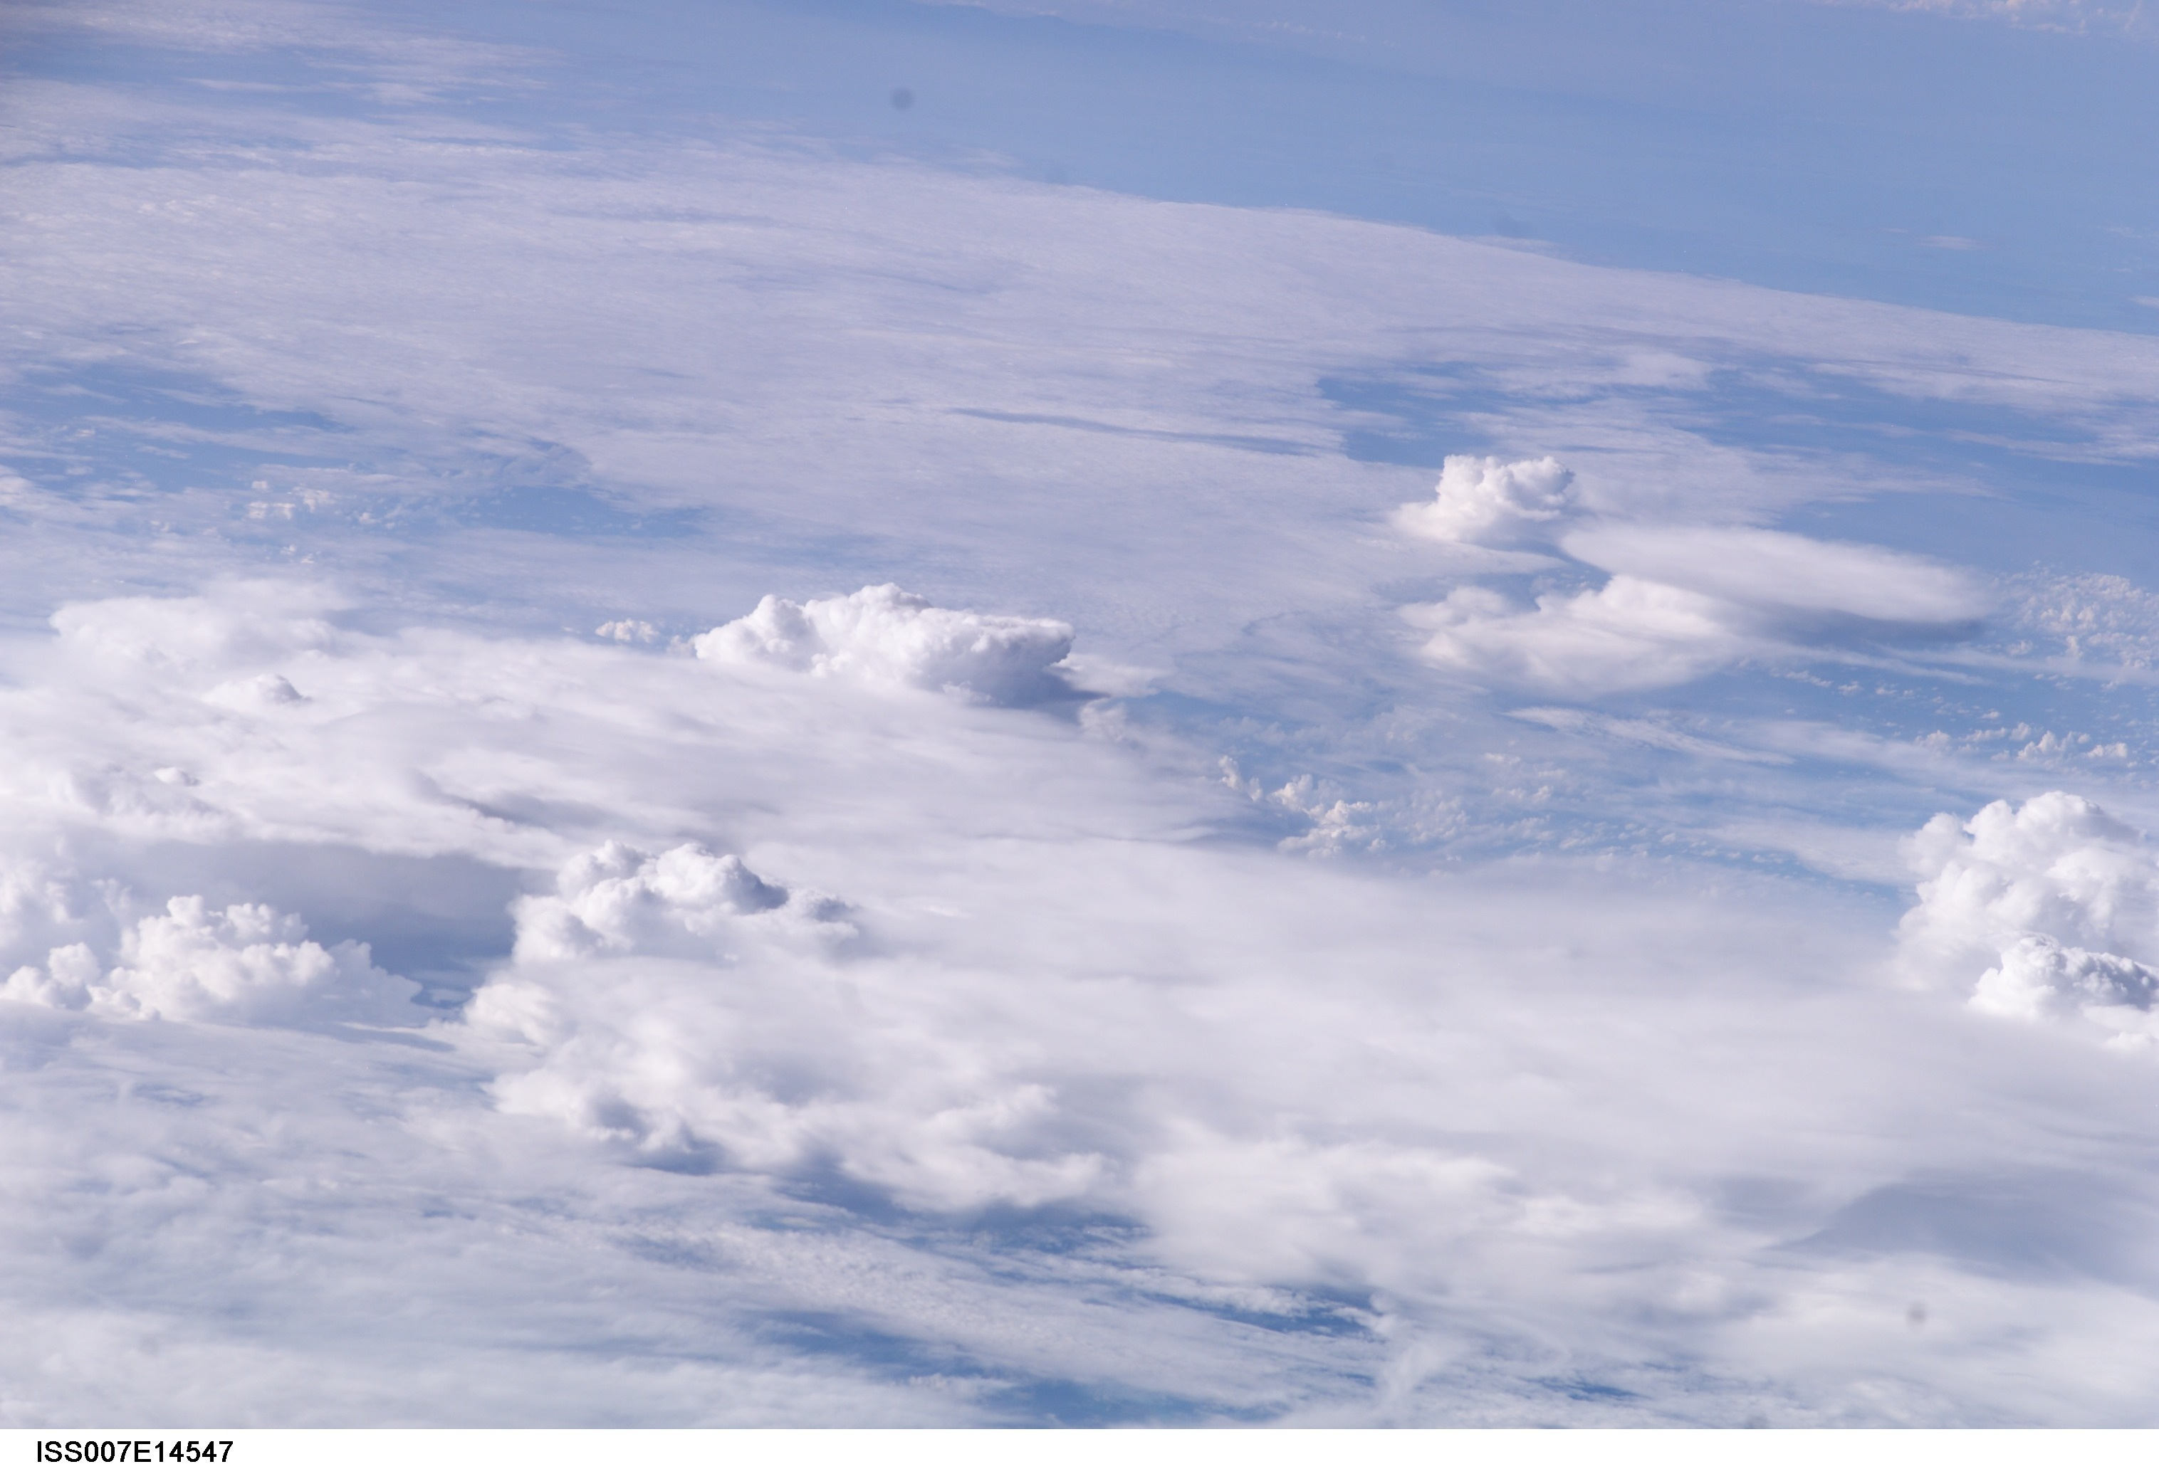
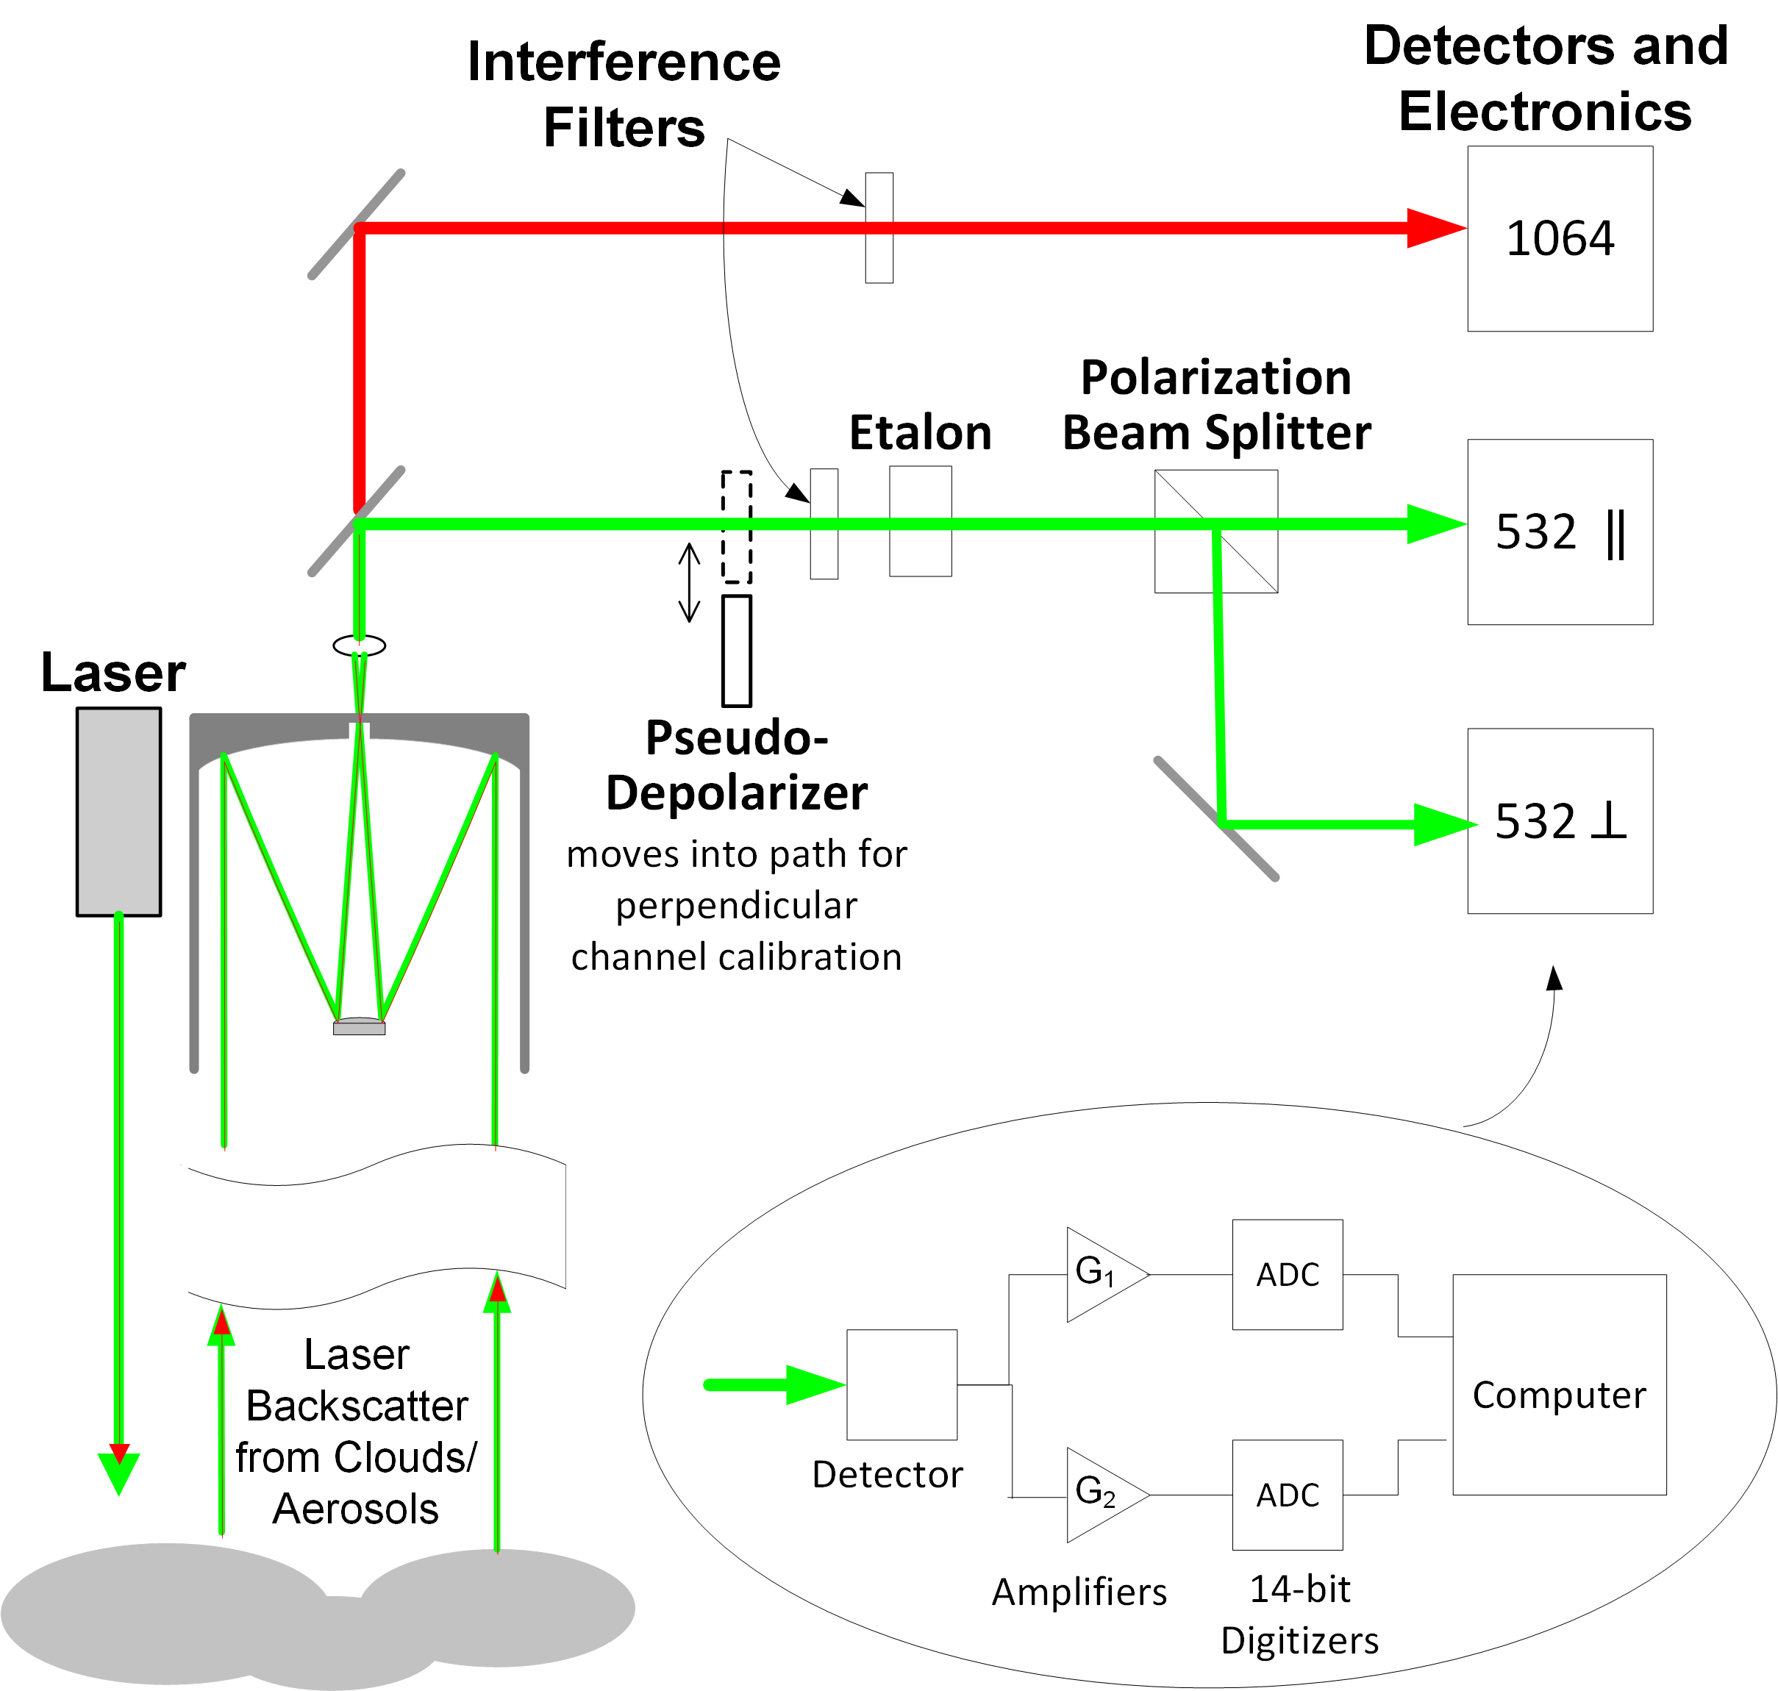
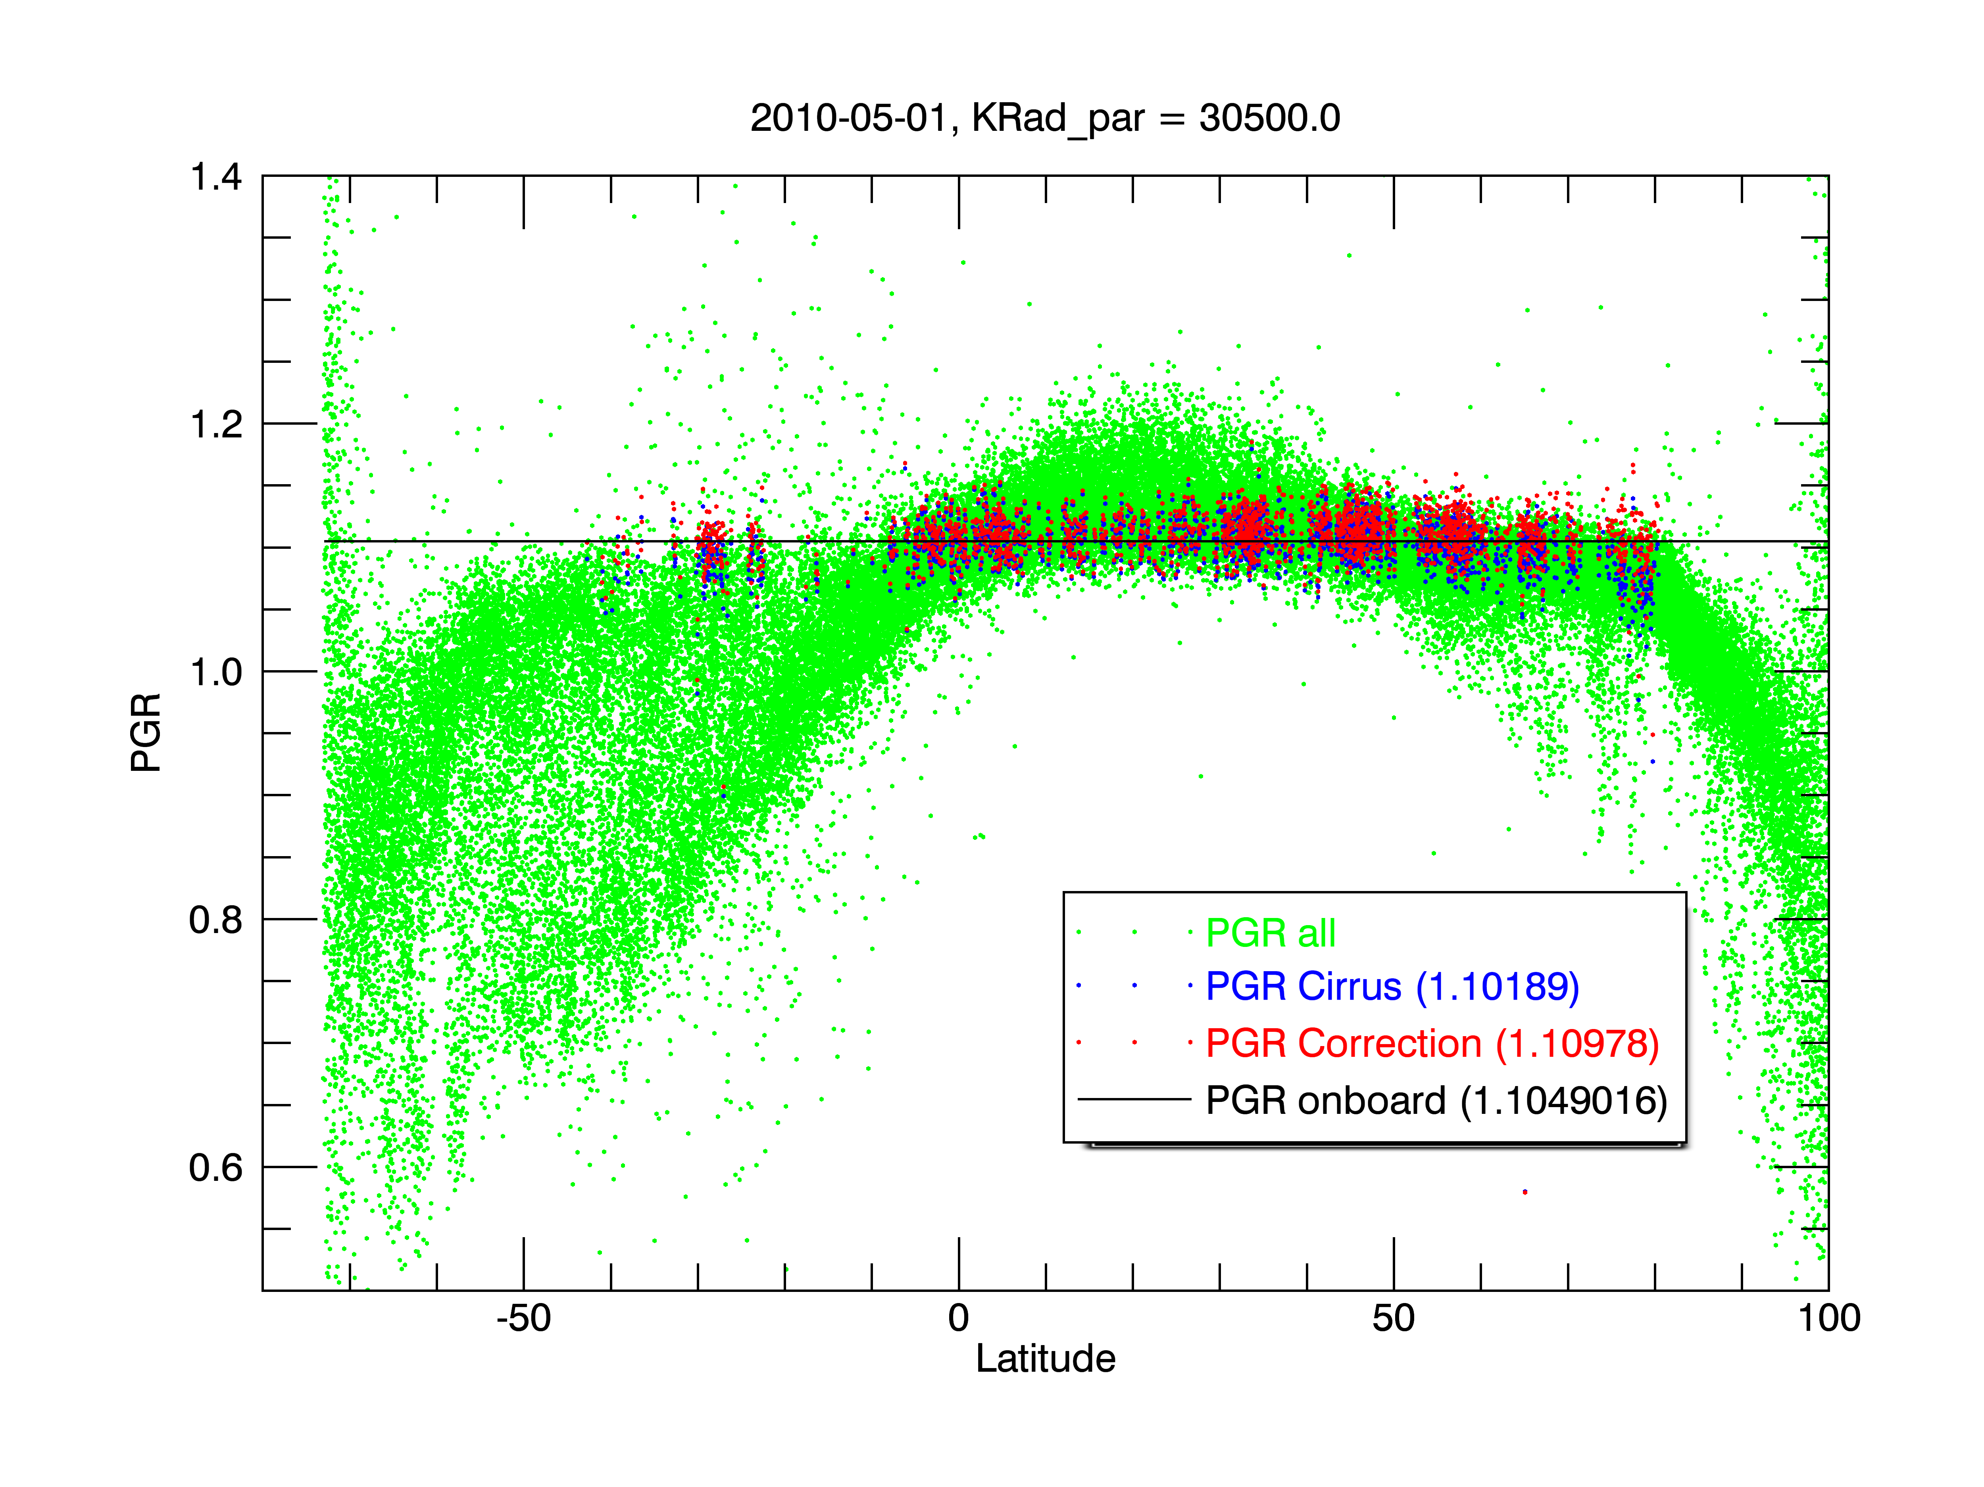
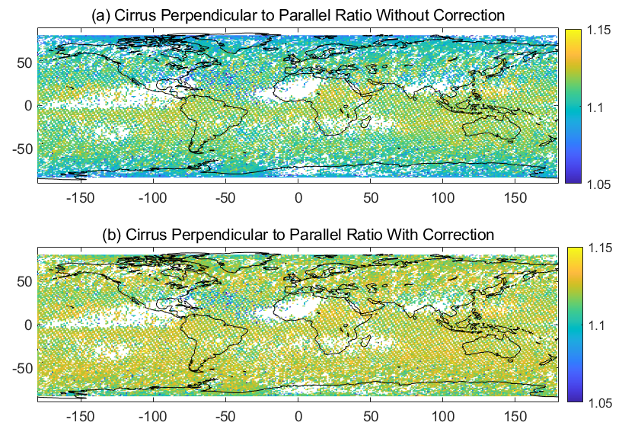
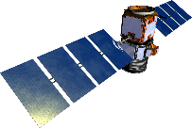
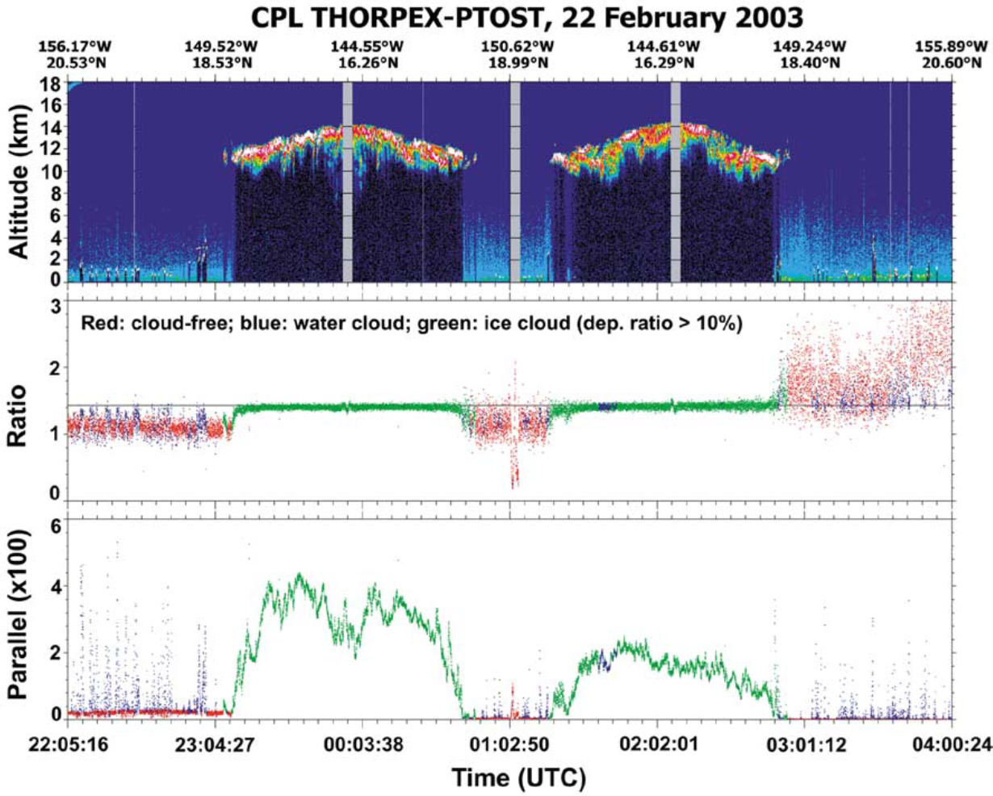
2nd LOGO
Polarization Calibration Using Solar Radiation Background Signal Scattered from Dense Cirrus Clouds in the Visible
and Ultraviolet Wavelength Regimes
Zhaoyan Liu¹, Yongxiang Hu¹, Pengwang Zhai², Shan Zeng³,
Mark Vaughan¹, Sharon Rodier³, and Xiaomei Lu¹
1 NASA Langley Research Center, Hampton VA USA
2 University of Maryland, Baltimore County, MD USA
3 Science Systems and Applications Inc., Hampton VA USA
Corresponding author: Zhaoyan.liu@nasa.gov
INTRODUCTION
METHODS
RESULTS
A previously developed technique [1], currently used to correct the daytime polarization calibration of the CALIPSO lidar [2], leverages the fact that the solar radiation background signals from dense cirrus clouds are largely unpolarized due to the internal multiple reflections within the non-spherical ice particles and the multiple scattering that occurs among these particles. Therefore, the ratio of polarization components of the cirrus background signals provides a good estimate for the polarization gain ratio (PGR) of the lidar.
Perpendicular to parallel ratio
Green: all data points
Blue: data points from high cirrus
Red: same as blue, but with molecular
scattering correction
Ice
Ice
Latitude
Fig. 5. One daytime orbit of CALIPSO measurement.
Water
Water
Fig. 3. CALIPSO Lidar
Sun
North
Zenith
Fig. 1. Polarization components for ice clouds (upper panels) and water clouds (lower panels).
VZA
Upwelling sunlight
SZA
Meridional plane
Fig. 6. Global map of perpendicular to parallel ratio (PPR) of sunlight scattered from high dense cirrus clouds without (a) and with (b) correction for the molecular scattering from one year (2008) of CALIPSO measurements. PPR shows a strong dependence on latitude due to the molecular scattering. The PPR distribution is more uniform with the correction for molecular scattering. The global mean is 1.107 and 1.120, respectively, without and with the correction.
Using airborne backscatter lidar measurements at 1064 nm, this “cirrus cloud background calibration” technique was demonstrated to work well in the infrared regime [1] and was used in the NASA’s space-borne CATS lidar.
RAA
Fig. 4. Geometry of lidar measurement.
CONCLUSIONS
However, molecular scattering is highly polarized and strongly dependent on the incident angle of the sun light and the view angle of the lidar receiver. In the visible and ultraviolet regimes, molecular contributions are too large to be ignored, and thus corrections must be applied to account for the highly polarizing characteristics of molecular scattering. Ignoring molecular scattering contributions can cause PGR errors of 2-3% at 532 nm, where the CALIPSO lidar makes its depolarization measurement. Because of the λ⁻⁴ wavelength dependence of molecular scattering, the PGR error can be even larger at the 355 nm wavelength that will be used by ESA’s EarthCARE lidar. To correct the molecular scattering contributions to the lidar received solar background signal, a look-up table of bidirectional reflectance from air molecules has been created using a polarization-sensitive radiative transfer model [3] as a function of incident sunlight zenith angle (SZA), lidar viewing zenith angle (VZA) and their relative azimuth angle (RAA) (Fig. 4) as well as the altitude of cirrus clouds.
We developed a molecular scattering correction to extend a previously developed 1064 nm polarization calibration technique to the visible and UV regimes where molecular scattering contributes significantly to the total background signal. Unlike CALIPSO’s periodic onboard calibration, which inserts an in-line pseudo depolarizer (Fig. 3), our technique can be applied to all daytime measurements of dense cirrus. NASA’s space-based CATS lidar used our method for all polarization calibrations and CALIPSO now uses it for its 532 nm daytime data [2]. Our technique could also be used by the 355 nm EarthCARE lidar, where the molecular scattering will be ~5 times larger than that at 532 nm.
Fig. 2. Example of airborne lidar observations. (Upper panel) Attenuated backscatter at 1064 nm, (middle panel) perpendicular-to-parallel component ratio, and (lower panel) parallel component of sunlight background signals. The green dots in the middle and lower panels are data points from the high cirrus clouds, blue from the low dense water clouds.
REFERENCES
1. Liu et al., IEEE Geosci. Remote Sens. Lett., 1, 157–161, 2004.
2. Vaughan et al., Reviewed & Revised Papers Presented at the 30th International Laser Radar Conference (ILRC), J. Sullivan and T. Leblanc, Eds.
3. Zhai et al., JQSRT, 111, 1025-1040, 2009

