Slide 1

NRC Informational Presentation
- Aircraft Capability Portfolio
January 26, 2023
Notes:
​(Jan. 21, 2022) --- The waning gibbous Moon is pictured above the Earth's horizon as the International Space Station orbited 272 miles above the Atlantic Ocean off the coast of southern Argentina.

Slide 2
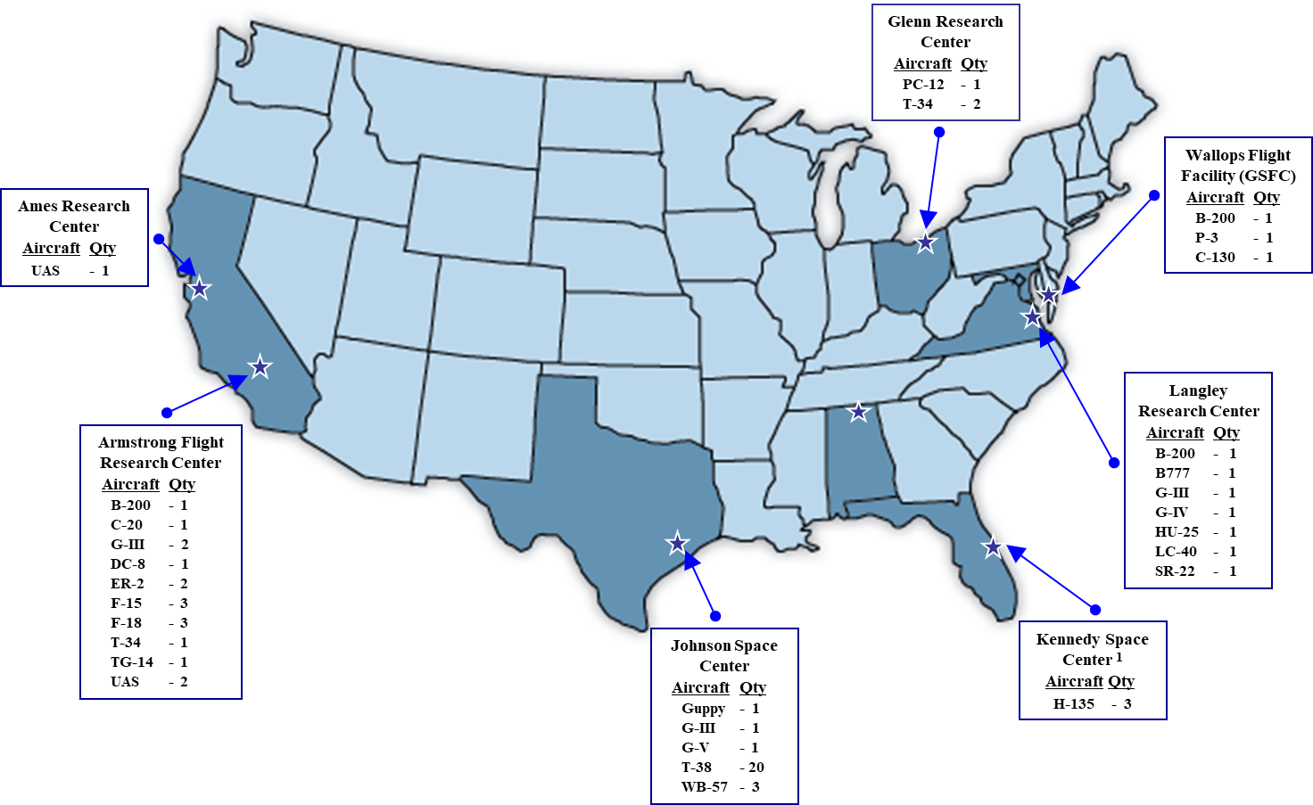
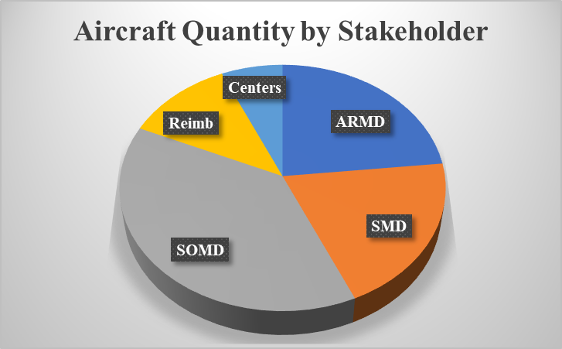
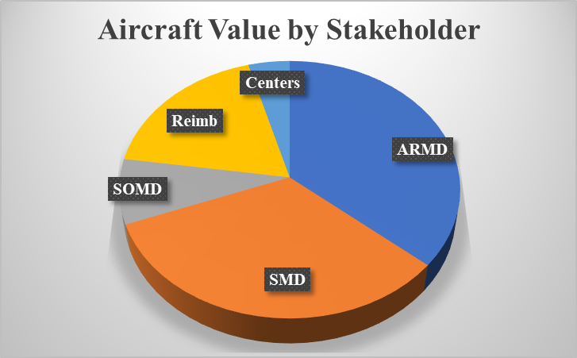
sUAS capability management delegated to Center Directors
Overview of Aircraft Capability Portfolio
Eastern Acft Region
Western Acft Region
Southern Acft Region
Notes:
General description of SETMO in notes
Management: Insert Director’s name
Staffing:
management office - FTE
management office - WYE
Center O&M - FTE
Center O&M – WYE
Governance:
Applicable NPR
Applicable Boards
Review Board timeframes?
Agency Performance Goals, as listed in the Volume of Integrated Performance VIPer) (if applicable)
E.g. Advance, 4.2.5: Maximize the availability of the SETMO portfolio of assets to meet NASA’s current and future test facility needs.

Slide 3
Aircraft Capability Portfolio Description
60 operational aircraft, including capital-asset UAS, maintained and operated by 3 aircraft regions
Enables the Agency’s missions and its strategic objectives
  Astronaut Training, e.g., T-38
  Astronaut Return, e.g., Gulfstream G-V
  Space Operations, e.g., Super Guppy
  Heliophysics, e.g., G-IV
  Airborne Science, e.g., Boeing 777, P-3, G-III
  Aeronautics Research, e.g., F-15 and F-18
  Security and environmental surveys, e.g., H-135
  Reimbursable Missions
Notes:
General description of SETMO in notes
Management: Insert Director’s name
Staffing:
management office - FTE
management office - WYE
Center O&M - FTE
Center O&M – WYE
Governance:
Applicable NPR
Applicable Boards
Review Board timeframes?
Agency Performance Goals, as listed in the Volume of Integrated Performance VIPer) (if applicable)
E.g. Advance, 4.2.5: Maximize the availability of the SETMO portfolio of assets to meet NASA’s current and future test facility needs.

Slide 4
Aircraft Capability Management
As with other US Federal agencies, NASA’s aircraft operational authority stems from 49 U.S. Code § 40102 (a) (41)
  Except for National Air Space (NAS) requirements, NASA aircraft operations are not regulated by the FAA.
  Airworthiness, maintenance, and operations are self-certified to standards and requirements established by Office of Safety and Mission Assurance (OSMA)
    NASA Procedural Requirements (NPR) 7900
  Except for (1) passenger carriage and (2) commercial purpose transports.
NASA Aircraft Capability Management Model
  Mission requirements established by NASA Mission Directorates (MDs), e.g., Aeronautics Research Mission Directorate (ARMD), Science Mission Directorate (SMD), and Space Operations Mission Directorate (SOMD)
  Operational and maintenance standards established by Office of Safety and Mission Assurance (OSMA)
  Strategic asset and capability stewardship by the Aircraft Capability Management Office (ACMO)
  Capability delivery by center flight operations
Notes:
General description of SETMO in notes
Management: Insert Director’s name
Staffing:
management office - FTE
management office - WYE
Center O&M - FTE
Center O&M – WYE
Governance:
Applicable NPR
Applicable Boards
Review Board timeframes?
Agency Performance Goals, as listed in the Volume of Integrated Performance VIPer) (if applicable)
E.g. Advance, 4.2.5: Maximize the availability of the SETMO portfolio of assets to meet NASA’s current and future test facility needs.

Slide 5
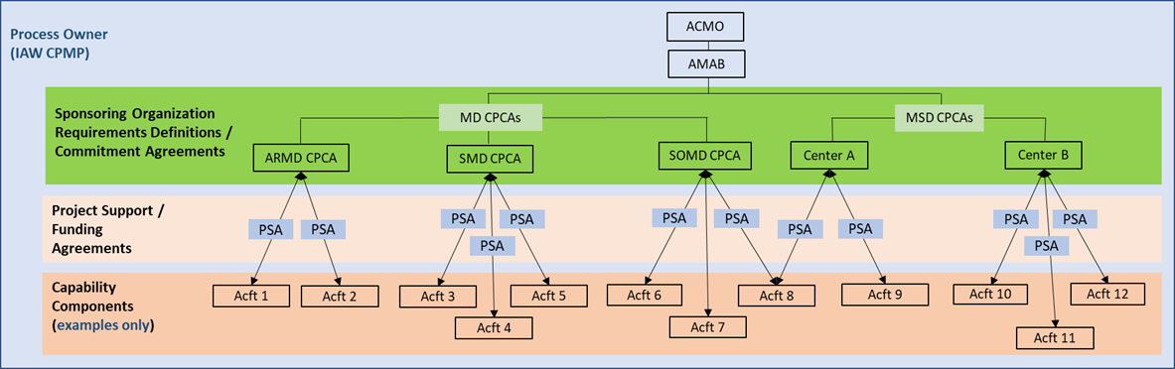
Aircraft Capability Management Construct
ACMO formed at the beginning of FY22.
  Office of 3
Tasked to strategically manage of NASA aircraft acquisition, utilization, and disposal (AUD), including assignment of aircraft.
  Decision-making through the Aircraft Management Advisory Board (AMAB)
    Voting members – ARMD, SMD, SOMD and 3 regional aircraft leads
    ACMO Chair
    Multiple standing non-voting members – OCE, OCFO, OGC, OP, OSI, & OSMA
Notes:
General description of SETMO in notes
Management: Insert Director’s name
Staffing:
management office - FTE
management office - WYE
Center O&M - FTE
Center O&M – WYE
Governance:
Applicable NPR
Applicable Boards
Review Board timeframes?
Agency Performance Goals, as listed in the Volume of Integrated Performance VIPer) (if applicable)
E.g. Advance, 4.2.5: Maximize the availability of the SETMO portfolio of assets to meet NASA’s current and future test facility needs.

Slide 6

Aircraft Capability Portfolio Outlook
Work in progress
  Capability Portfolio Management Plan (CPMP)
  Capability Portfolio Commitment Agreements (CPCAs)
    CPCA to be established between each requirements owner and centers providing the capability
    Documents MD budget/funding commitment and Center aircraft service commitment
  Aircraft Fleet Management Groups to consolidate and standardize operational and support practices and procedures
Continue maturation of Aircraft Capability Portfolio management processes, procedures, and documentation
Forge ahead toward increased collaboration and reduced redundancy
Notes:
General description of SETMO in notes
Management: Insert Director’s name
Staffing:
management office - FTE
management office - WYE
Center O&M - FTE
Center O&M – WYE
Governance:
Applicable NPR
Applicable Boards
Review Board timeframes?
Agency Performance Goals, as listed in the Volume of Integrated Performance VIPer) (if applicable)
E.g. Advance, 4.2.5: Maximize the availability of the SETMO portfolio of assets to meet NASA’s current and future test facility needs.

Slide 7
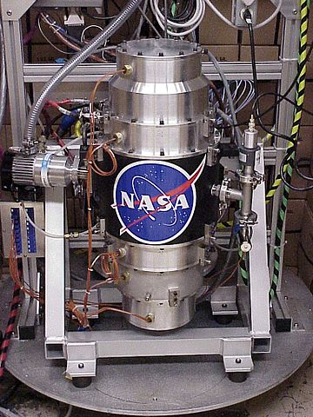
Backup
Notes:
Fly wheels, such as the NASA G2 flywheel module above, are one way to store rotational energy for use by spacecraft or machines on Earth. NASA’s looking for new energy storage systems to enable our future exploration missions.

Slide 8
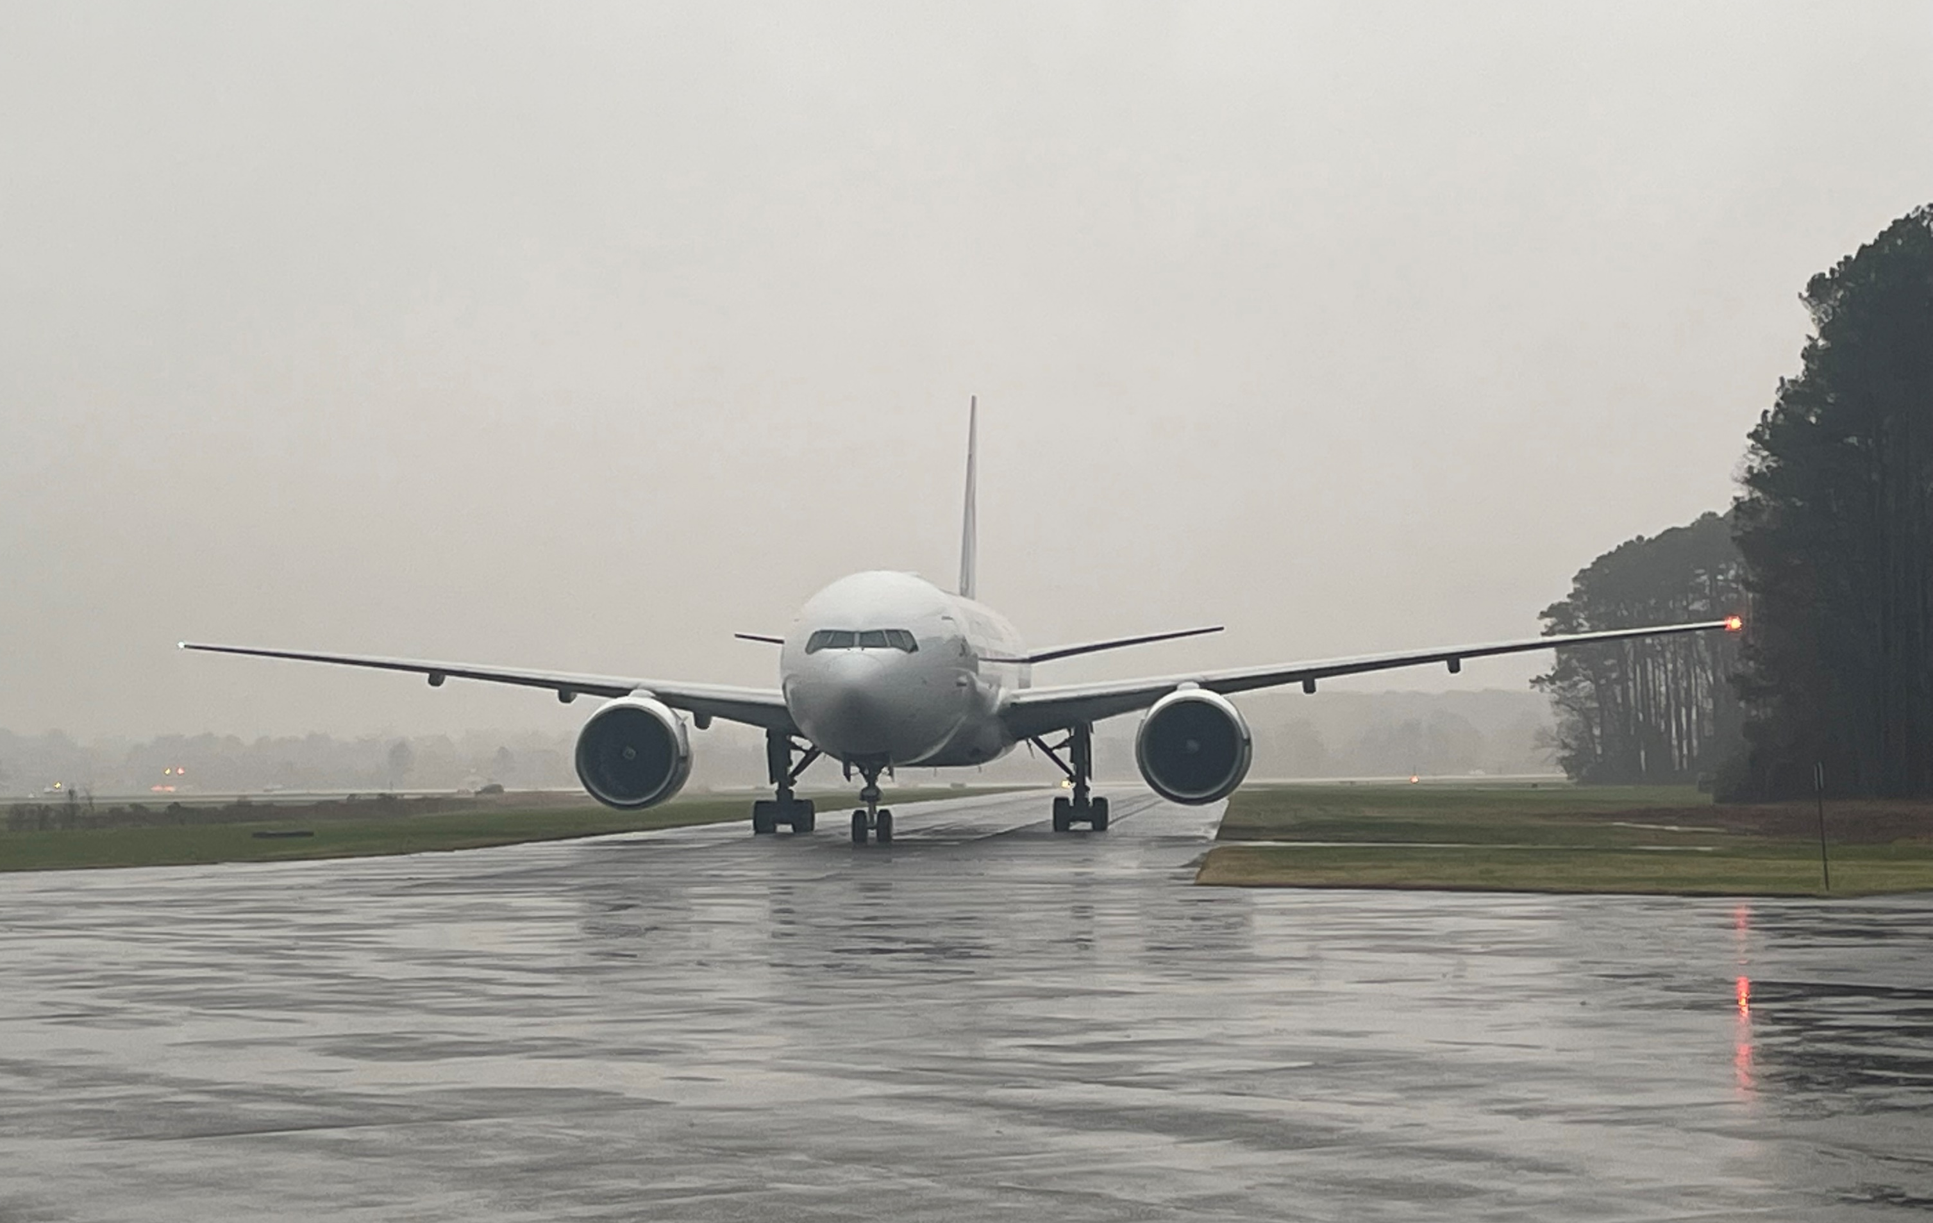

Slide 9
