Slide 1
Landing Humans and
Human-Class Cargo on the Moon and Mars
Lakiesha Hawkins Deputy Program Manager Human Landing System Program
IEEE Conference
Big Sky, Montana March 6, 2023

Slide 2
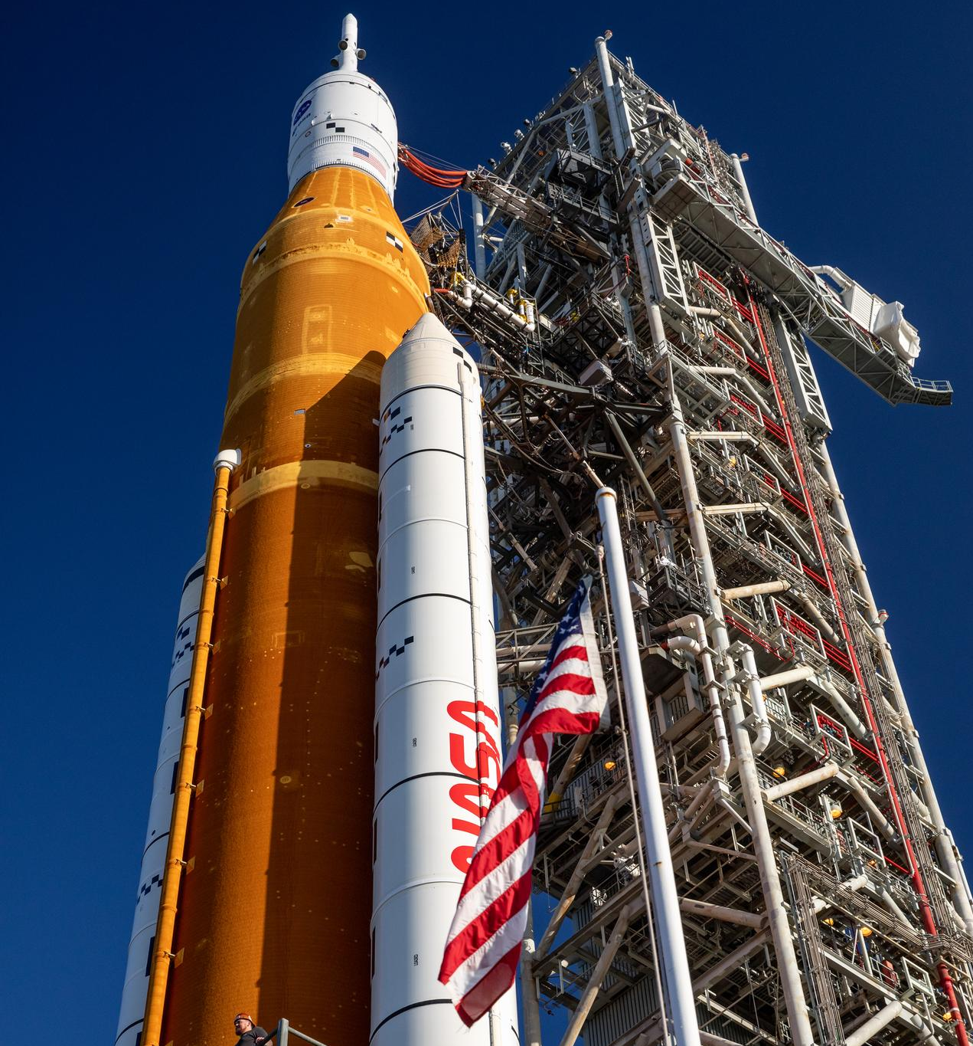
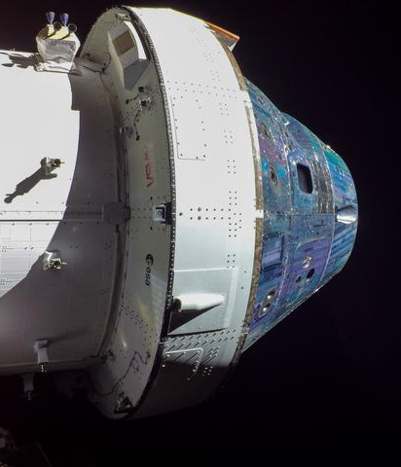
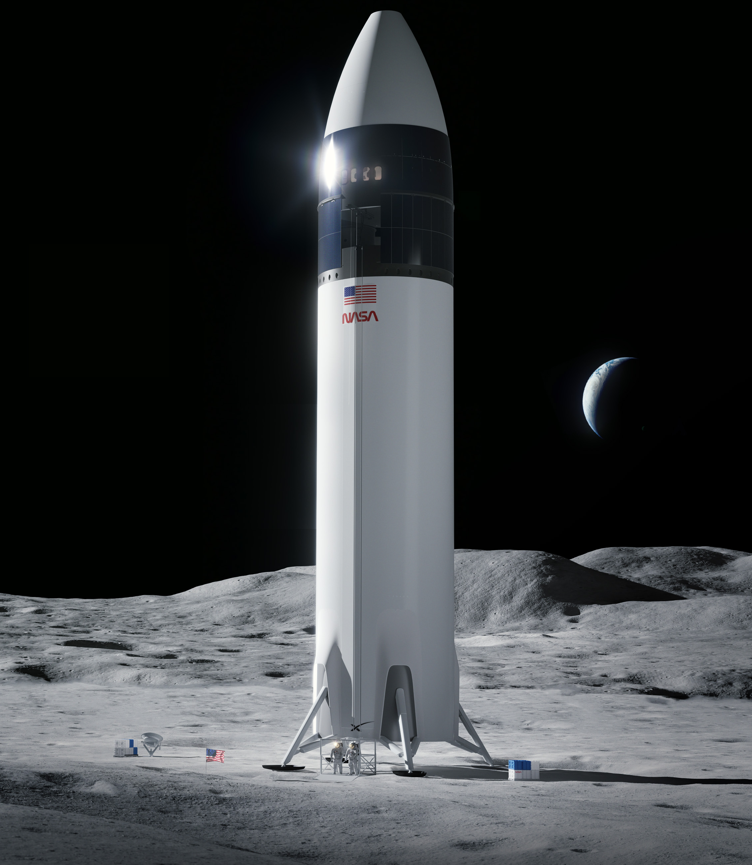
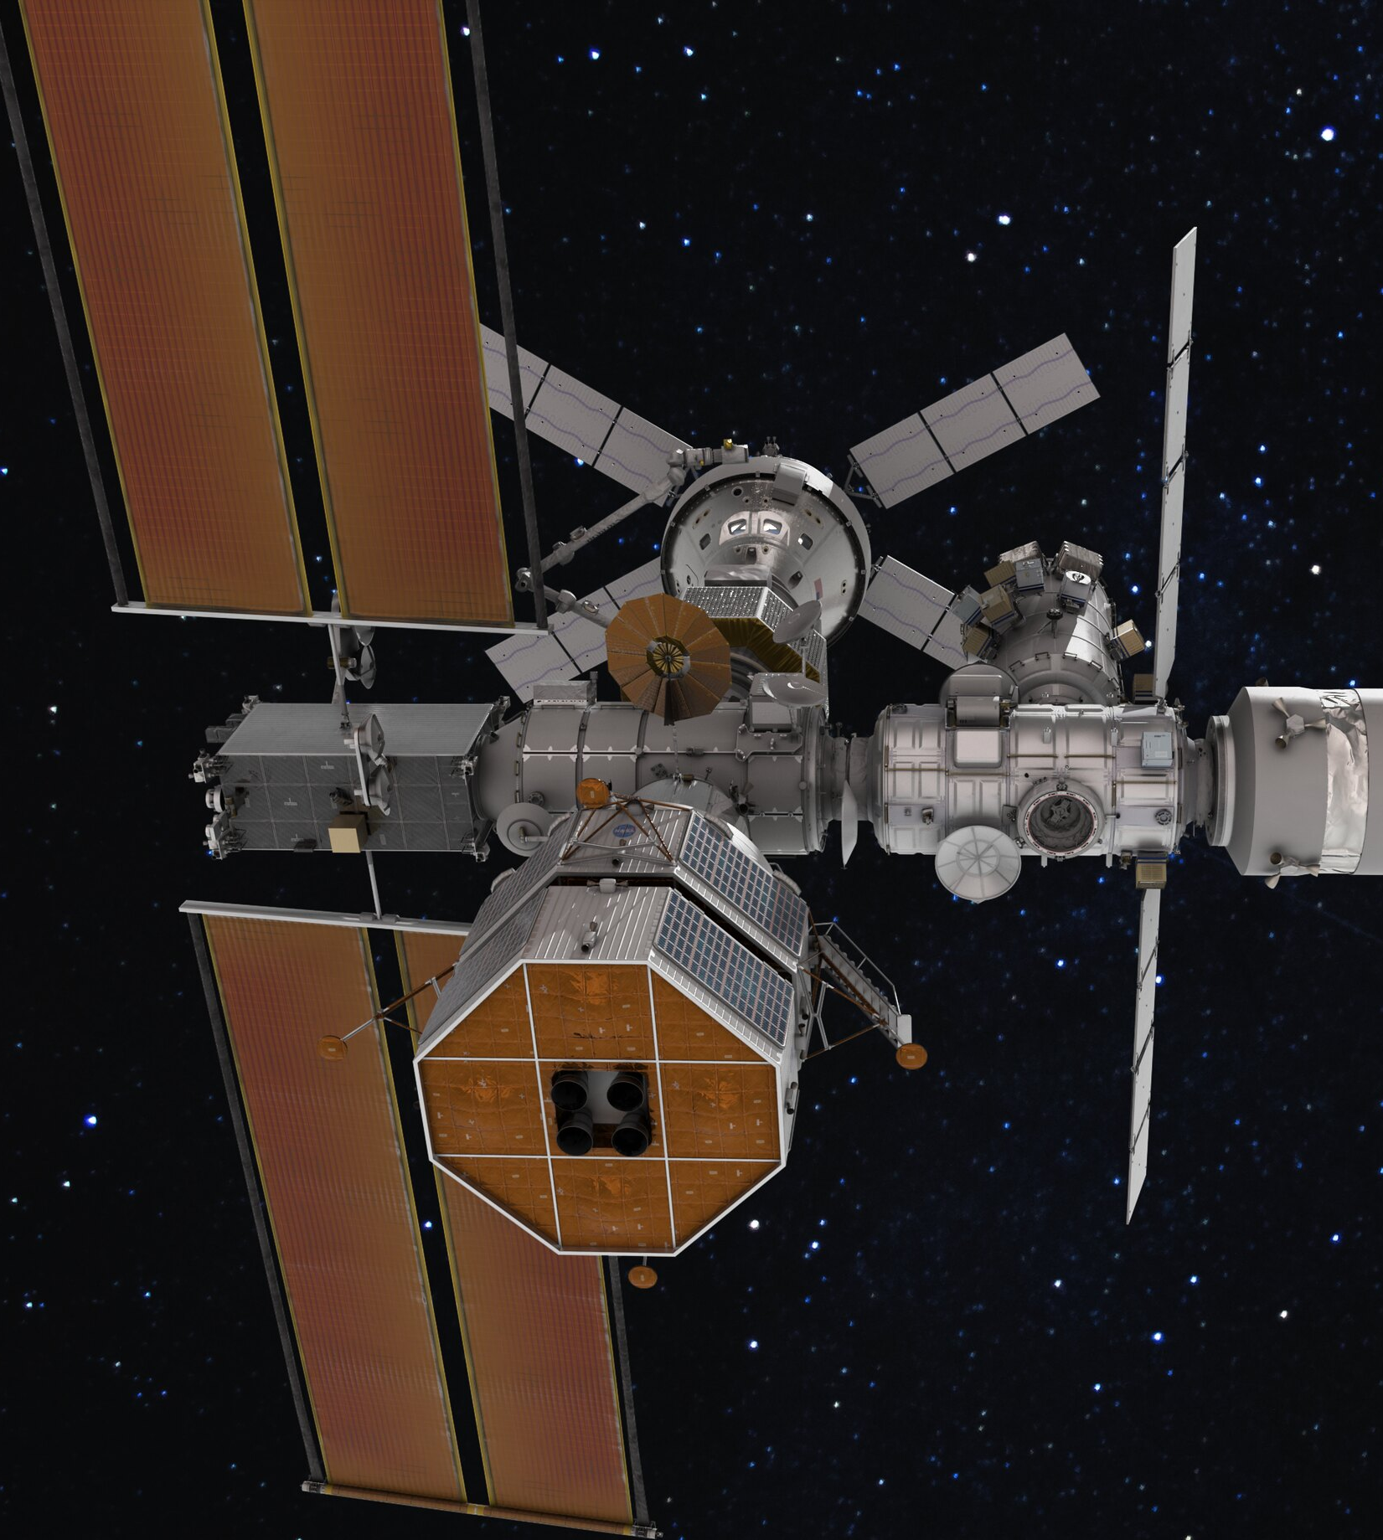

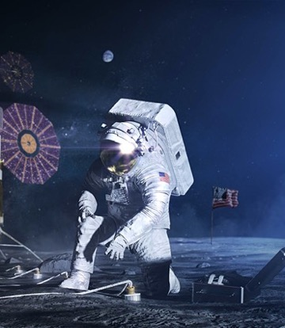
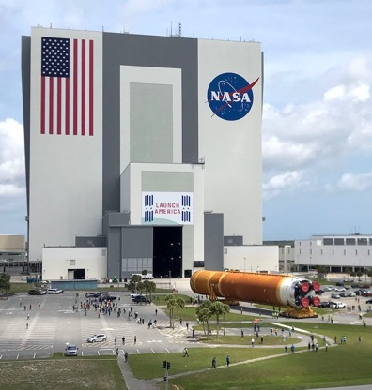
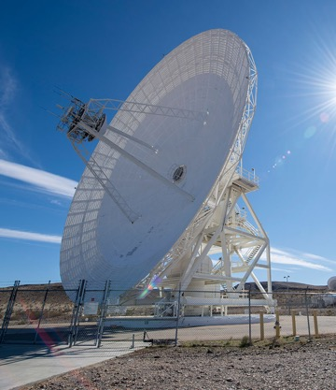
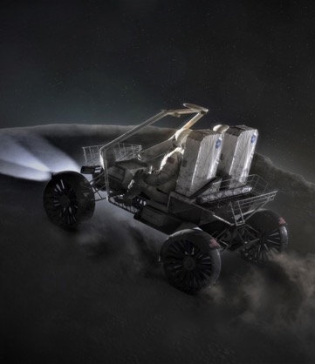

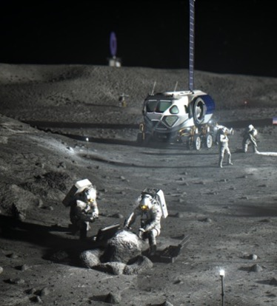
Artemis: A Foundation for Deep Space Exploration
Space Launch System
Orion spacecraft
Human Landing System
Gateway
Human Landing System
Surface Operations
Space Communications & Navigation
Exploration Ground Systems
Surface Mobility
Spacesuits
Artemis Base Camp

Slide 4
Human Landing System Acquisition Plans
Artemis III
First Crewed Demo
First Uncrewed Demo
SpaceX Initial Lunar Development
(Option A)
Initial Lunar Development
and Mission with Orion
Future Crewed Artemis Mission
SpaceX Sustaining Lunar Development
(Option B)
Preliminary Design
Sustaining Lunar Dev
NEW COMPETITION
Sustaining Lunar Development
(Appendix P)
(open to industry)
Future Crewed Artemis Mission
Uncrewed Demo
Acquisition
Sustaining Lunar Dev
First Lunar
Transport Mission
Next Lunar
Transport Mission
Sustaining Lunar Transport Services
(open to industry)
Sustaining Lunar Transport Task Orders
Acquisition

Slide 5



Human Landing System (HLS) Procurement Path
DESIGN STUDIES, RISK REDUCTION, AND INITIAL DEVELOPMENT
FULL DEVELOPMENT AND DEMONSTRATION
RECURRING TRANSPORTATION SERVICES
Initial Lander Studies and Risk Reduction
(Appendix E)
2018-2020
Aerojet Rocketdyne
Blue Origin
Boeing
Dynetics
Lockheed Martin
Masten Space Systems
Northrop Grumman
OrbitBeyond
Sierra Nevada Corporation
SpaceX
SSL
SpaceX Uncrewed Lunar Demo-A
Sustaining
Lunar Transport
(Future task order solicitation to deliver humans and human-class cargo)
SpaceX Crewed Lunar Demo-A
Full Development and Initial Demonstration
(Appendix H Option A)
2021-
Awarded to SpaceX
Initial Lander Development
(Appendix H Base Period)
2019-2021
Blue Origin Federation
Dynetics
SpaceX
SpaceX Crewed Lunar Demo-B
Sustainable Lander Studies and Risk Reduction
(Appendix N)
2021-
SpaceX only
Evolution from Initial to Sustaining
(Appendix H Option B)
Blue Origin
Dynetics
Lockheed Martin
Northrop Grumman
SpaceX
Parallel efforts to develop sustaining landers to deliver humans and human-class cargo
Company2 Uncrewed Lunar Demo
Contract Completed
Contract In Execution
Future Contract
Lunar Demo Flight
Company2 Crewed Lunar Demo
Open to all U.S. Industry except SpaceX
Sustaining Lunar Development
(Appendix P)
www.nasa.gov/nextstep

Slide 6
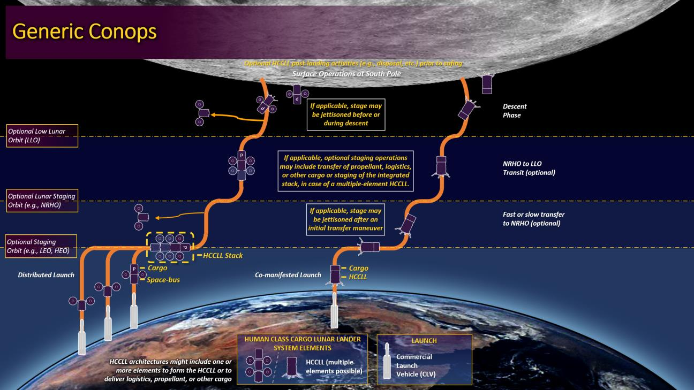

Slide 7
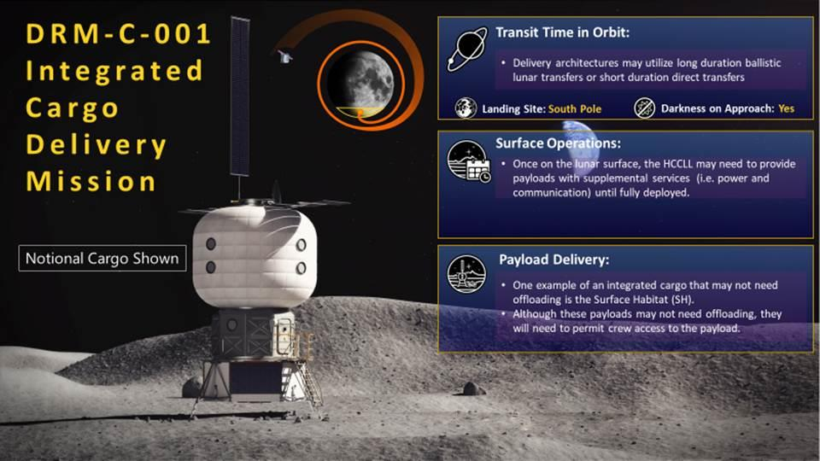

Slide 8
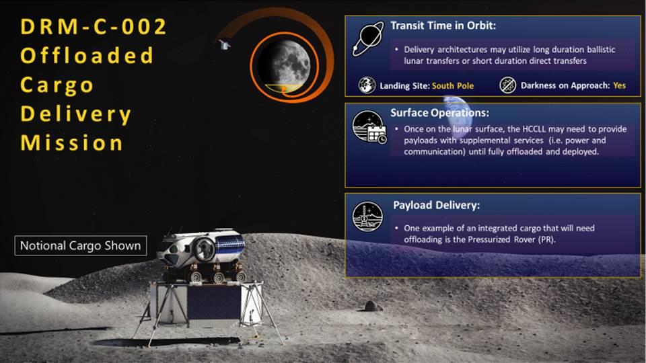

Slide 9
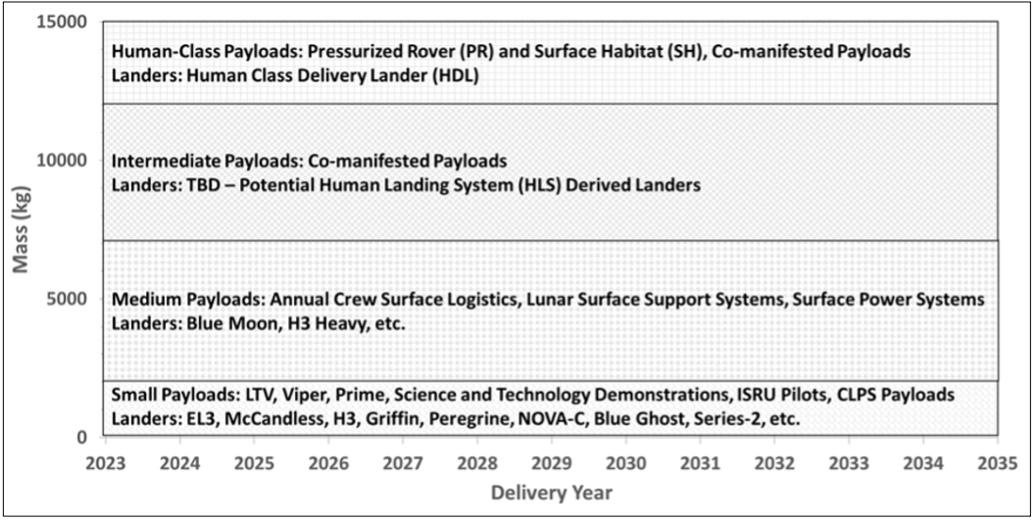
Payload Stratifications

Slide 10
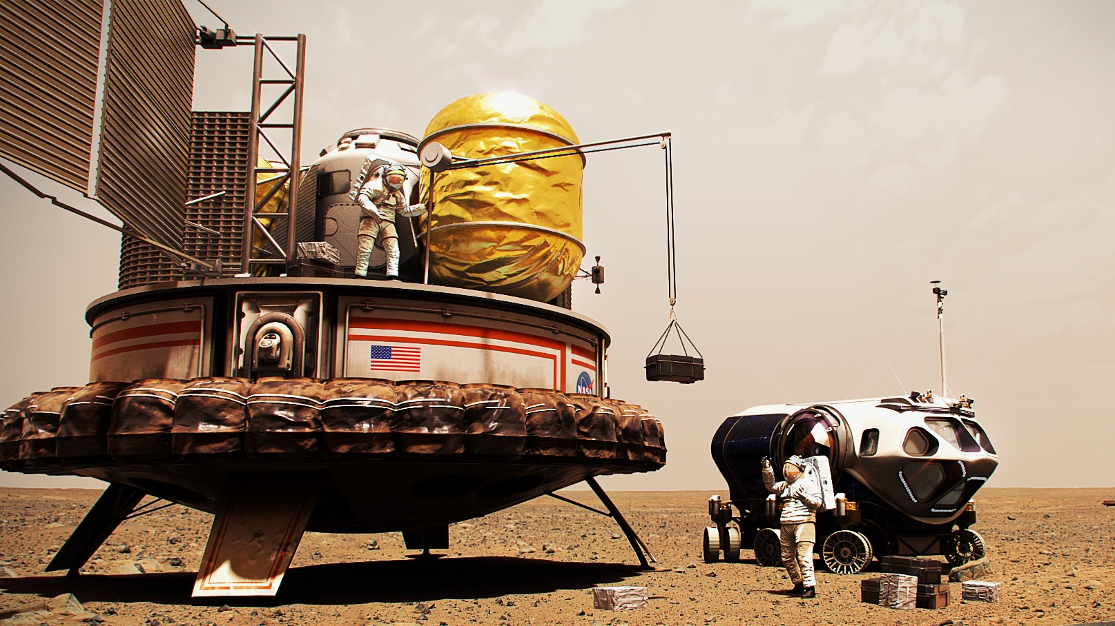
Landing Humans and Cargo on Mars

Slide 11
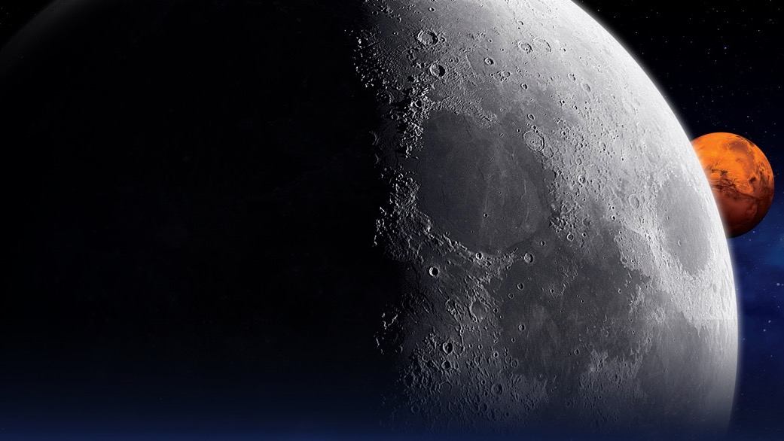
QUESTIONS?
Notes:
LRO image

Slide 12

Follow the missions

