Slide 1
Principal Component-based Radiative Transfer Model (PCRTM) for Hyperspectral Remote Sensors for UV, VVIS, NIR, IR, and FIR Spectral Regions
Xu Liu¹ (Presented by Q. Yang)
Q. Yang^{1,2}, W. Wu¹, X. Xiong¹, M. Zhao², P. Yang³, R. Spurr⁴, D. K. Zhou¹, and A. M. Larar¹
  ¹NASA Langley Research Center, Hampton, VA
  1SSAI, Hampton, VA
  ³Texas A & M, College Station, TX, USA
  ⁴RT Solution, Cambridge, MA, USA

Slide 2
There are two key challenges in exploring information content of hyperspectral sounders
Challenge No. 1: computation speed of Radiative Transfer Model (RTM)
  Line-by-line: millions of monochromatic radiative transfer (RT) calculations
  Channel-based RTMs: thousands of polychromatic RT calculations
  Principal Component (PC)-based RTMs: hundreds of monochromatic RT calculations
Challenge No. 2: need effective methods to deal with clouds
  90% of sounder FOVs contain clouds – need accurate and fast cloudy RTMs
  Only 5-20% of channels due to RTMs speed and cloud RT accuracy limitations
  Fitting cloud-cleared radiances does not satisfy radiometric closure requirement
Principal Component-based RTM (PCRTM) addresses these challenges
  Very fast
  Includes all spectral channels using PC scores

Slide 3
Principal Component Based Radiative Transfer Model (PCRTM)
PCRTM was specifically for hyperspectral remote sensors
  Number of RT calculations are << number of spectral channels
    Orders of magnitude faster than LBL RTMs
  RT calculations done monochromatically
    Physical-based RTM and accurate relative to LBL RTMs
  Provides analytical Jacobian needed for satellite data inversions
Sensor | Channel Number | PC score (seconds)
CLARREO, 0.1 cm⁻¹ | 19901 | 0.014 s
CLARREO, 0.5 cm⁻¹ | 5421 | 0.011 s
CLARREO, 1.0 cm⁻¹ | 2711 | 0.0096 s
IASI, 0.25 cm⁻¹ | 8461 | 0.011 s
AIRS, 0.5-2.5 cm⁻¹ | 2378 | 0.0060 s
CrIS,0.625-2.5 cm⁻¹ | 1317 | 0.0050 s
NAST-I, 0.25 cm⁻¹ | 8632 | 0.010 s
S-HIS, 0.5 cm⁻¹ | 4316 | 0.008 s
CrIS, 0.625 cm⁻¹ | 2211 | 0.009 s
Multiple scattering clouds and aerosols included
Wide range of spectral coverage
  Thermal: 50-3000 cm⁻¹
  Solar: 200 nm – 2500 nm
  Suitable for AIRS, CrIS, IASI, PREFIRE, IRS, IASI-NG, NAST-I, S-HIS, CLARREO, CPF, SBG, TEMPO, OMI, SCIAMACHY …
Fast:
  Milliseconds to fraction of seconds in IR
  3-4 orders of magnitude faster than LBL in solar
Accurate relative to LBL:
  Thermal: Bias error < 0.002 K RMS error < 0.03 K
  Solar: bias error < 0.001%, RMS error ~0.05%

Slide 4
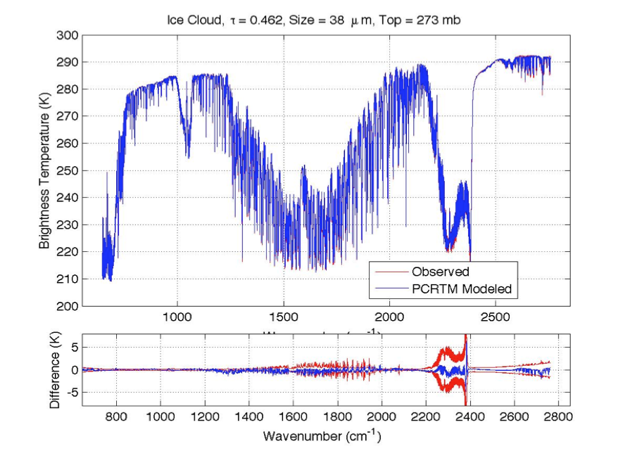
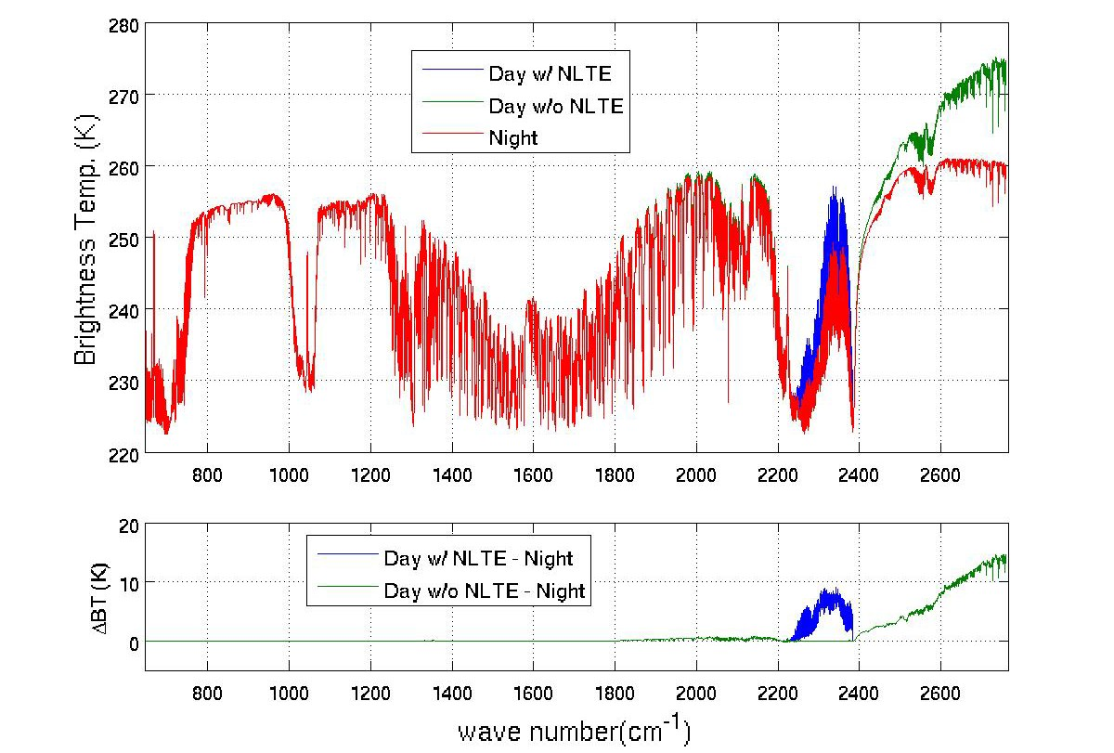
PCRTM Calculated Radiance Spectra Agree Well With Satellite Observations
IASI
CrIS
AIRS
Two PCRTM-based retrieval algorithms developed:
  L2 products: Single Field-of-view Sounder Atmospheric Product (SiFSAP)
L3 Products: Climate Fingerprinting Sounder Products (ClimFiSP)
  Both products will be available at NASA GES DISC for public access
Please visit Dr. Xu Liu’s poster (13p.04) on Tuesday, March 23 for all the exciting results
MODIS L2 + CPF simulator @646nm

Slide 5
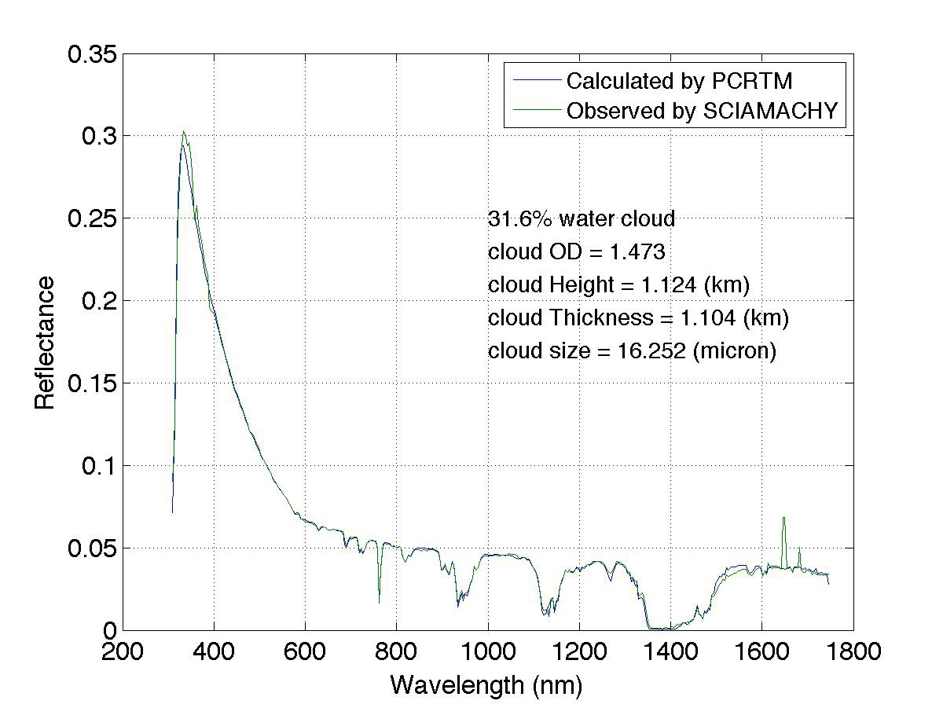
PCRTM Reduces RT Calculations by 3-4 Oders of Magnitude Relative to Correlated- Method for CPF-type Spectrometer
SCIAMACHY
PCRTM | nmo | nch | npc | nsmo | Speed -up
Land (8 nm) | 259,029 | 546 | 220 | 262 | 988
Ocean (8 nm) | 259,029 | 546 | 267 | 240 | 1079
Number of radiative transfer calculations for PCRTM are reduced by 3 orders of magnitude relative to modtran for spectral range from 300 nm to 2500 nm
PCRTM | M1 | M2 | Speedup to Regular PCRTM- SOLAR | Speedup to MODTRAN5
Land 8 nm | 263 | 49 | 5 | 5286
Ocean 8 nm | 241 | 23 | 10 | 11,262
Hybrid Stream method further speed up PCRTM-SOLAR by another factor of 5-10 relative to 32-stream PCRTM
(Xu.Liu-1@nasa.gov )
MODIS L2 + CPF simulator @646nm

Slide 6
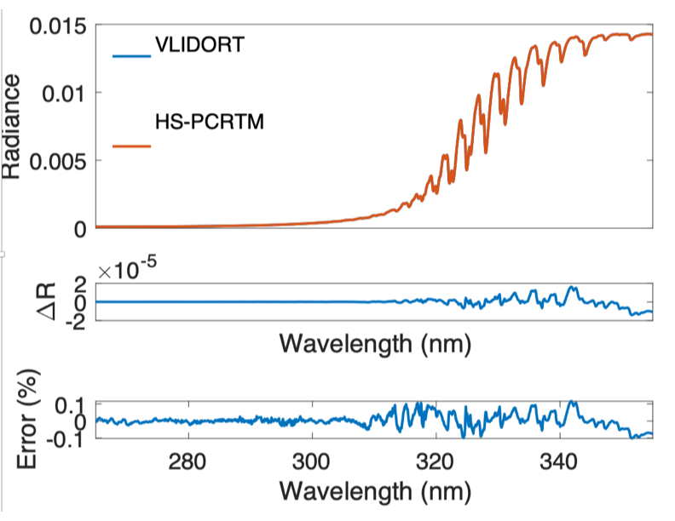
Example of HS-PCRTM Accuracy Relative to VLIDORT for TEMPO/OMI Ozone Spectral Region
The Hybrid Stream PCRTM (HS-PCRTM) can further reduce the computational time
  Perform 2-stream monochromatic RT calculations at original PCRTM selected frequencies
  Perform higher streams RT calculations at even less monochromatic frequencies
  The accuracy is not comprised (see example below)

Slide 7

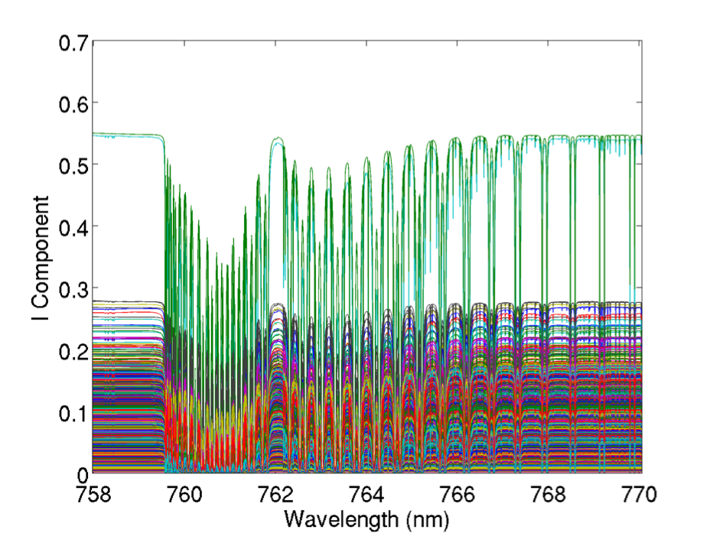
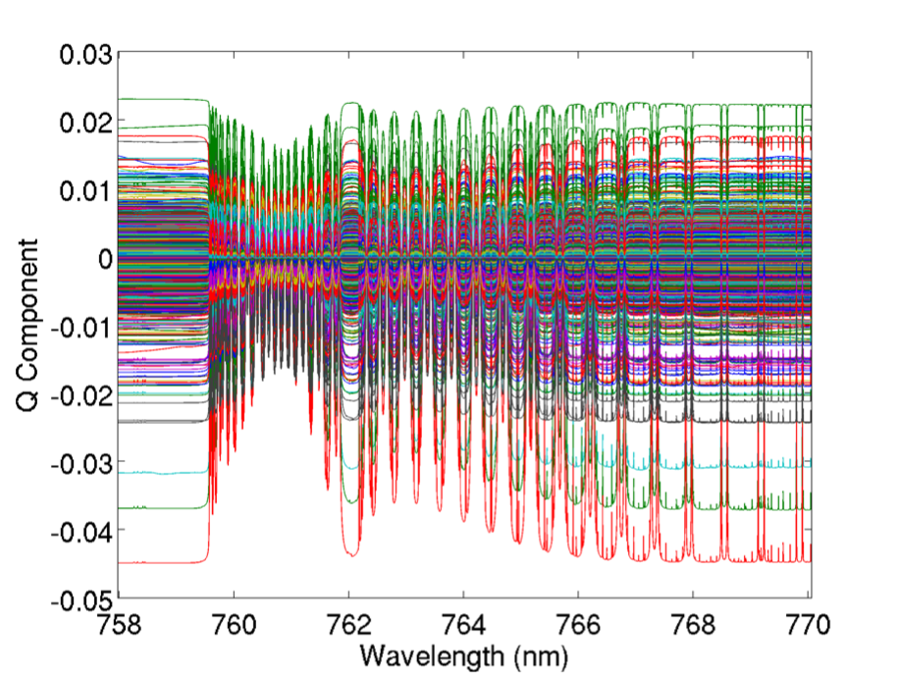
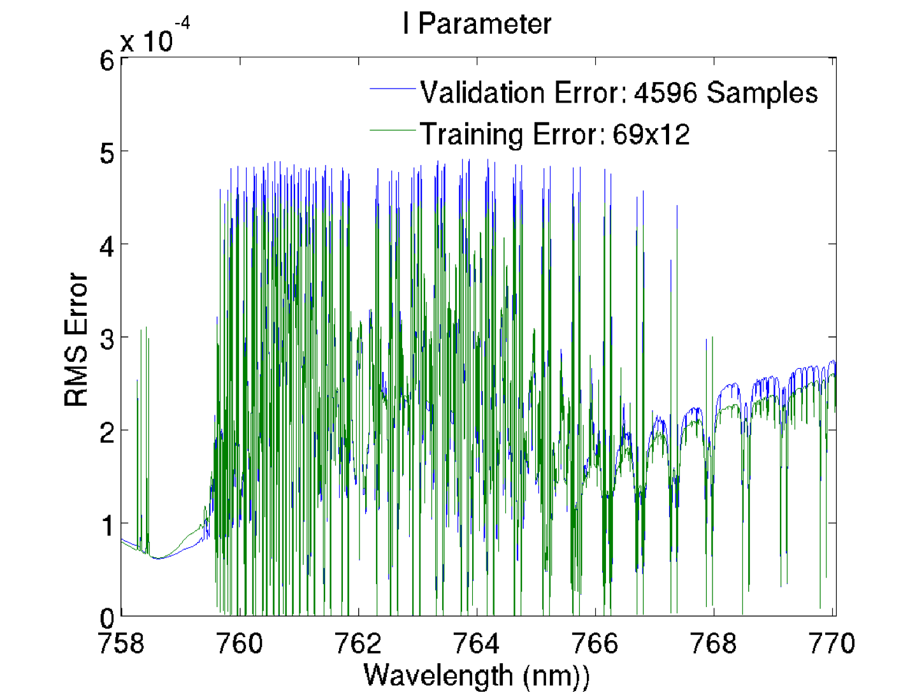
Example of PCRTM for very high spectral resolution(0.001 nm) polarized O₂-A band
Only 12 monochromatic RT calculations are needed to faithfully represent the 0.001 nm O₂-A band
A few dozens more monochromatic RT calculations are needed to include Q, U polarized components of the Stokes vector

Slide 8
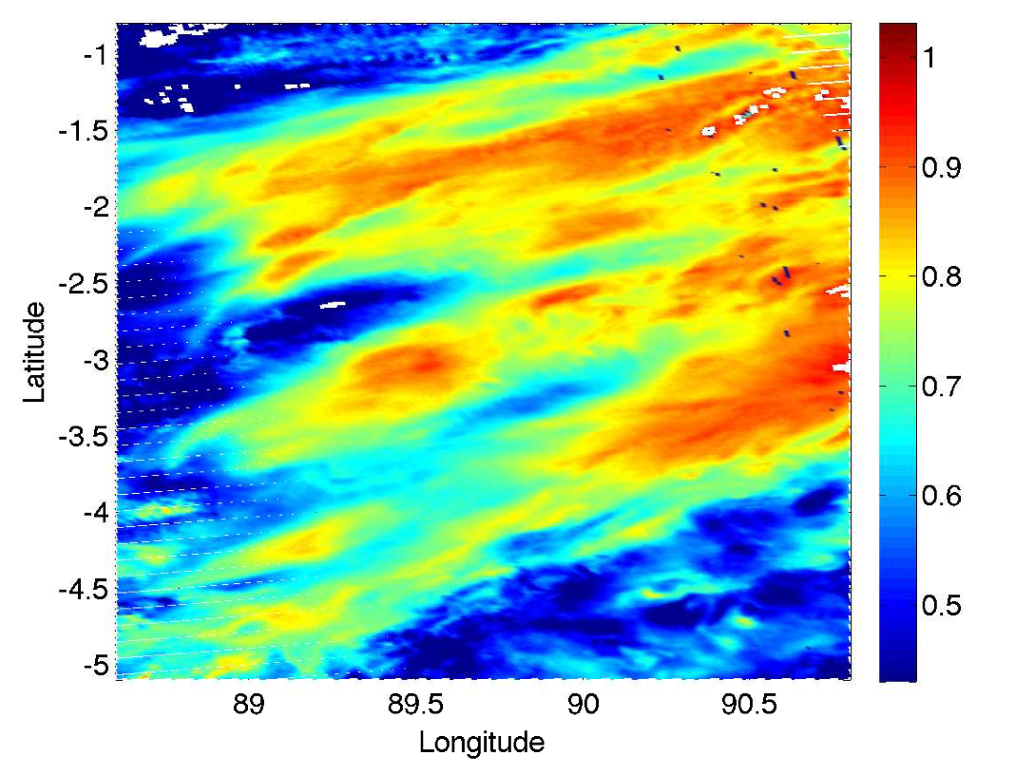
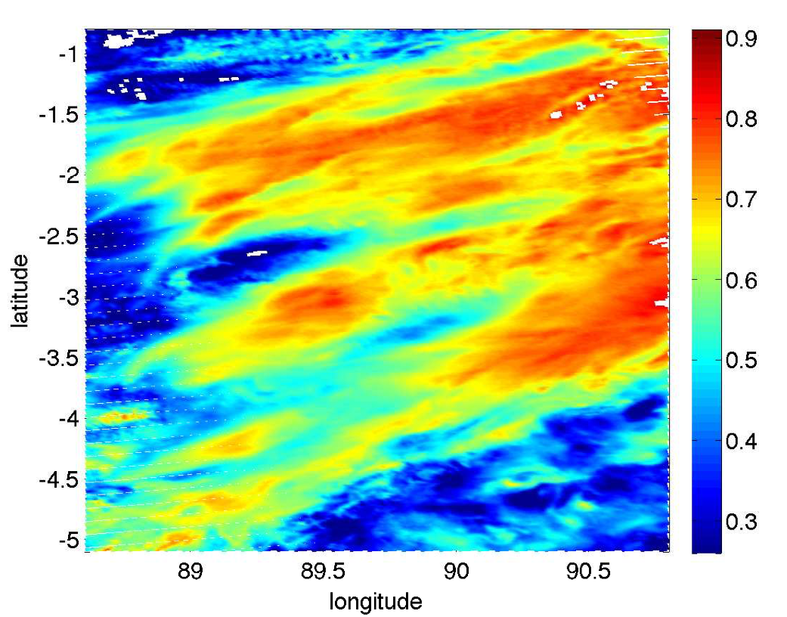
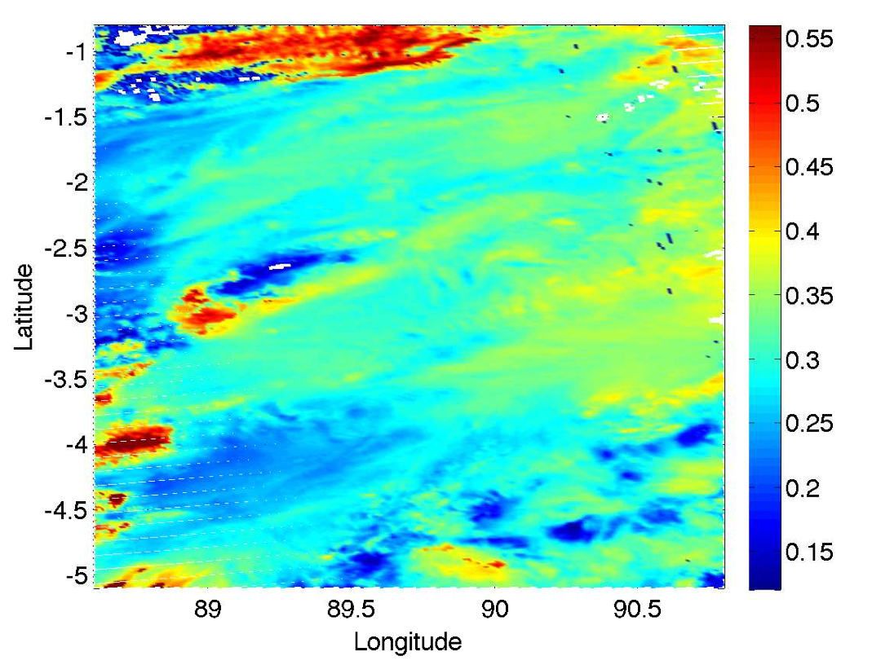
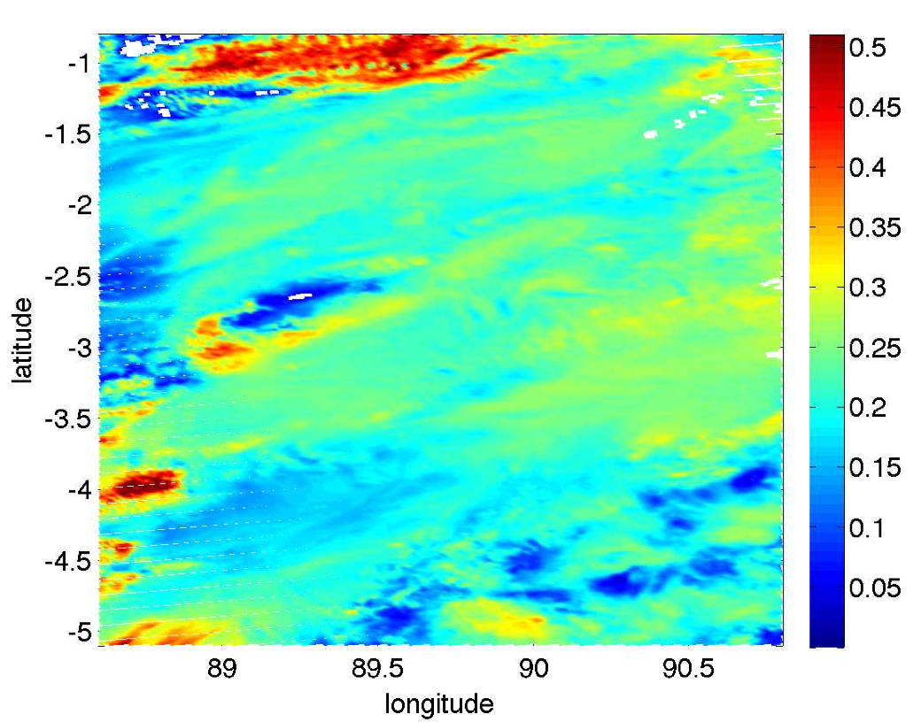
Examples of using PCRTM to generate high-resolution Proxy Data for Satellite Remote Sensing Applications
From PCRTM high-res Spectrum @488 nm
From observed VIIRS M3band @488 nm
From PCRTM high-res Spectrum @1610 nm
From observed VIIRS M10-band @1610 nm
(Xu.Liu-1@nasa.gov )

Slide 9
PCRTM High-fidelity Simulator for CPF at Various Spatial Resolutions
MODIS L2 + CPF simulator Refl. @ 645 nm
10km X 10 km spatial resolution
1km X 1km spatial resolution
(Xu.Liu-1@nasa.gov )

Slide 10
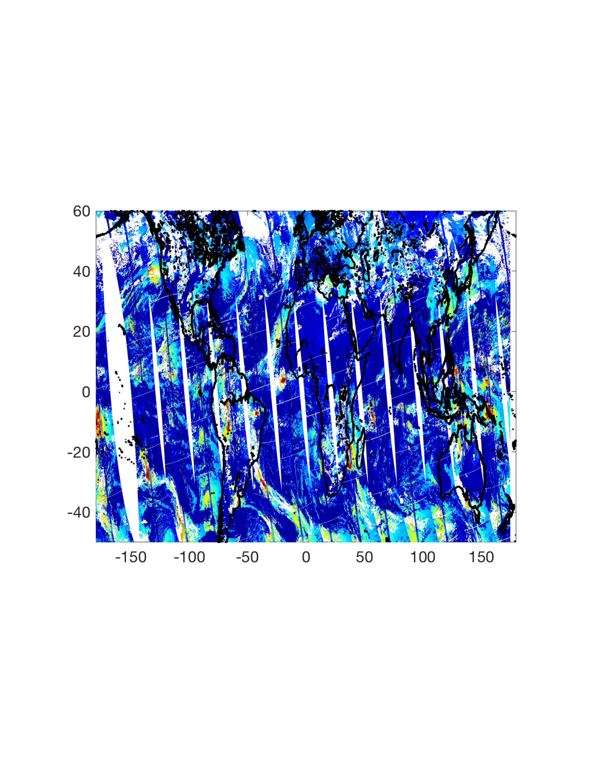
Global Scale, Data Intensive Simulations
Global TOA reflectance high spectral resolution spectra displayed at 646 nm
(Xu.Liu-1@nasa.gov )

Slide 11
Summary
PCRTM was first developed in 2004 for NAST-I instrument with over 8600 channels
  Extended to AIRS, CrIS, IASI, S-HIS, CLARREO-IR, PREFIRE..
  Mature retrieval algorithms have been developed based on PCRTM
  Please visit Dr. Xu Liu’s poster (13p.04) on Tuesday, March 23 for all the exciting results
PCRTM Accelerates the RT calculations by exploring spectral correlations
  PCRTM performs RT calculations monochromatically (i.e. accurate and physical)
  Hybrid-Steam PCRTM (HS-PCRTM) can further reduces RT calculation times
  Handle multiple scattering clouds
  Works for polarized RT calcuations of (I, Q, U)
  A few ms per spectrum in IR spectral region
  3-4 orders of magnitude faster than MODTRAN in solar spectral region
  Accurate relative to line-by-line models
  PCRTM provides Jacobian needed for a physical retrieval algorithm
We have developed PCRTM for solar spectral region
  Completed TEMPO/OMI spectral region
  In the process of extending to the whole TEMPO spectral regions
  VLIDORT is used for radiative transfer solver
  In the process of developing PCRTM for SBG decadal service mission
  In the process of testing the model using EMIT data

