Slide 1
Initial Discussion on NASA – CSA
Food System Development Collaboration
3/1/23

Slide 2
Current Focus Areas in Crops, Food, and Nutrition
Research needs: adapted crop varieties, water & nutrient delivery, & microbiome management
Technology development supported:
  Crop production for supplement nutrition and variety on long duration lunar surface & Mars transit missions
Supports NASA Moon to Mars Objectives
  HBS-1LM: Understand the effects of short- and long-duration exposure to the environments of the Moon, Mars, and deep space on biological systems and health, using humans, model organisms, systems of human physiology, and plants.
  HBS-2LM: Evaluate and validate progressively Earth-independent crew health & performance systems and operations with mission durations representative of Mars-class missions. Key aspects
  AS-5LM: Define crop plant species, including methods for their productive growth, capable of providing sustainable and nutritious food sources for lunar, Deep Space transit, and Mars habitation.
Key aspects
  Crop selection based on stressors associated LEO, BLEO, ug and partial gravity environments
  Long term microbial/fungal control and moisture management over many crop cycles
  Radiation affects on stored crop supplies and crop growth

Slide 3
OHALO III Prototype Crop Production System for Deep Space Exploration
Prototype system for the Deep Space Transport to be deployed on the ISS, targeting 2025
Initially used to validate water delivery and volume optimization concepts applicable on future deep space missions
    Designed to accept a variety of “hosted hardware” concepts via a standard set of user interfaces
    Sized as an ISS EXPRESS rack quad-locker payload
    Evolvable to accept a limited range of additional sensors and robotic aides
Designed to be a crop production system not a crop research facility such as VEGGIE and APH
The first crop system designed for the continuous production of fresh food to add key nutrients and variety to crew diet
Will serve as a baseline to assess crop production hardware operational performance, reliability and to identify future system requirements and risk/resource trades
3/1/23

Slide 4
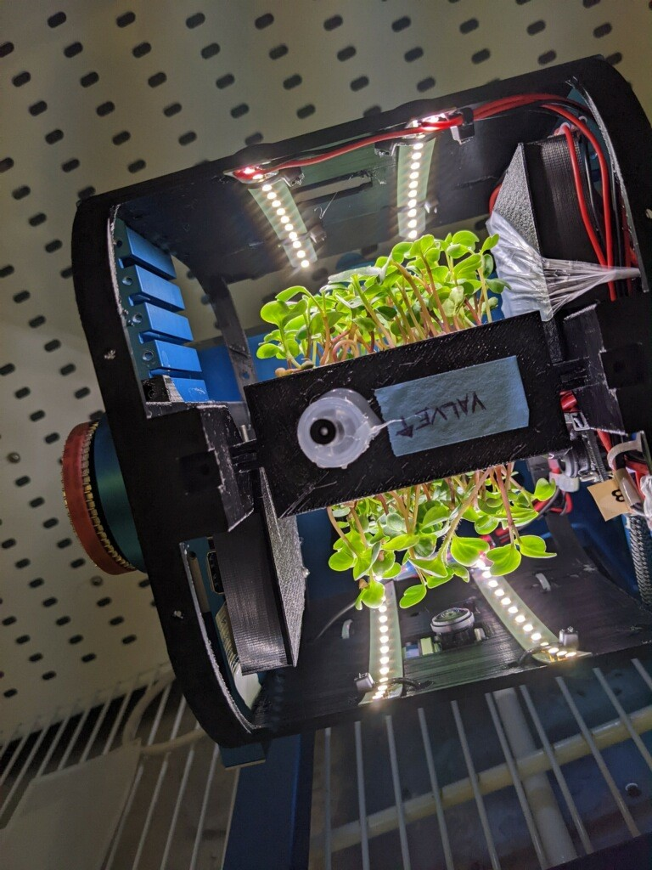
Microgreen Growth Hardware for ISS
Microgreens are edible, small plant seedlings grown for about 7-14 days and used as a nutritious, supplemental food source
Their small size (volume requirement) and rapid
growth make a candidate food crop for space
Terrestrially, microgreens are grown in trays using
capillary mats or NFT
For space, the growing materials, water/nutrient
delivery, lighting, harvesting and containment hardware
need development
Dr. Youbin Zheng’s group at the Univ. of Guelph,
Ontario is very active in microgreen research
NASA has an ongoing MOU with USDA ARS
study microgreens as a candidate space crop
Radish microgreens growing on a
Random Positioning Machine (RPM) at
Kennedy Space Center

Slide 5

Elemental Analysis / Sensing Capabilities for Space
Plant
Essential Elements
Nitrogen
Potassium
Calcium
Magnesium
Phosphorus
Sulfur
Manganese
Iron
Chlorine
Zinc
Boron
Copper
Nickel
Molybdenum
Monitoring and controlling essential plant nutrients is critical for controlled environment crop production systems on Earth and space
Currently, no real-time elemental or ion analysis capabilities exist for the ISS
On Earth, elemental analysis has typically been done using large, bench-top Inductively Coupled Plasma (ICP) spectrometry or Ion Chromatograph (IC) instruments

Slide 6
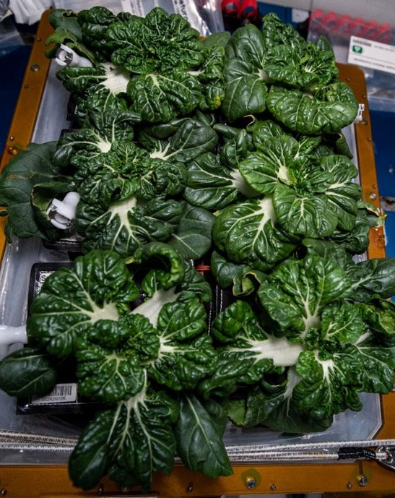
Food Safety Technologies and Procedures
Plants grown in space will have their own associated microbial communities (leaves, roots, growing media)
These plant growth systems could also harbor some human associated organisms and potential pathogens.
Providing sanitary and safe food from space-growth plants will be critical avoid/minimize risks of food-borne illness in the crew
Currently, space grown produce is sanitized with ProSan (citrate) wipes, but this is tedious for the crew and reduces the freshness of the foods.
Plant tissue and growth hardware sanitizing technologies and protocols are needed.
The development of realistic and effective approaches to mitigate the impacts of biofilms on the performance of growth hardware require development and validation
Pak choi greens grown in NASA’s
Veggie on the ISS

Slide 7
Other Space Needs / Areas for Collaboration
• Crop Sensing Technologies
Development of appropriate Robotic aides
• Waste Stream Recovery of Plant Nutrients
• Surface Crop System Integrated Ground Demonstrators
• Crop System Modeling
• Horticultural Technologies

